Slide 1
Design Concepts & Capacity Expansions of QNAP RAID 50/60

Slide 2
Your challenges, our solutions: Insufficient protection of RAID 5? Will performance be degraded when using RAID 50/60?

Slide 3
Why You Should Use RAID 50/60
Number of disks and their capacities will affect RAID protection level
With ServeTheHome RAID Calculator:
The failing rate of RAID 5/6 in 5 years:
RAID 5/6 protection can be degraded when NAS capacity increases.
Disk NO. | RAID Type | Disk Capacity | RAID Failing Rate
4 | RAID 5 | 8 TB | 0.07%
8 | RAID 5 | 8 TB | 0.77%
8 | RAID 6 | 8 TB | 0.001%
12 | RAID 6 | 8 TB | 0.01%
24 | RAID 6 | 8 TB | 0.64%
https://www.servethehome.com/raid-calculator/ Best Estimate Real World assuming bit error chance is 10^(-15), 150MB/sec rebuild speed

Slide 4
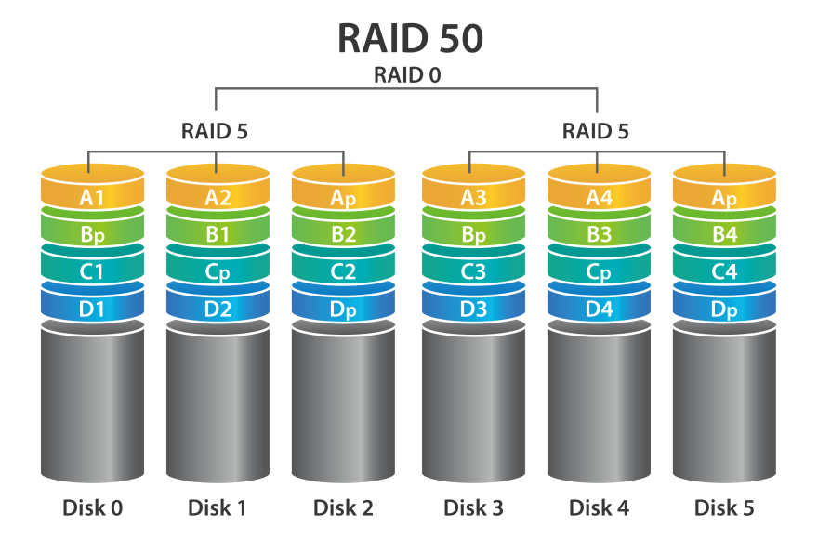
Better Protection with RAID 50/60
Protect your data with Lower space redundancy
On NAS with 8 bays, QNAP no longer recommends using RAID5
For enterprise models, RAND 6/RAID 10/RAID 60 is recommended:
Take 8TB disks as example:
RAID type | No. of disks | Disk failure tolerance | Raw capacity | RAID failing rate
RAID 6 | 24 | 2 | 176 TB | 0.64%
QNAP RAID 60 | 24 | 4 or more | 160 TB | 0.03%
RAID 10 | 24 | 12 | 96 TB | 0.02%

Slide 5
QNAP RAID 50/60 Design Concepts
Supported by NAS with 6 or more bays
Supports Storage Pool, Static Volume and Qtier Pool
Stripping Data Block to create RAID 50/60
RAID 50 Storage Pool
RAID 5 Storage Pool
A1
A2
B1
B2
C1
C2
A
B
C
RAID 5 #1
RAID 5 #2
RAID 5
Disk 1
Disk 2
Disk 3
Disk 4
Disk 5
Disk 6
Disk 1
Disk 2
Disk 3
Disk 4
Disk 5

Slide 6
When expanding, new sub-arrays are not allowed
Number of RAID 50/60 Sub-arrays cannot be changed after creation
No. of disks in Sub-arrays must be equal to avoid space waste
Capacity can be expanded through new RAID 50/60 and JBOD (Liner)
RAID 50 Storage Pool
RAID 5 (1-1)
RAID 5 (1-2)
Liner
RAID 5 (2-1)
RAID 5 (2-2)

Slide 7
Concept of RAID 50 "Write" Operation
1. Data Block A is striped into A1/A2 for writing operation
2. A1/A2 then are striped again within each sub-array
RAID 5 RMW (Read Modify Write) １Write =
Read Parity+ Read Data + Calculate Parity+ Write Parity+ Write Data
A1
A2
B1
B2
C1
C2
RAID 5 (1-1)
RAID 5 (1-2)
A1*
A1”
P
A2*
A2”
P
P
B1*
B1”
P
B2*
B2”
C1*
P
C1”
C2*
P
C2”
Disk1
Disk2
Disk3
Disk4
Disk5
Disk6
RCW (Read Reconstruct Write) = Read all Chunk Data + Calculate Parity + Write Parity + Write Data

Slide 8
Performance Comparison For RAID 50/60
Single RAID 0 = Performance can be N (No. of disks)* P (Disk performance)
Single RAID 5 = (N*P) / RMW or RCW operations
Compare RAID 50/60 to RAID 5/6 on HDD, performance can be reduced
No. of disks (HDD) | RAID type | Sequential read | Sequential write | No. of disks (SSD) | RAID type | Sequential read | Sequential write
6 | RAID 5 | 687 | 370 | 12 | RAID 5 | 3098 | 1904
6 | RAID 50 (2) | 566 | 305 | 12 | RAID 50(2) | 3092 | 1859
12 | RAID 5 | 1563 | 853 | 24 | RAID 6 | 4606 | 4481
12 | RAID 50 (2) | 1536 | 858 | 24 | RAID 60 (2) | 4607 | 4422
HDD : TS-1079 (6) TVS-EC2480U-SAS-RP R2 (12) Seagate ST1000NM0033 through SMB
SSD : TVS-EC2480U-SAS-RP R2 (12 /24) ST200FM0053(SAS) through iSCSI iSER https://www.storagecraft.com/blog/raid-performance/

Slide 9
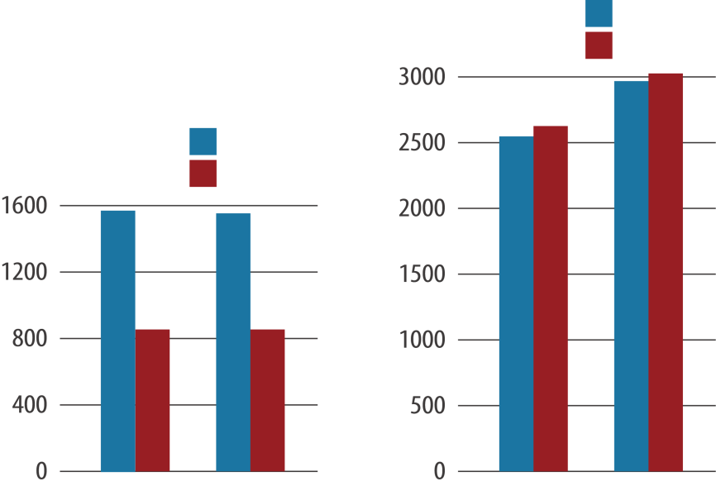
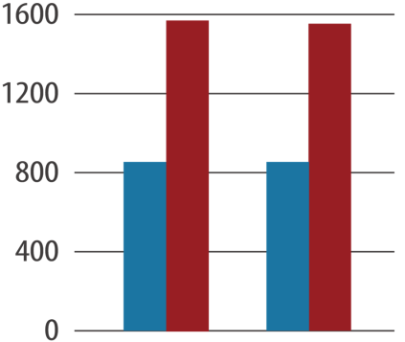
Performance With RAID 50/60 (HDD)
The random read/write performance for RAID 50/60 can reduce 10% when the RAID is consisted of HDD with more read head operations
RAID 50/60 on HDD is priority for data protection
RW 4KB
A RAID 50 can greatly increase RAID protection with little performance impact
RR 4KB
SW 4KB
SR 4KB
No. of disks | RAID type | Disk capacity | RAID failing rate
12 | RAID 5 | 8TB | 2.82%
12 | RAID 50 | 8TB | 0.29%
RAID 50 (2 sub-arrays)
RAID 5
RAID 50 (2 sub-arrays)
RAID 5
RAID performance calculating: https://www.storagecraft.com/blog/raid-performance/

Slide 10
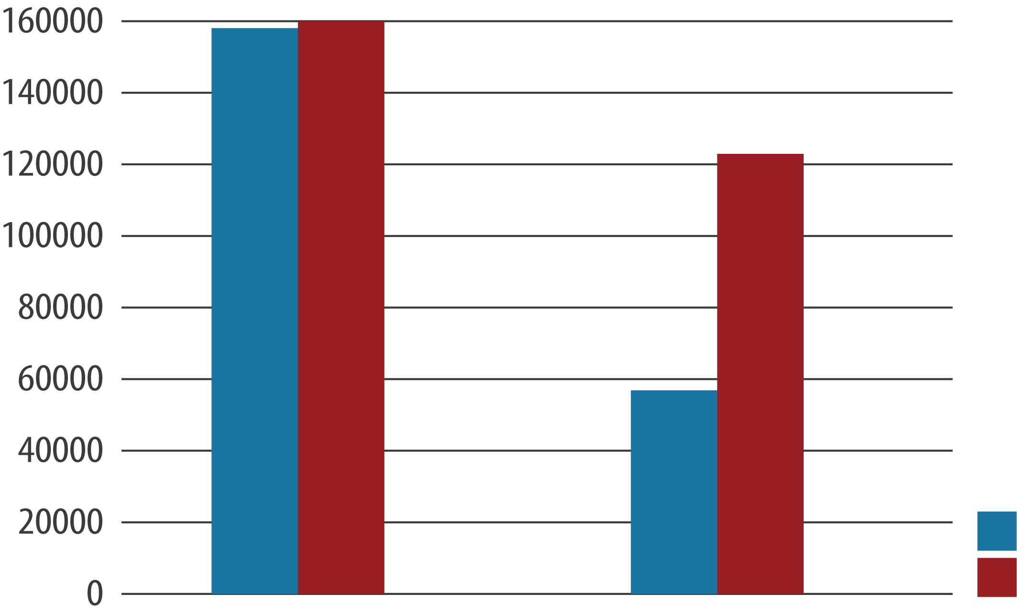
Why random RW performance is increased with RAID 50/60 (SSD)
RAID 50/60 with SSD will not suffer from read head operations penalty
With SSD RAID 50, Random Read and Write has increased
Suitable for all flash applications
300%↑
RAID 50 Storage Pool
Random write
A1
A2
A1
A2
A1
A2
RAID 5-1
RAID 5-2
A1*
A1’’
P
A2*
A2’’
P
SW 4KB
SR 4KB
Disk1
Disk2
Disk3
Disk4
Disk5
Disk6
RAID 50 (2 sub-arrays)
RAID 5

Slide 11
QNAP RAID 50/60 Use Case Suggestion
RAID 50/60 Value: Ensure Protection Level for High Capacity NAS
General Application: RAID 5 is not recommended, 6-14 Bays: RAID 6/10,
Beyond 16 Bays: RAID 60 With SSD Cache
Backup Destination: RAID 50 for NAS higher than 8 bays
RAID Type | RAID 5 | RAID 6 | RAID 10 | RAID 50 | RAID 60
Disk No. Requirement | > 3 | > 4 | > 4 | > 6 | > 8
Disk Fail Tolerance | 1 | 2 | half | 2~5 | 4~10
Capacity | ★★★★ | ★★★ | ★ | ★★★ | ★★
Scenario | Backup | General Usage | VDI or Database | High-Frequency Backup | VDI and Video Editing
Using 8TB disk with 16 bays NAS, RAID 6 5 years failing rate will beyond 0.1%

Slide 12
How to expand QNAP RAID 50/60?

Slide 13
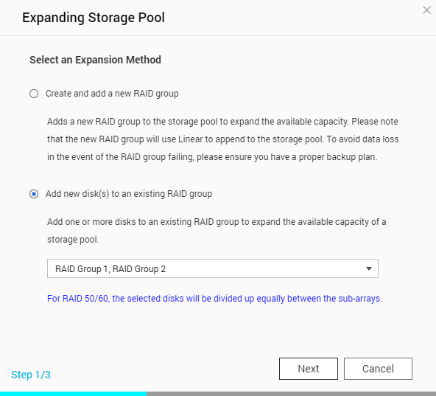
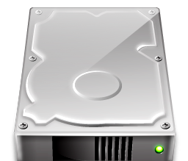
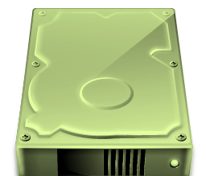
Add Disks to All Sub-arrays
In Storage Management select "Expand"
Using dedicated UI to add disk on all sub-arrays at once

Slide 14
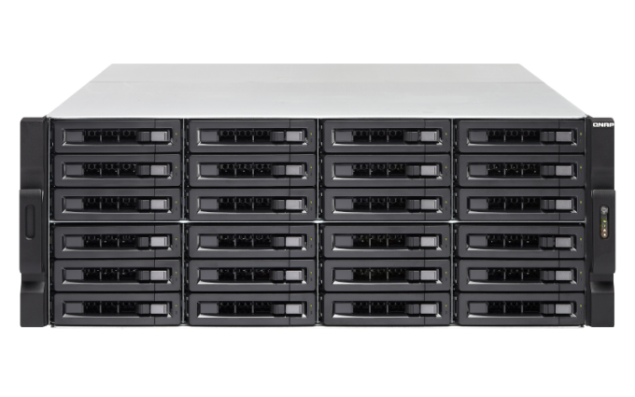
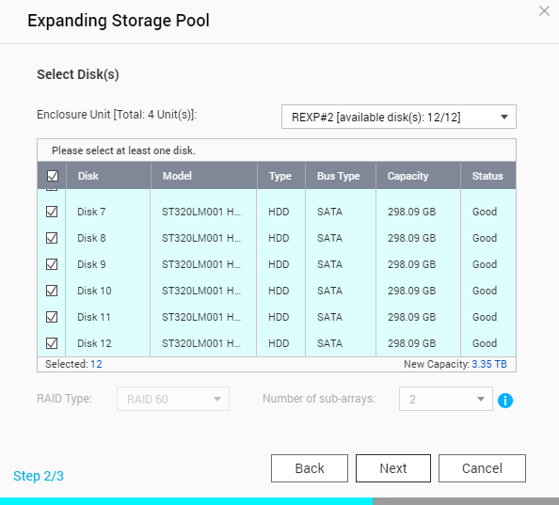
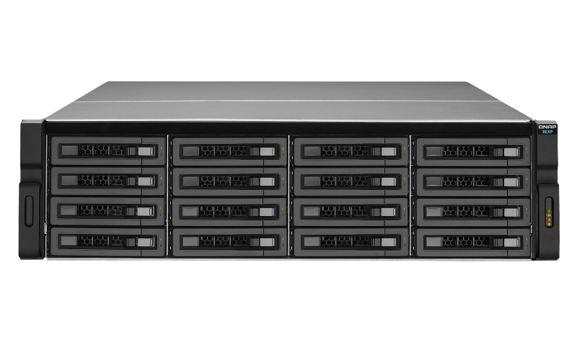
Add new RAID Group for Expansion
Add a new RAID 50/60 with same sub-array count for expansion
Using Expansion Enclosure if Host NAS has no free slots
The new RAID 50/60 must use same RAID type and sub-arrays count (Disk number can be different)
TS-EC2480U
REXP-1600U-RP

Slide 15
Demo：Expand RAID 50/60 By Adding Disks

Slide 16
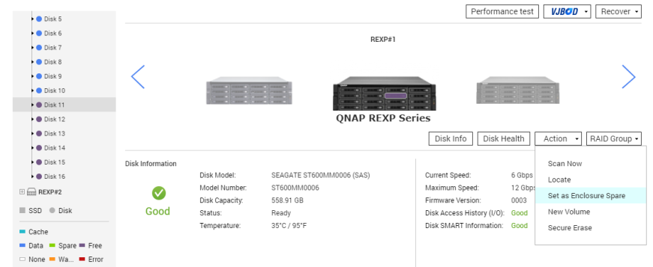
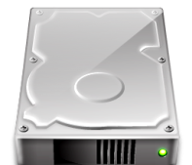
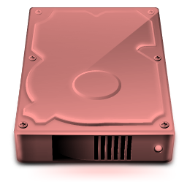
Use RAID 50/60 With Hot Spare
Local and Global Hot Spare can be used for each or all sub-arrays
It is recommended to reserve Global Hot Spare
Create RAID > go to "Disks/VJBOD" and set free disk as spare
RAID 50/60 Pool
Global Spare

Slide 17
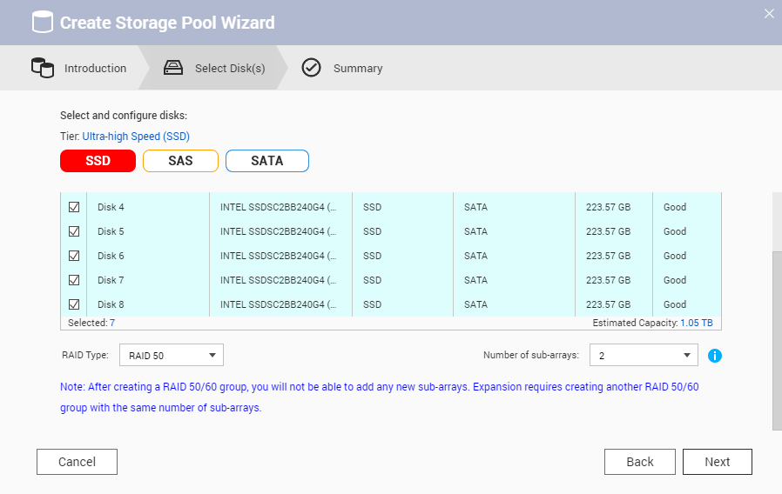
Using Qtier/SSD Cache with RAID50/60
SSD RAID 60 = High capacity/performance video editing server
SSD Cache RAID 10 + HDD RAID 60 = High capacity/performance file server
Qtier SSD RAID 50 + HDD RAID 60 = High capacity/performance VDI server
Qtier SSD RAID 10 + HDD RAID 60 = High capacity/performance Database
QNAP IOAware Qtier + RAID 50 pool
RAID 5 (1-1)
RAID 5 (1-2)
RAID 6
(2-1)
RAID 6
(2-2)

Slide 18
Thanks for listening

