Slide 2



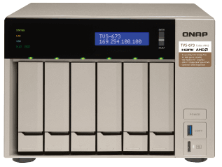
QNAP NAS & apps for your smart office
Now, with Domotz you get to know the network and device statuses in real-time. Your office is getting smarter!
Qfinder Pro allows you to quickly find and easily access all QNAP NAS over the same LAN
Qsync enables automatic file synchronization across different devices
Domotz Network Monitoring automatically detects all IP devices on your network and provides remote control and monitoring services
QVR Pro surveillance solution

Slide 3
Who are the people behind Domotz?
Founded in 2014
65% of employees are developers
Offices in the US, Italy and the UK

Slide 4
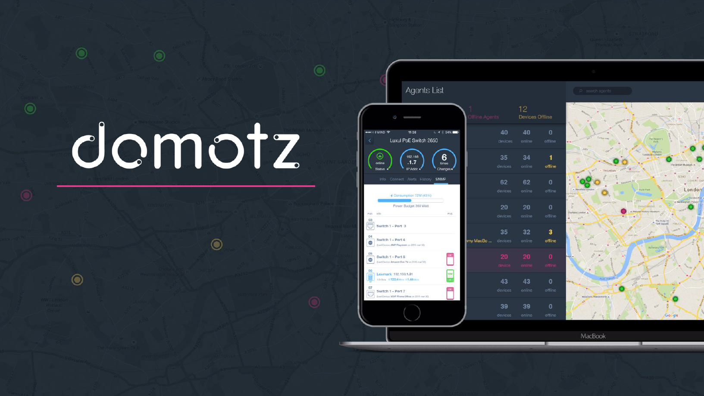
What does Domotz offer?
Network Monitoring, and Remote Diagnostics & Support for IT Professionals.

Slide 5
What can QNAP x Domotz do for you?
Remote network and device monitoring
Alerts
Monitor all IP devices on
any network regardless of the brand and device status
(checked every 30 seconds)
Email and push notification alerts when abnormality is detected
Remote power management
Monthly reports
Remotely power devices On/Off and reboot them directly via the Domotz app
Help your clients understand the value of remote support

Slide 6
Meet the Domotz Team
Video embedded here

Slide 7
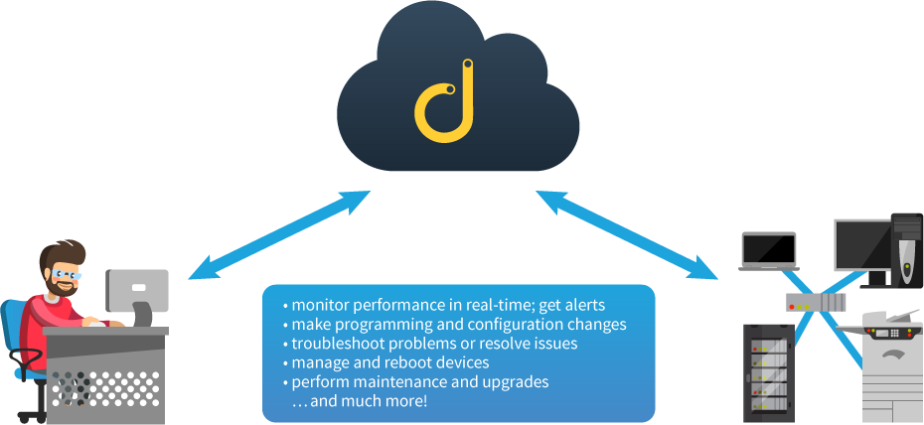
How Domotz works
Domotz Client
Mobile or browser app
connected remotely.
Domotz Agent
Software running
locally on network.
Domotz Cloud
Monitor performance in real-time & get alerts
Make program and configuration changes
Troubleshoot problems or resolve issues
Manage and reboot devices
Perform maintenance and upgrades
...and much more!

Slide 8
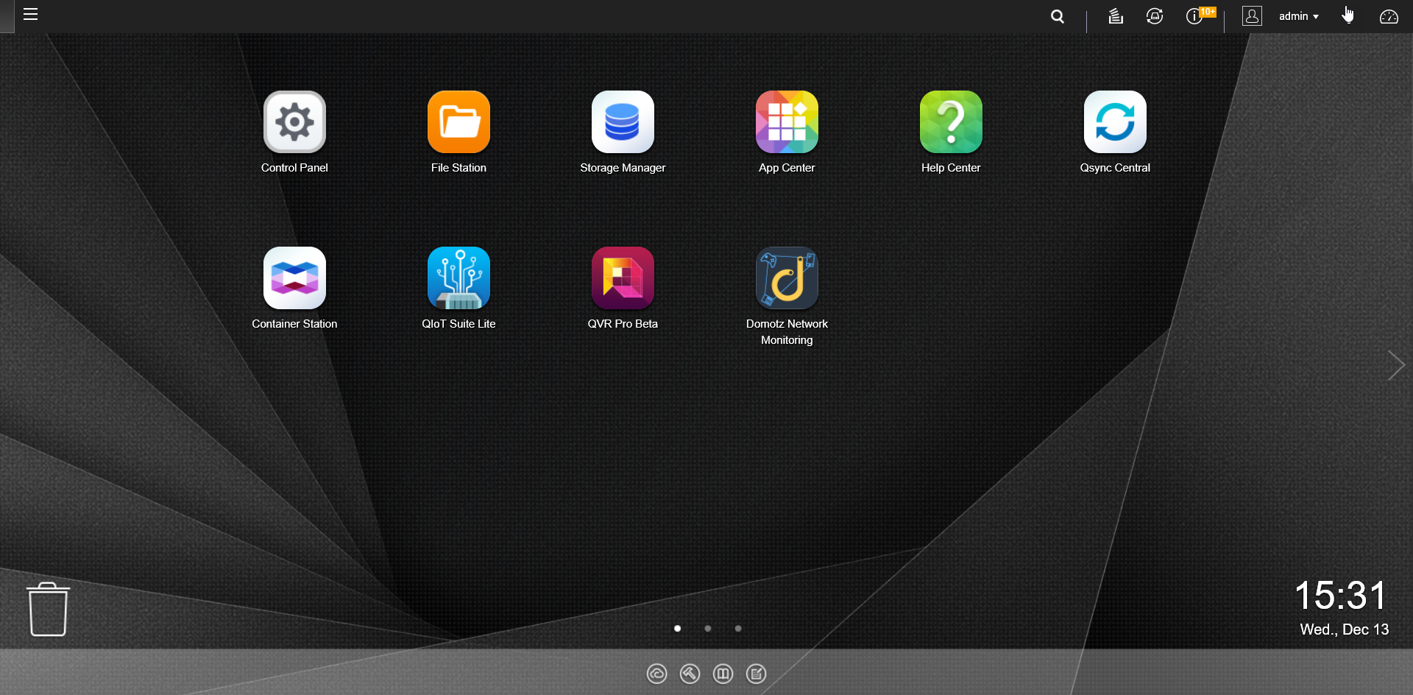
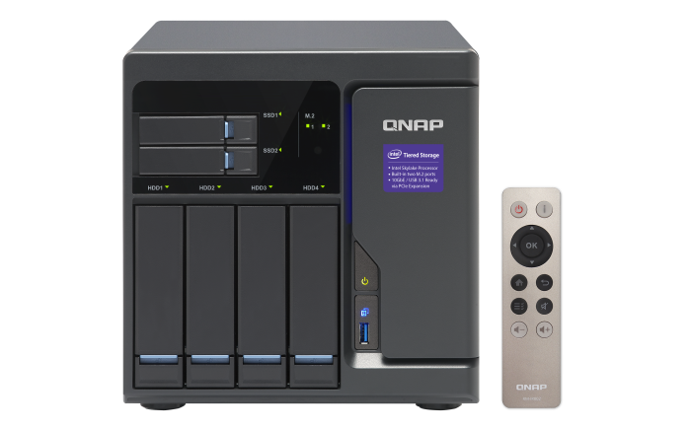
Install Domotz on QNAP NAS
Log into QTS; go to App Center and download the Domotz Network Monitoring app

Slide 9
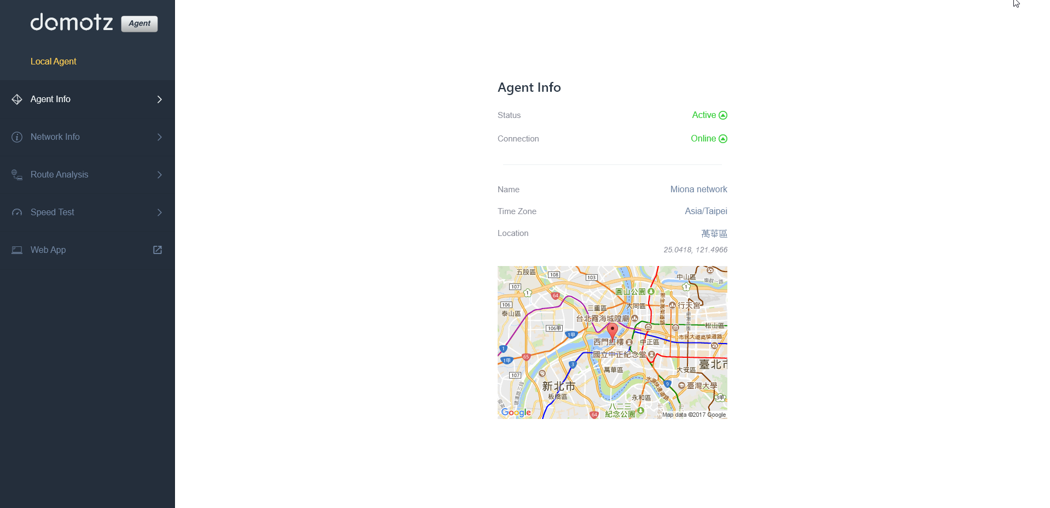
On NAS you can see
Go to Web App

Slide 10
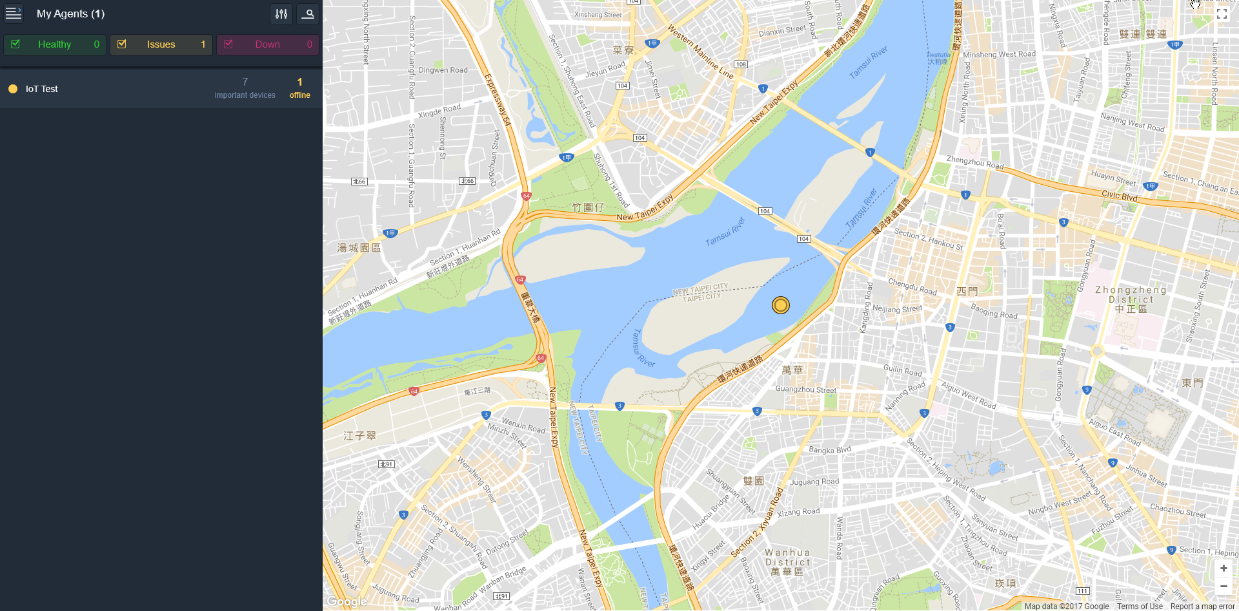
Web App
Summary status of current devices

Slide 11
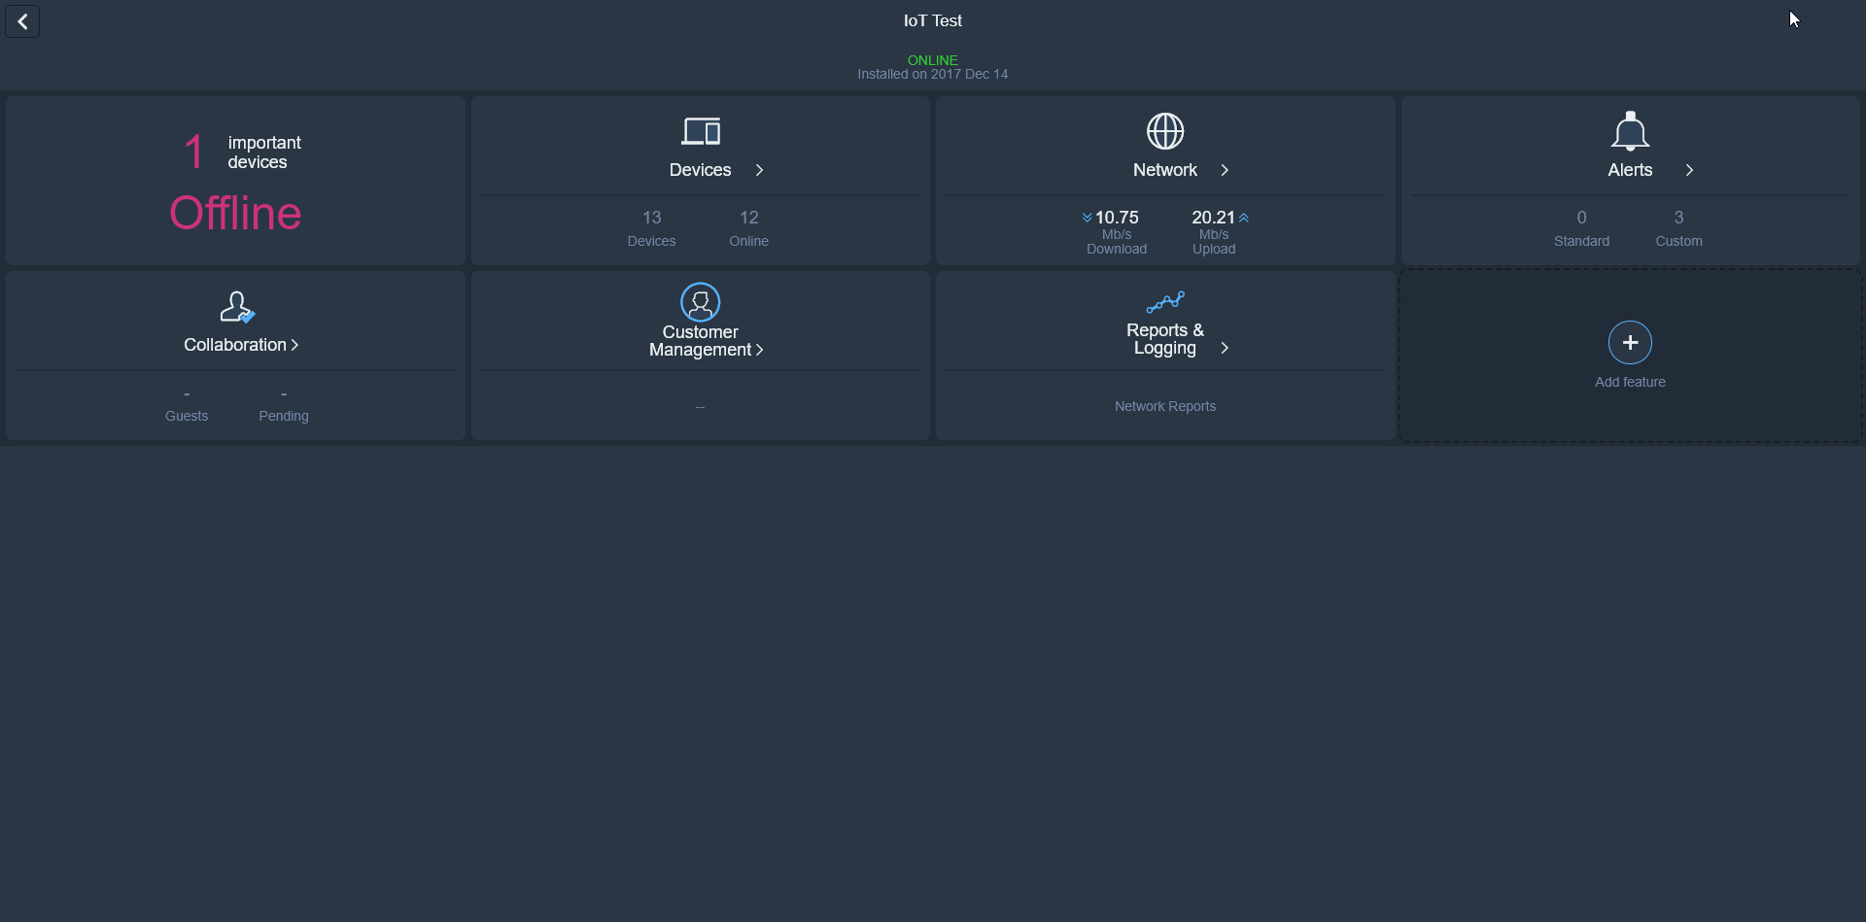
Web App dashboard
Status of important devices
Status of important devices
Uploading & downloading speeds

Slide 12
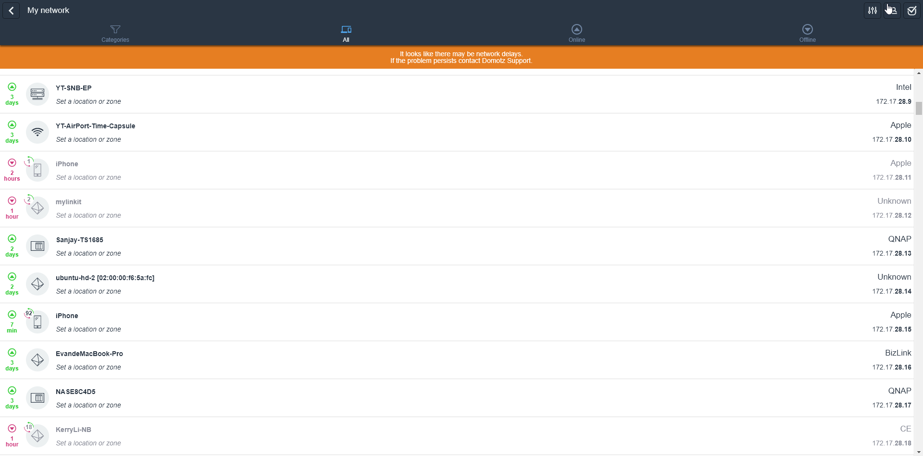
Local devices
Browse all devices connected to the same network

Slide 13
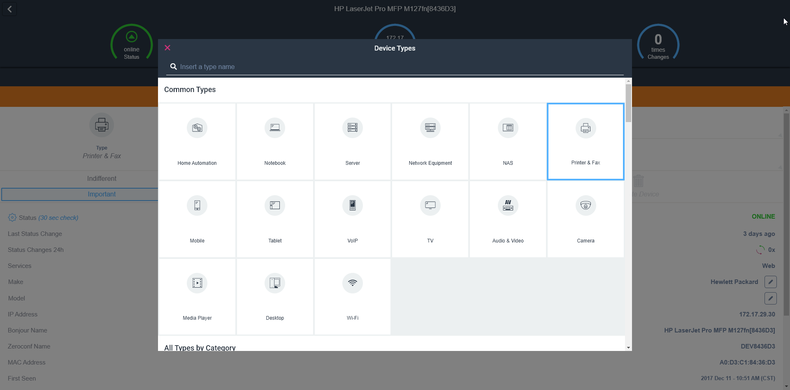
Device type
Click icon
Domotz detects your device type automatically, and it also allows you to manually change the type

Slide 14
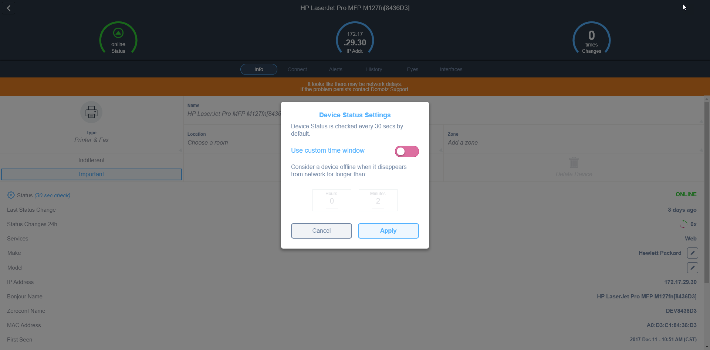
Device Status Setting
Domotz checks your device status every 30 seconds.
Manually setting is also available!

Slide 15
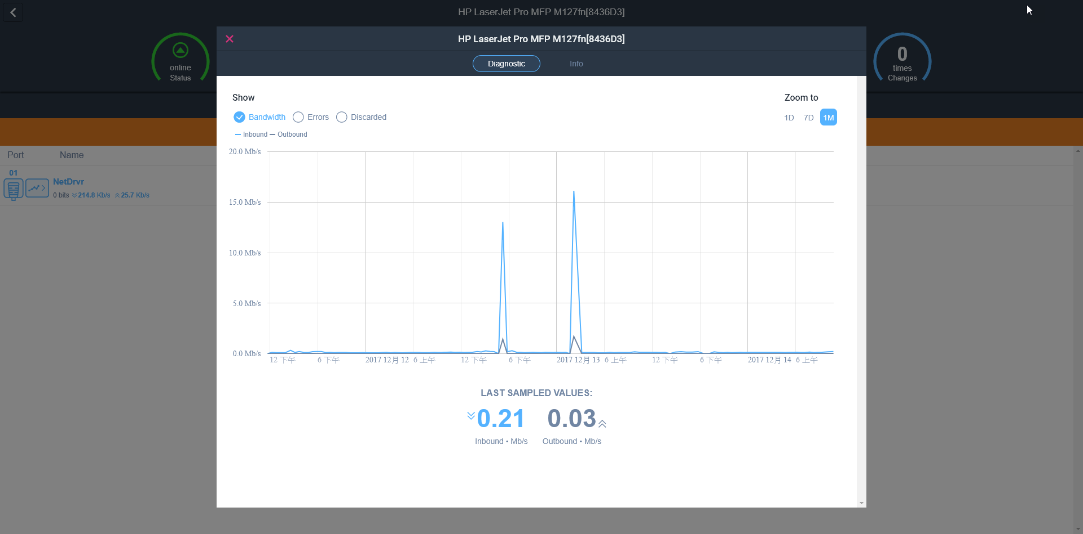
SNMP (Printer)
Current bandwidth

Slide 16
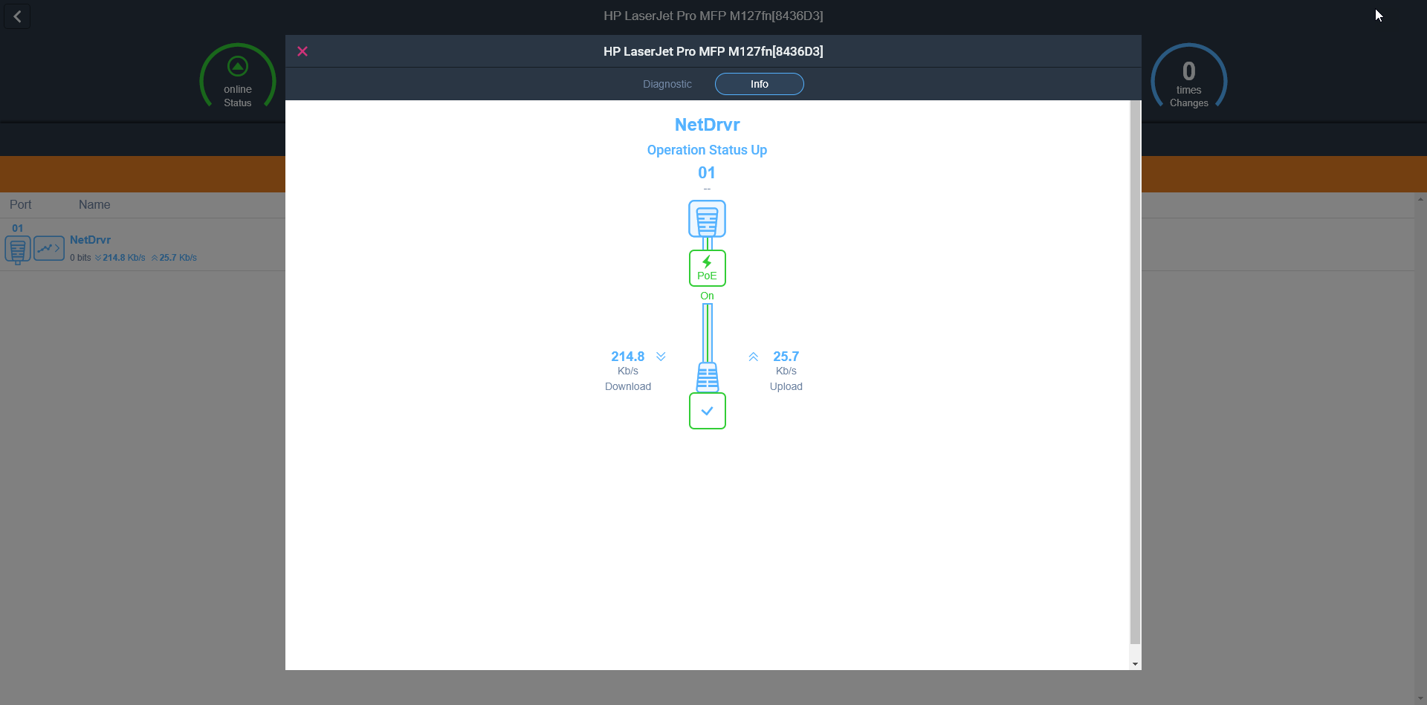
SNMP (Printer)
214.8
Downloading speed
25.7
Uploading speed

Slide 17
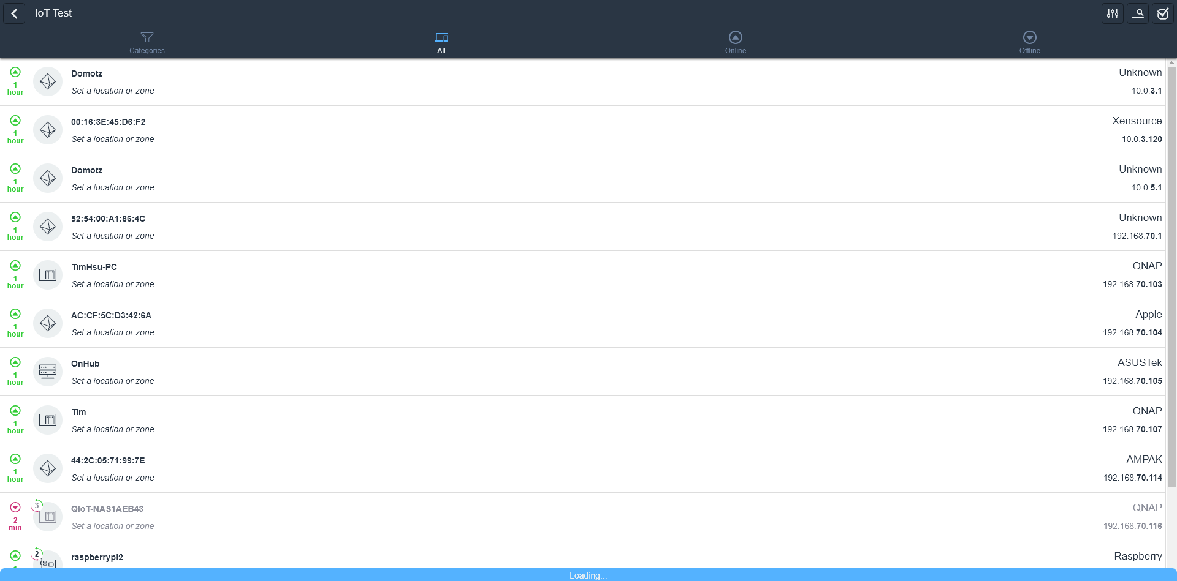
Current connected device list
IT personnel found one server offline

Slide 18
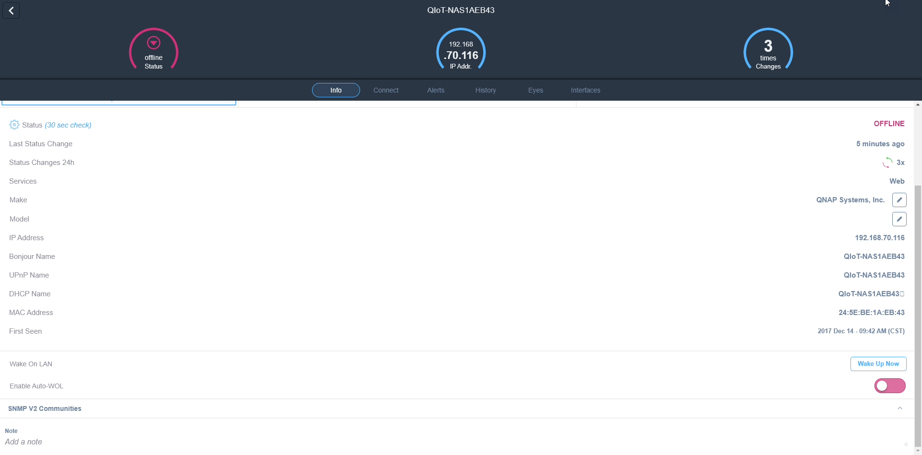
Wake on LAN
Click wake on LAN

Slide 19
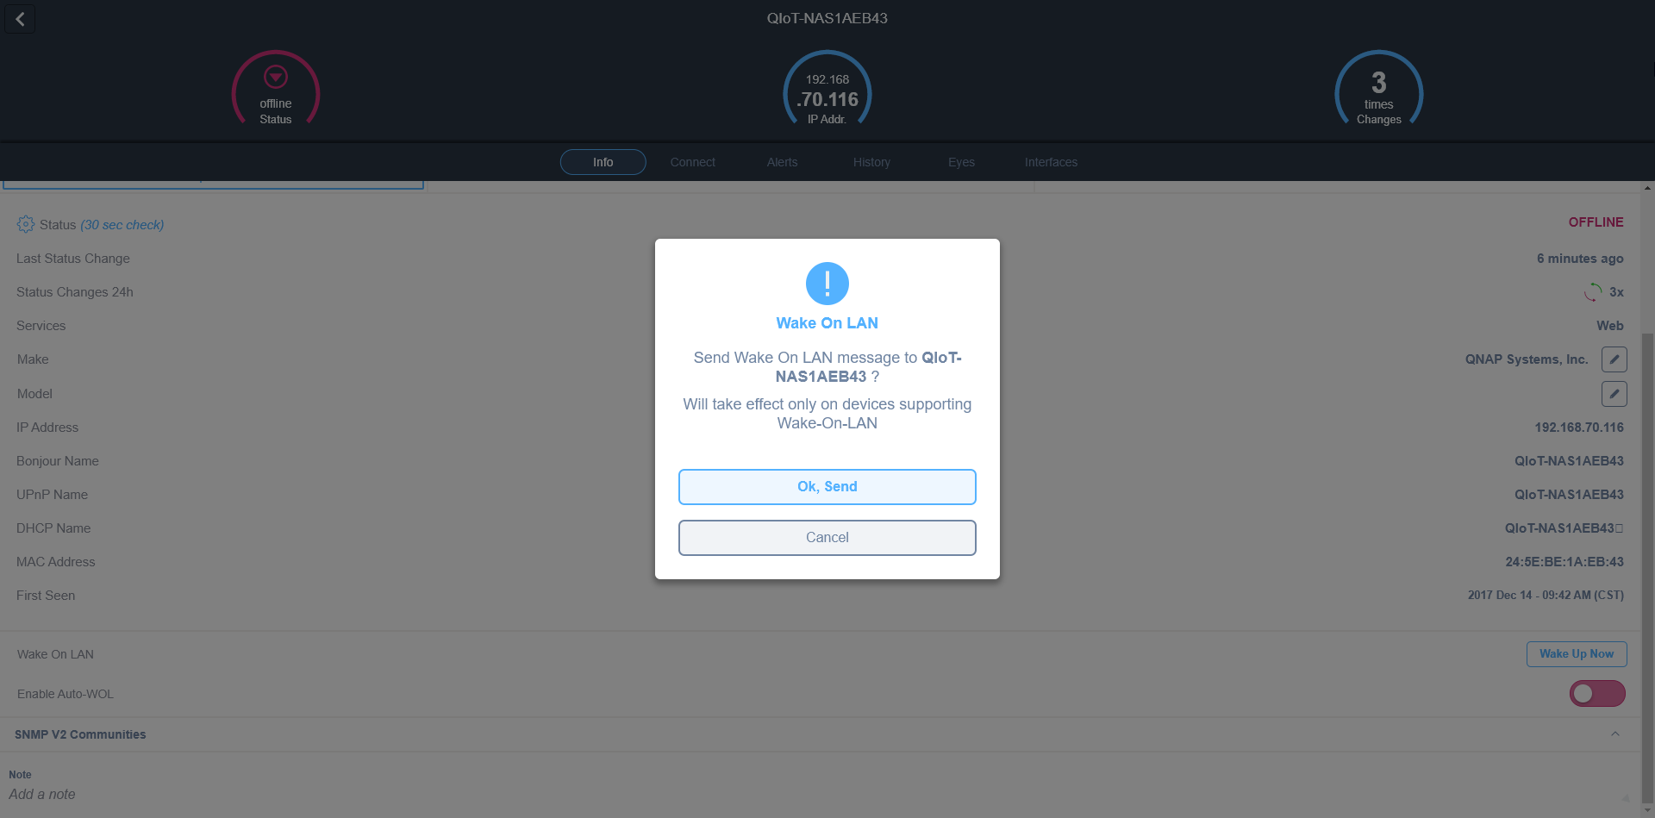
Wake on LAN
Click send

Slide 20
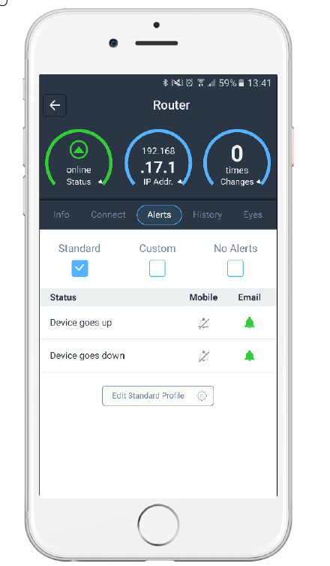
Alerts
Possible events
  Mobile up / down
  TCP service up / down
  Heartbeat lost
  SNMP sensor condition
  Network down
  Important device up /
  down
  A new device joins the
  network

Slide 21
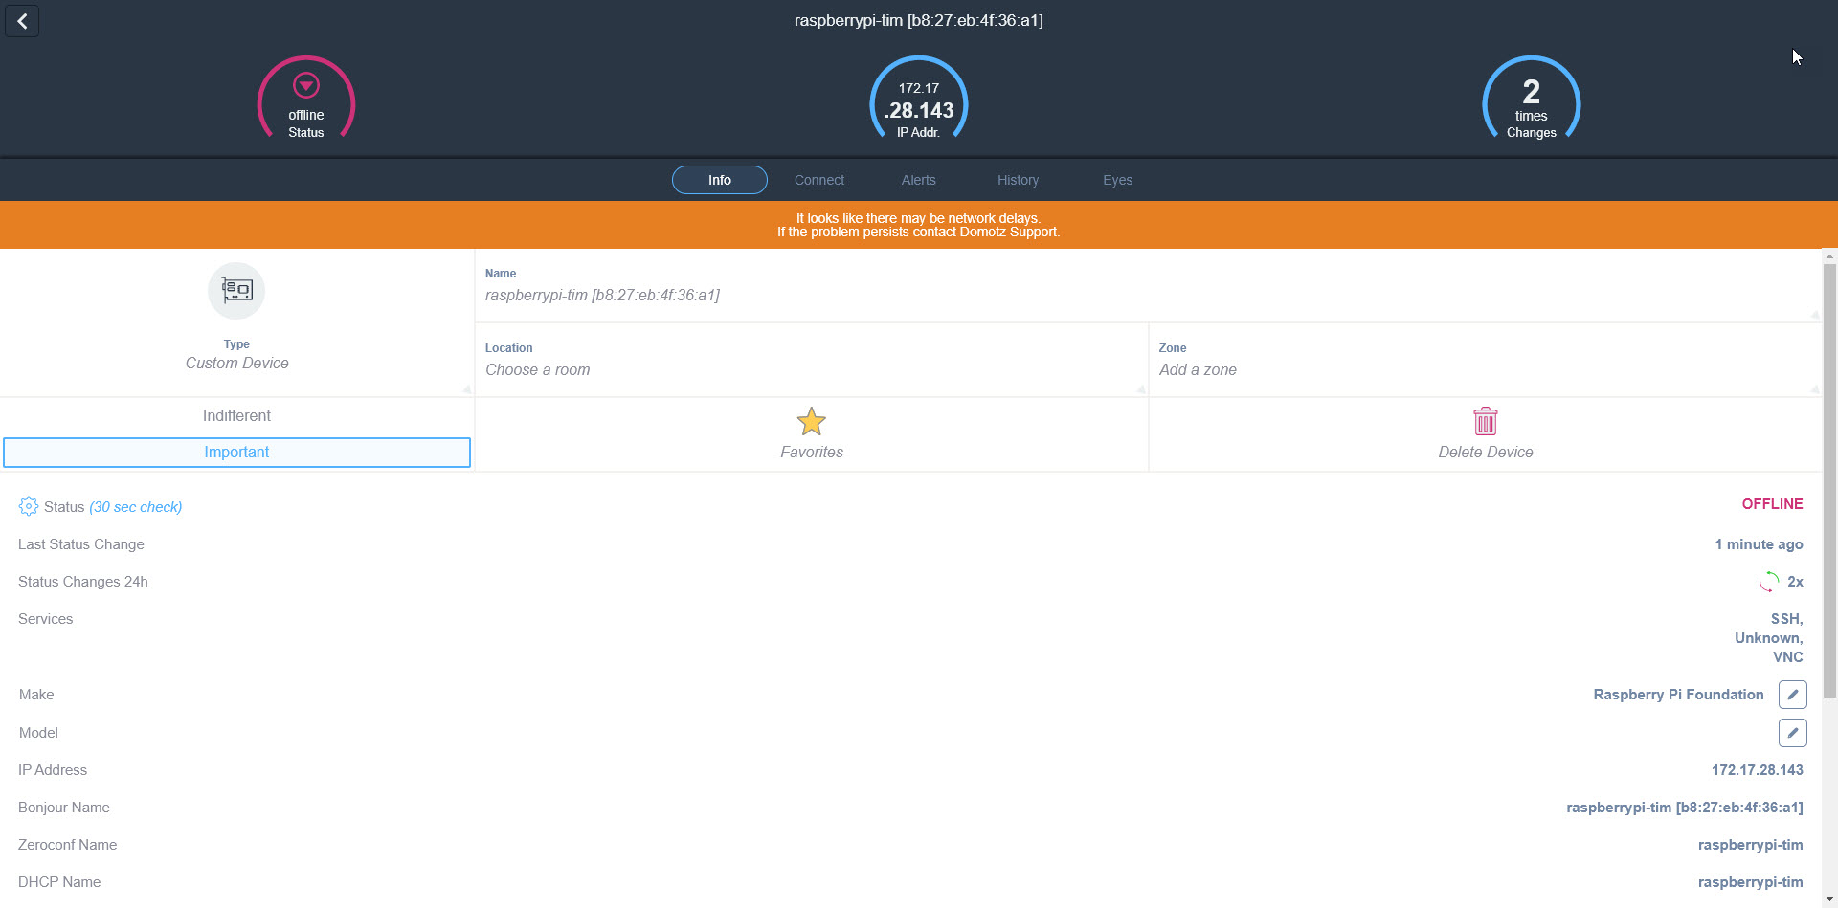
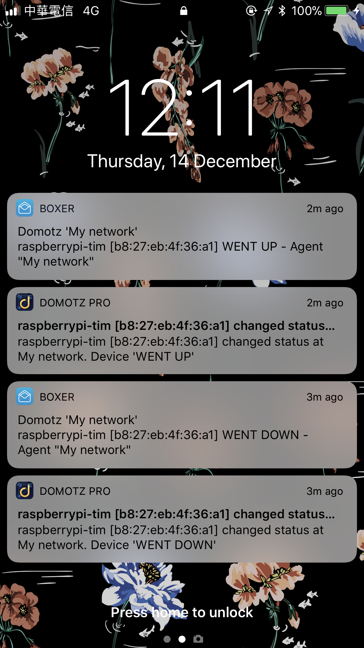
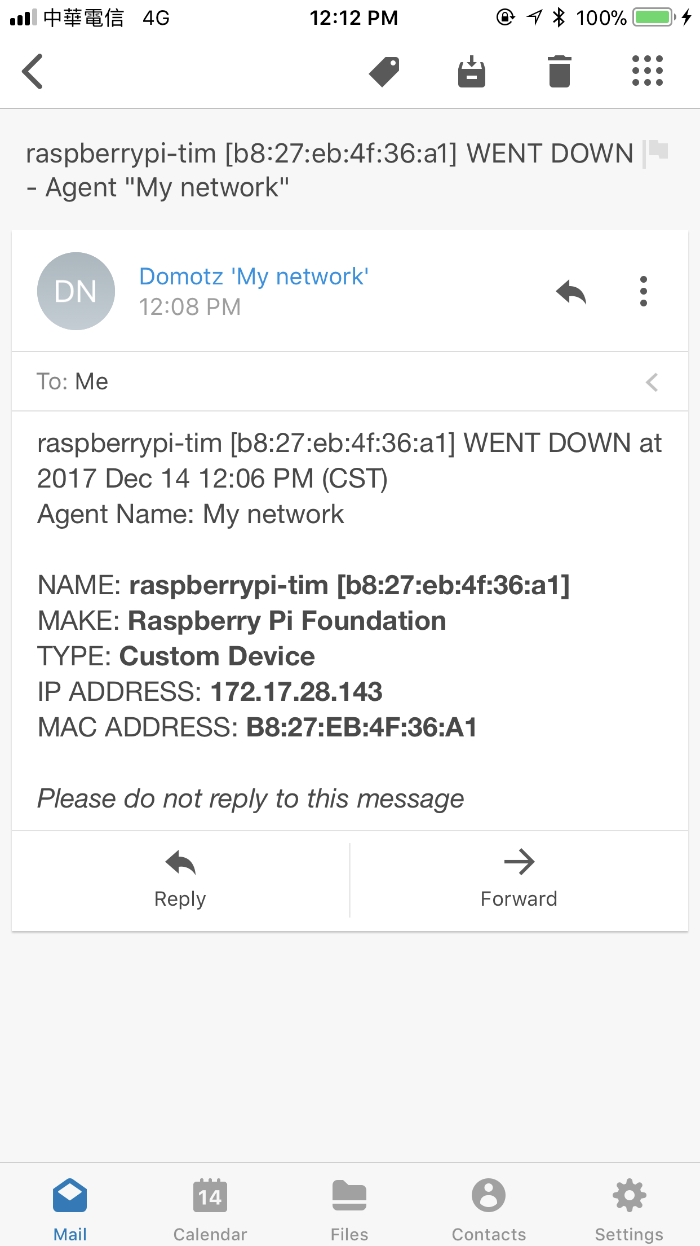
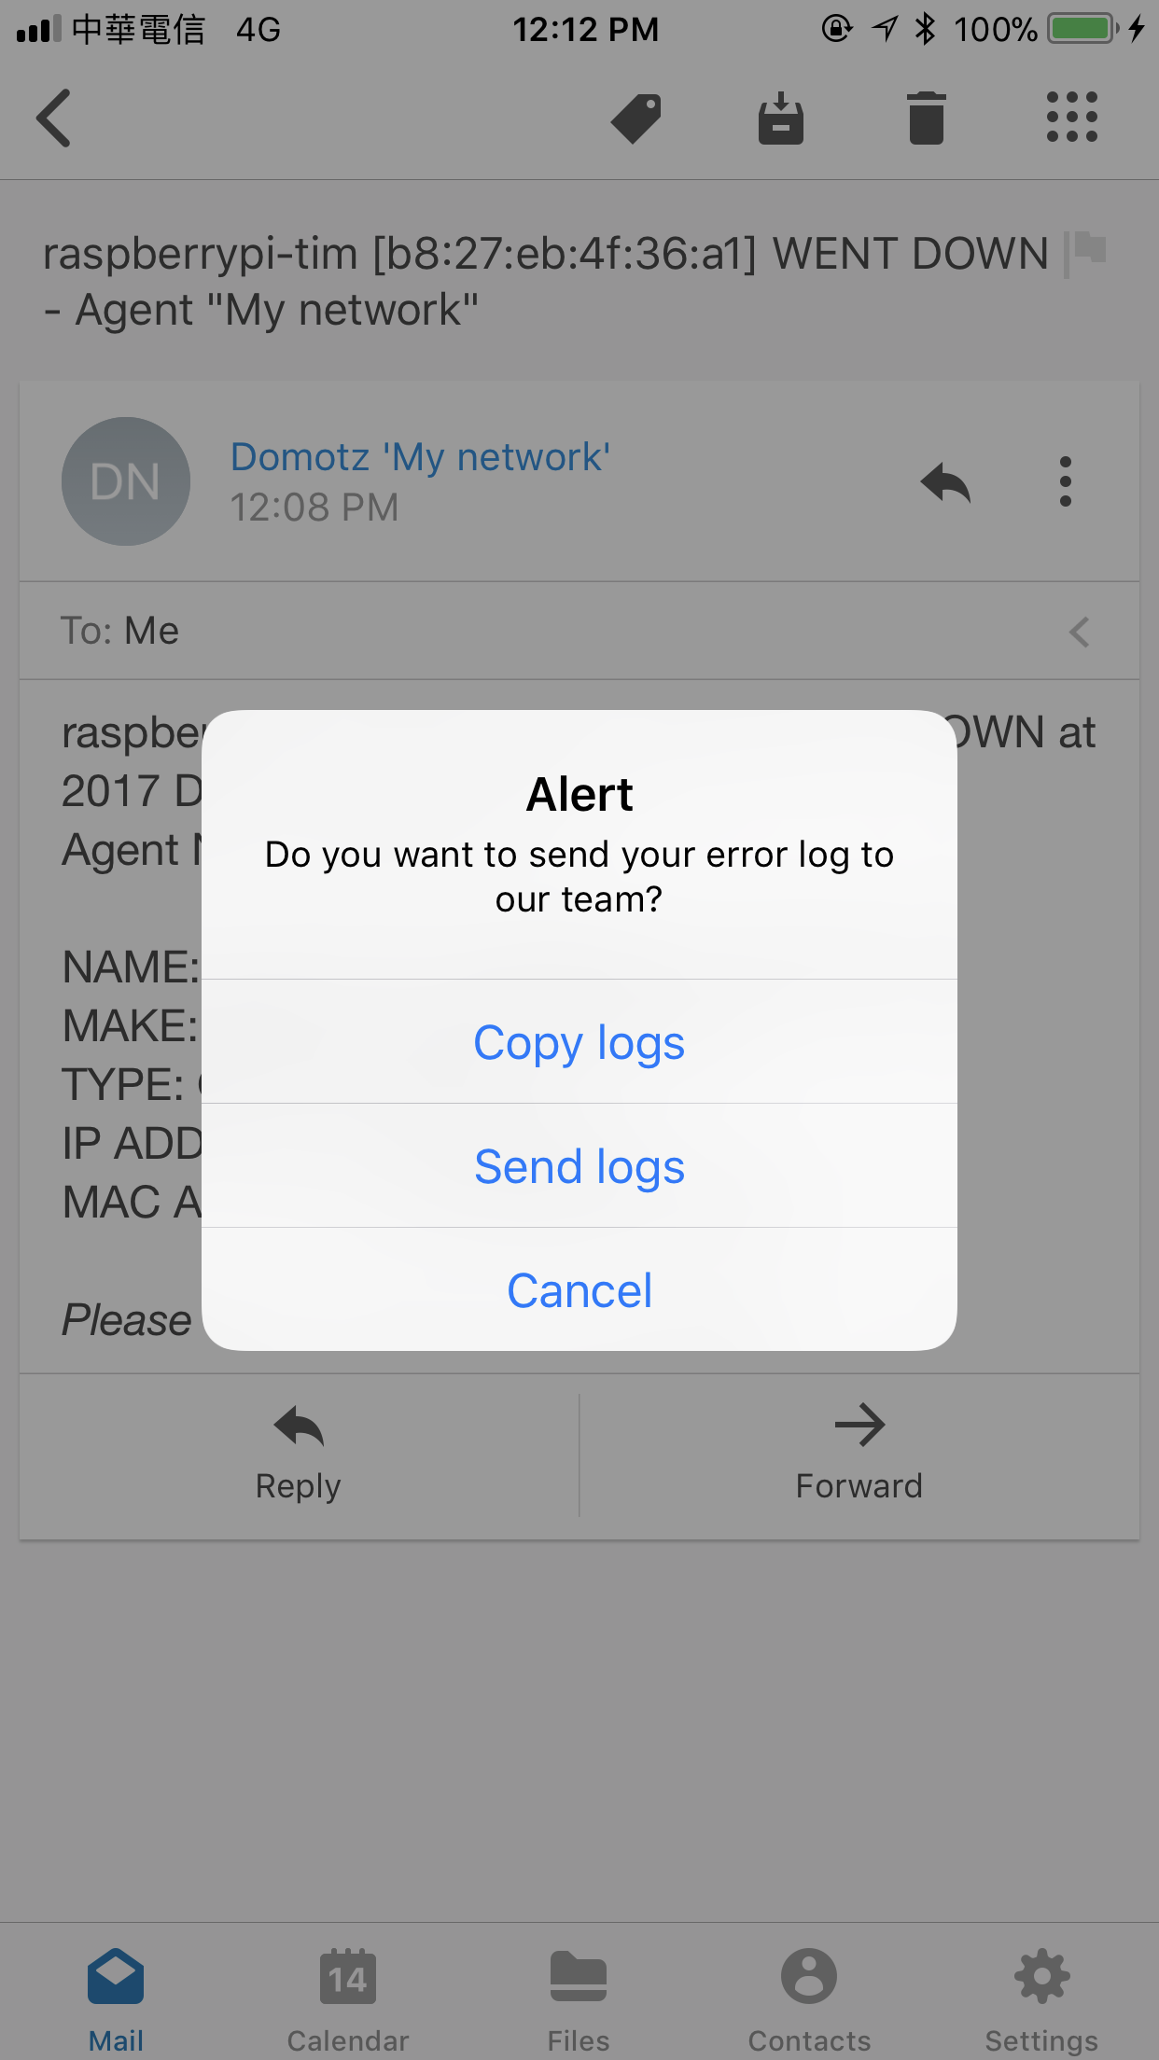
Alerts
When server goes down

Slide 22
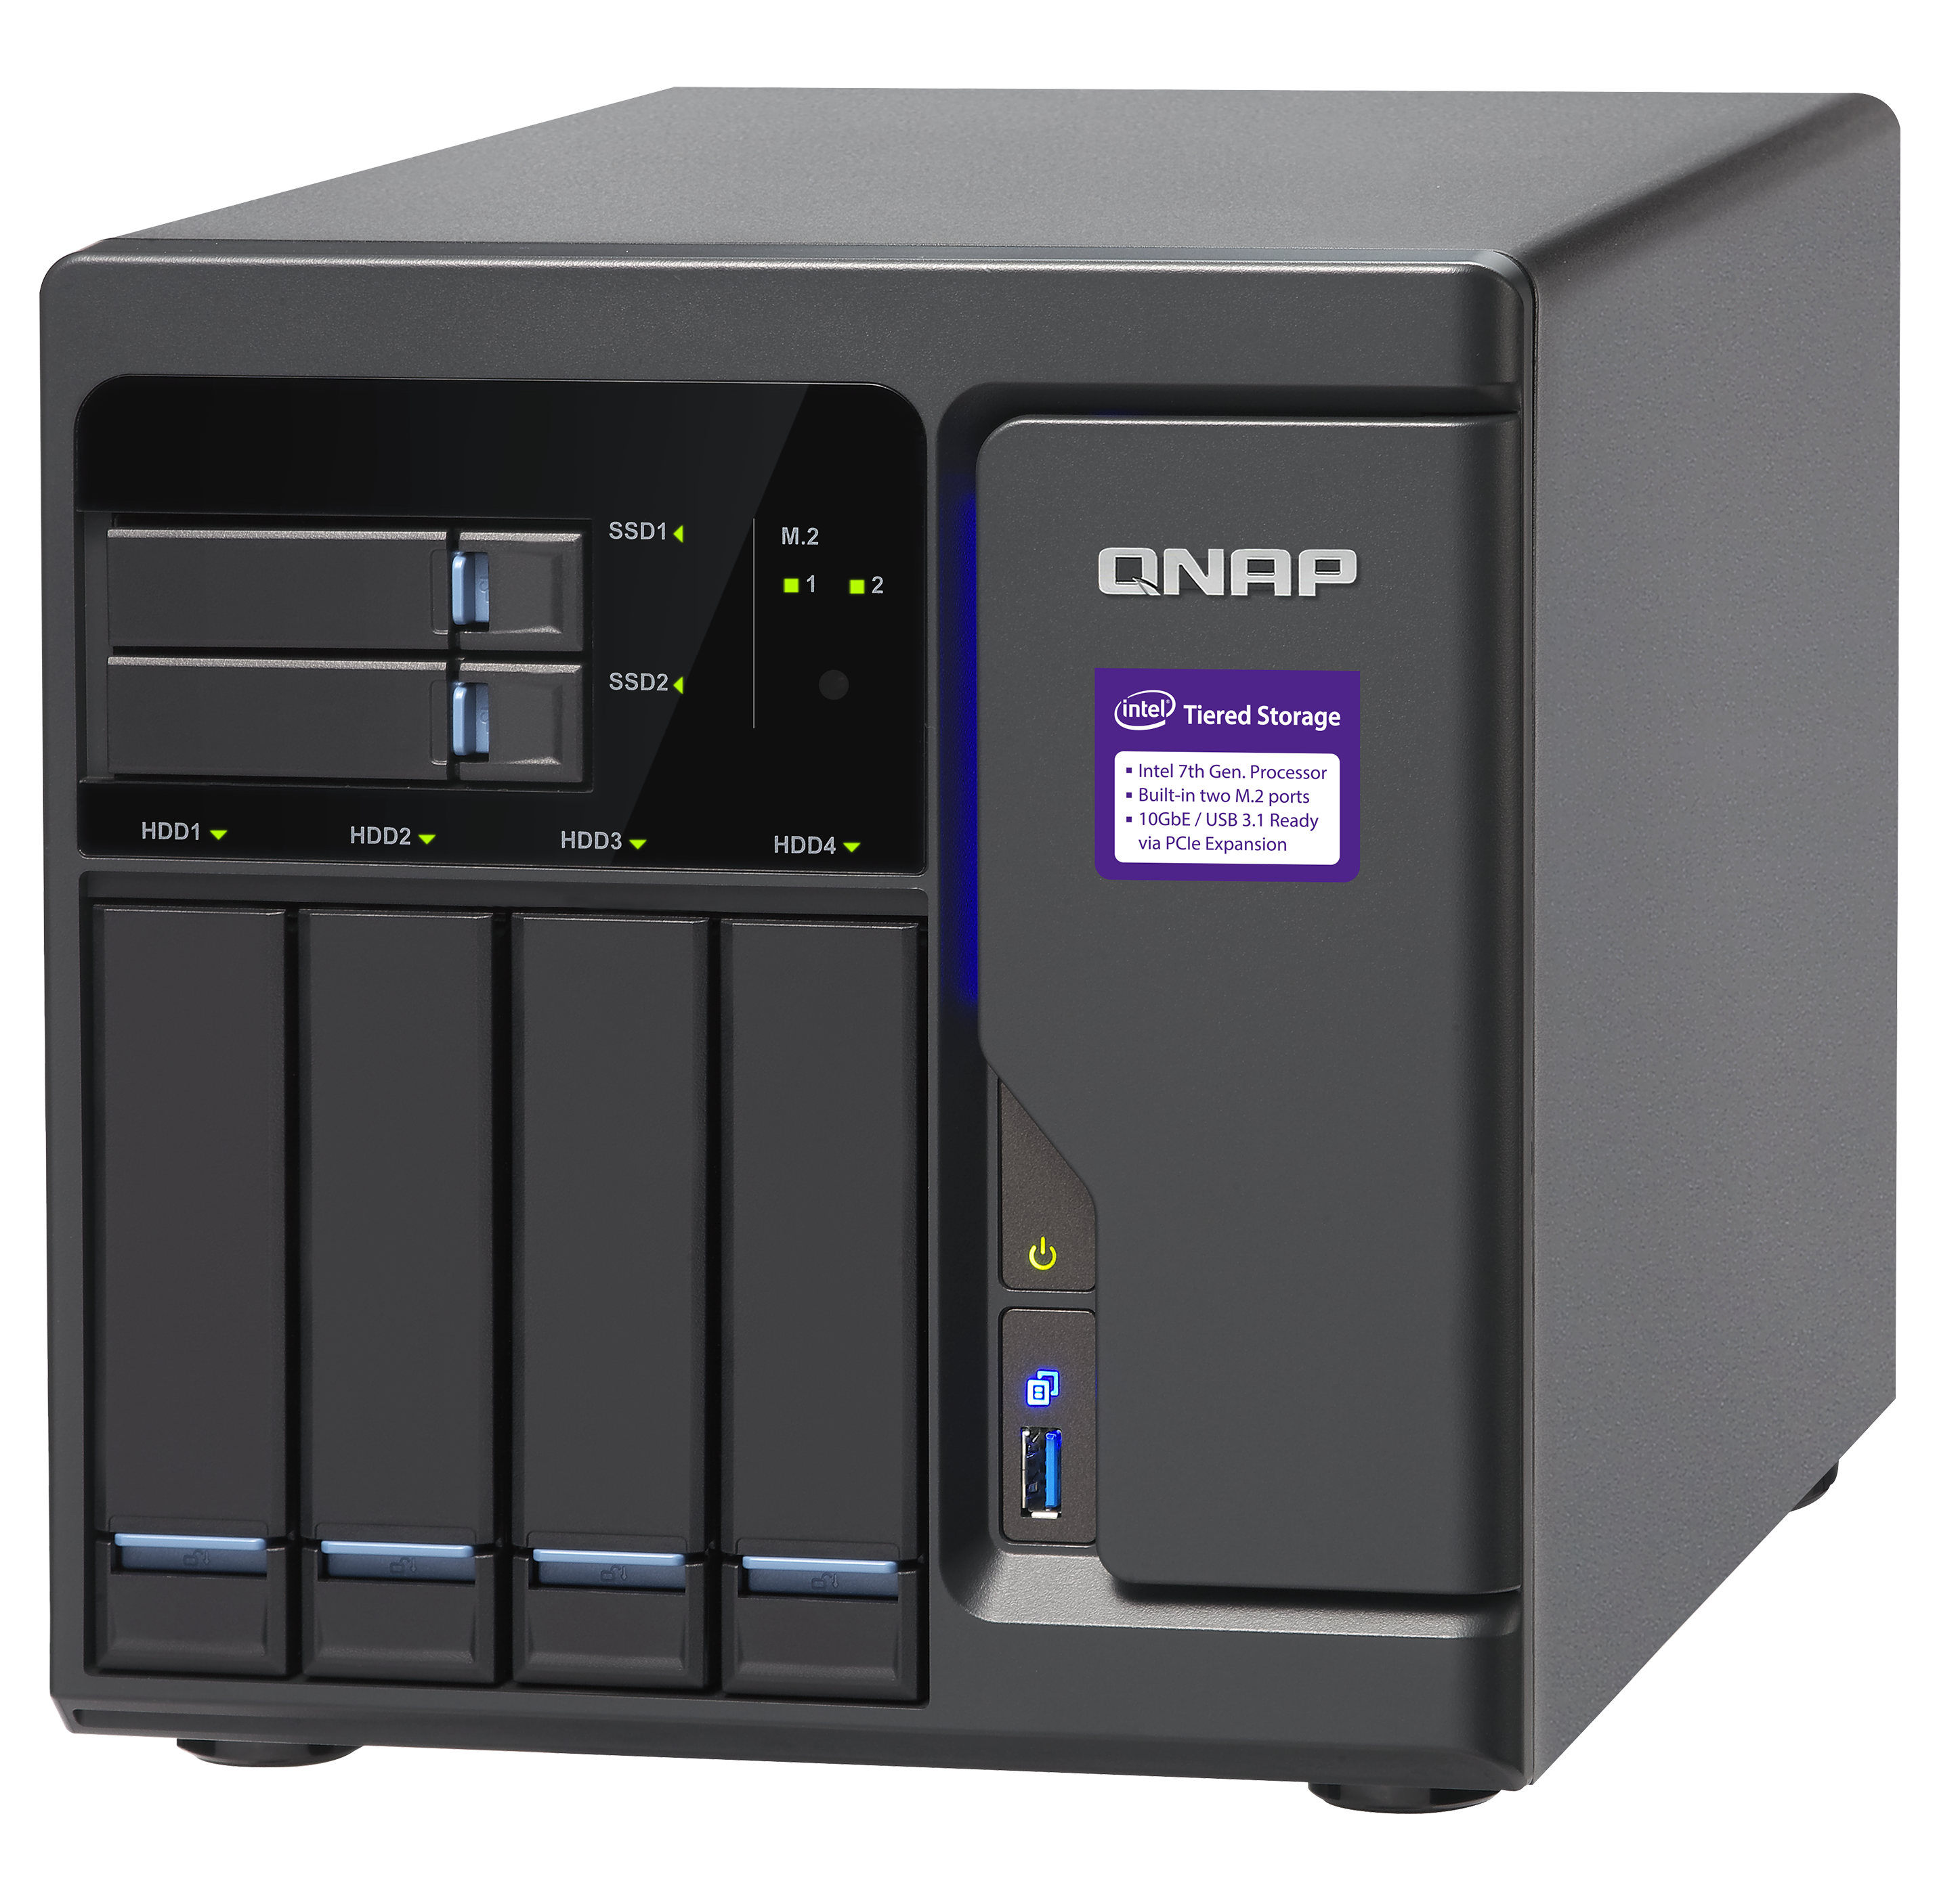
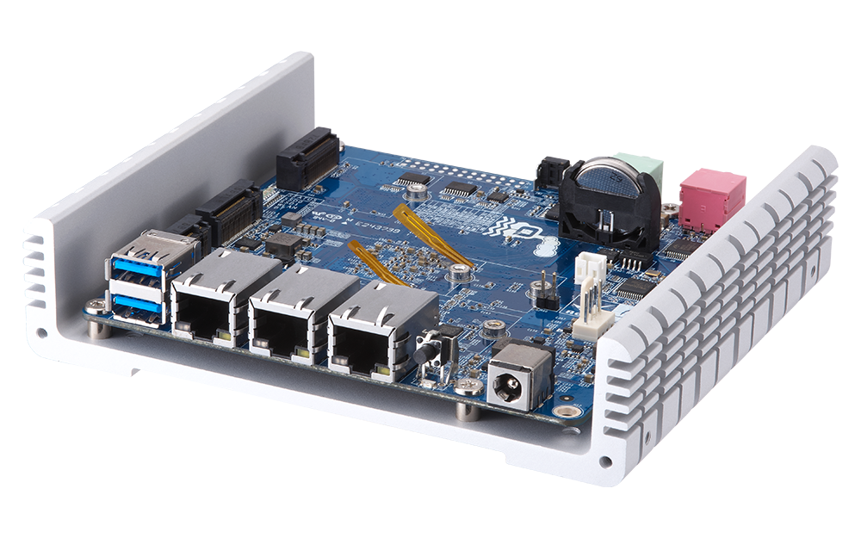
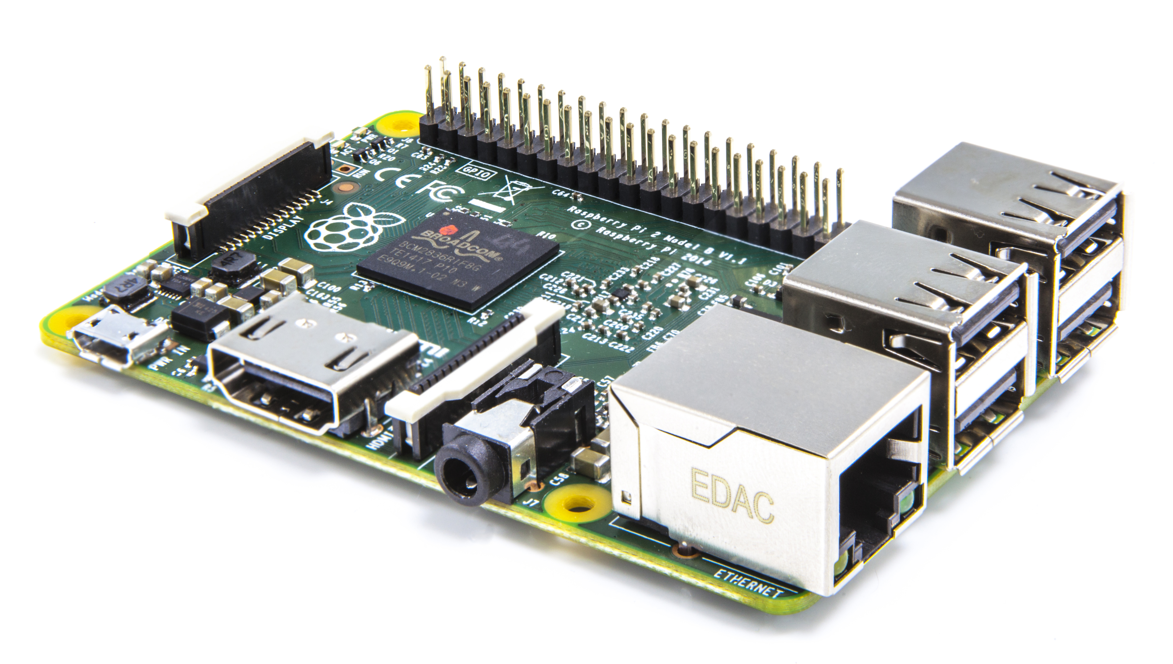
Domotz agents can be installed on
QNAP NAS
Enrich your life for the better
QBoat Sunny
Your first and smallest IoT server ever
Raspberry Pi
Tiny and affordable computer

Slide 23
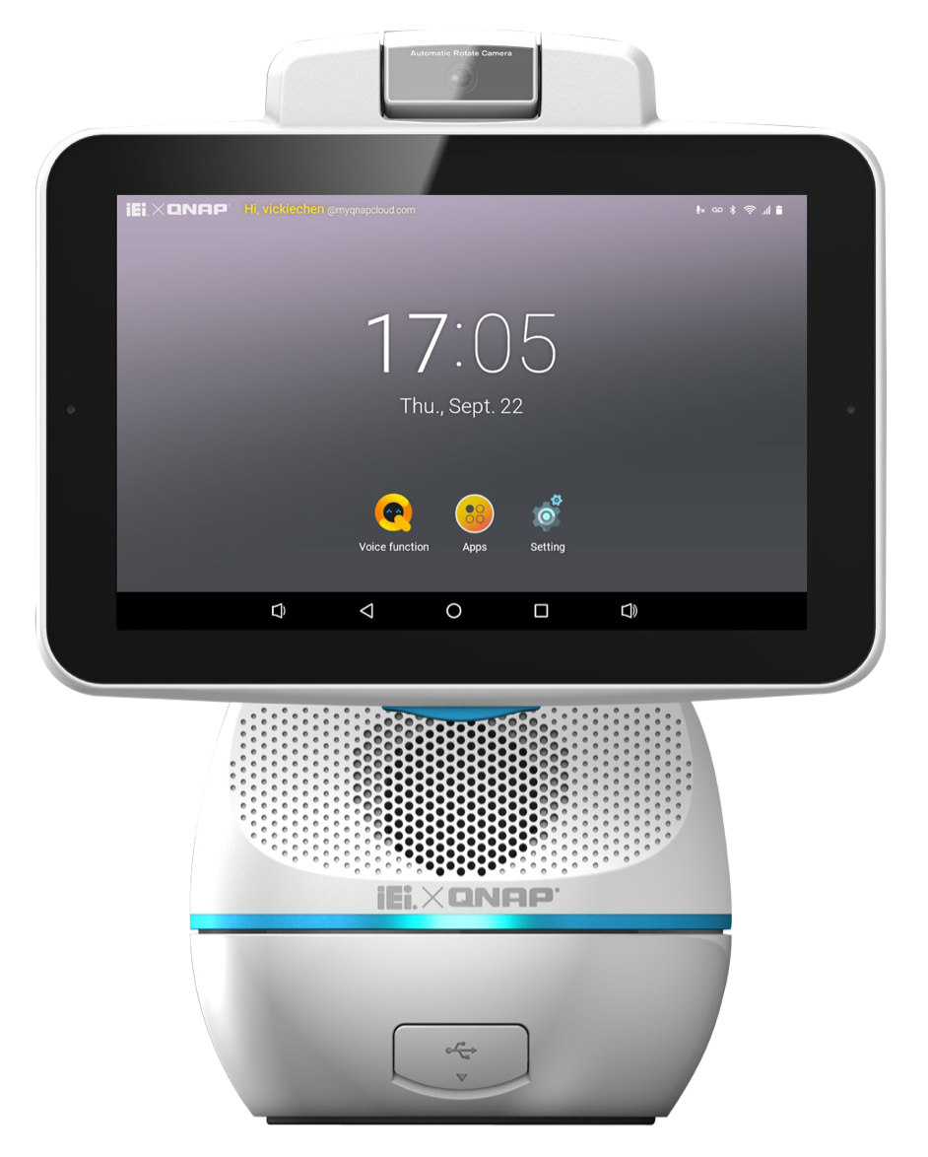
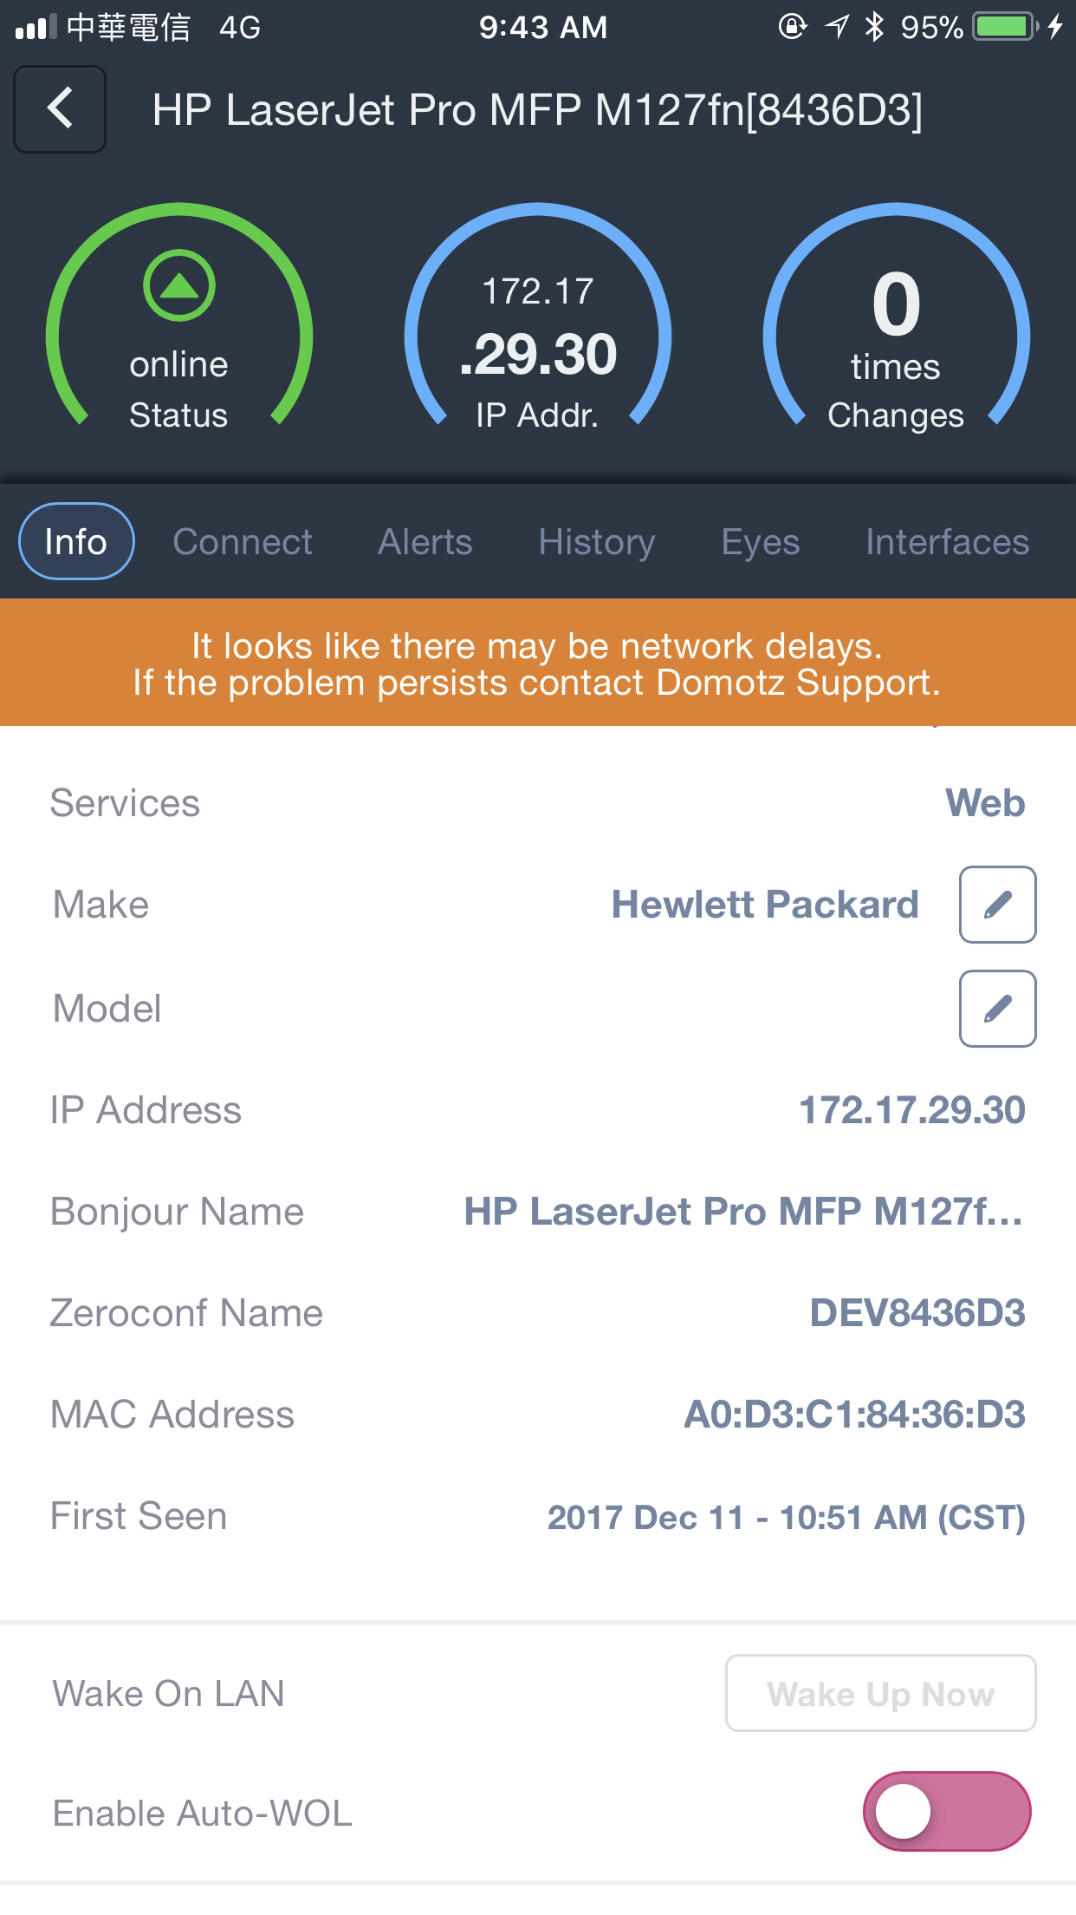
Domotz network monitoring can be installed
…on Afobot
Your personal virtual assistant
… on mobile devices
Check device status
On-The-Go

Slide 24
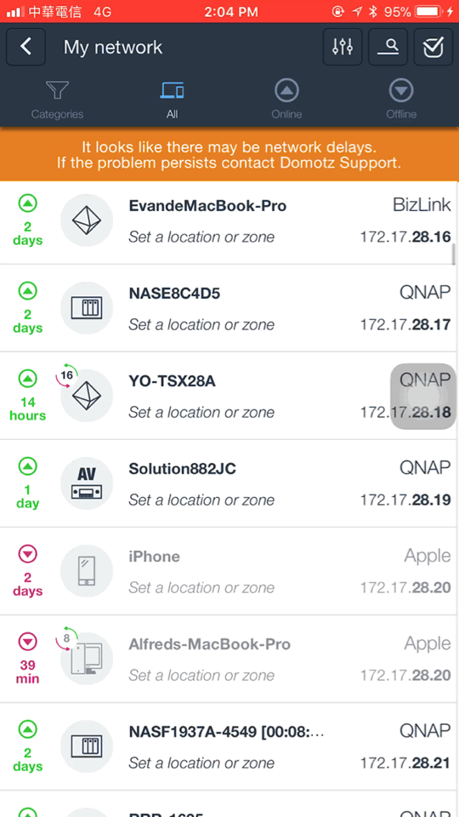
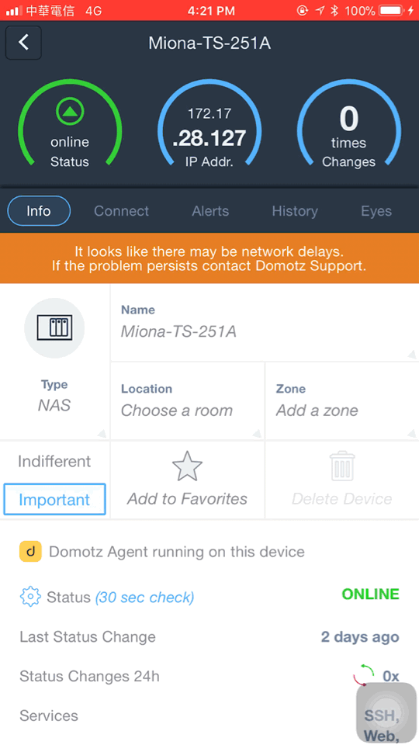
Domotz on your mobile
Device status and basic details
Devices connected to the same
network

Slide 25
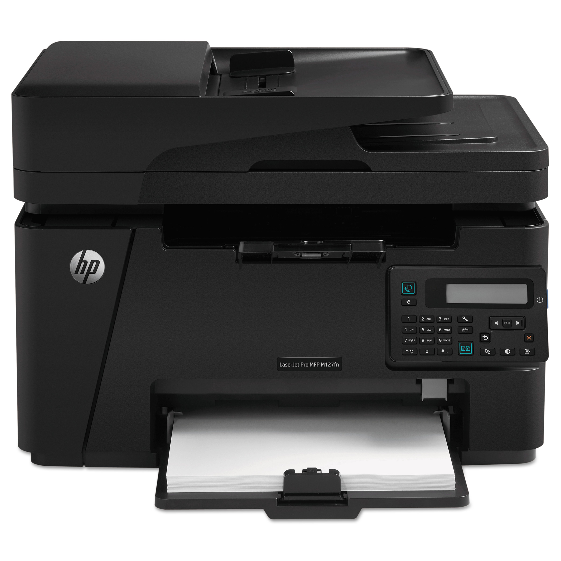
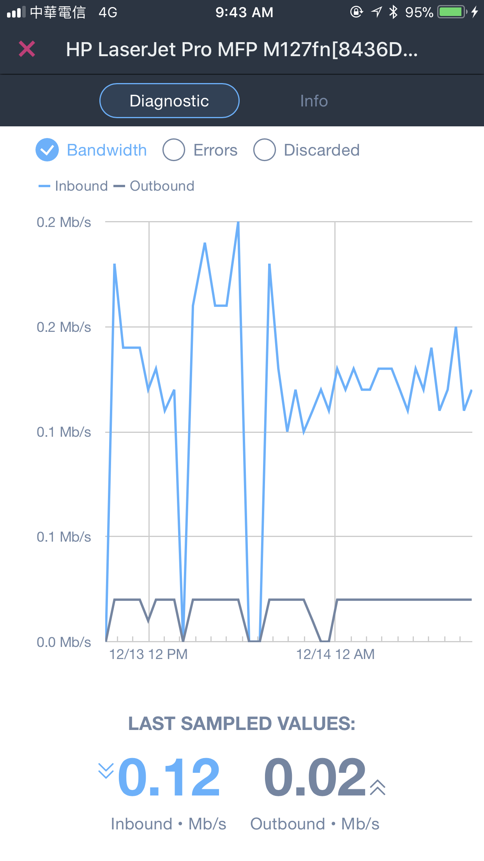
Domotz on your mobile
Problem can be resolved in real-time even when IT personnel is not in office.
Current
Bandwidth
IP info
Wake on LAN

Slide 26
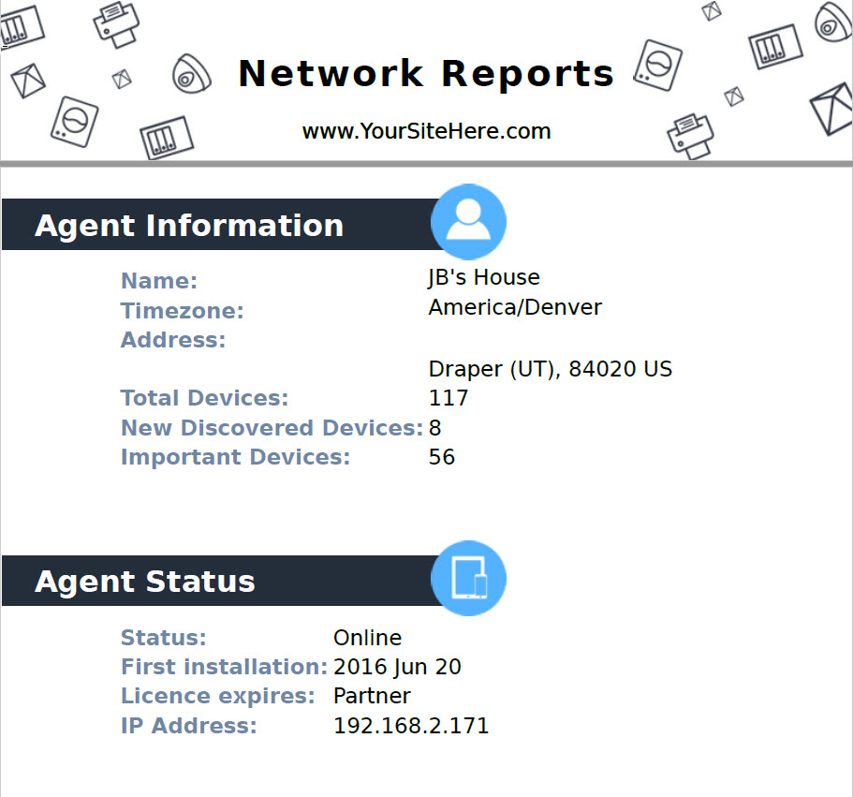
Monthly Report

Slide 27
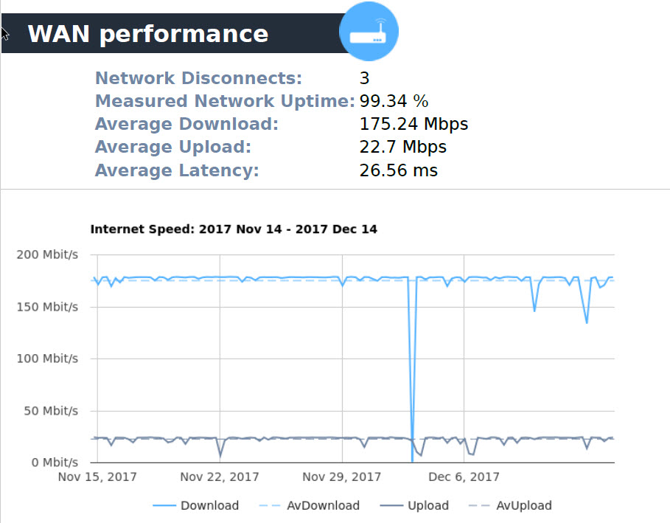
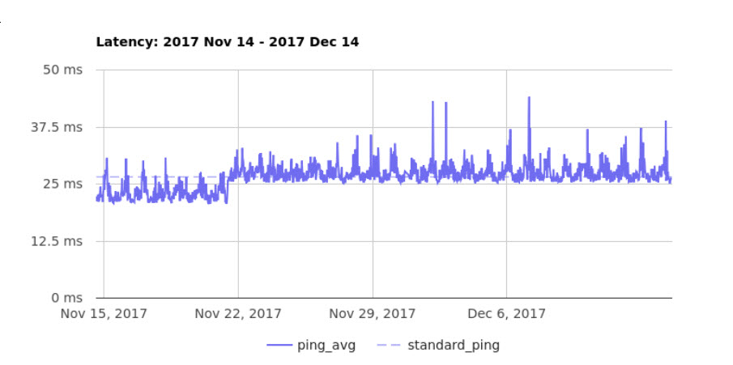
Monthly Report

Slide 28
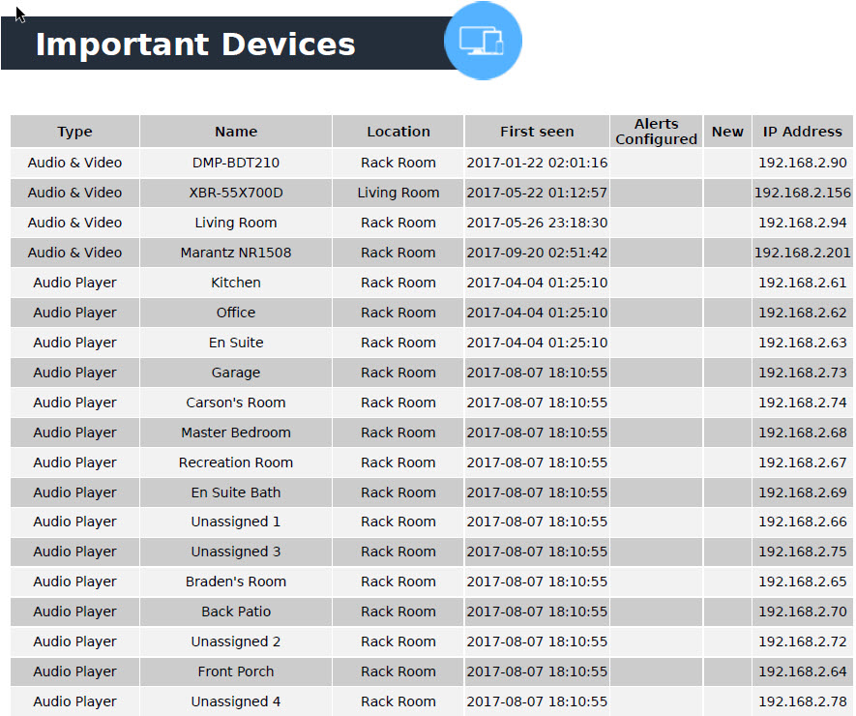
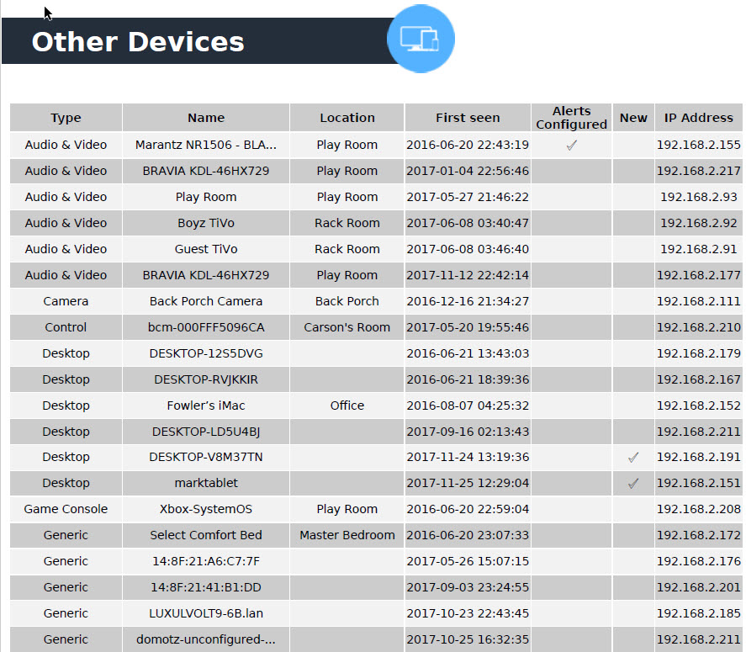
Monthly Report

Slide 29
Thank you

