Slide 1
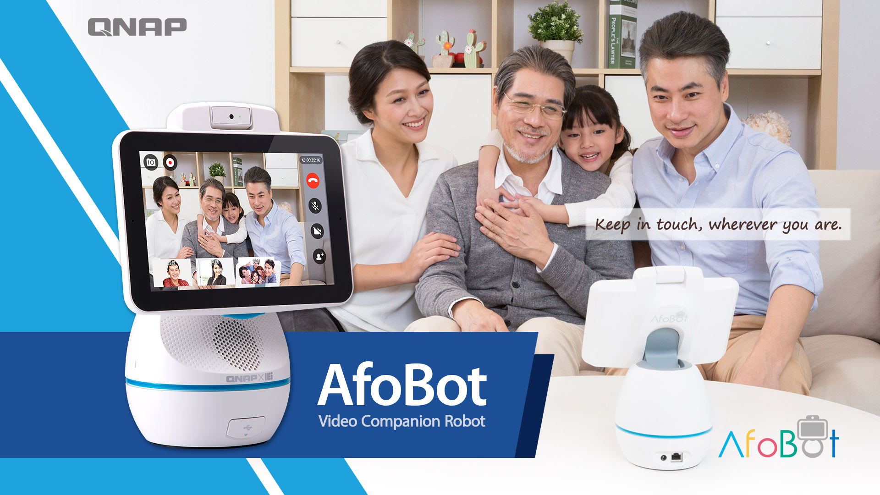

Slide 2


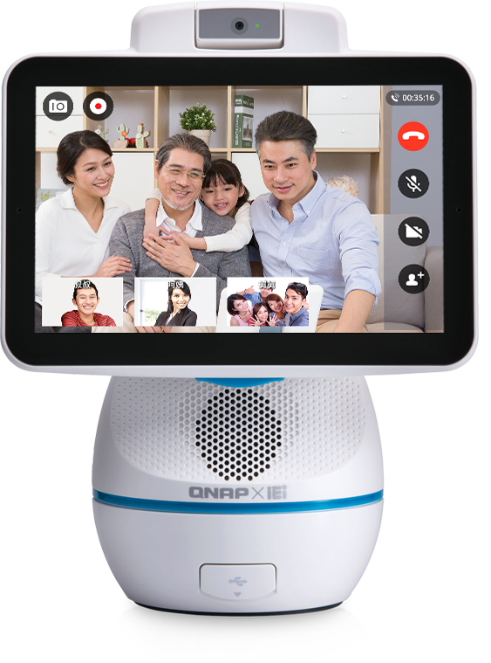


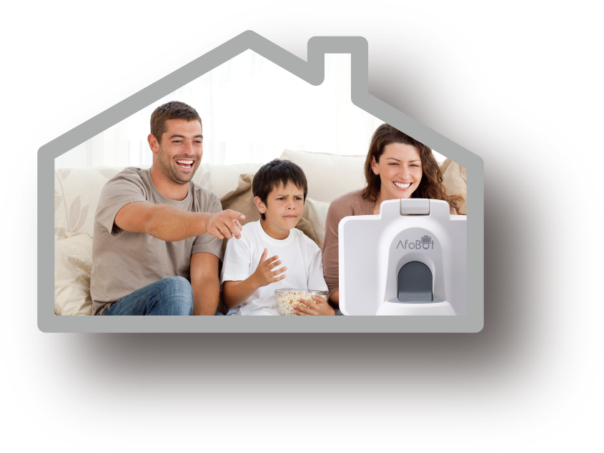
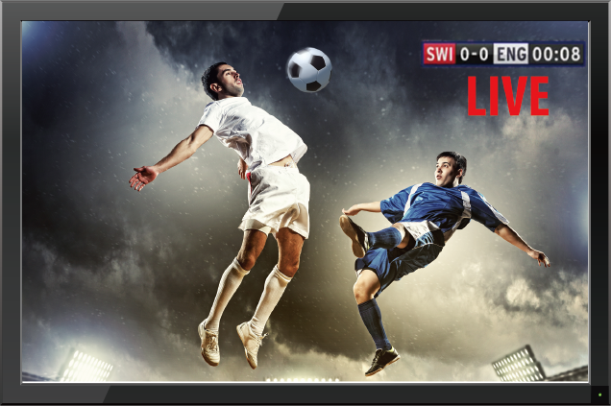
AfoBot Video companion robot
Smart video companion
Click-n-Home
Auto answer
Face tracking
4-peer video call
Call recording
F2.0 Aperture for
dim environment
Voice assistant
Multimedia by Voice control
Alarm
Music
Weather
Broadcast
Take photo
Video
Shared cloud album

Slide 3
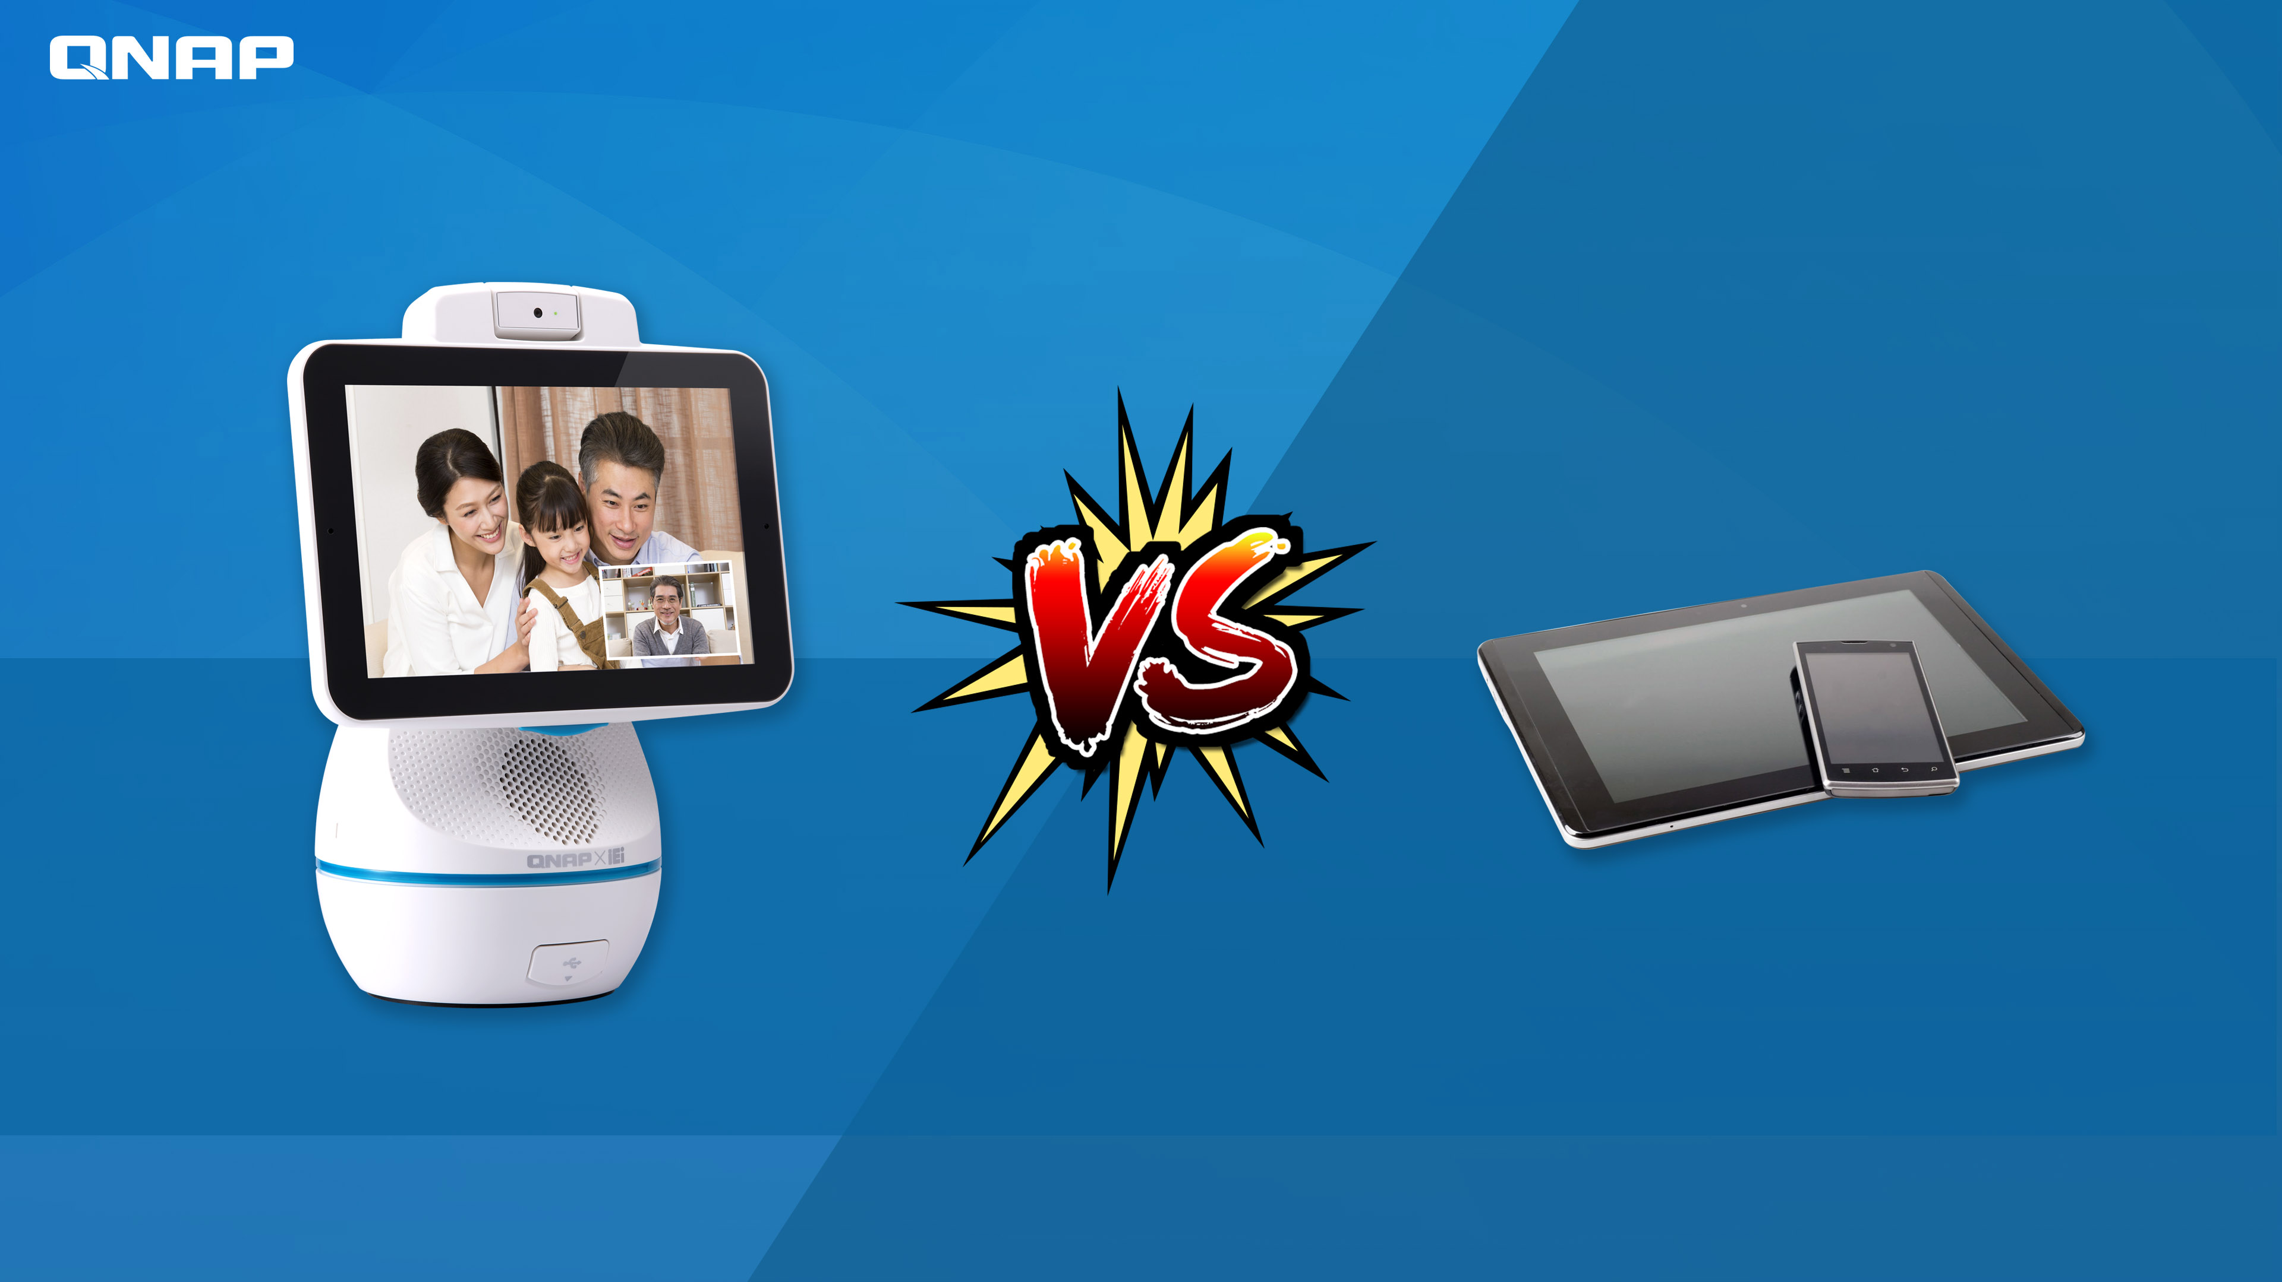
Application
Mobile / Tablet
AfoBot

Slide 4
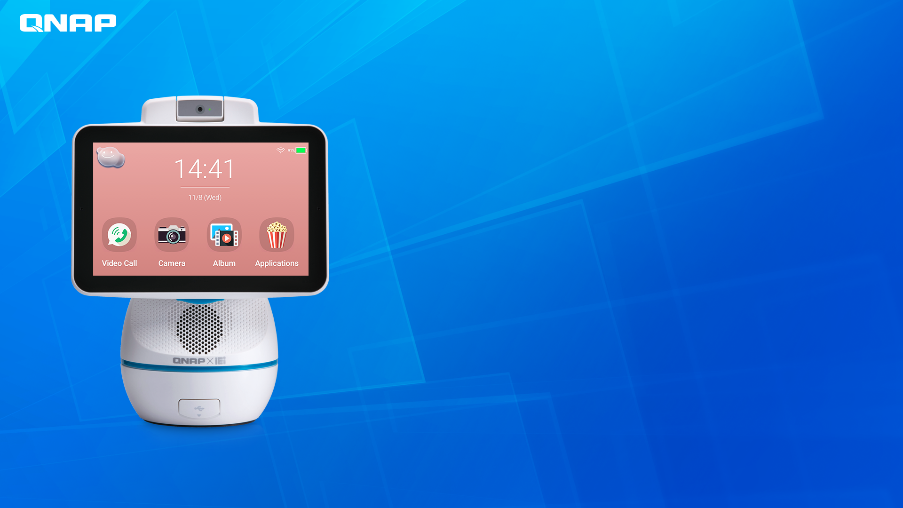
1. Companion
AfoBot
Video Companion Robot

Slide 5




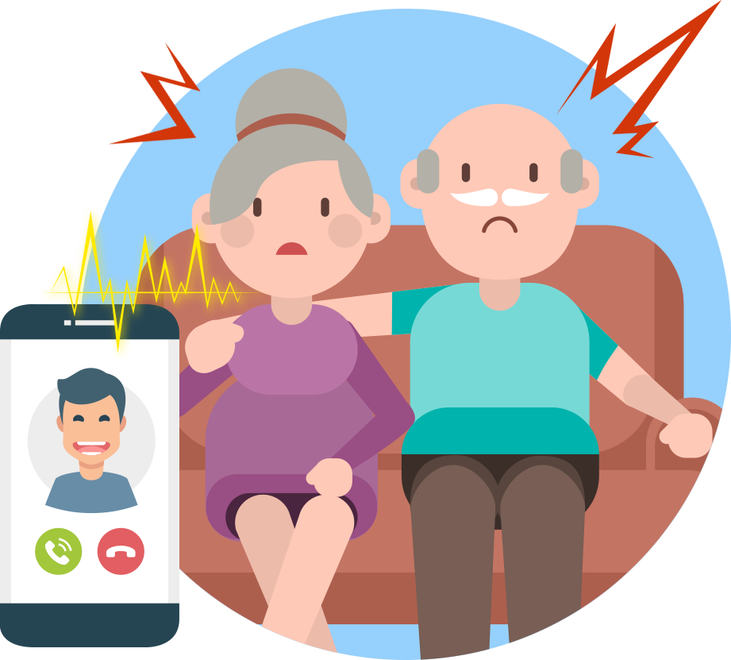

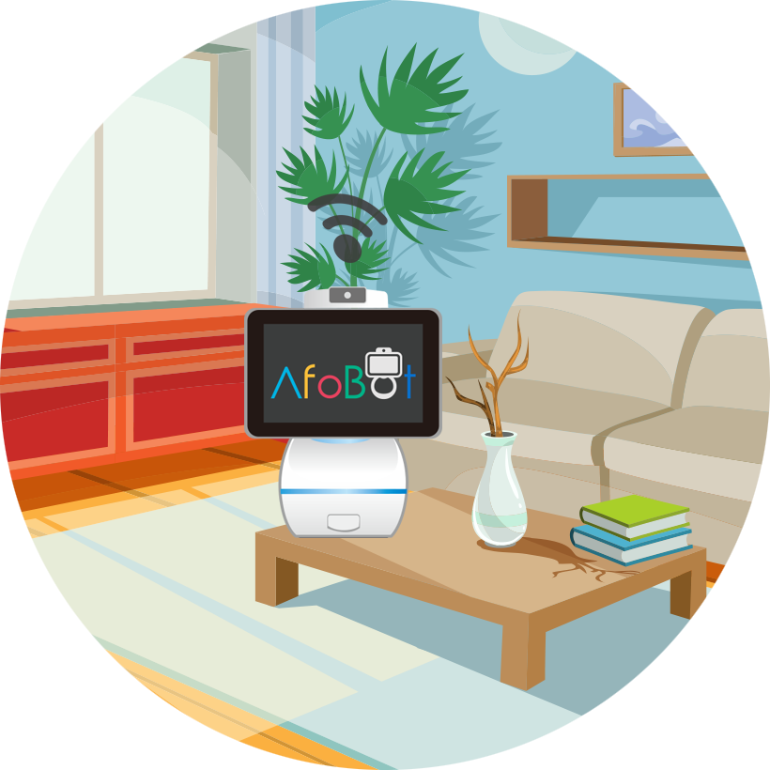
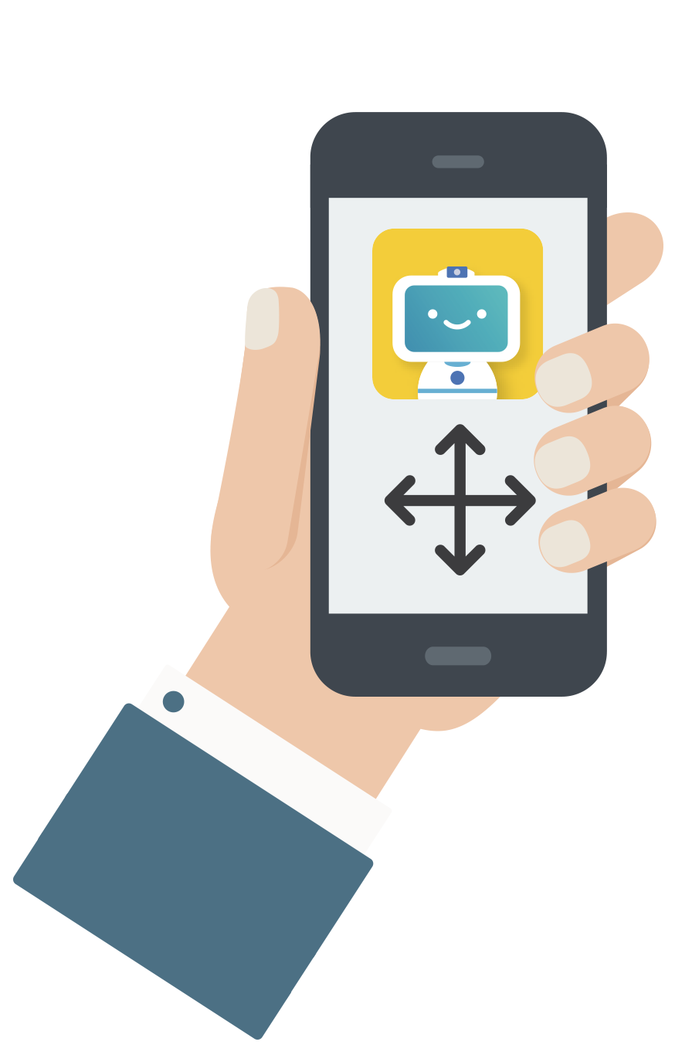

Want to connect with family but…
Phone / Cam
Weak
AfoBot
Win
Disturbs family
Click-n-home
Remote rotation control
Feels like being observed
5MP Cam (>1080P) + Dim vision mode
Notes:
一鍵回家
打開視訊
遠端360度旋轉
吵醒父母:
擔心父母正在休息, 打手機回家會吵醒
被監控感:
若安裝監視器, 讓家人有被監控的感覺

Slide 6
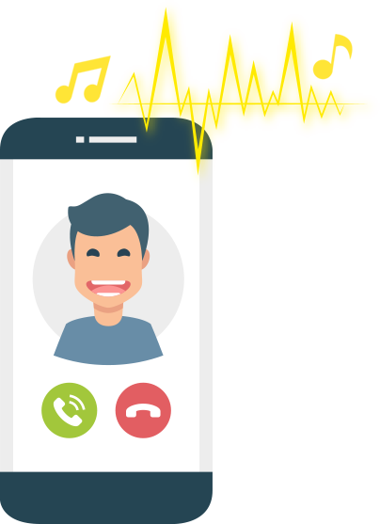

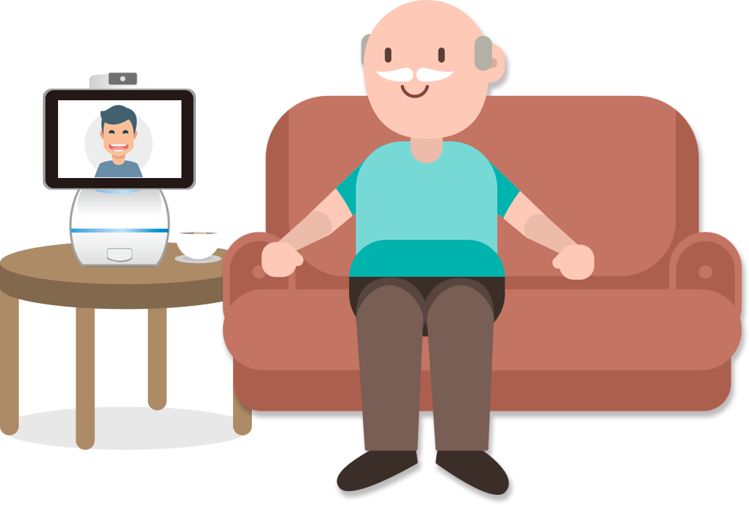

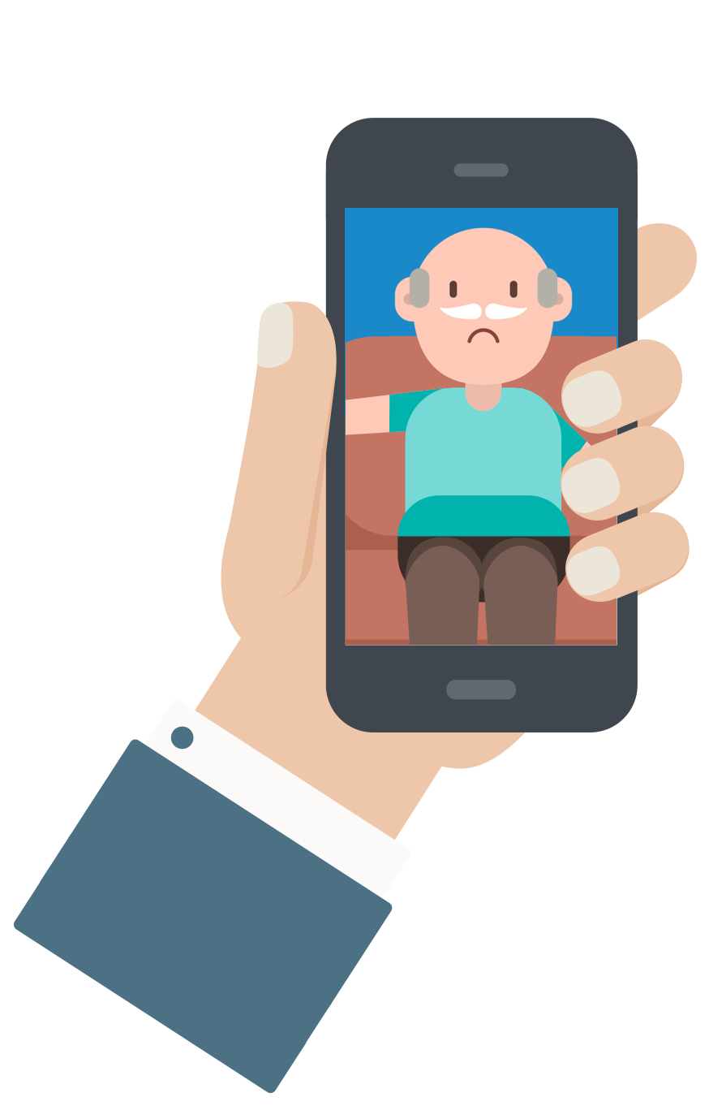
When making calls with aging parents...
Phone / Tablet
Weak
AfoBot
Win
Not carried when at home
Auto answer
Video call
Nobody
answers
Don't know how to
answer
Face Tracking
Voice dial to phone app
Notes:
一鍵回家
打開視訊
遠端360度旋轉
吵醒父母:
擔心父母正在休息, 打手機回家會吵醒
被監控感:
若安裝監視器, 讓家人有被監控的感覺

Slide 7



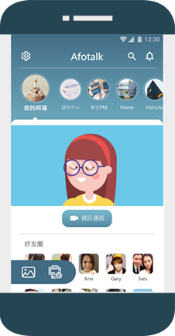
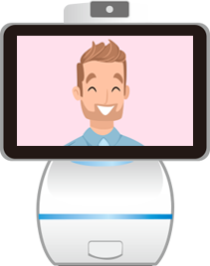
Wants to call kids at home
Phone / Tablet
Weak
AfoBot
Win
Need to hold the phone
Auto answer
Face tracking
Device cost
Device lost
Always connected
Notes:
一鍵回家
打開視訊
遠端360度旋轉
吵醒父母:
擔心父母正在休息, 打手機回家會吵醒
被監控感:
若安裝監視器, 讓家人有被監控的感覺

Slide 8


When busy cooking but need help…
Phone / Tablet
Weak
AfoBot
Win
Limited angles
Voice dial
Face Tracking
Greasy hands
Audible guidance for recipes
Both hands are busy
Audible alarms (timer…)
Notes:
一鍵回家
打開視訊
遠端360度旋轉
吵醒父母:
擔心父母正在休息, 打手機回家會吵醒
被監控感:
若安裝監視器, 讓家人有被監控的感覺

Slide 9
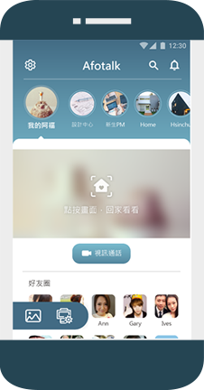
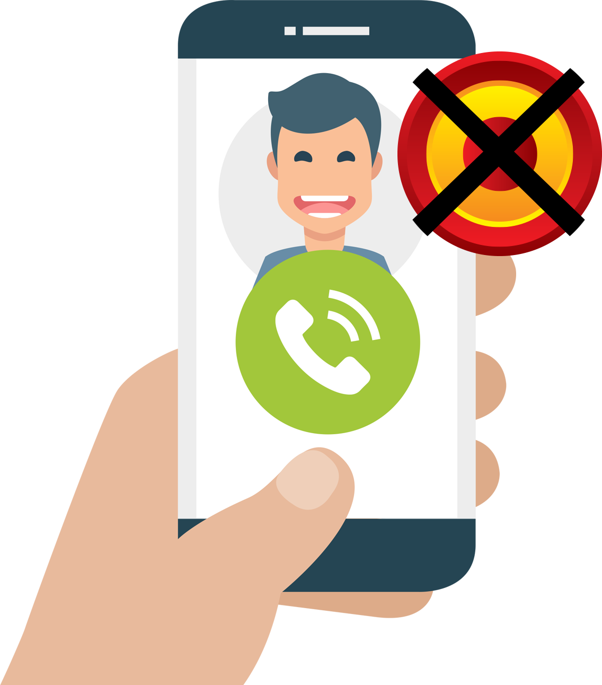
Record events to be remembered…
Phone / Tablet
Weak
AfoBot
Win
Can not record
Group video call (max. 4)
Can record
Screen size is limited.
REC
Notes:
一鍵回家
打開視訊
遠端360度旋轉
吵醒父母:
擔心父母正在休息, 打手機回家會吵醒
被監控感:
若安裝監視器, 讓家人有被監控的感覺

Slide 10
2. Voice assistant
AfoBot
Video Companion Robot

Slide 11





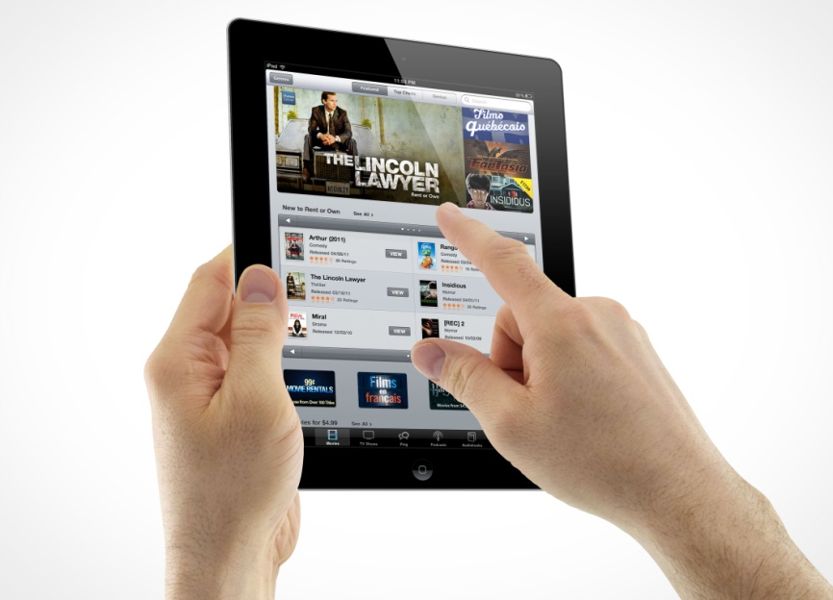
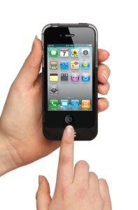

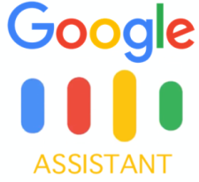

The evolution phases of UX
1
3
2

Slide 12



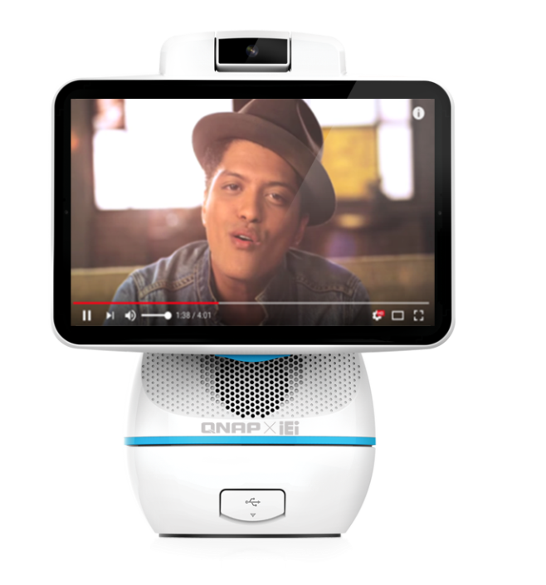
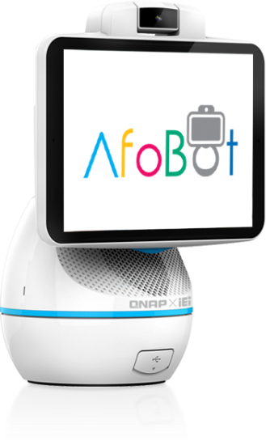

Key factor of voice interface
Natural Language Processing
Natural Language Understanding
Natural Language Integration
Natural Language Generation
Deep learning / Grammar / Intents /
Domain knowledge
Play
Just The Way
You Are

Slide 13

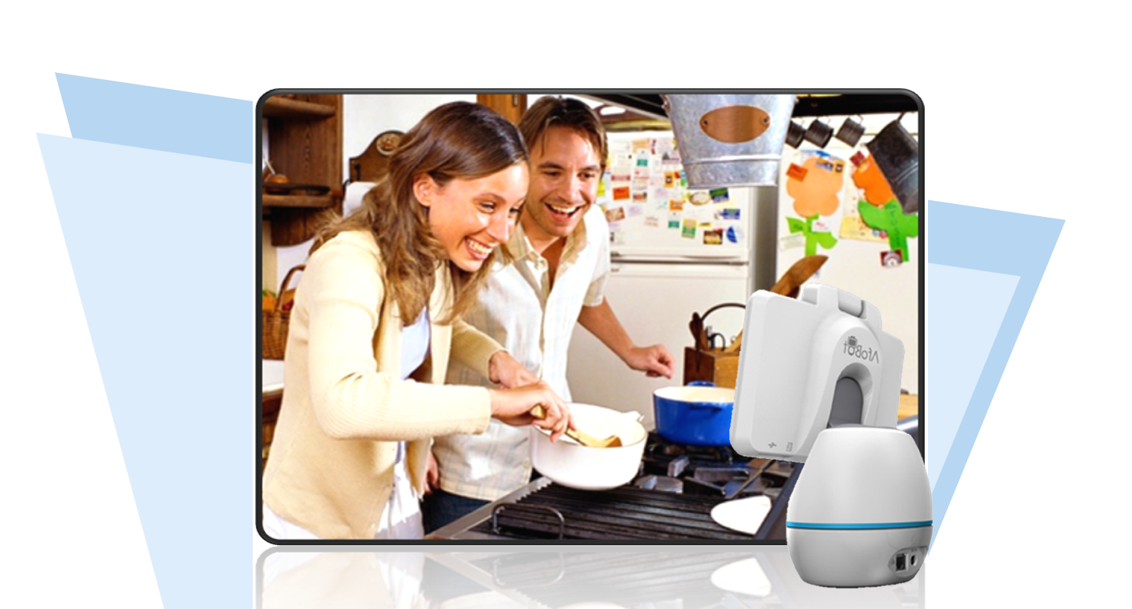


Manage things with voice @home
Phone / Tablet
Weak
AfoBot
Win
Phone is for single person
For 1 or family members
It is designed mainly for touch.
Ask for weather
Voice to set alarm
Notes:
一鍵回家
打開視訊
遠端360度旋轉
吵醒父母:
擔心父母正在休息, 打手機回家會吵醒
被監控感:
若安裝監視器, 讓家人有被監控的感覺

Slide 14

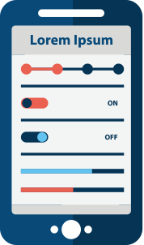


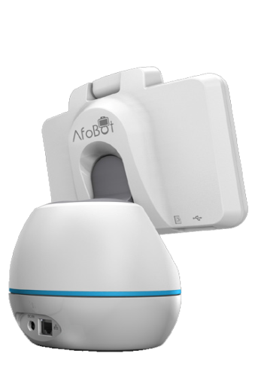


Manage things with voice @home
Phone / Tablet
Weak
AfoBot
Win
Limited angle
Take picture with voice
Limited size of screen
Cloud album (10GB)
Limited range
Digital photo frame
Notes:
一鍵回家
打開視訊
遠端360度旋轉
吵醒父母:
擔心父母正在休息, 打手機回家會吵醒
被監控感:
若安裝監視器, 讓家人有被監控的感覺

Slide 15
3. Multimedia by
Voice control
AfoBot
Video Companion Robot

Slide 16
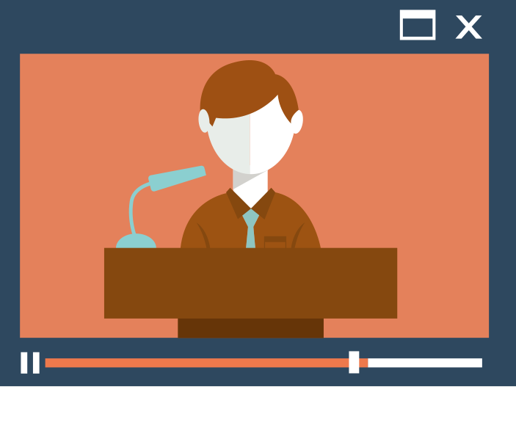
Play what you asked for
Phone / Tablet
Weak
AfoBot
Win
Inflexible
NLP, Flexible
More steps needed
1 step play
5W speaker
Notes:
一鍵回家
打開視訊
遠端360度旋轉
吵醒父母:
擔心父母正在休息, 打手機回家會吵醒
被監控感:
若安裝監視器, 讓家人有被監控的感覺

Slide 17

Development phases of AfoBot
Localization
Phase 1
Phase 2
Phase 3
Setp3
Voice platform
Content platform
Service platform
Target:
Specialized voice control experience which is better than Tablet.
Target:
Integrated AI assistants.
Target:
Integrations with local services
Service Platform
Local O2O :
Taxi, home cleaning, EC,
Food delivery…other strategic partnership
Purpose:
Integrate Reliable O2O Services
Partners
Regional applications: Digital contents, assistants.
music, movie, radio, news, weather, education…profit sharing
Local O2O : Service
Taxi, home clearance, EC
Food delivery…affiliate
Core feature: Voice interactions
Global/Google ; US/Alexa ; China/iFlytek ; Taiwan/Cyberon
Infrastructure

Slide 18
Major features
AfoBot
Video Companion Robot

Slide 19
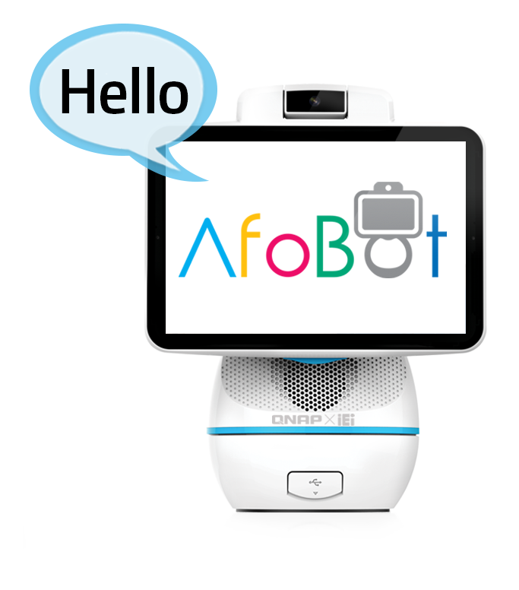
8 major strengths
Click-n-home
Remote camera control
Auto answer
Face tracking
Group video call and recording
Shared cloud album (10GB)
Personal voice assistant.
(Weather, alarm)
Search and play multimedia with voice interactions

Slide 20
HW Spec
AfoBot
Video Companion Robot

Slide 21



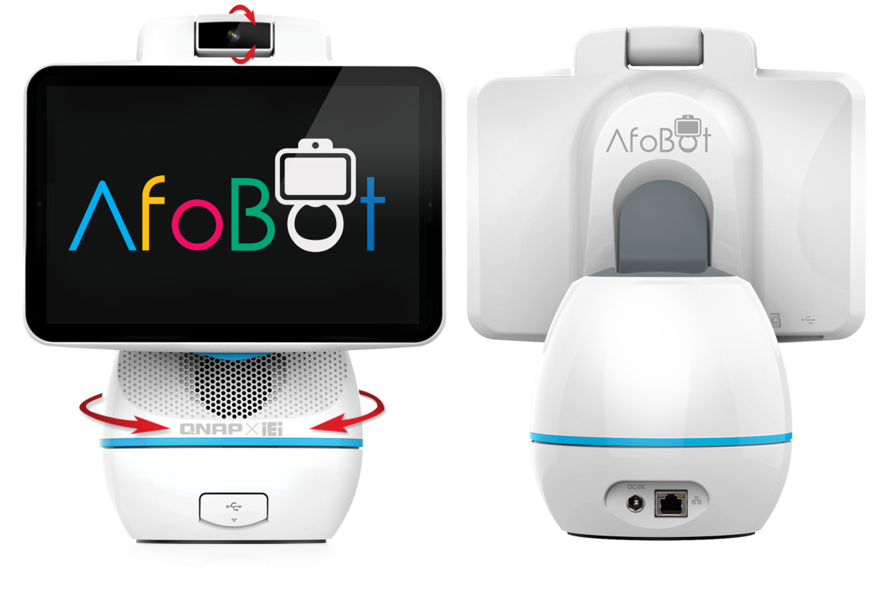






Hardware design
5MP Camera, tilt 100°
Microphone 2
Hinge 33°
Manual adjustment
Microphone1
Power button and voice assistant trigger
USB Type-C and microSD slot
Body can rotate 360°
USB-A slots
Power and wired network

Slide 22
Use cases
AfoBot
Video Companion Robot

Slide 23

AfoBot use cases (B2C)
Customizable hardware and software for different industries and demands
Why AfoBot?
AfoBot will provide SDK for Android developer, content maker, and service providers for developing their own applications. And provide value-add applications in retail, health care and kindergarten.
Companion
Video calls
Voice assistant
Education
Health care
Surveillance

Slide 24

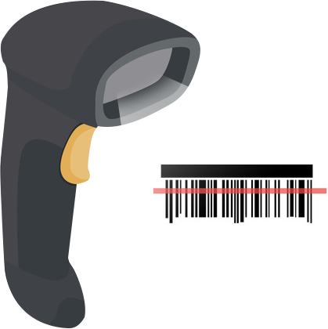
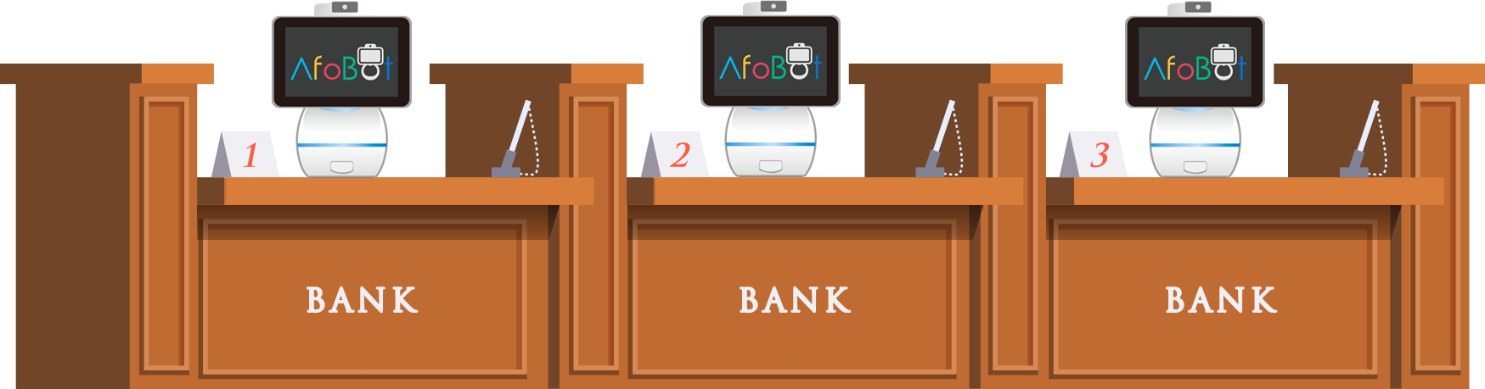
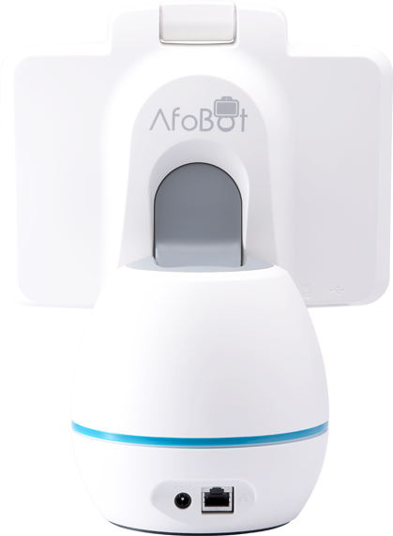


AfoBot @ Bank
1. Video customer service
2. Clerk assistant: Pooled clerk can face more customers.
3. Unmanned branch
4. Simple Video Teller Machine

Slide 25
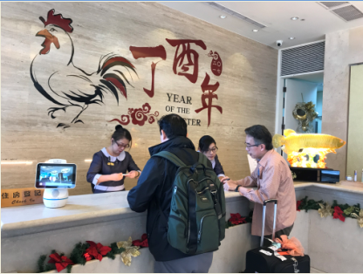
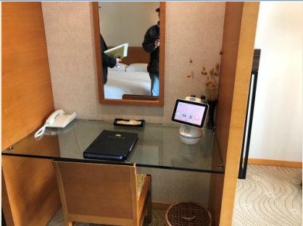
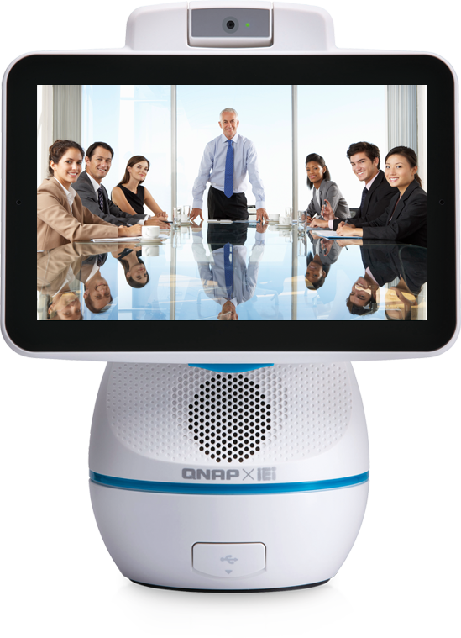
AfoBot @ Hotel
1. Self check in
2. Remote housekeeper
3. Points of interests.
4. Room services and remote control
5. Video conference, real-time interpretation services.

Slide 26
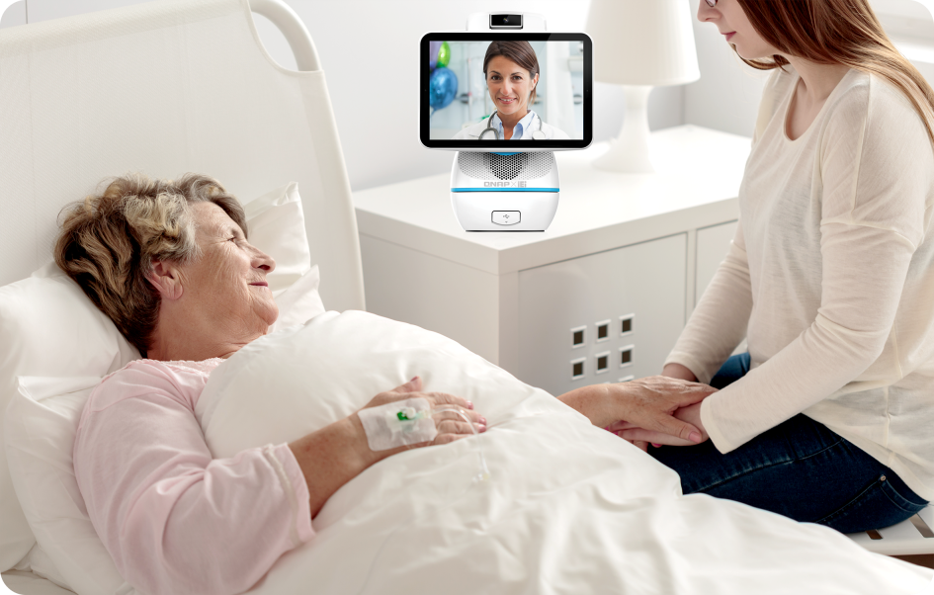

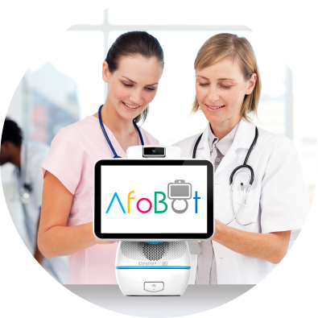
AfoBot @ Health Care
Doctors can access to multiple sites at same time.
Instructions can be conveyed even when doctors are away from hospital.
Patients can be visited remotely.
Voice trigger for emergency help. Can be an addition option.

Slide 27
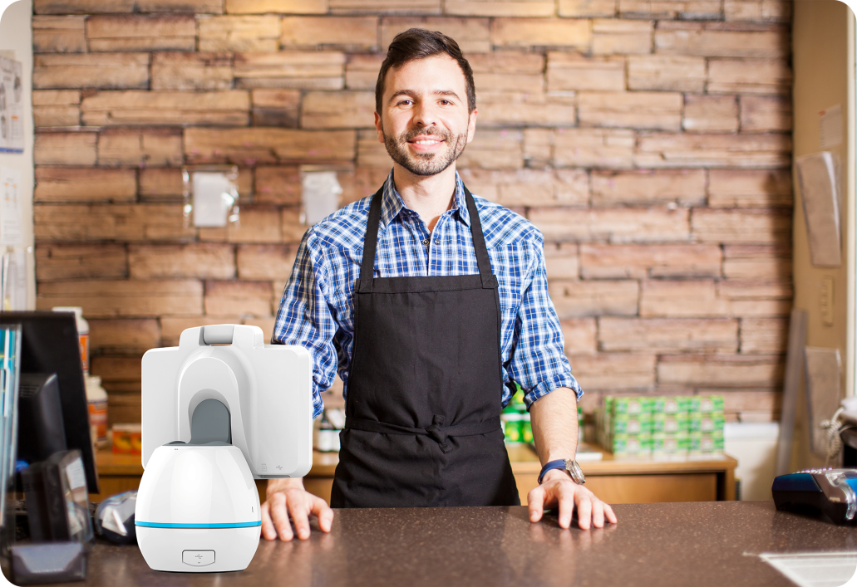
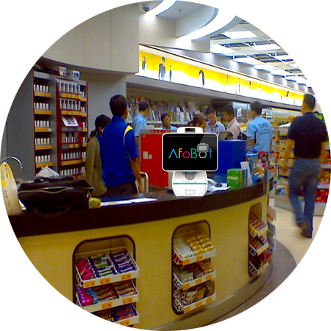
AfoBot @ Retail
A new channel to engage with customers.
New customer support method
As a catalogue which provides more interactions.
Provide tailored advertisement and recommendations based on age or gender.

Slide 28
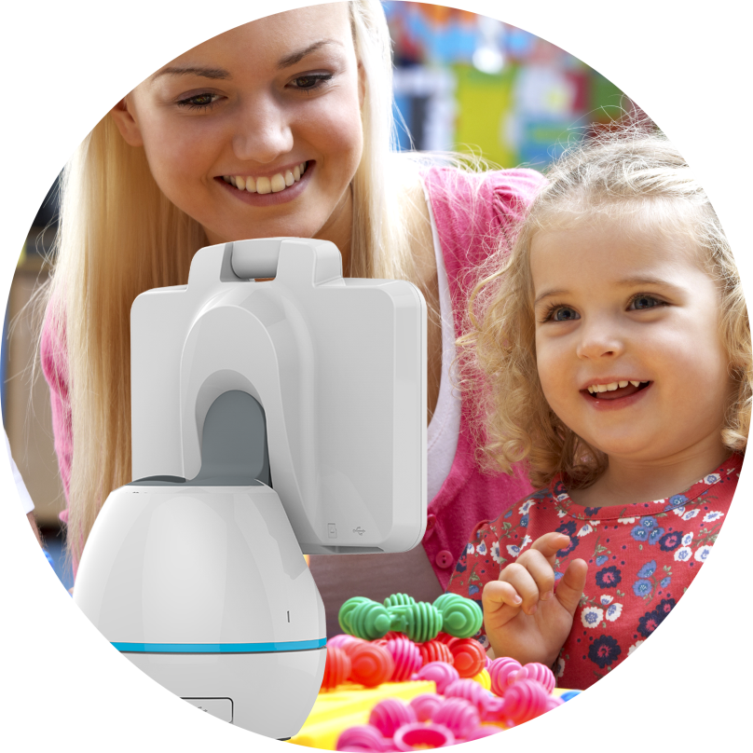
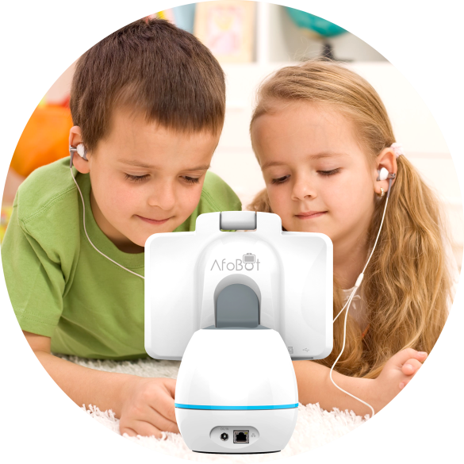
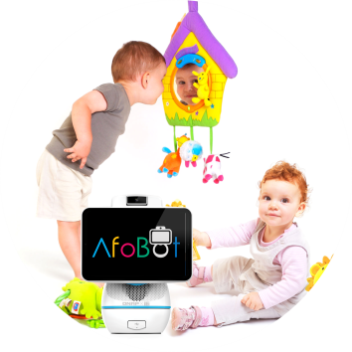
AfoBot @Kindergarten
Video feeds of the kindergarten can be accessed by parents.
Kids can also dial to parents when they like to.
Player of supplemental materials.

Slide 29
Looking for partners
AfoBot
Video Companion Robot

Slide 30
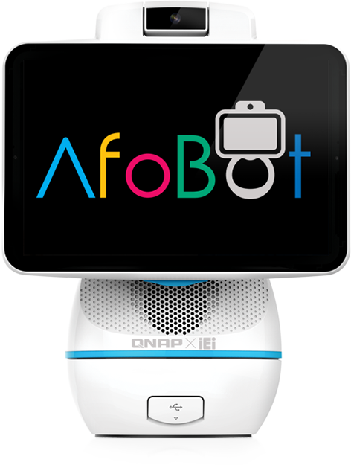
Thank you!!

