Slide 1
Most reliable team communication
Notes:
Hello everyone, QNAP has released Mattermost. today, we are going to talk about Mattermost.

Slide 2
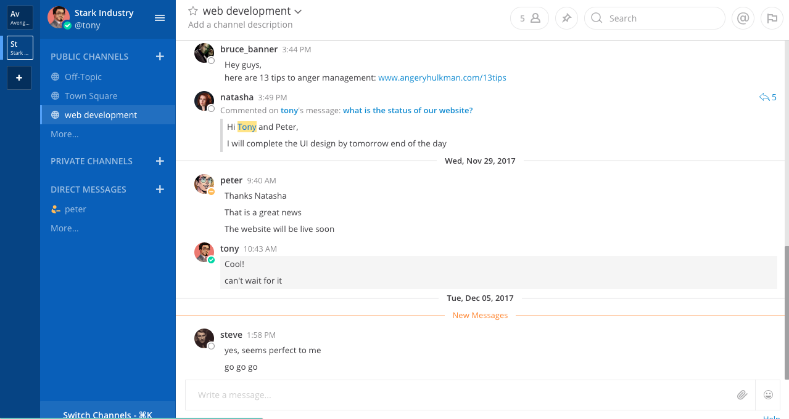
What is Mattermost?
most advanced workplace messaging solution in the world
Notes:
Mattermost is a slack-like team communication appllication and is known to be one of the best and most advanced workplace messaging solutions in the world. Many of you must have used skype, slack, hipchat, or some other communication tool, Mattermost is similar but with more advanced features.

Slide 3
Already using Mattermost?
◆ Switch to QNAP NAS and keep using Mattermost
◆ Secure all your important communication and confidential discussions in NAS
◆ Privacy for all your chat data
◆ Unlimited Storage (almost)
Notes:
But If you are already using Mattermost, you can just switch to QNAP NAS for all your security and data privacy purposes. Keep all the Workplcae communication safe.
Have almost unlimited storage capacity for all your shared files Story: Hipchat was hacked, accounts, emails, passwords were stolen.. even when hipchat hashes all passwords using the bcrypt algorithm, with a random salt, known to be security best practises. If this can happen with such high level encrypted security, anything can happen to your data. So, having your own network attahced storage, your own private cloud would make your data secure and away from hackers, under your nose, or “desk” haha!

Slide 4
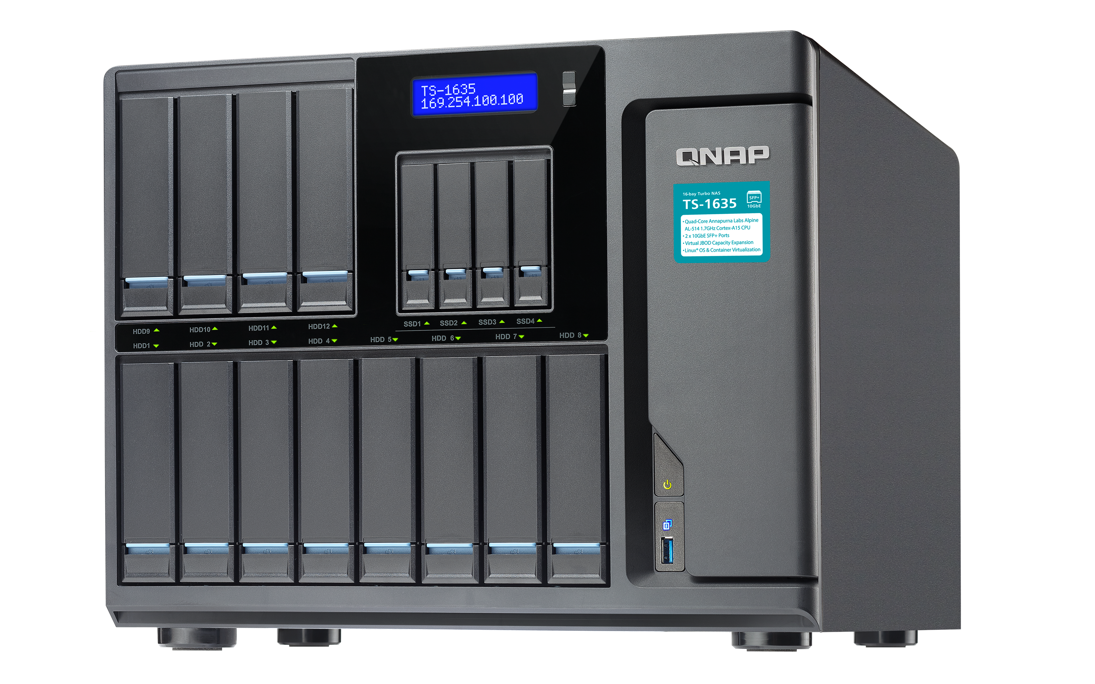
Why did QNAP choose Mattermost for you?
Enjoy world class instant messaging solution
Notes:
Many communication tools in the market, slack had more features, work related
Uber, HP Enterprise, Samsung, world’s top most companies use Mattermost.
You can scale your company too
All this over a secure server with all your chat data stored at one place on your QNAP NAS

Slide 5
Security and Privacy
Notes:
Communication is one of the most important tool for an organization
Many tools, slack had more features, work related
Privacy
Many enterprises use Skype and hangouts, for work communication
But with growth and increasing size of team, it’s difficult to organize,
So, slack was introduced, where you have all your team communication needs fulfilled,
But all, the Skype, , Hangouts, Slack have a drawback of privacy and security, since it is connected over the cloud,
With Mattermost on your QNAP NAS, you don’t have to worry about the security and privacy, since all your chat data would be residing in your NAS, next to you.
Not only this, QNAP on NAS has plenty of other features, that makes it better than Slack
We’ll discuss this fuas we go further

Slide 6
Basic Mattermost features
QNAP NAS
Private Cloud
Creating Team Messaging
Apps and Integrations
Safe and secure
Increase productivity
Getting started
Notifications
Mobile
System Console
Total control for system admin
Always be on track
Chat on the go
Notes:
First, let us go through the basic features that Mattermost is providing
Transform your QNAP NAS into a chat server
Create your own privately hosted chat solution by installing Mattermost on your NAS
2) System admin can manage all the users on your NAS and modify their access rights

Slide 7
Enterprise Mattermost features
Advanced Authentication
Encrypted Notifications
Custom Branding
Single Sign-On (SSO), AD/LDAP, SAML(E20)
Push notifications via HPNS
Design your own sign-in page
Premier Enterprise Support
Advanced Access Control
Advanced Enterprise Analytics
Assistance and guidance
Performance monitoring
Control user access
Notes:
There are plenty of advanced features in the paid versions of Mattermost.
We will go through each step by step after we have discussed the basics.

Slide 8
Basic Mattermost features
QNAP NAS
Private Cloud
Creating Team Messaging
Apps and Integrations
Safe and secure
Increase productivity
Getting started
Notifications
Mobile
System Console
Total control for system admin
Always be on track
Chat on the go
Notes:
Transform your QNAP NAS into a chat server
Create your own privately hosted chat solution by installing Mattermost on your NAS
System admin can manage all the users on your NAS and modify their access rights

Slide 9
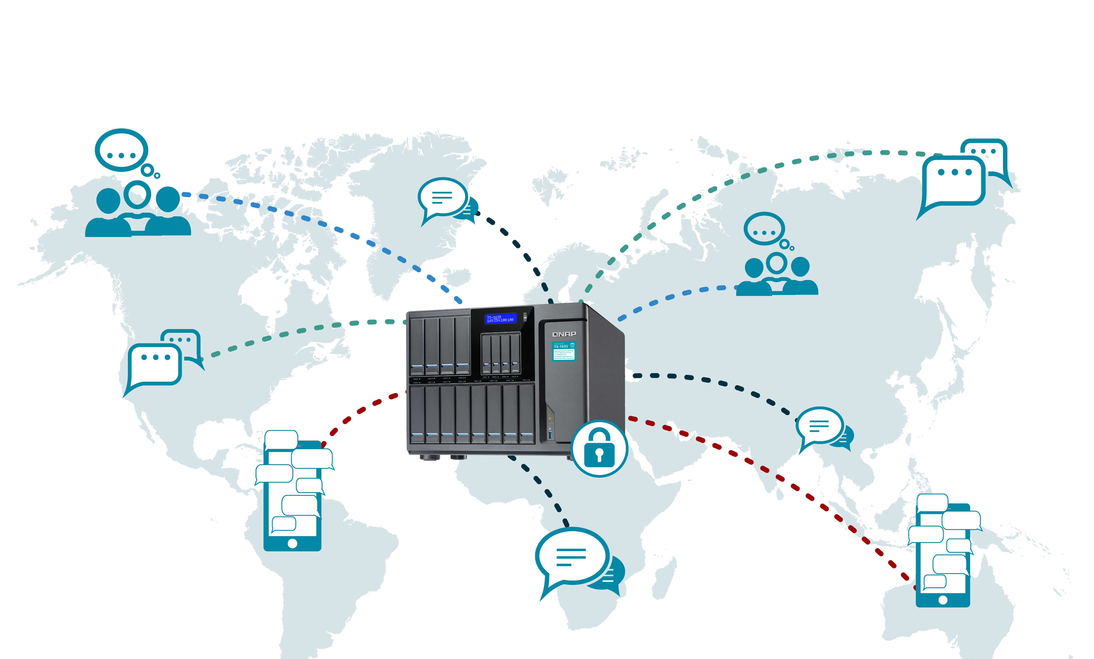
Communicate over private cloud
Notes:
Transform your QNAP NAS into a chat server
Create your own privately hosted chat solution by installing Mattermost on your NAS
https://thenextweb.com/insider/2017/04/24/hipchat-hacked-weekend-bad/#.tnw_j77nMKNW
HipChat was hacked (Uber case)
Uber needed an enterprise messaging solution that could scale to meet its needs: massive collaboration from tens of thousands of concurrent users across web, PC and phones, plus extensive workflow integration and automation, all with zero downtime. Slack couldn’t scale. HipChat wasn’t secure.
It now has operations in more than 71 countries and 620 cities; Uber drivers have collectively given passengers more than 5 billion rides.

Slide 10
Communication over private cloud
◆ Communicate on private cloud. Convenient and secure.
△ Personal plan, confidential projects, etc
◆ All your messages, files, photos are saved in your own private cloud.
△ Search to find messages
◆ Communication do not rely on third party server.
△ Unable to chat when third party server is down
Notes:
Personal discussions
Safeety of storage, files, adn discussiosn
Relaiblity on your own nas

Slide 11
Basic Mattermost features
QNAP NAS
Private Cloud
Creating Team Messaging
Apps and Integrations
Safe and secure
Increase productivity
Getting started
Notifications
Mobile
System Console
Total control for system admin
Always be on track
Chat on the go
Notes:
All the basic messaging features plus m

Slide 12
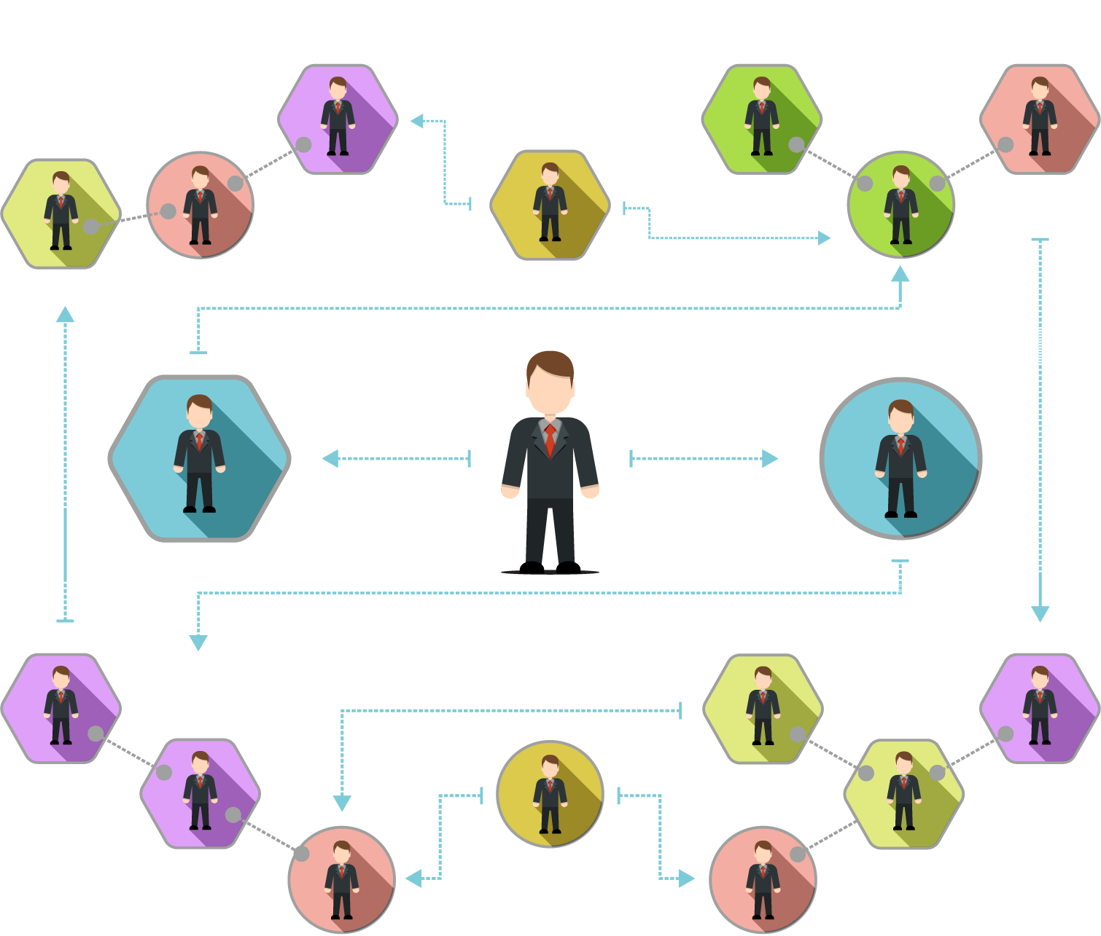
Teams and Channels
◆ Team creation and Channel
creation
◆ Channels within teams
◆ New teams can be created by
members if system admin has
enabled team creation
Notes:
Demo
Team: Marketing; Channels: Social media marketing, television marketing, etc Team: Developers; Channels: iOS developers, Android, etc

Slide 13
Advanced Messaging and Formatting
◆ Send, reply, edit, delete
◆ Linking to messages
◆ Mentioning teammates
◆ Formatting text
◆ Execute commands
◆ Flagging messages
◆ Pinning messages
◆ Threaded chatting

Slide 14
Personalization and settings
General: Name, email, picture, etc.
Look and feel of your interface
Turn on/off Notifications
Import themes from Slack
Custom themes

Slide 15
Basic Mattermost features
QNAP NAS
Private Cloud
Creating Team Messaging
Apps and Integrations
Safe and secure
Increase productivity
Getting started
Notifications
Mobile
System Console
Total control for system admin
Always be on track
Chat on the go

Slide 16
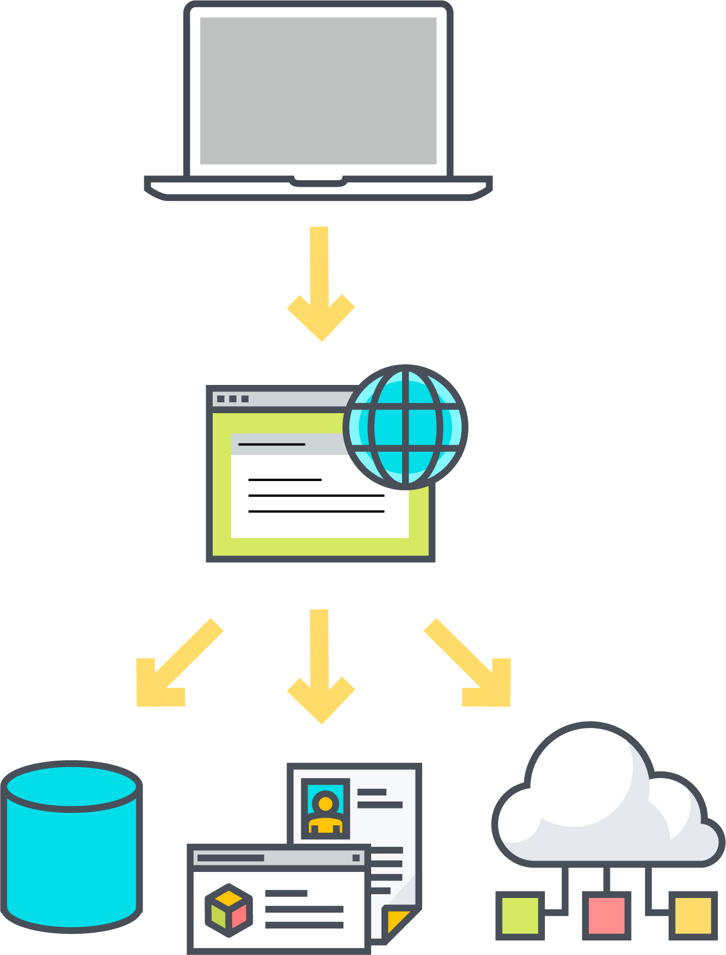
Webhook Integrations
◆ Incoming Webhook
△ Use incoming webhooks to connect external tools to Mattermost
◆ Outgoing Webhook
△ Allow external integrations to receive and respond to messages
Webhook
API
◆ Slash Commands
△ Send events to external integrations.
Notes:
To you want to experience the benefits of integration work. Webhook is a concept that alerts you to anything that happens to be thought of as a personalized integration service that sends out notifications to external platforms or applications to mattermost. You can use Gmail, Facebook, MailChimp and other services at the same time, integrate all the tools you want to become an invincible platform to see how much your imagination.
From the team calendar trip to share, track the progress of the project to the market business or customer service development, can be integrated into JANDI above, instant notification and immediate discussion!
Example: Services for Dropbpx, Google Drive, Google Calendar, Trello, GitHub, JIRA, RSS feeds, Bitbucket, and incoming webhooks.
Use the most common way to complete the most difficult work, this is your exclusive integration platform!
Only System admin and Team owner / creator has can create integrations,

Slide 17
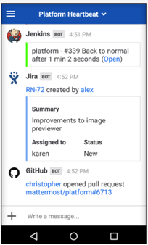
Integration
Never miss any updates !
Notes:
Example: (JIRA) Get a message when
Issue created
Issue updated
Issue deleted*
Only when an open issue is deleted, the channel will be notified, otherwise not
You can Integrate these apps and much more..

Slide 18
Basic Mattermost features
QNAP NAS
Private Cloud
Creating Team Messaging
Apps and Integrations
Safe and secure
Increase productivity
Getting started
Notifications
Mobile
System Console
Total control for system admin
Always be on track
Chat on the go

Slide 19
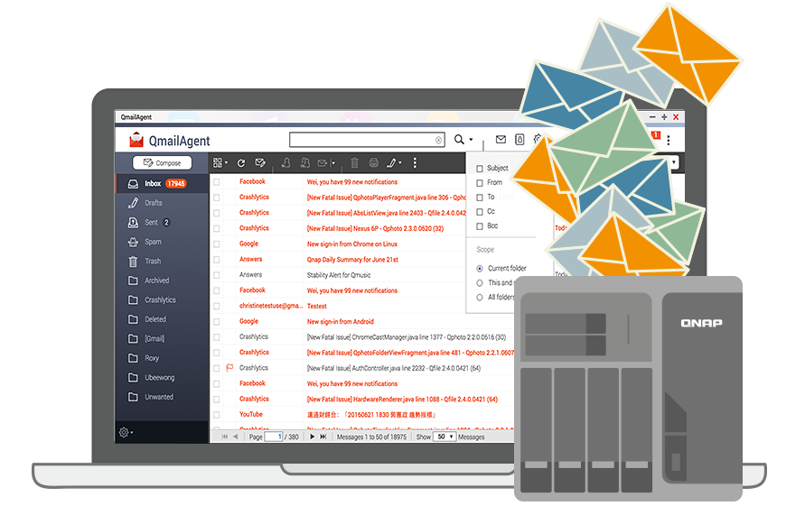
Notification
Send email for team invitation and notification for chat updates.
Notes:
You will need to set up SMTP in order to receive email notifications
Setting up SMTP:
Set to true, Specially during production, when you want to keep yourself updated.
Set up email notifications, for when you are offline in chat, or away, or unable to access.
Suppose, you are working o

Slide 20
Basic Mattermost features
QNAP NAS
Private Cloud
Creating Team Messaging
Apps and Integrations
Safe and secure
Increase productivity
Getting started
Notifications
Mobile
System Console
Total control for system admin
Always be on track
Chat on the go
Notes:
Always stay connected.

Slide 21
Mobile: Chat on the go
Install Mattermost on
iOS and Android
Notes:
Demo
Port forwarding should be enabled. 8065

Slide 22
Basic Mattermost features
QNAP NAS
Private Cloud
Creating Team Messaging
Apps and Integrations
Safe and secure
Increase productivity
Getting started
Notifications
Mobile
System Console
Total control for system admin
Always be on track
Chat on the go

Slide 23
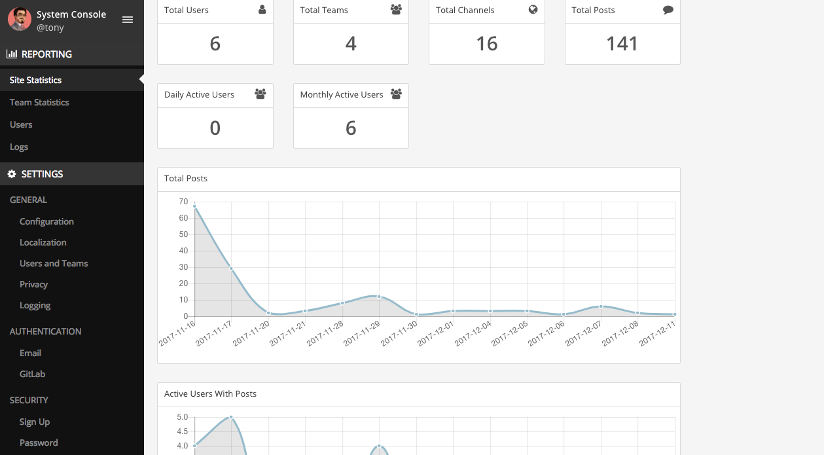
System Console
Dashboard for user and chat analysis
Notes:
demo

Slide 24
System Admin
◆ Control roles of members
◆ Deactivate/remove accounts
◆ Change limits (no. of people)
Activate Enterprise version
Notes:
demo

Slide 25
Why did QNAP choose Mattermost over others for you?
Why Mattermost is the best communication solution for your enterprise

Slide 26
Mattermost vs Slack
 | Mattermost | Slack
Team communication | √ | √
Instant search | √ | √
Integrations | √ | √
Security and Privacy | √ | ×
Storage | Unlimited teams, Unlimited* storage | 5 GB total
Legal Compliance | √ | ×
Notes:
Slack has limited storage of 5gb total per team whereas mattermost has Unlimited teams, and unlimited storage per team
Security: Mattermost offers modern communication behind your firewall. Run your vital communications under your existing security and IT policies. Deploy to public, private or hybrid clouds with full access to source code and total control of your single-tenant system.
Privacy: Your IP address, your usage patterns, the contents of your messages—SaaS services know more about your company than you do. In contrast, Mattermost provides the benefits of modern communication without sacrificing privacy.
Legal Compliance: Consumer data protection laws, data regulations, GDPR and even non-disclosure agreements are complex and ever-changing, with heavy penalties for breach. Self-hosting your communications simplifies compliance and reduces risk.

Slide 27
QNAP - Mattermost vs Synology Chat
 | QNAP - Mattermost | Synology- Chat
Team communication | √ | √
Instant search | √ | √
Privacy and security | √ | √
Webhook Integrations | √ | √
Adding external members | √ | ×
Managing member roles | √ | ×
Email notifications | √ | ×
Team and Site Statistics | √ | ×
Notes:
Add members directly by URL, Synology requires members to be registered on NAS.
easy and plenty of system level features, Managing users and member roles
Changing passwords
Deactivating accounts
easy to add/remove/ create /deactivate account in mattermost
east to manage roles, change passwords,
Configurations for certificates

Slide 28
QNAP - Mattermost vs Synology Chat
 | QNAP - Mattermost | Synology - Chat
Rate limiting Set max queries per second for the integrated APIs | √ | ×
Database management Change max idle connections Change max open connections Set query timeout | √ | ×
Configurations Configure Site URL Enable retrieval of certificates Configure port forwarding | √ | ×
Notes:
Add members directly by URL, Synology requires members to be registered on NAS.
easy and plenty of system level features, Managing users and member roles
Changing passwords
Deactivating accounts
easy to add/remove/ create /deactivate account in mattermost
east to manage roles, change passwords,
Configurations for certificates

Slide 29
Upgrade to Enterprise Edition
Notes:
Buy a licence key from Mattermost

Slide 30
Enterprise Mattermost features
Advanced Authentication
Encrypted Notifications
Custom Branding
Single Sign-On (SSO), AD/LDAP, SAML(E20)
Push notifications via HPNS
Design your own sign-in page
Premier Enterprise Support
Advanced Access Control
Advanced Enterprise Analytics
Assistance and guidance
Performance monitoring
Control user access

Slide 31
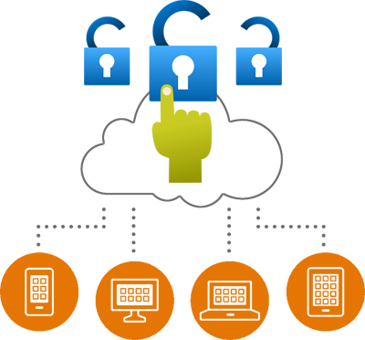
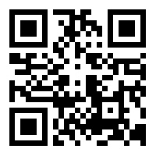
Advanced Authentication
E10 Enterprise edition
E20 Enterprise edition
◆ Multi-Factor
Authentication
△ Google Authenticator
◆ Active Directory/LDAP
SAML 2.0 integration
◆ Single Sign-On (SSO)
△ Okta/OneLogin/
Microsoft ADFS
◆ Centralized identity management
◆ Automatic account provisioning
Notes:
Single-sign-on. Users can sign-in to Mattermost with their SAML credentials.
Centralized identity management. Mattermost accounts can display user information from SAML, such as first and last name, email and username.
Automatic account provisioning. New Mattermost user accounts are automatically created the first time a user signs in with their SAML credentials on the Mattermost server.

Slide 32
Enterprise Mattermost features
Advanced Authentication
Encrypted Notifications
Custom Branding
Single Sign-On (SSO), AD/LDAP, SAML(E20)
Push notifications via HPNS
Design your own sign-in page
Premier Enterprise Support
Advanced Access Control
Advanced Enterprise Analytics
Assistance and guidance
Performance monitoring
Control user access

Slide 33
Encrypted Notifications
◆ Encrypted push notifications to iOS and Android mobile apps via Hosted Push Notification Service (HPNS).
△ Explicit privacy policy
△ Encrypted TLS connections between HPNS and Apple Push Notification Services
△ HPNS and Google’s Firebase Cloud Messaging service
△ Production-level uptime expectation

Slide 34
Enterprise Mattermost features
Advanced Authentication
Encrypted Notifications
Custom Branding
Single Sign-On (SSO), AD/LDAP, SAML(E20)
Push notifications via HPNS
Design your own sign-in page
Premier Enterprise Support
Advanced Access Control
Advanced Enterprise Analytics
Assistance and guidance
Performance monitoring
Control user access

Slide 35
Custom Branding

Slide 36
Enterprise Mattermost features
Advanced Authentication
Encrypted Notifications
Custom Branding
Single Sign-On (SSO), AD/LDAP, SAML(E20)
Push notifications via HPNS
Design your own sign-in page
Premier Enterprise Support
Advanced Access Control
Advanced Enterprise Analytics
Assistance and guidance
Performance monitoring
Control user access

Slide 37
Advanced Enterprise Support
◆ Mission Critical Response L1 – 60minutes,
L2 – 120 minutes
◆ Screen-sharing, collaboration phone calls,
and health checks
◆ Potential to influence product roadmap
and prioritization decisions
◆ Installation and deployment advisory
And much more...
Notes:
Premier Support key benefits & details
Mission Critical Response L1 – 60 minutes, L2 – 120 minutes – Critical and major issues impacting production environments receive top priority from the Mattermost support team.
Weekend coverage – Premier Support customers receive weekend support for L1 and L2 escalations.
Direct access to senior support team – Premier Support tickets are responded to by senior support engineers with advanced technical and soft skills to help customers with complex environments and mission critical needs.
Development team priority – Priority is given to issues from Premier Support customers escalated to the development organization for assistance or fixes.
Screen-sharing, collaboration phone calls, and health checks – Premier Support customers can reduce time to resolution by working with the Mattermost support team over phone or audio conference and screen-sharing sessions to isolate, identify and troubleshoot critical issues.
Access to private discussion channel with Mattermost technical staff – To discuss issues quickly and effectively, you can directly message Mattermost technical staff over a dedicated private channel in a hosted Mattermost instance.
Installation and deployment advisory – We’ll support your team in properly installing and piloting your deployment.
Account on-boarding – Our team works with you during a series of on-boarding discussions to ensure we have your detailed environment information available about your deployment before your first ticket is filed, reducing overall resolution times, questions, and delays for each follow-on issue.
Potential to influence product roadmap and prioritization decisions – With privileged access to senior support staff and members of the Mattermost product team, the Mattermost product roadmap is often influenced by Premier Support customers.
Licensing – Premier Support includes licensing for up to 4 standalone non-production environments.

Slide 38
Enterprise Mattermost features
Advanced Authentication
Encrypted Notifications
Custom Branding
Single Sign-On (SSO), AD/LDAP, SAML(E20)
Push notifications via HPNS
Design your own sign-in page
Premier Enterprise Support
Advanced Access Control
Advanced Enterprise Analytics
Assistance and guidance
Performance monitoring
Control user access

Slide 39
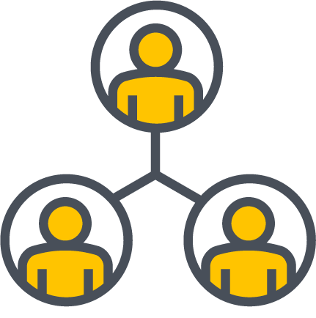
Advanced Access Control
Team invitations
Channel modifications
Announcement Banner
User Privacy
Notes:
https://docs.google.com/document/d/1v0ZkQVxu6psbgTTuIzvpk0IRjWwM2s8NQOGkyFz3N9c/edit#heading=h.g6mrwyaeev51

Slide 40
Enterprise Mattermost features
Advanced Authentication
Encrypted Notifications
Custom Branding
Single Sign-On (SSO), AD/LDAP, SAML(E20)
Push notifications via HPNS
Design your own sign-in page
Premier Enterprise Support
Advanced Access Control
Advanced Enterprise Analytics
Assistance and guidance
Performance monitoring
Control user access

Slide 41
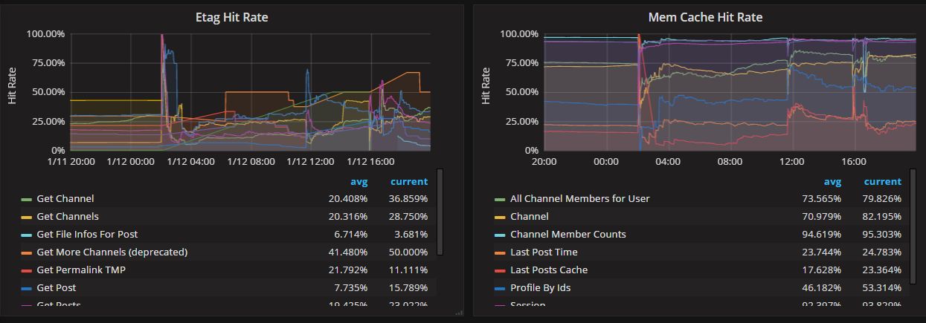
Advanced Enterprise Analytics
Track system health for large Enterprise deployments
Integrate with Prometheus and Grafana

Slide 42
Mattermost Release Date and Support Models
Mattermost on App Center : Mid-December
Mattermost is currently supported by x86 models: TS-x51, TS-x51+, TS-x51A, TS-x53, TS-x53A, TS-x53B, TBS-453A, TS/TVS-x63, TVS-x70, TVS-x71, TS/SS-x79, TS/TVS-x80, TVS-x82 series, TS-1685 , TS-X77 series and TDS-16489U
QTS version: 4.3.3 and above
Container station version: 1.7.2415 and above.

Slide 43
Thank you

