Slide 1

TS-128A / TS-228A
2018
The last mile of Snapshot
supported product line

Slide 2
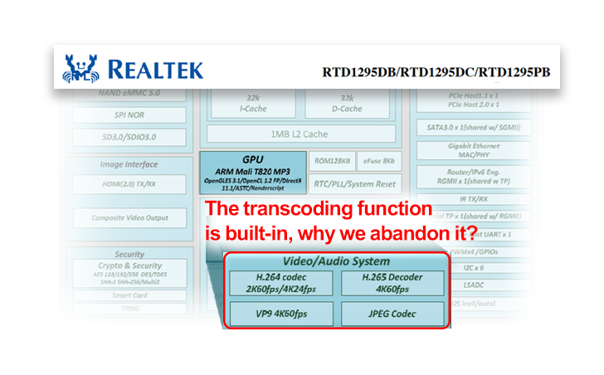
Snapshots vs video transcoding, which one comes first?
Data safety is always the top priority
Snapshots are the best way to stay away from ransomware threats
Qfinder Pro is the alternative to perform transcoding
Affordable Price
1GB RAM
Snapshots
Source: Realtek RTD1295 datasheet (Trademarks here are owned by their respective owners.)

Slide 3

With limited resources, we chose snapshots
Multimedia functions
Storage functions
Transcoding
Video playback for various devices
Snapshot
Protect data from Ransomware
Accidentally deleted data
Snapshot
Transcoding
Backup
Playback
Throughput performance
System Resources
System Resources
Cost
To bring the best product to users, we focus on storage functions

Slide 4


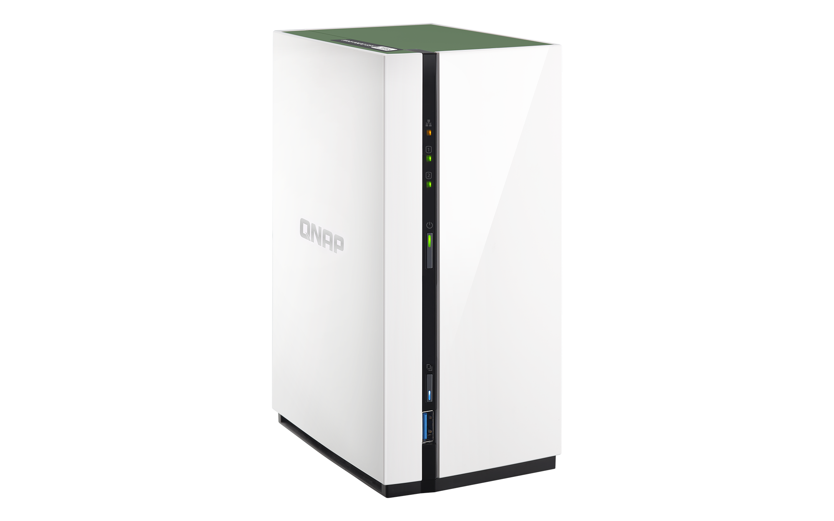
The best choice for NAS beginners
I’d like to buy my first NAS,
and I want it to be..
1 Affordable
2 Snapshot-ready
3 Multimedia capabale
4 Easy to use and sleek
With built-in 1 GB RAM, QNAP gives you both an affordable price and snapshots
Snapshot
Transcoding on PC and upload via Qfinder Pro
Streaming playback via VLC media player

Slide 5
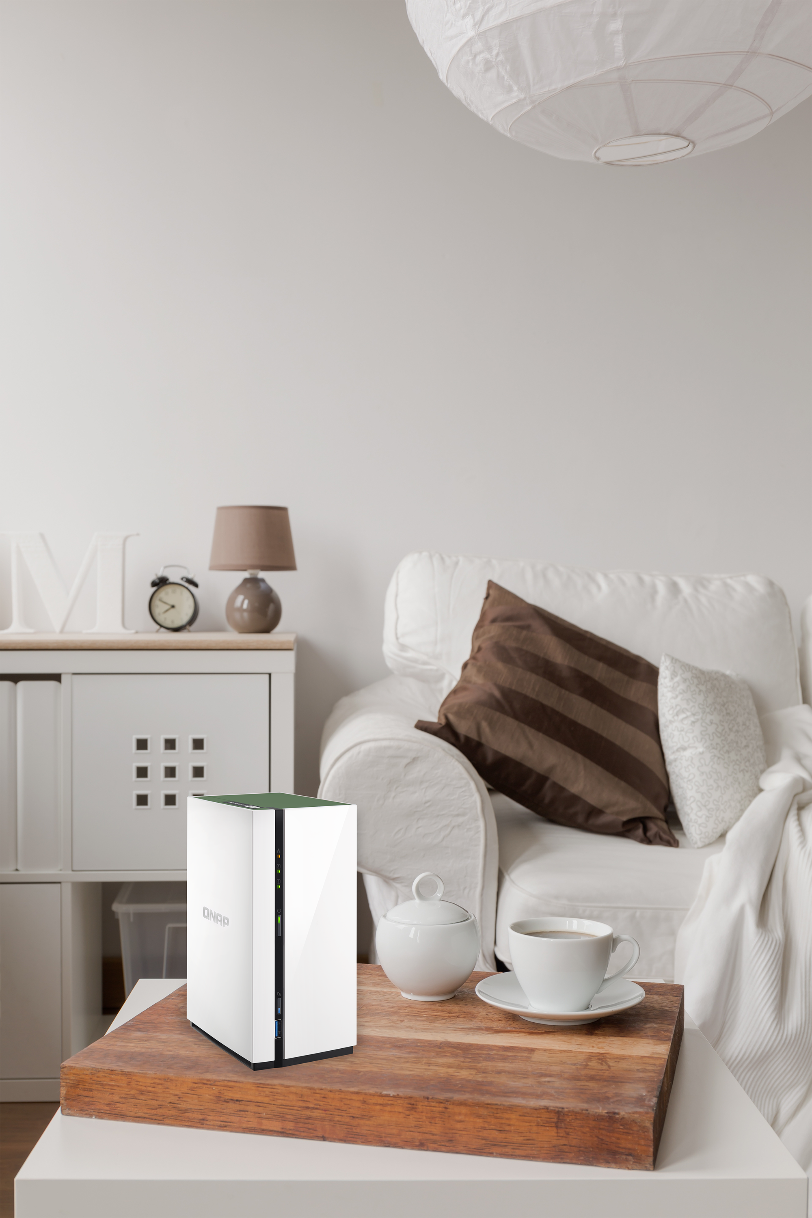

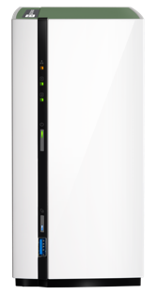

Upgraded Home NAS for 2018
For the
whole NAS
32
2017
2018
----------------
---------------------------
For a single volume/LUN
16
TS-228
Dual-core RTD1195
TS-228A
Quad-core RTD1295
The TS-x28's design is so modern and elegant but no snapshots…
Leveraging the classic design while giving you snapshot protections!

Slide 6
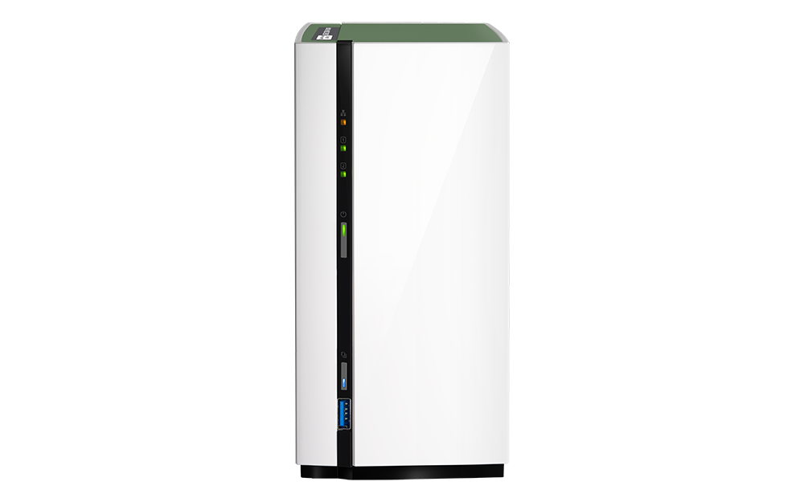
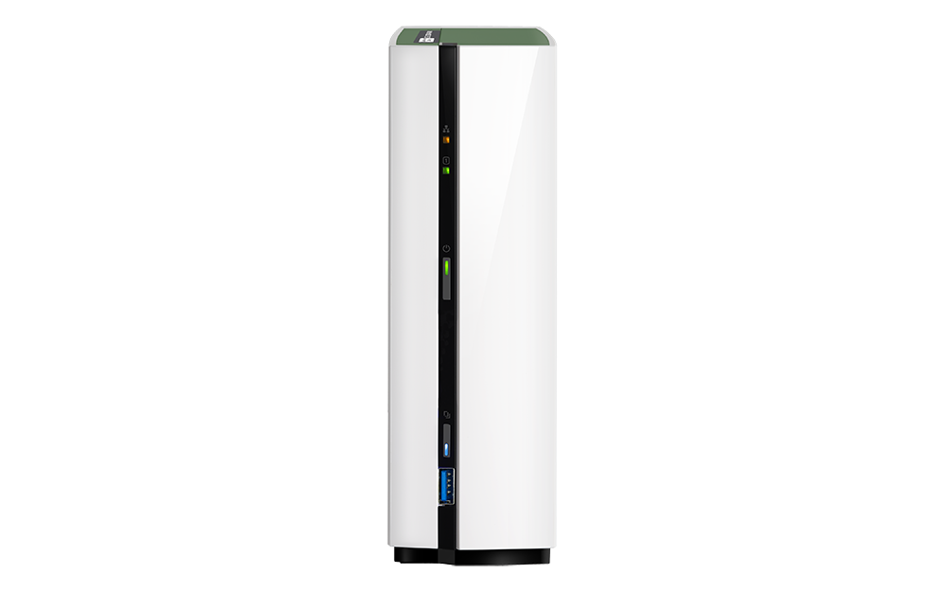
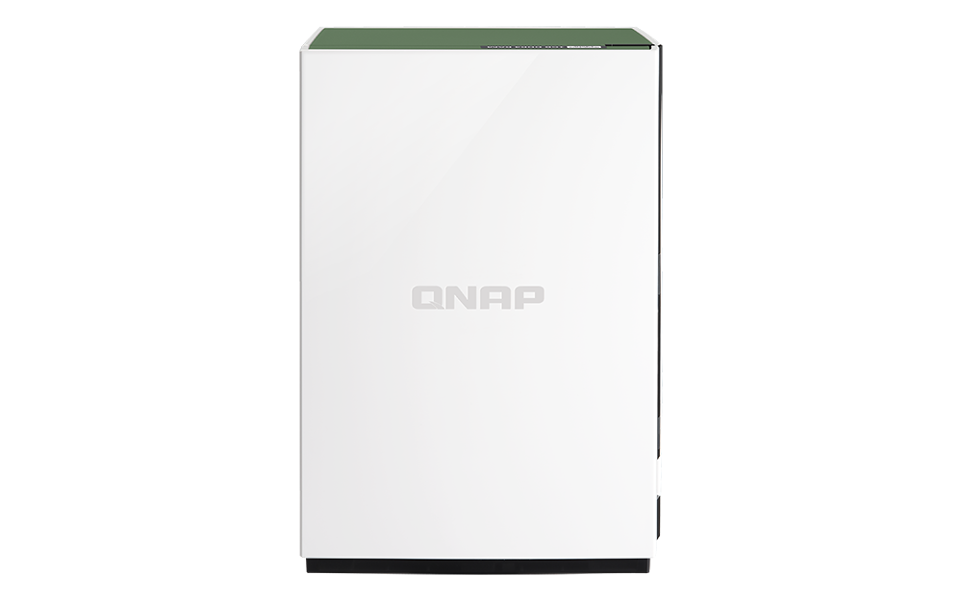
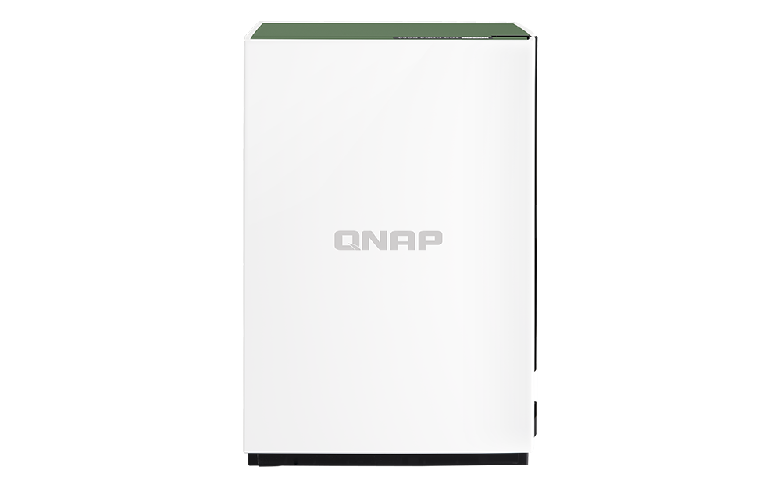
The most compact NAS
60
125
90
125
48% smaller
than TS-131P
Weight only 0.56 Kg
45% smaller
than TS-231P
Weight only 0.7 Kg
187.7
187.7
TS-128A
TS-228A
＊Unit: mm
＊HDDs and accessories not included

Slide 7
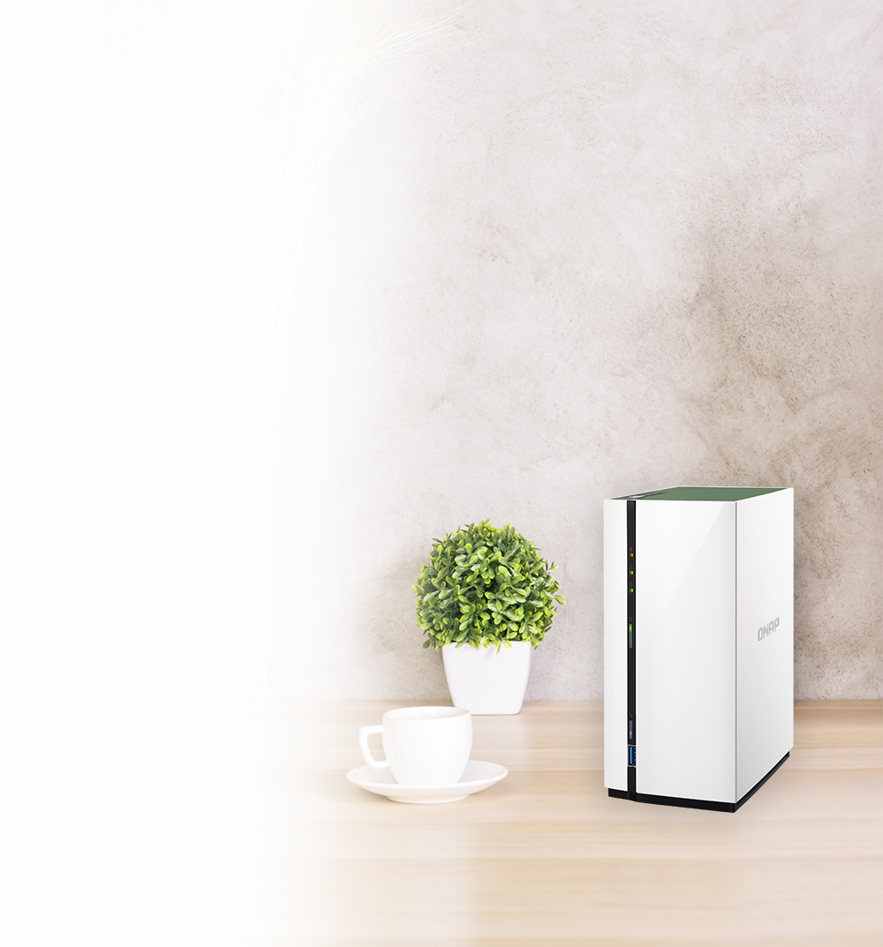
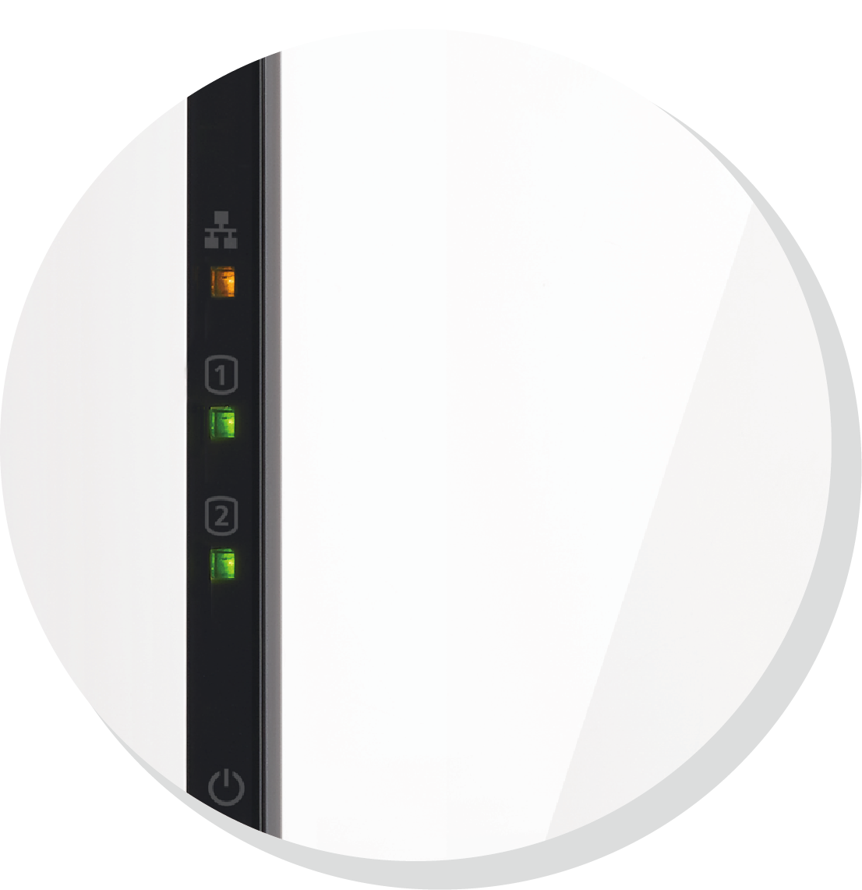
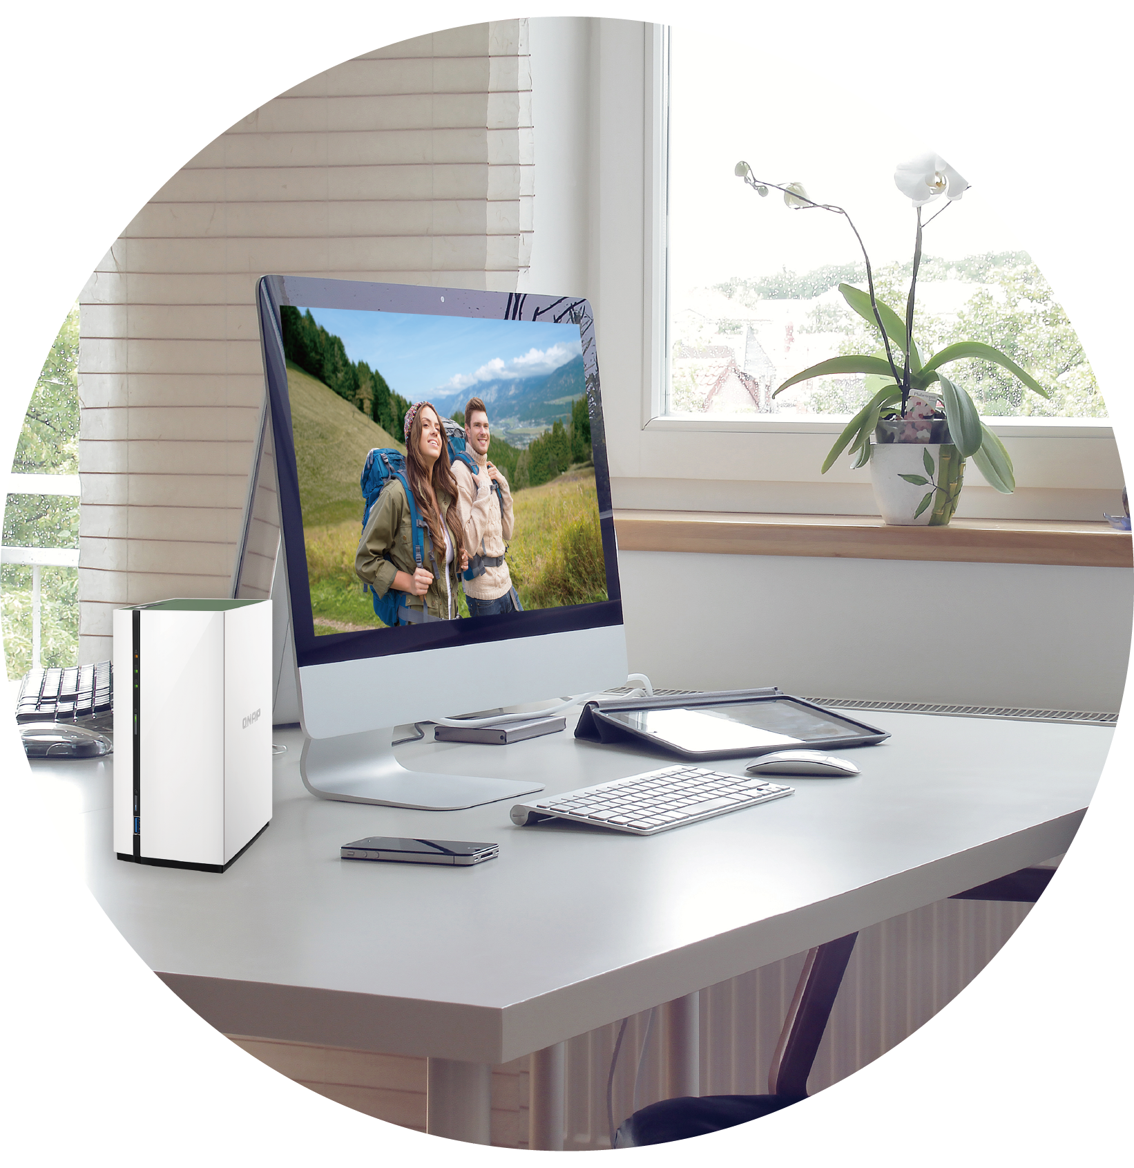

Contemporary Design that perfectly fit your home style
Vertical
Horizontal
Glossy chassis
Easily removes dusts
Notes:
https://previews.123rf.com/images/georgejmclittle/georgejmclittle1510/georgejmclittle151000217/47396325-digital-generated-workspace-desktop-with-blank-screen-computer--Stock-Photo.jpg

Slide 8


Quad-Core Processor and DDR4 RAM
Realtek RTD1295 Quad-Core 64-bit 1.4G Processor
Hardware Encryption Engine
DDR4 1 GB RAM

Slide 9
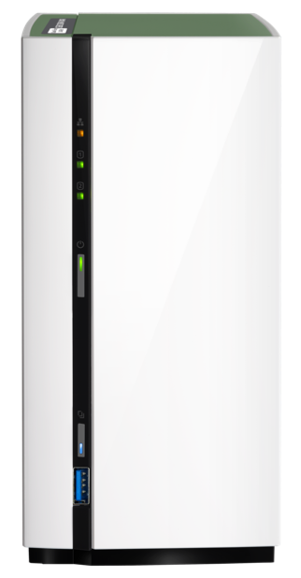
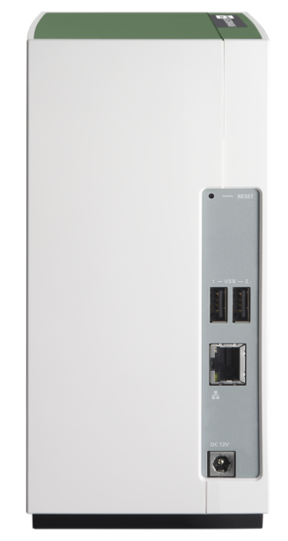
Buttons, indicators and connectors
LED indicators: STATUS, LAN, USB, HDD1-2
Reset Button
Power button
2 x USB 2.0 ports
1 x GbE RJ-45
USB 3.1 Gen 1 & One Touch Copy button
DC 12V Power input

Slide 10
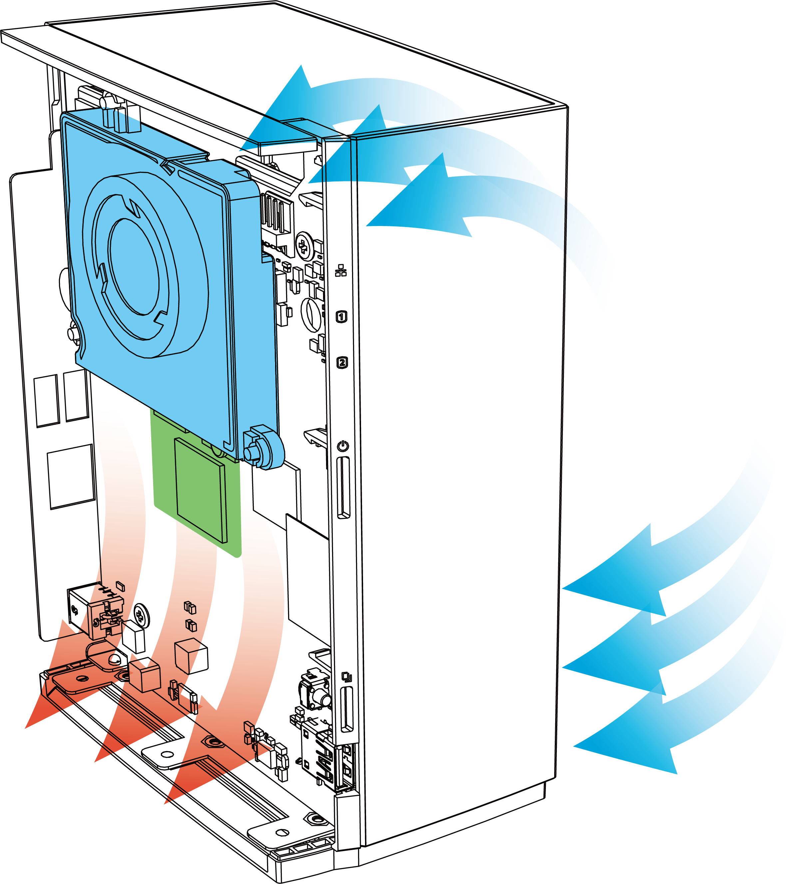


Eco-friendly design: quiet and energy saving
Hidden cooling fan
Noise level: 17.0 dB(A)
ARM Cortex A53
Energy Saving Architecture
HDD standby：5.14W
In Operation：12.21W
* Sound Level Test Environment: Refer to ISO 7779; Maximum HDD loaded; Bystander Position; Average data from 1 meter in front of operating NAS.
Designs and specifications are subject to change without notice.

Slide 11
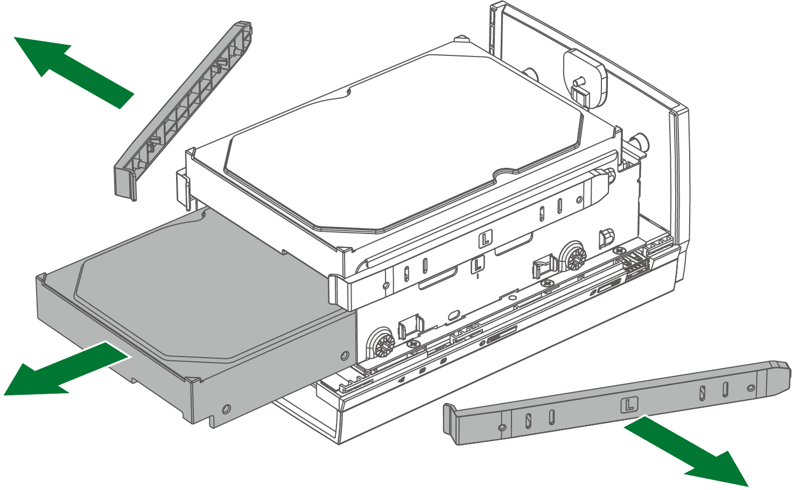

Support RAID1 and hot-swapping for data protection
TS-228A support RAID1 and hot-swapping for easily replacing faulty HDDs to secure data immediately
* TS-228A supports RAID1 protection

Slide 12

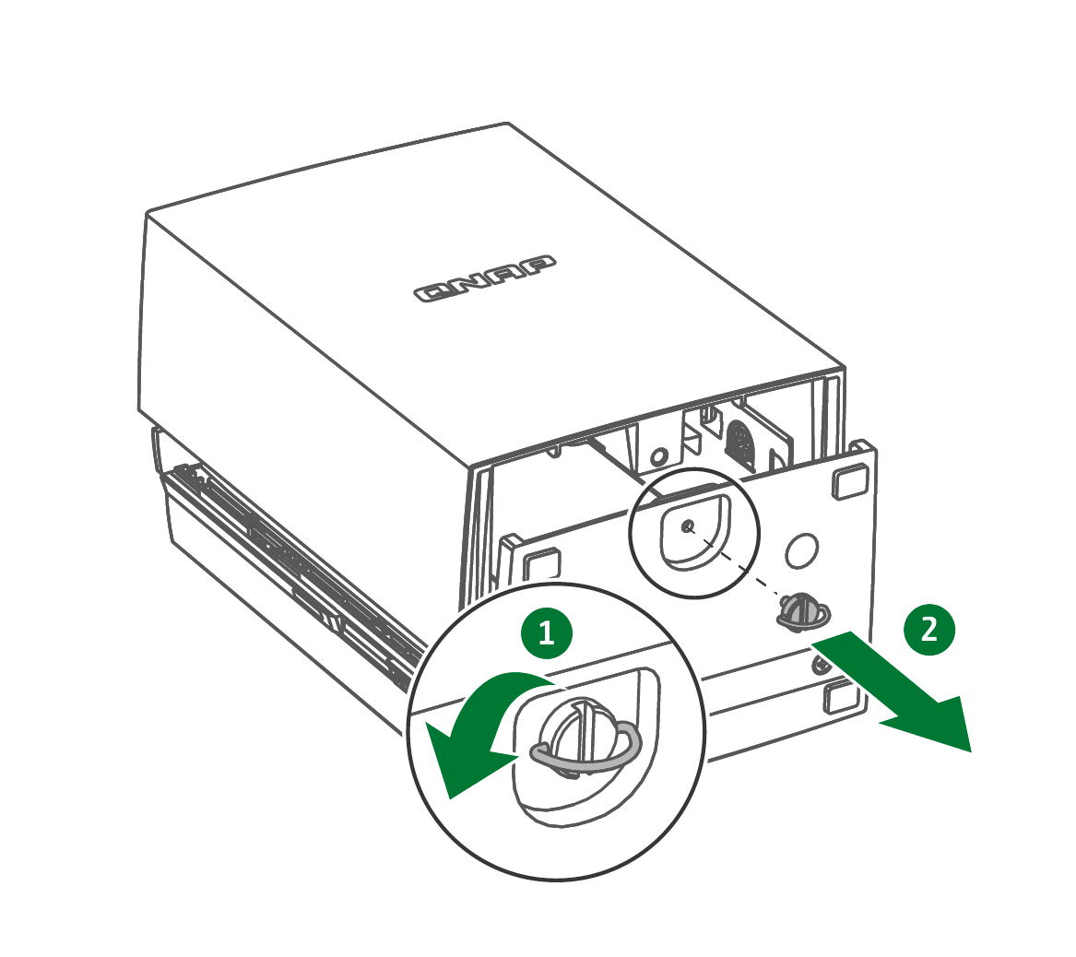
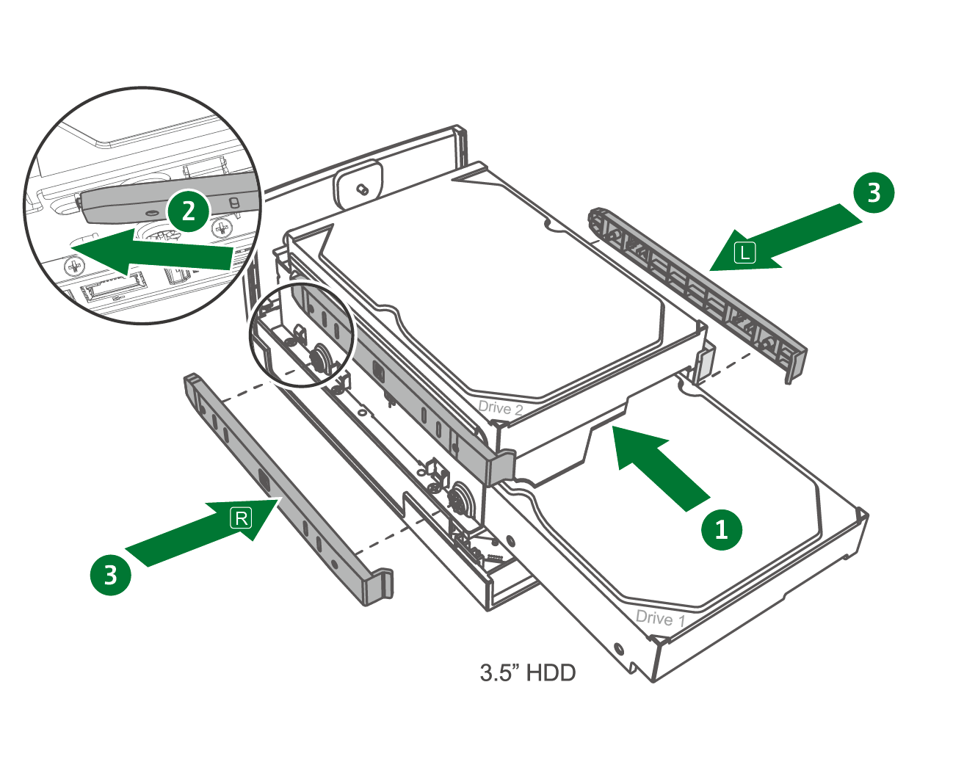
No tools are needed, easy and quick to set up TS-x28A
3.5”HDD
Notes:
畫面切到實機操作

Slide 13
TS-x28A
The Highest ROI Solution Helps You Against Ransomware

Slide 14

How Ransomware Causing Threat to Your Data?
According to Kaspersky Security Bulletin survey in 2017, every 10 second a personal will be attacked by Ransomware.
Two way of spreading: Email Attachments and Compromised Websites.
The later does not require user to trigger the virus.
Some variants can encrypt unmapped
network shares. While other delete shadow
volume copies on windows.

Slide 15
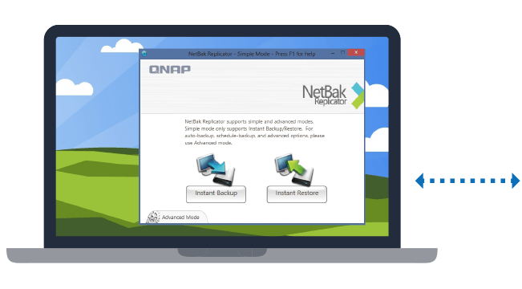
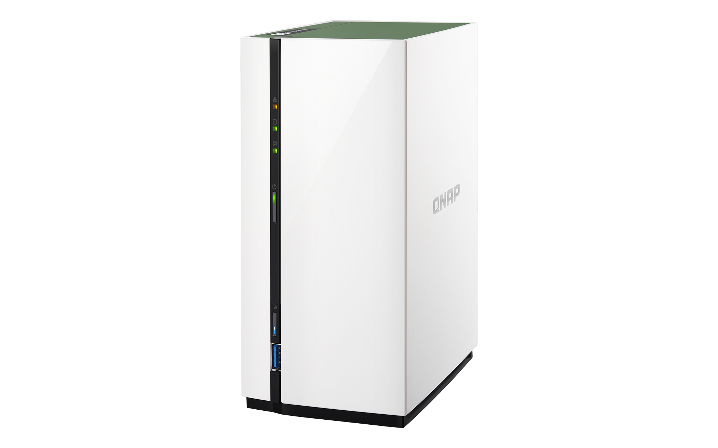
Using TS-x28A With Netbak to Backup Your Data
Whatever installing antivirus softwares or practicing using habits, Data backup is the most effective way againsting ransomware.
With QNAP free utility Netbak Replicator, data on PC can be real-time or scheduled backup to the TS-x28A easily.

Slide 16


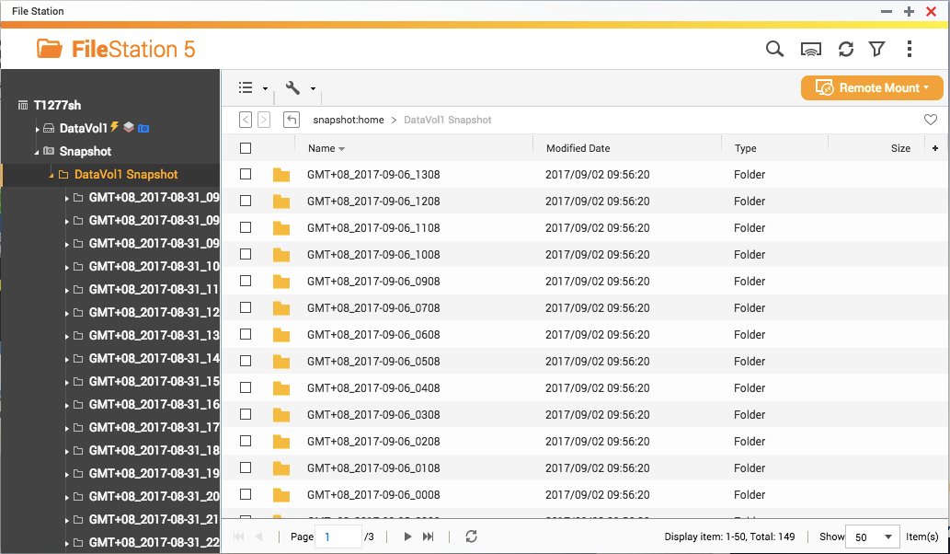

Protect your backup with QNAP Snapshot
Garbage in, garbage out. NAS can also be infected when backup data.
Start from 4.3.4, QNAP has porting the advance Snapshot feature to personal NAS as well!
Higher ROI

Slide 17
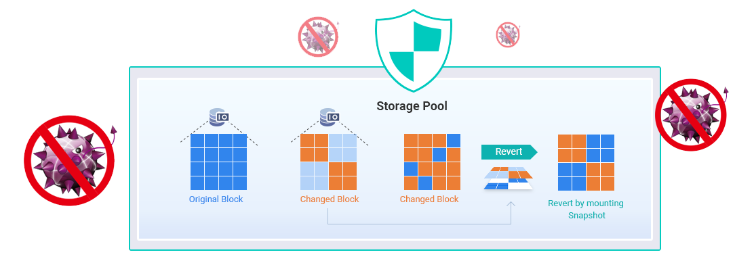
How QNAP Snapshot Can Protect Your Data?
Data changes will also be recorded outside the volume in regular based.
User can freely browser the past record in File Station.
Quickly revert the whole snapshot back on the entire NAS and prevent secondary infection.

Slide 18
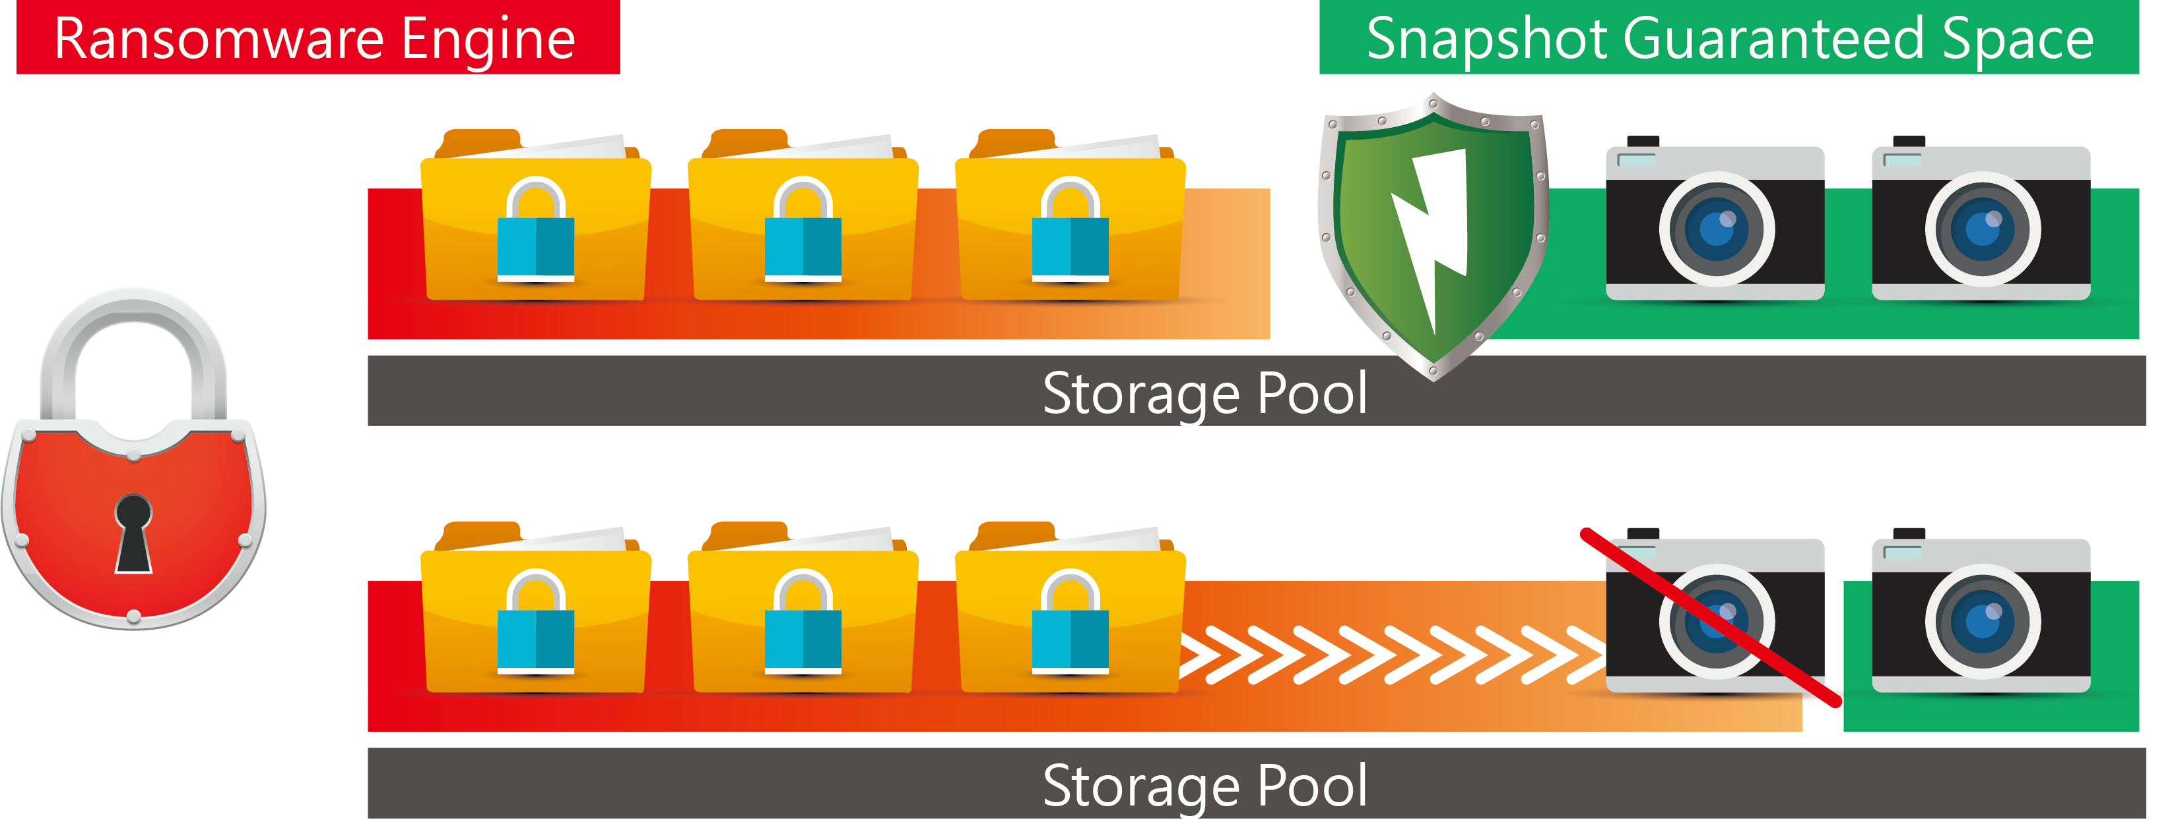
4 Defense Lines to Fight Against Ransomware
Linux-based QTS operating system makes the NAS more secure.
Snapshot Outside of Volume: Snapshot will not be affected by Ransomware.
Whole Volume revert: Overwrite all infected files at once.
Guaranteed Snapshot Space: Snapshot will not be recycled when Ransomware continue writing encrypted data.

Slide 19



The Best Entry-level NAS for Snapshot Protection
Product | QNAP TS-x28A | S Brand NAS
Snapshot On Linux
Snapshot Outside of Volume
Whole Volume Revert
Guaranteed Snapshot Space
For TS-x28A, each volume or iSCSI LUN can store 16 snapshots, and the whole device can store 32 snapshots with 1GB RAM.

Slide 20
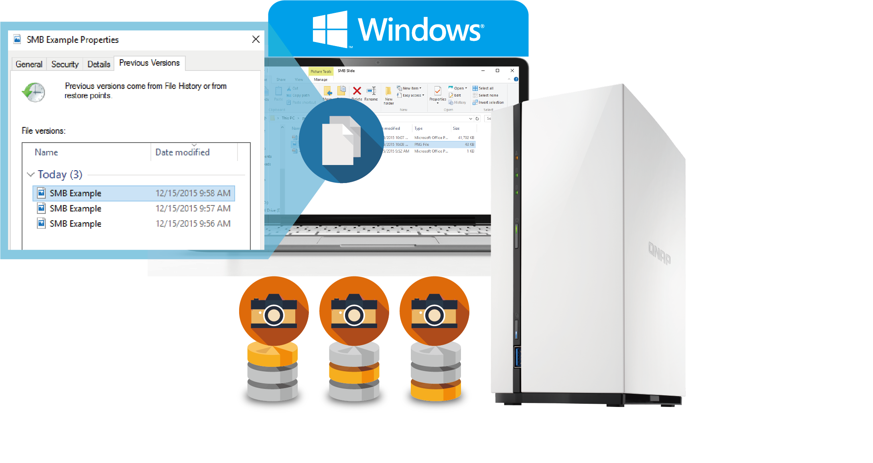
Integrated Windows Previous Version
Windows users can use Windows Previous Version to directly browse different versions of a file that are kept by snapshots
With SMB/CIFS/AFP/NFS, snapshots can be viewed in folders for restoring data

Slide 21
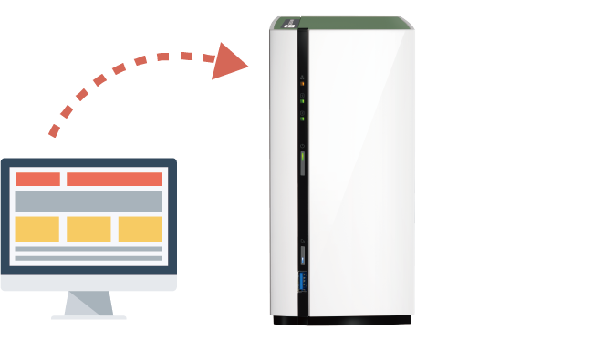
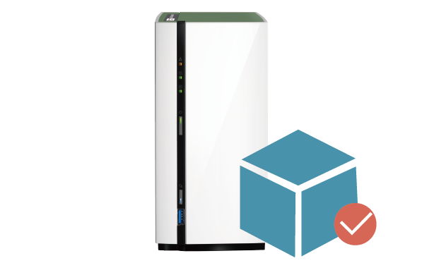
The 2 and 3 Steps To Protect Your Data With Netbak and Snapshot
Setup
Step 1: Using Netbak Replicator to create a regular
backup job
Step 2: Create a Snapshot schedule on the backup destination
Recover
Step 1: Unplug all the network cable of the NAS
Step 2: Use a clear computer to create a direct connection
Step 3: Login to the NAS with QTS and use “Snapshot Revert” to revert the whole volume.

Slide 22

Netbak Replicator and Snapshot Schedule Configuration. How to Recover data when PC be encrypted by Ransomware.
Live

Slide 23
QVHelper
Qfinder pro
360° Panorama Video
Qphoto 3

Slide 24


QVHelper
Your video playback helper
Notes:
媒體平臺 >>VLC playback>> Claire

Slide 25



In the past, playing videos on NAS is like...
The system doesn’t support certain formats,
so videos cannot be played.
OH NO!
I can’t watch
this video!

Slide 26


QVHelper
QVHelper allows users to stream media files from a QNAP NAS to VLC player on your PC and Mac, providing more choices for you to enjoy multimedia contents
VLC Player
* Required using Video Station 5.1.3 or later versions
* Required using Photo Station 5.6.0 or later versions
* File Station: QTS 4.3.4

Slide 27
QVHelper Demo
QVHelper Demo
Live

Slide 28

Qfinder pro
Media Upload
Notes:
媒體平臺 >>VLC playback>> Claire

Slide 29

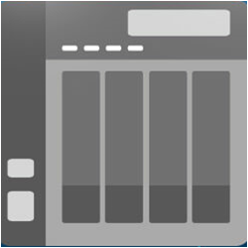
Media Upload
Batch Upload local files (photos or videos)
Perform local transcoding/conversion, then upload to NAS. This solves the problem that some entry-level ARM-based models don't support hardware transcoding.

Slide 30
Media Upload - Advanced Settings
Create thumbnails
File name conflict policies during upload
Settings for Upload
Original files
Transcoded files
Resolution
Performance comparison
720p m4v -> 360p mp4
Time spent for transcoding and upload
Qfinder Pro
S** Photo Station Uploader
37s
93s
There is a 56s difference

Slide 31
QVHelper Demo
Qfinder Demo
Live

Slide 32
360° Panorama
Video

Slide 33
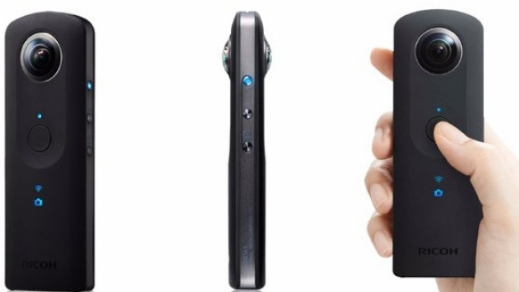
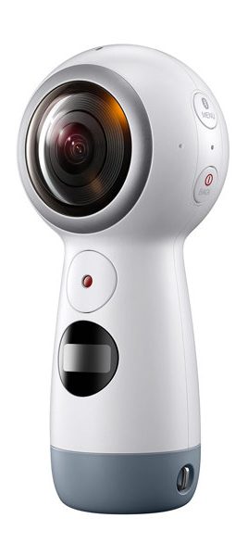
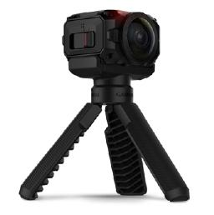
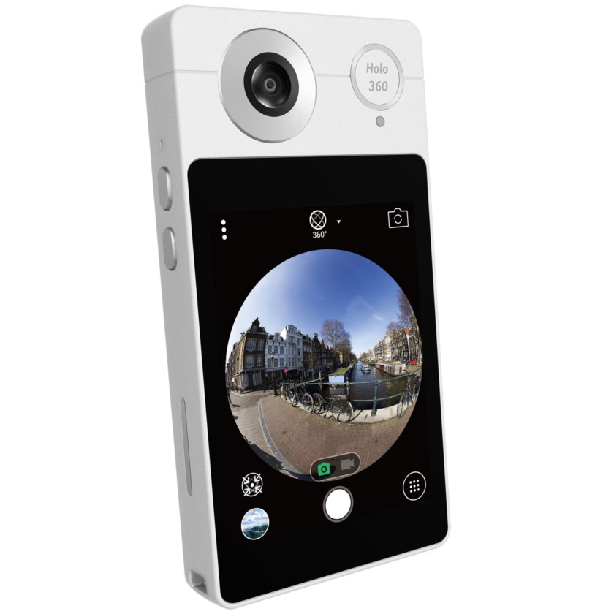
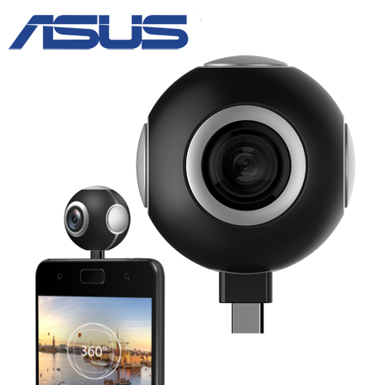
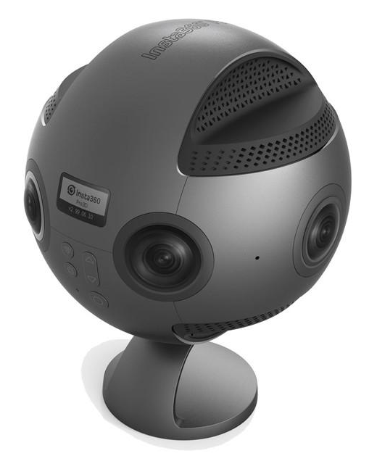
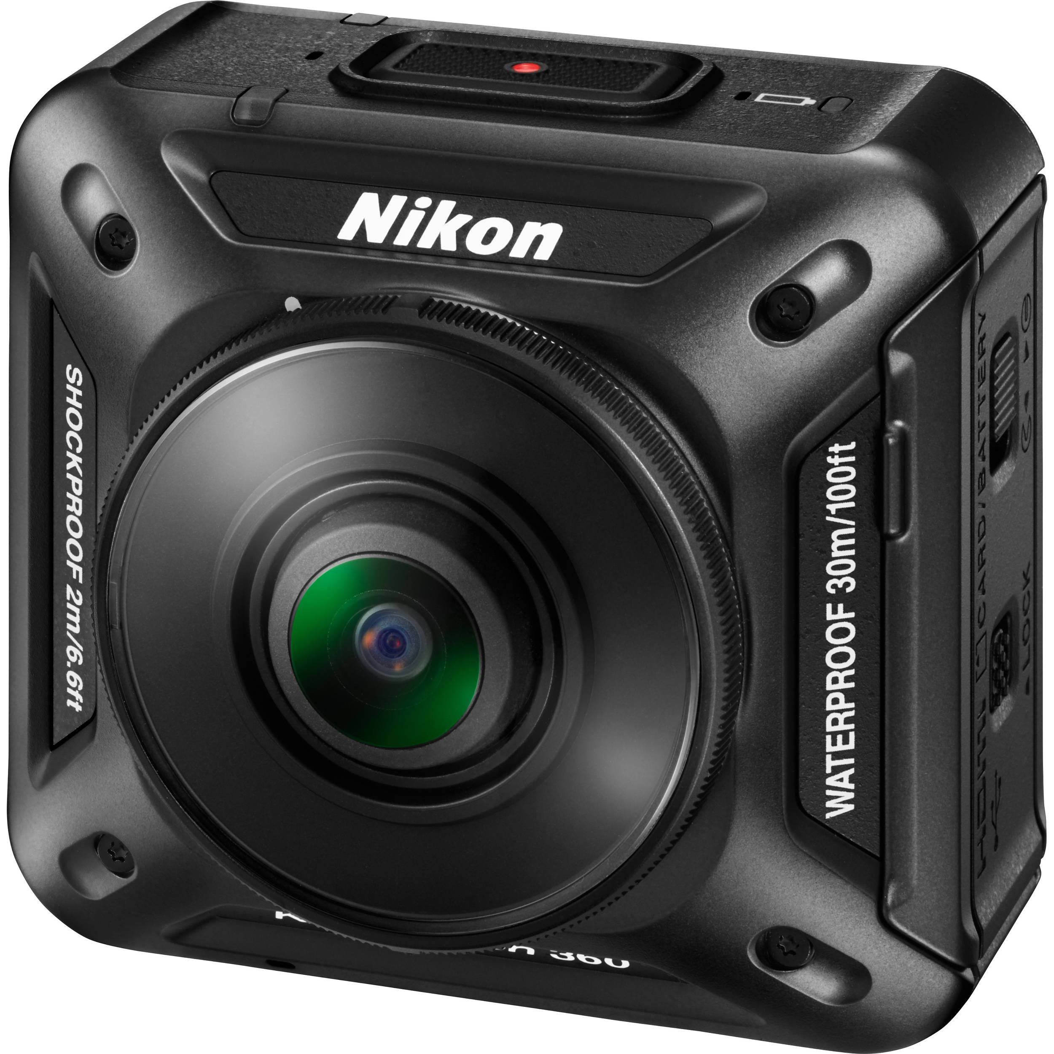
360 ° Camera
Nowadays popular 360 degree camera
Nowadays popular
360 ° degree camera
Ricoh Theta V/S
Samsung Gear 360
Garmin
VIRB® 360
Acer Holo 360
ASUS 360° Camera
Insta360 Pro 8K
Nikon
KeyMission 360

Slide 34



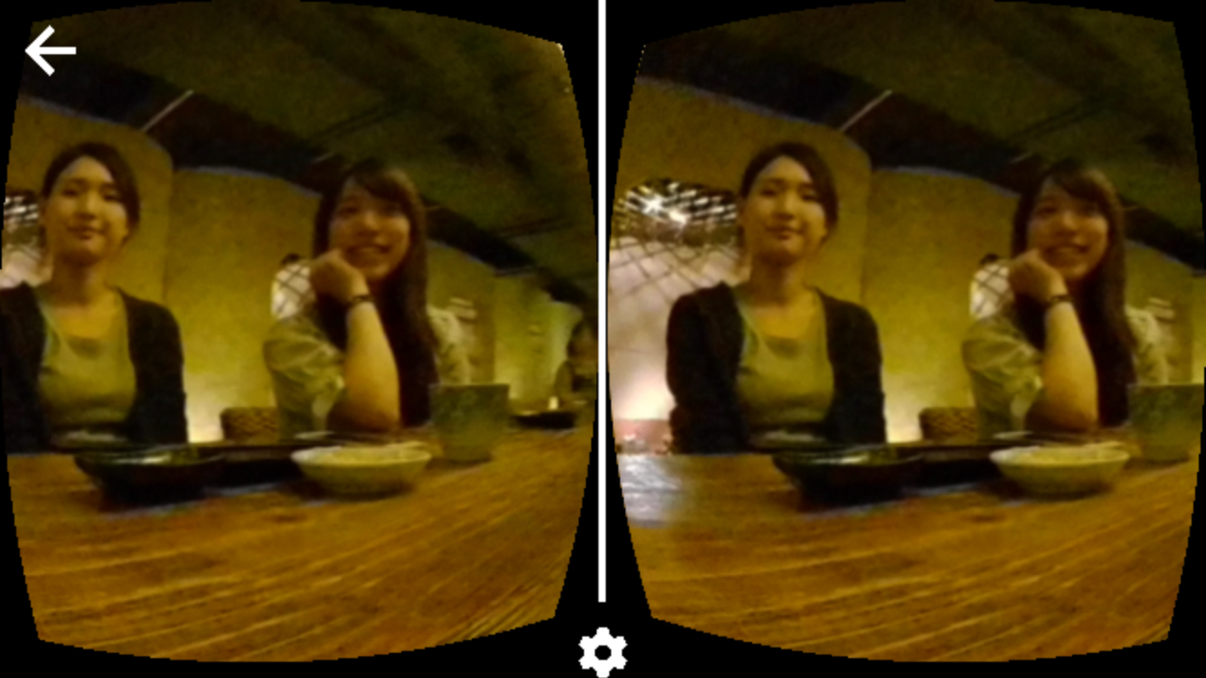
Panorama mode, experience the environment
360-degree view in panoramic mode, Keep all the good memories
Support panoramic mode in Video Station and Share link.
Google Cardboard
Google Daydream View
Samsung Gear VR
xiaomi vr play 2

Slide 35

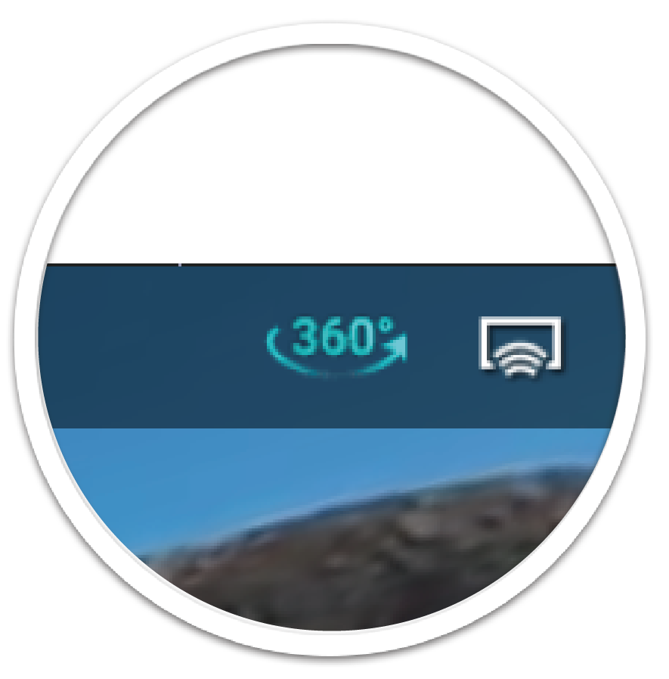
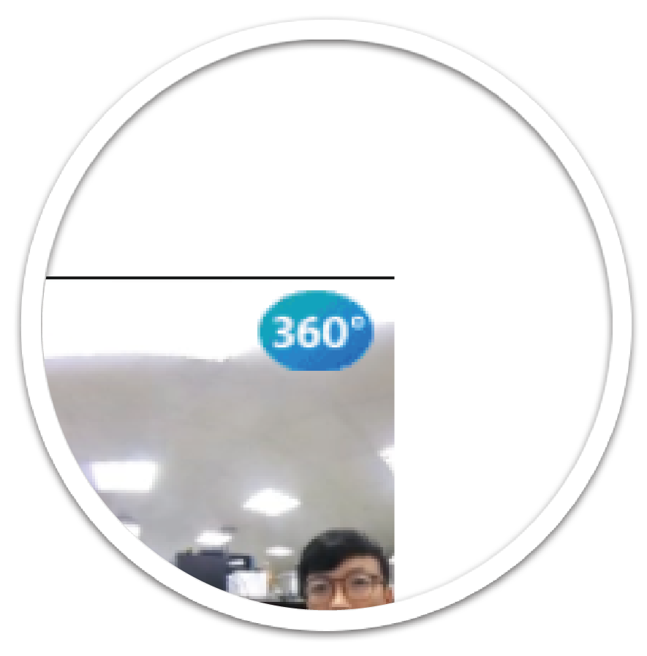
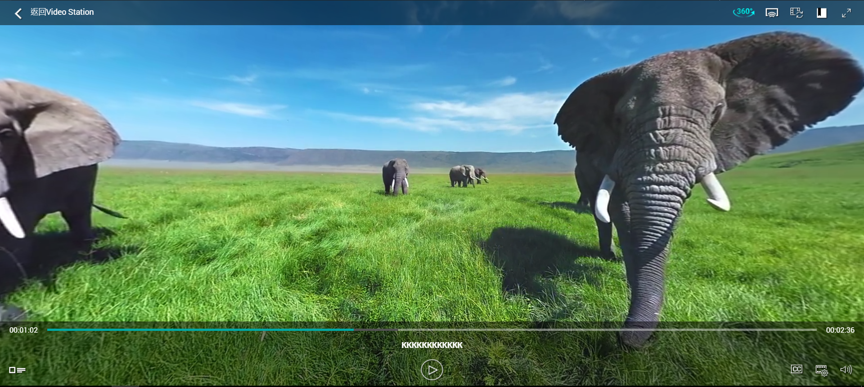
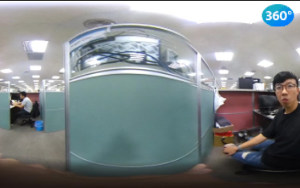
Video Station
Video Station will automatically recognizes videos taken with a 360-degree camera and automatically enables panorama mode when browsing
Support manually change 360-degree panorama mode

Slide 36

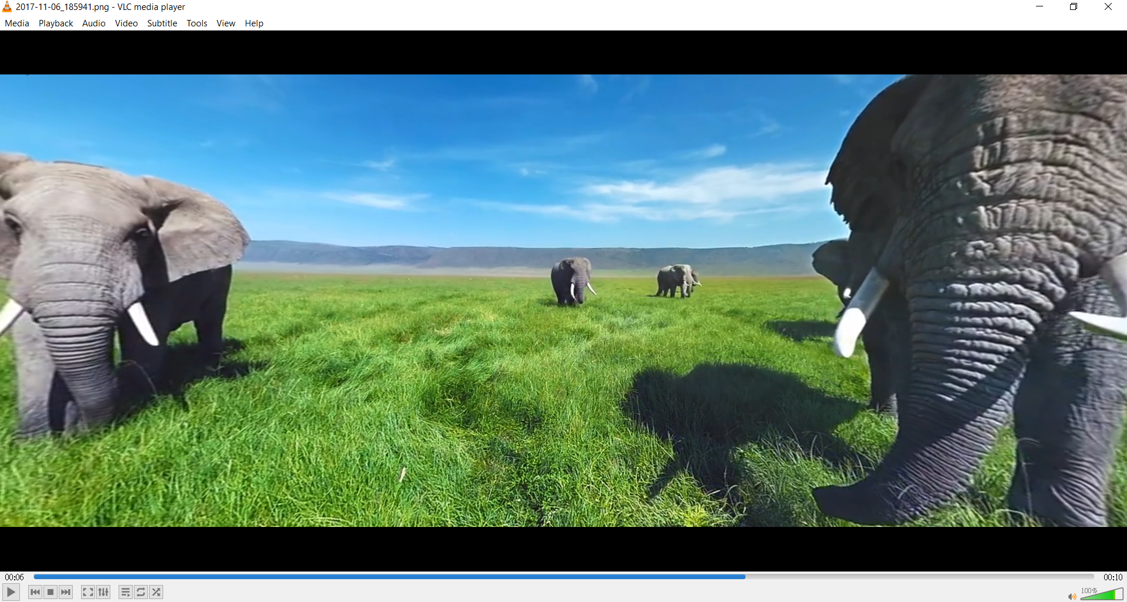
360-degree Video with VLC Player
Stream through Video Station to VLC Player 3.0.0
VLC Player 3.0.0

Slide 37
360° Panorama Video Demo
Live

Slide 38

Qphoto 3
on mobile, handy photos.

Slide 39




Collect the stunning moments of vacation.
Send me the
pictures!

Slide 40
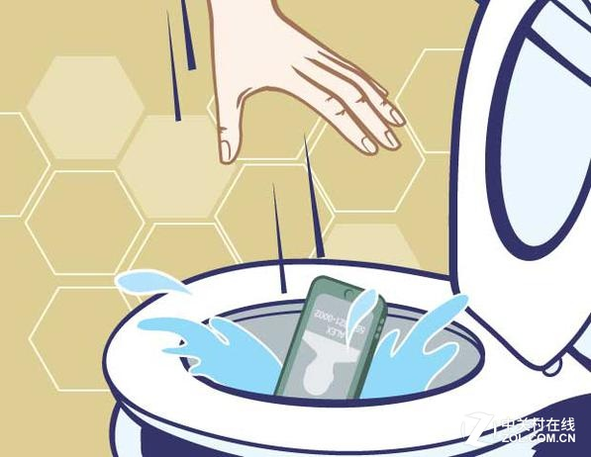

Then the tragedy happened at that night…
Phone’s in the toilet!
My phone was gone…
Precious pictures, videos, and memories were gone…
The friendship seemed to come to an end…

Slide 41




Photo/Video Instant Upload, expanding your storage
Before
I can’t have anymore photo or video.
Now
4G / Wi-Fi
Instantly uploading the photos and videos to the NAS when recording.

Slide 42
Qphoto 3 Demo
Live

Slide 43
Coming soon on 2018!

