Slide 1
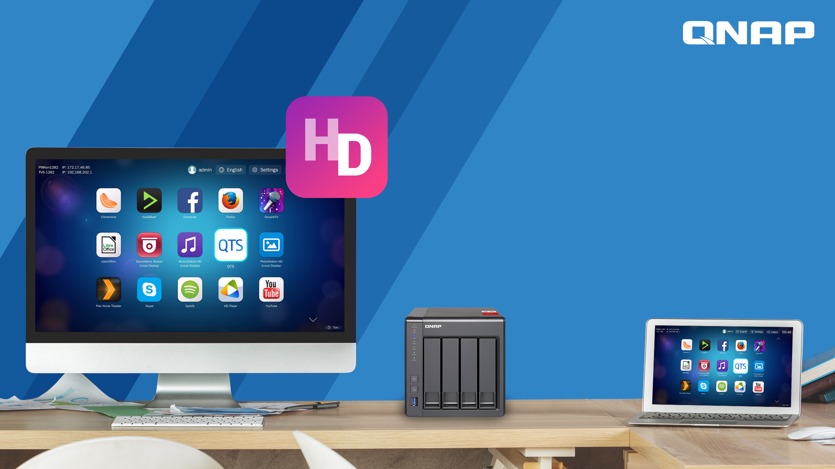
HD Station
HybridDesk Station

Slide 2


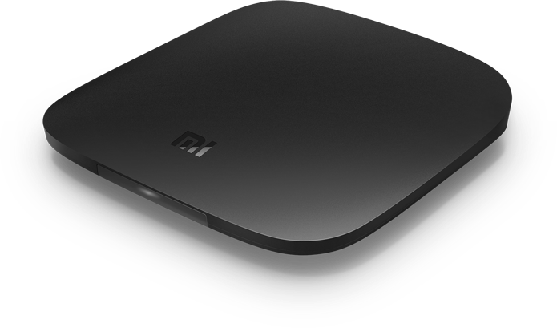
Have you ever wanted this?
How to play multimedia contents stored on my NAS on TV?
I want to watch YouTube videos!
Android Box
Another device? Too many!
Someone will say~

Slide 3
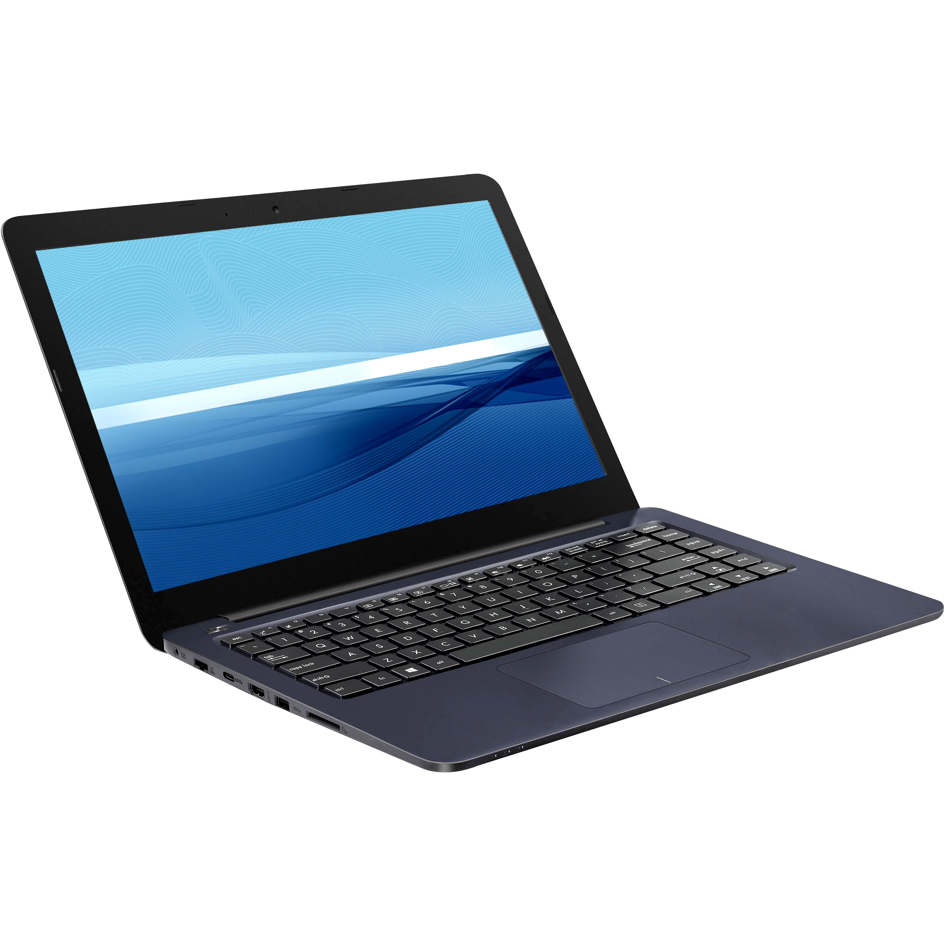

Have you ever wanted this?
View IP cam feeds on TV?
Using a laptop or desktop is much easier!
Then I need to go turn it on...
Someone will say~

Slide 4
Have you ever wanted this?
Shop online on TV?
Access my Windows VM on my NAS from TV?
Use a laptop or desktop!
For just some simple stuff I need to go to my PC again...
Someone will say~

Slide 5

Have you ever wanted this?
Why would you think that? It must be very complicated to operate.
Can all my needs be done with just NAS?
Really?
Someone will say~

Slide 6

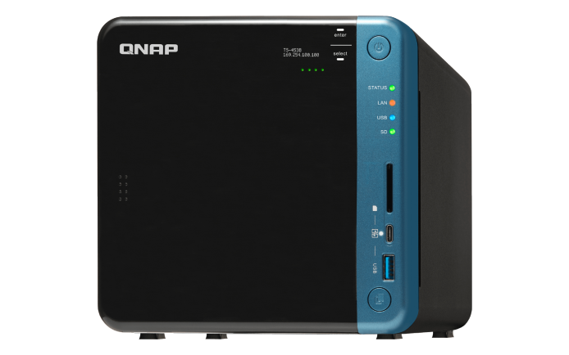
One NAS solves it all, period.

Slide 7

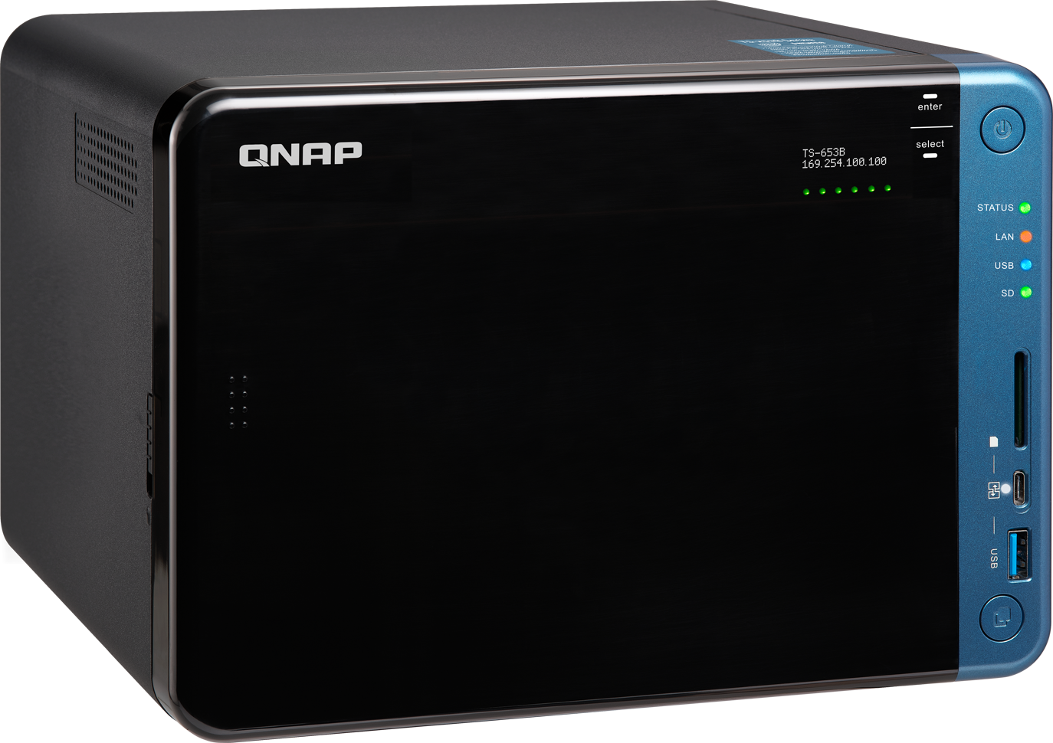

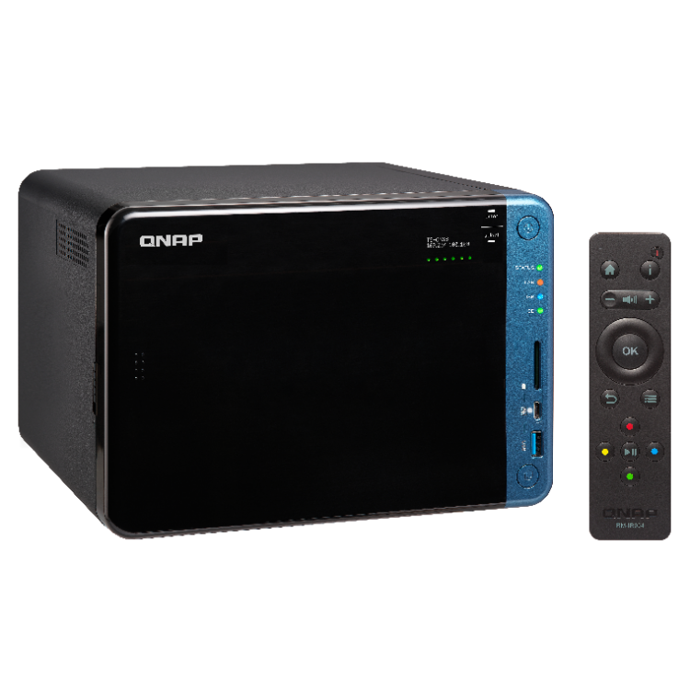

One NAS solves it all, period.
Use Windows utilities
View surveillance feeds
Surf the web
Watch YouTube videos
View photos/videos, listen to music
Versatile configuration for a cost effective solution
Notes:
你有多久沒有使用家中的電腦？
自從有智慧手機後，家裡的電腦很少開啟了。但沒有電腦又不行，有些工具需要在電腦上才可以使用。
我只需要儲存空間，及偶爾用一下電腦上的工具，例如：報稅時，需要安裝電子報稅軟體。
能不能用舊的螢幕，喇叭，搭配NAS的儲存，解決我現在的問題，我不想再多買電腦，佔空間，又浪費錢。

Slide 8

All about the HD Station
Basic Architecture
Configuration
Basic Introduction
QNAP QvPC technology
Various configuration method for your need
Simple platform
Easy to use
實機演練
Application
Demo

Slide 9

HD Station Architecture

Slide 10
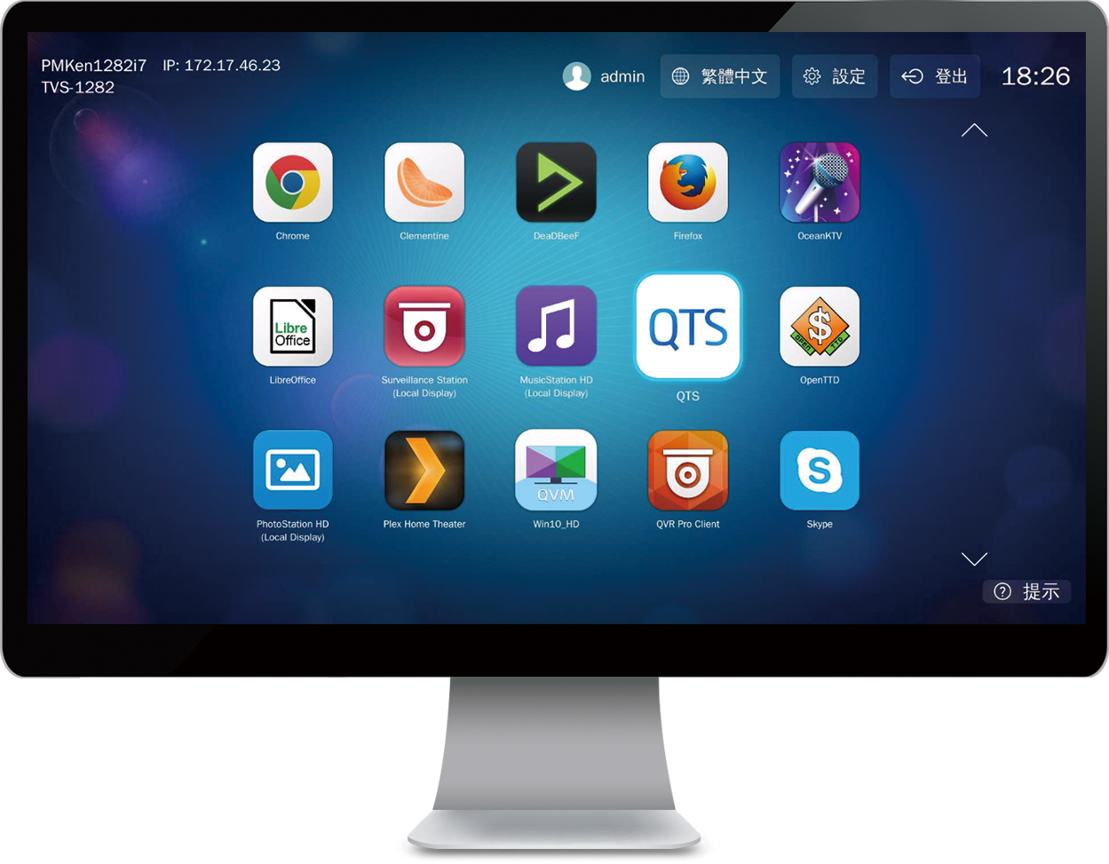
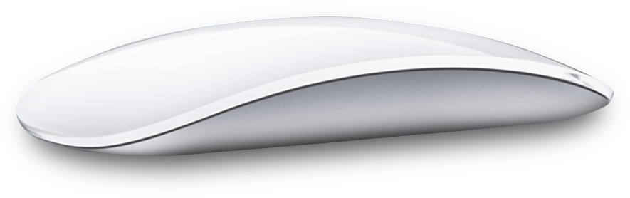
HD Station
QNAP QvPC technology
Desktop view on an external monitor via HDMI/DP

Slide 11
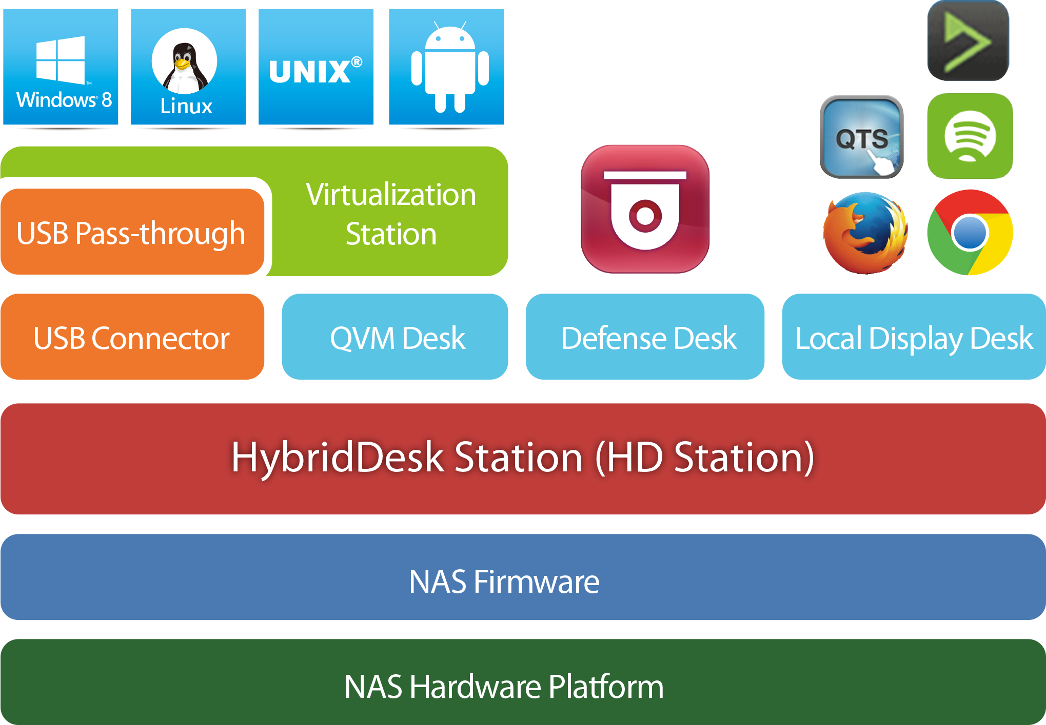
HD Station

Slide 12


QvPC Platform
Virtualization
Station
HD Station
Linux Station
Simple desktop
Various applications
Standard Ubuntu platform
you can install Ubuntu applications
Install your own operating systems
High flexibility
IT knowledge
Design for non-IT people
Flexibility

Slide 13


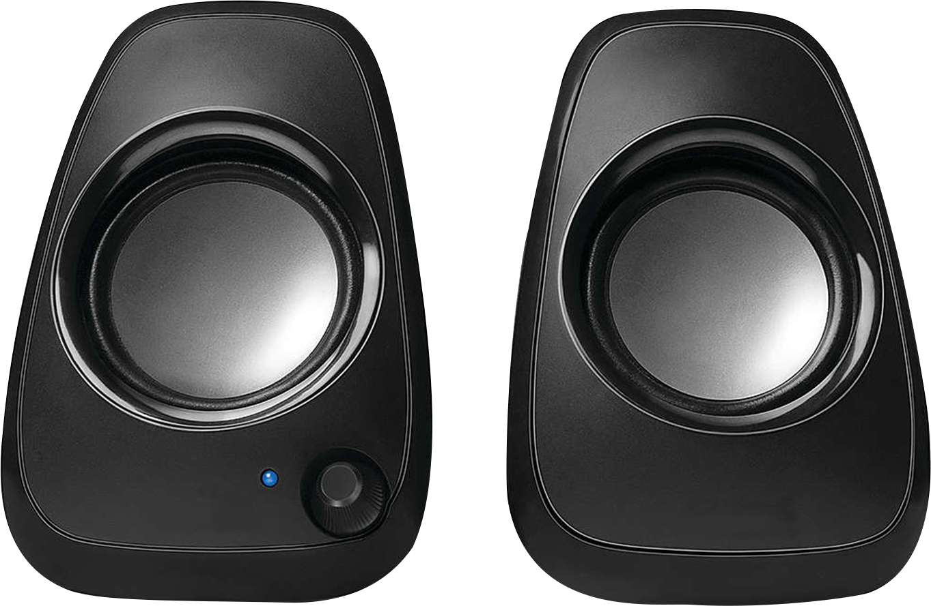
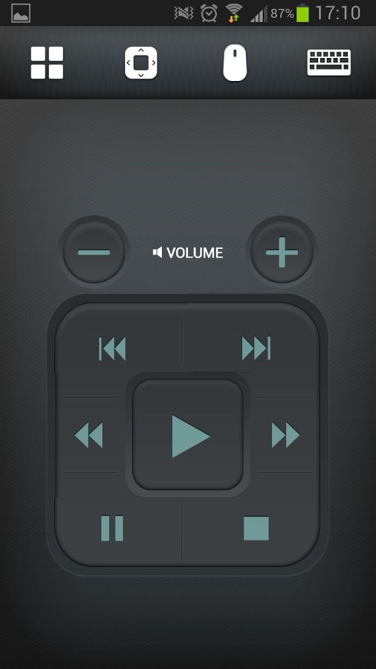
Models with Built-in HDMI
Flexible, cost saving
USB
HDMI
Mouse &
Keyboard
TS-x53B series
IR
Audio
Network
Controller
Qremote App

Slide 14
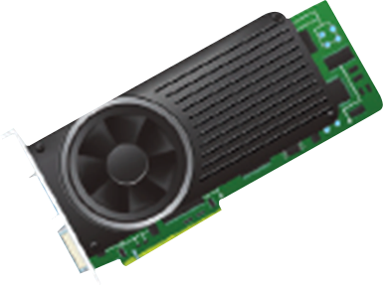
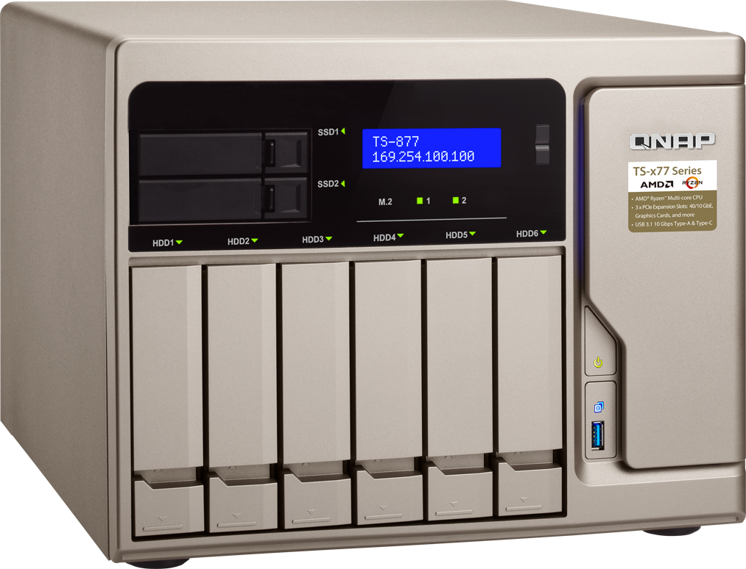
Using expansion graphics card
Nvidia graphics card
USB
HDMI / DP
Mouse &
Keyboard
TS-x77 series
IR
Audio
Network
MCE Controller
Qremote App

Slide 15
Basic Operations

Slide 16
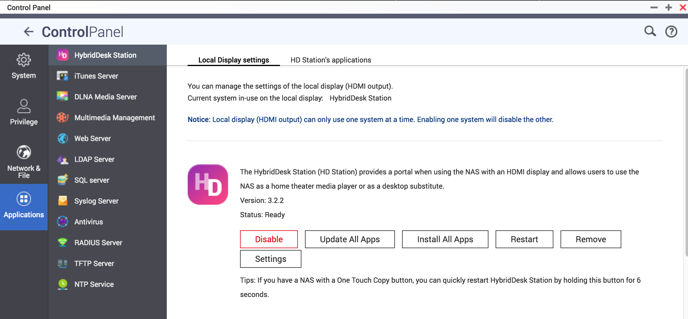
Install/Update the Application
Manage HD Station via QTS
Notes:
Demo

Slide 17
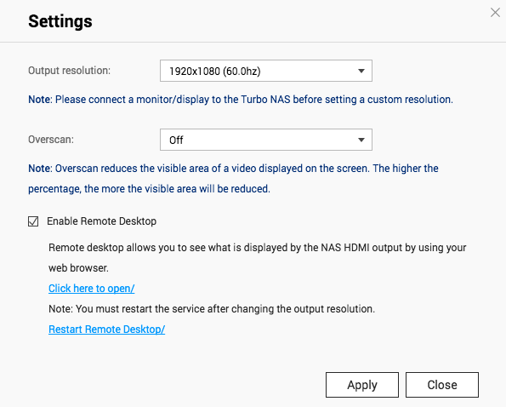
QTS - HD Station Setup
Set up HD Station via QTS
Resolution: set the resolution, just like using a PC
Overscan: Adjust the screen display size
Remote desktop: Allow you to view the HD Station display via web browser.
Notes:
Demo -VNC

Slide 18
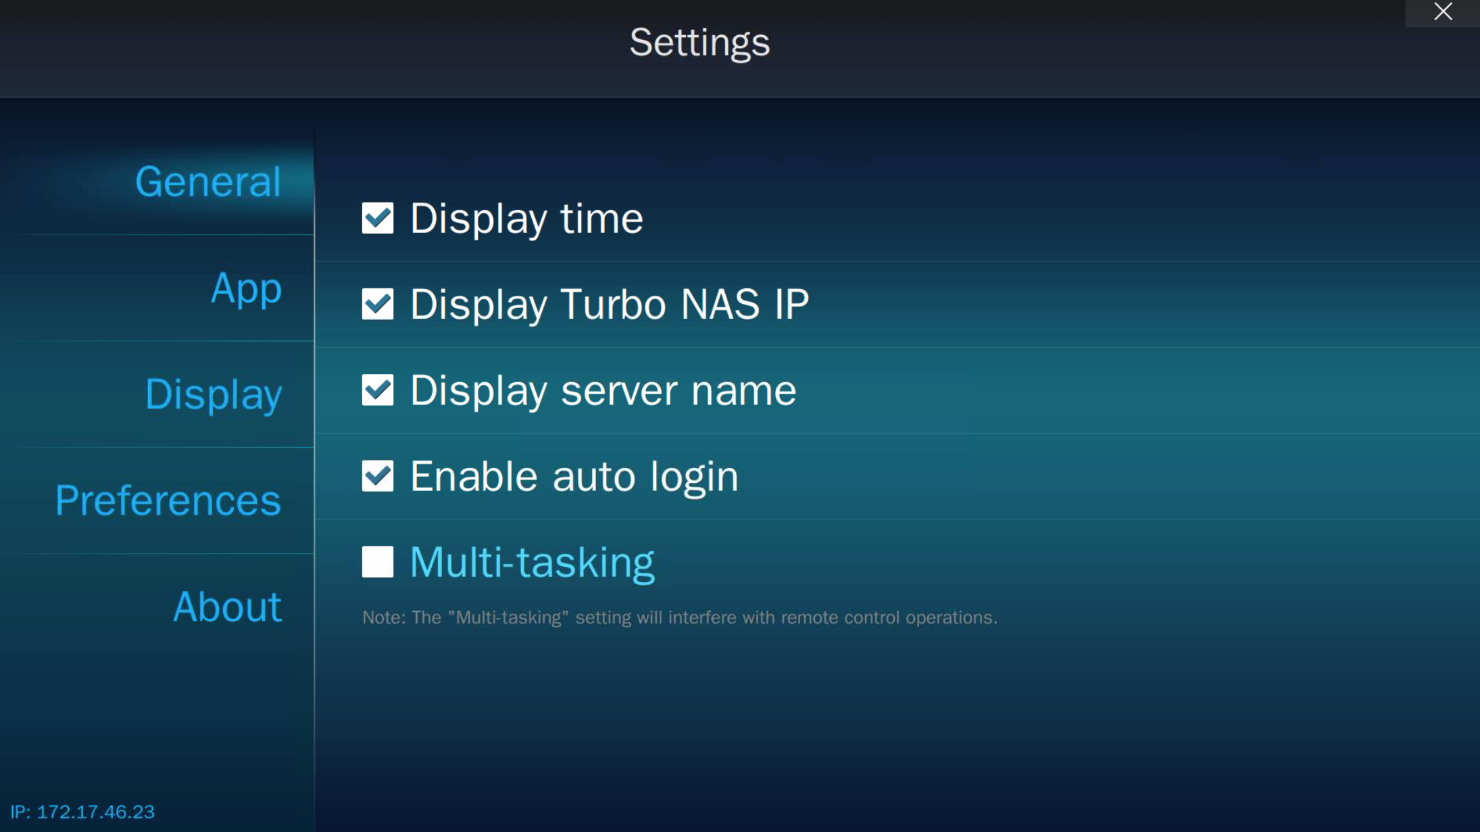
General Settings
Various functions and settings
General settings
Display time
Display NAS IP
Display server name
Enable auto login
Multi-tasking
    * Some apps are not designed for
    multi-tasking.

Slide 19
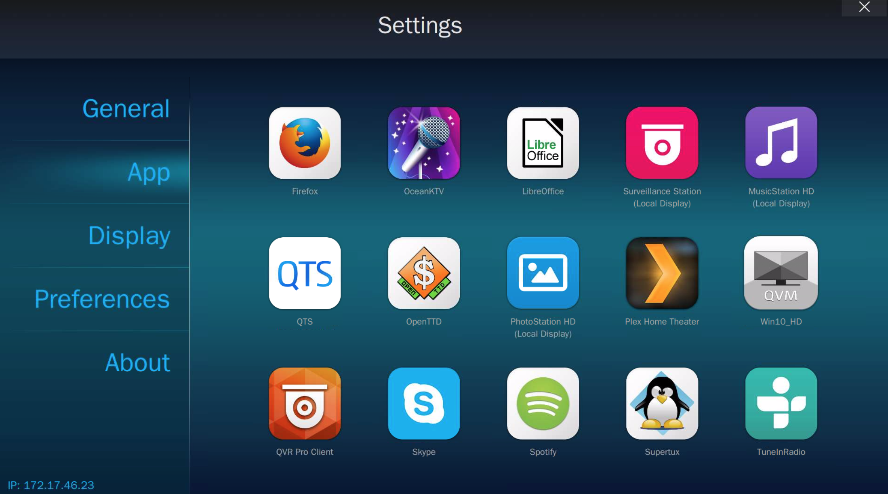
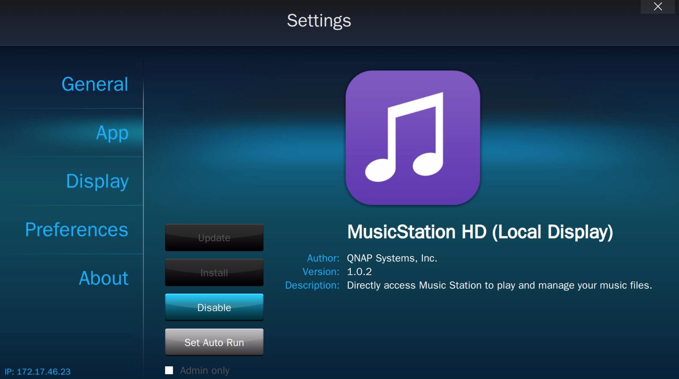
HD Station Settings - Applications
Manage applications for HD Station

Slide 20
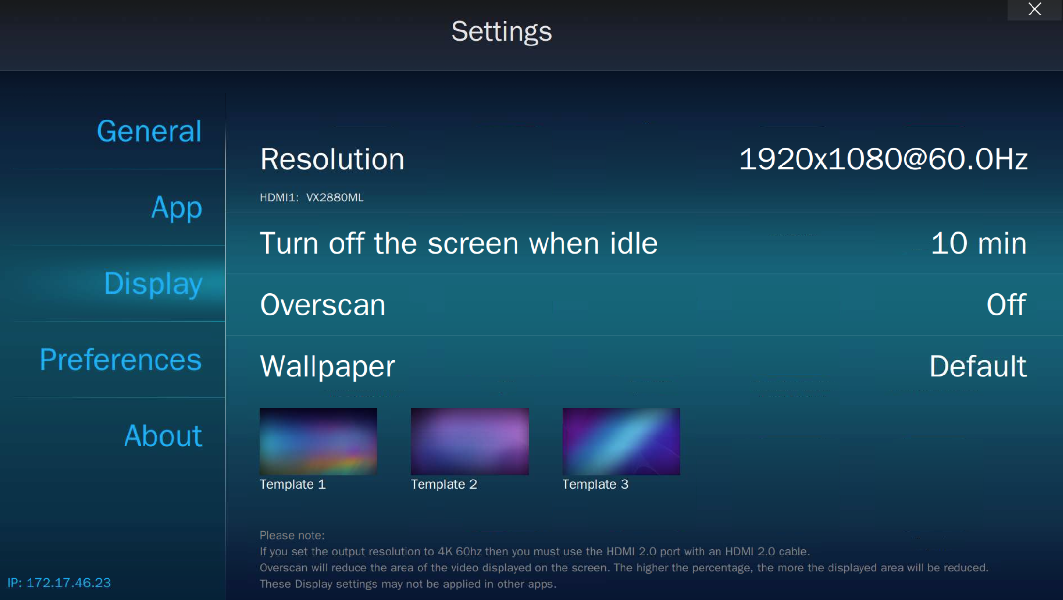
HD Station Settings - Display
Manage display settings
Manage display settings:
Resolution
Turn off the screen when idle
Overscan
Wallpaper

Slide 21
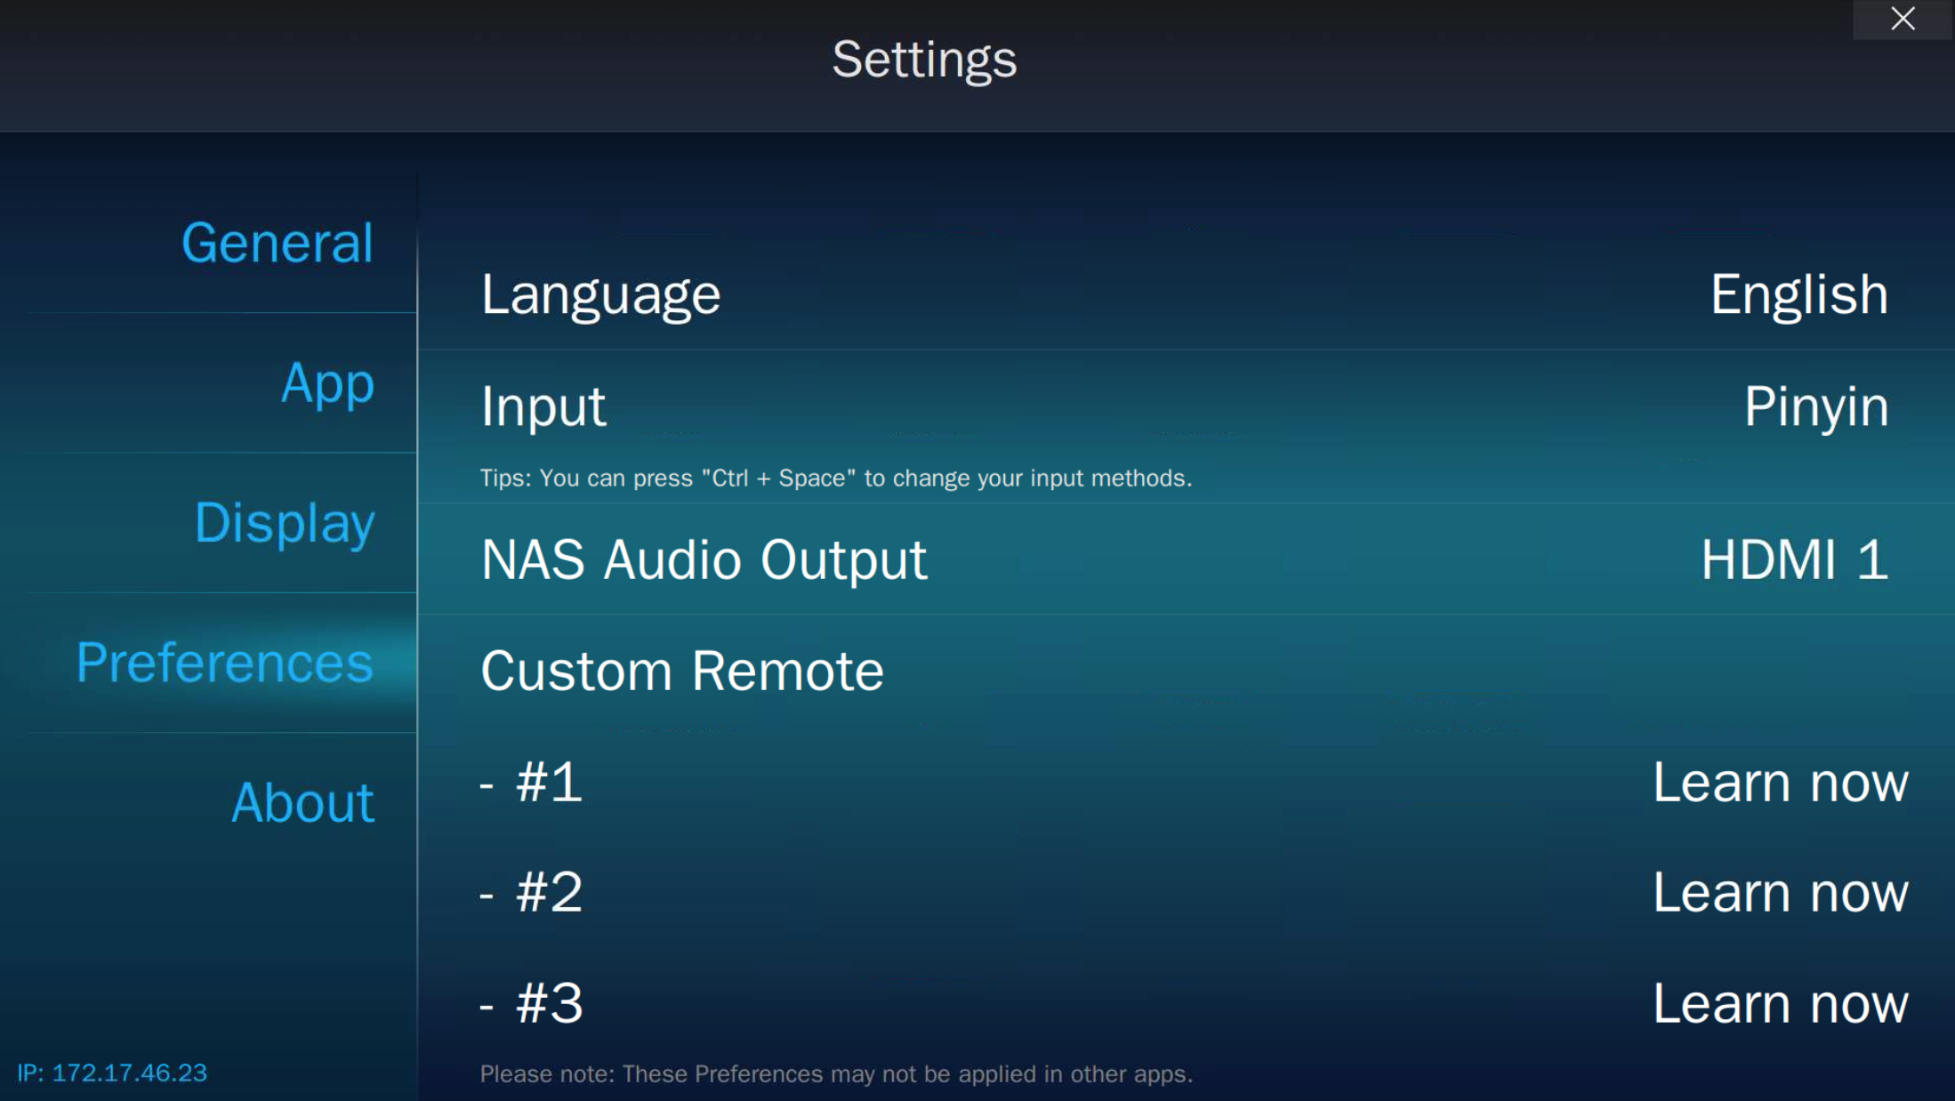
Preferences
Various configurable functions.
Preferences：
Languages
Input
Audio output: Define the NAS audio output
Custom remote: Use other remotes for HD Station
Notes:
Demo - Audio out

Slide 22
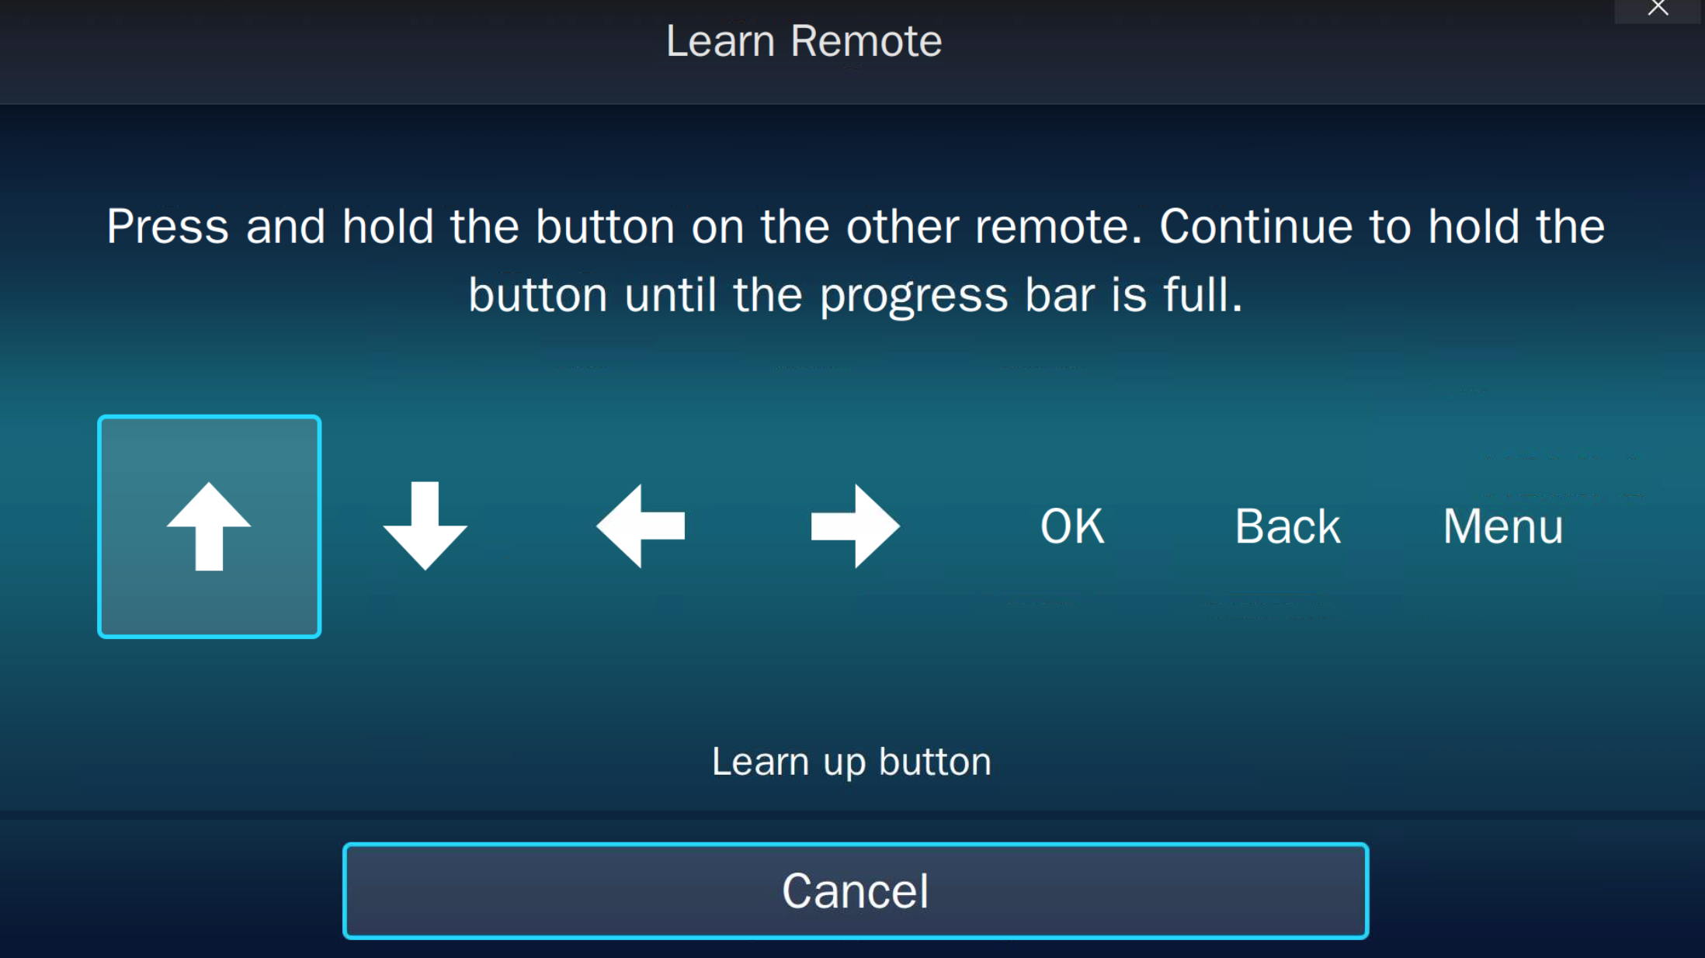


Remote learning
Using a remote that you already have
* Only supported for x53A series (or later) which included
the IR sensor
TV controller
Notes:
Demo

Slide 23
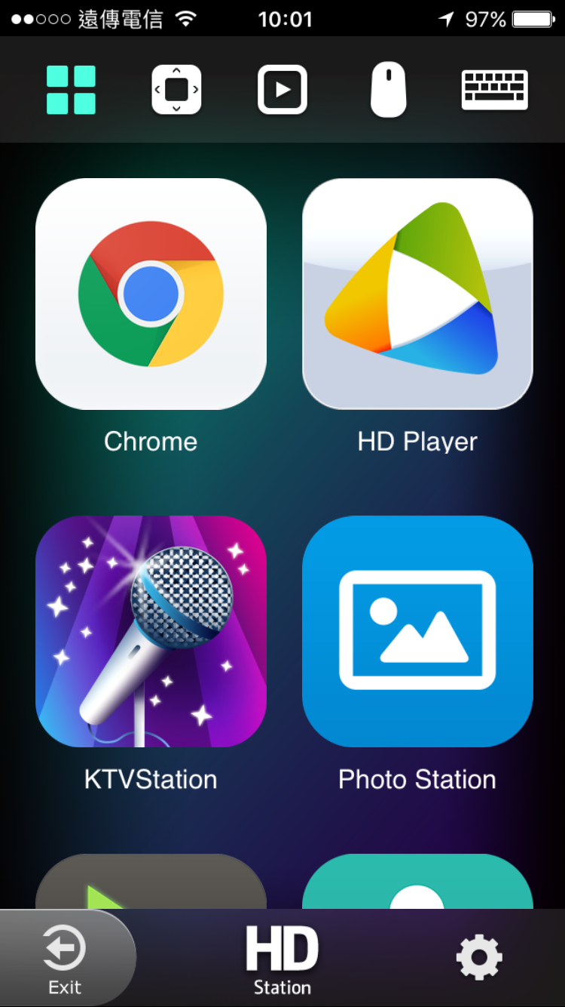
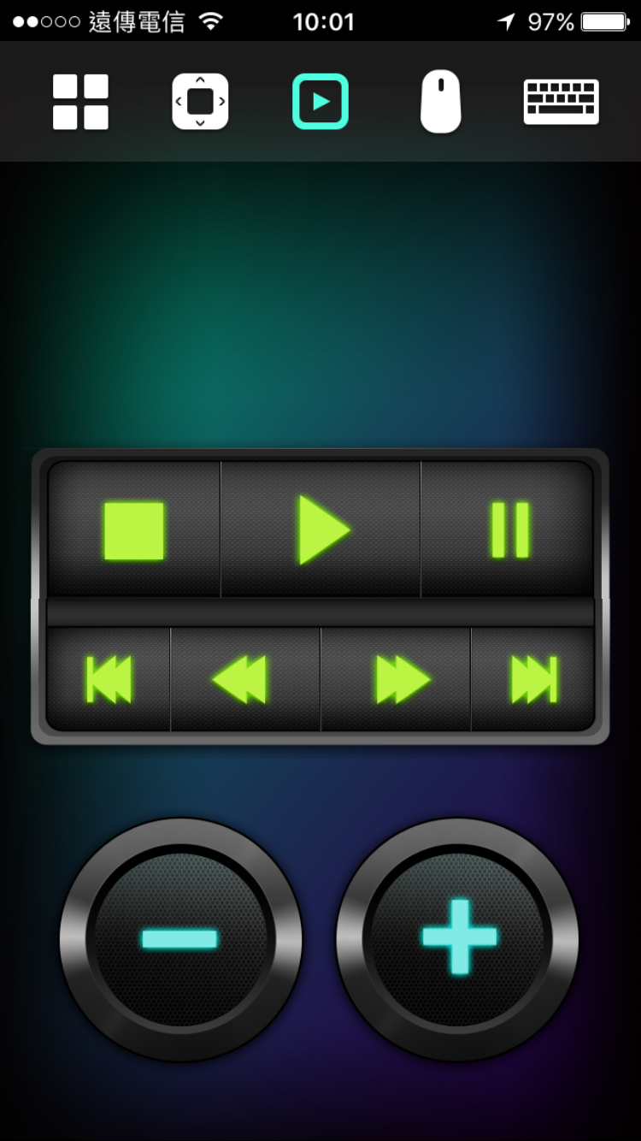
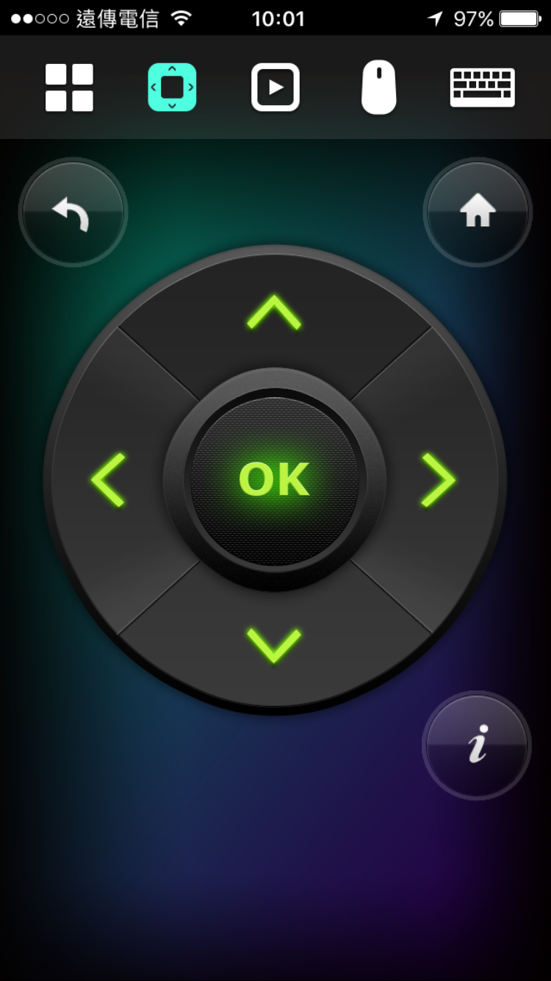
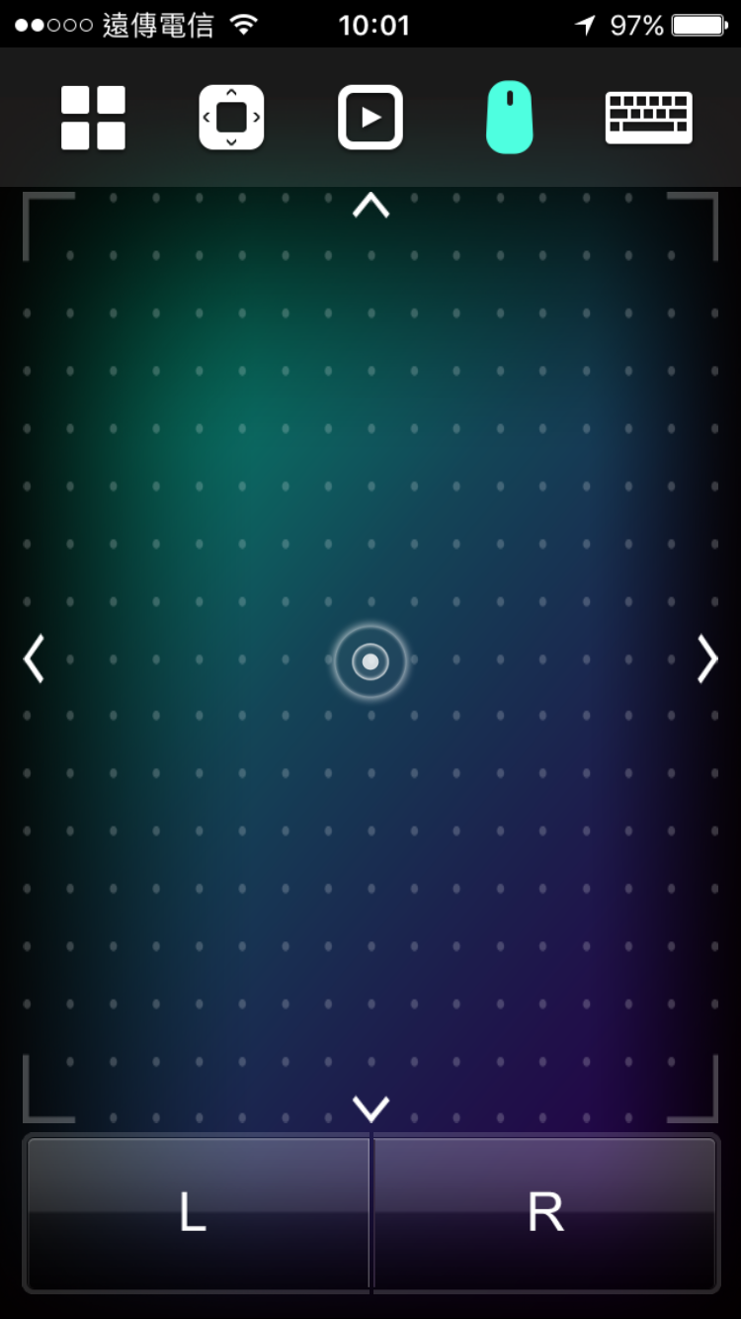
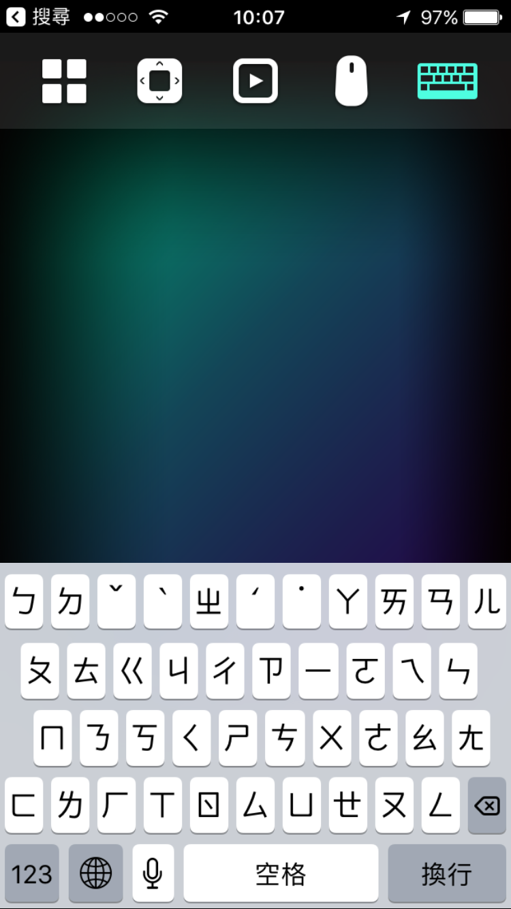
Qremote
Using Qremote on smart devices
* Supports iOS & Android devices.
Notes:
Demo - 輸入法

Slide 24
Rich Applications

Slide 25
Rich Applications
QTS
Management
Browser, Communication
& Office tools
Multimedia Applications
QTS
QTS
File Station HD
Photo Station HD
Video Station HD
Music Station HD
Surveillance Station
QVR Pro Client
Browsers
Chrome
Firefox
Communication
Skype
Office tools
LibreOffice
Multimedia
HD Player
OceanKTV
YouTube
Clementine
DeaDBeaf
Plex Home Theater
Spotify
TuneIn Radio
Meet almost all your needs

Slide 26
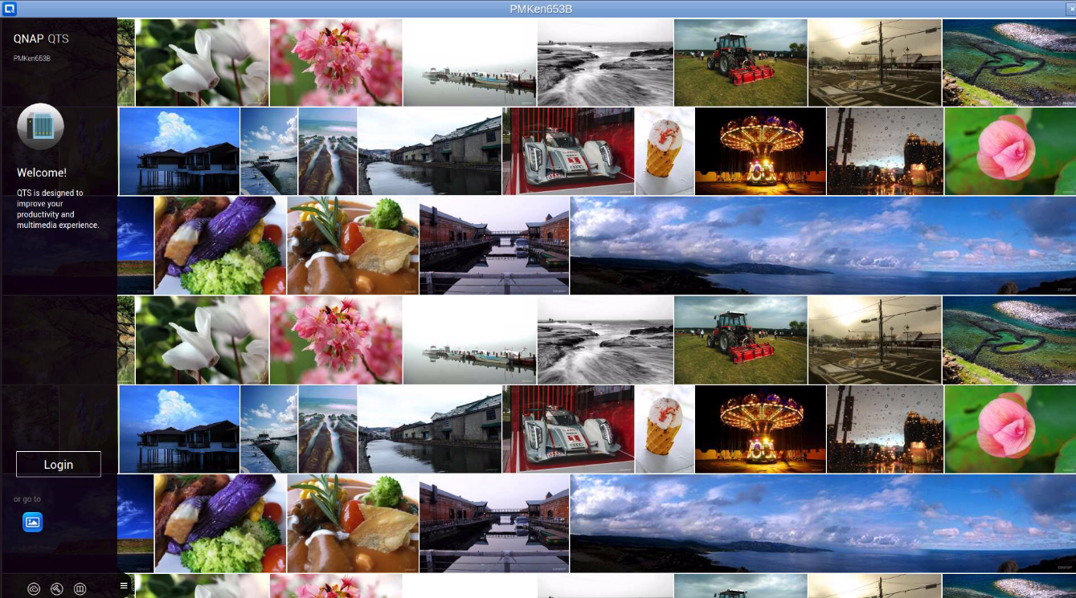
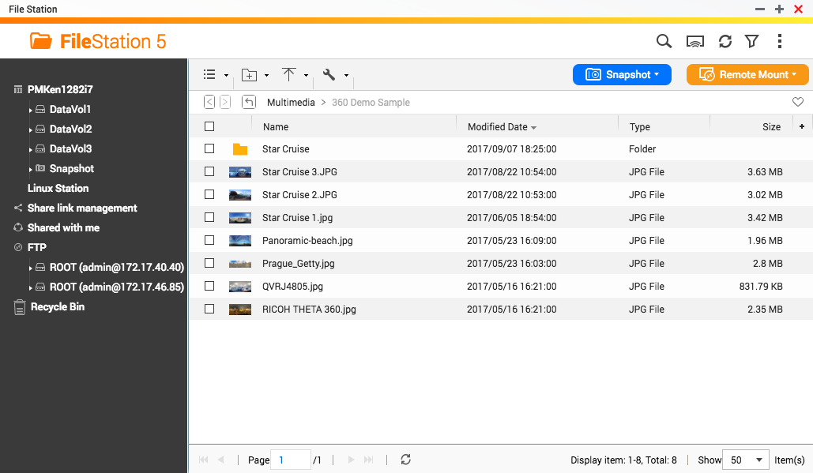
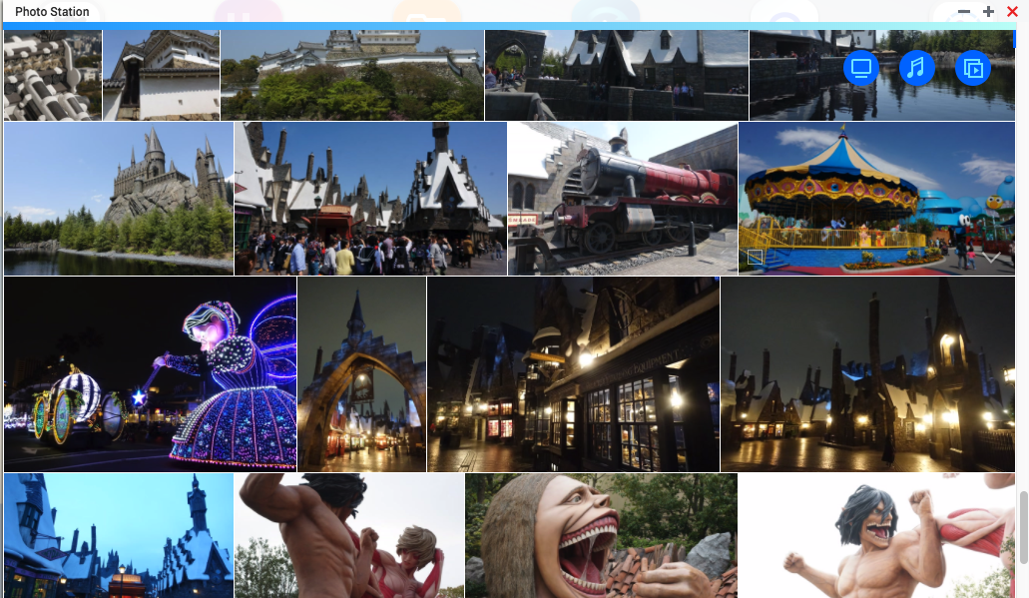
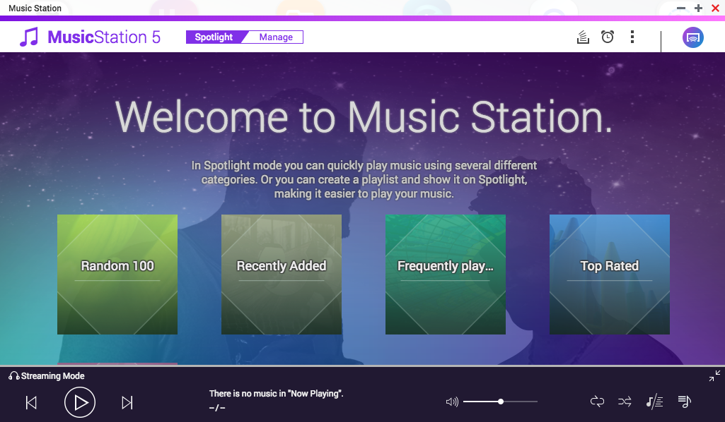
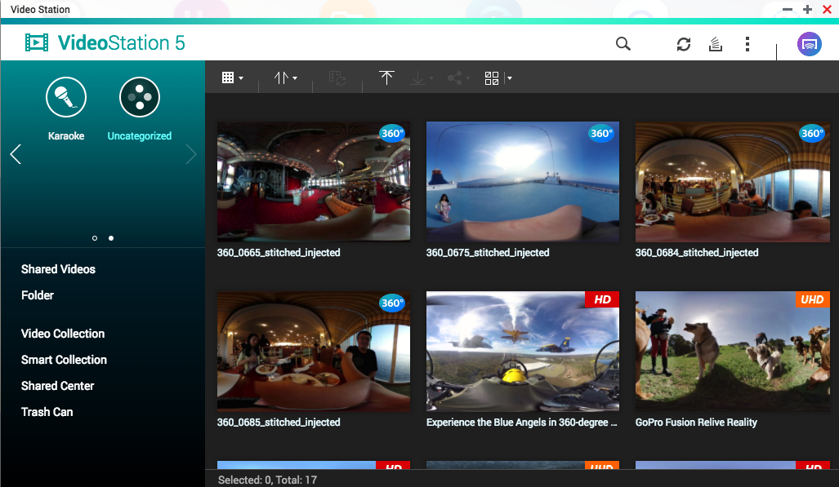
QTS on HD Station
Various shortcuts to QTS applications.
QTS
File Station
Photo Station
Music Station
Video Station

Slide 27
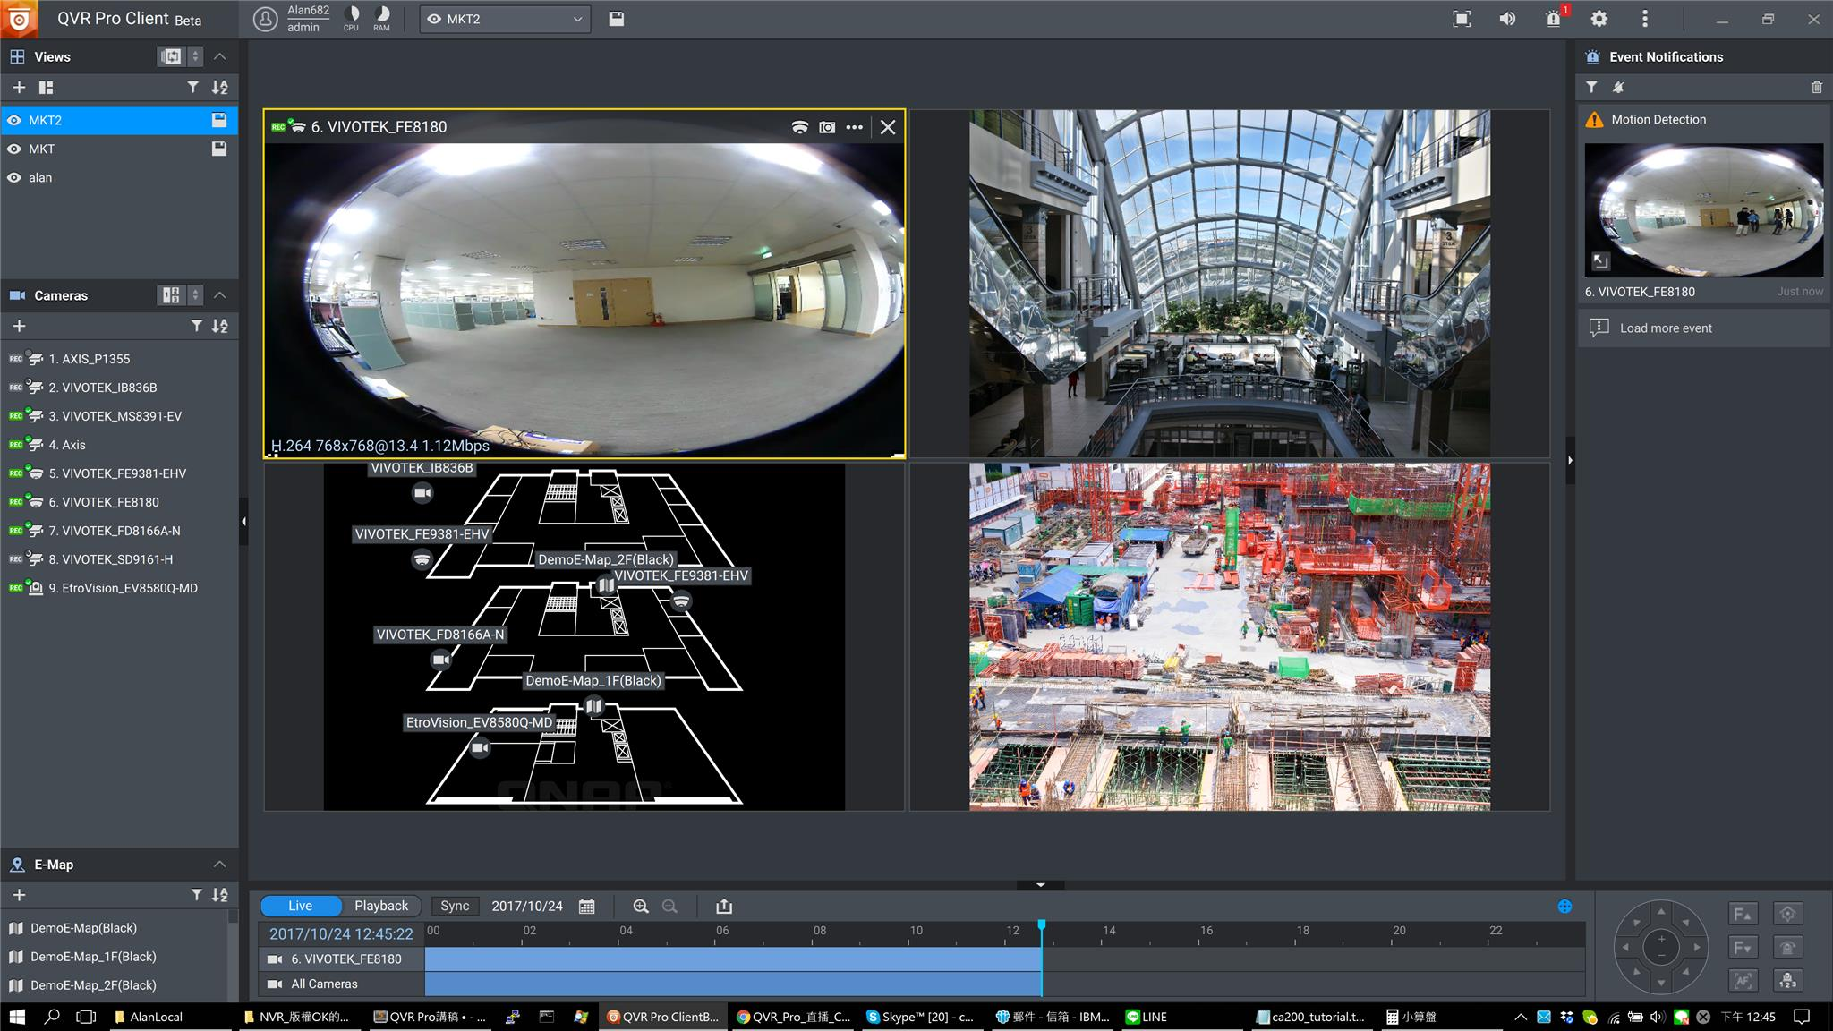
QVR Pro Client
Live view on TV directly

Slide 28
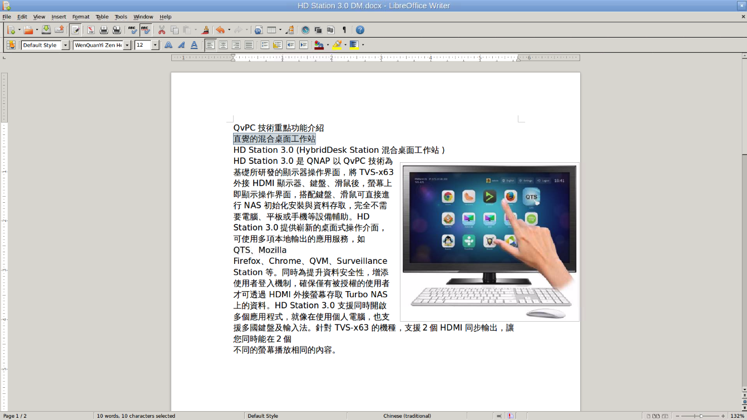
LibreOffice
LibreOffice is a powerful office suite – its clean interface and feature-rich functionality help you unleash your creativity and enhance your productivity.

Slide 29

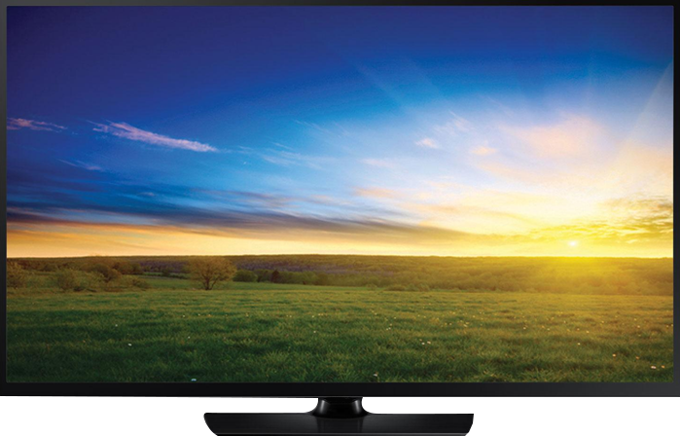
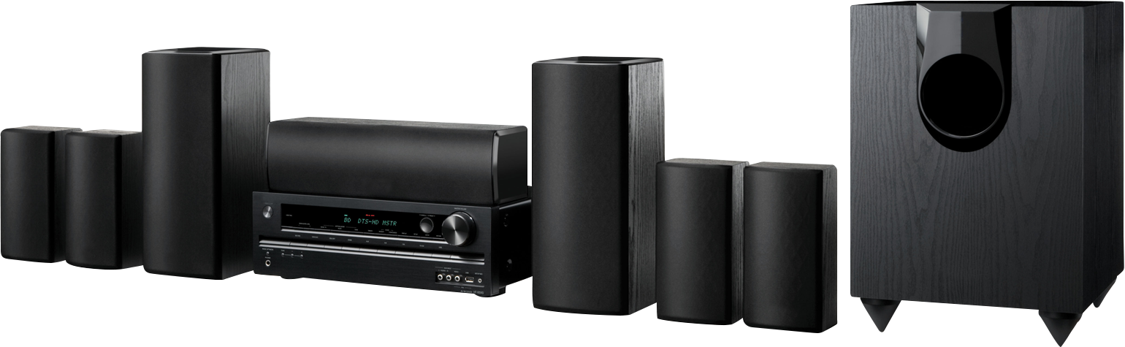
QNAP NAS vs Home Theater
QNAP NAS
Home Theater System
HD TV
Ultimate Theater Experience Combining QNAP NAS and Home Theater System for Unparalleled AV Experience

Slide 30
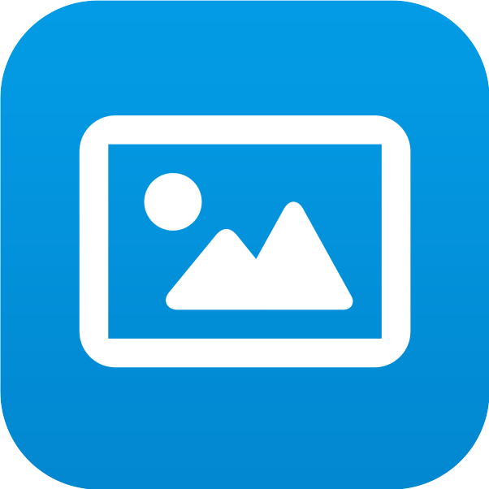


HD Player
HD Player allows you to watch multimedia contents on TV directly
Photo Station
Video Station
Music Station
HD Player
Play directly on TV
Notes:
加各station icon

Slide 31
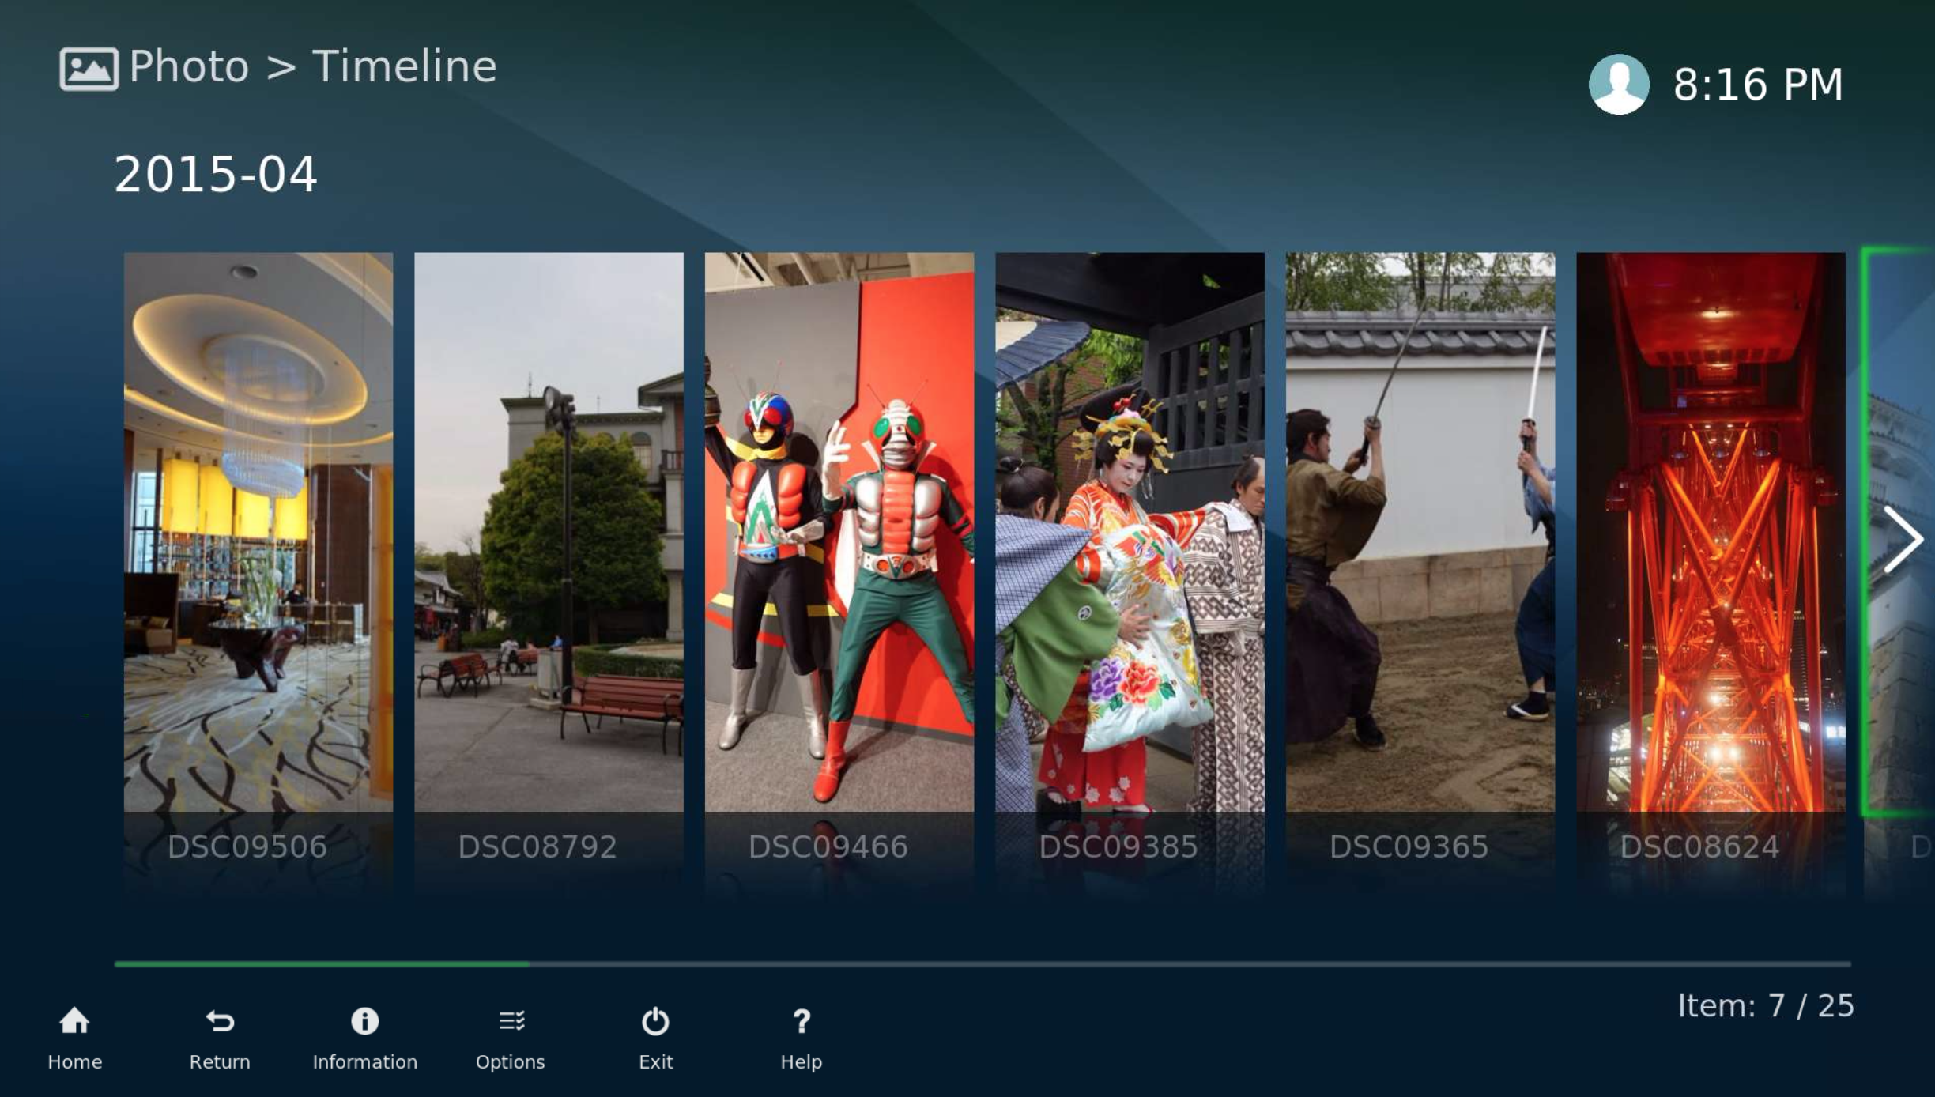
HD Player - Photo
View photos stored on NAS on TV directly.

Slide 32
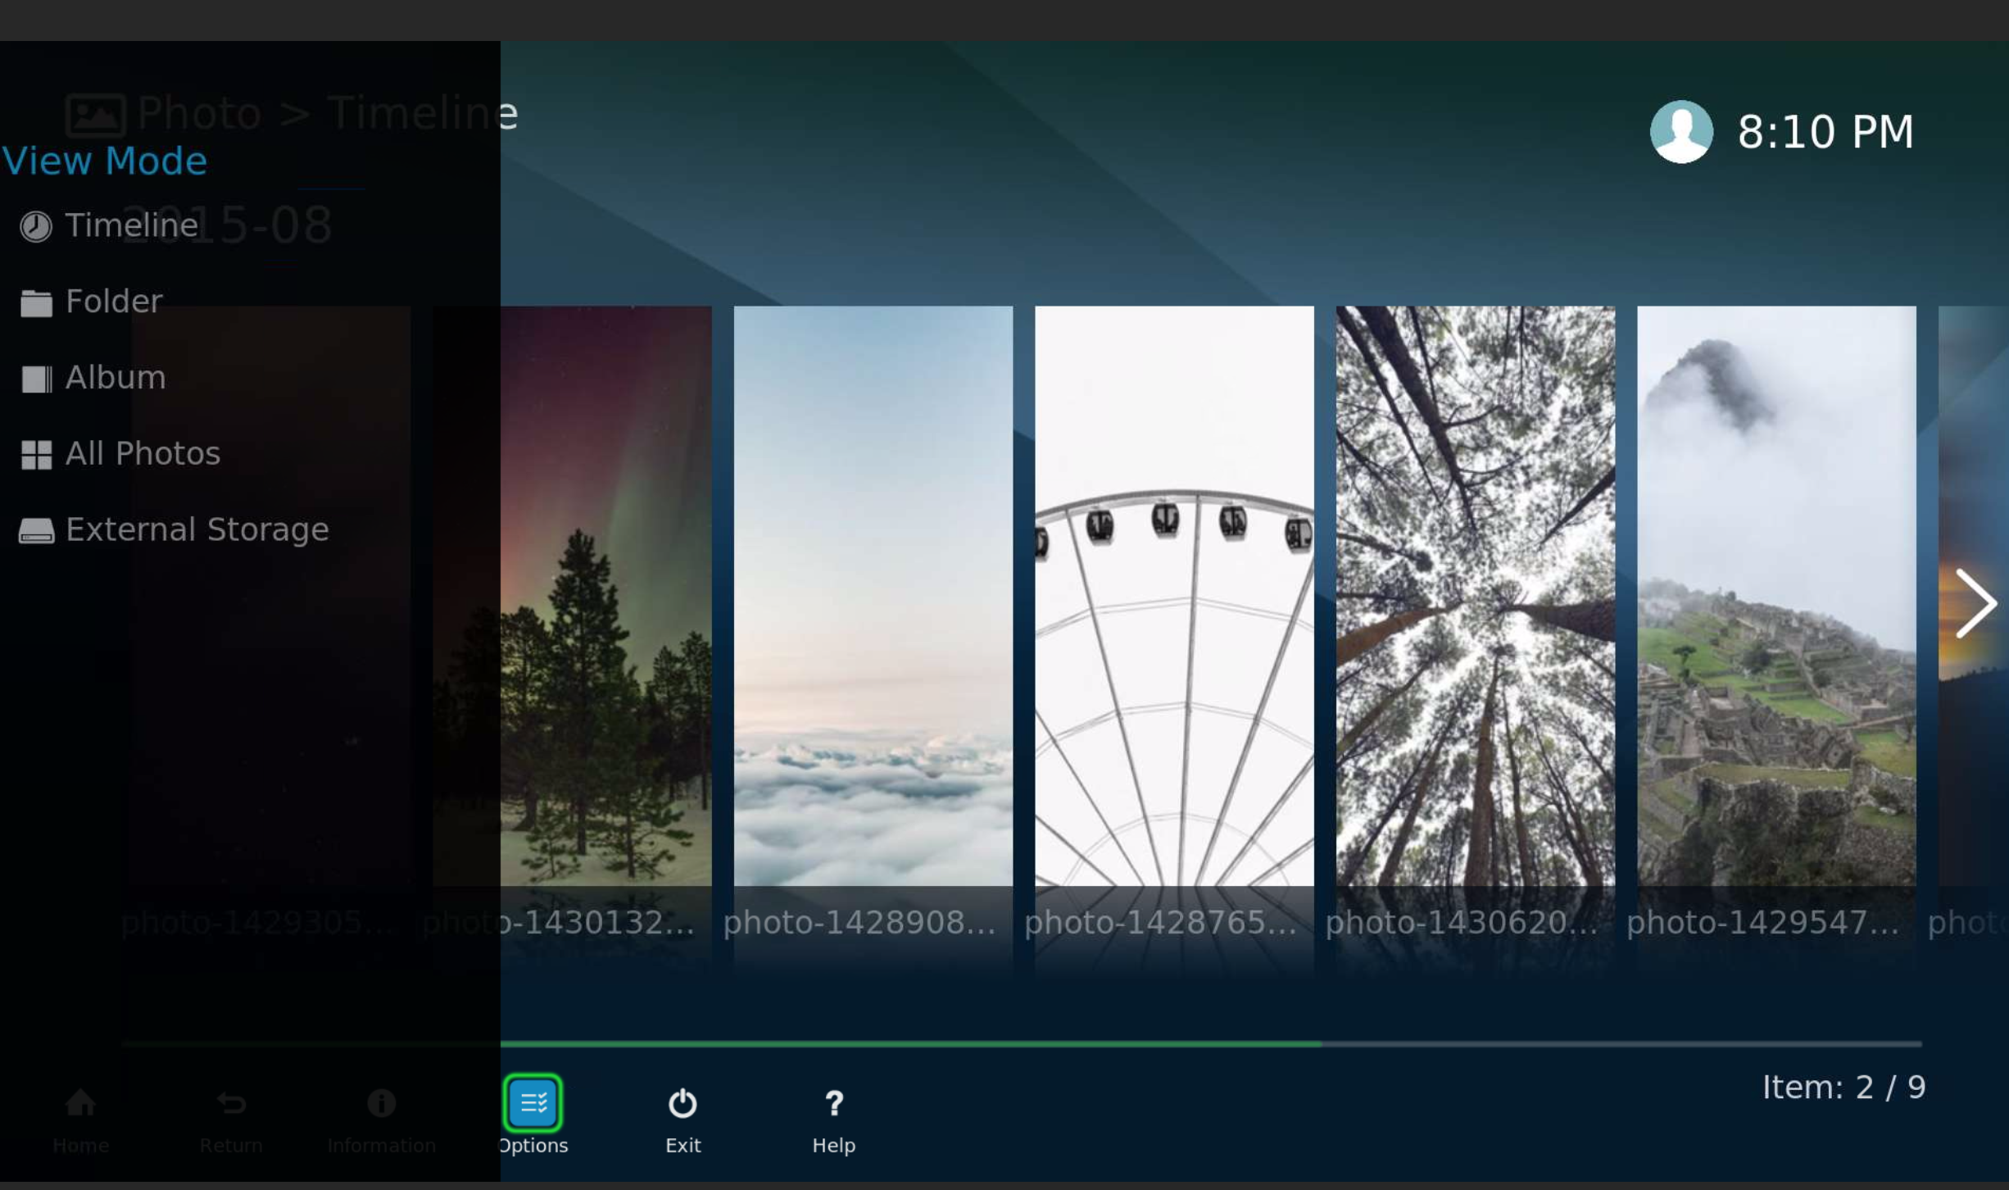
HD Player - Photo view mode
HD Player –
Photo View Mode：
Timeline
Private Collection
Folder
Album
All Photos

Slide 33
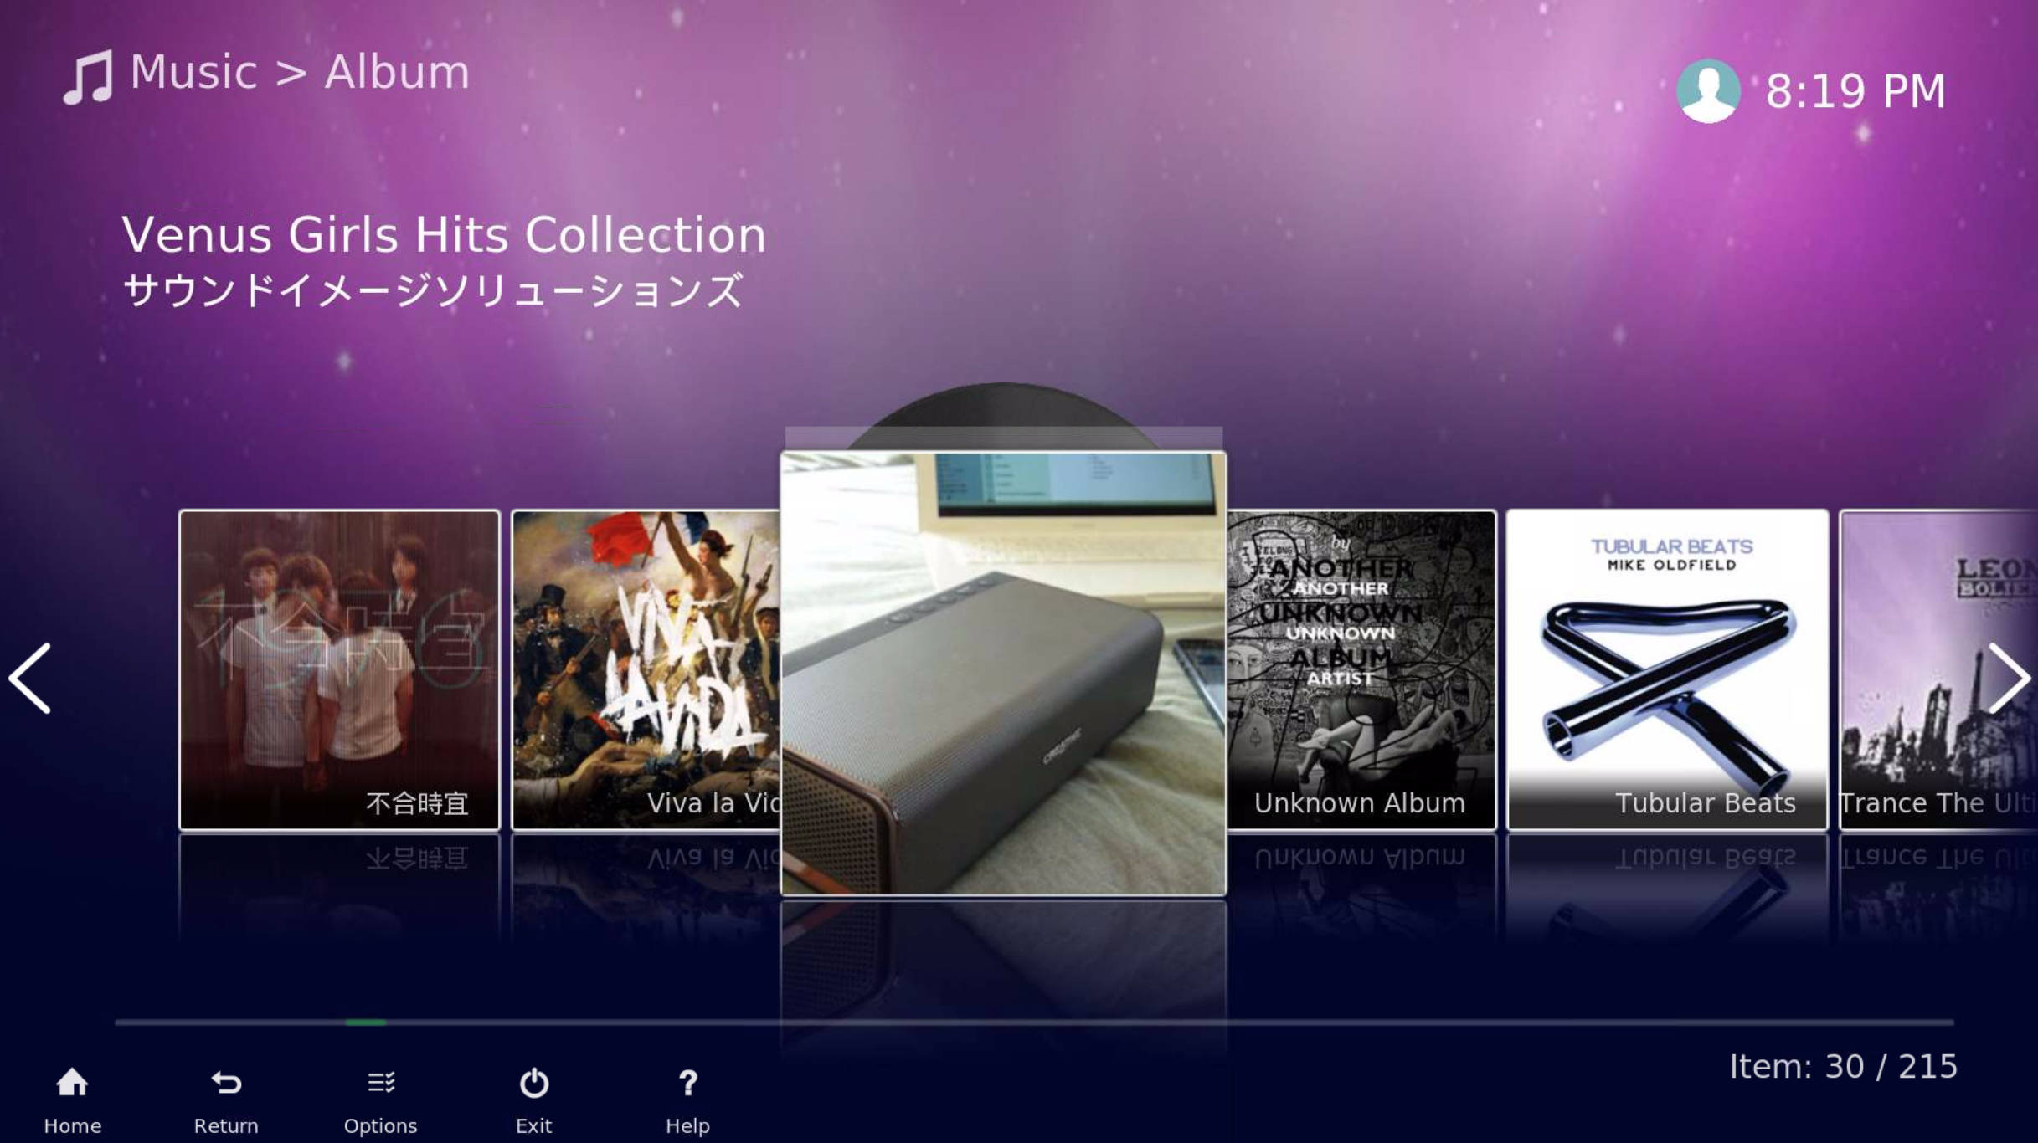
HD Player - Music
Listen to music on your NAS on your TV.

Slide 34
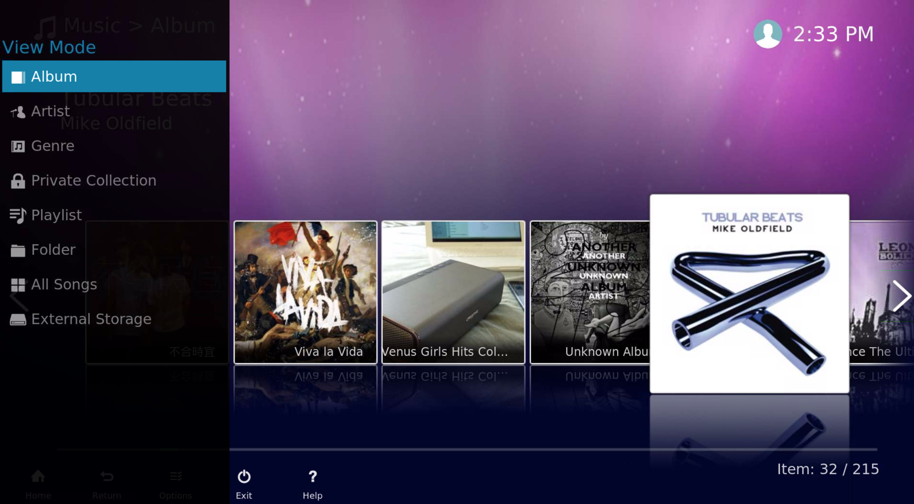
HD Player - Music view mode
HD Player –
Music view mode:
Album
Artist
Genre
Private Collection
Playlist
Folder
All Songs
External Storage

Slide 35
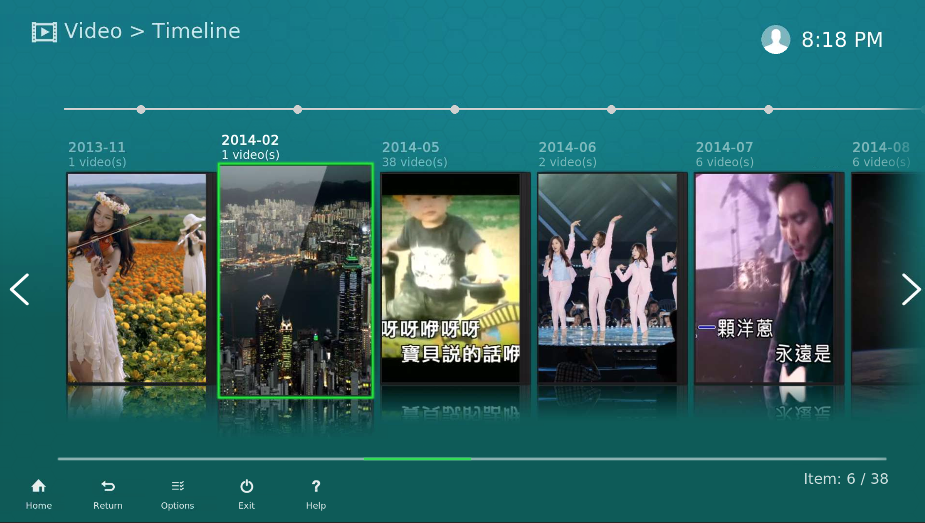
HD Player - Video
Playback the video which stored at your NAS on TV.

Slide 36
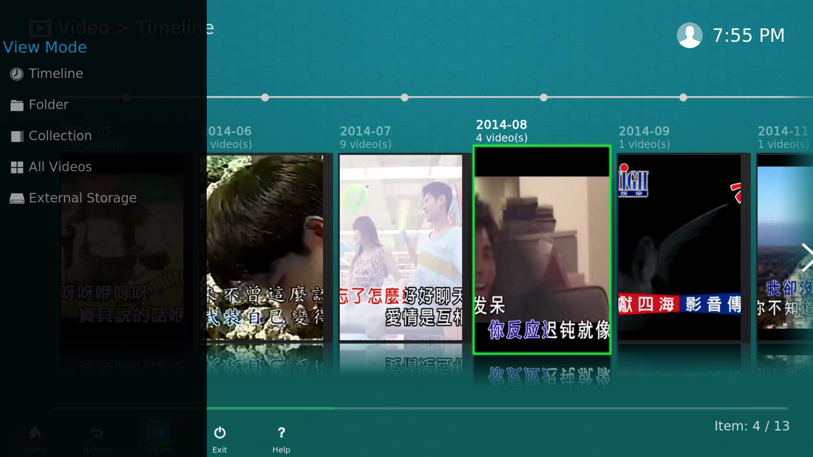
HD Player – Video view mode
HD Player –
Video view mode：
Timeline
Folder
Collection
All Videos
External Storage
Notes:
Demo

Slide 37
Audio Passthrough
Connect with your home theater system
Video
AV Receiver
HDMI
HDMI
Audio
Speaker

Slide 38
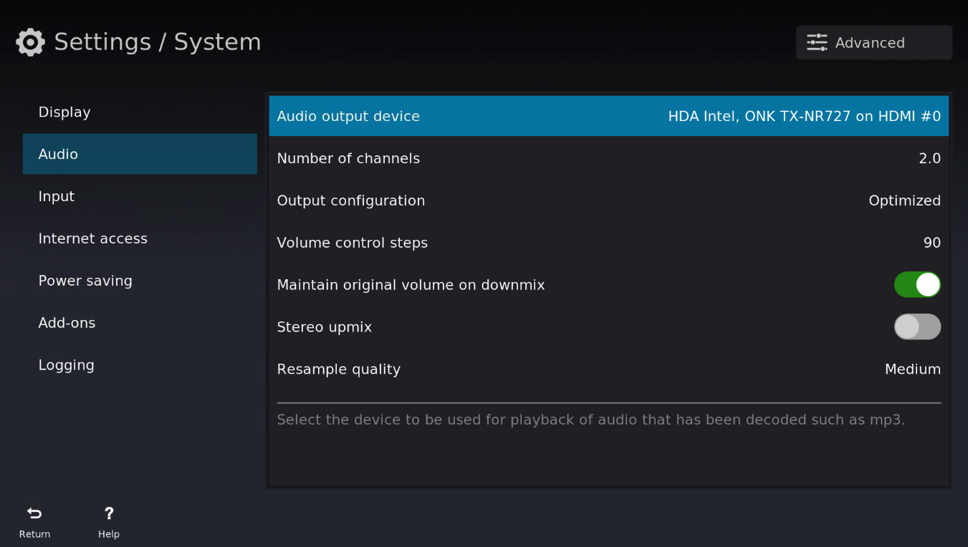
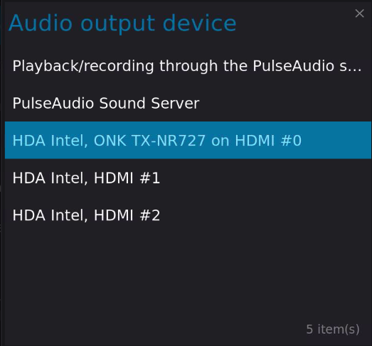
HD Player - Audio Passthrough setup 1
HD Player “Settings” -> “System“ -> “Audio”
1. Select the audio output device

Slide 39
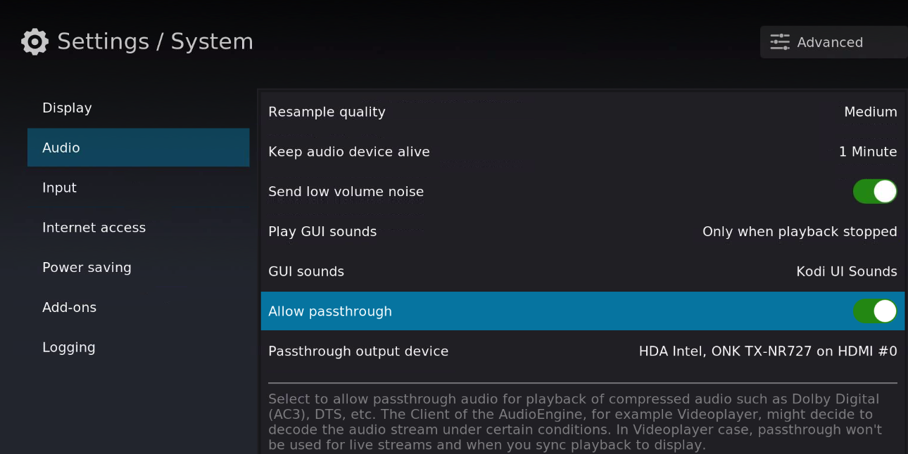
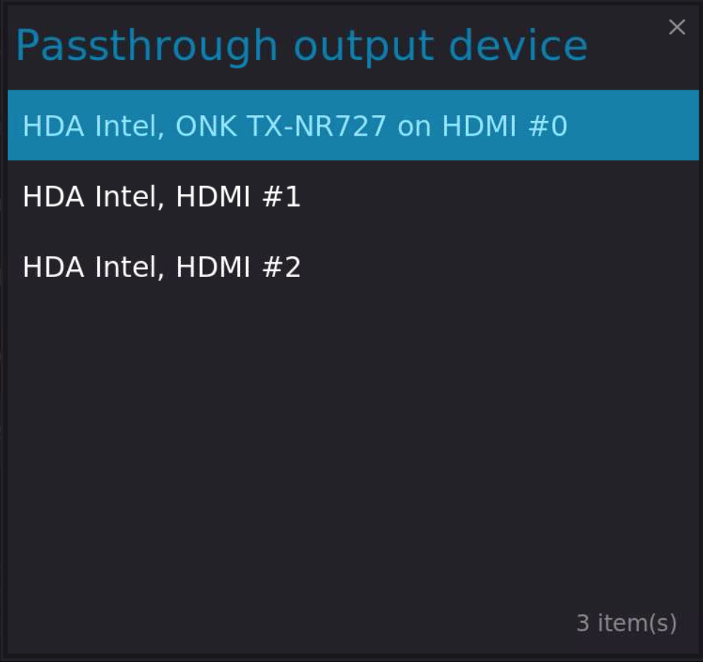
HD Player - Audio Passthrough setup 2/3
HD Player “Settings” -> “System“ -> “Audio”
2. Enable “Allow passthrough”
3. Set the passthrough output device
Notes:
Demo audio passthrough

Slide 40
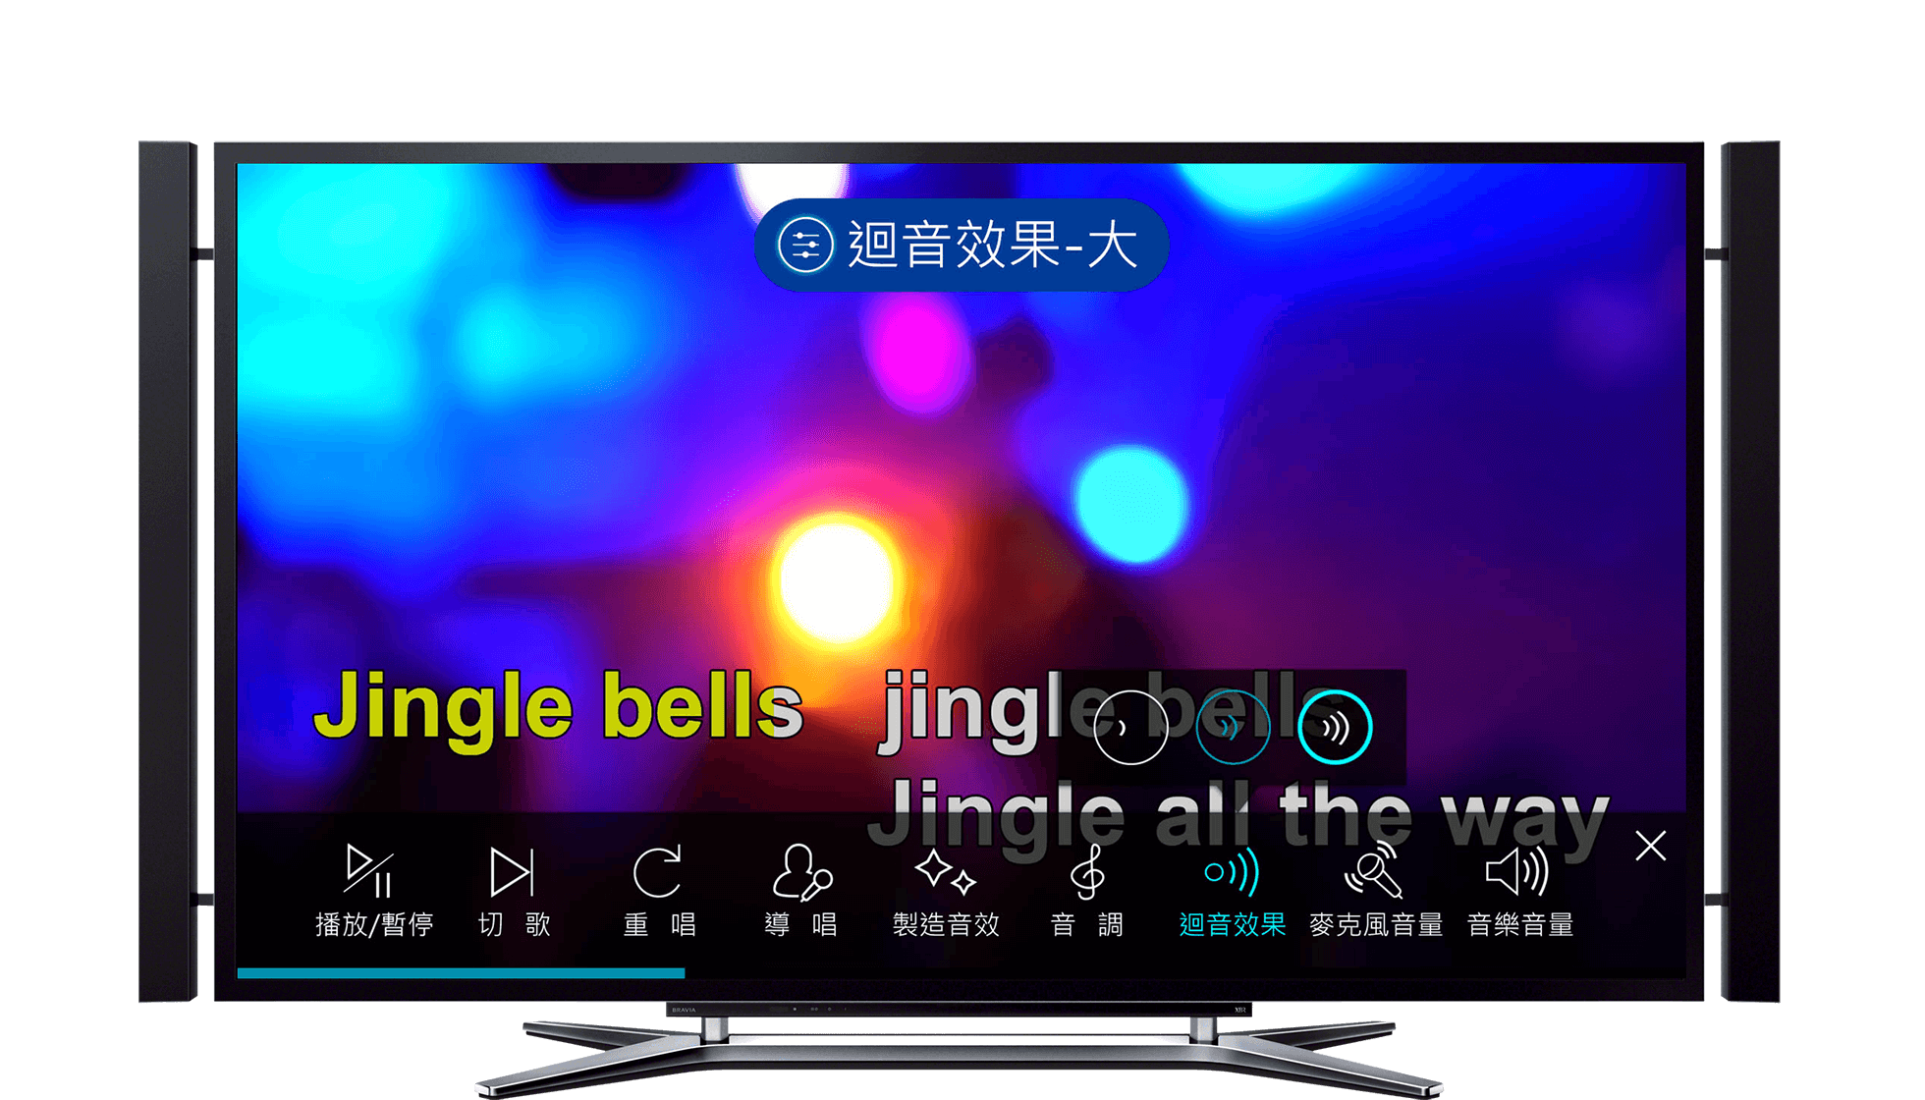
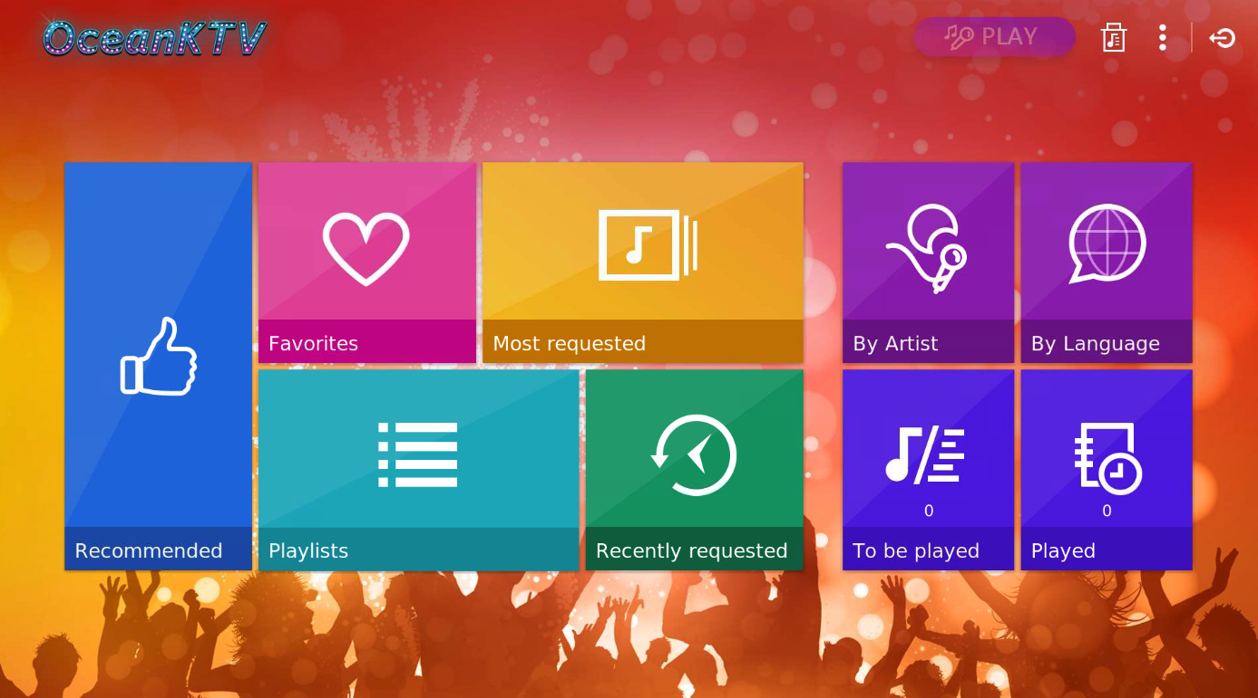
OceanKTV
Your exclusive karaoke system.

Slide 41
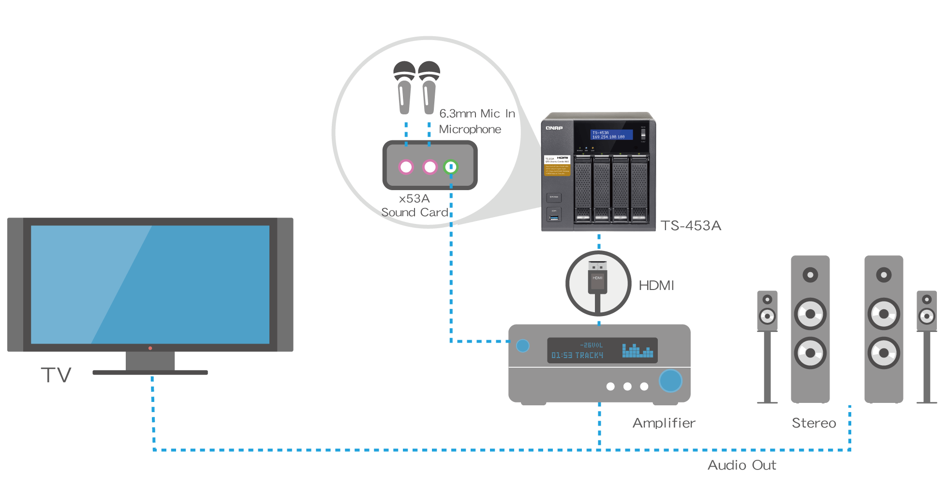
HDMI-out to TV, enjoy the best AV experience
Combine with your home theater system

Slide 42
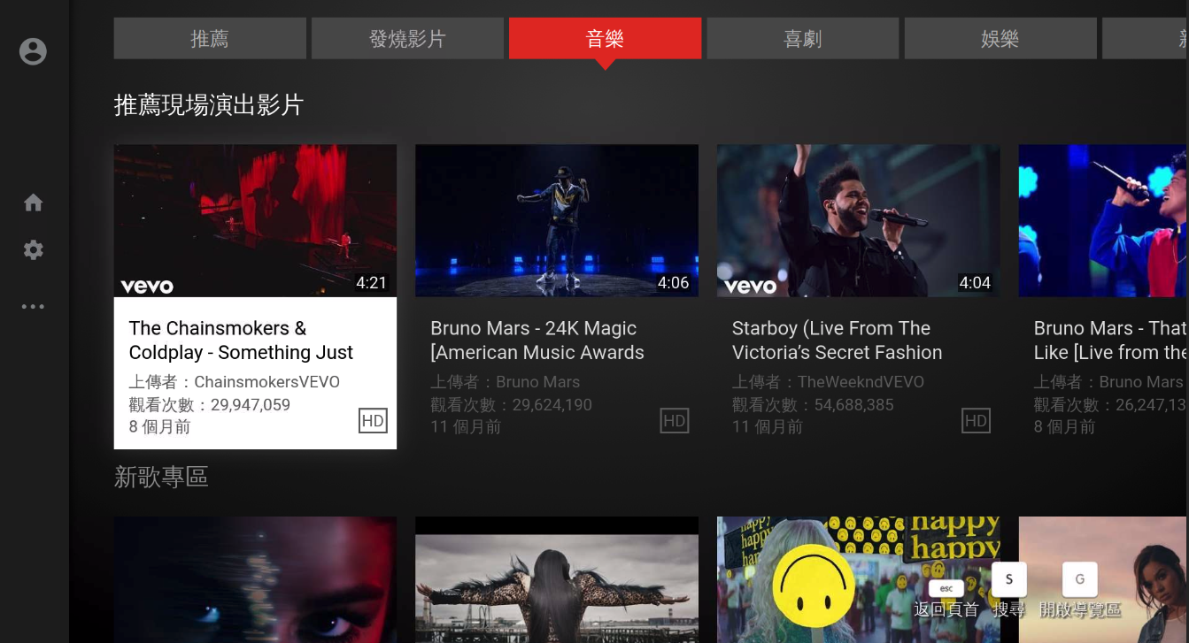
YouTube
Easily browse through and enjoy millions of videos on YouTube.
Notes:
Demo

Slide 43


YouTube – pairing
Control with the YouTube app on your mobile phone
Launch YouTube at HD Station, go to the setting and choose “LINK TV AND PHONE”. Than choose the “Link with TV Code”.
Launch YouTube on your mobile phone, then go to the settings of YouTube. Choose “Watch on TV” and enter the TV Code.
Notes:
Demo pairing

Slide 44


Plex Home Theater
Use the Plex Home Theater app to browse contents from Plex Media Server
Plex Media Server
Plex Home Theater

Slide 45
DEMO

Slide 46




Tips
If you need to restart HD Station...
Press and hold for 6s
Power button
One Touch Copy button

Slide 47


Remote desktop
With enhancement in QTS 4.3.4 and HD Station 3.2.0, you can access HD Station remotely without HDMI ports.
* Remote desktop is limited to video only; audio is not supported.

Slide 48


Dual screen
Set dual screen for multi-tasking
Monitor A
QVR Pro Client
Monitor B QTS
* Some applications are only display on main screen.

Slide 49
HD Station
HybridDesk Station

Slide 50
Thanks

