Slide 1
2017.12.04

Slide 2
About QNAP
Leading network-attached storage provider
Innovative software development and IoT integration applications
Complete portfolio from development and hardware design to manufacturing
Global market allocation – 20 offices in 14 Countries
Meets market expectations by supplying a complete portfolio of computer-based applications to apply in different fields including IoT, private/hybrid/public cloud and more.

Slide 3
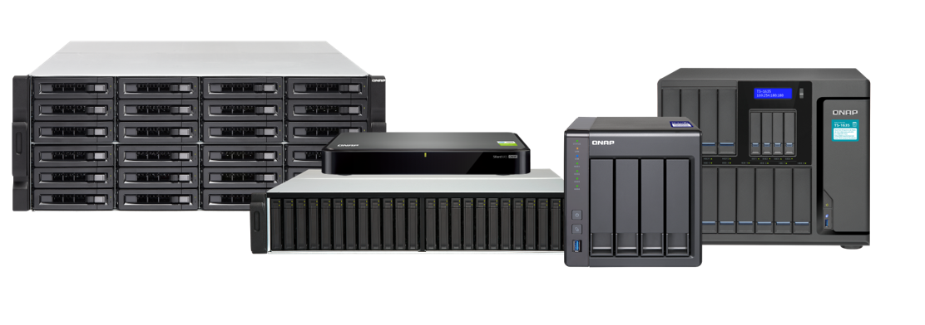
QNAP Sets The Trends
Leader in NAS servers

Slide 4
10GbE-ready NAS Expecting 10GbE as a standard
10GbE SFP+ Port
TS-431X
QNAP offers powerful, affordable high-speed 10GbE-ready NAS suited for all organizations - from huge enterprises to small offices - that require high bandwidth to tackle IT inefficiencies.
Notes:
Original:
Expecting 10GbE as a standard

Slide 5
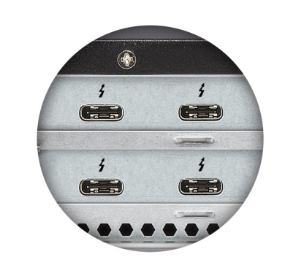
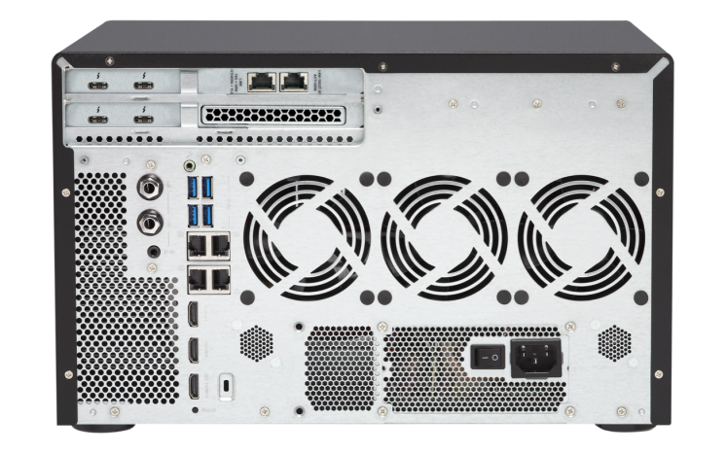
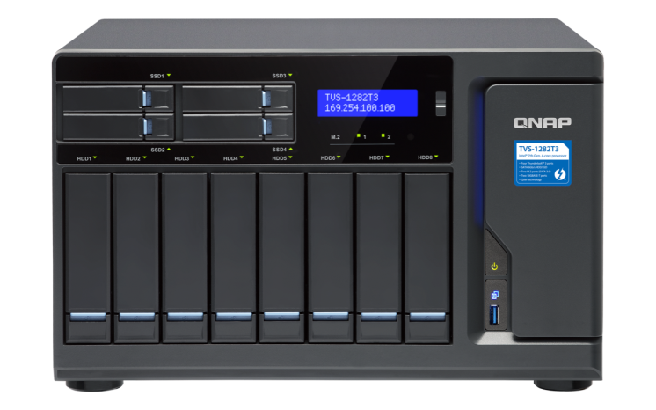
Thunderbolt™ NAS Boost creative media collaboration
Thunderbolt 3 Port
TVS-1282T3
QNAP Thunderbolt NAS solutions features ultra-high transfer speeds with expandable data storage, boosting productivity with 4K workflows and collaborative video editing for Thunderbolt-equipped Mac & Windows users.

Slide 6
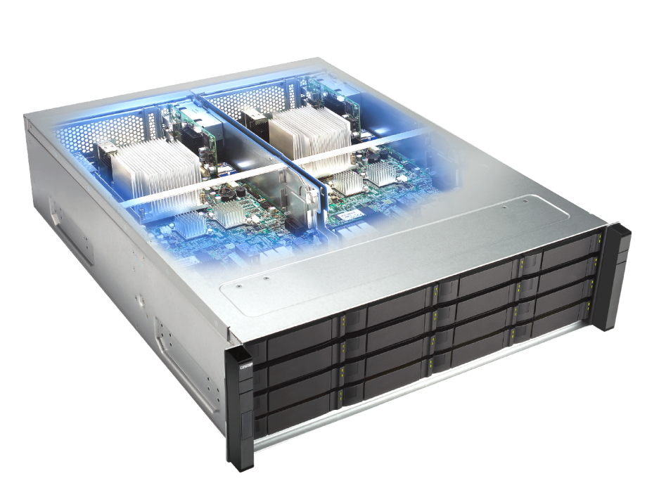
High Availability Dual-controllers for near-zero downtime
ZFS
Dual-controllers
ES1640dc v2
Designed for mission-critical IT tasks, the Enterprise ZFS NAS excels in providing High Availability solutions for file servers, virtualization servers, virtual desktops, online video streaming, snapshots and remote recovery.

Slide 7
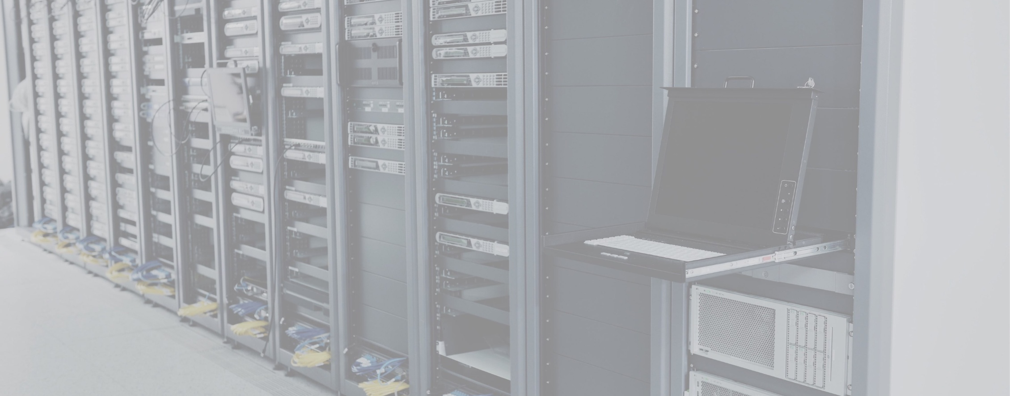
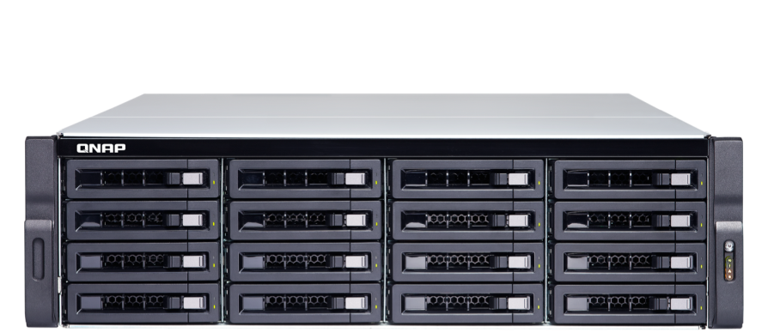
Virtualization Storage for virtualized environments, VMs and containers
TDS-16489U
QNAP NAS provides high-performance, reliable and affordable storage solutions for VMware® vSphere™, Microsoft® Hyper-V®, and Citrix® XenServer™. It is also a server to host virtual machines (with Virtualization Station) and containerized apps (with Container Station) for greater usage potential.

Slide 8
Qtier™ Optimization Enabling 24/7 optimized storage efficiency
Before
After
TES-3085U
Qtier Technology empowers QNAP NAS with Auto Tiering that helps continuously optimize storage efficiency across SSD, SAS, and SATA drives for around-the-clock acceleration.

Slide 9
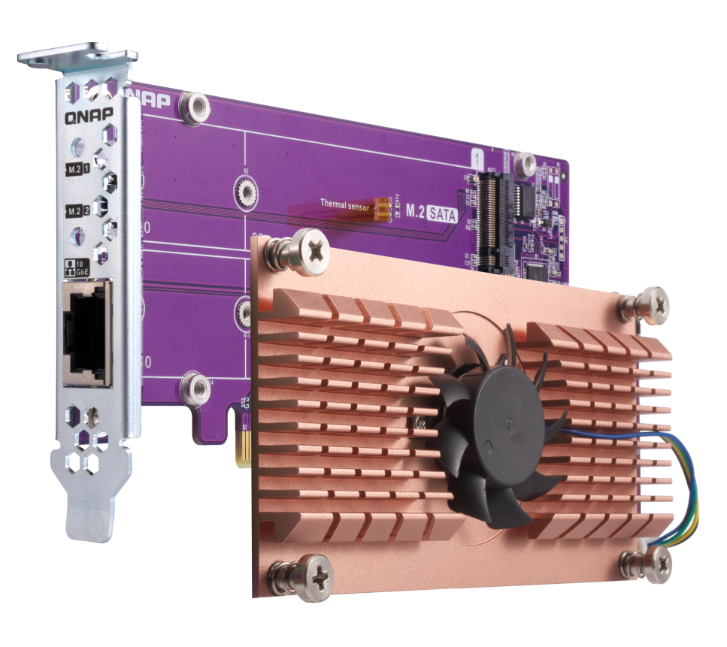
QM2 expansion card to QNAP
The QM2 series PCIe cards add support for M.2 SSDs and 10GbE RJ45 connectivity (optional) to a QNAP NAS. Combining SSD and 10GbE connectivity into one solution, the QM2 helps improve overall NAS performance while providing an affordable upgrade path for adopting 10GbE networks.

Slide 10
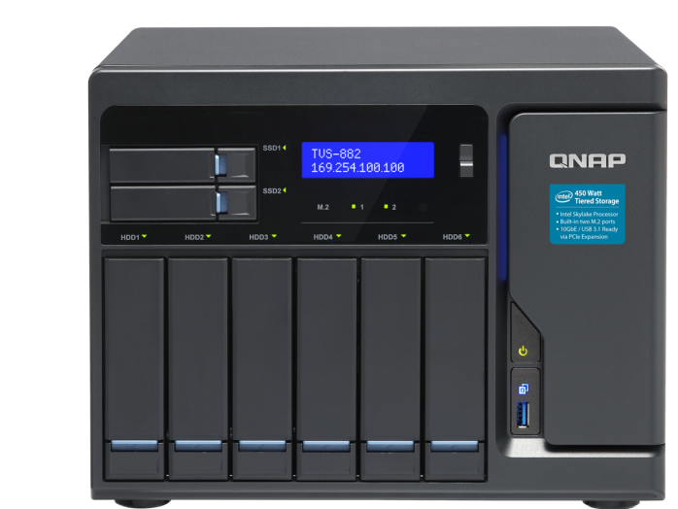
4K live-stream broadcasts Embracing live-streaming trends
TVS-882
DJ2 Live is an exclusive live broadcasting platform based on a private cloud that supports up to 4K video live-stream broadcasts and stores all the videos on the private, secure, high-capacity QNAP NAS.

Slide 11
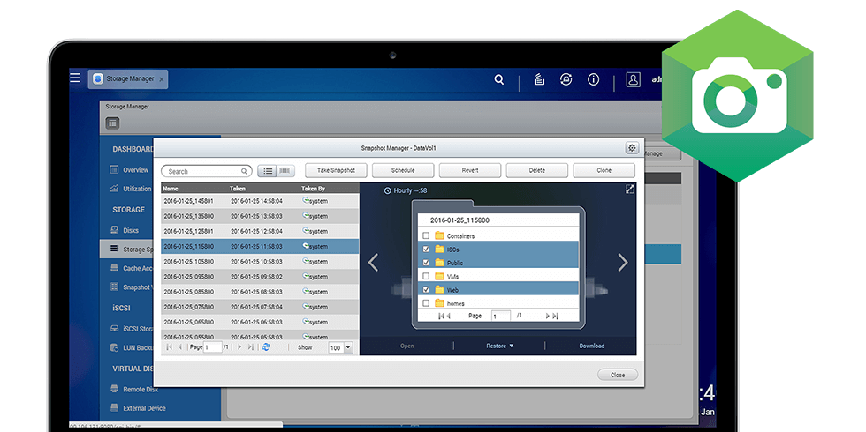
Snapshots data versioning and backup
Snapshots
Snapshots allow the server to record the State of the system atany time.
In the event of unexpected events in your system, you canrestore it to a previous state registered in the snapshot.

Slide 12
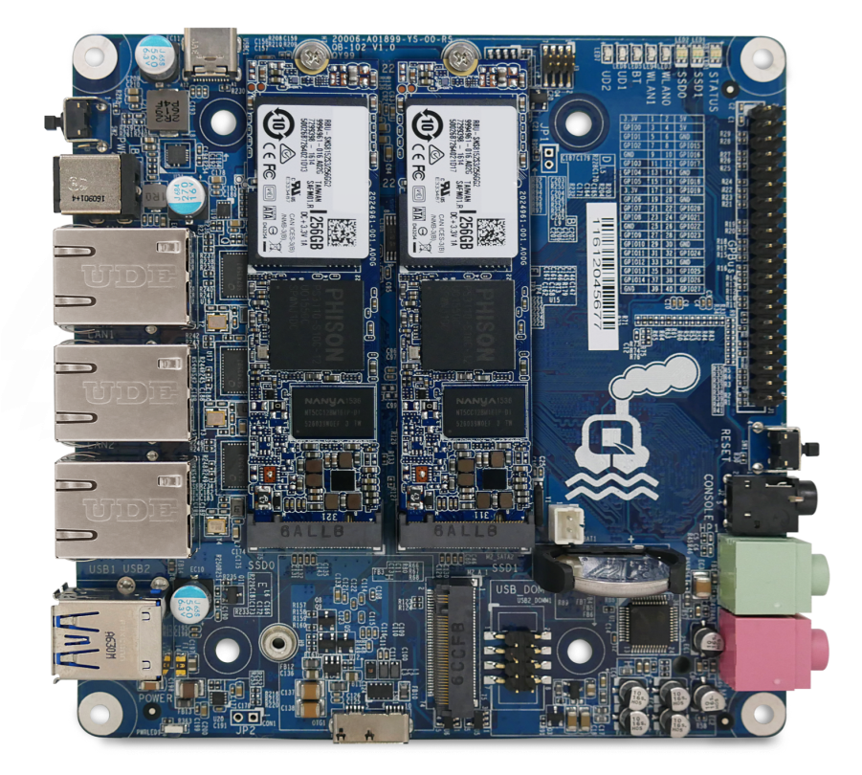
Internet of Things Private IoT cloud platform & IoT server
QBoat
QIoT Suite provides easily-adoptable practical modules for developers, accelerating IoT development and services. QBoat (QTS IoT Server) helps connect and manage IoT devices and applications to provide a handy solution for the great potential industrial demands of IoT.

Slide 13
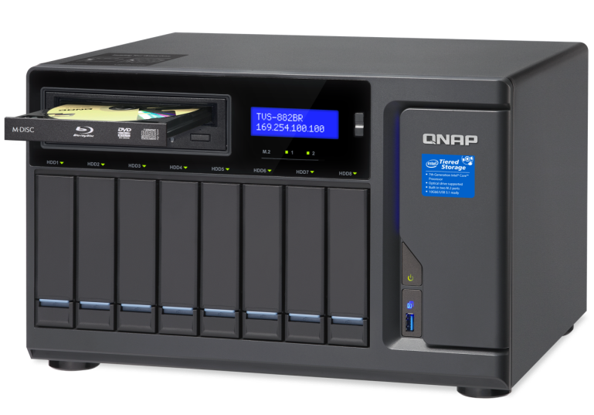
Blu-ray NAS NAS with optical disc drive compatibility
TVS-882BR
TVS-882BR features a 5.25" drive bay for installing optical disc drives, providing an extra method for transferring content from discs to the NAS or backing up NAS data to discs for multi-year data retention.

Slide 14
New Models

Slide 15
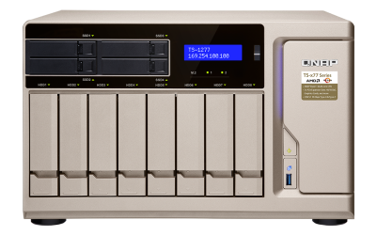
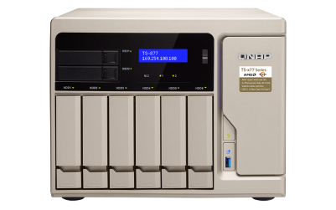
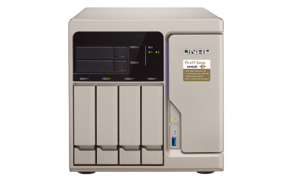
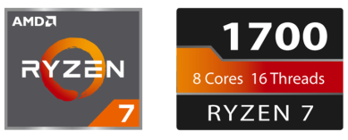
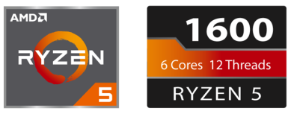
TS-x77 powered by AMD Ryzen
TS-1277-1600-8G
TS-877-1600-8G
TS-677-1600-8G
TS-1277-1700-64G
TS-877-1700-16G
TS-1277-1700-16G

Slide 16
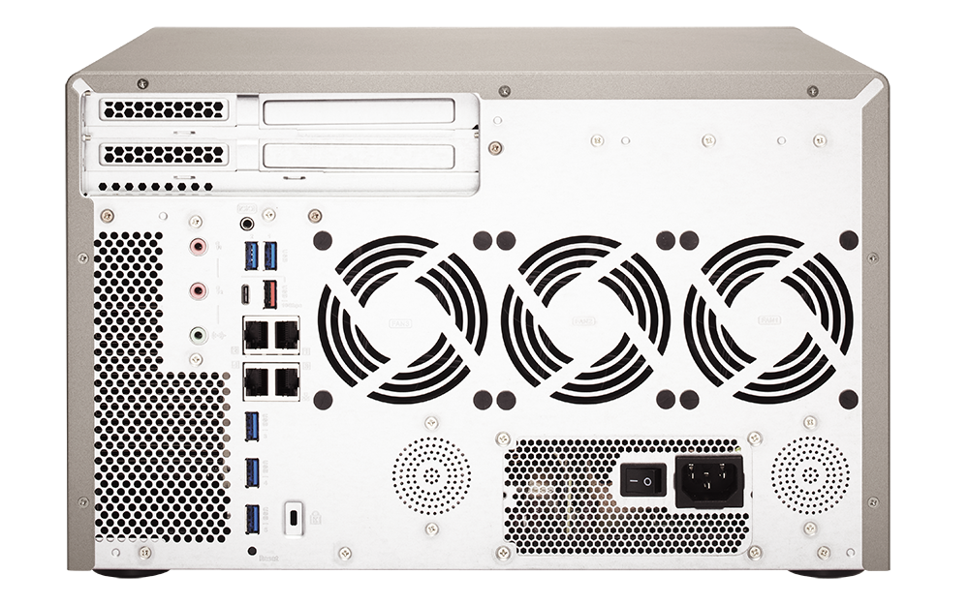
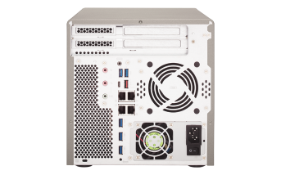
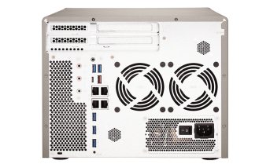
TS-x77 Rear overview
1 x USB 3.1 Gen 2
10G Type-A
1 x PCIe 3.0 x16
1 x USB 3.1 Gen 2
10G Type-C
1 x PCIe 3.0 x4
1 x PCIe 2.0 x4
2 x Dynamic Mic In
1 x Line out
2 x speakers
4 x GbE LAN
5 x USB 3.1 5G Gen 1 Type-A

Slide 17
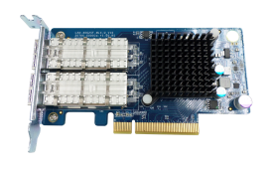
TS-x77 Optional 40GbE NIC for the speed of light
40GbE
(64KB, encrypted seq. transfer)
40GbE
(64KB, seq. transfer)
4500
4500
4114
4109
3000
3882
3000
3262
1500
1500
0
0
Read
Write
Read
Write
Tested in QNAP Labs. Figures may vary by environments.
Test environment: NAS: TS-1277-1700-32G with QTS 4.3.4
Volume type: RAID 0; 12 x Intel S3500 240GB SSDs (SSDSC2BB240G4)
Client PC: Intel® Core™ i7-4770 3.40GHz CPU; 16GB RAM; QNAP LAN-40G2SF-MLX 40GbE NIC ; Windows® 10 64-bit, IO Meter w/ 2 workers

Slide 18
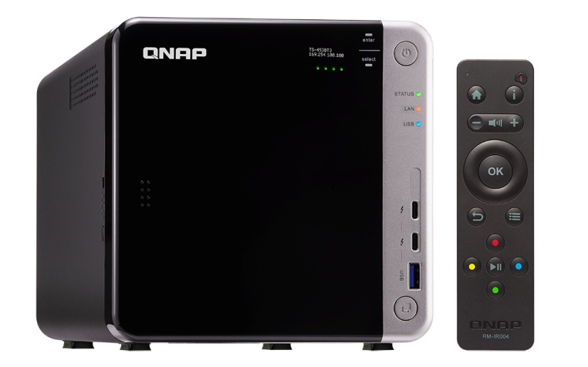
TS-453BT3-8G A 4-bay NAS server with Thunderbolt 3
J3455
Apollo Lake SoC
4-core 1.5 GHz
Max 2.3 GHz
M.2 SSD
MacBook Pro w/ AJA System Test Tool
540
514
360
356
180
0
(MB/s)
Read
Write

Slide 19
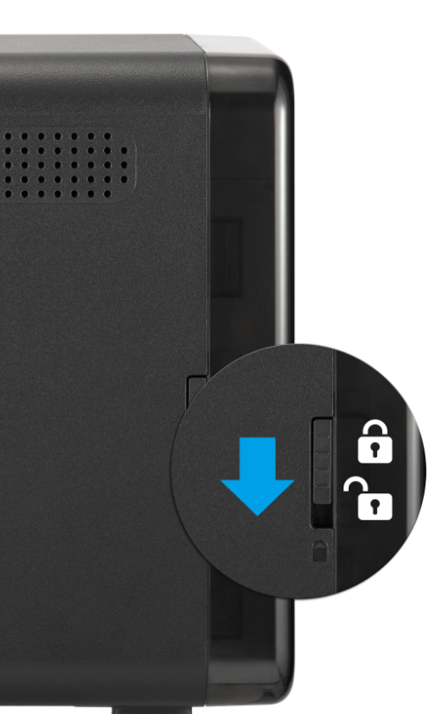
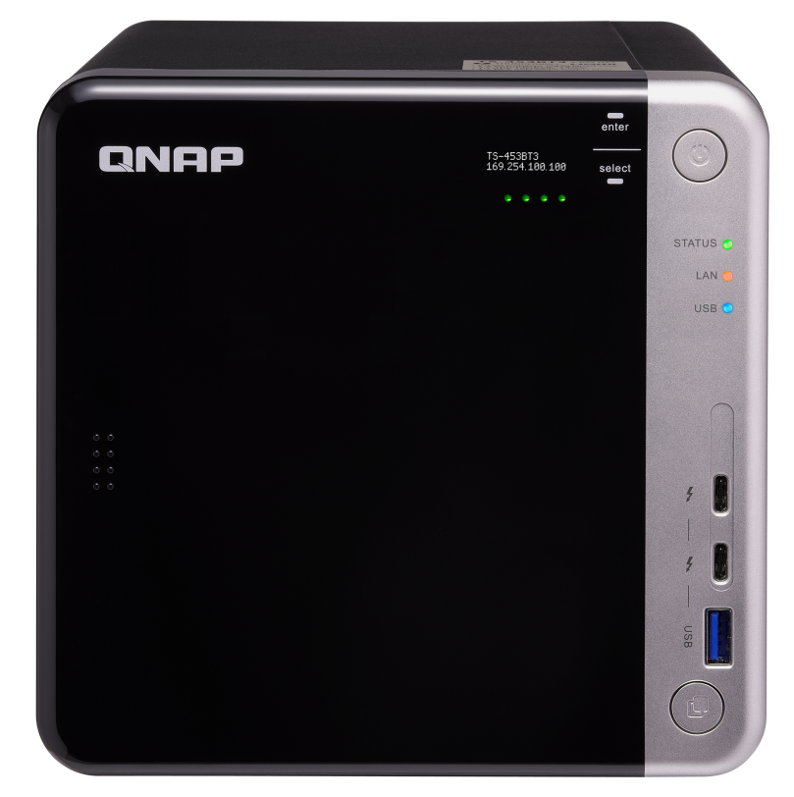
TS-453BT3 Front Side
4 x 3.5”/ 2.5”SATA 6Gb/s HDD/SSD slots
OLED status display & capacitive touch buttons
Power button
LEDs w/ adjustable brightness:
Drive、Status、LAN、USB
2 x Thunderbolt 3 ports
USB 3.1 Gen 1 & copy button
Lockable cover

Slide 20
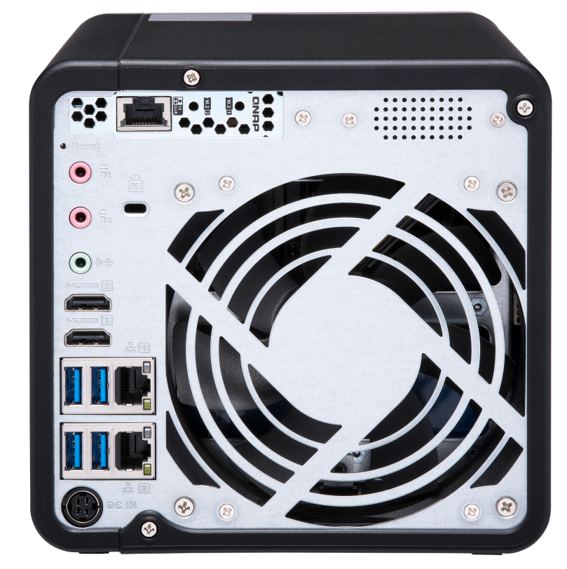
TS-453BT3 Rear Side
TS-453BT3 Rear Side
2 x M.2 2280 SATA SSD
Slots & 1 x 10GBASE-T
Port (PCIe 2.0 x 2 slot)
2 watt seaker +
T.I. amplifier
System status alert
Music playback
Kensington security slot
2 x 3.5mm dynamic Mic In
12 cm high reliability double ball bearing quiet fan
1 x 3.5mm line out
2 x 4K HDMI v1.4b output
4 x USB 3.1 Gen 1
2 x Gigabit LAN port
DC 12V power input

Slide 21
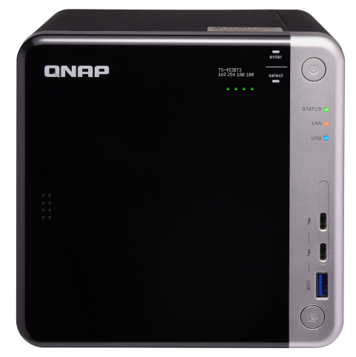
TS-453BT3 Cross-platform Collaboration
Thunderbolt
Ethernet
For Thunderbolt 2 Ｍac/PC
Thunderbolt 3 (USB-C) to Thunderbolt 2 Adapter (Apple)
Notes:
換圖TVS-1282T->453BT3
Ethernet換成其他顏色的線

Slide 22
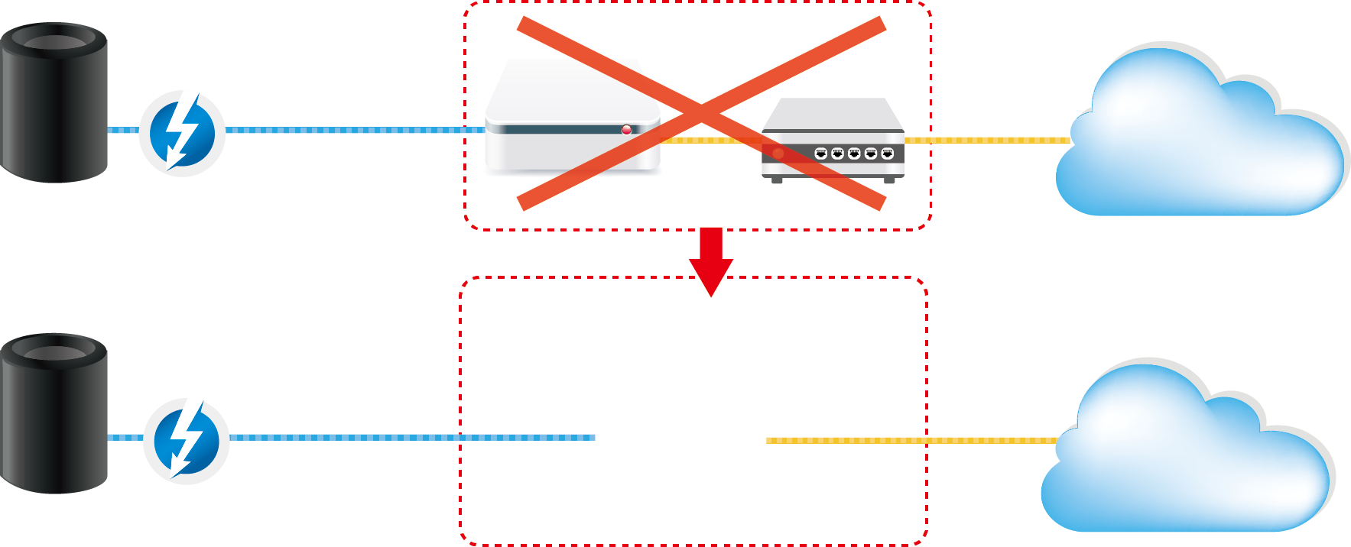
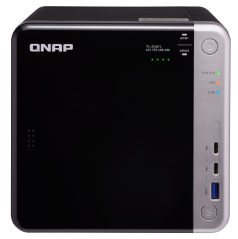
Thunderbolt to Ethernet (T2E) Technology
TS-453BT3 Thunderbolt to Ethernet (T2E) Technology
Thunderbolt to
10GbE converter
10Gigabit
switch
Thunderbolt
network
10Gb
network
Ethernet
Mac Pro
Thunderbolt
network
10Gb
network
Ethernet
Mac Pro
TS-453BT3

Slide 23
Photographer's Best Partner
TS-453BT3 Photographer's Best Partner
"Using the QNAP TVS-1282T3 and its Thunderbolt™ 3 interface, I'm much more efficient in my workflow. Compared to my previous NAS, that was connected to my network with 10 Gigabit, I now benefit from an 800% to 1000% faster data transfer rate.”
………………………………….
Falco Peters
"If you want to focus on getting the creative job done, QNAP devices are great partners. QNAP gives us a complete solution for all network storage and sync needs, in one easily-manageable ecosystem." ………………………………….
Martin Edström
"We have been able to condense a rather eclectic collection of different hard drives and storage systems into one single unit. This makes data-wrangling a whole lot easier." ………………………………….
Nick Rains
Notes:
12 cameras
4 or 5 editors

Slide 24
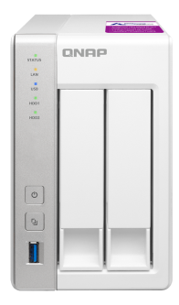
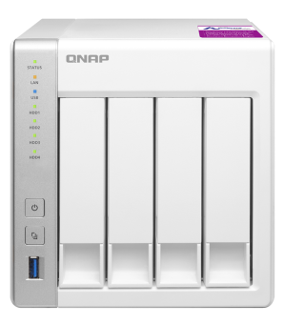
TS-x31P2 Memory Upgradable to 8GB DDR3 SODIMM
Annapurna Labs Alpine AL-314
200
221
220
TS-231P2-1G
1GB RAM
TS-431P2-1G
1GB RAM
195
100
160
QNAP
Accessory
0
(MB/s)
Download
Upload
Download
Upload
Normal volume
Encrypted volume
2GB、4GB
8GB memory
TS-431P2 (2 x GbE)
209 EUR
279 EUR

Slide 25
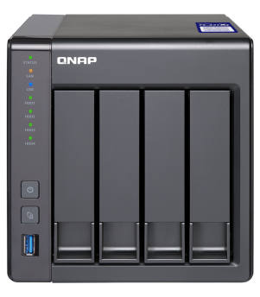
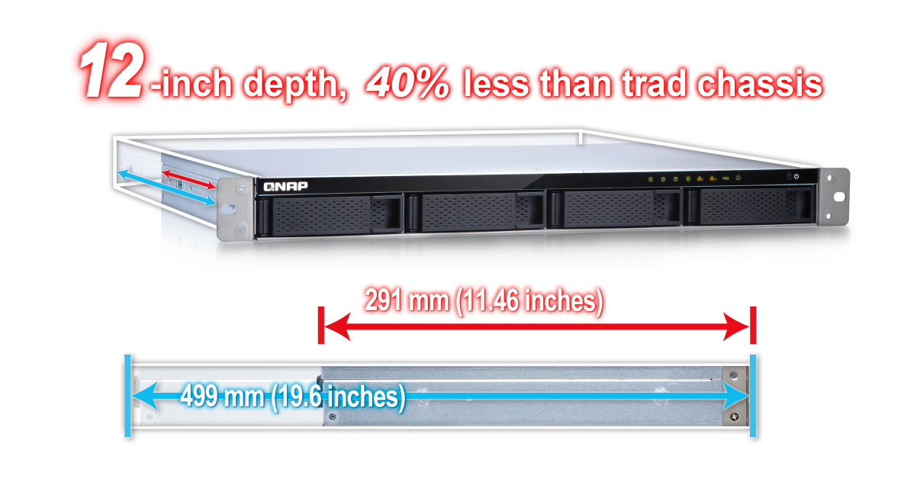
TS-x31X Memory upgrade to 8GB RAM
10GE
SFP+
TS-431X2-2G
2GB RAM
TS-431XeU-2G
2GB RAM

Slide 26
TS-x31X Efficiency
10GbE x1
10GbE x1
(Encrypted volume)
1200
1200
900
1055
1014
900
600
600
580
580
300
300
362
345
357
321
0
0
(MB/s)
(MB/s)
Download
Upload
Download
Upload
Download
Upload
Download
Upload
TS-431XeU
TS-431X2
TS-431XeU
TS-431X2
Tested in QNAP Labs. Figures may vary by environment Test environment: NAS operating system: QTS 4.3 (TS-431P2)
Volume type: RAID 5; 4 x Intel SSD S3500 240G
Client PCs: Intel® Core™ i7-6770 3.40GHz CPU; 32GB RAM; Mellanox 10GbE NIC ; Windows® 10 64-bit; 10GB file transfer by Robocopy

Slide 27
QTS 4.3.4

Slide 28
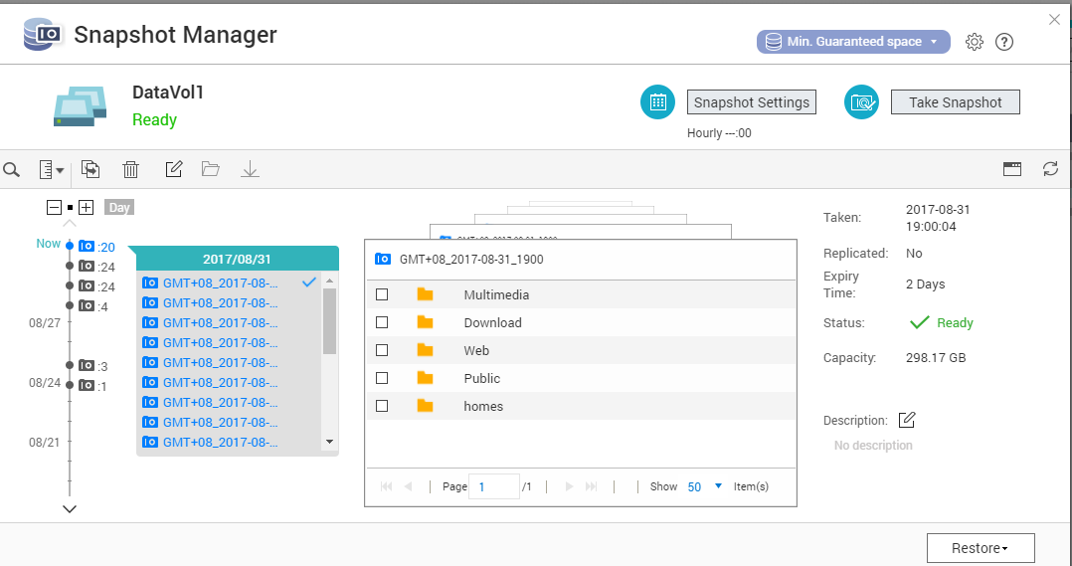
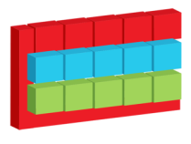
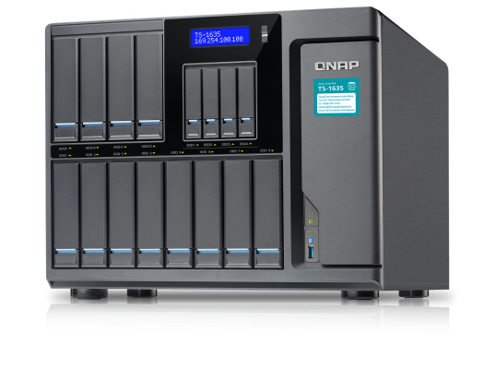
Snapshots for ARM-based NAS
Whole volume and block-based LUN snapshots
An efficient solution for mass data recovering
Volume Snapshot
Block-based iSCSI LUN
64 migawki per Wolumin/LUN, 256 migawek per NAS

Slide 29
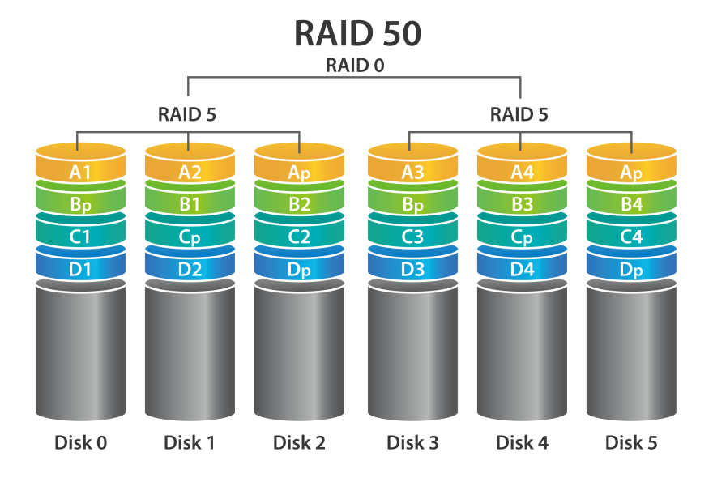
RAID 50 & 60 Reduce the Risk of RAID Failure
RAID 50/60
Less space used for redundancy + increased RAID protection
RAID type | Disks | Disk Failure Tolerance | Capacity | Chance of Failure
RAID 5 | 12 | 1 | 66TB | 6.15%
QNAP RAID 50 | 12 | 2 or more | 60TB | 0.6%
RAID 10 | 12 | 6 | 36TB | 0.2%
Actual disk failure tolerance depends on the number of RAID50/60 sub-arrays.

Slide 30
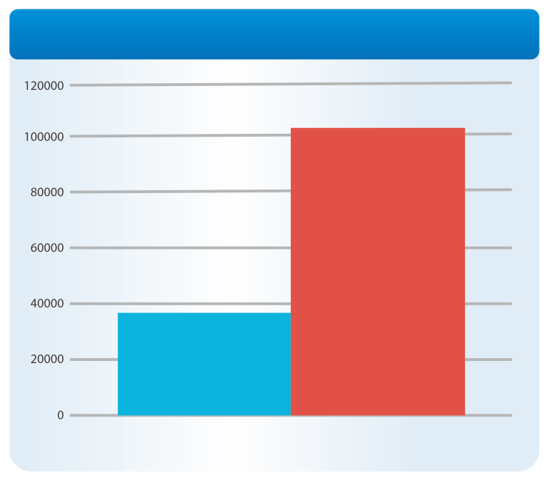
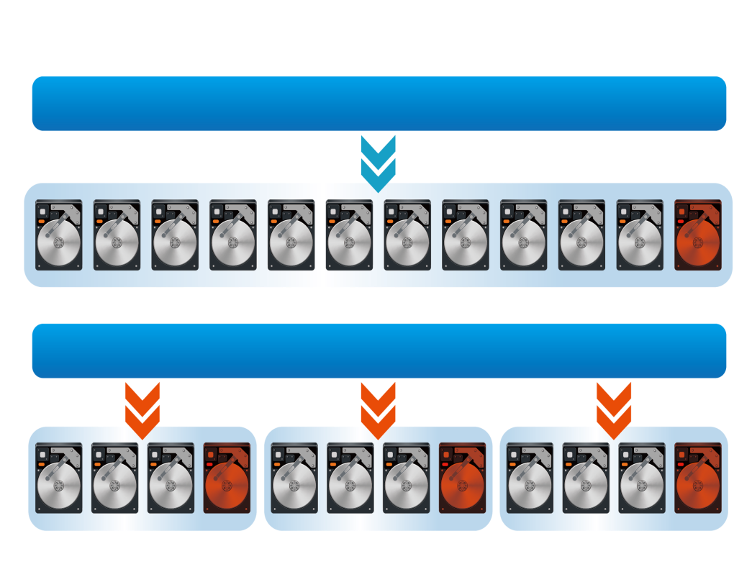
RAID 50 & 60 Increase "Random Write" Performance
RAID 50 vs. RAID 5
Multiple RAID groups calculating parity at the same time
Comparison between RAID 50
(3 sub-groups) and RAID 5 (SSD RAID)
Random Write IOPS
Increased to
RAID 5 Pool
300%
RAID 50
With 3
Subgourps
RAID 50 Pool
Single RAID 5
Random Write 4K Performance

Slide 31
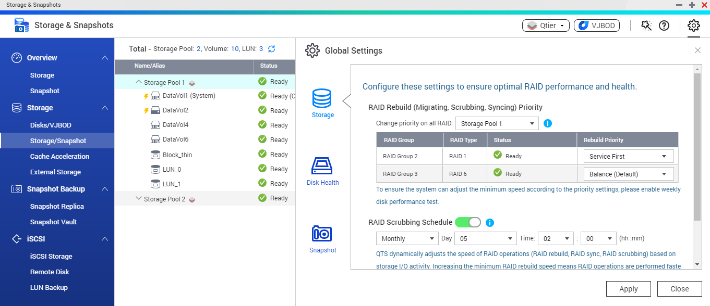
RAID – Priority
Priority:
- Service
- Balance
- Syncing

Slide 32
Advanced Secure Erase
Disks
Erase data from disks according to NIST standard
Support for SSD ATA commands
Automatically detect disk order in raid

Slide 33
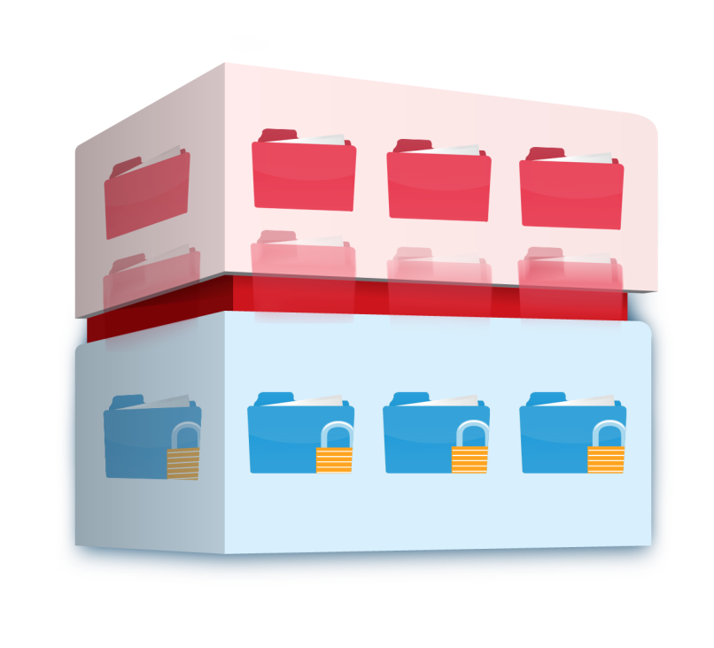
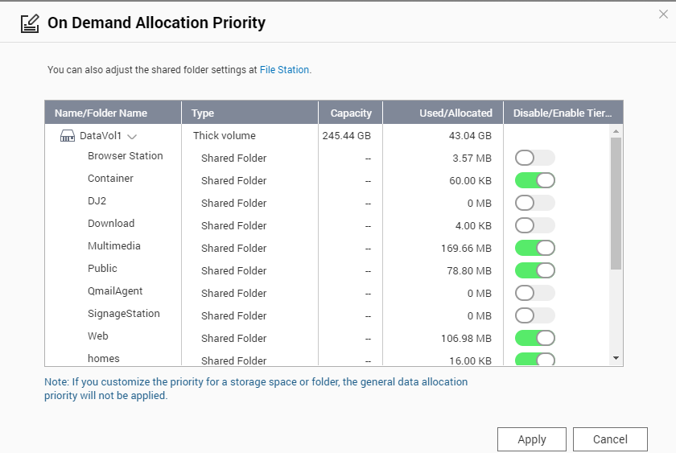
Qtier 2.0 Tiering On Demand
SSD only has limited capacity; needs to be used on key applications
Auto-tiering for individual shared folder or iSCSI LUN can be enabled or disabled
Hot data and reserved block
Cold and archived data

Slide 34
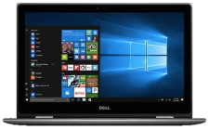
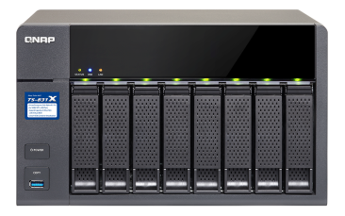
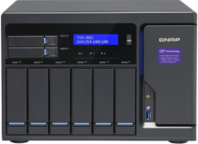
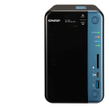
Replace JBOD with iSCSI VJBOD
Container Station
iSCSI LUN
2 x 10G SFP+
TS-831X
Virtual Pool 1
RAID
Ethernet, flexible connection
Virtual Pool 2

Slide 35
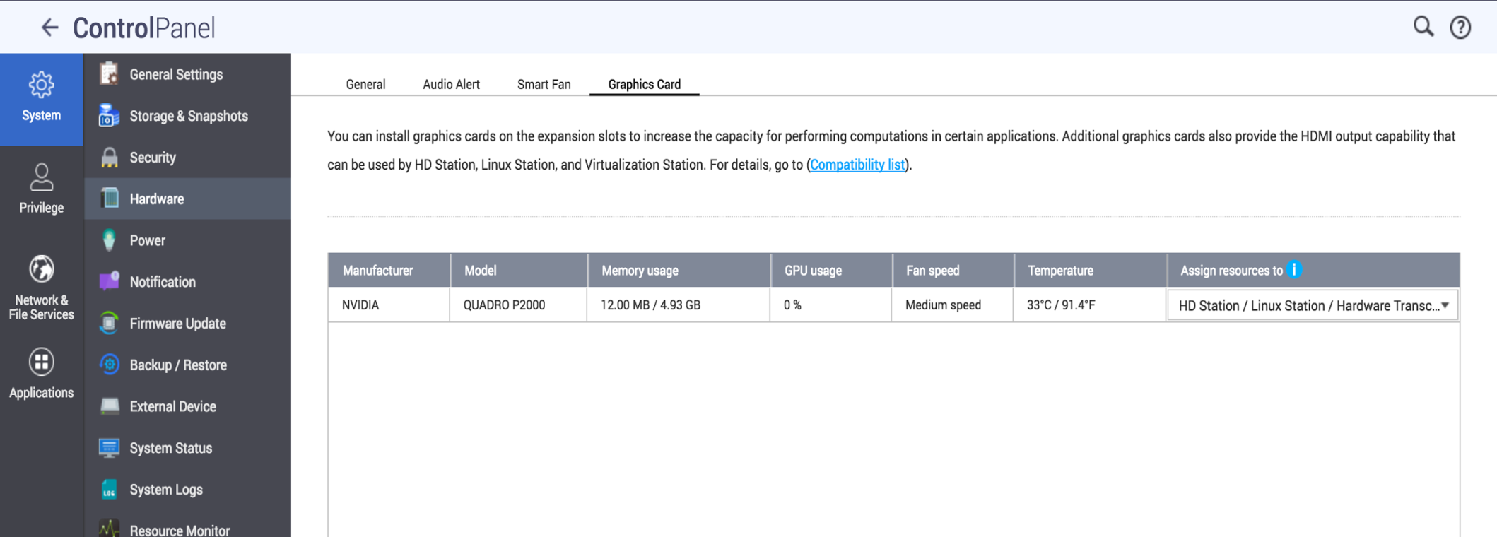
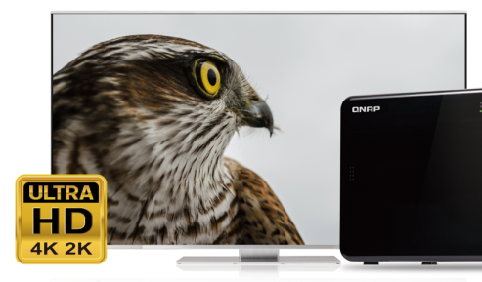
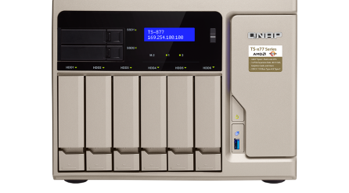
GPU

Slide 36
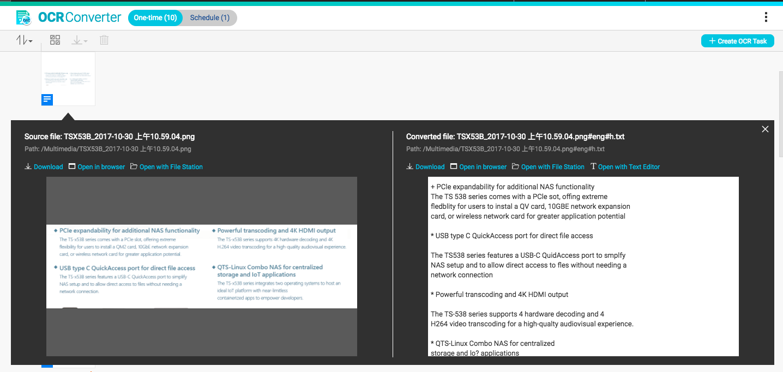
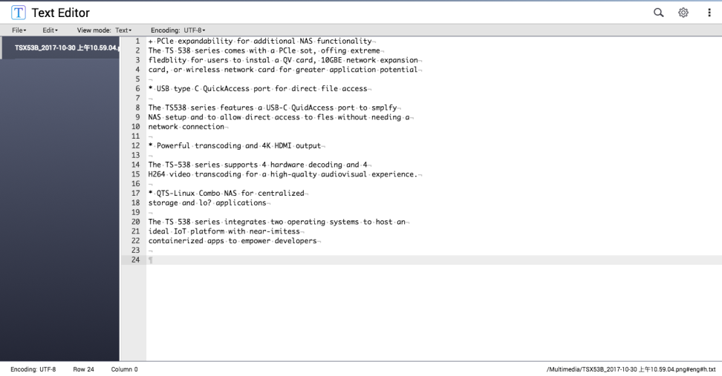
OCR : Best solution for document digitization
Convert images to editable files
Edit with Text Editor

Slide 37
Backup of mobile devices
Back up to QNAP NAS
using a direct USB connection.

Slide 38
Qboost – Enhances the performance of NAS
Clear
Cleans up junk files
Recycles storage space
Optimize
Releases memory
Increases operating speed
Application Scheduling
Allocates system resources efficiently

Slide 39
Qboost

Slide 40
QUSBCam2
QUSBCam2
Live streaming 1080P image
Surveillance Station 5.1
Record & Replay video by MPEG

Slide 41
QVR Pro and QIoT

Slide 42
Customizable QVR Pro Event Type
Through event URL, 3rd party can send events to QVR Pro via HTTP
QVR Pro and QIoT
Event URL
Notes:
URL以token方式認證

Slide 43
QVR Pro and QIoT
Action URL

Slide 44
QVR Pro, More than a Surveillance System

Slide 45
Allow and Deny
Privilege Setting
Group-
Security
Group-
Cashier
Role-
Employee
Role-
Manager
Result
Security
Cashier
Manager
Subcontractor
Storage Room | Entrance | Cash Desk | E-map
CH S. | CH E. | CH C. | E-map
Storage Room | Entrance | Cash Desk | E-map
CH S. | CH E. | CH C. | E-map
Storage Room | Entrance | Cash Desk | E-map
CH S. | CH E. | CH C. | E-map
Storage Room | Entrance | Cash Desk | E-map
CH S. | CH E. | CH C. | E-map

Slide 46
QVR Center
Centralized management
Easy to manage up to 128 QVR Pro
QVR Center is the central management QPKG of QVR Pro
It can be installed on the same NAS with QVR Pro or
on different NAS.
Easy to manage up to 128 QVR Pro (QVR Pro Gold)
Compatible with QVR Pro Client just like QVR Pro.

Slide 47
QVR Guard - Standby
QVR Guard - Standby
QVR Pro
Connected
Health Detection
Connected
IP Camera
QVR Pro Client
QVR Guard

Slide 48
QVR Guard - Failover
QVR Pro
Health Detection
Automatic Connection
Switch Connection
Manually
QVR Pro Client
IP Camera
QVR Guard

Slide 49
QVR Guard - Playback
QVR Pro
Connected
Connected
Health Detection
IP Camera
Check Recording
QVR Pro Client
QVR Guard

Slide 50
Customize actions of buttons
QButton
Play your favorite music playlist with a single button or set other buttons to play the previous or next song.
View pre-selected channels on Surveillance Station for quick surveillance monitoring.
Set a button to restart or power off your NAS for greater convenience.

Slide 51
QButton
01
Click the color button to open create rule page
Music Station
Next Song
Music Station
Play music
Drag and drop an app to
the left box
03
Przenieś aplikację do okienka
po lewej stronie
Music Station
Stop playing music
NAS
Restart NAS
02
Enable and disable rules

Slide 52
Easily drag and drop files in Cinema28
資料夾瀏覽功能，快速播放檔案到每個裝置
享受影音不中斷
Cinema28

Slide 53
360° Panorama Video

Slide 54
Qmedia

Slide 55
QNAP Security

Slide 56
Certyfikaty

Slide 57
Industrial Integrated IoT Solution Provider
Leading Network-Attached Storage Provider
Unique Electronic Manufacturing Service
Intelligent Medical System Provider
Leading Automation System Products Provider
Professional Chassis Manufacturer

Slide 58
AfoBot
Innovation in
software
development
Reliability of
hardware
AfoBot - Your Intelligent Companion Assistant

Slide 59
QBoat
Reliability of
hardware
Innovation in
software
development

Slide 60
Mustang 200
Innovation in
software
development
Reliability of
hardware

Slide 61
Thank you
Copyright ©2017 QNAP Systems, Inc. All Rights Reserved.

