Slide 2

QTS 4.3.4 New Features
Basics of Data Storage
Video Playback
with VLC
Hybrid Backup Sync
Performance and stability are keys!
A single portal for data backup and recovery!
More multimedia formats are supported by leveraging capabilities of VLC
Storage & Snapshots
File Station
Qboost
Evolved for data safety & snapshots for ARM-based NAS!
Highly integrated file management app for complete file operations
Optimize and boost the performance of ARM-based NAS

Slide 3

Basics of data storage
Performance and stability are the keys!

Slide 4
Why doesn't QNAP adopt Btrfs?
Foundations of storage: performance and stability
  High performance must be guaranteed
  Ext4 is a more mature filesystem for protecting customer data
Analysis: drawbacks of the Btrfs filesystem
  Btrfs's degraded performance: cannot utilize full potential of most major HDD
  Btrfs's management difficulties: storing snapshots inside a volume makes managing protection even harder
Notes:
快照與檔案系統獨立，達成全域共享，兼顧共享資料與 iSCSI LUN
快照與檔案系統獨立，空間分開管理

Slide 5

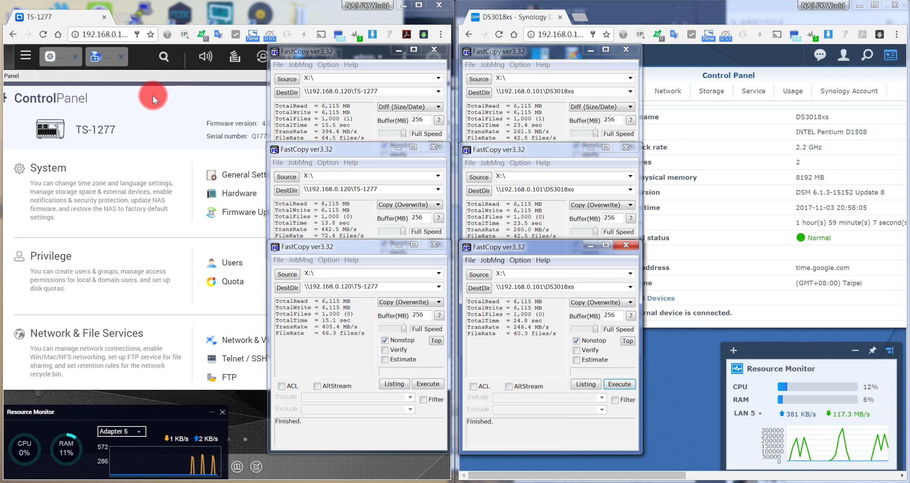
EXT4 v.s. Btrfs
Performance
Comparison
TS-1277 (8GB, EXT4) DS3018xs (8GB, Btrfs)
10GbE, Samba, 6 x HDD
Time for copying 3,000 files
TS-1277
DS3018xs
44.4sec
71.7sec
TS-1277 is 61.5% faster
Source:
NAS PK World in Youtube
https://youtu.be/IES4KEDGSc0

Slide 6
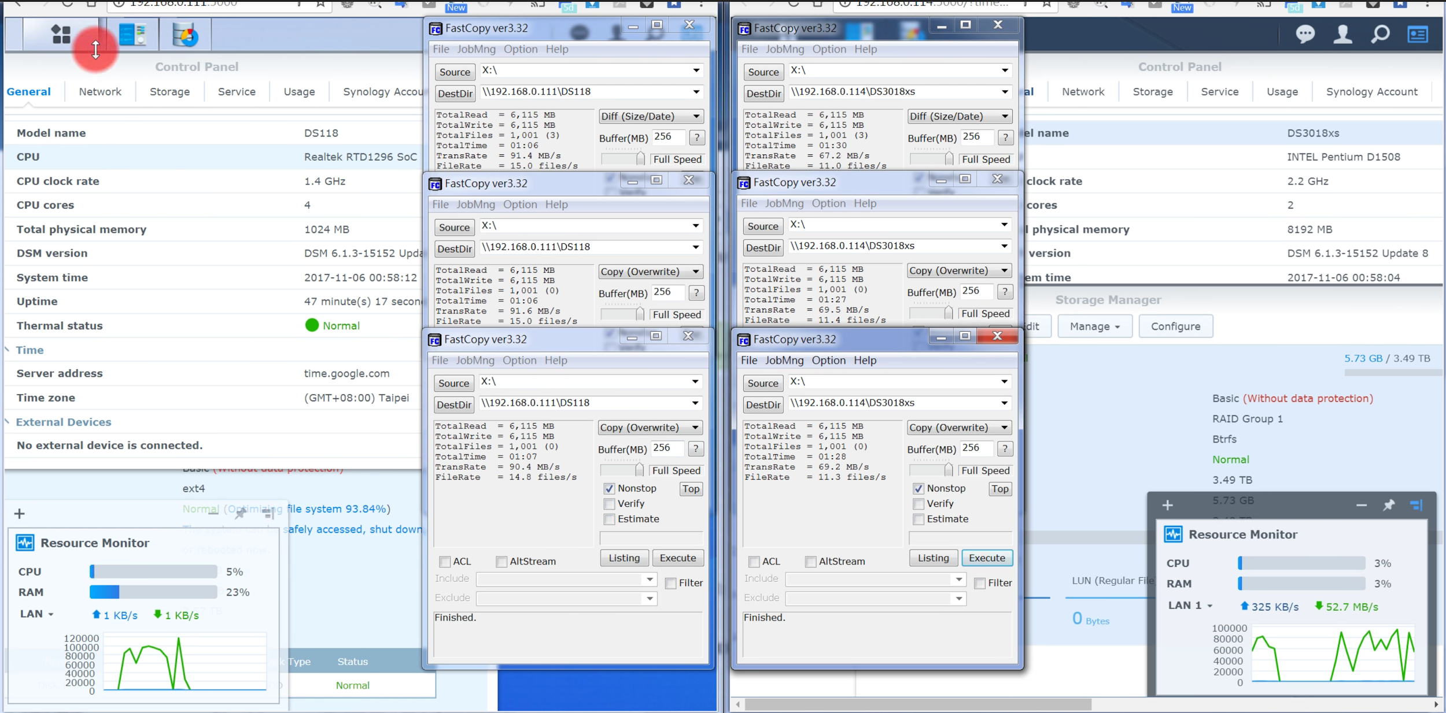
Ext4 v.s. Btrfs in Models
Performance
Comparison
DS118 (1GB, EXT4) DS3018xs (8GB, Btrfs)
Time for copying 3,000 files
DS118
DS3018xs
199sec
256sec
Ext4 is 33% faster
Source:
NAS PK World in Youtube
https://youtu.be/kHyDbu1Tm4g

Slide 7

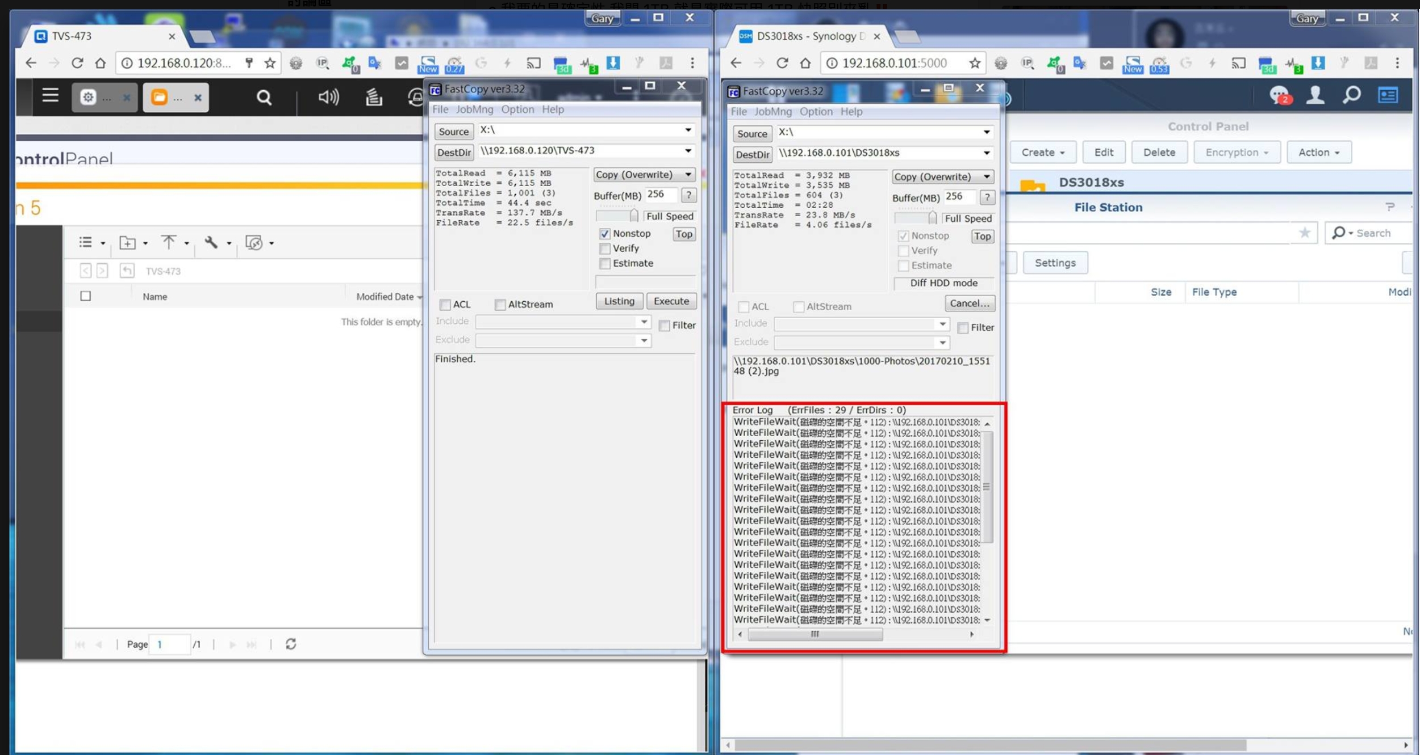


A Snapshot space that can be managed
QTS: In-house developed Ext4 snapshots stored outside the volume
DSM: Open-source Btrfs snapshots stored inside the volume
QTS snapshots:
Space usage will not be interfered
DSM snapshots:
Snapshot space usage cannot
be controlled
Snapshot affects data storage
Source:
https://www.facebook.com/groups/NAS.World/permalink/1784142828550586/
File Transfer
Completed
File Transfer
Failed

Slide 8
Storage & Snapshots
Evolved for Data Safety

Slide 9

Your challenges, our solutions:
How to protect data from the threat of Ransomware?

Slide 10
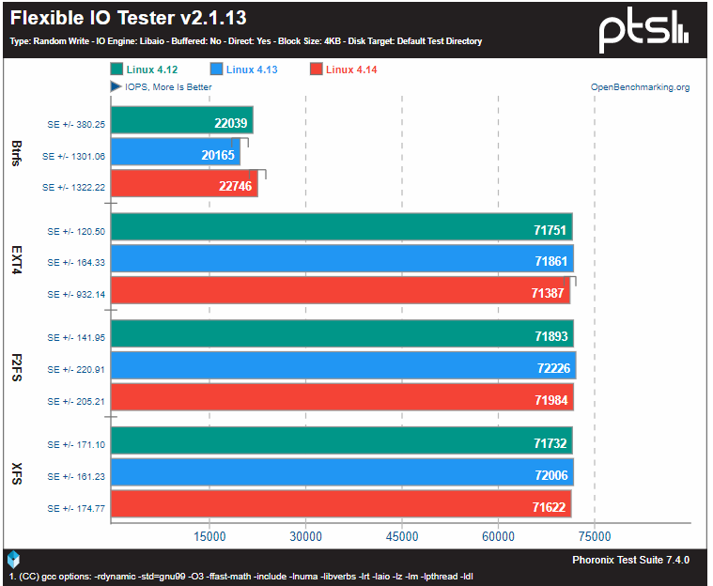
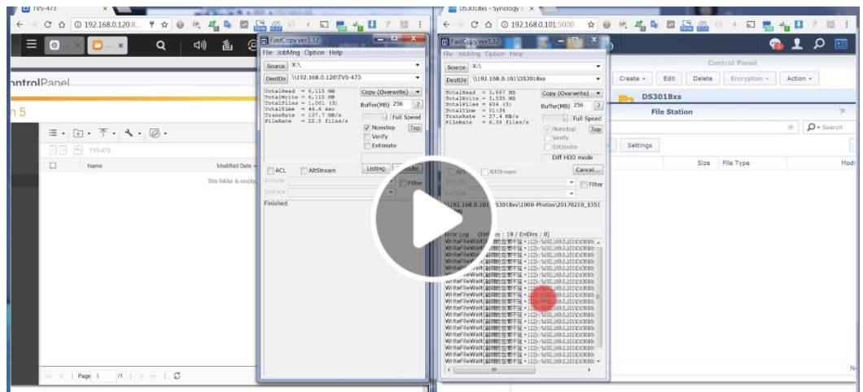
Why doesn't QNAP adopt customized Btrfs?
Linux Hardware Reviewer Phoronix 11/18 Latest Report
Btrfs performance is still largely behind other FS such as EXT4
Snapshot space usage cannot be control
https://www.facebook.com/gate.studios/videos/10214940914857902/
https://www.phoronix.com/scan.php?page=article&item=linux414-fs-compare&num=1
Notes:
https://www.phoronix.com/scan.php?page=article&item=linux-412-fs&num=2

Slide 11
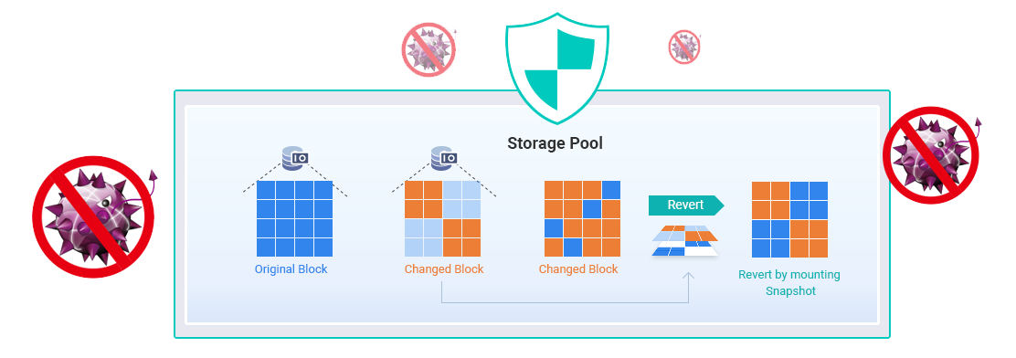
Why are Snapshots important?
When data is encrypted, data in backup destinations will also be affected
Data needs to be "backed up" while backups need backups as well
Block-based snapshots help protect data security from ransomware

Slide 12
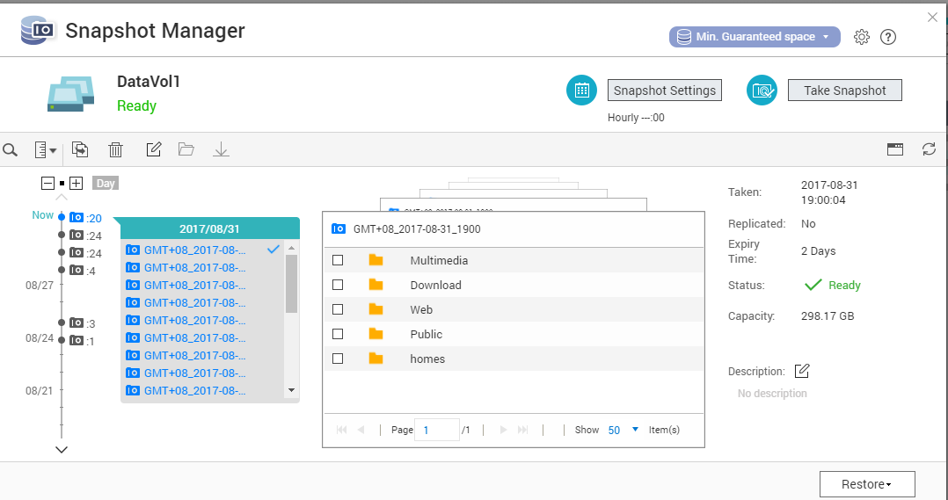

Completed Snapshot Solution
Whole Volume Snapshot with File-based LUN coverage
Block-based LUN Snapshot
An efficient solution for mass data recovering
  Volume &
  File-based LUN
  Block-based iSCSI LUN
Notes:
磁碟區快照圖會再換

Slide 13
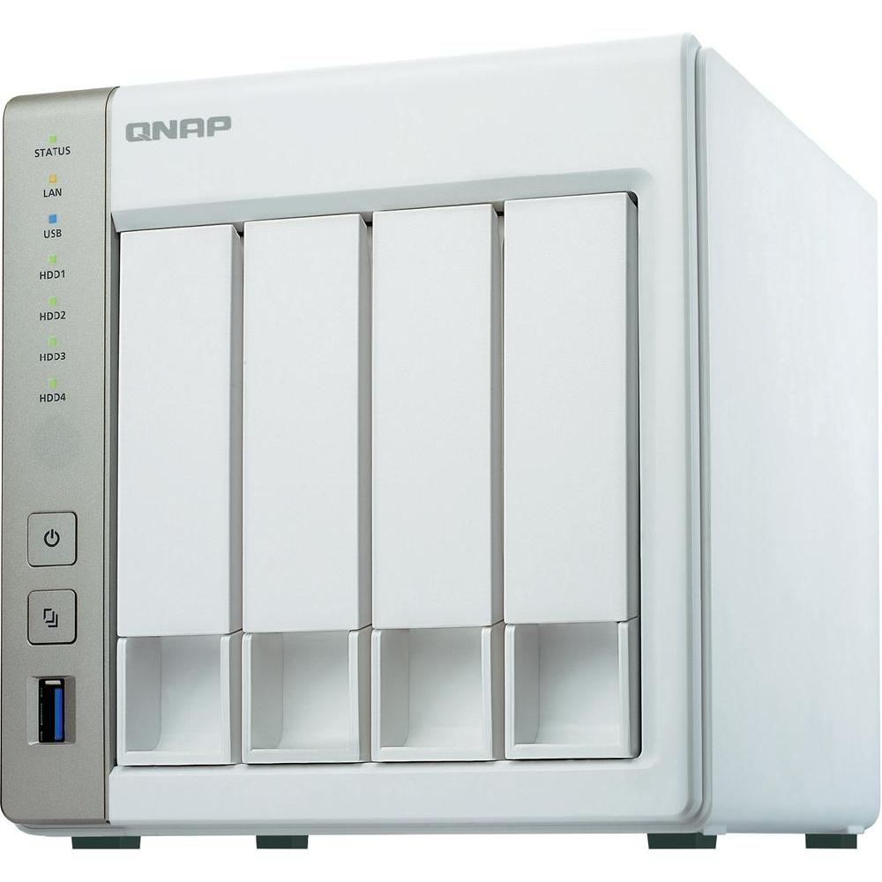
NAS with 1GB RAM Now Supports Snapshots
x86 NAS that only has 1GB RAM can now also utilize snapshot protection
Maximum numbers of snapshots vary by RAM sizes*:
Increased ROI
RAM Size | Max total Snapshot | Max per LUN/Volume
1G | 32 | 16
2G | 64 | 32
>=4G | 1024 | 256
*TS-x51 maximum snapshot number is 256

Slide 14
Snapshot Protection stored out of "Volume"
Snapshots are stored in the storage pool and separated from volumes or LUNs
Easier snapshots controlling while maintaining data storage service
Share snapshot storage space for maximum space utilization
Convert a thick volume to thin volume when required
Storage Pool (10TB)
Volume 3TB (Thick)
Free
Snapshot
Free
Volume 3TB (Thick)
Snapshot
Volume 1TB
(Thin)
Free
Snapshot
Free

Slide 15
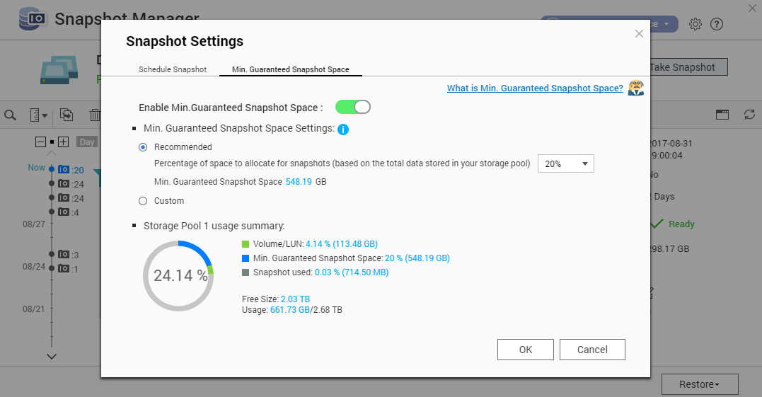
Enable Min. Guaranteed Snapshot Space
Create a dedicated space using unallocated space in storage pool to prevent ransomware disrupting snapshot protection

Slide 16
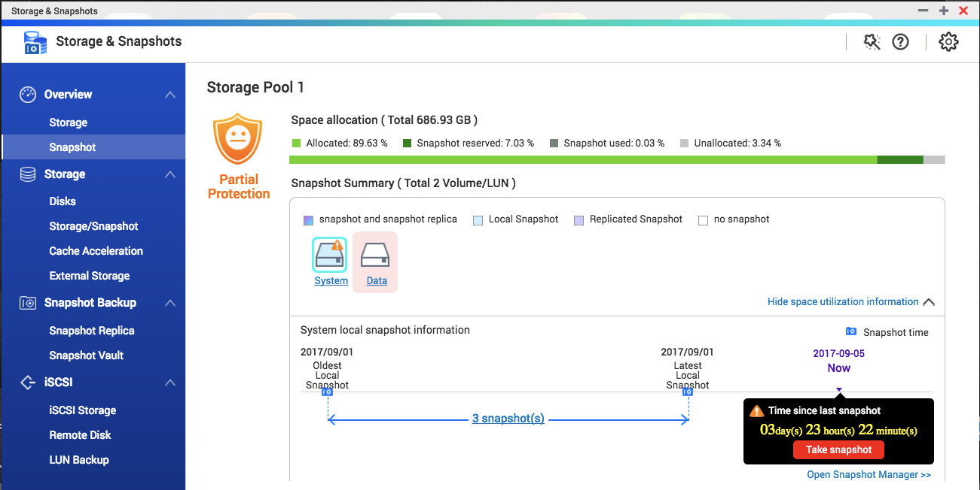
Monitor Snapshot Protection at a Glance
Snapshot Overview
A centralized dashboard to manage snapshot protection
Snapshot shared folder
A solution for creating folder snapshots

Slide 17

Easily Manage All Snapshots
File Station
Support creating new snapshots, browsing snapshot contents and restoring data
Notes:
demo

Slide 18
Backup Snapshots to Remote Sites
Snapshot Replica
Snapshot
Vault
Backup
Snapshot Vault
A incremental snapshot backup plan
Allowing viewing and restoring data at remote NAS
Snapshot Vault can also be backed up

Slide 19



Improved Snapshot Backup Plan
Using snapshots to quickly backup data to a remote site
Redefined Snapshot Replica jobs; choose from different plans
Only transfer modified data, saving bandwidth and increasing backup speed
Back up all newly created snapshots
Configure multiple snapshot replica schedules
Notes:
19

Slide 20
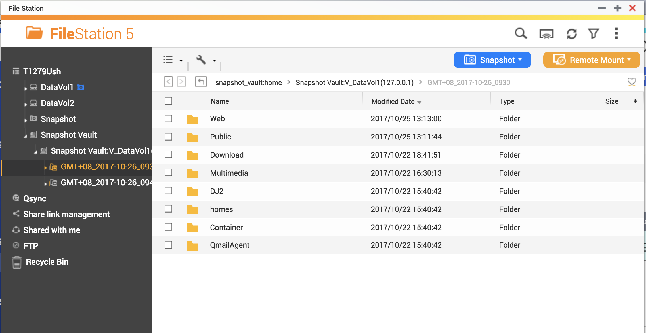
Intuitive Snapshot Management at Remote NAS
Backed up snapshots can be browsed through File Station
Snapshots will be displayed chronologically like local folders
Browse through snapshots and use copy-paste to quickly restore files

Slide 21
Demo: Use Snapshots to protect
NASdata from ransomware

Slide 22

Your challenges, our solutions:
How can I improve storage performance with limited SSD resources?

Slide 23
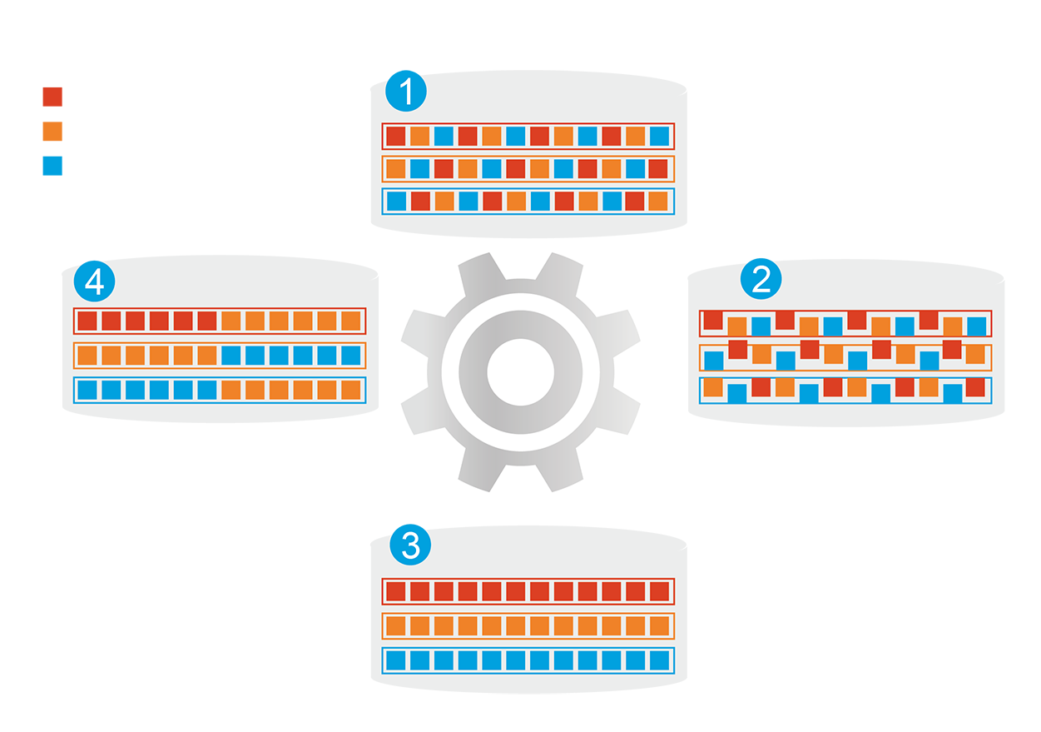
Hybrid Storage System
Automatically moves data between different tiers
SSD cache capacity not limited by RAM size
Before tiering:
Frequently-accessed data
performance is not optimized
Frequently-accessed data
Infrequently-accessed data
Rarely-accessed data
Changes in data
access patterns
Start data tiering
How Qtier Works
After tiering:
Frequently-accessed data
performance is optimized
Notes:
23

Slide 24
Replace SSD Cache with Qtier 2.0™
SSD Cache
Applications
Cannot be used to store data
Fixed bypass options
> For short term performance boost
SSD
HDD
Sequential
Qtier 2.0
Random
The SSD tier can store data
IO Aware and Tiering On-demand
> For both short and long term
performance improvements
SSD Cache
Qtier 2.0
Notes:
取消表格

Slide 25
Qtier 2.0 is I/O Aware
The SSD tier has a cache-like reserved space to handle burst IO in real time
Qtier provides substantial performance improvements when processing applications that requires accessing the metadata (e.g. backup) as compared to SSD cache
Date
free
Burst I/O at C and D
Move D to SSD reserve space
A
B
A
B
D
SSD Tier
SSD Tier
C
D
C
HDD Tier
HDD Tier
BLK | Hit | Timeout
C | 50 | 0
D | 50 | 0
BLK | Hit | Timeout
C | 50 | 0
D | 200 | 0
Pre-Cache
With Cache
Notes:
25

Slide 26
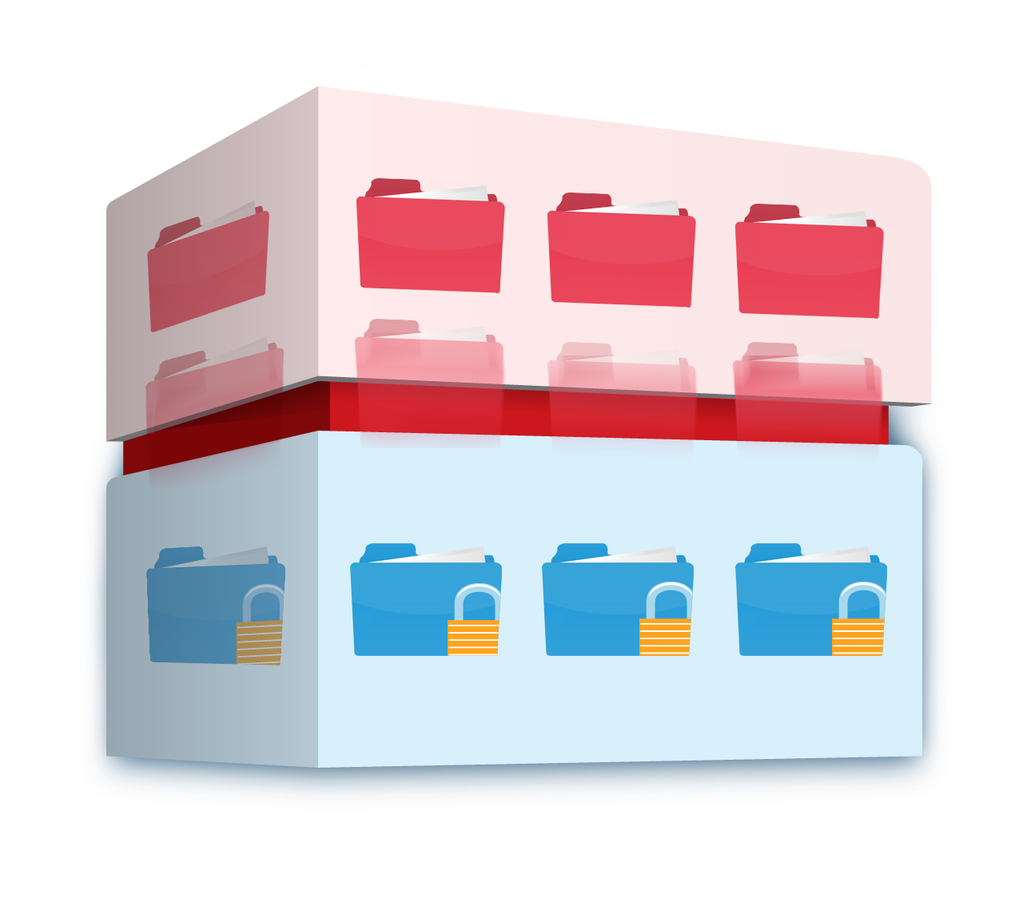
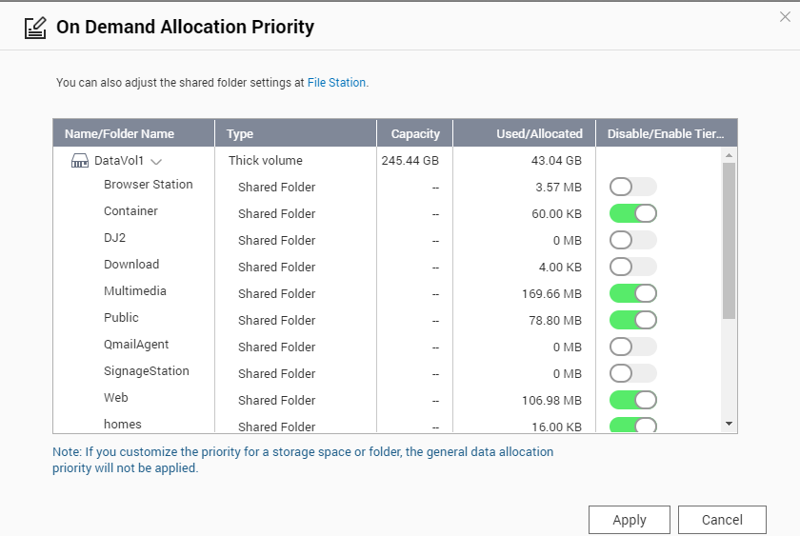
Qtier 2.0 Tiering On Demand
SSD only has limited capacity; needs to be used on key applications
Auto-tiering for individual shared folder or iSCSI LUN can be enabled or disabled
Hot data and reserved block
Cold and archived data
Notes:
26

Slide 27
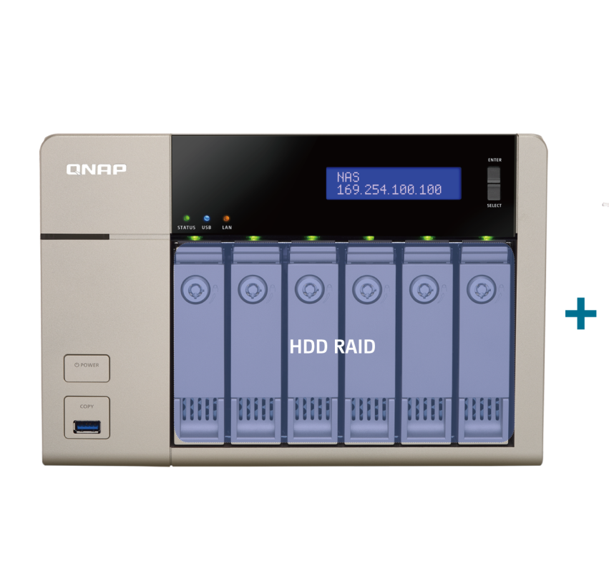
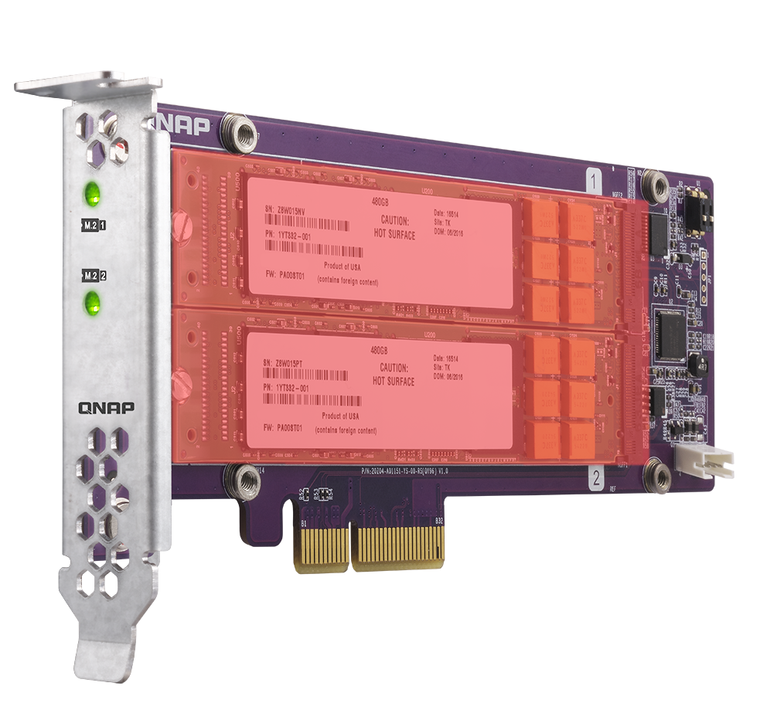
On-line Upgrade to Qtier Pool
Add SSD/HDDs using free bays, an expansion unit, or the new QM2 SSD expansion card
More support models: TDS-x89U, TES-x85/x85U (QTS), TS-x85, TVS-x82/x82U, TVS-x80/x80U,
TS-x80/x80U, TVS-x79U, TS-x79U, SS-x79U, TS-x77, TVS-x73, TS-x73/x73U, TVS-x71/x71U, TVS-x70,
TS-x70/x70U, TVS-x63, TS-x63/x63U, TS-x53A, TS-x53B/x53BU, TS-x53pro.
QM2 SSD RAID
Notes:
27
流程圖 > 移除 Cache > 升級Qtier Pool

Slide 28
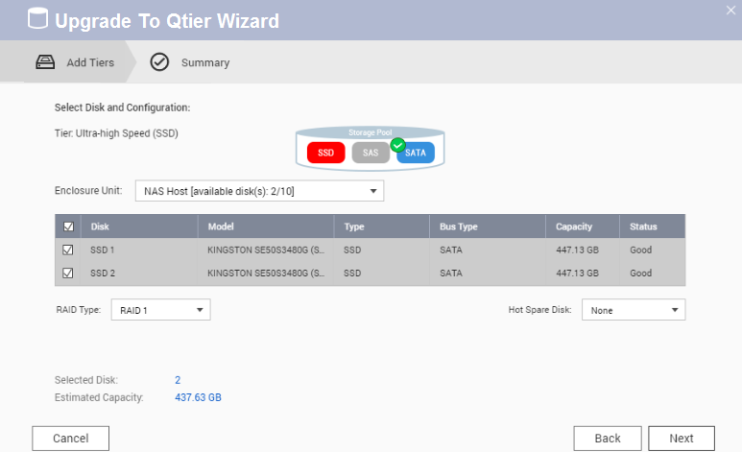
How to Replace SSD Cache with Qtier
１
Step
Stop SSD Cache Online
Step
2
Confirm the SSDs that will be added to the Storage Pool
Step
3
Upgrade to Qtier Pool!
Notes:
28
流程圖 > 移除 Cache > 升級Qtier Pool

Slide 29
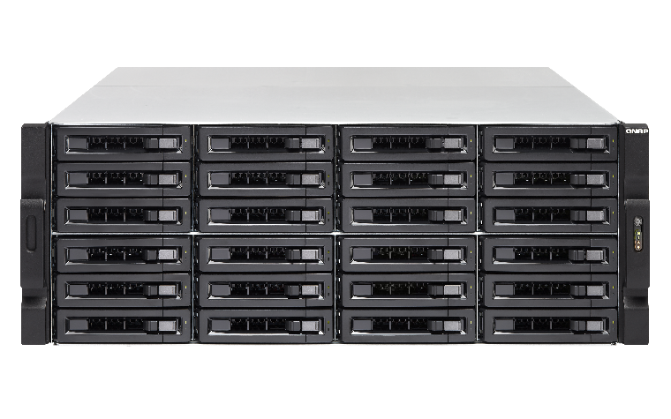
Unleash the full potential of SSD
<Test> TVS-EC2480-SAS-RP
12 SSDs in RAID 10, 12 HDDs in RAID 6
5 VMs IOmeter test with standard 4K random read-write
Adopting Mellanox’s 40GbE iSER solution
40 GbE iSER
180,000 IOPS
with 40TB
<1 ms
Response time
HOT Ultra-high
Performance
SATA HDD Capacity
Notes:
29

Slide 30
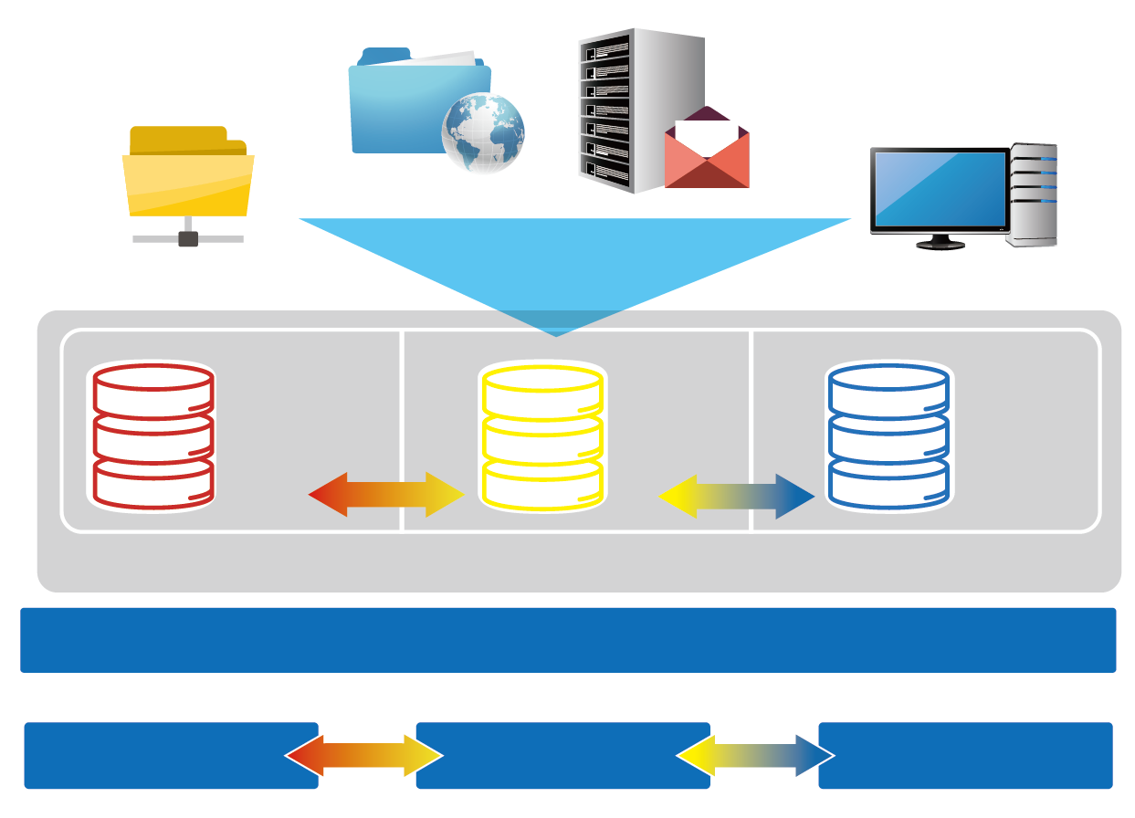
Leading Tiering Technology
Web server
Email Server
Advantages
File server
Virtual Desktop Application
SSD as storage
Satisfy both random and sequential usages
Triggered by events, data tiering
PCIe NVMe,
M.2, General SSD RAID NL, SAS,
SATA HDD
SAS HDD
RAID
NL, SAS,
SATA HDD
RAID
Use Cases
Qtier storage pool
File Server
Web Server
Mail Server
VDI Hosting
Local NAS

Local NAS
Expansion unit 1
Expansion unit 2
Notes:
30

Slide 31

Storage & Snapshot
Your challenges, our solutions:
Is RAID 5 not suitable when more than 8 disks are used?
QTS 4.3.4
Ripple
PM

Slide 32


RAID Protection Decreases as Capacity Increases
The risk of using RAID5/6 increases as capacity grows!
According to ServeTheHome RAID Calculator
Chance of a RAID 5 group failing within 5 years
Disks | Capacity | Risk
4 | 4TB | 0.1%
4 | 8TB | 0.2%
8 | 4TB | 1%
8 | 8TB | 2.2%
12 | 4TB | 4.1%
12 | 8TB | 6.5%
https://www.servethehome.com/raid-calculator/ , conservative estimate assuming bit error chance is 10^(-15), 150MB/sec rebuild speed
Notes:
32
4~8~12
4TB 8TB

Slide 33
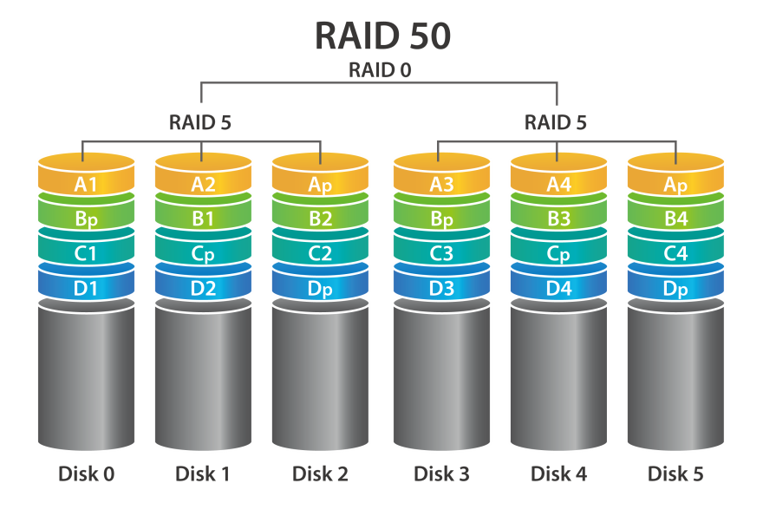
RAID 50 & 60 Reduce the Risk of RAID Failure
Less space used for redundancy + increased RAID protection
RAID type | Disks | Disk Failure Tolerance | Capacity | Chance of Failure
RAID 5 | 12 | 1 | 66TB | 6.15%
QNAP RAID 50 | 12 | 2 or more | 60TB | 0.6%
RAID 10 | 12 | 6 | 36TB | 0.2%
Actual disk failure tolerance depends on the number of RAID50/60 sub-arrays.
Notes:
33

Slide 34
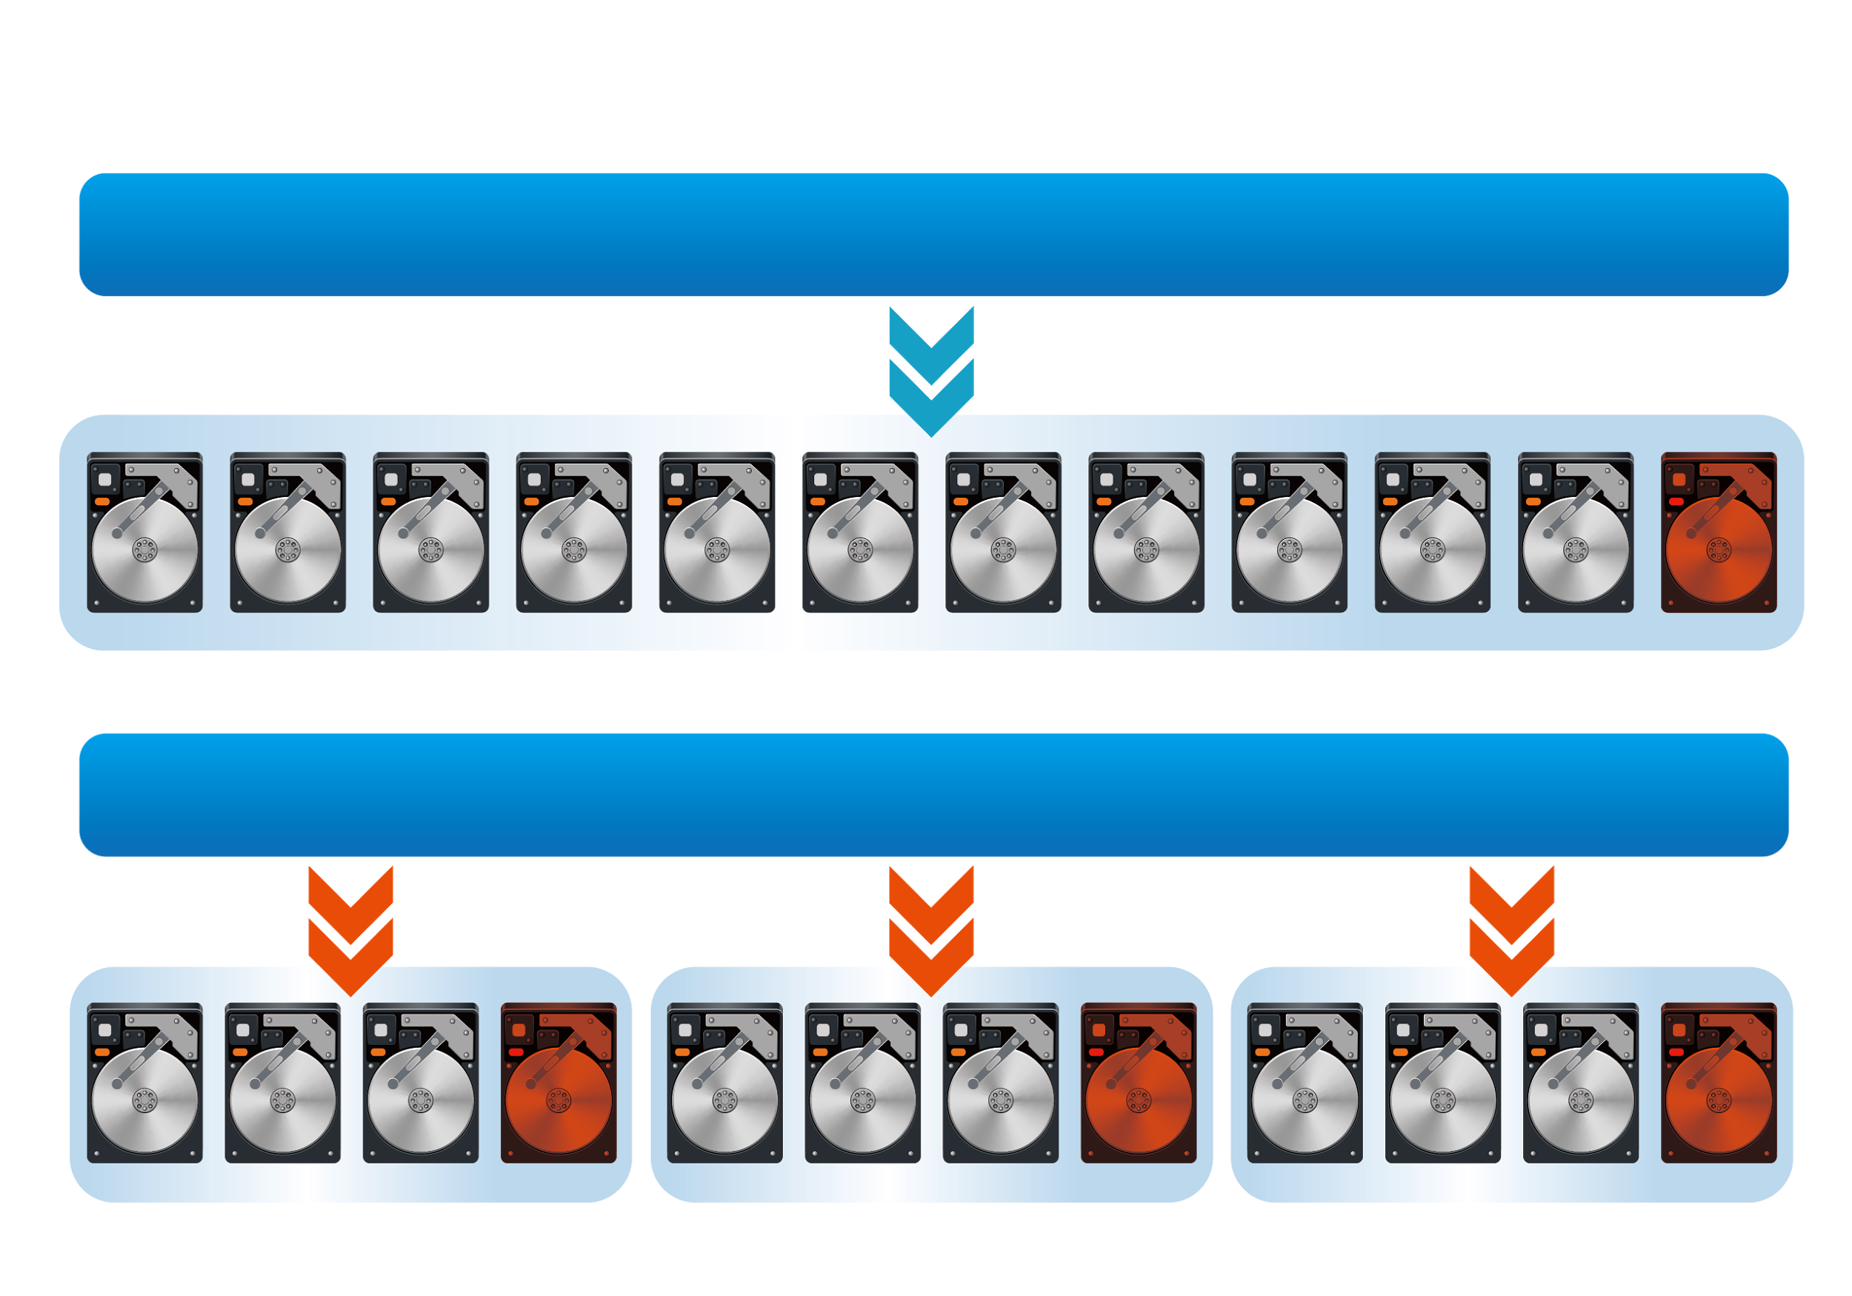
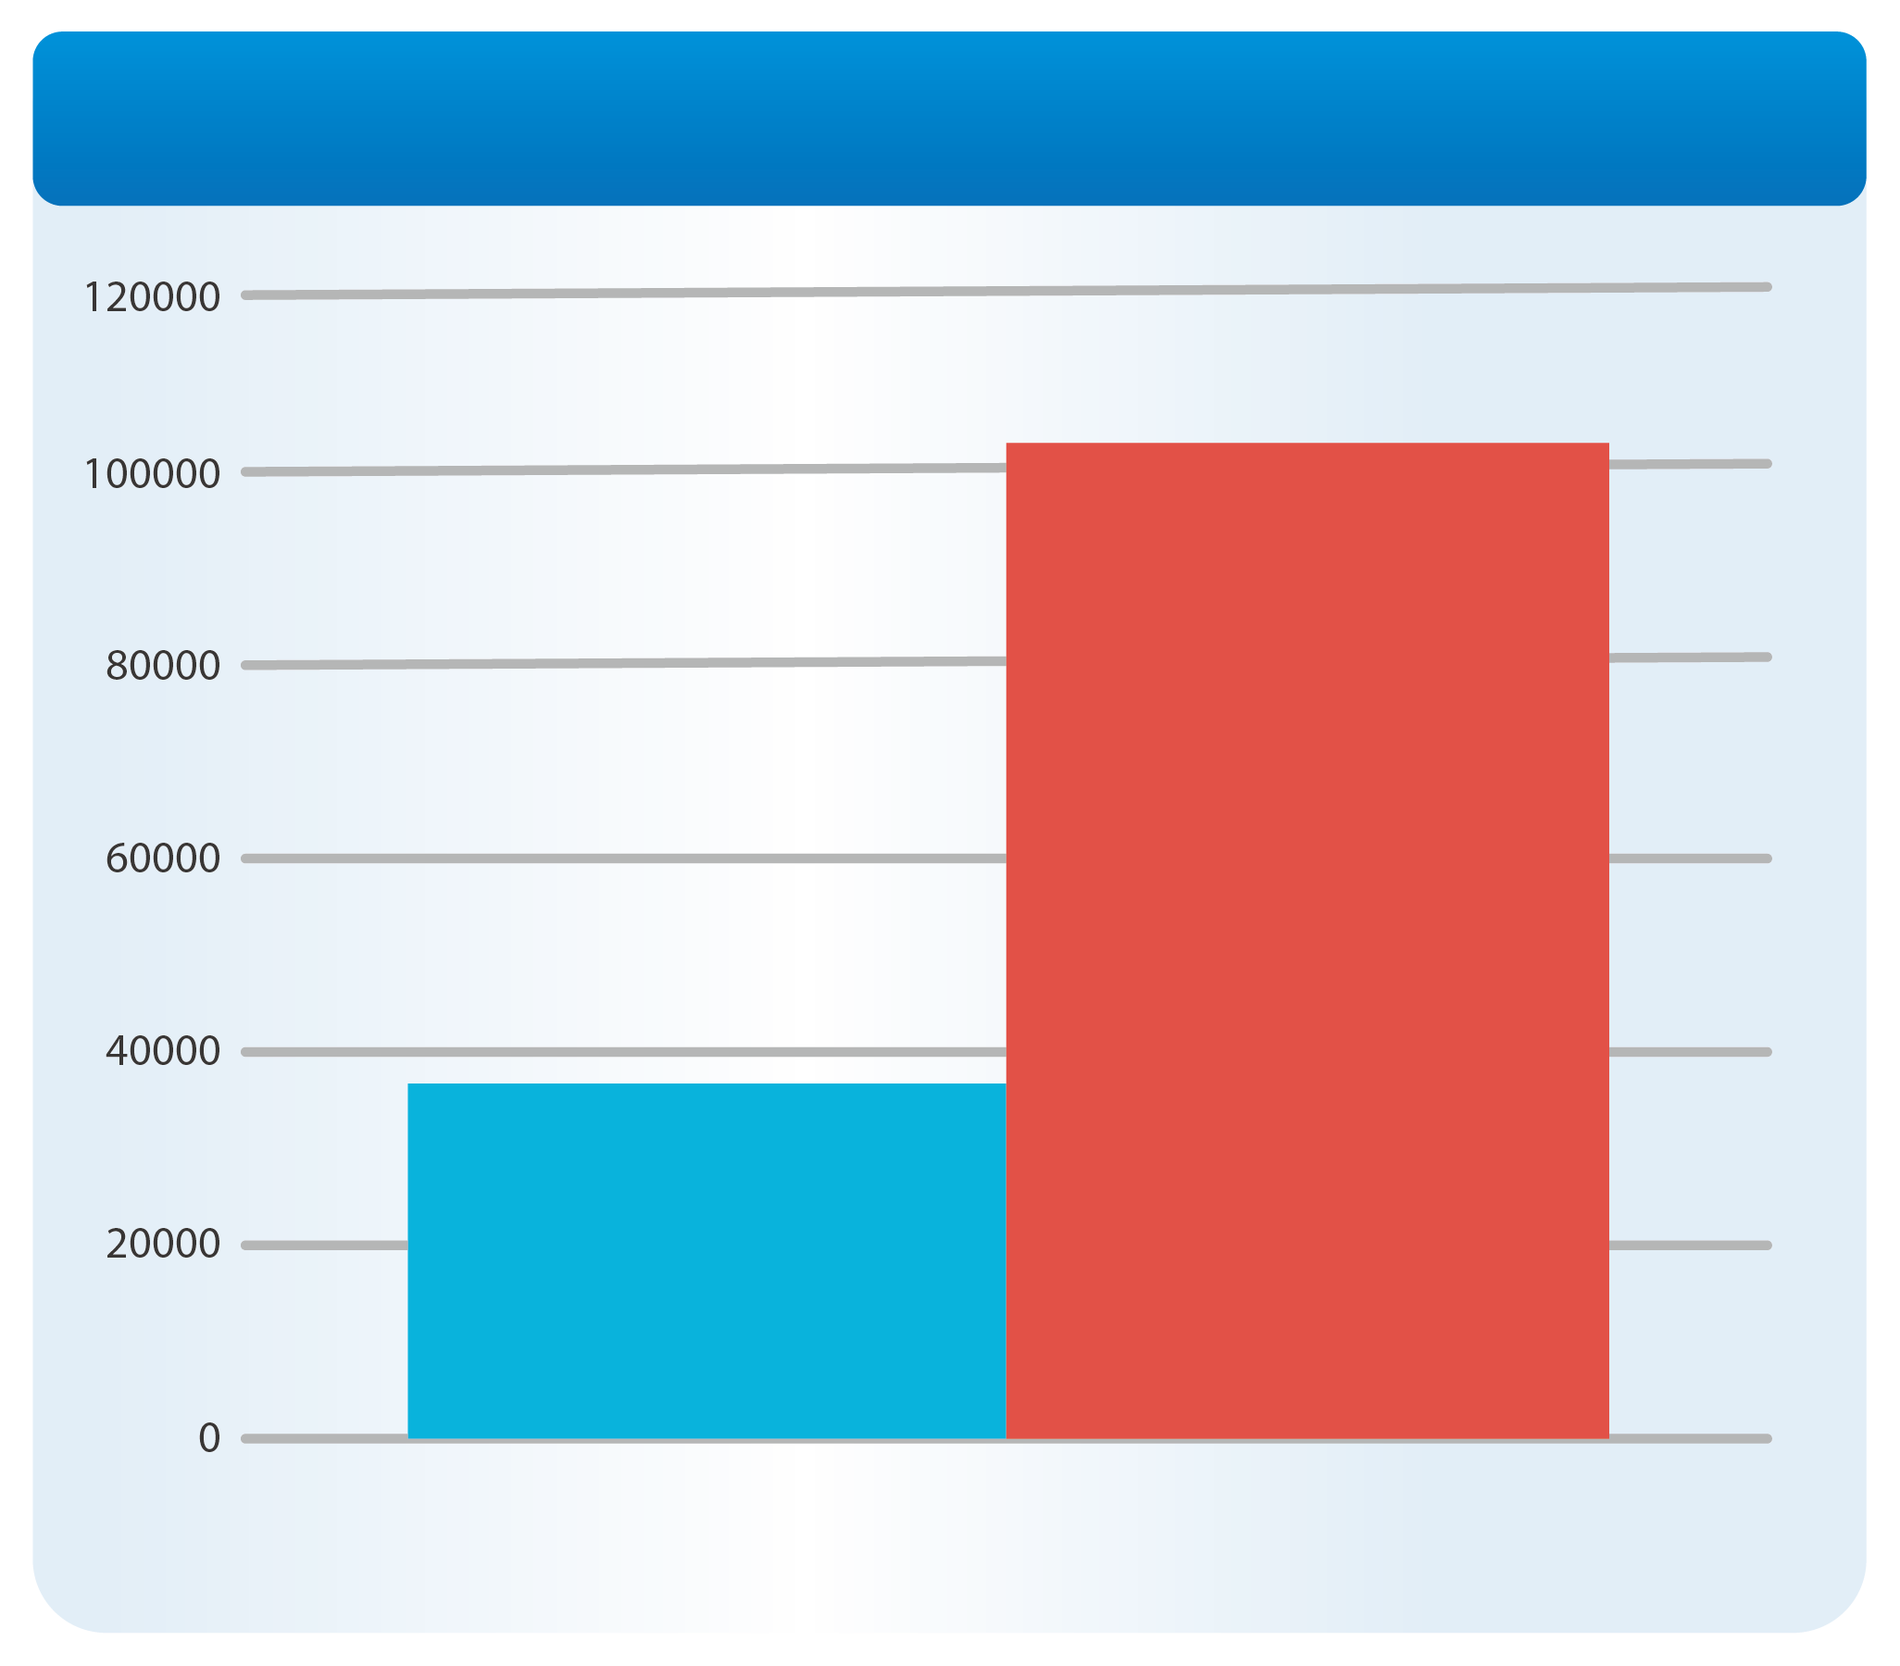
RAID 50 & 60 Increase "Random Write" Performance
Multiple RAID groups calculating parity at the same time
Comparison between RAID 50
(3 sub-groups) and RAID 5 (SSD RAID)
RAID 5 Pool
Random Write IOPS
Increased to
300%
RAID 50
With 3
Subgourps
RAID 50 Pool
Single RAID 5
Random Write 4K Performance
Notes:
34

Slide 35
QNAP Offers Different Types of RAID
RAID Type | RAID 5 | RAID 6 | RAID 10 | RAID 50 | RAID 60
Disk Count | At least 3 | At least 4 | At least 4 | At least 6 | At least 8
Disk Failure Protection | 1 | 2 | Half of the disk | 2~5 | 4~10
Write Performance | ★★ | ★ | ★★★★ | ★★★ | ★★★
Capacity | ★★★★ | ★★★ | ★ | ★★★ | ★★
Use Cases | Backup only | General application | For VDI hosting and database | High frequency backup | For VDI or media editing that need high capacity
Notes:
35

Slide 36
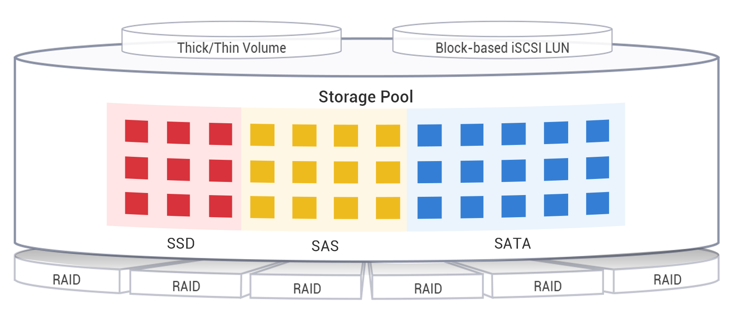
Deploy RAID 50/60 With Qtier
HDD RAID 50 = High capacity backup server
HDD RAID 60 + Read-Only SSD Cache = High capacity file server
SSD RAID 50 + HDD RAID 60 = High capacity and performance virtual storage server
The RAID 50/60 Pool cannot be expanding with striping after creation .
Notes:
36

Slide 37
Demo: Combining Qtier 2.0
with RAID 50/60

Slide 38

Your challenges, our solutions:
iSCSI VJBOD: the expansion solution to maximum your ROI
PM

Slide 39
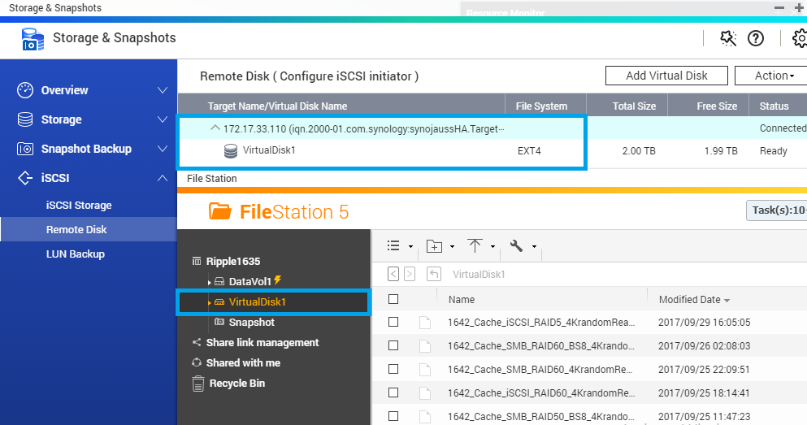
Dual Mode: iSCSI Initiator and Target
Major storage vendors support iSCSI Target
QNAP NAS supports both iSCSI Initiator and iSCSI Target
１
Mount iSCSI target from other storage
Use the unique iSCSI expansion (VJBOD)
2

Slide 40
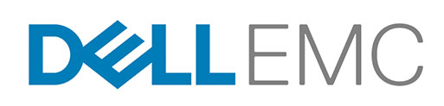




Use iSCSI Initiator to Mount Other Storage
iSCSI Initiator and Target are industry standard
QNAP iSCSI Initiator can be used with EMC, NetApp, Synology and QSAN iSCSI target without modifications
Unused space can be mounted to QNAP for versatile features
Trademarks are owned by their respective companies.
Notes:
貼LOGO

Slide 41
Block-based vs File-based iSCSI LUN
File-based iSCSI LUN
Allocate space in Volume
Blocked-based iSCSI LUN
Allocate space in pool
  Easily allocate and manage space
  Support VAAI thin provisioning
  Avoid interference from volume
Applications
Shared
Folder
File-Based iSCSI LUN
Clear
interference
Volume
Block-based
iSCSI LUN
Storage Pool

Slide 42
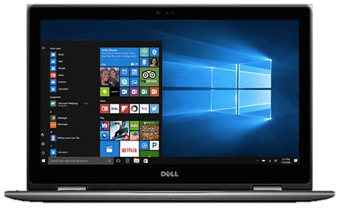

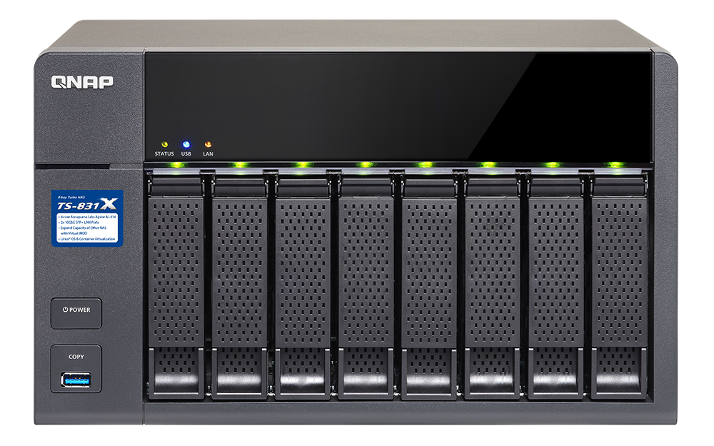
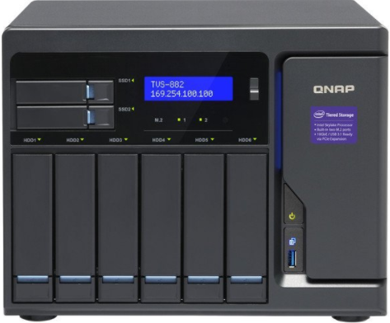


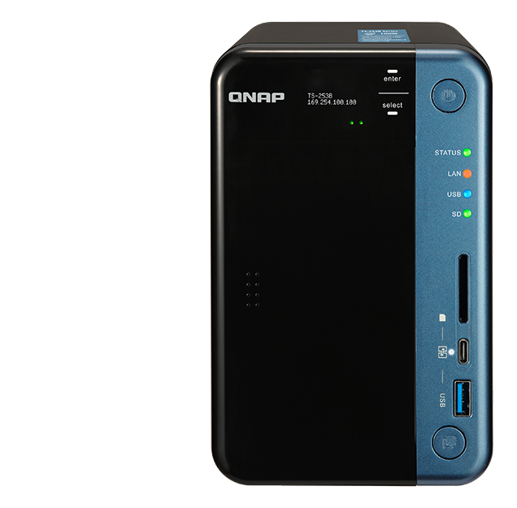
Replace JBOD with iSCSI VJBOD
Uses VJBOD to
mount a LUN as local disk
Create Storage Pool,
take snapshots, use the media
library, Qsirch indexing
Fully utilize storage
space on NAS
Container Station
iSCSI LUN
2 x 10G SFP+
TS-831X
Virtual Pool 1
RAID
Ethernet, flexible conncetion
Virtual Pool 2
Notes:
42
NAS > eSATA < JBOD > LUN backup > to other NAS

Slide 43
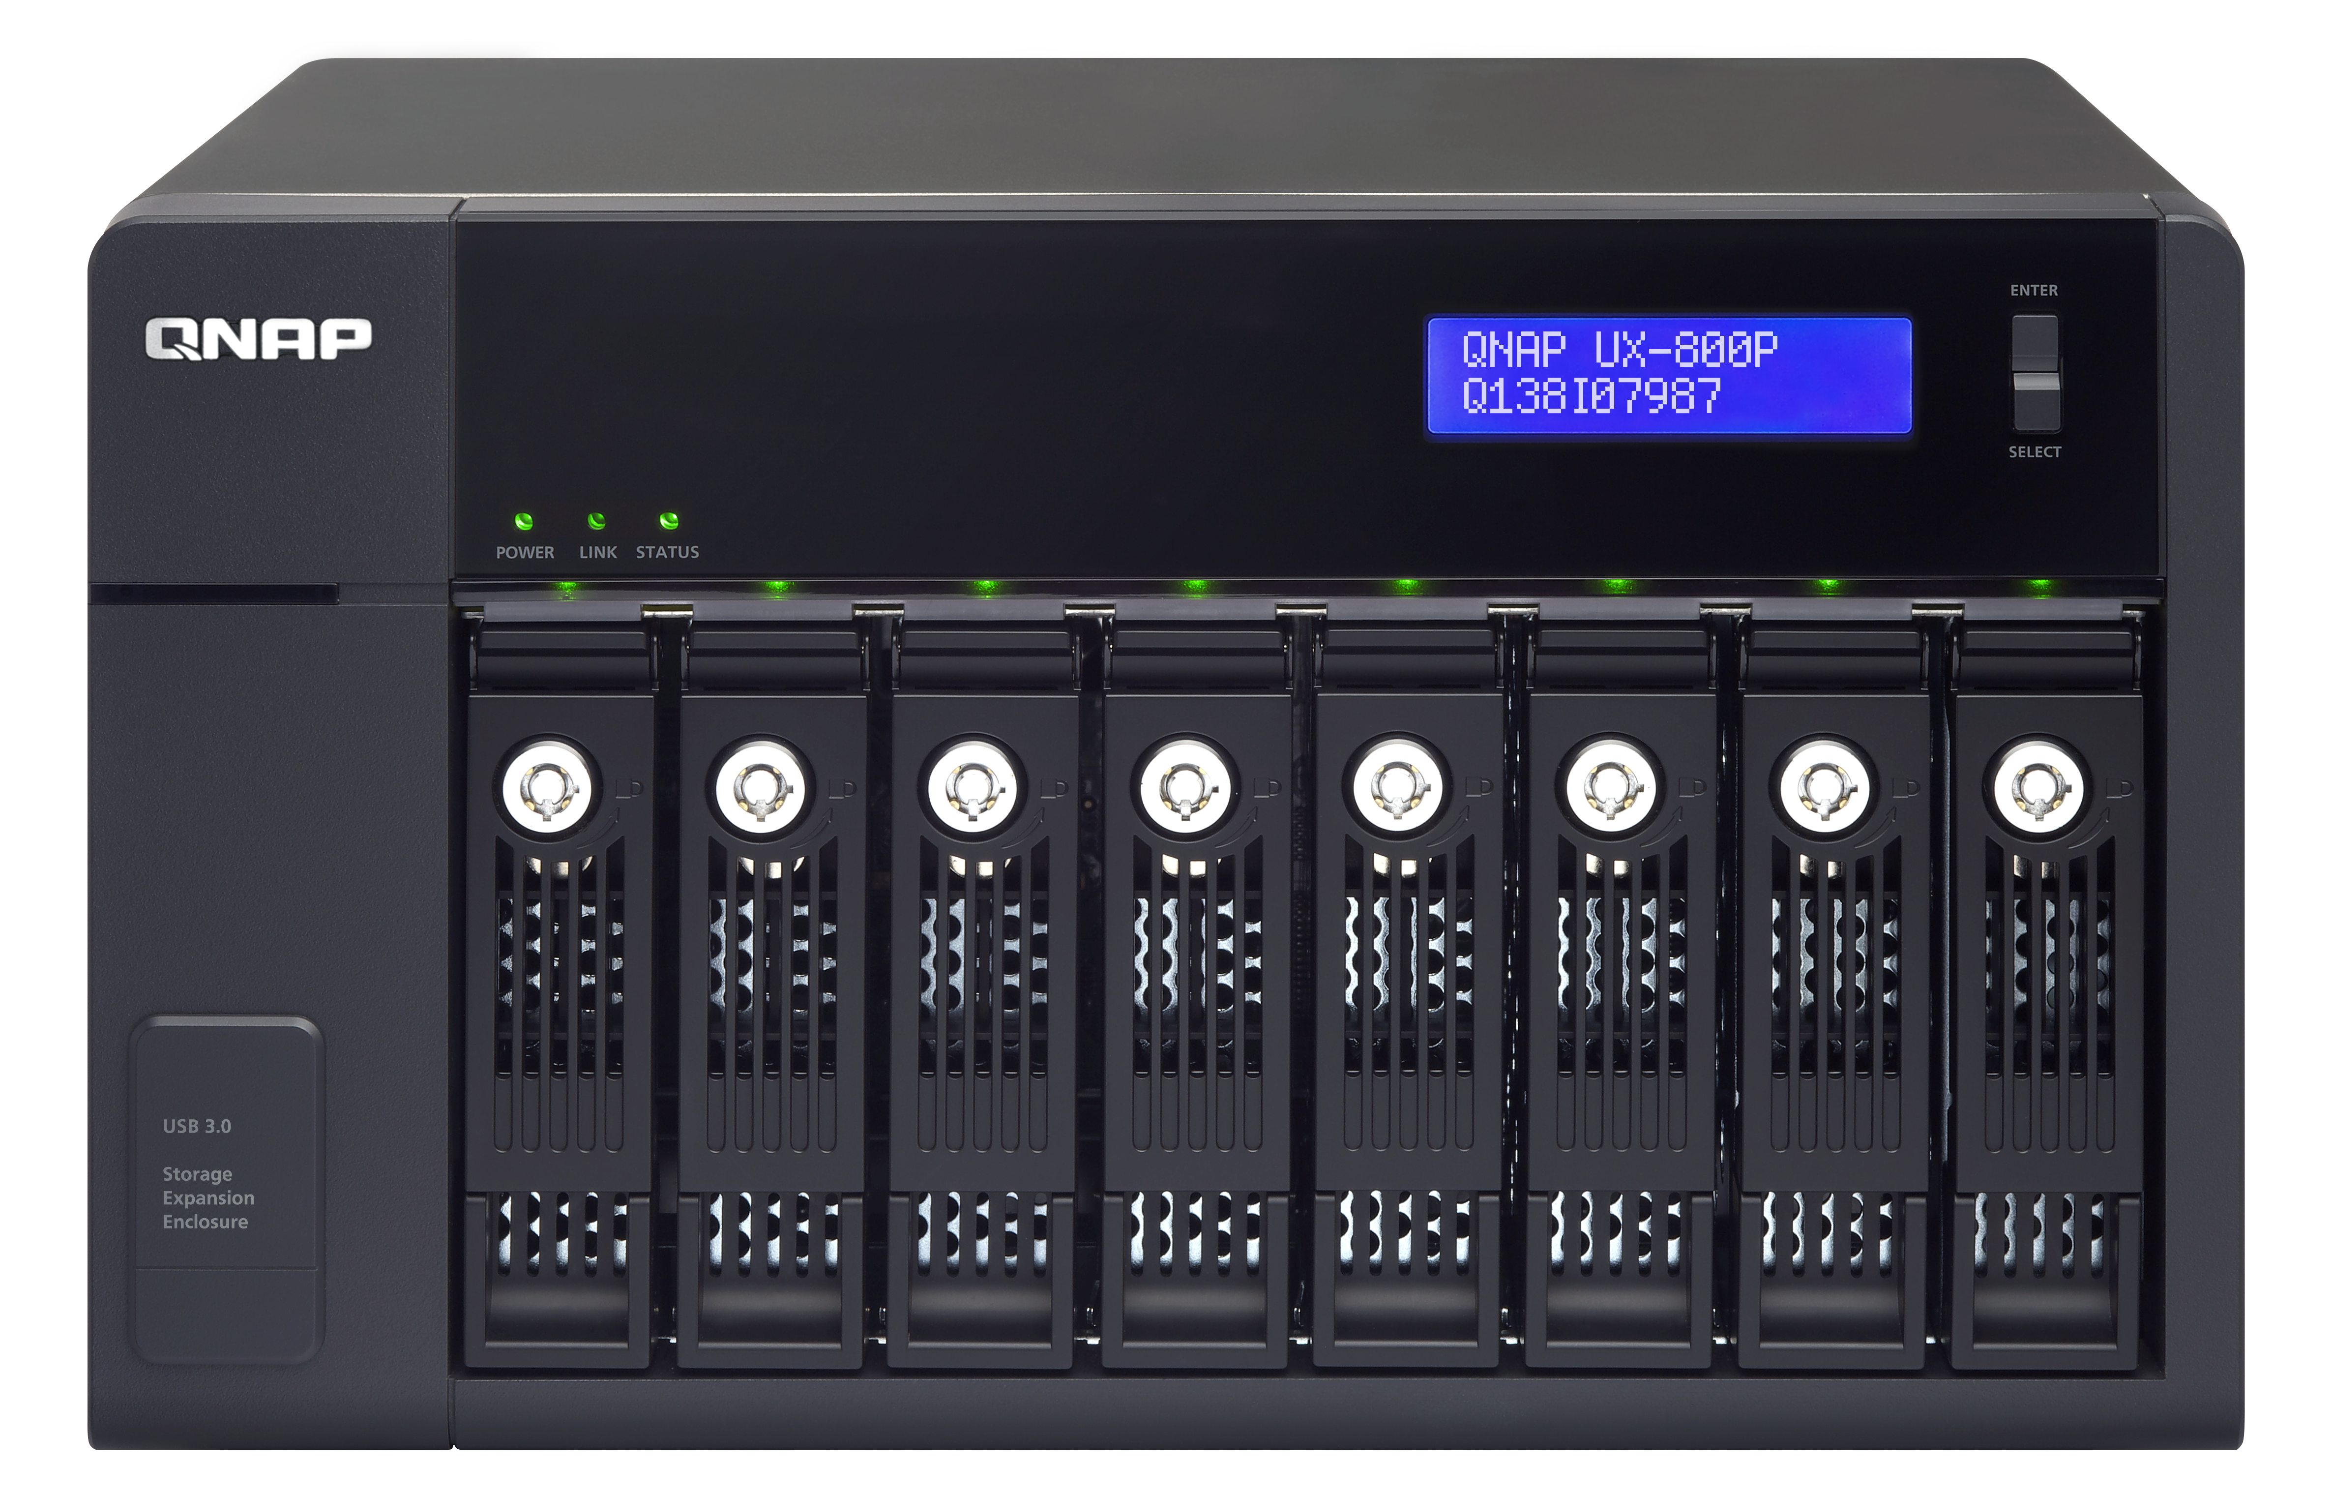
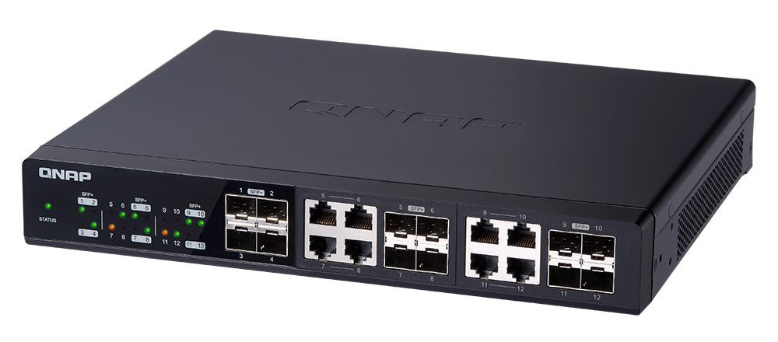
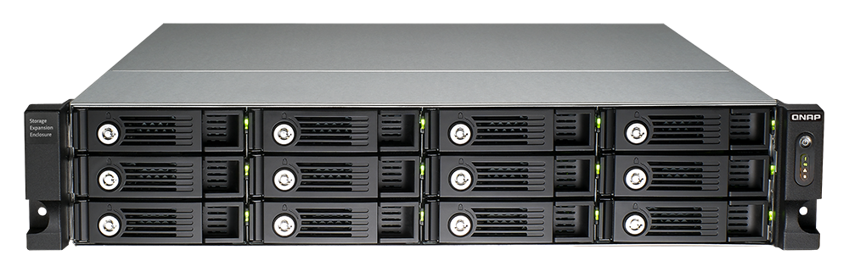
Combine JBOD with VJBOD for Highest Capacity
An 8-bay NAS and 4 units of UX-800P can create a storage space of maximum 300TB* (8TB per disk).
Add Virtual JBOD:
Over 1 PB total
raw storage space
Total > 1 PB
USB 3.0
JBOD 8TB x 8 x 6 = 384TB
iSCSI
8TB x 8=64TB
8TB x 12 x 8 = 768TB
Notes:
43

Slide 44
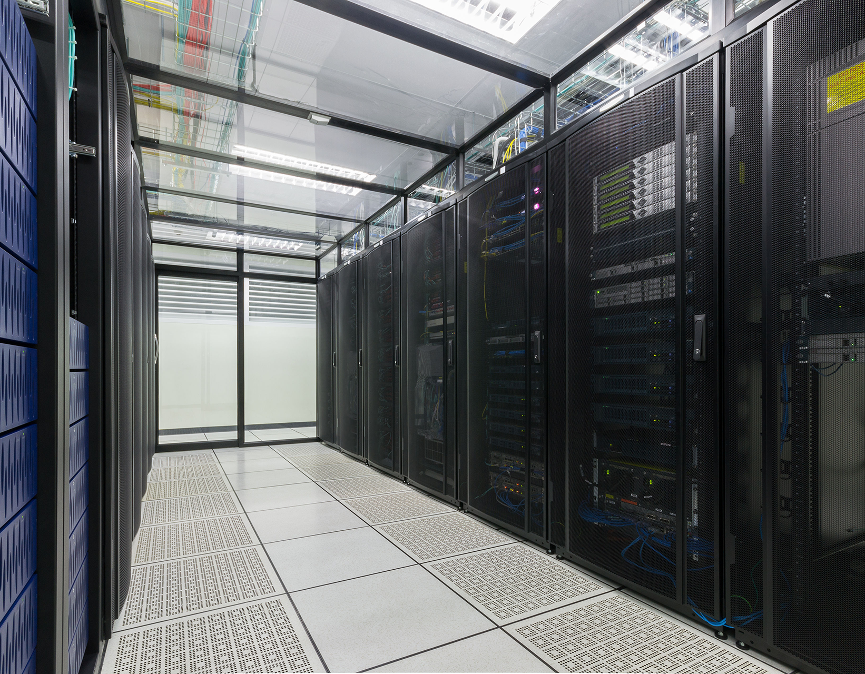
QNAP Hybrid Backup Sync
Solid Backup Solutions for Data Security and Recovery
To realize 10GbE high performance backup experience
Notes:
http://172.17.31.247:8080/cgi-bin/
TS-1635 with snapshot

Slide 45




A Solid Data Protection Solution in one App
Hybrid Backup Sync
Backup
Restore
Sync

Slide 46

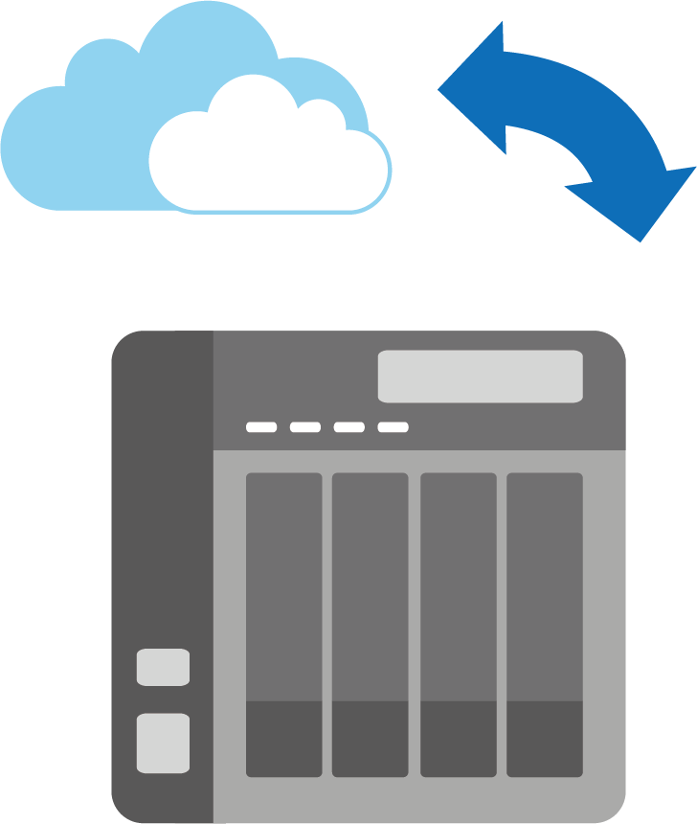







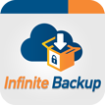

Backup – Hybrid Cloud Perfectly Integrated
Cloud
Local
Remote

Slide 47
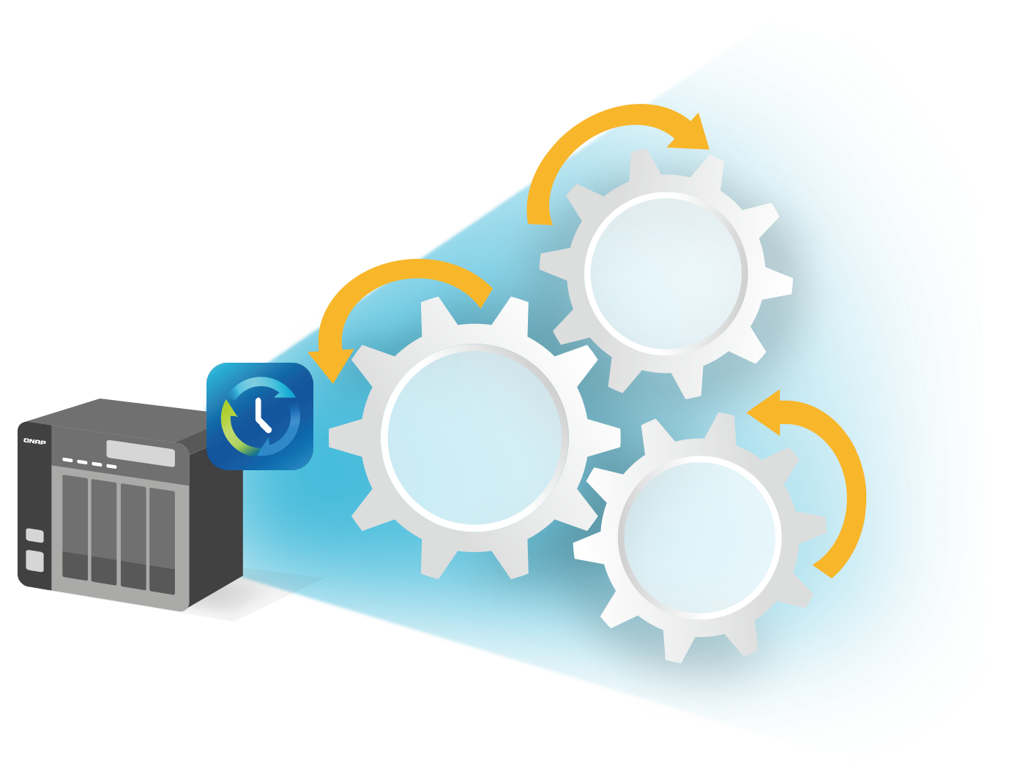
Backup - Essential of Smart Backup
Data
Reduction
Multi-Version
Backup
Data
Security

Slide 48

Multi-version Backup
Simple versioning
Smart versioning
NOW
JAN.
APR.
SEP
DEC.

Slide 49
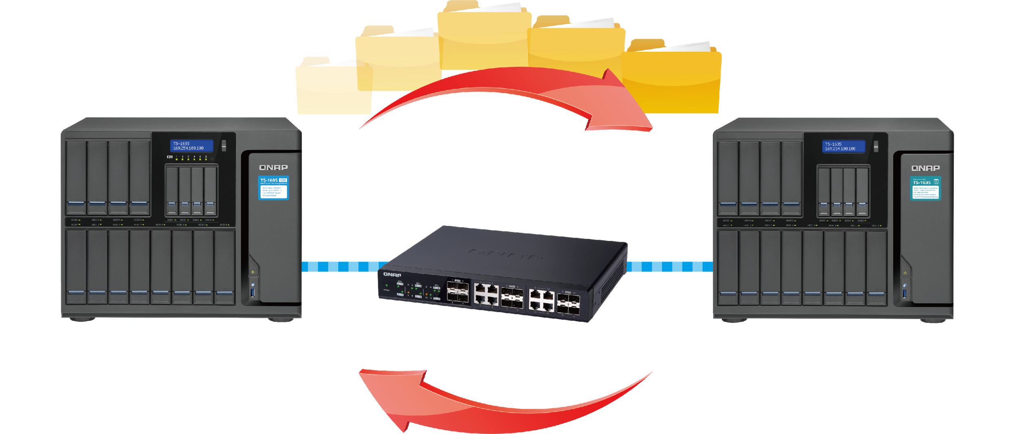
Back up over 10 Gigabit Ethernet
Economical enterprise-level disaster recovery solution
Highly Efficient Data Backup
Recover from Disaster in time
Protect the sensitive
and classified data
Backup
Disaster
Recovery

Slide 50
Demo: 10GbE high performance backup experience

Slide 51
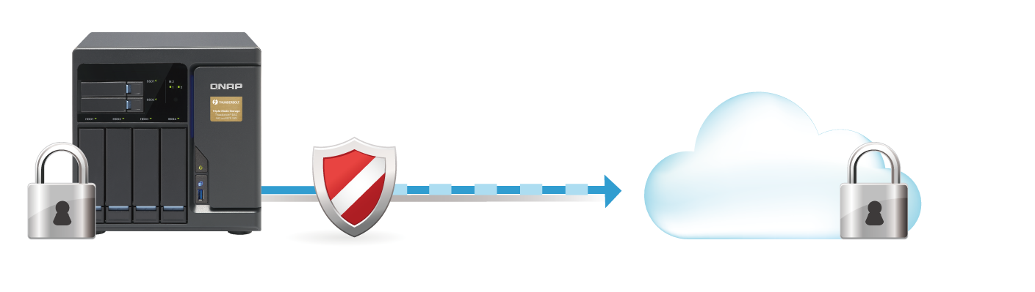
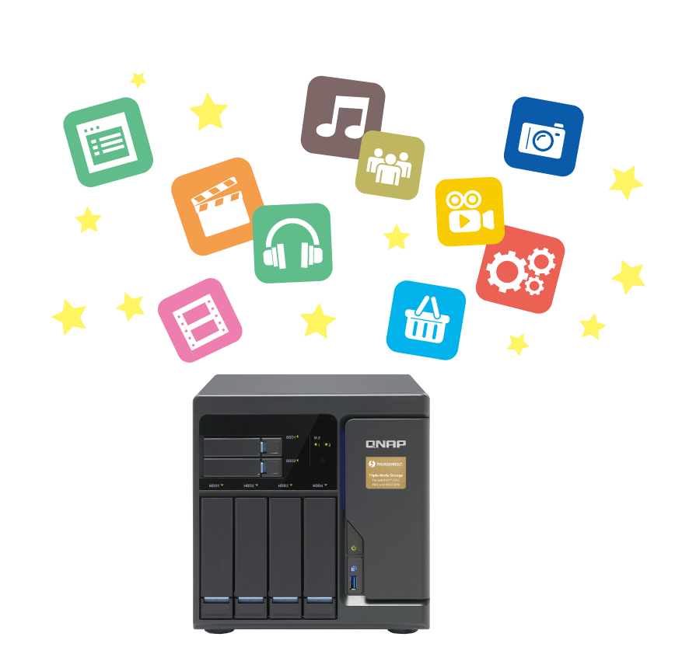
Cloud Security and Data Reduction
Secure connection (HTTPS)
Server-side encryption
Client-side encryption
Client-side-encryption
Secure connection
(HTTPS)
Server side encryption
01
Data Filter: Data size/Date/Type
02
Data Compression
03
Sparse File Detection

Slide 52

Sync – Access the data anytime and anywhere
One-way Sync
Active Sync
Two-way Sync
Cloud
Remote
Local

Slide 53



Cloud Sync-Flexible Settings to Meet Your Needs
Mirror
Copy
Move

Slide 54




Comprehensive Data Protection Solutions
Local
Remote
Cloud
Taipei
Kaohsiung
RTRR
(Local to remote backup/sync)
Backup / Sync
360km
Mac Time Machine
Netbak Replicator
External Device
JBOD

Slide 55
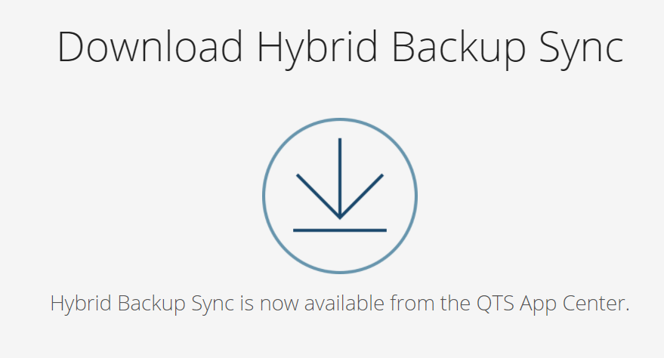
Get More information
https://www.qnap.com/solution/hybrid-backup-sync/en/

Slide 56

File Management
Maximize your productivity in finding and archiving files

Slide 57

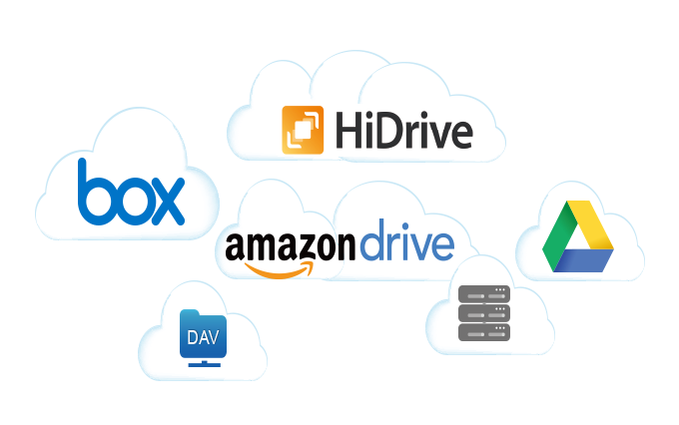

You have too many to handle...
?
Categorize
?
Manage
?
?
?
?
Search
?

Slide 58





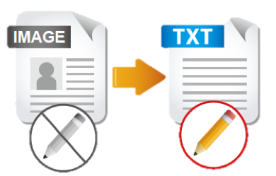





QNAP meets all needs for an office
File Station
OCR Converter
Qsirch
Qfiling
Store and backup
File Digitization
Search
Archive
Ｗith OCR Converter, Qsirch can search for image context.

Slide 59






How to manage many kinds of cloud spaces and devices?
Scenario
1
10:00~12:00 Daily Routine

Slide 60


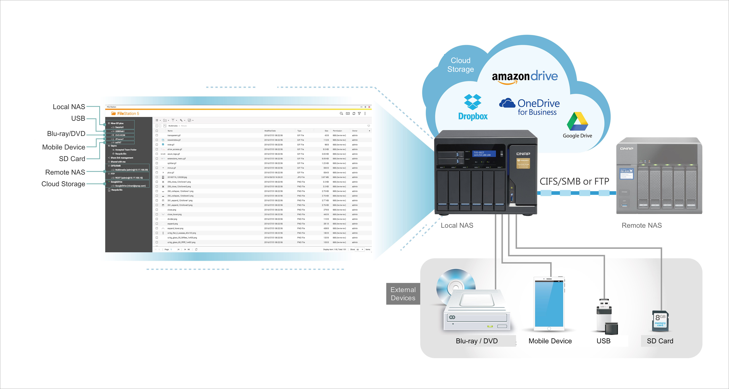
File Station: A single app to manage all files
8 Cloud Storages
NEW
NEW
Remote NAS
New Support
4 External Devices
One simple interface

Slide 61








File Station: A single app to manage all files
QNAP File Station
Other Brand
Cloud Storages
Blue-Ray/DVD, Mobile Devices
SDCard, USB
SDCard, USB
External Devices

Slide 62





What to do if important files are missing?
Scenario
2

14:00 Conference
13:30 Rehearsal

Slide 63
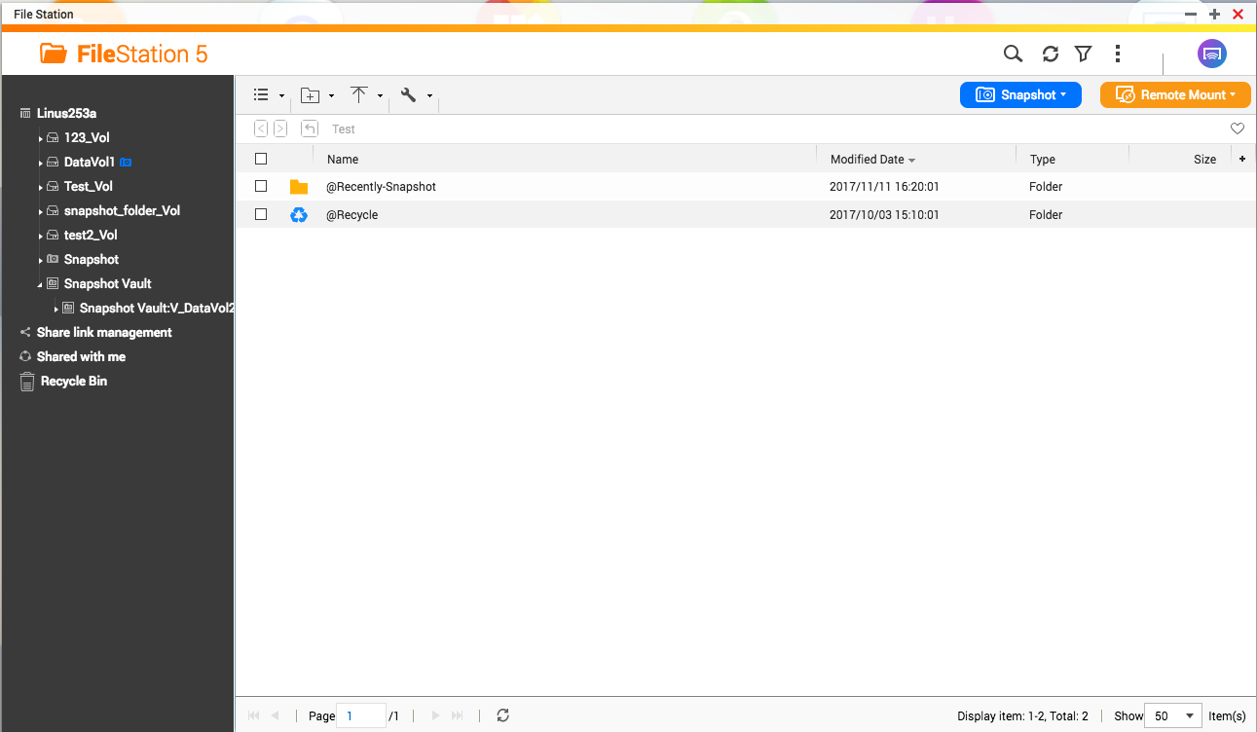
Take Snapshot in File Station

Slide 64
Demo

Slide 65
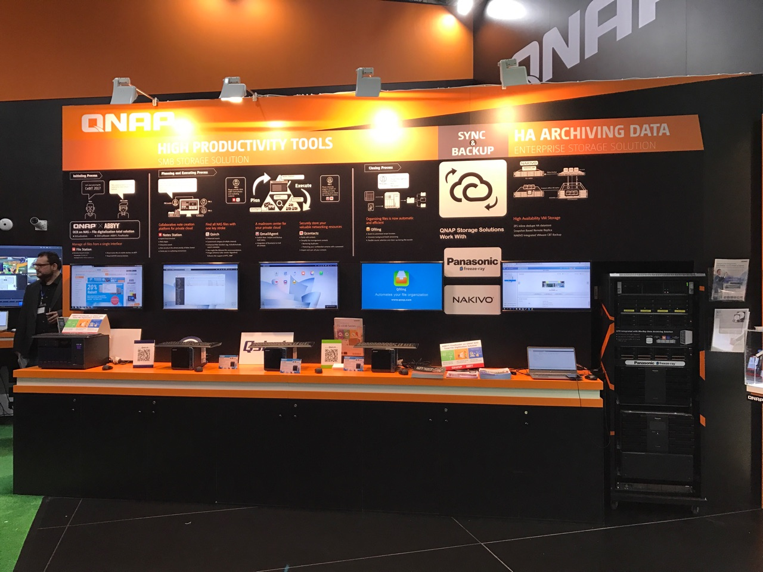



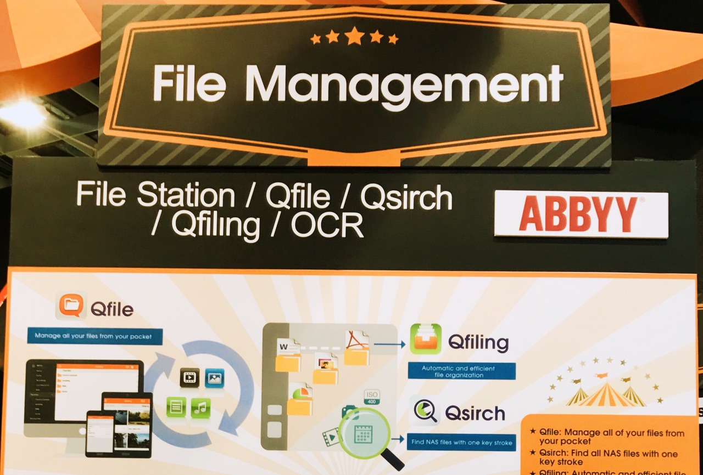
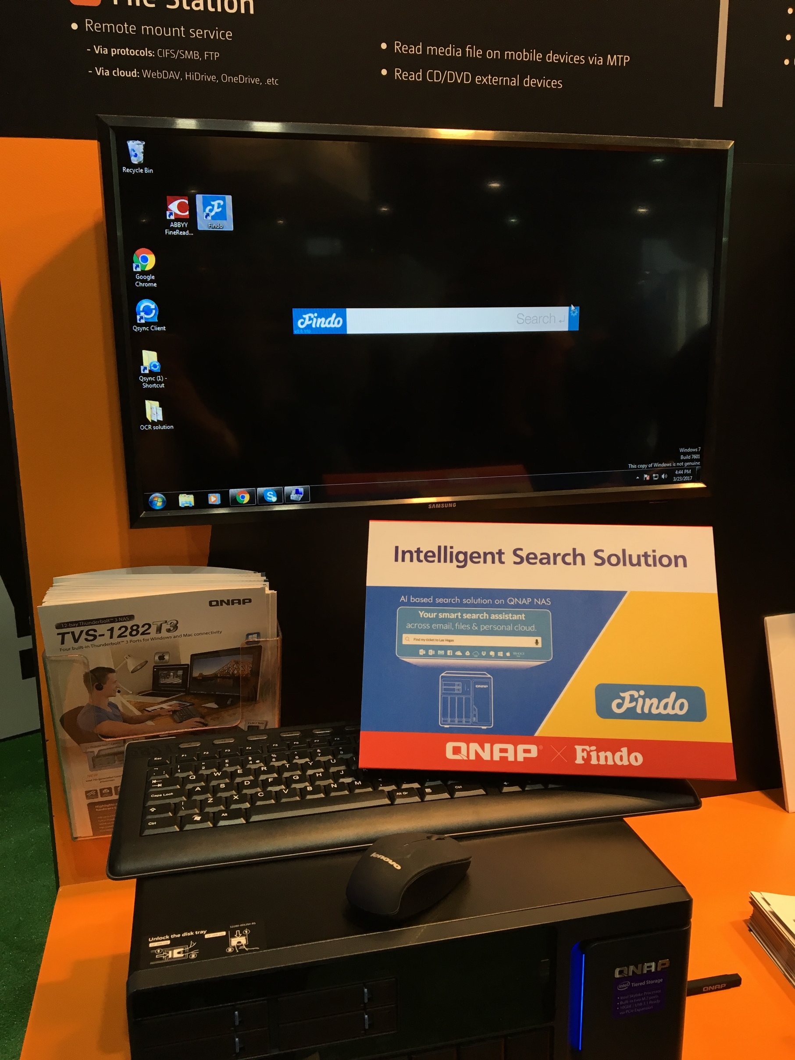
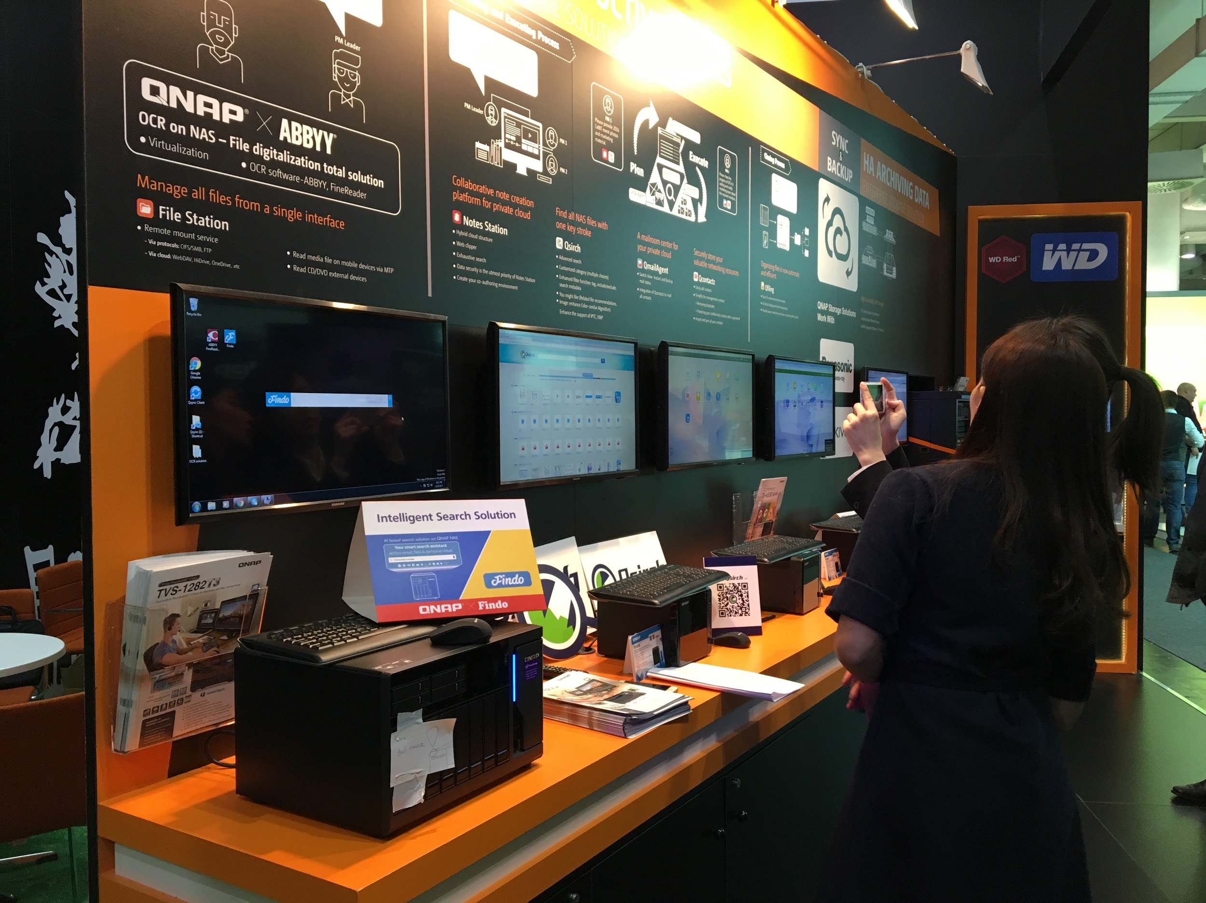

How to organize files efficiently?
Scenario
3
16:00 Market Research

Slide 66
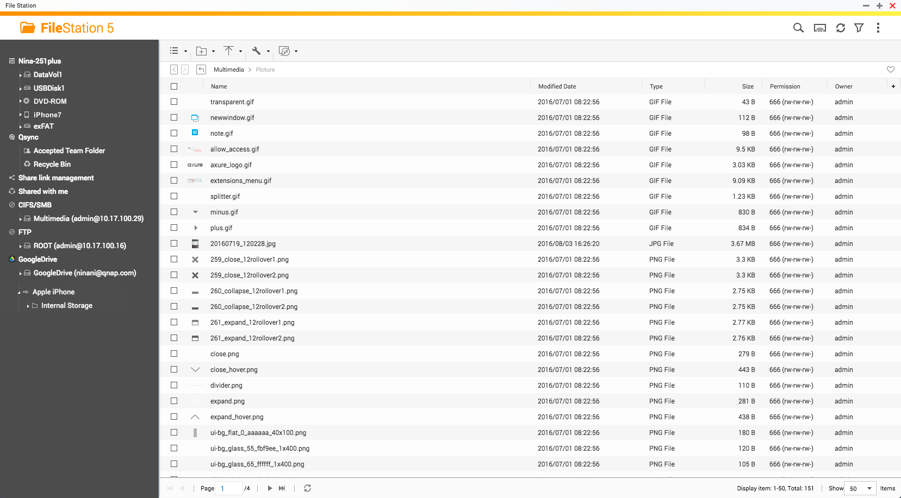
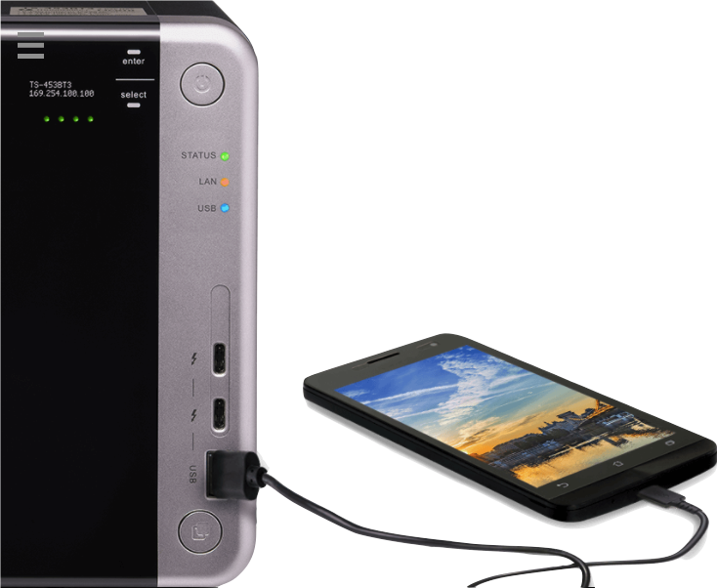

Direct access to files on mobile devices via USB

Slide 67








OCR: Best solution for document digitization
Picture with text
Searchable documents
Search
Edit
Archive

Slide 68




OCR: Best solution for document digitization
Convert images to editable files
Edit with Text Editor

Slide 69
Demo

Slide 70


Smart file searching and archiving
Qsirch
Qfiling

Slide 71












QNAP maximizes your productivity
Qfiling
File Station
Categorize
Manage
Search
Text Editor
Qsirch
OCR Converter

Slide 72

Standalone GPU Support
Extend functionality enhance efficiency
Notes:
Support GPU

Slide 73


Standalone Graphics Card and QTS
應用擴充
虛擬機應用支援
Powerful computing capacity
Extend functionality
Excellent graphic processing capability
VM Support
Enhance transcoding efficiency

Slide 74




Assigning GPU Resources as Needed
GPGPU Hardware Resource Allocation
HD Station
Virtualization Station
Adobe After Effects, Photoshop….
Linux Station
Hardware
Accelerated Transcoding
File Station, Video Station, Photo Station

Slide 75




Output from HDMI port of Graphics Card
TS-x77
TDS-16489U
TS-1685
Use HD Station or Linux Station via HDMI/DP port on a standalone graphics card

Slide 76



HW distributing process
In ”Control Panel” → "System" → "Hardware" →” Graphics Card”to see the detected graphic cards
Assign resource
If you want to assign GPU to HD Station/ Linux Station
You need to install NVIDIA GPU Driver in App Center
You can only choose one at a time!

Slide 77


HD Station
HybridDesk Station (HD Station)
Desktop view on an external monitor via HDMI/DP
Use your NAS as a PC with a keyboard and mouse

Slide 78

HD Station Architecture

Slide 79
Rich Applications
QTS
Management
Browser, Communication
& Office tools
Multimedia Applications
QTS
File Station HD
Photo Station HD
Video Station HD
Music Station HD
Surveillance Station
QVR Pro Client
Browsers
Chrome
Firefox
Communication
Skype
Office tools
LibreOffice
HD Player
OceanKTV
YouTube
Clementine
DeaDBeaf
Plex Home Theater
Spotify
TuneIn Radio

Slide 80



Home Theater
QNAP NAS
Home Theater System
HD TV
Ultimate Theater Experience Combining QNAP NAS and Home Theater System for Unparalleled AV Experience

Slide 81

Linux Station
Comprehensive services on the open-source Linux platform

Slide 82


Feature Highlights
QTS and Linux
dual platform
PCIe graphic card resource
Multimedia

Slide 83
Feature Highlights
QTS and Linux
dual platform
PCIe graphic card resource
Multimedia

Slide 84


Enjoy the Best of both QTS and Linux
Use dual platform services of QTS and Linux like a desktop computer
Direct access to NAS data with no limitation of file size and application speed
Enjoy the rich applications provided by Ubuntu App Center
Great Linux platform for development and store your data in a private storage
Fast, Convenient
and Secure!

Slide 85
Feature Highlights
QTS and Linux
dual platform
PCIe graphic card resource
Multimedia

Slide 86



Smoother and Faster!
Go to [Control Panel] > [System] > [Hardware] > [Graphics Card] page to assign PCIe graphics card resource to Linux Station.
Use PCIe graphic card resource for multimedia playback, hardware acceleration, multi-functional development and enjoy a smoother and faster application.
This feature is available for Linux Station 1.5 and above.

Slide 87
Feature Highlights
QTS and Linux
dual platform
PCIe graphic card resource
Multimedia

Slide 88

Rich multimedia applications right after installation
Google Chrome and YouTube browser, QTS shortcut and NAS data, KODI and the rich multimedia applications are ready right after installation.
Use QNAP remote RM-IR002 and RM-IR004 to control KODI at your fingertips.

Slide 89
Transcoding Performance Improvements
Reduce approximately 60% (up to 90%) of the transcoding time* *
x77+ NVIDIA GeForce GTX 1060 | x77 AMD Ryzen | x82 Intel i3 CPU
10s | 3m17s | 4m35s
* Test video：H.264/4K/ 3m20s
Through the powerful graphics computing capability of GPU, it can enhance the efficiency of video transcoding in QTS
** The performance depends on NAS and the installed graphics card.

Slide 90

Virtualization Station
Improve graphics processing by leveraging GPU

Slide 91


Running virtual machines
Support various Operating Systems to install on Virtual Machine (VM)
IT infra-integration by virtualizing servers
Connect graphics card to empower VMs with higher processing capabilities and OpenGL/DirectX support.
伺服器
伺服器
伺服器
虛擬機工作站

Slide 92





3 steps for GPU connection
１
２
Step
Step
Install Guest Tool
Connect GPU card
３
Step
Install GPU card driver

Slide 93




GPU - manipulating image processing
Support OpenGL, DirectX
Discrete GPU accelerates image processing and computer graphics, offloading CPU utilization
虛擬機
虛擬機工作站
GPU
Pass-through
KVM/ VFIO
21%
68%
外接顯示卡
Tested in QNAP Labs. Figures may vary by environment.
NAS：TS-1277 Ryzen 1700
QTS 4.3.4, Seagate ST4000VN0001
nVIDIA GeForce GTX 1060 6GB
GPU connected
GPU connected

Slide 94









Web browsers & HDMI output
Remote access
Local HDMI output
Web browsers or remote connection utilities
Plugging in keyboard, mouse and monitor

Slide 95

QVHelper
Your video playback helper

Slide 96


In the past, playing videos on NAS is like...
!
!
Impacts NAS operations
Gets lag very often

Slide 97


In the past, playing videos on NAS is like...
Certain formats are not supported. Many videos cannot be played.
OH NO!
I can’t watch
this video!

Slide 98



QVHelper
QVHelper allows you to stream media files from a QNAP NAS to VLC media player on your PC and Mac, providing a greater choice for you to enjoy most audio/video contents.
* Required using Video Station 5.1.3 or later versions
* Required using Photo Station 5.6.0 or later versions
* File Station: QTS 4.3.4
VLC Player

Slide 99


Qboost
Optimize NAS system performance
Notes:
http://172.17.31.247:8080/cgi-bin/
TS-1635 with snapshot

Slide 100


wasting time
Still
because of lagging？
Lowers your working efficiency
Notes:
(放搜尋系統卡頓的訊息)

Slide 101



Qboost
Application
Scheduling
Optimize
Clear

Slide 102




Qboost
Clean cache memory
Clean swap memory
Optimize
Free Memory
Free Memory
96%
9%
67%
170MB
Optimize
Optimizing…

Slide 103


Qboost
Delete unnecessary system files
Empty Recycle Bin
Clear
Junk Files
Junk Files
Choose files to delete
Unnecessary system files
Recycle Bin
Note: Files will be permanently deleted
Clear

Slide 104

Some applications use huge amount of memory capacity, and “Optimize” cannot release cache memory effectively. What can we do?

Slide 105


Qboost
Schedule to enable / disable applications
Allocate system resources more efficiently
Application Scheduling
Schedule OceanKTV manually
You may be too busy to use home entertainment apps during weekdays. Mostly, you use OceanKTV app and sing at home on the weekend. But the app still takes up resources, even it's not activated.

Slide 106

Demo Qboost
Optimize, Clear,
Application scheduling

Slide 107

Three solutions
Clear
Cleans up junk files
Recycles storage space
Optimize
Releases memory
Increases operating speed
Application Scheduling
Allocates system resources efficiently

Slide 108




















And there's more supporting QTS 4.3.4
Thunderbolt NAS Series
Rackmount Series
TDS-16489U, TS-x85U, 1582TU, x80U, x73U, x71U, x70U, x69U, x63U, x53BU, x53U, 451U, x31XU and 431U
Tower Series
TS-1685, x82, 882ST2/ST3, x80, x73, x71, x70, x69, x63, 453Bmini, x53B, x53A, x53 Pro, 453mini, x51A, x51, 1635, x31X, x31P, x31+, x31 and x28
For a list of supported models, please visit https://www.qnap.com/zh-tw/product/eol.php

Slide 109
Thank You

