Slide 1
How to quickly access and connect to Internet
Qfinder Pro
Browser Station
myQNAPcloud Connect
Easily find and configure NAS
Secure and
convenient access
to private networks
Access files quickly and securely via VPN
Notes:
https://www.qnap.com/zh-tw/utilities#f8_08

Slide 2
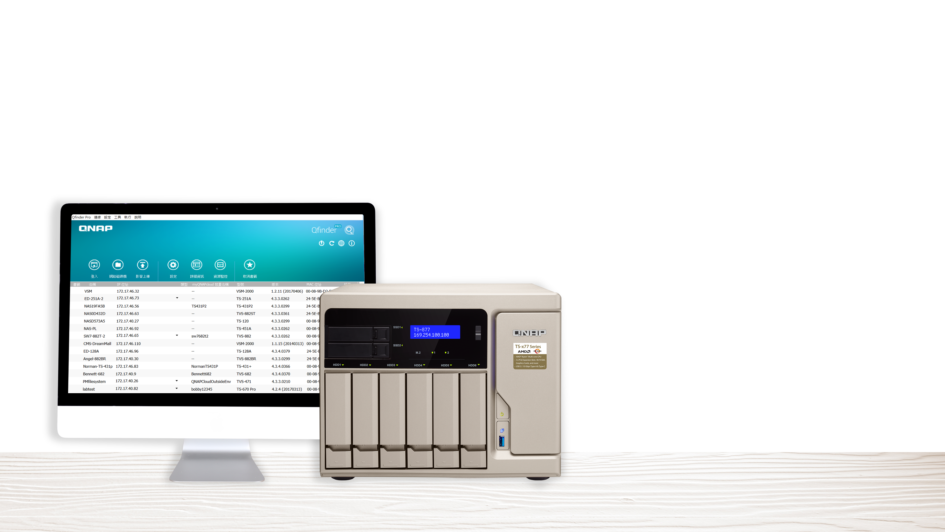
Qfinder Pro
Qfinder Pro
Easily find and configure NAS

Slide 3
The Qfinder Pro you already knew...
Use Qfinder Pro to connect to QNAP NAS and perform initializations
Find and access all QNAP NAS over the same LAN

Slide 4
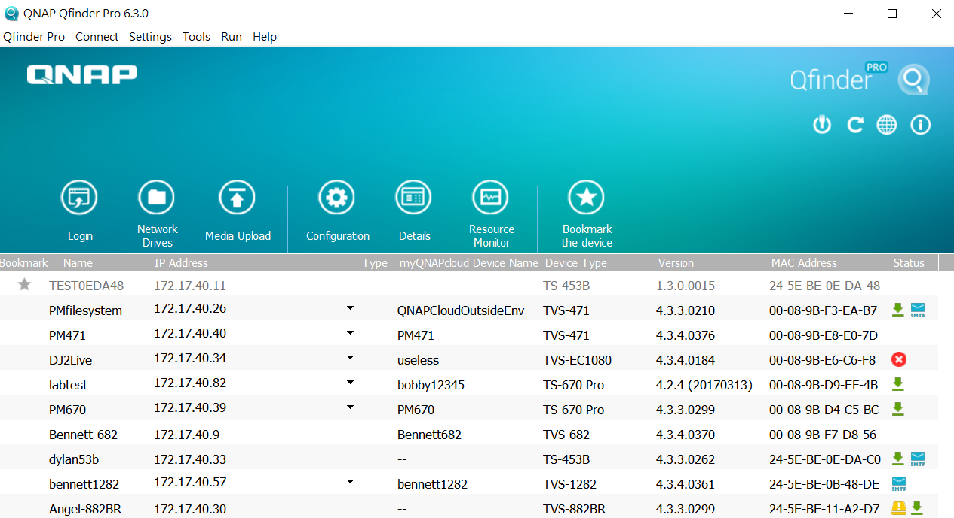
The Qfinder Pro you didn't know...
Notes:
放各個功能的icon圖
但別小看Qfinder Pro

Slide 5
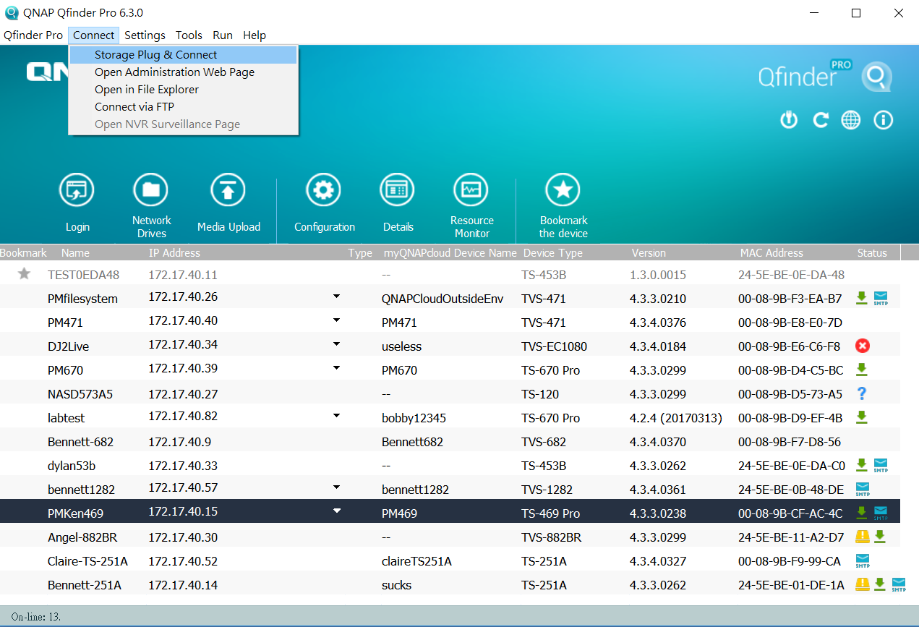
The Qfinder Pro you didn't know...
Mount folders
Wake on LAN
Firmware Update Right-click to see this option

Slide 6
QNAP Qfinder Pro
S** Assistant
Search and connect to NAS
Network Drives
Wake on LAN
Search and access to NAS
Network Drives
Set up Wake on LAN
Notes:
照片上傳
影片轉檔設定
資源監控
CPU 使用率
記憶體使用率
區域網路
儲存空間

Slide 7
QNAP Qfinder Pro
S** Assistant
Search and access to NAS
Network Drives
Remote Wake Up(Wake on LAN)
General settings for NAS
Media Upload
Resource Monitor
Mount folders
Software update
Live update
Search and access to NAS
Network Drives
Set up WOL
Printer Device
More functions!
The devil is in the detail!
Notes:
照片上傳
影片轉檔設定
資源監控
CPU 使用率
記憶體使用率
區域網路
儲存空間

Slide 8
Exclusive functions in Qfinder Pro
Insiders only!

Slide 9
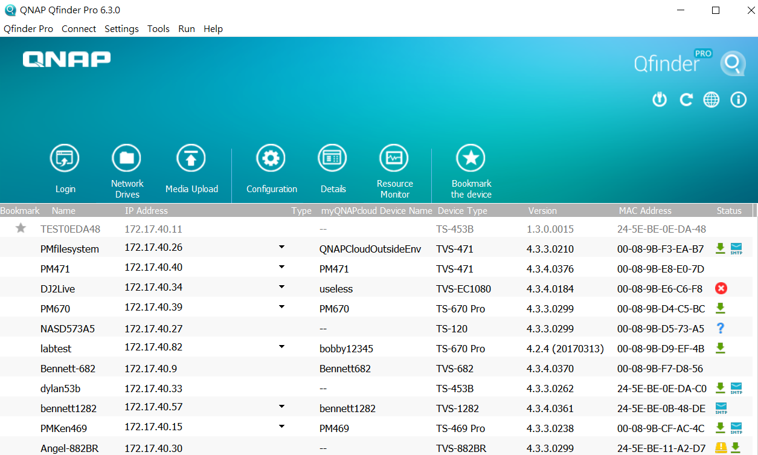
NAS overview on Qfinder Pro main page
On Qfinder Pro main page, You can learn about all NAS on the same LAN:
NAS Status (overview)
New firmware available for this NAS
HDD nearly full or in abnormal state
NAS fatal error
NAS not initialized
SMTP notification not set
Basic info
IP Addresses
List all available IPs of selected NAS so users can access NAS via different routes.
Notes:
放各個功能的icon圖
但別小看Qfinder Pro

Slide 10
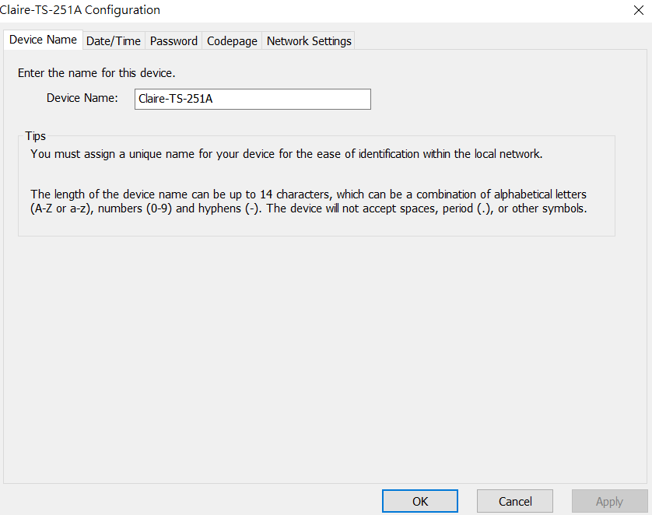
NAS Settings
Directly configure settings
in Qfinder Pro, such as:
General Settings
Device Name
Date / Time
Password
Codepage
Network Settings
SMTP Settings

Slide 11
Media Upload
Batch Upload local files (photos or videos)
Perform local transcoding/conversion, then upload to NAS. This solves the problem that some entry-level ARM-based models don't support hardware transcoding.

Slide 12
Media Upload - Advanced Settings
Create thumbnails
File name conflict policies during upload
Settings for Upload
Original files
Transcoded files
Resolution
Performance comparison
720p m4v -> 360p mp4
Time spent for transcoding and upload
Qfinder Pro
S** Photo Station Uploader
37s
93s
There is a 56s difference

Slide 13
Mount folders - Windows
Mount NAS folders in Windows File Explorer, allowing you to save time from having to log into QTS and access files
Create a Network Drive
Map the Network Drive
Create a Virtual Disk
Create a new shared folder and mount it
Directly mount the selected shared folder
Create a virtual disk and mount it
Notes:
您可以透過Qfinder Pro Windows的Storage Plug & Connect功能將NAS上的資料夾掛載到Windows的檔案總管。這是一個很方便的功能，掛載資料夾後，您不必登入QTS系統也可以由Windows檔案總管瀏覽並存取NAS上的資料。
請注意：Storage Plug & Connect目前只支援Qfinder Pro Windows版本。

Slide 14
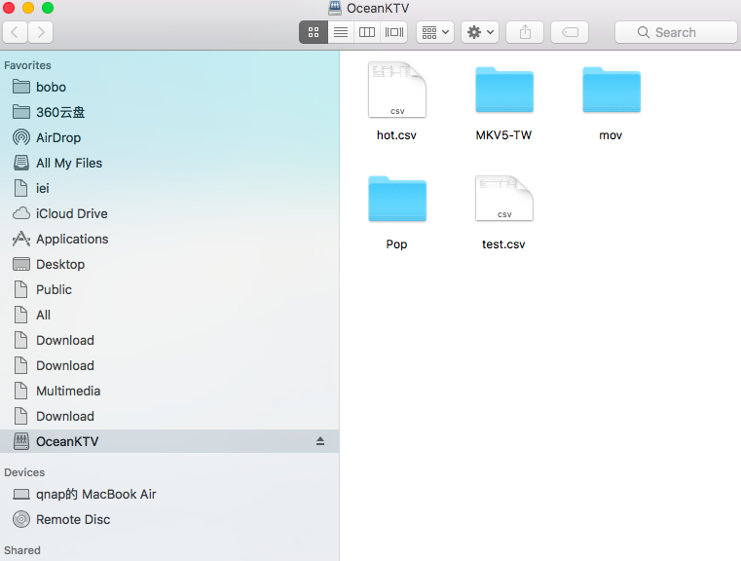
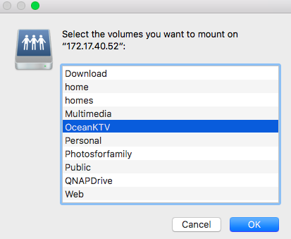
Mount folders - macOS
exclusive
Mount NAS folders in macOS Finder. Even you restart the computer, mounted folders are still there.
Auto configure appropriate system settings and enhance transmission efficiency of SMB connections in macOS.
1
2
Notes:
MAC也可以

Slide 15
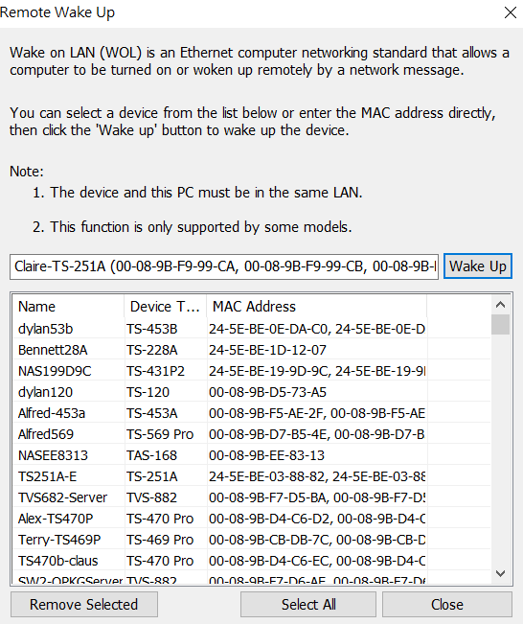
Wake on LAN (WOL)
Shut down NAS and save power when not used. Remotely wake up NAS in sleep mode when you need to use NAS through Wake on LAN.
Function comparison
Qfinder Pro
S** Assistant
Memorize NAS that was previously found.
Even it is not found now, it can be still woken up.
You can not find NAS once it enters sleep mode.
You can't wake up NAS!

Slide 16
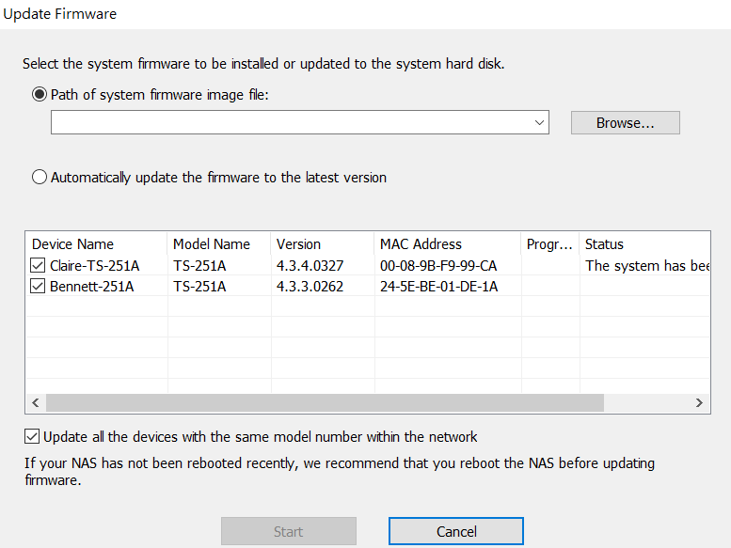
QTS Update
Use Qfinder Pro to update QTS directly without logging in to web interface
Manually upload
(system firmware image file)
Live update
(system firmware image file)
Update all NAS of the same model name within the network

Slide 17
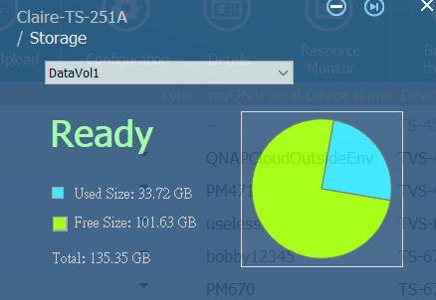
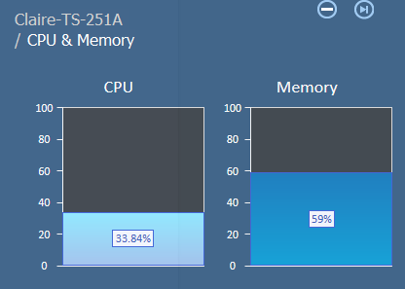
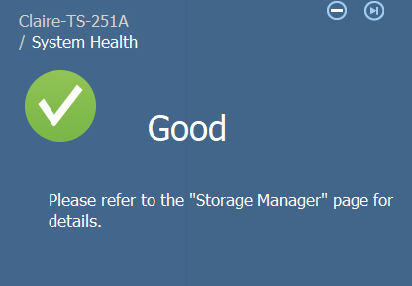
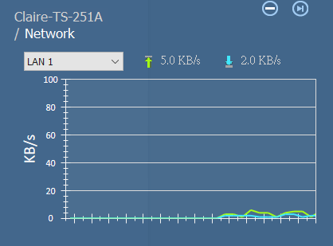
Resource Monitor
Quick overview of utilizations of NAS, CPU and memory. Also, learn about if NAS is in normal state or not
Notes:
Resources monitoring helps you to find out the allocation of resources of your NAS.

Slide 18
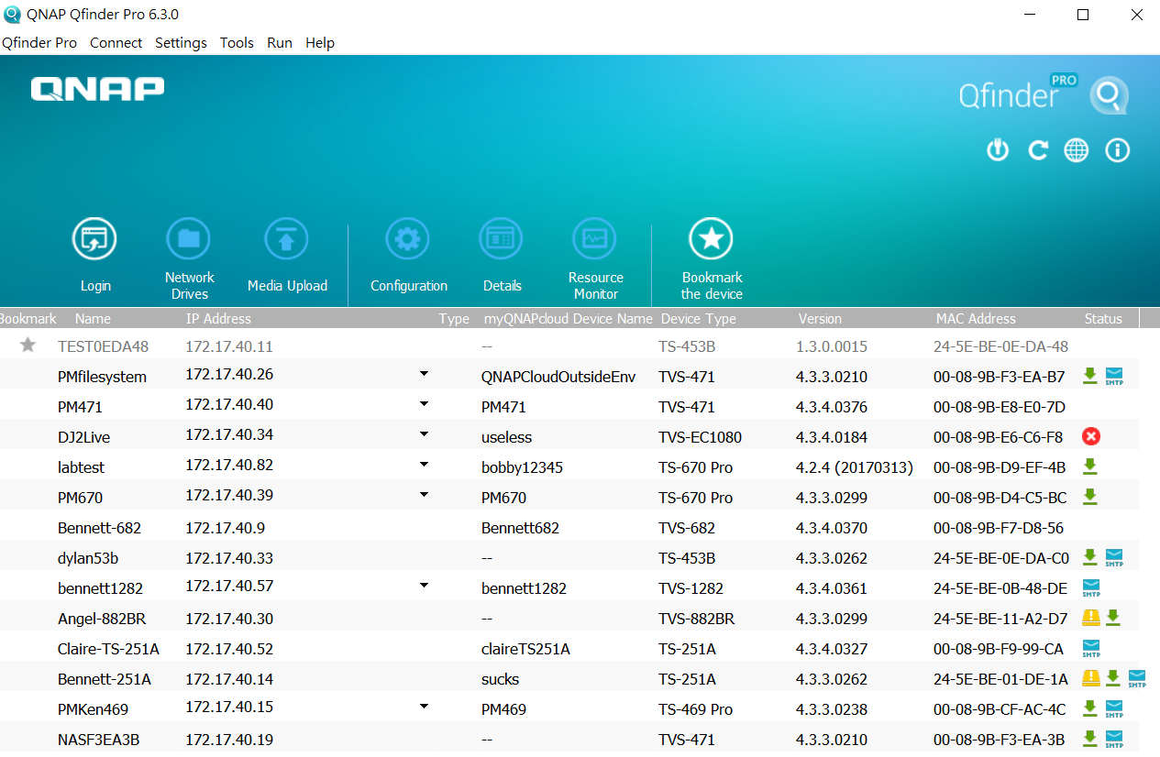
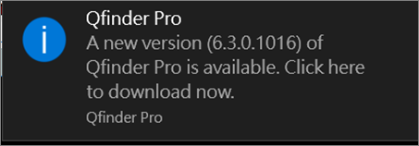
Qfinder Pro version check and live update
Qfinder Pro automatically check for new versions and show a notification that there is a new version available.
Update now to enjoy new functions and better user experience!
Notes:
Qfinder Pro version inspection and online update
Qfinder Pro automaticlly inspect and remind you if there is a updated version. In that case, you could use the newest and best version of Qfinder Pro and yet have a perfect experience.

Slide 19
Qfinder Pro for Chrome & Chromebook

Slide 20
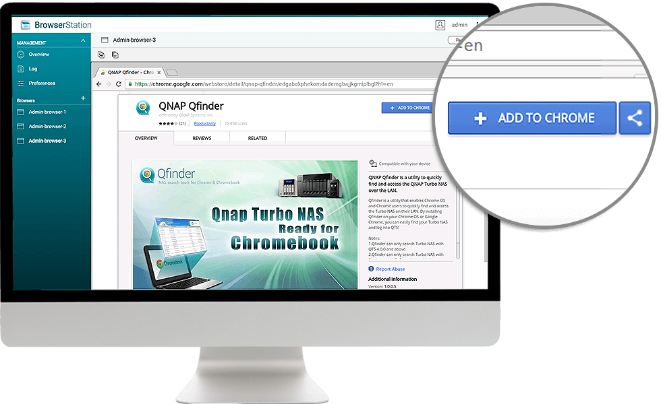
Quickly access NAS with Chrome integration
Install QNAP Qfinder browser extension for Chrome to quickly find and access QNAP NAS on the LAN

Slide 21
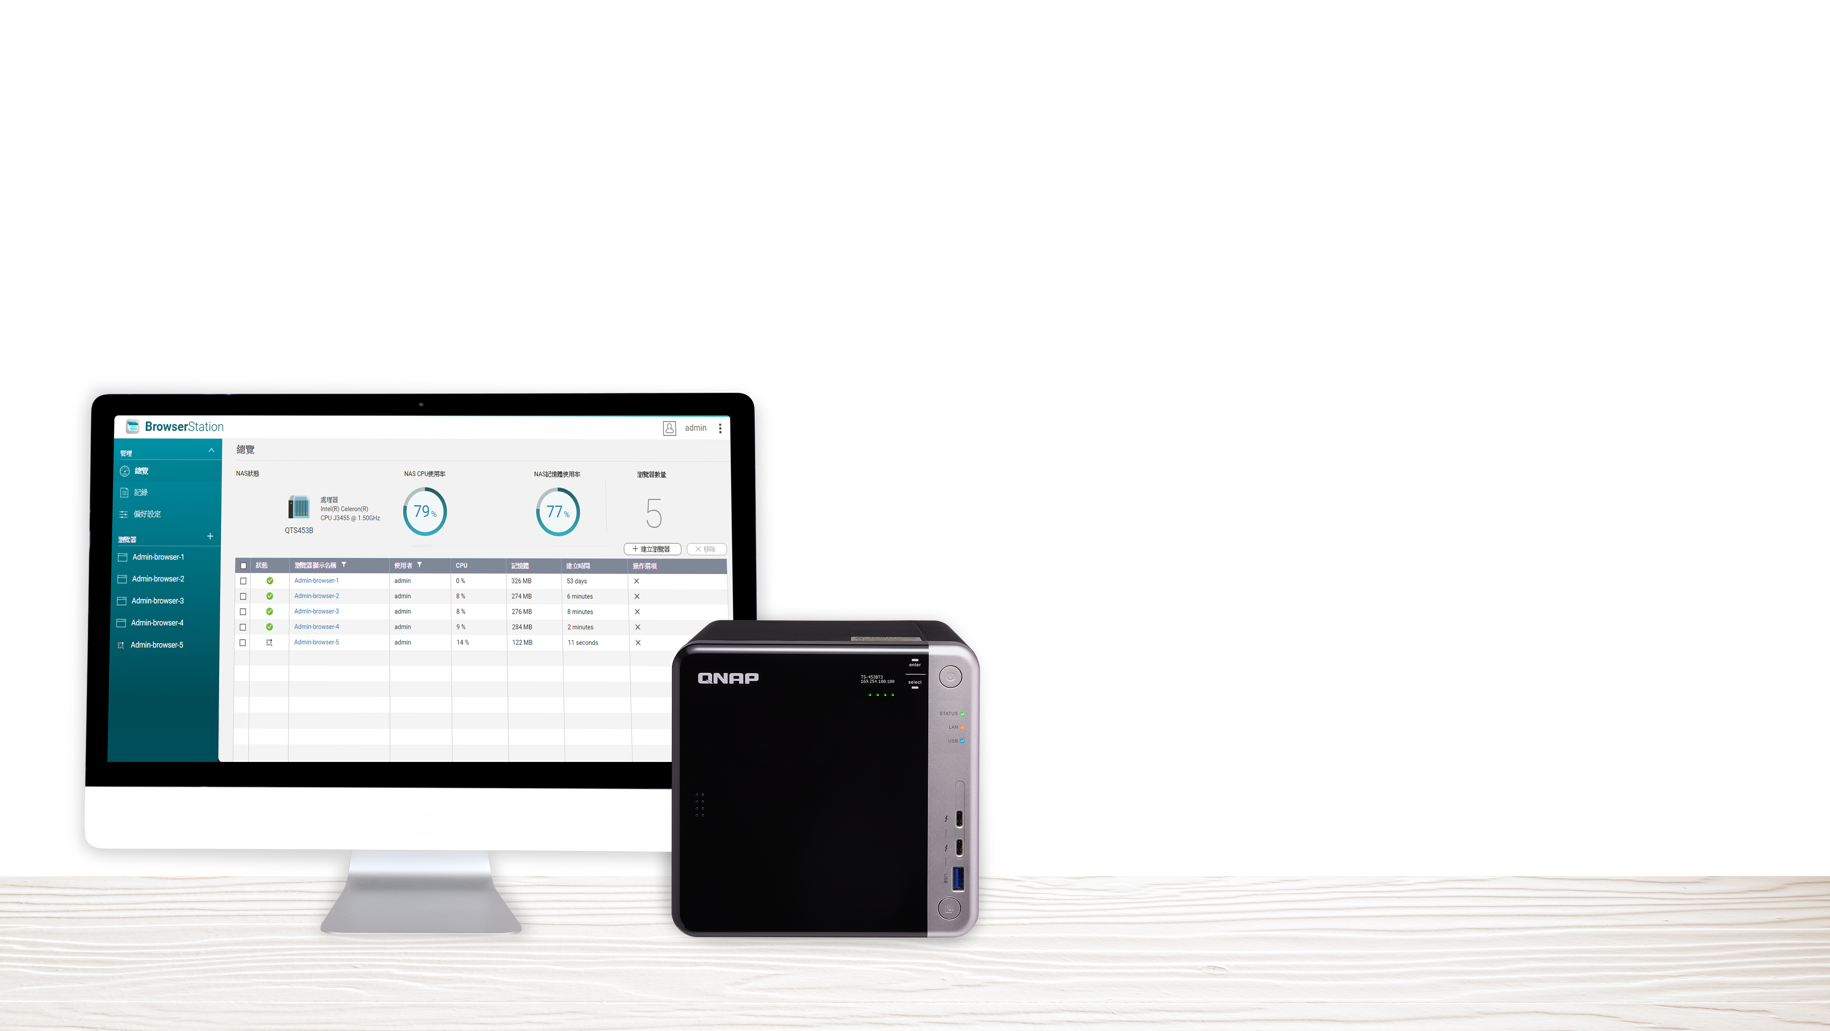
Browser Station
Secure and convenient access to private networks

Slide 22
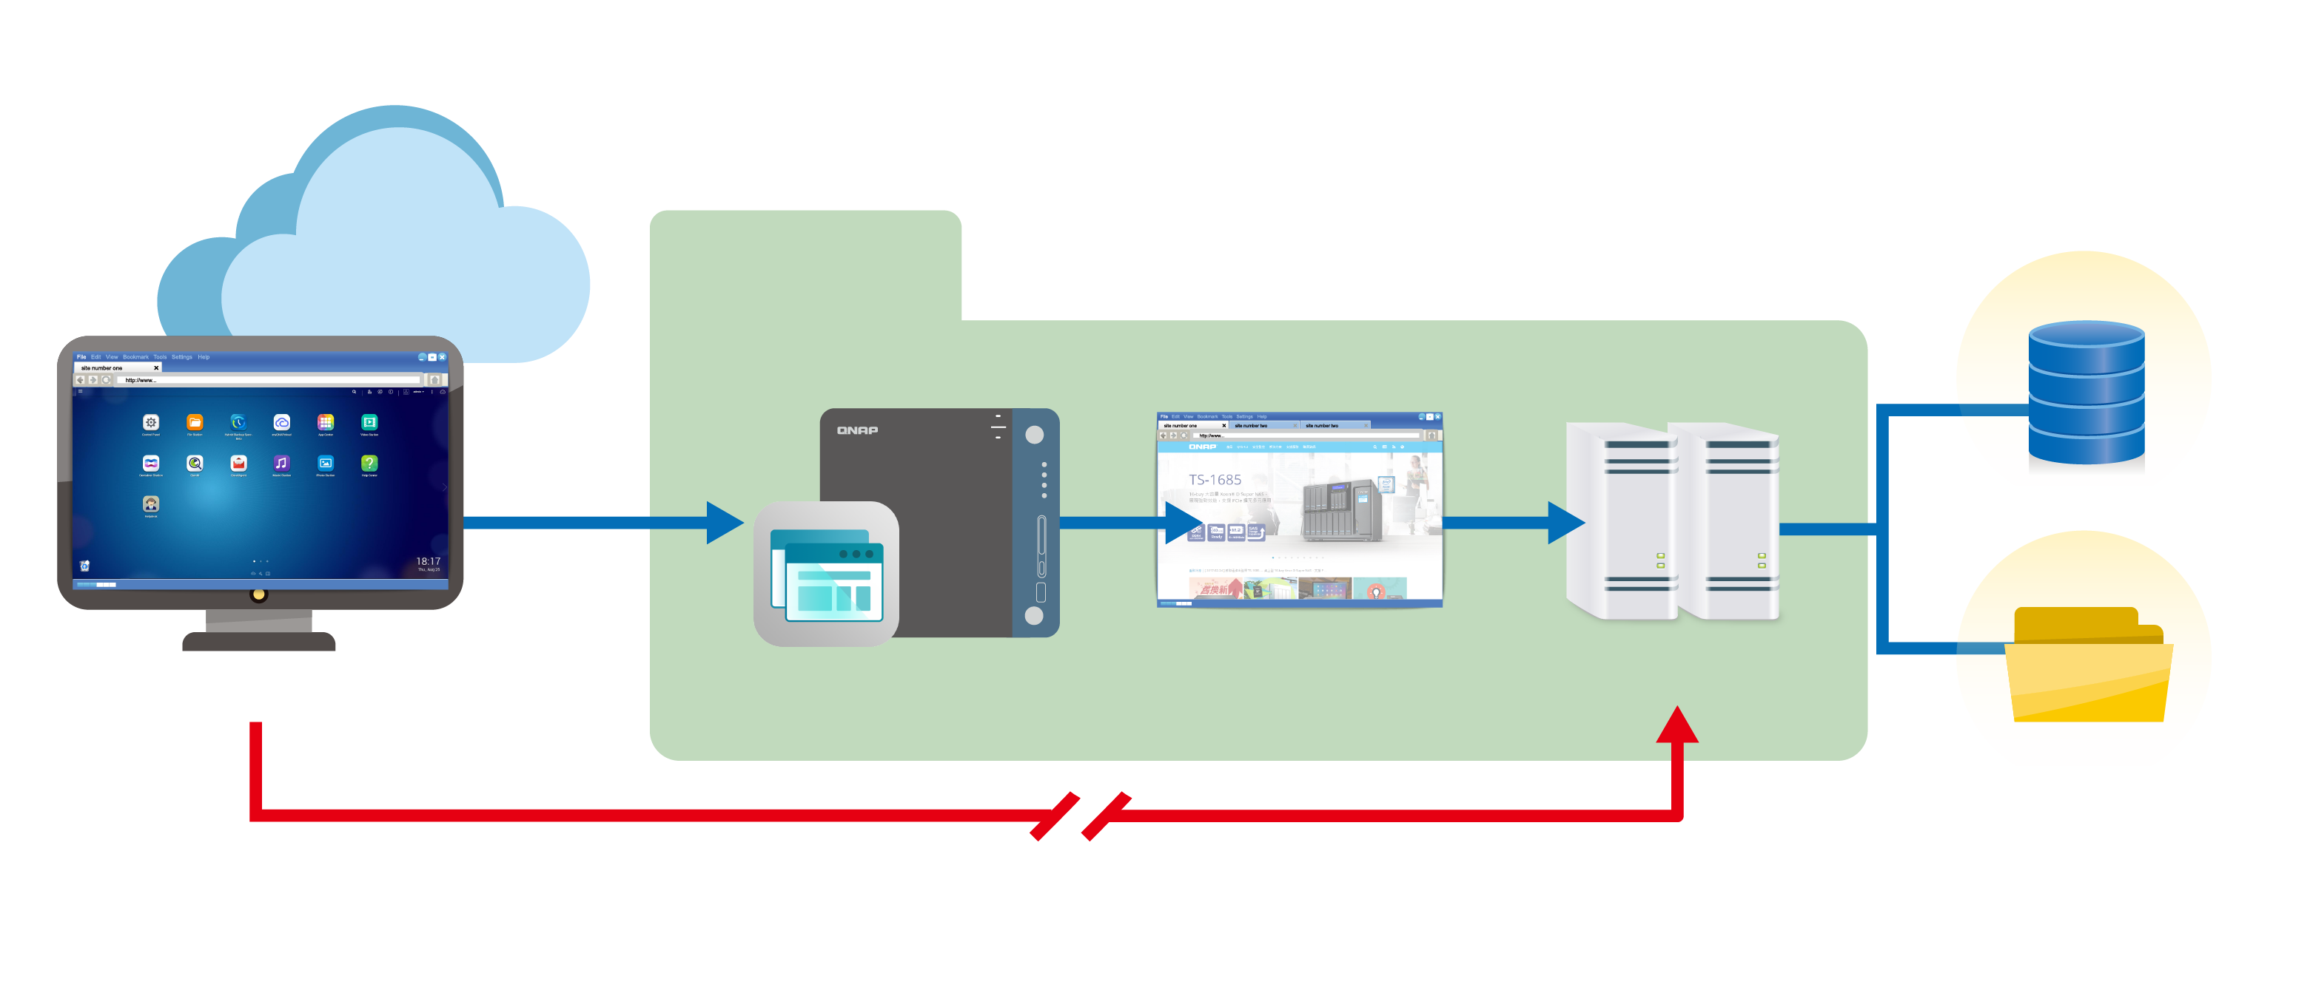
Browser Station
Secure and convenient access to private networks
Creating virtual browsers on NAS helps you easily access resources on LAN from remote devices without setting up a proxy or VPN
Specify a shared folder on NAS for downloading files
myQNAPcloud
Local Network
Database
Internet
File Exploer
Browser
Brower Station
Server
Notes:
What is browser station?
you could browse whatever you want via NAS. How to do it? you need to establish virtual browser on your NAS so that you could break the limitations on Internet
Also, You could choose the destination file for your downloaded files and those files are directly stored in your NAS.

Slide 23
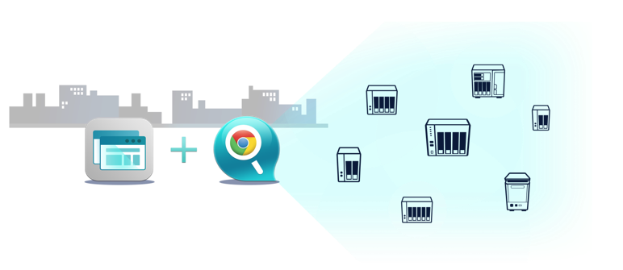
With QNAP Qfinder extension…
Break barriers and access NAS directly
Browser Station
QNAP Qfinder
Notes:
Browser Station along with Qfinder add-on

Slide 24
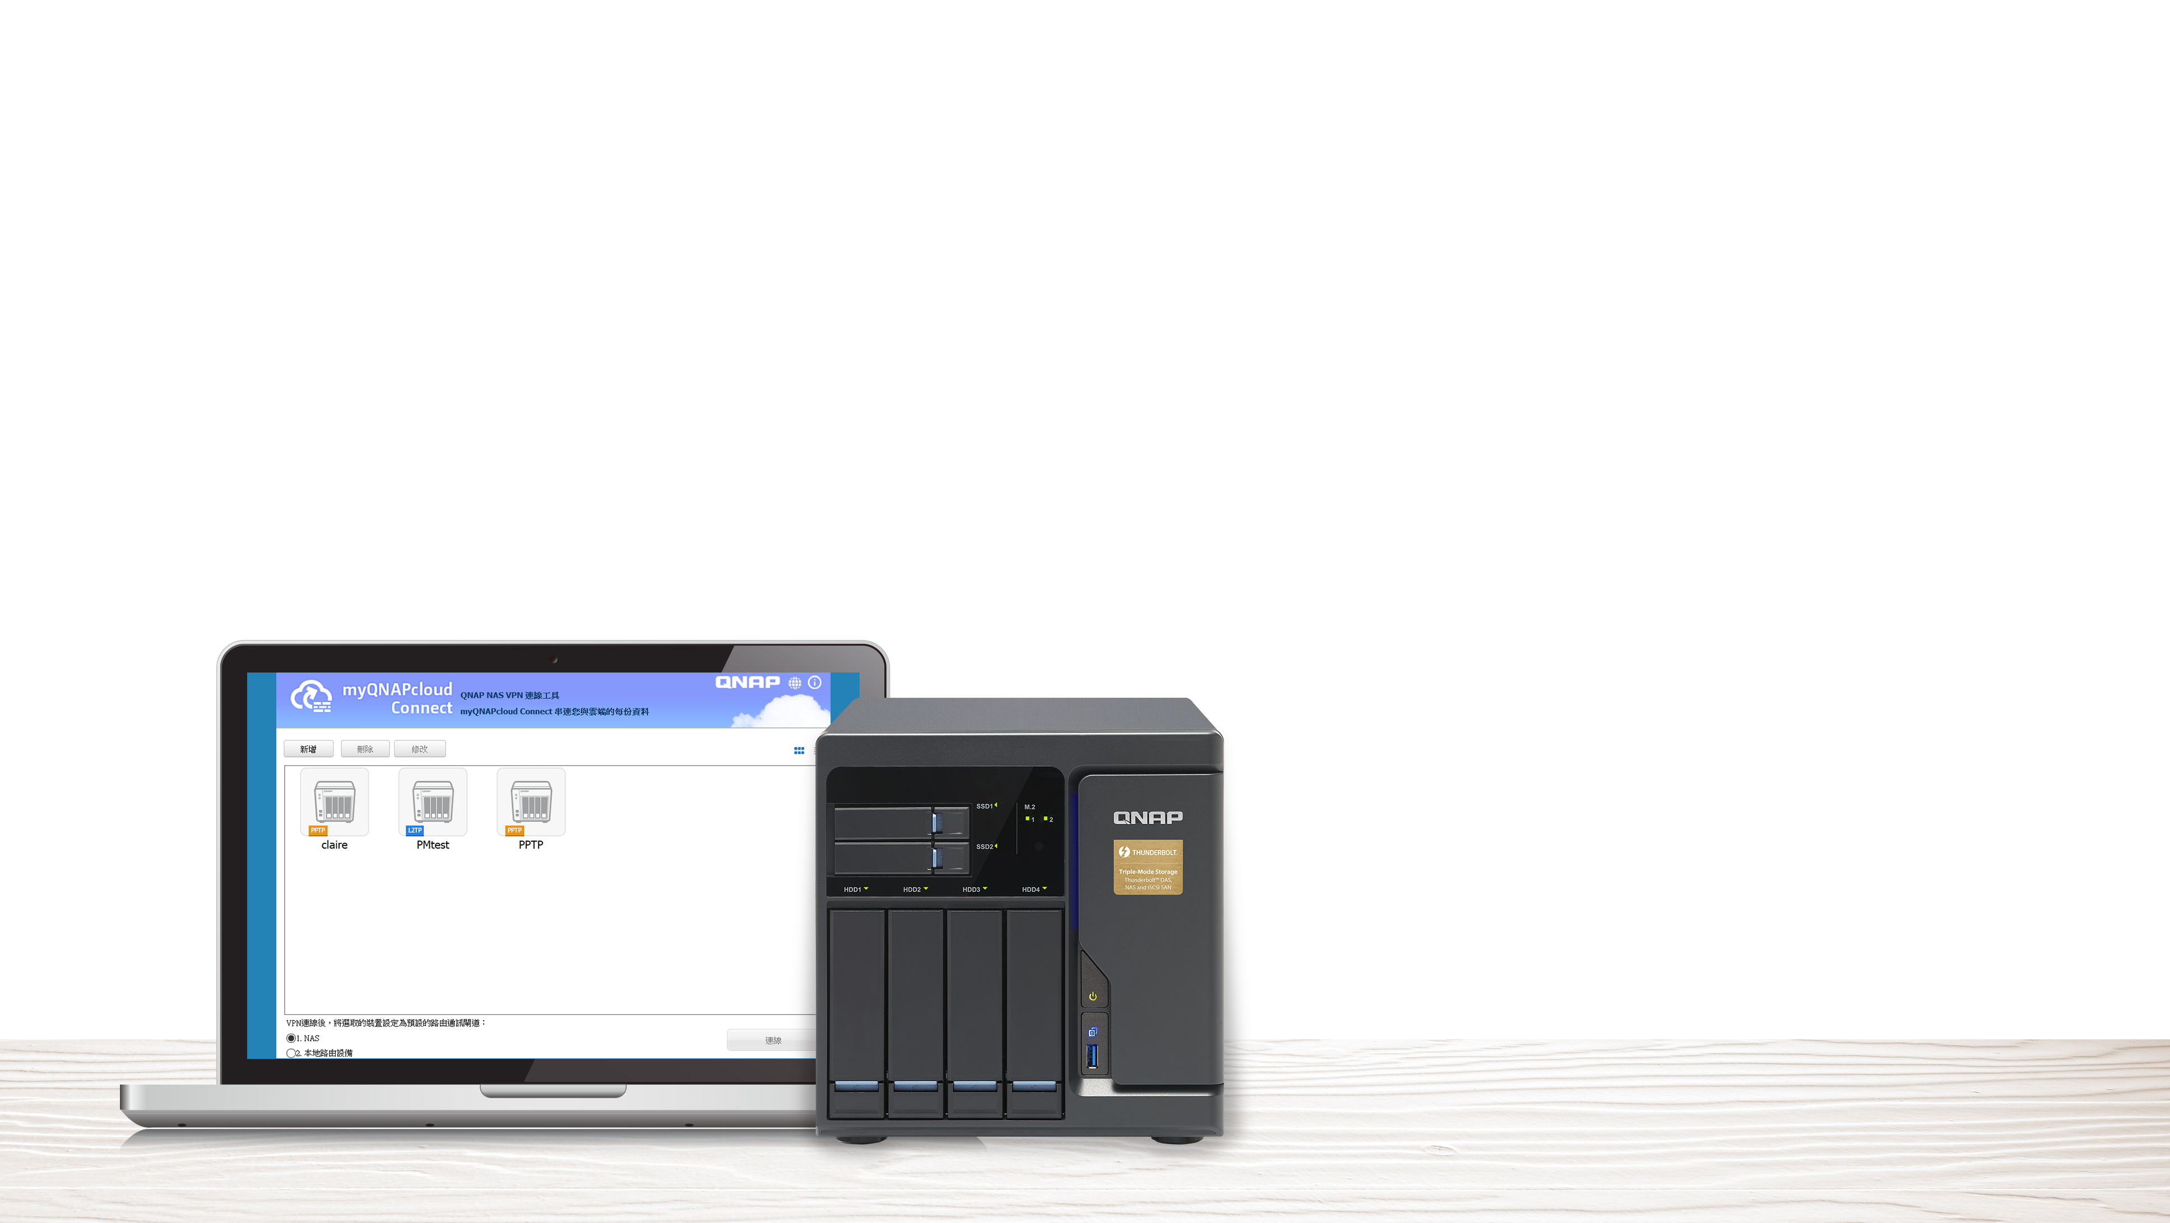
myQNAPcloud Connect
Access files quickly and securely via VPN
透過VPN連線以便利安全的方式存取資料

Slide 25
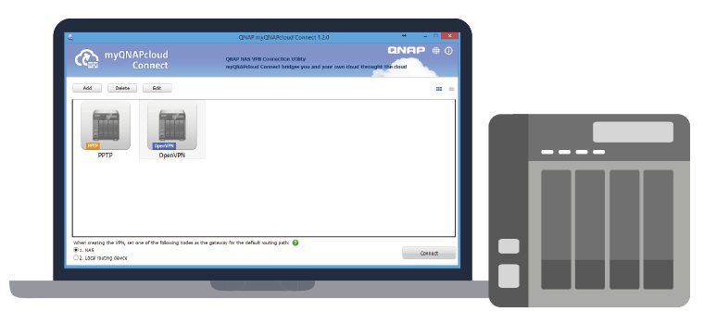
myQNAPcloud Connect
Designed for Windows users
Access published services on NAS over Internet via VPN
Easily manage files by drag-and-drop within Windows Explorer
Support OpenVPN, PPTP, and L2TP/IPSec protocol

Slide 26
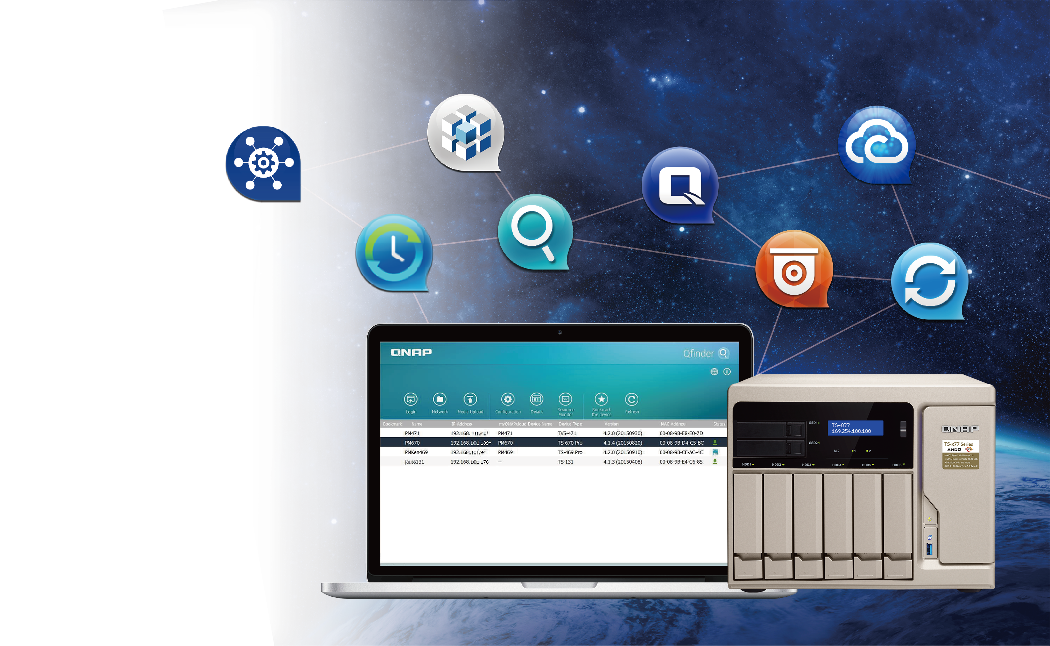
More utilities for QNAP NAS
QNAP NAS Utilities
More useful utilities to assist with your daily routine
For PC:
Qsync, QVhelper, QVR Client
For Server:
vSphere (Web) Client plug-in, Q'center Virtual Appliance, QNAP Snapshot Agent
Multimedia:
Video HD (KODI Add-on), Qmedia (Android, tvOS, Roku)
Notes:
Here are some more tools that could help you with your daily work.
for PC
for server
multimedia applicaton

Slide 27
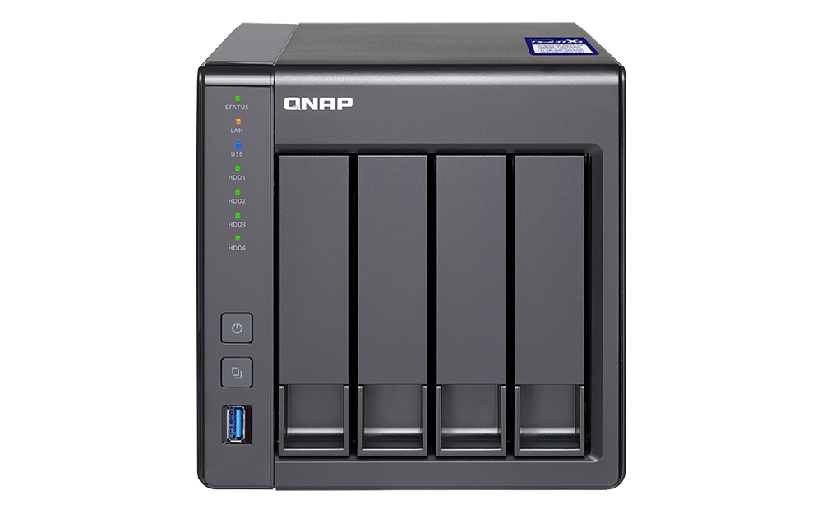
Live
Demo

