Slide 1
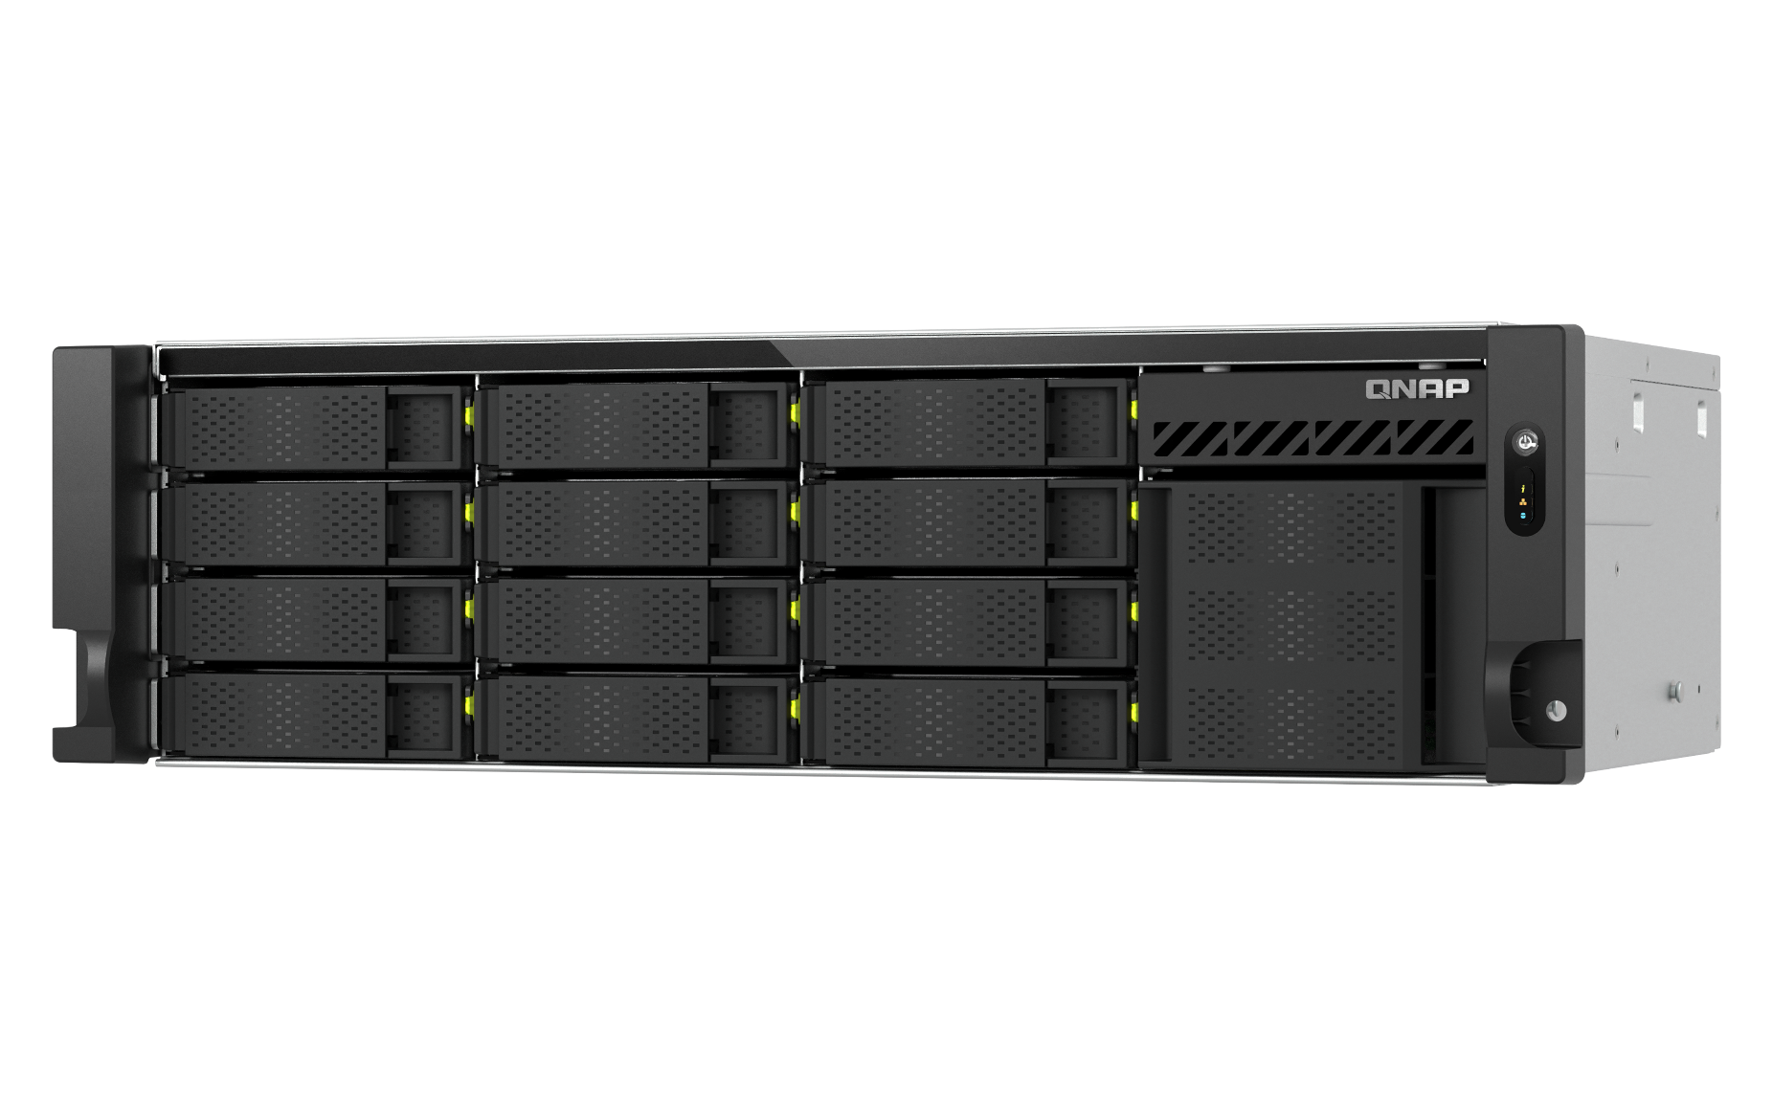






TS-h1655XeU-RP
3U 12 x 3.5" HDD & 4 x E1.S/M.2 NVMe SSD Hybrid Short-Depth 12-inch Rackmount NAS with Intel Atom® 8-Core 2.8GHz Processor
2025/08

Slide 2
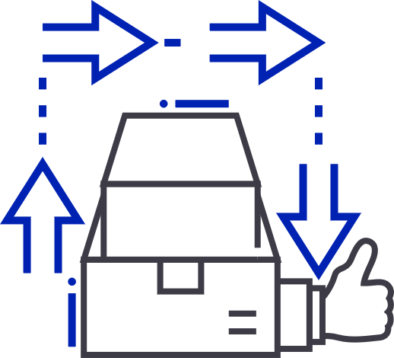


Adapting server solutions: The rise of short racks for diverse needs
In today's fast-paced tech landscape, traditional server rooms and data centers often come with significant space and design constraints. In recent years, manufacturers such as Supermicro, ASRock, Dell... and more have also been continuously releasing short-depth server products.
Space Efficiency
Cost-Effective
Flexibility
Short racks offer a compact solution, making them ideal for environments where space is limited, such as small offices or studio settings.
They provide the necessary infrastructure without occupying excessive floor area, accommodating various types of equipment in constrained spaces.
By reducing the amount of physical space needed, short racks can also help lower setup and operational costs

Slide 3
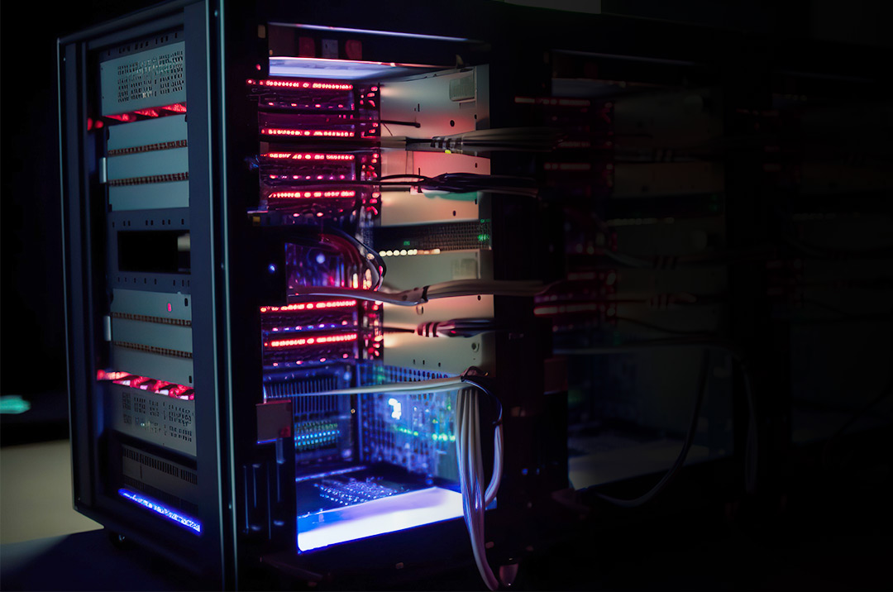
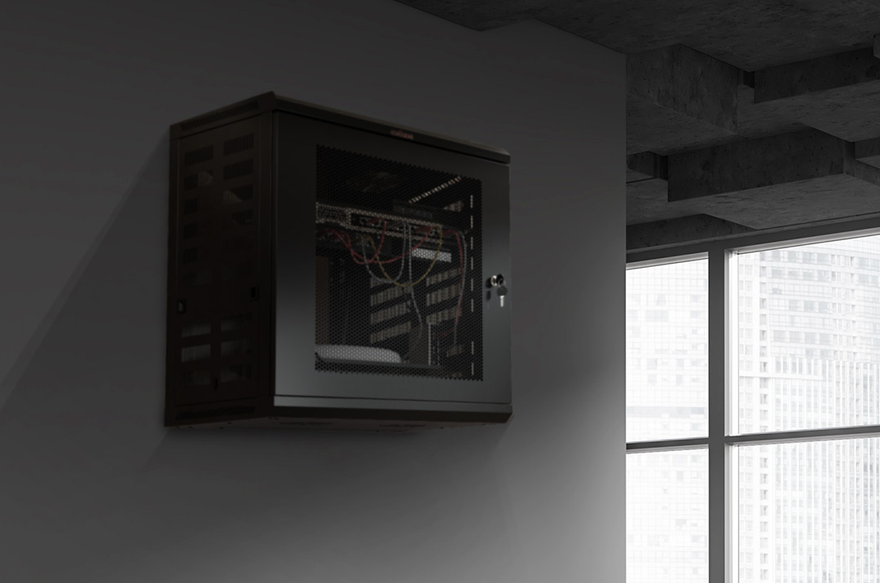

Perfect for space-limited edge environments
Network Cabinets/Racks
Wall-mounted Network Cabinets
Server Racks
Media studios, campuses, or small offices can conveniently store short-depth NAS along with network devices in compact cabinets.
(The rails can only be secured if the back of the cabinets can be opened.)
In limited space environments like laboratories or factories, short-depth NAS can be placed in wall-mounted cabinets close to computers or servers, facilitating easier access.
Short-depth NAS can also be placed inside standard server racks in the server room, with the saved space used for cable management.

Slide 4
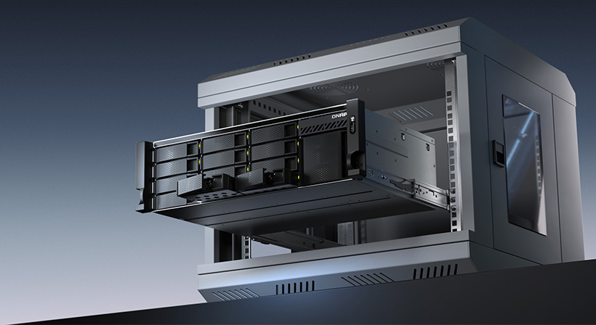
The chassis depth has been reduced to 12 inches
Compared with 3U rackmount NAS in the market
Reduced by 50%+
Power buttonexpansion
LED Indicators:
System status, network, USB

Slide 5

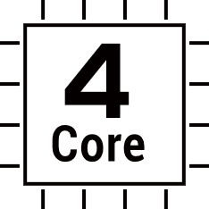

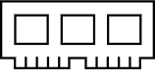
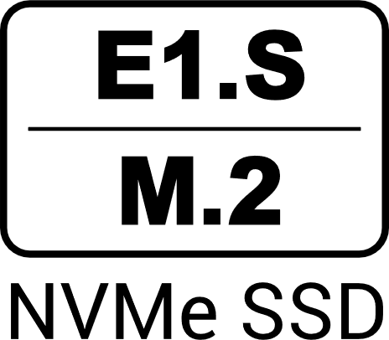
Powered by Intel Atom® 8-core processor,
12-inch short-depth rackmount NAS
Intel 8-core CPU
1 x 10GBASE-T &
2 x 2.5GbE Multi-Gig LAN Ports
8
Powered by Intel Atom C5125 8-core processor 2.8GHz, providing powerful performance
Core
Sufficient network bandwidth provides smooth data transmission experience
12-inch short-depth rackmount NAS
Dual PCIe Gen3 x4 slots
Provide a variety of expansions including 5/10/25GbE network card, M.2, HBA and other expansion cards
30-cm / 12-inch short chassis supports most of the cabinet on the market
Maximum 64 GB Memory
4 x E1.S PCIe Gen3 x2
(pre-installed M.2 adapter) slots
Pre-installed 1 x 8G DDR4 SODIMM RAM, support up to 64GB memory (2 x 32GB).
Also support ECC memory
DDR4
Provides 4 x E1.S SSD slots, supporting up to 15mm E1.S. Also comes standard with M.2 adapter to support M.2 2280 NVMe SSD

Slide 6
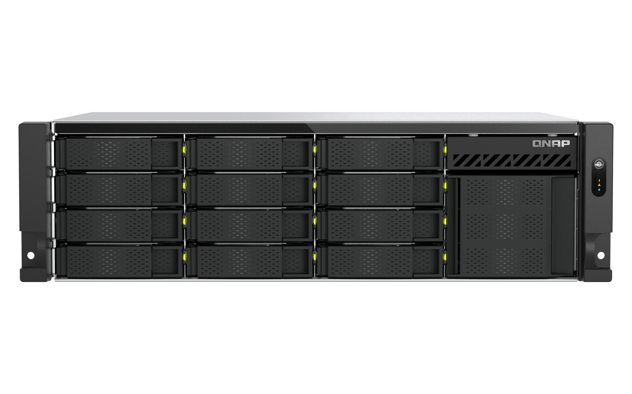
TS-h1655XeU-RP front views
Power button
LED Indicators:
System status, network, USB expansion
12 x 3.5-inch/2.5-inch SATA 6Gb/s HDD/SSD bays
Air Intake holes

Slide 7
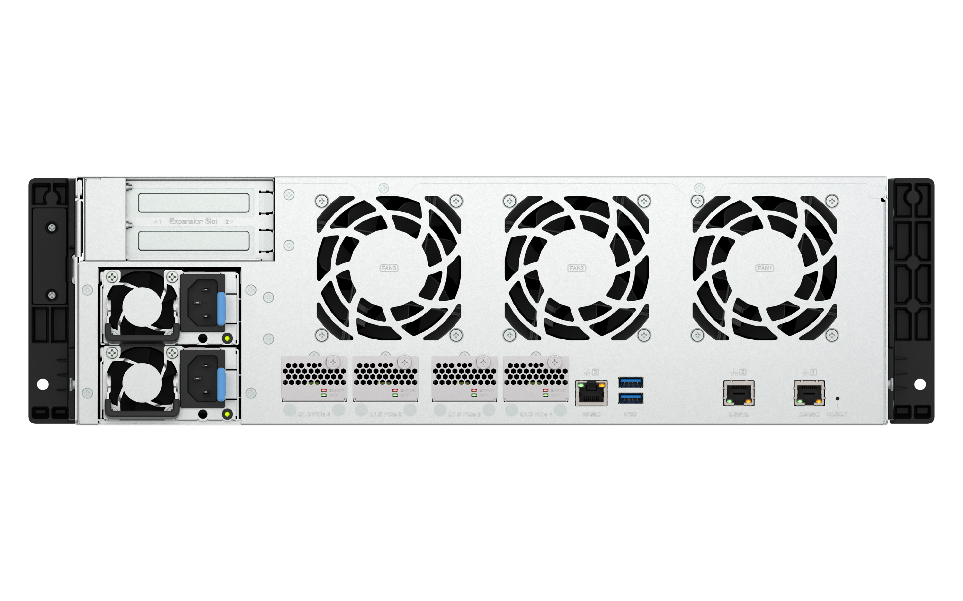
TS-h1655XeU-RP rear views
2 x PCIe Gen3 x4 slots
slot 1 & slot 2
77 x 20 x 220 mm ( H x W x D)
1 x 10GBASE-T
2 x USB 3.2 Gen 1
2 x 300W PSU
4 x E1.S / M.2 2280 PCIe Gen3 x2 slots, support NVMe SSDs, or 10GBASE-T network port through QXG-ES10G1T accessory
2 x 2.5G RJ45 ports
K-Lock

Slide 8
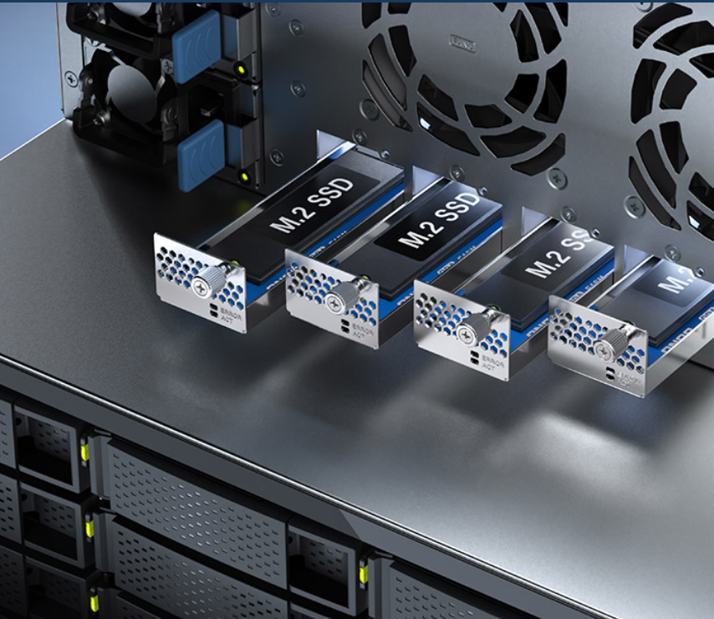
Powerful expansion with E1.S / M.2
PCIe NVMe slots
Enhance SSD caching
Install E1.S / M.2 PCIe NVMe drives for SSD caching to accelerate random read/write efficiency (IOPS) and reduce latency, especially beneficial for handling numerous small files.*
Setup SSD high-speed storage pool
Create a data storage pool with E1.S / M.2 PCIe NVMe SSDs to expedite intensive data transfers and access efficiency.
Upgrade to 10GbE high-speed connectivity
Install the QXG-ES10G1T 10GbE network module for immediate access to faster connection capabilities. (Additional purchase)
*​Note :
Installing a 5.9mm E1.S SSD, please remove the built-in E1.S to M.2 adapter in the slot.
Installing a 9.5/15mm E1.S SSD, a QNAP tray TRAY-E1S-01 is required.

Slide 9
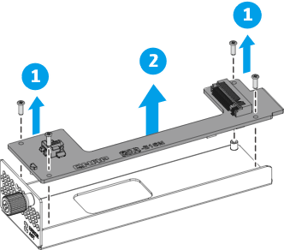
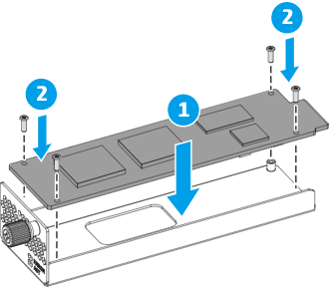
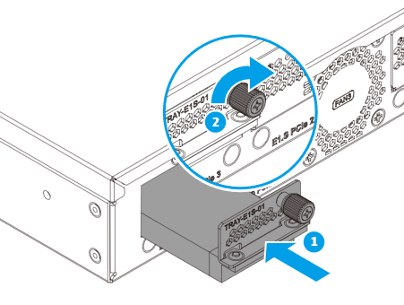
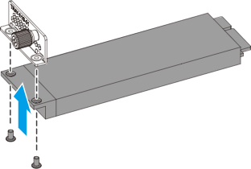
Installing E1.S solid-state drives into TS-h1655XeU-RP
Installing 5.9 mm E1.S solid-state drives​
Remove the M.2 SSD adapter.
Attach the screws that secure the drive to the tray frame.
Installing 9.5 mm and 15 mm E1.S solid-state drives
Place the drive on the TRAY-E1S-01 tray base so that the holes on the drive align with the holes on the tray base.
Then attach the screws that secure the drive to the tray base.
Insert and tighten the tray into the bay

Slide 10
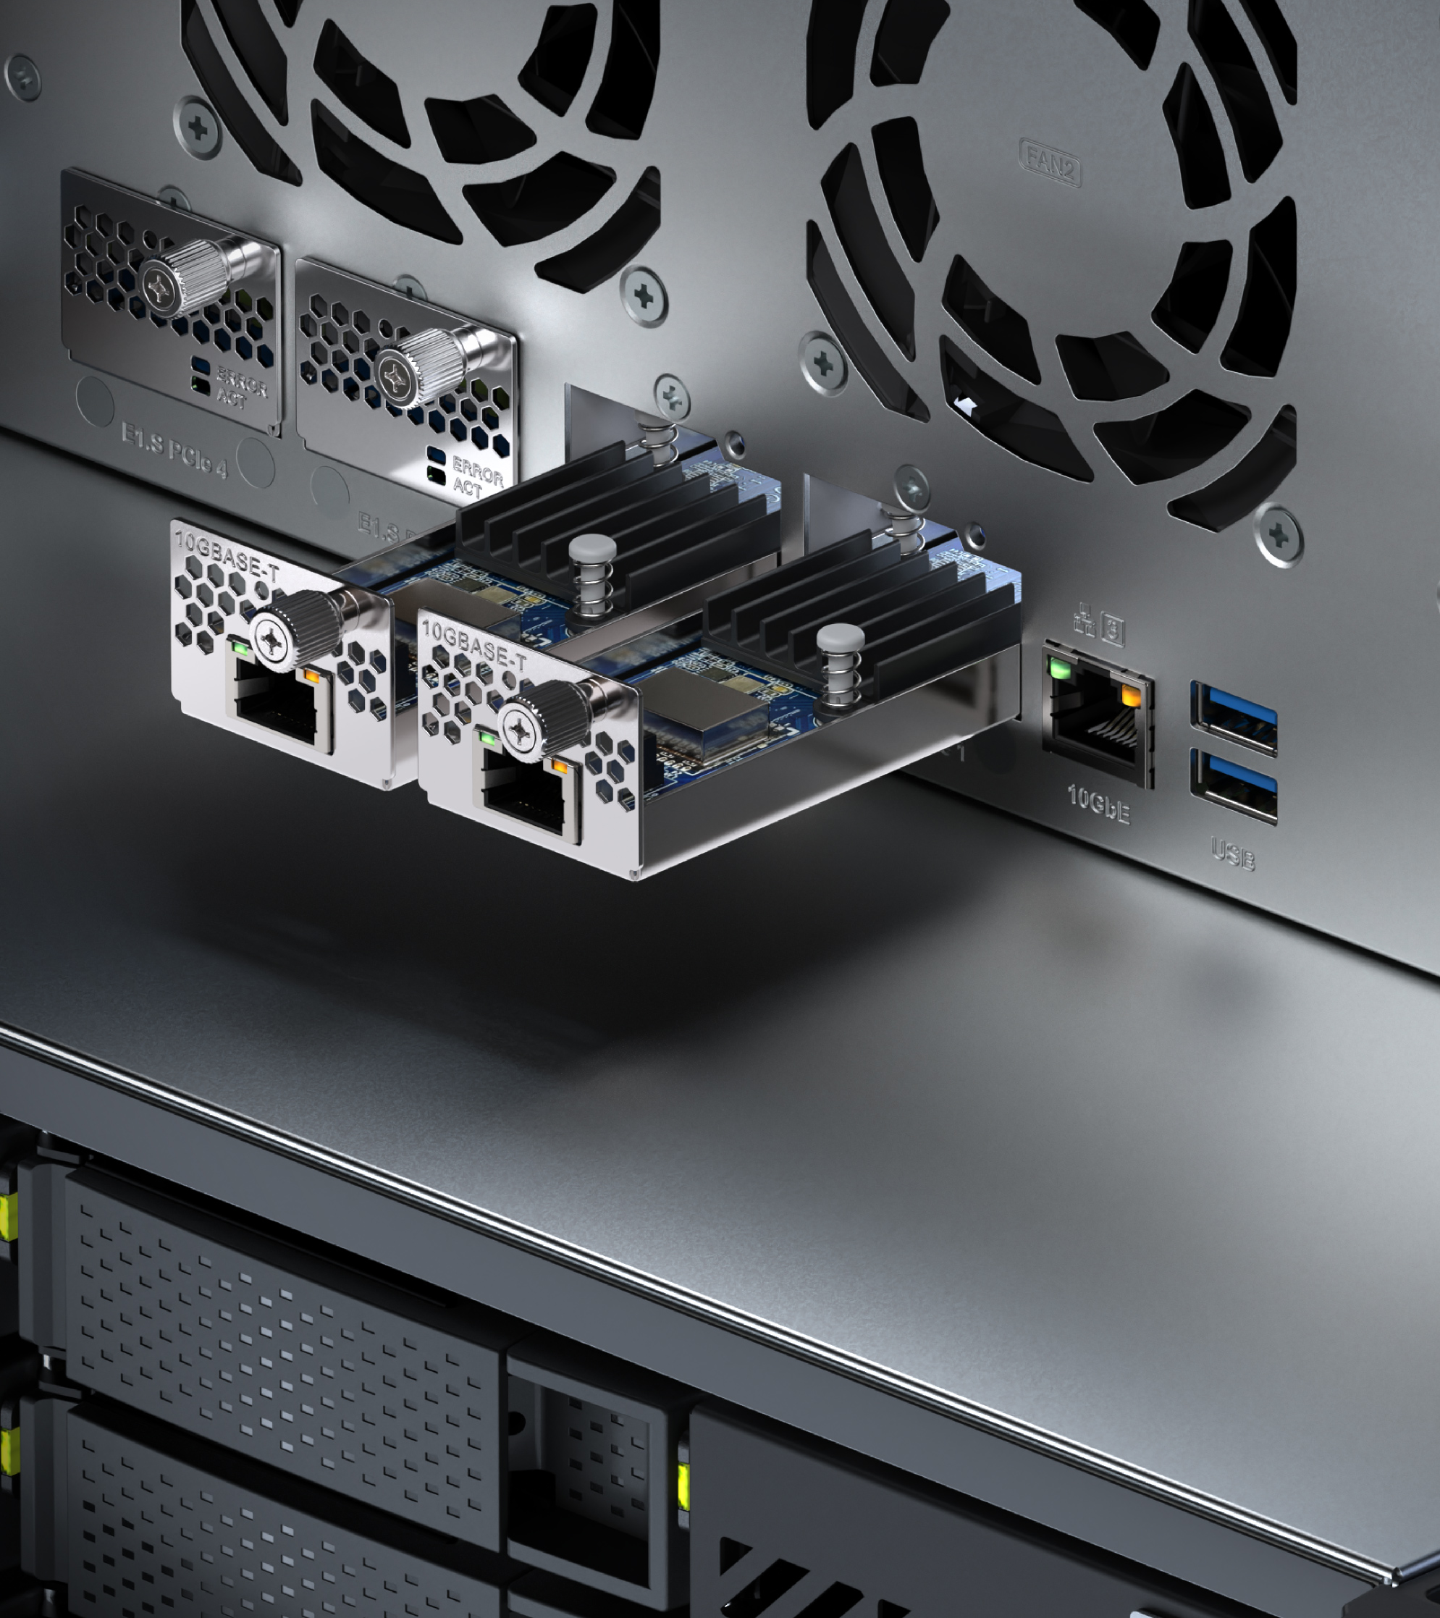
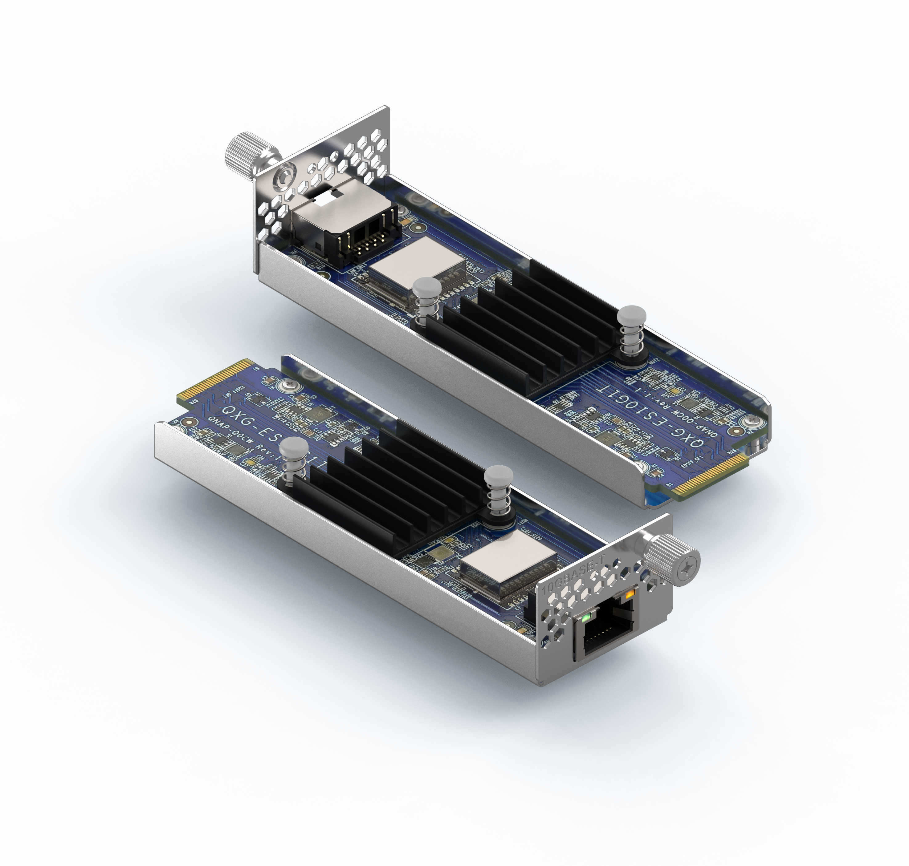
QXG-ES10G1T, upgrade your NAS to 10GbE with E1.S slots
(Additional purchase required)
QXG-ES10G1T
Multi-Gig 10GBASE-T Network adapter
Support 10G/5G/2.5G/1G/100M network connectivity.

Slide 11
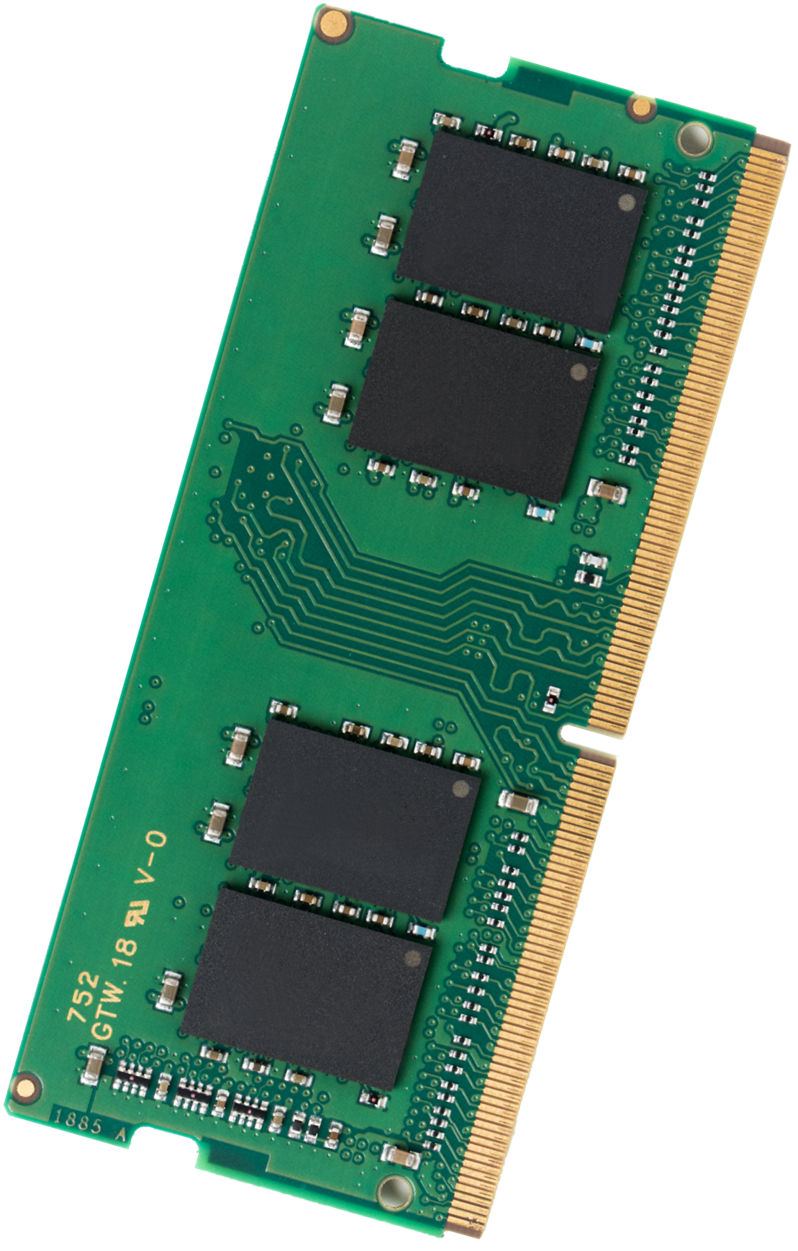

Supports ECC memory (Error Correcting Code)
Reliable memory and avoiding data corruption
TS-h1655XeU-RP supports ECC memory, automatically detecting and timely correcting single-bit errors
System supports up to 64GB ( 2 x 32GB) memory
The NAS is pre-installed with a 8GB DDR4 SO-DIMM non-ECC memory by default.
ECC memory and non-ECC memory modules cannot be installed together

Slide 12
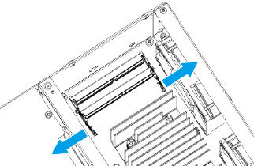
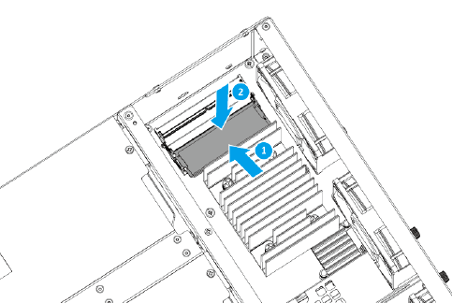
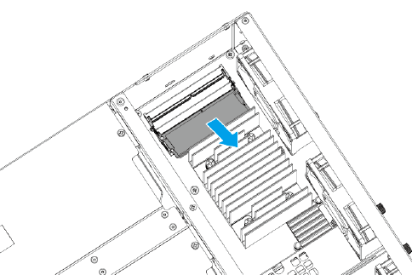
Replacing TS-h1655XeU-RP DDR4-SODIMM RAM
1.
3.
2.
Push the retention clips outward simultaneously to release the module.
Then carefully slide the module out of the slot.
Verify that the metal connectors are completely inserted into the slot.
Then press down on the module until the retention clips lock the module into place.

Slide 13
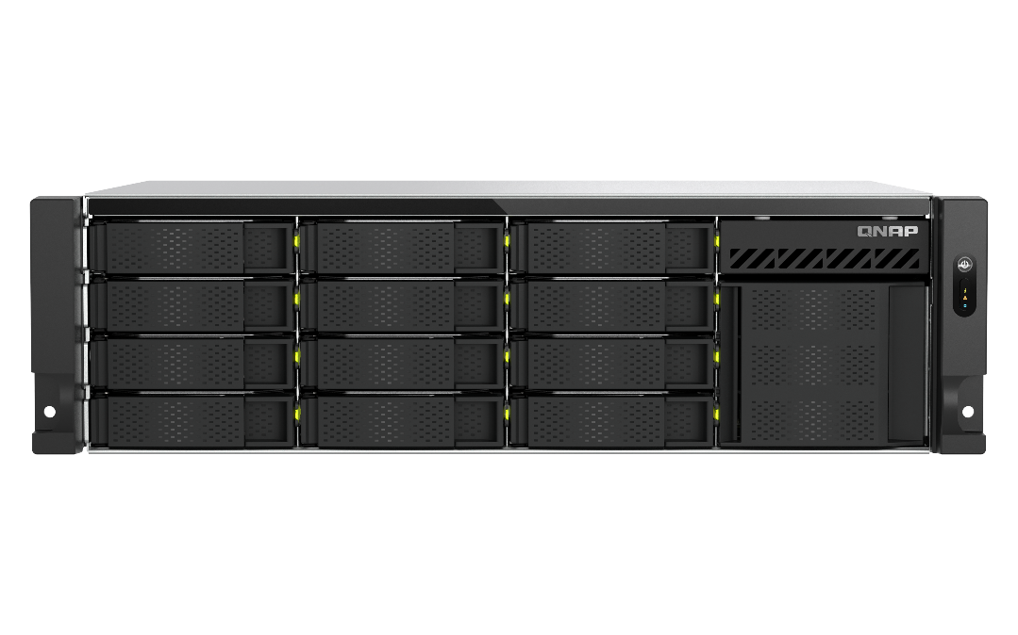
Integrated 2 x 2.5 GbE and 1 x 10GBASE-T, expand to 4 x 25GbE via QNAP PCIe network interface cards
2 x 2.5 SMB Sequential Throughput (1MB)
4 x 25 GbE SMB Sequential Throughput , 3 Host (1MB)
4,926 MB/s
5000
591 MB/s
588 MB/s
600
4500
4000
400
3500
3000
2,552 MB/s
200
2500
(MB/s)
2000
0
Write
Read
Write
Read
Environment:
NAS | TS-h1655XeU-RP, Hero h5.2.4, 12 x Samsung 870 EVO 1TB, RAID 5, thick volume
PC | 3 host with QNAP QXG-25G2SF-CX4, 32G RAM, Windows Server 2019
IOmeter : RAM*4, 30-sec ramp up time, 3-min seq. run time, 1 workers, 32-outstanding
Tested in QNAP Labs. Figures may vary by environment.

Slide 14
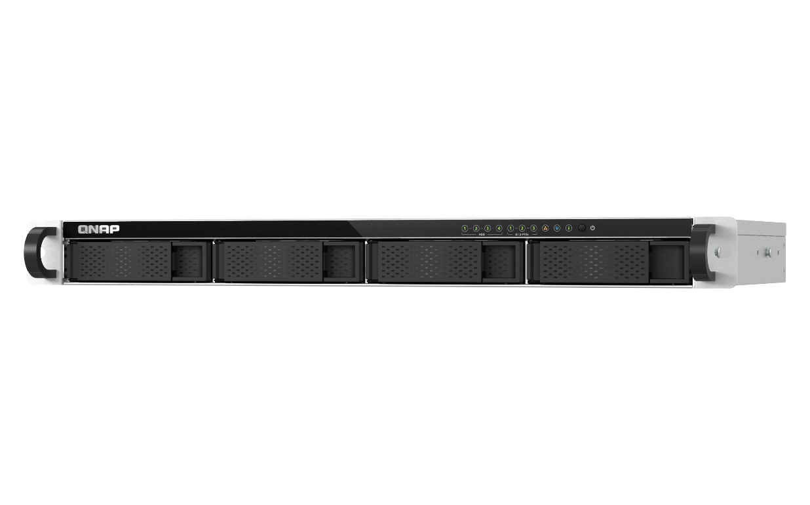
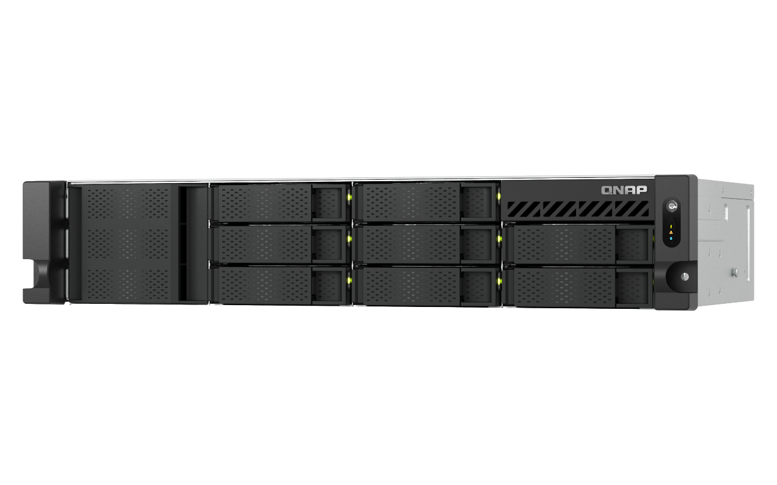

Comprehensive 12-inch(30cm) Short-Depth Solution
High-capacity storage architecture in a limited space. QNAP launches a 3U dual-power solution with a depth of only 30 cm — a model that competitors cannot offer.
 | TS-h1655XeU-RP-8G | TS-855eU-RP | RS1221+
CPU | Intel ® Atom® C5125 8-core processor, 2.8GHz | Intel ® Atom® C5125 8-core processor, 2.8GHz | AMD Ryzen V1500B 4-core 2.2 GHz
Memory | 8 GB non-ECC SODIMM DDR4 (1 x 8 GB) | 8 GB non-ECC SODIMM DDR4 (1 x 8 GB) | 4 GB DDR4 ECC UDIMM
Max. Memory | 64 GB (2 x 32 GB) | 64 GB (2 x 32 GB) | 32 GB (16 GB x 2)
Drive | 12 x 3.5” SATA 6Gb/s + 4 x E1.S/M.2 | 8 x 3.5” SATA 6Gb/s | 8 x 3.5” SATA 6Gb/s
M.2 | (4 x E1.S/M.2) | 2 x M.2 2280 (PCIe Gen 3 x 4) | -
GbE | - | - | 4 x 1GbE
2.5 GbE | 2 | 2 | -
10 GbE | 1 x 10GBASE-T | - | -
PCIe | 2 x PCIe Gen 3 x4 | 2 x PCIe Gen3 x4 | 1 x PCIe Gen3 x8
USB | 2 x USB 3.2 Gen 1 | 4 x USB3.2 Gen 1 | 2 x USB3.2 Gen 1
PSU | 2 x 300W Redundant PSU | 2 x 300W Redundant PSU | 1 x 250W PSU
Dimensions (H x W x D) | 3U Short-depth 133 mm x 432.4 mm x 296 mm | 2U Short-depth 88.6 mm x 432 mm x 296 mm | 2U Short-depth 88 mm x 482 mm x 306 mm

Slide 15
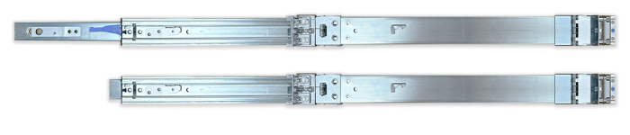
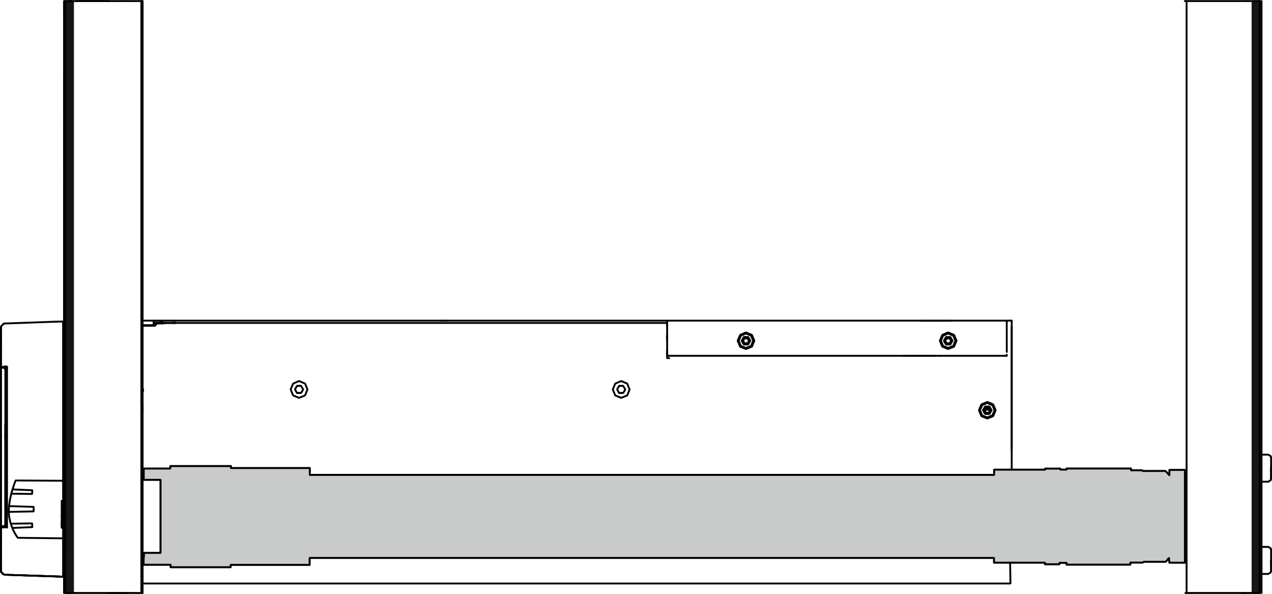

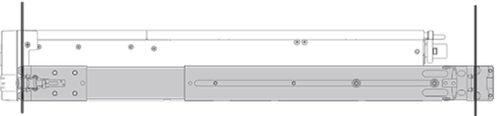
Rail Kit :
NAS installation and maintenance made convenient
Whether for compact racks or standard racks,
QNAP offers corresponding rail kits to choose from.
5" ~ 16.3" / 126 ~ 415 mm
Rail-S01
Mounting post depth: 5" ~ 16.3" / 126 ~ 415 mm
RAIL-S01
18” ~ 32”/ 443 ~ 815 mm
RAIL-B02 (normal rail kits)
Mounting post depth: 18” ~ 32”/ 443 ~ 815 mm
Cannot setup in small cabinet
RAIL-B02

Slide 16

Choose between
QTS and ZFS based QuTS hero
TS-h1655XeU-RP is shipped with the QuTS hero operating system, which has powerful data transmission performance and more efficient memory usage, and WORM. You can also change to the QTS operating system according to your needs
 | QuTS hero | QTS
File system | ZFS | Ext4
SSD cache | Read Cache | Read/Write Cache Read Cache Write Cache
Inline Compression | Yes (LZ4 compression, ideal for RAW files and document files) | No
Inline Deduplication | Yes (At least 16 GB RAM required) | No
HBS with QuDedup for Remote Backup | Yes | Yes
Power Failure Protection (Software) | ZIL Copy-on-Write | No
Permission Management | Rich ACL (14 types) | POSIX ACLs (3 types) + certain special permissions
Capacity Expansion | Upgrade RAID capacity Change higher capacity disk drives Attach expansion enclosures/JBODs | Add a disk drive to a RAID group Upgrade RAID capacity Change higher capacity disk drives Attach expansion enclosures/JBODs
Data Security | Better (Self-Healing & Copy-on-Write) | Standard
Recommendation SSD Configuration for Video Editing Applications | Use SSD Pools Note: Set the block size 128K when creating Folders/LUNs | Editing (from original/RAW files): Use SSD Pools Post production: Enable Read/Write cache Note: Set the block size to 32K or 64K when creating Volumes, and choose “All I/O” for cache mode.

Slide 17
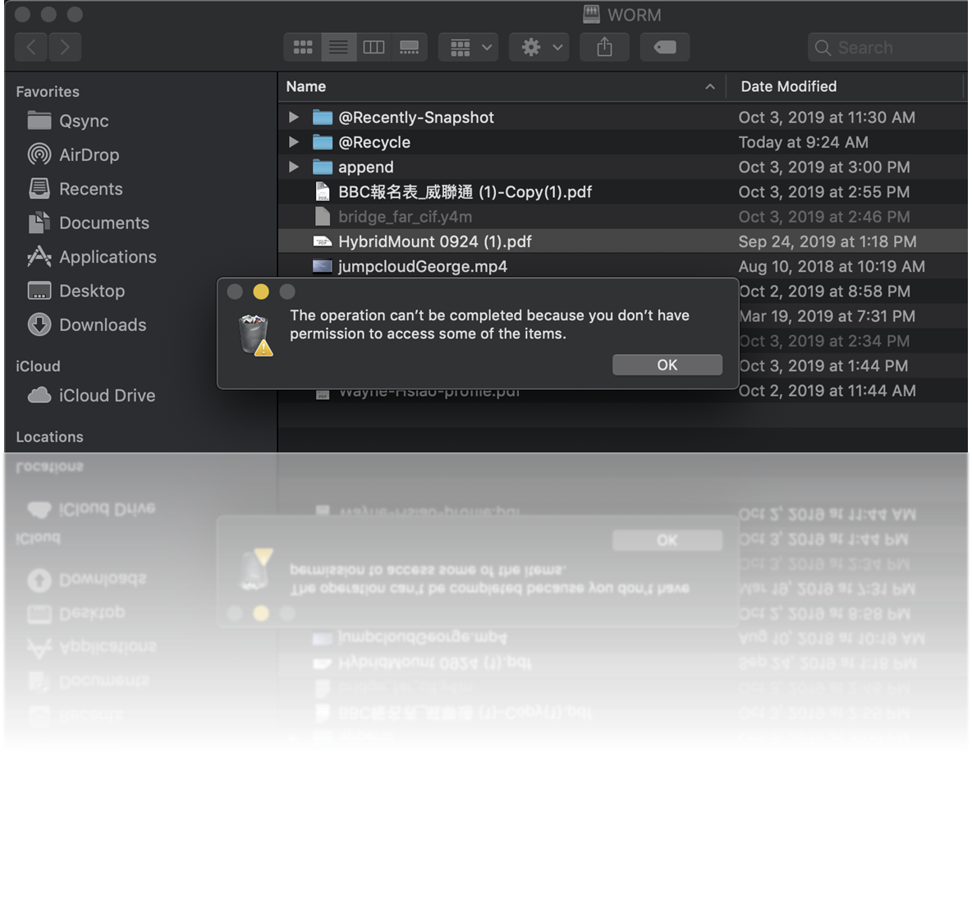
WORM (Write Once Read Many times)
WORM is used to avoid modification of saved data. Once this feature is enabled, data in shared folders can only be read and cannot be deleted or modified to ensure data integrity.
Enterprise Mode
remove the shared folder through QuTS hero UI or SSH commands (QCLI).
Compliance Mode
Have to take the Storage Pool offline and remove the Pool if want to destroy data.

Slide 18



Value-Added solutions for short-depth NAS
myQNAPcloud Storage
QNAP-Hosted cloud storage. Free 16GB storage space available for NAS data backup
HybridMount
Allows users to integrate cloud storage into the NAS system, enabling seamless collaboration between cloud and local storage.
VJBOD (Virtual JBOD)
Allows users to use other QNAP storage devices as virtual drives, extending the storage capacity

Slide 19



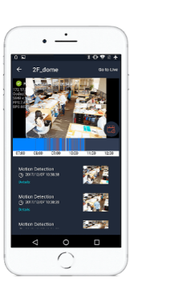


Build a comprehensive surveillance system with a TS-h1655XeU-RP, QVR Pro/Elite, and IP cameras
QVR Pro
QVR Pro Client
6,000+ Compatible cameras
8 embedded monitoring channels
expand up to 128 channels by purchasing QVR Pro licenses*
View USB camera images through QUSBCam2
iOS & Android mobile devices
Support cross-platform ： Windows, Mac, Ubuntu
QVR Elite
The flexible subscription QVR Elite can be expanded to a maximum of 192 channels by purchasing licenses*​
Use HDMI output and USB keyboard and mouse to control the NAS through installing Graphic card
*The maximum number of channels supported varies by NAS model, network configuration, and camera settings

Slide 20

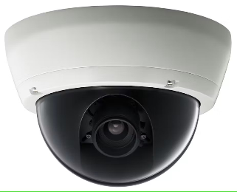


1-year+ of continuous surveillance recording storage with 288TB raw capacity in 1 single NAS
24TB x 12 = 288TB raw capacity
QVR Pro
8-channel included
Support up to 128ch*
8 channels, footage preserved for 365+ days
8 cameras; reserved for 365 days; 1920x1080(h.264/medium quality;30FPS); total 182TB required
*The maximum number of channels supported varies by NAS model, network configuration, and camera settings

Slide 21



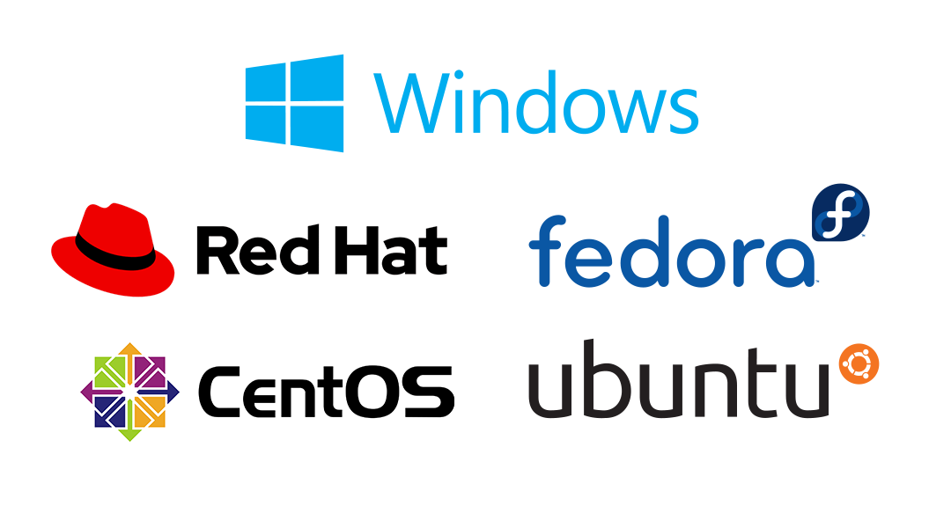
Smart and automatic file management​
Virtualization Station
Container Station
Virtualization Station is a fast and reliable hypervisor on QNAP NAS and appliances. You can run multiple virtual machines on Virtualization Station to meet versatile virtualization needs.
Experience LXD and Docker® lightweight virtualization technologies, download apps from the Docker Hub Registry®, import/export containers, and create abundant microservices.
The brand new UI
Recreate containers with ease
Save the frequently used container commands for efficiency
Upload Image and YAML files from cloud or local devices
Multiple network modes

Slide 22

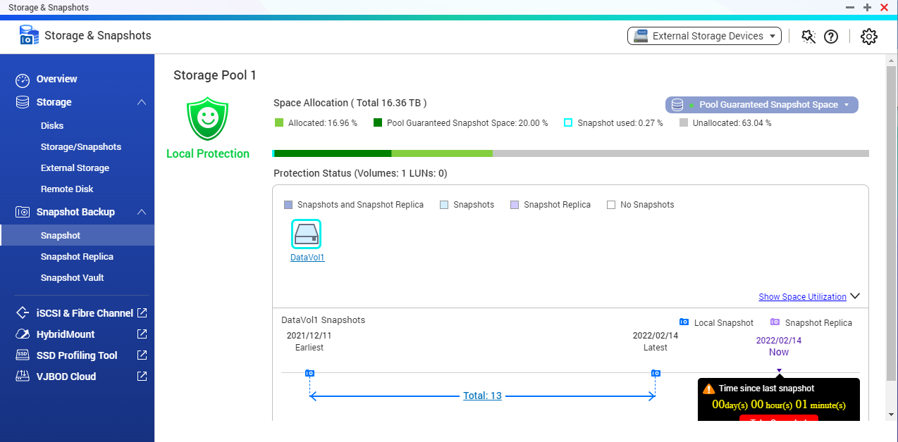
Snapshots help you fight with Ransomware Threats​
TS-h1655XeU-RP supports Snapshot , like taking a photo - within seconds the complete status of your NAS system and data is recorded
Mitigate the growing threat of ransomware
Step 1 ​
Regularly update, and use Malware Remover​
Step 2​
Routinely back up to your NAS, and create multi-version snapshots​
Step 3​
Back up snapshots to another QNAP NAS​

Slide 23
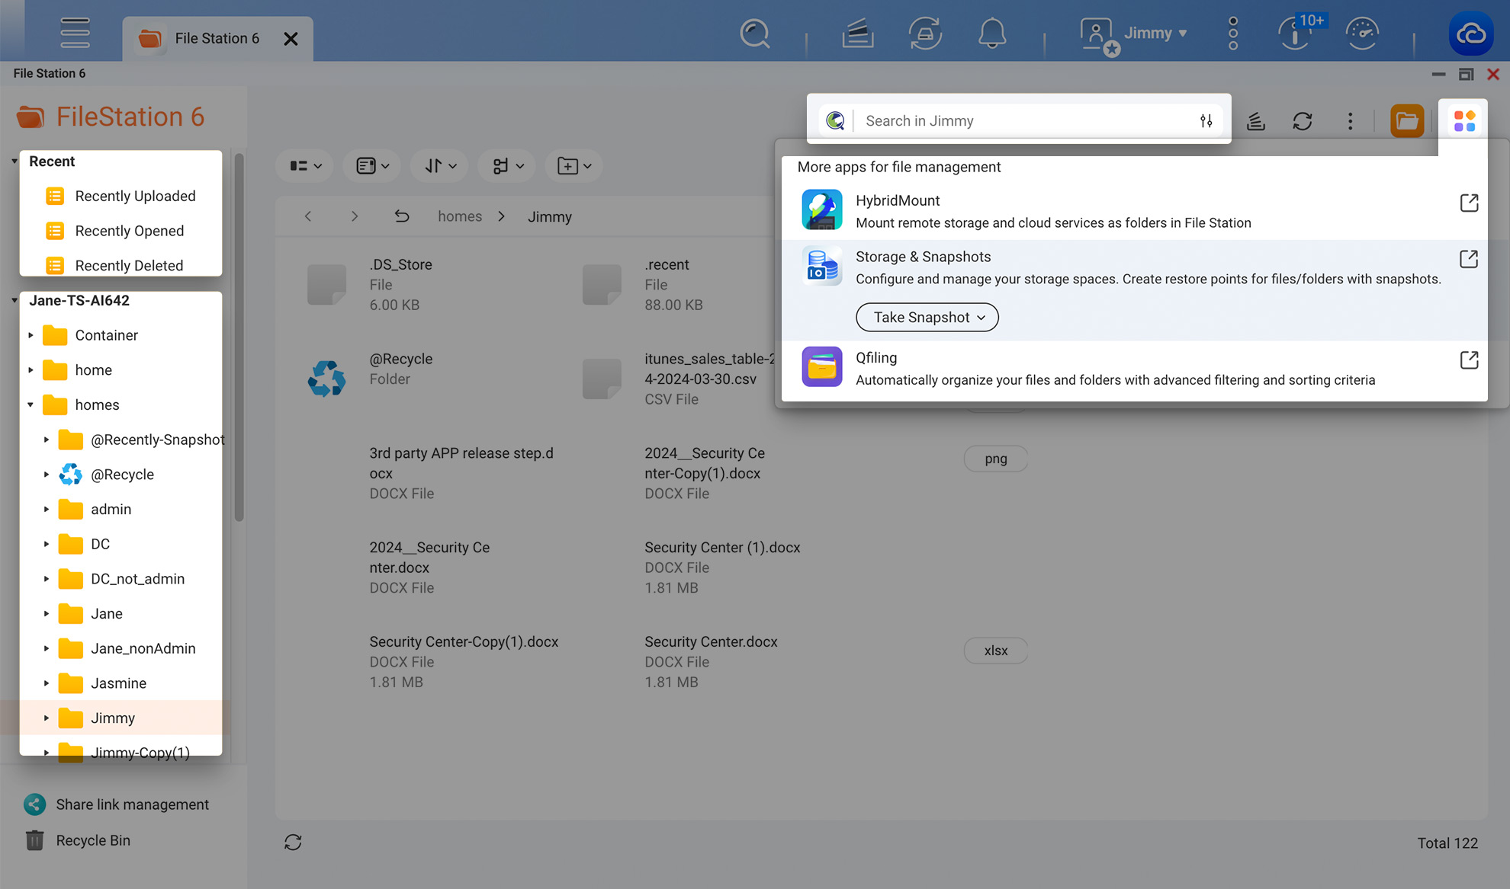

File Station : Easy to use, easy to find​
All the files and folders stored on your NAS and connected storage spaces are accessible through a familiar interface, and rich search/sort functions are available to help find files.​
“Recently” sections
File Station displays files that have been recently uploaded, accessed, and deleted in the left panel, allowing you to quickly find desired files.
Search bar
The full-text search engine Qsirch is now supported! You can find files by filename and text in documents.

Slide 24

Smart and automatic file management​
Qsirch
The AI-powered search engine for your NAS
Qfiling
Automatically filing and archiving​
RAG Search
AI Semantic Search​
Keyword Search
BETA
Source
Schedule
Filter
Edit
Destination
Using an intuitive interface, you can easily switch between general search (Keyword / AI semanticA search) or RAG search to quickly find files stored on your NAS and gain an advanced data analysis experience.
2 type of task: filing task, recycling task​
3 type of scheduling rule: one-time, scheduling, real-time​
9 editing module: AI face blur, encryption and decryption, video transcoding and so on​

Slide 25


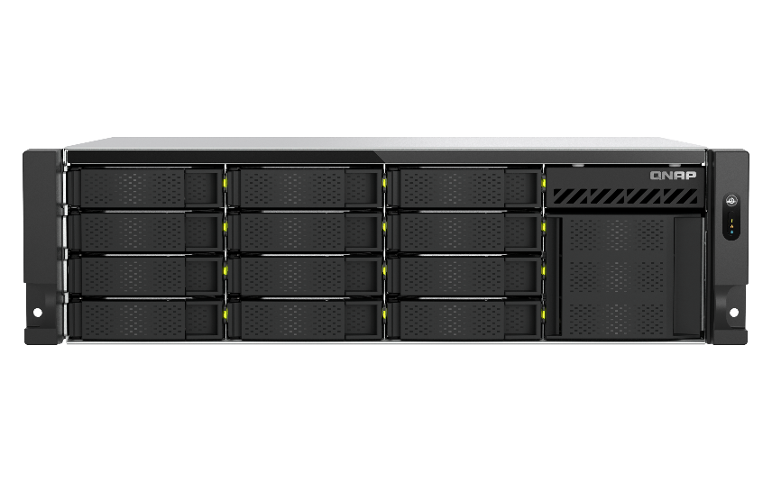
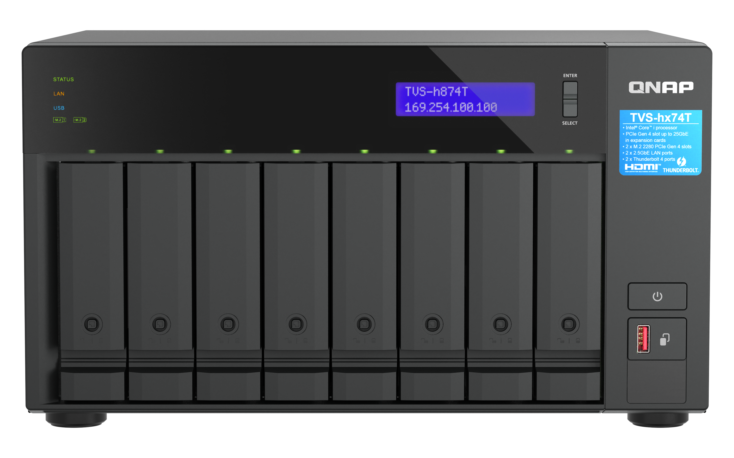

Easy to use HBS fulfilling backup
3-2-1 practice with deduplication
HBS (Hybrid Backup Sync)
Complete 3-2-1 backup strategy and recovery plan: 3 copies、2 media type、1 remote backup​
2 media type
3 copies
Copy 1
Copy 2
Copy 3
NAS
NAS off-site
Google Drive

Slide 26
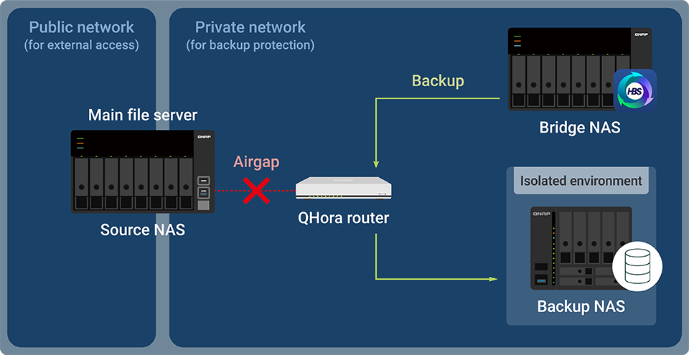
Secure NAS data with air-gapped network isolation for backups
Airgap+.
Safeguard business data against ransomware.
QNAP’s next-generation Airgap+ feature uses a logically isolated network to achieve efficient, convenient, and secure backups for enterprises and the media and entertainment (M&E) industry.

Slide 27

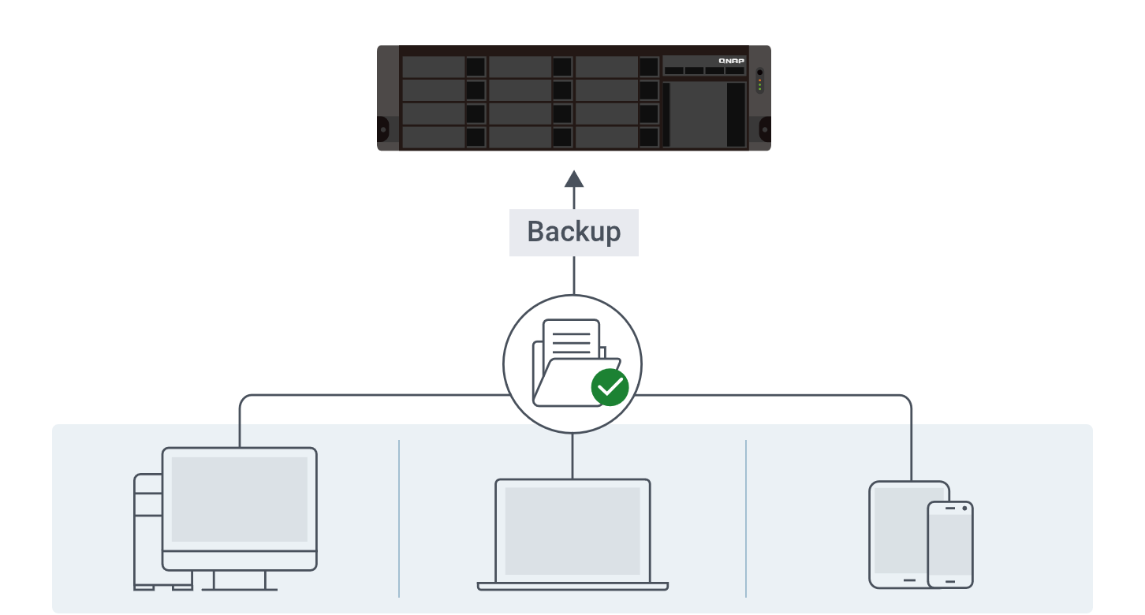
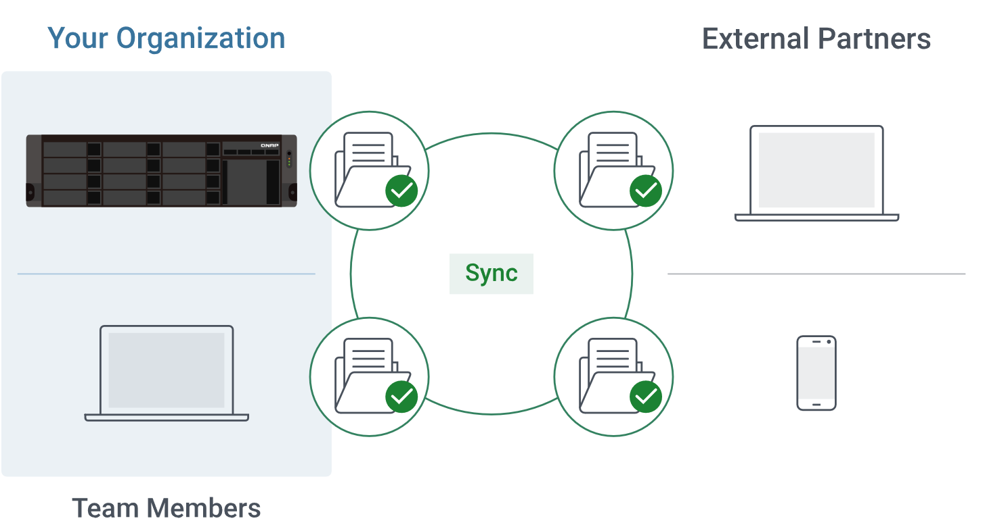
Qsync : Easily Backup or sync files and folders
Qsync is more than just a sync tool — it also lets you back up files on Windows® / Mac® computers to your NAS, ensuring your data is always safe
Worry-free backup for data security
Real-time sync, Always up-to-date files

Slide 28
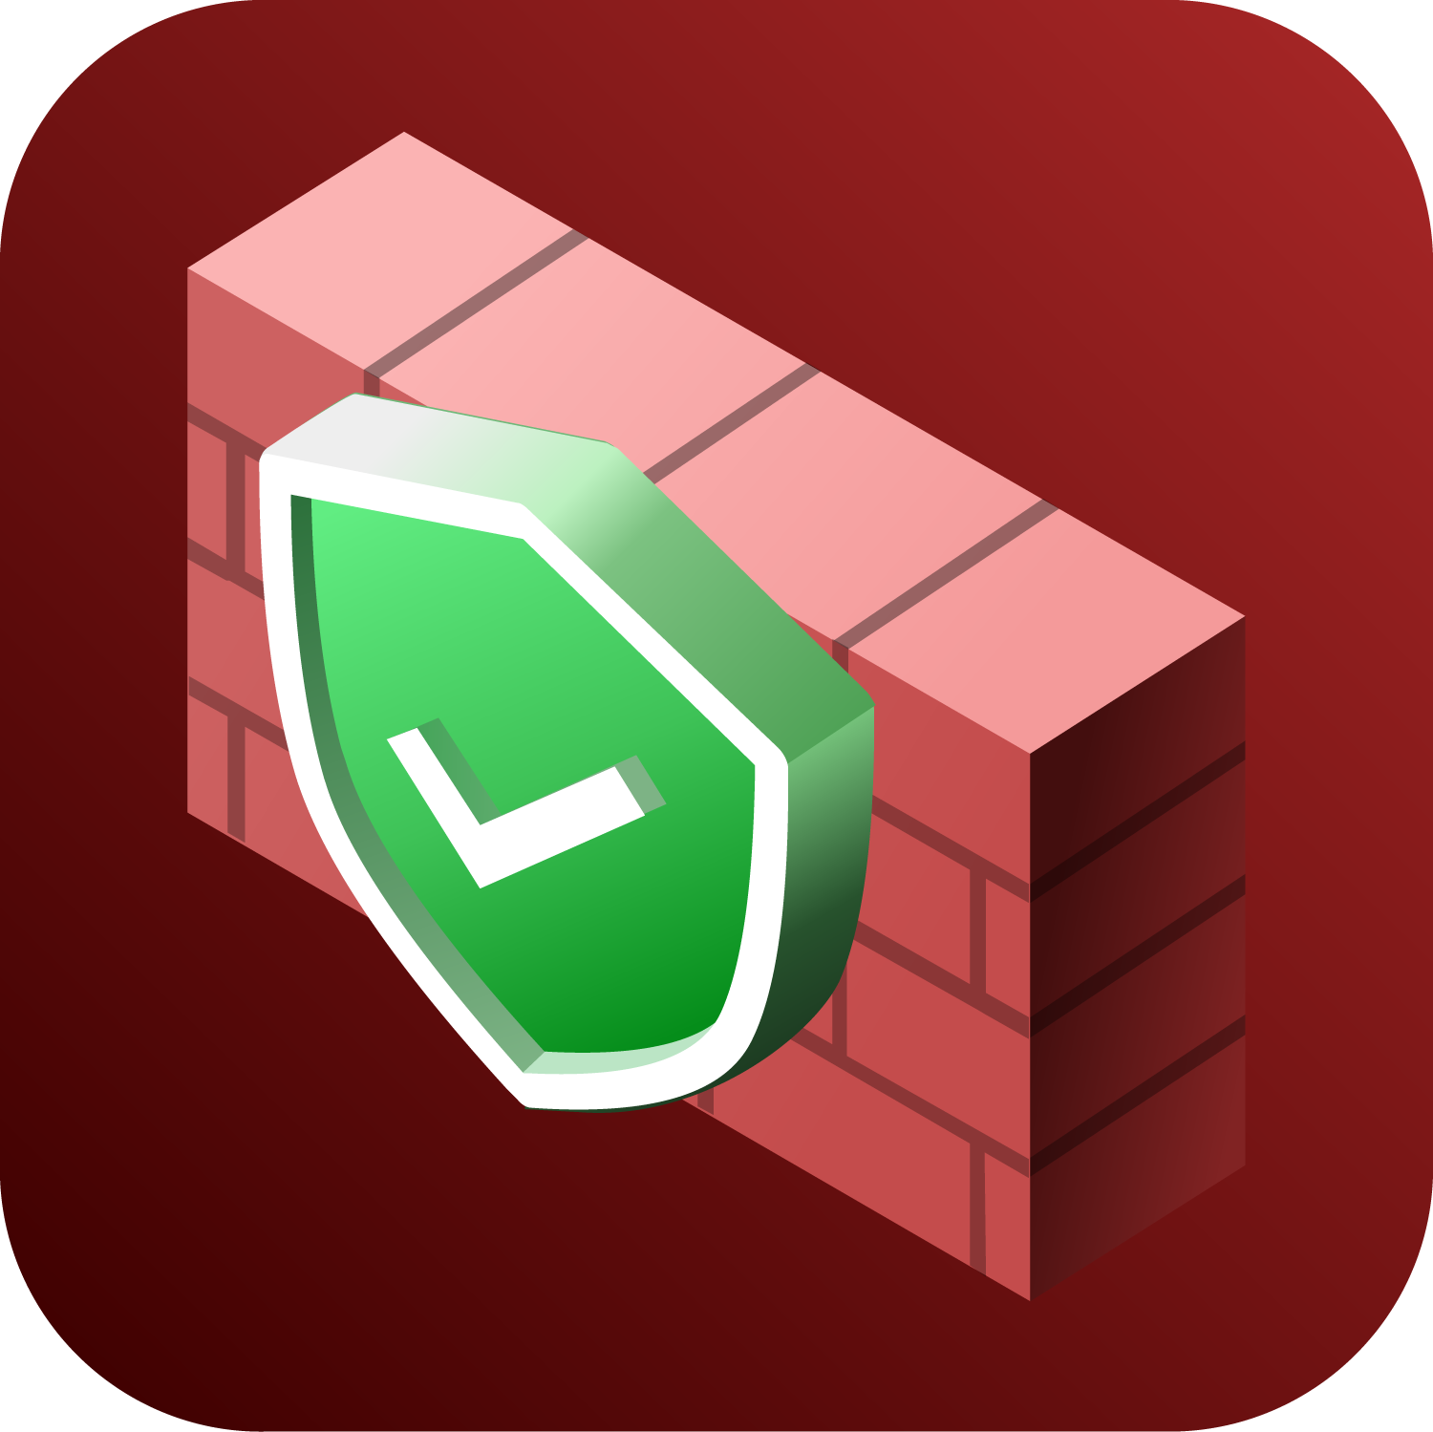

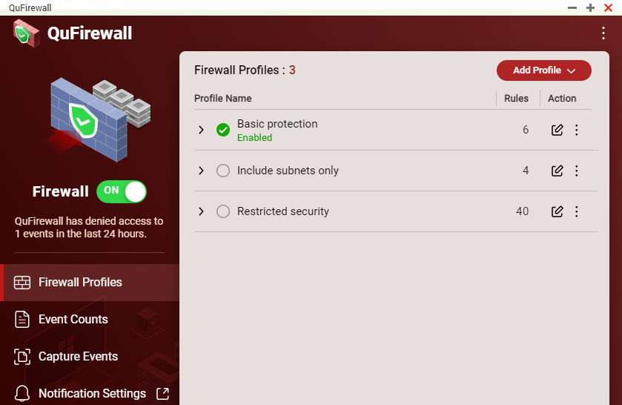
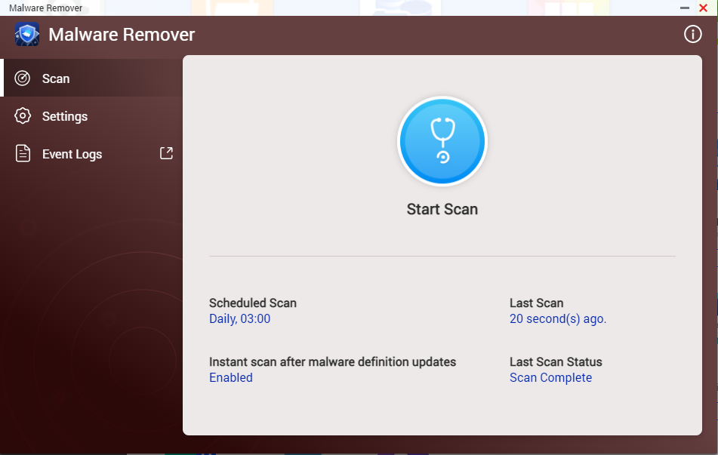
Data security​​
QuFirewall
You can allow/deny IP addresses and regions to prevent unauthorized access and brute force attacks for safeguarding data and service security.
Malware Remover
Regularly scan your NAS using the latest malware definitions. When under attack, infected files will be immediately removed to ensure NAS data security.

Slide 29

3-year standard warranty covering hardware repair and support services​
TS-h1655XeU-RP is backed by a 3-year warranty at no additional cost. ​​
You can also purchase a warranty extension that extends your warranty coverage up to 5 years total​. (P/N: LIC-NAS-EXTW-BROWN-2Y-EI )

Slide 30
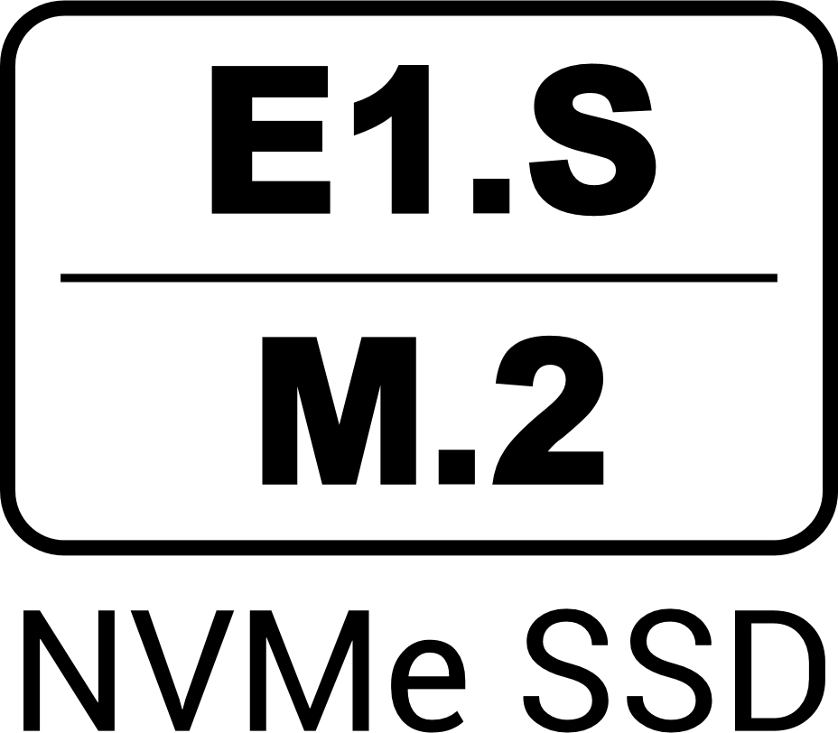

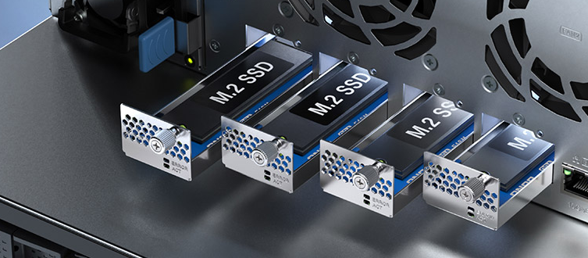

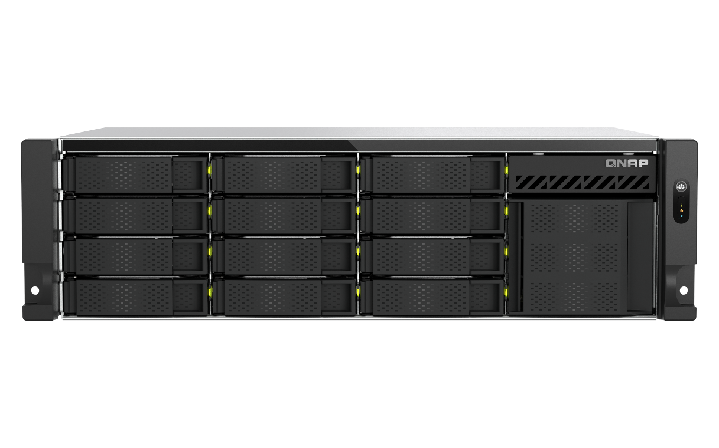
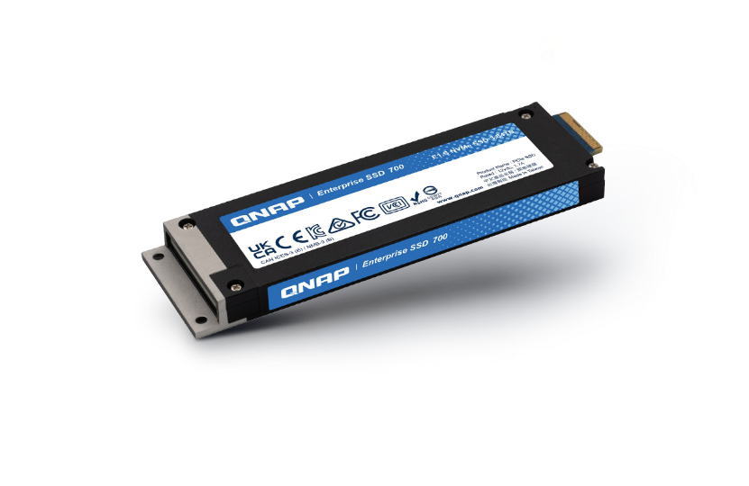
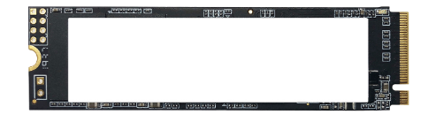


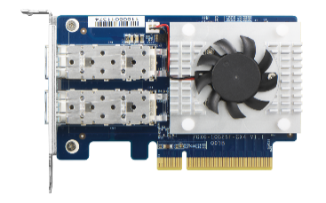

USB 3.2 Gen2 (10Gbps)
與 One-Touch-Copy
3個
PCIe Gen3 x4
擴充槽
Support 10GBASE-T NIC,
QXG-ES10G1T
Supports both
4 x E1.S NVMe SSD slots, supporting up to 15mm E1.S, and pre-installed adapter to support M.2 2280 NVMe SSD
USB 3.2
Gen 1 port
IntelQAT
Up to
64GB DDR4 RAM
Support QNAP E1.S SSD
TS-h1655XeU-RP
ECC memory can also be installed
C5125 2.8GHz
8-Core
Processor
2.5GbE X2
WORM Support in QuTS hero (Write Once Read Many times)​
2.5GbE
Short-depth 12-inch
4 x M.2 2280
4 x 25GbE
SMB Throughput 1MB, 3 Host
Write : 2,552 MB/s
Read : 4,926 MB/s
Up to 4 x M.2 2280 NVMe SSD, Support hot-swapping
10GBASE-T
Up to
5-year
warranty​

Slide 31
TS-h1655XeU-RP
3U 12 x 3.5" HDD & 4 x E1.S/M.2 NVMe SSD Hybrid Short-Depth 12-inch Rackmount NAS with Intel Atom® 8-Core 2.8GHz Processor
2025/08

