Slide 1
Notes:
QNAP Newly launched 10G SFP+ desktop NAS, TS-432X & TS-632X. Powered by Annapurnalabs AL524 4-core processor, built-in 4G memory, Max. 16GB and optional ECC. Comes with a PCIe Gen 3 slot support qnap various expansion card.

Slide 2

Rising Demand for 10GbE Network Speeds
The demand for 10 Gigabit Ethernet (10GbE) network speeds is experiencing significant growth.
According to research institute, 10G Network Card Market Size was valued at US$ 95 Billion in 2023, and is projected to reach US$ 180.01 Billion by 2031, growing at a CAGR of 9.56% from 2024 to 2031. *
Data Growth Explosion
Modern applications require substantial data storage and faster access speeds, driving the need for higher bandwidth.
Evolving Business Needs
Businesses require faster and more reliable network connections to support mission-critical applications and improve overall operational efficiency.
Price Reduction
The cost of 10GbE equipment has decreased significantly, making it a more affordable option for businesses compared to earlier high-speed technologies.
*https://www.linkedin.com/pulse/10g-network-card-market-share-2031-statistics-zvcif/
Notes:
Features :
TS-432X : 4-bay 3.5" SATA NAS, TS-632X : 6-bay 3.5" SATA NAS.
- Powered by AnnapurnaLabs AL-524 quad-core CPU to provide powerful NAS performance
- Built-in 10GbE SFP+ : TS-432X built with a 10GbE SFP+ / TS-632X built with dual 10GbE SFP+ to provide high speed network environment
- Pre-installed 4 GB Non-ECC memory, 1 x DDR4 SODIMM slot can be upgraded, ECC supported
-2 x 2.5G LAN ports, Sufficient 2.5 GbE network bandwidth provides smooth data transmission experience
-1 x PCIe Gen3 x4 slot, Provide a variety of expansions including network card, M.2 and other expansion cards
-Provides USB One-Touch-Copy button, allowing you to easily copy files in the USB folder to the NAS

Slide 3
Quad-core TS-432X / TS-632X tower NAS with 10GbE SFP+ support
Needs for a larger storage space and efficient file backup and sharing
Ready-to-use applications for worry-free file backup and sharing
All models with 2.5GbE support, additional 10GbE SFP+
Notes:
Why we need TS-432X / T-632X?

Slide 4




Powered by AnnapurnaLabs AL-524 quad-core 2.0GHz 4/6–bay NAS
4
AnnapurnaLabs 4-core CPU
2 x 2.5GbE LAN Ports
AnnapurnaLabs AL-524 quad-core 2.0GHz processor Provide powerful NAS performance
Sufficient 2.5 GbE network bandwidth provides smooth data transmission experience
Core
Built-in 10GbE SFP+
1 x PCIe Gen3 x4 slot
10GbE
TS-432X built with a 10GbE SFP+ / TS-632X built with dual 10GbE SFP+ to provide high speed network environment
SFP+
Provide a variety of expansions including network card, M.2 and other expansion cards
Maximum 16 GB Memory
USB One-Touch-Copy button
16 GB
Pre-installed 4 GB Non-ECC memory, 1 x DDR4 SODIMM slot can be upgraded, ECC supported
Provides USB One-Touch-Copy button, allowing you to easily copy files in the USB folder to the NAS
Notes:
Features :
TS-432X : 4-bay 3.5" SATA NAS, TS-632X : 6-bay 3.5" SATA NAS.
- Powered by AnnapurnaLabs AL-524 quad-core CPU to provide powerful NAS performance
- Built-in 10GbE SFP+ : TS-432X built with a 10GbE SFP+ / TS-632X built with dual 10GbE SFP+ to provide high speed network environment
- Pre-installed 4 GB Non-ECC memory, 1 x DDR4 SODIMM slot can be upgraded, ECC supported
-2 x 2.5G LAN ports, Sufficient 2.5 GbE network bandwidth provides smooth data transmission experience
-1 x PCIe Gen3 x4 slot, Provide a variety of expansions including network card, M.2 and other expansion cards
-Provides USB One-Touch-Copy button, allowing you to easily copy files in the USB folder to the NAS

Slide 5

64-bit quad-core 2.0 GHz processor crafted for storage solution
Integrated I/O
Annapurna Labs SoC integrates 10GbE, SATA 6Gbps, PCIe lanes in a small 27 x 27 mm BGA form
AARCH64 architecture
ARM Cortex-A57 Quad-core 2.0GHz AL-524 CPU with 64-bit instructions for high performance and energy saving​
10GbE & 2.5GbE
Single 10GbE(TS-432X)/ Dual 10GbE(TS-632X) SFP+ and 2 x 2.5GbE RJ45 to provide high-speed network environment
Cryptography
Operates with SIMD registers for multiple encryption/decryption instructions per cycle

Slide 6
Features 10GbE SFP+ and 2.5GbE connectivity
1/2 x 10GbE SFP+ & 2 x 2.5GbE ports
Sufficient 10GbE SFP+ and dual 2.5 GbE network ports provide a smooth data transmission experience.
10G SFP+
2.5GbE
Notes:
Sufficient 10GbE SFP+ & Dual 2.5 GbE network ports, provide smooth data transmission experience
TS-432X built with 1 x 10G SFP+ ports and Dual 2.5 GbE network ports
TS-632X built with 2 x 10G SFP+ ports and Dual 2.5 GbE network ports

Slide 7

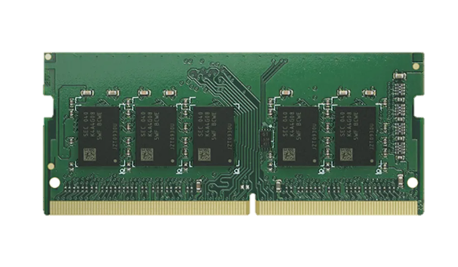
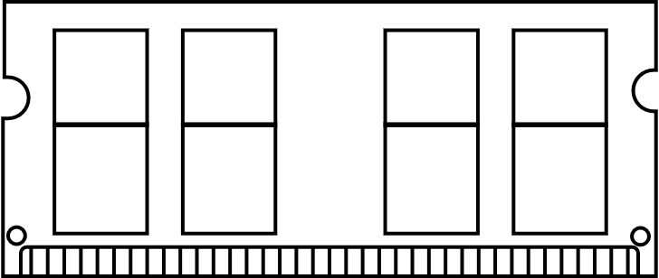
Support ECC Memory
(Error Correcting Code)
Reliable memory and avoiding data corruption
TS-432X / TS-632X support ECC memory, automatically detecting and timely correcting single-bit errors
System supports up to 16GB memory
* The NAS is pre-installed with a 4GB non-ECC memory
by default. (1 x DDR4 SODIMM slot)

Slide 8
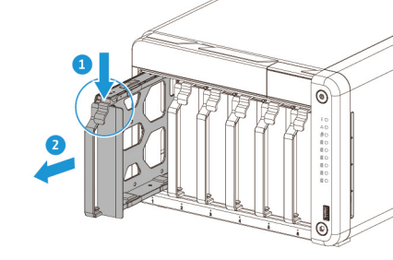

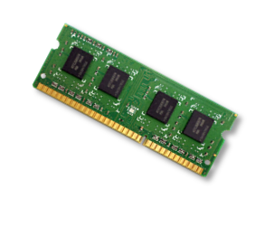
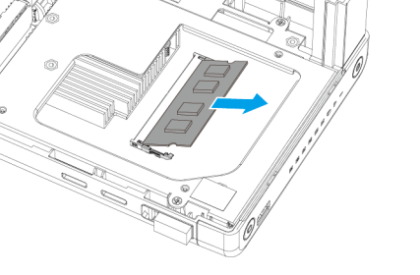
Upgradeable to 16GB memory for multi-tasking,
ECC supported
TS-432X-4G / TS-632X-4G
Remove a drive tray by simultaneously pressing the latch and pulling the tray.
4GB RAM (1 x 4GB)
Remove an existing module. Then install a new module.
1 x DDR4 SODIMM, support up to 16GB SODIMM memory, optional ECC
Notes:
TS-432X / TS-632X pre-installed 4G non ecc memory with 1 x DDR4 sodimm slots. Can upgrade to 16GB, optional ECC.
And easy to install, first Remove a drive tray by simultaneously pressing the latch and pulling the tray. And Remove an existing module. Then install a new module. For detail can check user guide on product web site

Slide 9
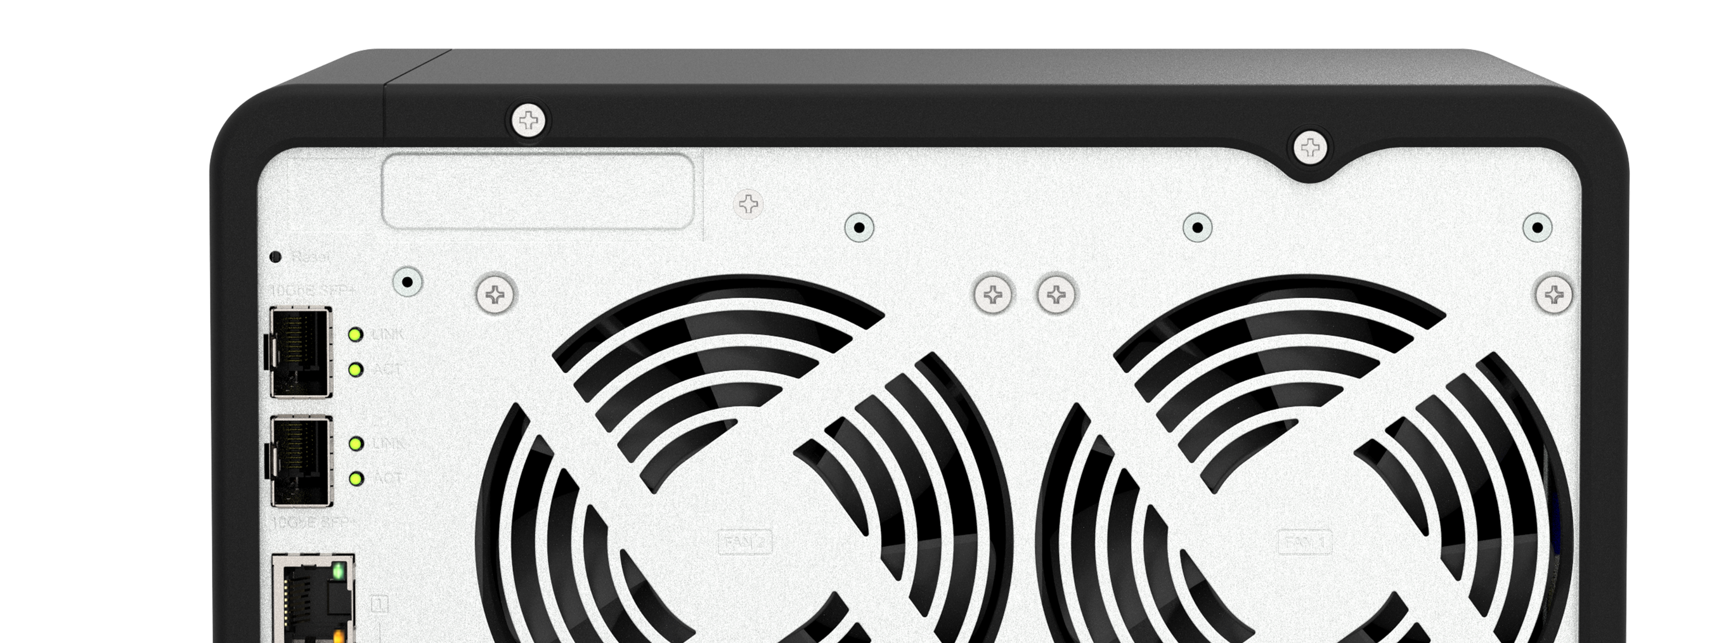
PCIe Gen3 slot for flexible network deployment and adding SSD cache
The TS-432X and TS-632X provide a low-profile PCIe Gen3 expansion slot, supporting a variety of expansions including network cards, M.2 drives, and other expansion cards.
For more, please check QNAP compatibility list later:
https://www.qnap.com/go/compatibility/
1 x PCIe Gen3 x4

Slide 10
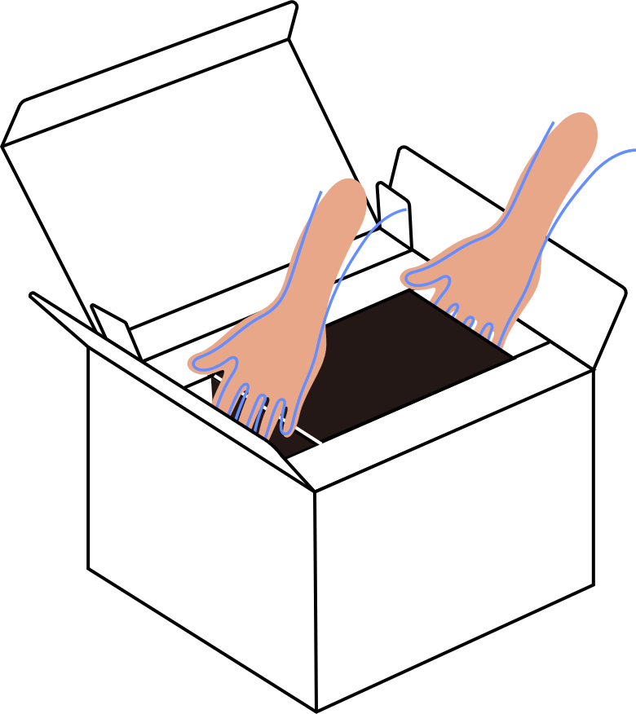


Less packaging. More sustainability.
The TS-432X / TS-632X come in a lighter protective package, ensuring their safety while reducing waste.*
Reduced the package size of TS-432X NAS to be 66% smaller than the current 4–bay TS-464 NAS.
Remove the NAS from the space reserved on both sides to prevent it from slipping off.
If you want to ship with HDDs, please remove them and pack them separately.

Slide 11
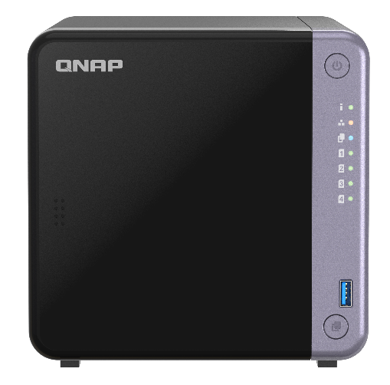
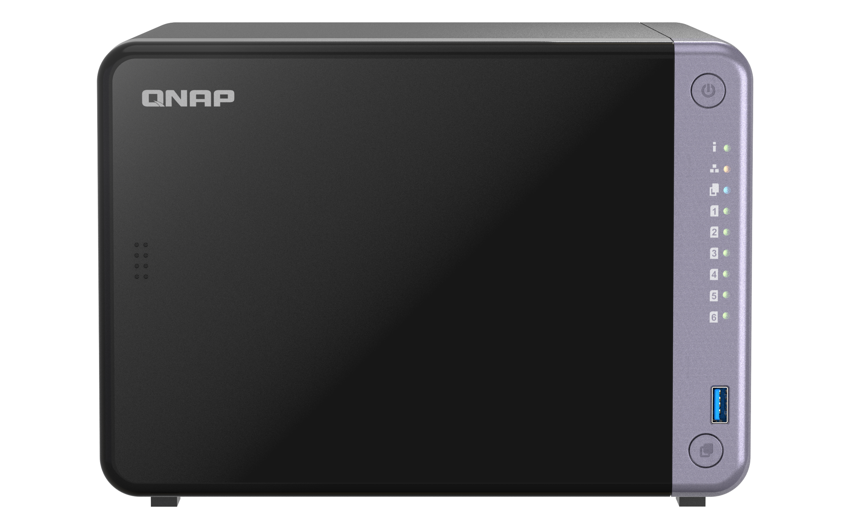
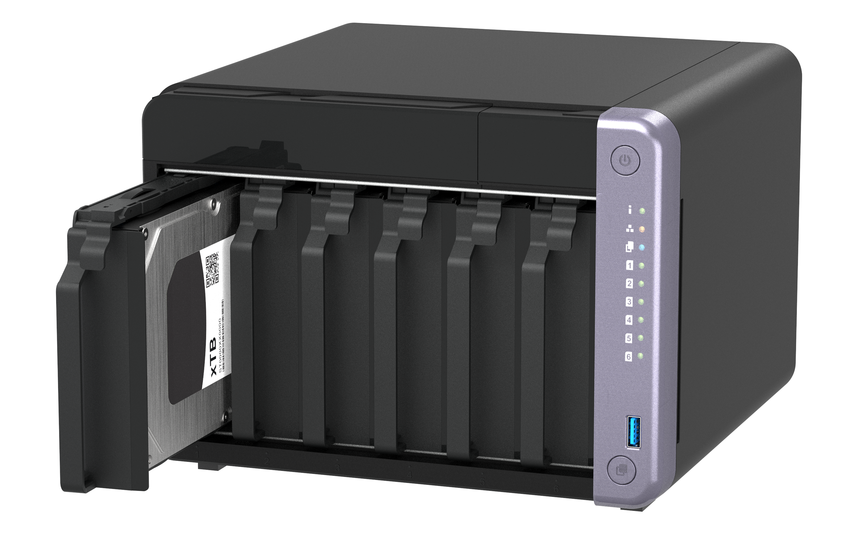
TS-432X / TS-632X front view
TS-632X
TS-432X
Power button
LED :
Status, LAN, USB Copy, HDD1-6
3.5"/ 2.5”SATA
6Gb/s HDD/SSD tray
USB 3.2 Gen 1 & OTC button
Notes:
TS-432X / TS-632X front view
-Remove the front cover, you can see 3.5"/ 2.5”SATA 6Gb/s HDD/SSD trays

Slide 12
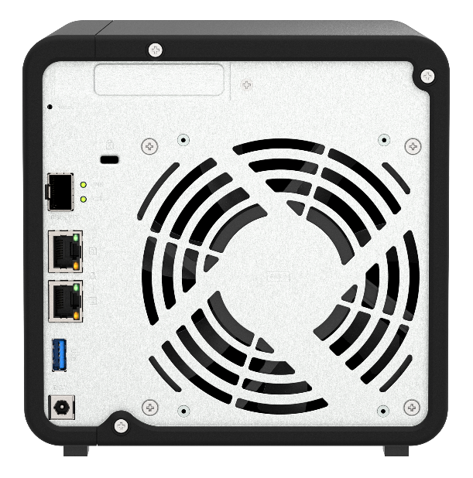
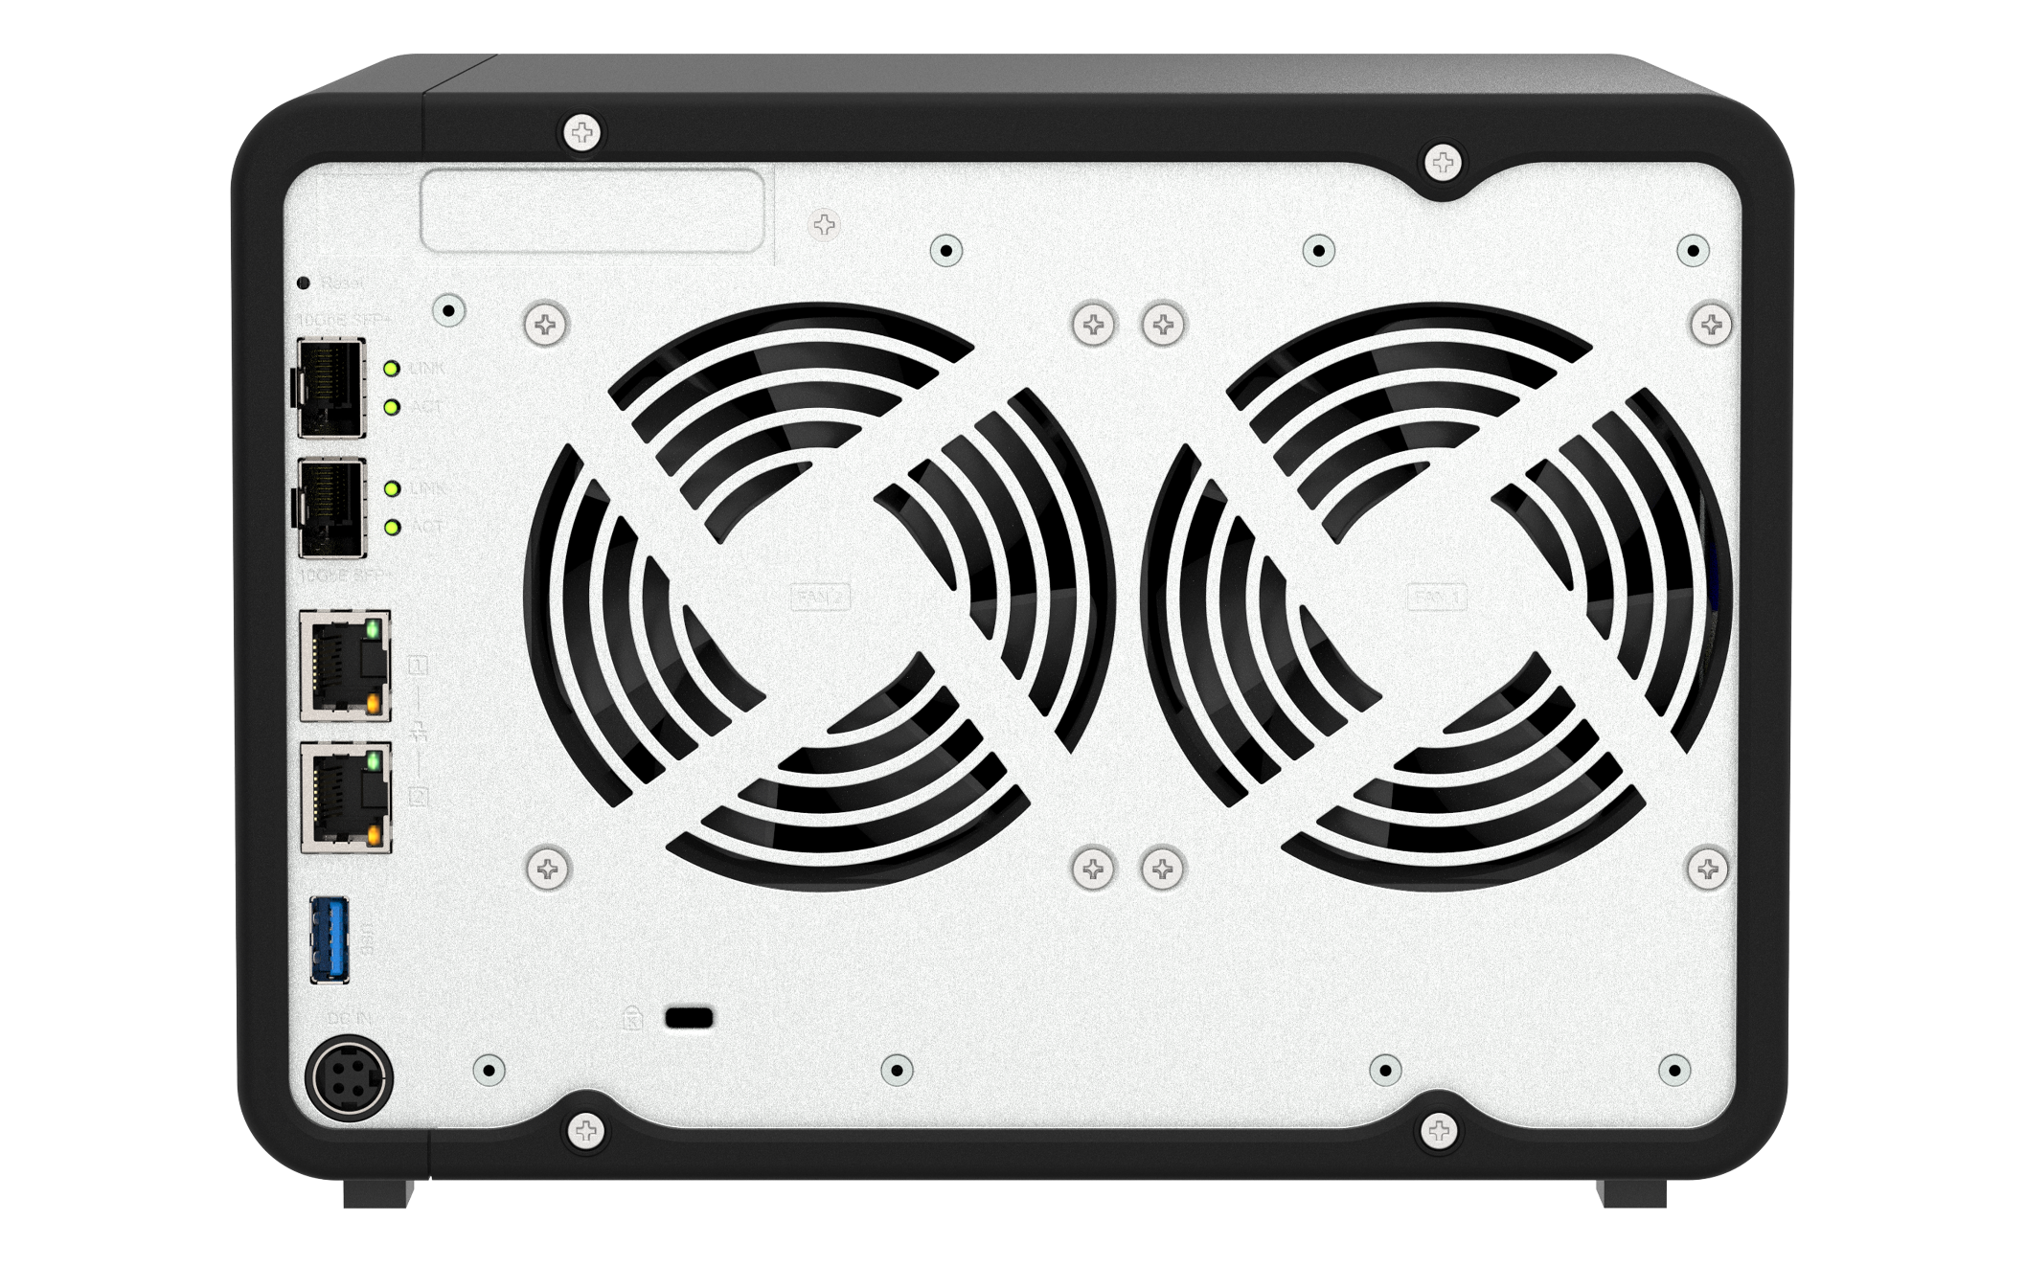
TS-432X / TS-632X rear view
TS-632X
PCIe Gen3 x4
TS-432X
10G SFP+ ports
TS-632X : 2 ；TS-432X : 1
2 x 2.5GbE
1 x USB 3.2 Gen 1 port
K-lock
Power Input

Slide 13

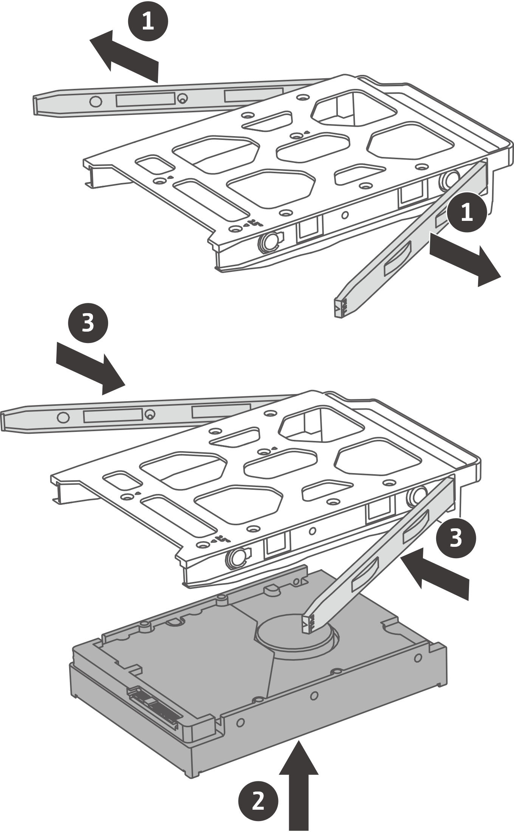
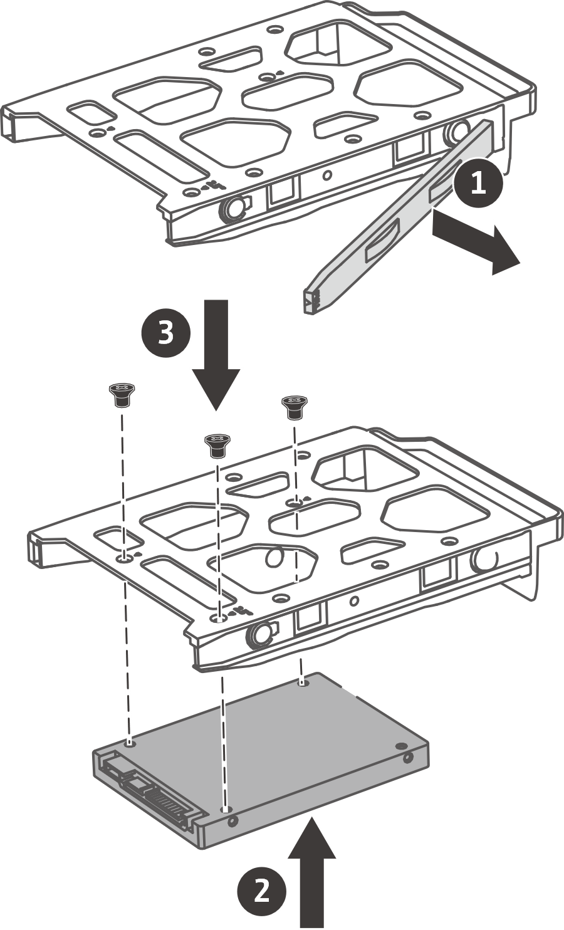
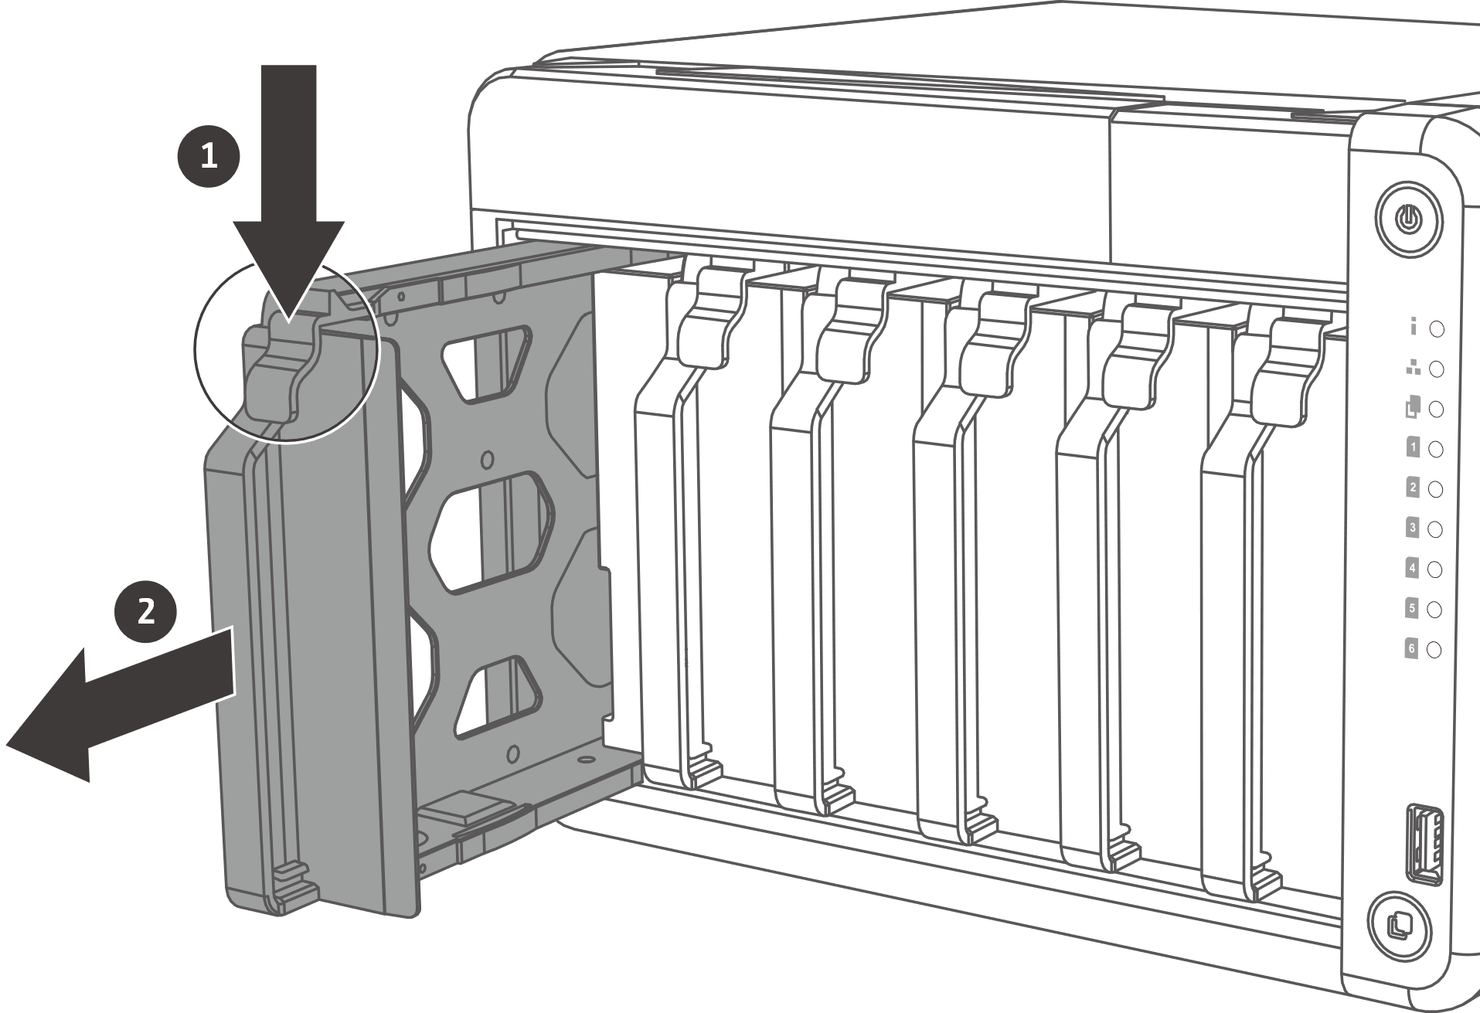
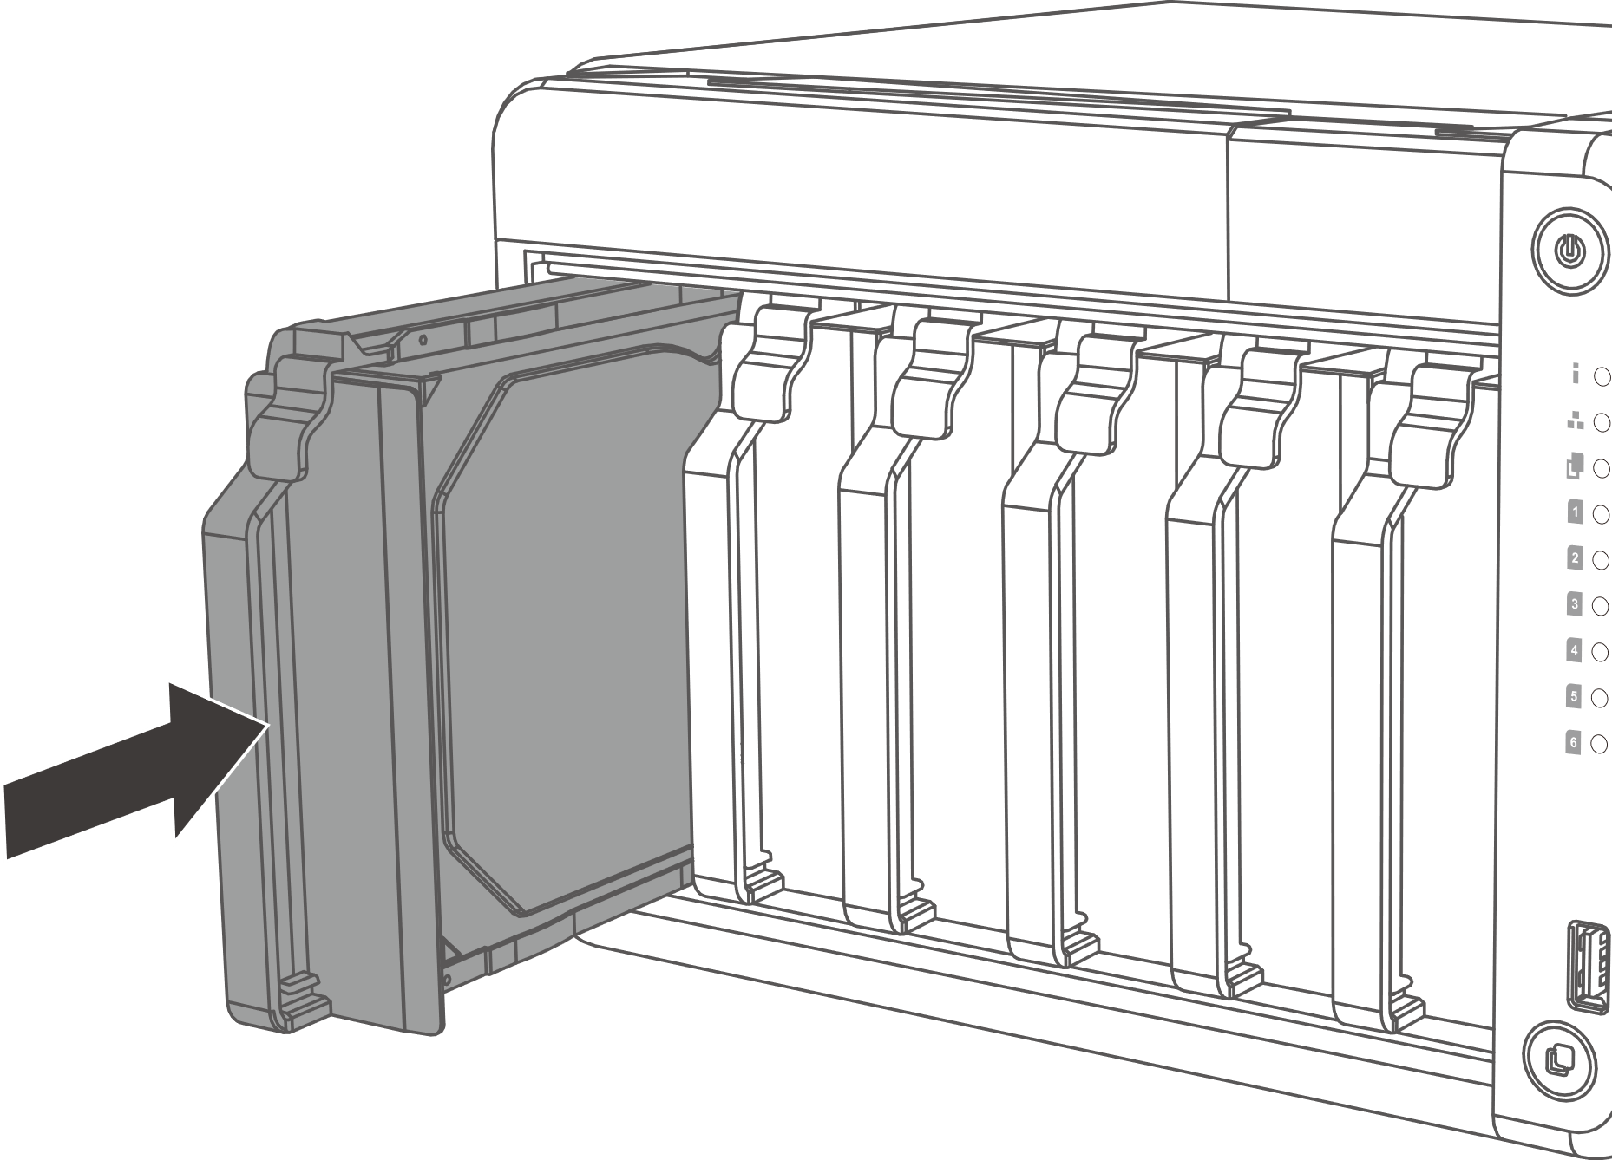
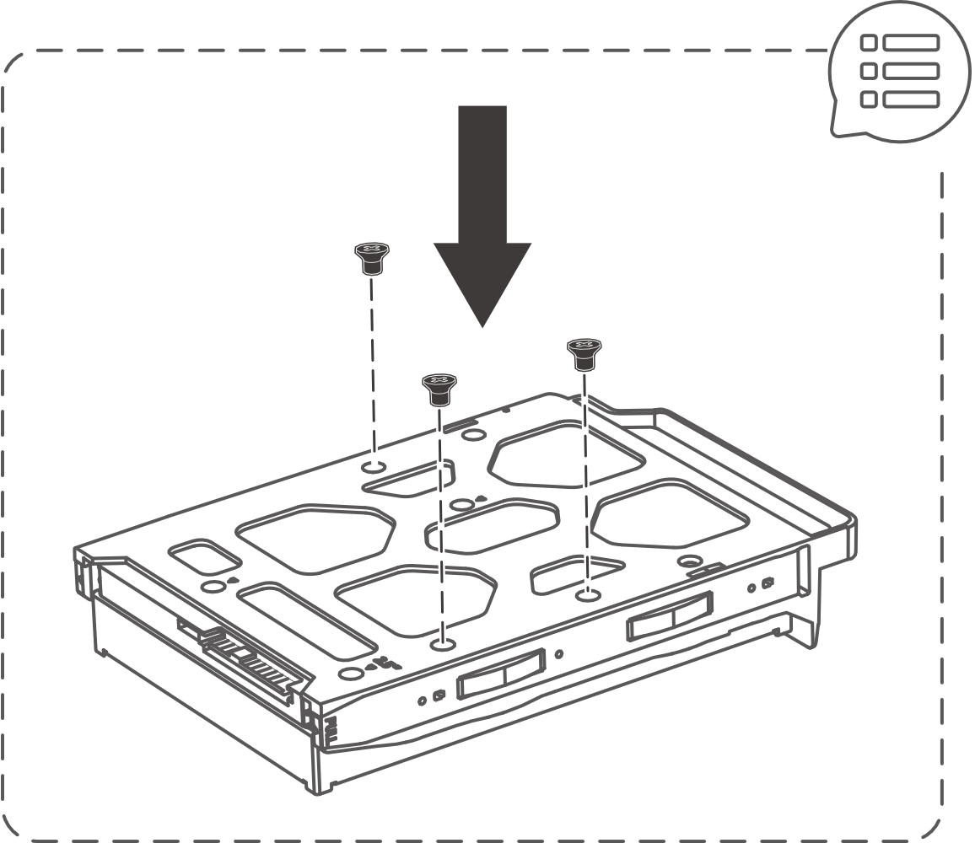
Easy to install HDDs and SSDs
Install 3.5-inch drives without tools​
01
02
03
3.5-inch HDD
2.5-inch HDD / SSD
Notes:
Easy to install HDDs and SSDs
After Remove the front cover, Remove a drive tray by simultaneously pressing the latch and pulling the tray.
For 3.5" HDD, Remove the fastening panels from the sides of the drive tray and Place the drive on the tray so that the holes on the bottom of the drive are aligned with the holes on the bottom of the tray then Attach the fastening panels to lock the drive to the tray.
Insert the tray into the bay.

Slide 14

Built-in 10G SFP+ and 2.5GbE LAN ports, you can enjoy a high-speed network environment right out of the box
2 x 2.5GbE
SMB Sequential Throughout 1MB
2 x 10GbE SMB
SMB Sequential Throughout 1MB
590 MB/s
590 MB/s
2251 MB/s
1082 MB/s
Test Environment:
NAS：TS-632X
OS：QTS 5.1.7.2743
Volume type：6 x Samsung 860 PRO 512GB, RAID 5, thick volume
Client PC：Windows Server 2019, Intel Core i7-6700 3.4GHz, 64GB RAM, w/ QXG-10G2SFCX4 & QXG-2G4T-I225
IOmeter : 16MB, 30-sec ramp up time, 3-min seq. run time, 16 workers, 4-outstanding
12吋短機箱可支援市面上大部分的機櫃
內建2埠M.2(PCIe Gen 3 x1)，可提供SSD快取，加速隨機存取的速度
PCIe Gen 3 x 8插槽，提供各式應用的高速擴充卡
雙系統靈活切換配置QTS and QuTS hero
Notes:
Performance :
-2 x 2.5GbE SMB Sequential Throughout 1MB
Write : 590MB/s
Read : 590MB/s
-2 x 10GbE SMB SMB Sequential Throughout 1MB
Write : 1082MB/s
Read : 2251MB/s

Slide 15
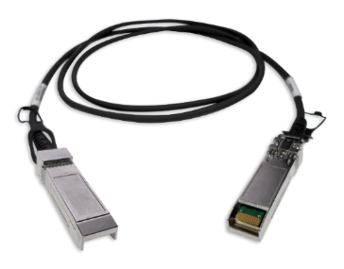
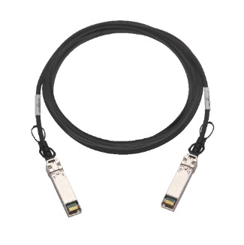
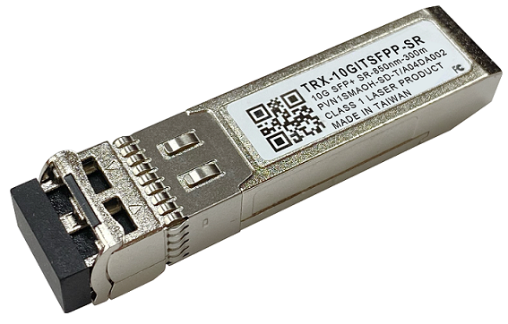
Short distance SFP+ DAC cables and Transceivers
1.5M SFP+ 10GbE
DAC cable
3.0M SFP+ 10GbE
DAC cable
5.0M SFP+ 10GbE
DAC cable
10GbE SFP+ SR Transceiver
Part number:
CAB-DAC15M-SFPP
Part number:
CAB-DAC30M-SFPP
Part number:
CAB-DAC50M-SFPP
Part number:
TRX-10GITSFPP-SR

Slide 16
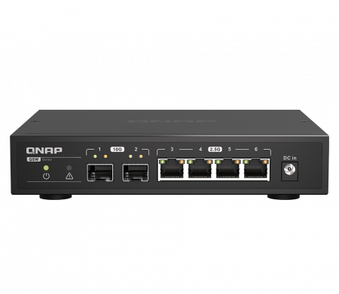
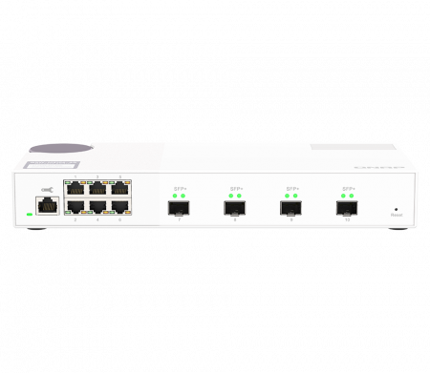
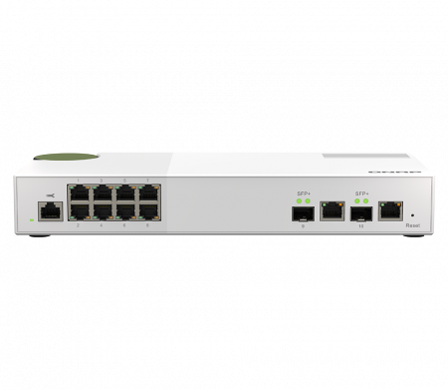
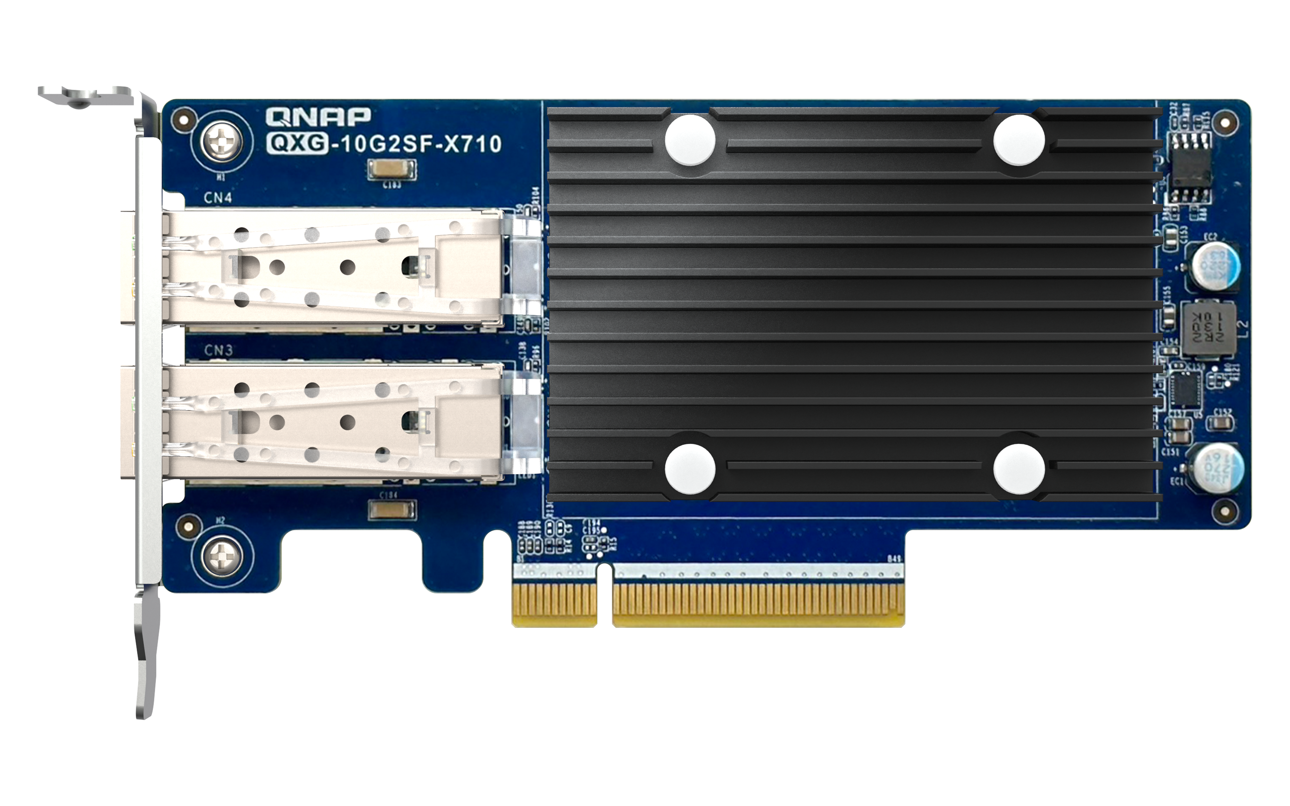
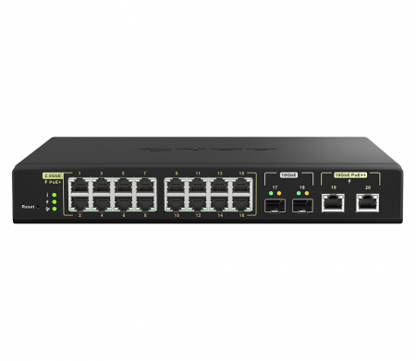
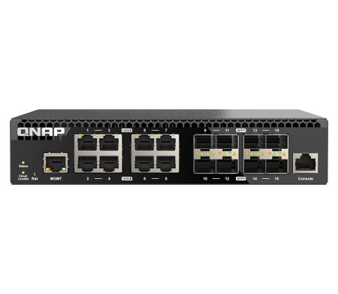
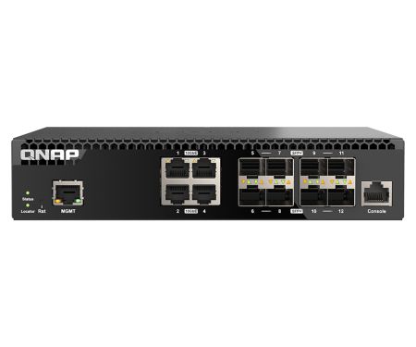
QNAP 10GbE networking and storage solutions are here to solve slow network issues
QSW 10GbE SFP+ Switch
QSW 10GbE SFP+ NIC
QSW-2104-2S
QSW-2106-4S
QSW-M2108R-2C
QXG-10G2SF-X710
4 x 2.5GbE RJ45 ports,
2 x 10GbE SFP+ fiber ports
6 x 2.5GbE RJ45 ports,
4 x 10GbE SFP+ fiber ports
8 x 2.5GbE RJ45 ports,
2 x 10GbE SFP+ fiber/RJ45 combo ports
2 x 10GbE SFP+ NIC
QSW-M2116P-2T2S
QSW-M3216R-8S8T
QSW-M3212R-8S4T
16 x 2.5GbE 802.3at PoE+ (30w) ports,
2 x 10GbE 802.3bt PoE++ (90w) ports and 2 x 10GbE SFP+ fiber ports
8 x 10GbE RJ45 ports,
8 x 10GbE SFP+ fiber ports
4 x 10GbE RJ45 ports,
8 x 10GbE SFP+ fiber ports

Slide 17
Hardware Spec.
SKU | TS-432X-4G | TS-632X-4G | TS-431X3-4G
Processor | Alpine Processor AL524 (2.0 GHz Quad-Core) | Alpine Processor AL524 (2.0 GHz Quad-Core) | Alpine Processor AL314 (1.7 GHz Quad-Core)
System memory | 4GB DDR4 SODIMM (Max. 16GB, optional ECC supported) | 4GB DDR4 SODIMM (Max. 16GB, optional ECC supported) | 4GB DDR3 SODIMM (Max. 8GB)
RAM slot | 1 | 1 | 1
Drive Bay | 4 x 3.5-inch SATA 6Gb/s, 3Gb/s | 6 x 3.5-inch SATA 6Gb/s, 3Gb/s | 4 x 3.5-inch SATA 6Gb/s, 3Gb/s
GbE | - | - | 1
2.5 GbE | 2 | 2 | 1
10 GbE | 1 x 10GbE SFP+ | 2 x 10GbE SFP+ | 1 x 10GbE SFP+
PCIe | 1 x PCIe Gen 3 x4 |  | -
USB | Front: USB3.2 Gen1 Type-A x1 Rear: USB3.2 Gen1 Type-A x1 |  | Front: USB3.2 Gen1 Type-A x1 Rear: USB3.2 Gen1 Type-A x2
Power Supply | 90W adapter, 100-240V | 120W adapter, 100-240V | 90W adapter, 100-240V
Fan | 1 x 120mm | 2 x 90mm | 1 x 120mm
Notes:
Compared with the previous TS-431X3, TS-432X / TS-632X have upgraded specifications

Slide 18
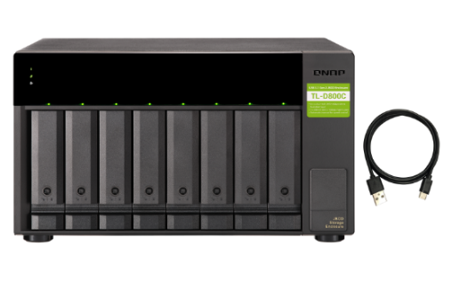
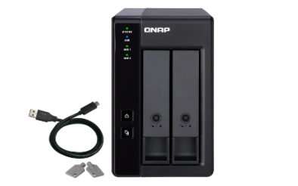
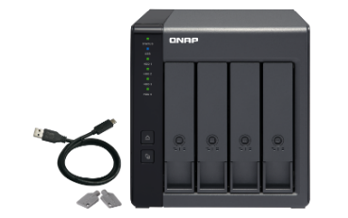
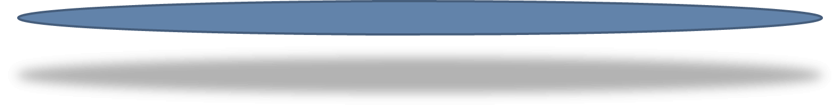
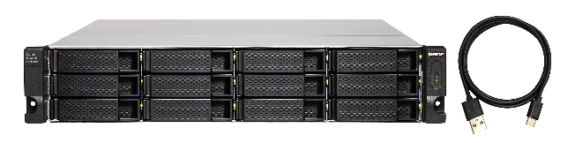

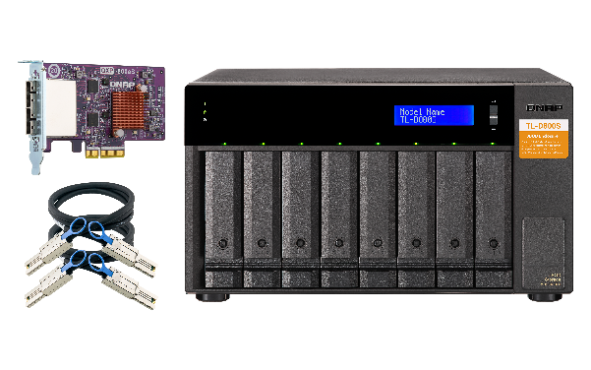
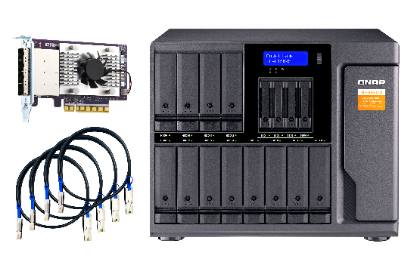
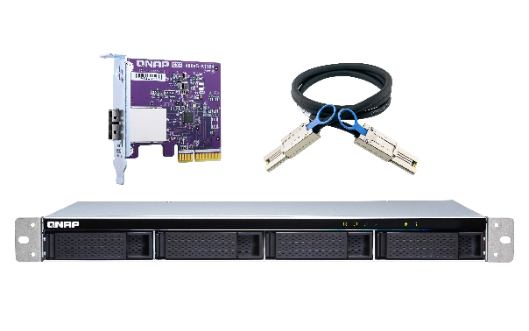
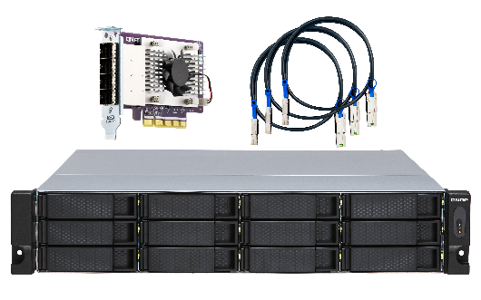
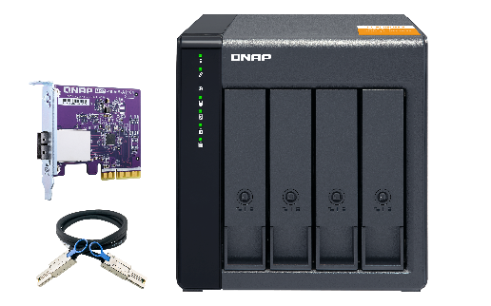
Optional Support USB / SATA JBOD & RAID Storage Expansion Unit​, up to additional 200TB storage space
Maximum of JBOD / RAID expansion enclosures
*TR-002 | 2
*TR-004 | 2
*TR-004U | 2
TL-D800C | 1
TL-R1200C-RP | 1
TL-D400S | 1
TL-D800S | 1
TL-D1600S | 1
TL-R400S | 1
TL-1200S-RP | 1
USB
TR-002
TR-004
TL-D800C
TR-004U
TL-R1200C-RP
SATA
TL-D400S
TL-D800S
TL-D1600S
TL-R400S
TL-R1200S-RP
Notes:
We can choose a variety of expansion devices. There are 2-bay to 12-bay options for USB storage expansion, and some JBOD models support hardware RAID and power backup. And There are 4-bay to 16-bay options for SATA storage expansion. If you need capacity expansion, you can refer to the purchase.

Slide 19
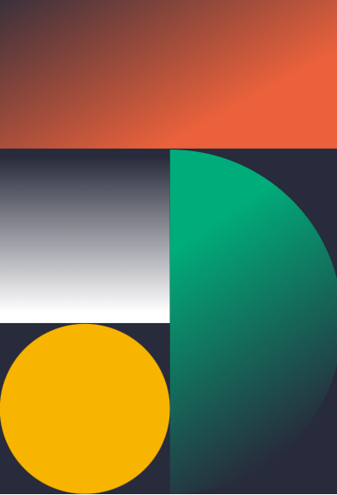
Equipped with the latest QTS 5.1 NAS operating system​
Boosted performance. Flexible management. Higher security
Enable SMB multichannel for full throughput and multi-path protection
Secure your NAS account with two-factor authentication (2FA)
Delegated administration to boost management productivity and ensure data security
Automatic RAID disk replacement with spares before potential failure
Improved drive health analysis and failure prediction

Slide 20

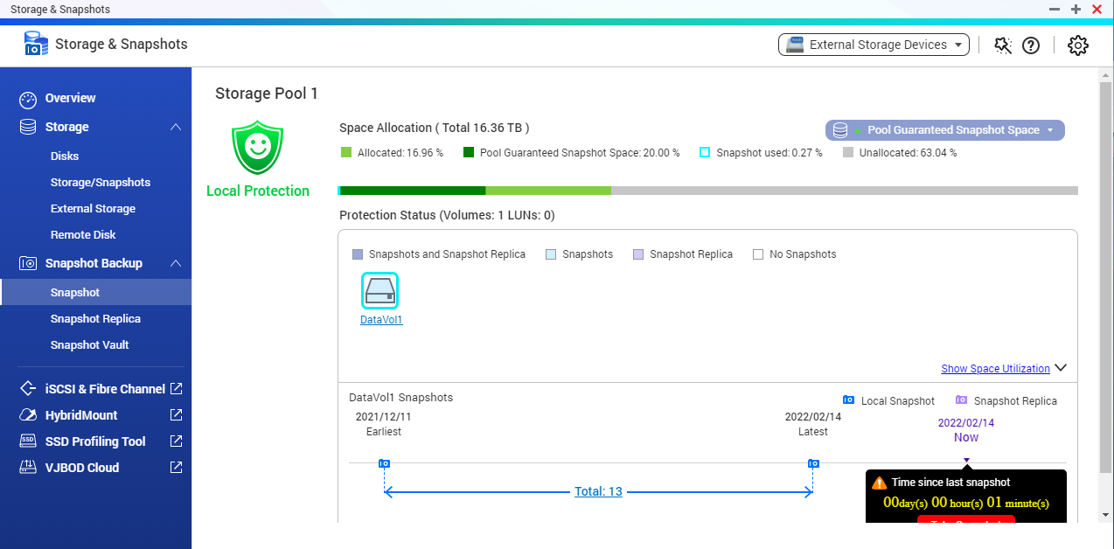
Snapshots help you fight with Ransomware Threats​
TS-432X/TS-632X supports Snapshot , like taking a photo - within seconds the complete status of your NAS system and data is recorded
Mitigate the growing threat of ransomware
Step 1 ​
Regularly update, and use Malware Remover​
Step 2​
Routinely back up to your NAS, and create multi-version snapshots​
Step 3​
Back up snapshots to another QNAP NAS​

Slide 21

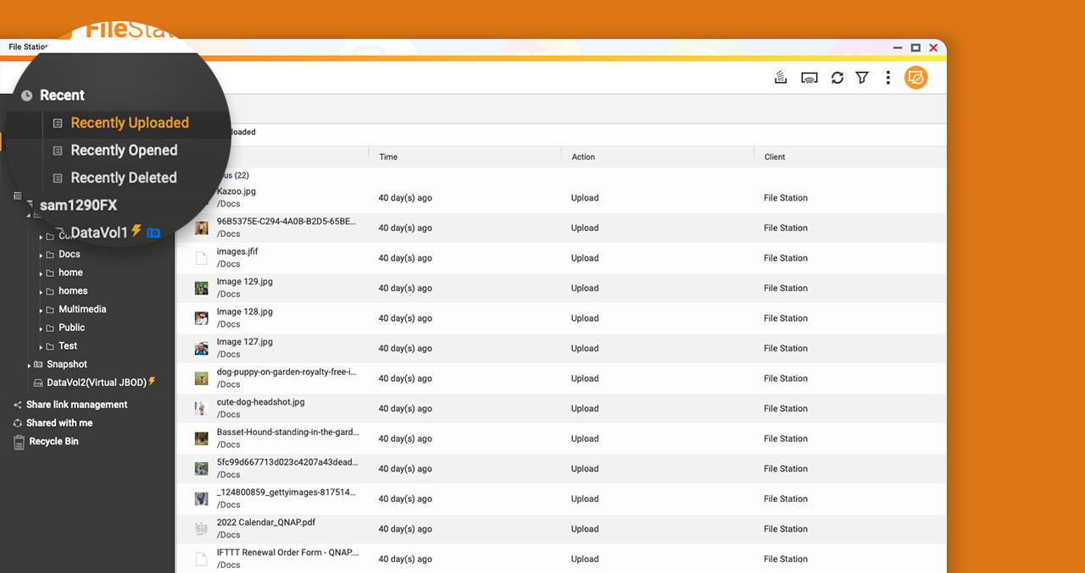
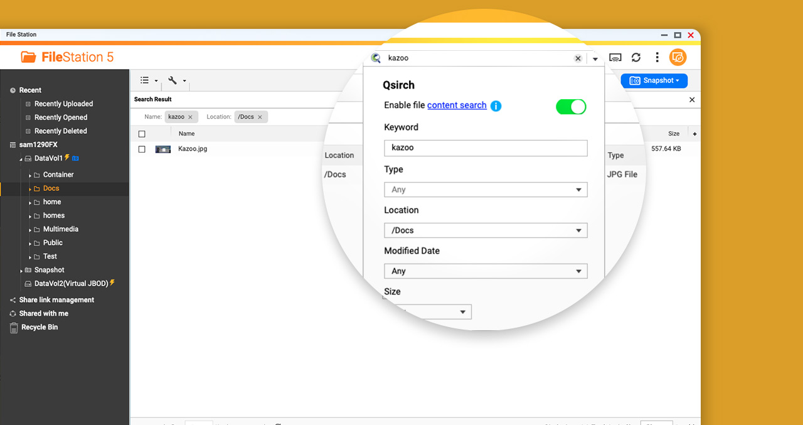
Manage and search files easily with the new File Station
手機瀏覽
網頁瀏覽
File Station is the master of managing all your files from NAS and connected devices (including USB devices, SD cards, remote NAS, cloud services, and more). Operated with an easy-to-use interface, File Station simplifies everyday file browsing, access, and searching
"Recently" sections
File Station displays files that have been recently uploaded, accessed, and deleted in the left panel, allowing you to quickly find desired files.
Search bar
The full-text search engine Qsirch is now supported! You can find files by filename and text in documents,or use filter to search for files much faster.

Slide 22


Smart and automatic file management​
Qsirch 5
Qfiling 3
A powerful, Google™-like search tool​
Automatically filing and archiving​
Search image, music, video, document, and email by keyword and filters. ​
5 advanced image search: search by face, text in image, things, color and map.​
Supports Qfiling to perform archival tasks based on your search criteria.​
Source
Schedule
Filter
Edit
Destination
2 type of task: filing task, recycling task​
3 type of scheduling rule: one-time, scheduling, real-time​
9 editing module: AI face blur, encryption and decryption, video transcoding and so on​

Slide 23


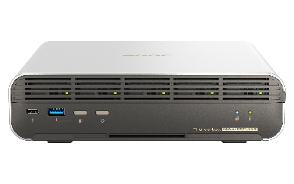
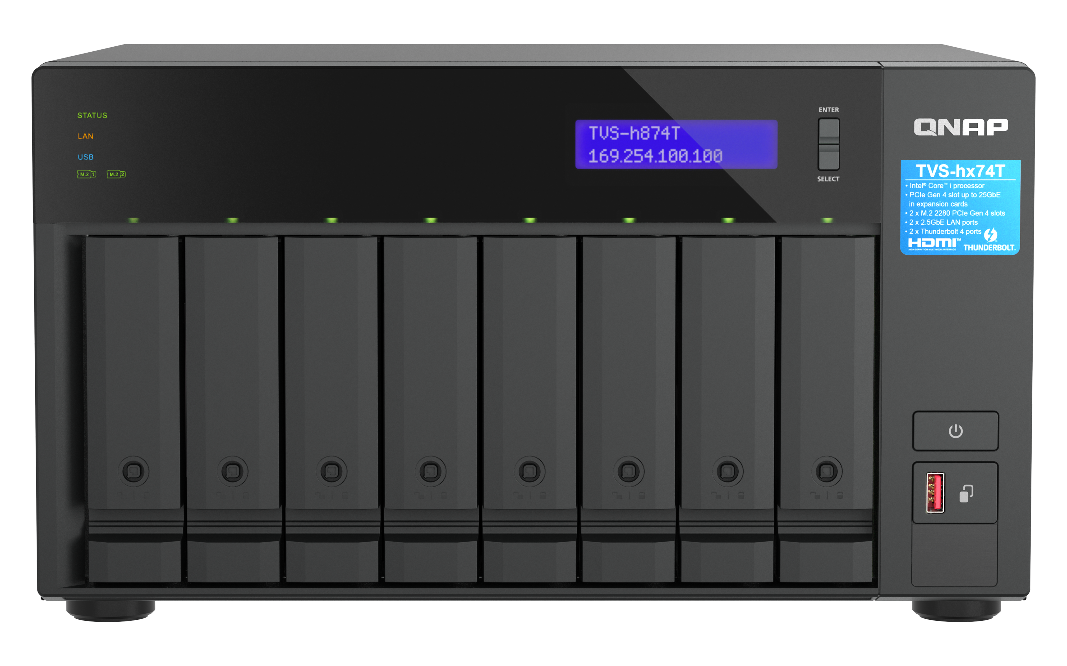

Easy to use HBS 3.0 app fulfilling backup
3-2-1 practice with deduplication
HBS 3 (Hybrid Backup Sync 3)
Complete 3-2-1 backup strategy and recovery plan: 3 copies、2 media type、1 remote backup​
2 media type
3 copies
Copy 1
NAS
Copy 2
NAS off-site
Copy 3
Google Drive
Notes:
When it comes to network storage equipment, there is no doubt security is first. In addition to the backup mechanism provided by QNAP NAS, we will also share the concept of data security.then What is the correct backup strategy? It will be backup 3-2-1 . This has been a backup strategy recommended by the US government for a long time. Here is a brief introduction. There are only three key points for backing up 3-2-1. , There are three files icon on the screen, we are naming them as copies, first: you need to prepare three copies for important files, second: put them in two different media like NAS and Google Drive, Third: keep one remote backup such as setting the NAS at home and company or Taiwan and the United States, the above three key points, we recommend you use two NAS to achieve government-level data backup strategy.
So
Keep 3 copies, on 2 types of storage, and store 1 copy off-site to ensure your data safety

Slide 24











QuMagie : Store and auto-organize your photos on QNAP NAS
QuMagie
  QuMagie integrates AI image recognition and intelligent classification for your photo.
QNAP NAS
Mobile
Mobile
Browse, manage photos
Upload, Back-up​
Photos
PC
手持裝置
QuMagie
手持裝置
Camera
Share photos
Social Media
手持裝置
PC
QNAP AI Core

Slide 25
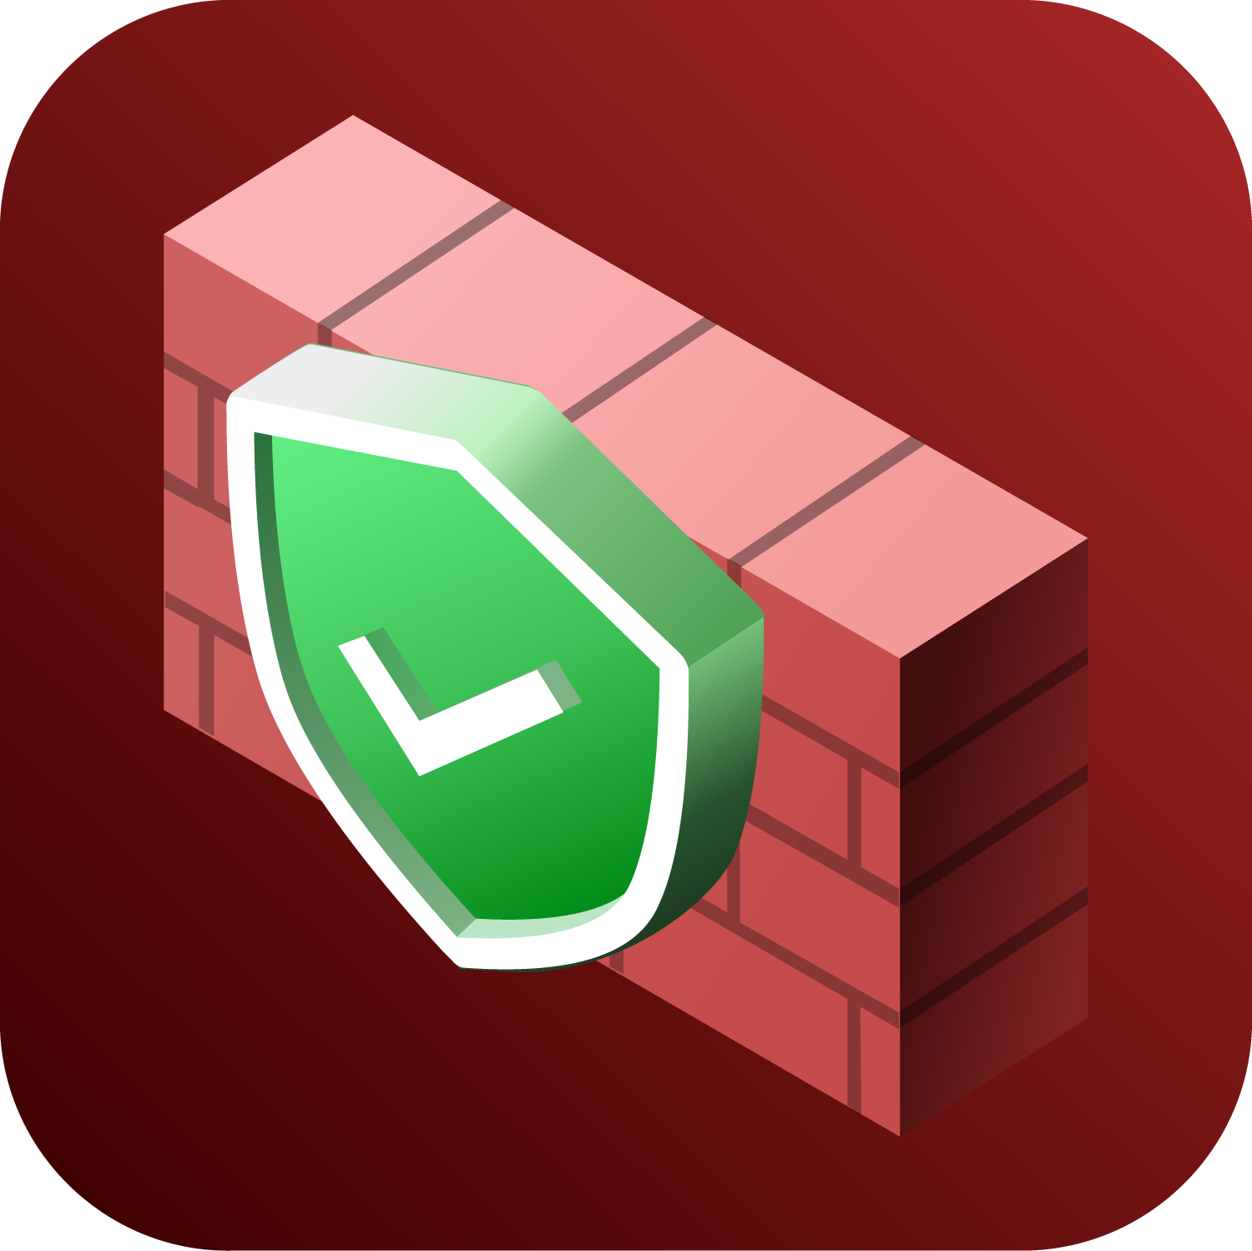

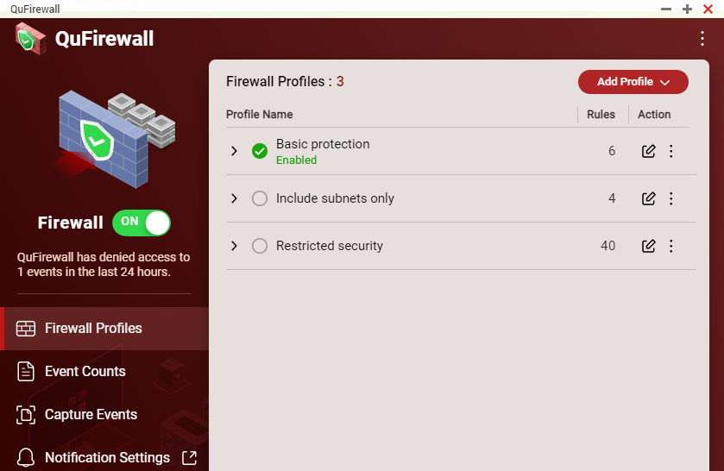
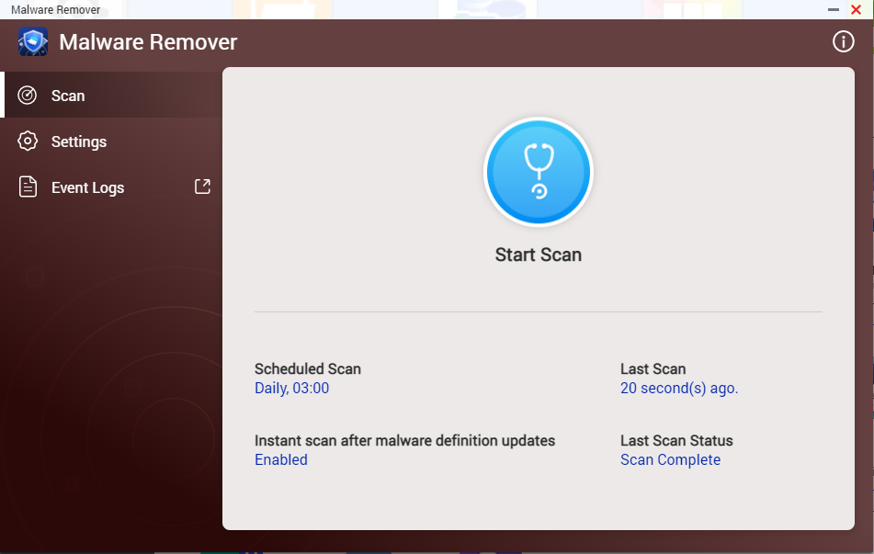
Data security​​
QuFirewall
You can allow/deny IP addresses and regions to prevent unauthorized access and brute force attacks for safeguarding data and service security.
Malware Remover
Regularly scan your NAS using the latest malware definitions. When under attack, infected files will be immediately removed to ensure NAS data security.

Slide 26

2-year standard warranty covering hardware repair and support services​
TS-432X/TS-632X is backed by a 2-year warranty at no additional cost. ​​
You can also purchase a warranty extension that extends your warranty coverage up to 5 years total​
Warranty extension P/N : LIC-NAS-EXTW-GREEN-3Y-EI
TS-432X
TS-632X

Slide 27

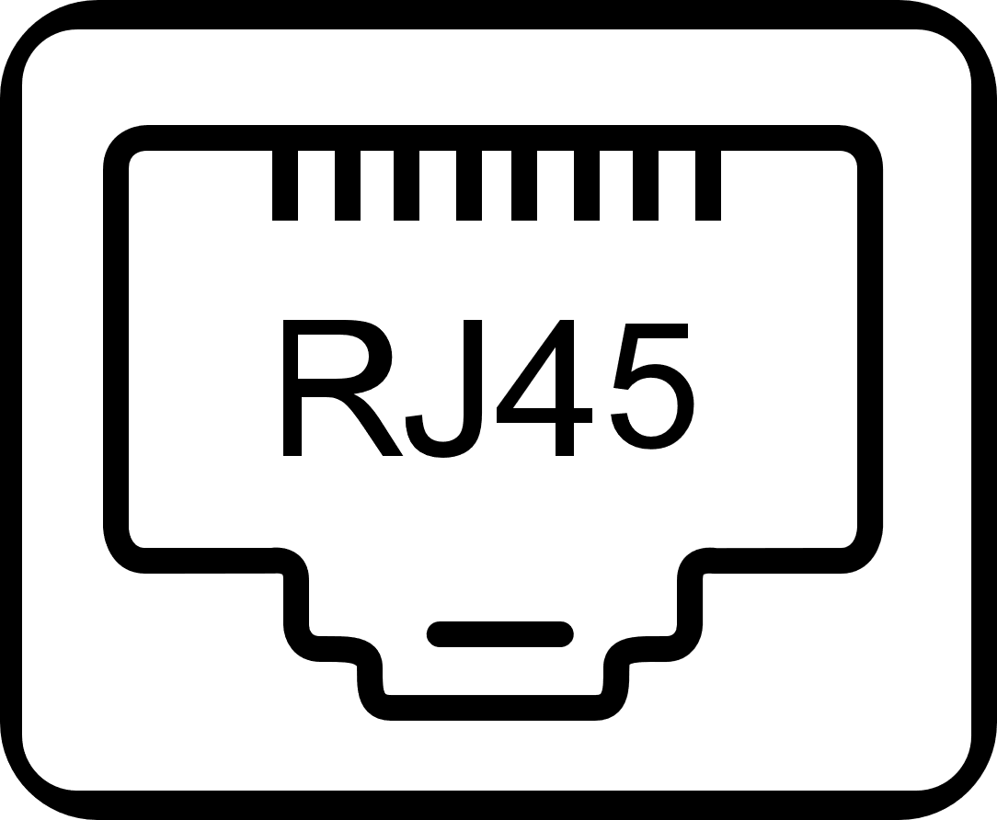







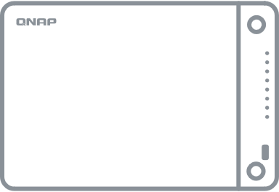


USB 3.2 Gen2 (10Gbps)
與 One-Touch-Copy
3個
PCIe Gen3 x4
擴充槽
JBOD expansion
Experience the latest innovations and improvements in QTS 5
AL-524 quad-core, 2.0GHz
Optional Support USB / SATA JBOD & RAID storage expansion Unit
2 x 2.5GbE
4GB SODIMM RAM
USB 3.2 Gen1
&
One-Touch-Copy
PCIe Gen3 x4 slot, Provide a variety of expansions including network card, M.2 and other expansion cards
IntelQAT
Maximum 16GB RAM, ECC optional
Up to 5-year
warranty​
110TB
App Center
Up to
Install-on-demand apps extend NAS features
Storage capacity
(TS-632X with 22TB HDD, RAID 5)
Built-in 10GbE SFP+
2.5GbE
TS-432X : 1 x 10GbE SFP+ port
TS-632X : 2 x 10GbE SFP+ ports
10
GbE
10
GbE
QSW-10GbE SFP+ Switch
TS-632X / TS-432X
AnnapurnaLabs AL524 quad-core NAS
Notes:
Recap TS-432X/TS-632X feature

Slide 28
PM： Andy Chuang
Copyright© 2024 QNAP Systems, Inc. All rights reserved. QNAP® and other names of QNAP Products are proprietary marks or registered trademarks of QNAP Systems, Inc. Other products and company names mentioned herein are trademarks of their respective holders.​​​​​​​
Notes:
Thanks for your attention
Cost-effective 4-bay and 6-bay 10GbE NAS, designed to accelerate your workloads. If you are interested, please visit our product page

