Slide 1
Company Profile
2025

Slide 2
About QNAP® Systems, Inc.
Product Introduction
Product Application Areas
Competitive Advantage

Slide 3
Company Profile and History

Slide 4
QNAP Systems, Inc.
Global Leader in Data Storage Solutions
QNAP (Quality Network Appliance Provider) is dedicated to software application development and hardware design optimization. We have our own production lines to provide comprehensive and advanced storage and networking solutions.
Founded in March 2004.
10 subsidiaries and 7 offices worldwide.
Approximately 1,200 employees globally.
Over 520 R&D engineers dedicated to innovation.
Manufactured in Taiwan at our own factory.

Slide 5
Business Philosophy
We are focused on providing comprehensive solutions for enterprise data access and data protection
Innovation-driven
Customer-centric
Security first
Committed to technological innovation and product development, we constantly introduce competitive network storage solutions to enhance users' data management experience.
We offer diversified and flexible products and services while continuously improving product quality and after-sales support to create value for our customers.
Through continuous technological upgrades and process optimization, we enhance product stability and security to maintain a leading position in a highly competitive market.

Slide 6
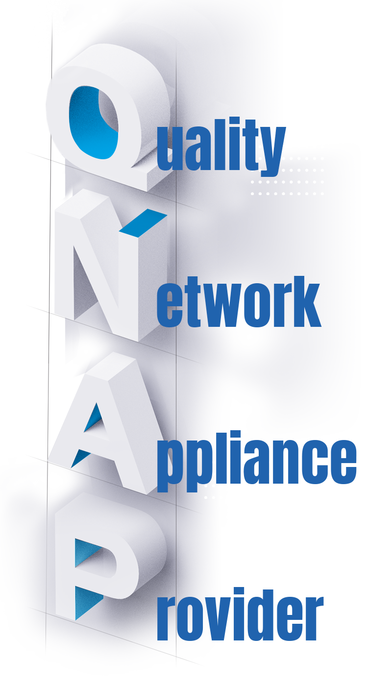
QNAP Value: History of a Treasured Brand
QNAP has been at the forefront of the network storage industry for 20 years, starting with RAID technology and gradually expanding to operating systems and a rich app ecosystem. This expansion propelled the QNAP brand into the global market, and helped establish Taiwan as a major producer of NAS devices. QNAP stands out with the following unique qualities, which are rare in Taiwan's tech industry.
Independent Brand
Software and Hardware R&D
Global Marketing
In-house Production

Slide 7
Key Milestones
2004
2006 - 2008
2010 - 2015
2016 - 2017
2018
QNAP established.
The global headquarters is in Xizhi, New Taipei City.
Integrated Multimedia Station and Download Station to lead the multimedia NAS trend.
Led the industry in providing NAS RAID configuration migration and storage expansion mechanisms.
Launched the world’s first Thunderbolt NAS.
Established USA Office and Warehouse Center / Canada Office / Germany Office and Warehouse Center / Europe Warehouse Center / Italy Office.
Pioneered the virtual machine workstation to redefine NAS multitasking applications.
PC World's Best Tech Product: TS-469 Pro NAS
Launched dual-control architecture Enterprise ZFS NSA series.
Launched the industry's first NAS with an AMD Ryzen processor, the TS-x77 series.
Established Japan office/India R&D and after-sales service center.
Launched the first home NAS with PCIe slot - TS-251B
Established UK Office / Thailand Office / Hong Kong Office.
Red Dot Product Design Award: TVS-951X 9 bay 10GbE multimedia NAS.
2019 - 2020
2021
2022
2023
2024
Launched the cloud gateway which flexibly integrates local storage with public cloud services.
CES Innovation Award: HS-453DX Fanless NAS.
Released QuTS hero operating system.
Launched QuWAN SD-WAN network optimization solution.
Launched Cloud NAS (QuTScloud) that can be hosted on public/private clouds.
Led the industry by launching 24-bay U.2 NVMe all-flash array with dual-port 100GbE Ethernet cards.
Innovated ADRA NDR active cybersecurity defense device.
Red Dot Award for Innovative Product Design - QGD-3014-16PT Desktop Smart Cloud PoE Switch.
Established European headquarters in Willich, Germany.
Red Dot Product Design Award: TS-h1290FX desktop 12 bay all-flash NAS.
Launched our own cloud storage, myQNAPcloud Storage.
Released the world's first Thunderbolt NAS supporting E1.S / M.2 SSD.
TechRadar Pro Picks Award Winner for CES 2023.
Launched the proactive surveillance and video backup solution QVR Recording Vault and the innovative isolated backup solution Airgap+.
Established Korea office.
Deepened collaboration with Trend Micro Labs and expanded participation in the Pwn2Own cybersecurity competition.

Slide 8
Worldwide Deployment of Subsidiaries
Italy｜Roma 2015
Sales / Marketing / After-Sales Service
Germany (Europe HQ) ｜Ｗillich 2022
Sales / Marketing / Warehouse / After-Sales Service
Korea｜Seoul 2024
Sales / Marketing
UK｜Swindon 2018
Sales / Marketing / Warehouse / After-Sales Service
Japan｜Tokyo 2016
Sales / Marketing / Warehouse / After-Sales Service
Taiwan (Global HQ)｜New Taipei City 2004
R&D / DQV / Sales / Marketing / Technical Support / Warehouse
Hong Kong｜Kowloon Bay 2018
Sales / Marketing / Technical Support
USA｜Pomona 2009
Sales / Marketing / Warehouse / After-Sales Service
India｜Bengaluru 2017
R&D / Technical Support
Canada｜Ontario 2015
Sales / Marketing / Technical Support

Slide 9
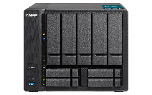
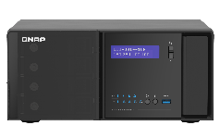
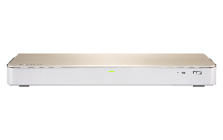
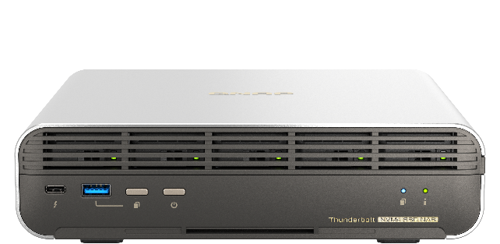
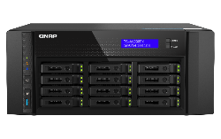
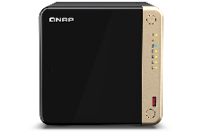
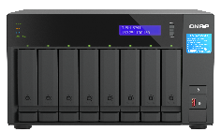
Awards
2018 Red Dot Award: Product Design
CES 2019
Innovation Awards
2021 Red Dot Award: Innovative Product Design
TVS-951X
9-bay 10GbE Multimedia NAS
HS-453DX
Fanless NAS
QGD-3014-16PT
Desktop Smart Edge PoE Switch
2022 Red Dot Award: Product Design
2023 TechRadar Pro Picks Award Winner for CES 2023
2024 TechRadar Pro Picks Award for CES 2024
2024 TechRadar Pro Picks Award for CES 2024
TS-h1290FX
Desktop 12-bay All-Flash NAS
TS-464
Quad-core dual-port 2.5GbE NAS
TVS-h874T
Thunderbolt™ 4-bay NAS.
TBS-h574TX Thunderbolt™ 4 All-Flash NASbook

Slide 10
Corporate Leadership
Chairman of QNAP
Meiji Chang
General Manager of QNAP
Jack Liou
Headquarters Sales VP
Banson Chang
Regional VP of Canada
Siimon Tsai
Regional Manager of
Southern Europe
Tony Chou
Regional VP of
Japan & Korea
Jack Yang
Regional VP of US
James Wu
Regional VP in Europe
Dale Chen
Regional Manager of UK
Posen Wang

Slide 11
Key Channel Customers

Slide 12
Product Introduction and Applications

Slide 13
4 Key Application Areas
We develop smart enterprise information systems based on the rigid demands of data storage
High-performance data storage and protection
Cloud and on-premises backup and disaster recovery
Low latency is a prerequisite for agile enterprise services and a key indicator of competitiveness
Comprehensive backup and hybrid cloud offsite backup are critical components of modern enterprise data management architectures
Intelligent Video Surveillance
AI Edge Computing
Visual recognition is the foundation for AIoT application development
The implementation of enterprise AI applications begins with the deployment of AI edge computing

Slide 14
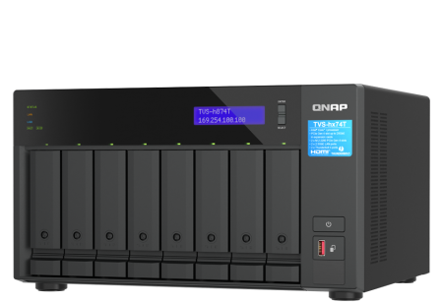
Core Product Line: Network Attached Storage (NAS)
Suitable for data centers
Suitable for AI ultra-high-speed computing
What is NAS?
Rackmount NAS
All-flash NAS
NAS is a server that provides access to data over a network. It is a data protection server that integrates network, storage, and computing to ensure that assets will not be damaged or stolen.
Suitable for edge computing
Suitable for offices
Suitable for mobile scenarios
Compact NAS
Desktop NAS
Portable NAS

Slide 15
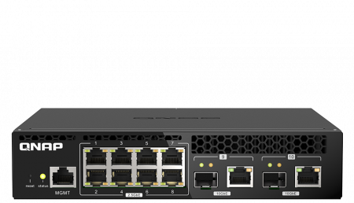
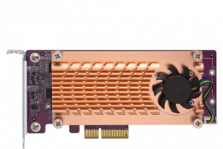
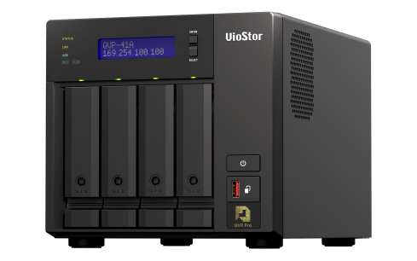
Value-Added Product Line: Software Subscriptions and Accessories
Service value-added and applications
Storage peripheral product line
Cybersecurity and networking product line
JBOD expansion enclosure and expansion card
Switch/SDWAN Router
Starting from storage, QNAP has developed various value-added applications and created a complete storage industry ecosystem.
AI video surveillance service
Subscription-based cloud storage
Subscription-based software
NVR video management server
Value-added software subscription
myQNAPcloud Storage
Cloud storage

Slide 16
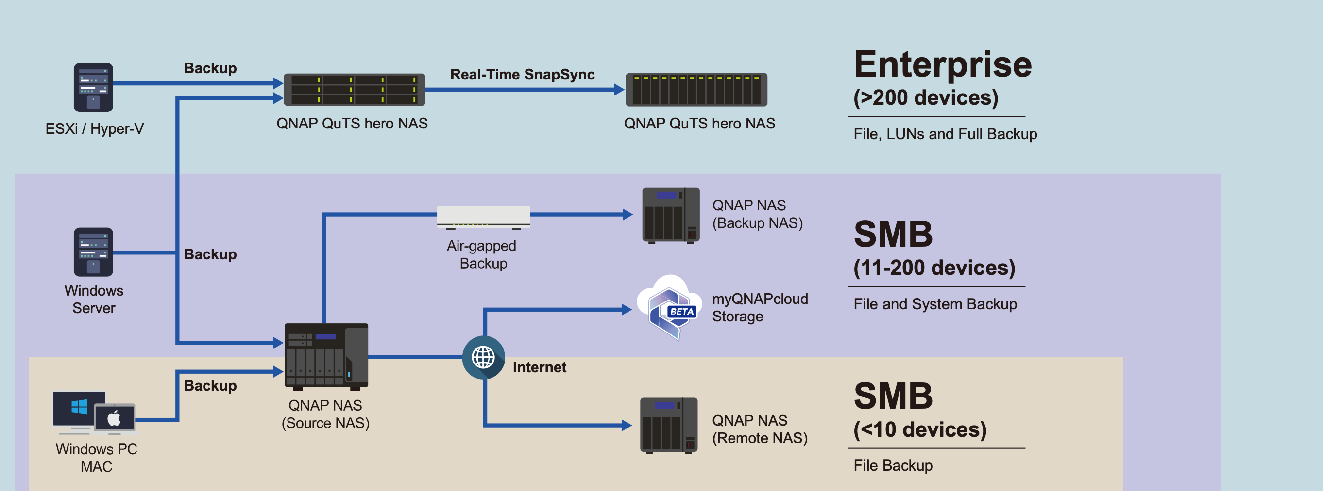
NAS is Essential for Every Industry!
Enterprises of all sizes, industries of all types, businesses and individuals all need QNAP NAS
Data center
Energy industry
Healthcare services
Mining and quarrying industry
Research institute
Telecommunications industry
Wholesale and retail industry
Manufacturing Industry
Aerospace industry

Slide 17
Integrated Hardware and Software Solutions

Slide 18
All-flash storage. Ultimate performance.
Low latency
Inline data compression and compaction
Up to 1M IOPS random read
SSD TRIM
QSAL (QNAP SSD Antiwear Leveling) patented algorithm
QNAP’s All-Flash Storage Solutions feature ZFS data reduction and SSD optimization technologies to maximize SSD performance and lifespan. Perfect for keeping your business agile and efficient!

Slide 19
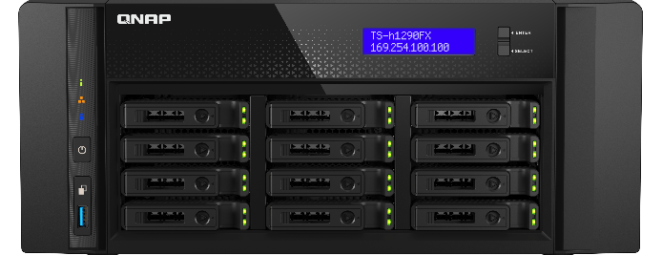
High-performance ZFS-based OS with greater reliability
QuTS hero is our operating system for high-end and enterprise QNAP NAS. With Linux and ZFS, QuTS hero supports advanced data reduction technologies for further driving down costs and increasing reliability of SSD (all-flash) storage.
Powerful real-time data reduction technology maximizes storage space efficiency.
Near-limitless, instant snapshots
Seamlessly integrate JBODs for expanding capacity up to petabyte-scale storage
Real-time SnapSync
WORM (Write Once, Read Many)

Slide 20
Petabyte-level Storage Expansion
As hard drive capacities continue to grow, the cost per bit of storage is steadily decreasing. QNAP is committed to supporting the latest hard drive and storage technologies and providing highly reliable, flexible, and agile storage solutions to reduce system failure risks.
4.5 PB Storage Solution
From HDD to NVMe
QNAP NAS and JBOD can be configured to provide up to 4.5 PB storage space, offering robust big data storage solutions for enterprises and research institutions.
QNAP offers the simplest vertical scale-up solution, increasing both performance and capacity by connecting up to 12 JBOD to a high-performance all-flash NAS.

Slide 21
ADRA Network Detection and Response (NDR) appliances
The QNAP ADRA series Network Detection and Response (NDR) appliances selectively screen network traffic and detect the lateral movement of malware, stopping hostile activities before data leakage and encryption can occur.
The rapid-screening ADRA NDR cybersecurity appliances
Threat detection: uncover hostile activities in time
Threat analysis: provides valuable insights for taking further actions
Threat response: stop and contain malware attacks

Slide 22
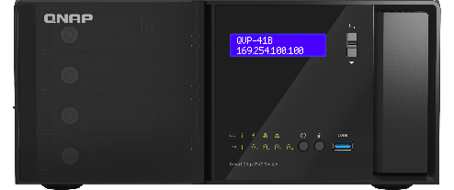
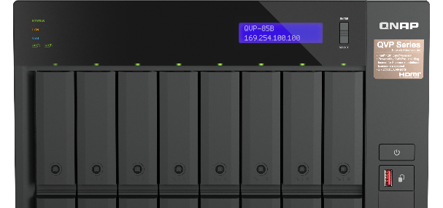
Next-generation intelligent IP surveillance and remote backup solution
With the subscription-based QVR Elite smart surveillance solution you only pay for the channels you need, allowing you to affordably safeguard your property. You can arrange a dedicated, independent storage space for surveillance data on the QNAP NAS and enjoy simplified camera management, storage space allocation, camera live viewing and playback. Recordings are saved as MP4 files for playback on nearly every device.
Direct monitoring on an HDMI display
Leverage AI-based applications for value-added services
QVR Pro Client: Centralized monitoring and management
Saves recordings using the MP4 video format
Easy capacity expansion
Low cost: flexible subscription plan

Slide 23
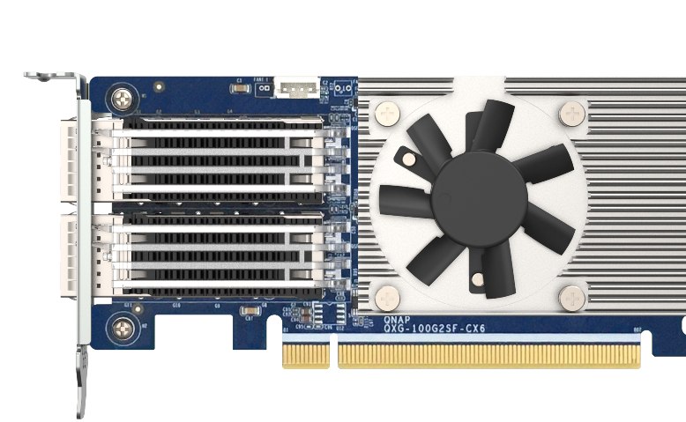
Join the ultra-high-speed 100GbE network generation
According to market research, the demand for 100 GbE switches took off in 2023. Enterprises, hyper scalers, and service providers worldwide continue to invest in higher-speed network infrastructure to support higher-speed servers and higher bandwidth demands of new applications such as Generative AI workloads.
Half-width rackmount 100 GbE managed switch
100 GbE network expansion card
The QSW-M7308R-4X is a 100GbE Layer 2 Managed Switch with four 100GbE QSFP28 ports and eight 25GbE SFP28 ports, providing up to 1200 Gbps switching capacity. Its compact half-width rackmount design meets the high-bandwidth needs of big data storage, video editing, virtualization, and AI applications, accelerating deployment in data centers and multimedia studios.
The QNAP PCIe 4.0 dual-port 100 GbE network expansion card delivers an impressive 100 Gbps bandwidth to overcome performance bottlenecks. Its low latency makes it ideal for bandwidth-demanding applications such as data centers, virtualization, multimedia streaming, and transfer, as well as mission-critical backup and restore tasks.

Slide 24
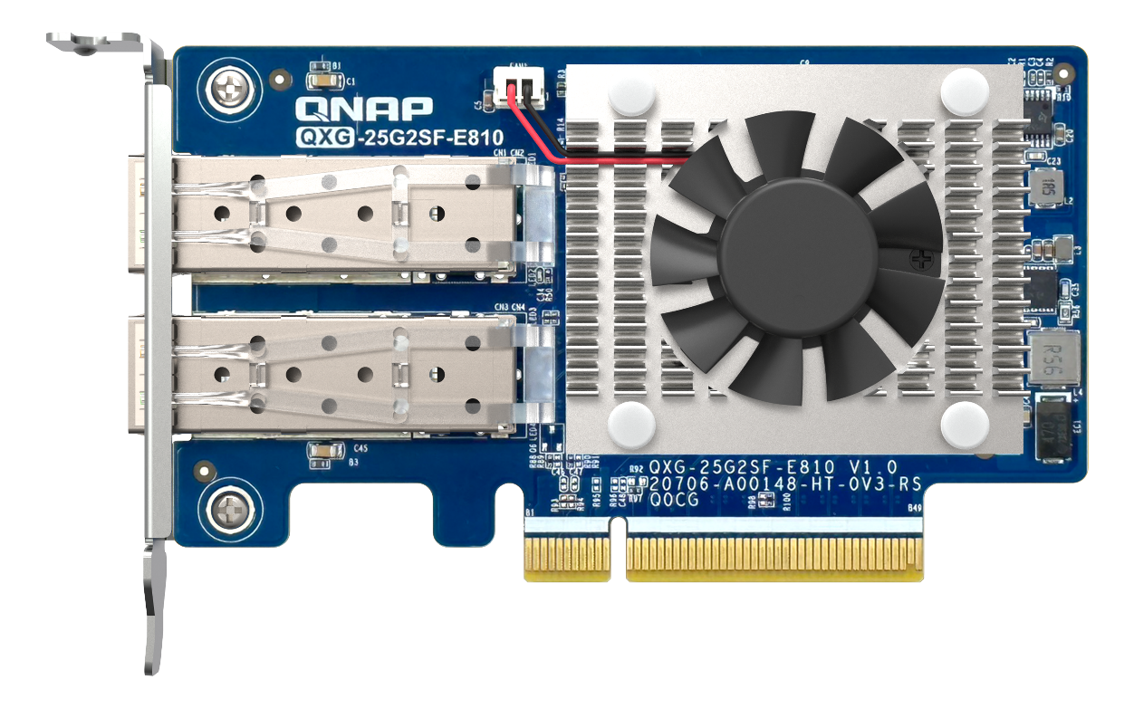
High-speed 25GbE networking solution
25GbE 網卡
When running SAN servers, cluster servers and AI computing applications, enterprises need 25GbE to break through transmission performance bottlenecks. QNAP offers a complete 25GbE solution to help enterprises quickly upgrade to 25GbE networking at a cost-efficient price, while enjoying low latency, reliability, and high compatibility.
25GbE-ready All-flash NAS
Affordable 25GbE managed switch
The TS-h3088XU-RP provides a built-in dual-port 25GbE SFP28 SmartNIC with the NVIDIA® Mellanox ConnectX-4 Lx SmartNIC controller that supports iSCSI Extensions for RDMA (iSER) to increase the performance of data transfer between NAS and ESXi server and offload CPU workloads.
The QSW-M5216-1T is a 25GbE Layer 2 web managed switch that provides flexible network interfaces for high compatibility at an affordable price, enabling small businesses to quickly upgrade to an ultra-high-speed backbone network by integrating to existing network infrastructure.

Slide 25
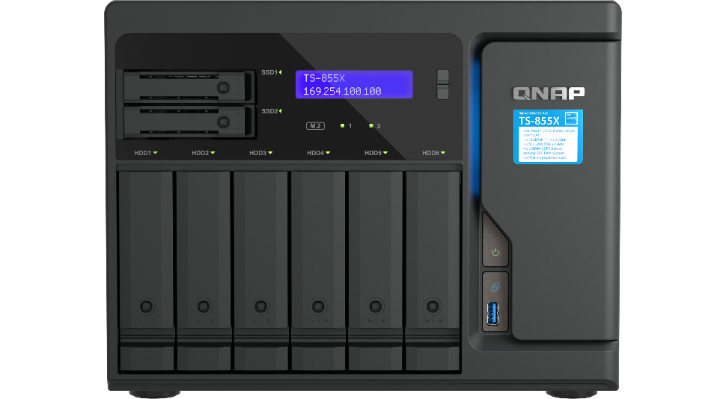
10GbE network solutions
10GbE NAS solutions
10GbE improves overall network performance and everyday tasks with ten times the bandwidth of 1GbE. By offering 10GbE-ready NAS, network adapters and switches, QNAP is a one-stop provider for everything needed to embrace 10GbE networking.
QNAP provides NAS with built-in 10GbE connectivity and optional 10GbE expandability, ideal for large file transfer, storage, and backup with fast, reliable and cost-efficient advantages.
10GbE network adapters
QNAP provides 10GbE PCIe expansion cards and Thunderbolt to 10GbE adapters to empower devices with 10GbE connectivity. The QM2 Expansion Card not only includes 10GbE connectivity, but also provides the ability to add M.2 SSDs to your workstation or NAS.
10GbE switches
QNAP’s QSW Series 10GbE switches supports 10GBASE-T and NBASE-T standards, allowing you to take advantage of higher network speeds with existing Cat 5e and 6a cables. Both SFP+ (fiber) and RJ45 (copper) ports are available for servicing a range of network needs.

Slide 26
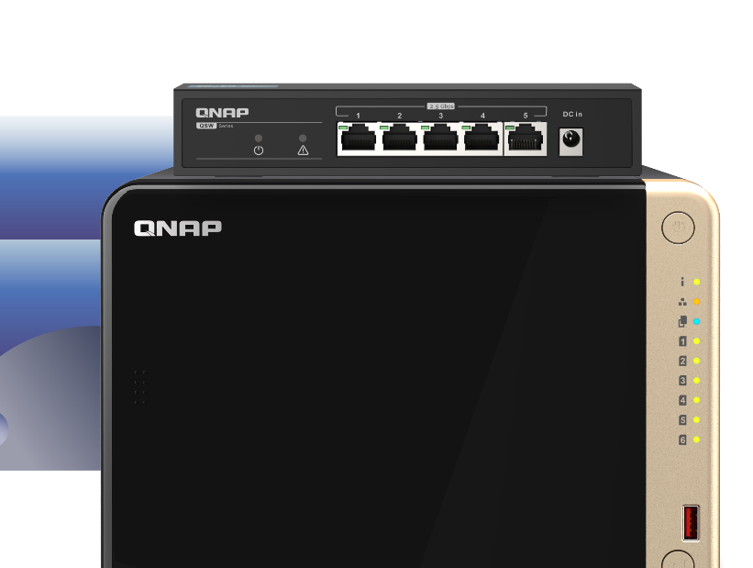
2.5GbE Ethernet
The lack of consumer-grade switches has made it hard for home and personal users to adopt 2.5GbE/5GbE networking. QNAP now offers cost-effective multi-port switches that support 10G/5G/2.5G/1G/100M Ethernet, helping you to transform your home network at a wallet-friendly price.
2.5GbE switches
QNAP offers a 10GbE switch series supporting five speeds (10G / 5G / 2.5G / 1G / 100M) and a 2.5GbE switch series.
2.5 times faster
2.5GbE is 2.5 times faster than standard Ethernet (1GbE), increasing network performance to boost productivity.
Works with existing cables
No special cables or connectors are required to take advantage of 2.5GbE. Simply use your existing CAT5e cables as normal with your new 2.5GbE infrastructure.
More affordable
If you can’t budget a 10GbE upgrade at this time, the more affordable 2.5GbE provides a notable improvement in current Ethernet speeds.

Slide 27
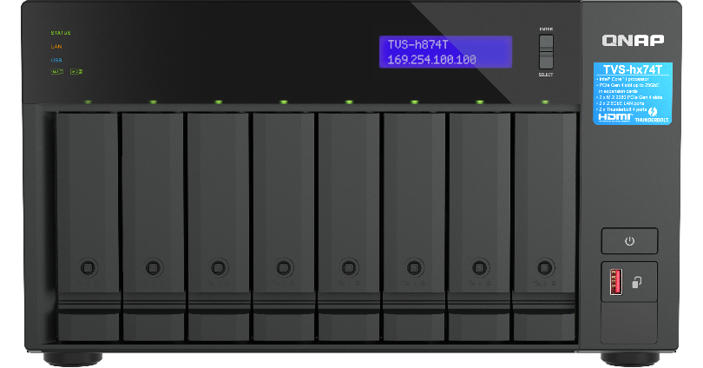
Breakthrough performance and outstanding connectivity with Thunderbolt™ NAS
QNAP NAS with Thunderbolt™ provides fast, efficient, scalable and secure storage, enabling the perfect collaboration environment for Mac® and Windows® multimedia professionals.
Ultra-high-speed transfer (up to 40GbE bandwidth)
High availability with USB Type-C
Daisy chain multiple Thunderbolt devices
Connect the Thunderbolt NAS to multiple Thunderbolt workstations for efficient collaboration.
Thunderbolt™ NAS with HDMI output supports 4K UHD display

Slide 28
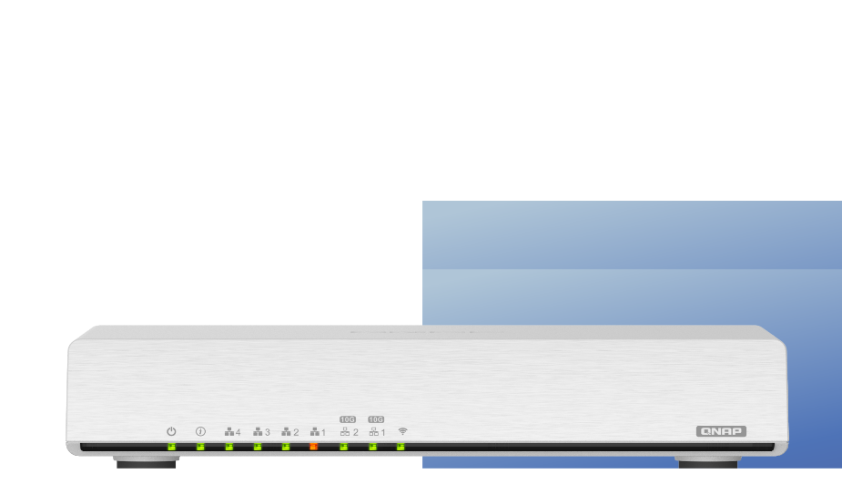
SD-WAN Solution for Resilient IT Infrastructure
Convenient single user account login to VPN: supports Authentication Server and SAML SSO
Automatically establishes a mesh VPN
Adopts load balancing technologies for WAN Aggregation and QoS for combining bandwidth
Powerful and convenient central cloud management.
Optimizes fiber/network transmission to lower the cost of VPN equipment and bandwidth expenses.
Adopts DPI to analyze L7-Payloads for content information from websites and devices
User-friendly Web GUI
QNAP's QuWAN SD-WAN solution features SAML SSO, enabling users to join the VPN easily and conveniently with a single login. It also includes IPsec encryption, cloud-centric management, and QVPN Service for multi-site networks.

Slide 29
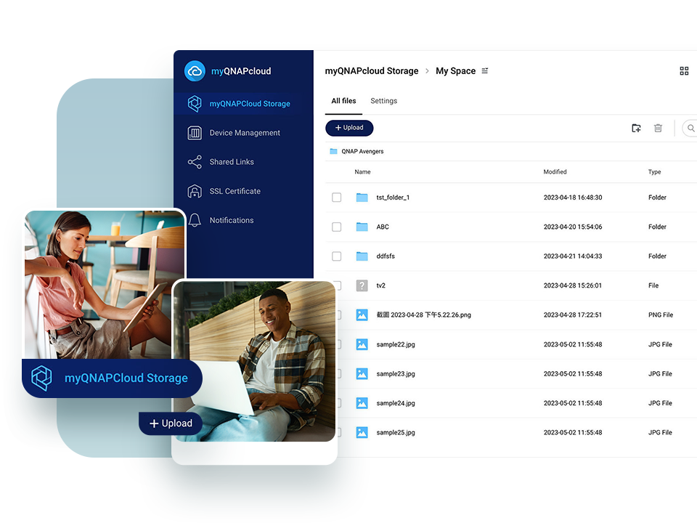
QNAP-hosted cloud storage
myQNAPcloud Storage
Back up your NAS data to a trusted cloud hosted by QNAP. myQNAPcloud Storage is designed for QNAP users to easily carry out off-site backup to meet disaster recovery requirements.
Works perfectly with QNAP backup solutions
Use myQNAPcloud Storage as a file drive
Worldwide coverage with 12 data centers
No costs for data transmission
WORM; Lock/Unlock
Personal Vault

Slide 30
Easily build a personal cloud and access anywhere
An easy-to-use, all-in-one backup solution
Greater multimedia enjoyment
Easy and secure remote connection with myQNAPcloud
A secure backup center with snapshot protection
Connect to a TV or monitor with HDMI
In contrast to the limited storage space and potential security issues with public cloud services, the QNAP NAS is advantageous for establishing a secure and large-capacity personal cloud.

Slide 31
Product Application Areas

Slide 32
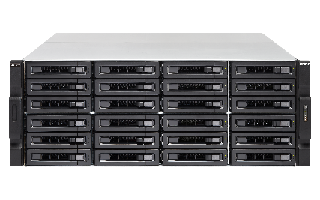
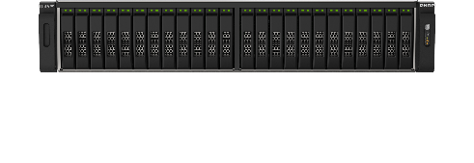
Enterprise IT Infrastructure
Supports backbone architectures and secondary backups for corporate data centers
From HDD to NVMe
Data Backup and Recovery
Infrastructure as a Service (IaaS)
Workspace Collaboration
Network Infrastructure

Slide 33
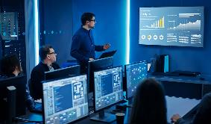
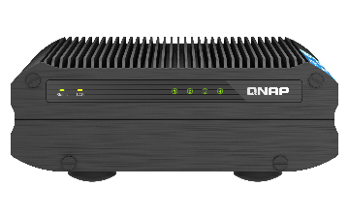
Industrial Manufacturing Sector
Manufacturing Industry Cybersecurity and Edge Computing Solutions
Wide temperature and wide voltage power NAS system
Industrial-grade managed network switches
Targeted ransomware cybersecurity defense systems
PoE++ / PoE+ Ethernet power supply switches
IoT private cloud platform

Slide 34
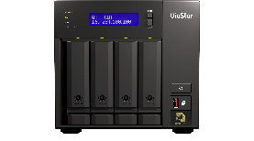
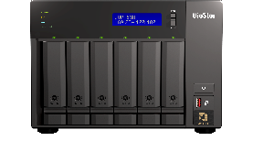
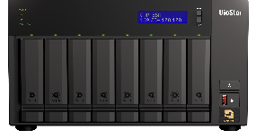
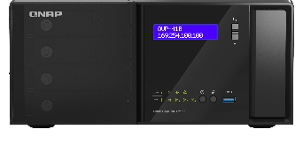
Enterprise Video Surveillance Sector
Integrated Recording, Analysis, and Management Surveillance System
Real-time video surveillance
Intelligent AI Video event search
Supports facial recognition and search
High availability video failover
Cloud monitoring service

Slide 35
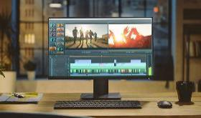
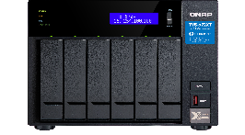
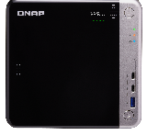
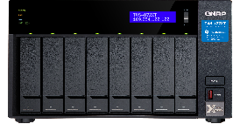
Content Creation and Video Editing Sector
Suitable for Pre-production Storage, Post-production, and Animation Effects
4K/8K high-resolution online editing
Thunderbolt high-speed data transfer
Cross-platform file collaboration
Petabyte-level file storage
Compatible with non-linear editing applications
Video content backup and protection

Slide 36
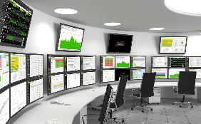
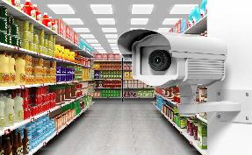
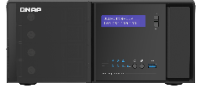
Retail and Department Stores
Meets the Needs of Multi-site Information Architecture
POS system virtual machine application
AI smart retail data analysis
Cross-camera facial recognition and tracking
Crowd hot-spot map
Dwell time and conversion rate analytics
Multi-point SD-WAN setup
Centralized branch file backup to head office

Slide 37
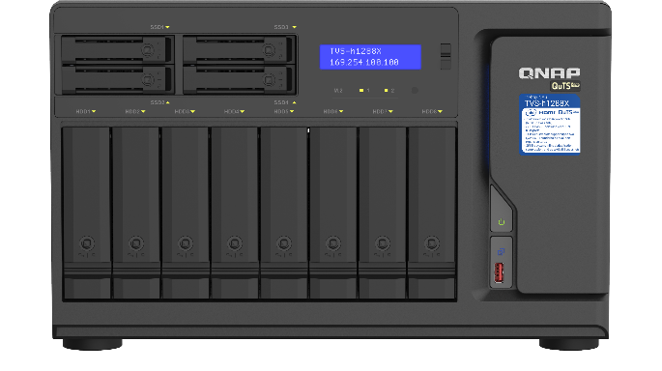
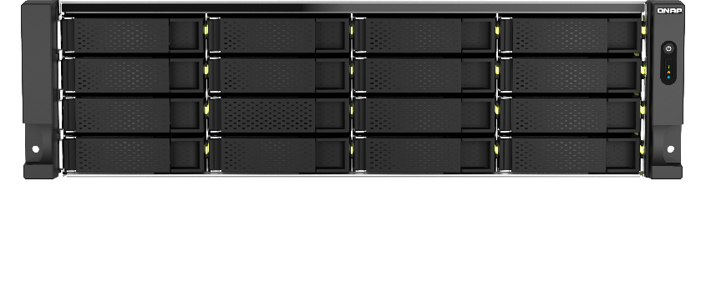
Healthcare Sector
Sensitive Data Protection and Backup
Sensitive data storage and backup
HIPPA compliance
Medical imaging machine learning model
Medical journal document extraction
Telemedicine interaction
Integration of DICOM images

Slide 38
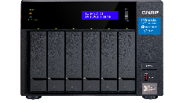
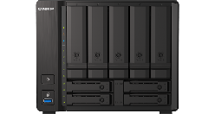
Education Sector
Campus Security and Data Sharing
Multi-point data sharing and synchronization
FTP file management system
Compact classroom storage devices
Remote teaching interaction
Campus security monitoring

Slide 39
QNAP Solution Advantages

Slide 40
Enterprise-grade High-performance Storage Technology
Use ZFS file system for both data efficiency and integrity.
High availability (HA) technology for enterprise service stability.
All-flash high-performance storage with real-time data compression and accelerated write speed.
Petabyte-level, horizontal-scale-out data service architecture for massive expansion.
Innovative Thunderbolt technology, supporting plug-and-play high-speed team collaboration.

Slide 41
High-speed Cybersecurity Network Aggregation Technology
Ultra-high-speed 100GbE network switching technology with data center-level fault-tolerance protection.
SD-WAN high-security agile networking technology for cross-region enterprise networks.
Malicious network activity detection and response technology for intranet endpoints and data security.

Slide 42
Data Backup and Synchronization Technology
Endpoint, server, and cloud backup synchronization with comprehensive backup and disaster recovery architecture.
Cloud SaaS service backup empowers enterprises with absolute control over their data.
Snapshot protection and offsite backup to ensure data resilience.

Slide 43
Multi-cloud Integration and Cloud Services
Cloud storage mounting and S3 cloud gateway technology for seamless integration between on-premise NAS and cloud.
AMIZ cloud device management services to monitor device hardware and connection status.
myQNAPCloud cloud storage subscription allows businesses to quickly perform NAS data backups.
QuWAN integration with SaaS account authentication to build secure SD-WAN remote access network for enterprises.

Slide 44
Intelligent and Edge AI Computing
AI Core facial and object recognition technology for analyzing photos and semantic search in documents.
Cross-camera facial tracking and object detection with the AI-powered surveillance system QVR Pro.
NAS integration with GPU, TPU, and NPU to enhance performance and enable AI computing deployment.
Edge RAG architecture integrating third-party AI models and cloud intelligence for rapid deployment of edge AI applications.

Slide 45
STAY ONE STEP AHEAD
Copyright© 2025 QNAP Systems, Inc. All rights reserved. QNAP® and other names of QNAP Products are proprietary marks or registered trademarks of QNAP Systems, Inc. Other products and company names mentioned herein are trademarks of their respective holders.​​​​​​​

