Slide 2
QTS 4.3.4 New Features
Basics of Data Storage
Video Playback
with VLC
Hybrid Backup Sync
Performance and stability are keys!
A single portal for data backup and recovery!
More multimedia formats are supported by leveraging capabilities of VLC
Storage & Snapshots
File Station
Qboost
Evolved for data safety & snapshots for ARM-based NAS!
Highly integrated file management app for complete file operations
Optimize and boost the performance of ARM-based NAS

Slide 3
Basics of data storage
Performance and stability are the keys!

Slide 4
Why doesn't QNAP adopt Btrfs?
Foundations of storage: performance and stability
High performance must be guaranteed
Ext4 is a more mature filesystem for protecting customer data
Analysis: drawbacks of the Btrfs filesystem
Btrfs's degraded performance: cannot utilize full potential of most major HDD
Btrfs's management difficulties: storing snapshots inside a volume makes managing protection even harder
Notes:
快照與檔案系統獨立，達成全域共享，兼顧共享資料與 iSCSI LUN
快照與檔案系統獨立，空間分開管理

Slide 5
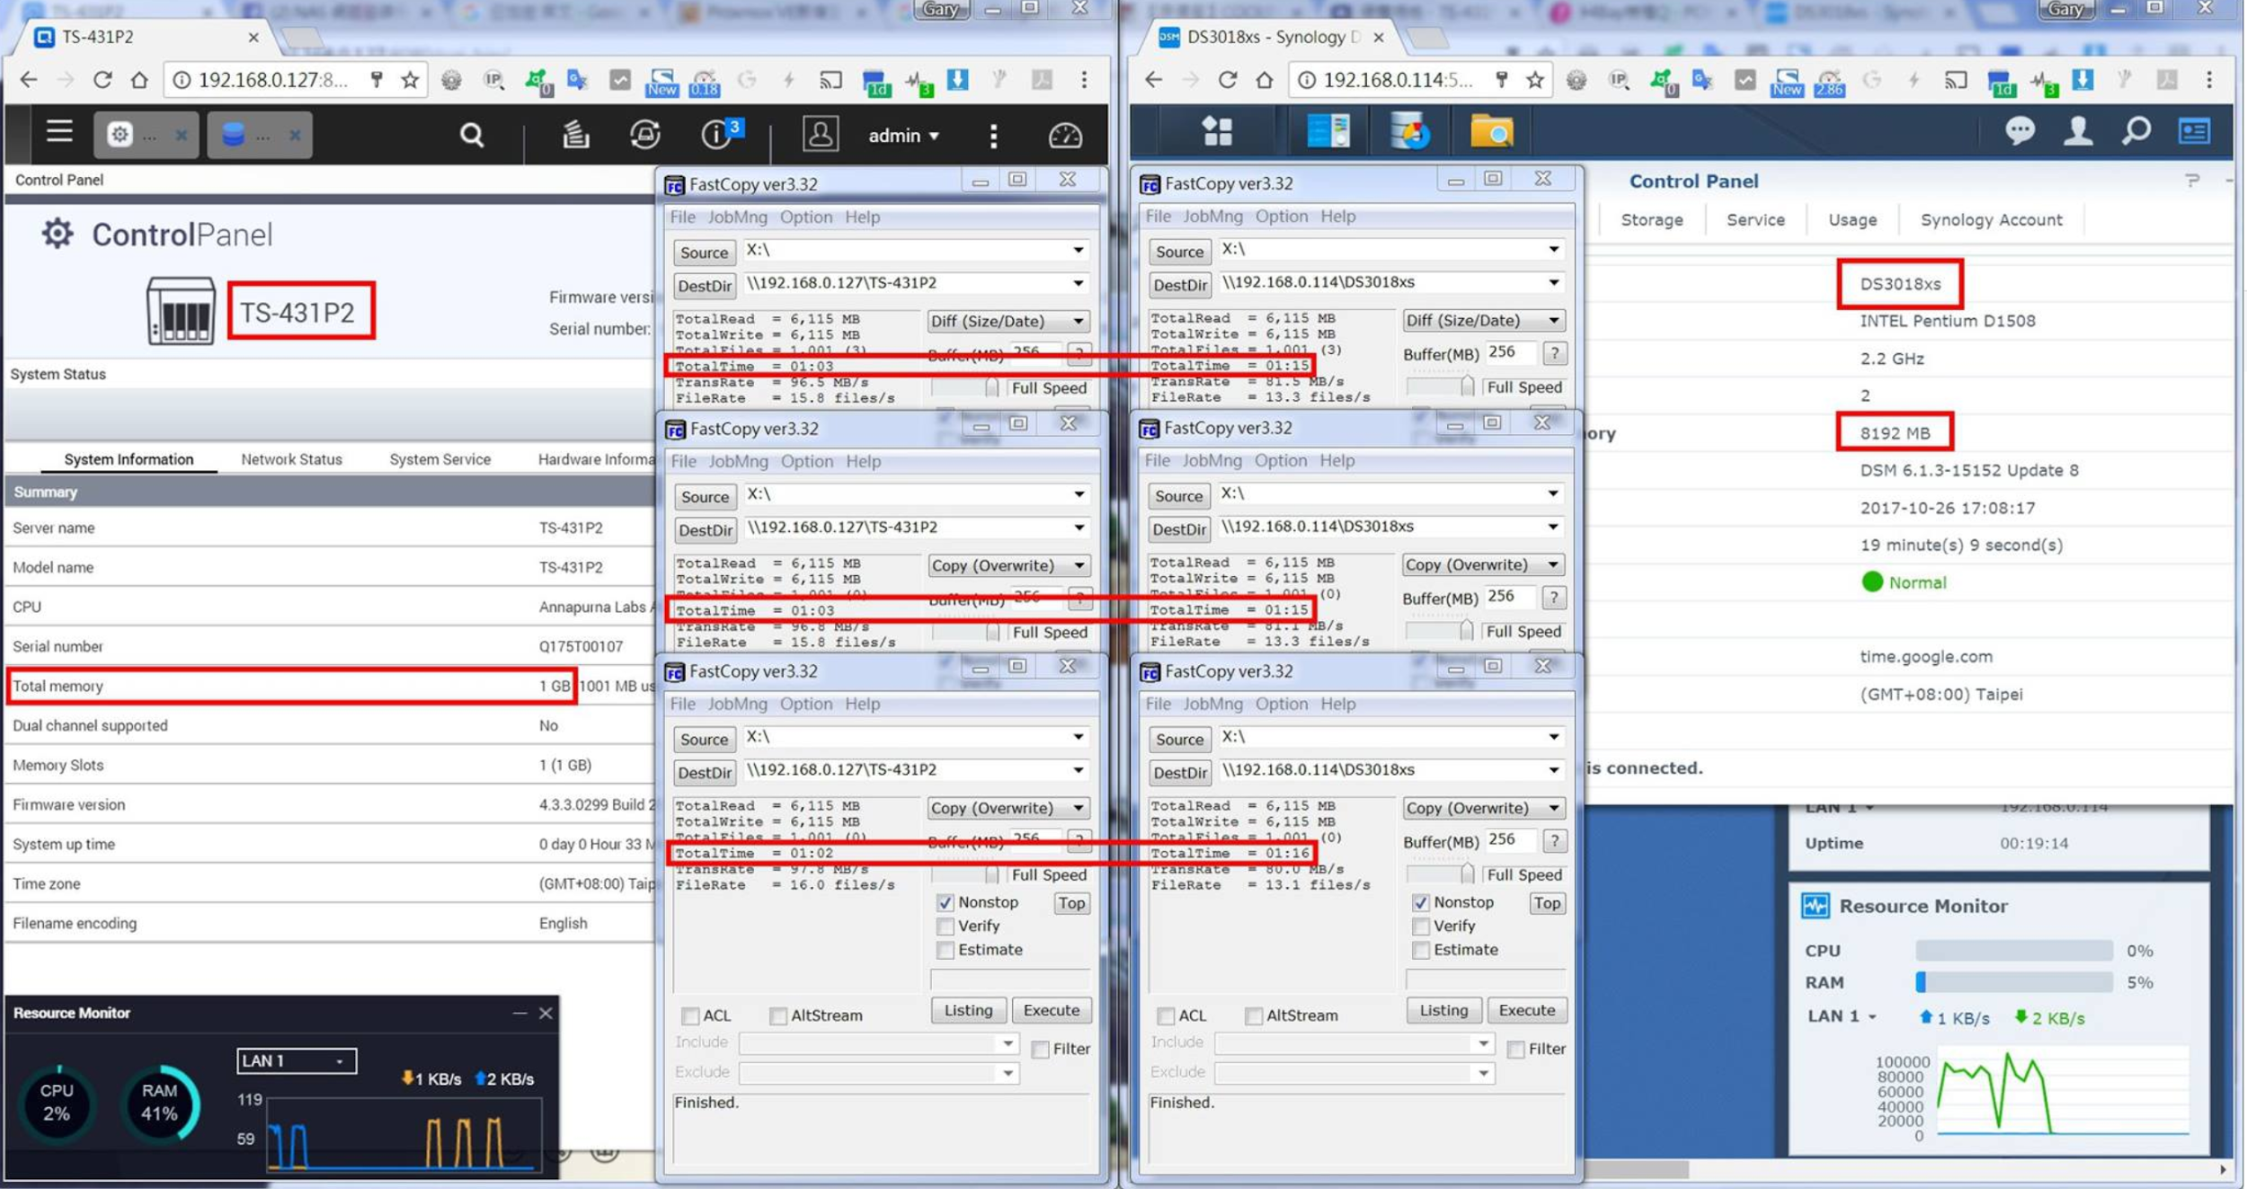
Ext4 v.s. Btrfs
Performance Comparison
TS- 431P2 (1GB, Ext4) DS3018xs (8GB, Btrfs)
Transferring time
TS-431P2
DS3018xs
188sec
226sec
slower
~16.81%
Source: NAS PK World on Youtube
https://youtu.be/e85qdnOOmOs

Slide 6
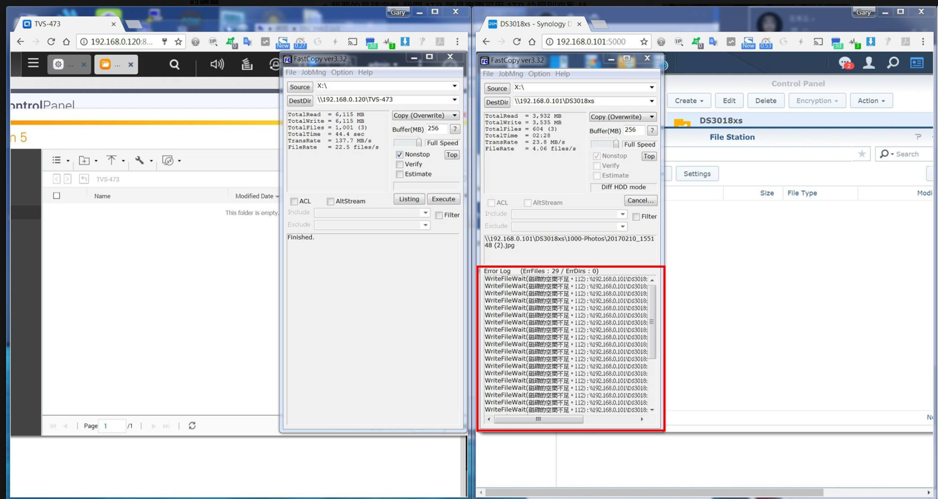
A Snapshot space that can be managed
QTS: In-house developed Ext4 snapshots stored outside the volume
DSM: Open-source Btrfs snapshots stored inside the volume
QTS snapshots:
Space usage will not be interfered
DSM snapshots:
Snapshot space usage cannot
be controlled
Snapshot affects data storage
Source: NAS PK World on Youtube
https://youtu.be/5J1132pmH-4

Slide 7
Storage & Snapshots
Evolved for Data Safety

Slide 8
Your challenges, our solutions:
How to protect data from the threat of Ransomware?

Slide 9
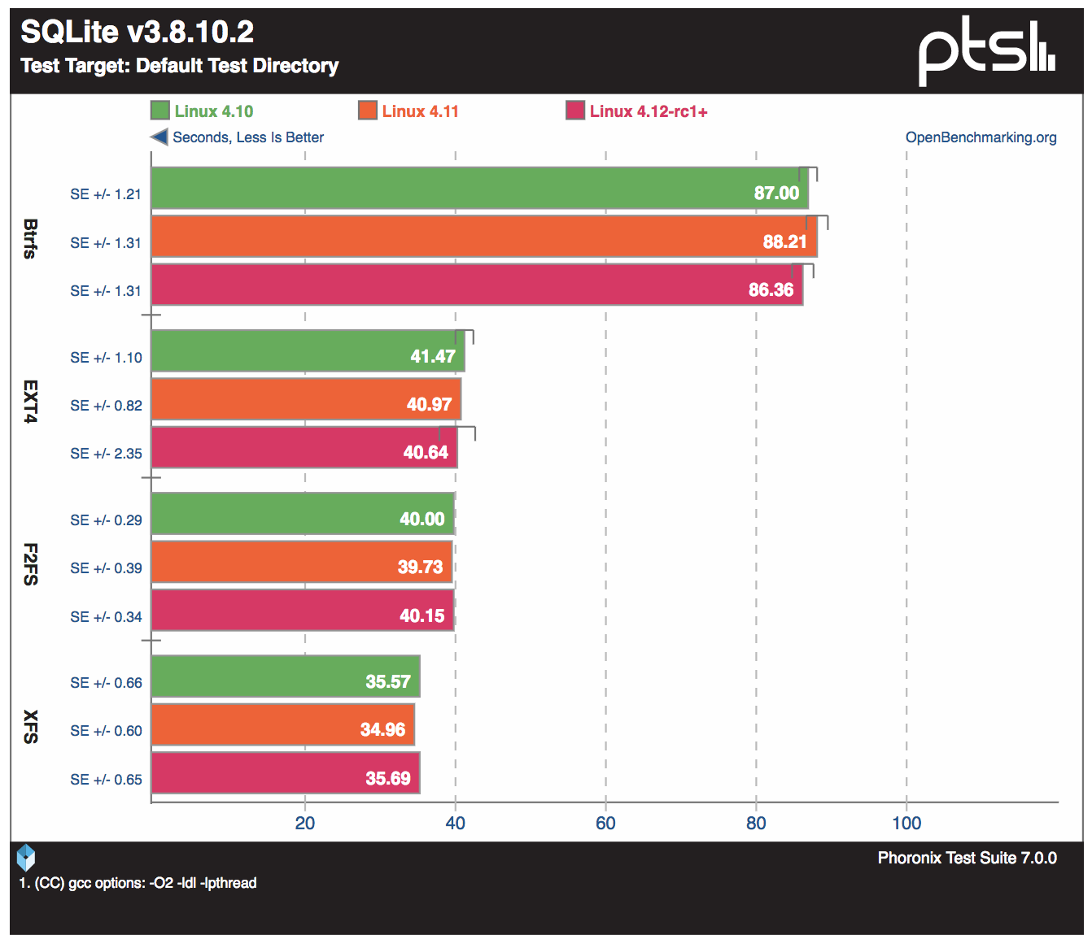
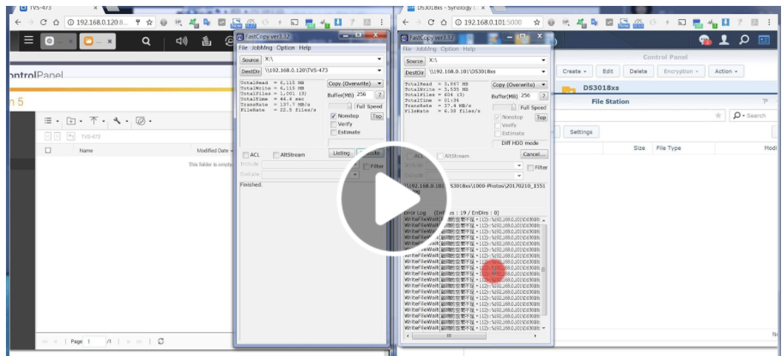
Why doesn't QNAP adopt customized Btrfs?
Higher IO latency
Snapshot space usage cannot be control
https://www.facebook.com/gate.studios/videos/10214940914857902/
Less is better
Notes:
https://www.phoronix.com/scan.php?page=article&item=linux-412-fs&num=2

Slide 10
ARM-based NAS has a big market share
NAS Selling Share
40%
of users have selected ARM-based NAS
ARM
Pros
60%
A high ROI solution for general users
X86-based NAS
Cons
Limited memory and computing power for advance features
Notes:
標題可以再刪短一點

Slide 11
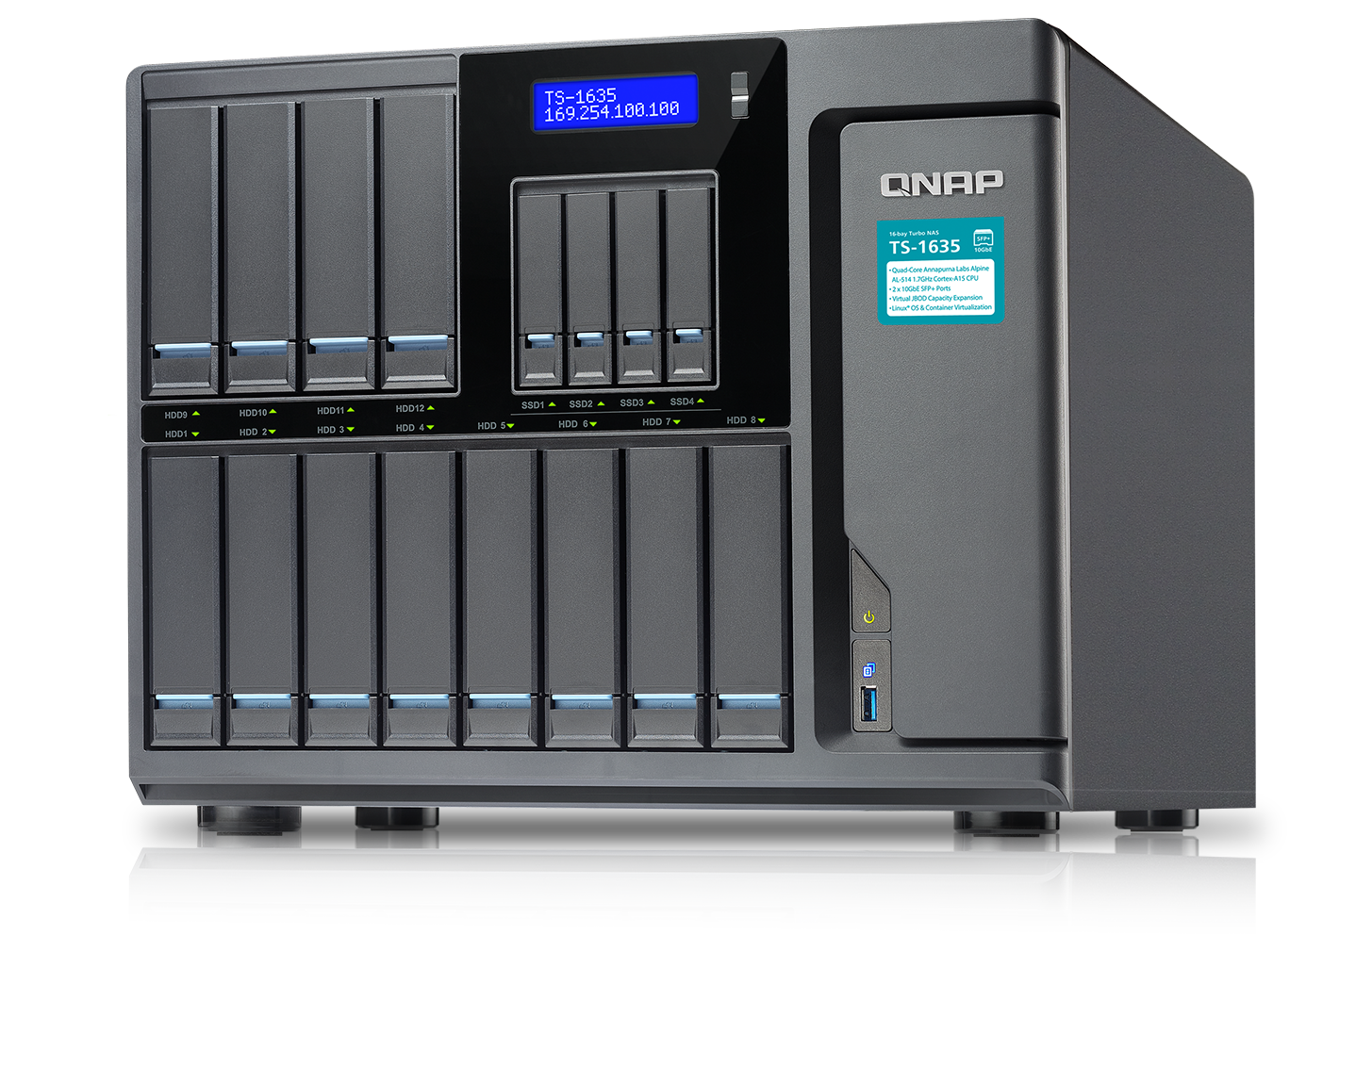
ARM-based NAS that supports snapshots
Increased ROI
A tight cooperation with Annapurna Labs allows ARM-based NAS to support snapshots
QNAP NAS with Annapurna Labs CPU: TS-x31X, TS-x31P/P2, TS-431X2,
TS-x31XU, TS-431XeU and TS-1635.
RAM Size | Max total Snapshot | Max per LUN/Volume
1G | 32 | 16
2G | 64 | 32
>=4G | 256 | 64

Slide 12
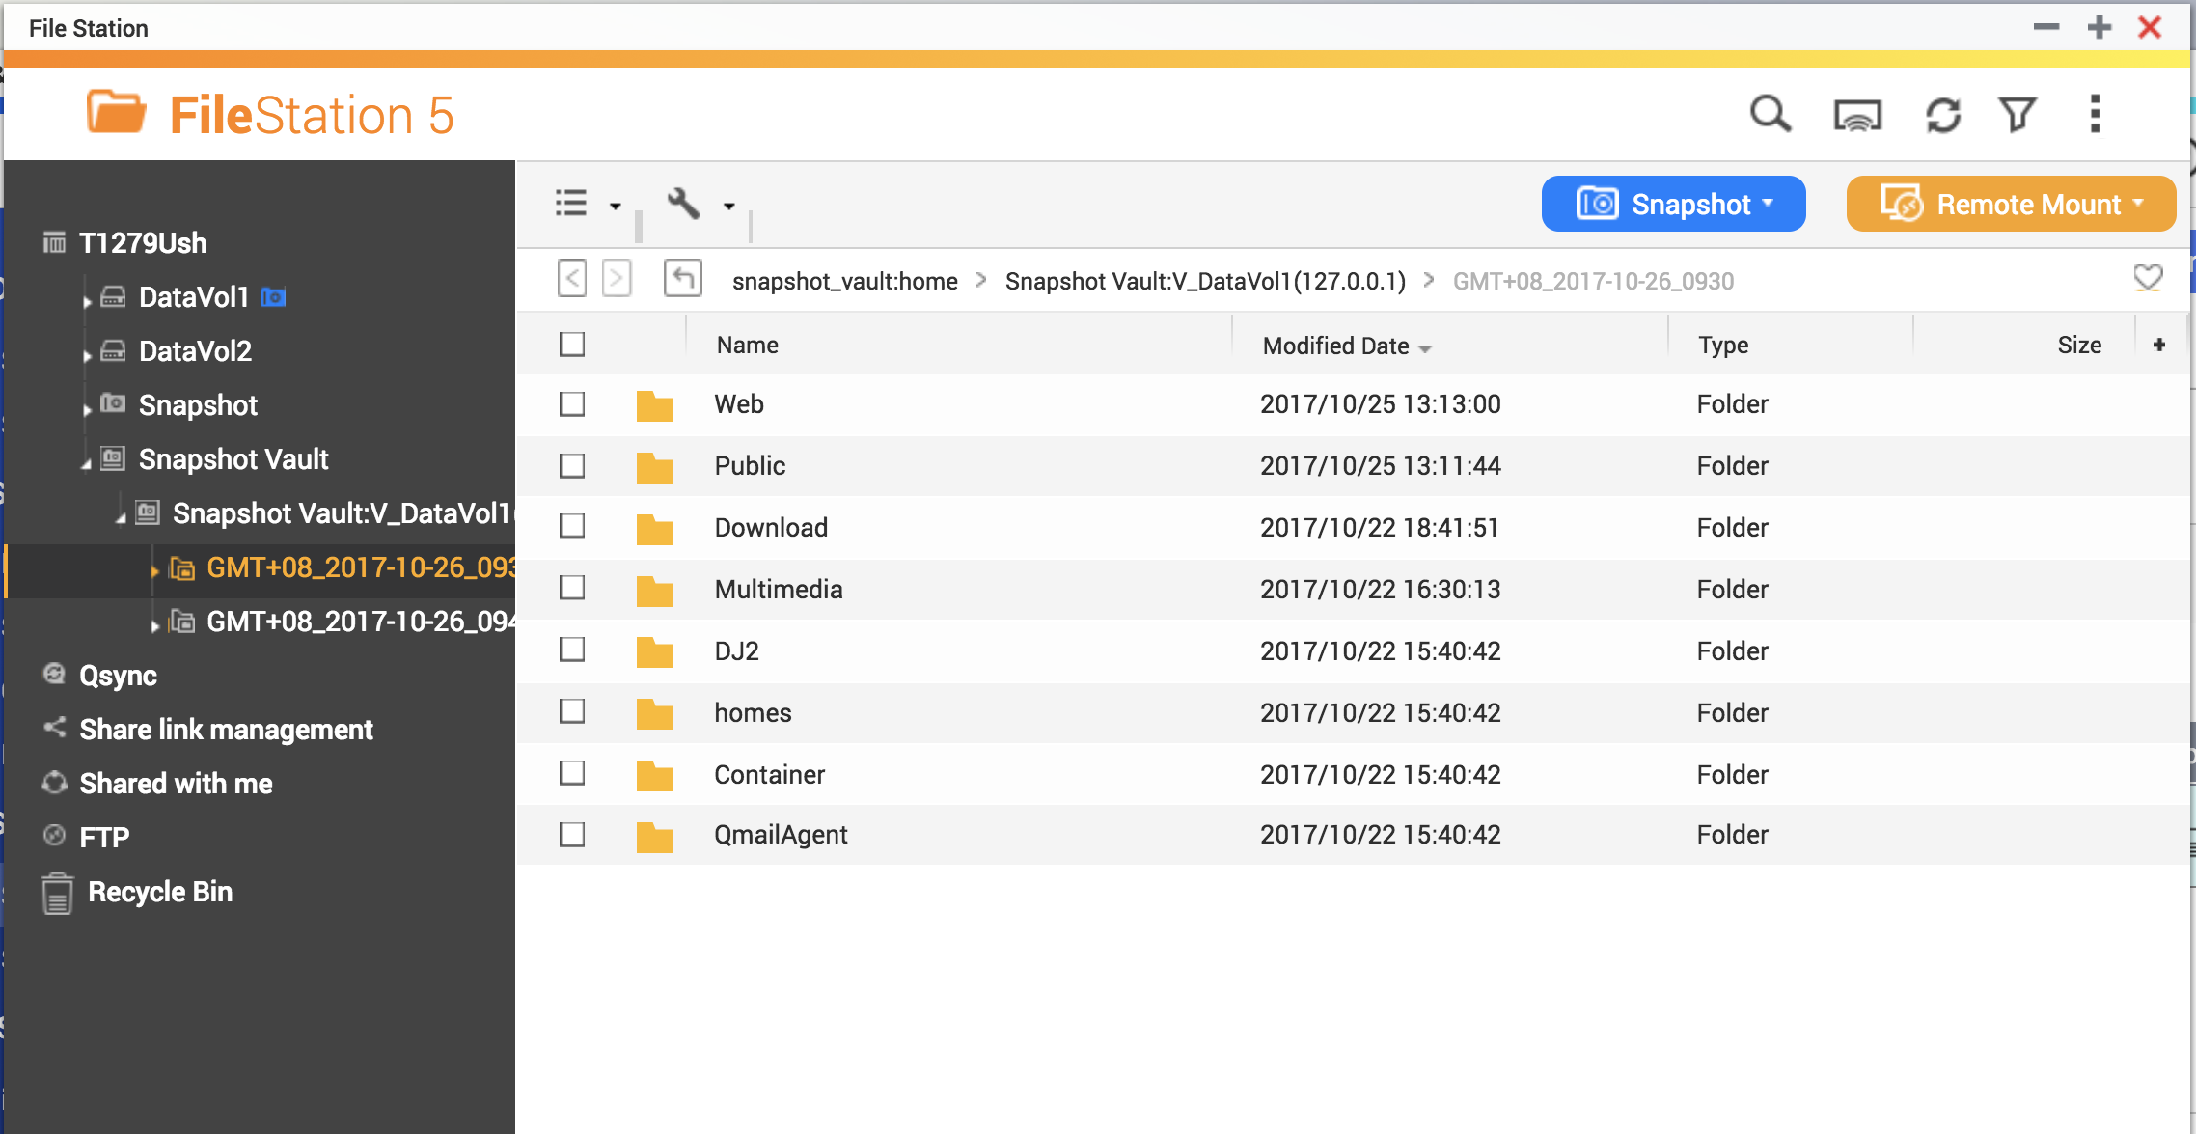
Intuitive Snapshot Management at Remote NAS
Backed up snapshots can be browsed through File Station
Snapshots will be displayed chronologically like local folders
Browse through snapshots and use copy-paste to quickly restore files

Slide 13
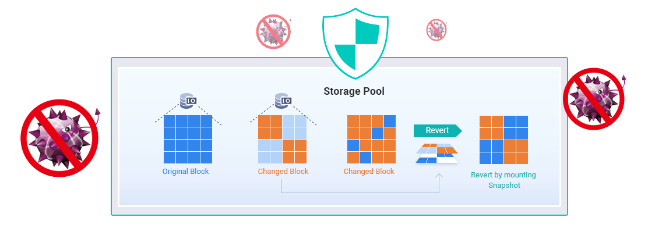
Why are snapshots important?
When data is encrypted, data in backup destinations will also be affected
Data needs to be "backed up" while backups need backups as well
Block-based snapshots help protect data security from ransomware

Slide 14
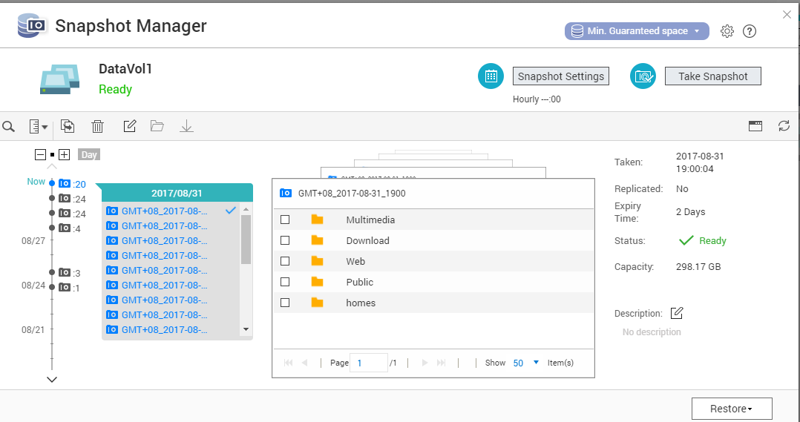
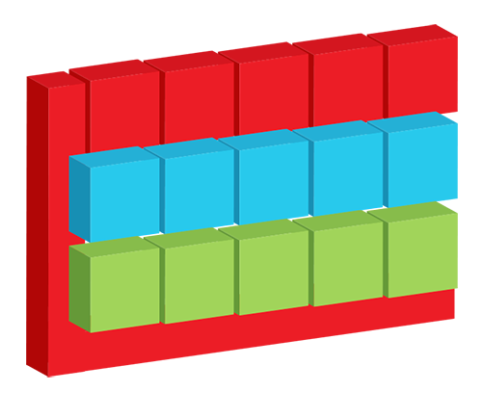
Versatile snapshot modes
Whole volume and block-based LUN snapshots
An efficient solution for
mass data recovering
Volume
Block based iSCSI LUN
Notes:
磁碟區快照圖會再換

Slide 15
Snapshot protection stored out of "Volume"
Snapshots are stored in the storage pool and separated from volumes or LUNs
Ability to convert Thick volume to Thin Volume and release storage pool space (Thin volume will still use the same space that snapshots use)
Snapshots can be stored in an unallocated storage space, and "Min. guaranteed snapshot space" further allows customized space usage
Storage Pool (10TB)
Volume 3TB (Thick)
Free
Snapshot
Volume 3TB (Thick)
Free
Snapshot
Volume 1TB
/ 3TB (Thin)
Free
Snapshot
Free

Slide 16
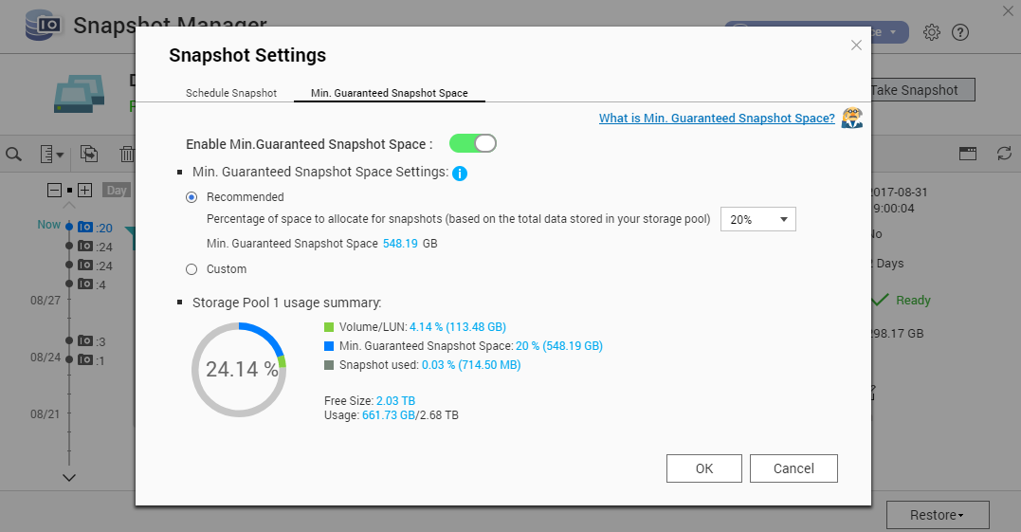
Enable Min. Guaranteed Snapshot Space
Create a dedicated space using unallocated space in storage pool to prevent ransomware disrupting snapshot protection

Slide 17
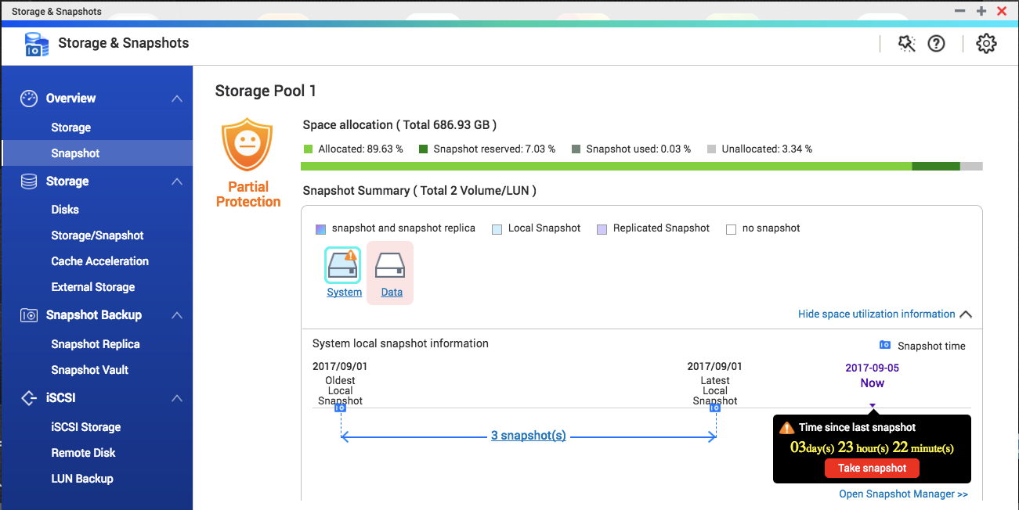
Monitor Snapshot Protection at a Glance
Snapshot Overview
A centralized dashboard to manage snapshot protection
Snapshot shared folder
A solution for creating folder snapshots

Slide 18
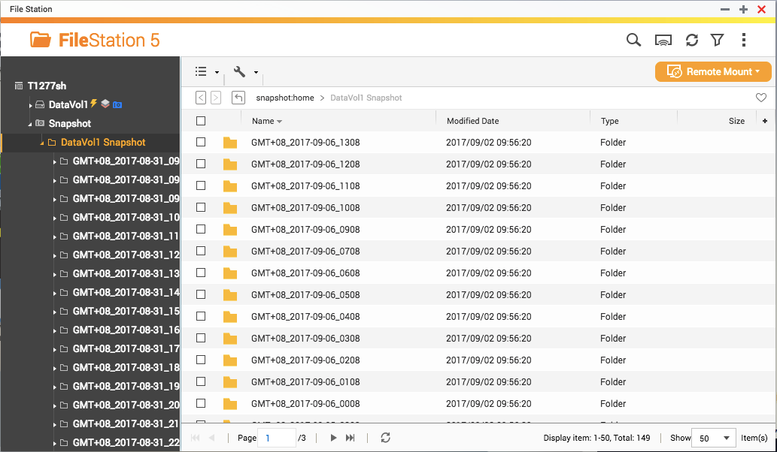
Easily Manage All Snapshots
File Station
Support creating new snapshots, browsing snapshot contents and restoring data
Notes:
demo

Slide 19
Backup Snapshots to Remote Sites
Snapshot Replica
Snapshot
Vault
Backup Snapshot Vault
A incremental snapshot backup plan
Allowing viewing and restoring data at remote NAS
Snapshot Vault can also be backed up

Slide 20
Improved Snapshot Backup Plan
Using snapshots to quickly backup data to a remote site
Redefined Snapshot Replica jobs; choose from different plans
Only transfer modified data, saving bandwidth and increasing backup speed
Back up all newly created snapshots
Configure multiple snapshot replica schedules
Notes:
20

Slide 21
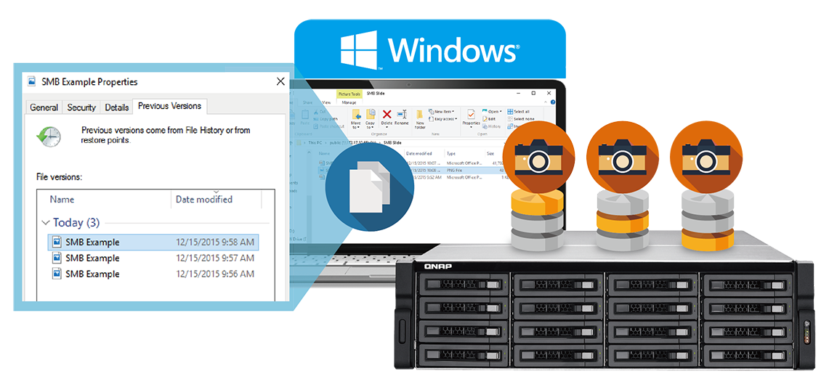
Integrated Windows Previous Version
Windows users can use Windows Previous Version to directly browse different versions of a file that are kept by snapshots
With SMB/CIFS/AFP/NFS, snapshots can be viewed in folders for restoring data

Slide 22
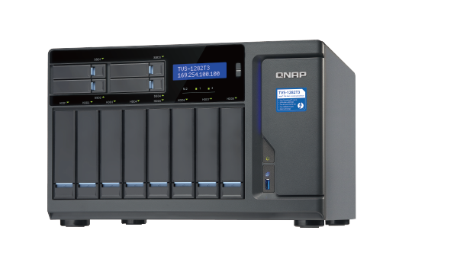
Snapshot Agents
Snapshot Agent triggers Windows VSS to flush data to the LUN or does VMware snapshots for all VMs in the LUN
Snapshot Agent communicates between NAS, Microsoft® VSS and VMware ® vSphere™ to create application- consist snapshots
2
NAS prepares to take a snapshot
１
Snapshot Agent reports the snapshot can be now taken
NAS takes the snapshot
iSCSI
3
4
１
The backup software sends a snapshot request to Windows
NAS takes a snapshot upon receiving the request from Windows VSS Hardware Provider
3
2
Windows VSS flushes data to the iSCSI LUN
4
The backup software uses the snapshot on NAS to make a backup
iSCSI

Slide 23
Demo

Slide 24
Your challenges, our solutions:
How can I improve storage performance with limited SSD resources?

Slide 25
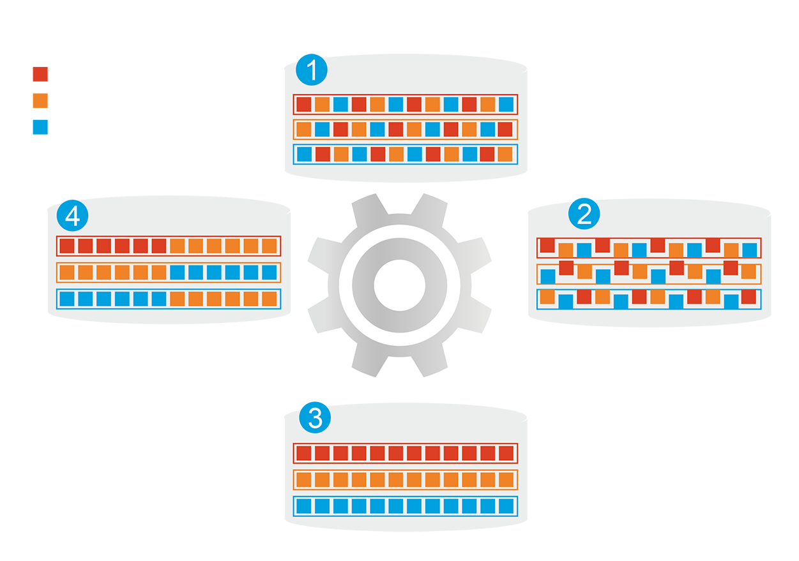
Hybrid Storage System
Automatically moves data between different tiers
SSD cache capacity will not be limited by RAM size
Before tiering: Frequently-accessed data performance is not optimized
Frequently-accessed data
Infrequently-accessed data
Rarely-accessed data
Changes in data access patterns
Start data tiering
How Qtier Works
After tiering: Frequently-accessed data performance is optimized
Notes:
25

Slide 26
Replace SSD Cache with Qtier 2.0™
SSD Cache
Applications
Cannot be used to store data
Fixed bypass options
> For short term performance boost
SSD
HDD
Sequential
Qtier 2.0
Random
The SSD tier can store data
IO Aware and Tiering On-demand
> For both short and long term
performance improvements
SSD Cache
Qtier 2.0
Notes:
取消表格

Slide 27
Qtier 2.0 is IO Aware
The SSD tier has a cache-like reserved space to handle burst IO in real time
Performance improvements are more obvious compared to SSD cache with applications with sequential pattern but still need to access metadata (E.g. backup)
Date
free
Burst I/O at C and D
Move D to SSD reserve space
A
B
A
B
D
SSD Tier
SSD Tier
C
D
C
HDD Tier
HDD Tier
BLK | Hit | Timeout
C | 50 | 0
D | 50 | 0
BLK | Hit | Timeout
C | 50 | 0
D | 200 | 0
Pre-Cache
With Cache
Notes:
27

Slide 28
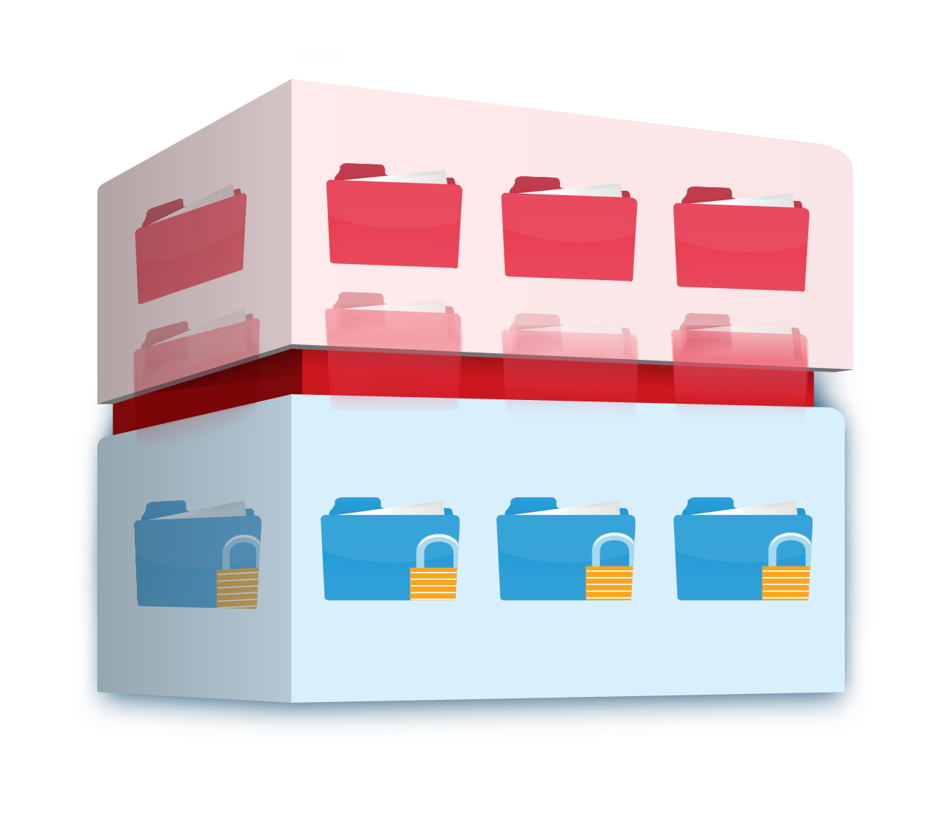
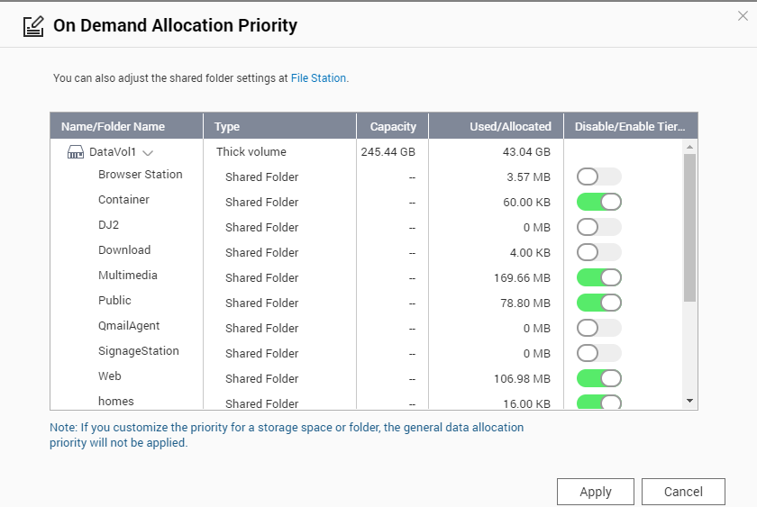
Qtier 2.0 Tiering On Demand
SSD only has limited capacity; needs to be used on key applications
Auto-tiering for individual shared folder or iSCSI LUN can be enabled or disabled
Hot data and reserved block
Cold and archived data
Notes:
28

Slide 29
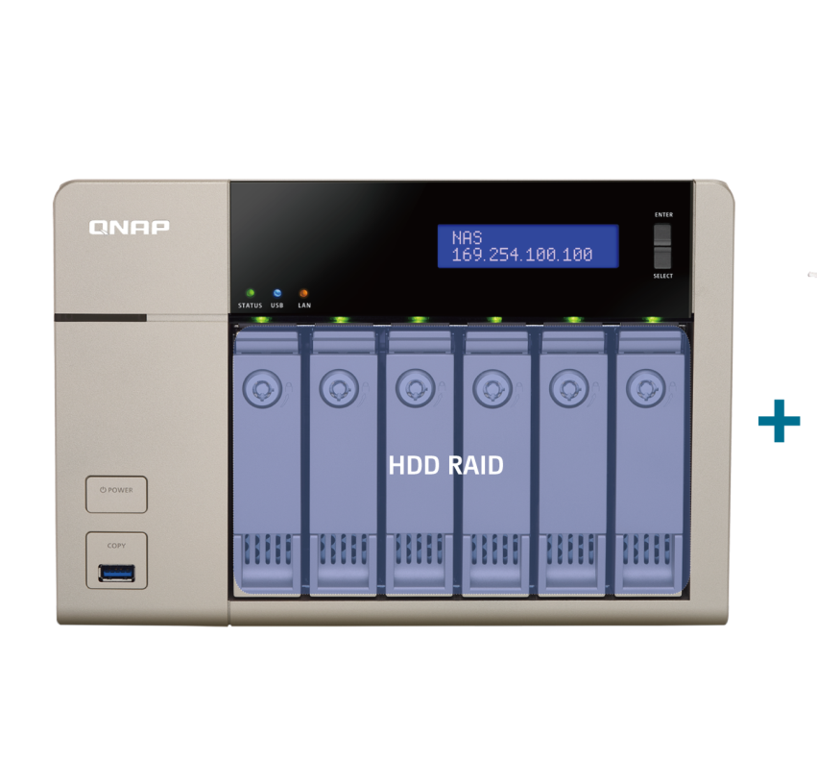
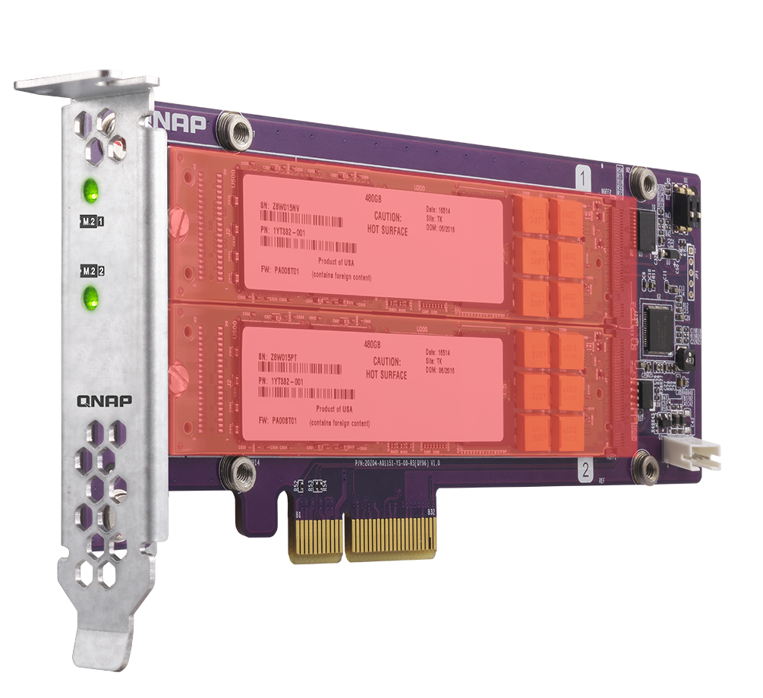
Upgrade to Qtier Pool, Uninterrupted
Storage pools that are created after QTS 4.2 can be upgraded (no need to start again from scratch!)
Add SSD/HDDs using free bays, an expansion unit, or the new QM2 SSD expansion card
QM2 SSD RAID
Notes:
29
流程圖 > 移除 Cache > 升級Qtier Pool

Slide 30
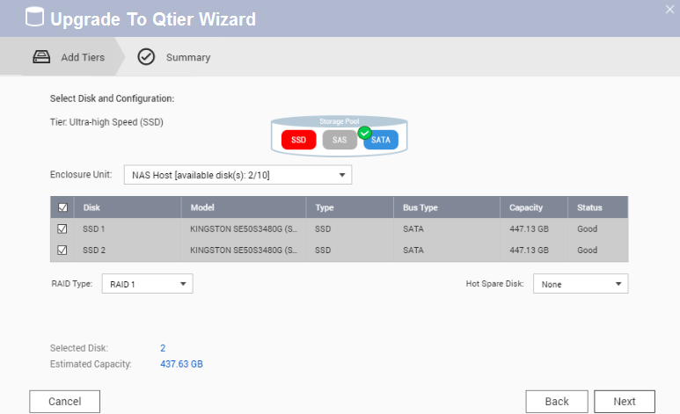
How to Replace SSD Cache with Qtier
１
Step
Stop SSD Cache Online
Step
2
Confirm the SSDs that will be added to the Storage Pool
Step
3
Upgrade to Qtier Pool!
Notes:
30
流程圖 > 移除 Cache > 升級Qtier Pool

Slide 31
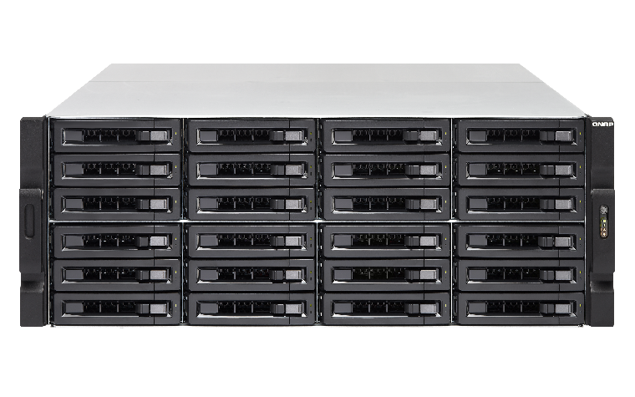
Unleash the full potential of SSD
<Test> TVS-EC2480-SAS-RP
12 SSDs in RAID 10, 12 HDDs in RAID 6
5 VMs IOmeter test with standard 4K random read-write
Adopting Mellanox’s 40GbE iSER solution
40 GbE iSER
180,000 IOPS with 40TB
<1 ms
Response time
HOT Ultra-high
Performance
SATA HDD Capacity
Notes:
31

Slide 32
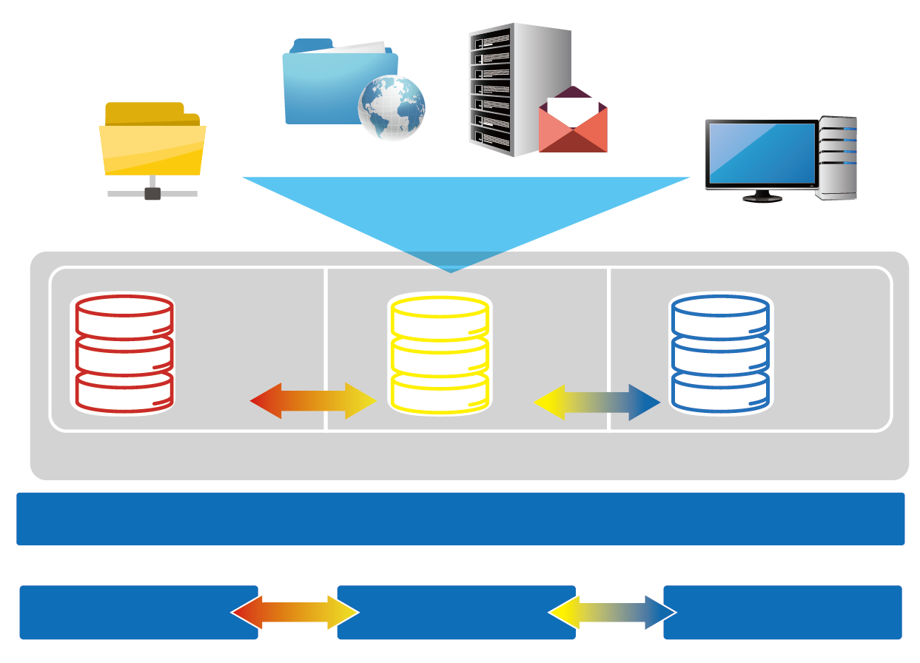
The Leading Tiering Technology
Web server
Email Server
Advantages
File server
Virtual Desktop Application
SSD as storage
Satisfy both random and sequential usages
Triggered by events, data tiering
PCIe NVMe,
M.2, General SSD RAID NL, SAS, SATA HDD
SAS HDD RAID
NL, SAS, SATA HDD RAID
Use Cases
Qtier storage pool
File Server
Web Server
Mail Server
VDI Hosting
Local NAS

Local NAS
Expansion unit 1
Expansion unit 2
Notes:
32

Slide 33
Demo

Slide 34
Storage & Snapshot
Your challenges, our solutions: Is RAID 5/6 not suitable when more than 6 disks are used?
QTS 4.3.4
Ripple
PM

Slide 35
RAID Protection Decreases as Capacity Increases
The risk of using RAID5/6 increases as capacity grows!
According to ServeTheHome RAID Calculator
Chance of a RAID 5 group failing within 5 years
Disks | Capacity | Risk
4 | 4TB | 0.1%
4 | 8TB | 0.2%
8 | 4TB | 1%
8 | 8TB | 2.2%
12 | 4TB | 4.1%
12 | 8TB | 6.5%
https://www.servethehome.com/raid-calculator/ , conservative estimate assuming bit error chance is 10^(-15), 150MB/sec rebuild speed
Notes:
35
4~8~12 4TB 8TB

Slide 36
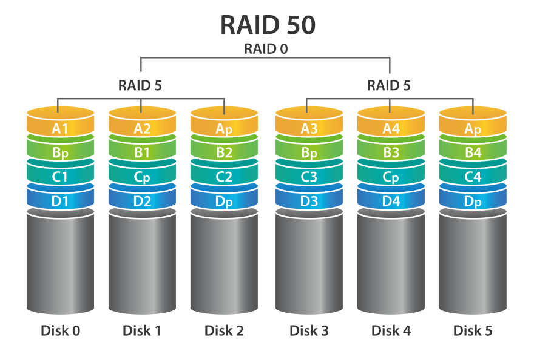
RAID 50 & 60 Reduce the Risk of RAID Failure
Less space used for redundancy + increased RAID protection
RAID type | Disks | Disk Failure Tolerance | Capacity | Chance of Failure
RAID 5 | 12 | 1 | 66TB | 6.15%
QNAP RAID 50 | 12 | 2 or more | 60TB | 0.6%
RAID 10 | 12 | 6 | 36TB | 0.2%
Actual disk failure tolerance depends on the number of RAID50/60 sub-arrays.
Notes:
36

Slide 37
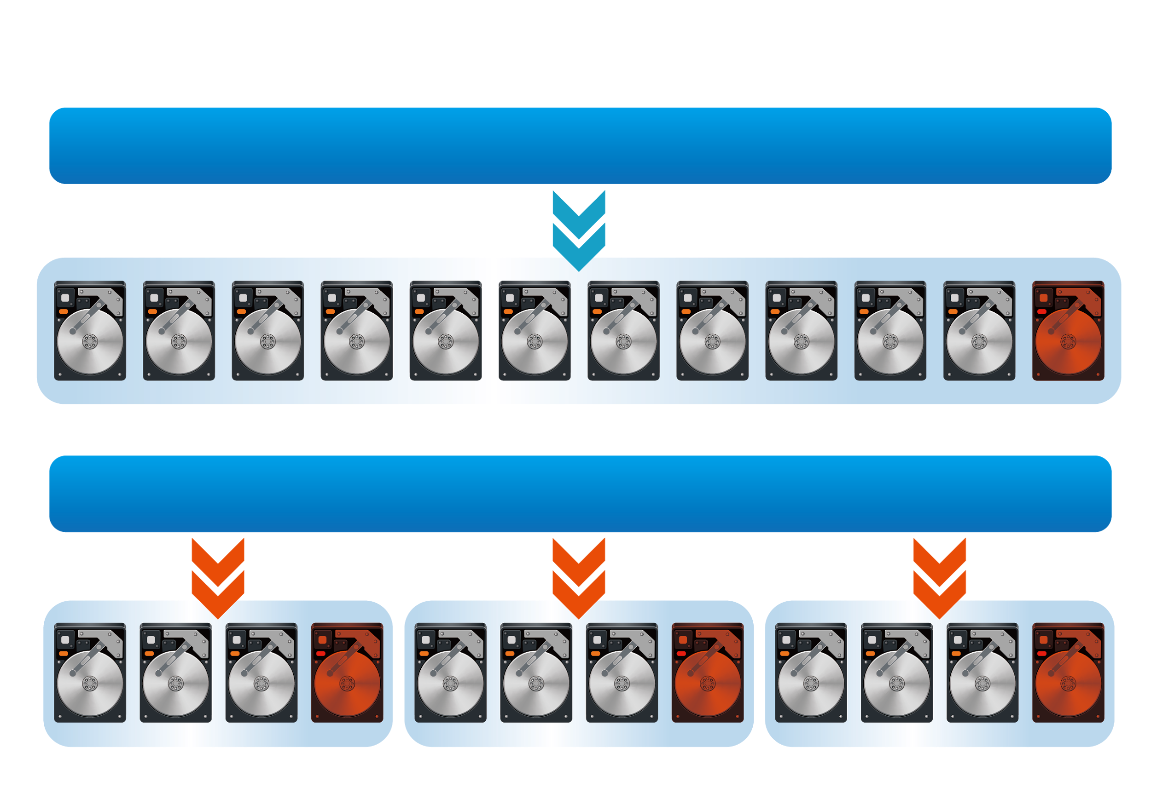
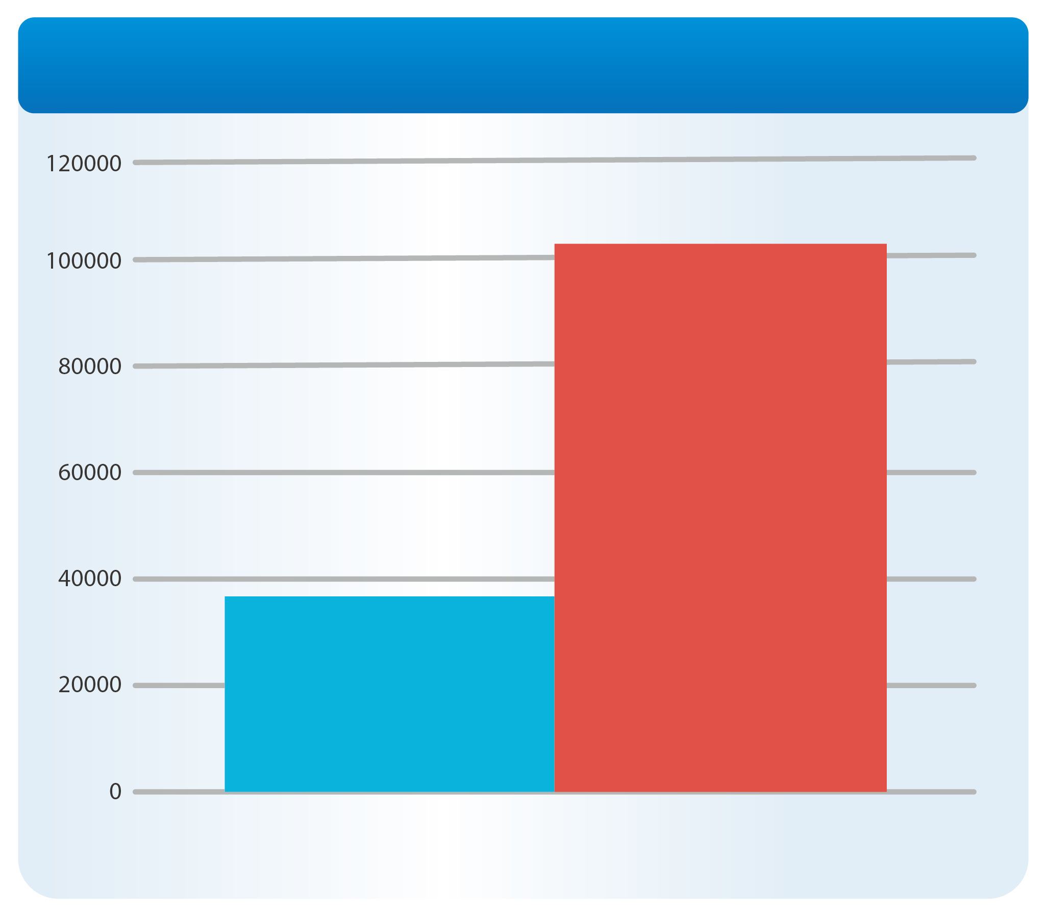
RAID 50 & 60 Increase "Random Write" Performance
Multiple RAID groups calculating parity at the same time
Comparison between RAID 50
(3 sub-groups) and RAID 5 (SSD RAID)
RAID 5 Pool
Random Write IOPS
Increased to
300%
RAID 50
With 3
Subgourps
RAID 50 Pool
Single RAID 5
Random Write 4K Performance
Notes:
37

Slide 38
QNAP Offers Different Types of RAID
RAID Type | RAID 5 | RAID 6 | RAID 10 | RAID 50 | RAID 60
Disk Count | At least 3 | At least 4 | At least 4 | At least 6 | At least 8
Disk Failure Protection | 1 | 2 | Half of the disk | 2~5 | 4~10
Write Performance | ★★ | ★ | ★★★★ | ★★★ | ★★★
Capacity | ★★★★ | ★★★ | ★ | ★★★ | ★★
Use Cases | Backup only | General application | For VDI hosting and database | High frequency backup | For VDI or media editing that need high capacity
Notes:
38

Slide 39
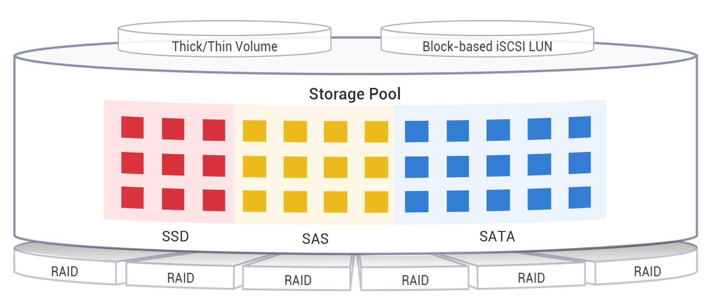
Deploy RAID 50/60 With Qtier
HDD RAID 50 = High capacity backup server
HDD RAID 60 + Read-Only SSD Cache = High capacity file server
SSD RAID 50 + HDD RAID 60 = High capacity and performance virtual storage server
The RAID 50/60 Pool cannot be expanding with striping after creation .
Notes:
39

Slide 40
Demo

Slide 41
Your challenges, our solutions: iSCSI VJBOD: the expansion solution to maximum your ROI
PM

Slide 42
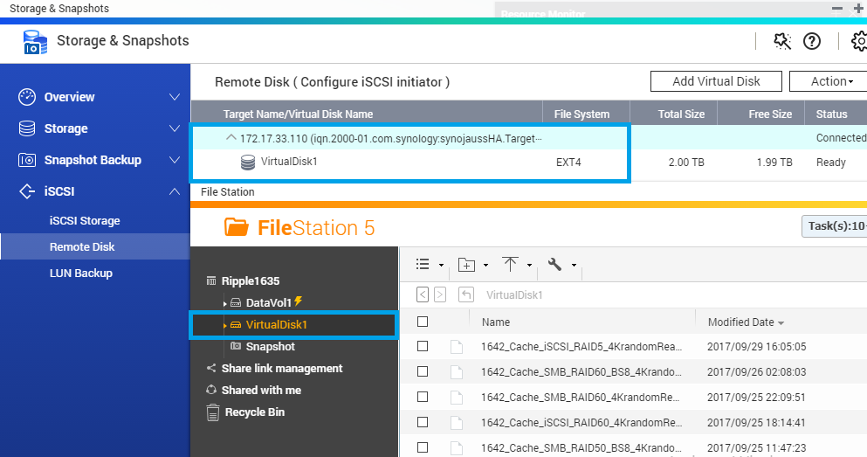
Dual Mode: iSCSI Initiator and Target
Major storage vendors support iSCSI Target
QNAP NAS supports both iSCSI Initiator and iSCSI Target
１
Mount iSCSI target from other storage
Use the unique iSCSI expansion (VJBOD)
2

Slide 43
Use iSCSI Initiator to Mount Other Storage
iSCSI Initiator and Target are industry standard
QNAP iSCSI Initiator can be used with EMC, NetApp, Synology and QSAN iSCSI target without modifications
Unused space can be mounted to QNAP for versatile features
Trademarks are owned by their respective companies.
Notes:
貼LOGO

Slide 44
Block-based vs File-based iSCSI LUN
File-based iSCSI LUN Allocate space in Volume
Blocked-based iSCSI LUN Allocate space in pool
Easily allocate and manage space Support VAAI thin provisioning Avoid interference from volume
Applications
Shared Folder
File-Based iSCSI LUN
Clear
interference
Volume
Block-based
iSCSI LUN
Storage Pool

Slide 45
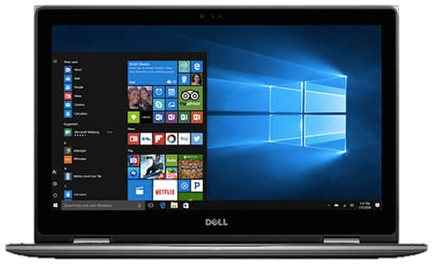
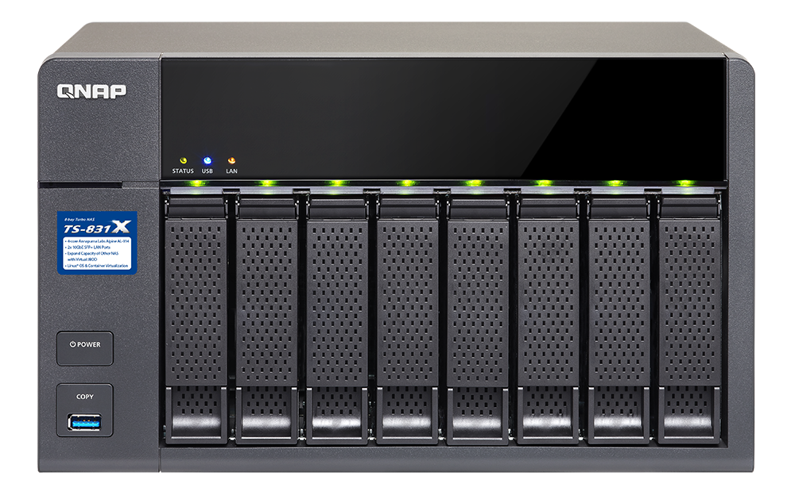
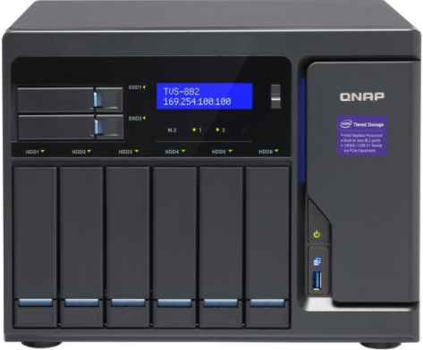
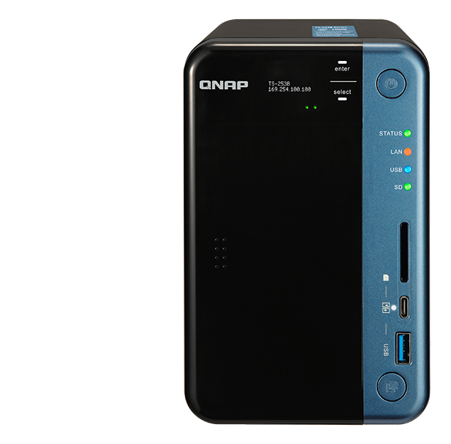
Replace JBOD with iSCSI VJBOD
Uses VJBOD to mount a LUN as local disk
Create Storage Pool, take snapshots, use the media library, Qsirch indexing
Fully utilize storage space on NAS
Container Station
iSCSI LUN
2 x 10G SFP+
TS-831X
Virtual Pool 1
RAID
Ethernet, flexible conncetion
Virtual Pool 2
Notes:
45
NAS > eSATA < JBOD > LUN backup > to other NAS

Slide 46
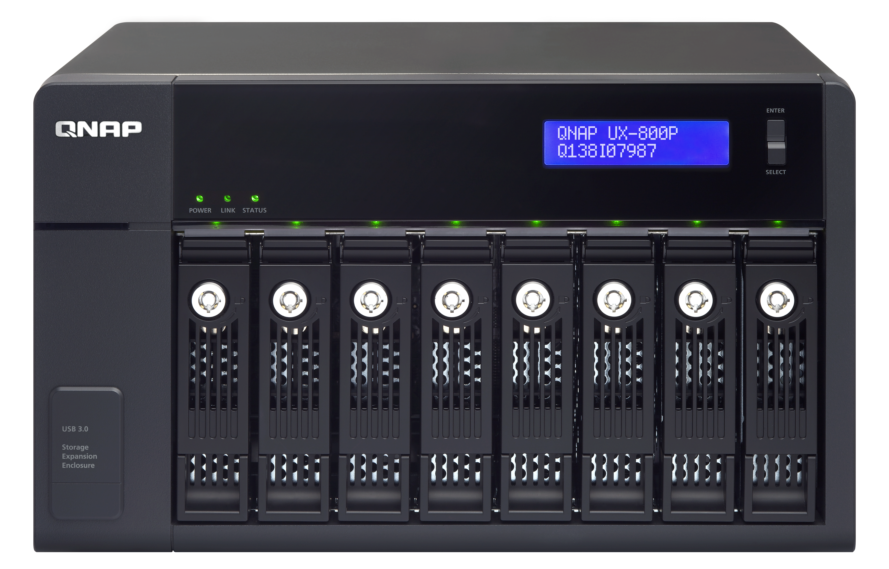
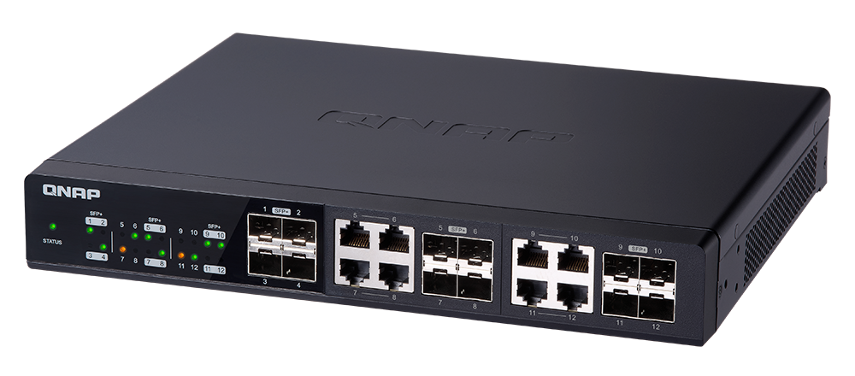
Combine JBOD and VJBOD for Highest Capacity
An 8-bay NAS and 4 units of UX-800P can create a storage space of maximum 300TB* (8TB per disk).
Add Virtual JBOD:
Over 1 PB total raw storage space
Total > 1 PB
USB 3.0
JBOD 8TB x 8 x 6 = 384TB
iSCSI
8TB x 8=64TB
8TB x 12 x 8 = 768TB
Notes:
46

Slide 47
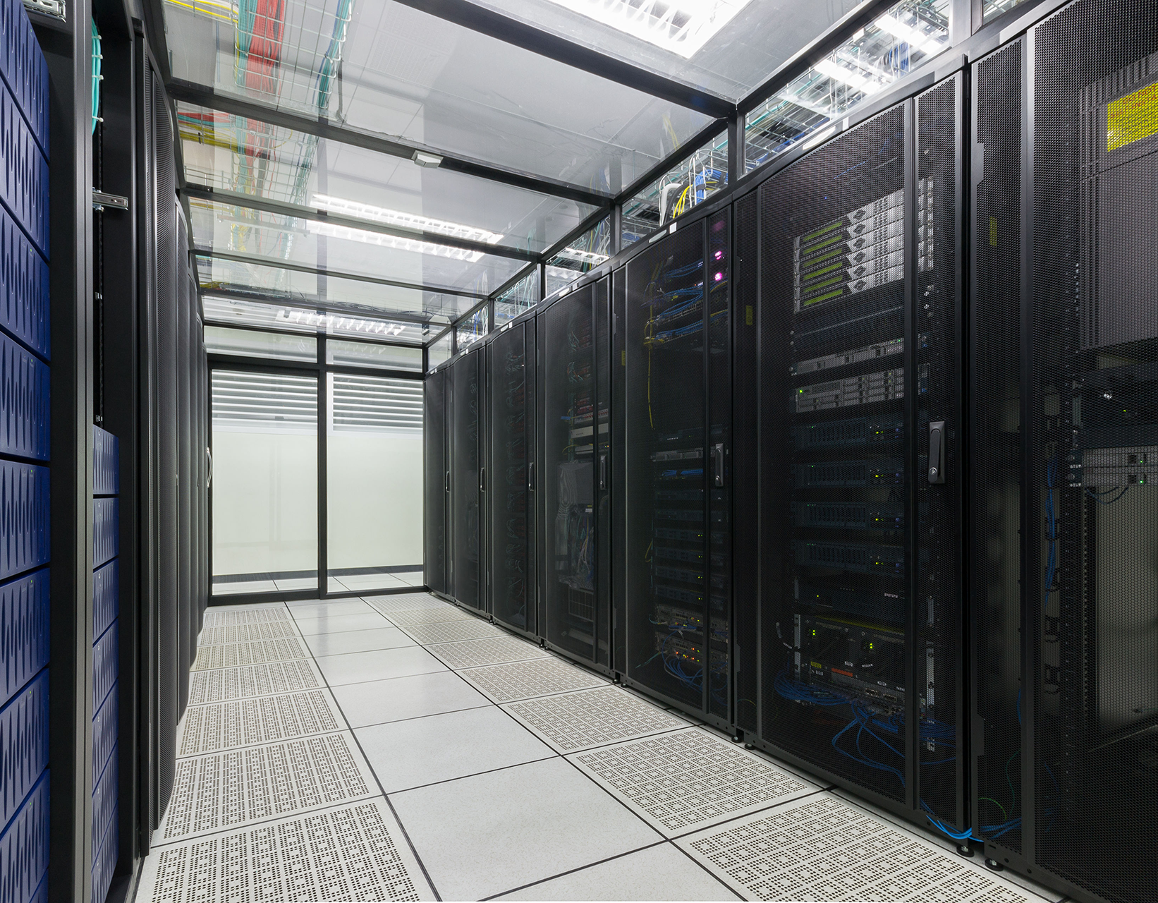
QNAP Hybrid Backup Sync Solid Backup Solutions for Data Security and Recovery
To realize 10GbE high performance backup experience
Notes:
http://172.17.31.247:8080/cgi-bin/
TS-1635 with snapshot

Slide 48
Single App for Solid Data Protection
Hybrid Backup Sync
Backup
Restore
Sync

Slide 49
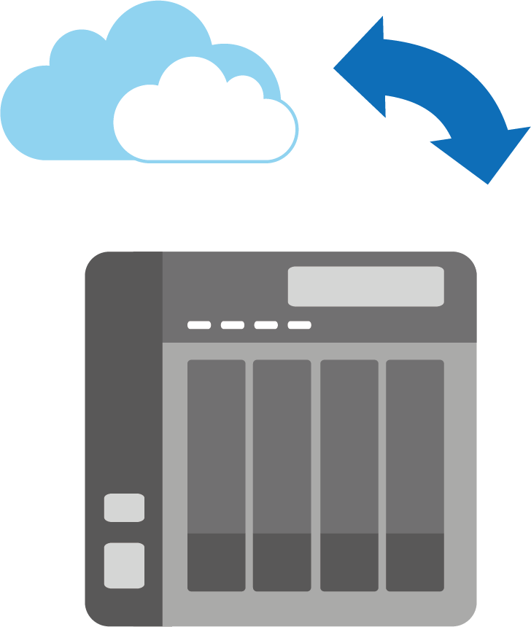
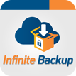
Backup – Hybrid Cloud Perfectly Integrated
Cloud
Local
Remote

Slide 50
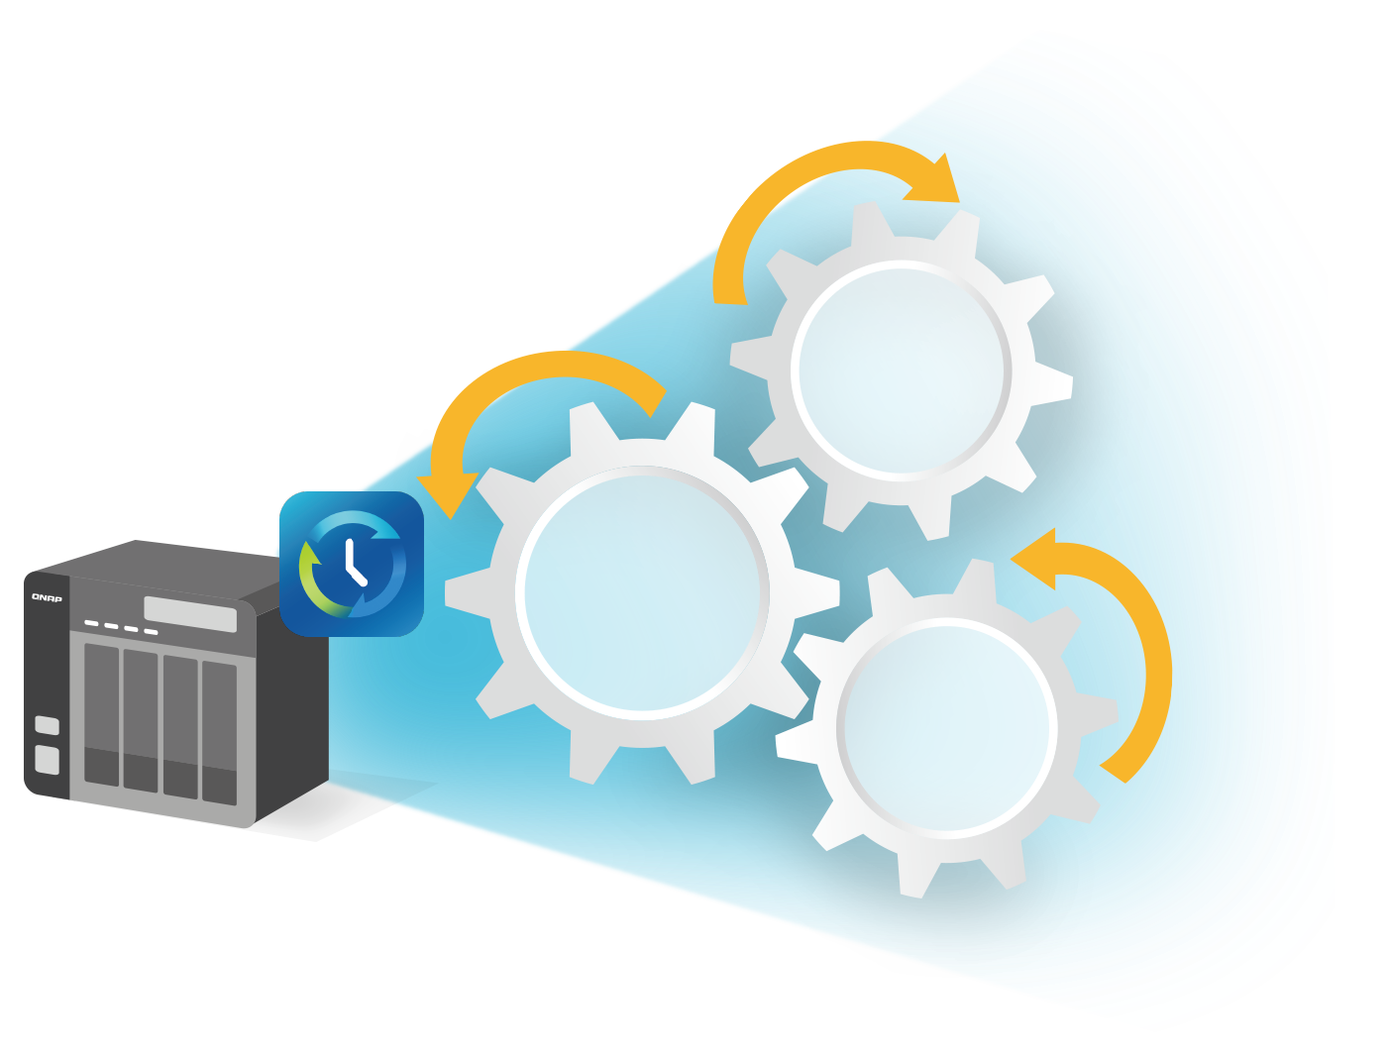
Backup - Essential of Smart Backup
Data
Reduction
Multi-Version
Backup
Data
Security

Slide 51
Multi-version Backup
Simple versioning
Smart versioning
NOW
JAN.
APR.
SEP
DEC.

Slide 52
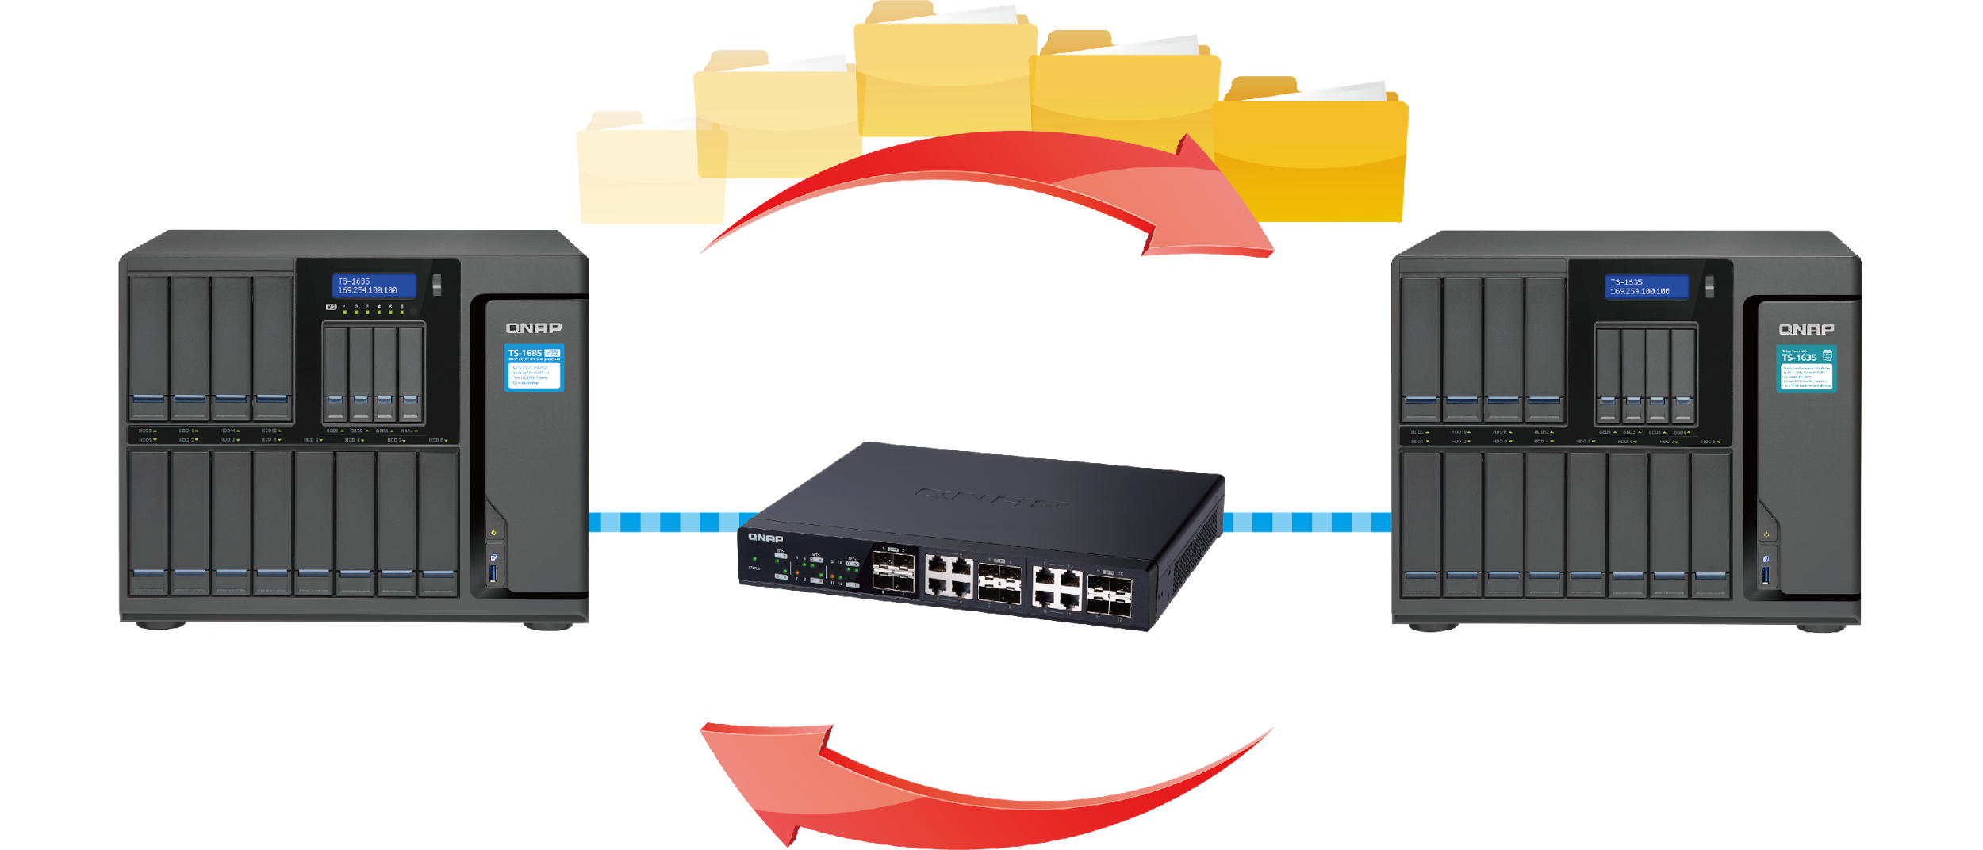
Back up over 10 Gigabit Ethernet
Economical enterprise-level disaster recovery solution
Highly Efficient Data Backup
Recover from Disaster in time
Protect the sensitive
and classified data
Backup
Disaster
Recovery

Slide 53
Demo

Slide 54
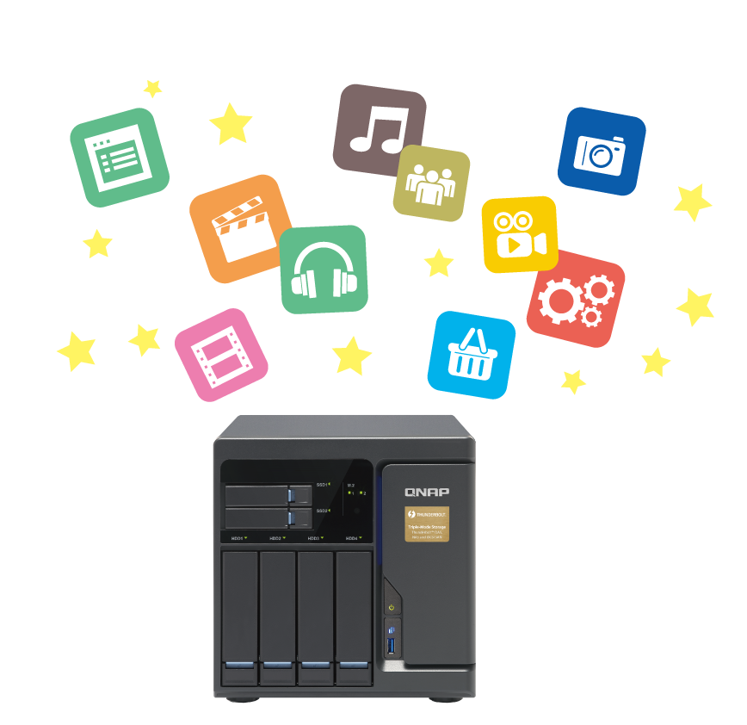
Cloud Security and Data Reduction
Secure connection (HTTPS)
Server-side encryption
Client-side encryption
Client-side-encryption
Secure connection
(HTTPS)
Server side encryption
01
Data Filter: Data size/Date/Type
02
Data Compression
03
Sparse File Detection

Slide 55
Sync – Access data anytime, anywhere
One-way Sync
Active Sync
Two-way Sync
Cloud
Remote
Local

Slide 56
Cloud Sync-Flexible Settings to Meet Your Needs
Mirror
Copy
Move

Slide 57
Comprehensive Data Protection Solutions
Local
Remote
Cloud
Taipei
Kaohsiung
RTRR
(Local to remote backup/sync)
Backup / Sync
360km
Mac Time Machine
Netbak Replicator
External Device
JBOD

Slide 58
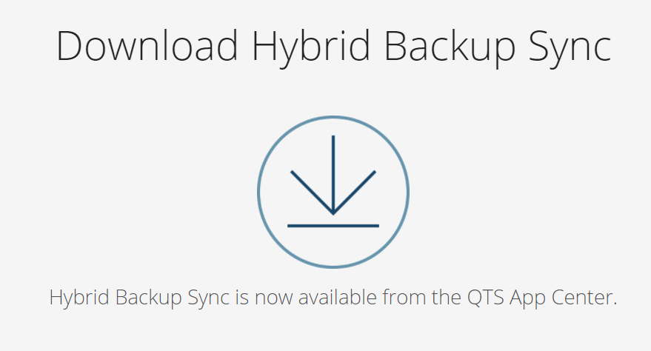
Get More information
https://www.qnap.com/solution/hybrid-backup-sync/en/

Slide 59
File Management
Maximize your productivity in finding and archiving files

Slide 60
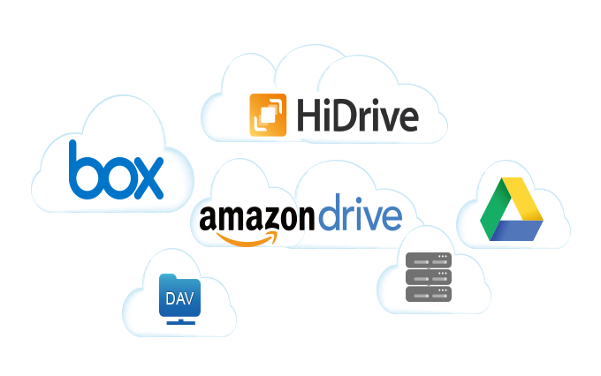
You have too many to handle...
?
Categorize
?
Manage
?
?
?
?
Search
?

Slide 61
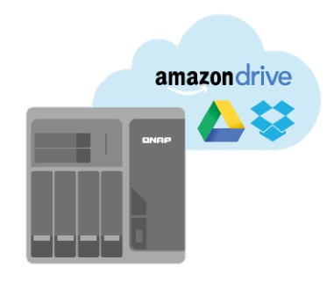
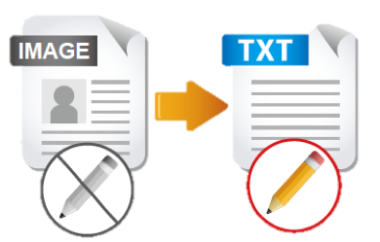
QNAP meets all needs for an office
File Station
Qsirch
OCR Converter
Qfiling
Store and backup
Search
File Digitization
Archive

Slide 62
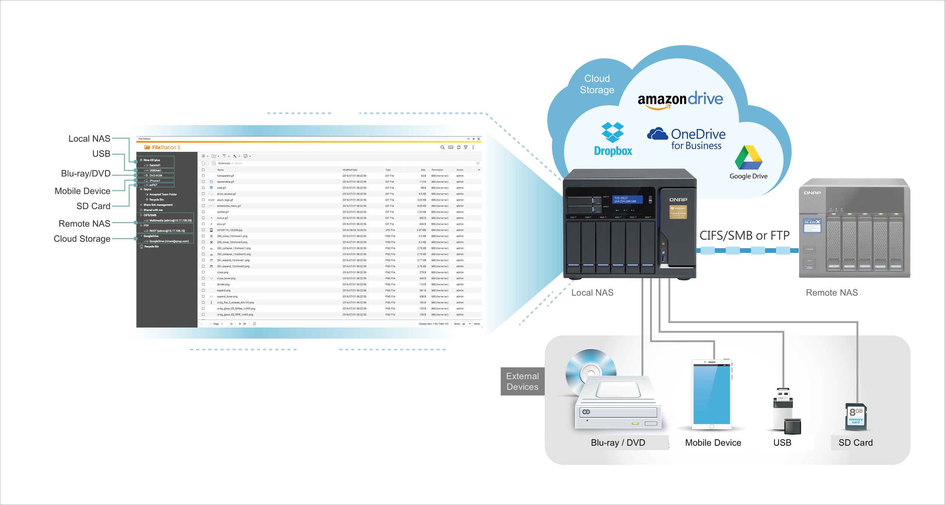
File Station: A single app to manage all files
8 Cloud Storages
NEW
NEW
Remote NAS
New Support
4 External Devices
One simple interface

Slide 63
File Station: A single app to manage all files
QNAP File Station
Other Brand
Cloud Storages
Blue-Ray/DVD, Mobile Devices
SDCard, USB
SDCard, USB
External Devices

Slide 64
Demo

Slide 65
Qsirch: The NAS search expert
Documents
Images
Instant
Emails
Instant
Emails

Slide 66
Search like a pro via advanced search
More friendly
QNAP
QNAP
Other Brand
Notes:
截圖不需美編，字為原 UI 字串

Slide 67
Qsirch: The NAS search expert
Documents
Images
Instant
Emails
Instant
Emails

Slide 68
Search image files without typing any keywords
More smart
QNAP
Other Brand
Notes:
截圖不需美編，字為原 UI 字串

Slide 69
Qsirch: The NAS search expert
Documents
Images
Instant
Emails
Instant
Emails

Slide 70
Mail files can also be found
QNAP Exclusive
Full-text searching for email content
Custom Filters
Browse
Reply and forward the mail directly.
Notes:
截圖不需美編，字為原 UI 字串

Slide 71
Qsirch: The NAS search expert
Documents
Images
Instant
Emails
Instant
Emails

Slide 72
Search files in many ways
QNAP Exclusive
Open API
Qsirch Helper
Mobile App
Notes:
截圖不需美編，字為原 UI 字串

Slide 73
Demo

Slide 74
OCR: Best solution for document digitization
Picture with text
Searchable documents
Search
Edit
Archive

Slide 75
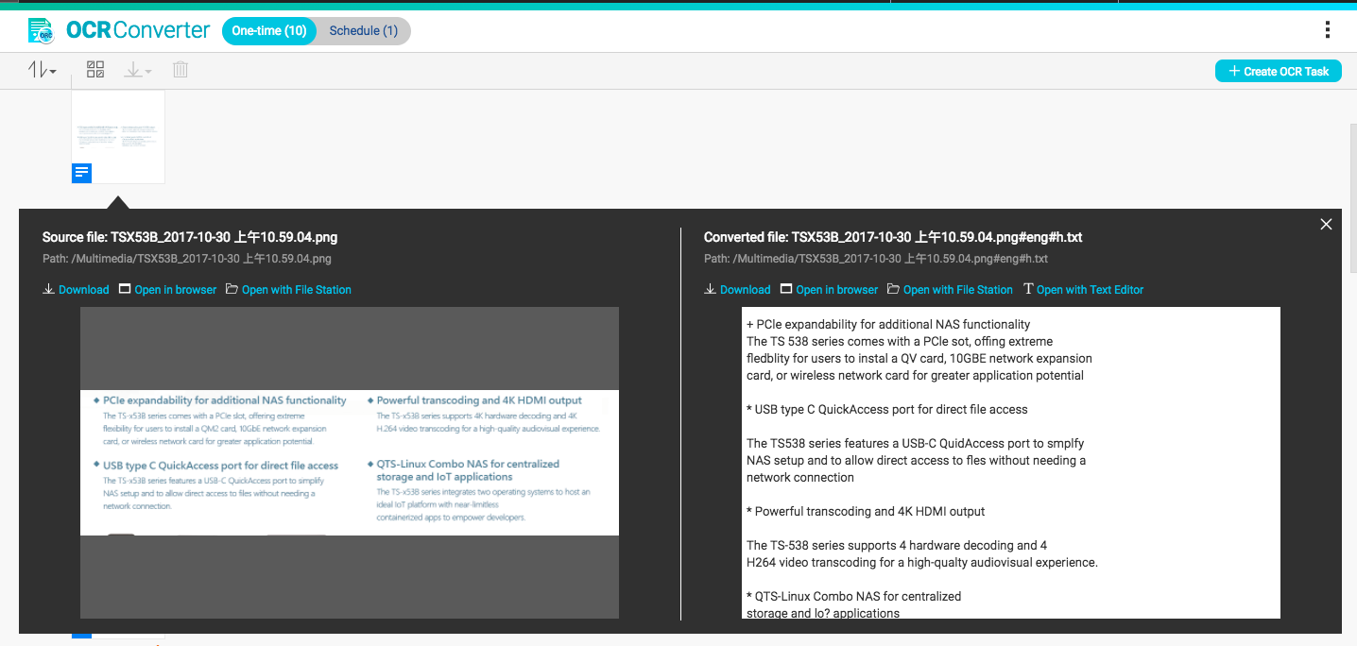
OCR: Best solution for document digitization
Convert images to editable files
Edit with Text Editor

Slide 76
Demo

Slide 77
Qfiling: Organizing files is now automatic and efficient
Support up to
3 devices
NAS
iSCSI
USB
Notes:
截圖不需美編，字為原 UI 字串

Slide 78
Qfiling: Organizing files is now automatic and efficient
Preview before archiving
Flexible source and destination
Scheduled and background tasks
Create your own recipe
78
Notes:
截圖不需美編，字為原 UI 字串
Go to demo session.

Slide 79
QNAP maximizes your productivity
Qfiling
File Station
Categorize
Manage
Search
Text Editor
Qsirch
OCR Converter

Slide 80
QVHelper
Your video playback helper

Slide 81
In the past, playing videos on NAS is like...
The system doesn’t support certain formats, so videos cannot be played.
OH NO!
I can’t watch
this video!

Slide 82
QVHelper
QVHelper allows users to stream media files from a QNAP NAS to VLC player on your PC and Mac, providing more choices for you to enjoy multimedia contents
* Required using Video Station 5.1.3 or later versions
* Required using Photo Station 5.6.0 or later versions
* File Station: QTS 4.3.4
VLC Player

Slide 83
QVHelper Demo
Live

Slide 84
Qboost
Enhances the performance of NAS
Notes:
http://172.17.31.247:8080/cgi-bin/
TS-1635 with snapshot

Slide 85
wasting time
Still
because of lagging？
Lowers your working efficiency
Notes:
(放搜尋系統卡頓的訊息)

Slide 86
Qboost
Application
Scheduling
Optimize
Clear

Slide 87
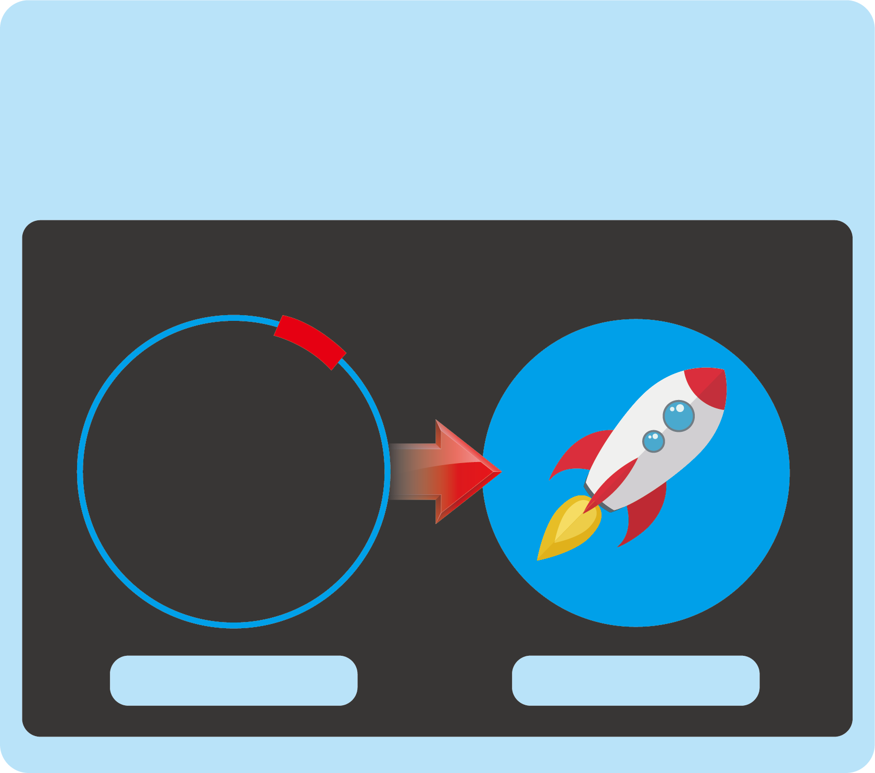
Qboost
Clean cache memory
Clean swap memory
Optimize
Free Memory
Free Memory
9%
170MB
Optimize
Optimizing…

Slide 88
Qboost
Delete unnecessary system files
Empty Recycle Bin
Clear
Junk Files
Junk Files
Choose files to delete
Unnecessary system files
Recycle Bin
Note: Files will be permanently deleted
Clear

Slide 89
Lots of applications can take a huge amount of memory, and Optimize can not release cache memory effectively. What can we do?

Slide 90
Qboost
Set schedules to enable / disable applications
Allocate system resources more efficiently
Application Scheduling
Schedule Notes Station manually
I only use Notes Station during working hours.
I want it to release NAS resources when it's not active.

Slide 91
Demo Qboost
Optimize, Clear,
Application scheduling

Slide 92
Three solutions
Clear
Cleans up junk files
Recycles storage space
Optimize
Releases memory
Increases operating speed
Application Scheduling
Allocates system resources efficiently

Slide 94
Easy-to-deploy IoT solution
Stage 1 Data Collecting
Sensors
Devices
Development
Board
Stage 2 Data Processing
Applications
Stage 3 Data Visualization
Rules Setting
Threshold
Local Storage
Show Data in Charts & Tables

Slide 95
Meet a wide range of your IoT requirements
ARM-based
X86-based
Most cost-efficient solution
for your IoT project
Support fog computing ,
increase data processing
performance
Min. RAM : 2GB
Complete storage solution ,
media , surveillance ,and VM
application supported
Flexibility with QIoT container,
easy to try different application
with your innovation idea
Min. RAM : 4 GB

Slide 96
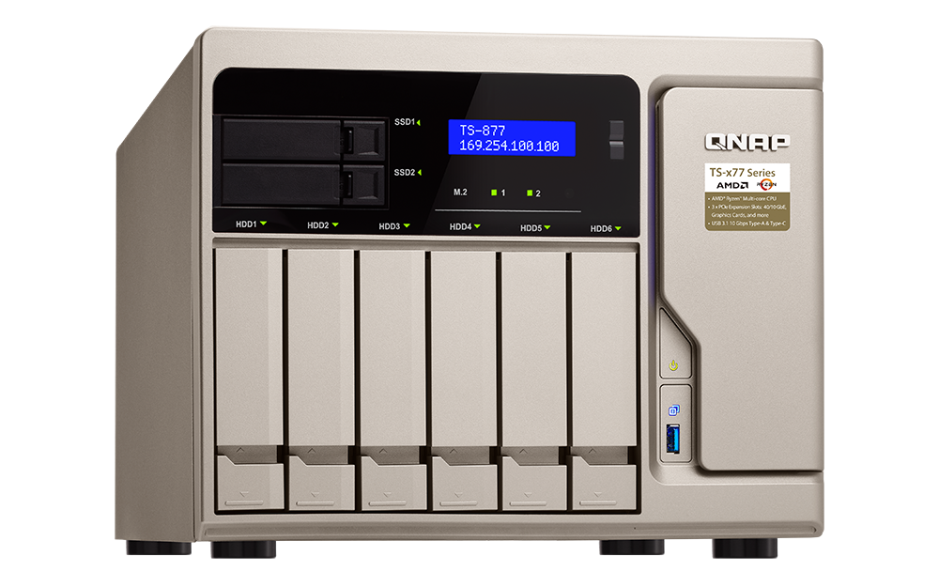
QTS 4.3.4 for the new models
TS-x77 Series
TS-431XeU / TS-431X2
AMD Ryzen 6- & 8-core CPU; good for VMs
Annapurna Labs AL314 4-core CPU; affordable 10GbE SFP+ solution
TVS-x73X Series
AMD RX-421BD 4-core APU with 10GBASE-T port
TS-453BT3
TS-431P2 / TS-231P2
Intel J3455 4-core CPU w/ Thunderbolt 3 + 10GBASE-T ports
Annapurna Labs AL314 4-core CPU, RAM upgradeable up to 8GB
Notes:
Recap >> Show QTS 4.3.4 available on ARM based models - X31X >>Jeffrey, Jason

Slide 97
And there's more supporting QTS 4.3.4
Thunderbolt NAS Series
Rackmount Series
TDS-16489U, TS-x85U, 1582TU, x80U, x73U, x71U, x70U, x69U, x63U, x53BU, x53U, 451U, x31XU and 431U
Tower Series
TS-1685, x82, 882ST2/ST3, x80, x73, x71, x70, x69, x63, 453Bmini, x53B, x53A, x53 Pro, 453mini, x51A, x51, 1635, x31X, x31P, x31+, x31 and x28
For a list of supported models, please visit https://www.qnap.com/zh-tw/product/eol.php

Slide 98
Thank You

