Slide 1
Q'center V1.7
A Central Storage Management System to Maximum your ROI

Slide 2
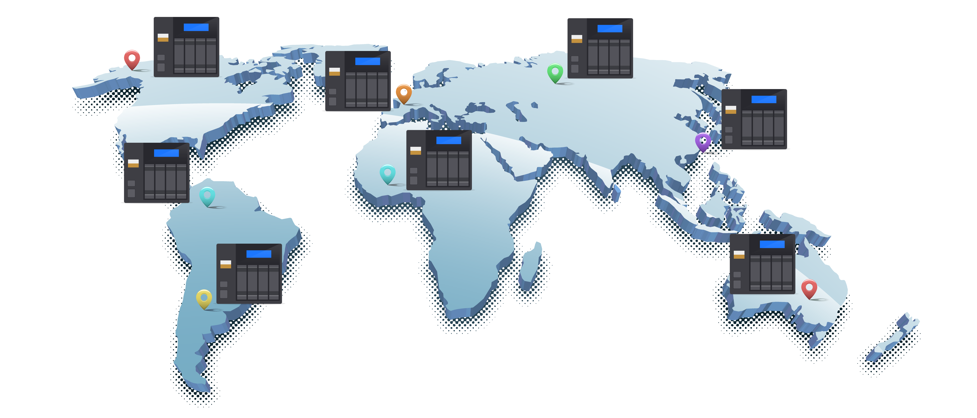
The Acclaimed CMS for QNAP NAS
200,000 NAS around the globe have installed Q'center
1,500,000 NAS managed by Q'center
In average, per business customer, 10 NAS being managed by Q'center
Notes:
2
被管理的NAS數量

Slide 3
Your challenges, our solution:
How to make sure if multiple NAS is in their optimal condition?

Slide 4
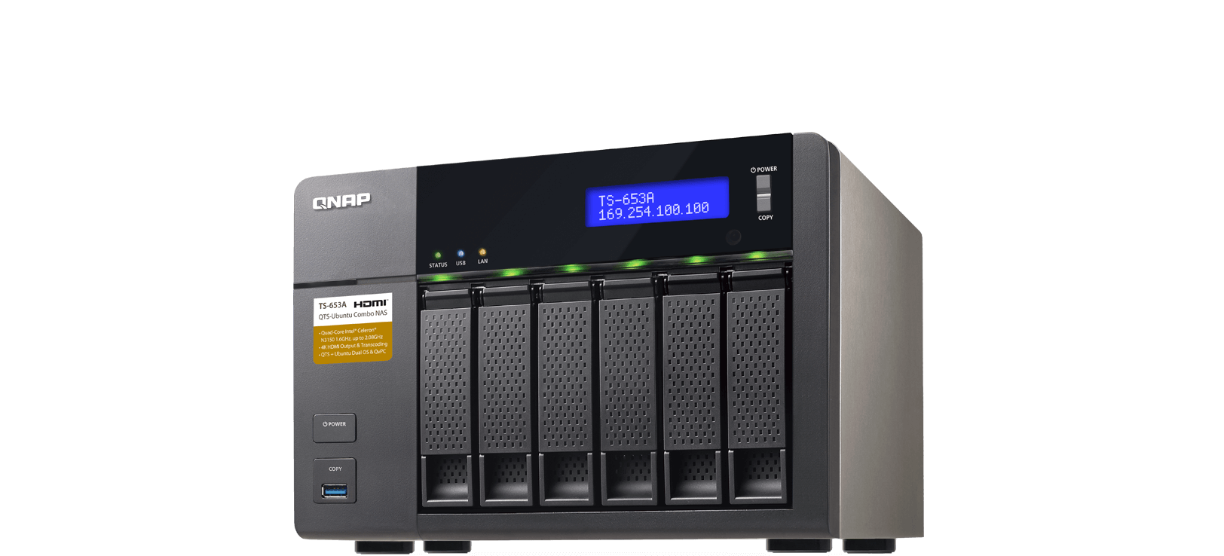
3 Aspects for Monitoring Your Storage
First dimension: system resource usage, status and log
Second dimension: storage resource usage
Third dimension: storage performance and health
System Resource
Is there a tool to monitor disk health?
Storage Perfromacne
Storage Resource
Notes:
4

Slide 5
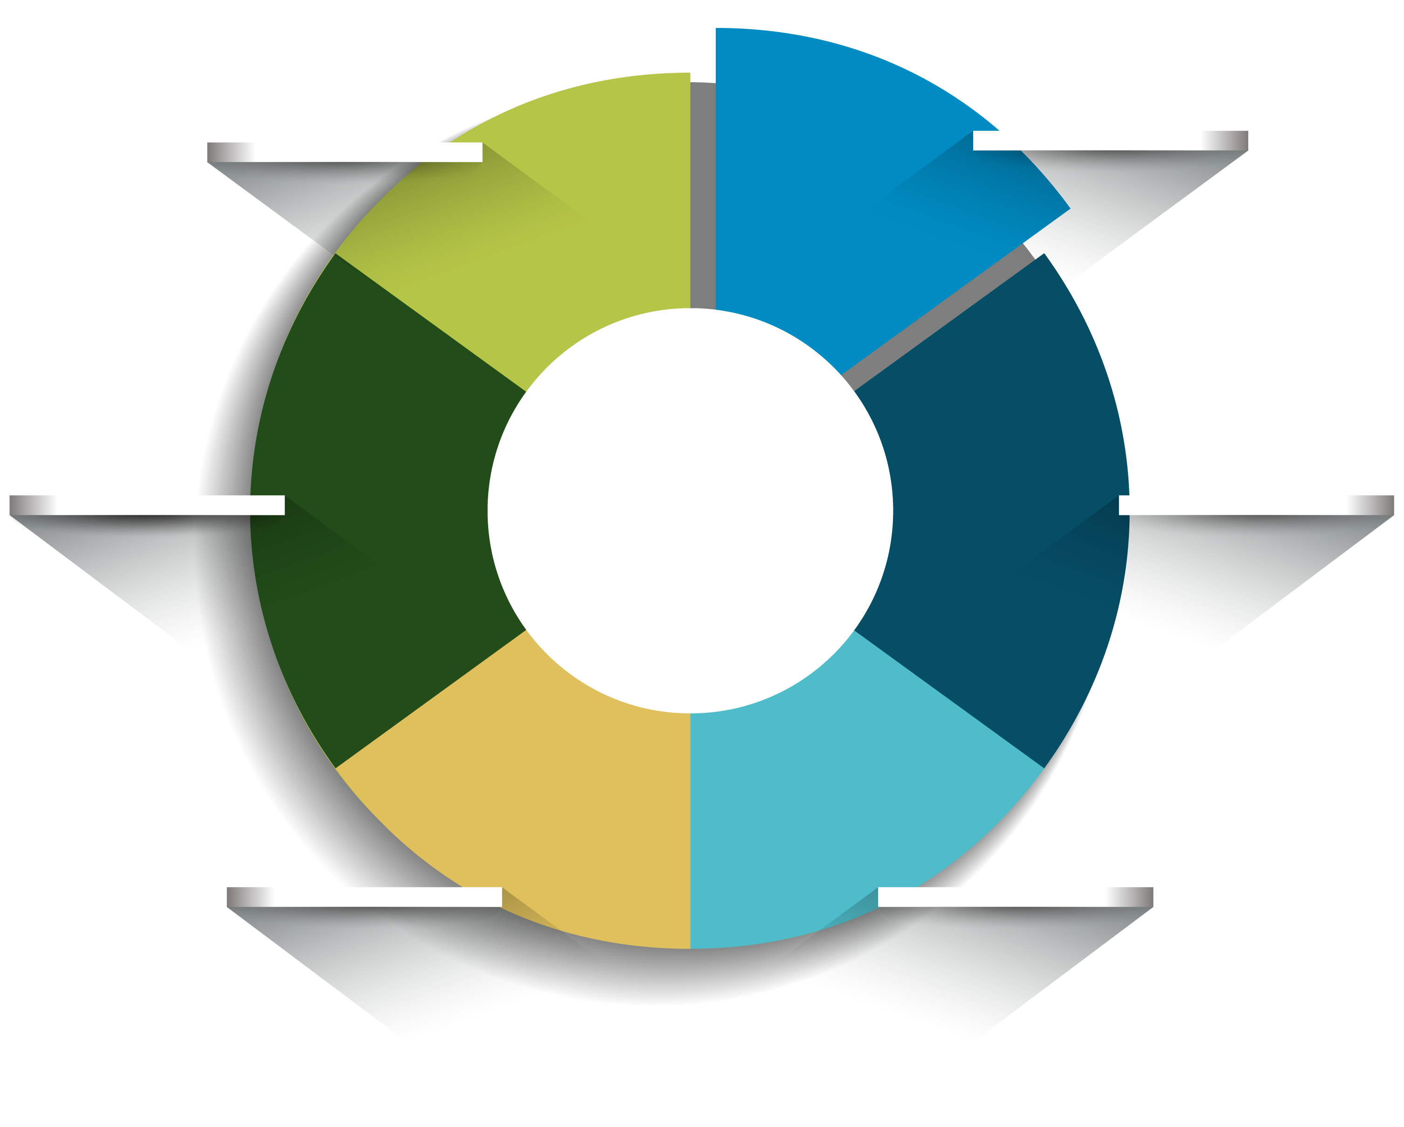
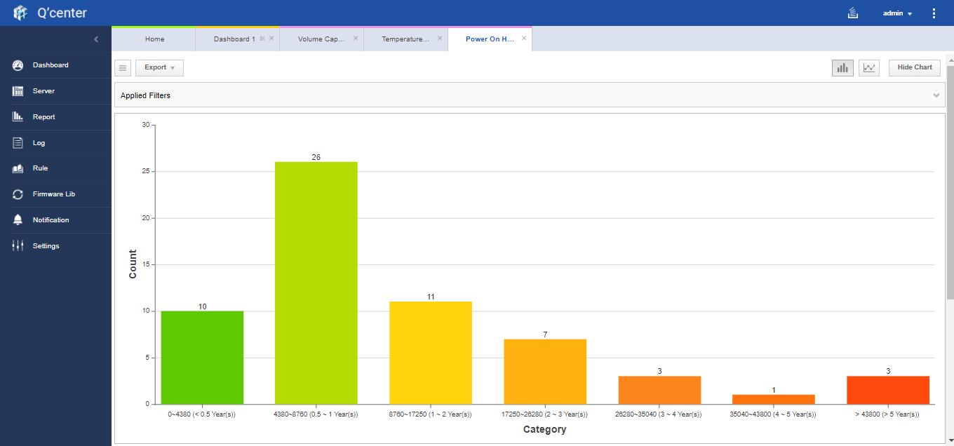
30 Different Reports in 5 Categories
5 Categories: Inventory, Storage Space, Performance, Hardware, Disk
30 Analysis Reports: E.g. S.M.A.R.T. Monitoring
ID198 Uncorrectable Sector Count
ID5 Reallocated Sector Count
ID197 Current Pending Sector Count
ID9 Power-On Hours
ID188
Command Timeout
ID187 Reported Uncorrectable Errors
Notes:
5

Slide 6
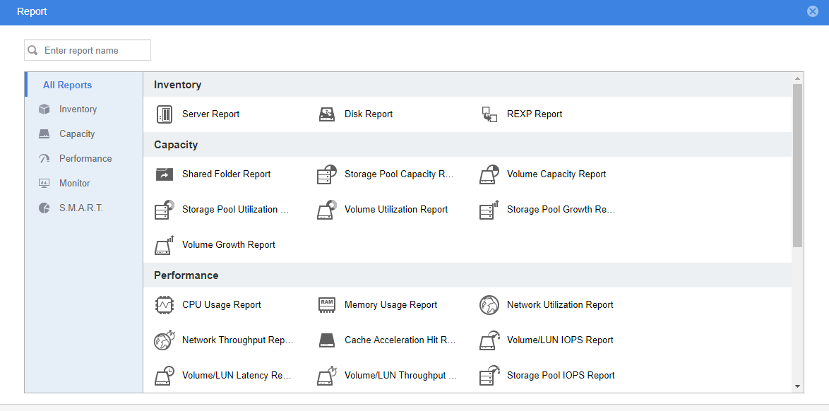
The Items that Q’center Monitored
Notes:
6

Slide 7
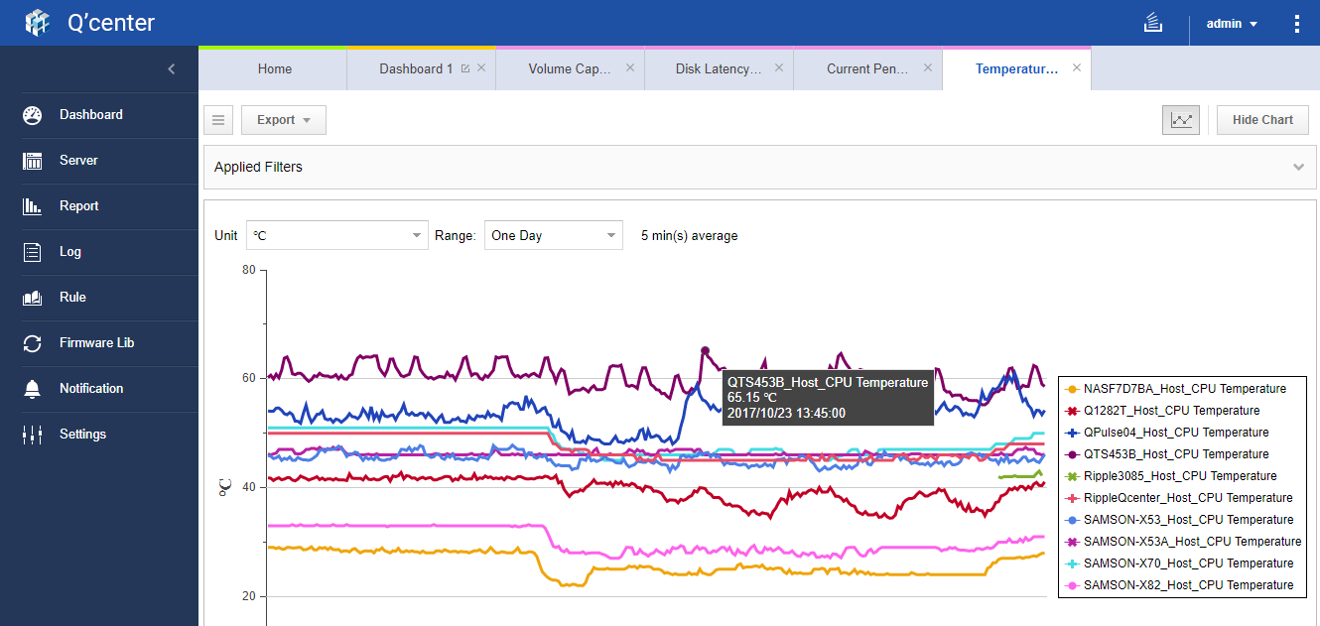
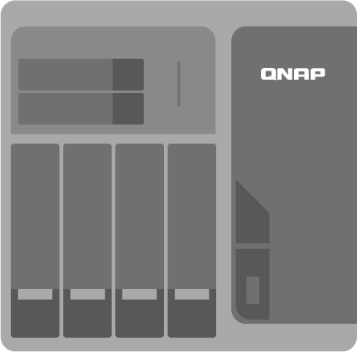
Detect Potential Issues
Hardware: Temperature and Fan Speed
Detect effects of environmental changes and
prevent system failures
Notes:
7

Slide 8
A Professional Monitoring Tool
Brand/ Monitoring Items | QNAP Q'center | S Brand CMS
CPU/Memory/Network | V | V
Shared Folder/Storage Space Usage | V | V
Storage Performance and Logs | V | X
Long-term HW Monitoring (Temp/Fan Speed) | V | V
Periodical Disk Health Report | V | X
An independent and professional suite
The Q'center Agent on every NAS will collect more than 100 variables each minute
Notes:
8

Slide 9
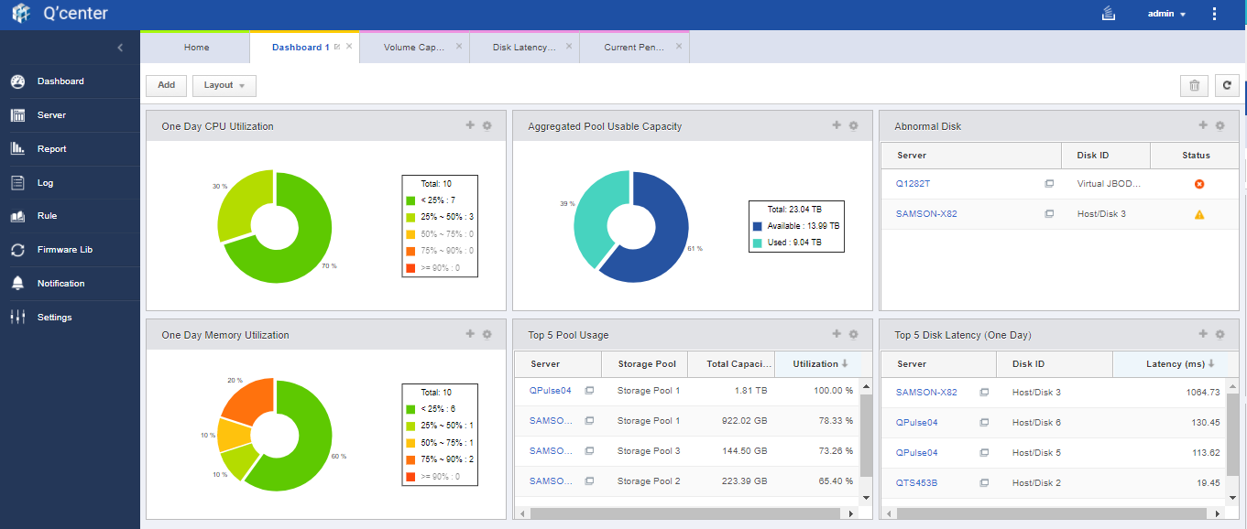
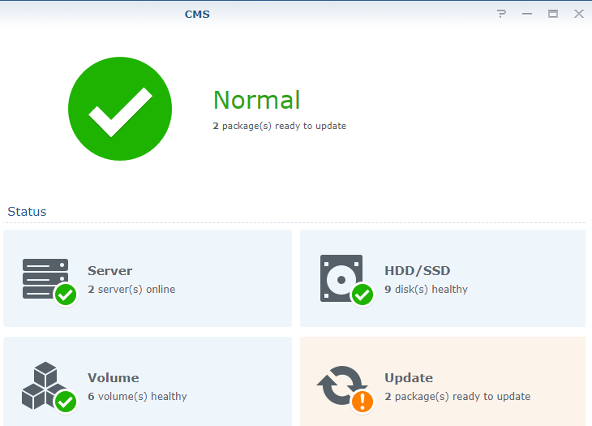
Intuitive GUI
QNAP Q'center
S Brand CMS
A three dimensional, fully customizable interface
A basic monitoring interface
Notes:
9
左右邊比較

Slide 10
Live Demo
How to use Q'center and easily find disks that need to be replaced?
Notes:
10

Slide 11
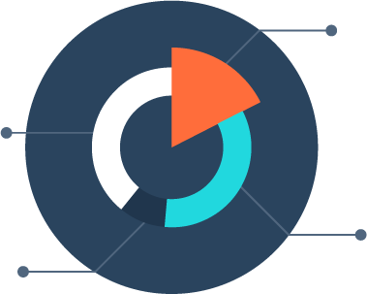
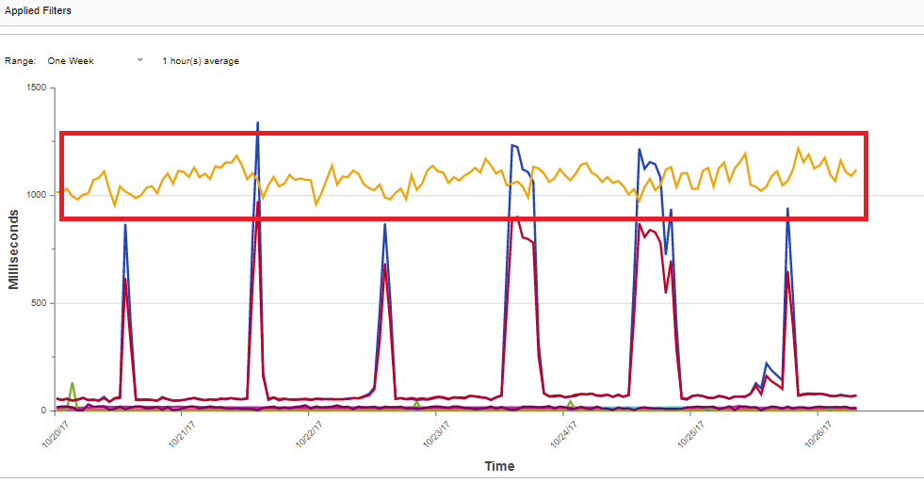
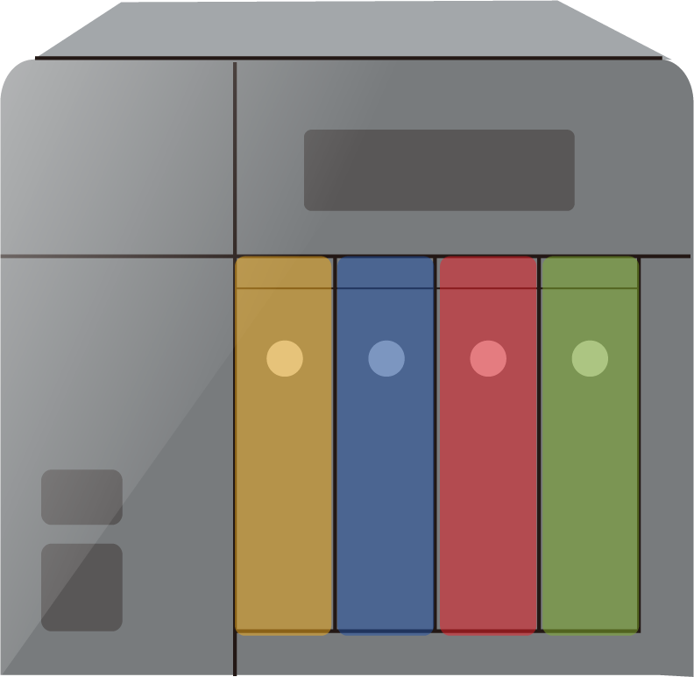
Long-term Self Monitoring Tool
Log long-term (over a year) space or performance usage
Customizable
dashboard
Q'center can be used even for a single NAS for self monitoring
Notes:
11

Slide 12
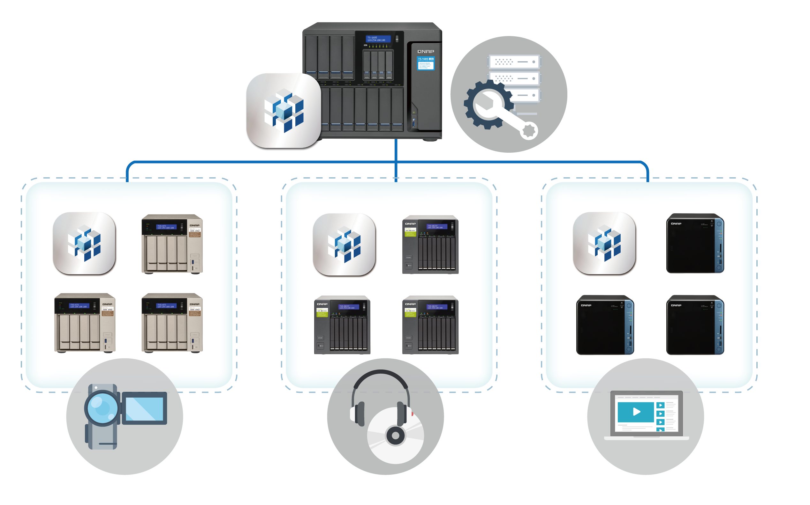
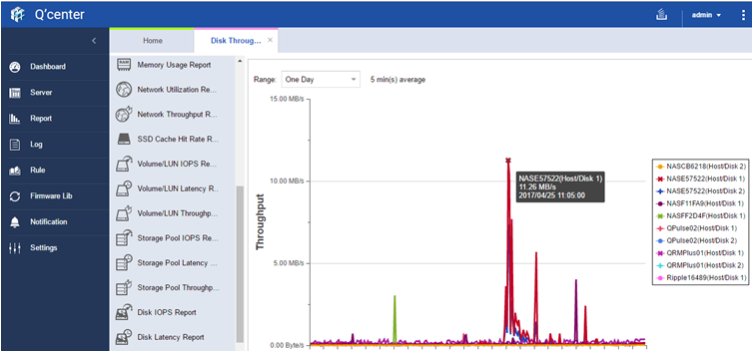
A NAS can be Monitored by Several Q'centers
A NAS can be monitored by up to 10 Q'centers
Build a distributed monitoring system or
a backup site
IT Dept.
Dept1
Dept2
Dept3
Notes:
12
提供上限

Slide 13
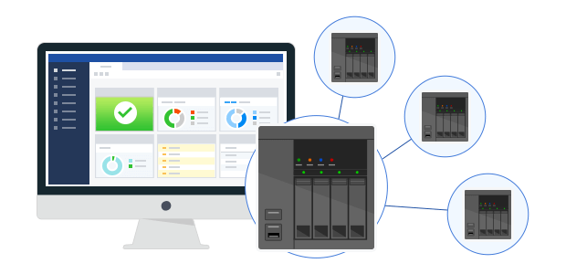
Helps you Work Smarter, not Harder
Functions of Q'center Central Management System:
:
Upgrade FW, apps and change settings for multiple NAS
Backup NAS settings
Create shared folders
Brand/Function | QNAP Q'center | S Brand CMS
Upgrade FW | V | V
Install apps | V | V
Change Settings | V | V
Backup Settings | V | X
Create Shared folders | V | X
Notes:
13

Slide 14
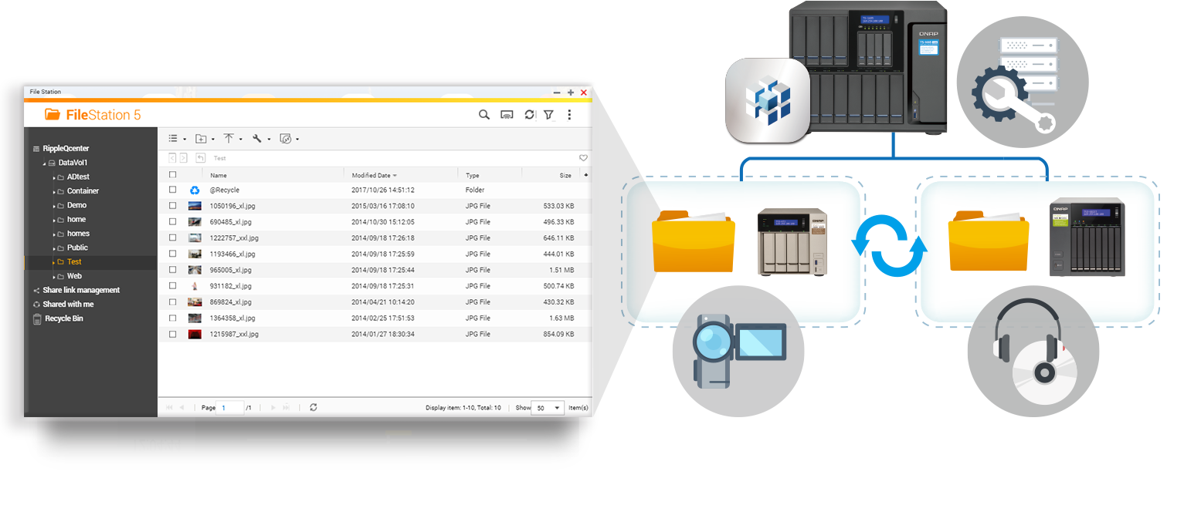
Create Shared Folders on Multiple NAS
Case: Create an identical folder on different branch office's NAS to store IT resource
Use Q'center to create multiple shared folders & configure permissions directly
Notes:
14

Slide 15
Live Demo
How to create a shared folder on multiple NAS with Q'center
Notes:
15

Slide 16
Your challenge, our solution:
How to deploy Q'center and monitor over a hundred NAS?

Slide 17
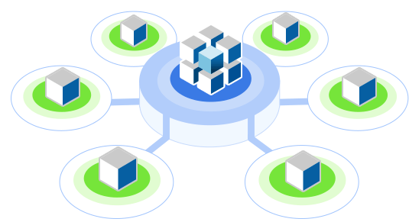
Core Optimizations to Monitor over 1,000 NAS
2 major challenges for device monitoring:
Chosen hardware spec. can not meet requirements for monitoring
Monitored devices cannot connect back to the server
The Q'center solution:
One Portal
Two Deployment Methods
(NAS/VM)
Three Connection Types
(LAN/WAN/over NAT)
Notes:
17

Slide 18
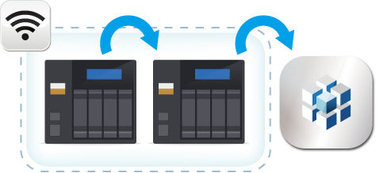
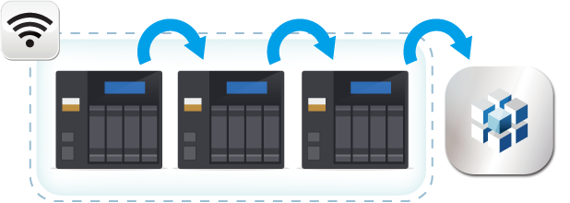
One Portal
The NAS under the same subnet will form a connection cluster
Under the same subnet: Only 1 NAS will transfer data back to Q'center
When a NAS cannot connect to Q'center, its data can still be sent by other NAS
Each Q'center Agent will transfer 50KB~200KB data per min.
Notes:
18
自主研發的技術

Slide 19
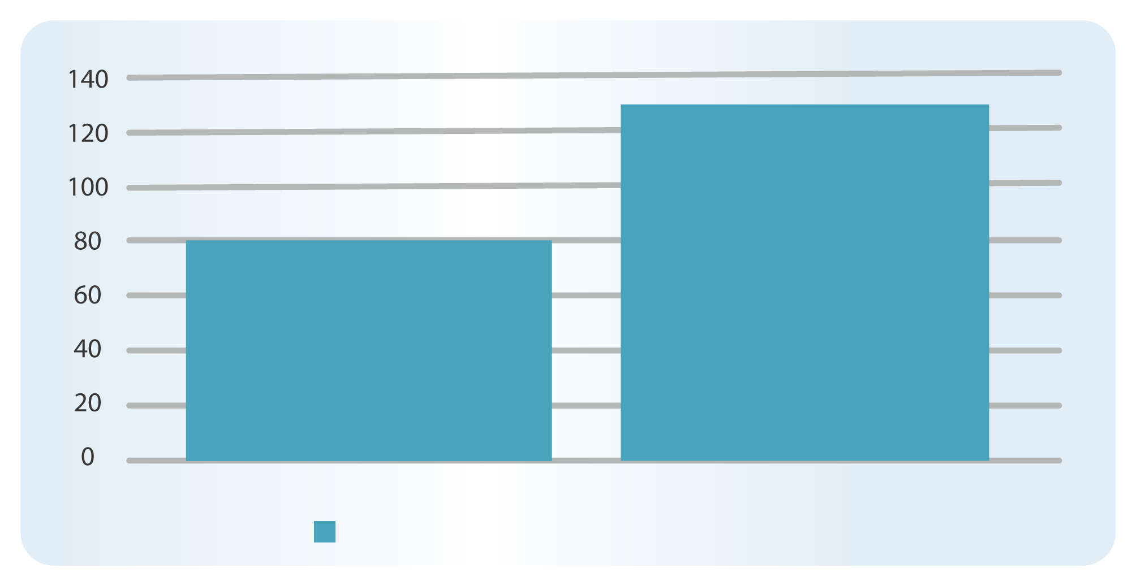
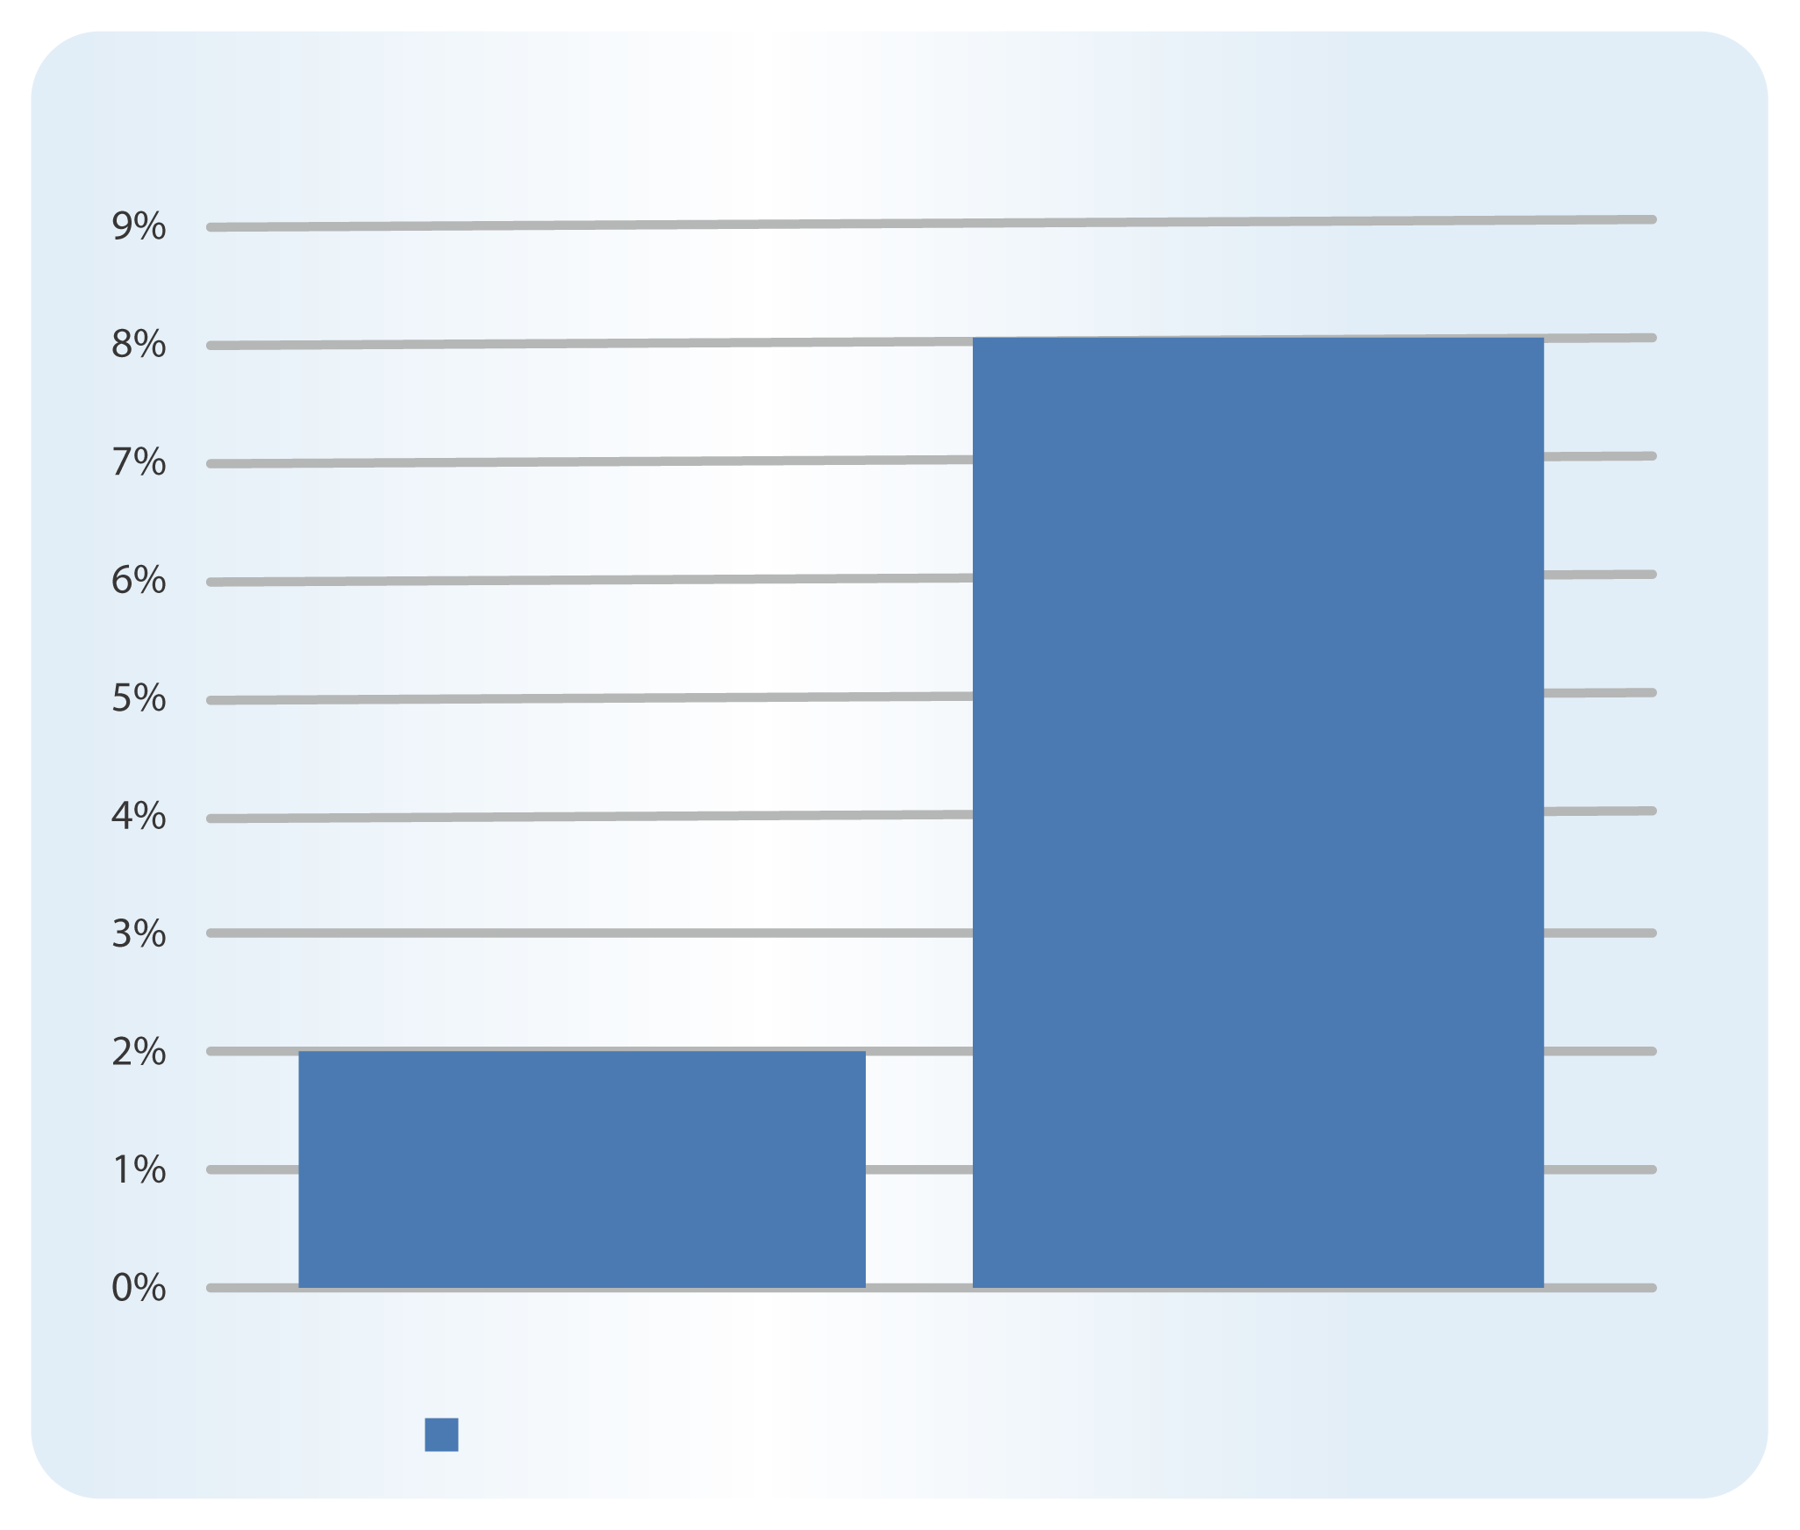
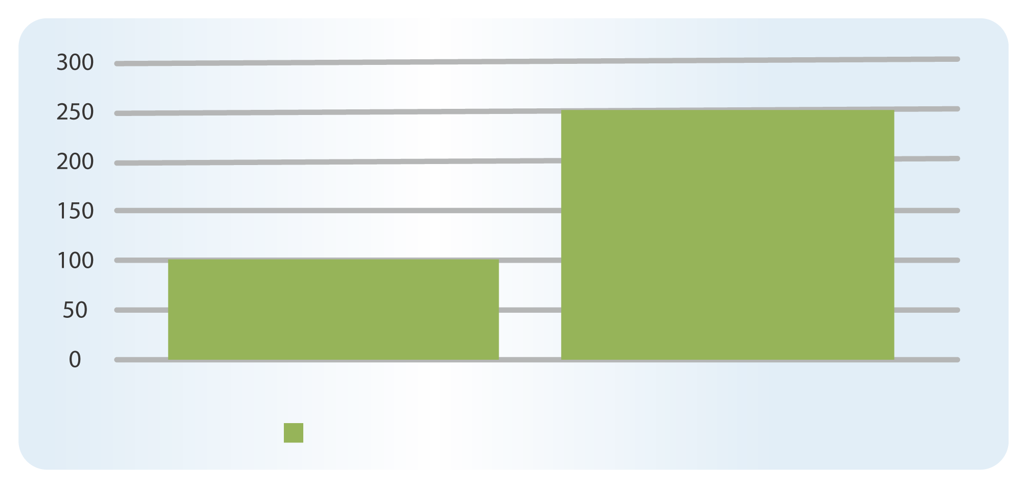
Reduce Resource Requirements
TVS-1282 (i7) to monitor 100 NAS under the same or different networks
CPU usage reduces by 75%, network usage reduces by 40%, disk IOPS reduces by 60%
A single portal reduces resource requirement
130 KBps
8%
80 KBps
Same network
Different network
Network Uage (KBps)
2%
250 IOPS
100 IOPS
Same network
Different network
Same network
Different network
CPU Usage (%)
Disk Usage (IOPS)
Notes:
19

Slide 20
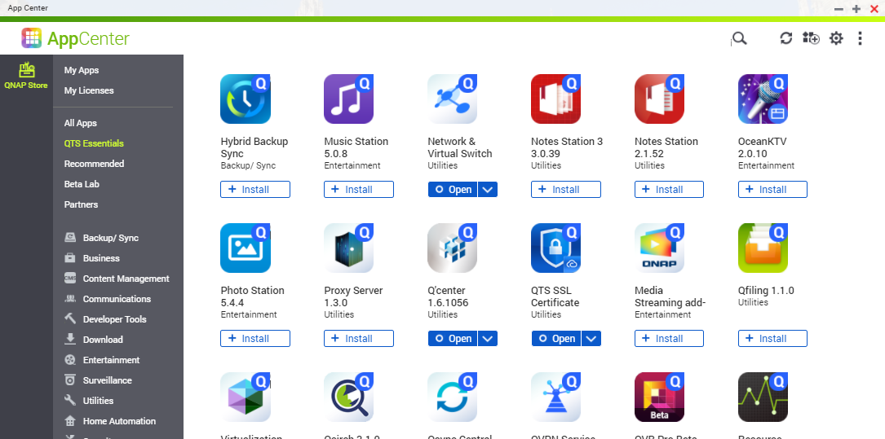
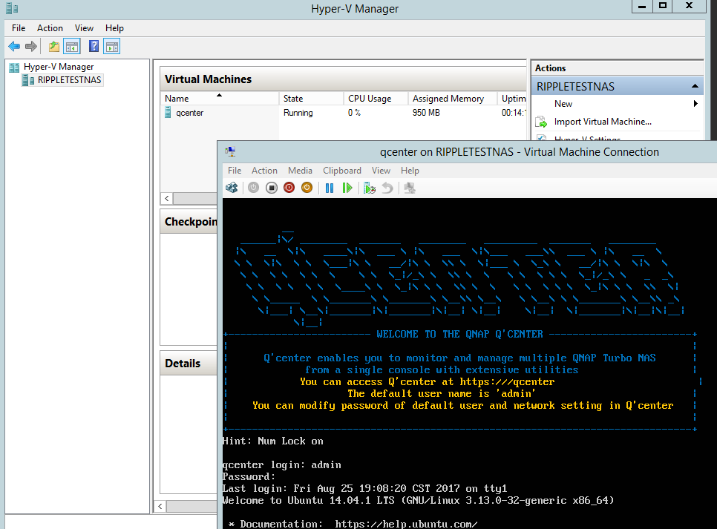
Two Deployment Methods: NAS/VM
Download Q'center from QNAP NAS App Center
Download Q'center VM Edition from QNAP website and port into hypervisors
VMware / Windows (2 editions)
１
２
Notes:
20

Slide 21
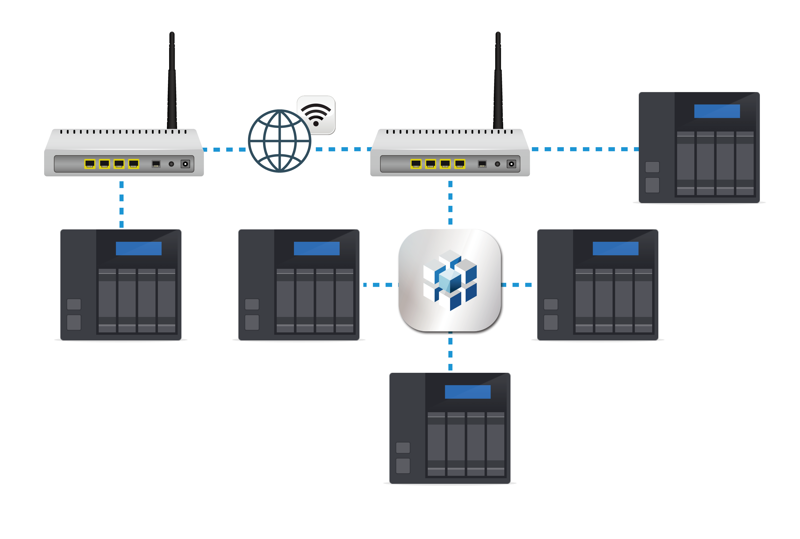
3 Connection Types: LAN/WAN/over NAT
Add NAS to Q'center through different methods
Subnet |  | Search by IP
Over NAT/ VPN |  | Connect to Q'center
WAN |  | Search by myQNAPcloud Account
１
２
3
Notes:
21

Slide 22
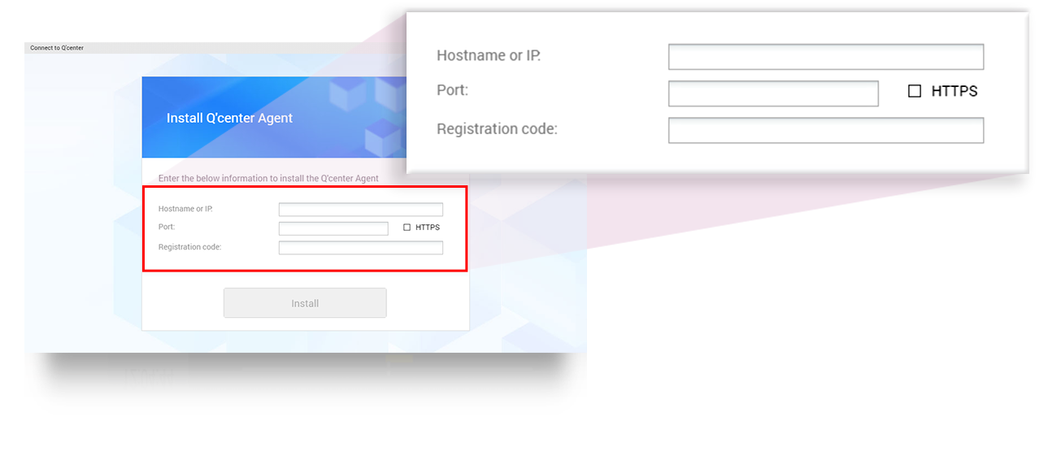
No Need to Modify Firewall Settings
Install Connect to Q'center app on NAS to be monitored
Set Q'center IP to connect to Q'center Server directly
Single portal tech. available
Can be used with VPN connections
Notes:
22

Slide 23
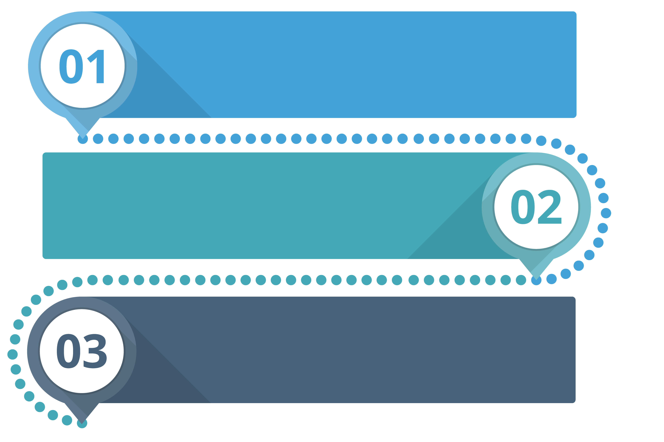
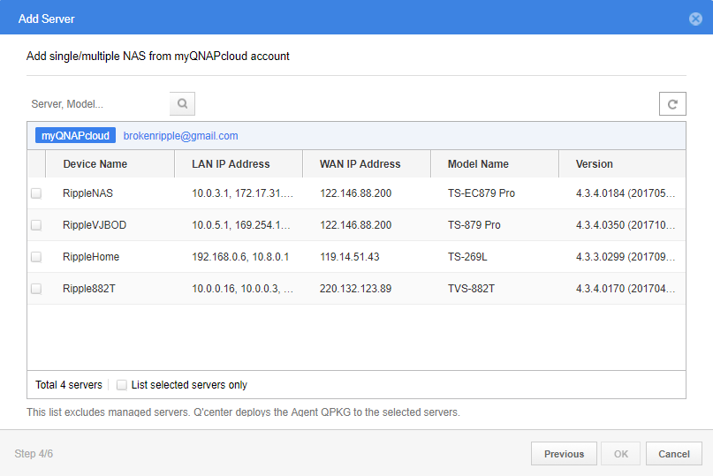
Find Your NAS Through myQNAPcloud
Add a NAS to your myQNAPcloud ID
Enable myQNAPcloud on NAS where Q'center is installed
From Q'center, search NAS of the same myQNAPcloud ID
*The added NAS will be connected via WAN IP instead of through myQNAPcloud relay
Notes:
23

Slide 24
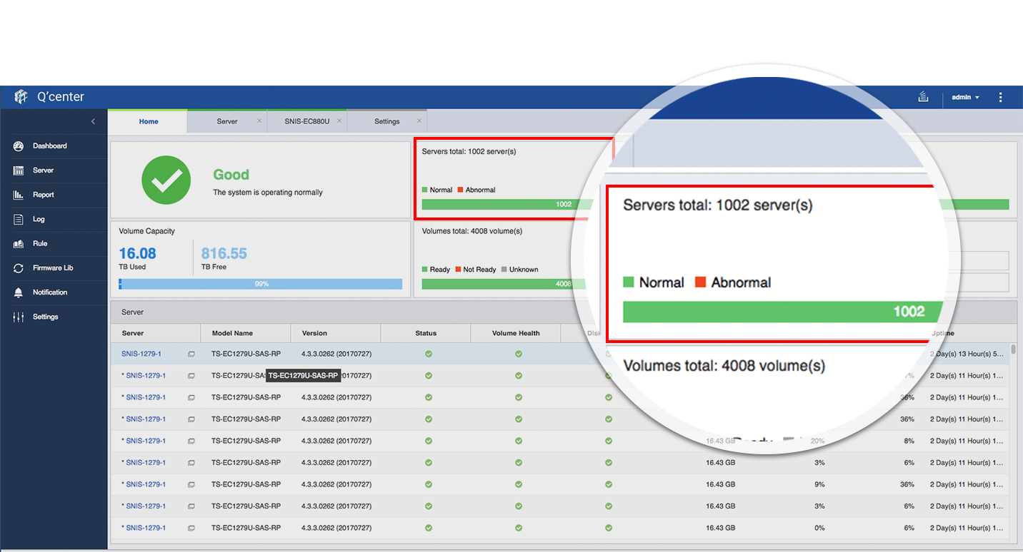
Support Monitoring of > 1,000 NAS
Aug. 2017, Q'center V1.6.1056
Monitors 1,000 QNAP NAS in QNAP Lab with TDS-16489U E5-2620*2, 64GB Memory
Notes:
24

Slide 25
Best Practices for Deploying Q'center
Factor 1: Are monitored NAS on the same or different subnets?
Factor 2: NAS Configurations (Disks, Network, Connection Logs, etc)
NAS count | CPU | RAM | Storage | SSD Cache | Suggested model
1~50 | Intel® Quad-Core | 1GB | 100GB | No Need | TS-x51
50~100 | Intel® Celeron® | 4GB | 100GB | No Need | TS-x53B
100~500 | Intel® i5 | 8GB | 200GB | Needed | TVS-x82
500~1000 | Intel® Xeon® E3 | 16GB | 200GB | Needed | TVS-x80U
500~1000 with complex configurations | Intel® Xeon® E5 | 64GB | 500GB | Needed | TDS-x89U
Notes:
25

Slide 26
<Use Case> Tesco Lotus Thailand
One of the biggest supermarket chains in Thailand
1,200 stores, 200 of them have deployed QNAP NAS
Q'center (app ver.) and the following HW:
TVS-1282
Intel® i7-6700
16GB RAM with SSD RAID
Theerapong Boonma, Local Distributor: The Q'center is looking good in managing 200 NAS. We are looking forward to adding more servers!
Notes:
26
Tesco 泰國合作綜合超市
超過 1200 個 販售超市 初步導入QNAP NAS 於其中 200 個站點
採用方案: Q'center App 版本
搭配 TVS-1282 Intel ® i7-6700 16GB 記憶體 使用SSD RAID

Slide 27
<Case> Italian Agriculture Association
Total 724 Branch office, 200 has deployed QNAP NAS
Q'center VMware Version
IBM Flex System x400
Intel® Xeon® CPU E5-4650
4GB Virtual Memory
IT managers: Thanks for great support from QNAP,
it really makes a difference!
Notes:
27

Slide 28
Make the Best Use of Your NAS with Q'center
3-Dimension monitoring
Single portal, NAS/VM dual mode and 3 connection types (LAN/NAT/WAN)
Monitoring over 1,000 QNAP NAS
Q'center Official Page: https://www.qnap.com/solution/qcenter
Deployment Best Practice:
https://www.qnap.com/en/how-to/tutorial/article/best-practices-for-deploying-qcenter
Notes:
28

Slide 29
THANK YOU

