Slide 1
Half-width Rackmount 100GbE Managed Switch, cost-optimized for enterprise IT
This is a conceptual illustration. Please refer to the actual product for accuracy.
Notes:
Welcome everyone to the QNAP channel. I'm Jerry, the product manager at QNAP. Today, I'm here to introduce QNAP's first ultra-speed 100GbE network switch, the QSW-M7308R-4X.
歡迎大家收看QNAP頻道，我是QNAP產品經理Jerry，今天要介紹QNAP第一台高速100GbE網路交換器 QSW-M7308R-4X

Slide 2


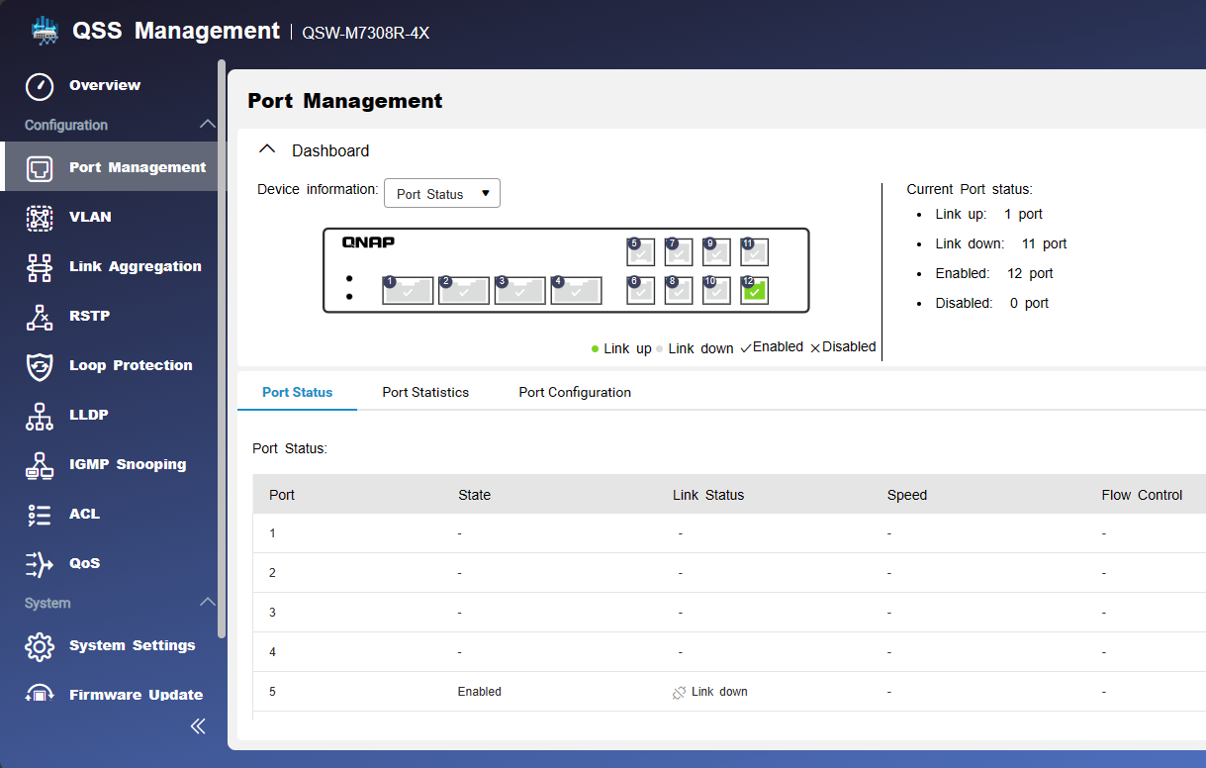
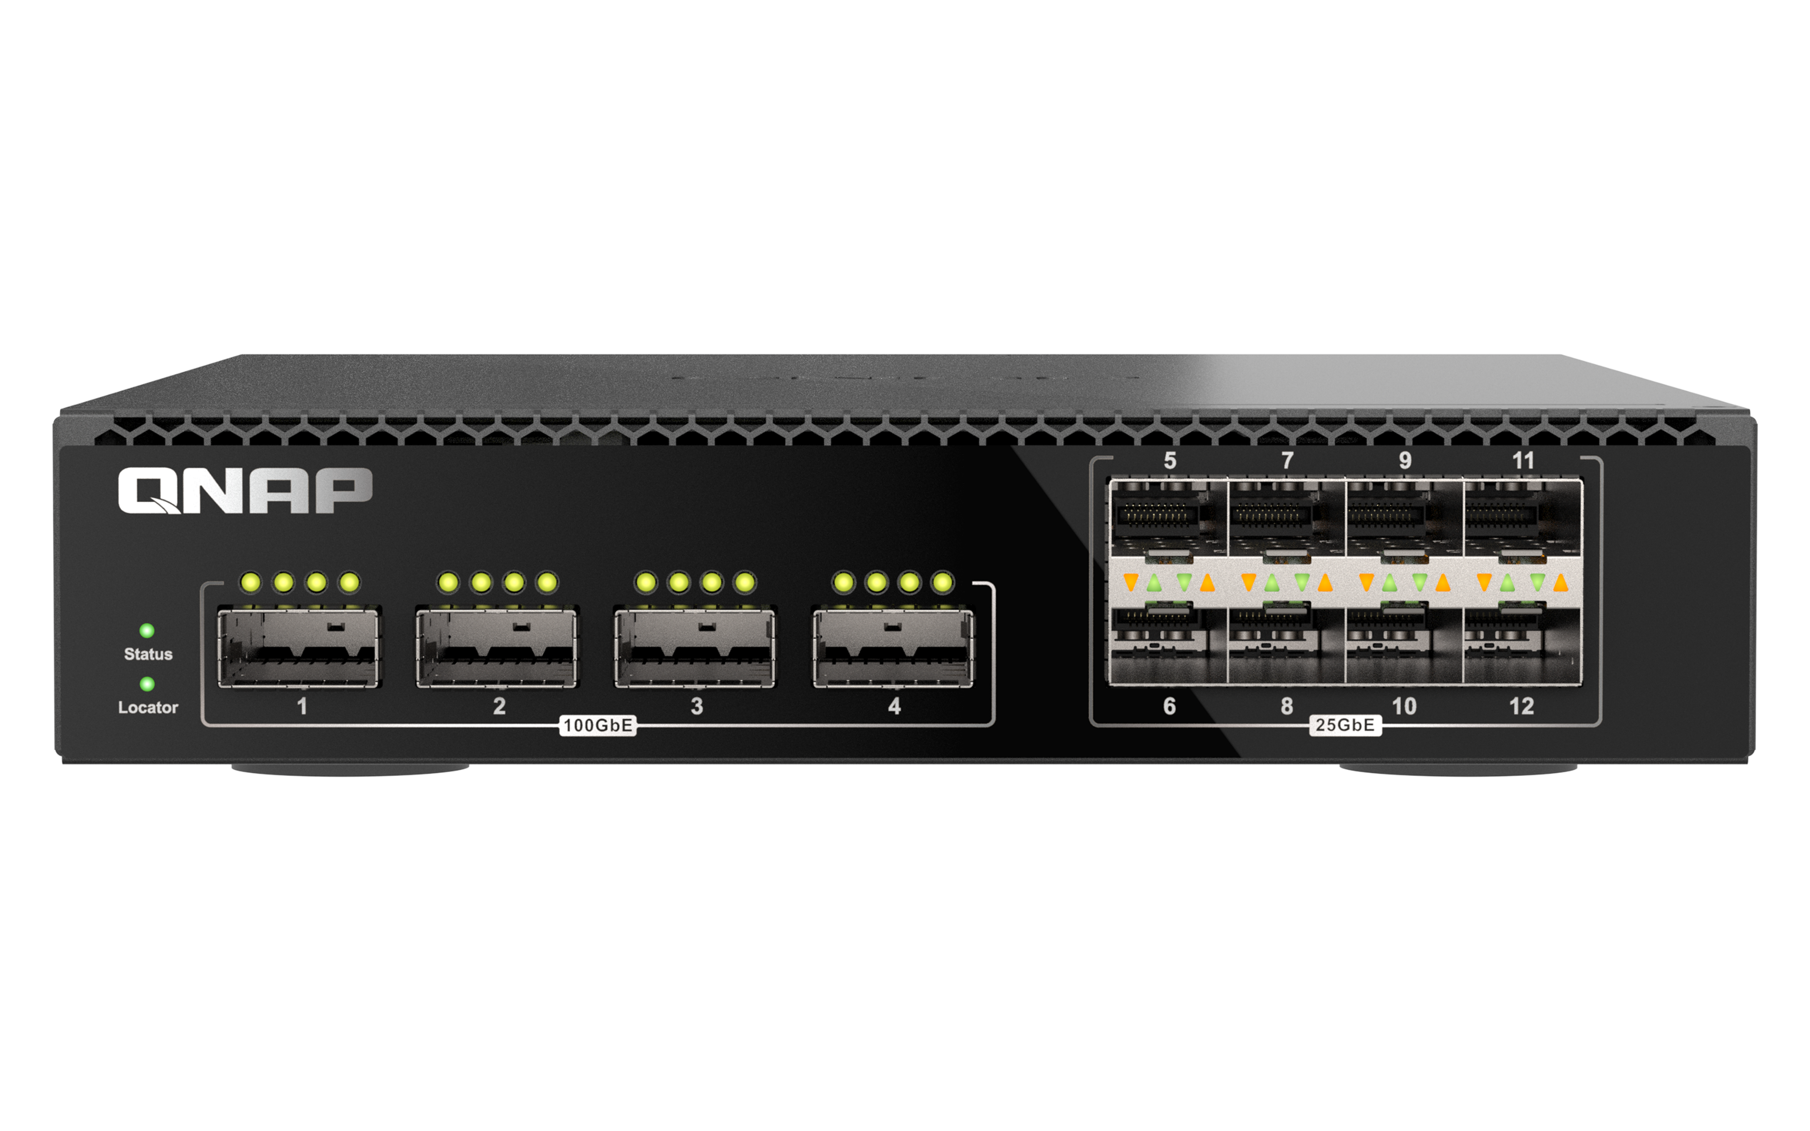
100GbE network speeds have become mainstream
According to the February 2023 report from Dell'Oro Group, 100GbE is poised to become the mainstream server network connection speed this year, surpassing the shipment volume of 25GbE within the next four years. By 2027, it is anticipated that higher port speeds will account for 44% of server market revenue. The report also predicts significant growth in the Smart NIC market, foreseeing a substantial increase in demand for the QSW-M7308-4X 100GbE network switch
Designed for enterprise
core networks
High-speed network switching
Graphical web management interface
4 x 100GbE ports and 8 x 25GbE ports for the fastest network speeds and support for rack and server connections.
QSS (QNAP Switch System), a user-friendly graphical web interface, provides functions such as an overview dashboard, network port management, and configuration guides, making network management more intuitive and easy.
Suitable for the core high-speed network requirements of enterprises, providing stable and high-performance solutions.
Reference link: https://www.thefastmode.com/expert-opinion/33200-ethernet-fifty-years-and-still-going-strong
Notes:
Why did QNAP launch a 100GbE ultra-speed switch? The main reason is that we've observed 100GbE becoming the mainstream in enterprise and server networks, leading to an increased demand. To meet this demand, QNAP has introduced a stable and efficient solution – this switch includes 4 ports of 100GbE and 8 ports of 25GbE. It also features a clear and user-friendly web management interface for easy navigation. This trend was also highlighted in Dell's 2023 report.
為何 QNAP 會推出 100GbE 高速 Switch 呢? 主要是觀察到 100GbE 往速已成為了企業核心網路與伺服器網路主流，其需求量將因此上升，因此 QNAP 專此提供了一個穩定且高效的解決方案，此交換器包含4個100GbE網路以及8個25GbE網路，並有一目了然的Web管理介面，直覺且易用，於Dell 2023年的報告也提到這個趨勢。

Slide 3



100GbE switch-accelerated GPU cluster
Based on Nvidia's September 2023 GPU Cluster optimal performance configuration, achieving a network bandwidth of 100GbE or above on each node is crucial for minimizing the impact of insufficient node bandwidth on overall performance. Therefore, deploying QSW-M7308R-4X is an economical and high-speed solution, effectively reducing the bottleneck in node network bandwidth. This setup is ideal for accelerating scientific computing tasks, such as simulating complex natural phenomena, designing new materials, or developing novel drugs. It is also well-suited for training large-scale machine learning/deep learning models, enabling rapid processing of massive amounts of data, including images, videos, or text.
Calculating complex scientific
Training AI model
Processing big-data
Reference link: https://docs.nvidia.com/ai-enterprise/sizing-guide/0.1.0/best.html
Notes:
Nvidia recommends a minimum 100GbE network bandwidth for GPU clusters to achieve optimal performance. The QSW-M7308R-4X, an economical and high-speed 100GbE switch, is perfect for GPU clusters. It accelerates scientific computing, machine learning, and deep learning applications—essential for tasks like climate studies, seismic analysis, drug development, and large AI models. With its high-speed capabilities, businesses can push innovation boundaries and empower an intelligent future.
參考 Nvidia 建議 GPU Cluster 的節點網路頻寬至少為 100GbE，可獲得最佳效能。QSW-M7308R-4X 是一款經濟且高速的 100GbE 交換機，適合用於 GPU Cluster。它可以幫助您加速科學計算和機器學習/深度學習應用，複雜的科學計算如，氣候的變遷，地震或洪水 ; 大量的數據例如開發新的疫苗或藥物，大型的AI模型如目前最紅的大型語言模型，高速的網路速度可讓企業突破創新極限，賦能智慧無限未來。

Slide 4
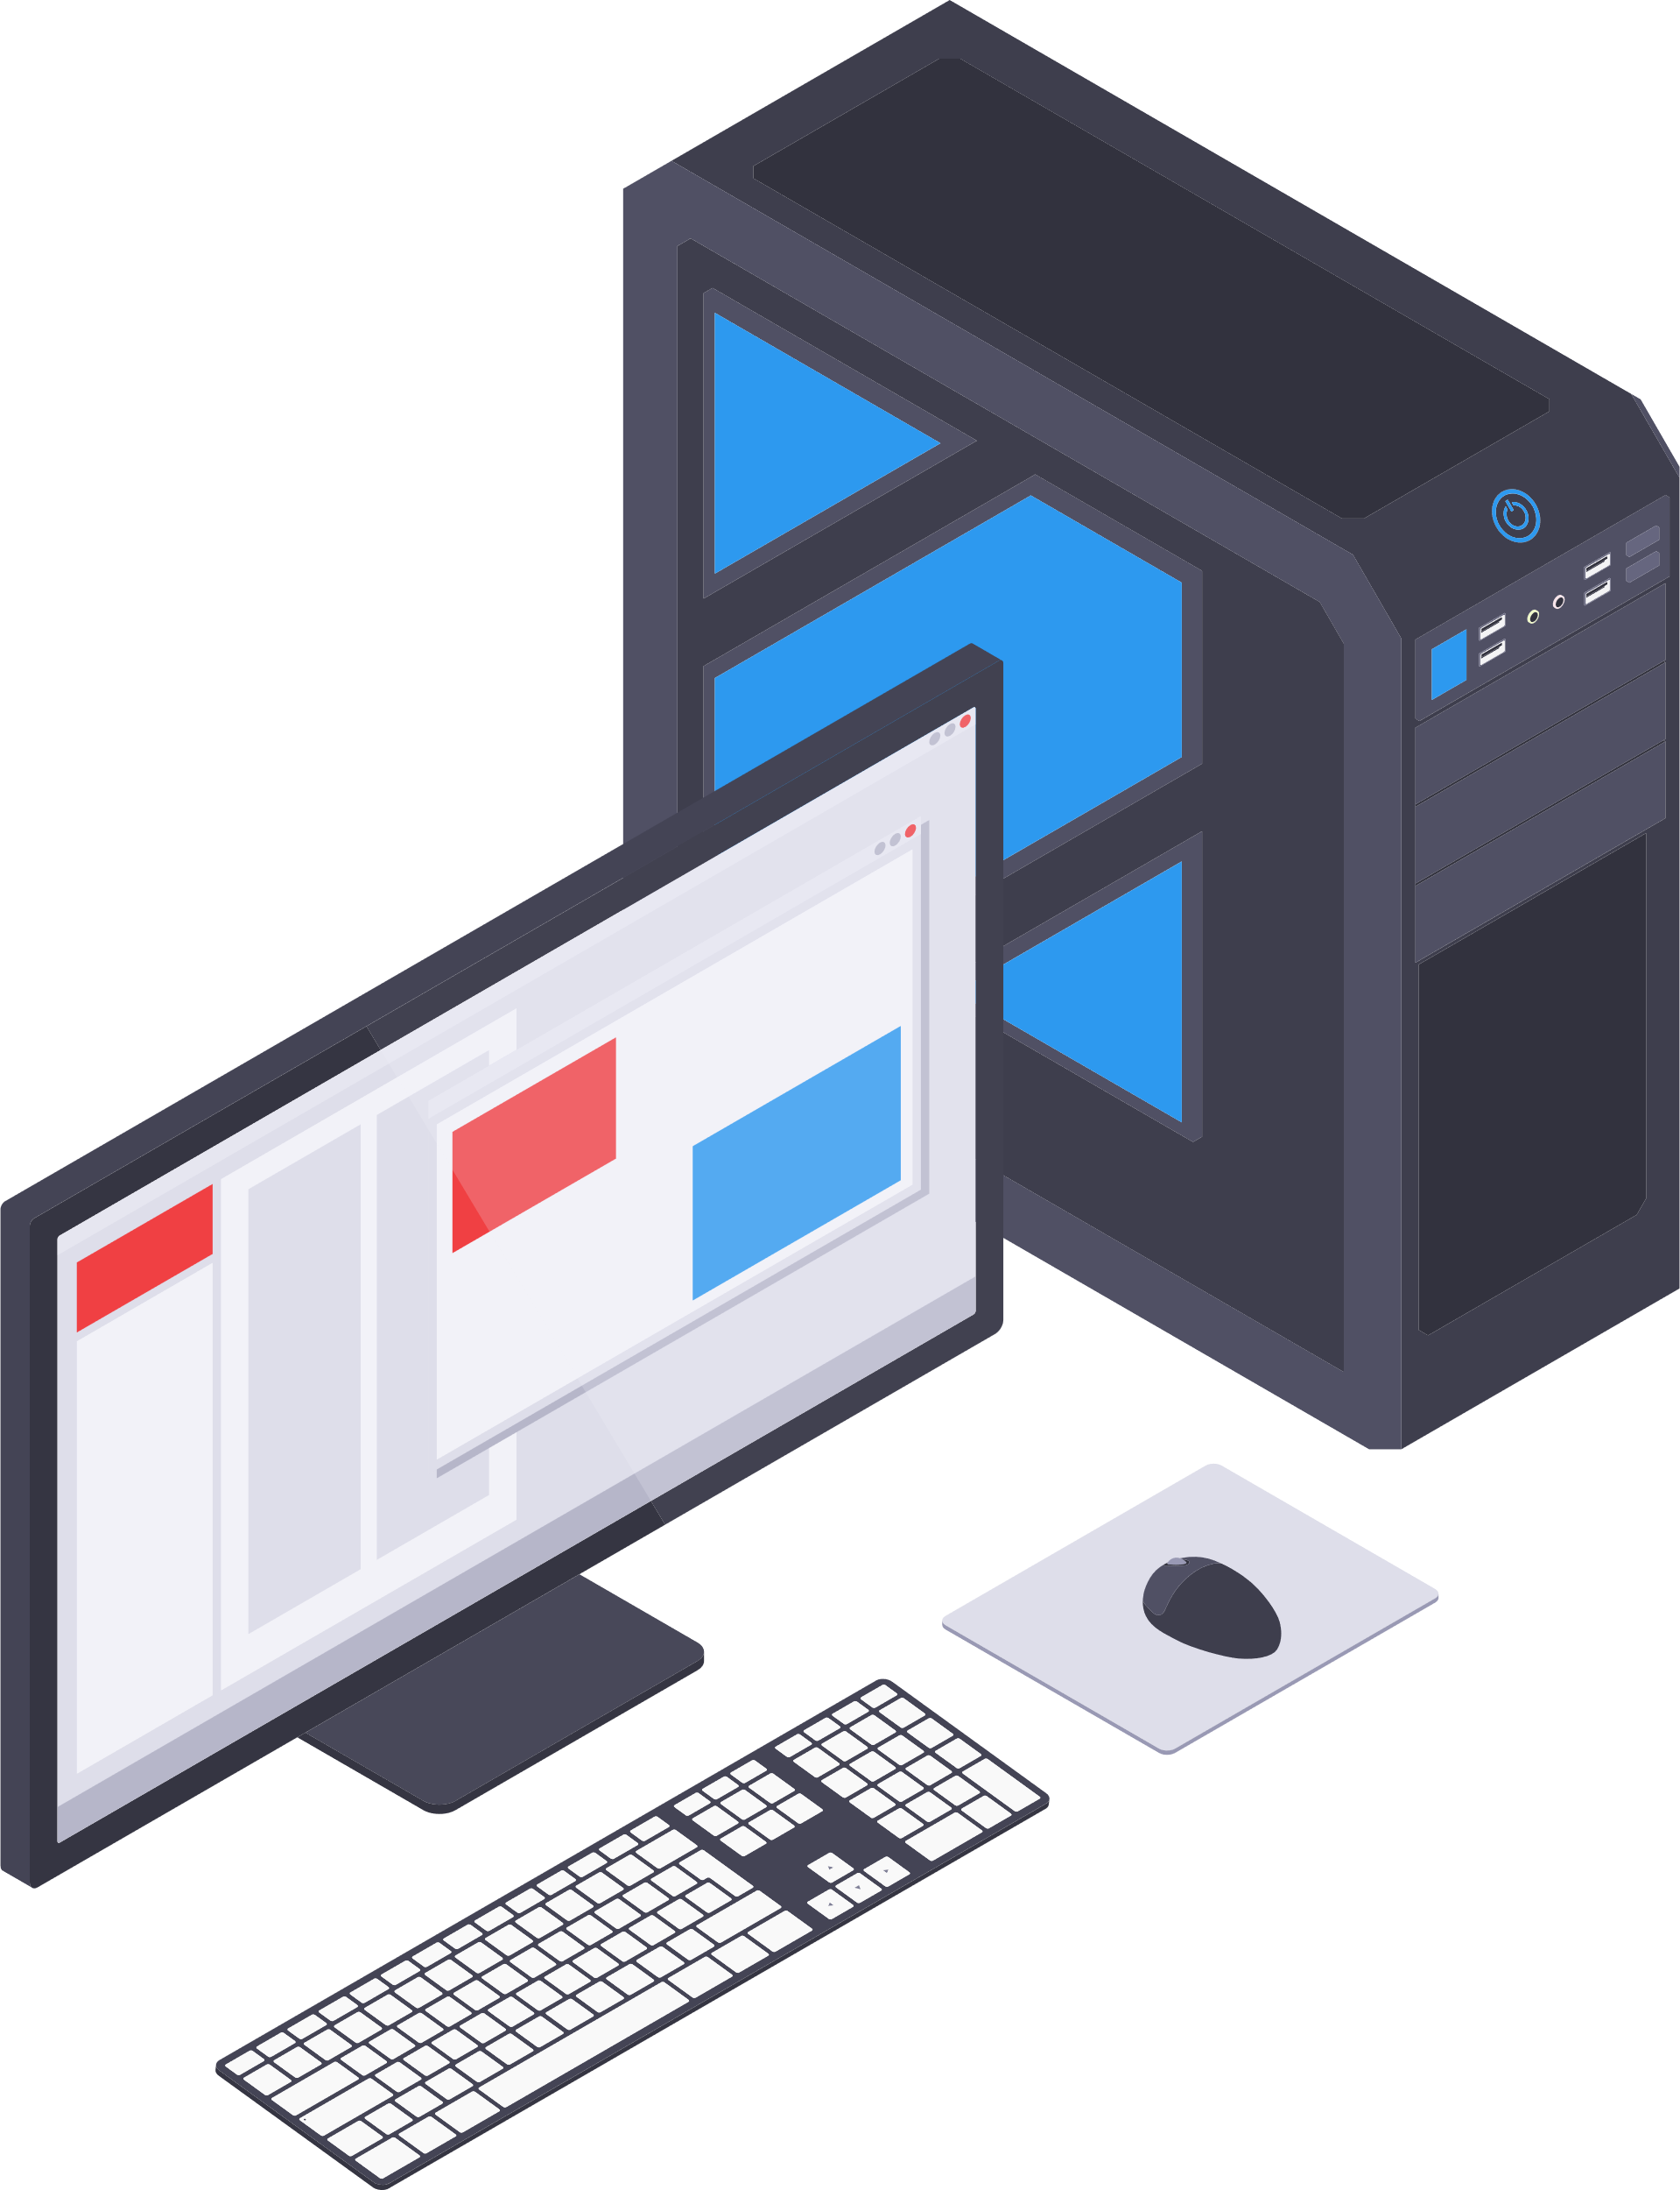
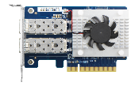
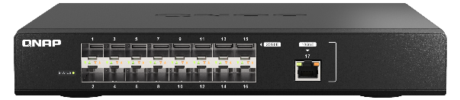
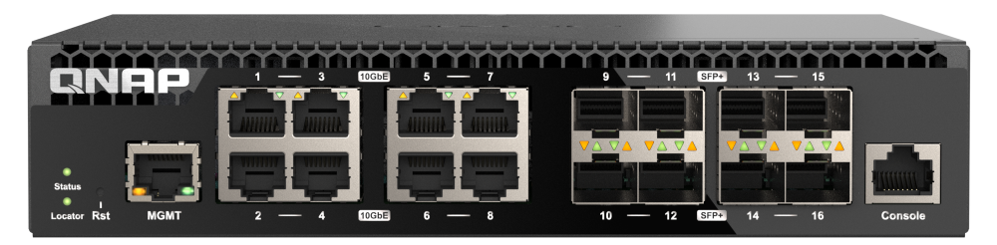

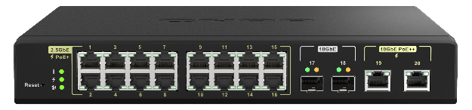
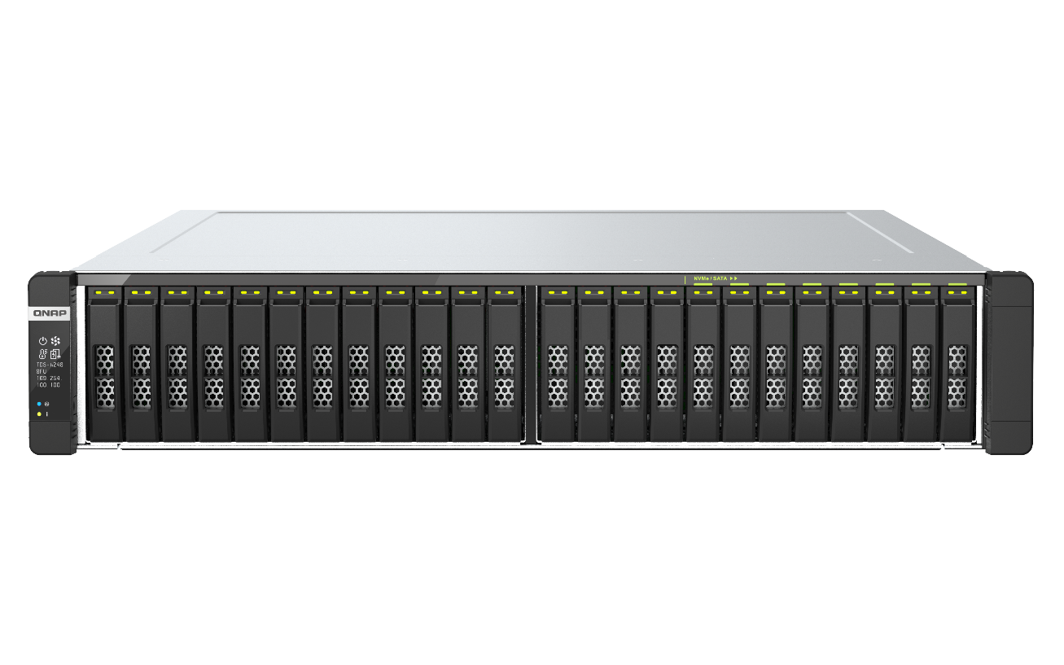
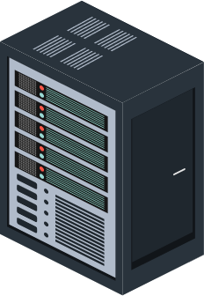
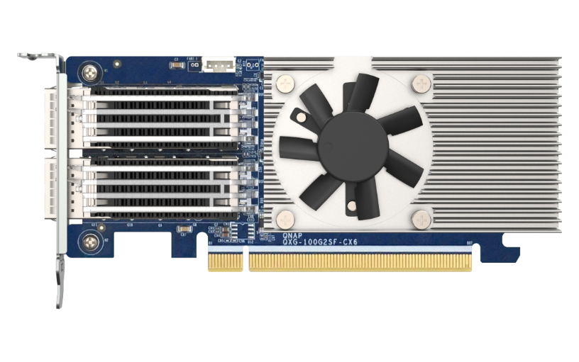


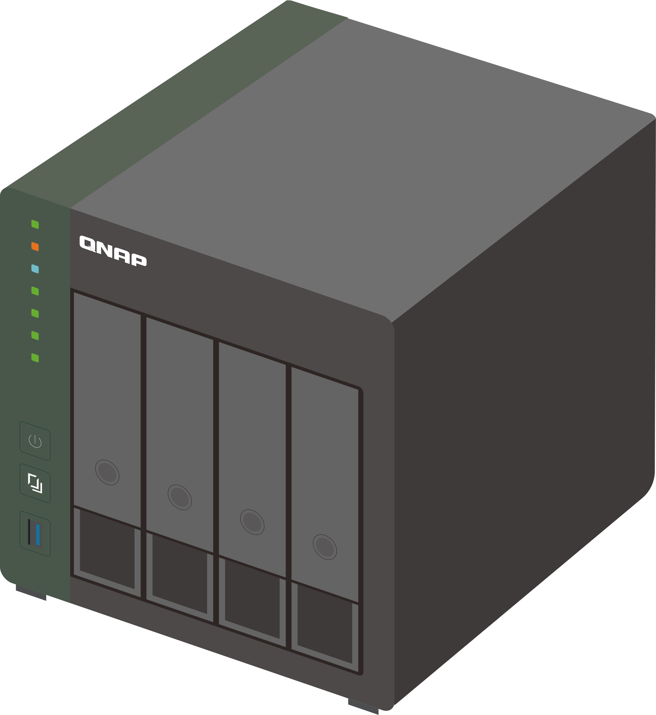
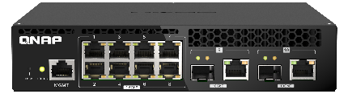
Ultra-high bandwidth required for enterprise backbone networks (500~1,000 staff)
100GbE
2.5GbE
10GbE PC
25GbE
2.5GbE PoE
10GbE
Internet
QSW-M5216-1T
QSW-M7308R-4X
QSW-M3216R-8S8T
2.5Gb ETH WiFi6 AP
QSW-M2116P-2T2S
QSW-M5216-1T
2.5GbE Devices
QSW-M2108R-2C
100GbE NAS +
100GbE card
100GbE Server
Notes:
The QSW-M7308R-4X 100GbE switch, boasting a remarkable 1200Gbps switching capacity, provides significant advantages for enterprise core networks. It meets the growing data demands, ensuring efficient and low-latency data transmission. Alongside the new 100GbE switch, the QNAP switch series includes 25GbE, 10GbE, and 2.5GbE options, suitable for diverse hierarchical setups. PoE versions are also available for direct connections to WiFi AP or IP cameras, reducing power cabling costs.
QSW-M7308R-4X 100GbE交換器以其高達1200Gbps的交換能力，為企業 Core 網路帶來顯著的優勢。可支援企業日益增長的數據需求，確保高效的數據傳輸和低延遲。 QNAP 交換器系列 除了新推出的 100GbE交換器外，包含了25GbE/10GbE/2.5GbE等不同網速適合各階層 Aggregation 或 Access 層的架設使用，也提供了PoE版本可直接連接 WIFI AP 或 IP cam，減少電源佈線的成本。

Slide 5
QSW-M7308R-4X Switch support FEC
QNAP's new QSW-M7308R-4X 100GbE network supports reliable and secure FEC (Forward Error Correction) function, which can provide greater error tolerance, improve network utilization, and improve the overall efficiency of enterprise networks
1
Improve transmission reliability
Enabled FEC of 100GbE switches can effectively reduce the error rate in data transmission and improve overall transmission reliability.
2
Reduce the number of retransmissions
With the FEC function, even if some errors occur, they can be corrected without retransmitting, saving valuable time and resources.
3
Improve network performance
FEC function can effectively reduce the transmission packet loss rate, improve the network's overall performance, and ensure fast and stable data transmission.
Notes:
Suppose deploying a 100GbE network switch in your office network. By utilizing servers or PCs to back up data to a NAS for storage, enabling FEC (Forward Error Correction) enhances the reliability of data transmission and network connections. This reduces the time on file retransmissions, improving efficiency. The newly launched 100GbE Switch QSW-M7308R-4X and the widely available 25GbE Switch QSW-M5216-1T both support this reliable FEC feature.
假設您架設 100GbE 網路交換器於辦公室網路。透過 Server 或 PC 將資料備份至 NAS 存儲資料。於啟用 FEC 後可以提高資料傳輸和網路連接的可靠性，減少了重傳檔案時間的浪費，也加強了效率，新推出的 100GbE Switch QSW-M7308R-4X 與以量產的 25GbE Switch QSW-M5216-1T 也同樣支援此可靠的功能。

Slide 6
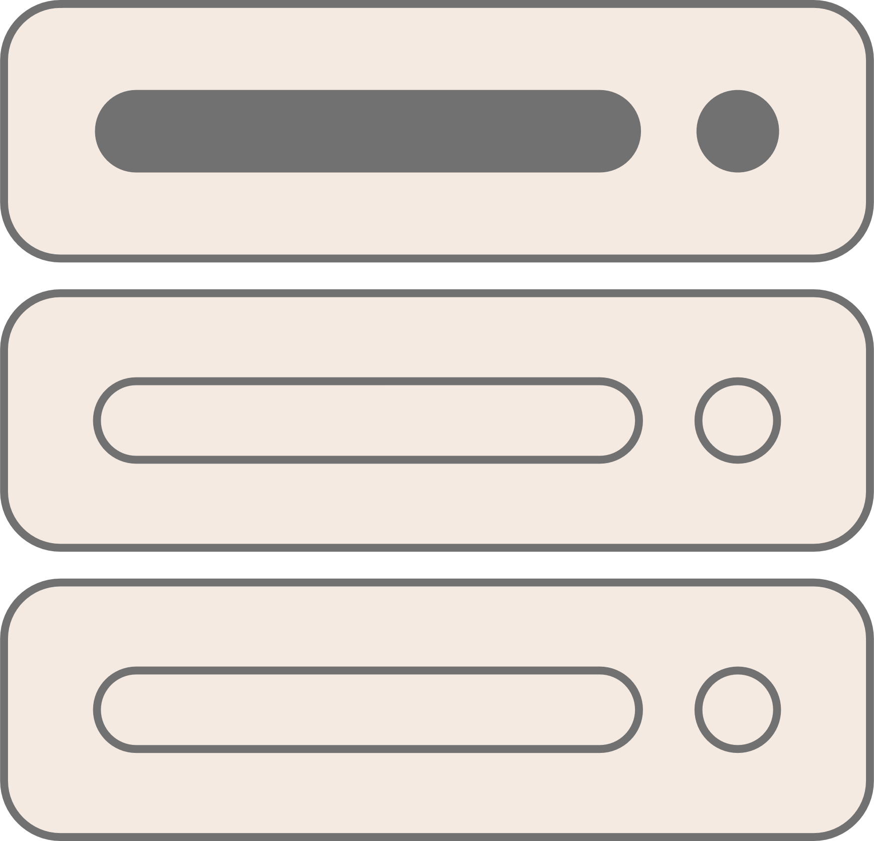
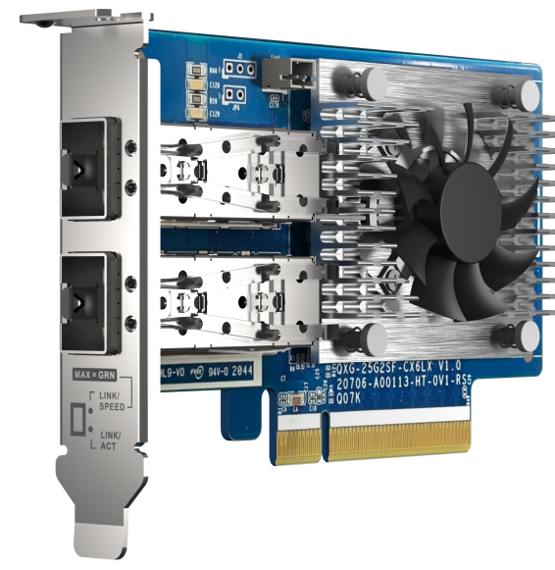
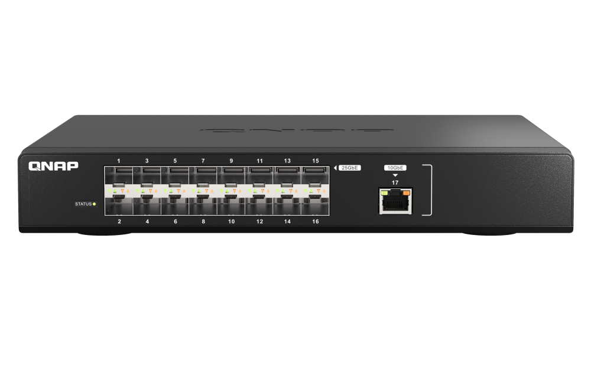
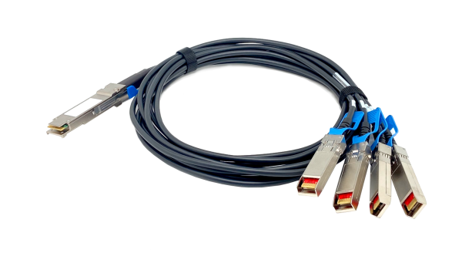
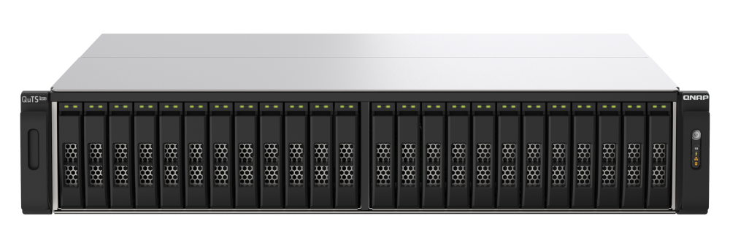
Configure 100GbE divided into four 25GbE
The QSW-M7308R-4X 100GbE high-speed network switch can be used with a high-speed network switch, in addition to directly connecting to the 100GbE port, it can also be connected to the 25GbE port on the switch through a four-part breakout cable, or connected to a 25GbE expansion card to connect more devices, and the network failover backup mechanism can be set by the switch side to ensure high reliability of uninterrupted network services. Expected 2024 H2 support
QSW-M7308R-4X
NAS or Server
With 25GbE card
( QXG-25G2SF-CX6 )
CAB-DAC15M-QSFP28-B4
QSW-M5216-1T
Build-in 25GbE QNAP NAS
Notes:
The QSW-M7308R-4X comes with 8 built-in 25GbE ports, allowing compatibility with QNAP's 25GbE network cards for NAS or server use. Additionally, it can be connected to more devices through the 16-port 25GbE switch QSW-M5216-1T. If more ports are needed, a software upgrade in the second half of 2024 will enable the QSW-M7308R-4X to support 100GbE with a 1-to-4 breakout, utilizing LACP for fault tolerance to enhance bandwidth and ensure connection reliability. This switch can transform into a 25-port 25GbE switch.
QSW-M7308R-4X 內建 8 個 25GbE 網路孔 可搭配 QNAP 的 25GbE 網卡安裝於NAS或server使用，也可透過 16-port 25GbE switch QSW-M5216-1T 連接更多的設備，若仍需要擴充更多的 port，QSW-M7308R-4X 將可於2024下半年度進行軟體升級，支援 100GbE 1 對 4 個 25GbE 的分線，搭配 LACP 的容錯功能提升頻寬並保障連線的可靠度，此 Switch 可變身為 25 port 25GbE 交換器。

Slide 7
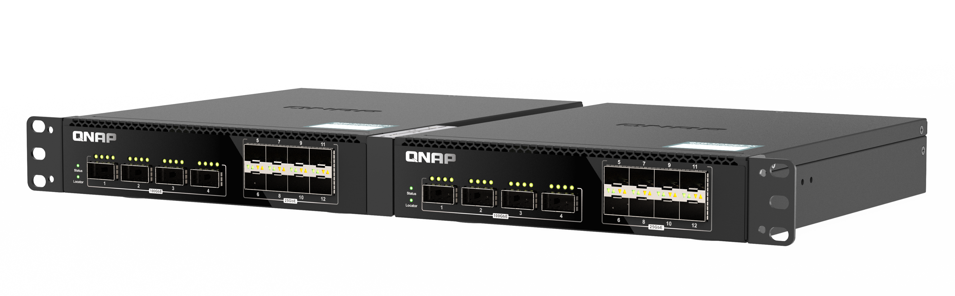
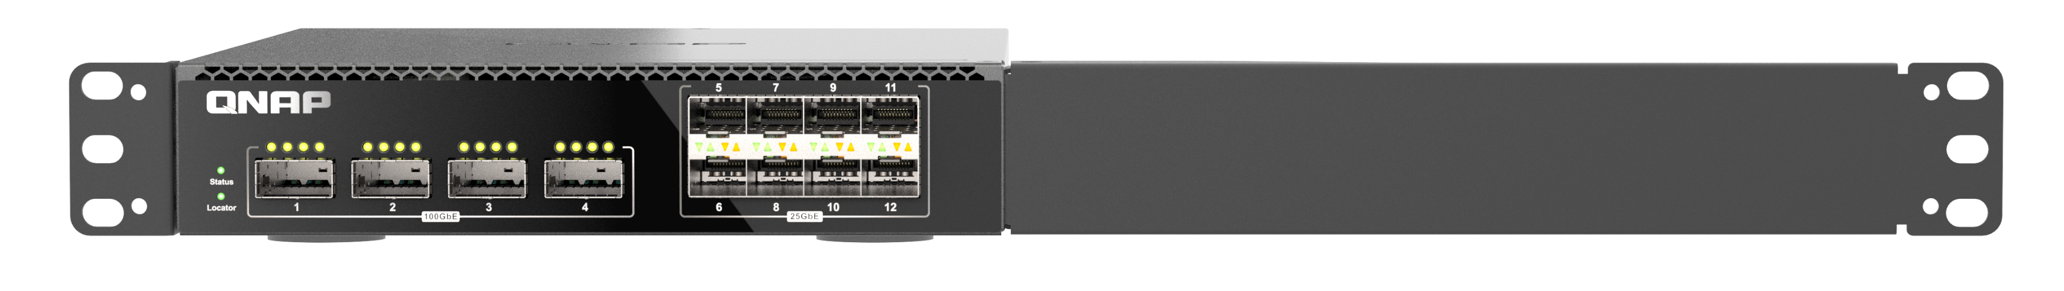
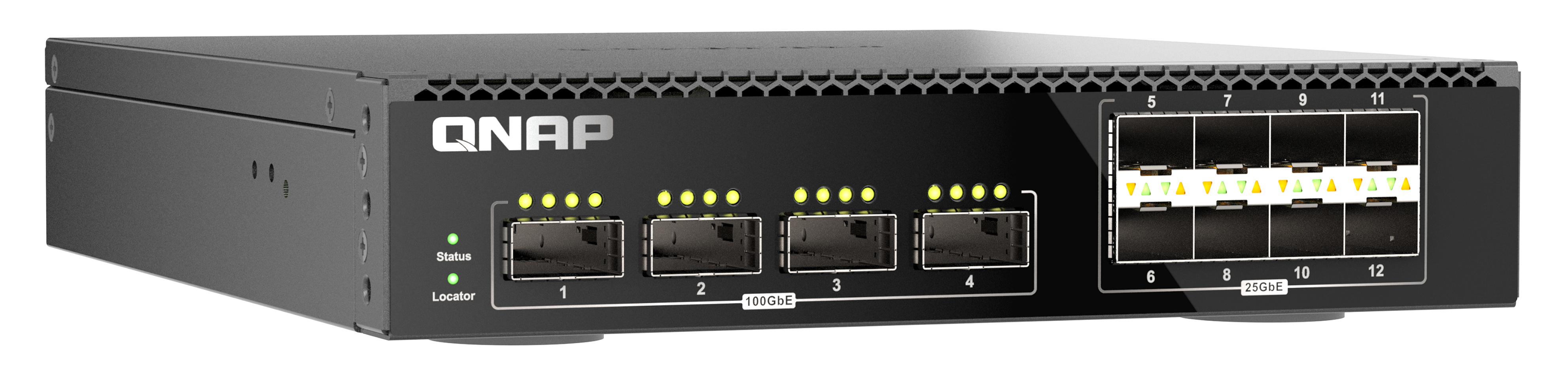
QSW-M7308R-4X Half-Width /
Single unit / Desktop flexible configuration
The QSW-M7308R-4X adopts a half-rack width design, allowing enterprises to accommodate two half-width switches in a 1U space according to their needs. It can be flexibly purchased and expanded as enterprises grow. It can also be attached to the foot mat with the packaging connotation and placed on the tabletop, which is space-saving
Half-width rackmount flexible configuration
With the exclusive rack kit SP-EAR-QSW2FOR1-01, you can install two half-width rack-type switches
Rackmount single unit
The QSW-M7308R-4X can be installed in a 1U cabinet with the bracket included in the package
Desktop configuration
Attach the foot pad of the QSW-M7308R-4X package to easily place it in the office or any where.
Notes:
This switch offers three installation options: place it in any office corner with the included footpads, mount it on a server rack using the provided brackets, or use a dedicated rack kit for efficient 1U space utilization with any QNAP half-width rack-type switch.
這台交換器有三種架設方式，由下至上，第一種是只要將 QSW-M7308R-4X裝上包裝內附的腳墊即可擺放於辦公室的任何角落，第二種是安裝包裝內的 bracket 即可安裝於機櫃上，架設於機房完全沒問題，第三種是可以選購專用的機架套件，即可安裝 QNAP 任意一款 半寬機架型的 Switch，可充分利用 1U 的空間。

Slide 8

QSW-M7308R-4X supports LACP, creating a total bandwidth of nearly 200 Gbps for you.
1 x 100GbE iPerf
Network speed test
2 x 100GbE RDMA Performance testing
23,367 MB/s
23,380 MB/s
11,905 MB/s
11,894 MB/s
Test environment:
NAS | TS-h2490FU-7232P-64GB with QXG-100G2SF-E810
NIC: QXG-100G2SF-E810, MTU 9000
SWITCH | QSW-M7308-4X
客户端 PC | OS: Ubuntu 20.04 , CPU: Xeon Scalable ,RAM: 64GB
Notes:
This page showcases 100GbE performance. Through iPerf testing on the left, a single port achieves almost 12GB/s. On the right, using LACP to connect two sets of network lines achieves a speed of 23.3 GB/s, fully showcasing the potential of 100GbE.
此頁我們可以看到 100GbE 的效能，左邊是透過 iPerf 進行測試，連接 1 port 可達到 將近 12GB/s 的速度，右邊的圖透過 LACP 連接兩組網路線則達到了 23.3 GB/s ，將 100GbE 的網速規格發揮的淋漓盡致。

Slide 9




With the QXG-100G2SF-CX6 enjoy 200GbE total bandwidth for 4K video editing across teams
Connect the QSW-M7308R-4X's two 100GbE LAN ports to the QNAP All-Flash NAS and seamlessly link with the QXG-100G2SF-CX6 expansion card to achieve a total bandwidth of 200GbE. This streamlined connectivity facilitates smooth collaboration across teams in our information-intensive world.
25GbE
100GbE
Editorial team
100GbE
QXG-100G2SF-CX6
100G Switch
25GbE
100G / 25G Switch
100GbE
Share with other teams
All-Flash NAS
25GbE
10GbE
Notes:
For extensive 4K/8K video editing needs, the QXG-100G2SF-CX6 provides a seamless experience with a bandwidth of 200G. This facilitates smooth collaboration across teams, allowing video editing teams to edit and transfer high-quality 4K/8K videos over the shared 200GbE network bandwidth. The content can be quickly uploaded to an All-flash NAS and synchronized for sharing with other teams.
而面對大量的 4K/8K影音編輯需求，透過 QXG-100G2SF-CX6 ，可以暢享 200G 總頻寬，跨團隊合作也能暢行無阻，可讓影音編輯團隊透過共 200 GbE 的網路頻寬來編輯和傳輸高畫質的 4K/8K影音，並快速上傳至 All-flash NAS，再同步分享給其他團隊，

Slide 10
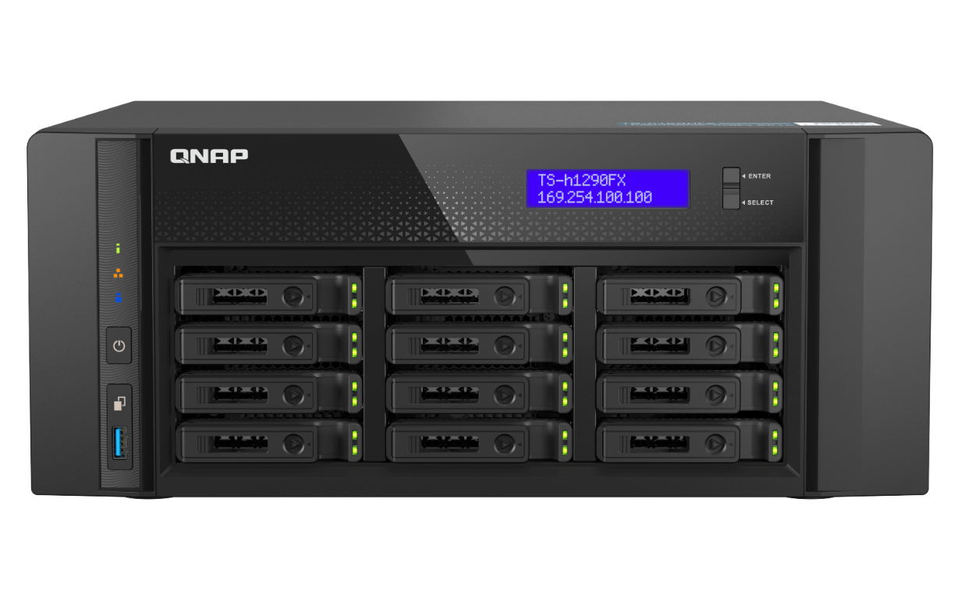
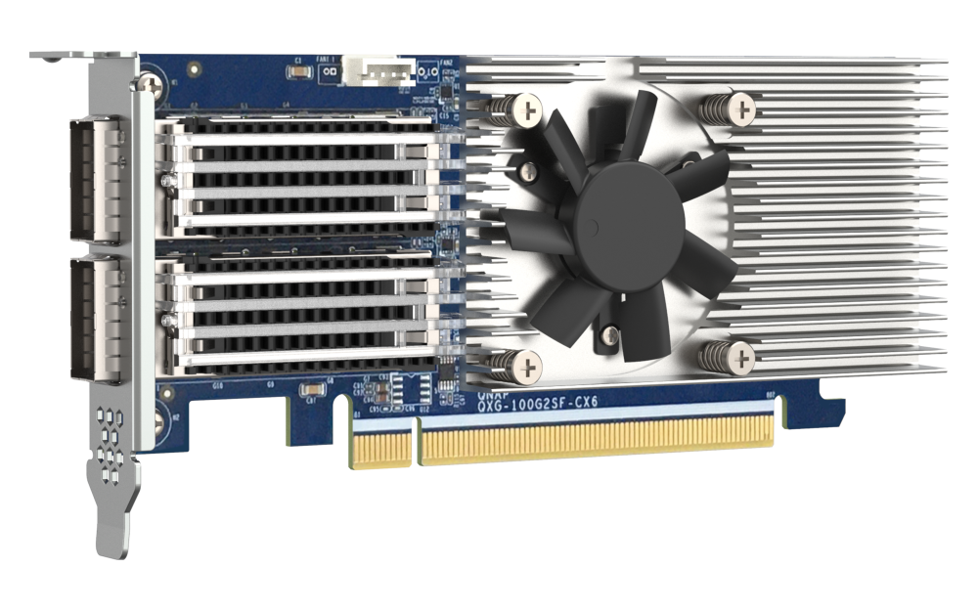

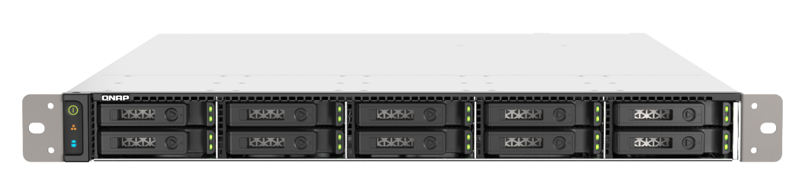
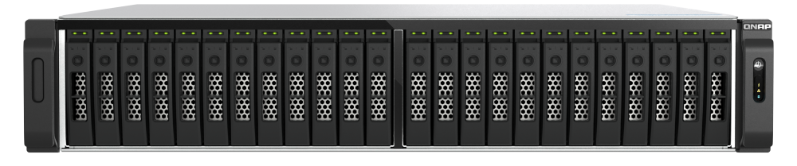


QSW-M7308R-4X 100GbE Advice with QNAP All-Flash Solution
TS-h2490FU
TS-h1290FX
QXG-100G2SF-CX6
TS-h3077AFU
TS-h1090FU
TDS-h2489FU
QSW-M7308R-4X
Notes:
The QSW-M7308R-4X supports QNAP's full range of All-flash NAS models, including the TS-h2490FU, TS-h1090FU, TDS-h2489FU, TS-1290FX, and the newly released TS-h3077AFU.
QSW-M7308R-4X 支援 QNAP 全快閃系列的NAS機種，其中有 TS-h2490FU、TS-h1090FU、TDS-h2489FU、TS-1290FX，以及新推出的 TS-h3077AFU，

Slide 11
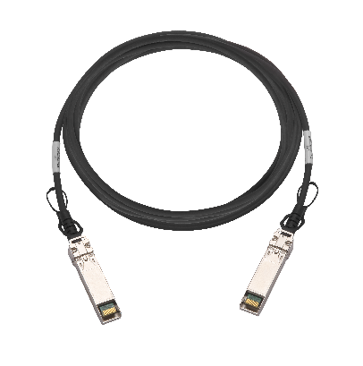
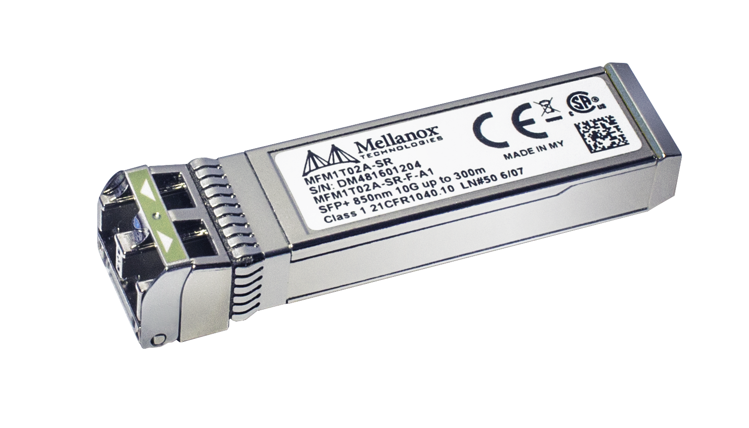
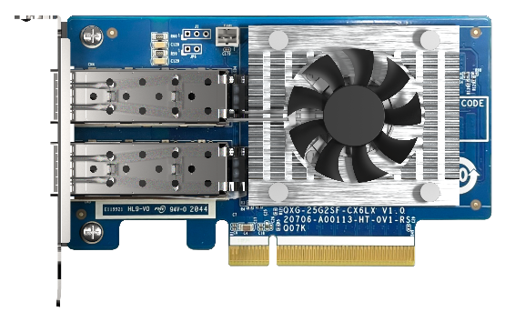
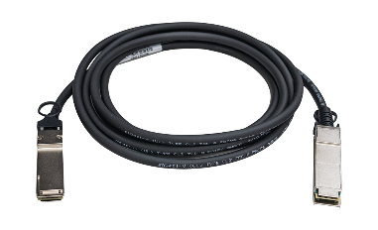
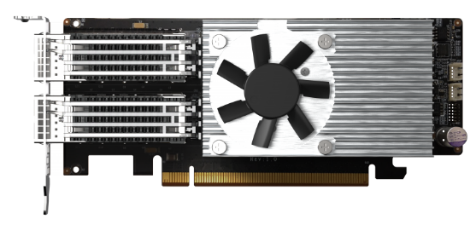

25GbE / 100GbE optional accessories
25GbE SFP28 DAC
CAB-DAC30M-SFP28
CAB-DAC15M-SFP28
100GbE SR Transceiver
QXG-25G2SF-CX6
Check the compatibility list
100GbE QSFP28 DAC
25GbE SR Transceiver
QXG-100G2SF-E810
CAB-DAC15M-Q28
QXG-100G2SF-CX6
TRX-25GSFP28-SR
Notes:
This page features accessories for the QSW-M7308R-4X, including 100GbE and 25GbE network cards, and DAC cables. Users interested in connecting through transceivers can also refer to the above-mentioned models for purchasing options.
此頁是 QSW-M7308R-4X 相關選購配件，包含 100GbE 與 25GbE 的網卡 以及DAC連接線，對於想透過 Transceiver 來連接的使用者也可參考上述的型號進行選購

Slide 12
Compatible with DAC and Transceiver
Transceivers :
1. Finisar FTLC9558REPM QSFP28 100G光纖模組
2. Finisar FTLC1156RDPL-1Y QSFP28, 10km,100G-LR4
3.10Gtek AMQ28-SR4-M1
4.Opstran QSFP28 LR4 for Dell 407-BCDH
5.Invaxon QSFP28 LR4 for Cisco QSFP-100G-LR-S
6.Fiber QSFP28 SR4 for Dell Q28-100G-SR4
DAC Cable :
1. 100G QSFP28 DAC Cable - 100GBASE-CR4 QSFP28 to QSFP28 Passive Direct Attach Copper Twinax Cable for Cisco QSFP-100G-CU3M
2. Mellanox Passive Copper Cable, ETH 100GbE, 100Gb/s, QSFP28, 1m, Black, 30AWG, CA-N
3. Mellanox MCP2M00-A005 Compatible 5M 25GBase SFP28 to SFP28 Passive Direct Attach Copper Twinax Cable, 25 Gb Ethernet
4. Cisco SFP-H25G-CU5M Compatible 25G SFP28 Copper Cable (5-meter, AWG24, passive)
5. 25G SFP28 SFP+ DAC Cable - 25GBASE-CR SFP28 to SFP28 Passive Direct Attach Copper Twinax Cable for Dell Force10, 5-Meter(16.5ft)
6. CYSKY 25G SFP28+ DAC Cable, 3-Meter (9.84ft) Passive Direct Attach Copper Twinax Cable for Cisco, Ubiquiti, D-Link, Netgear, Mikrotik, Open Switch Devices
Notes:
This page continues the list of cables and transceivers mentioned above, providing options for reference and purchase.
此頁是延續上述的 cable 與 Transcevier 清單，可參考選購

Slide 13
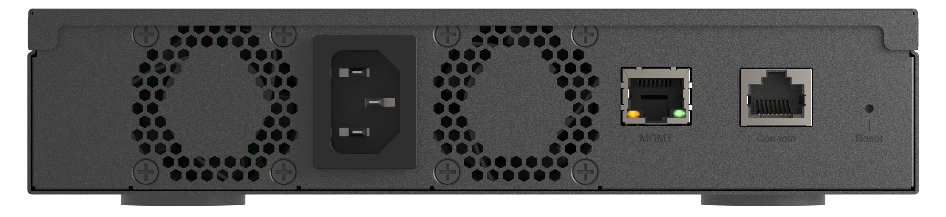
QSW-M7308R-4X Exterior I/O
4 x 100G QSFP28
Status
8 x 25G SFP28
Locator
Management Port
AC Input
Console Port
Smart Cooling FAN
Reset
Dimension (HxWxD)
43.3 x 207 x 248.8 mm
1.7 x 8.15 x 9.8 inch
Management Port: Through OOB for secure access (must enable in QSS)
Console Port: Managed by CLI commands
Notes:
The front panel of the QSW-M7308R-4X features status and locator indicator lights, 4 ports of 100GbE, and 8 ports of 25GbE. The rear panel includes two fans, a power interface, and a management port, which requires enabling OOB in QSS for use. Additionally, there is a console port accessible through CLI commands.
QSW-M7308R-4X 正面包含狀態與Locator指示燈, 4個100GbE網路port, 以及 8個25GbE網路port，後方有兩個風扇，電源接口，以及Management Port，需再QSS中開啟OOB才能使用，另外一個是可透過CLI command的 console port

Slide 14
QSW-M7308R-4X Specification
100GbE LAN port | 4 x QSFP28
25GbE LAN port | 8 x SFP28
1GbE network management port | 1
Console port | 1
Indicators | Status, Positioning
Switching Capability | 1200 Gbps
MAC address table | 32k
Support standards | IEEE 802.3 Ethernet IEEE 802.3u 100BASE-T IEEE 802.3ab 1000BASE-T IEEE 802.3z 1000BASE-SX/LX IEEE 802.3ae 10G Fiber IEEE 802.3by 25 Gigabit Ethernet IEEE 802.3bj 100 Gigabit Ethernet IEEE 802.3bm 100G Fiber IEEE 802.3x Full-Duplex Flow Control IEEE 802.1Q VLAN Tagging IEEE 802.1w RSTP IEEE 802.3ad LACP IEEE 802.1AB LLDP IEEE 802.1p Class of Service Forward Error Correction(FEC)
Notes:
The table provides specifications for the QSW-M7308R-4X. In addition to the features mentioned earlier, this switch has a total network switching capacity of 1200 Gbps. It supports various IEEE standards and includes support for FEC (Forward Error Correction).
此表為QSW-M7308R-4X規格介紹，除了前頁介紹的部分，此交換器擁有總共 1200 Gbps 的網路交換能力，並支援多種IEEE標準，並支援FEC

Slide 15
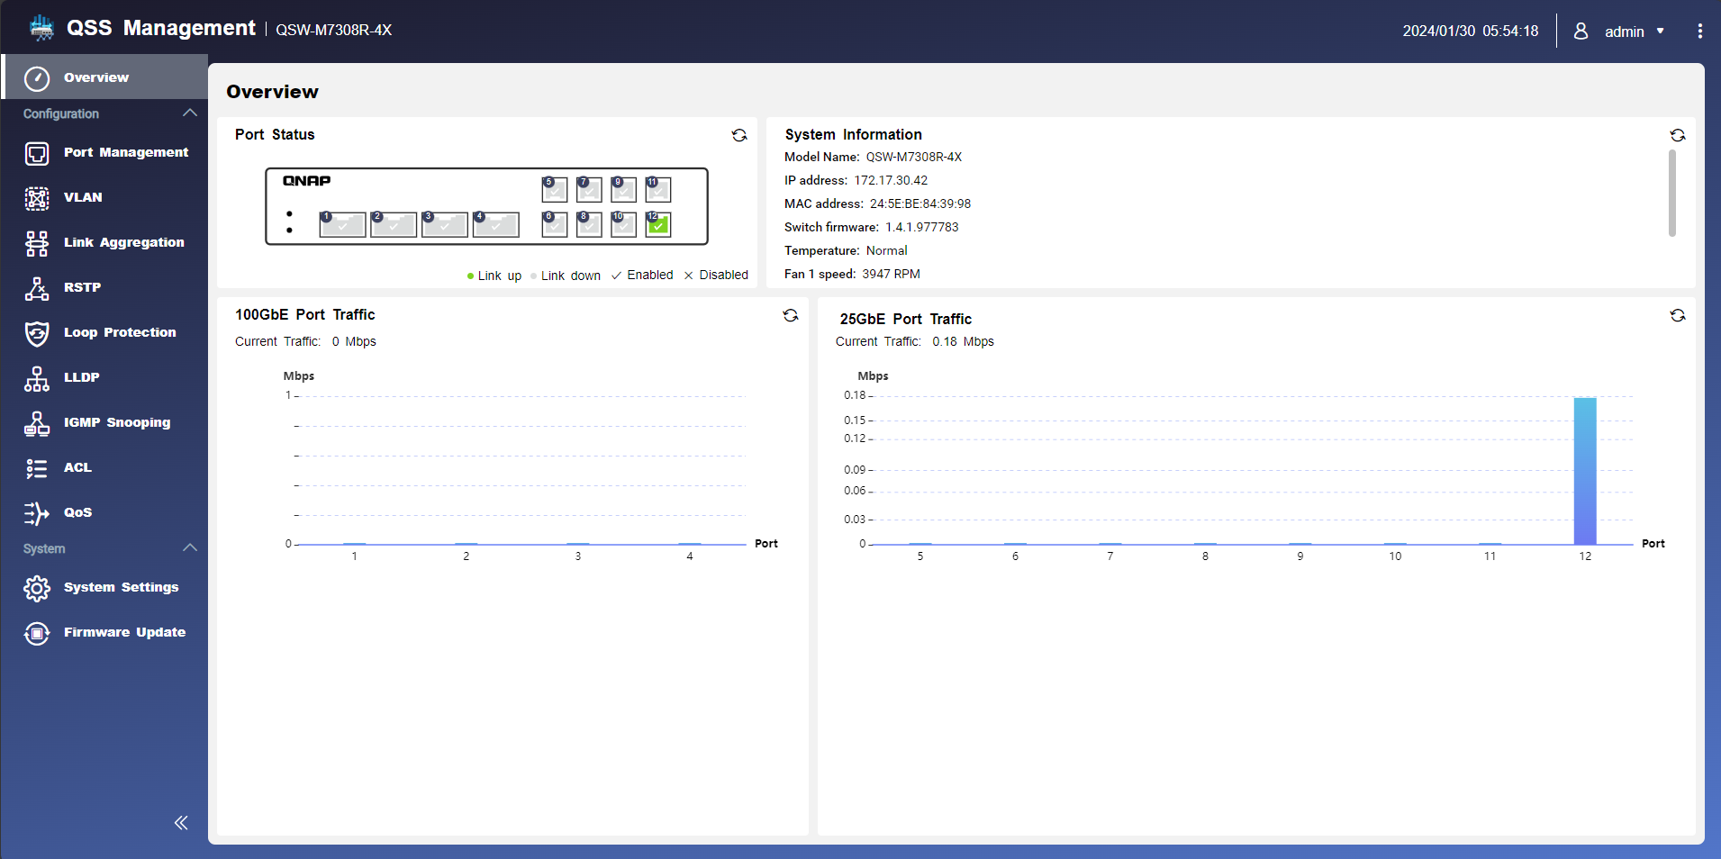
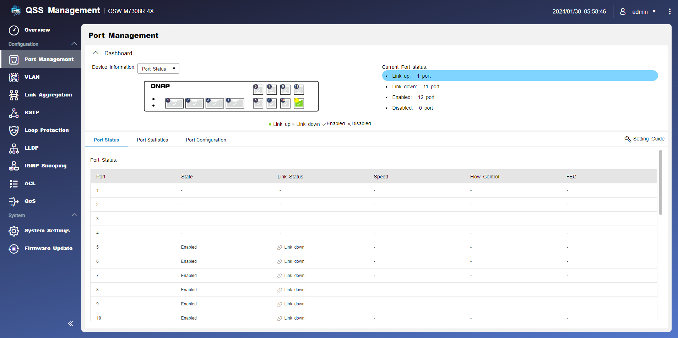
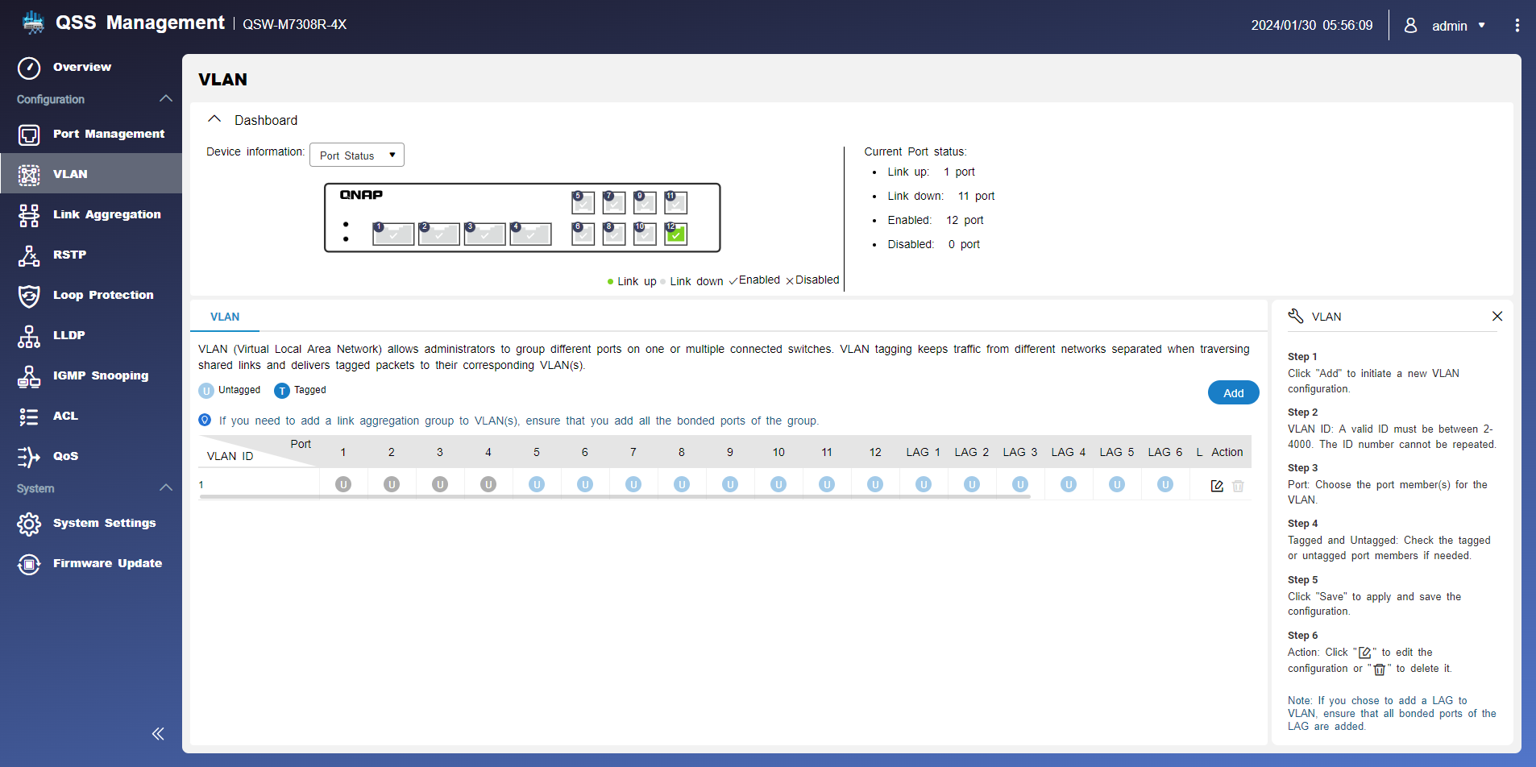
Simple and straightforward interface design
Concise and visual
Guide users through configuration
Notes:
For user convenience, accessing the QSS system can be done through Qfinder Pro. The interface is designed to be simple and clear, with functional options on the left side. Users can easily configure settings by following the instructions and guidance provided.
使用上我們可以透過 Qfinder pro 登入QSS系統，映入眼簾的便是簡單且明瞭的介面設計，功能選項至於左手邊，使用時僅須按照說明與引導其可輕鬆的設定

Slide 16

Clearly divide the individual networks within the studio
Virtual Area Networks (VLANs) can be used to explicitly separate different departmental networks
It is easy to manage, and different networks can be connected conditionally
It is also possible to separate the network of employees and guests
Notes:
A managed switch enables IT to enhance network security, traffic management, and resource allocation efficiency through VLAN segmentation. This approach streamlines troubleshooting and allows for flexible responses to diverse network requirements across departments or purposes.
透過管理型Switch進行VLAN劃分，IT人員可有效提高網路安全性、流量管理及資源分配效率，降低故障排除時間。同時，透過VLAN的配置，IT人員能更靈活地應對不同部門或用途的網路需求，提供更精緻的網路服務與管理。

Slide 17

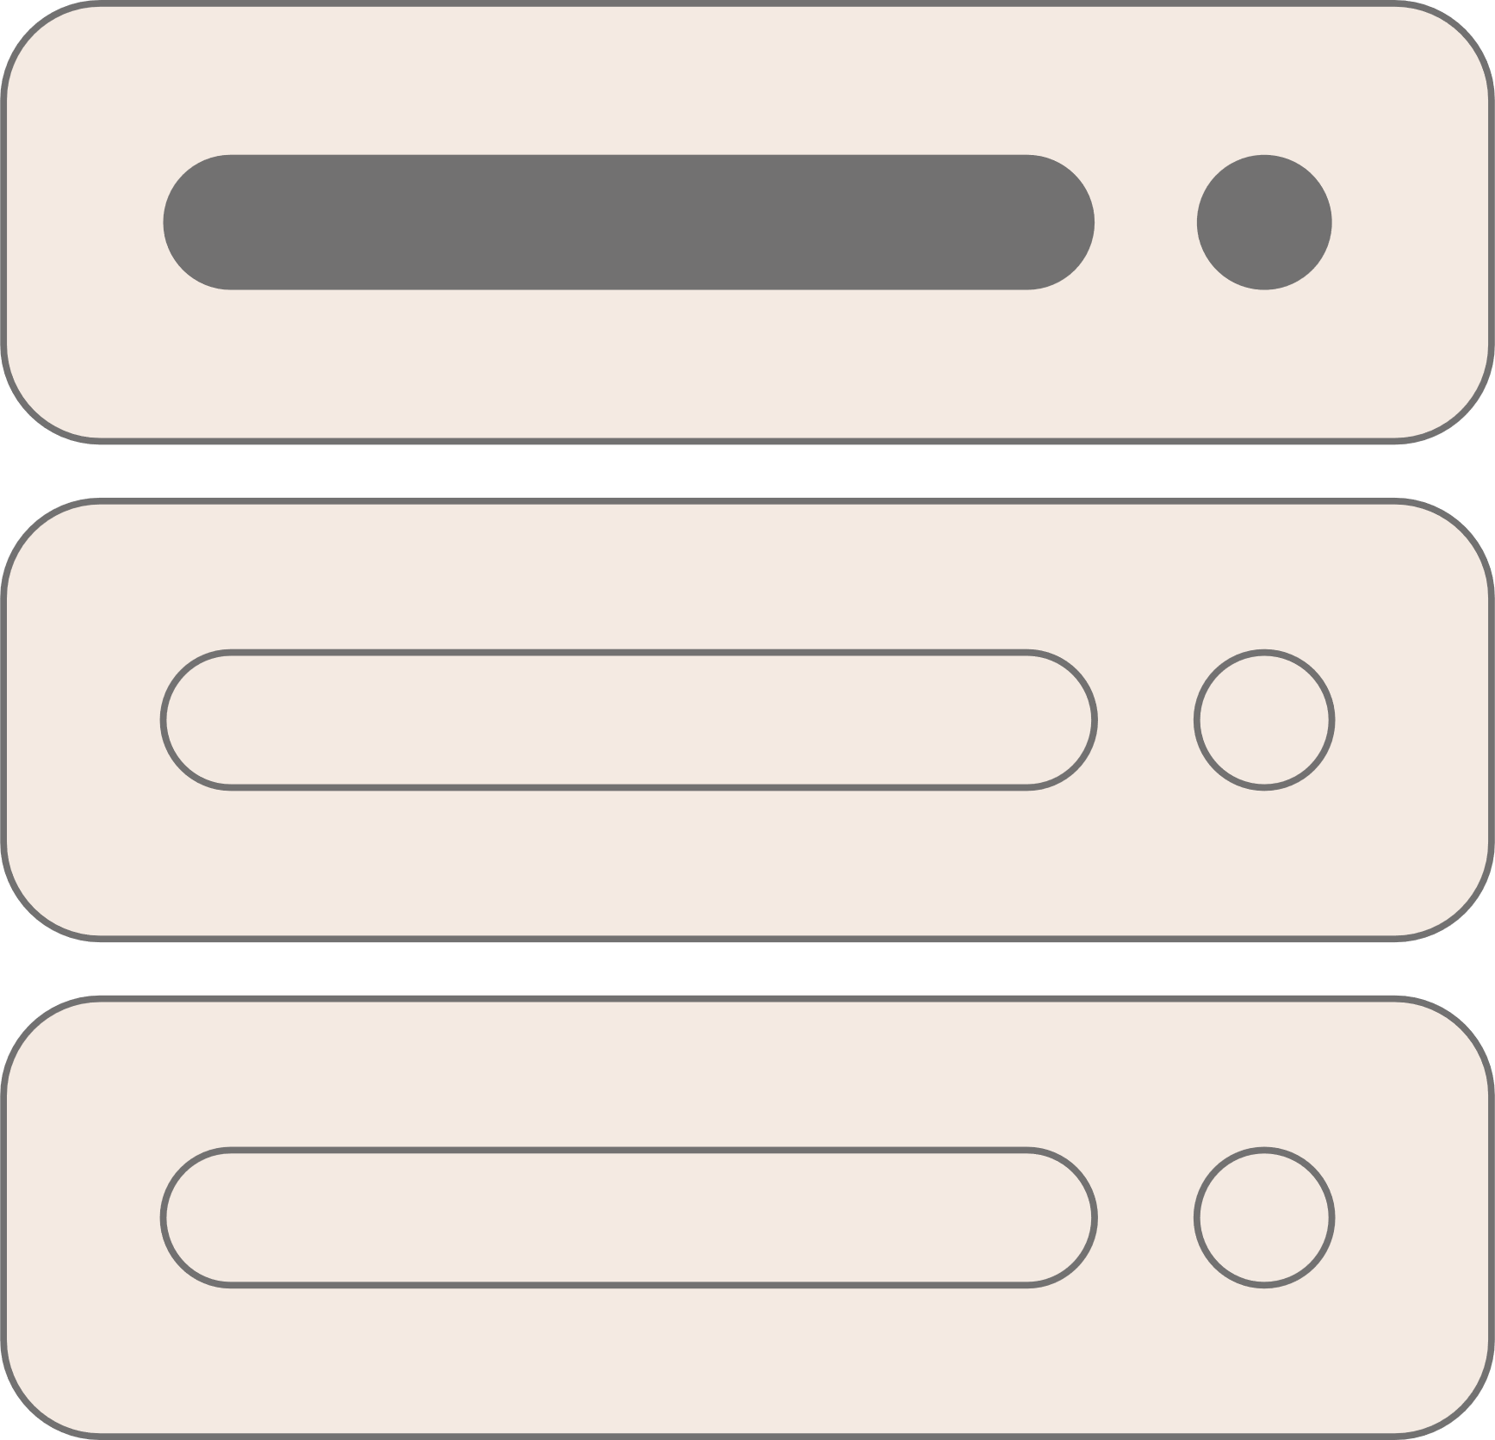
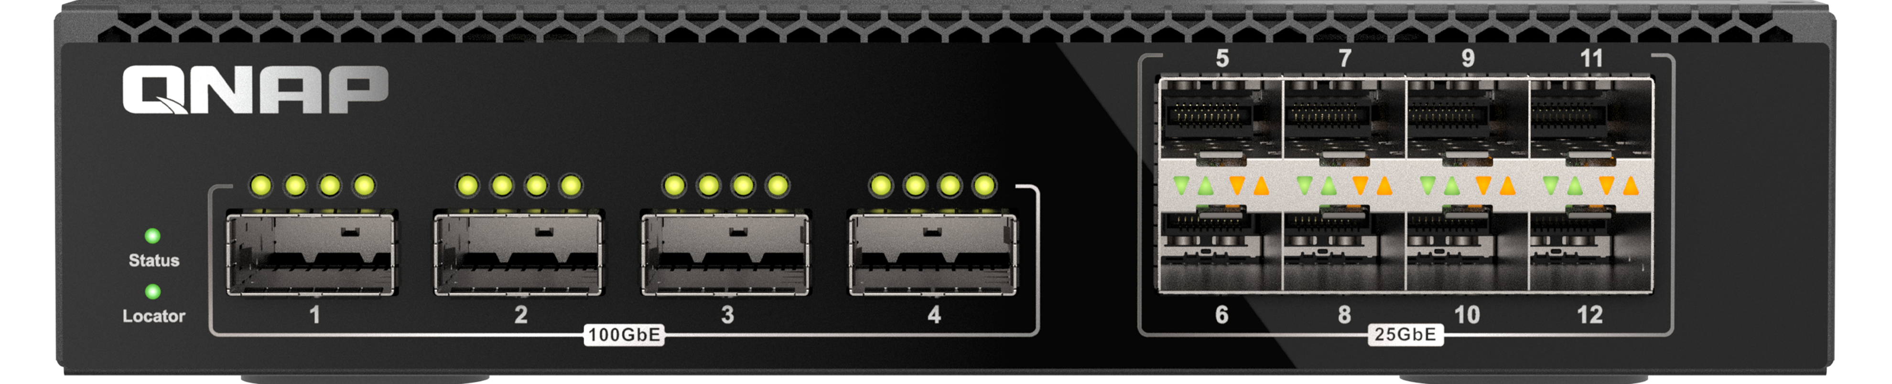
LACP connection is performed through two QSW-M7308R-4Xs
Server
In addition to the original network redundancy and double bandwidth, using two QSW-M7308R-4X units for LACP connection has the following advantages
Scalability : More network ports can be used to connect more devices and share ultra-high-speed network resources
Management : Additional network segments can be divided to facilitate IT management, isolate sensitive or high-traffic areas to prevent congestion, and improve security
Failover capabilities : Since there are two switches in the network, if switch A fails, the users connected to switch B will not be affected, and the service will not be completely interrupted
2 x QSW-M7308R 4X
NAS
Notes:
Dual QSW-M7308R-4X switches with LACP connections provide redundancy, doubled bandwidth, and scalability. Segmenting management enhances IT efficiency and security, isolating traffic. Fault tolerance ensures continuous service even if one switch fails. These advantages collectively boost network performance, security, and ensure smooth operation and management.
透過雙 QSW-M7308R-4X 的 LACP 連線，不僅可實現備援及雙倍頻寬，更具擴展性，透過多埠連接各種設備，實現超高速共享。同時，分段管理提升IT效能，劃分區段有助於隔離流量、提高安全性。容錯功能保障連續服務，當一交換器故障時，另一交換器仍保持連通，用戶無中斷。整合上述優勢，提升網路效能、安全性，確保順暢運作及管理。

Slide 18

Accurately distribute audio and video streams to devices
IGMP snooping All stream assignments can be accurately recorded
Avoid transmission errors or packet loss that cause audio or video interruptions or degradation of quality.
Notes:
In an enterprise network with 8 devices, if 4 are streaming the same video without IGMP Snooping, all multicast traffic is sent to every device, causing bandwidth waste and increased latency. With IGMP Snooping, the switch detects only 4 devices in the multicast group, directing multicast traffic solely to them. This improves bandwidth use, reduces latency, and enhances video streaming quality.
假設一個企業網路中有 8 台設備，其中 4 台設備正在觀看同一個影音串流。如果沒有使用 IGMP Snooping，那麼所有的多播流量都會傳送到所有的設備，即使是沒有加入多播群組的設備也會收到。這會造成頻寬浪費和延遲增加。如果使用 IGMP Snooping，交換器會偵測到只有 4 台設備加入了多播群組，因此只會將多播流量傳送到這 4 台設備。這樣就可以提升頻寬利用率、降低延遲，並改善影音串流的品質。

Slide 19

Optimize network transmission paths at any time
RSTP, Rapid Spanning Tree Protocol) Monitor and optimize network transmission paths at any time
No matter how complex the network architecture is, files will always be transferred with the fastest path
Notes:
In a corporate network, multiple switches on the same segment may cause loops without RSTP or STP. These loops result in continuous traffic circulation, degrading network performance or causing complete failure. Implementing RSTP prevents such loops by determining connection paths based on switch priority and traffic cost, and designating active and backup paths for efficient network traffic transmission.
在一個企業網路中，有多台交換器連接到同一個網段。若沒有使用 RSTP 或 STP，則可能會出現 loop。當發生 loop 時，網路流量會在環路中不斷循環，導致網路性能下降甚至癱瘓。
通過使用 RSTP，可以防止網路中出現 loop。RSTP 會根據交換機的 優先級 和 網路流量成本來決定連結路徑。生成樹會指定哪些鏈路是活動路徑，哪些鏈路是備用路徑。只有活動鏈路才會傳輸網路流量，從而防止網路中出現環路。

Slide 20
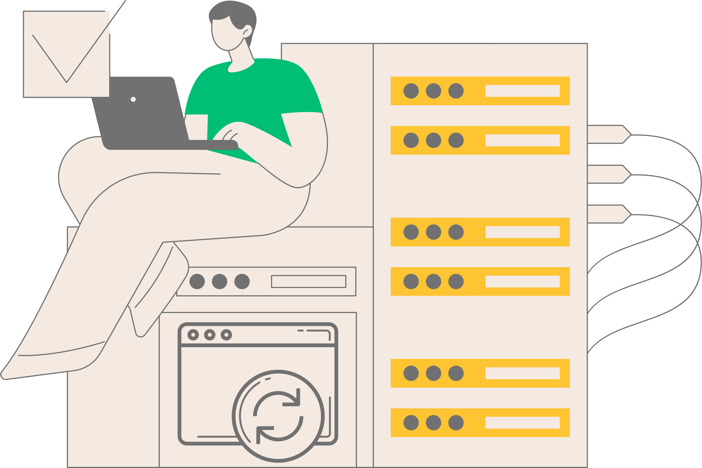
Switch Firmware Version Checking and Automatic Updates
One-click automatic updates
Automatically detects whether there is a new firmware
Manual update
Notes:
The QSS system in QNAP managed switches comes with standard software version checking, allowing users to update the firmware with a single click. It also automatically detects whether new firmware is available, helping users maintain the optimal status of the switch.
QNAP管理型交換器中的QSS系統，標配了軟體版本檢查，可一鍵更新任體，也可自動偵測有無新的韌體讓使用者維持交換器的最佳狀態。

Slide 21

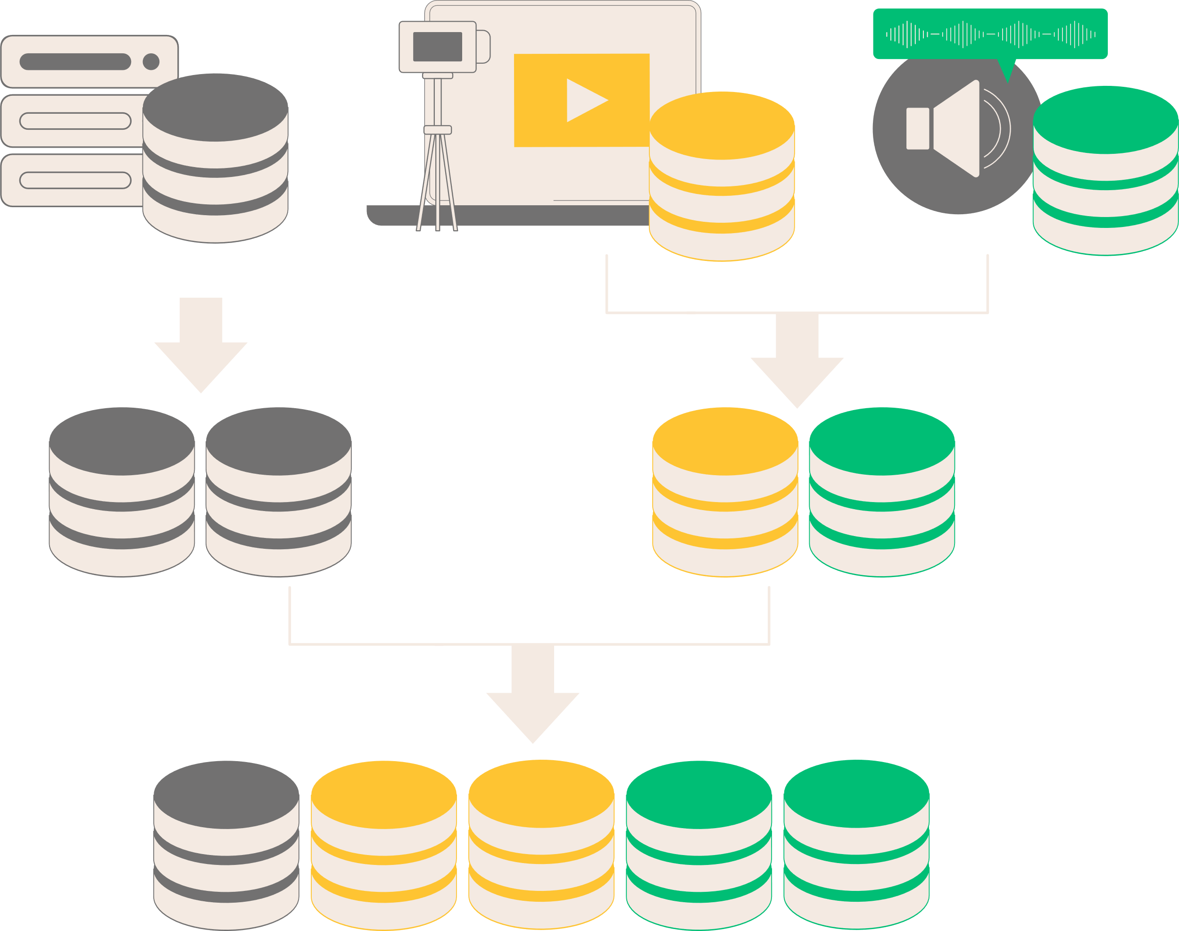

The QSW-M7308R-4X supports IEEE 802.3x, LLDP, QoS etc
Through flow control (IEEE 802.3x) Monitor network congestion to avoid packet drops
Link Layer Discovery Protocol (LLDP), Let managers see at a glance which devices are connected to the switch
Quality of service (QoS) Different network devices and packets can be classified and prioritized to improve the distribution of network traffic.
Notes:
In addition to the mentioned management functions, the network switch includes IEEE 802.3x flow control to prevent buffer overflow, LLDP for device information exchange, and QoS for prioritized traffic handling—enhancing overall network management efficiency.
除了先前介紹到網路交換器管理功能外，也包含了 IEEE 802.3x flow control 可防止接收端緩衝區溢位，確保網路流量的順暢傳輸 ; LLDP 可讓網路設備相互交換資訊，簡化網路管理 及 QoS 可根據流量優先級對流量進行分類和處理，這些一併提高網路管理效率的功能。

Slide 22
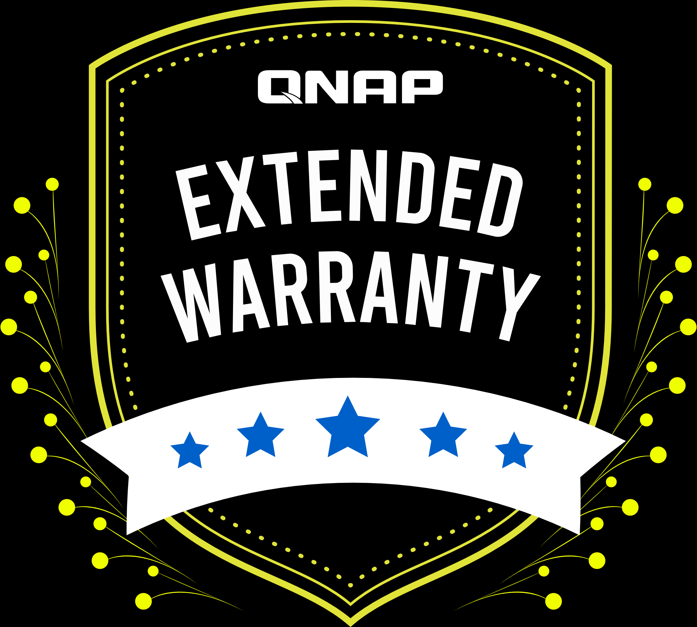
Extended warranty,
Up to 5 years of coverage
The QSW-M7308R-4X includes a complimentary 2-year product warranty. For extended coverage, consider the QNAP Extended Warranty Plan, offering up to 5 years of product warranty and additional value.
Extended warranty purchase P/N
LW-SWITCH-YELLOW-3Y (Physical)
LW-SWITCH-YELLOW-3Y-EI (Electronic)
Notes:
In closing, don't forget that QNAP offers extended warranties for Switch products. The QSW-M7308R comes with a free 2-year warranty, and for those seeking extra coverage, explore our cost-effective plans, offering up to 5 years of protection.
簡報的尾聲要提醒你QNAP有推出NAS的延長保固，QSW-M7308R 購買即享有 2 年的免費產品保固。客戶若有延長保固的需求可考慮選購延長保固最高5年的超值方案。

Slide 23
Copyright© 2024 QNAP Systems, Inc. All rights reserved. QNAP® and other names of QNAP Products are proprietary marks or registered trademarks of QNAP Systems, Inc. Other products and company names mentioned herein are trademarks of their respective holders.​​​​​​​
Notes:
Thank you for watching today's new product presentation. I'm QNAP Jerry. Until next time, goodbye!
謝謝收看今天的新產品介紹，我是 QNAP Jerry 下次見

