Slide 1
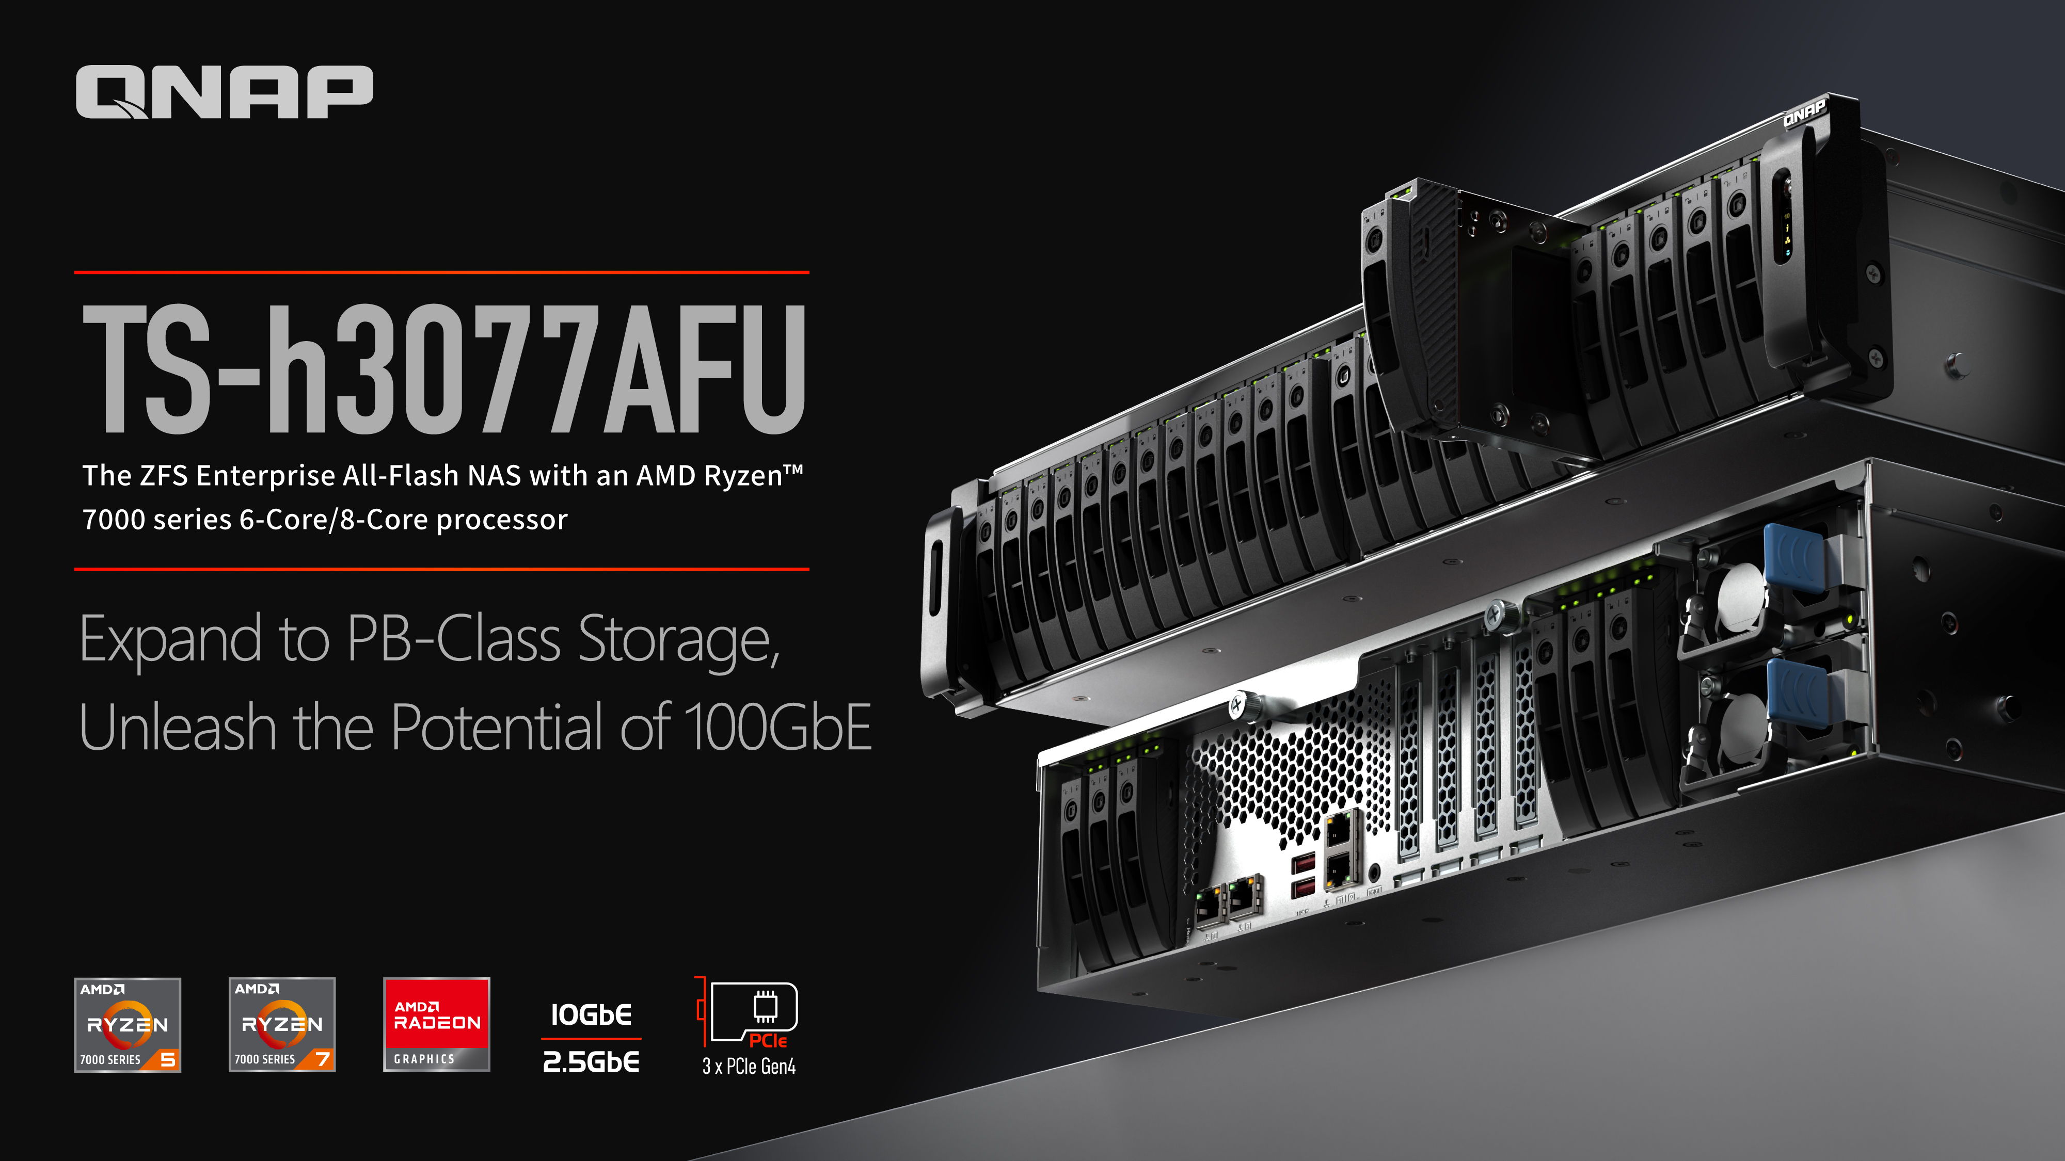
Notes:
Hey everyone,
Welcome to QNAP channel, I'm QNAP product manager, Alex Shih.
In today's presentation, we're unveiling the latest addition to our lineup: the TS-h3077AFU - The ZFS enterprise All-Flash NAS, powered by an AMD Ryzen 7000 series processor.
This powerhouse isn't just about storage; it's about unleashing the full potential of your data with PB-class storage expansion and the lightning-fast speeds of 100GbE connectivity.
So buckle up, because we're about to dive into the future of storage solutions.
Now, let's explore how the TS-h3077AFU can revolutionize your data management strategies.

Slide 2

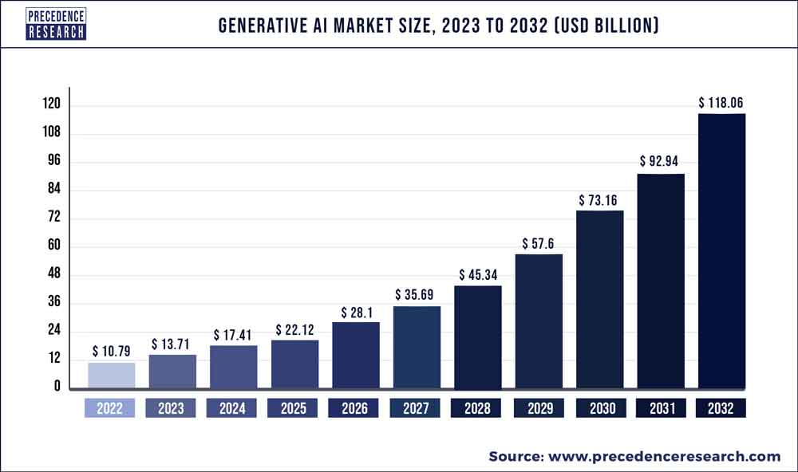
Unleashing the Power of AI: Why All-Flash Arrays are Essential ?
Research Institution Data: The global generative AI market is expected to experience approximately 19% annual growth.
Speed and Low Latency: All-flash arrays offer significantly faster data access and lower latency compared to traditional storage solutions, ensuring quick retrieval and processing of AI workloads.
Optimized for Random Access Patterns:AI algorithms often exhibit random access patterns rather than sequential.
Improved Reliability and Durability: Flash storage is inherently more reliable and durable than traditional disk-based storage. This is crucial for AI applications that demand continuous and reliable access to data.
Parallel Processing and Scalability: AI workloads often benefit from parallel processing. All-flash arrays support parallelism, enabling scalable performance for growing AI demands without compromising speed.
Notes:
At first, we delve into the realm of artificial intelligence, exploring why all-flash arrays stand as indispensable pillars in this dynamic landscape.
The global generative AI market is on a soaring trajectory, with an anticipated 19% annual growth rate. To keep pace with this exponential expansion, speed and low latency are paramount. All-flash arrays rise to the challenge, offering lightning-fast data access and minimizing latency, crucial for swiftly retrieving and processing AI workloads.
AI algorithms often defy the conventional flow, exhibiting random access patterns. Here's where all-flash arrays shine, optimized to effortlessly handle such irregularities, ensuring seamless operation.
Reliability and durability are non-negotiable in the AI realm. Unlike traditional disk-based storage, flash storage boasts inherent resilience, a vital attribute for AI applications demanding continuous and dependable data access.
Parallel processing is the heartbeat of AI operations. All-flash arrays embrace this need, facilitating parallelism and scalable performance, adeptly meeting the burgeoning demands of AI without sacrificing speed.
In conclusion, as we venture deeper into the AI revolution, all-flash arrays stand as not just tools, but indispensable enablers, unleashing the full potential of artificial intelligence.

Slide 3
The Next-Gen Ryzen Enterprise All-Flash NAS
2 x 10G BASE-T + 2 x 2.5G RJ45
3 x PCIe Gen 4 expansion slot
Designed for Enterprise Applications
Notes:
The Next-Gen Ryzen Enterprise All-Flash NAS.
Picture this: 2 x 10G BASE-T ports plus 2 x 2.5G RJ45 connectors, ensuring lightning-fast connectivity for your data needs. Not stopping there, we've got you covered with 3 x PCIe Gen 4 expansion slots, ready to scale as your business grows. In a nutshell, this beast is designed for Enterprise Applications. Get ready to unleash the power of next-gen technology.

Slide 4






TS-h3077AFU Takes Hardware Advancement to the Next Level
Ryzen™ 7 3700X
# of CPU Cores: 8
# of Threads: 16
Max. Boost Clock: 4.4GHz
Base Clock: 3.6GHz
Memory Support: DDR4
GPU: N/A
AMD Ryzen™ 7 7000 Series
# of CPU Cores：8
# of Threads：16
Max Boost Clocl: 5.3GHz
Base Clock: 3.8GHz
Memory Support: DDR5
GPU: AMD Radeon™ graphics iGPU
Ryzen™ 5 3600
# of CPU cores: 6
# of Threads: 12
Max. Boost Clock: 4.2GHz
Base Clock: 3.6GHz
Memory Support: DDR4
GPU: N/A
AMD Ryzen™ 5 7000 Series
# of CPU Cores: 6
# of Threads: 12
Max. Boost CLock: 5.1GHz
Base Clock: 3.8GHz
Memory Support: DDR5
GPU: AMD Radeon™ graphics iGPU
Notes:
In this page, we're stepping into the future with the TS-h3077AFU, taking hardware advancement to a whole new level.
Let's talk CPU power. In this corner, we have the new generation Ryzen 7 7000 series 8-core CPU.
With a max boost clock of 5.3GHz and a base clock of 3.8GHz, this bad boy is built to fly.
And it's not just about speed; it's about support too.
Say hello to DDR5 memory support and AMD Radeon™ graphics iGPU, taking your computing experience to new heights.
So, what's the takeaway? The TS-h3077AFU isn't just an upgrade; it's a leap forward.
With faster processing, enhanced memory support, and integrated graphics, it's the next-gen powerhouse you've been waiting for.

Slide 5




2U 30-bay
30-bay
Ryzen 5 7600 / Pro 7645,
32GB RAM (1 x 32GB)
30-bay
Ryzen 7 7700 / Pro 7745,
64GB RAM (2 x 32GB)
Notes:
Let's talk the 2 SKUs of TS-h3077AFU.
First up, we have the first SKU: the TS-h3077AFU-R5-32G. Under the hood, you'll find a Ryzen 5 7600 or Pro 7645 CPU paired with a solid 32GB of RAM. It's the perfect balance of power and performance, ready to tackle your storage needs head-on.
But wait, there's more! Introducing the second SKU: the TS-h3077AFU-R7-64G. This bad boy packs a punch with a Ryzen 7 7700 or Pro 7745 CPU and a whopping 64GB of RAM (that's 2 x 32GB sticks). With this beast by your side, you'll be blazing through tasks like never before.
So whether you're looking for a solid performer or a powerhouse, we've got you covered with our TS-h3077AFU 2U 30-bay All-Flash NAS lineup.

Slide 6
TS-h3077AFU
Gain a competitive advantage by deploying an AMD Ryzen™ 7000 series-powered SATA SSD all-flash storage with 30 drive bays. The TS-h3077AFU is ideal for AI training, media production companies, enterprises, and science research institutions that require high-performance large capacity storage for storing recordings, business assets, Big Data, and virtual machines.
Notes:
Let's talk about the TS-h3077AFU.
Imagine gaining a competitive edge with lightning-fast storage powered by the AMD Ryzen™ 7000 series.
With a compact 30 drive bays, this beast is designed for those who demand top-notch performance.
Whether you're in AI training, media production, enterprise, or scientific research, the TS-h3077AFU is your go-to solution.
It's perfect for storing everything from recordings and business assets to Big Data and virtual machines.
So, if you're ready to elevate your storage game and stay ahead of the curve, look no further than the TS-h3077AFU.

Slide 7
TS-h3077AFU
Front / Rear View
Power button &
LED indicators:
System status, network, external expansion enclosures, disks
30 x 2.5" SATA 6Gb/s SSD slot, support diverse configurations
Performance
1.6 Milliaon IOPS ran. read (4K block size)
17,327 MB/S seq. read (1M block size)
2 x 2.5GbE
RJ45
2 x 10 GBASE-T
Tested by Iometer with 5 clients with 6 x 25GbE
2 x USB 3.2 Gen2 Type-A
Redundant PSU
Notes:
Now, Let's take a closer look at the TS-h3077AFU, both inside and out.
Starting with the front, you'll find a compact 30 x 2.5" SATA 6Gb/s SSD slots, offering versatile configurations to suit your needs.
And don't miss the power button and LED indicators on the right pillar, giving you instant updates on system status, network activity, external expansion enclosures, and disk usage.
Now, flipping to the rear, we've got you covered with 2 x 2.5GbE RJ45 ports, 2 x USB 3.2 Gen2 Type-A ports for fast data transfers, and 2 x 10 GBASE-T ports for lightning-fast networking.
Plus, with redundant PSU, you can rest assured knowing your system stays powered up without a hitch.
And let's talk performance. Tested by Iometer with 5 clients and 6 x 25GbE, this powerhouse can reach up to 1.6 million IOPS in random reads and a blazing 17,327 MB/s in sequential reads.
So, whether you're looking for versatility, reliability, or sheer performance, the TS-h3077AFU has got you covered.

Slide 8
TS-h3077AFU
Easily remove the top cover for upgrades
3x PCIe Gen4 expansion Slots
(2x PCIe Gen4 x4, 1x PCIe Gen4 x8 or Gen4 x4)
Balancing performance and expandability, offering the flexibility to expand with 100GbE/25GbE Smart NIC, Fibre Channel, or JBOD.
4 x DDR5 UDIMM RAM Slots, delivering immense bandwidth and expandable up to a maximum of 128GB. Shipped with non-ECC memory, with the option to upgrade to ECC memory. Note: ECC and non-ECC memory cannot be mixed.
Notes:
The top cover of the TS-h3077AFU is easy-to-remove, making upgrades a breeze.
With 3 PCIe Gen4 expansion slots, including 2x PCIe Gen4 x4 and 1x PCIe Gen4 x8 or Gen4 x4, you've got the flexibility to balance performance and expandability. Whether you're eyeing 100GbE/25GbE Smart NICs, Fibre Channel cards, or JBOD expansions, we've got you covered.
But wait, there's more. We're talking 4 x DDR5 UDIMM RAM slots, offering immense bandwidth and expandability up to a surprising 128GB. And here's the kicker: while it ships with non-ECC memory, you have the option to upgrade to ECC memory for added reliability. Just remember, ECC and non-ECC memory can't be mixed.

Slide 9
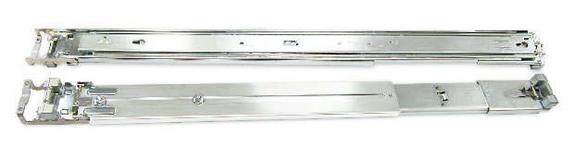
TS-h3077AFU Dimensions
Optional Rail Kit Accessory:RAIL-A03-57
Support Model：
TS-h3077AFU
Max. Load Capacity：
Handles up to 57kg when fully extended
Notes:
The TS-h3077AFU comes in a standard 2U rack-mounted design, perfect for fitting seamlessly into your server rack.
And with the dedicated rail kit "RAIL-A03-57," setting up this All-Flash NAS is a breeze.
Designed specifically for QNAP rackmount NAS units like the TS-h3077AFU, the RAIL-A03-57 can handle a maximum weight of 57 kilograms when fully extended, making it the perfect installation tool for your setup.

Slide 10
Powerful 6-core/12-thread & 8-core/16-thread High Frequency 5nm Processors
Multicore Efficiency with Low Power Consumption
AMD Ryzen™ 7 7000 series 8 Cores / 16 Threads
AMD Ryzen™ 5 7000 series 6 Cores / 12 Threads
The all-new AMD AM5 high-performance processors deliver robust capabilities with up to 32MB cache, reaching a maximum frequency of 5.3 GHz. Equipped with integrated AMD Radeon™ Graphics, they support 4K video transcoding and accelerate various AI applications.
Max. Overclocking
Thumbnail Performance Compared to the Previous Generation x77XU
5.3 GHz
6.73X
Boosted by
8-Cores / 16-Threads
CPU Benchmark Compared to the Previous Generation x77XU
3.8 GHz
1.55X
Boosted by
Note: Specifications on this page are based on the AMD Ryzen™ 7 7700 as an example. Detailed specifications may vary depending on the chosen CPU SKU.
For more information, visit: CPU Comparison (Ryzen7 7700 vs. Ryzen7 3700X)
PassMark Software © 2008-2023
Notes:
In this page, we are going to dive into the heart of the TS-h3077AFU: its powerful CPU lineup.
We're talking about the latest and greatest from AMD: the Ryzen™ 7 7000 series, boasting a mighty 8 cores and 16 threads, and the Ryzen™ 5 7000 series, with 6 cores and 12 threads. These processors are built on the cutting-edge 5nm process, delivering unparalleled performance.
But that's not all. With up to 32MB cache and a maximum frequency of 5.3 GHz, these CPUs pack a serious punch. And let's not forget about the integrated AMD Radeon™ Graphics, perfect for handling 4K video transcoding and accelerating AI applications.
So, whether you're crunching numbers, editing videos, or diving into the world of AI, the TS-h3077AFU's CPU has got you covered.

Slide 11
3 x PCIe Gen4 Slots, Faster and Beyond!
When slot 1 is unoccupied
by a PCIe expansion card:
When installing a PCIe
expansion card in slot 1
Occupied
3 x PCIe Slots (CPU)
3 x PCIe Slots (CPU)
Unoccupied
Slot 2 provides the width of PCIe Gen4 x8 when Slot 1 is not in use, and provides the width of PCIe Gen4 x4 when Slot 1 is in use.
Notes:
In this page, We're talking about not one, not two, but three PCIe Gen4 expansion slots provided by TS-h3077AFU.
Slot 1 gives you Gen 4 x 4, Slot 2 offers Gen 4 x 8 or Gen 4 x 4 (depending on Slot 1 usage), and Slot 3 provides Gen 4 x 4.
Now, here's where it gets interesting.
When Slot 1 is not in use, Slot 2 kicks it up a notch with the width of PCIe Gen4 x8.
But when Slot 1 is in use, Slot 2 seamlessly adjusts to Gen4 x4, ensuring you always get the performance you need.

Slide 12
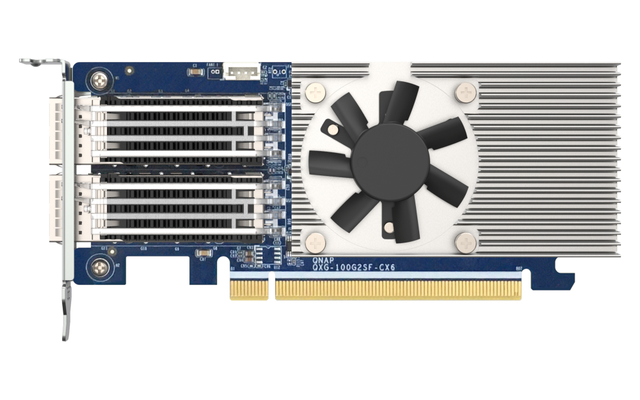
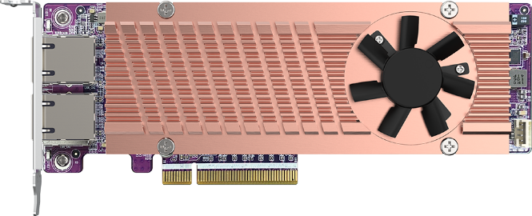
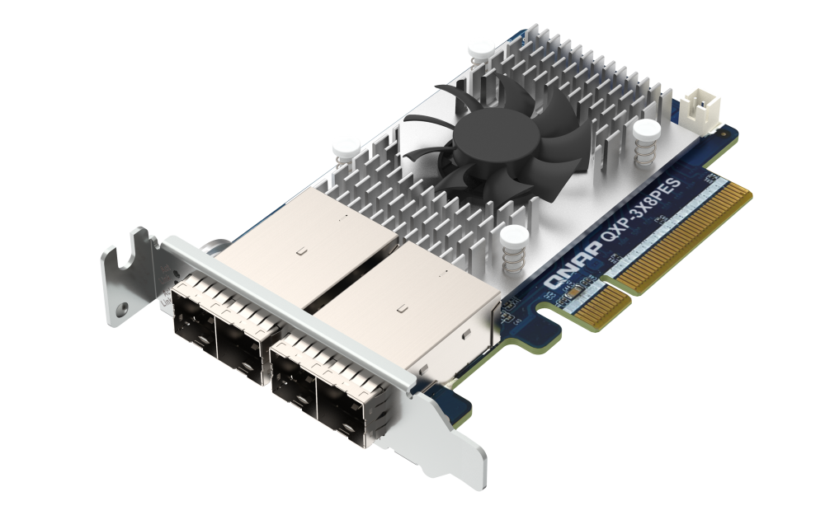
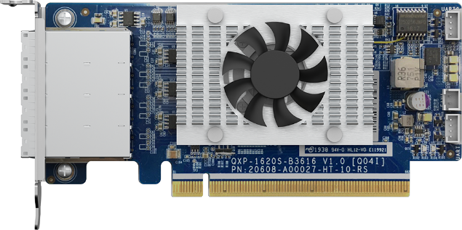
Leading the Industry: Diverse Range of QNAP PCIe Expansion Cards
The 100GbE / 25GbE Network Expansion Cards (e.g., QXG-100G2SF-CX6 or QXG-25G2SF-E810) offer high throughput and low latency, enabling enterprises to swiftly accomplish tasks.
The QM2 card (e.g., QM2-2P410G2T) features 10GBASE-T Ethernet ports and/or M.2 NVMe SSD slots, instantly adding more SSD cache for accelerated storage.
The QXP-3X4PES or QXP-3X8PES expansion card is designed specifically for NAS in conjunction with the QNAP TL-Rx00PES-RP JBOD series storage expansion devices. It can connect up to 192 additional SATA hard drives, expanding storage capacity to over 1PB.
The SAS expansion card (QXP-820S-B3408) is specifically designed for NAS in conjunction with the QNAP TL SAS JBOD series storage expansion devices. It can connect up to 16 units of the 16-bay TL-R1620Sep-RP SAS JBOD, providing versatile storage solutions.
Notes:
Let's talk about the diverse range of QNAP PCIe expansion cards that are perfect companions for the TS-h3077AFU.
First up, we have the Smart NICs. Whether it's the 100GbE or 25GbE Network Expansion Cards like the QXG-100G2SF-CX6 or QXG-25G2SF-E810, these cards offer lightning-fast throughput and minimal latency, ensuring enterprises can tackle tasks with ease.
Next, we have the M.2 expansion card - QM2. Take the QM2-2P410G2T for example, featuring 10GBASE-T Ethernet ports and/or M.2 NVMe SSD slots, instantly boosting your storage with more SSD cache for accelerated performance.
Looking for more storage expansion? Check out the PCIe-SATA JBOD and SAS JBOD expansion cards. The QXP-3X4PES or QXP-3X8PES PCIe-SATA JBOD expansion card, along with the SAS expansion card like the QXP-820S-B3408, are tailor-made for NAS, providing seamless integration with QNAP TL series storage expansion devices, and offering versatile storage solutions to meet your needs.
So whether you're looking to amp up your network speed, boost storage performance, or expand storage capacity, these QNAP PCIe expansion cards are here to lead the way.

Slide 13
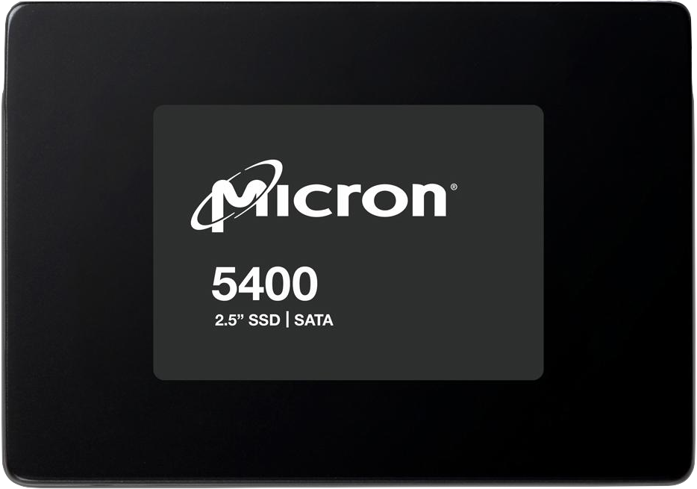
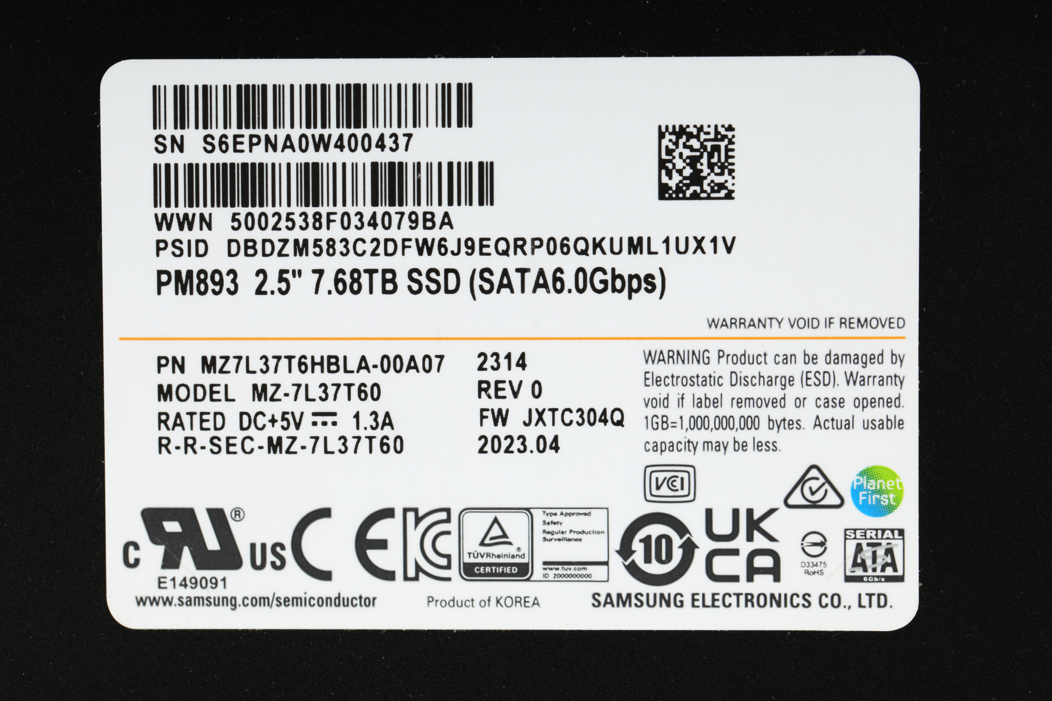
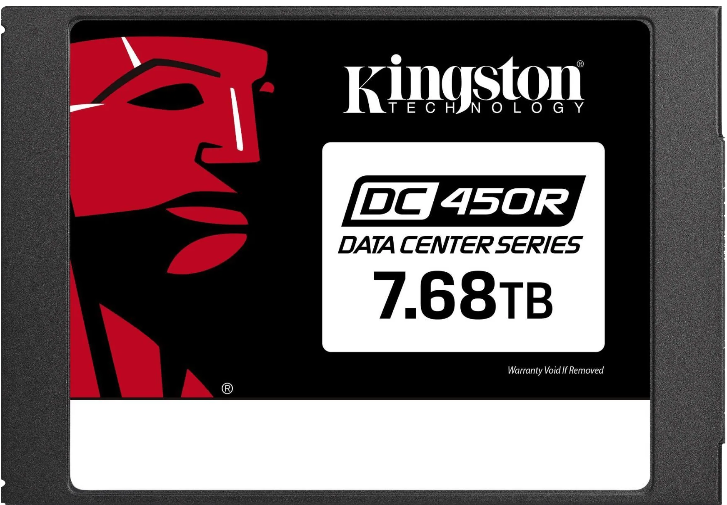
Choose The Large Capacity SATA SSDs for TS-h3077AFU
In today's data-driven landscape, All Flash NAS systems play a crucial role in providing high-performance storage solutions. Large capacity SSDs further elevate the capabilities of these systems by delivering enhanced performance, increased storage efficiency, and improved reliability.
Miron 5400 Pro 7.68TB
MTFDDAK7T6TGA-1BC1ZABYY
Samsung PM893 7.68TB
MZ7L37T6HBLA
Kingston DC450R 7.68TB
SEDC450R/7680G
Notes:
When it comes to unleashing the full potential of your TS-h3077AFU, choosing the right large capacity SSDs is key.
In today's data-driven world, All Flash NAS systems are the backbone of high-performance storage solutions. And large capacity SSDs take it up a notch, offering enhanced performance, increased storage efficiency, and improved reliability.
Take, for example, the Micron 5400 Pro 7.68TB SSD, the Samsung PM983 7.68TB SSD, or the Kingston DC450R 7.68TB SSD. These SSDs are not just compatible, but perfectly suited for your TS-h3077AFU, ensuring you get the most out of your storage solution.
So whether you're dealing with massive datasets, demanding workloads, or mission-critical applications, these large capacity SSDs have got your back.

Slide 14
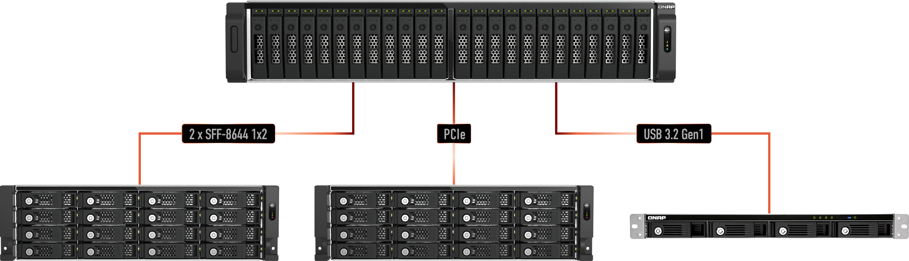
Versatile Storage Expansion Choices
The TS-h3077AFU offer flexible capacity expansion options, catering to various devices and scenarios through different interfaces. Options include VJBOD, USB JBOD, SAS JBOD, SATA JBOD, and TL-Rx00PES-RP PCIe SATA JBOD, providing adaptability based on specific equipment and requirements.
TR-004U
RAID enclosure
TL-Rx00Sep-RP
SAS JBOD
TL-Rx00PES-RP
PCIe-SATA JBOD
Notes:
Let's talk about the versatile storage expansion choices available for the TS-h3077AFU.
This bad boy offers flexible capacity expansion options, catering to various devices and scenarios through different interfaces. We're talking VJBOD (via iSCSI), USB JBOD, SAS JBOD (like the TL-Rx00Sep-RP series), SATA JBOD (like the TR-004U RAID enclosure), and PCIe SATA JBOD (like the TL-Rx00PES-RP series).
Whether you're looking to expand your storage capacity, enhance your data backup strategy, or streamline your storage infrastructure, these expansion choices have got you covered. So whether you're dealing with specific equipment requirements or diverse storage needs, the TS-h3077AFU's expansion options provide adaptability and versatility for every scenario.

Slide 15

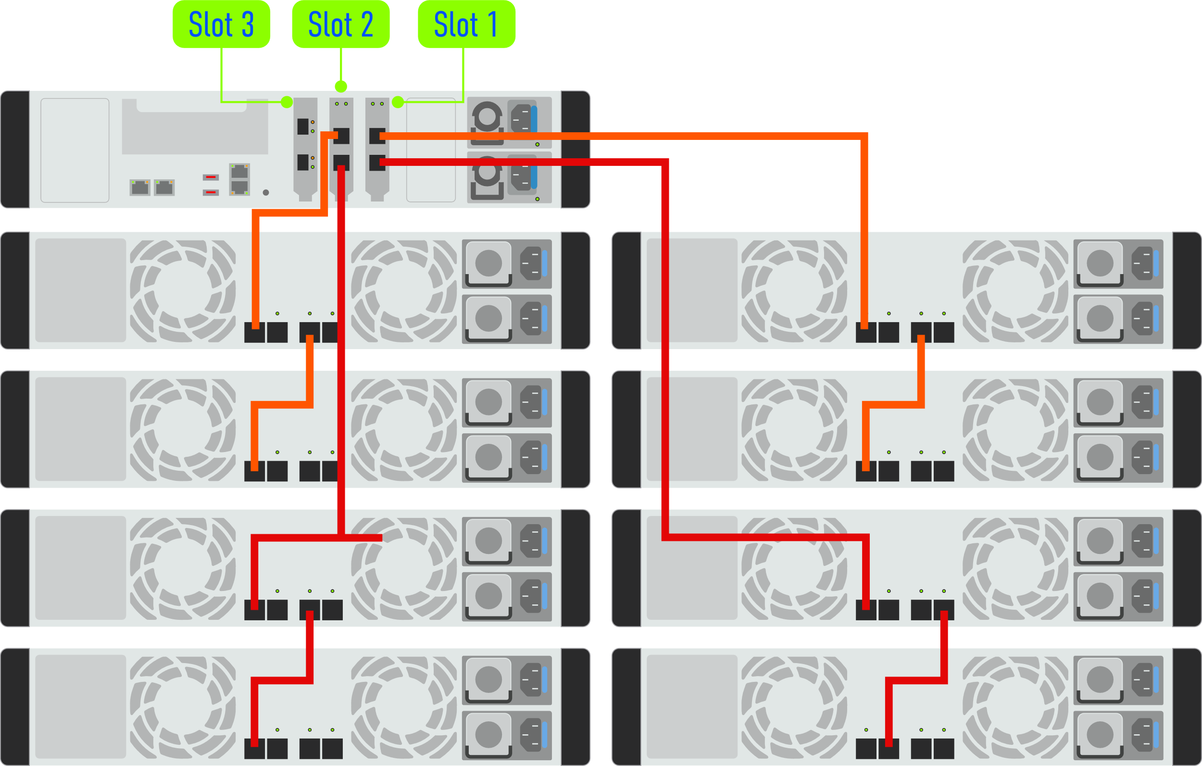
Petabyte-Grade Value Solution:
Balancing Performance and Capacity
The TS-h3077AFU can support up to 8 TL-Rx00PES PCIe SATA JBODs, providing a total space for up to 208 disks (total capacity reaching 4PB, with over 3PB of usable space). Simultaneously, they ensure optimal network performance with dual 25GbE ports, catering to the diverse capacity and performance expansion needs of enterprises in various scenarios.
TL-Rx00PES JBOD comes in 3 SKUs: TS-R1200PES-RP (12-bay, now available), TL-R1600PES-RP (16-bay, now available), and TL-R2400PES-RP (24-bay, launching in Feb 2024).
Note: For NAS compatibility details, refer to the compatibility list at https://www.qnap.com/go/compatibility-expansion/pcie
Notes:
Let's talk about how the TS-h3077AFU achieves the perfect balance between performance and capacity, offering a petabyte-grade value solution.
The TS-h3077AFU can support up to 8 TL-Rx00PES PCIe SATA JBODs, allowing for a whopping total of up to 208 disks. That's a total capacity reaching 4PB, with over 3PB of usable space. But here's the kicker: it doesn't compromise on network performance, thanks to its dual 25GbE ports.
Whether you're dealing with massive datasets, demanding workloads, or mission-critical applications, the TS-h3077AFU's configuration caters to the diverse capacity and performance expansion needs of enterprises in various scenarios. So whether you're aiming for optimal performance, maximum capacity, or a perfect balance of both, this solution has got you covered.

Slide 16

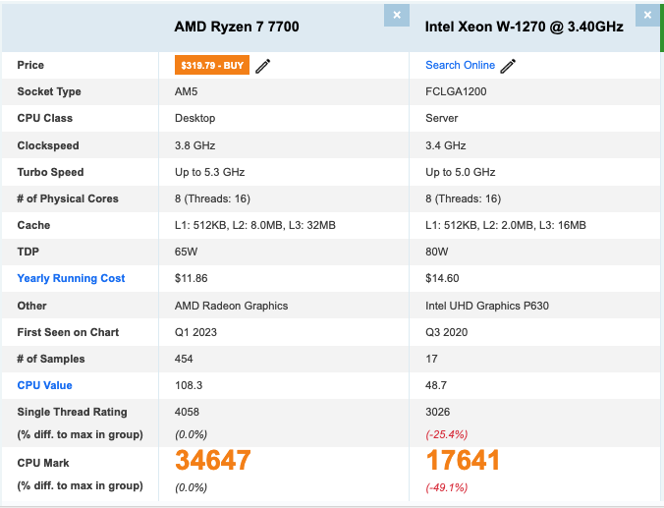
Unleashing 1.9x CPU Power with the Next-Gen Model
TS-h3077AFU, equipped with the AMD Ryzen™ 7000 Series processors, not only deliver high clock speeds but also provide increased bandwidth, ensuring robust performance for enterprise applications.
Protocol | Unit | IO Access | TS-h3077AFU-R7 (32Gx4,8C16T)
 |  |  | 5 host 25GbEx6
iSCSI | Throughput (MB/s) | SW-1M | 6,073
 |  | SR-1M | 10,740
 | IOPS | RW-4K | 1,202,262
 |  | RR-4K | 1,669,854
SMB | Throughput (MB/s) | SW-1M | 9,559
 |  | SR-1M | 17,327
 | IOPS | RW-4K | 635,797
 |  | RR-4K | 1,428,002
CPU Benchmark single thread Compares with the Previous Generation TS-h3088XU-RP
CPU Benchmark multi-core Compares with the Previous Generation TS-h3088XU-RP
Up to
Up to
1.34X
1.96X
These test results were conducted in the QNAP laboratory, and actual performance may vary based on real-world environments.
NAS: TS-h1677AXU-RP-R7-32G, with QXG-25G2SF-CX6*1, QXG-25G2SF-E810*2, OS: QTS h5.1.4, Volume type： Samsung 870 EVO 1TB x30 (RAID 50)
Client PC：5* Client PC simultaneously read and write 16GB file (= 80GB totally), Intel Core™ i7-7700 4.20GHz CPU, 32GB DDR4 RAM, QXG-25G2SF-CX4, Windows® Server 2016, and Intel Core™ i3-8100 3.60GHz CPU, 4GB DDR4 RAM, QXG-25G2SF-CX4, Windows® Server 2016
Notes:
Let's talk about the powerhouse that is the TS-h3077AFU, and how it's unleashing 1.9 times the CPU power compared to its predecessor(ˈpredəˌsesər) TS-h3088XU-RP.
Equipped with the latest AMD Ryzen™ 7000 Series processors, this bad boy doesn't just deliver high clock speeds; it also provides increased bandwidth, ensuring robust performance for all your enterprise applications.
Now, let's get into the numbers. When it comes to CPU benchmarks, the TS-h3077AFU blows its predecessor, the TS-h3088XU-RP, out of the water. We're talking up to a 1.34 times improvement in single-thread performance, and a whopping 1.96 times improvement in multi-core performance.

Slide 17
Next-Gen Memory Performance:
Max 128GB DDR5 RAM and Optional ECC
More Powerful, Faster, and More Stable Than Ever!
Clock Speed Comparison with the Previous Generation DDR4
1.5X
4 x DDR5 UDIMM slots, supporting expansion up to a total of 128 GB, with an option to upgrade to ECC RAM.
Clock speeds starting from 4800MT/s, delivering at least 50% higher performance compared to DDR4.
Reduced power consumption, cost-effectiveness, and environmental consciousness. Approximately 20% lower power consumption compared to DDR4.
Boosted by
up
RAM Order P/N
Ordering P/N | Memory
RAM-16GDR5T0-UD-4800 | 16G DDR5 UDIMM 4800MHz
RAM-32GDR5T0-UD-4800 | 32G DDR5 UDIMM 4800MHz
RAM-16GDR5ECT0-UD-4800 | 16G DDR5 ECC UDIMM 4800MHz
RAM-32GDR5ECT0-UD-4800 | 32G DDR5 ECC UDIMM 4800MHz
Notes:
Today, we're diving into the world of next-gen memory performance with the TS-h3077AFU.
With 4 DDR5 UDIMM slots supporting expansion up to a whopping total of 128GB, this bad boy packs a serious punch. Plus, you have the option to upgrade to ECC RAM for added stability and reliability.
But here's where it gets really exciting. With clock speeds starting from 4800MT/s, DDR5 delivers at least 50% higher performance compared to DDR4. That means faster data processing, smoother multitasking, and overall improved system responsiveness.
And let's not forget about the benefits beyond performance. DDR5 also brings reduced power consumption, cost-effectiveness, and environmental consciousness to the table. With approximately 20% lower power consumption compared to DDR4, you're not just getting more power; you're also being kinder to the planet.
If you're looking to upgrade, just check out the compatible DDR5 options in the bottom right corner of the table.

Slide 18
Built-in GPU: Elevating AI Image Recognition and Video Transcoding Efficiency
The TS-h3077AFU come equipped with an integrated AMD Radeon™ Graphics GPU. Not only does it accelerate facial recognition efficiency, but it also enhances video transcoding, ensuring smoother streaming transmissions and improving compatibility across various platforms. Transcoding into H.264/265 further optimizes storage efficiency.
 | TS-h1677AXU | TS-h1887XU | TS-h1677XU | TS-464eU | TS-453E
Thumbnail/Hour | 91009 | 50055 | 11917 | 12834 | 11917
Facial Recog./Hour | 66740 | 55616 | 37077 | 10215 | 10215
1080p Video FPS | 712 | w/o igpu | w/o igpu | 171 | 167
Comparison with the Previous Generation 77XU Series
Boosted by
7.63X
Notes:
Let's talk about how the TS-h3077AFU is taking AI image recognition and video transcoding to the next level with its built-in iGPU.
Equipped with an integrated AMD Radeon™ Graphics iGPU, this bad boy isn't just a storage powerhouse; it's also a processing beast. The iGPU accelerates facial recognition efficiency, making tasks like image analysis a breeze. Plus, it enhances video transcoding, ensuring smoother streaming transmissions and improving compatibility across various platforms. And with transcoding into H.264/265, storage efficiency gets a boost too.
Now, if you're wondering just how powerful this iGPU is, just check out the test results from the TS-h1677AXU in the table below. It's using the same iGPU, giving you a glimpse of the incredible capabilities that the TS-h3077AFU brings to the table.

Slide 19
SPEC: TS-h3077AFU
SKU​ | TS-h3077AFU-RP-R5-32G​ | TS-h3077AFU-RP-R7-64G
CPU | Ryzen™ 5 7000 series 6C12T 3.8 ~ 5.1 GHz​ | Ryzen™ 7 7000 series 8C16T 3.8~5.3 GHz
Memory (default)​ | 32GB (32GB x1) DDR5 none-ECC UDIMM​ | 32GB (32GB x2) DDR5 none-ECC UDIMM
Max. Memory​ | 128GB (4 x 32GB)​
Memory Slots | 4 x DDR5 UDIMM, ECC supported
O.S | QuTS hero (default) / QTS (optional)
Disk Slots | 30x 2.5” SATA SSD slots
I/O Port | 2 x 2.5GbE + 2 x 10G Base-T​
PCIe Slots | 3 x PCIe Gen4 expansion slots (Slot 1: Gen4 x4, Slot 2: Gen4 x8 or Gen 4 x4, Slot 3: Gen4 x4)​ Support 10GbE, 25GbE x 2 NIC **Slot 2 provides the width of PCIe Gen4 x8 when Slot 1 is not in use, and provides the width of PCIe Gen4 x4 when Slot 1 is in use.​
USB​ | 2 x USB 3.2 Gen2 Type-A​
GPU | AMD Radeon™ Graphics iGPU
PSU | Redundant PSU
System Fan | 3 x 60mm​
Notes:
Let's summerise the hardware specs of the TS-h3077AFU.
First off, we've got two SKUs: the TS-h3077AFU-R5-32G and the TS-h3077AFU-R7-64G. The main difference? The R5-32G comes with an AMD Ryzen 5 7000 series 6-core CPU and 32GB DDR5 non-ECC RAM, while the R7-64G boasts an AMD Ryzen 7 7000 series 8-core CPU and 64GB DDR5 non-ECC RAM.
When it comes to memory, the TS-h3077AFU supports up to 128GB total, with 4 DDR5 UDIMM slots and optional ECC RAM support.
Operating system-wise, it's rocking QuTS hero h5.1.x by default, with the option to switch to QTS if you prefer.
In terms of storage, you've got 30 SATA SSD slots to play with, ensuring plenty of space for all your data.
Connectivity-wise, there's 2 x 2.5GbE ports and 2 x 10G Base-T ports, along with 3 PCIe Gen4 expansion slots for additional add-ons like networking cards or storage expansion.
Don't forget about the GPU – it's got an AMD Radeon™ Graphics iGPU onboard, ensuring smooth visuals and accelerated processing.
And with features like redundant PSU and 3 system fans, you've got reliability and cooling covered.

Slide 20

Enterprise-Grade Operating System
Powered by QuTS hero with Enterprise ZFS Technology
Notes:
After the introduction of TS-h1277AXU-RP and TS-h1677AXU-RP's HW highligh, let's dive into the.
Powerful QuTS hero – which Leveraging the ZFS file system， emphasizing data security， and ensuring higher reliability.

Slide 21






QuTS hero h5.1.x Highlights
Stability
& Scalability
Management & Application
Data Integrity
Data Protection
Data Efficiency
QuTS hero no longer needs file system checks (FSCK), with ZFS Mirror layer, COW (copy on Write) could keep the data integrity.
The native ZFS snapshot feature allows max 65,536 snapshots (supports folder/LUN)
SnapSync
More RAID types available
WORM (write once read many)
SMB signing and Encryption AES-NI Acceleration
SMB Signing with GMAC
Authenticator and Passwordless
Offers inline compression, inline compaction & inline deduplication for better storage utilization
ZIL & L2ARC
Write Coalescing
Pool over provisioning
SMB Multichannel
iSCSI Read Zero Copy
Enhanced performance on encrypted LUN/folder
Easily expanded to PB-level storage space.
Provide ECC RAM supported model to reach the enterprise level stability
Expand/Upgrade ZFS RAID
Provide the service of SSD/HDD life prediction
Predictive Migration
Detailed ACL
Protocols & Connection
Delegated Administration
AMIZ cloud
NFS Fixed Ports
Notes:
This page shows the overview of QuTS hero h5.1.x Highlights. Today, we'll delve into key features such as "Data Integrity," "Data Protection," "Data Efficiency," "Stability & Scalability," and "Management & Application." Stay tuned as we explore each highlight in detail throughout the presentation. Let's begin the journey into the powerful capabilities of QuTS hero h5.1.x.

Slide 22




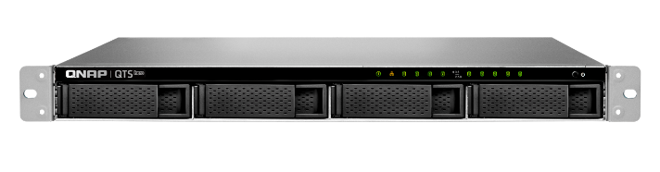
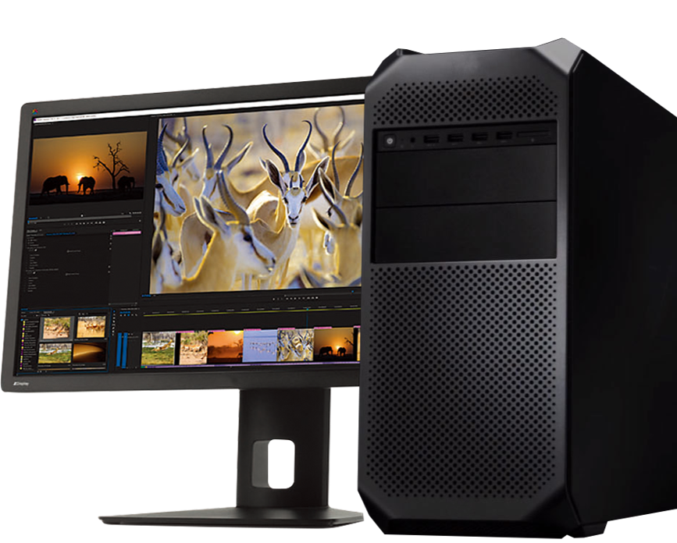
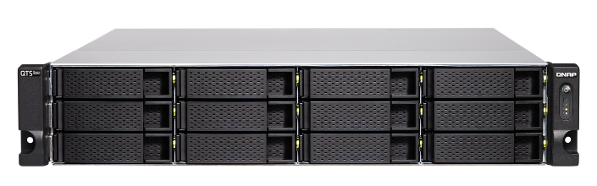
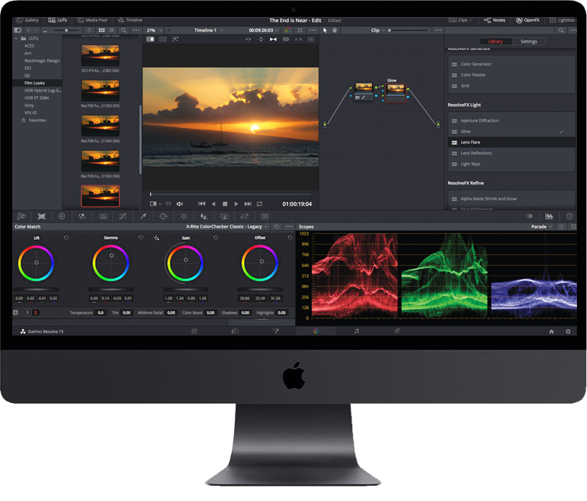
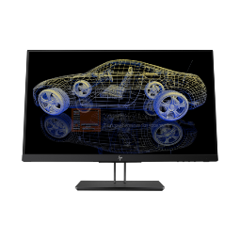

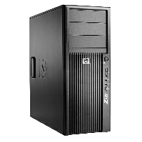


AES-NI Acceleration for
SMB3 Signing and Encryption
AES
AES
H/W
acceleration
H/W
acceleration
Up to 3X faster!
AES-NI
AES-NI
AES-NI accelerated SMB3 Signing and Encryption
PM 手繪草圖說明, 再協助微調圖示
Notes:
In this session, we'll explore the benefits of leveraging AES-NI supported CPUs for hardware acceleration in SMB3 Signing and Encryption. This innovative approach results in efficiency gains of over three times compared to utilizing standard AES instruction sets. Let's delve into the details of this accelerated encryption method and its impact on performance.

Slide 23
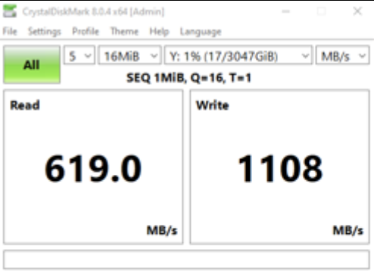
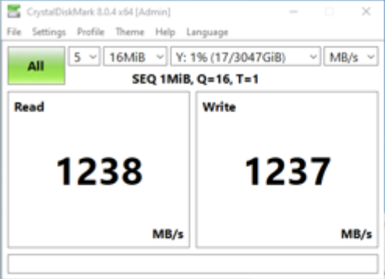
Supports AES-128-GMAC for
SMB signing acceleration
In 10Gb/s network, AES-NI enabled CPU, new GMAC algorithm outperforms the former CMAC algorithm significantly.
QuTS hero h5.1 supports AES-128-GMAC signing acceleration (only in Windows Server 2022 and Windows 11 clients) that not only greatly increases data signing efficiency over SMB 3.1.1 but also enhances the CPU utilization of the NAS system - providing the best balance of security and performance.
CMAC
GMAC
x86
2X Faster
Notes:
AES-GMAC:
Purpose: GMAC is primarily used for authenticated encryption with associated data (AEAD). It combines the AES encryption algorithm with a Galois field multiplication-based authentication code. GMAC is commonly used in protocols like IPsec to provide confidentiality and integrity protection for transmitted data.
Advantages: GMAC is parallelizable, meaning it can be efficiently implemented on modern processors that support parallel processing. This makes it suitable for high-performance applications, capable of delivering faster authentication and encryption.
AES-CMAC:
Purpose: CMAC is a block cipher-based message authentication code, typically used in scenarios where only message authentication is required without encryption. It takes variable-length messages as input and generates a fixed-size tag that can be used to verify the integrity of the message.
Advantages: CMAC is a symmetric key algorithm, and its security is based on the underlying block cipher (in this case, AES). It is considered secure and suitable for applications that only require message authentication without confidentiality.
Benefits of using AES-GMAC:
Comprehensive security: AES-GMAC provides both encryption and authentication in a single operation, streamlining cryptographic processing.
Parallel processing: As mentioned earlier, GMAC can leverage parallel processing, potentially achieving performance improvements on modern hardware.
Performance: GMAC is designed to be efficient, making it suitable for high-performance environments where both confidentiality and integrity are needed.
In conclusion, the choice between AES-GMAC and AES-CMAC depends on the specific security and performance requirements of the application. If encryption and authentication are needed in a high-performance environment, AES-GMAC may be a suitable choice. If only message authentication without encryption is required, AES-CMAC might be a more lightweight option.

Slide 24

SMB Multichannel for Multiplied Network Performance and Fault-tolerant Connections
A SMB 3 client automatically establishes multiple connections to the SMB server for a single SMB session, and with the multiple connections achieves bandwidth aggregation and network fault tolerance.
Without Multichannel
With Multichannel
Faster!
Network fault tolerance!
Notes:
In this page, I'm excited to talk to you about "SMB Multichannel for Multiplied Network Performance and Fault-tolerant Connections." In the world of SMB 3, our clients automatically establish multiple connections to the SMB server within a single session. Picture this: on the left side without SMB Multichannel, data transmission is limited to a single channel, hampering performance and susceptible to disruptions in case of line failure. Now, on the right side with SMB Multichannel, we've empowered the system with multiple channels, significantly boosting SMB transmission efficiency, all while ensuring fault tolerance to tackle disruptions. Let's dive into the details and discover the transformative power of SMB Multichannel in QuTS hero h 5.1.x!

Slide 25

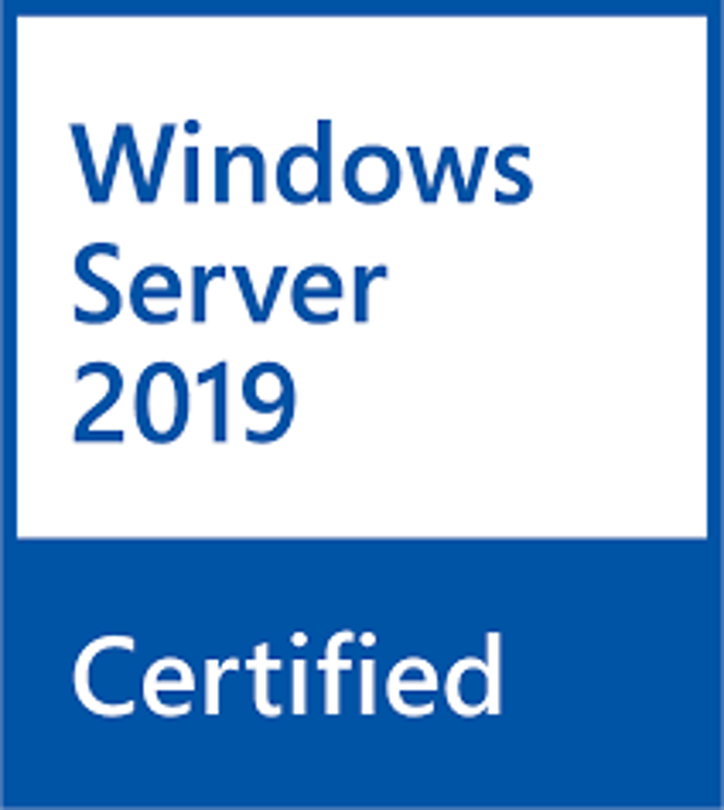
可排版
Virtualization Storage Solutions
Virtualization applications significantly enhance the management efficiency and resource availability of enterprise IT. QNAP NAS provides a reliable, high-performance, and cost-effective storage solution for diverse virtualization platforms.
Note: Virtualization certifications are still in progress. The NAS models are expected to be certified by the end of Q1, 2024.
Notes:
With the flourishing development of virtualization applications, ensuring sufficient and high-performance storage space to accommodate a vast number of virtual machines and related applications has become a significant challenge for IT administrators. QNAP NAS for enterprises is specifically designed for virtualization and cluster environments, offering an affordable yet high-performance solution for large-capacity virtualized storage needs.

Slide 26



Performance-demanding
NAS Applications
Virtualization
Data Centers
Media & Entertainment
In the realm of non-structured data processing, breaking through the performance bottlenecks of I/O-intensive applications, ideal for extensive virtualization environments and Desktop Virtualization (VDI) applications.
Delivering ultra-low latency and high IOPS performance, providing data centers hosting critical business systems and data with microsecond-level response times.
Meeting the demands of seamless 4K/8K media streaming and post-production needs, enhancing efficiency in multimedia workflows through faster data transfer, access, and backup.
Notes:
At this session, let's explore the ideal environments for our performance-demanding NAS applications, specifically the TS-h1277AXU-RP and TS-h1677AXU-RP.
First up, in the realm of virtualization, these NAS solutions excel at handling non-structured data, smashing through I/O-intensive applications. Perfect for extensive virtualization environments and Desktop Virtualization (VDI) applications.
Next, for data centers seeking top-notch performance, these NAS models deliver ultra-low latency and high IOPS, providing microsecond-level response times for hosting critical business systems and data.
And for the world of Media & Entertainment, our NAS solutions meet the demands of seamless 4K/8K media streaming and post-production. Elevate your multimedia workflows with faster data transfer, access, and backup.
Stay tuned as we delve into each scenario, showcasing the power and versatility of the TS-h1277AXU-RP and TS-h1677AXU-RP. Let's maximize performance in your NAS applications!

Slide 27
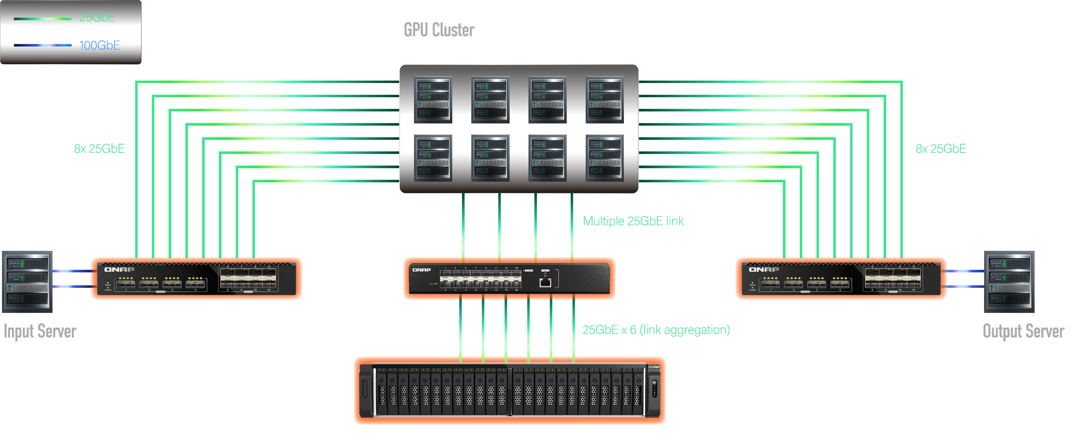
Use Case Example AI Model Training
Notes:
At our 1st use case, we ar going to talk about one of the hottest topics in tech right now: AI model training.
Meet the TS-h3077AFU - the ultimate All-Flash NAS designed specifically for AI model training.
With support for lightning-fast 25GbE and 100GbE connectivity, this NAS offers unbeatable performance at an incredible value.
Now, let's talk architecture. Picture this: a robust setup featuring the TS-h3077AFU as the storage backbone, coupled with 3 x QNAP 25GbE smart NICs.
Input and output servers equipped with QNAP 100GbE smart NICs are connected to the QNAP 100GbE switch QSW-M7308R-4X.
And let's not forget the GPU cluster, comprising servers with GPUs and multiple 25GbE NICs, all seamlessly connected to the QNAP switches for data exchange.
With this setup, your AI model training process is streamlined, efficient, and ready to tackle even the most complex tasks.

Slide 28
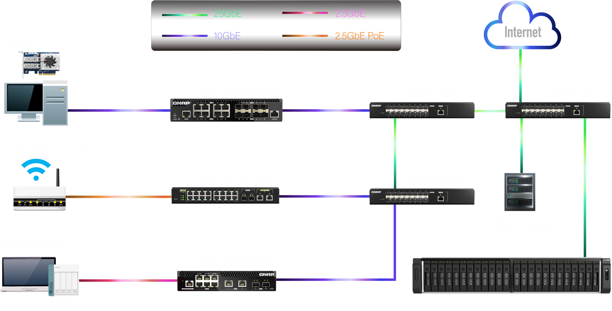
Use Case Example
Office File Server
Notes:
The second use case is the future of office file servers – a seamless blend of speed, reliability, and versatility!
Imagine this: an advanced network setup featuring lightning-fast 25GbE switch (QSW-M5216-1T), ensuring rapid data transfer, a robust 10GbE switch (QSW-M3216R-8S8T) for efficient connectivity, and a flexible 2.5GbE switch (QSW-M2116P-2T2S) perfect for collaborative tasks.
But that's not all! Fueling this innovation is the TS-h3077AFU storage configuration - your fortress of secure and scalable storage. Say goodbye to data concerns as this solution caters to your growing needs with reliability at its core.
Now, let's talk client configuration. Empower your team with a 25GbE server for lightning-fast data exchange, a 10GbE workstation ensuring a smooth workflow, a 2.5GbE PC and other devices for versatile tasks, and a 2.5GbE Wi-Fi 6 AP providing flexible wireless connectivity.
So, get ready to elevate your office productivity and embrace a future where speed meets reliability. This configuration isn't just about files; it's about unlocking a new era of efficiency.

Slide 29
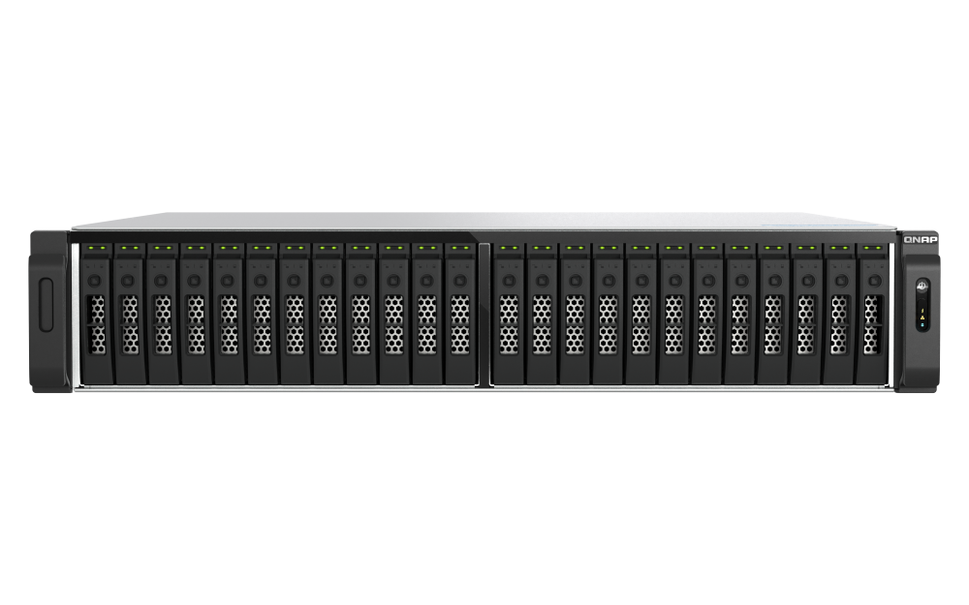
Use Case Example
Data Center Remote Redundancy
Local Data Center Facility
Remote Data Center Facility
Primary ESXi server with 25GbE NIC
Secondary ESXi server with
25GbE NIC
QNAP QSW-M5216-1T 25GbE switch
QNAP QSW-M5216-1T 25GbE switch
Multiprotocol Label Switching
Local-sitePrimary NAS
TS-h3077AFU
With 25GbE NIC
Secondary NAS
TS-h1277AXU-RP / TS-h1677AXU-RP
With 25GbE NIC
DR-site Primary NAS
TS-h3077AFU
With 25GbE NIC
Notes:
The last case, let's Revolutionize your Data Center with our cutting-edge Remote Redundancy Configuration! In this advanced setup, we employ a robust 25GbE switch (QSW-M5216-1T) to ensure high-speed networking capabilities.
At the local site, our primary storage solutions TS-h3077AFU stand tall, ready to handle your data storage needs efficiently. Paired with ESXi servers equipped with multiple 25GbE NICs, your local operations are optimized for peak performance.
Connecting seamlessly between the local and remote sites is our Multiprotocol Label Switching (MPLS) line, ensuring secure and efficient data transfer. At the remote site, mirrored configurations of TS-h3077AFU provide redundancy, and ESXi servers with multiple 25GbE NICs ensure a smooth, uninterrupted workflow. Elevate your Data Center's reliability and resilience with our state-of-the-art remote redundancy configuration.

Slide 30
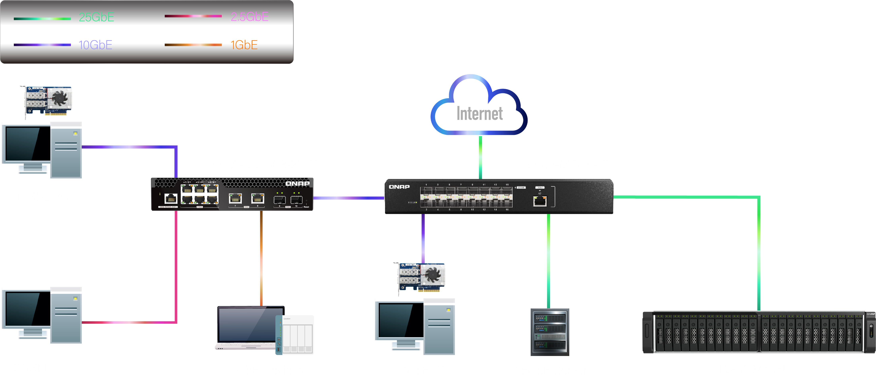
Use Case Example
Multimedia Studio
In the cutting-edge Multimedia Studio, our network thrives with a core 10GbE switch, distributed 10GbE switch, and accessible 2.5GbE switch. Storage prowess is embodied in the TS-h3077AFU, while clients boast a 25GbE server, 10GbE workstation, and a versatile 2.5GbE PC. Elevate your multimedia experience!
Notes:
[Opening Scene]
Welcome to our Multimedia Studio, the heart of innovation and creativity. In this dynamic environment, connectivity is key, and that's why we've designed a cutting-edge network infrastructure.
[Network Configuration]
Our network is powered by the latest technology, featuring a robust 10GbE core switch that forms the backbone of seamless connectivity. Complementing this, we have a distributed 10GbE switch ensuring efficient data distribution and an accessible 2.5GbE switch for versatile connectivity.
[Storage Solution]
At the core of our data management is the TS-h3077AFU, a high-performance storage solution. It provides the reliability and capacity needed to support the demanding requirements of a Multimedia Studio.
[Client Configuration]
On the client side, we offer a 25GbE server for unparalleled speed, a responsive 10GbE workstation for smooth workflows, and a versatile 2.5GbE PC ensuring flexibility in your creative process.
[Closing Scene]
Elevate your multimedia experience with our state-of-the-art configuration. Our Multimedia Studio is not just a workspace; it's a platform where ideas come to life. Join us on this journey of creativity and connectivity. Thank you for being part of our innovation ecosystem.

Slide 31
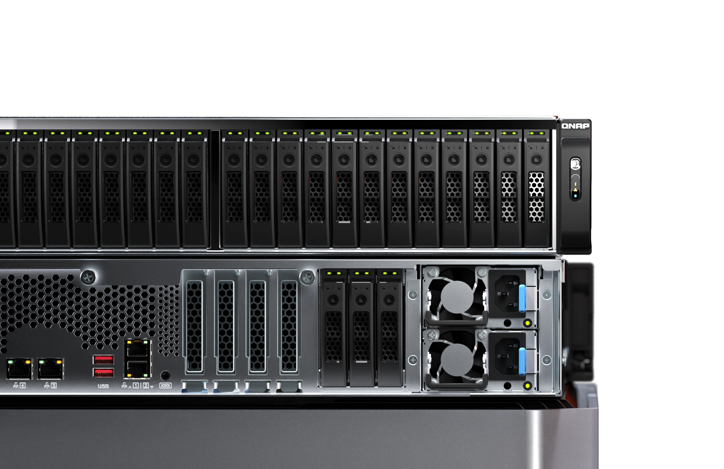

Standard 5-Year Warranty
and Support Services
TS-h3077AFU enterprise NAS models come with an exclusive 5-year hardware warranty, covering both hardware repairs and support services. QNAP offers this prestigious warranty service to ensure the continuous operation of your business organization and provide uninterrupted services to your customers.
Notes:
In this page, we're talking about something that sets our TS-h3077AFU enterprise NAS models apart: our exclusive 5-year standard warranty and support services.
When you invest in a TS-h3077AFU, you're not just getting top-notch hardware - you're getting peace of mind. Our 5-year hardware warranty covers both hardware repairs and support services, ensuring that your business operations continue smoothly without any interruptions.
We're proud to offer this prestigious warranty service because we understand the importance of keeping your business running smoothly and providing uninterrupted services to your customers.
So, rest assured knowing that with the TS-h3077AFU, you're not just investing in a product - you're investing in reliability and support for years to come.

Slide 32
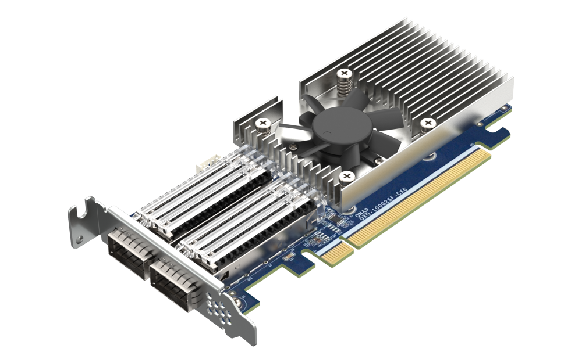
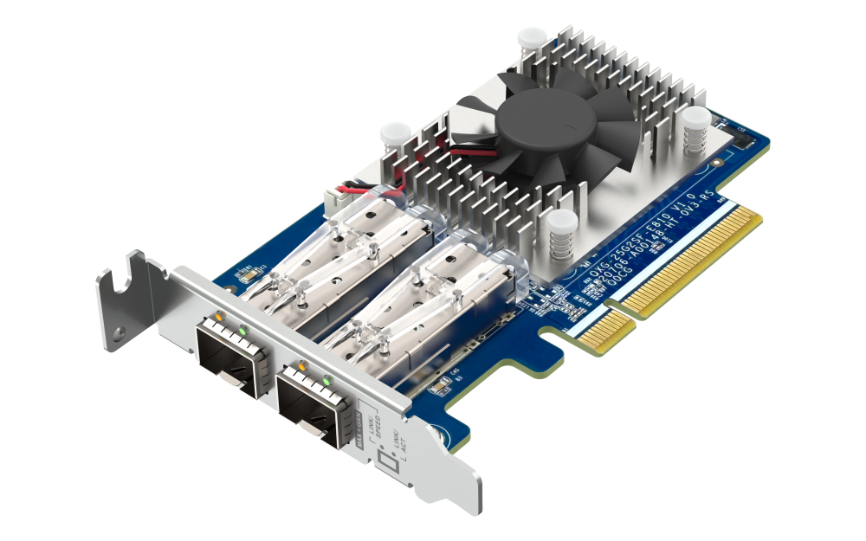
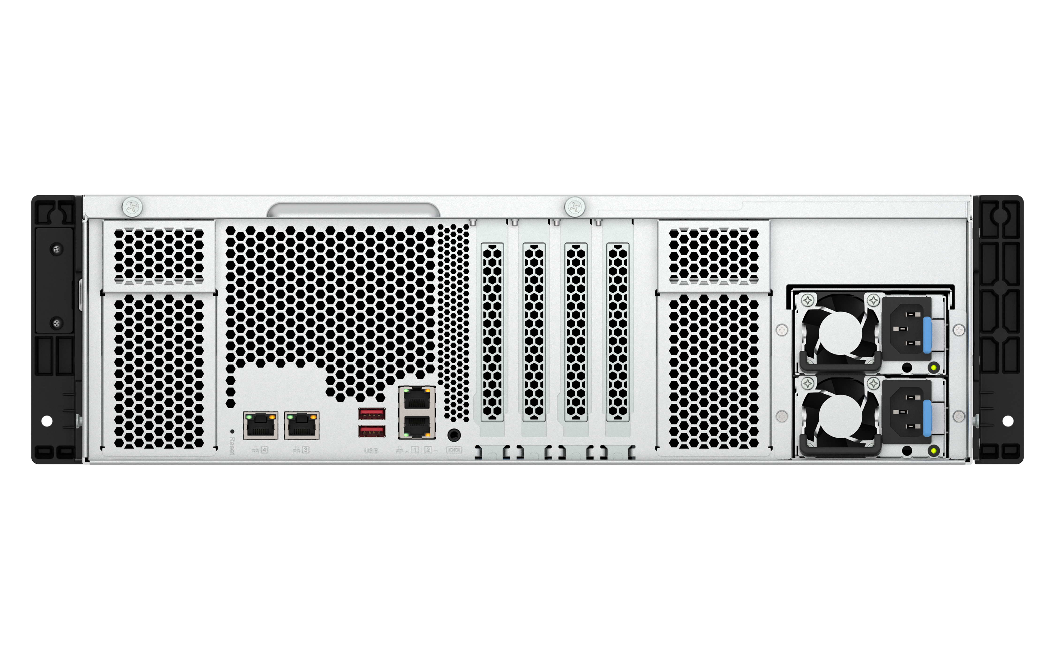


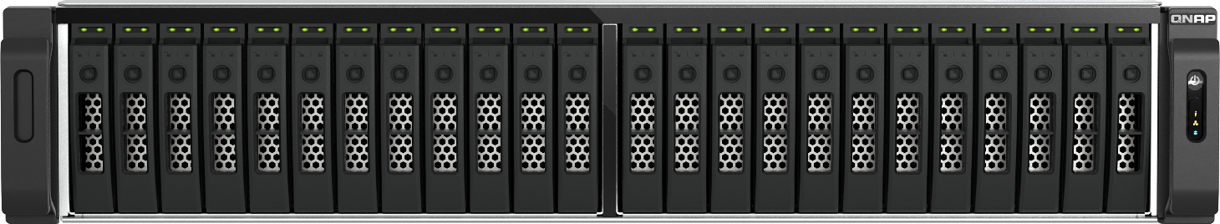
USB 3.2 Gen2 (10Gbps)
與 One-Touch-Copy
3個
PCIe Gen3 x4
擴充槽
Support dual OS
(Default is QuTS hero)
100 / 25GbE NIC support
3 x PCIe Gen4 expansion slots for Ethernet, FC, storage, and more
Expand your storage capacity to 3PB+ with additional JBOD
IntelQAT
2 x 10GBASE-T +
2 x 2.5GbE +
2 x USB-A 3.2 Gen 2 10Gbps
Integrated graphics
TS-h3077AFU
Enterprise All-Flash NAS
Up to
8 Cores
AMD Ryzen™
7000 series Processors
32GB RAM
64GB RAM
2.5GbE
Up to Total
128GB
Faster!
DDR5
Standard
5-year
Warranty
3PB up
Unleash performance with over 4800MT/s UDIMM, optional ECC support
Empower your enterprise with an efficient virtualization environment
Storage
capacity
(TS-h1677AXU-RP
support up to 8x TL-R2400PES-RP installed with 22 TB HDD)
Notes:
In the last session, let's quickly recap the key features of the TS-h3077AFU:
The TS-h3077AFU, an Enterprise-grade 30-bay All-Flash SATA NAS.
Powered by AMD Ryzen 7000 series CPU, with up to 8 cores overclocked to 5.3GHz.
Boasts an integrated iGPU - AMD Radeon graphics for accelerated media decoding and AI applications.
Supports DDR5 memory, delivering over 4800MT/s UDIMM speed with optional ECC support.
Standard configurations include 16GB or 32GB RAM, expandable up to a total of 128GB.
Built with 2 x 10GBASE-T, 2 x 2.5GbE, and 2 x USB-A 3.2 Gen 2 10Gbps ports for high-speed expansion.
Features 3 x PCIe Gen4 expansion slots for Ethernet, FC, storage, and various QNAP PCIe expansion cards.
Supports QNAP 100GbE / 25 GbE smart NICs - "QXG-100G2SF-CX-6" and "QXG-25G2SF-E810."
Easily expand storage capacity to 3PB+ with additional JBOD.
Enjoy exclusive 5-year standard warranty, ensuring robust hardware and software support for your peace of mind.

Slide 33


The Next Generation Enterprise All-Flash NAS with AMD Ryzen™ 7000 series Processor
Copyright© 2024 QNAP Systems, Inc. All rights reserved. QNAP® and other names of QNAP Products are proprietary marks or registered trademarks of QNAP Systems, Inc. Other products and company names mentioned herein are trademarks of their respective holders.​​​​​​​​​
Notes:
In conclusion, the TS-h3077AFU is truly the next-generation enterprise all-flash NAS, powered by the AMD Ryzen™ 7000 series Processor.
Its versatility and performance make it the perfect fit for a wide range of enterprise applications.
Whether you're in AI model training, office file server setups, or any other demanding business environment, the TS-h3077AFU is ready to meet your needs and exceed your expectations.
Thank you for your attention, and we look forward to helping you revolutionize your enterprise storage solutions.
See you next time on our QNAP channel, bye bye.

