Slide 2

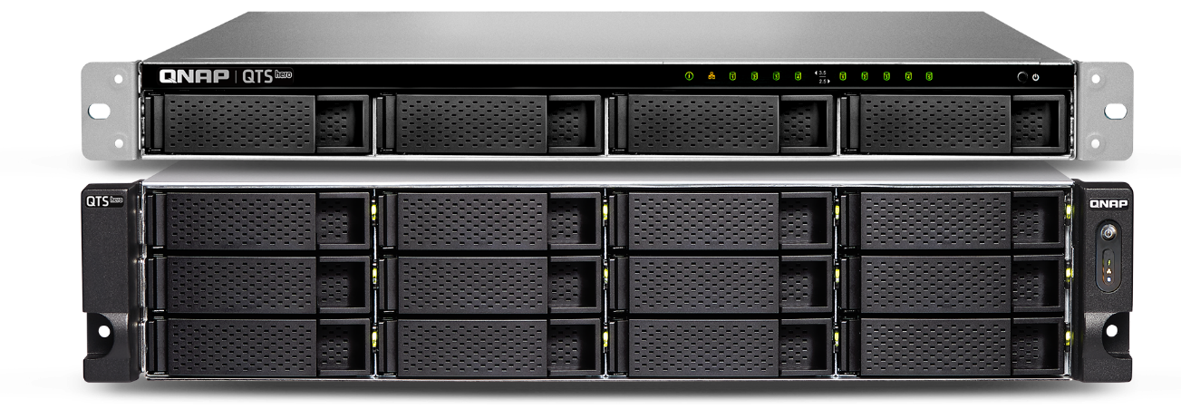







QuTS hero:
The best Unified Hybrid Storage
QTS hero: Unified Hybrid Storage
Most Affordable
Hybrid Storage
Data Self-healing
ZFS on Linux
Flash Endurance
Cloud Ready
Unified
Virtualization Ready
65,536 Snapshots

Slide 3






QuTS hero Highlights
Data Integrity
Data Protection
Data Efficiency
Stability
& Scalability
Management & Application
QuTS hero no longer needs file system checks (FSCK), with ZFS Mirror layer, COW (copy on Write) could keep the data integrity.
The native ZFS snapshot feature allows max 65,536 snapshots​ (supports folder/LUN)​
SnapSync
More RAID types available
WORM (write once read many)​
SMB signing and Encryption AES-NI Acceleration
SMB Signing with GMAC
Authenticator and Passwordless
Offers inline compression, inline compaction & inline deduplication for better storage utilization​
ZIL & L2ARC
Write Coalescing
Pool over provisioning
SMB Multichannel
iSCSI Read Zero Copy
Enhanced performance on encrypted LUN/folder
Easily expanded to PB-level storage space.
Provide ECC RAM supported model to reach the enterprise level stability​
Expand/Upgrade RAID
Provide the service of SSD/HDD life prediction​
Predictive Migration
Detailed ACL
Protocols & Connection
Delegated Administration
AMIZ cloud
NFS Fixed Ports

Slide 4
Chapter
01
DATA INTEGRITY

Slide 5
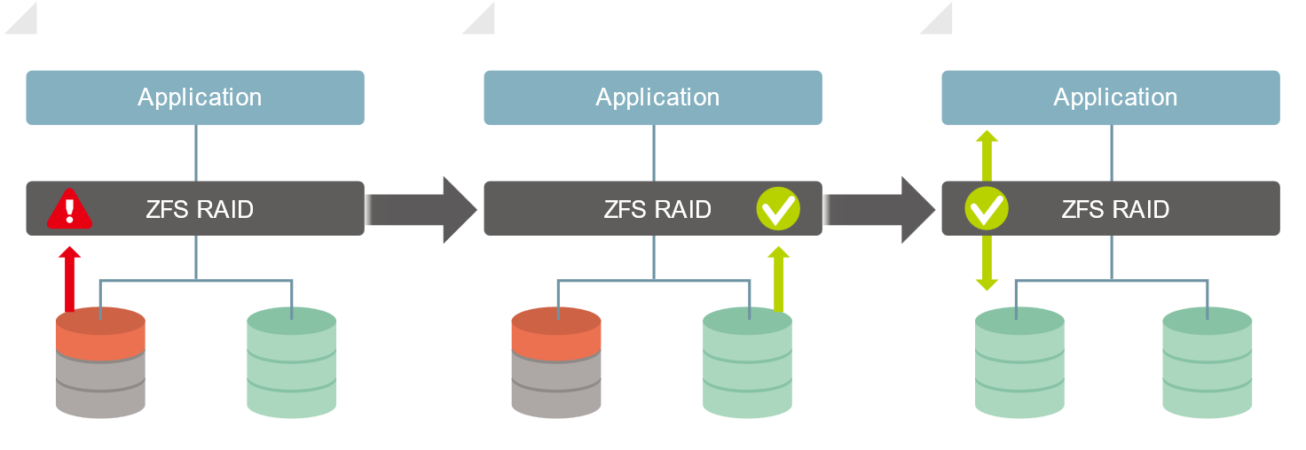
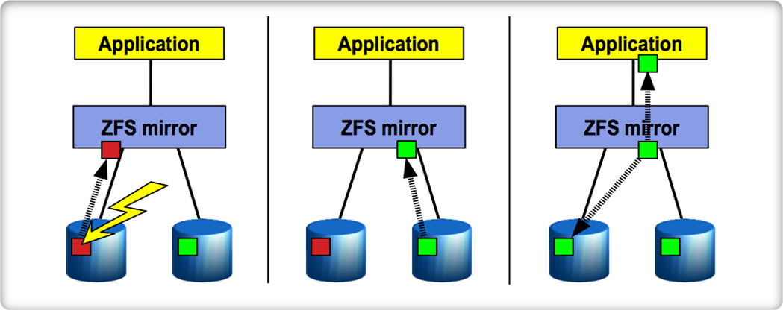




Data Integrity and Self Healing
Found that checksum and data did not match, the data was damaged.
Get the correct data from Data Copy
Submit the correct data to the application, and automatically repair the damaged data.
Avoid data silent corruption that occurred on running system
Application
Application
Application
ZFS mirror
ZFS mirror
ZFS mirror

Slide 6

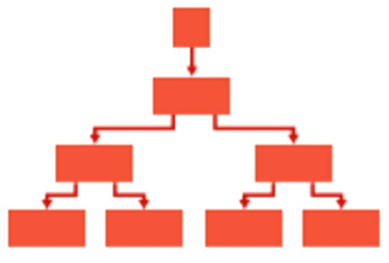
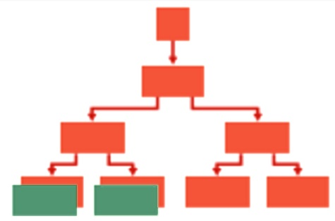


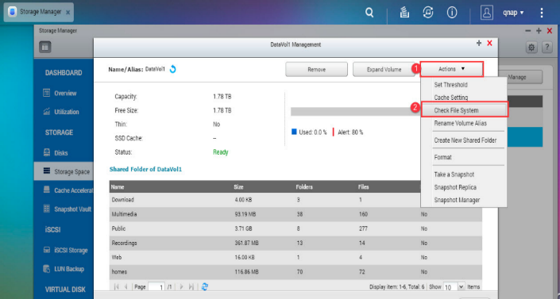

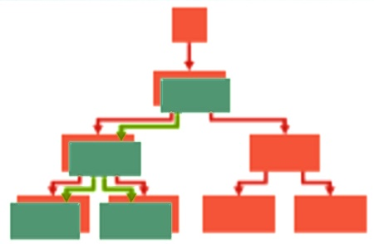
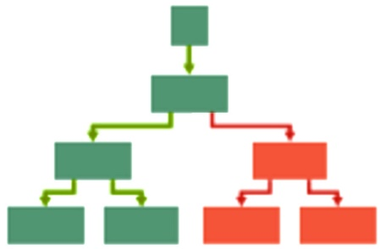

COW (copy on write) avoid data loss that occurred on power outage
ZFS has no need to use traditional journal to protect metadata, because they are never updated in-place.
COW mechanism will copy the written data to the new block and redirect the index to the new block after writing.
Original block structure
COW new block when modifying
Redirect to new block after writing
Delete the old block data
No more “check file system”

Slide 7
Chapter
02
DATA PROTECTION

Slide 8

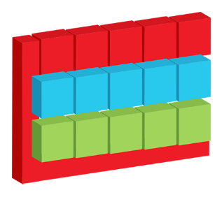
Snapshot Protection (65,536)
Shared Folder Snapshot
Snapshot Manager is operated based on shared folder.​ With [Clone], [Restore] & [Folder Revert] support.​​
LUN Snapshot
NAS Maximum Snapshot 65,536
  Shared Folder Snapshot
  iSCSI LUN Snapshot

Slide 9

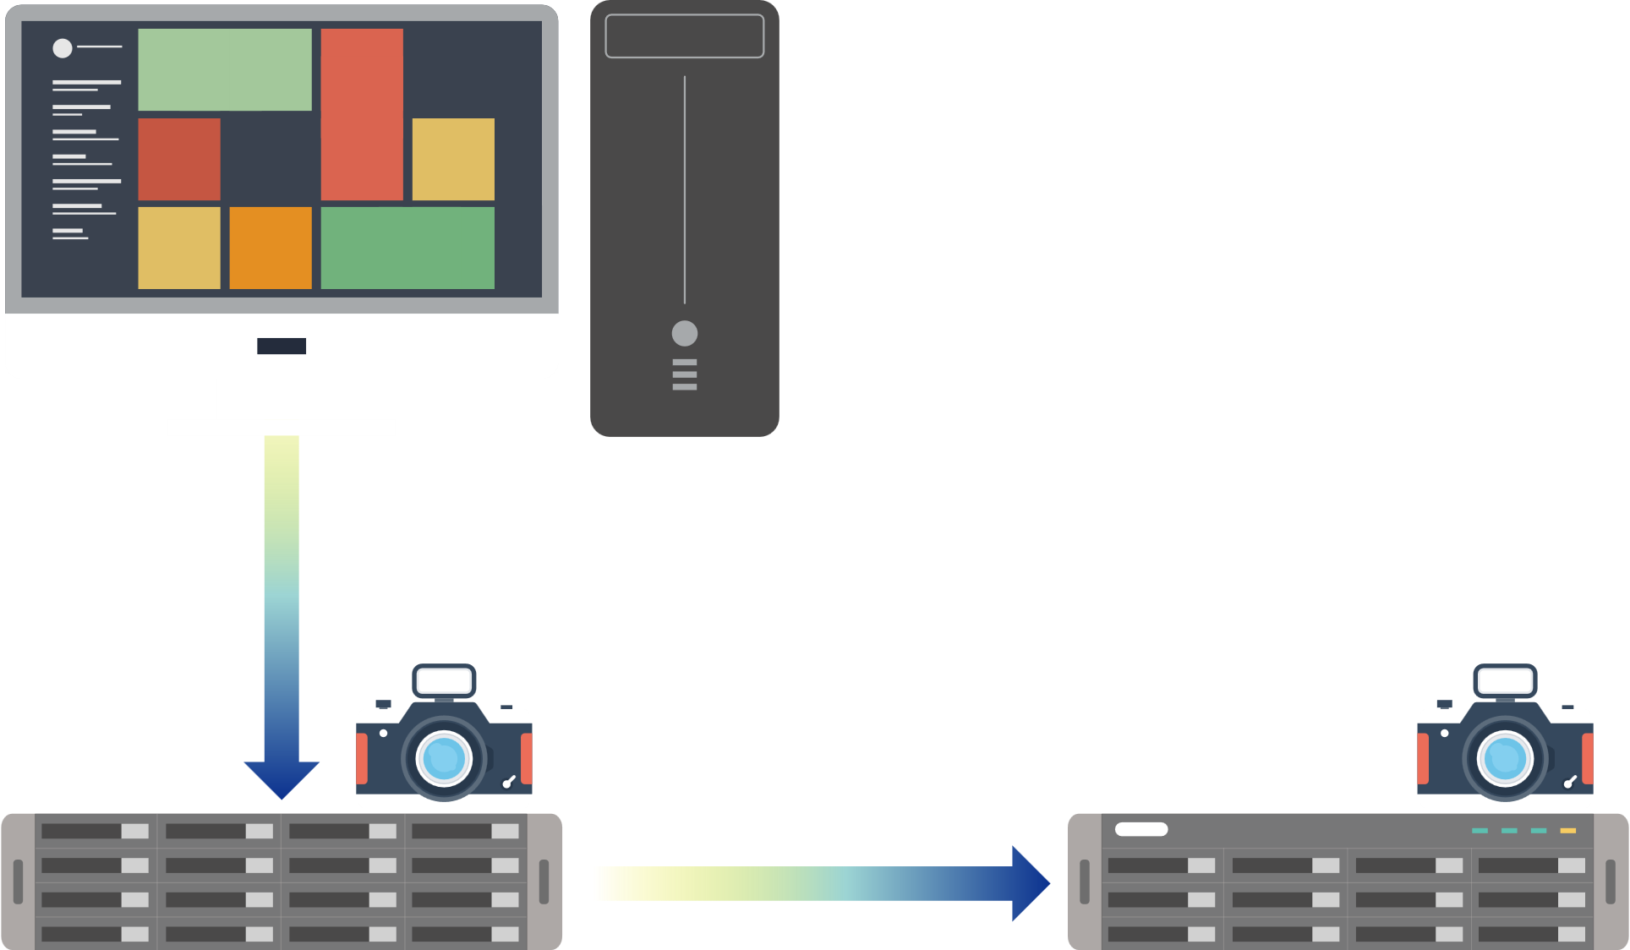
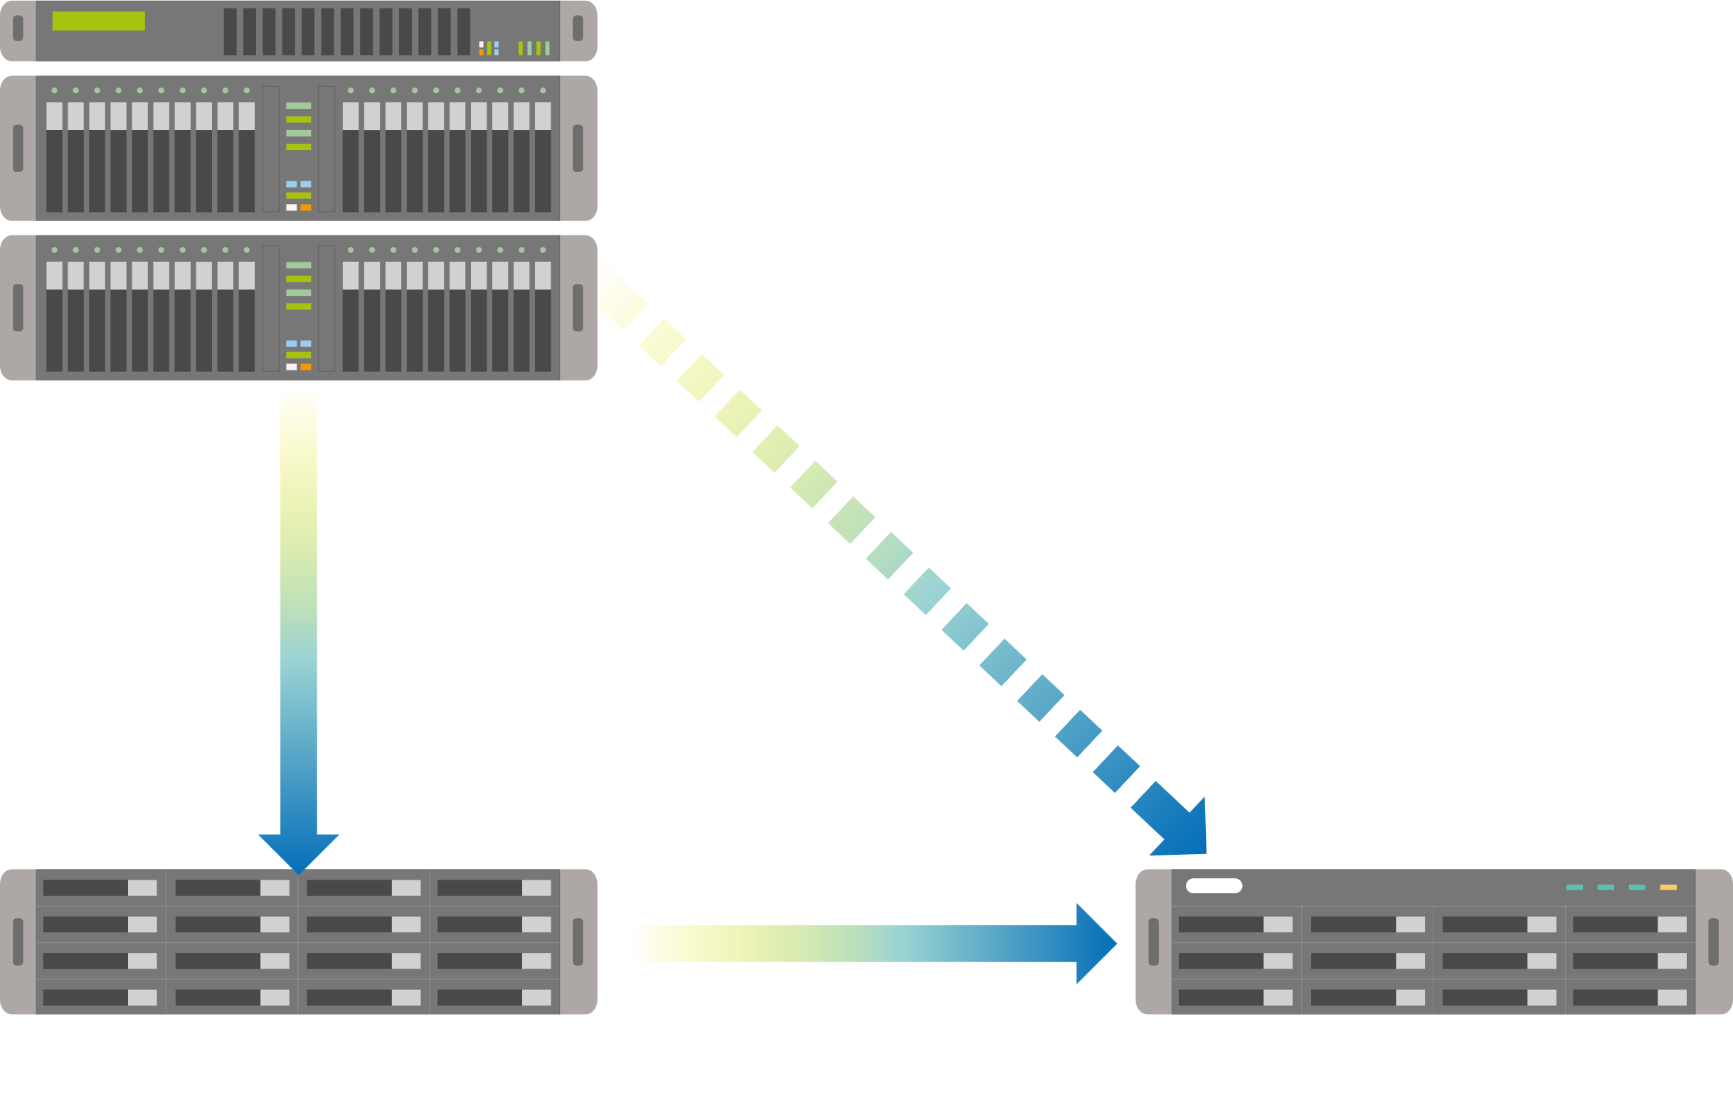
SnapSync – cost-effective replication solution for backup, data protection & disaster recovery
Scheduled SnapSync: 5min~60min
Realtime SnapSync: RPO=0
Production Server (VMware / Windows DFS / Proxmox... etc.)
Disaster Recovery
( RPO=0 )
10GbE
(around 1150MB/s)
10GbE
(around 1000MB/s, decreased by 10~15%)
Normal
Normal
by Schedule
Real-time SnapSync
Snapshot send
Direct Connected via 25GbE
Primary NAS
Secondary NAS
Primary NAS
Secondary NAS
Notes:
cost-effective replication solution for backup, data protection & disaster recovery

Slide 10
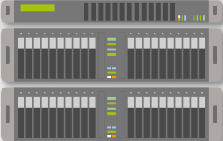
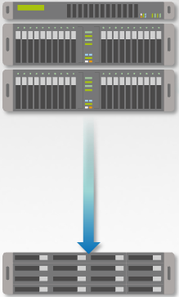
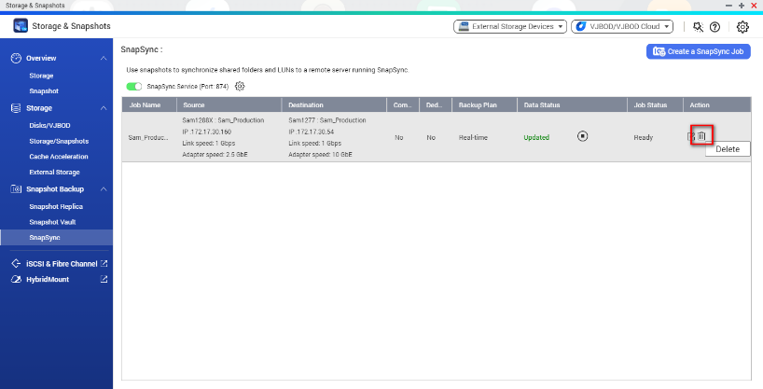



How to do when disasters happen
If unfortunately a disaster happens
(1) Delete SnapSync task
(2-A) Remount to secondary NAS IP
Primary NAS
192.168.100.100
Secondary NAS
192.168.100.200
Production Server
Production Server
Mount Target = 192.168.100.200
!
Or
(2-B) Change the secondary NAS IP as same as original primary NAS.
The exclusive permissions of the folder will be removed when deleting the SnapSync task.
NAS (Shared Storage)
Secondary NAS
192.168.100.200 => 192.168.100.100
Note: Disaster Recovery automation via VMware SRM will be supported in the future.

Slide 11
Best Practices for the configuration of Realtime SnapSync
Before SnapSync Protection
Best Practices for Configuration
After Realtime SnapSync enabled
Production Server
Production Server
Primary NAS
Secondary NAS
10GbE performance when SnapSync enabled
(1000MB/s, decrease around 10~15%)
Direct Connected via 25GbE
The I/O performance of the secondary NAS should be the same as the primary NAS.
Recommended to connect the two networks directly to avoid interference and reduce latency. (If it is a long-distance transmission, the latency should be less than 5ms, and the maximum cannot exceed 10ms, otherwise you can also consider using schedule SnapSync)
QNAP 25GbE is recommended (slightly higher than the transfer rate of production server)
10GbE
(1150MB/s)
10GbE
Real-time SnapSync
NAS (Shared Storage)
Primary NAS
Direct Connected via 25GbE
Secondary NAS
QNAP Lab Test Environment:
IO mode: sync = standard, Block size = 128K, Jumbo Frame (MTU) = 9000
Also supports QES NAS SnapSync to QuTS hero NAS
Notes:
Also supports QES NAS (QES 2.1.1 v11 or newer) SnapSync to QuTS hero NAS

Slide 12
Safer RAID types: Triple Parity & Triple Mirror
Even if three hard disks are damaged at the same time, this RAID service can keep going (redundant tolerance of 3 sets of parity information)
3 sets of identical data for redundant tolerances, will give you 3 times the protection.
Triple Parity
Triple Mirror
A1
A2
Ap
Aq
Ar
A1
A1
A1
B1
Bp
Bq
Br
B2
A2
A2
A2
Cp
Cq
Cr
C1
C2
A3
A3
A3
Dq
Dr
D1
D2
Dq
A4
A4
A4
Er
E1
E2
Ep
Eq
Disk 1
Disk 2
Disk 3
Disk 4
Disk 5
Disk 1
Disk 2
Disk 3
Disk 1
Disk 2
Disk 3
Disk 4
Disk 5
Disk 1
Disk 2
Disk 3

Slide 13




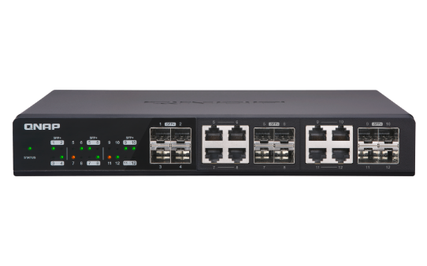
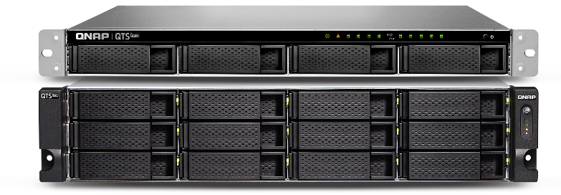
Three-layer backup solution:
Provide you the most complete data backup protection
HBS 3:
File level, multi-version management
RPO: daily / schedule
Snapshot & Replica:
Block level, multi-version management, ZFS provides the most lightweight snapshot without affecting storage performance at all.
RPO: hourly
SnapSync:
Block level, Mirror the data copy and always kept up to date.
RPO: Realtime
QTS 4.4.x

Slide 14






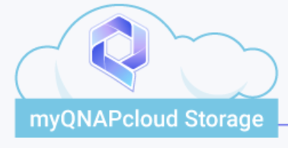



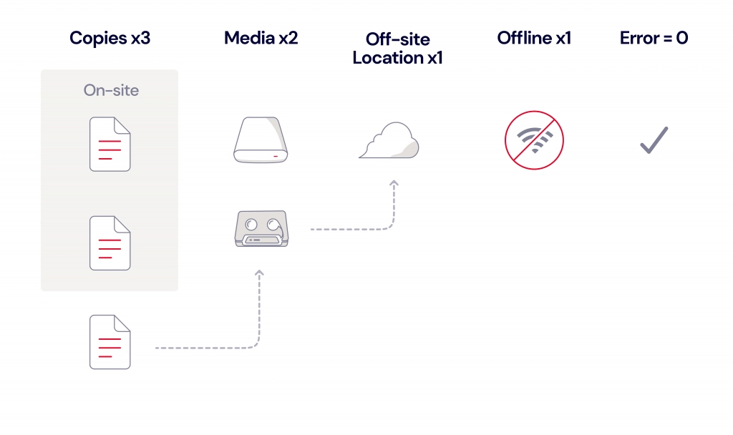
New Backup Golden Rule
Backup 3-2-1-1-0
At least 3 copies of your data.
Store the backups on 2 different media.
At least 1 of the copies at an offsite location.
At least 1 of the copies offline(immutable backup).
Verified backups without errors.
Copies x3
Media x2
Off-site
Location x1
Offline x1
Error = O
On-site
Multiple Clouds
Local NAS
QNAP NAS

Slide 15

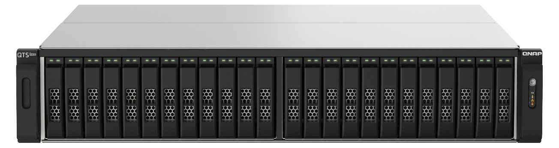

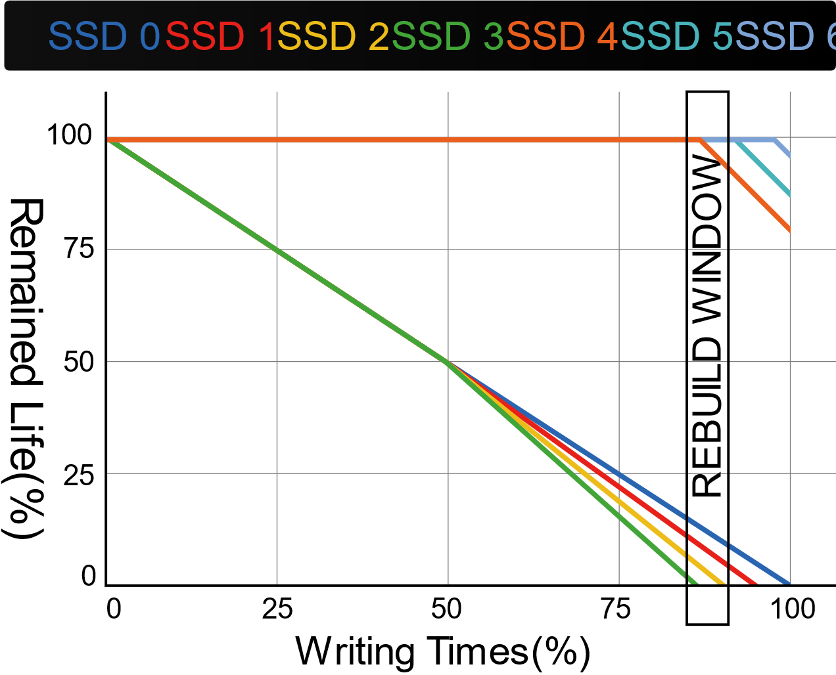

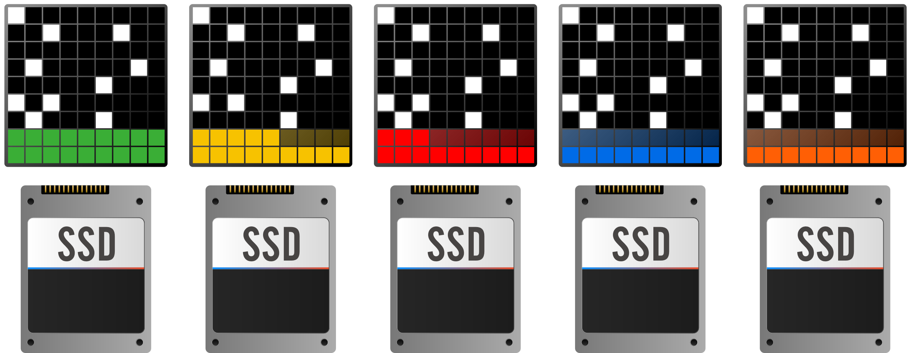
QNAP Patented QSAL technology: preventing multiple SSD malfunctioning at the same time
QSAL
dynamic distribution
QSAL (QNAP SSD Anti-wear Leveling) When SSD life falls below 50%, the SSD OP would be dynamically adjusted to achieve the life control of each SSD, and to ensure that there is enough rebuild time at the end of the previous SSD life to avoid RAID damage.
For SSD RAID 5 / 6 / 50 / 60 / TP (Triple Parity), QSAL will be enabled by default automatically.

Slide 16




WORM (Write Once Read Many times)
WORM is used to avoid modification of saved data. Once this feature is enabled, data in shared folders can only be read and cannot be deleted or modified to ensure data integrity.
Enterprise Mode: remove the shared folder through QuTS hero UI or SSH commands (QCLI).
Compliance Mode: Have to take the Storage Pool offline and remove the Pool if want to destroy data.

Slide 17




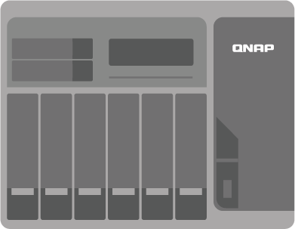
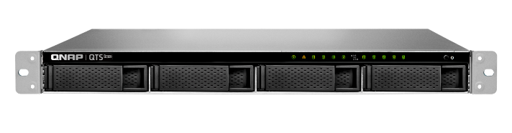

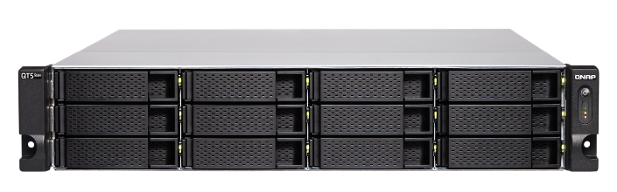


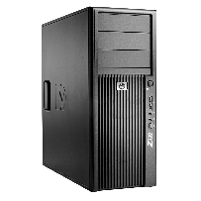


AES-NI accelerated for SMB3 Signing and Encryption
150 MB/s
AES
AES
H/W
acceleration
H/W
acceleration
450 MB/s
AES-NI
AES-NI
AES-NI accelerated for SMB3 Signing and Encryption
PM 手繪草圖說明, 再協助微調圖示

Slide 18
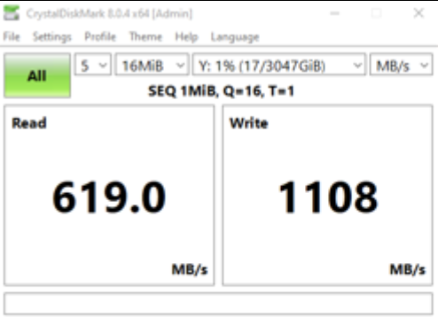
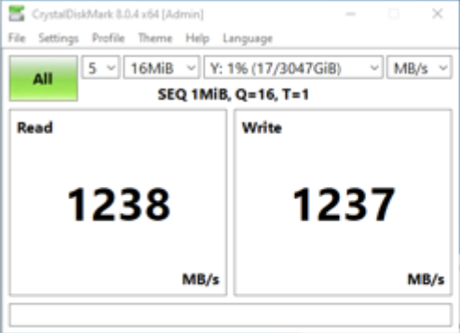
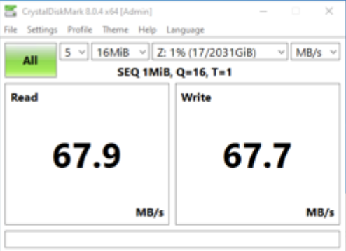
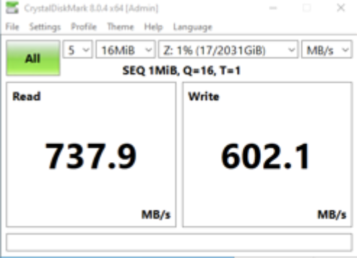
SMB Signing with GMAC: Secure and Fast!
In 10 GBs network, AES-NI enabled CPU, new GMAC algorithm outperforms the former CMAC one significantly.
CMAC
GMAC
x86
X2 Faster
ARM 64
X10 Faster
TS-h1887XU
TS-1232PXU

Slide 19


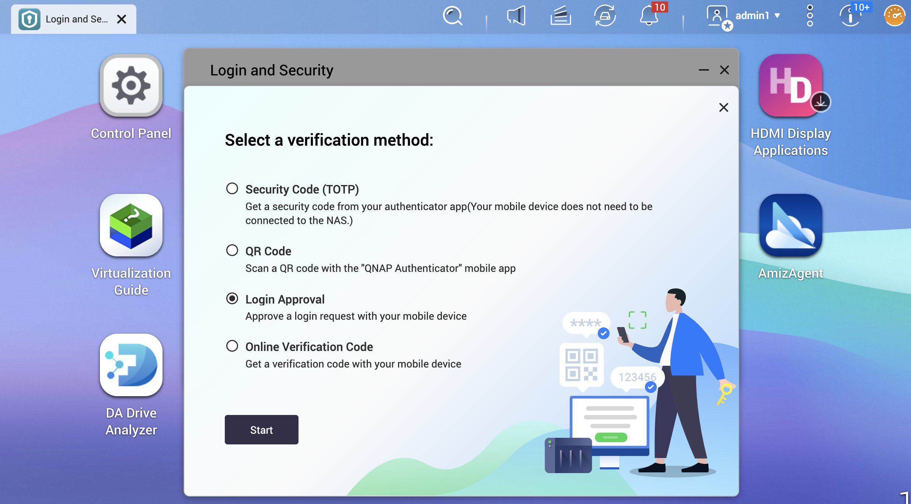
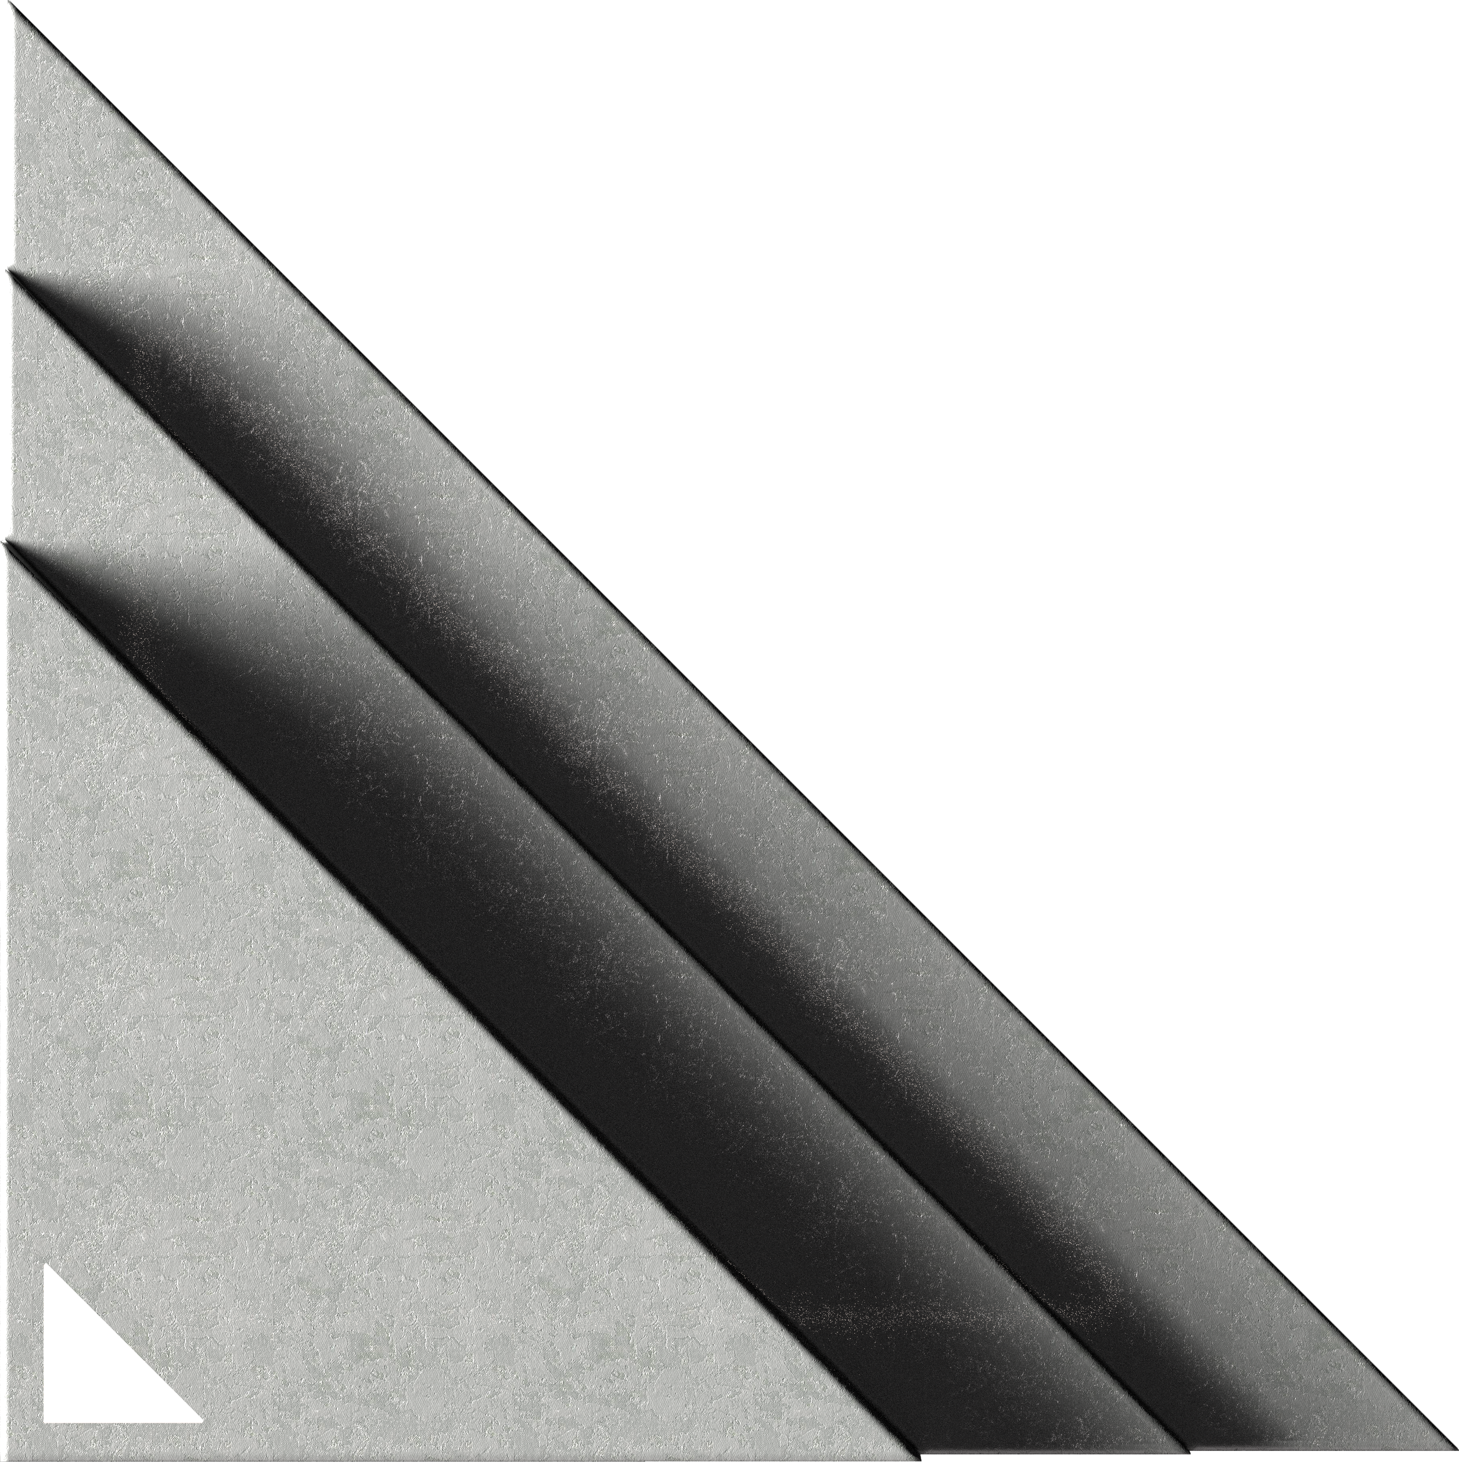
QNAP Authenticator
New 2 Step Verification
Password
Options with
Security Code (TOTP, Time-based One-Time Password; Mobile device does not need to connect to NAS)
QR Code
Login Approval
Online Verification Code

Slide 20
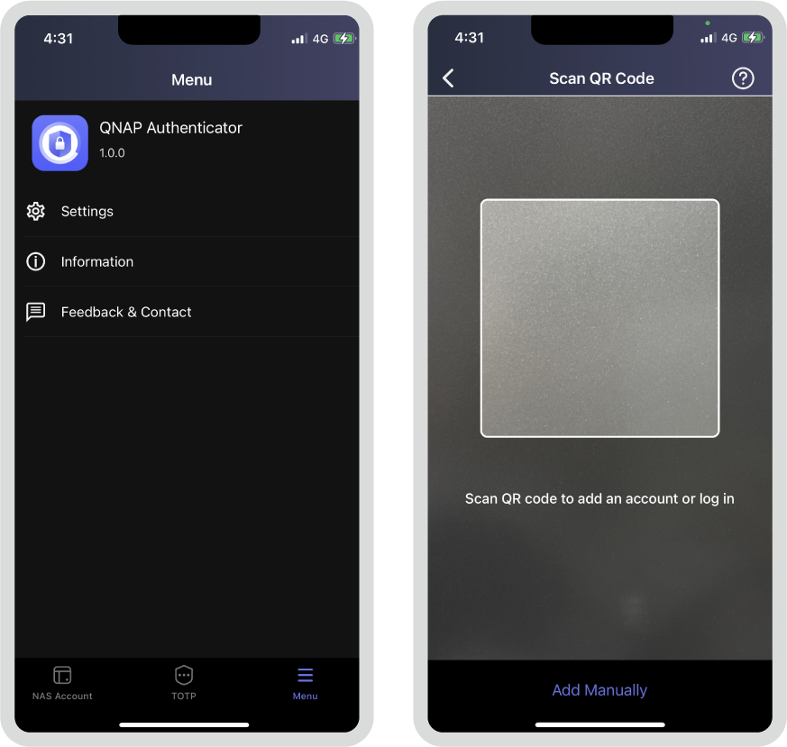
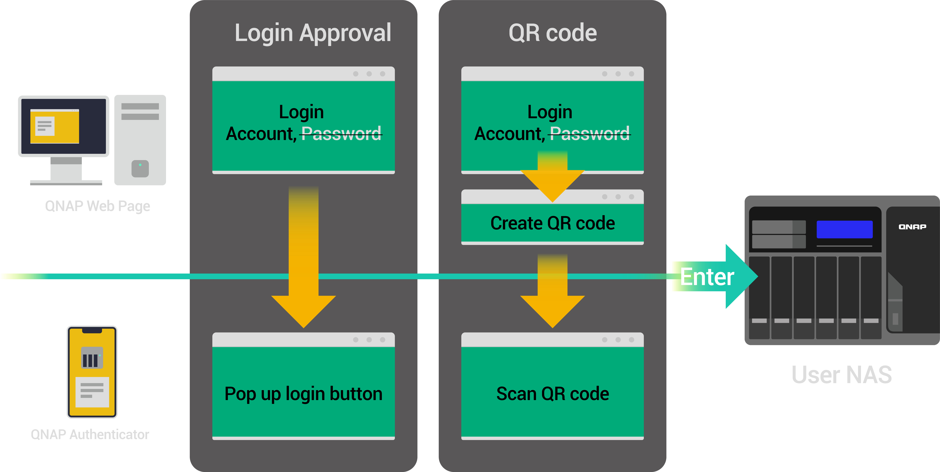
QNAP Authenticator: Passwordless
If 2 Step Verification is not necessary, QNAP Authenticator can still let you not to memorize password by “Log-in Approval” or QR Code

Slide 21
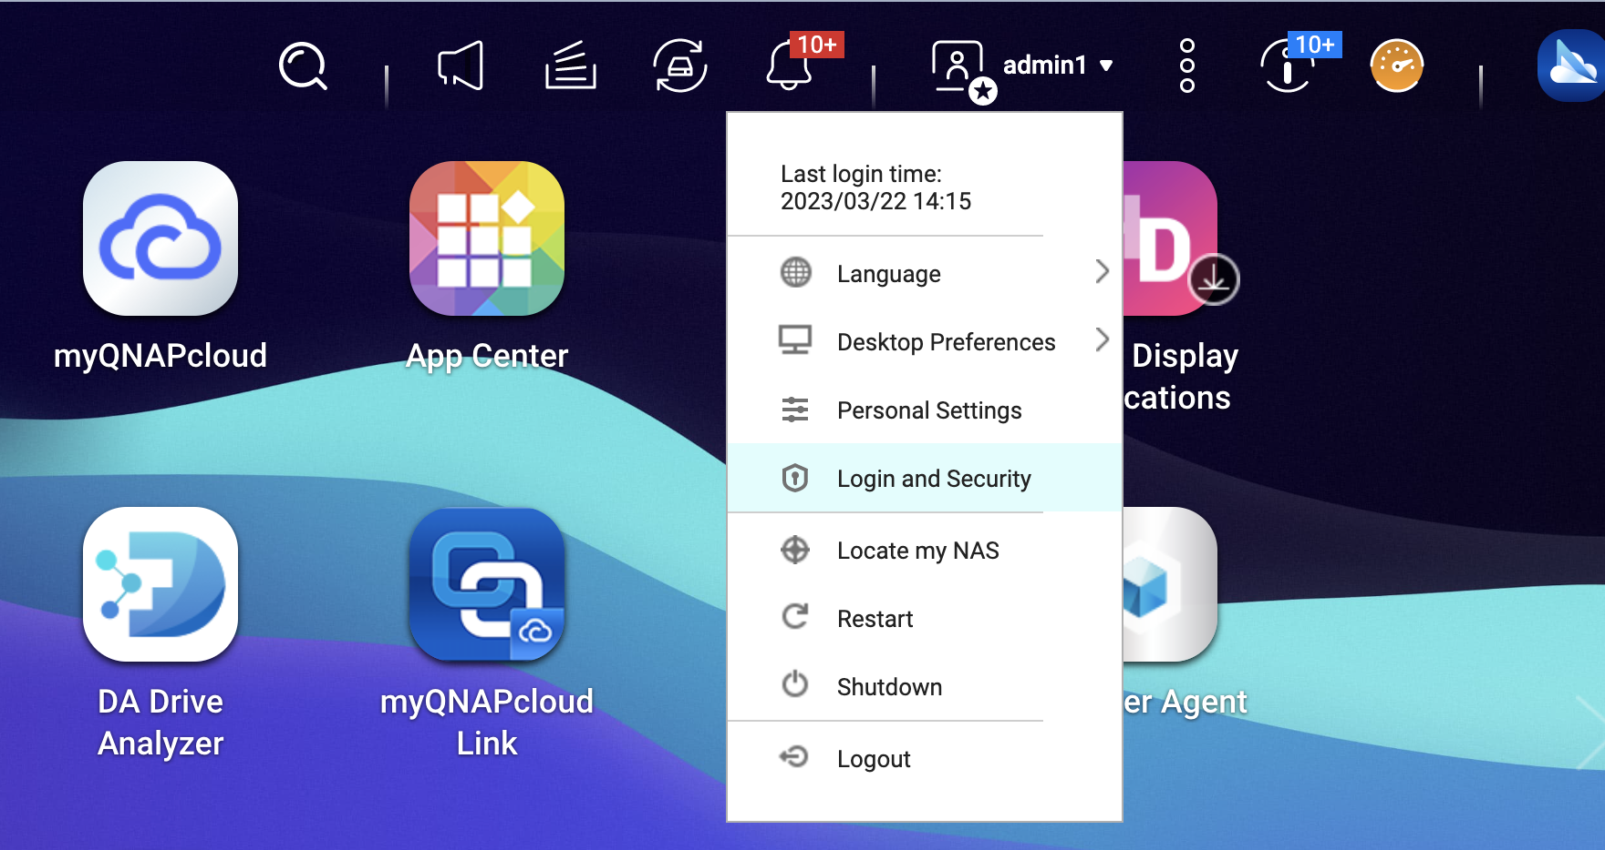
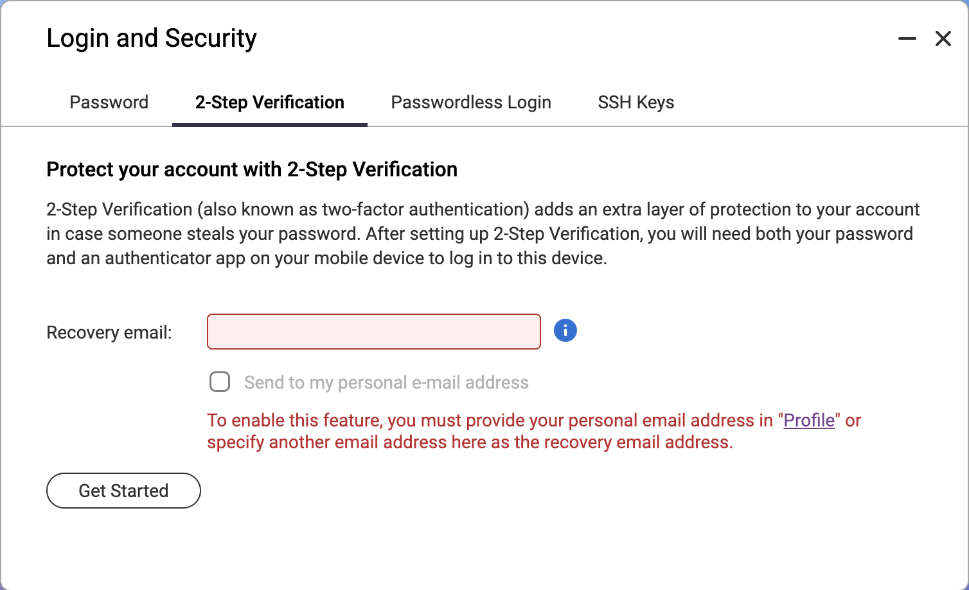
Configure from “Login & Security”
[Note] to send a recovery email, the QTS should login to QNAP ID, or the SMTP service should be enabled on Notification Center

Slide 22
Chapter
03
DATA EFFICIENCY

Slide 23
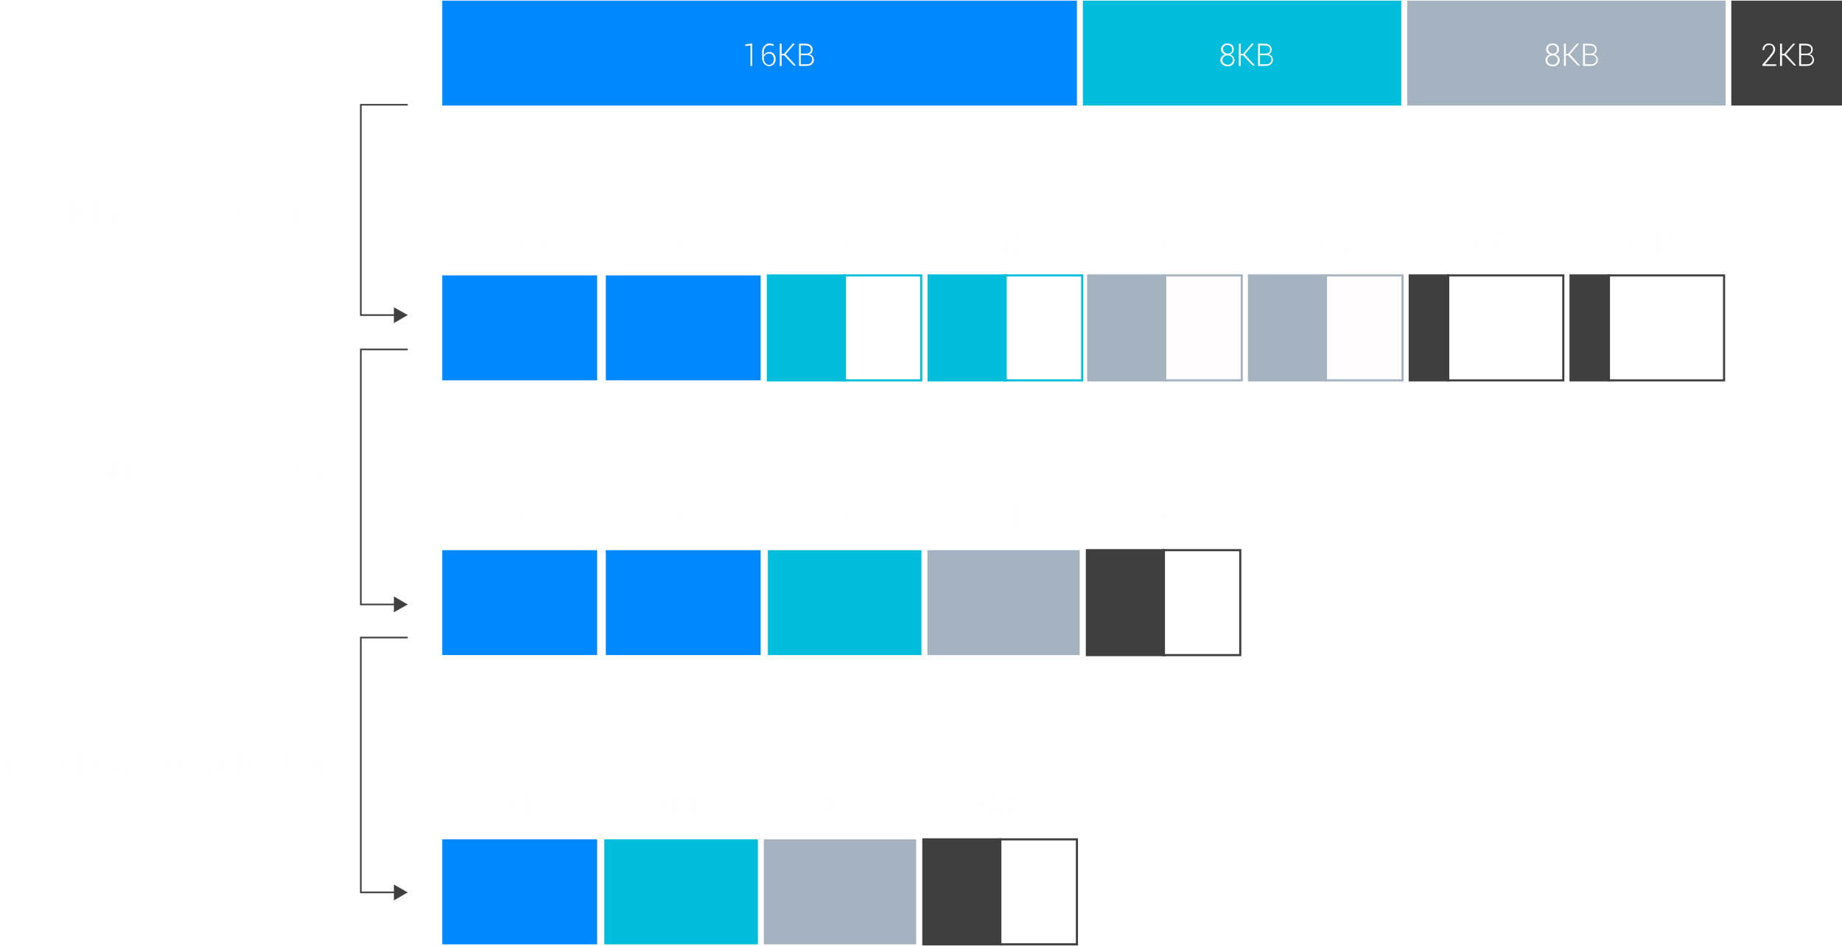
Data Efficiency with Powerful Data Reduction
Inline data deduplication is block-based and runs before data is written to storage. This greatly optimizes storage usage while significantly decreasing storage capacity requirements. Coupled with inline compression and inline compaction technologies, ZFS significantly reduces the overall storage footprint - especially helpful for increasing SSD storage efficiency when highly-repetitive data or massive small files are generated. All-flash solutions thus achieve higher cost efficiency while improving both random write performance and SSD lifespan.
Deduplication requirement:
minimum 16GB RAM
Recommended 64GB RAM or more

Slide 24
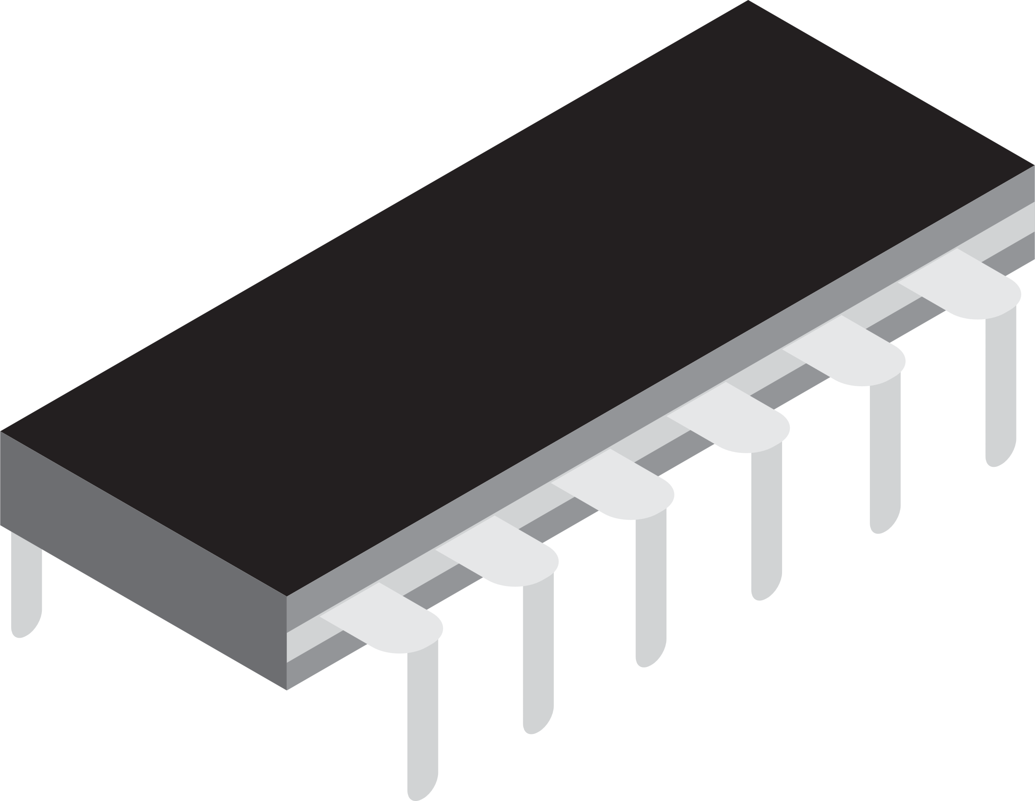
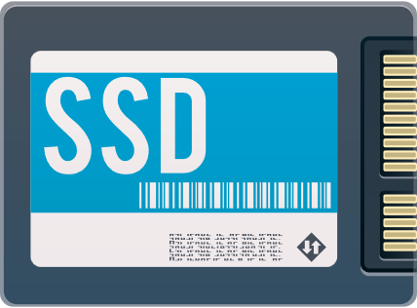
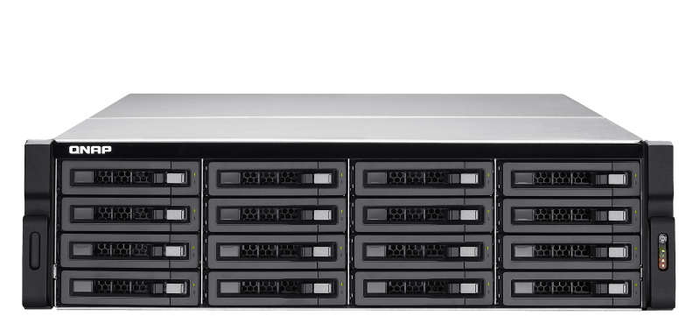
L2ARC cache, and ZIL which provide power loss protection
Layer-2 Adaptive Replacement Cache: (L2ARC) ​
Ideal for SSD read cache​​
Large "hybrid" cache​​
Read performance enhancements
ZFS Intent Log: (ZIL) ​
Ideal for SSD write log​
Write Data integrity​ (COW)
Provides the power loss protection for writing data.
RAM Read Cache
SSD write journal
ARC
RAID 1
Mirror
SSD Read Cache
L2ARC
ZIL
Disk
Storage Pool

Slide 25
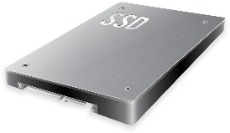
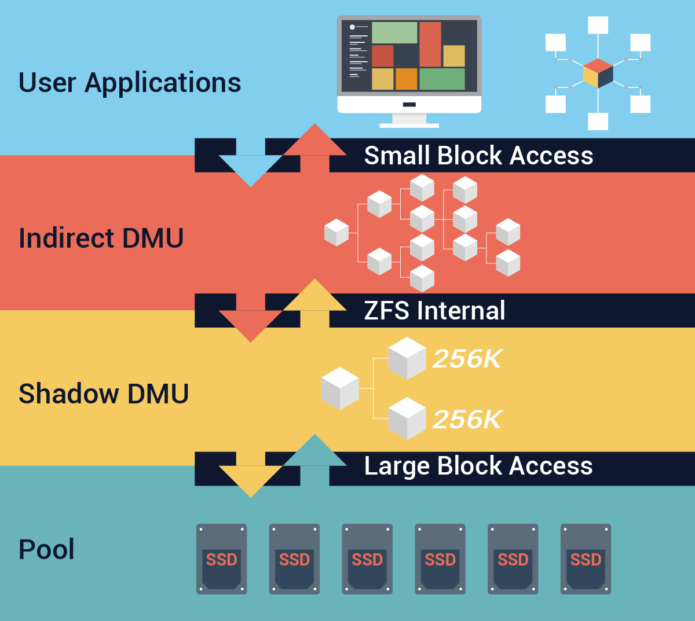

Write Coalescing: improve the random access
QNAP exclusive Write Coalescing algorithm that transform all random write to sequential writes along with reduced I/O.

Slide 26
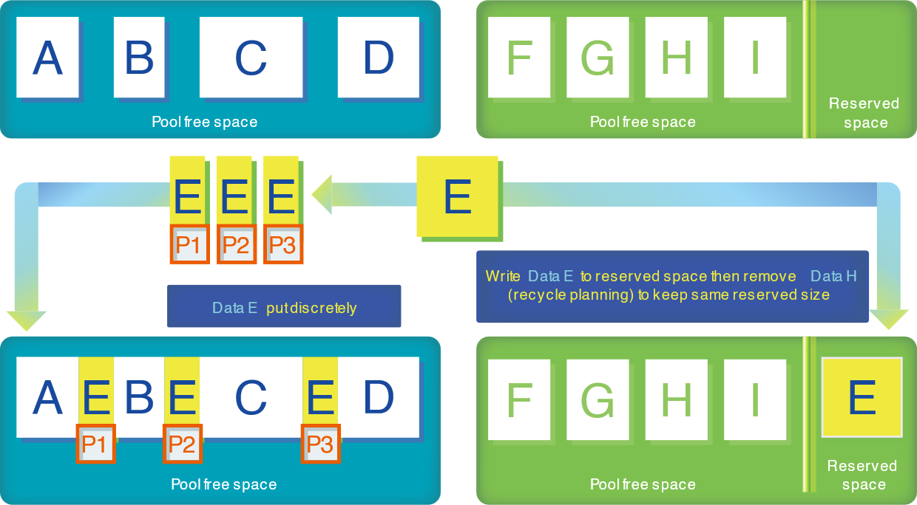
Pool over-provisioning: Improve the performance for fragmented pool (The scenario when big block write to HDD )
w/o OP
w/ OP

Slide 27
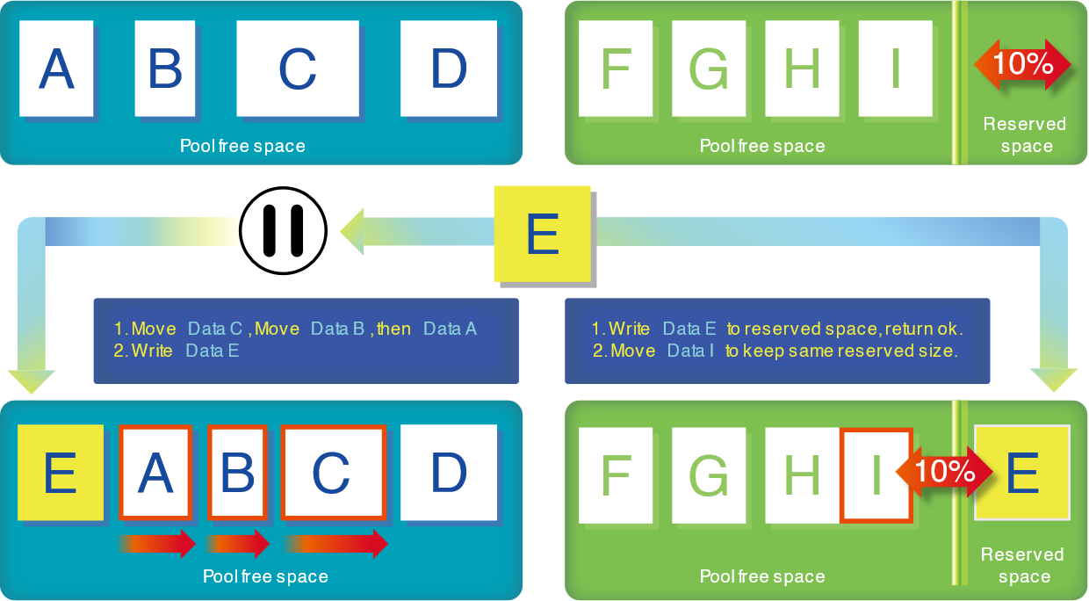
Pool over-provisioning: Improve the performance for fragmented pool (The scenario when big block write to HDD )
w/o OP
w/ OP

Slide 28
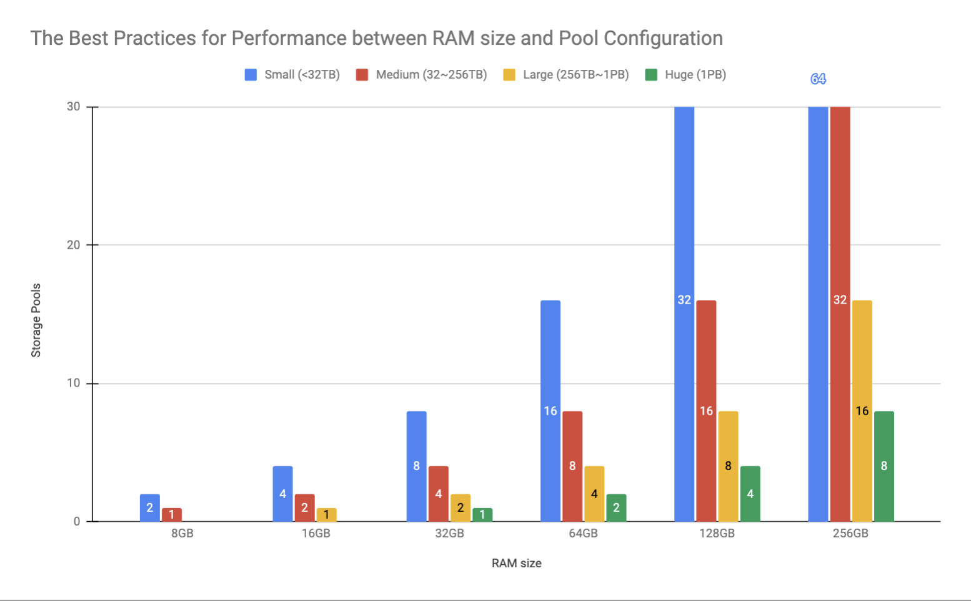
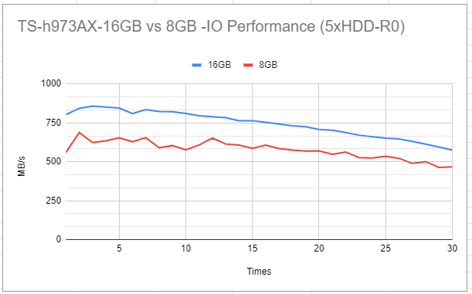
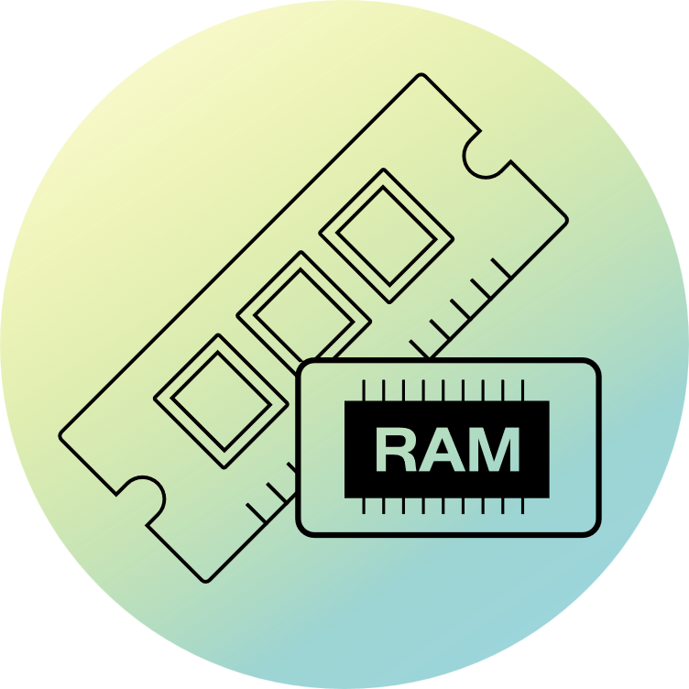
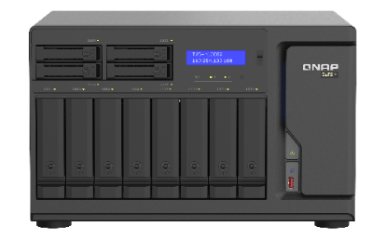




ZFS structure consideration:
Performance dependency between memory size and storage pools
Using entry-level model TS-973AX as a reference,
We already created one SSD pool and one HDD pool around 35TB. The performance difference of the HDD pool is displayed
RAM
Used Storage size (TB)
Choose sufficient memory for different storage configurations for better performance.

Slide 29

SMB Multichannel
A SMB 3 client automatically establishes multiple connections to the SMB server for single SMB session, and with the multiple connections achieves bandwidth aggregation and netowork fault tolerence.
Without Multichannel
With Multichannel
Faster!
Network fault tolerance!

Slide 30
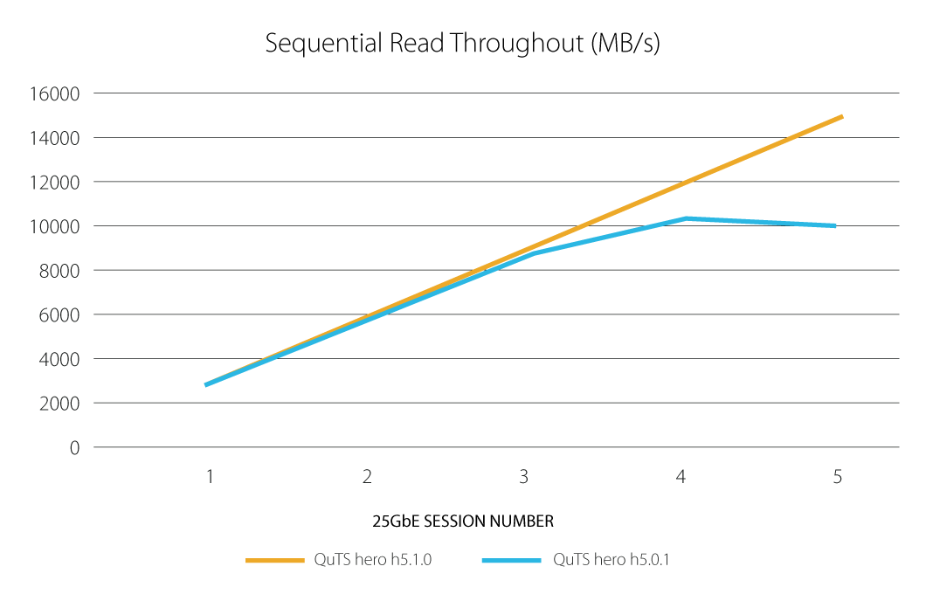
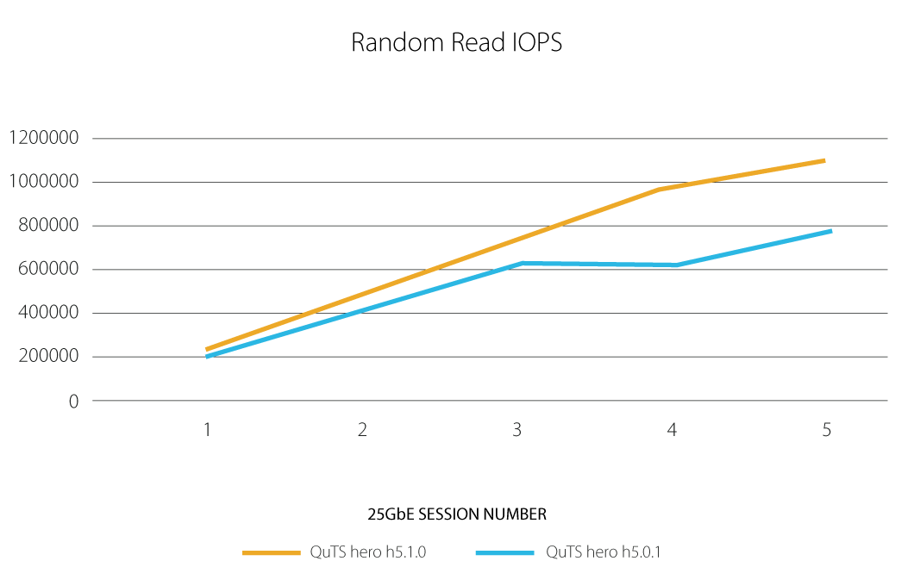
Improved iSCSI read performance by socket zero-copy
In high-speed data transmission, iSCSI performance is possibly affected by CPU overhead. QuTS hero 5.1 supports socket zero-copy technology that significantly offloads CPU resources, thus improving read performance for iSCSI LUN.

Slide 31
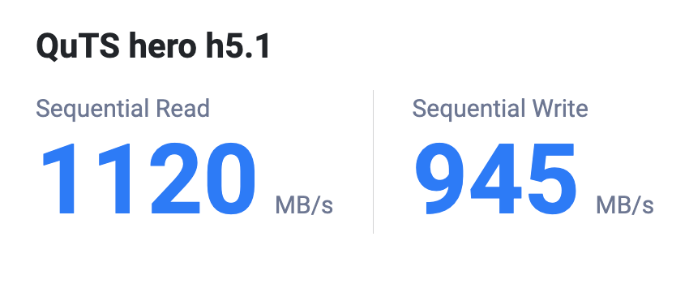

Enhance the performance of encrypted folders/LUNs
You can encrypt the contents of specific shared folders and LUNs to prevent unauthorized access. From QuTS h5.1, the performance of encrypted shared folders and LUNs has been greatly enhanced.
Test environment:
Crystal Disk Mark 32GB pattern size
Client: Windows Server 2022 (AMD EPYC 7232P 3.0GHz, DDR4 128GB) with 1 x 25GbE NIC
NAS: TVS-h474, QuTS hero h5.1, M.2 SSDx2 Raid1 Pool / share folder / encrypt share folder

Slide 32
Chapter
04
STABILITY & SCALABILITY

Slide 33


SAS 12Gb/s JBOD Expansion
  QXP-1620S SAS HBA (Optional)
  Each NAS can connect up to 16 JBODs (REXP/TL-R1220Sep/TL-R1620Sep)
  Each NAS supports 256 HDD Drives for 4.6PB of raw capacity

Slide 34

Up to 5 petabytes capacity per shared folder
The 128-bit ZFS filesystem has huge capacity potential and supports native handling of standard RAID levels and additional ZFS RAID layouts (RAID Z). ZFS-based QNAP storage solutions provide up to 5 PB capacity for individual shared folders, enabling enterprises to tackle storage-demanding applications including Big Data analysis, edge computing, and AI. Designed to deal with petabytes of data, RAID Z quickly handles creating ready-to-use high-capacity RAID.

Slide 35



Recommended to use ECC Memory
(Error Correcting Code)
Higher reliability and data integrity
Order more RAM on QNAP website
The NAS supports ECC memory for auto error correction. ECC is not mandatory for ZFS. It's just a really, really good idea. It allows ZFS to make its data integrity guarantees that it claims to make. Any data storage on any filesystem will benefit from ECC RAM.

Slide 36
Expand ZFS RAID-Z capacity
Expanding the capacity of a ZFS RAID-Z previously required adding another RAID group. Now, you can simply add a single disk to an existing RAID-Z for storage expansion, or conveniently add 2 to 3 disks for upgrading RAID level with Parity.
The minimum number of disks for expanding RAID capacity:
Current RAID level | New RAID level | Minimum disks required
RAID 5 (Z) | RAID 6 (Z2) | 2
RAID 5 (Z) | RAID TP (Z3) | 3
RAID 6 (Z2) | RAID TP (Z3) | 2
RAID 5 (Z) | RAID 5 (Z) | 1
RAID 6 (Z2) | RAID 6 (Z2) | 1
RAID 1 | RAID Triple Mirror | 1 (only 1 disk can be added)

Slide 37

AI Prediction for Drive Health -
DA Drive Analyzer
Prevent the long service down time or data loss because of the sudden failure of the drive. New improvement to arrive!

Slide 38


Predictive Migration
Depending on the drive health analytical tools, selected conditions can trigger data migration to the spare disk.
S.M.A.R.T.
WDDA
IHM
DA Drive Analyzer
SSD Estimated remaining life

Slide 39

Predictive Migration:
Protect Your Data Before Drive Fails.
When a drive has failed, RAID will rebuild its data to the new drive. Depending on the CPU or Drive bottlenecks, RAID rebuild can take days to weeks to complete, due to the process of heavy calculation.
On the other hand, before a drive fails, when the system can detect the risk of drive failing, it may start to migrate the data to the spare drive. Such process should complete within hours, because it copies the files and synchronizes without calculating from the RAID strips.

Slide 40
Chapter
05
Management & Application

Slide 41





More detailed Access Control
14 Windows ACL Permission

Slide 42































Convert your local storage to public cloud with different protocols
File based CSP
Object based CSP
HDD volume for cloud gateway
SSD volume for local service
HybridMount
QuObject
Support different protocol
SMB, AFP, NFS, iSCSI, FTP, FibreChannel, S3, WebDAV
Application Server
(iSCSI Initiator)

Slide 43
Delegated Administration
Administrator group users have the highest privileges including access sensitive data.
User group users have almost none administrative privileges.
Sole administrator may cause heavy workloads and poor responsiveness.
Many administrators may cause improper authority and pose the risk of data leakage.

Slide 44
New 8 Roles delegateable to the User group users
Administrator Have full authority of the NAS, and the only role who can delegate roles. | System Management Have the most administrative capability under Administrator including all privilege of other delegated roles. | Backup Management Manage and monitor backup jobs of the NAS.
Backup Operation Execute backup jobs of specified shared folders. | User and Group Management Create or delete local accounts for individual users and groups. | Shared Folder Management Manage shared folders and grant access rights for users or groups.
Application Management Install, update, and manage apps in the App Center. | Access Management Manage overall accessibility of the NAS. | System Monitoring Oversee utilization of NAS system and storage resources.

Slide 45

AMIZ Cloud
One portal, multiple systems.
Organized management
(via Organization Center).
Dashboard of system health
Customized threshold alerts with various notification methods
Central App management
Basic system management

Slide 46

Grouped by Organization Center,
Managed in Amiz Cloud
https://www.qnap.com/en/software/amiz-cloud
https://organization.qnap.com/

Slide 47

Option for Fixed NFS Service Ports
NFS dynamically assigns service ports which can cause problem of firewall configuration. New advanced option to set the static ports saves the trouble of firewall reconfiguration when NFS restarts.

Slide 48





Recomended Models
TS-h2490FU
TS-h1290FX
TVS-h874T
TS-h3087XU-RP
TBS-574TX

Slide 49
Copyright© 2023 QNAP Systems, Inc. All rights reserved. QNAP® and other names of QNAP Products are proprietary marks or registered trademarks of QNAP Systems, Inc. Other products and company names mentioned herein are trademarks of their respective holders.​​​​​​​

