Slide 1
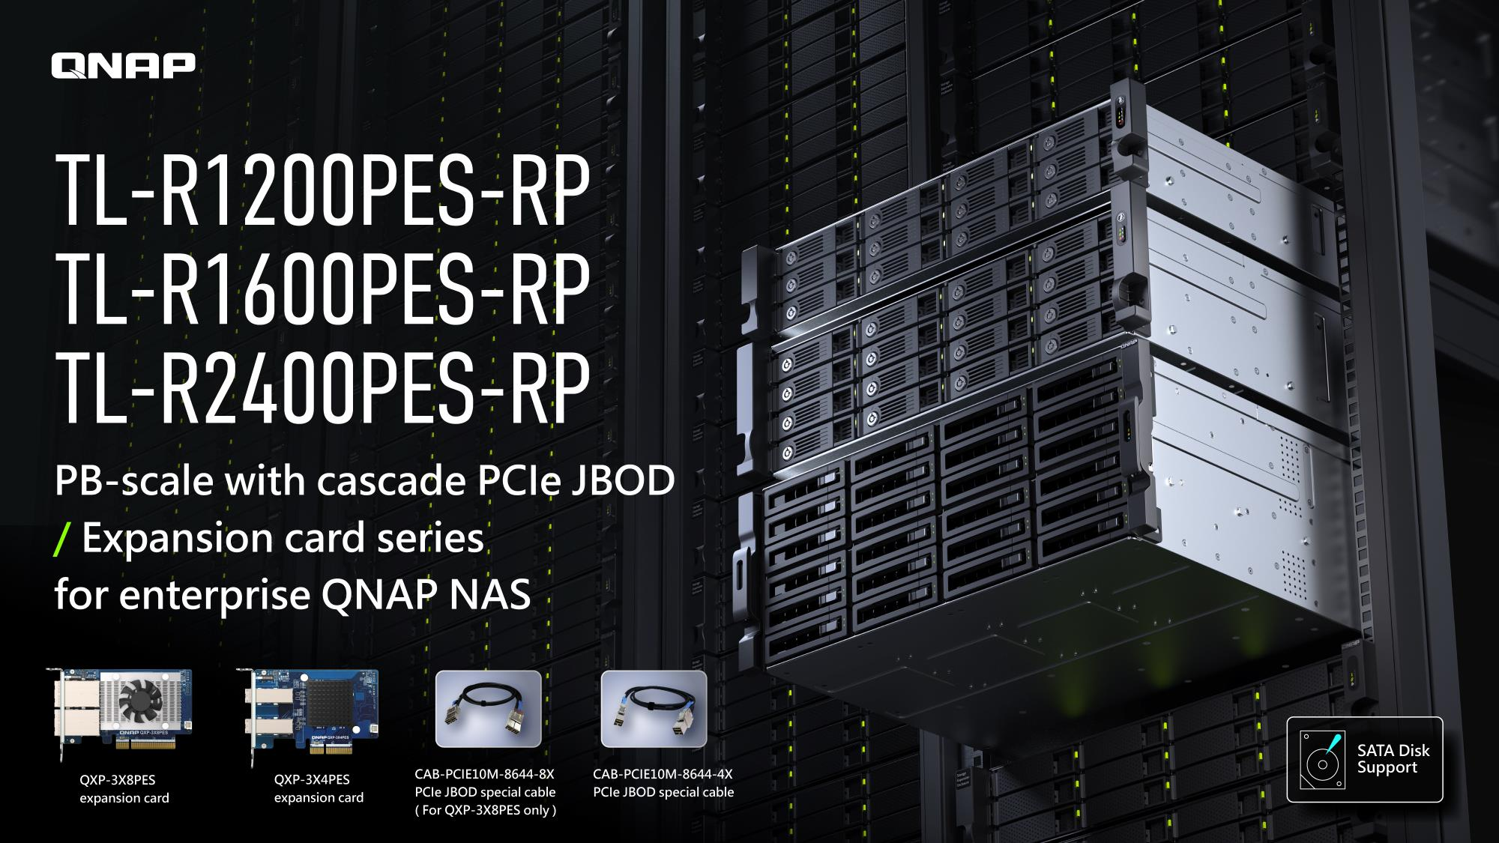

Slide 2

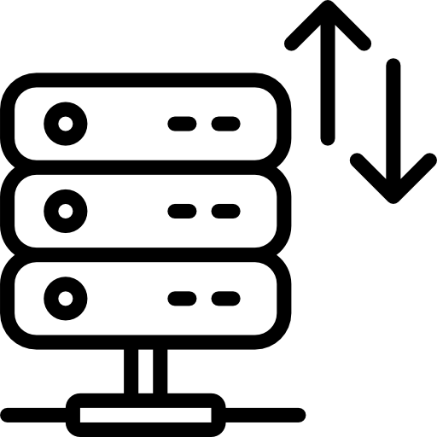



TL-R1200PES-RP, TL-R1600PES-RP
TL-R2400PES-RP petabyte-scale storage
PB-scale solutions
Maximum 12 JBODs supported
PB
Scale
SATA HDD (22 TB Each) with 12 units in series for a total capacity of 4 PB
A single NAS can support up to 12 TL PES SATA JBOD units (depending on the NAS platform and the number of PCIe slots, please refer to the NAS/JBOD compatibility list)
Bandwidth up to 64 Gb/s
Support up to 288 SATA drives
With the QXP-3X8PES expansion card, the bandwidth can reach up to 64 Gb/s, making data transfer much faster
12 x TL-R2400PES-RP JBOD can support up to 288 cost-effective (SATA) disks
Host-based power management
Hot-swappable functionality for easy migration
HOT
SWAP
In addition to supporting hot-swappable hard drives, JBOD hot-swappable is also provided, making it faster for IT personnel to migrate large amounts of data between NAS models
JBOD power status is linked with the host NAS, which helps to reduce hardware management tasks for IT staff.
12吋短機箱可支援市面上大部分的機櫃
內建2埠M.2(PCIe Gen 3 x1)，可提供SSD快取，加速隨機存取的速度
PCIe Gen 3 x 8插槽，提供各式應用的高速擴充卡
雙系統靈活切換配置QTS and QuTS hero

Slide 3
Budget-conscious 1PB space?
Private on-premise cloud v.s. public cloud
AWS S3 public cloud storage cost is calculated based on the western US region with 1 petabyte (uploading 85 TB per month) which costs about US$25,500, and you need to pay separately for removing data. QNAP has launched the new TL PCIe Interface SATA JBOD, which uses 2 x TL-R2400PES JBOD, 1 x QXP-3X8PES expansion card and 46 x 22TB hard drives, with a total cost of only $24,500. Buying the NAS with JBOD can provide significant cost saving in the long run.
 | Private cloud expansion | Public cloud augmentation
Control | Take full control | Partial control
Sensitive data security | Higher | Could be lower
Hardware required | Necessary | Unnecessary
Configuration | Customize | Preset configurations
Scalability | limited | Higher
Performance | Higher | Lower
1PB cost | low | Ignore (does not include cost of reading data)
Link: https://aws.amazon.com/tw/s3/pricing/
Notes:
\

Slide 4
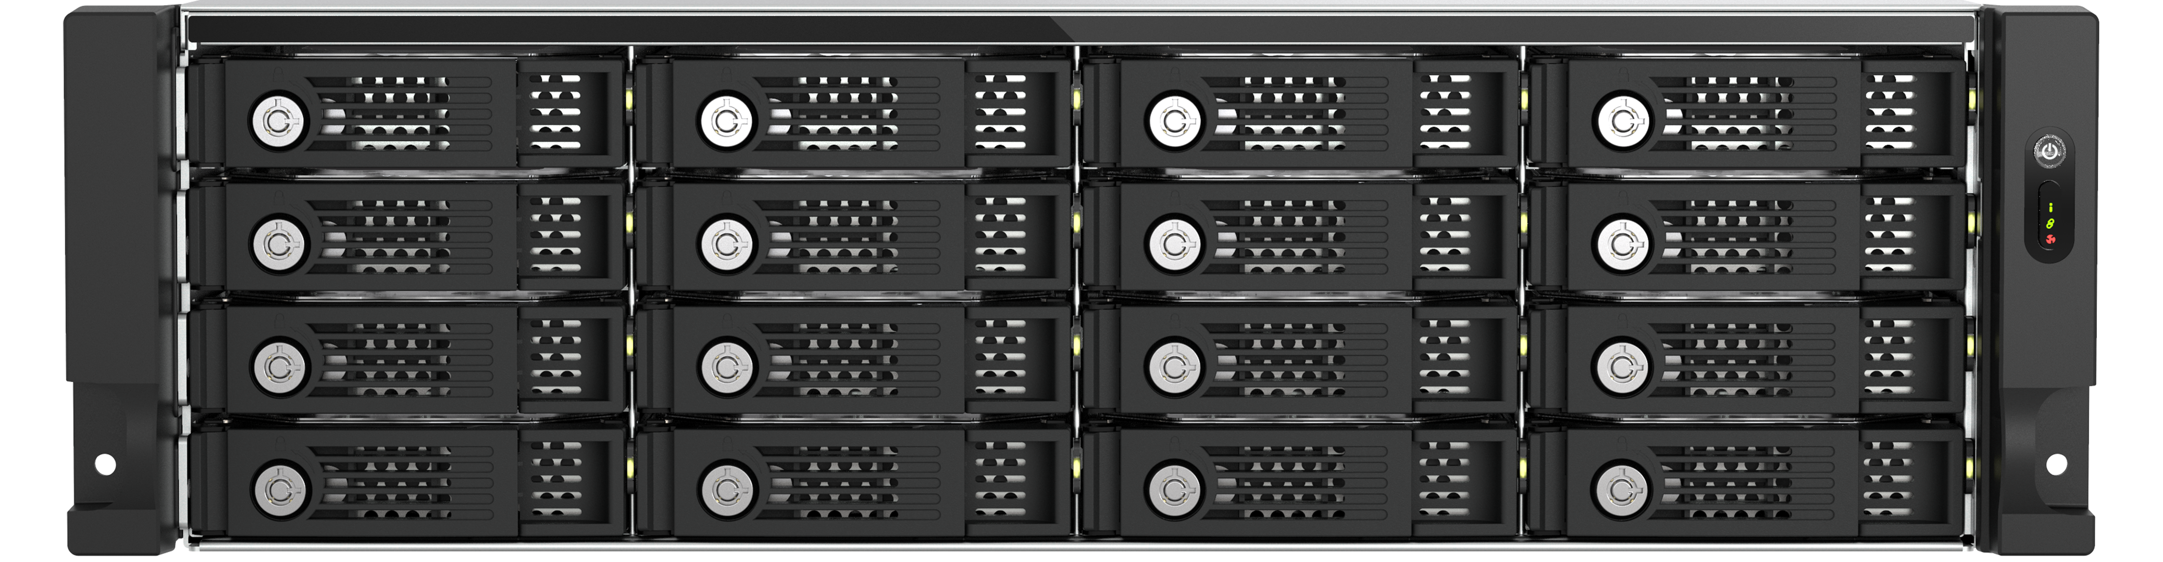
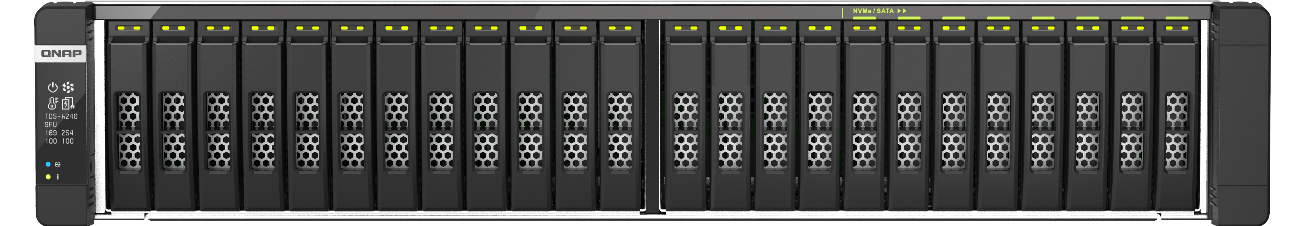
Add additional PB storage for
QNAP all-flash NAS models
Enterprise - All-Flash NAS series
Rack-mounted PCIe JBOD series
TL-R1200PES-RP, TL-R1600PES-RP, TL-R2400PES-RP
As enterprises set up QNAP‘s high-speed, all-flash NAS storage devices, IT can expand the QNAP PCIe JBOD series to reach up to 4 petabytes of storage capacity whenever the company grows with more storage need.
To find out what NAS models that are compatible with PCIe JBOD, refer to the compatibility list below
https://www.qnap.com/go/compatibility-expansion/pcie

Slide 5
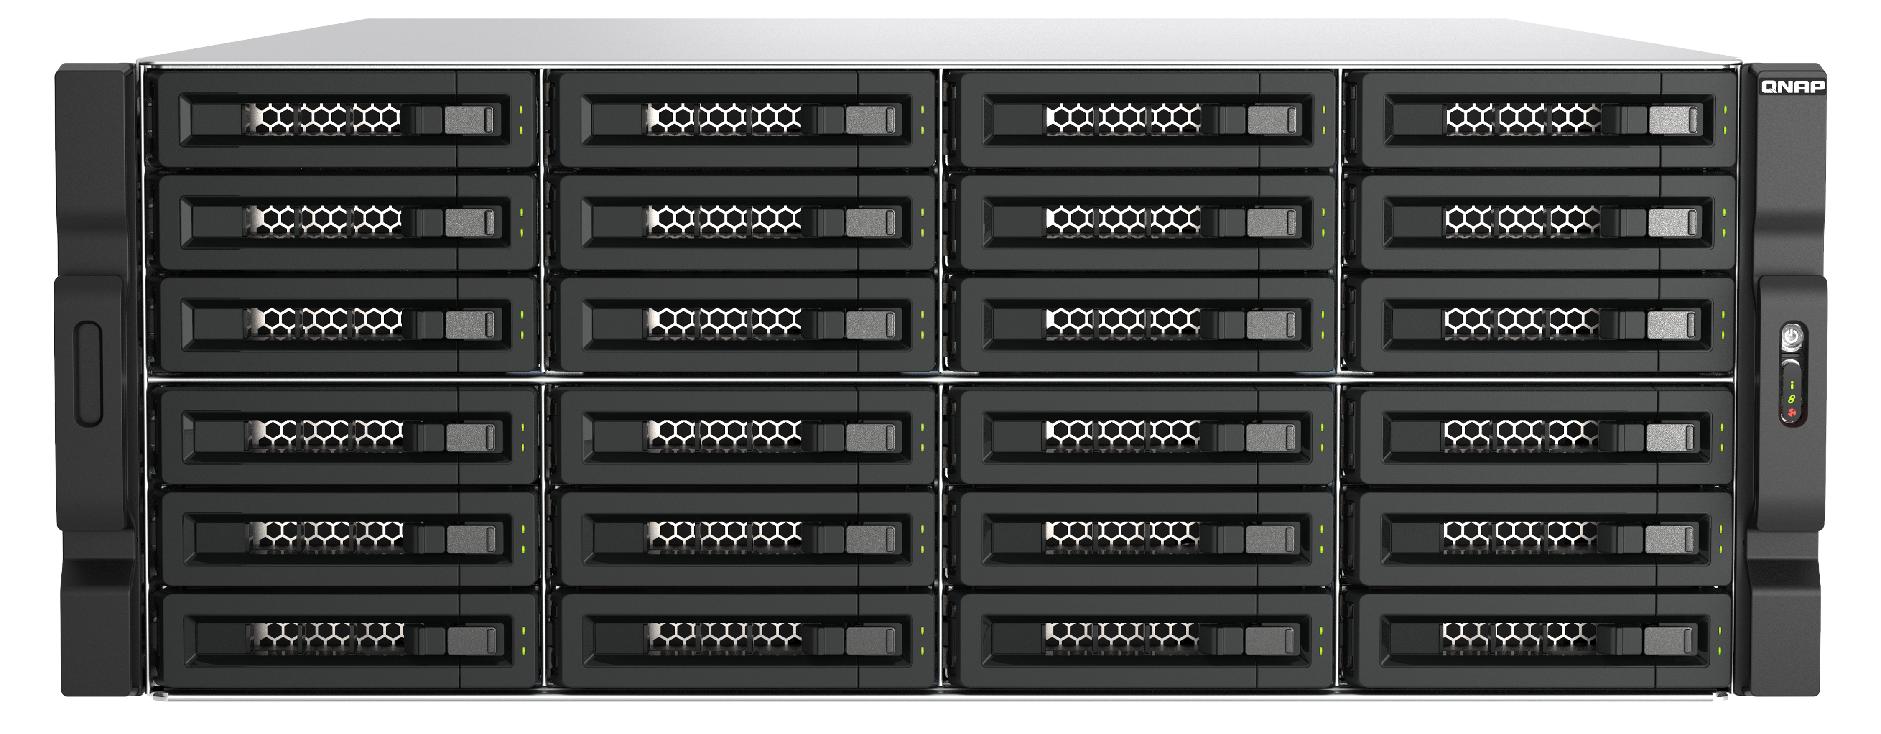
Expand NAS capacity with TL PCIe JBOD, total up to 288 disks, and 4 PB capacity
12 x TL-R2400PES-RP
PCIe JBOD
288 x 22TB
3.5-inch SATA HDD
Note: For details about the number of NAS systems supported, see Compatibility List
https://www.qnap.com/go/compatibility-expansion/pcie
Notes:
如前頁提到 PCIe JBOD 最高支援容量為 4PB，計算方式是使用 12 台 24-bay PCIe JBOD TL-R2400PES-RP，使用 22TB 硬碟來評估，共支援高達 288 顆 SATA 硬碟。這邊需注意的是每一台 NAS 支援的數量不同，詳情需參考相容性清單。
As mentioned on the previous page, the maximum supported capacity of PCIe JBOD is 4PB. The calculation method is to use 12 24-bay PCIe JBOD model TL-R2400PES-RP and use 22TB hard drives for evaluation. A total of up to 288 SATA hard drives are supported. It should be noted here that each NAS supports different quantities. Please refer to the compatibility list for details.

Slide 6
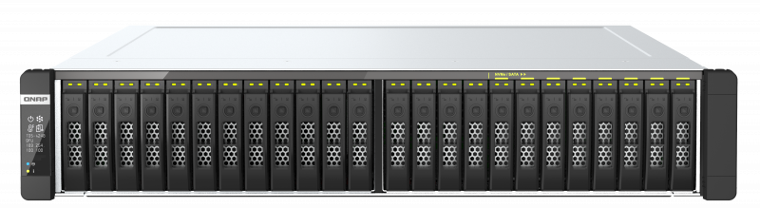

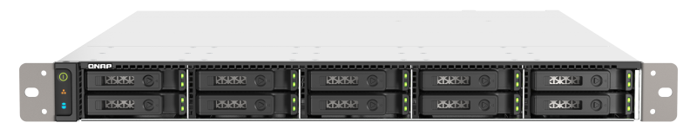
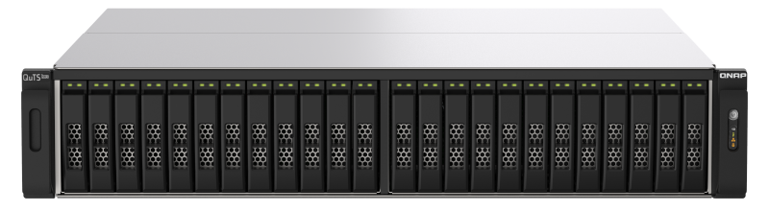
QNAP all-flash NAS supports the new TL PCIe JBOD for additional petabyte capacity
 | TDS-h2489FU | TS-h2490FU | TS-h1090FU | TS-h3088XU-RP (coming soon)
CPU | 2 x Intel Xeon Silver Series | AMD EPYC 7002 series | AMD EPYC 7002 series | Intel® Xeon W-1200 series
NAS max RAM support | 1 TB | 4 TB | 1 TB+ (12 x 128 GB) | 128 GB
Form factor | 2U rackmount | 2U rackmount | 1U rackmount | 2U rackmount
Storage Interface | 2.5-inch U.2 NVMe | 2.5-inch U.2 NVMe | 2.5-inch U.2 NVMe / SATA | 2.5-inch SATA SSD
Drive bay | 24-bay | 24-bay | 10-bay | 30-bay
NAS max capacity | 118 TB | 118 TB | 34.5 TB | 150 TB
Max support PCIe JBODs | 10 | 12 | 8 | 4
PCIe JBOD max capacity | 3 PB | 4 PB | 2 PB | 1 PB
Note:
1. U.2 Is based on 7.68TB
2. JBOD max capacity is based on 3.5” SATA 22TB HDD
3. Based on NAS QuTS hero h5.1.2 and above

Slide 7
The supported NAS models as of Dec. 2023
Model | PCIe Slot | Recommend Card | Max Bandwidth | Max capacity | Max JBODs | Max Memory | BIOS | Notes
TS-h3087XU-RP | Slot 2, Slot 3 | QXP-3X4PES | 32Gb/s | 1 PB | 4 | 128 GB | Q08HAR16 above
TS-h2287XU-RP, TS-h1887XU-RP | Slot 2, Slot 3 | QXP-3X4PES | 32Gb/s | 1 PB | 4 | 128 GB | Q084AR15 above
TS-h987XU-RP | Slot 1 | QXP-3X8PES | 64Gb/s | 1 PB | 4 | 128 GB | Q08DAR17 above
TDS-h2489FU | Slot 1 | QXP-3X8PES | 64Gb/s | 3 PB | 10 | 1000 GB | Q053AR24 above
TS-h2490FU | Slot 1, Slot 2, Slot 3 | QXP-3X4PES QXP-3X8PES ( Slot 2 only ) | 64Gb/s | 4 PB | 12 | 4000 GB | Q03XAR19 above | Only PCIe slot 2 can support 64Gb/s and the maximum # of JBOD is 4. However, if the slot 3 is used, then the slot 2 bandwidth becomes 32Gb/s.
TS-h1090FU | Slot 1, Slot 2 | QXP-3X8PES | 64Gb/s | 2 PB | 8 | 1000 GB | Q09BRR10 above
TS-855eU, TS-855eU-RP | Slot 2 | QXP-3X4PES | 32Gb/s | 0.5 PB | 2 | 64 GB | Q0BUAR08 above

Slide 8
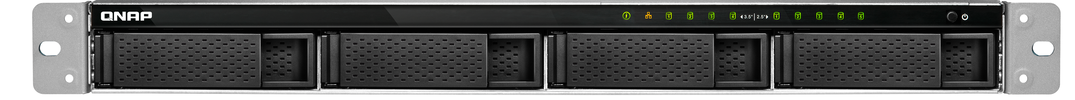
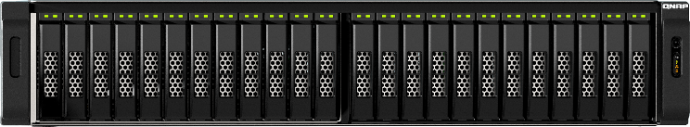
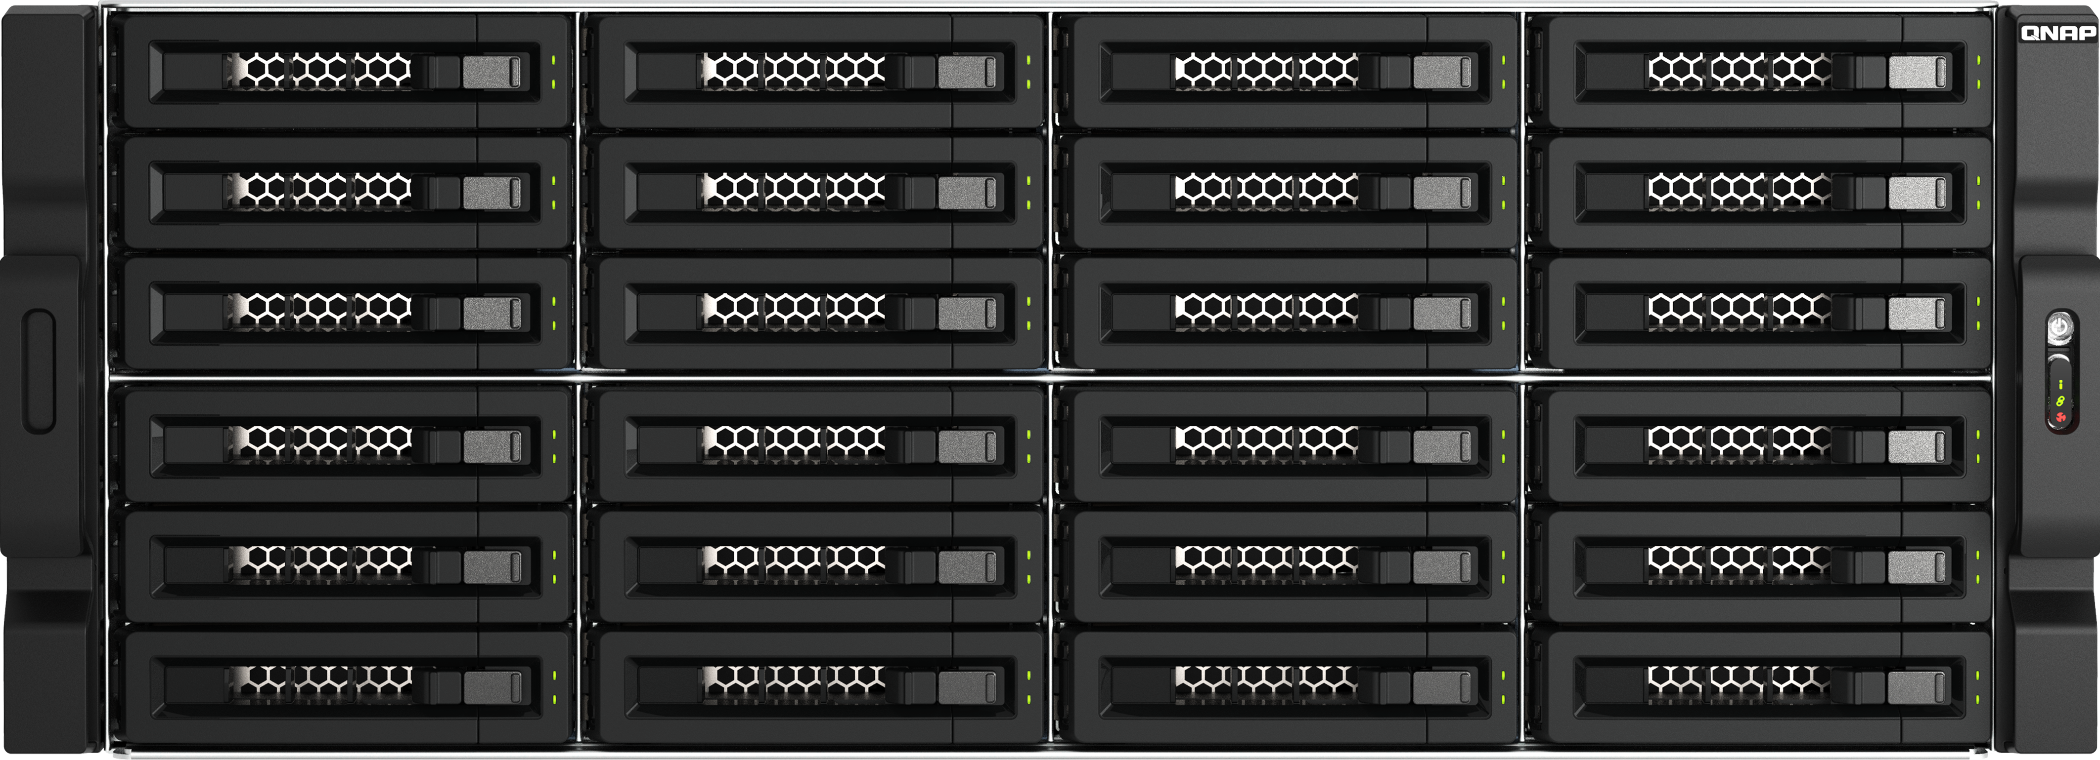
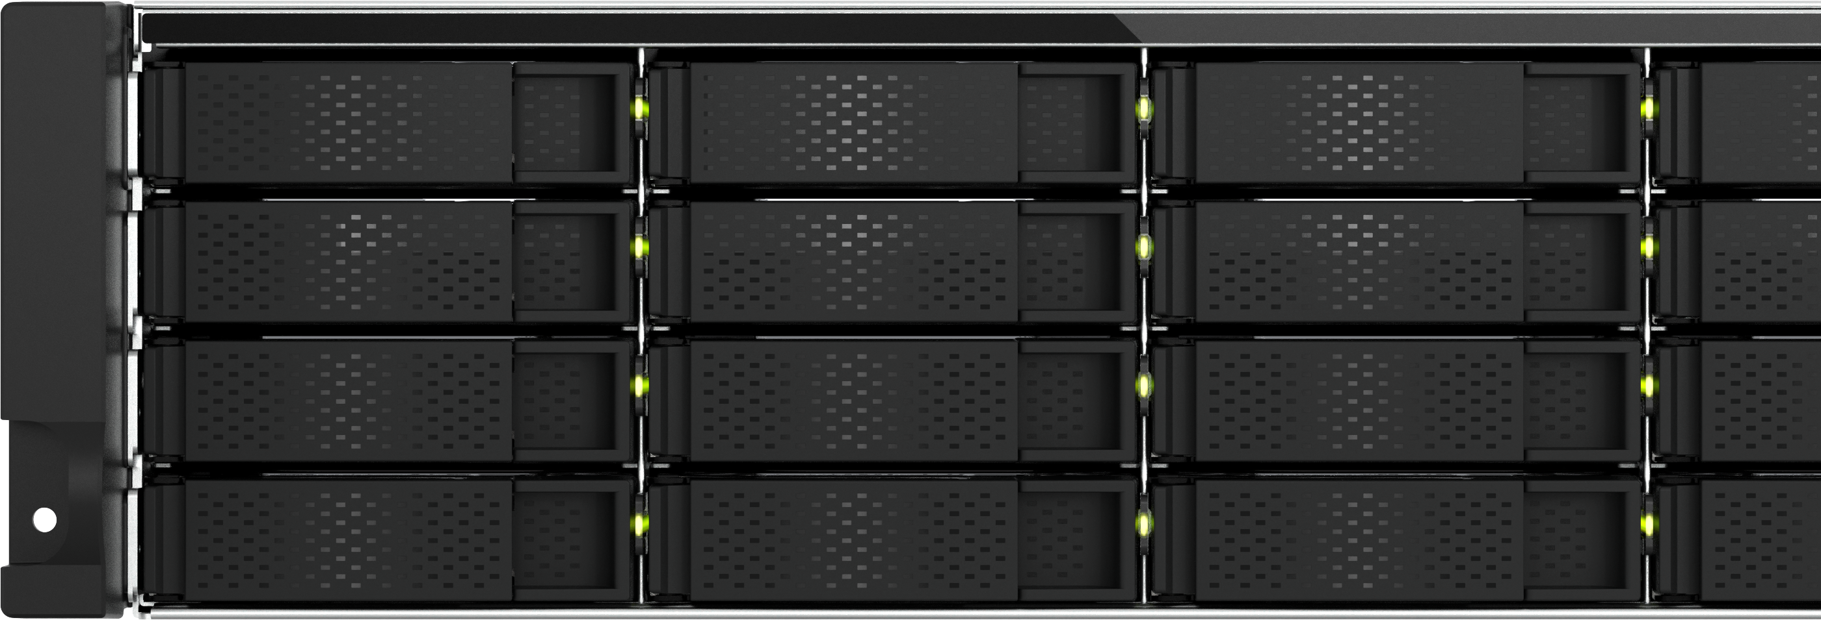
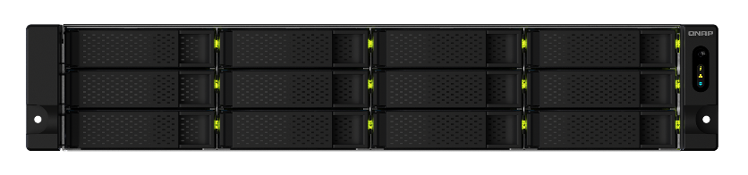
The 2nd phase of compatible rackmount NAS is planned for 2024 Q1
Models
TS-h1886XU-RP R2, TS-h2483XU-RP, TS-2483XU-RP, TS-h1683XU-RP, TS-1683XU-RP, TS-h1283XU-RP,
TS-1283XU-RP, TS-883XU-RP, TS-983XU-RP, TS-h3088XU-RP, TS-h2477XU-RP, TS-h1677XU-RP,
TS-h1277XU-RP, TS-877XU-RP, TS-h977XU-RP, TS-h977XU, TS-1273AU-RP, TS-1673AU-RP, TS-873AeU,
TS-873AeU-RP, TS-h3077AFU-RP, TS-h1677AXU-RP, TS-h1277AXU-RP

Slide 9
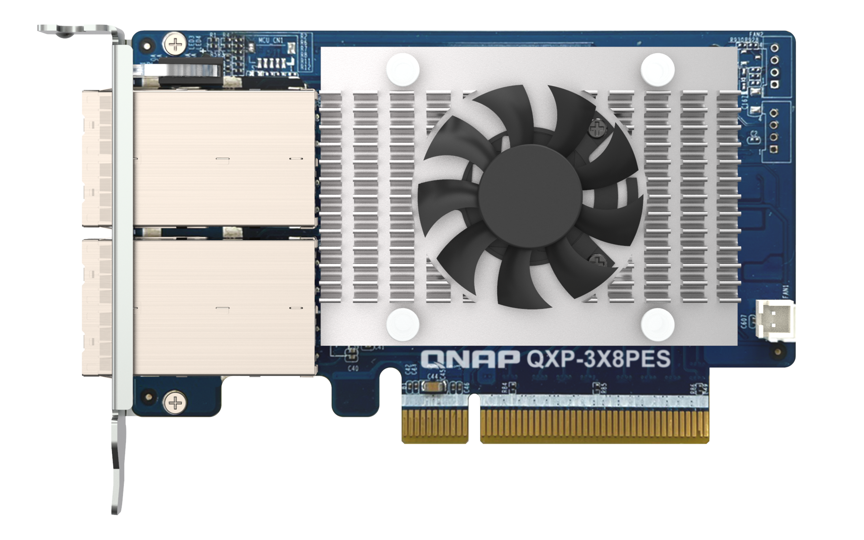
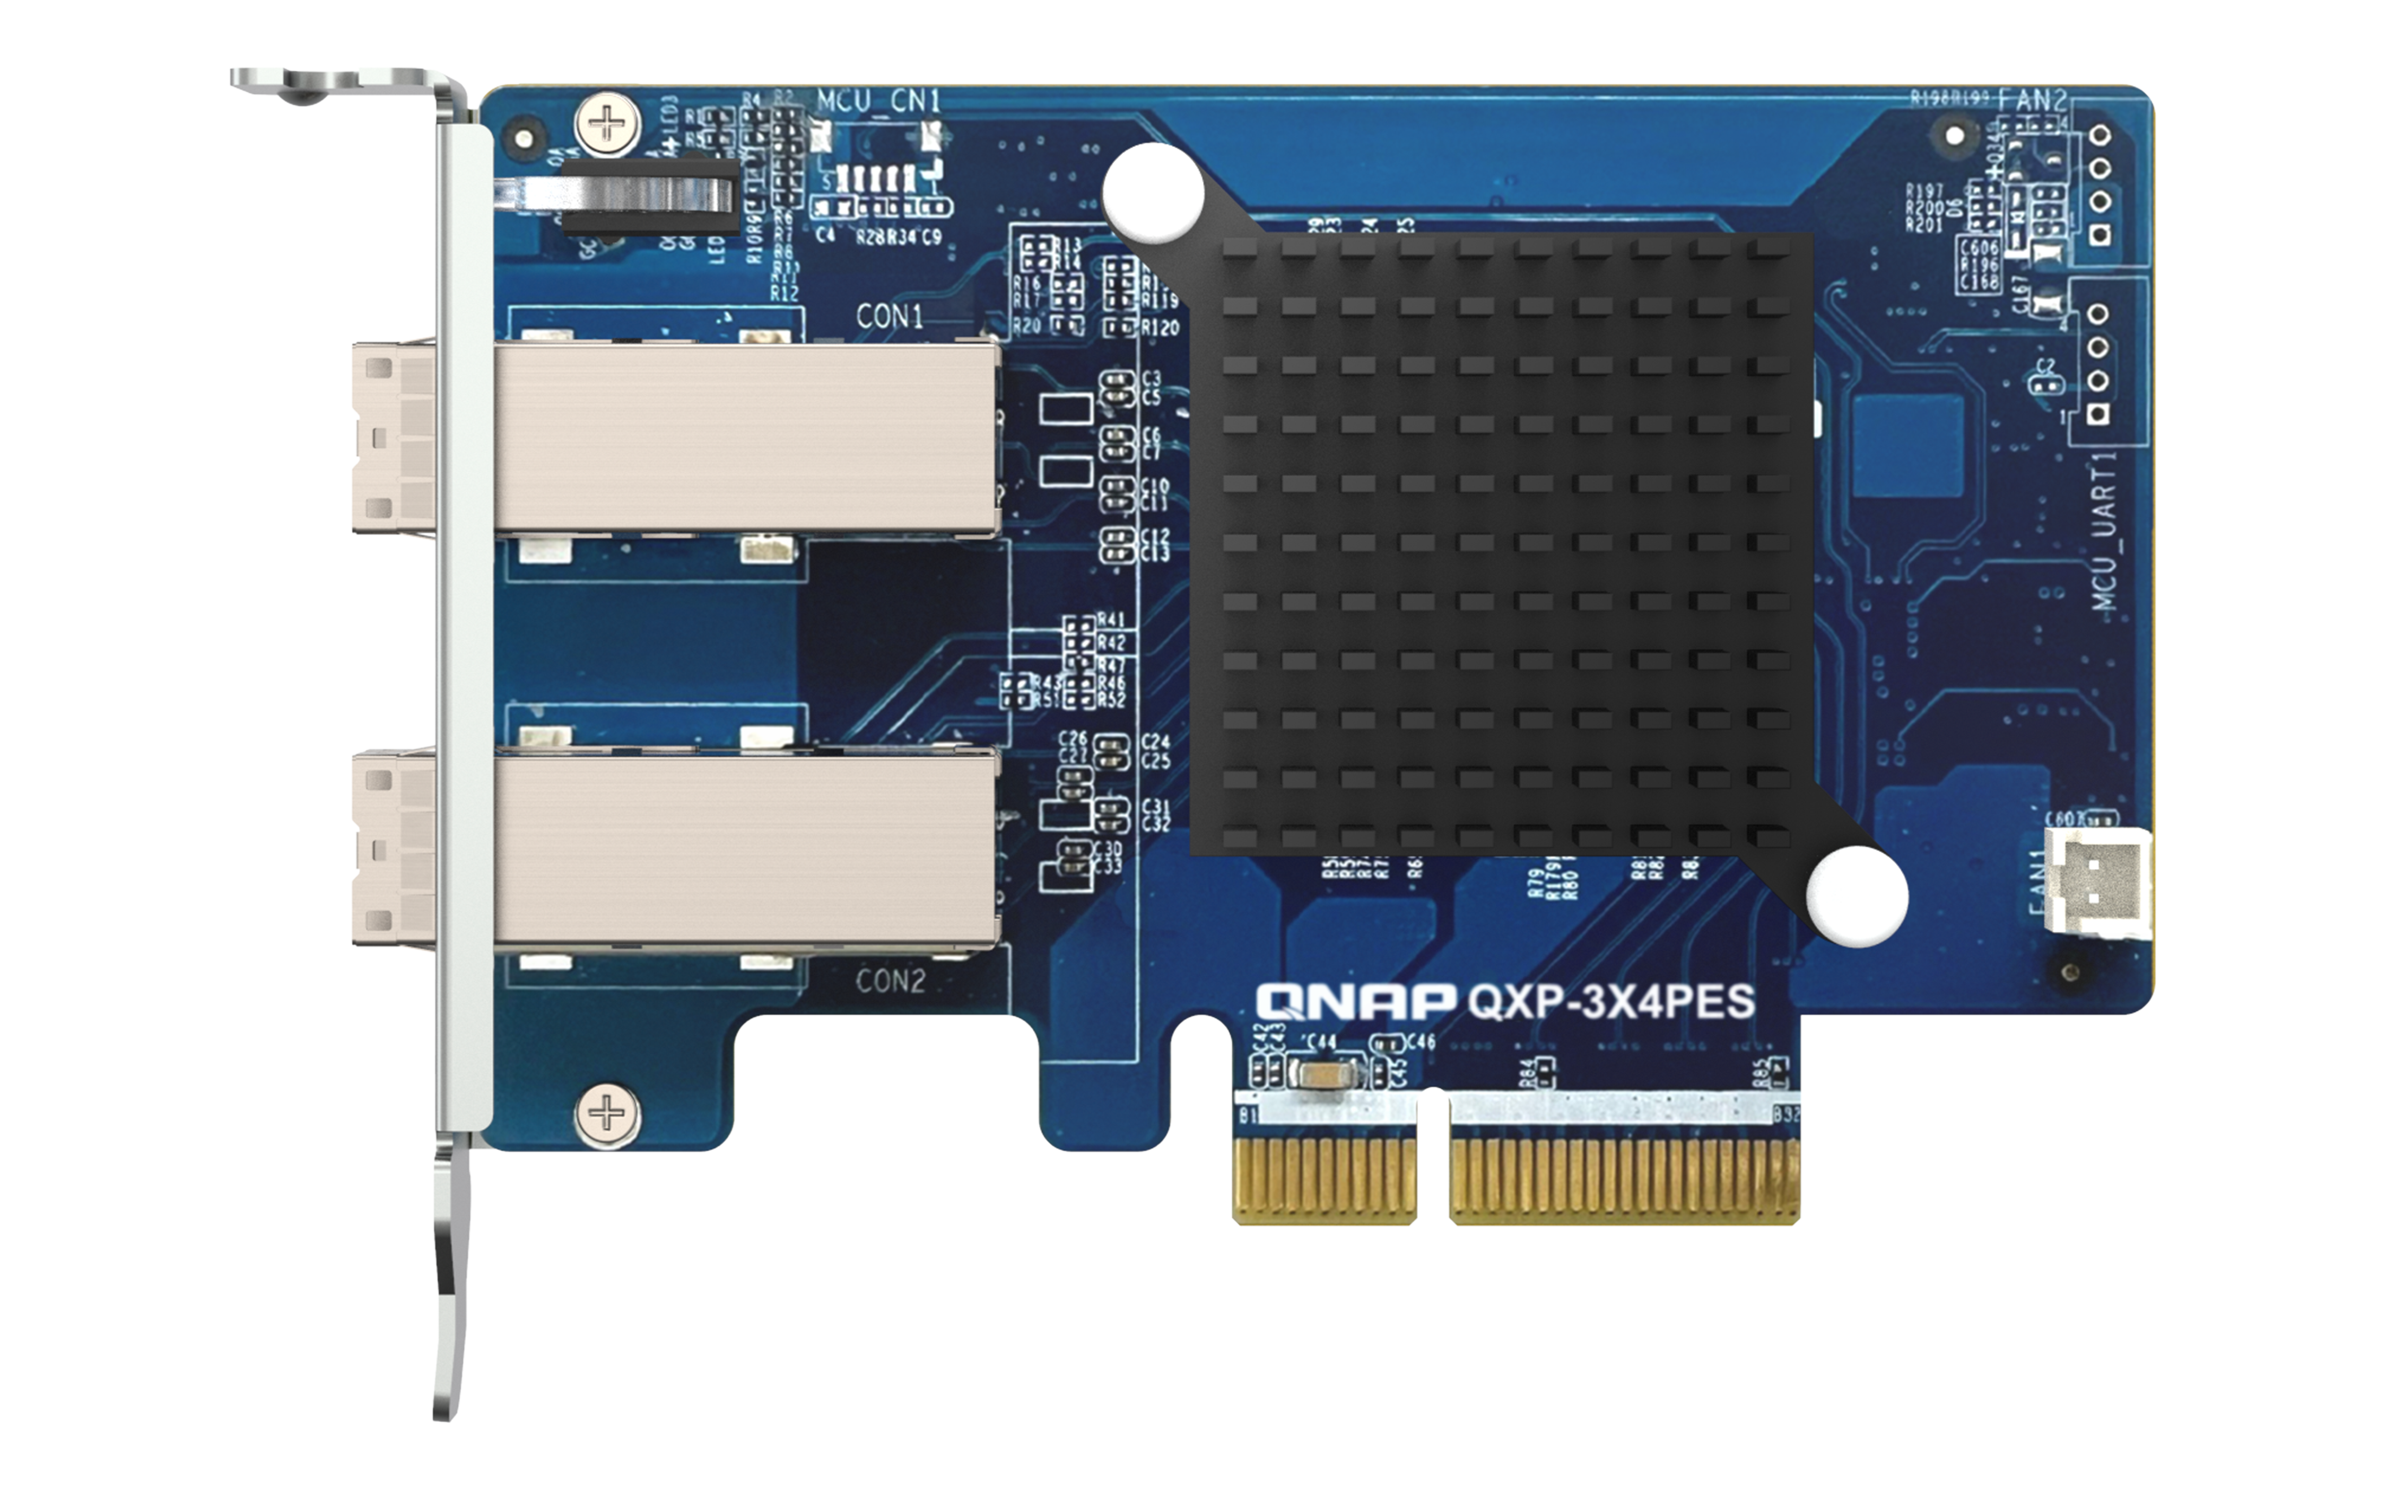
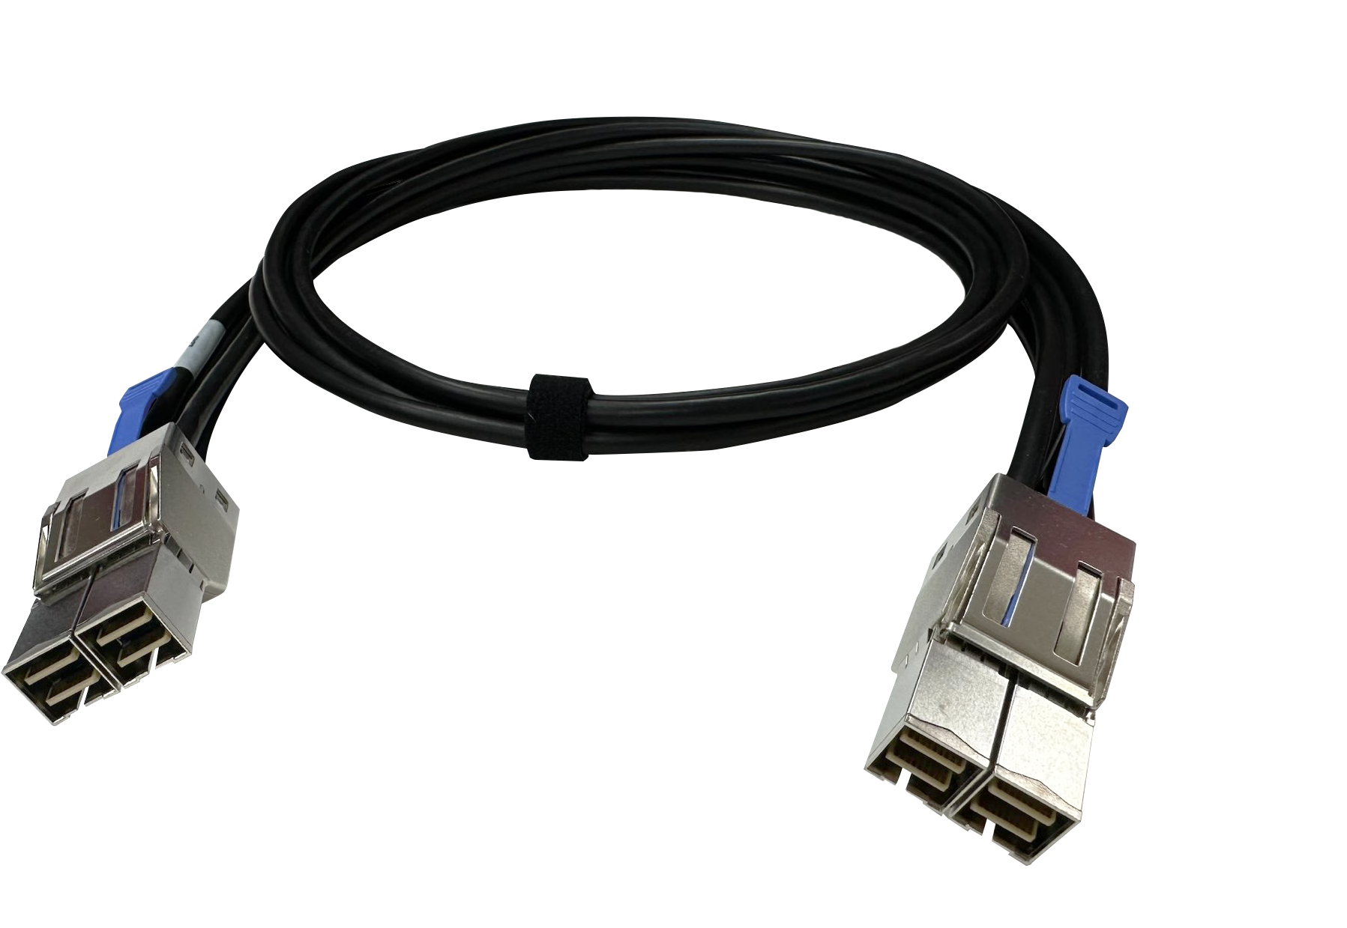
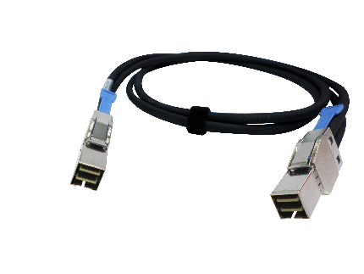
[ Purchase accessories ] Dual-port PCIe expansion cards
QXP-3X8PES, QXP-3X4PES
& connection cables CAB-PCIE10M-8644-4X,
CAB-PCIE10M-8644-8X
The new high-speed dual-port PCIe expansion card with 8X/4X special cable supports TL-R1200PES-RP, TL-R1600PES-RP, and TL-R2400PES-RP PCIe JBOD series, providing up to 64Gb/s bandwidth support for QNAP-compatible NAS. Please note that the JBOD unit does not include an expansion card; it only contains an 8X connection cable. The expansion card and 4X connection cable must be purchased separately. Please refer to the PCIe JBOD compatible list for selection.
QXP-3X8PES expansion card
( Optional )
QXP-3X4PES expansion card
( Optional )
CAB-PCIE10M-8644-8X
PCIe JBOD special cable ( For QXP-3X8PES only, JBOD package contains 1 cable )
CAB-PCIE10M-8644-4X
PCIe JBOD special cable
( Optional )

Slide 10
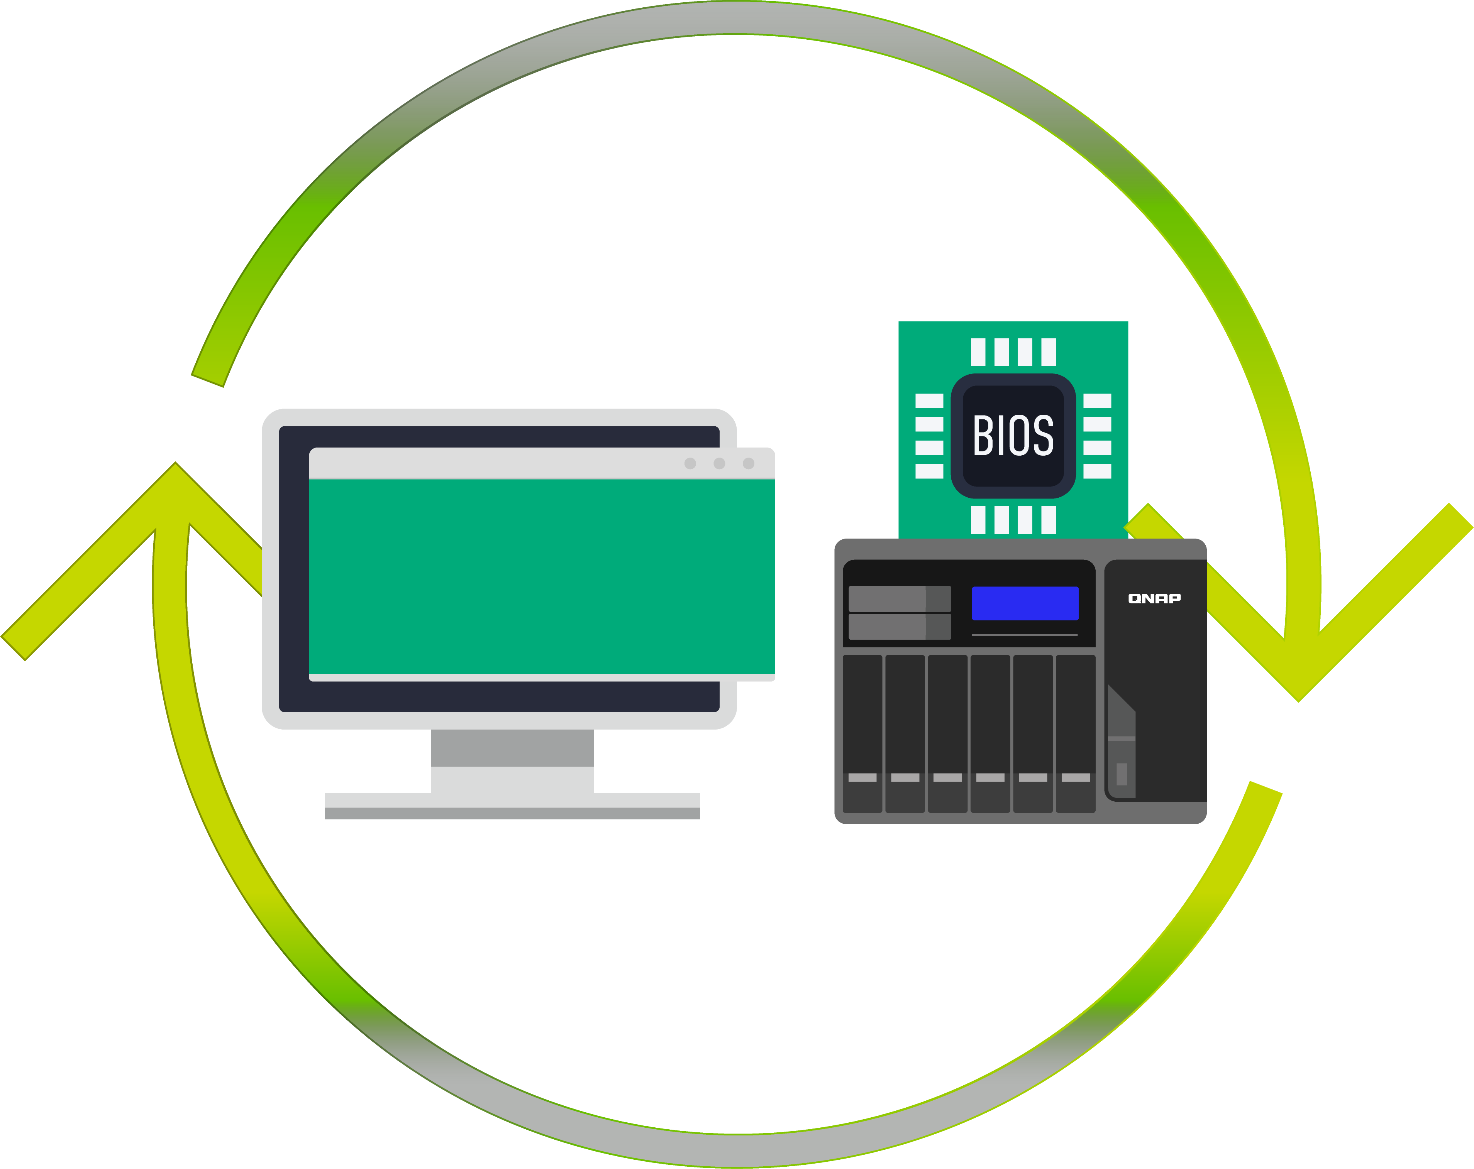
The NAS operating system must be QuTS hero h5.1.2 / QTS 5.1.2 or higher, and the BIOS may be required for an update.
QTS 5.1.2
QuTS hero 5.1.2
Please check the compatible list first and update your NAS QTS/QuTS hero version and BIOS firmware. For more details, refer to the compatibility list.
Note: Please refer to the compatibility list to check the version
Compatibility: https://www.qnap.com/go/compatibility-expansion/pcie

Slide 11
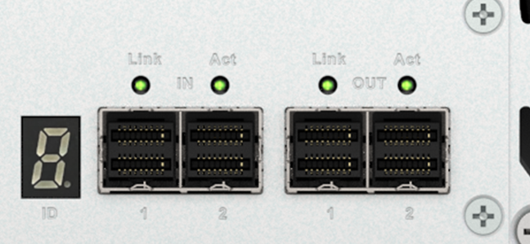
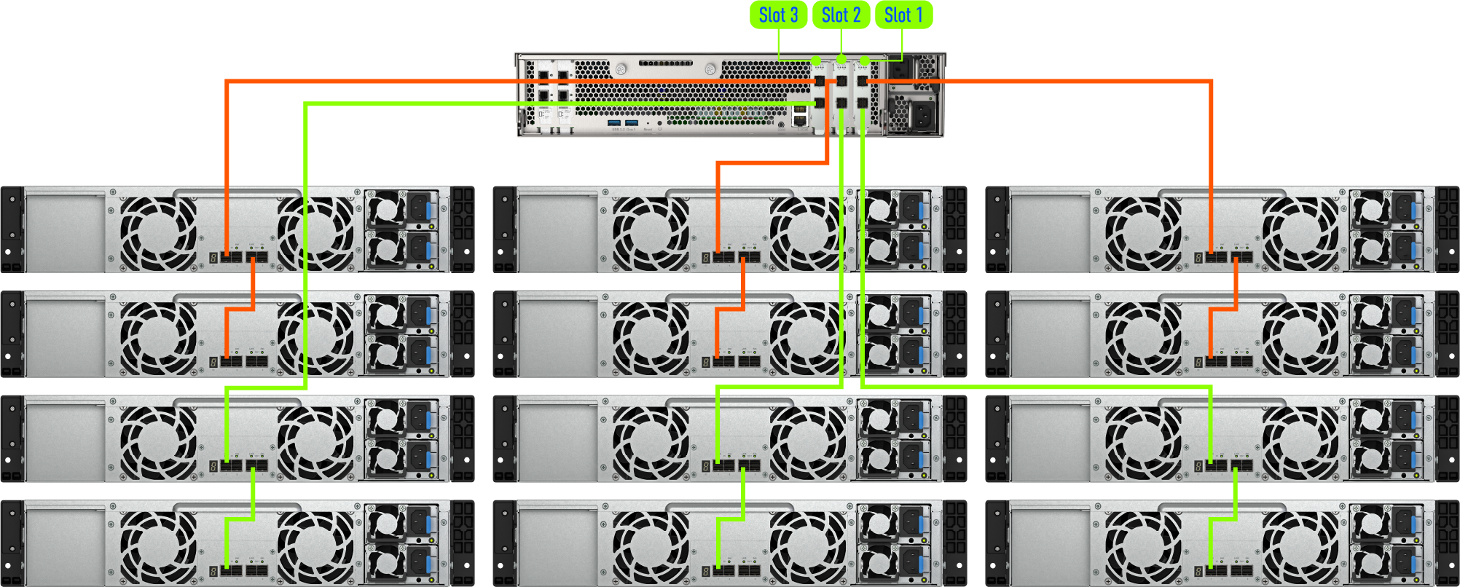
NAS TS-h2490FU + 3 x QXP-3X4PES cards
connecting 12 x TL-R1200PES-RP
IN
OUT
For the difference in the number of supported units, check the compatibility list.
https://www.qnap.com/go/compatibility-expansion/pcie

Slide 12
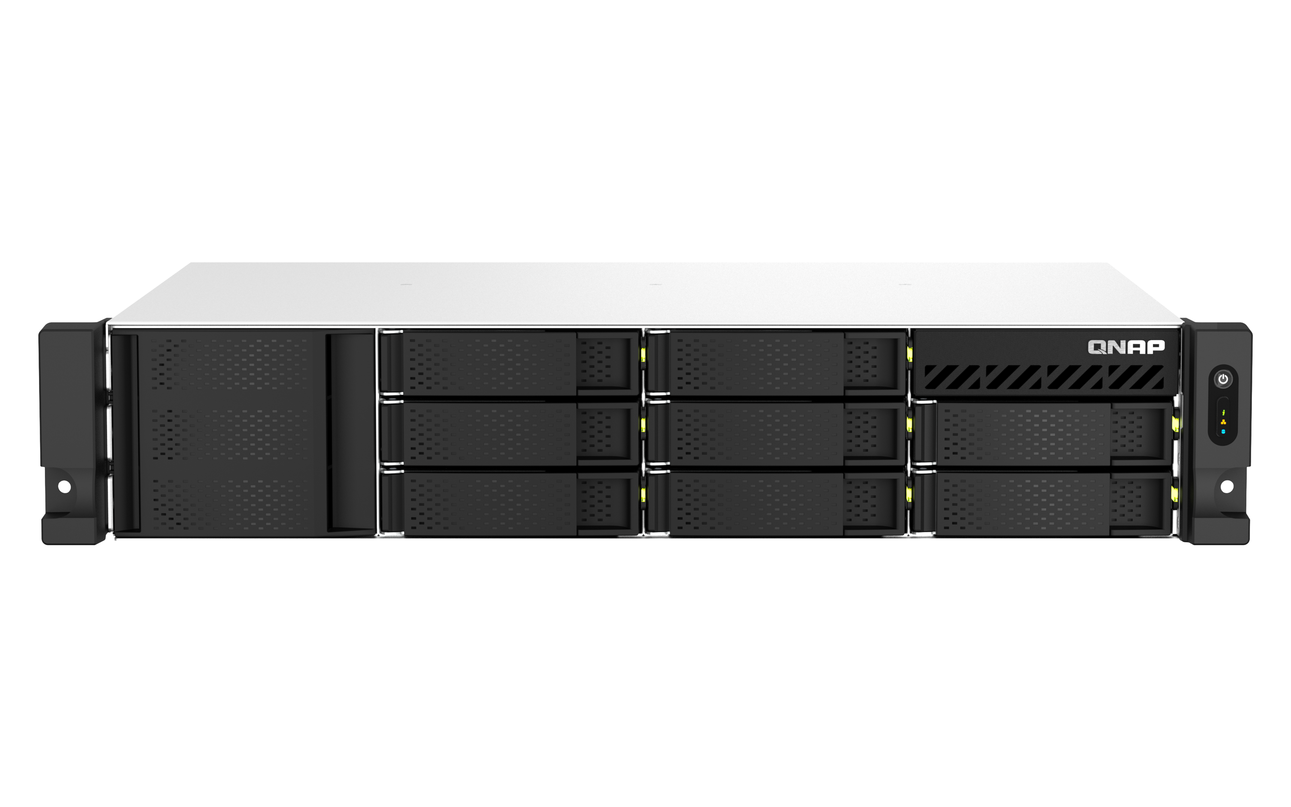
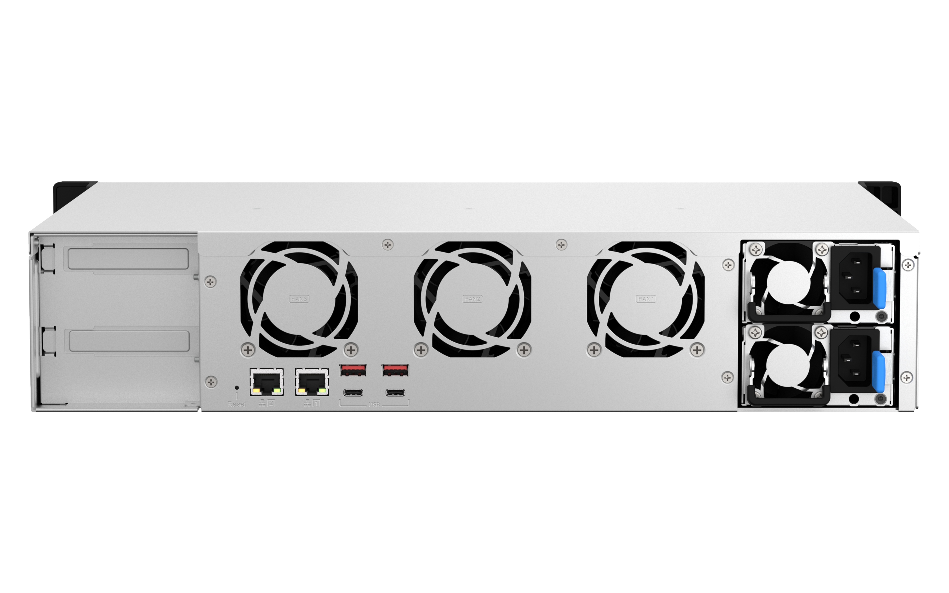
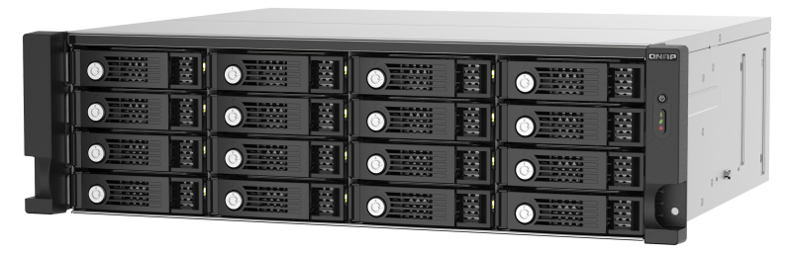
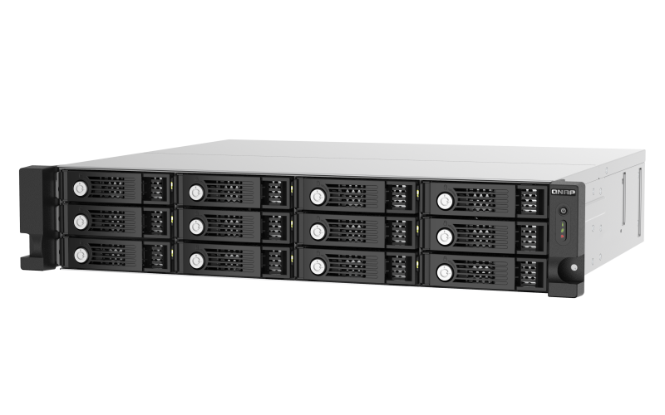


TL-R1200PES-RP & TL-R1600PES-RP
short-depth 37-cm / 14.6-inch design
Different from the typical 2U/3U rackmount JBODs that are over 60 cm deep and heavy, the QNAP PCIe JBOD series has a 30% smaller and lightweight design, making it the top choice for business users with redundant power design.
37cm /14.6 inch
TL-R1600PES-RP
13.1cm /
5.17 inch
The volume is significantly reduced by 30%, which can save transportation costs.
43.2cm / 17 inch
37cm /14.6 inch
TL-R1200PES-RP
The 37cm / 14.6-inch short-depth chassis is designed to be lightweight and friendly for setting up.
8.9cm /
3.49 inch
43.2cm / 17 inch
12吋短機箱可支援市面上大部分的機櫃
內建2埠M.2(PCIe Gen 3 x1)，可提供SSD快取，加速隨機存取的速度
PCIe Gen 3 x 8插槽，提供各式應用的高速擴充卡
雙系統靈活切換配置QTS and QuTS hero

Slide 13
The hot-swappable function makes it easier for IT to migrate large-capacity JBODs
When NAS transmits a large number of files or a single large amount of data over a network, it not only takes a long time to transfer but also occupies a lot of bandwidth, resulting in reduced work efficiency. The TL-R1200PES-RP, TL-R1600PES-RP, and TL-R2400PES-RP support hot-swappable data migration: just install the QXP-3X4PES or QXP-3X8PES on another NAS B, safely uninstall the JBOD from NAS A, and then arrange the migration, transport the JBOD to another location, and then connect and mount it with the NAS.

Slide 14
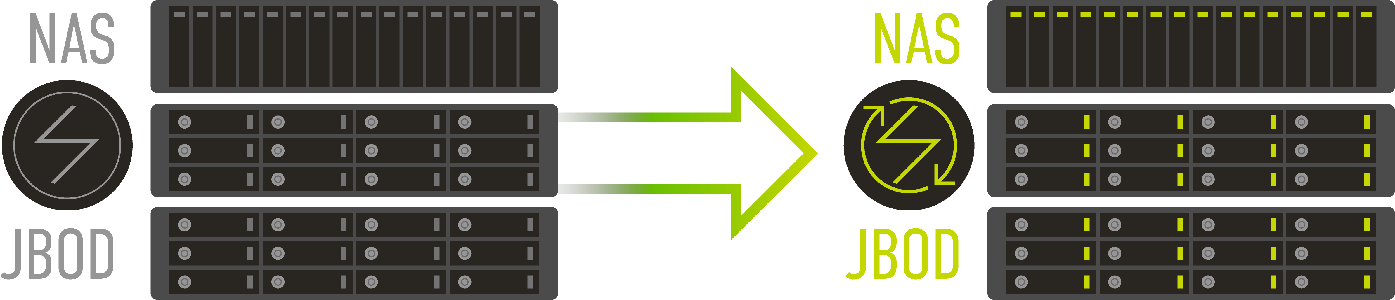
Host-based power management
When the power outage occurs, usually the expansion JBOD device of NAS will also shut down. When the power is recovered, IT personnel needs to press the power button on-site to restart the expansion JBOD device, making it difficult to restart the JBOD if the server room is at a remote location or during off-work hours. To eliminate the inconvenience of switching on JBODs physically on site, the new QNAP TL PCIe JBODs provide a convenient function that allows the power on/off to be linked to the power status of NAS host, which can be used to turn on the JBOD together when the NAS is restarted after a power recovery.

Slide 15
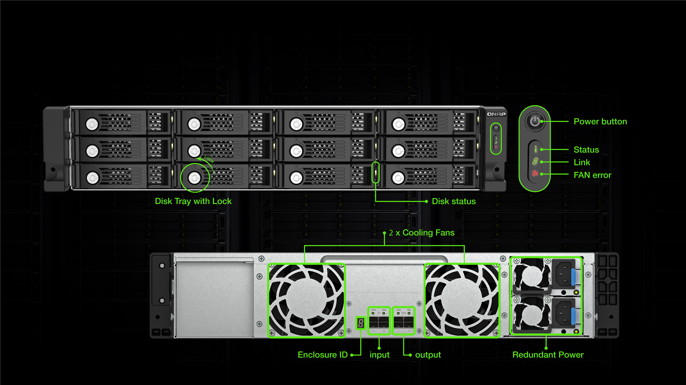
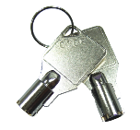
TL-R1200PES-RP front / rear view
Tray keys in pack
H x W x D
(88.65 x 482.2 x 423.8 mm)
(3.49 x 18.98 x 16.69 inch)

Slide 16
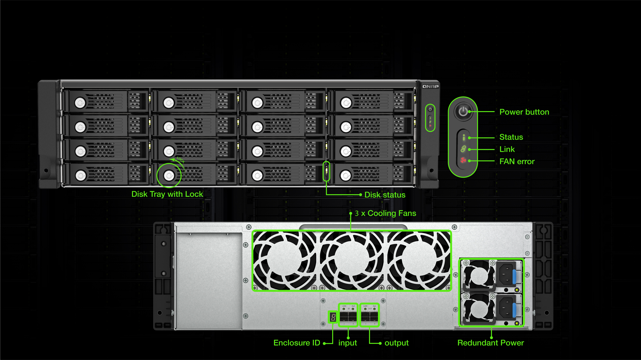
TL-R1600PES-RP front / rear view
Tray keys in pack
H x W x D
(131.3 x 482.2 x 425.3 mm)
(5.17 x 18.98 x 16.74 inch)

Slide 17
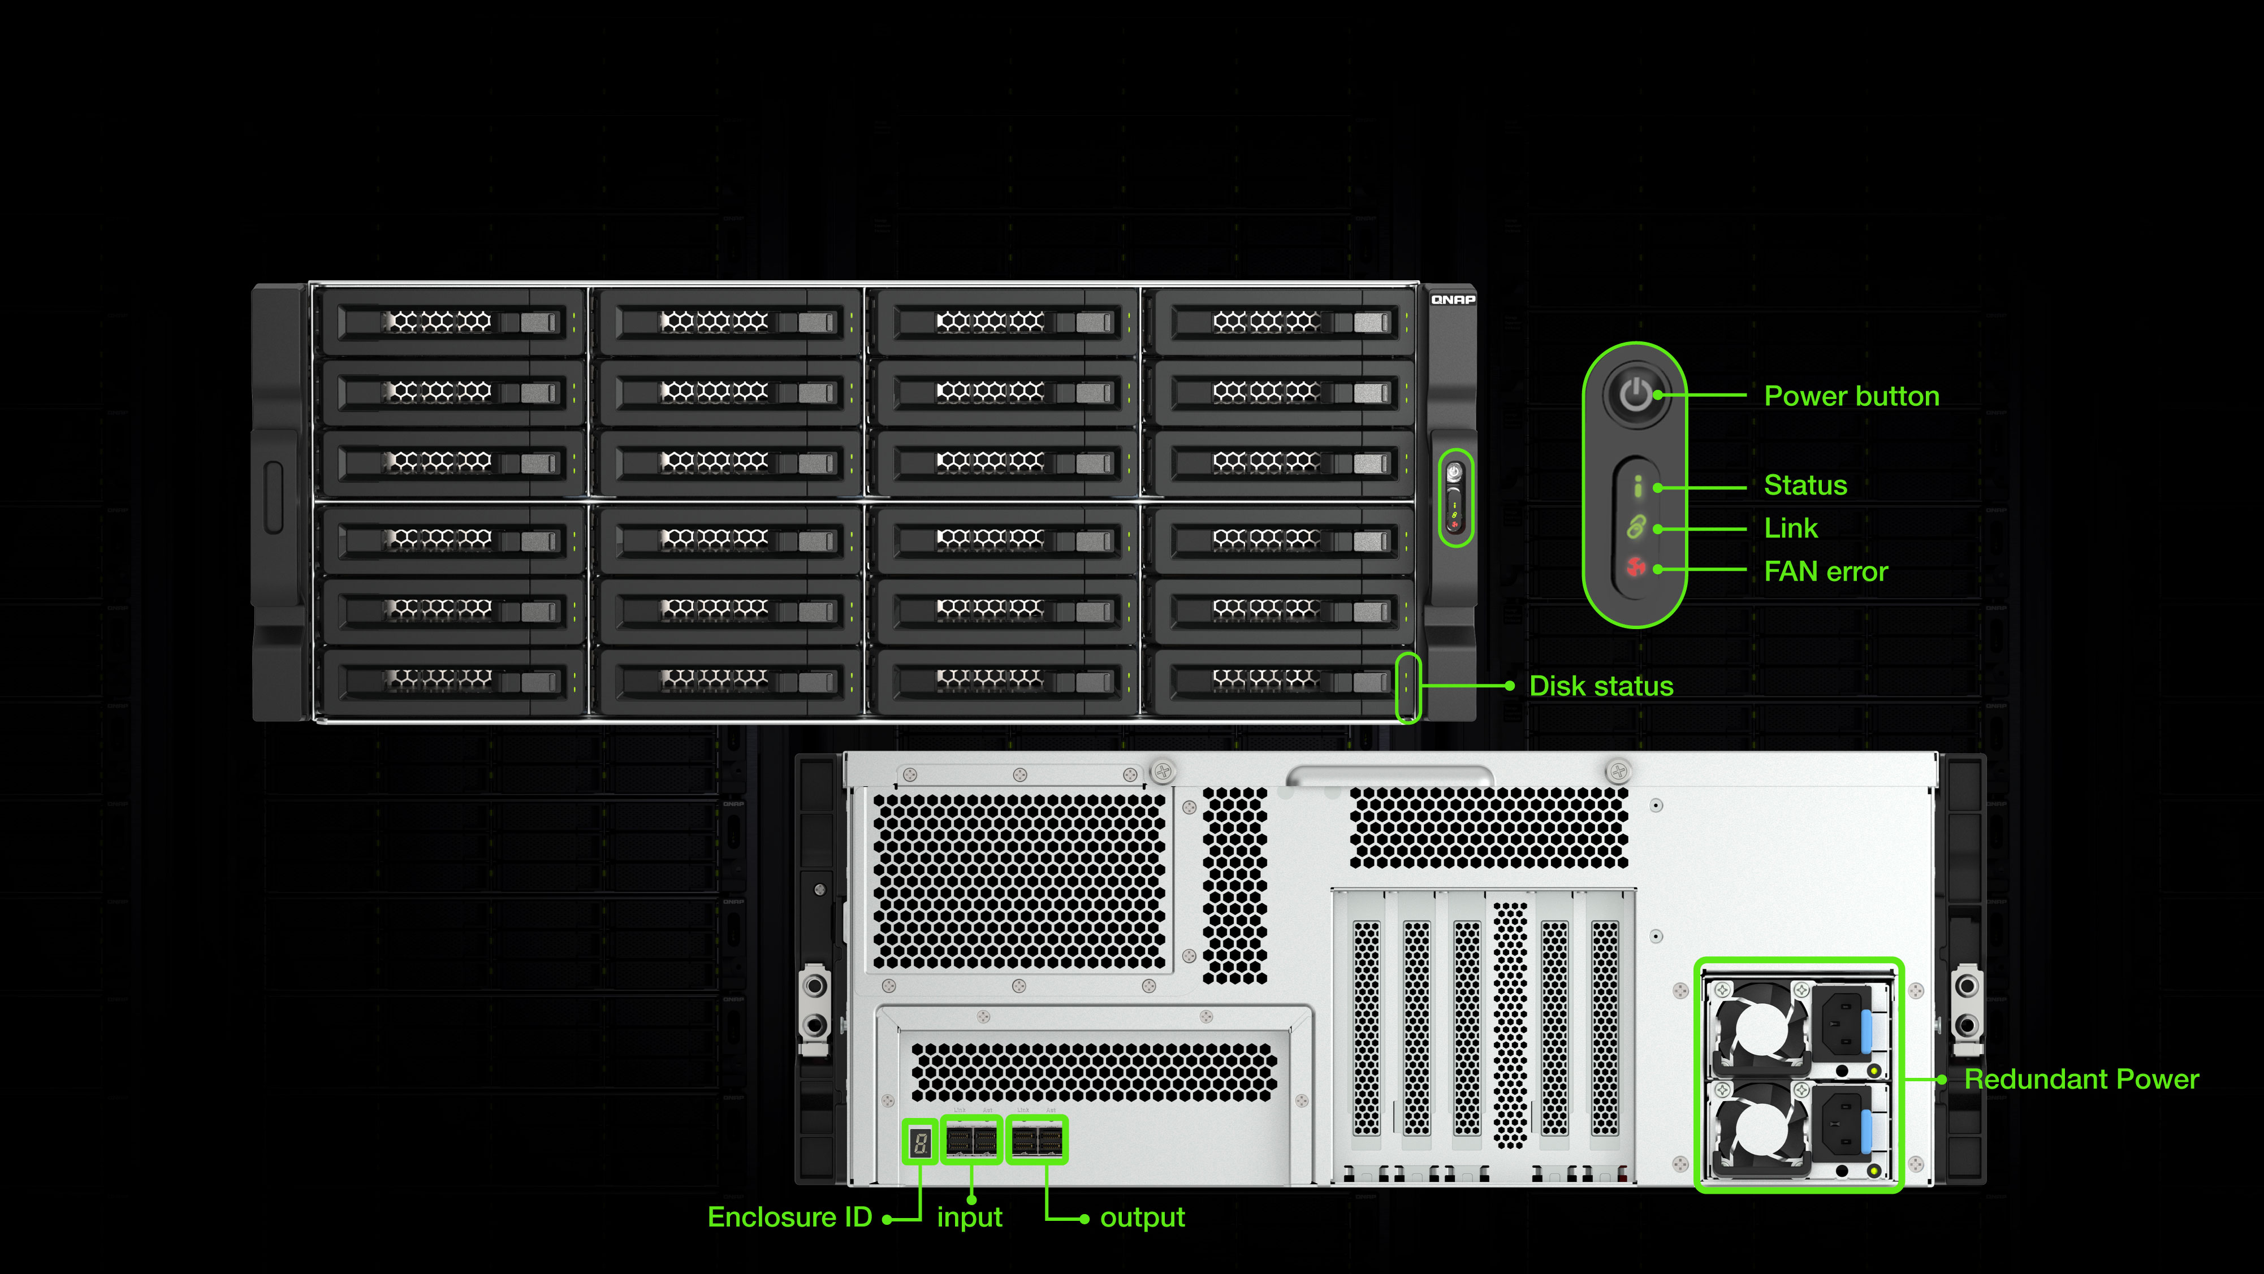
TL-R2400PES-RP front / rear view
H x W x D
(176.15 x 442.4 x 630.2 mm)
(6.94 x 17.42 x 24.81 inch)

Slide 18
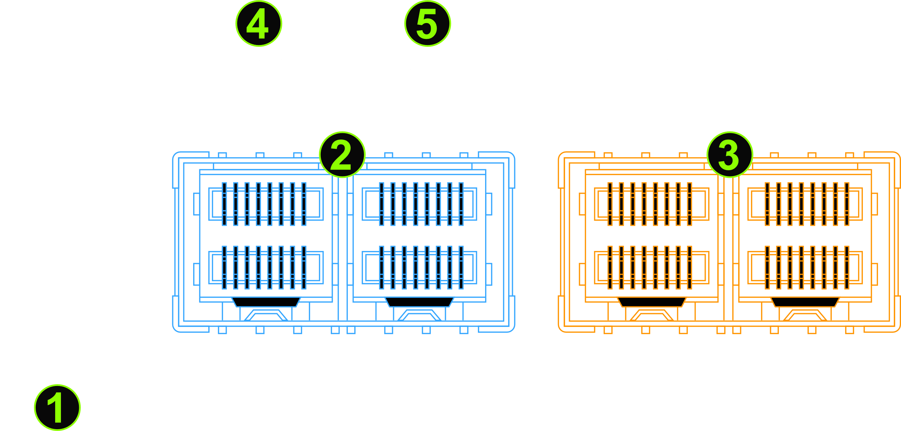
PCIe JBOD port I/O & LED of TL-R1200PES-RP, TL-R1600PES-RP, and TL-R2400PES-RP
No. | Component | Description
 | Enclosure ID | Show enclosure ID (0 - 9, A, b, c)
 | IN | Connect to NAS host or upstream JBOD
 | OUT | Connect to downstream JBOD
 | LINK LED | When the connection bandwidth is PCIe Gen 3x8, the LED is green, and it will turn to amber at lower.
 | ACT LED | Steady green LED when the JBOD link connection is normal; blinking green LED during activity.
1
2
3
4
5

Slide 19
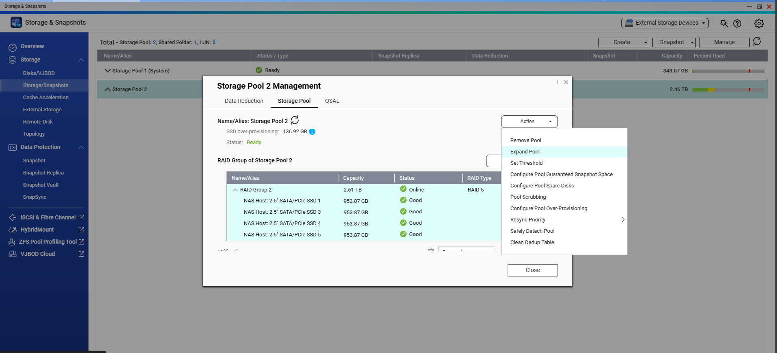
Expand the NAS storage pool capacity
Expand NAS storage pool: It is a commonly used function for IT personnel to expand the capacity of the NAS. After the NAS correctly identifies the new JBOD, select the storage pool where the JBOD is located in the QTS UI, and then select [Expand Pool] in the action, and follow the steps to get more storage space.
Storage pool expansion allows only the same kinds of disks, SSDs and HDDs cannot be mixed

Slide 20
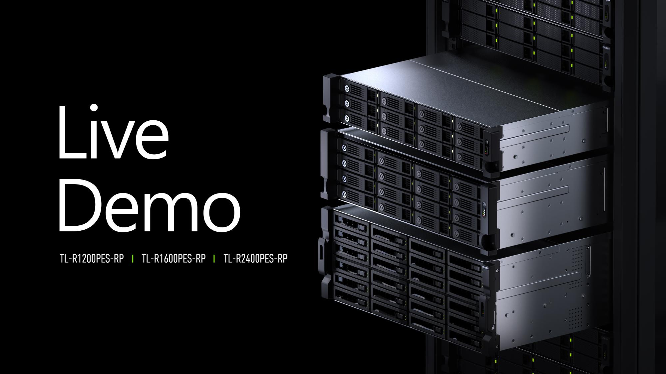

Slide 21

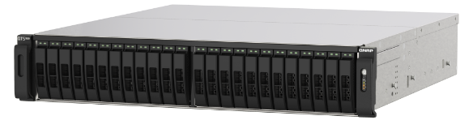
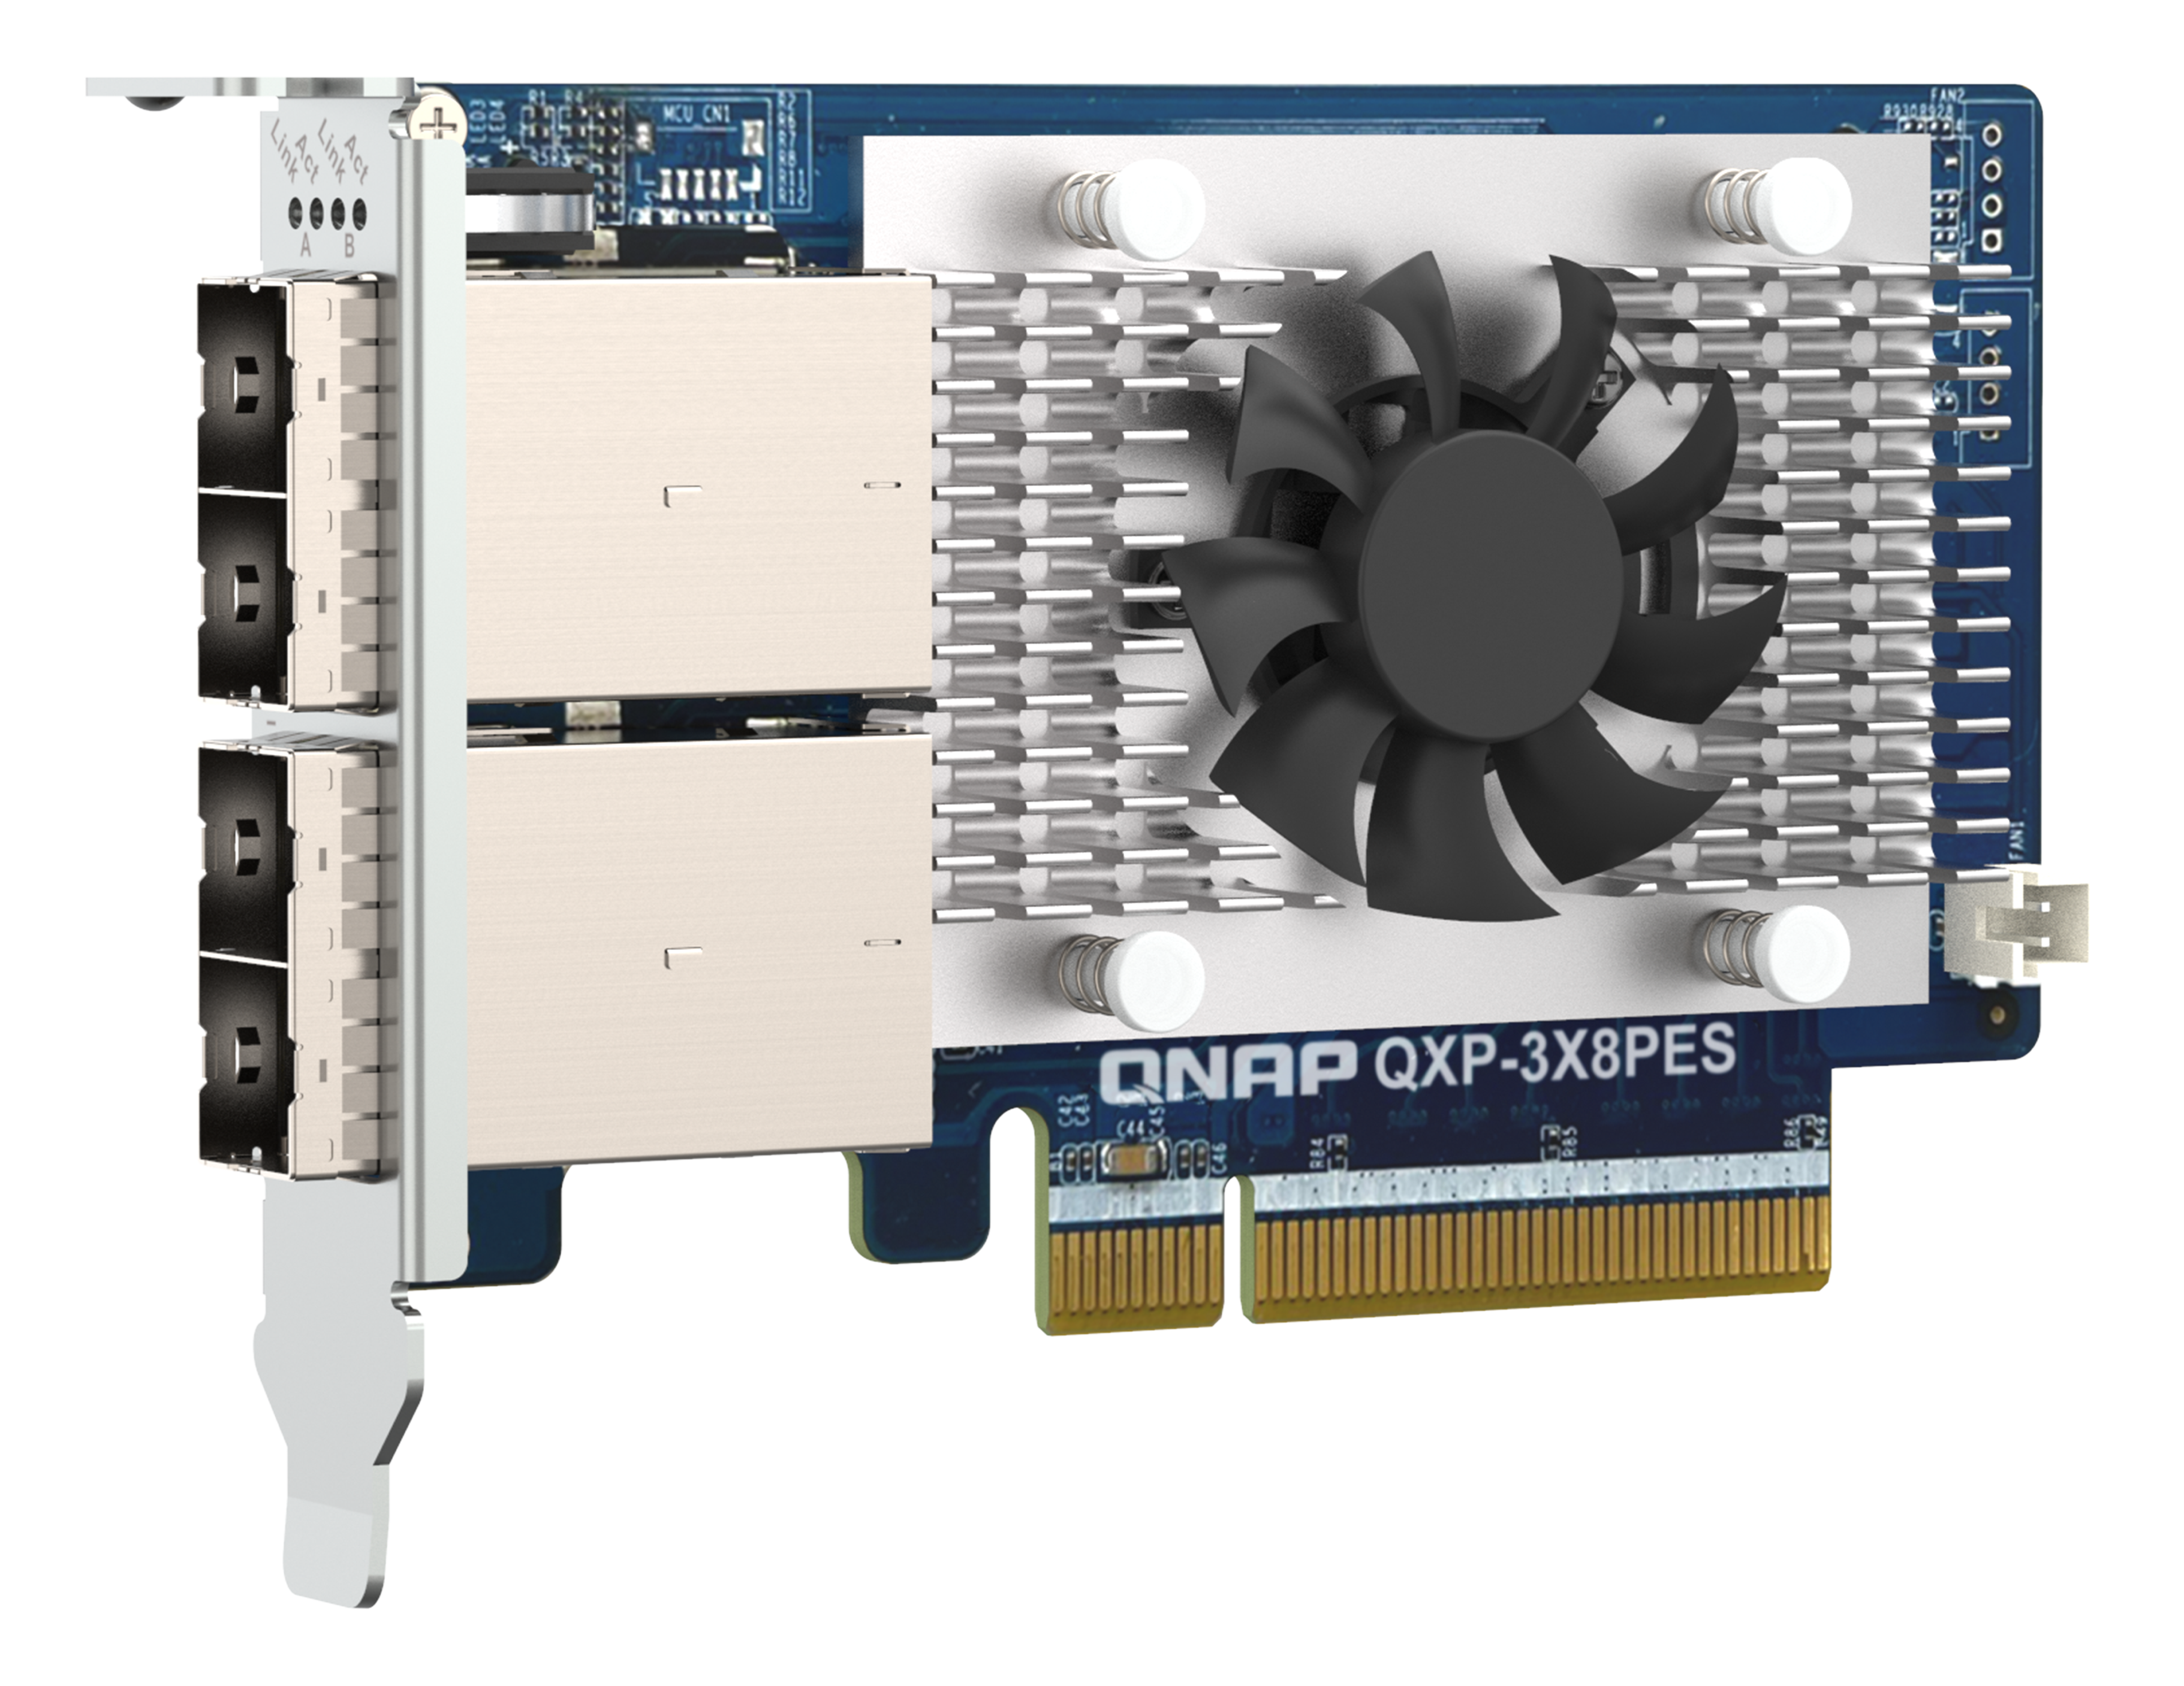
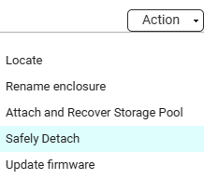
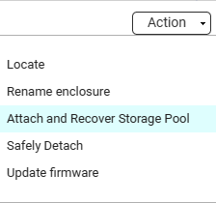
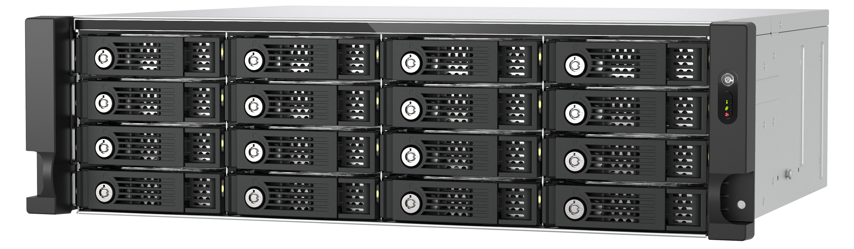

SAS JBOD data migration:
SATA HDDs from SAS JBOD to PCIe SATA JBOD
To migrate the JBOD with SATA HDD expansion on the original NAS from SAS JBDO to SATA JBOD, perform the following steps: 1. Safely detach pool, 2. Normal shutdown, 3. To install the PCIe expansion card, 4. Transferring SATA HDD to PCIe JBOD, 5. Remove SAS JBOD, 6. Boot NAS after connecting the PCIe JBOD, 7. Mount and restore.
SAS expansion card
TS-h2490FU (NAS)
PCIe expansion card
Safely detach
Recover
TL-R1620Sep-RP (SAS JBOD)
TL-R1600PES-RP
(PCIe JBOD
16 x HDDs

Slide 22


Comprehensive QNAP JBOD choices
for storage expansion
* JBOD is calculate with 3.5” 22TB HDD
 | PCIe JBOD | SATA JBOD | USB JBOD | SAS JBOD
Model | TL-R1200PES-RP, TL-R1600PES-RP, TL-R2400PES-RP | TL-D400S, TL-R400S, TL-D800S, TL-R1200S-RP, TL-D1600S | TL-D800C, TL-R1200C-RP | TL-R1220Sep-RP, TL-R1620Sep-RP
Form factor | Rackmount | Rackmount / Tower | Rackmount / Tower | Rackmount
Operating system | QTS/QuTS hero | QTS/QuTS hero/Windows/Ubuntu | QTS/QuTS hero/Windows/Ubuntu | QTS/QuTS hero/Windows
Max support 3.5” HDD | 24-bay | 12-bay | 12-bay | 16-bay
Max support JBODs | 12 (not support Multipath) | 2 | 2 | 16 (support Multipath)
Max expansion capacity | 4 PB | 347 TB | 347 TB | 4 PB
Max support HDDs | 288 | 24 | 24 | 256
Application | DATA-intensive application | Low-load or moderately loaded | Low-load or moderately loaded | DATA-intensive application
Max Bandwidth | 64 Gb/s | 64 Gb/s | 10 Gb/s | 96 Gb/s
Required expansion card | v | v | Optional | Optional
Cost | $$ | $ | $ | $$$
Pool combined with NAS | v | x | x | v

Slide 23
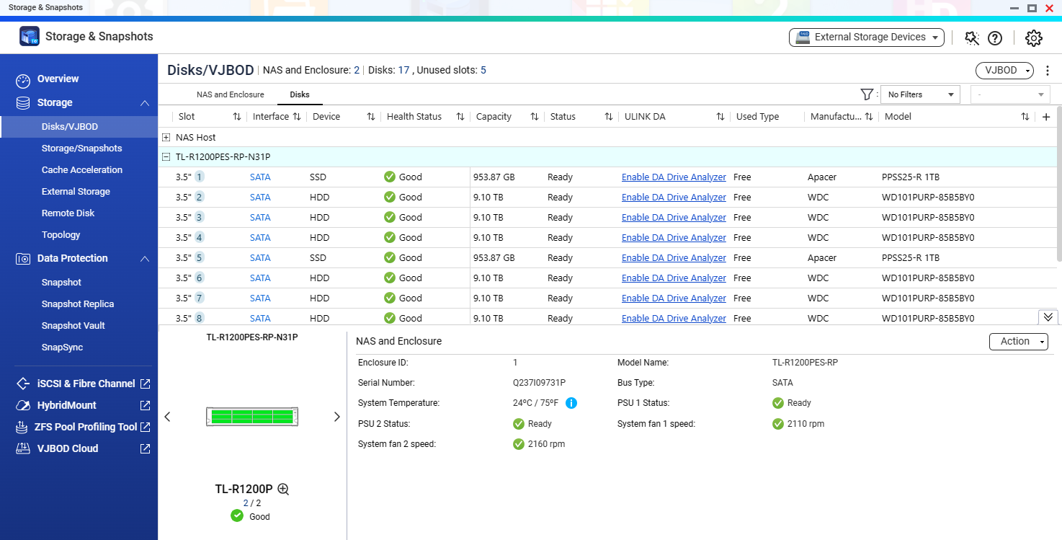
Use [ Storage & Snapshot ] to easily manage JBOD in NAS QTS 5.1.2 / QuTS hero h5.1.2
The TL PCIE JBOD series, the same as the TL SAS JBOD series, can be monitored and managed in NAS [Storage & Snapshot]. Compared with the TR-002/TR-004/TR-004U RAID DAS series, it can support more QTS/QuTS hero local drive management functions.
QTS JBOD & Disk Information
Disk S.M.A.R.T. info
Disk performance test
Locate JBOD
Attach and Recover Storage Pool
Safety Detach
Note: Because of the maximum 22TB HDD capacity and the maximum supported JBOD units per NAS, QuTS hero can support up to 4PB pool, QTS can support up to 304TB pool.

Slide 24
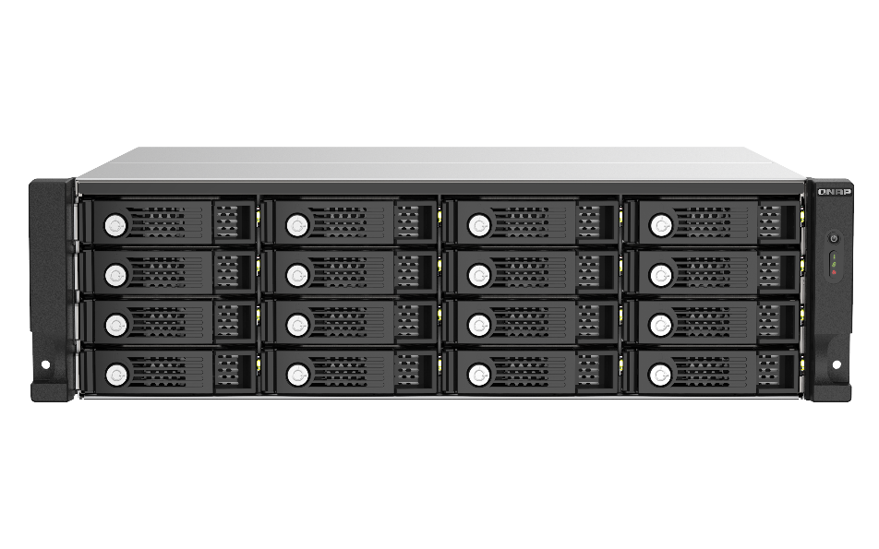

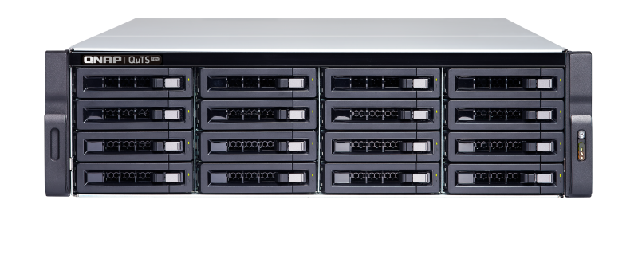


Expand NAS storage flexibly
or as backup space
The TL series JBOD can be used as a QNAP NAS expansion space and can expand the local storage capacity of the NAS. Supports all operations that can be done with normal storage pools, or create a snapshot backup job to back up snapshots of disk blocks and LUNs to TL JBOD.
Based on the software RAID architecture, the TL JBOD series is suitable for fixed expansion devices on the same NAS platform.
NAS snapshot Replica
NAS data backup
PCIe JBOD series
NAS series

Slide 25
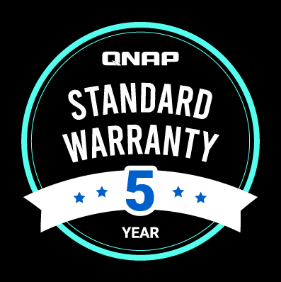
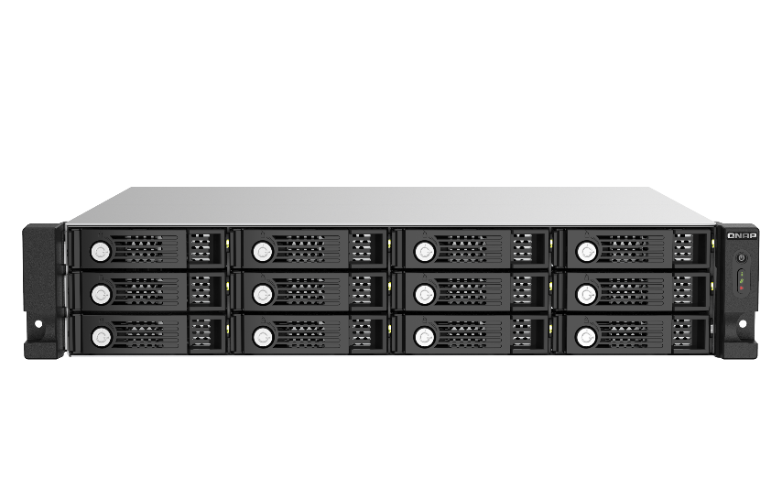
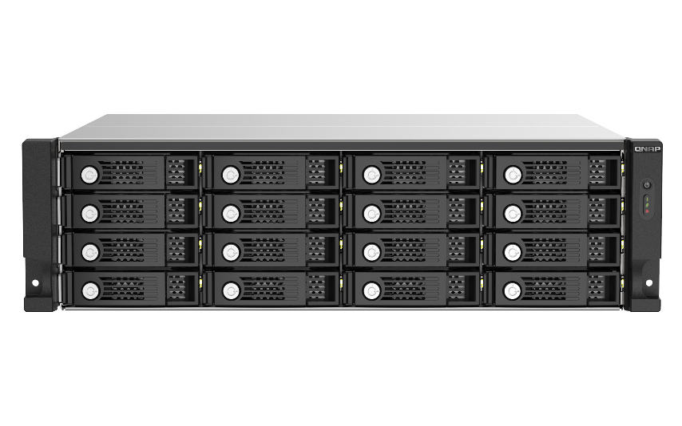
Enterprise-ready with a
5-year standard warranty covering hardware and technical support
5-year standard warranty
TL-R1200PES-RP & TL-R1600PES-RP & TL-R2400PES-RP
include standard five-year warranty.
QNAP's warranty starts from the product sold
Repairs under normal use during the warranty period,
Replacement parts are free of charge (except consumables and accessories)
https://www.qnap.com/service/product-warranty/en/

Slide 26
TL PCIe JBOD series specifications
 | TL-R1200PES-RP | TL-R1600PES-RP | TL-R2400PES-RP ( 2024 Q1 launch )
Drive bay | 12 x 2.5 / 3.5-inch, SATA 6Gb/s | 16 x 2.5 / 3.5-inch, SATA 6Gb/s | 24 x 2.5 / 3.5-inch, SATA 6Gb/s
Cascade | v | v | v
Form factor | 2U Rackmount | 3U Rackmount | 4U Rackmount
Expansion port | 1 port SFF8644(IN), 1 x port SFF8644(OUT) | 1 port SFF8644(IN), 1 x port SFF8644(OUT) | 1 port SFF8644(IN), 1 x port SFF8644(OUT)
Expansion interface | PCIe Gen3 x8 | PCIe Gen3 x8 | PCIe Gen3 x8 (internal)
Redundant power | v | v | v
FAN | 2 x 80mm | 3 x 80mm | 3 x 80mm
Enclosure ID indicators | 1 | 1 | 1
Operating temperature | 0 - 40 °C (32°F - 104°F) | 0 - 40 °C (32°F - 104°F) | 0 - 40 °C (32°F - 104°F)
Power | Redundant PSU | Redundant PSU | Redundant PSU
Dimensions (HxWxD) | 88.65 × 432 × 370.65 mm 3.49 x 17.01 x 14.59 inch | 131.3 × 432.4 × 370.85 mm 5.17 x 17.02 x 14.6 inch | 176.15 x 442.4 x 630.2 mm 6.94 x 17.42 x 24.81 inch

Slide 27


PB-scale with cascade PCIe JBOD
/ expansion card series for QNAP enterprise & SMB NAS
Copyright© 2023 QNAP Systems, Inc. All rights reserved. QNAP® and other names of QNAP Products are proprietary marks or registered trademarks of QNAP Systems, Inc. Other products and company names mentioned herein are trademarks of their respective holders.​​​​​​​

