Slide 1
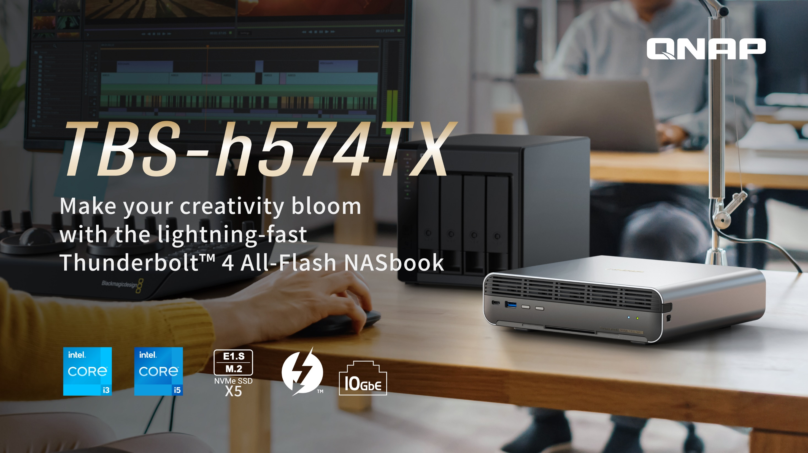

Slide 2
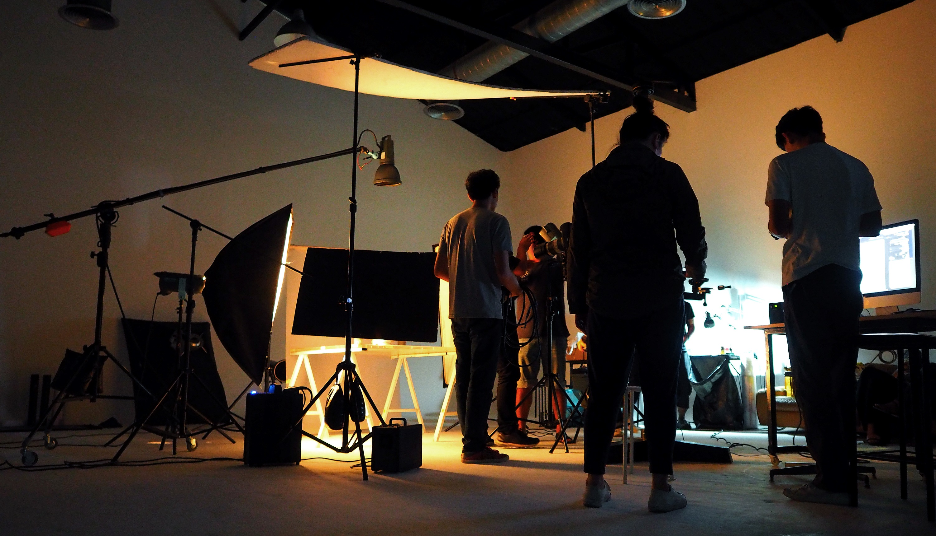
^{A Faster and Bigger Storage}
^{for the 4K / 8K Video Era​}
 | Date Rate | File Size
HD 1080P (ProRes 422) | 220 Mb/s | 90 GB/hr
4K (ProRes 422) | 630 Mb/s | 300 GB/hr
BlackMagic 4K | 1.4 Gb/s | 630 GB/hr
Canon 4K | 2.3 Gb/s | 1 TB/hr
Phantom Flex 4K | 2.3 Gb/s | 1 TB/hr
Red 8K | 2.4 Gb/s | 1.1 TB/hr
ARRI Alexa 6.5K RAW | 7.3 Gb/s | 3.3 TB/hr

Slide 3
Thunderbolt NAS for Video editing​
 | How Thunderbolt NAS can help
Collaboration | Support two Mac® or Windows® notebook/workstation edit photos/videos simultaneously​ Connects to a network via Ethernet, making it easier to collaborate on projects and share resources
Expandability | Multiple built-in drive slots make it easy to create high-capacity storage space Capacity expansion is very convenient through JBOD solution
User friendly | Provide fast, smoother, easy-to-used operating system​ The companion mobile app allows you to remotely access your NAS files
Data Security | Centralize backups and ensure consistent backups with snapshot​ You can set permissions or passwords to prevent files from being snooped indiscriminately

Slide 4

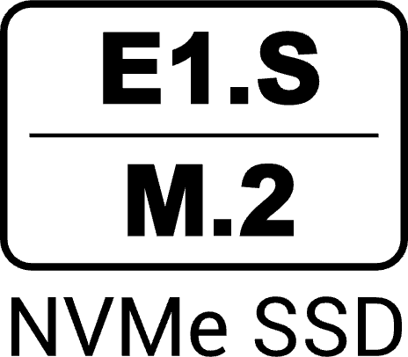




TBS-h574TX All-Flash Thunderbolt 4 NAS,
Powered by a 13th Gen Intel® Core Processor
Intel® Core 13th Gen processor
5 x E1.S (preinstalled M.2 adapter) slots
Core™ i3 / i5 optimizes your content creation and productivity with Intel powerful hybrid architecture
Provides 5 of E1.S PCIe SSD slots, supporting up to 15mm E1.S. Five of M.2 adapters are included to support M.2 2280 NVMe SSD
Dual Thunderbolt 4
1 x 10GBASE-T & 1 x 2.5GbE
Provides two Thunderbolt 4 ports to support high transfer speeds so you can focus more on content creation
Provides 10GbE / 2.5GbE LAN ports to help you enjoy a smooth data transmission experience
Compact and metal chassis design
USB One-Touch-Copy button
The compact and silver metal chassis design can better fit into your working environment.
Provides USB One-Touch-Copy button, allowing you to easily copy files in the USB folder to the NAS

Slide 5
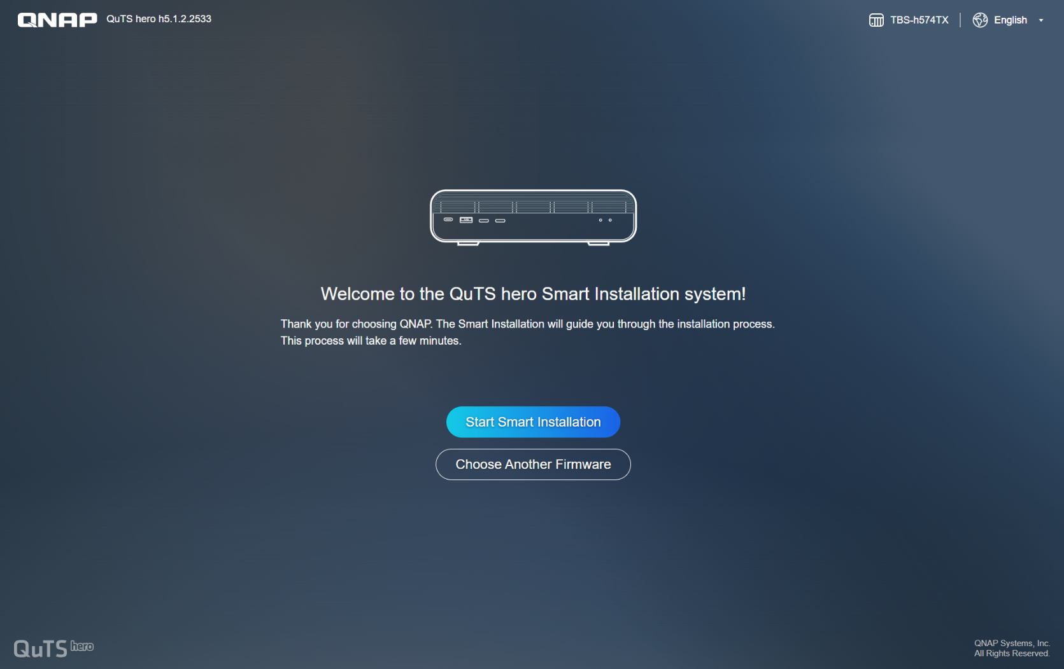
Switch NAS Operating Systems between
QuTS hero and QTS during Setup
TBS-h574TX is shipped with the QuTS hero operating system. And also supports QTS - QNAP’s standard NAS operating system – that provides performance, efficient memory utilization
Note
​​QTS and QuTS hero use different file systems. You must remove all the drives from the TBS-h574TX before switching from QuTS hero to QTS.

Slide 6

Choose between ​​
QTS and ZFS based QuTS hero​​
ZFS-based QuTS hero ensures performance and data integrity​
Faced with the explosive growth of data, VDI popularity, increasing SSD adoption, 8K media, and other disruptive IT trends, modern businesses need dependable storage systems to meet future demands. QNAP’s new “QuTS hero” operating system combines the app-based QTS with a 128-bit ZFS file system to provide flexible storage management, comprehensive data protection and optimized performance to meet the needs of business-critical applications.​​
Learn More: Why QNAP business NAS uses ZFS​​
​​ | QuTS hero​​ | QTS​​
Filesystem​​ | ZFS​​ | Ext4​​
SSD Cache​​ | Read Cache​​ | Read/Write Cache​​ Read Cache​​ Write Cache​​
Inline Compression​​ | Yes​​ (LZ4 compression, ideal for RAW files and document files)​​ | No​​
Inline Deduplication​​ | Yes​​ (At least 16 GB RAM required, TBS-h574TX-i3-12G is not supported)​​ | No​​
Power Failure Protection (Software)​​ | ZIL​​ Copy-On-Write​​ (Service continues after power recovery)​​ | No​​ (Risk of filesystem-level corruption on power-loss and system downtime required for “Check File System”)​​
Permission Management​​ | Rich ACL (14 types)​​ | POSIX ACLs (3 types) + certain special permissions​​
Capacity Expansion​​ | Upgrade RAID capacity​​ Change higher capacity disk drives​​ Attach expansion enclosures/JBODs​​ | Add a disk drive to a RAID group​​ Upgrade RAID capacity​​ Change higher capacity disk drives​​ Attach expansion enclosures/JBODs​​
Data Security​​ | Better​​ (Self-Healing & Copy-on-Write)​​ | Standard​​
Recommendation SSD Configuration for Video Editing Applications​​ | Use SSD Pools​​ ​​ Note: Set the block size 128K when creating Folders/LUNs​​ | Editing (from original/RAW files): Use SSD Pools​​ Post production: Enable Read/Write cache​​ ​​ Note: Set the block size to 32K or 64K when creating Volumes, and choose “All I/O” for cache mode.​​

Slide 7
TBS-h574TX Front View
5 x E1.S NMVe SSD slots, support up to 15mm E1.S SSD, and
pre-installed adapters to support M.2 2280 PCIe SSD for each slot
Thunderbolt 4 port
Power button
LED Indicator:
USB Copy, Status
USB 3.2 Gen 2 Type-A
USB One-Touch copy button

Slide 8
TBS-h574TX Rear View
2.5GbE LAN port
HDMI 1.4b, support 4K output
DC input
10GBASE-T
LAN port
Thunderbolt 4 port
Reset button
System Fan : 2 x 40mm
1 x USB 2.0
1 x USB 3.2 Gen 2 Type-A

Slide 9
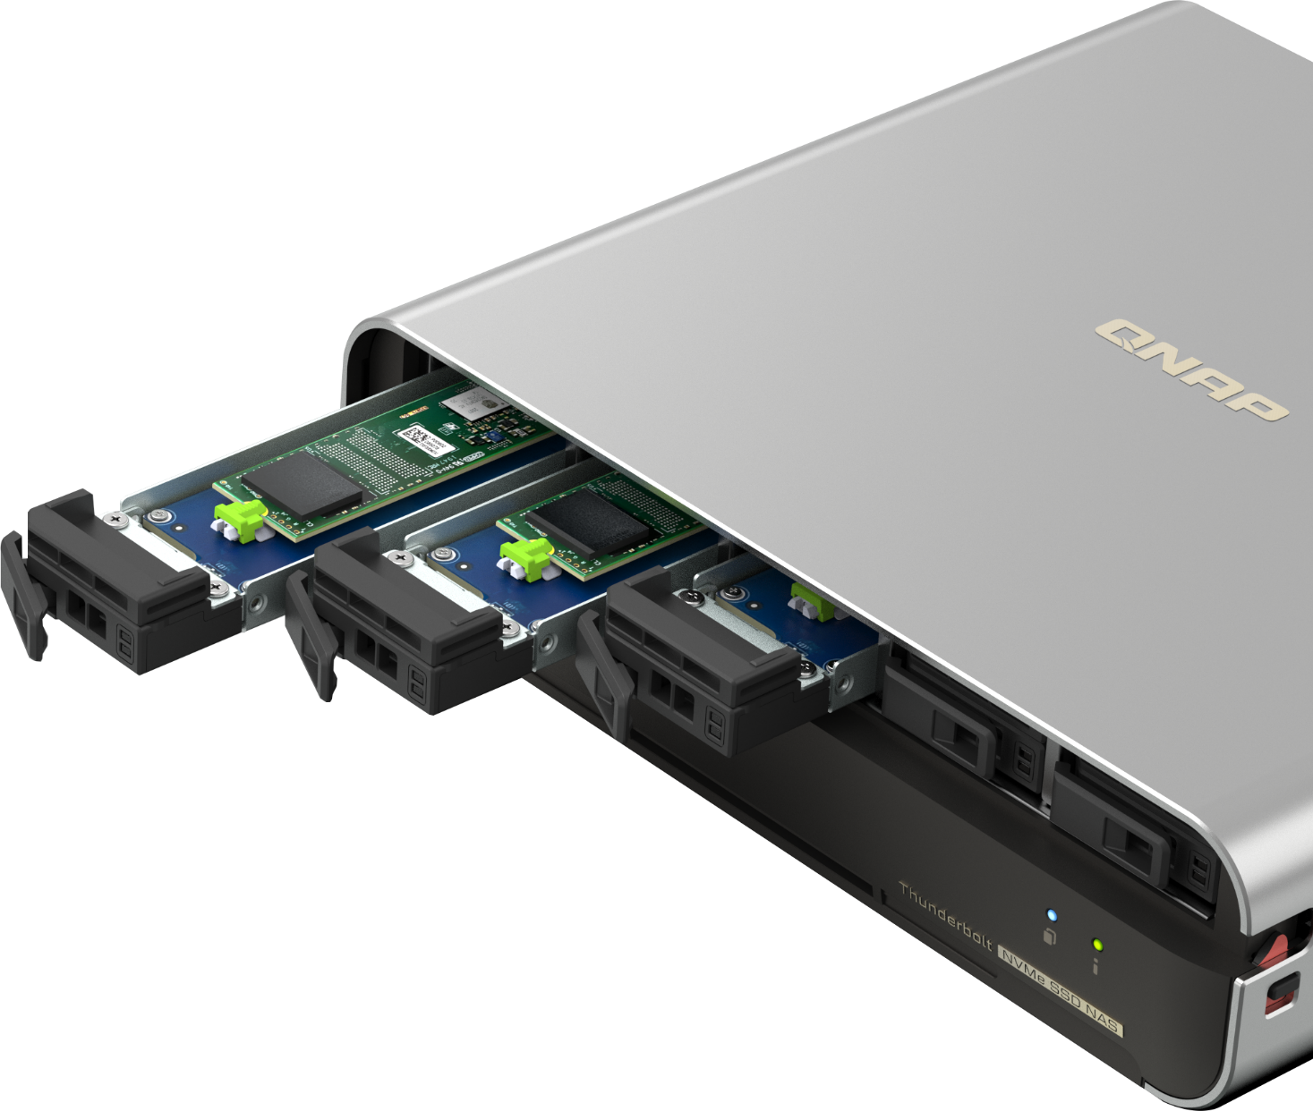
E1.S SSD Provides Small Storage Solutions with Higher Capacity and Hot-swappable Applications
Large-capacity storage space is required for video editing, and frequent reading and writing of SSDs is more likely to cause damage and require replacement of the SSDs.
TBS-h574TX is QNAP's new E1.S NAS solution, providing 5 E1.S SSD slots and supporting up to 15mm-height E1.S SSDs. Also comes standard with an M.2 transfer adapter to support M.2 2280 NVMe SSD, allowing you to support hot swapping under the M.2 storage architecture.

Slide 10
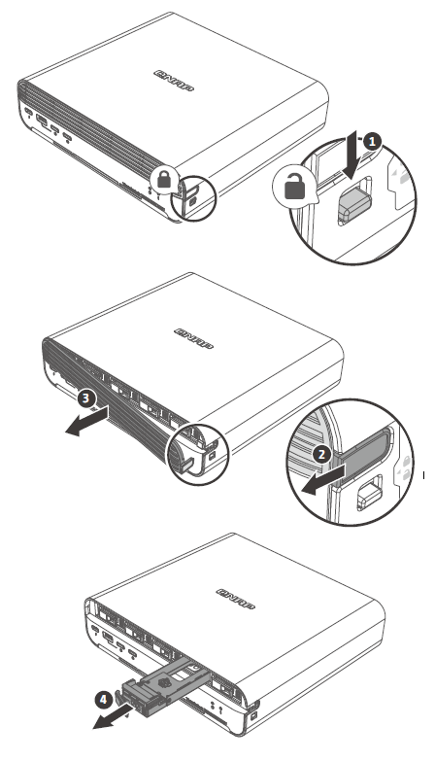
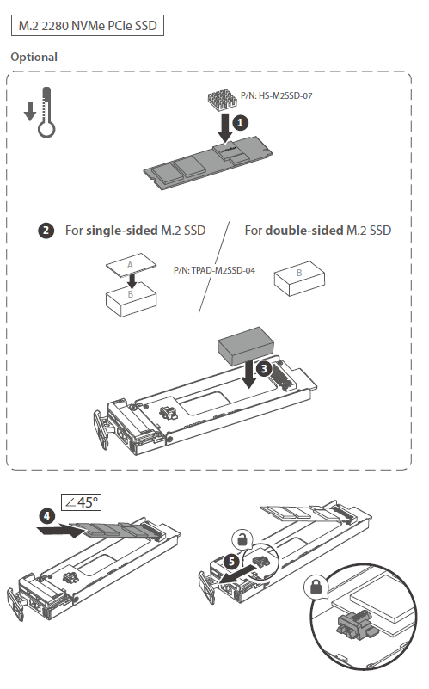
Tool-free Quick Installation of M.2 2280 NVMe SSD for Hot-swappable Usage
If you want to install heat-dissipation module on M.2 SSDs, with a heat-dissipation module, you can purchase the QNAP heatsink HS-M2SSD-07 and the thermal pad TPAD-M2SSD-04.
Step 1 :
Install the heatsink on the controller.
Step 2 :
Single-sided M.2 SSD : Install both thermal pad A and B on the SSD tray.
Double-sided M.2 SSD : Install thermal pad B on the SSD tray.
Step 3 :
Pull the locker and hold it in place, carefully press down the M.2 SSD with 45 degree.
Note : Heatsinks must not exceed a height of 4.5 mm
Slide the lock down to release the front cover

Slide 11
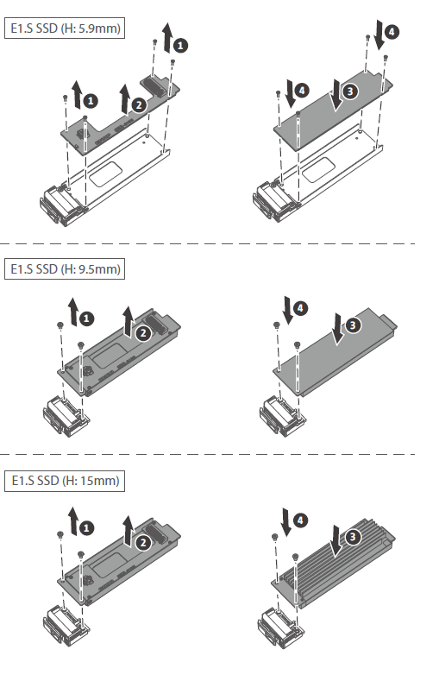

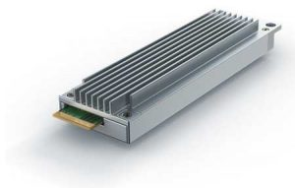
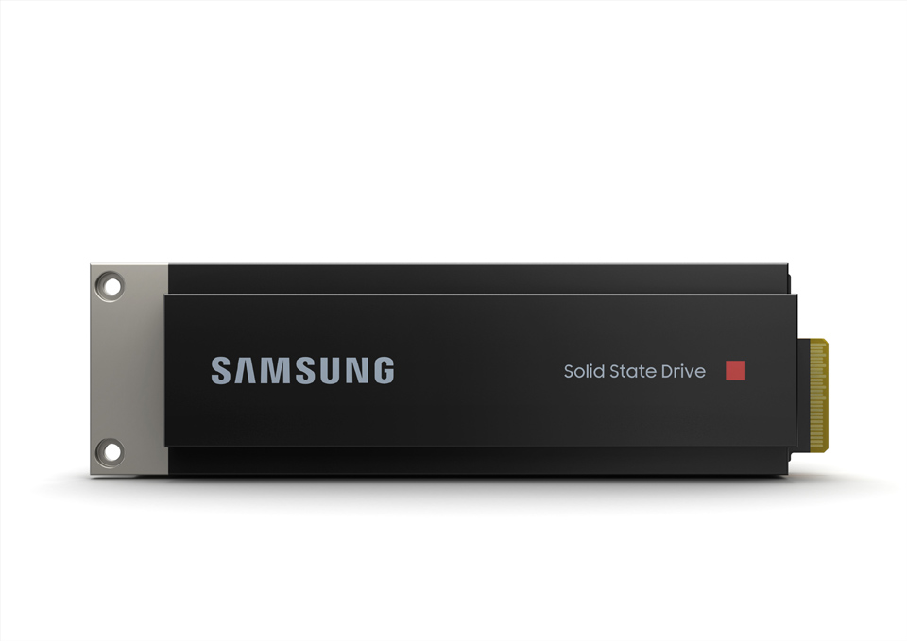

5 x E1.S NVMe SSD
Slots, up to
15mm E1.S SSD
TBS-h574TX contains 5 E1.S NVMe SSD slots, supporting up to 15mm E1.S SSD with cooling fin, giving you a variety of SSD options to build storage space

Slide 12
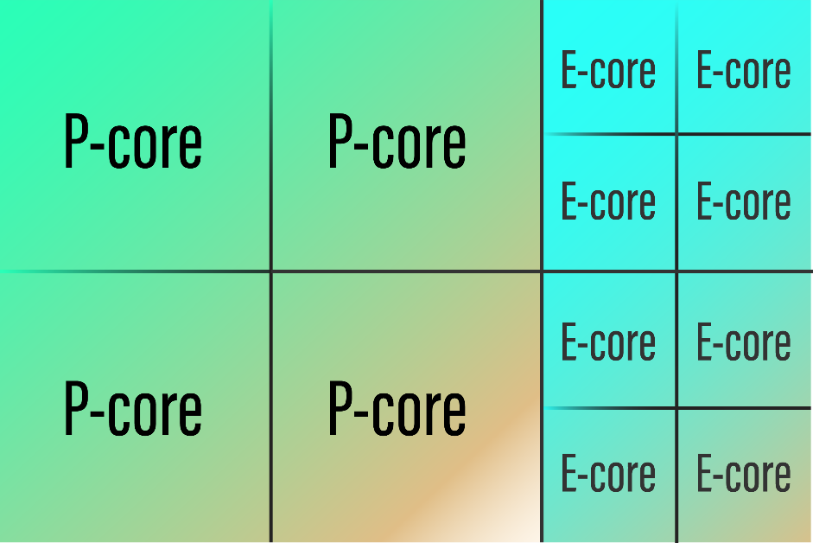


Up to 12-core/16-thread Intel
Core i5 13th Gen Processor
Powerful 13th generation Intel® Core™ i3 / i5 processors
Equipped with Intel 13th generation processors to provide strong performance and continued to use Intel's performance hybrid architecture to optimize your content creation and productivity. Integrating the latest Intel Graphics can support 4K video transcoding and accelerate various applications.
High performance P-core focuses on performance, low power consumption E-core focuses on multi-core computing, and the hybrid architecture brings higher efficiency to work tasks.

Slide 13

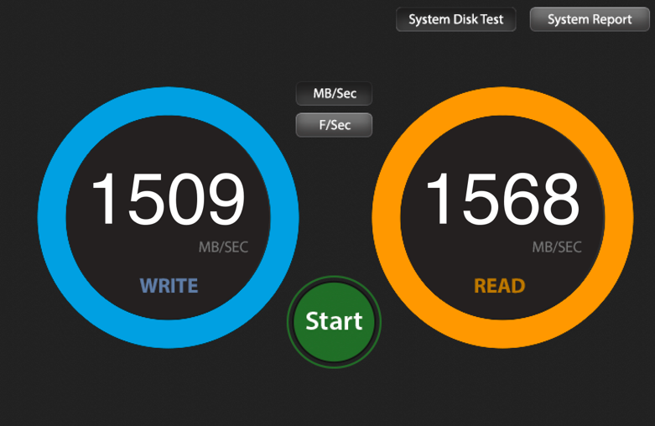
Thunderbolt 4 ​
Exceptional Performance​
Built-in Thunderbolt 4 ports via Thunderbolt Networking
Write: 1,637 MB/s, Read: 1,736 MB/s via AJA System Test
1,637
1,736
NAS : TBS-h574TX-i5-16G
O.S. : QuTS hero h5.1.2
Volume Type : Samsung 980 RPO 1TB x 3 + 970 EVO Plus 1TB x2, RAID 5
Client PC：MacBook Pro M2 Pro, Mac OS 13.5, 16GB RAM
AJA :
Data Pattern : 5120 x 2700 5K RED / Testing Data Size : 16GB / Codec Type : 16bit RGBA

Slide 14
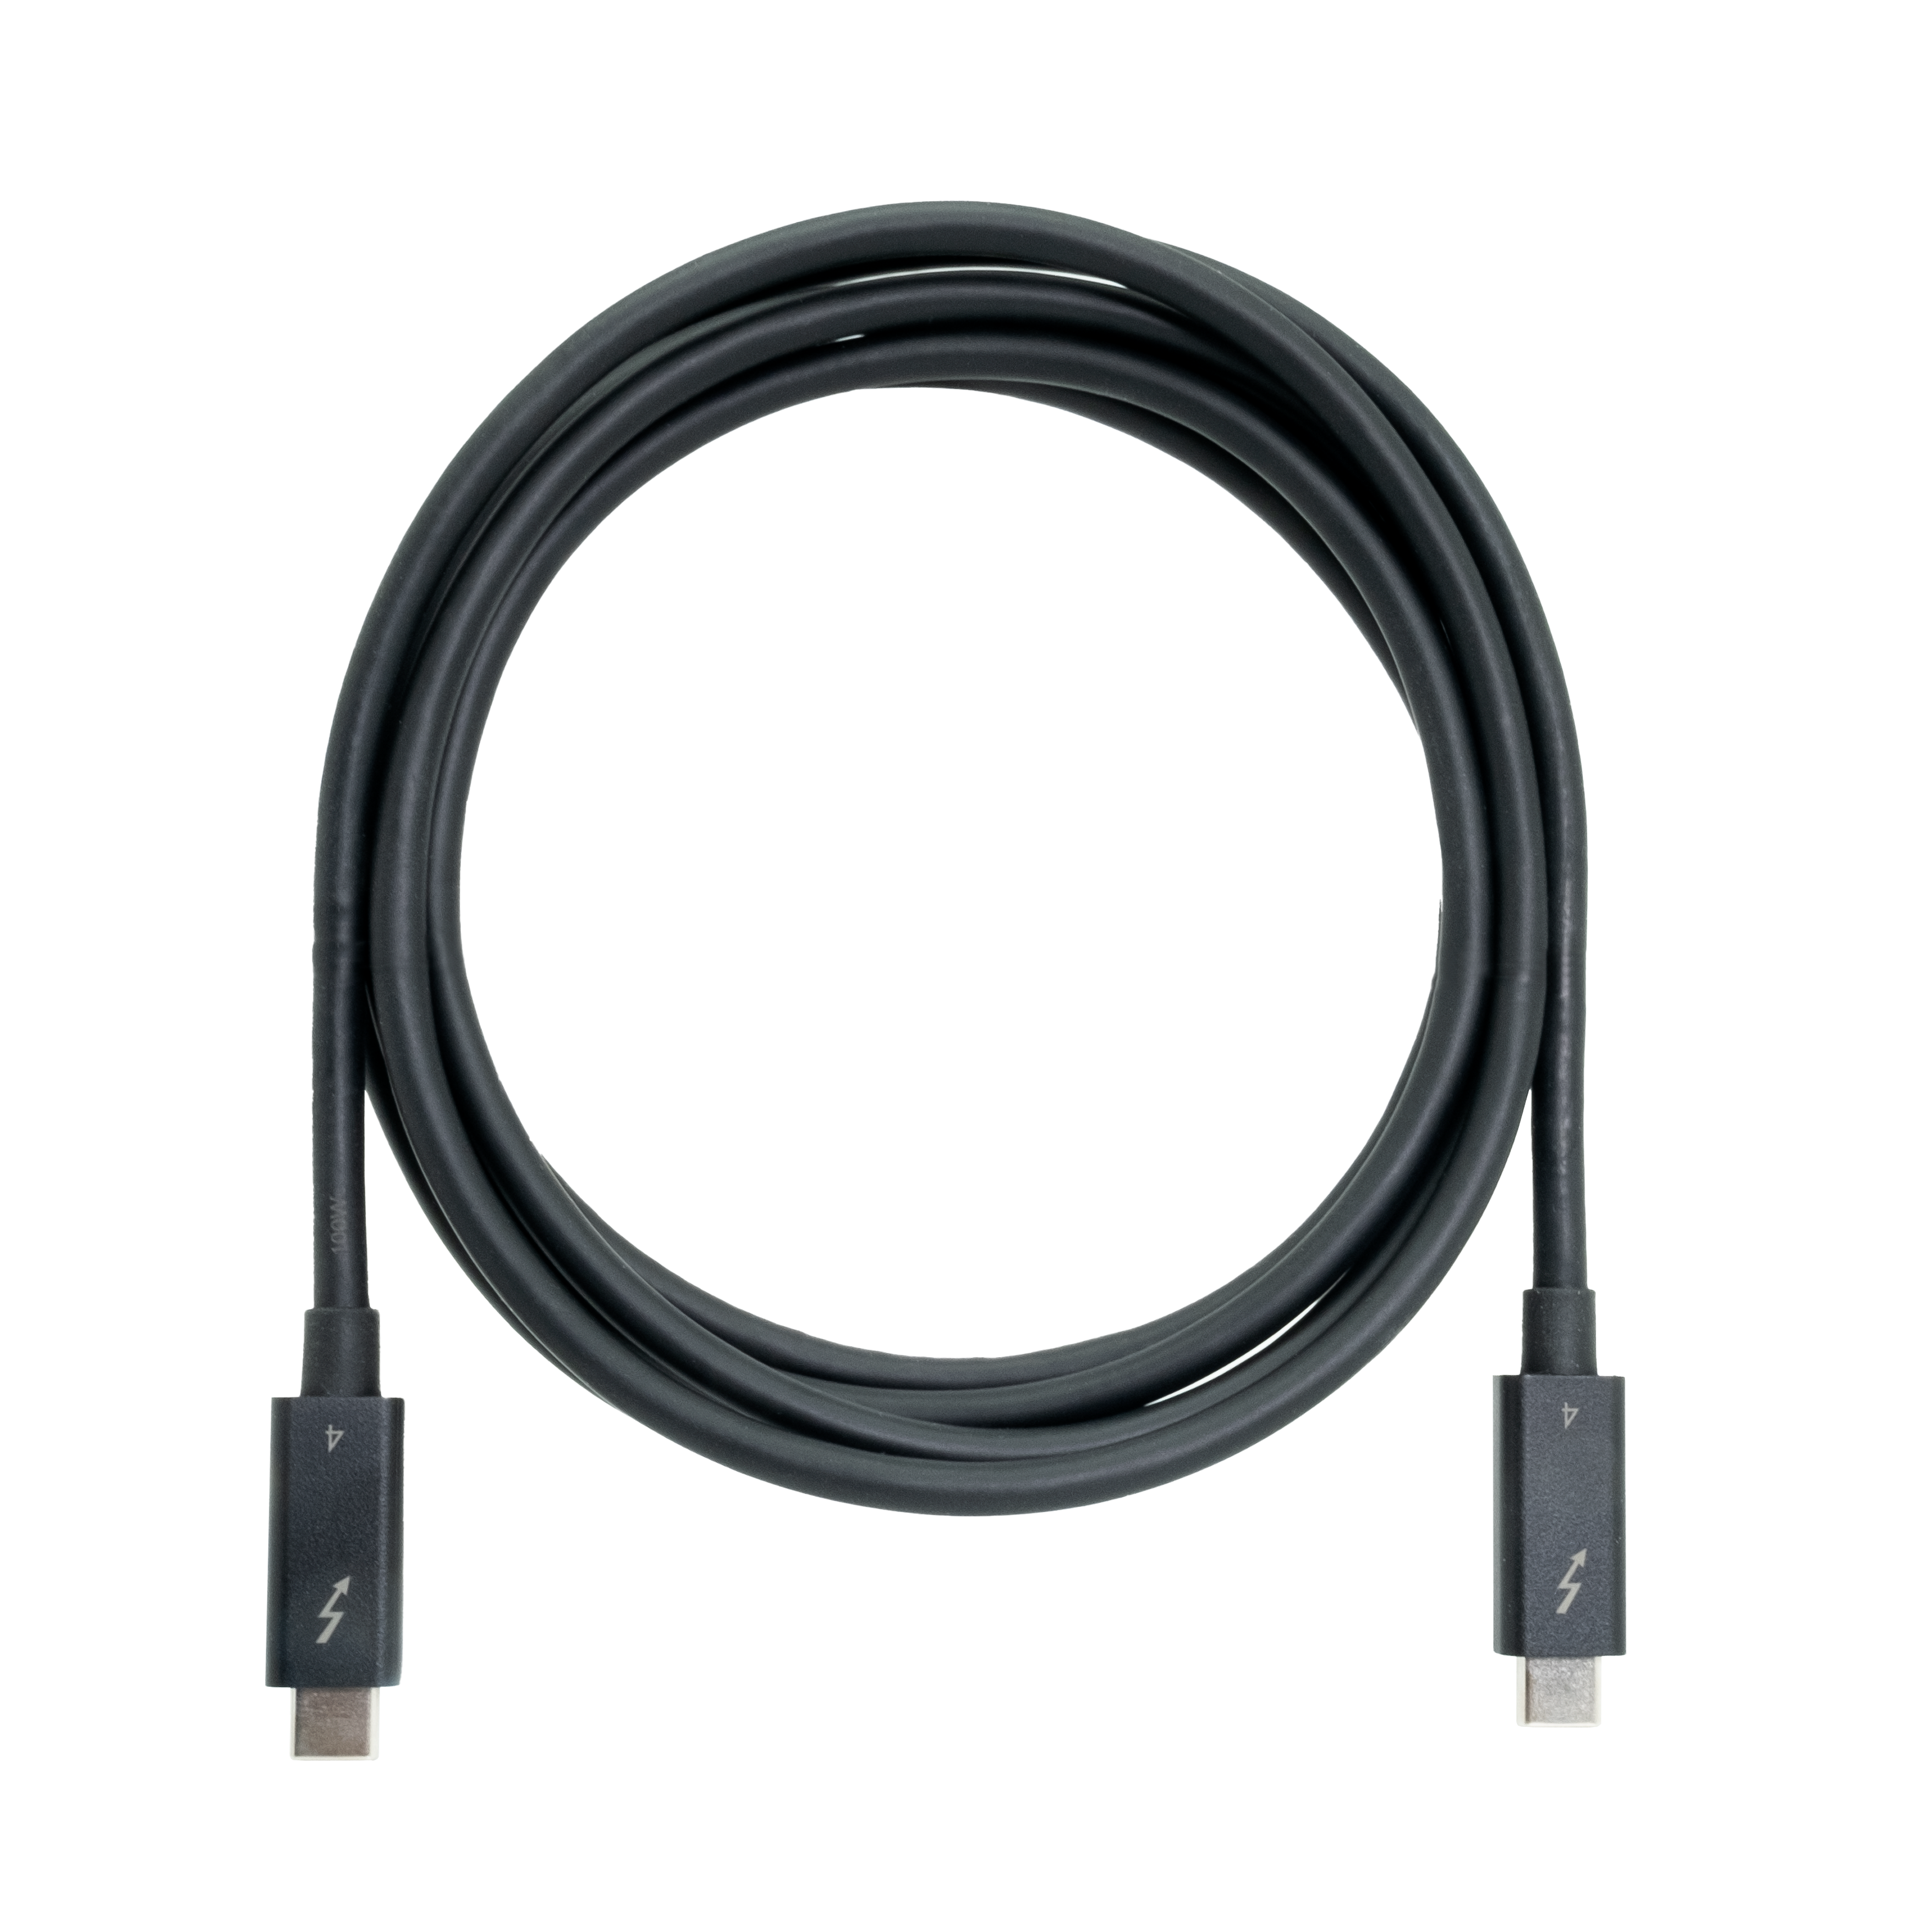
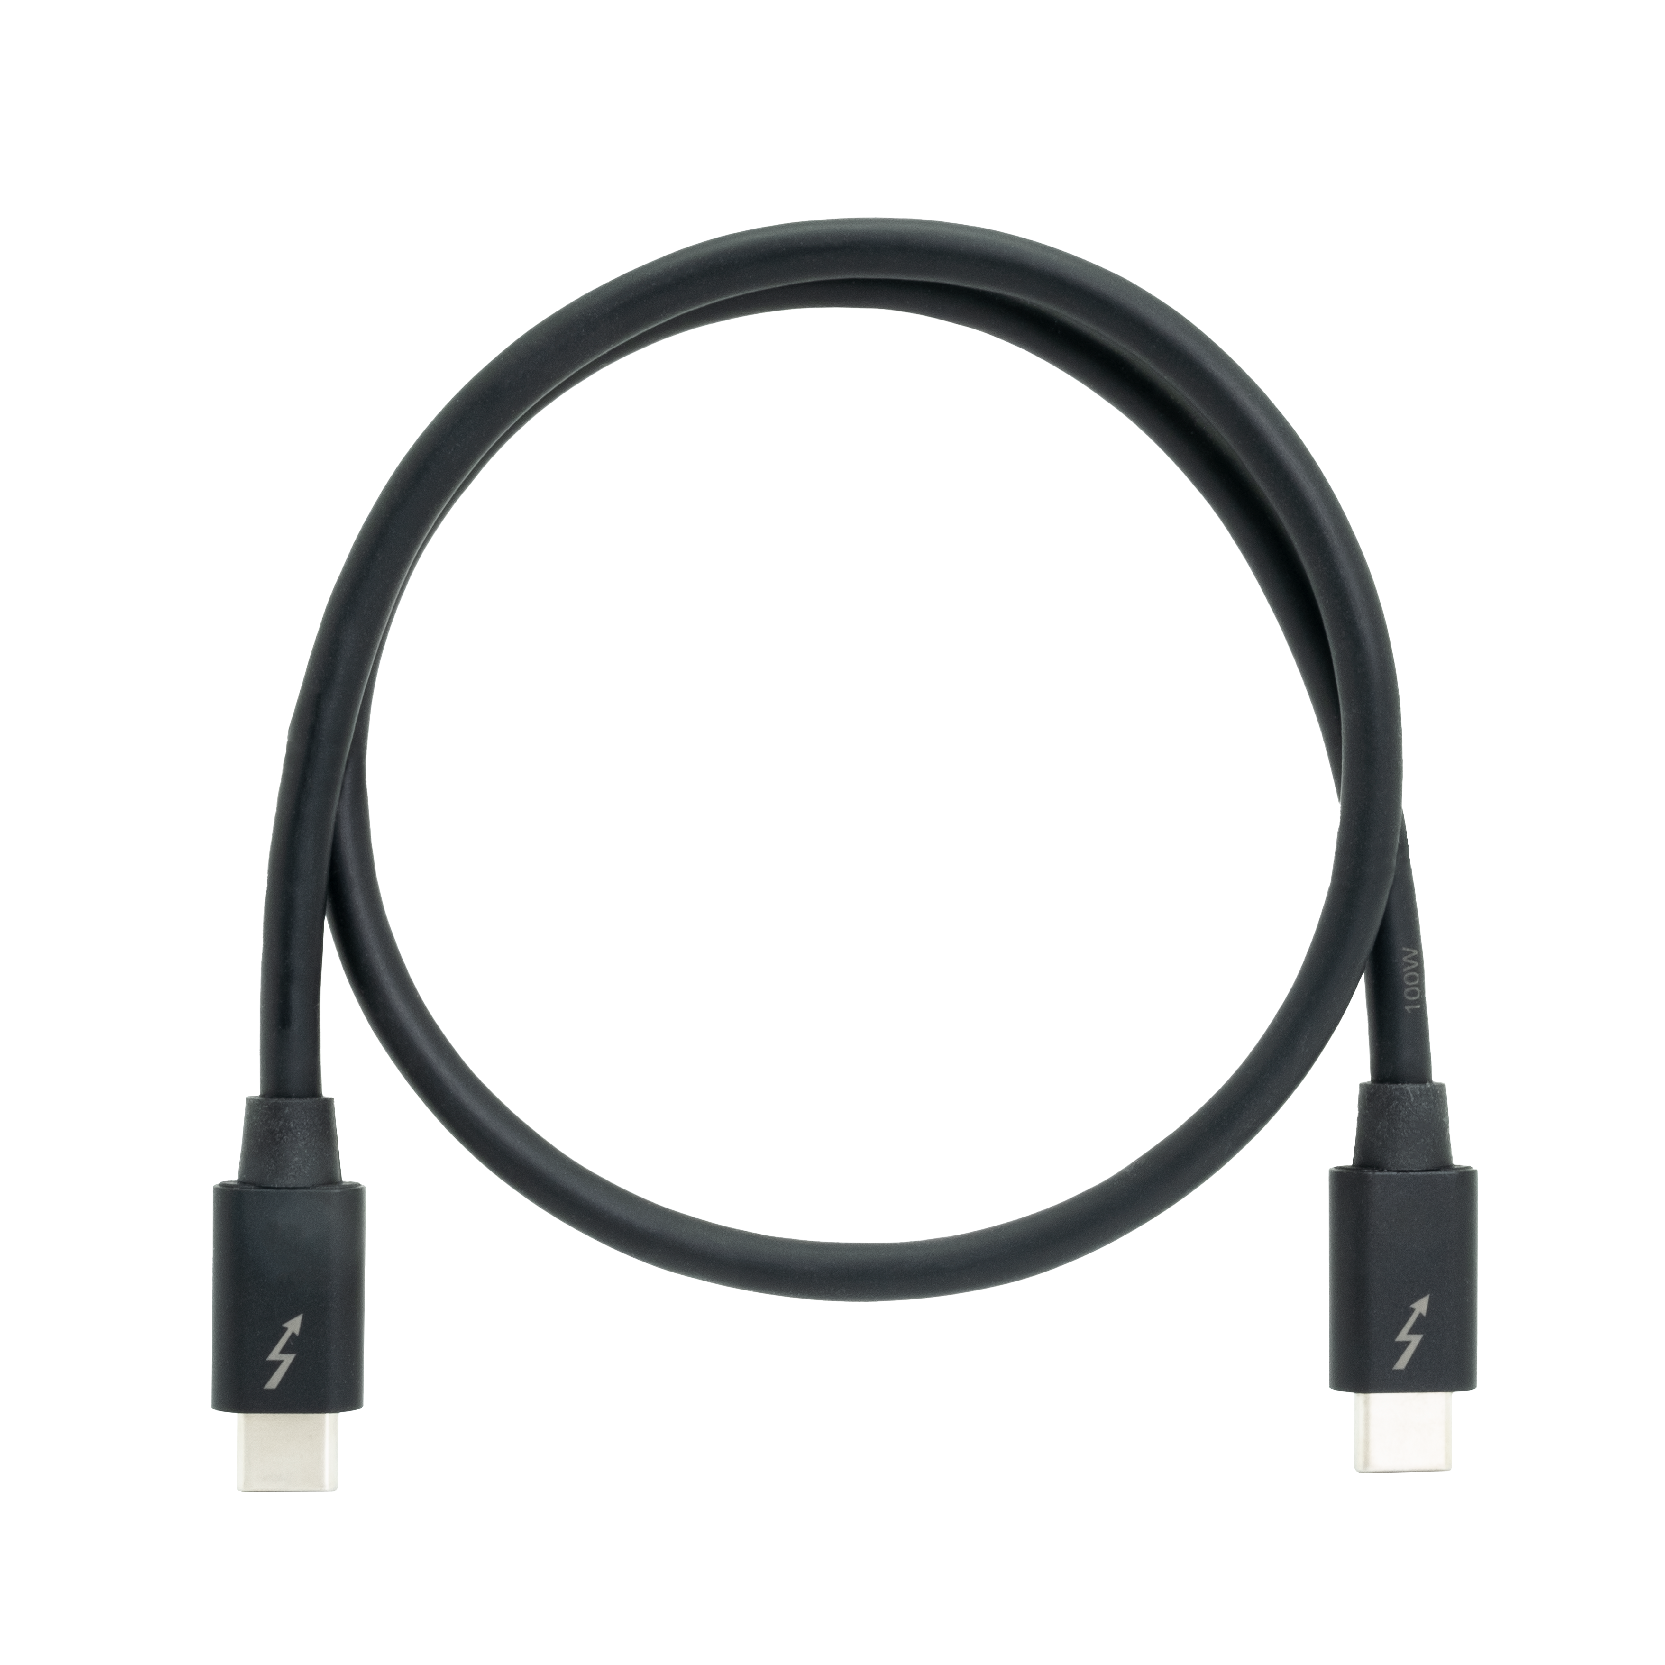

QNAP Thunderbolt Accessories: ​
Thunderbolt 3 & Thunderbolt 4 Cables​
QNAP also provides a variety of Thunderbolt cables to choose from. In addition to Thunderbolt 4 cables, there are also more affordable Thunderbolt 3 cables for Thunderbolt 3 computers, allowing you to meet high-speed transmission at a lower cost. ​
Thunderbolt 4 Cables
Thunderbolt 3 Cables
CAB-TBT4-2M :
2 meter (6.56 ft.)
CAB-TBT4-0M5 :
0.5 meters (1.64 ft.)
CAB-TBT315M-40G :
1.5 meters (4.92 ft.)
CAB-TBT320M-40G-LINTES :
2 meters (6.56 ft.)
12吋短機箱可支援市面上大部分的機櫃
內建2埠M.2(PCIe Gen 3 x1)，可提供SSD快取，加速隨機存取的速度
PCIe Gen 3 x 8插槽，提供各式應用的高速擴充卡
雙系統靈活切換配置QTS and QuTS hero

Slide 15
10GBASE-T and 2.5GbE LAN Ports for High-speed Network Environment Right out of the Box
1 x 2.5GbE
Windows File Transfer
1 x 10GbE SMB
Sequential Throughput (1MB)
295 MB/s
295MB/s
1,182 MB/s
1,181 MB/s
Test environment : ​
NAS: TBS-h574TX
OS：QuTS hero h5.1.2
Volume type: Samsung 980 RPO 1TB x 3 + 970 EVO Plus 1TB x2, RAID 5
Client PC: Windows Server 2022, AMD EPYC 7302P 3.0GHz, 96GB RAM,
IOmeter : 16MB, 30-sec ramp up time, 3-min seq. run time, 8 worker, 16-outstanding
12吋短機箱可支援市面上大部分的機櫃
內建2埠M.2(PCIe Gen 3 x1)，可提供SSD快取，加速隨機存取的速度
PCIe Gen 3 x 8插槽，提供各式應用的高速擴充卡
雙系統靈活切換配置QTS and QuTS hero

Slide 16

Built-in HDMI Port for 4K Video Output
Up to 1.35 GHz
Intel® Iris® Graphic
Up to 80 EUs
The foundational building block of GPU
HDMI 4K output
1 x HDMI 1.4b
The supported video and audio formats may vary depending on the software's compatibility
This slide shows the specification of Intel Core i5 1340PE integrated GPU
Notes:
16

Slide 17
Video Editing Storage Solution
12吋短機箱可支援市面上大部分的機櫃
內建2埠M.2(PCIe Gen 3 x1)，可提供SSD快取，加速隨機存取的速度
PCIe Gen 3 x 8插槽，提供各式應用的高速擴充卡
雙系統靈活切換配置QTS and QuTS hero

Slide 18

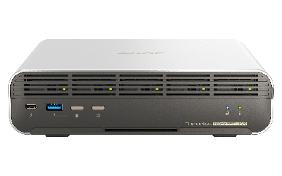



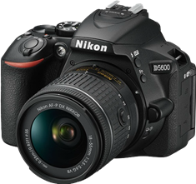


Video File Management Solution for Pre-production – Raw Footage On-site Editing and Powerful Video Transcoding
DIT (Digital Imaging Technician) is the keyman to take responsibility of video file management on shooting site in a frontline video production team.
DIT can quickly import large raw footage from camera SD cards to the TBS-h574TX through USB 3.2 Gen 2 (10Gbps) ports and proceed with video transcoding on the NASbook.
The TBS-h574TX comes with a built-in HDMI™ output, allowing on-site personnel to immediately play raw footage from the NASbook on a large screen
Benefits for a pre-production team：
Fast file import from SD cards to NASbook
Store small files to myQNAPcloud Storage
Remote access and sharing video files
High-resolution video display using HDMI™ output
Rough cut on-site using Thunderbolt™ 4
Thunderbolt™ 4 Onsite Video Editing
TBS-h574TX
Backup
Take photos/videos and upload raw files to TBS-h574TX
Output footage via HDMI 4K screen
12吋短機箱可支援市面上大部分的機櫃
內建2埠M.2(PCIe Gen 3 x1)，可提供SSD快取，加速隨機存取的速度
PCIe Gen 3 x 8插槽，提供各式應用的高速擴充卡
雙系統靈活切換配置QTS and QuTS hero

Slide 19
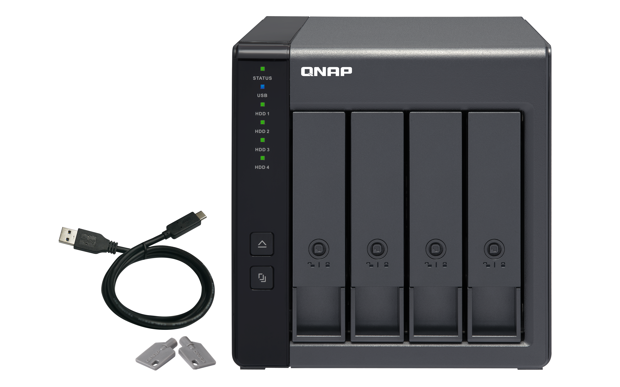
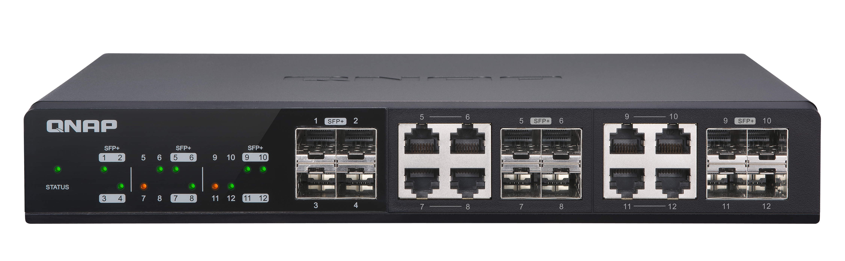

TBS-h574TX Helps You Achieve Efficient Collaboration in Post-production
NAS is way more collaborative than DAS. The TBS-h574TX provides Thunderbolt™ 4 and 10GbE connectivity that allow the post-production team to edit video files directly from the NASbook, without waiting for files to move from drive to drive, computer to computer.
Benefits for a post-production team：
Directly connect the NASbook to Mac® via Thunderbolt™ 4
Directly connect the NASbook to Windows® workstations through 10GbE and 2.5GbE connectivity
File storage and backup by connecting a DAS through the high-speed UBS 3.2 Gen 2 ports
Thunderbolt™ 4 port provides direct connection to Mac or Windows NB/Computer
TBS-h574TX
QSW 10GbE Switch
Save finished files to USB external DAS
PC
PC
12吋短機箱可支援市面上大部分的機櫃
內建2埠M.2(PCIe Gen 3 x1)，可提供SSD快取，加速隨機存取的速度
PCIe Gen 3 x 8插槽，提供各式應用的高速擴充卡
雙系統靈活切換配置QTS and QuTS hero

Slide 20
Hot-swappable M.2 SSDs Facilitate File Sharing for Collaboration and Delivery
You can configure a TBS-h574TX for each work team in the two locations, and configure the system disk and RAID configuration. Through convenient hot-swappable technology, the SSD can be used like an external hard drive: remove the SSD from NAS A and install it into NAS B to complete the transfer of large amounts of files.
Benefits for remote teamwork：
Hot-swappable feature enables physically transferring large media files
*Set SSD 1 of one TBS-h574TX as the system disk. The rest of the SSDs 2~5 can be RAID or Single Disk setup. With hot-swappable support, the storage pool can be transferred to another TBS-h574TX without shutting down.
SSD 1
SSD 2
SSD 3
SSD 4
SSD 5
RAID or Single
w
*Note :
Before migrating the storage pool, you need to click “Safely Detach Pool”in Storage & Snapshots
To rebuild the storage pool, you need to click “Rebuild Storage Pool” in Storage & Snapshots
SSD 6
SSD 2
SSD 3
SSD 4
SSD 5
12吋短機箱可支援市面上大部分的機櫃
內建2埠M.2(PCIe Gen 3 x1)，可提供SSD快取，加速隨機存取的速度
PCIe Gen 3 x 8插槽，提供各式應用的高速擴充卡
雙系統靈活切換配置QTS and QuTS hero

Slide 21



An Official Adobe Partner
for Video, Audio, and Image Solutions​
QNAP NAS is the best centralized storage for Adobe users, allowing streamlined collaborative workflows on projects of all types (including photos, graphics, videos, and music). Higher file transfer performance can be achieved using a QNAP NAS with 2.5GbE, 10GbE, or Thunderbolt™ connectivity, and storage capacity can be scaled up for larger storage spaces to support your amazing creative work!​
12吋短機箱可支援市面上大部分的機櫃
內建2埠M.2(PCIe Gen 3 x1)，可提供SSD快取，加速隨機存取的速度
PCIe Gen 3 x 8插槽，提供各式應用的高速擴充卡
雙系統靈活切換配置QTS and QuTS hero

Slide 22
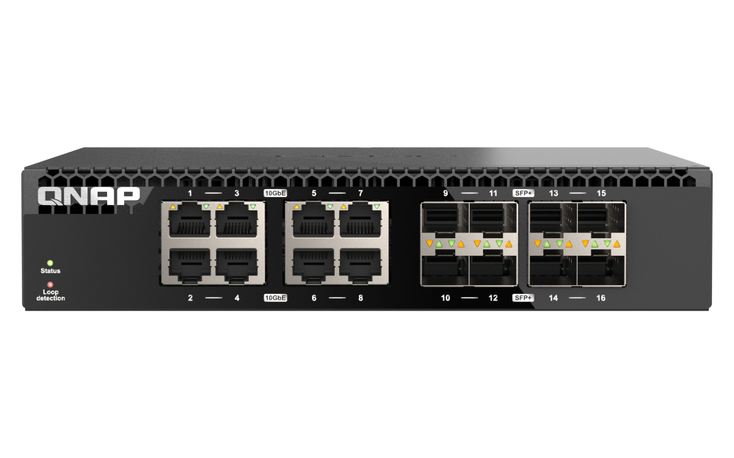
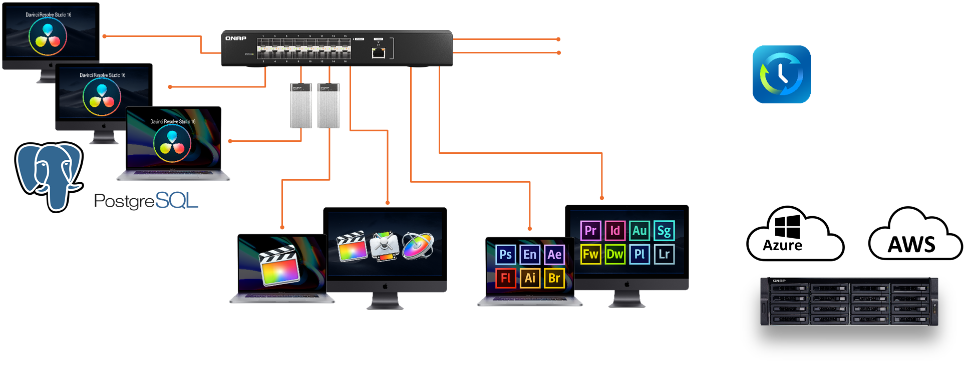
Complete Solutions to Create a High-speed, Efficient and Secure Collaboration Environment for Mac® and Windows®
QSW 10GbE Switch
QSW-3216R-8S8T
Edit videos simultaneously via Thunderbolt
TBS-h574TX
Backup
Take photos/videos and upload files to Thunderbolt NAS
DaVinci Resolve + PostgreSQL
FCPX & Motion
Project for Adobe Creative Suite
12吋短機箱可支援市面上大部分的機櫃
內建2埠M.2(PCIe Gen 3 x1)，可提供SSD快取，加速隨機存取的速度
PCIe Gen 3 x 8插槽，提供各式應用的高速擴充卡
雙系統靈活切換配置QTS and QuTS hero

Slide 23

Compact and Durable Metal Case Design
2.24 kg / 4.94 lbs
Light weight. Take it everywhere!
Small size &
space saving
60 x 215 x 199 mm
2.36 x 8.46 x 7.83 inch
(H x W x D)

Slide 24
TBS-h574TX Specifications
Ordering SKU | TBS-h574TX-i3-12G | TBS-h574TX-i5-16G | TBS-h574TX-i5U-16G
CPU | Intel Core i3-1320PE 8C(4P+4E)/12T up to 4.50GHz | Intel Core i5-1340PE 12C(4P+8E)/16T up to 4.50GHz | Intel Core i5-1235U 10C(2P+8E)/12T up to 4.4GHz
Memory | 12GB onboard RAM (Non-expandable) | 16GB onboard RAM (Non-expandable) | 16GB onboard RAM (Non-expandable)
Drive tray | 5 x E1.S up to 15mm ( or 5 x M.2 2280 PCIe w/ the supplied M.2 adapters ) Support Hot-swapping
LAN | 1 x 10GBASE-T Multi-Gig (RJ-45) + 1 x 2.5GbE (RJ-45)
Thunderbolt | 2 x Thunderbolt 4
USB | 1 x USB 3.2 Gen2x1 (10Gb/s, Type-A, front) 1 x USB 3.2 Gen2x1 (10Gb/s, Type-A, rear) 1 x USB 2.0 (Type-A, rear)
Dimensions (H x W x D) | 60 x 215 x 199 mm (2.36 x 8.46 x 7.83 inch)
Weight | 2.24 kg (4.94 lbs)
HDMI | 1 x HDMI (1.4b), support 4K output
Power supply | 120W adapter

Slide 25





Supports up to 12 More SATA HDDs with One JBOD, ​adding 264TB (12 x 22TB) of storage space​​
USB
Maximum # of JBOD / RAID expansion units
TR-002​ | 2​
TR-004​ | 2​
TR-004U​ | 2​
TL-D800C​ | 1
TL-R1200C-RP​ | 1
TR-002
TR-004
TL-D800C
Note: These expansion units can only be used as an individual storage pool or volume on the NAS. Their storage pool or volume cannot be combined into the connected NAS. NAS applications cannot be installed on the them.​​
TR-004U
TL-R1200C-RP

Slide 27

Enterprise-level OS
ZFS-based QuTS hero

Slide 28







QuTS hero O.S. with Powerful Data Reduction Technologies to Extend SSD Endurance
Only available when during inline data process before writing
ZFS file system with inline deduplications and compression feature​
It's the best choice to pair with the all-flash and SSD storage because it reduces the data size and pattern that need to be written to the SSD directly​
寫入
Deduplication ​
Minimum：16GB RAM​
A
B
C
D
A
B
C
D
D
C
A
B
A
B
C
D
D
C
A
B
Original Data​
Compressed Data​
Deduplicated Data​
SSD Pool
Compression​
Deduplication​
Write to SSDs as sequential as much as possible​

Slide 29






File Station Web UI & Qfile Mobile App:
Easy to Use, Easy to Find​ & Share
手機瀏覽
網頁瀏覽
All the files and folders stored on your NAS and connected storage spaces are accessible through a familiar interface, and rich search/sort functions are available to help find files.​
Qfile
File Station
Local NAS
Remote NAS
Cloud Storage

Slide 30


Smart and Automatic File Management​
Qsirch 5
Qfiling 3
A powerful, Google™-like search tool​
Automatically filing and archiving​
Search image, music, video, document, and email by keyword and filters. ​
5 advanced image search: search by face, text in image, things, color and map.​
Supports Qfiling to perform archival tasks based on your search criteria.​
Source
Schedule
Filter
Edit
Destination
2 type of task: filing task, recycling task​
3 type of scheduling rule: one-time, scheduling, real-time​
9 editing module: AI face blur, encryption and decryption, video transcoding and so on​

Slide 31


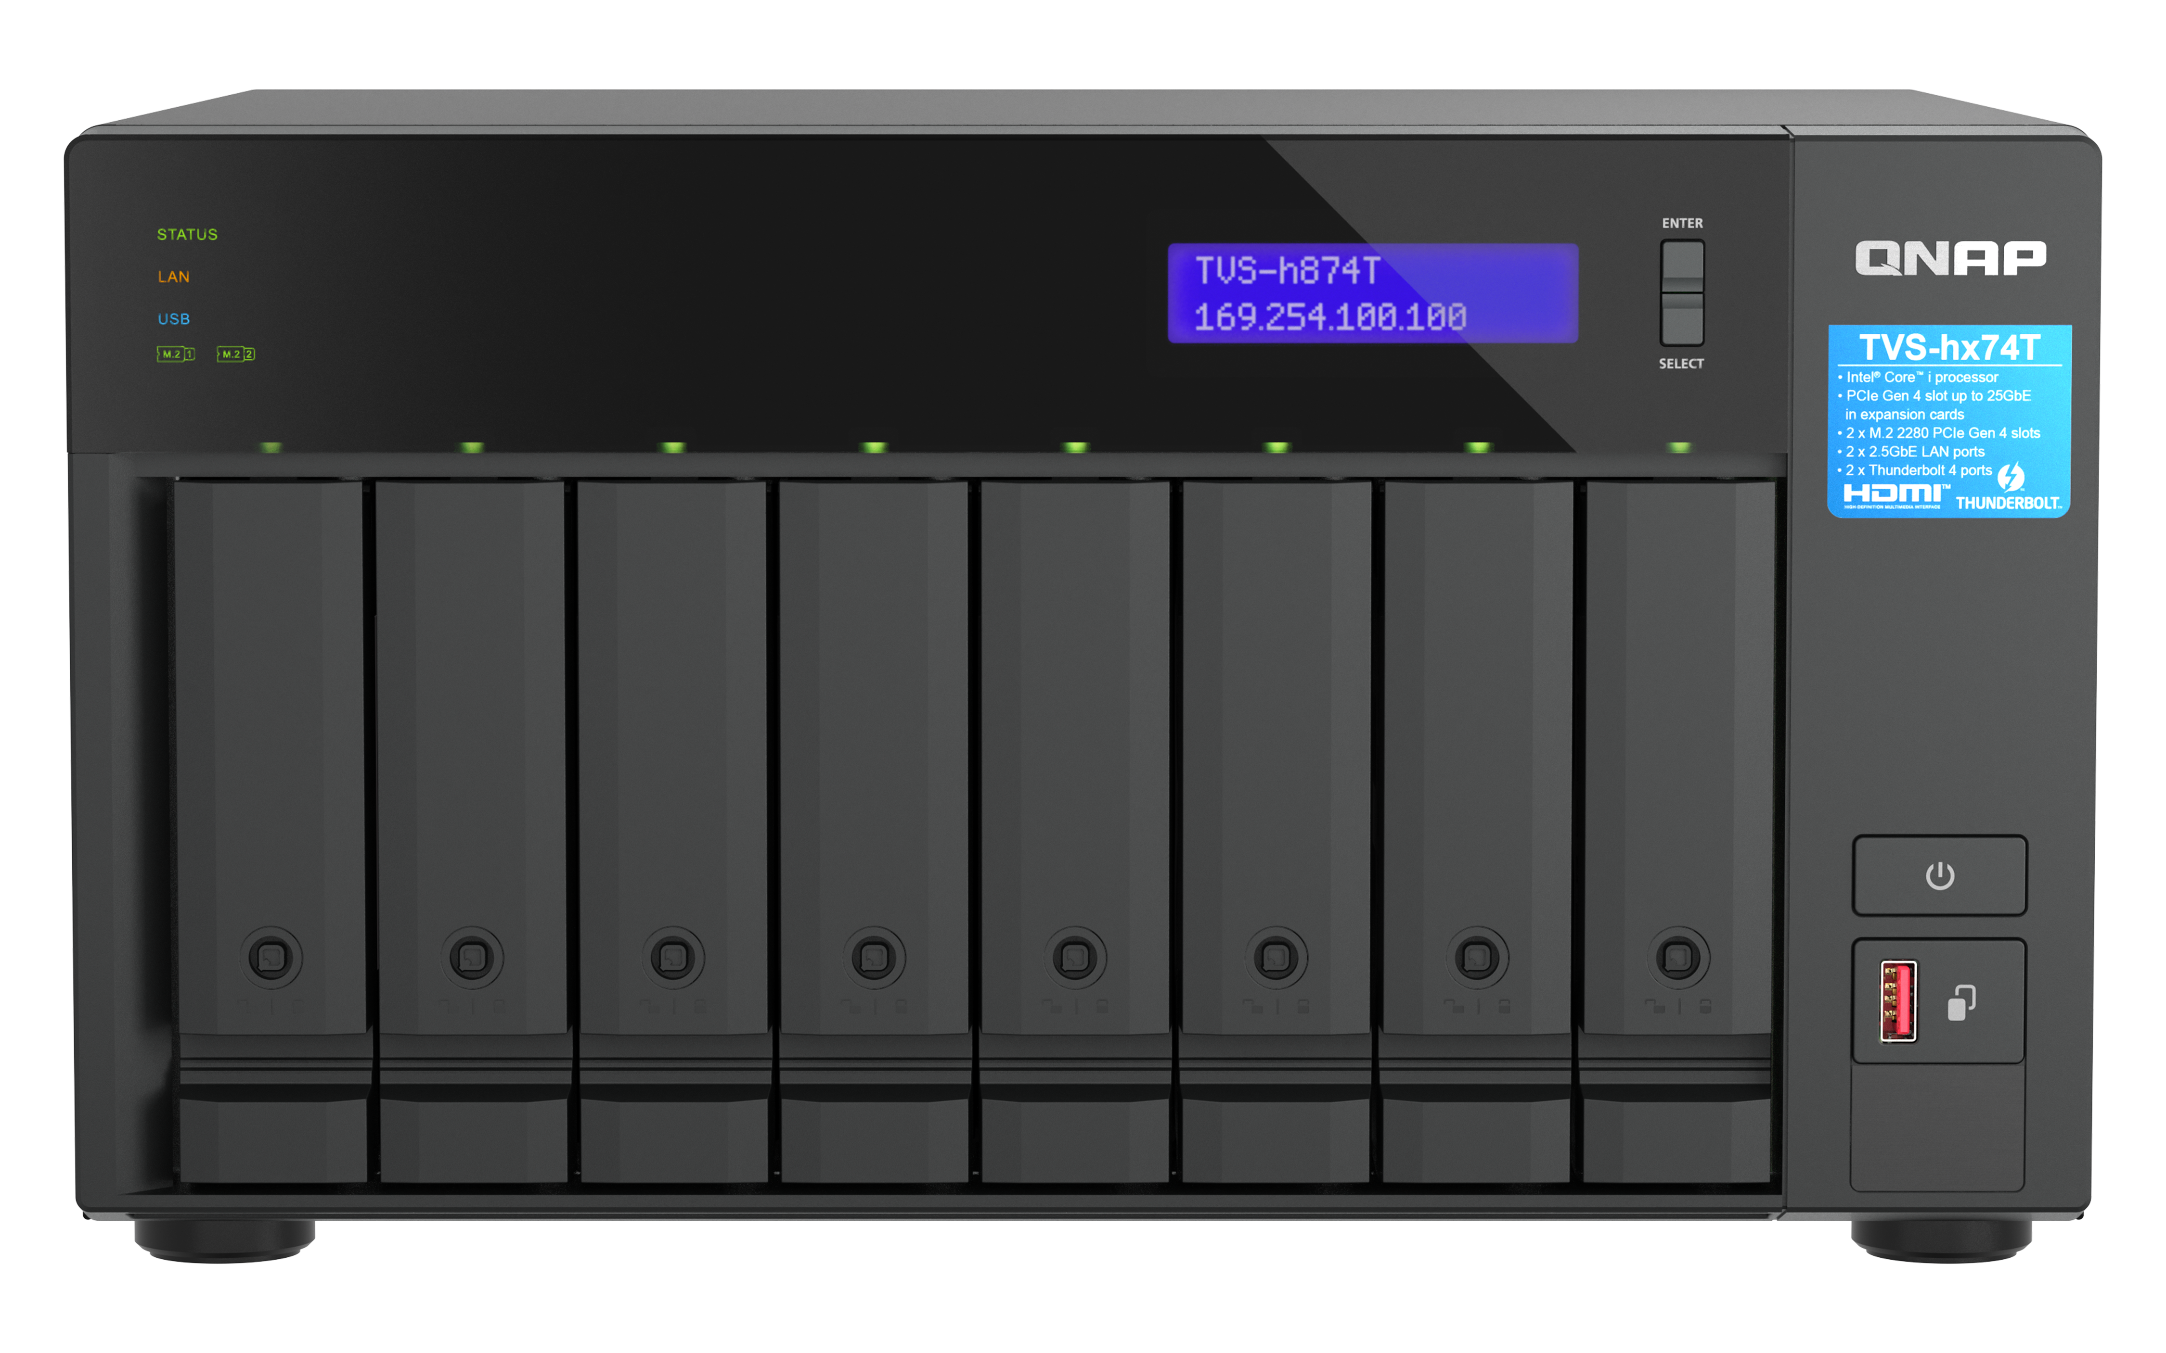

HBS 3.0 NAS App Fulfilling Data Backup
3-2-1 Practice with Deduplication
HBS 3 (Hybrid Backup Sync 3)
Complete 3-2-1 backup strategy and recovery plan: 3 copies、2 media type、1 remote backup​
2 media type
3 copies
Copy 1
NAS
Copy 2
NAS off-site
Copy 3
Google Drive

Slide 32




NetBak PC Agent (Beta):
License-free Windows® PC & Server Backup and Recovery
Back up Windows® PC/server
NetBak PC Agent is a license-free Windows® utility for backing up full system, disks, folders, files from PC/Server and recovering your important data to a QNAP NAS.
Backup
Windows 11
Windows Server
Recovery
QNAP NAS
Windows PC/Server
Note :
Users must install Hyper Data Protector v2.0 on their NAS.
Beta Program : Till December 22, 2023 (The official release will be announced separately)

Slide 33






High-performance Multimedia
Management & Streaming Platform​
QuMagie AI smart photo albums and auto classification​
Plex Server media streaming​
CAYIN MediaSign Player​
HEVC (H.265) video transcoding​
Roon Server identifies your entire music library stored on the NAS
Use Cinema28 for ​
multi-room streaming​

Slide 34


Snapshots Protect and Restore your Data. Easy and Fast!
TBS-h574TX supports Snapshot, like taking a photo - within seconds the complete status of your NAS system and data is recorded. ​
QTS supports up to 1,024 snapshots, QuTS hero supports up to 65,536 snapshots
Mitigate the growing threat of ransomware​
Step 1 ​
Regularly update, and use Malware Remover​
Step 2​
Routinely back up to your NAS, and create multi-version snapshots​
Step 3​
Back up snapshots to another QNAP NAS​

Slide 35




Secured Access & Enhanced Data Security​​
QuFirewall
You can allow/deny IP addresses and regions to prevent unauthorized access and brute force attacks for safeguarding data and service security.
Malware Remover
Regularly scan your NAS using the latest malware definitions. When under attack, infected files will be immediately removed to ensure NAS data security.

Slide 36

3-year Standard Warranty Covering Hardware Repair and Support Services​
TBS-h574TX is backed by a 3-year hardware warranty at no additional cost. ​​
You can also purchase a warranty extension that extends your warranty coverage up to 5 years total​.
For TBS-h574TX : LW-NAS-GREY-2Y (2-year extended warranty), USD$ 199

Slide 37



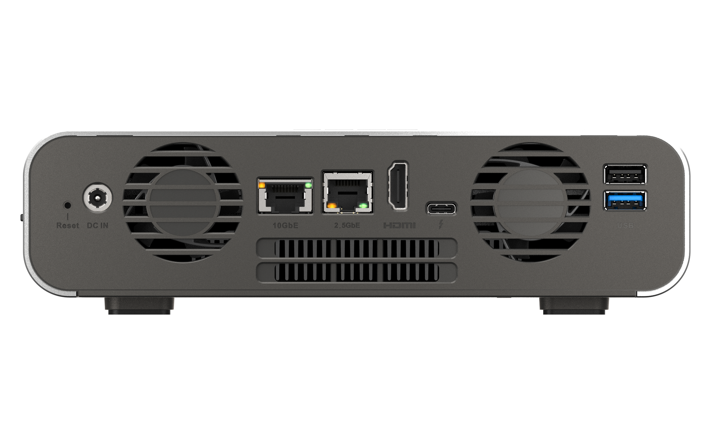
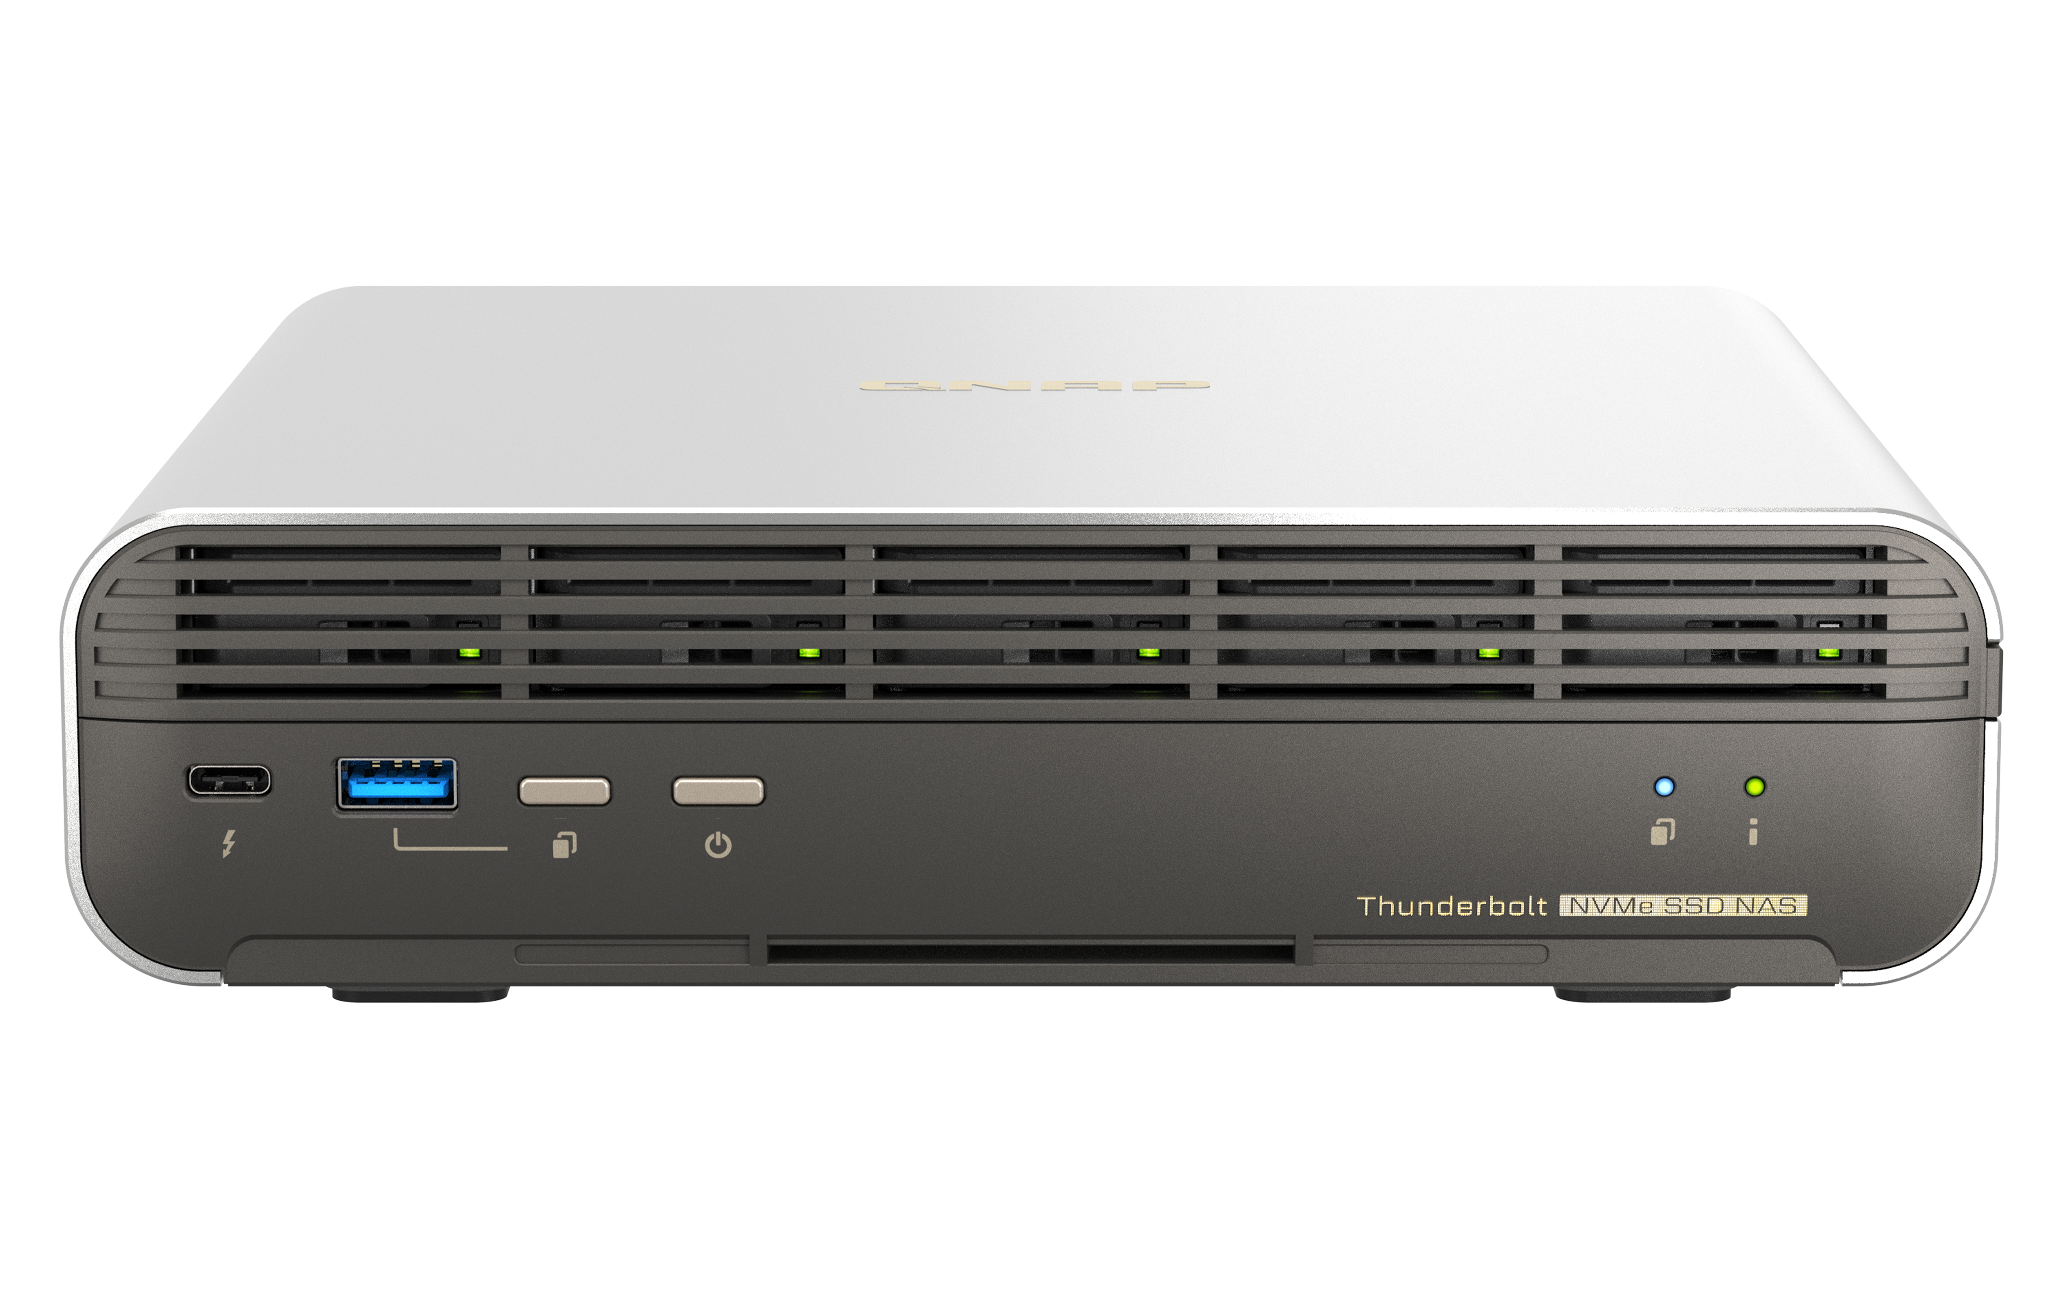
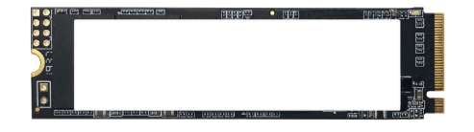


USB 3.2 Gen2 (10Gbps)
與 One-Touch-Copy
3個
PCIe Gen3 x4
擴充槽
Support both
NASbook, compact and metal chassis design
5 x E1.S NVMe SSD slots, supporting up to 15mm E1.S, and pre-installed adapters to support M.2 2280 NVMe SSD
Add 12 more HDDs via
USB JBOD
IntelQAT
USB-A 3.2 Gen2
(10Gbps) & One-Touch-Copy Button
1 x HDMI
4K output
All Flash Thunderbolt 4 Nasbook
TBS-h574TX
Dual Thunderbolt 4
Up to
12 -core
Intel Gen 13
processor
1 x 10GBASE-T
+ 1 x 2.5GbE
i3: 12GB RAM
i5: 16GB RAM
2.5GbE
Dual Thunderbolt 4 ensures two clients accessing & editing
5 x M.2 2280
Maximum Memory
16TB
Up to 5 x M.2 2280 NVMe SSD, Support hot-swapping
Up to
Collaboration between Final Cut Pro and Adobe Premiere Users​
Storage capacity
Up to
5-year
warranty​
(TBS-h574TX with 4 TB SSD, RAID 5)

Slide 38

Make your creativity bloom with the lightning-fast Thunderbolt™ 4 All-Flash NASbook
Copyright© 2023 QNAP Systems, Inc. All rights reserved. QNAP® and other names of QNAP Products are proprietary marks or registered trademarks of QNAP Systems, Inc. Other products and company names mentioned herein are trademarks of their respective holders.​​​​​​​​​

