Slide 1
Notes:
Hi, I'm Chris Chang, Product Manager at QNAP. Today I'm going to introduce the new half-width rackmount 16-port 10GbE unmanaged switch QSW-3216R-8S8T.

Slide 2
Wi-Fi 7 , The Next Generation Wireless Network Transfer Rate
With smart home, logistics, manufacturing and unmanned needs multiply, so that Wi-Fi technology iterative update. According to TrendForce's research, to meet the communication needs of the meta-universe and other industry visions, there are many large companies that have set their sights on the next generation of Wi-Fi 7. Looking ahead to the next generation of Wi-Fi 7, there are already companies such as MediaTek, Qualcomm, Broadcom, etc. that are in the process of laying out their plans. TrendForce believes that even though it has already gained the limelight. It is estimated that Wi-Fi 7 will be applied in late 2023~early 2024.In an era of rapidly increasing network capacity, it is important to have a network switch with multiple 10GbE network ports to fully utilize the Wi-Fi 7 and Wi-Fi 6E wireless router products.
Source: TrendForce, Adslzone
Notes:
With smart home, logistics, manufacturing and unmanned needs multiply, according to TrendForce's research, to meet the communication needs of the meta-universe and other industry visions, there are many large companies that have set their sights on the next generation of Wi-Fi 7, such as MediaTek, Qualcomm, Broadcom, etc. that are in the process of laying out their plans. TrendForce estimates that Wi-Fi 7 will be applied in late 2023~early 2024.In an era of skyrocking network capacity, it is important to have a network switch with multiple 10GbE network ports to fully utilize the Wi-Fi 7 and Wi-Fi 6E wireless router product.

Slide 3
Network Switch is the Foundation for all Network Applications
Targeting the pain points of SMB/SOHO to enhance their network requirements
In today's context of increasing network transmission speed requirements, SMB/SOHO need to build a comprehensive 10GbE high-speed network architecture. To build a complete 10GbE high-speed network infrastructure for SMB/SOHO, it is necessary to consider all aspects, and the first thing that should be considered is the foundation of all applications - the network switch. When purchasing a 10GbE network switch, you should not only consider the transmission speed and price, but also think more comprehensively about how to maximize the effective investment in your enterprise's information flow infrastructure, i.e., consider the application scenarios and future scalability of the network switch. Since the network switch is the backbone of the network deployment, any change is a huge project, so it is recommended that users consider the "one-stop-shopping" approach to avoid the need to adjust the specification later and cause a great deal of trouble for network administrators and users. QNAP's full 10GbE switch QSW-3216R-8S8T provides you with a considerable amount of expansion flexibility, greatly minimizing the need to replace equipment in the future.
Notes:
For SMB and SOHO, QNAP has taken note of your needs and designed products that precisely address your pain points. When SMB and SOHO want to build a comprehensive 10GbE high-speed network infrastructure. The first step is to build a purchase a good network switch, which will serve as the foundation for all applications. When purchasing a network switch, not only do you need to consider price and transmission speed, but you also need to consider how to maximize the effectiveness of your investment in the network equipment, and QNAP suggests that you should give greater consideration to the application scenarios and the future scalability of the network switch. If you do not fully consider the above scenarios, you will need to replace your network switches frequently in the future, which will not only result in wasted investment, but also cause considerable trouble for network administrators and users. The QSW-3216R-8S8T full 10GbE switch has up to 16 network ports, which gives you a lot of room for future expansion and greatly reduces the need to replace equipment in the future.

Slide 4
Specifications
Half-width Rackmount 16-Port 10GbE Unmanaged Switch Fast Deployment of High-Speed Network Environment for SMB/SOHO
Notes:
First of all, I would like to introduce you the specification of QSW-3216R-8S8T.

Slide 5
Half-width Rackmount 16-Port 10GbE Unmanaged Switch
10GbE BASE-T RJ45 Ethernet Port x8
Intelligent port supports 5 speeds: 10G/5G/2.5G/1G/100Mbps
10GbE SFP+ Fiber Port x8
Supports 1GbE SFP
Notes:
The QSW-3216R-8S8T Half-width rackmount with 16-Port Full 10GbE Unmanaged Network Switch features 8 ports of 10GbE BASE-T RJ45 Ethernet ports supporting 5 network speeds of 10G/5G/2.5G/1G/100Mb, and 8 ports of 10GbE SFP+ Fiber optic ports, for a total of 16 ports of 10GbE network.

Slide 6
Highly Intuitive LED Status Indicators
Status Indicator
Green: System ready
Orange: Warning
Network Port Indicator (separate signal alerts for each port)
Green: 10Gbps transfer rate
Orange: Less than 10Gbps transfer rate
Notes:
QSW-3216R-8S8T uses highly intuitive LED status indicators. The green block on the left is the switch status indicator, green means the system is normal and orange means there is a problem with the system, while the blue block on the right is the network status indicator, with separate indicators for each of the 16 network ports. The green color indicates a 10Gbps transmission rate, while the orange color indicates a transmission rate below 10Gbps.

Slide 7
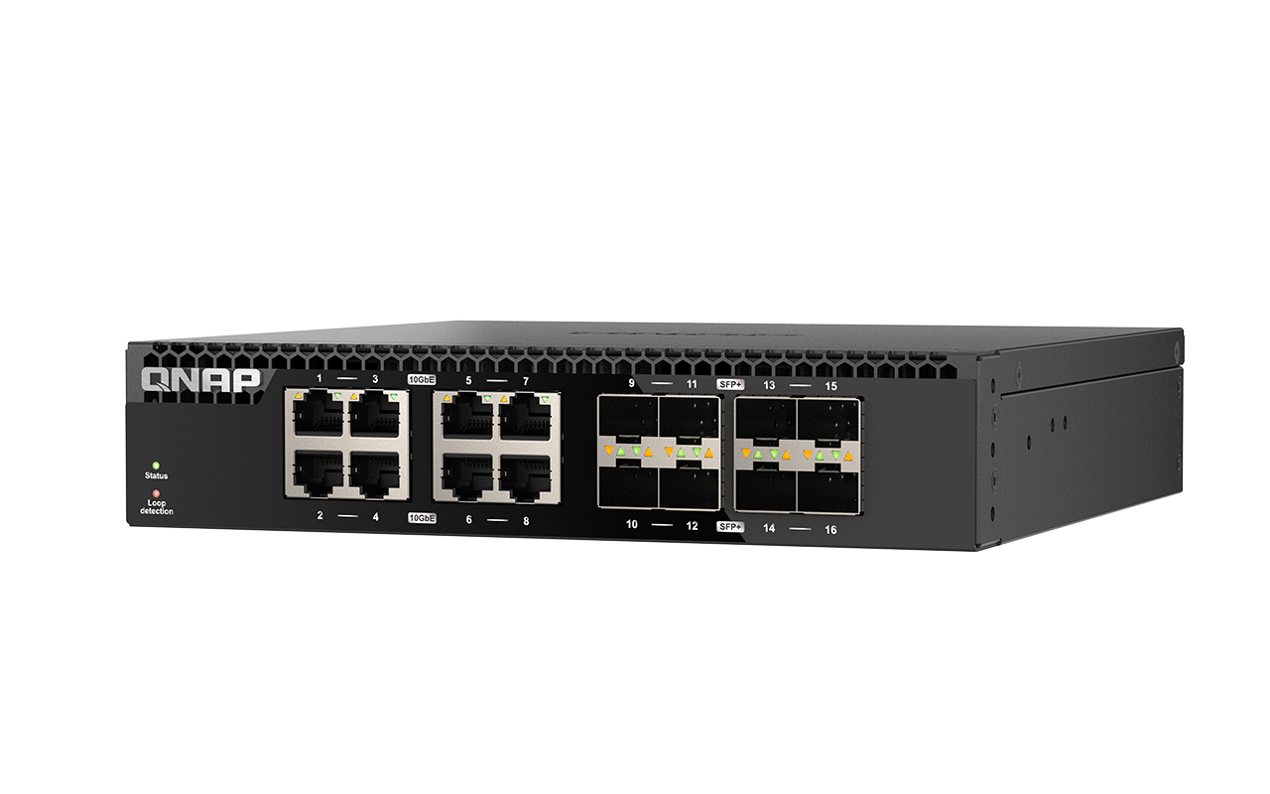
Metal Case with Dual Fan Design for Enhanced Cooling Capability
Dual-fan design not only improves cooling capability, but also reduces the problem of ineffective cooling when a single module fails, and effectively reduces noise level.
The sturdy metal case can effectively dissipate heat during high-speed access to maintain stable system operation.
Notes:
QSW-3216R-8S8T is designed with metal casing and dual fans to greatly enhance the cooling capacity. The dual-fan design not only enhances the cooling capacity, but also ensures the basic cooling function in case of single module failure, and effectively reduces the noise level; the metal casing ensures effective cooling when the system is running efficiently, and maintains the system's stable operation.

Slide 8
Plug and Play, High-Speed Network Environment Easily Established
The QSW-3216R-8S8T features plug-and-play set up, eliminating the need for complicated network setup, and supports Auto Negotiation, which automatically detects the optimal transmission speed in RJ45 ports (10G/5G/2.5G/1G) for different connected devices, eliminating the need for a full upgrade of the old device.
 | CAT 5e | CAT 6 | CAT 6A
100M | V | V | V
1G | V | V | V
2.5G | V | V | V
5G | V | V | V
10G | ꓫ | V (55m) | V
Upgrade of existing network cable environment ！
Support for Multi-Giga NBASE-T
Industry Standards
Simultaneous 10Gbps network transmission up to 16 ports!!!
Notes:
QSW-3216R-8S8T is designed to be plug-and-play, minimizing the threshold for use. 5GbE speeds can be achieved by using your existing CAT5e cable, while 10GbE speeds can be achieved by purchasing CAT6 or higher cables.

Slide 9
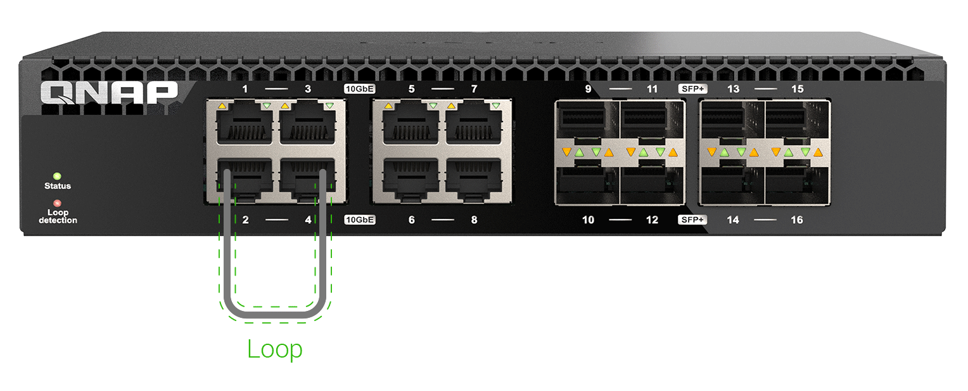
User-friendly Design with Loop Detection and Blocking Features
Loop detection and blocking to
ensure proper network operation
QSW-3216R-8S8T has built-in network loop detection. Once the loop is detected, it will directly target the network port with loop to lock it, so that the network environment can be restored to normal in the shortest possible time.
Notes:
QSW-3216R-8S8T has built-in network loop detection, which automatically locks out the port where the loop is occurring once it is detected, so that the network environment can be restored to normal in the shortest possible time.

Slide 10
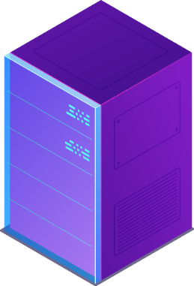
Support Flow Control in Full-Duplex Mode
The QSW-3216R-8S8T supports the flow control function, which follows the IEEE 802.3x Full-Duplex Flow Control protocol in full duplex mode to avoid packet loss due to bandwidth mismatch.
Flow control to manage all device traffic
33%
33%
100%
33%
Notes:
QSW-3216R-8S8T also supports full duplex flow control, allowing your device to follow the flow control protocol at all times to avoid packet loss due to bandwidth mismatch.

Slide 11
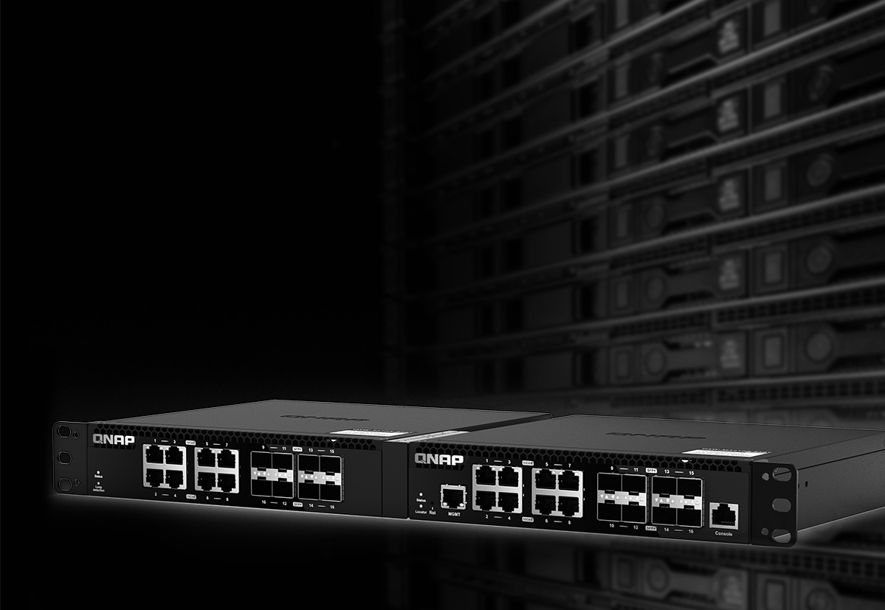
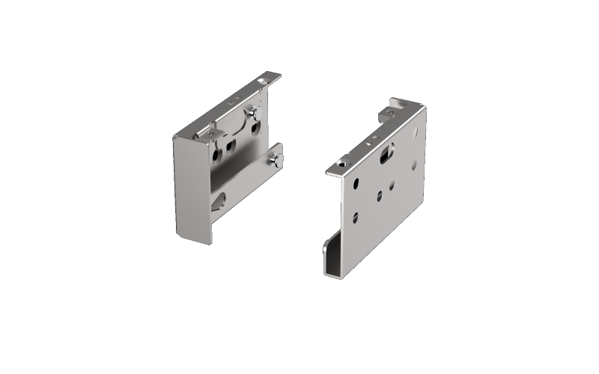
Half-width design, space saving, two models in 1U
With a half-width rackmount design, a QSW-3216R-8S8T can be installed in a 1U rack space with another half-width rackmount switch for efficient physical space utilization and tidy cabling.
Note: The optional SP-EAR-QSW2FOR1-01 rackmount kit is required if two half-width rackmount switches are installed.
SP-EAR-QSW2FOR1-01
Notes:
QSW-3216R-8S8T features a half-width rackmount design that allows users to readily accommodate two half-width switches in a 1U space, which not only saves space, but also facilitates management by IT staff. To assemble two half- width switches, a dedicated rack kit is required.

Slide 12
QSW-3216R-8S8T 10GbE Switch Specifications
 | QSW-3216R-8S8T
10GbE SFP+ | 8 ports
10GbE BASE-T RJ45 | 8 ports
Switch Bandwidth | 320Gbps
Support Jumbo Frame | Up to 9K package size
Support MAC Address Table | Up to 16K
Design | Half-width Rackmount
Operating Temperatures | 0°C to 40°C (32°F to 104°F)
Width 207 mm/8.15 inch
Length 199.5 mm/7.85 inch
Height 43.3 mm/1.7 inch
Notes:
The following table shows the detailed specifications of the QSW-3216R-8S8T, which features both 8-port 10GbE SFP+ and 8-port 10GbE BASE-T RJ45 Ethernet ports, achieving a switch bandwidth of 320 Gbps. Below are the width, depth and height of the QSW-3216R-8S8T.

Slide 13
2-year Product Standard Warranty Optional 3-year Extended Warranty
The QSW-3216R-8S8T comes with a free 2-year product warranty. If you need a longer warranty, you can purchase the QNAP Extended Warranty Service Plan LW-SWITCH-YELLOW-3Y-EI for up to 5 years of product warranty and value protection.
More Information: QNAP Warranty Service
QNAP Warranty Service Address:
https://www.qnap.com/service/product-warranty/go/
Notes:
The QSW-3216R-8S8T is covered by a 2-year free warranty, or for a longer warranty, you can purchase the Extended Warranty Program, LW-SWITCH-YELLOW-3Y-EI, which provides up to a 5-year warranty. For more warranty information, please click the hyperlink below.

Slide 14
Combined with QNAP Products
for Multiple QNAP Switch Use cases
Notes:
Above is the specification of QSW-3216R-8S8T, and then we will introduce how to realize the application scenario of QSW-3216R-8S8T with QNAP products.

Slide 15
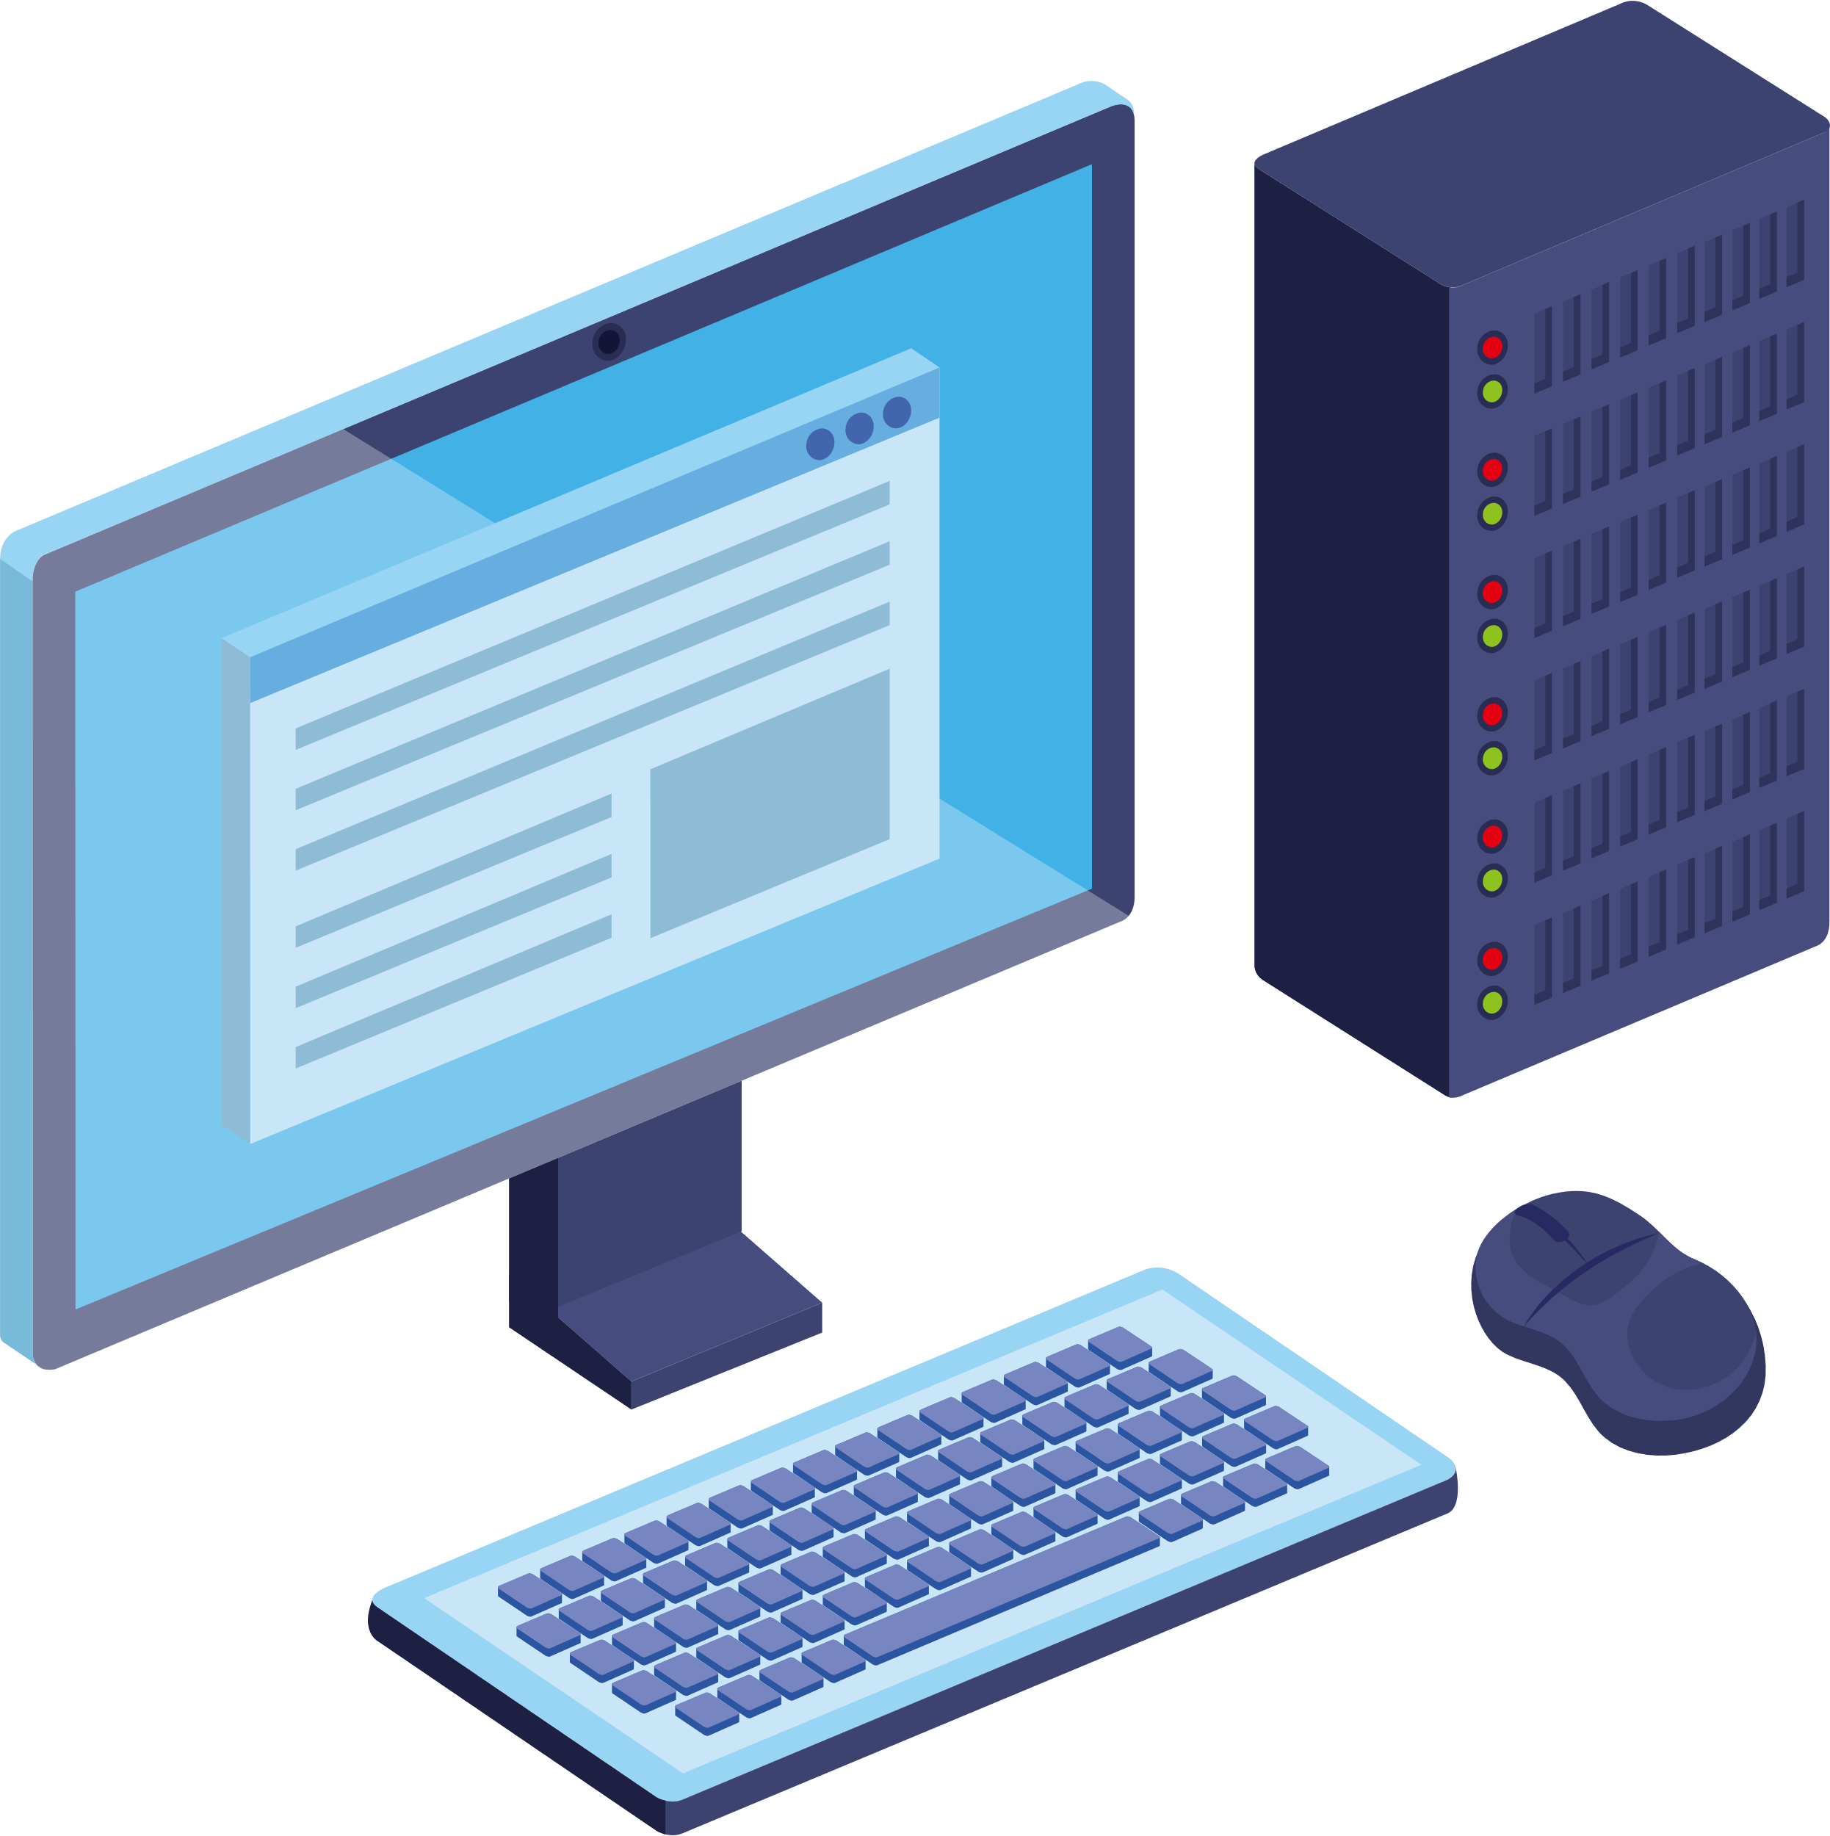
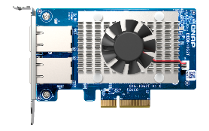
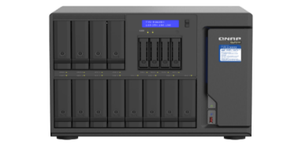
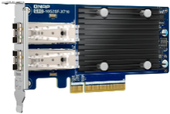
16-Port 10GbE SFP+ and RJ45 Network for Flexible Configuration of Network Architecture
QSW-3216R-8S8T features eight 10GbE SFP+ fiber ports and eight 10GbE Ethernet ports, which can flexibly connect network devices with different interfaces of fiber optic (SFP+) and copper (RJ45) cables to meet the high-speed network configuration of SMB/SOHO, and achieve smooth file transfer, VM applications, or multimedia audio and video playback and sharing. When using the RJ45 interface, it can be used with Cat 6 to achieve10GbE network transmission speed for efficient data transfer; it also provides low-speed connectivity for downward compatibility with legacy devices.
QHora-301W WiFi 6 Router
Internet
10Gbps RJ45
Wi-Fi 6 Wireless Device
QSW-3216R-8S8T
10Gbps RJ45
1 Gbps
1 Gbps
10Gbps RJ45
10Gbps SFP+
TS-855eU-RP + QXG-10G2SF-X710
PC + QXG-10G2T
Notes:
With a total of 16 10GbE network ports, the QSW-3216R-8S8T offers the flexibility to connect to fiber and copper interfaces to meet the high-speed network configuration needs of small and medium-sized businesses and SOHO offices. The illustration below combines the QHora router, QNAP NAS and QXG series network expansion cards to easily realize wired and wireless high-speed network architectures.

Slide 16
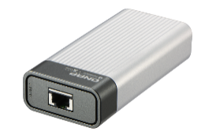
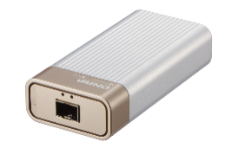
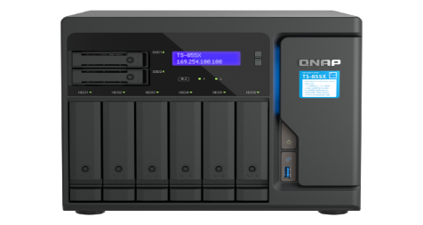
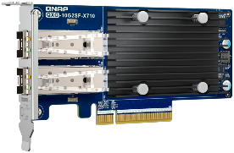
Comprehensively Upgrade your Network, Storage and Computer Equipment to Enhance Team Productivity
PC + QXG Series Multi-Gig Network Expansion Card
PC and server with PCIe slots can install QNAP network expansion cards supporting 10G/5G/2.5G/1G/100M Multi-Gig for simplicity and flexibility.
10/5/2.5GbE
PC + QXG-10G2T
Wi-Fi 6
Wireless access point (Wi-Fi 6)
10/2.5GbE
10GbE
QNA-T310T1S
QNA-T310G1T
QSW-3216R-8S8T
QHora-301W WiFi 6 Router
QSW-3216R-8S8T
Pair with the QHora-301W to create a high-speed hybrid network configuration that supports high-speed Wi-Fi 6 wireless transmission and 10GbE wired networking, as well as enterprise-grade SD-WAN VPN networking capabilities.
10/5/2.5GbE
Laptop
Several NAS models support 2.5GbE/10GbE networks. The use of Port Trunking Network Aggregation brings the advantage of bandwidth consolidation.
Laptop can also be paired with a QNAP network adapter to expand 10GbE through the Thunderbolt port, making it easy to boost network speeds.
TS-855X
TS-855eU-RP + QXG-10G2SF-X710
QNAP NAS + QXG Series Multi-Gig Network Expansion Card
Notes:
Here's a more detailed look at how to implement a 10GbE network architecture using the diverse QNAP product line. This includes QHora routers, QNAP NAS, QXG series network expansion cards and QNA series network converters.

Slide 17
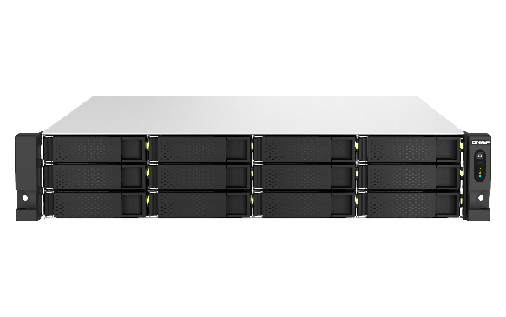
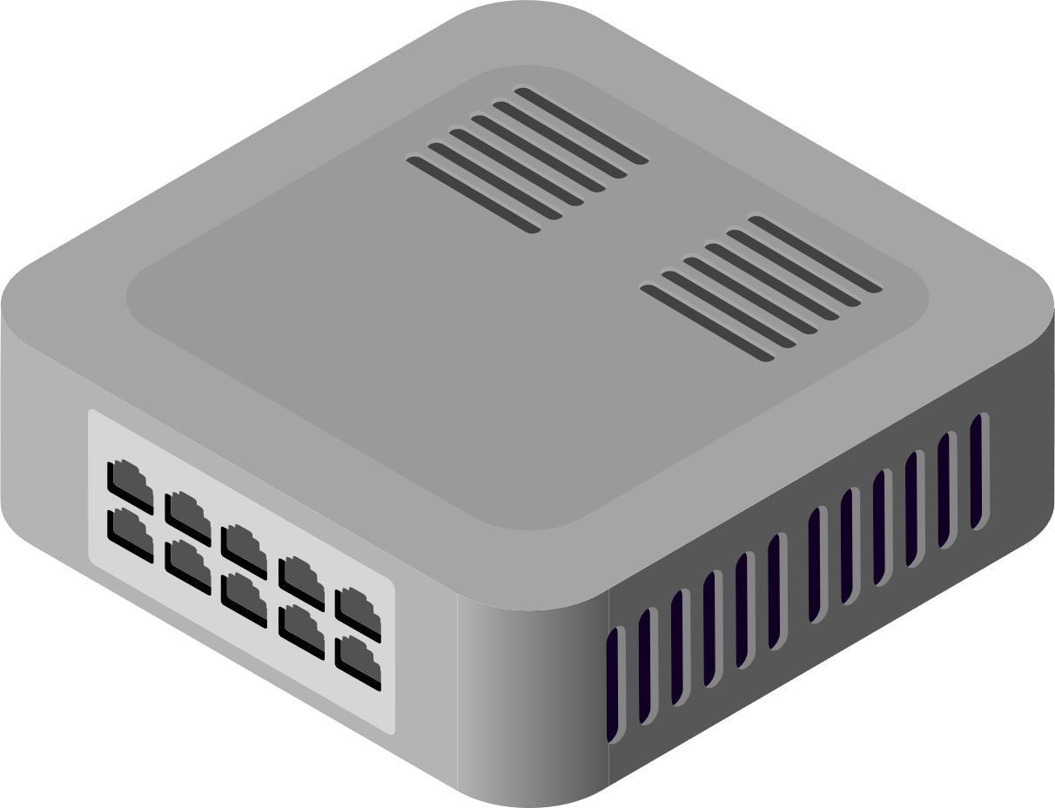
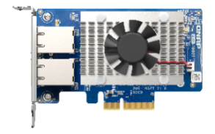
Minimize the cost of upgrading your network from 1GbE to 5GbE speeds with CAT5e cable
1GbE
1GbE
1GbE
1G/100Mb Switch
CAT 5e
CAT 5e
TS-h1887XU-RP
1GbE
1GbE Switch
CAT 5e
Direct speed up of the original cable
5GbE
Use the NAS's built-in 10GBASE-T RJ45 port
5GbE
CAT 5e
QXG-10G2T
5GbE
CAT 5e
TS-h1887XU-RP
5GbE
5 GbE Network Speed
CAT 5e
QSW-3216R-8S8T
QXG-10G2T
Notes:
This section introduces how you can quickly upgrade your 1GbE network speeds with minimal cost. Instead of fully upgrading your equipment, simply use the QSW-3216-8S8T and QXG-10G2T to directly upgrade your PCs and NAS to 5GbE speeds using existing cables.

Slide 18
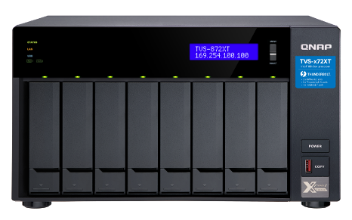
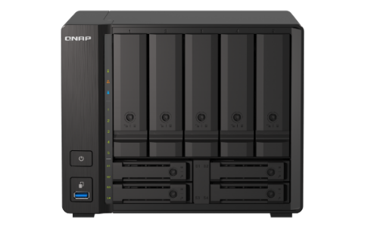
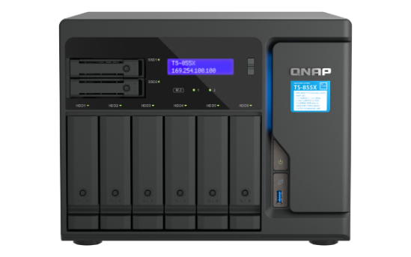
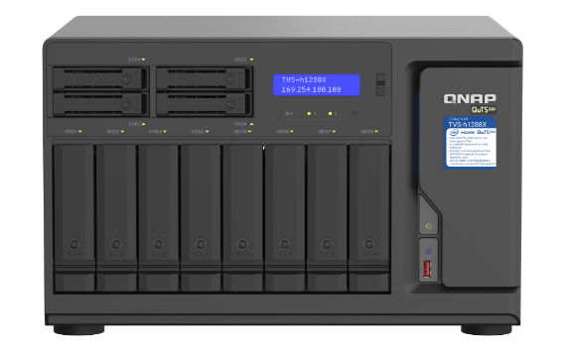
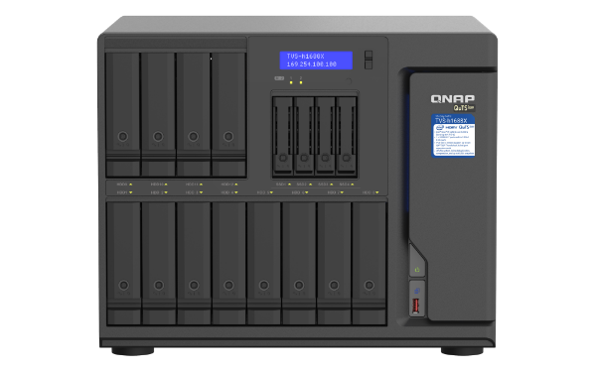
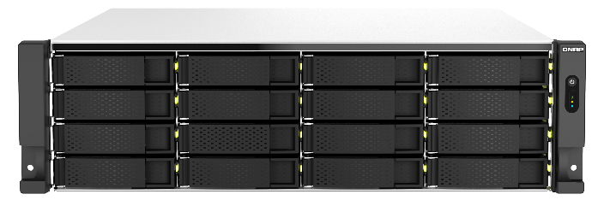
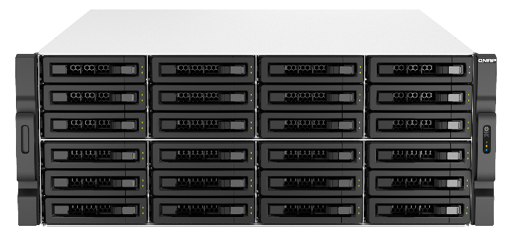
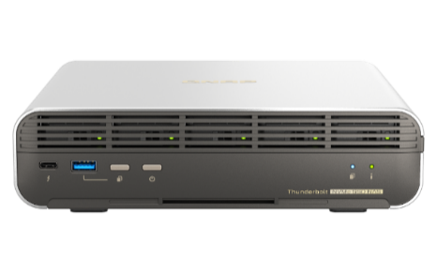
Many QNAP NAS Support 10GbE High-Speed Network Transmission
TVS-872XT
TS-h973AX
TS-855X
TVS-h1288X
TVS-h1688X
TS-h987XU-RP
TS-h1887XU-RP
TS-h2287XU-RP
TS-h3087XU-RP
TS-h1283XU-RP
TS-h1683XU-RP
TBS-h574TX
More QNAP NAS with 10GbE High-Speed Network Transmission Support
Notes:
QNAP has a variety of NAS with built-in 10GbE network speed, including TOWER, RACKMOUNT, and THUNDERBOLT NAS. To learn more about NAS with 10GbE network speed support, please click the hyperlink below.

Slide 19
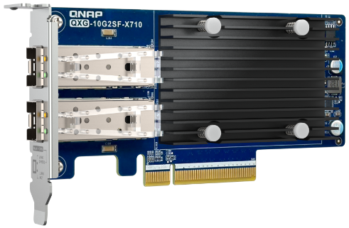
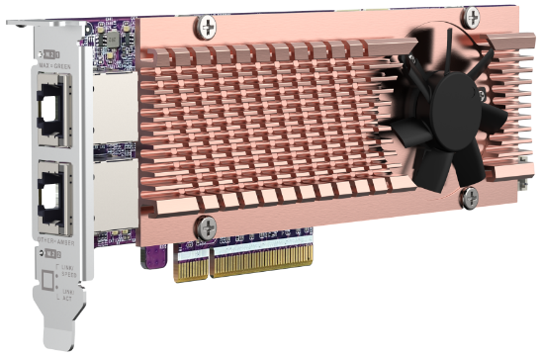
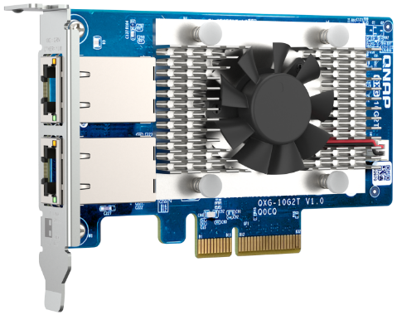
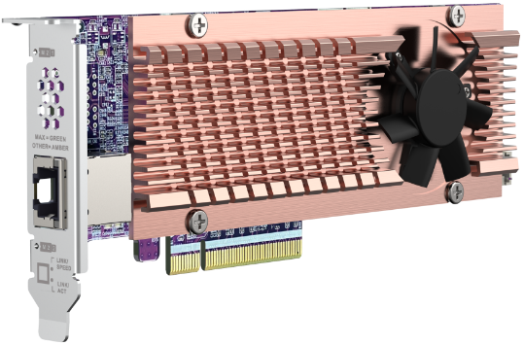
QNAP 10GbE Network Expansion Cards
QXG-10G2SF-X710 (SFP+ x2)
QXG-10G2T-X710 (RJ45 x2)
QXG-10G2TB (RJ45 x2)
QXG-10G2T (RJ45 x2)
QXG-10G1T (RJ45 x2)
QM2-2P410G2T (RJ45 x2)
QM2-2P410G1T (RJ45 x2)
QM2-2P10G1TB (RJ45 x2)
QM2 M.2 SSD/10GbE PCIe Expansion Card
QXG 10GbE Network Card
Notes:
QNAP also has several 10GbE network expansion cards, including the QXG series 10GbE network expansion cards and the QM2 series M.2 SSD/10GbE PCIe dual-function expansion cards.

Slide 20
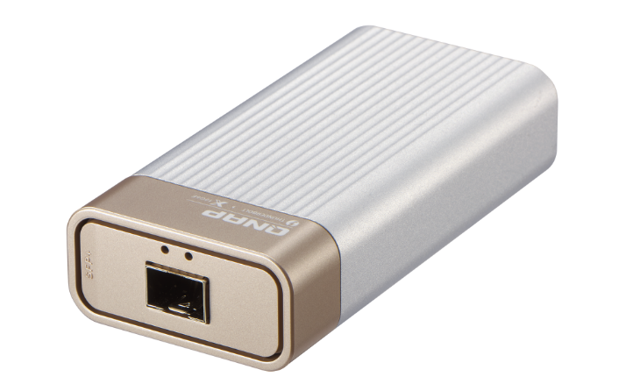
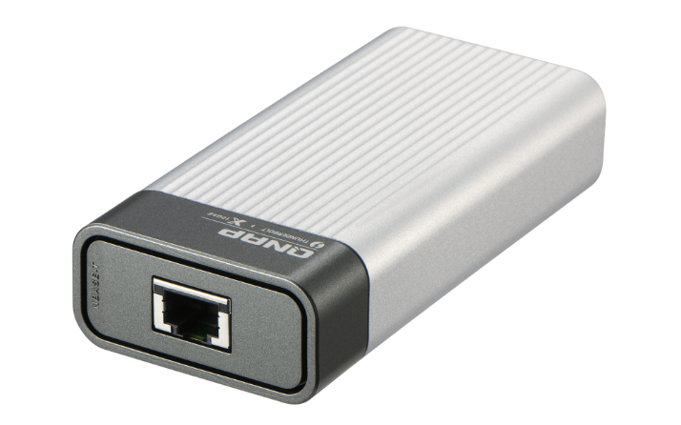
QNAP QNA Series 10GbE Network Adapters
Host with Thunderbolt 3
10G/1G 2-speed
SFP+ fiber port
Host with Thunderbolt 3
10G/5G/2.5G/1G/100M 5-speed
RJ-45 NBASE-T Ethernet port
QNA-T310G1S
QNA-T310G1T
Note: The QNA series of network adapters also support Thunderbolt 4.
Notes:
If your laptop doesn't have a network port, QNAP has 10GbE network adapters that support Thunderbolt, and can be used as long as your laptop has Thunderbolt3. The adapters also support Thunderbolt 4 interface.

Slide 21
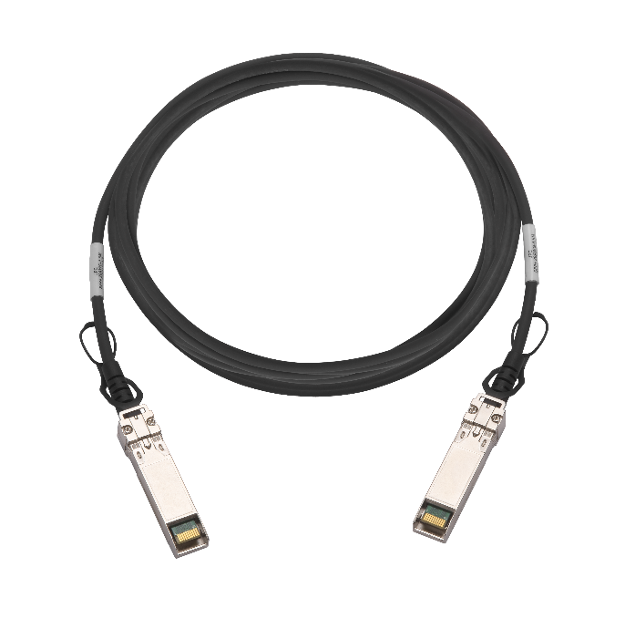
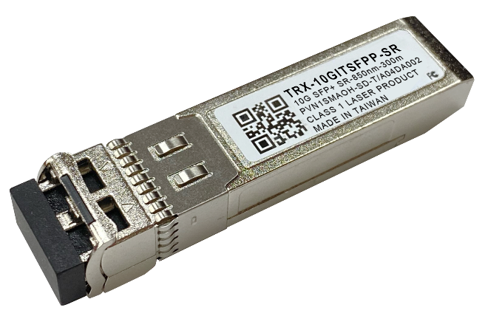
QNAP Provides Complete 10GbE Accessories
CAB-DAC15M-SFPP (1.5m)
CAB-DAC30M-SFPP (3m)
CAB-DAC50M-SFPP (5m)
TRX-10GITSFPP-SR
10GbE SFP+ DAC
10GbE SR Transceiver
Notes:
QNAP's complete 10GbE product line also includes 10GbE fiber optic transmission cables in various lengths and 10GbE transceiver.

Slide 22
Half-width Rackmount 16-Port 10GbE Unmanaged Switch Fast Deployment of High-Speed Network Environment for SMB/SOHO !
Copyright © 2023 QNAP Systems, Inc. All rights reserved. QNAP® and other names of QNAP Products are proprietary marks or registered trademarks of QNAP Systems, Inc. Other products and company names mentioned herein are trademarks of their respective holders.
Notes:
The above is the product introduction for QSE-3216R-8S8T today. The half-width rackmount 16-port full 10GbE unmanaged switch is the fastest way for SMB/SOHO to upgrade to 10GbE network. Thank you for watching today, looking forward to seeing you next time, bye bye.

