Slide 1
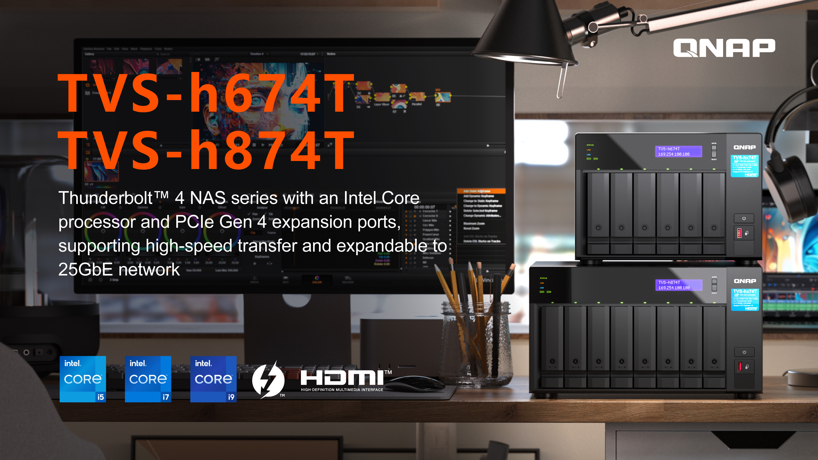
Notes:
Hello everyone, welcome to todays QNAP livestream. Today, we'll have an introduce of our new Thunderbolt 4 NAS. TVS-h674T and TVS-h874T
So lets take a look in detail !

Slide 2

A faster and bigger storage need for the 4K / 8K era
 | Date Rate | File Size
HD 1080P (ProRes 422) | 220 Mb/s | 90 GB/hr
4K (ProRes 422) | 630 Mb/s | 300 GB/hr
BlackMagic 4K | 1.4 Gb/s | 630 GB/hr
Canon 4K | 2.3 Gb/s | 1 TB/hr
Phantom Flex 4K | 2.3 Gb/s | 1 TB/hr
Red 8K | 2.4 Gb/s | 1.1 TB/hr
ARRI Alexa 6.5K RAW | 7.3 Gb/s | 3.3 TB/hr
Notes:
First we'll delve into the various video specifications in the market to explain the need for high-speed transmission.
Let's take a look at some common video formats and their corresponding data rates:
HD 1080P (ProRes 422): 220 Mb/s, approximately 90 GB per hour of footage.
4K (ProRes 422): 630 Mb/s, around 300 GB per hour of footage.
BlackMagic 4K: 1.4 Gb/s, approximately 630 GB per hour of footage.
Canon 4K: 2.3 Gb/s, approximately 1 TB per hour of footage.
Phantom Flex 4K: 2.3 Gb/s, approximately 1 TB per hour of footage.
Red 8K: 2.4 Gb/s, approximately 1.1 TB per hour of footage.
ARRI Alexa 6.5K RAW: 7.3 Gb/s, approximately 3.3 TB per hour of footage.
As you can see, these video formats require significant data rates, ranging from hundreds of megabits per second to multiple gigabits per second. Working with such high-resolution and data-intensive footage demands a robust and high-speed transmission solution.

Slide 3

High efficiency video editing storage for NAS with Thunderbolt and 25GbE
Video editing requires large file sizes and fast processing speeds to ensure smooth editing.
Thunderbolt : Allows for fast transfer speeds and low latency, ensuring that editing is seamless and without interruption.
25GbE : Allows for faster data transfer rates and is ideal for working with high-resolution videos.
Notes:
Today ~ we will focus on two key features that cater to the needs of the video editing market:
Thunderbolt Technology: Our solution leverages Thunderbolt technology, enabling lightning-fast transfer speeds and low latency. This ensures a seamless editing experience without any interruptions. with Thunderbolt Mac or Windows computers, no need to buy network card accessories.
25GbE: We provide 25GbE (25 Gigabit Ethernet) connectivity, which offers faster data transfer rates. With 25GbE, you can quickly transfer and access your video, enabling smooth playback and editing.

Slide 4
Thunderbolt NAS for Video editing
 | How Thunderbolt NAS can help
Collaboration | Support two Mac® or Windows® notebook/workstation edit photos/videos simultaneously Connects to a network via Ethernet, making it easier to collaborate on projects and share resources
Expandability | Provide a variety of expansions including 10G/25GbE network card, M.2 and other expansion cards Capacity expansion is very convenient through JBOD solution
User friendly | Provide fast, smoother, easy-to-used operating system The companion mobile app allows you to remotely access your NAS files
Data Security | Centralize backups and ensure consistent backups with snapshot You can set permissions or passwords to prevent files from being snooped indiscriminately
Notes:
and why Thunderbolt NAS is an essential solution for video editing industry
Collaboration: Thunderbolt NAS supports the simultaneous editing of photos and videos on two Mac® or Windows® notebooks/workstations. This feature allows multiple users to work together, boosting productivity and facilitating seamless collaboration. Additionally, the Thunderbolt NAS can be easily connected to a network via Ethernet, enabling efficient project collaboration and resource sharing among team members.
Expandability: Our Thunderbolt NAS offers a range of expansion options, including 10G/25GbE network cards, M.2 card, and other expansion cards. This flexibility allows you to customize and expand your NAS according to your specific requirements. Furthermore, capacity expansion is made convenient through a JBOD (Just a Bunch of Disks) solution, enabling you to increase storage capacity as needed.
User-Friendly: We provide a fast, smooth, and user-friendly operating system for our NAS. The intuitive interface makes it easy to navigate and manage your NAS efficiently. Additionally, our companion mobile app allows you to remotely access your NAS files, providing convenience and flexibility in accessing and managing your data from anywhere.
Data Security: With Thunderbolt NAS, you can centralize your backups, ensuring consistent and reliable data protection. The snapshot feature allows you to create point-in-time copies of your data. Moreover, you have the option to set permissions or passwords, safeguarding your files from unauthorized access and ensuring data privacy.
So Whether you are a creative professional, a small business, or a home user, Thunderbolt NAS offers a comprehensive and reliable solution for storing, accessing, and protecting your valuable data.

Slide 5






Supporting dual Thunderbolt 4, up to Intel® Core™ i9 processor, tailor-made for video editing
Intel® Core™ i processor
Dual Thunderbolt 4 ports
Intel® Core™
Intel® Core™ i9 16-core (8P+8E) / 24-thread
Intel® Core™ i7 12-core (8P+4E) / 20-thread
Intel® Core™ i5 6-core / 12-thread
Featuring two Thunderbolt 4 slots, supporting high-speed transfers to allow you to focus more on creative work
Dual M.2 PCIe SSD slots
Dual PCIe Gen 4 slots
PCIe Gen 4 x4 M.2 2280 slots for optimal configuration of NVMe SSD and 3.5" SATA HDD
Providing two PCIe Gen 4 expansion slots for optional QNAP expansion cards, and pre-installed with a dual-port Thunderbolt™ 4 expansion card in slot #2
Maximum 64 GB memory
Dual 2.5 GbE LAN ports
64 GB
Pre-installed with 32/64 GB, expandable as needed with 2 x DDR4 SODIMM slots
Dual 2.5 GbE network ports, provide smooth data transmission experience​
Notes:
TVS-h674T and TVS-h874T is our new Thunderbolt 4 NAS, Supporting dual Thunderbolt 4, up to Intel® Core™ i9 processor, tailor-made for video editing.
Powered by intel core i9 / i7 or i5 processor, up to 16 core and 24 thread, provide powerful performance. Dual Thunderbolt 4 ports support high-speed transfers to allow you to focus more on your work.
dual M.2 PCIe SSD slots, which you can optimize configuration of NVMe SSD and 3.5" SATA HDD and dual PCIe Gen 4 slots for optional QNAP expansion cards, and pre-installed with a dual-port Thunderbolt™ 4 expansion card in slot 2.
Preinstalled with 32G or 64G memory, expandable as needed with 2 x DDR4 SODIMM slots
And dual Dual 2.5 GbE network ports, provide smooth data transmission experience

Slide 6
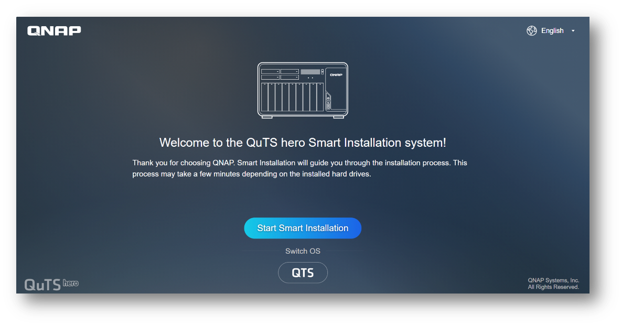
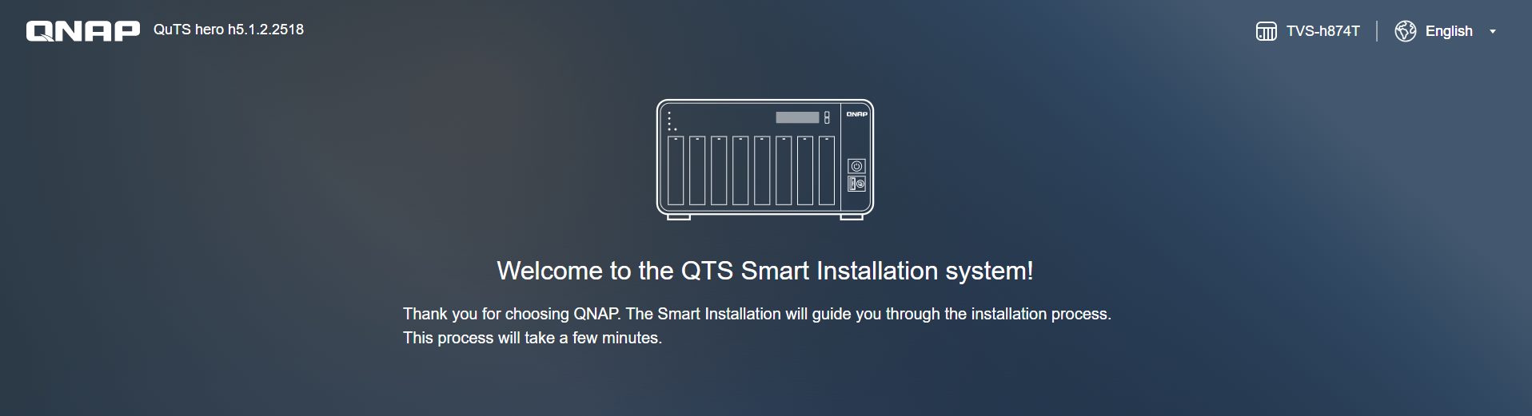
Switch NAS operating systems between QuTS hero and QTS for higher everyday performance​
TVS-h674T / TVS-h874T are shipped with the enterprise-level QuTS hero operating system, and also supports QTS - QNAP’s standard NAS operating system – that provides efficient memory utilization, and the advantage of Qtier auto-tiering.
Note :
​​​QTS and QuTS hero use different file systems. You must remove all the drives & backup data from the TVS-h674T / TVS-h874T before switching from QuTS hero to QTS.
Notes:
TVS-h674T / TVS-h874T is shipped with the QuTS hero operating system. And also supports QTS - QNAP’s standard NAS operating system – that provides performance, efficient memory utilization, and the advantage of Qtier auto-tiering.
And QTS and QuTS hero use different file systems. You must remove all the drives from the TVS-h674T / TVS-h874T before switching from QuTS hero to QTS.

Slide 7

Choose between ​
ZFS-based QuTS hero and QTS​
ZFS-based QuTS hero ensures performance and data integrity​
Faced with the explosive growth of data, VDI popularity, increasing SSD adoption, 8K media, and other disruptive IT trends, modern businesses need dependable storage systems to meet future demands. QNAP’s new “QuTS hero” operating system combines the app-based QTS with a 128-bit ZFS file system to provide flexible storage management, comprehensive data protection and optimized performance to meet the needs of business-critical applications.​
Learn More: Why QNAP business NAS uses ZFS​
​ | QuTS hero​ | QTS​
Filesystem​ | ZFS​ | Ext4​
SSD Cache​ | Read Cache​ | Read/Write Cache​ Read Cache​ Write Cache​
Inline Compression​ | Yes​ (LZ4 compression, ideal for RAW files and document files)​ | No​
Inline Deduplication​ | Yes​ (At least 16 GB RAM required)​ | No​
Power Failure Protection (Software)​ | ZIL​ Copy-On-Write​ (Service continues after power recovery)​ | No​ (Risk of filesystem-level corruption on power-loss and system downtime required for “Check File System”)​
Permission Management​ | Rich ACL (14 types)​ | POSIX ACLs (3 types) + certain special permissions​
Capacity Expansion​ | Upgrade RAID capacity​ Change higher capacity disk drives​ Attach expansion enclosures/JBODs​ | Add a disk drive to a RAID group​ Upgrade RAID capacity​ Change higher capacity disk drives​ Attach expansion enclosures/JBODs​
Data Security​ | Better​ (Self-Healing & Copy-on-Write)​ | Standard​
Recommendation SSD Configuration for Video Editing Applications​ | Use SSD Pools​ ​ Note: Set the block size 128K when creating Folders/LUNs​ | Editing (from original/RAW files): Use SSD Pools​ Post production: Enable Read/Write cache​ ​ Note: Set the block size to 32K or 64K when creating Volumes, and choose “All I/O” for cache mode.​
Notes:
TVS-h674T and TVS-h874T are shipped with the QuTS hero operating system, which combines the app-based QTS with a 128-bit ZFS file system to provide flexible storage management, comprehensive data protection and optimized performance to meet the needs of business-critical applications. Can Improve your storage performance with inline data deduplication, compression, and compaction. Most important, for data security is much more better.

Slide 8

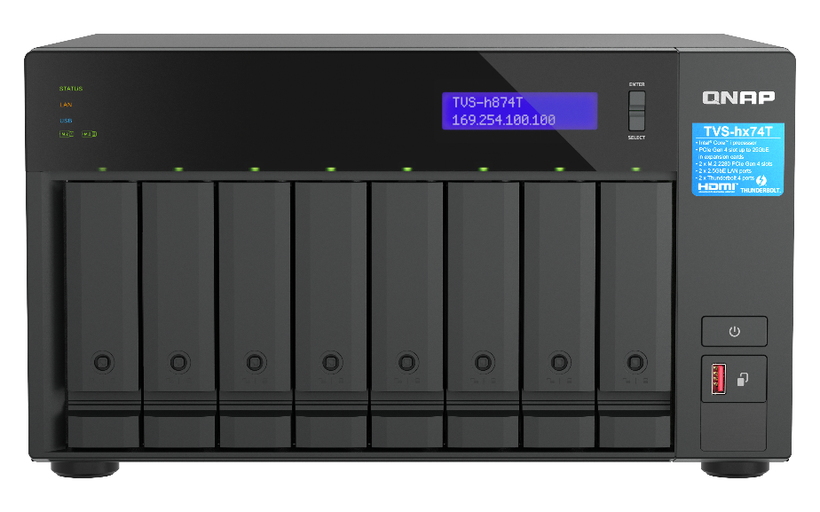
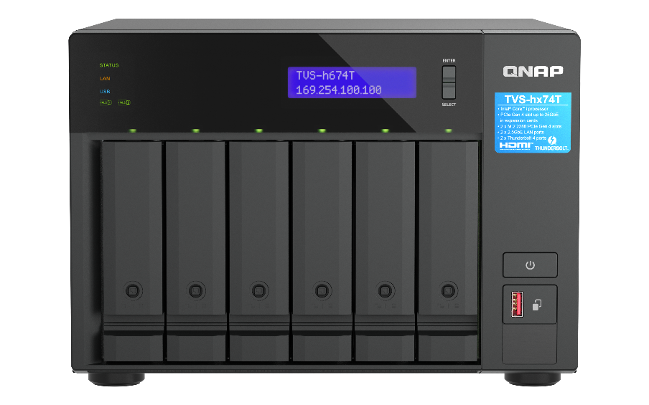
New Intel® Core™ Thunderbolt 4 NAS
TVS-h874T-i9-64G
Performance-cores (P-cores) and Efficient-cores (E-cores). Both types of core have a different role.
Performance-cores :
Physically larger, high-performance cores designed for raw speed while maintaining efficiency.
Efficient-cores :
Physically smaller, with multiple E-cores fitting into the physical space of one P-core.
Intel Core i9 16-core (8P+8E) / 24-thread
DDR4 64GB RAM (2 x 32GB)
2 x 2.5GbE ports
2 x Thunderbolt 4 ports
TVS-h874T-i7-32G
Intel Core i7 12-core (8P+4E) / 20-thread
DDR4 32GB RAM (2 x 16GB)
2 x 2.5GbE ports
2 x Thunderbolt 4 ports
TVS-h674-i5-32G
Intel Core i5 6-core / 12-thread
DDR4 32GB RAM (2 x 16GB)
2 x 2.5GbE port
2 x Thunderbolt 4 ports
Notes:
So lets take a look of the sku, for TVS-h874T. We have TVS-h874T-i9-64G powered by Intel core i9 16-core( 8 p-core and 8 e-core included) processor and 64G RAM. Another sku of tvs-h874T is TVS-h874T-i7-32G, powered by intel core i7 12-core( 8 p-core and 4 e-core included) processor and 32G RAM.
Performance-cores (P-cores) and Efficient-cores (E-cores). Both types of core have a different role.
Performance-cores :
Physically larger, high-performance cores designed for raw speed while maintaining efficiency.
Efficient-cores :
Physically smaller, with multiple E-cores fitting into the physical space of one P-core.
And for TVS-h674T. We have only one sku, TVS-h674T-i5-32G powered by intel Core i5 6-core processor and 64G RAM.

Slide 9
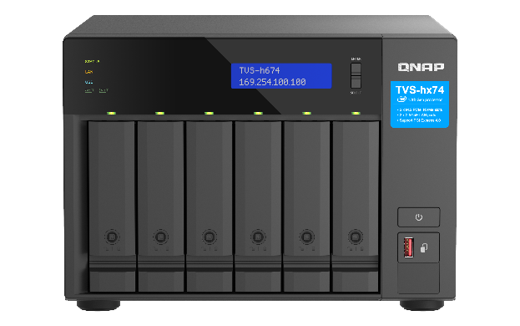
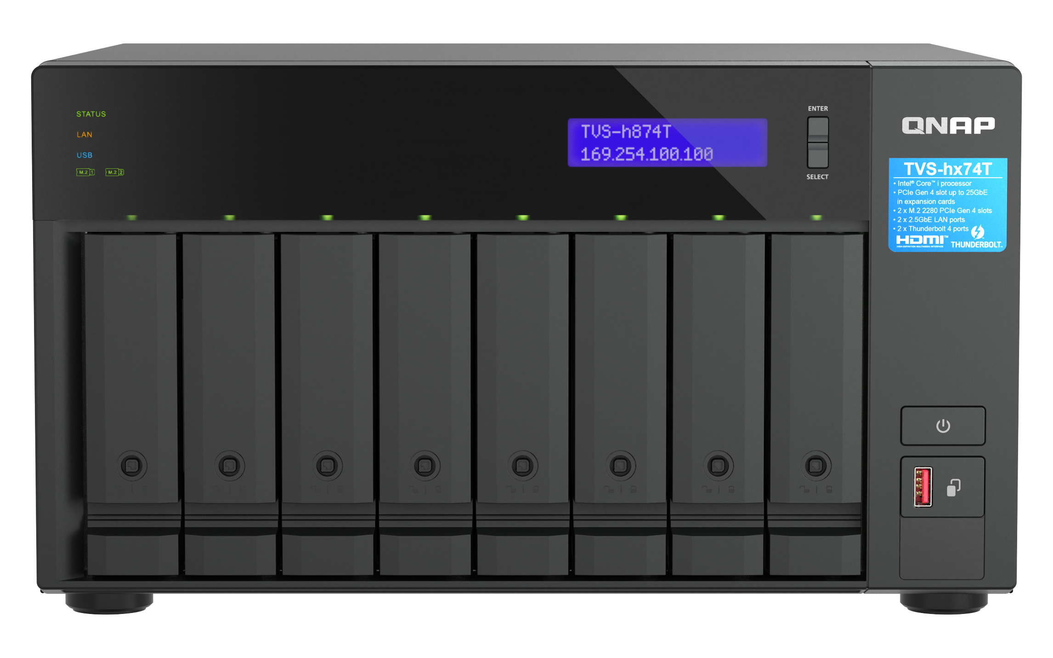

TVS-h674T / TVS-h874T front view
LCM system indicator​
Adjustable LEDs :
HDD、Status、LAN、USB、2 x M.2 ​
TVS-h674T
Tray key
included
3.5"/ 2.5”SATA
6Gb/s HDD/SSD tray (Lock-able)
Power button
USB 3 Gen 2 (10Gb) & One Touch Copy button
TVS-h874T

Slide 10
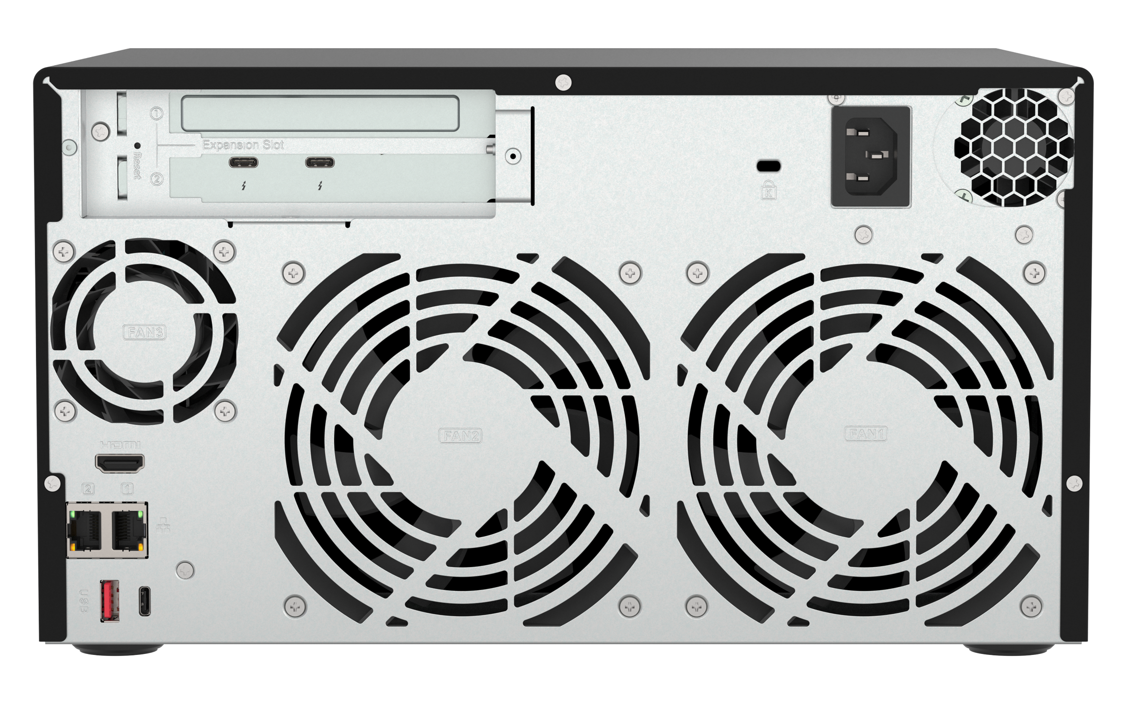
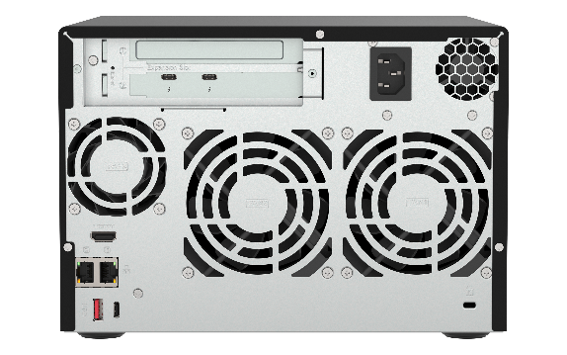
TVS-h674T / TVS-h874T rear view
1 x PCIe Gen 4 x16
Internal
power supply (100-240V)
2 x Thunderbolt 4 ports
(Pre-installed Thunderbolt AIC)
1 x HDMI 1.4b
4K output
Smart Fan
2 x 2.5GbE LAN ports
2 x USB 3 Gen 2 ports
(Type-C & Type-A)
TVS-h674T
TVS-h874T

Slide 11



Powerful next-gen processor options with up to 16 cores and 24 threads
Powerful performance with Intel® Core™ i5 / i7 / i9 series processors
Intel Core i9 16-core (8P+8E) / 24-thread
Intel Core i7 12-core (8P+4E) / 20-thread
Intel Core i5 6-core / 12-thread
The new Intel powerful processors deliver robust performance, featuring up to 30MB of cache, Turbo Boost Max technology with a maximum frequency of up to 5.0 GHz, and integrated Intel UHD Graphics for supporting 4K video transcoding and accelerating various AI applications
1.51x
Transcoding performance compared to previous TVS-x72XT
Boost up to
5.0 GHz
Max 16C / 24T
3.54x
CPU mark compared to previous TVS-x72XT
16-core
The specifications on this page use Intel Core i9-12900E as an example.
Detailed specifications vary depending on the CPU selected for each SKU
https://www.cpubenchmark.net/compare/5053vs3260/Intel-i9-12900E-vs-Intel-i5-8400T
Notes:
TVS-h874T and TVS-h674T are powered by Powerful performance with Intel® Core™ i5 / i7 / i9 series processors. The new Intel powerful processors deliver robust performance, featuring up to 30MB of cache, Turbo Boost Max technology with a maximum frequency of up to 5.0 GHz, and integrated Intel UHD Graphics for supporting 4K video transcoding and accelerating various AI applications
Compared to previous TVS-72XT, for Transcoding performance, TVS-h874T is 1.5 time faster and for CPU benchmark is 3.5 time higher.
And The specifications on this page use i9-12900E as an example.

Slide 12

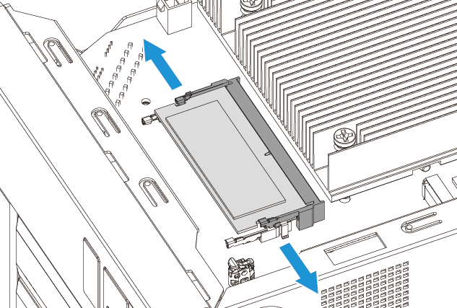
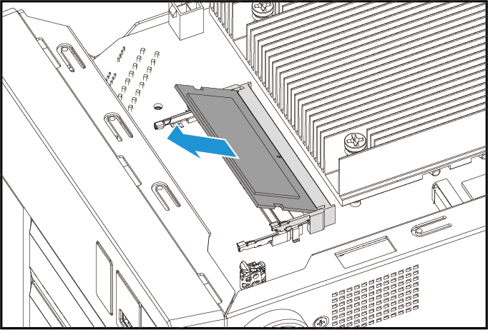

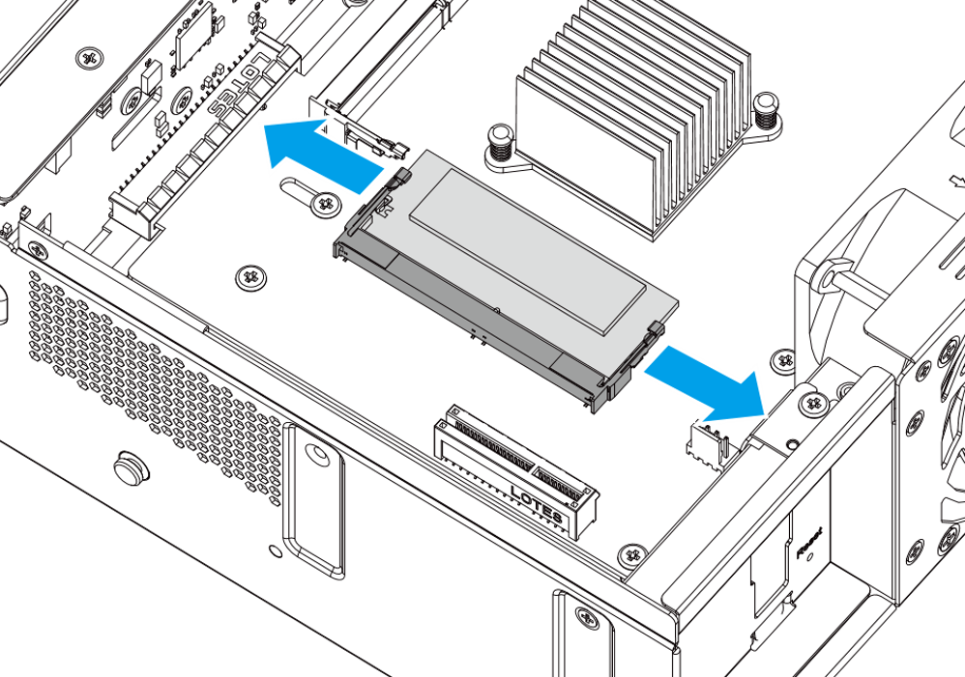
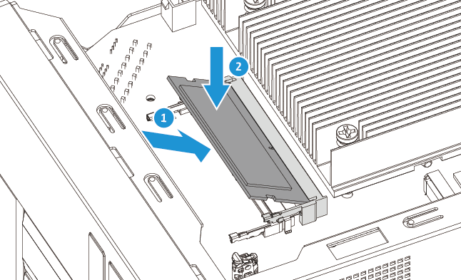
Large preinstalled 32/64 GB DDR4 RAM, upgradeable to max 64GB DDR4 memory
1. Remove the cover
2. Remove the old RAM (optional)
NAS ordering P/N
Ordering P/N | Memory
TVS-h674T-i5-32G | 32GB (2 x 16GB SODIMM)
TVS-h874T-i7-32G | 32GB (2 x 16GB SODIMM)
TVS-h874T-i9-64G | 64GB (2 x 32GB SODIMM)
2 x DDR4 SO-DIMM slots, max. 64 GB (2 x 32 GB), DDR4 dual channel memory
QNAP optional RAM modules for easy upgrade and better multi-app or multi-user usage
3. Install the new RAM
Notes:
TVS-h674T and TVS-h874T are Large preinstalled 32/64 GB DDR4 RAM, upgradeable to max 64GB DDR4 memory. There are 2 DDR4 so-dimm slots.
QNAP also provide optional RAM modules for easy upgrade and better multi-app or multi-user usage

Slide 13
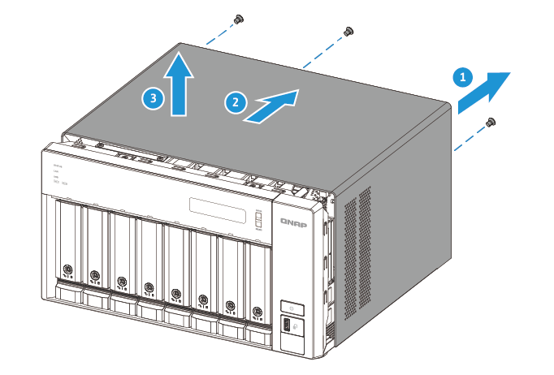
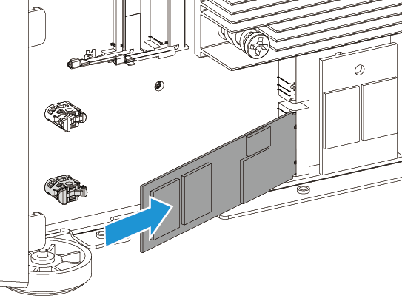
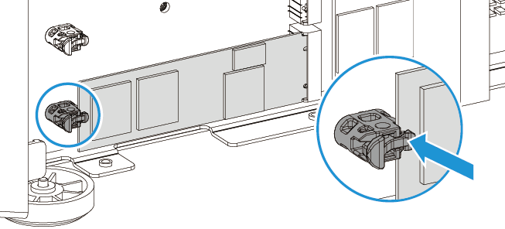
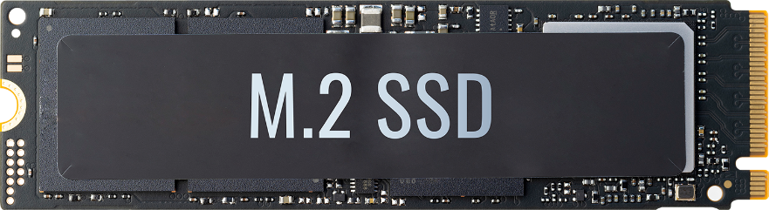
2 x M.2 PCIe SSD slots as default shared folder to improve overall performance in QuTS hero
Use 2 x M.2 slots as System Drive & Default Shared Folders to improve performance in QuTS hero
The first Storage Pool you create is where the system drive, default shared folders, and apps are stored. In this step, it is recommended to create an SSD RAID with at least two SSDs to attain optimal system performance and efficient app metadata management. (With an all-HDD configuration, the first Storage Pool is also where the system drive and default shared folders are stored.)
Improve random data access speeds with an SSD cache
Maximize the value of SSDs with Qtier Technology
1. Remove screws and cover
2. Install M.2 NVMe SSD
3. Tool-less M.2 installation
Note: Qtier is only supported in the QTS OS, not in the QuTS hero OS.
Notes:
And provide 2 x M.2 2280 PCIe SSD slots as default shared folder to improve overall performance in QuTS hero.
You can Use 2 x M.2 slot as System Drive & Default Shared Folders to improve performance in QuTS hero and Improve random data access speeds with an SSD cache
And on the right side, you will see the guide to install the M.2 ssd. First remove screws and cover then install M.2 2280 NVMe SSD without tools, which is very convenient.

Slide 14

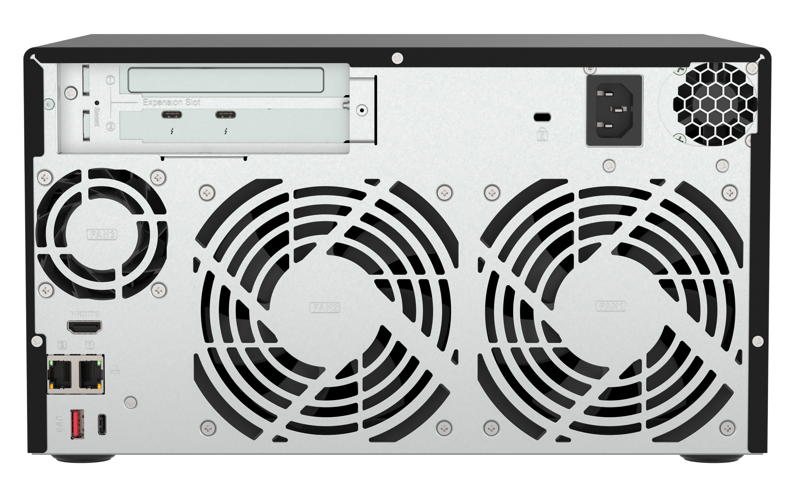

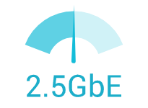

Built-in 2 x 2.5 GbE LAN ports, aggregated for maximum 5Gbps bandwidth
2.5GbE-supported motherboards, Wi-Fi 6 AP, switches, and LAN cards are now becoming popular
2.5GbE benefits
2.5X the speed
Same cable
2 x 2.5GbE LAN ports (also 1GbE/100M)
1GbE to 2.5GbE
Huge leap in performance
Use the same Cat.5e/ Cat.6/ Cat. 6A
LAN cables
Notes:
Built-in 2 x 2.5 GbE LAN ports, aggregated for maximum 5Gbps bandwidth.
As we can see 2.5GbE-supported motherboards, Wi-Fi 6 AP, switches, and LAN cards are now becoming popular.
We provide dual 2.5G port to have a Huge leap in performance from 1Gbe, and you can use the same Cat.5e/ Cat.6/ Cat. 6A LAN cables

Slide 15



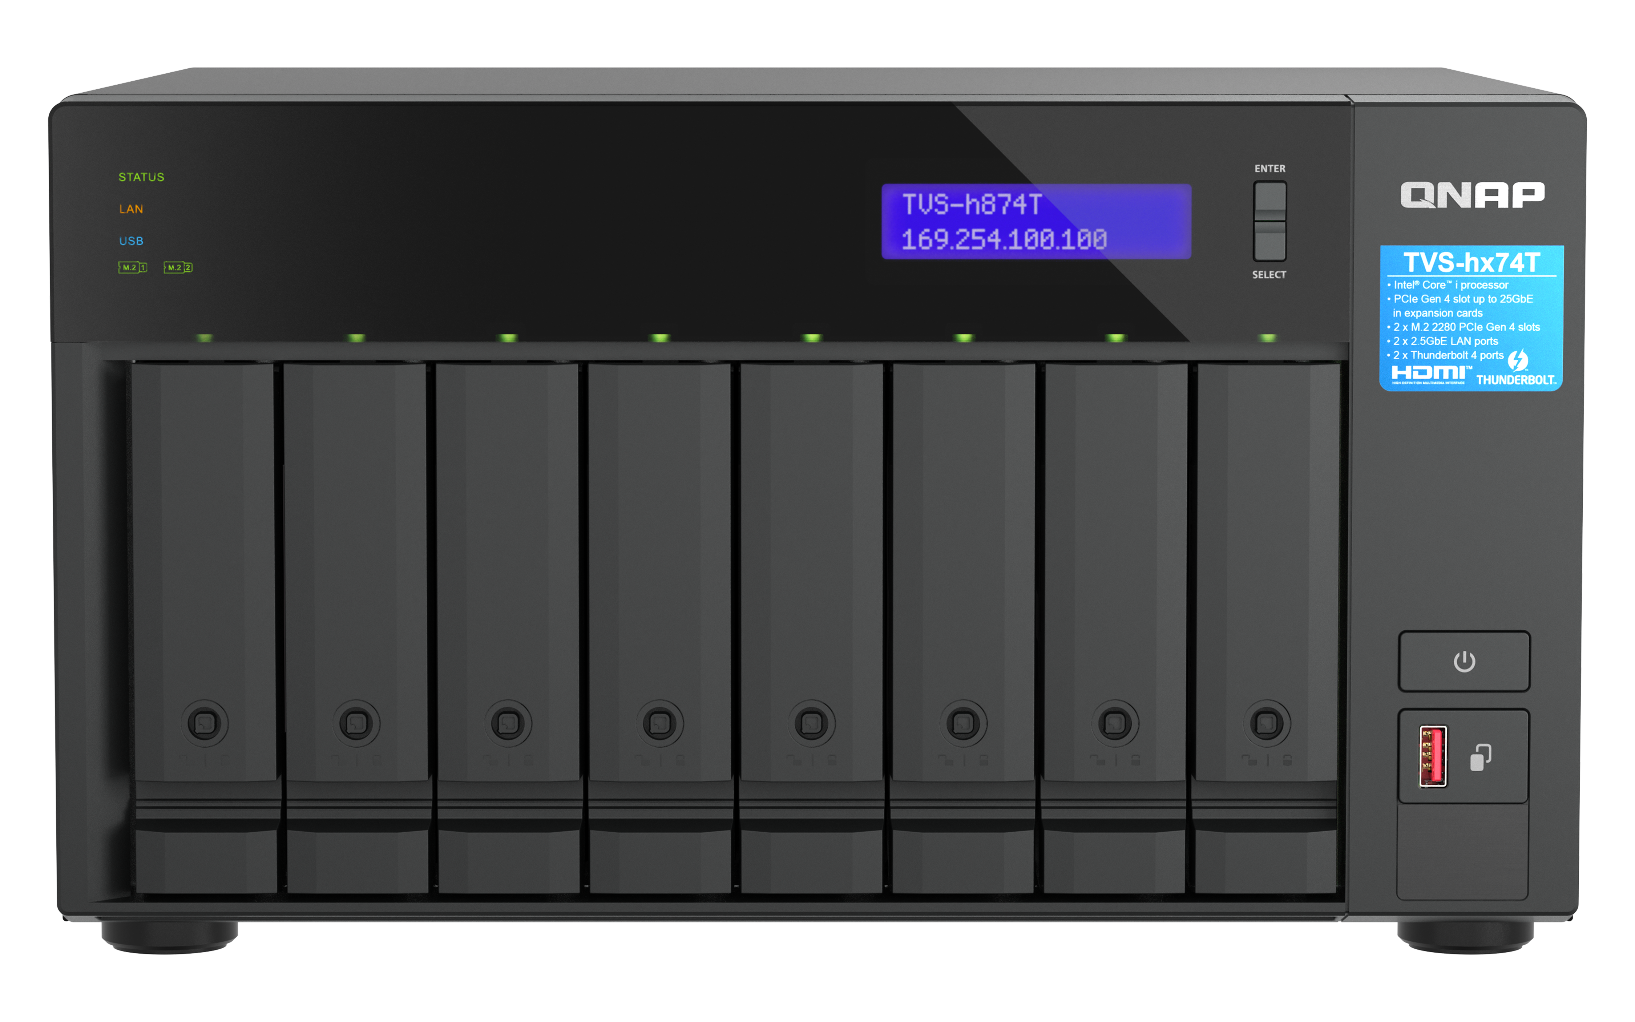
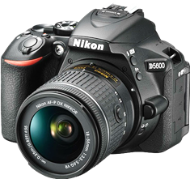
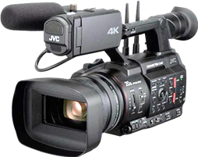
The second PCIe slot is preinstalled with a dual-port Thunderbolt 4 expansion card, supporting high transfer speeds so you can focus more on your creative work.
Two editors edit photos/videos via Thunderbolt simultaneously
PCIe slot 2
Preinstalled Thunderbolt 4
expansion card
Take images/ footages and uploads raw files from external to Thunderbolt NAS
Notes:
The second PCIe slot is preinstalled with a dual-port Thunderbolt 4 expansion card, supporting high transfer speeds so you can focus more on your creative work.
You can Take images/ footages and uploads raw files from external to Thunderbolt NAS then edit photos/videos via Thunderbolt simultaneously

Slide 16
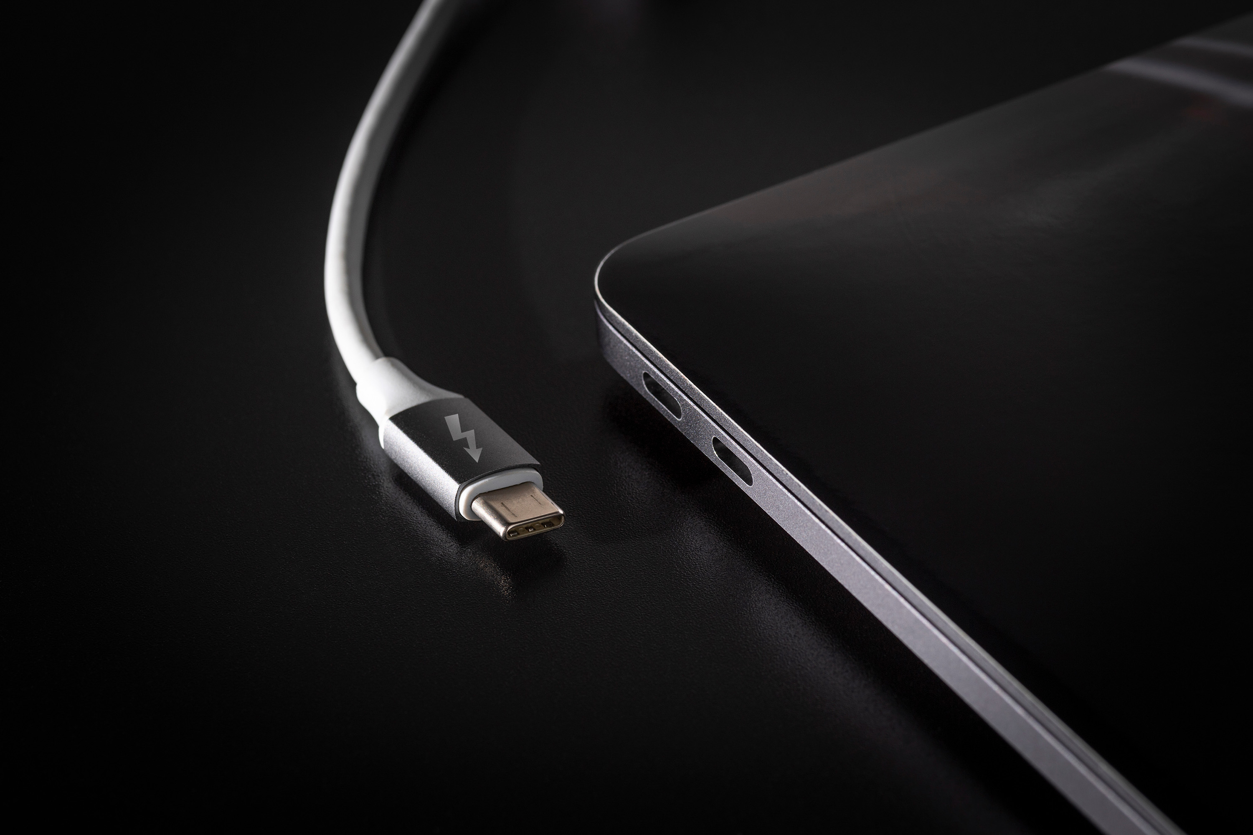

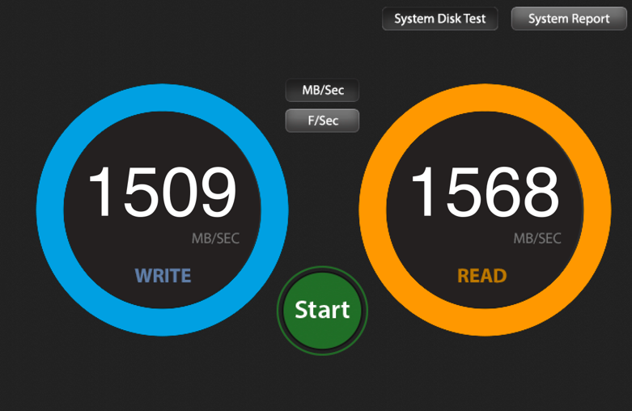
Thunderbolt 4
exceptional performance, ready to use
Built-in two Thunderbolt 4 ports
Up to xxxx MB/s
Built-in Thunderbolt 4 ports via Thunderbolt Networking
Write : 1,758 MB/s, Read : 1,738 MB/s
via AJA System Test
1,758
1,738
NAS : TVS-h874T-i9-64G
FW : QuTS hero h5.1.1
SSD : Samsung 860 EVO 1TB x 8, RAID 5
Client : Mac Studio 2022
CPU : Apple M1 Max (10 cores)
O.S. : MacOS 13.5
Notes:
On this page, show the Thunderbolt performance of TVS-h874T, as tested using AJA.
For the performance test, the following setup was used:
Client : Mac Studio 2022
CPU : Apple M1 Max
Operating System: macOS 13.5
the results demonstrated speeds exceeding 1700MB/s.
This performance ensures fast and efficient data transfer, enabling seamless video editing workflows even with high-resolution files and demanding codecs.

Slide 17
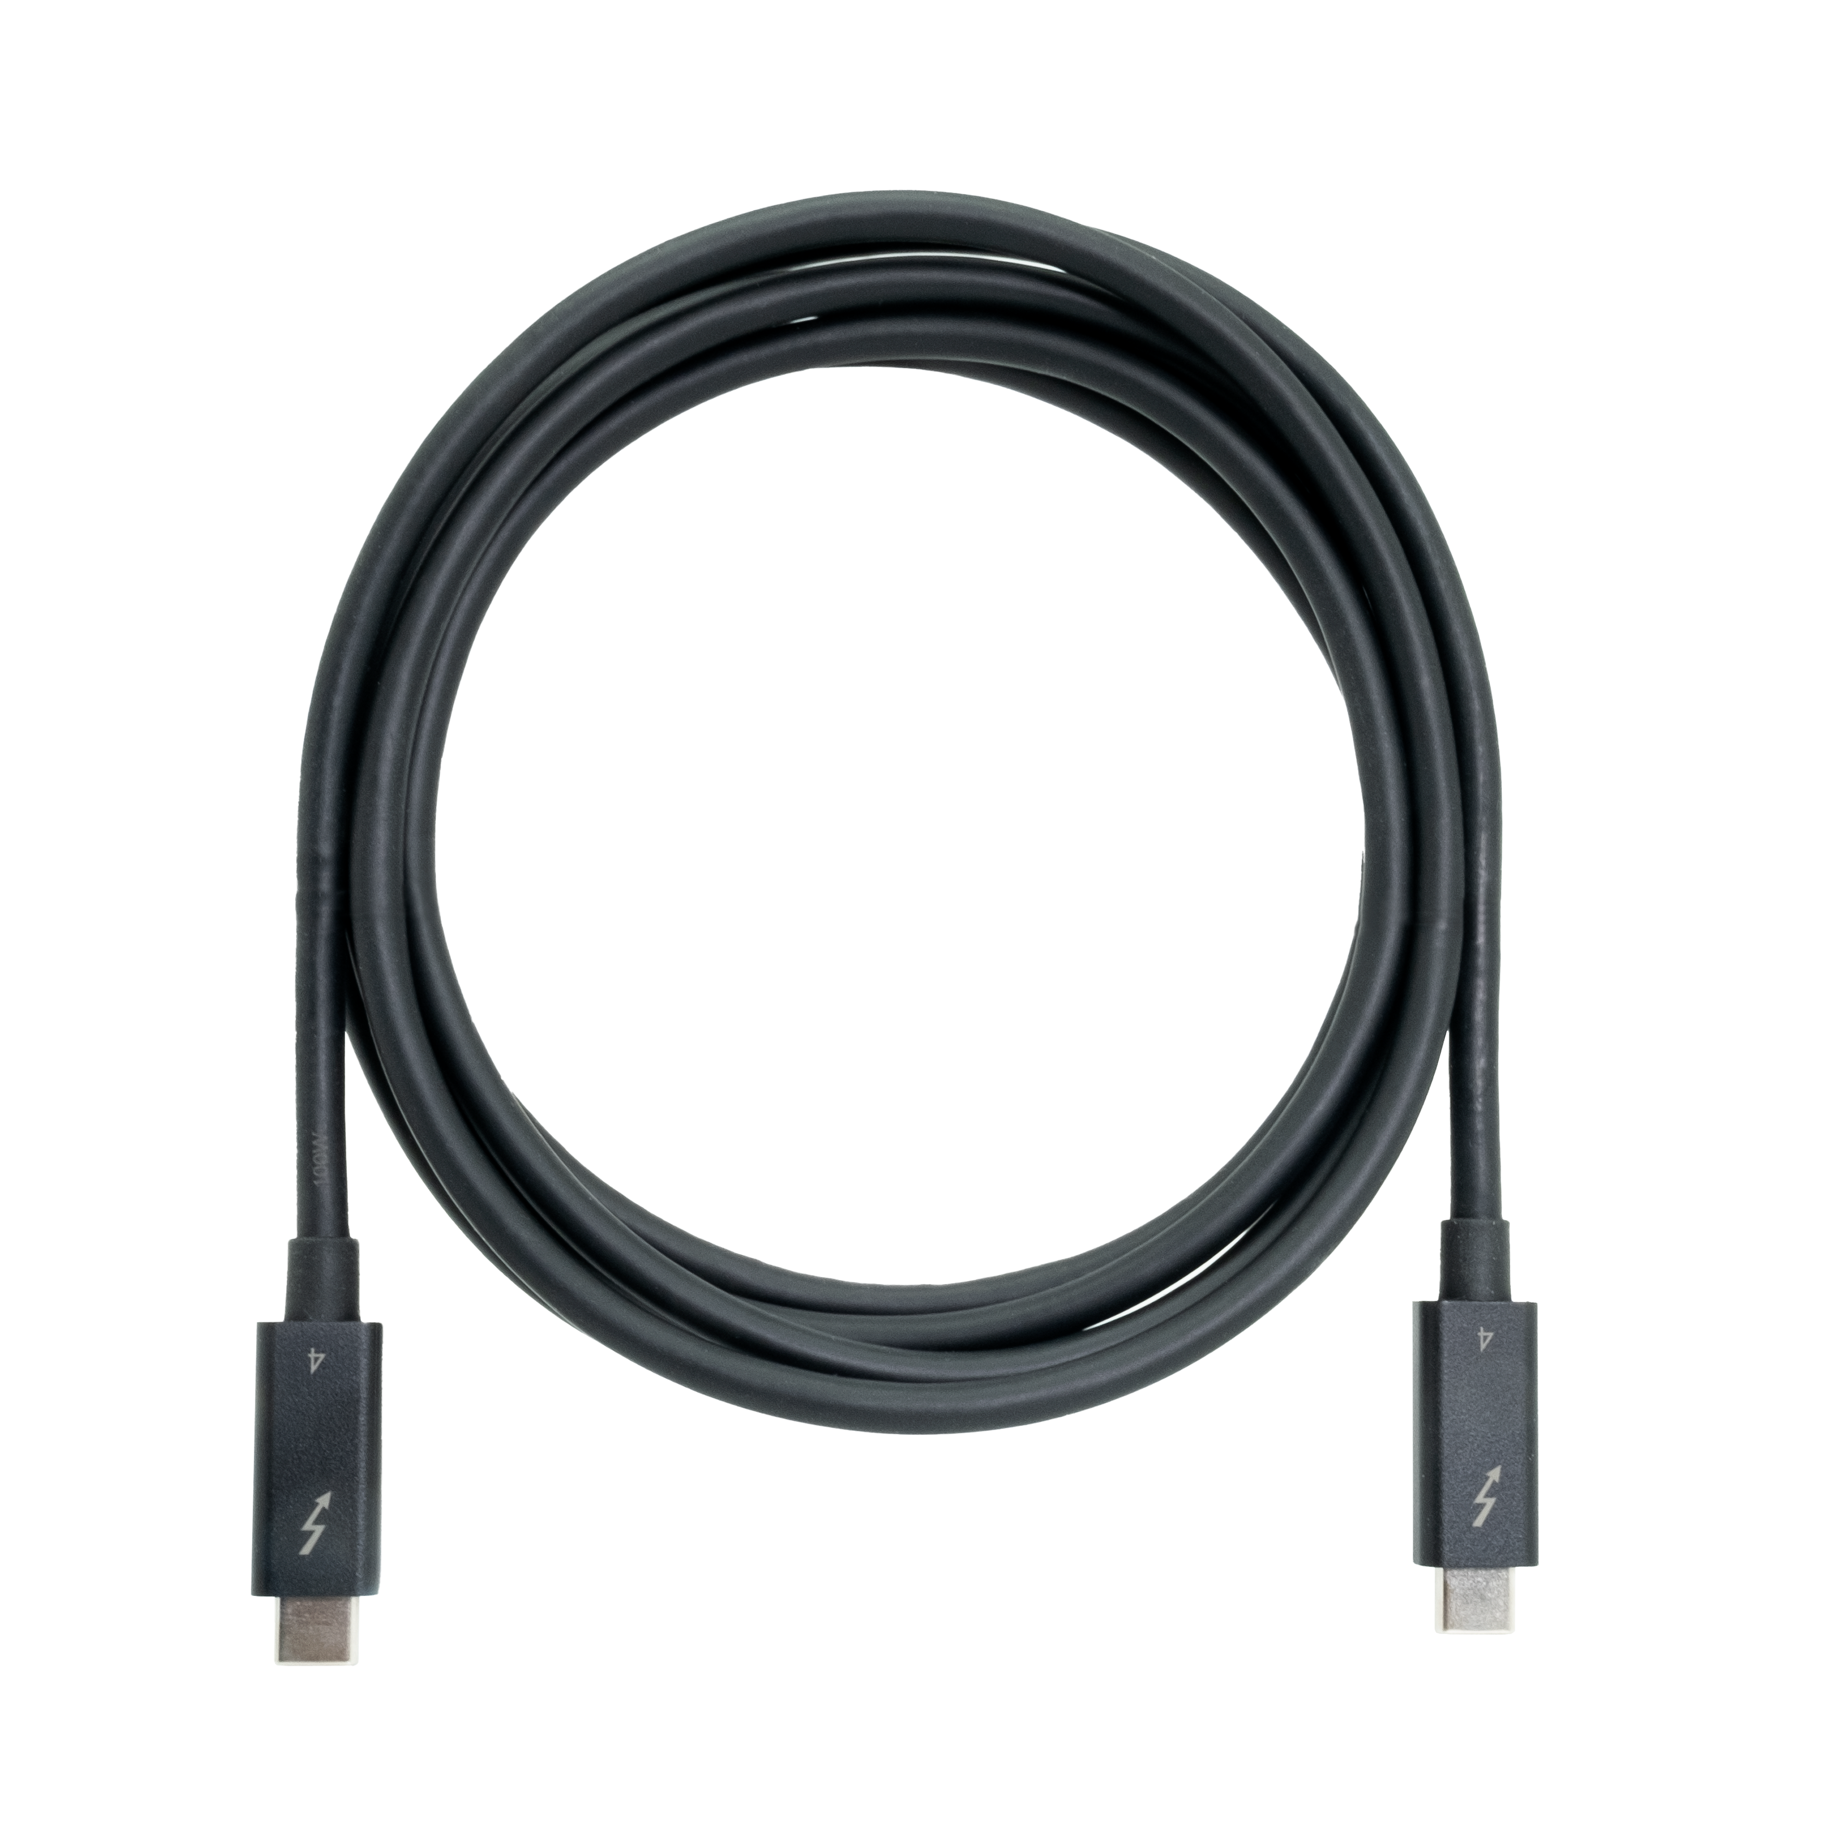
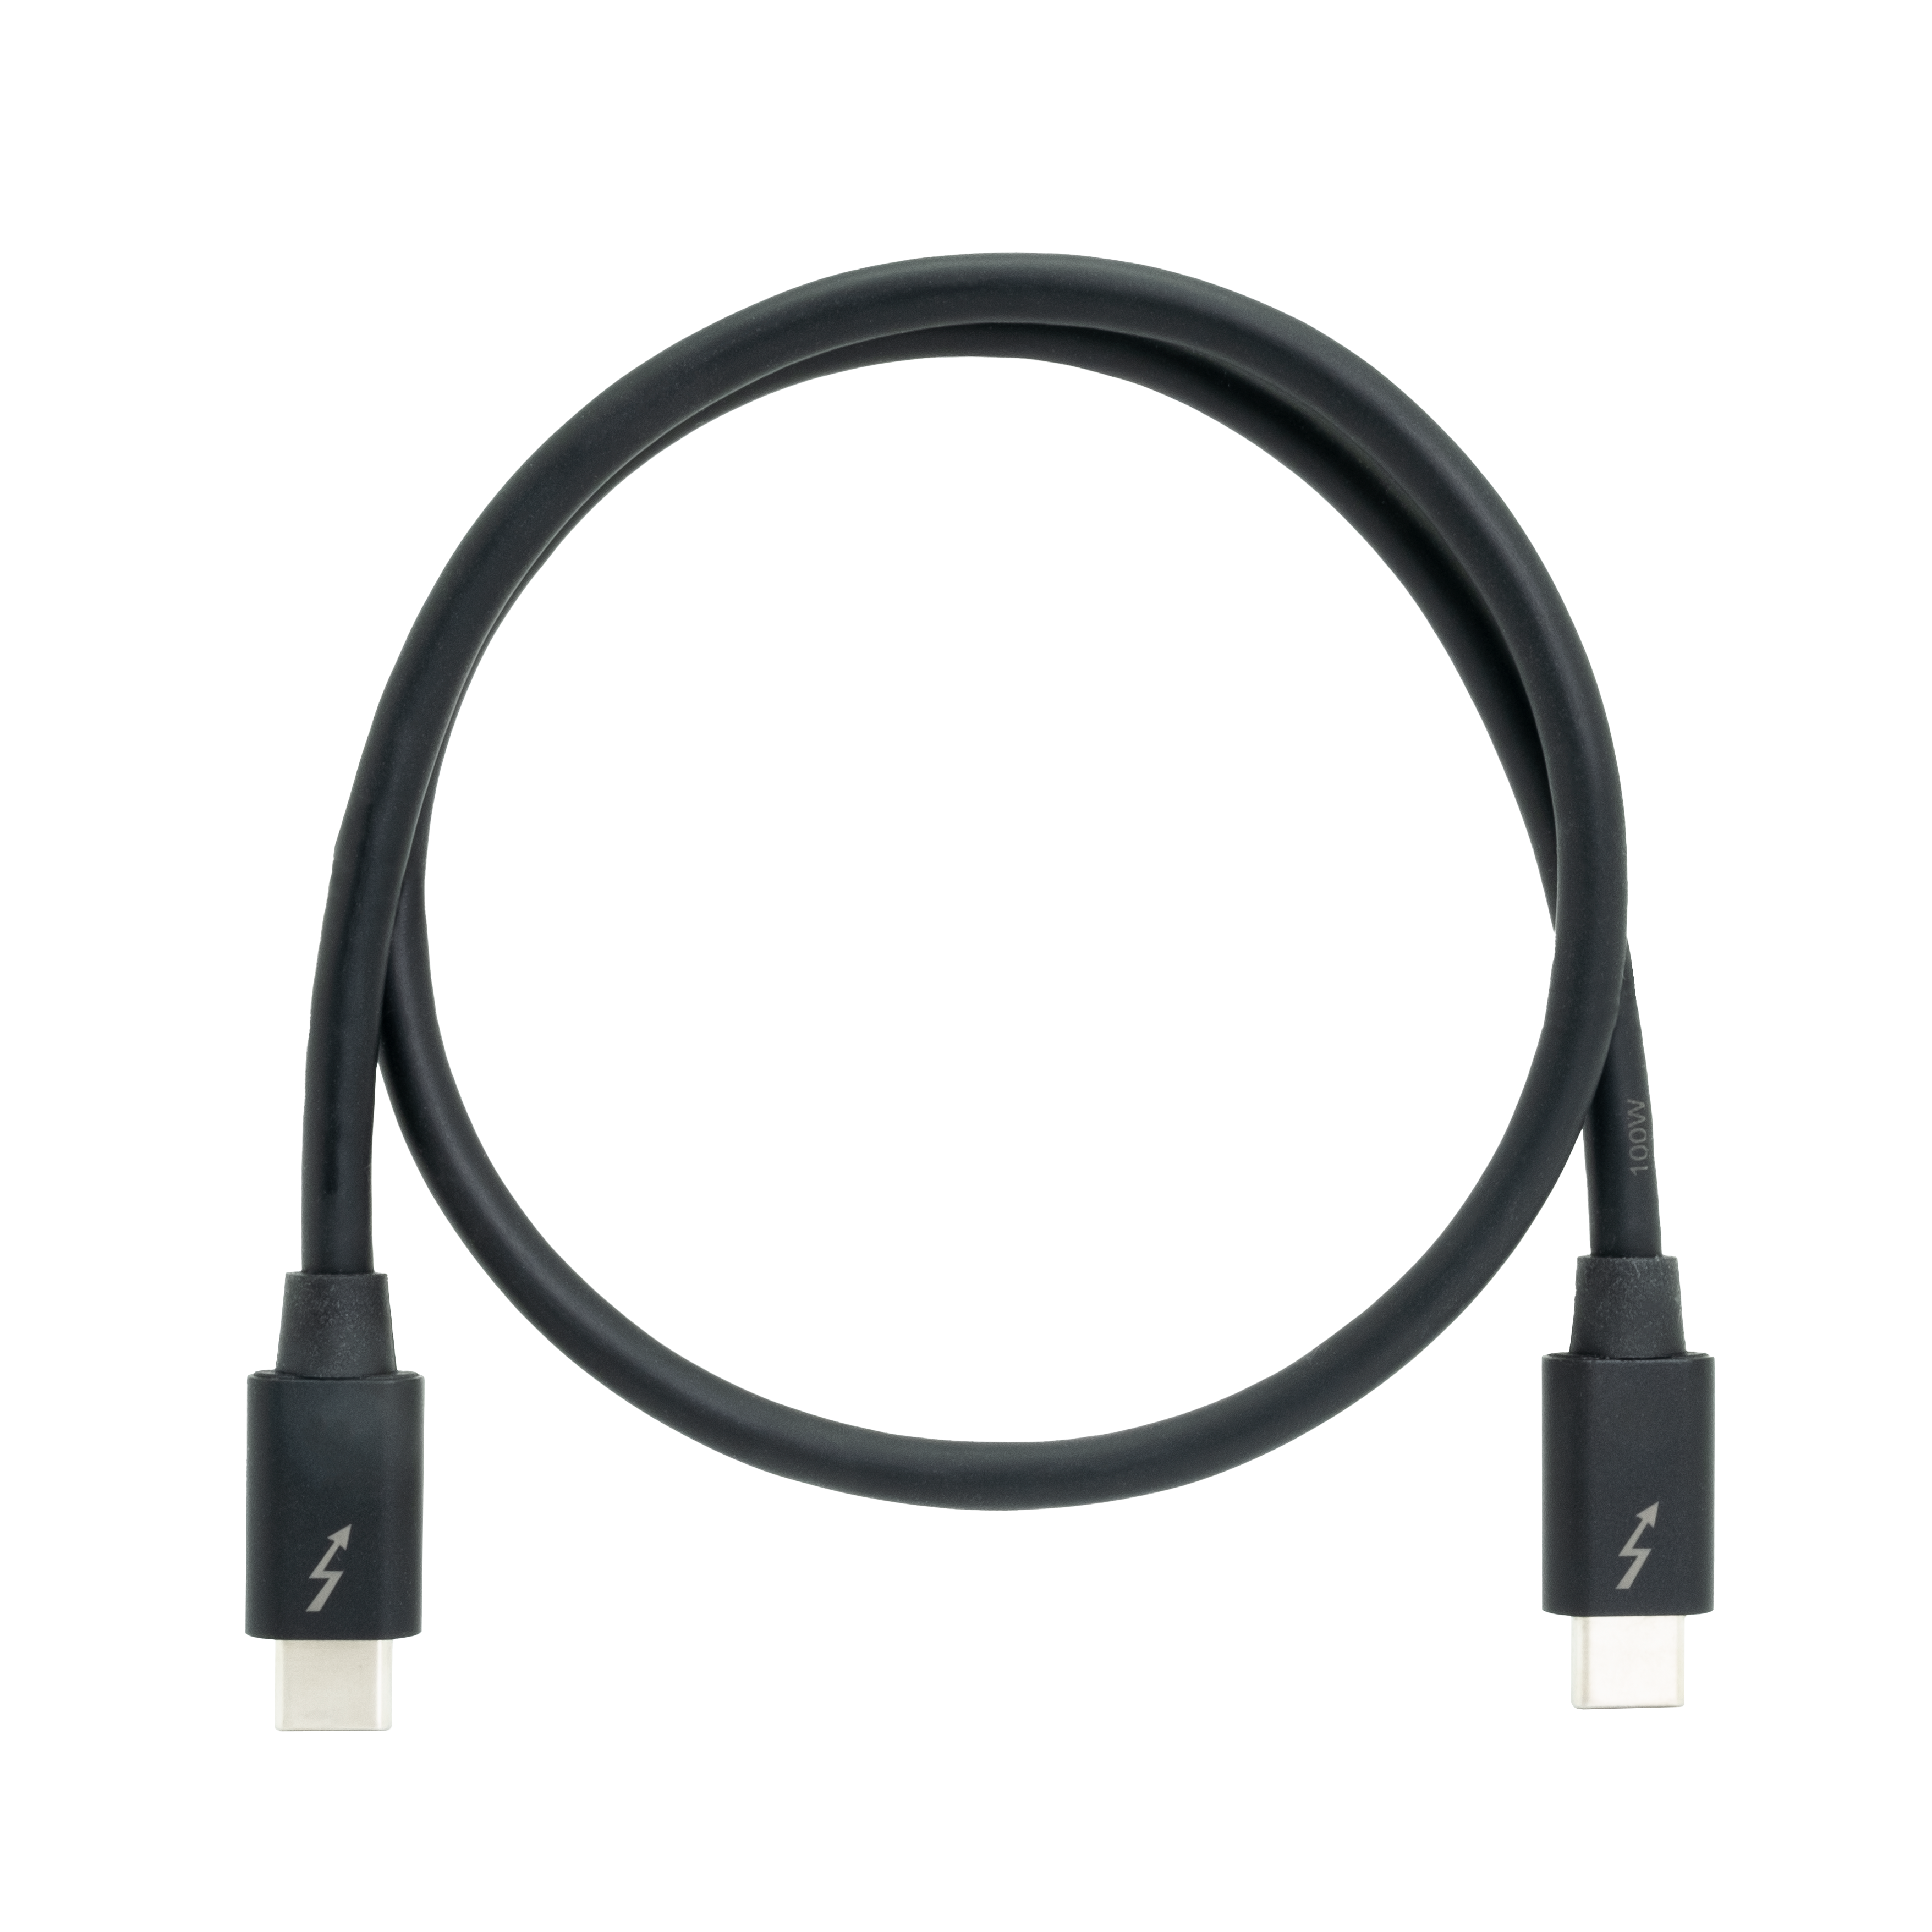
QNAP Thunderbolt accessories:
Thunderbolt 3 & Thunderbolt 4 cables
QNAP also provides a variety of Thunderbolt cables to choose from. In addition to Thunderbolt 4 cables, there are also more affordable Thunderbolt 3 cables for Thunderbolt 3 computers, allowing you to meet high-speed transmission at a lower cost.
Thunderbolt 4 Cables
Thunderbolt 3 Cables
CAB-TBT4-2M: 2 meters (6.56 ft.)
CAB-TBT4-0M5: 0.5 meters (1.64 ft.)
CAB-TBT320M-40G-LINTES: 2 meters (6.56 ft.)
CAB-TBT315M-40G: 1.5 meters (4.92 ft.)
Notes:
QNAP also provides a variety of Thunderbolt cables to choose from. In addition to Thunderbolt 4 cables, there are also more affordable Thunderbolt 3 cables to choose from, allowing you to meet high-speed transmission at a lower cost.

Slide 18
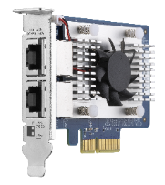
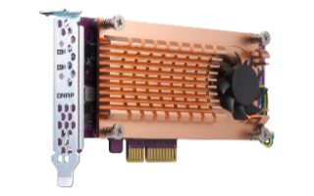
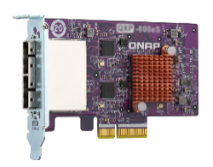
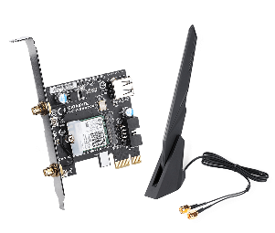
Slot # 1 support network, M.2 SSD, JBOD expansion, FC, and wireless expansion cards
Slot 1:PCIe Gen 4 x16
QXG 25GbE/10GbE/5GbE
/2.5GbE NICs
QM2 M.2 SSD Expansion
QXP SAS, SATA, USB
Expansion
QXP Wi-Fi 6 & FC AIC
Note : Compatibility is subject to official website announcements.
Notes:
And for PCIe slot 1 , it’s a PCIe Gen 4 x16 Slot, you can install various expansion card from qnap, include QM2、QXG、QXP card, for more you can reach our website

Slide 19


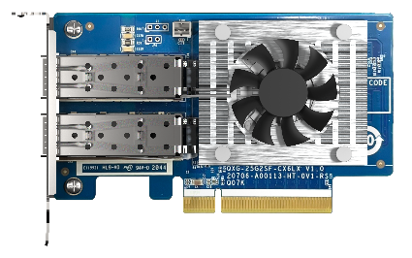
Integrated dual 2.5 GbE ports, and expandable to
25GbE high-speed network with an optional NIC
2 x 2.5GbE
SMB Sequential Throughput (1MB)
2 x 25GbE
SMB Sequential Throughput (1MB)
5,908 MB/s
590 MB/s
591 MB/s
3,838 MB/s
Test environment : ​
NAS: TVS-h874T-i7-32G
OS：QuTS hero h5.0.1
Volume type: RAID 5; 8 x Samsung 860 EVO 1TB ​
Client PC: Windows Server 2019, AMD EPYC 7232P 3.0GHz, 64GB RAM,
IOmeter : RAM*4, 30-sec ramp up time, 3-min seq. run time, 1 worker, 32-outstanding
With a QXG-25G2SF-CX6
Dual-port SFP28 25Gb NIC
12吋短機箱可支援市面上大部分的機櫃
內建2埠M.2(PCIe Gen 3 x1)，可提供SSD快取，加速隨機存取的速度
PCIe Gen 3 x 8插槽，提供各式應用的高速擴充卡
雙系統靈活切換配置QTS and QuTS hero
Notes:
Comes with dual 2.5 GbE network ports as standard, and can be further expanded to 25GbE high-speed network with PCIe Gen 4 slots
This page shows the performance of 2 2.5G and 2 25G with QXG-25G2SF-CX6, the read / write performance of SMB Sequential throughput of 2 2.5G can reach 590 MB/s
And for 2 25G SMB sequential throughput, 3838 MB/s write performance, 5908 MB/s read performance.

Slide 20
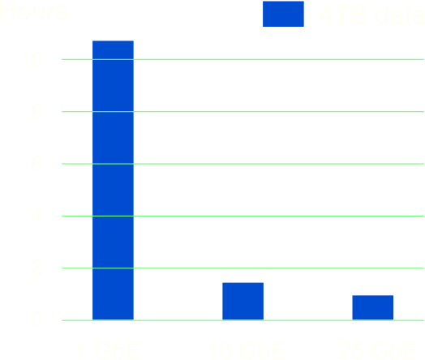
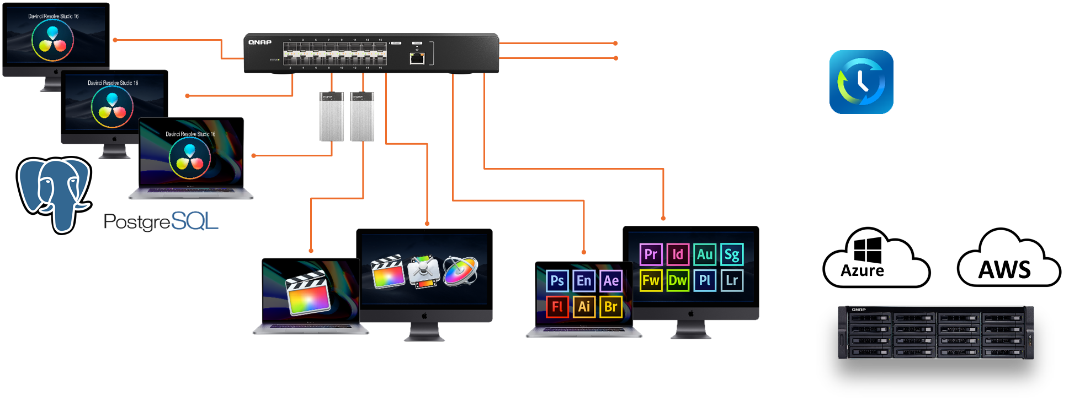

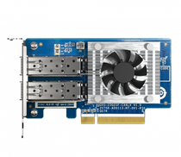

Time is money! Upgrade to faster 25GbE and share or backup data quickly!
When transferring a 4TB (1 hour of 8K) video, 1GbE takes 11 hours.
When using 25GbE network, it only takes 20 minutes to transfer the same file.
TVS-h874T
QSW 25GbE switch
QNAP 25GbE NIC
Backup
20 min !
DaVinci Resolve + PostgreSQL
Libraries for FCPX & Motion
Project for Adobe Creative Suite
Notes:
Imagine transferring a massive 4TB video file, which represents approximately 8 hours of 8K footage. With a traditional 1GbE network, it would take a staggering 11 hours to complete the transfer.
However, when we replace the network device with a high-speed 25GbE connection, the transfer time dramatically decreases. In fact, it only takes a mere 20 minutes to transfer the same 4TB video file.
This remarkable improvement in transfer time showcases the power of 25GbE network.

Slide 21
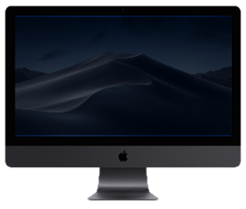
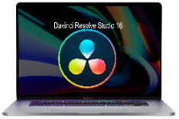



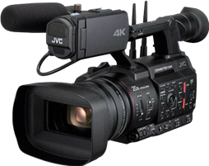
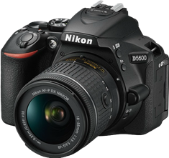


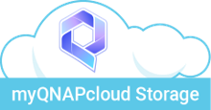




A comprehensive solution to unleash your creativity through various connectivity options
Directly edit multimedia content on the TVS-hx74T from your workstation via Thunderbolt 4 or upgradable 25/10 GbE
Supports team collaboration in Adobe Premiere Pro or DaVinci Resolve editing environment
Upload videos/photos from an external USB drive
Back up NAS data to another NAS, cloud services, or external storage devices
If additional storage space is needed, QNAP also offers a variety of JBOD options for quick capacity expansion.
Upload files from Mac/Windows PC over the network
Notes:
We provide a comprehensive solution to unleash your creativity through various connectivity options
You can Upload videos/photos from an external DAS via USB 3.2 Gen 2 ports or Directly edit multimedia content on the TVS-hx74T from your workstation via Thunderbolt 4 or upgradable 25/10 GbE
And also Supports team collaboration in Adobe Premiere Pro or DaVinci Resolve editing environment.
For back up solution, you can Back up NAS data to another NAS, cloud services, or external storage devices and If additional storage space is needed, QNAP also offers a variety of JBOD options for quick capacity expansion.

Slide 22



myQNAPcloud One :
Whole New Cloud Service offered by QNAP
myQNAPcloud One is a subscription service that provides expanded storage and other benefits to users. With a myQNAPcloud One subscription, users can access more storage space on Cloud Drive, as well as extra features and benefits on other QNAP products.
myQNAPcloud Object
myQNAPcloud Surveillance
myQNAPcloud Storage
myQNAPcloud Surveillance
myQNAPcloud Object
NAS backup
HBS integration
NAS gateway (HybridMount)
Config backup
Recording backup
Playback
Event / Sub-stream recording
Standard Object service
S3 Compatible (Partial / Quota / ACL)
Support Object Lock & Lifecycle
Data Migration
Cross-Site
Replication
Notes:
myQNAPcloud One :
Whole New Cloud Service offered by QNAP
myQNAPcloud One is a subscription service that provides expanded storage and other benefits to users. With a myQNAPcloud One subscription, users can access more storage space on Cloud Drive, as well as extra features and benefits on other QNAP products.

Slide 23




QNAP is an official Adobe Partner for video and audio solutions
QNAP NAS is the best centralized storage for Adobe users, allowing streamlined collaborative workflows on projects of all types (including photos, graphics, videos, and music). Higher file transfer performance can be achieved using a QNAP NAS with 2.5GbE, 10GbE, or Thunderbolt™ connectivity, and storage capacity can be scaled up for larger storage spaces to support your amazing creative work!
Notes:
QNAP NAS is the best centralized storage for Adobe users, allowing streamlined collaborative workflows on projects of all types (including photos, graphics, videos, and music). Higher file transfer performance can be achieved using a QNAP NAS with 2.5GbE, 10GbE, or Thunderbolt™ connectivity, and storage capacity can be scaled up for larger storage spaces to support your amazing creative work!

Slide 24

Built in HDMI port for video output or Surveillance station
Up to 1.50 GHz
Intel UHD
Graphics 730/770
Up to 32 EUs
Dedicated EU for graphic
HDMI 4K output
1 x HDMI 1.4b
1920 x 1080, 60Hz
The supported video and audio formats may vary depending on the software's compatibility
Notes:
24
Built in HDMI port for video output or Surveillance station, Up to 1.50 GHz with integrated Intel UHD Graphics and an HDMI port support 4K output

Slide 25

The only Thunderbolt NAS company in the storage industry offering full selections
 | TVS-h874T | TVS-h674T | TVS-472XT | TVS-672XT |  | TVS-872XT
SKU | TVS-h874T-i9-64G TVS-h874T-i7-32G | TVS-h674T-i5-32G | TVS-472XT-i3-4G | TVS-672XT-i3-8G |  | -TVS-872XT-i3-8G -TVS-872XT-i5-16G
CPU | Intel® Core™ i9 16-core 24-thread Processor Intel® Core™ i7 12-core 20-thread Processor | Intel® Core™ i5-12400 6-core 12-thread Processor, up to 4.4GHz | Intel® Core™ i3 processor |  |  | Intel® Core™ i3 processor Intel® Core™ i5 processor
O.S. | QuTS hero |  | QTS
Memory | 64 GB / 32 GB SODIMM DDR4 Maximum 64 GB (2 x 32 GB) |  | 4 GB SODIMM DDR4 Maximum 64 GB (2 x 32 GB) |  | 8 GB / 16 GB SODIMM DDR4 Maximum 64 GB (2 x 32 GB)
LAN | 2 x 2.5 GbE (2.5G/1G/100M) |  | 2 x 1GbE 1 x 10GBASE-T
Thunderbolt | 2 x Thunderbolt 4 |  | 2 x Thunderbolt 3
PCIe | 2 x PCIe Gen 4, Upgradeable to a 25GbE network environment Slot 2 preinstalled a Thunderbolt 4 AIC |  | 2 x PCIe Gen 3, Upgradeable to a 25GbE network environment Slot 1 preinstalled a Thunderbolt 3 AIC
M.2 | 2 x M.2 2280 PCIe Gen 4 x4 |  | 2 x M.2 2280 PCIe Gen3 x2
HDMI | 1 x HDMI, support 4K output |  | 1 x HDMI, support 4K output
USB | 1 x Type-C USB 3.2 Gen 2 2 x Type-A USB 3.2 Gen 2 |  | 1 x Type-A USB 3.2 Gen 1 2 x Type-C USB 3.2 Gen 2 2 x Type-A USB 3.2 Gen 2
Notes:
TVS-h674T and TVS-h874T are Thunderbolt NAS with improved performance and expandability compared.
Compared to previous sku, TVS-h674T and TVS-h874T are powered by much powerful CPU with Intel Core i9/i7/i5 processor, up to 16 Core and 24 Thread.
And preinstalled larger memory with 32G and 64G
Two PCIe Gen 4 slots Upgradeable to a 25GbE network environment Slot 2 preinstalled a Thunderbolt 4 AIC
And 2 M.2 2280 PCIe Gen 4 x4 slots, provide faster data transmission

Slide 26
Live Demo
2 x 25GbE SMB Sequential Throughput
Thunderbolt 4 performance

Slide 27
Enterprise-level OS
ZFS-based QuTS hero
Notes:
High-performance ZFS-based operating system with greater reliability

Slide 28







NAS & QuTS hero O.S. support powerful data reduction technologies to extend SSD endurance
Only available when during inline data process before writing
ZFS file system with inline deduplications and compression feature
It's the best choice to pair with the all-flash and SSD storage because it reduces the data size and pattern that need to be written to the SSD directly.
Write
A
B
C
D
A
B
C
D
D
C
A
B
A
B
C
D
Deduplication
Minimum：16GB RAM
D
C
A
B
Original Data
Compressed Data
Deduplicated Data
SSD Pool
Compression
Deduplication
Write to SSDs as sequential as much as possible.
Notes:
NAS & QuTS hero O.S. support powerful data reduction technologies to extend SSD endurance.
ZFS file system with inline deduplications and compression feature
Compress data to reduce storage I/O workloads for improved performance. In VDI, deduplicated virtual desktops are easily cached to achieve optimal virtual desktop performance.
Inline deduplication is block-based and is carried out before data is written to storage. This greatly optimizes storage usage while significantly decreasing storage capacity requirements.

Slide 29




Prevent silent data corruption & self-healing
Application
Application
Application
ZFS RAID
ZFS RAID
ZFS RAID
Avoid silent data corruption that occurred on the running system.
Notes:
Data integrity is key to the reliability of applications and databases. As SSD adoption grows, businesses will encounter a greater risk of data loss as it is difficult to recover data from a dead SSD. Designed with a focus on data integrity, ZFS uses end-to-end checksums to detect and correct silent data corruption caused by hardware defects, bugs in firmware or metadata errors.

Slide 30

SMB Multichannel for doubled speed
A SMB 3 client automatically establishes multiple connections to the SMB server for a single SMB session. The connection also provides bandwidth aggregation and network fault tolerance.
Requirement: Both NAS and Client device support SMB 3.0 protocol. NAS: QTS 5.1.0 (or later), QuTS hero h5.1.0 (or later). Clients: Windows Server 2012 (or later), macOS Big Sur 11.3.1 (or later)
Without Multichannel
With Multichannel
Faster!
Network fault tolerance!
Notes:
A SMB 3 client automatically establishes multiple connections to the SMB server for single SMB session, and with the multiple connections achieves bandwidth aggregation and network fault tolerance.
With Multichannel we can provide faster and network fault tolerance solution.

Slide 31






File Station : Easy to use, easy to find
手機瀏覽
網頁瀏覽
All the files and folders stored on your NAS and connected storage spaces are accessible through a familiar interface, and rich search/sort functions are available to help find files.
Qfile
File Station
Local NAS
Remote NAS
Cloud Storage
Notes:
And for NAS, we need file management.
We provide File station, which make All the files and folders stored on your NAS and connected storage spaces are accessible through a familiar interface, and rich search/sort functions are available to help find files. Improve your work efficiency by connecting all your storage resources to QNAP NAS. Cloud storage, remote NAS, and USB storage devices can all be connected to provide central access and management for your files
The companion mobile app Qfile Pro allows you to remotely access your NAS files. It also is a handy tool for backing up mobile files such as photos, videos, and documents to your NAS

Slide 32










Easily make NAS your team collaboration portal with File Station
 | Edit with Office Online | View in Google Docs | Open with Google Chrome Extension
Requirement | CloudLink needs to be enabled | CloudLink needs to be enabled | Use Chrome with extension “Office Editing for Docs, Sheets & Slides” to open
Supported formats | .docx, .pptx, .xlsx | .doc, .ppt, .xls .docx, .pptx, .xlsx | .doc, .ppt, .xls .docx, .pptx, .xlsx
Capabilities | •File collaboration •Auto save to NAS in real time | •Document preview •Convert to Google docs for editing & saving in your Google Drive | •Document preview •Convert to Google docs for editing & saving in your Google Drive
Save to NAS in real time
Multi-user online editing
檔案即時同步並回存至NAS中
支援多人線上編輯
 | 以 Office Online 編輯 | 在 Google Docs 中檢視 | 以 Google Chrome 擴充功能開啟
必要設定 | 啟用 MyQNAPCloud CloudLink | 啟用 MyQNAPCloud CloudLink | 以 Chrome 瀏覽器開啟，並安裝擴充功能：Office Editing for Docs, Sheets & Slides
支援格式 | .docx, .pptx, .xlsx | .doc, .ppt, .xls .docx, .pptx, .xlsx | .doc, .ppt, .xls .docx, .pptx, .xlsx
支援能力 | 文件共同編輯與同步至 NAS 檔案 | 文件檢視 可轉成 Google 文件進行編輯 | 文件檢視 可轉成 Google 文件進行編輯
到 設定>文件 裡，選擇你習慣的預設開啟方式吧！
Notes:
The most commonly used document software in general enterprises is Office and Google Doc. You can use the web version of Office to directly open and edit Microsoft® Office documents stored in the QNAP NAS, which greatly saves the need to copy Word documents, Excel worksheets and The trouble of downloading PowerPoint from the NAS to the computer for modification!
Let NAS be an enterprise team workstation, and various files and functions make collaborative work easier. There are also some necessary settings to pay attention here, such as. To edit with office online ,CloudLink needs to be enabled

Slide 33


Smart and automatic file management
Qsirch 5
Qfiling 3
A powerful, Google™-like search tool
Automatically filing and archiving
Search image, music, video, document, and email by keyword and filters.
5 advanced image search: search by face, text in image, things, color and map.
Supports Qfiling to perform archival tasks based on your search criteria.
Source
Schedule
Filter
Edit
Destination
2 type of task: filing task, recycling task
3 type of scheduling rule: one-time, scheduling, real-time
9 editing module: AI face blur, encryption and decryption, video transcoding and so on
Notes:
And for File management.
Qsirch is a powerful full-text search engine exclusively designed for QNAP NAS, allowing you to find files stored on NAS faster to maximize data value. Simply enter keywords to start searching for files, images, videos, music, emails, and more - Qsirch makes file searching faster and easier!
And Qfiling
When using QNAP NAS as centralized file storage, being able to efficiently organize files is a fundamental principle for everyday management and usage. But when faced with a huge number of files spread across multiple folders, it becomes increasingly harder, more time consuming, and frustrating to categorize and archive them. With Qfiling organizing files is now automatic and efficient

Slide 34



Qsync 5.0 – Cross-device file sync for individuals and teams
Qsync enables efficient file synchronization between a QNAP NAS and linked devices such as computers, laptops, and mobile devices. ​
With Qsync, you can easily access data across all your devices and share it among your team members.​
If you own many devices, any file changed on one device will be automatically synchronized with the others.​
For team works, any file changed will be automatically distributed to your teams’ devices, accelerating and streamlining your workflows.​
Notes:
As a NAS for data storage management, if multiple people and multiple devices are used, we also have Qsync to support cross-device team collaboration tools
Qsync enables efficient file synchronization between a QNAP NAS and linked devices such as computers, laptops, and mobile devices. With Qsync, you can easily access data across all your devices and share it among your team members.

Slide 35



Easy to use HBS 3.0 app fulfilling backup
3-2-1 practice with deduplication
HBS 3 (Hybrid Backup Sync 3)
Complete 3-2-1 backup strategy and recovery plan: 3 copies、2 media type、1 remote backup
2 media type
3 copies
Copy 1
NAS
Copy 2
NAS off-site
Copy 3
Google Drive
1 remote backup
Notes:
When it comes to network storage equipment, there is no doubt security is first. In addition to the backup mechanism provided by QNAP NAS, we will also share the concept of data security.then What is the correct backup strategy? It will be backup 3-2-1 . This has been a backup strategy recommended by the US government for a long time. Here is a brief introduction. There are only three key points for backing up 3-2-1. , There are three files icon on the screen, we are naming them as copies, first: you need to prepare three copies for important files, second: put them in two different media like NAS and Google Drive, Third: keep one remote backup such as setting the NAS at home and company or Taiwan and the United States, the above three key points, we recommend you use two NAS to achieve government-level data backup strategy.
So
Keep 3 copies, on 2 types of storage, and store 1 copy off-site to ensure your data safety

Slide 36








All-in-one solution for hosting virtual machines and containerized apps
Virtualization Station
Container Station
Experience LXD and Docker® lightweight virtualization technologies, download apps from the Docker Hub Registry®, import/export containers, and create abundant microservices.
Virtualization Station allows you to create virtual machines (VM) on Turbo NAS, supporting Windows®、Linux® operating systems.
Container Station
Container
Application
Application
Application
Filesystem
Filesystem
Filesystem
Host OS
Hardware
Notes:
With up to intel core i9 16core processor, it can also be a virtual machine and container workstation
Virtualization Station is a fast and reliable hypervisor on QNAP NAS and appliances. You can run multiple virtual machines on Virtualization Station to meet versatile virtualization needs and to benefit from cost savings and advanced features.
QNAP Container Station exclusively integrates LXD and Docker®, Kata lightweight virtualization technologies, allowing you to operate multiple isolated Linux® systems on a QNAP NAS as well as download apps from the built-in Docker® Hub/LXD Image Server Registry.

Slide 37





High-performance multimedia streaming platform
QuMagie AI smart photo albums and auto classification
Plex Server media streaming
CAYIN MediaSign Player
HEVC (H.265) video transcoding
Use Cinema28 for
multi-room streaming
Notes:
And we also provide various High-performance multimedia streaming platform. Such as
Qumagie : AI smart photo albums and auto classification
CAYIN MediaSign player to support video transcoding
Cinema28 for multi-room streaming
And Plex for media streaming

Slide 38


Snapshots - A standard feature in every QNAP NAS
TVS-h674T / TVS-h874T supports Snapshot, like taking a photo - within seconds the complete status of your NAS system and data is recorded.
QTS supports up to 1,024 snapshots, QuTS hero supports up to 65,536 snapshots
Mitigate the growing threat of ransomware
Step 1
Regularly update, and use Malware Remover
Step 2
Routinely back up to your NAS, and create multi-version snapshots
Step 3
Back up snapshots to another QNAP NAS
Notes:
support Snapshot, like Taking a snapshot is like taking a photo - within seconds the complete status of your NAS system and data is recorded. If an unexpected situation arises on your system, you can revert to the state recorded by a snapshot. With greater space-efficiency and flexibility compared to traditional backup methods, snapshots are the best way to protect your files and data.

Slide 39




Data security for enhanced data protection​
QuFirewall
You can allow/deny IP addresses and regions to prevent unauthorized access and brute force attacks for safeguarding data and service security.
Malware Remover
Regularly scan your NAS using the latest malware definitions. When under attack, infected files will be immediately removed to ensure NAS data security.
Notes:
And for data security
QuFirewall is the built-in firewall app used by the QTS, QuTS hero, QNE Network, and QuTScloud operating systems used by QNAP appliances. You can allow/deny IP addresses and regions to prevent unauthorized access and brute force attacks for safeguarding data and service security.
Malware Remover : Regularly scan your NAS using the latest malware definitions. When under attack, infected files will be immediately removed to ensure NAS data security.

Slide 40










Supports up to 24 more HDDs with two JBOD units, ​add nearly 500TB (24 x 22TB) of storage space​
USB
Maximum # of JBOD / RAID expansion units
TR-002​ | 2​
TR-004​ | 2​
TR-004U​ | 2​
TL-D800C​ | 2
TL-R1200C-RP​ | 2
TL-D400S​ | 2
TL-D800S​ | 2
TL-D1600S​ | 2
TL-R400S​ | 2
TL-R1200S-RP​ | 2
TR-002
TR-004
TL-D800C
TR-004U
TL-R1200C-RP
SATA
TL-D400S
TL-D800S
TL-D1600S
TL-R400S
TL-R1200S-RP
Note: These expansion units can only be used as an individual storage pool or volume on the NAS. Their storage pool or volume cannot be combined into the connected NAS. NAS applications cannot be installed on the them.​
Notes:
We can choose a variety of expansion devices. There are 2-bay to 12-bay options for USB storage expansion, and some JBOD models support hardware RAID and power backup. And There are 4-bay to 16-bay options for SATA storage expansion. If you need capacity expansion, you can refer to the purchase.

Slide 41



3-year standard warranty covering hardware repair and support services​
TVS-h674T / TVS-h874T is backed by a 3-year warranty at no additional cost. ​
You can also purchase a warranty extension that extends your warranty coverage up to 5 years total
For TVS-h674T : EXTW-BROWN-2Y (2-year extended warranty), USD$ 399
For TVS-h874T : EXTW-RED-2Y (2-year extended warranty), USD$ 599
Notes:
is backed by a 3-year warranty at no additional cost.
You can also purchase a warranty extension that extends your warranty coverage up to 5 years total

Slide 42





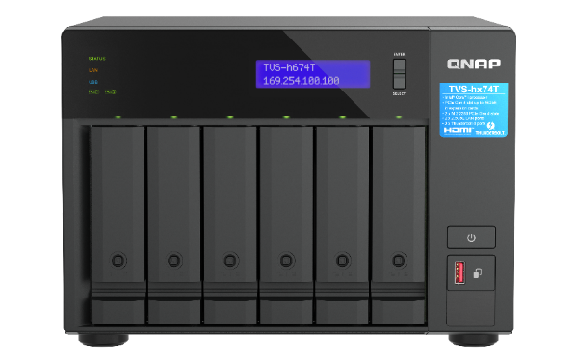

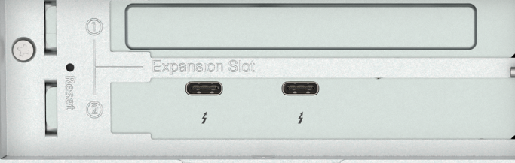



USB 3.2 Gen2 (10Gbps)
與 One-Touch-Copy
3個
PCIe Gen3 x4
擴充槽
Support both
Support
5/10/25GbE
NIC
3.5”
HDD
TVS-h874T
8-bay 3.5" SATA HDD NAS
TVS-h674T
6-bay 3.5" SATA HDD NAS
Support Multiple JBOD
IntelQAT
USB 3.2 Gen2
(10Gbps) & One-Touch-Copy
1 x HDMI
4K output
個直連 2.5 GbE
Dual
Thunderbolt 4
TVS-h674T / TVS-h874T
Up to
16-core
Intel Processor
2 x 2.5GbE
2
64GB
2.5GbE
Maximum Memory
2 x M.2 2280
PCIe Gen 4 slots,
(Slot 2 is pre-installed with a Thunderbolt 4 AIC)
154TB
PCIe Gen4 x4 bays
Collaboration between Final Cut Pro and Adobe Premiere Users
Up to
storage capacity
SR-IOV
Optional 5-yr warranty
(TVS-h874T with 22 TB HDD, RAID 5)
Notes:
TVS-h674T and TVS-h874T is our new Thunderbolt 4 NAS, Supporting dual Thunderbolt 4, up to Intel® Core™ i9 processor, tailor-made for video editing.
Powered by intel core i9 / i7 or i5 processor, up to 16 core and 24 thread, provide powerful performance. Dual Thunderbolt 4 ports support high-speed transfers to allow you to focus more on your work.
dual M.2 PCIe SSD slots, which you can optimize configuration of NVMe SSD and 3.5" SATA HDD and dual PCIe Gen 4 slots for optional QNAP expansion cards, and pre-installed with a dual-port Thunderbolt™ 4 expansion card in slot 2.
Preinstalled with 32G or 64G memory, expandable as needed with 2 x DDR4 SODIMM slots
And dual Dual 2.5 GbE network ports, provide smooth data transmission experience
Collaboration between Final Cut Pro and Adobe Premiere Users

Slide 43

Thunderbolt™ 4 NAS series with an Intel Core processor and PCIe Gen 4 expansion slots, supporting high-speed transfer and expandable to 25GbE network
Copyright© 2023 QNAP Systems, Inc. All rights reserved. QNAP® and other names of QNAP Products are proprietary marks or registered trademarks of QNAP Systems, Inc. Other products and company names mentioned herein are trademarks of their respective holders.

