Slide 1
Notes:
Hello everyone! I'm Alex Shih, the product manager at QNAP. Today, I'd like to introduce our new networking products in the QGD Family - the "QGD-1600" and "QGD-1602" series.

Slide 2
Overview
Hardware Features & Advantages
Software Features & Advantages
L2 Network management functions
QTS applications
ADRA NDR
Multi-purpose for one machine: support network management, storage, computing, etc.
Guardian’s diverse use scenes
Notes:
Digital transformation brings profits, not burdens.
Tool: Guardian.
*Less investment, more benefits.
*Effortless - a single device can assist you in achieving what was previously unattainable in digital transformation.
In today's presentation, we will cover the following agenda:
Hardware Features & Advantages
Software Features & Advantages
Multi-purpose for one machine: support network management, storage, computing, etc.
Guardian's diverse use cases.

Slide 3
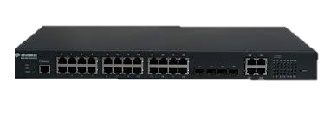
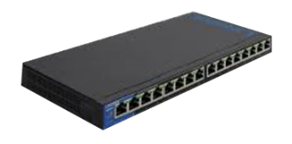
QNAP Networking Equipment Product Evolution
3rd Generation
Guardian Smart Edge Switch
2nd Generation
1ST Generation
L2/ L3 Managed Switch
Unmanaged switch
With QTS NAS OS
Run virtual machines
Hybrid cloud storage
Notes:
Let's start by looking at the evolution of QNAP's switch products. We've come a long way, from the first-generation unmanaged switch to the second-generation managed L2/L3 switch, and now, we're proud to introduce the third-generation Guardian Smart Edge Switch. With this innovative device, we've seamlessly integrated both switch and NAS capabilities. Users can enjoy not only network management but also harness the power of QTS. It's not just a network management-oriented switch but also capable of running VMs and even connecting to cloud storage, meeting a wide range of service requirements.

Slide 4
Hardware Advantages
Guardian's unique strengths and features
Notes:
After the previous introduction, let's now move on to the hardware benefits.

Slide 5
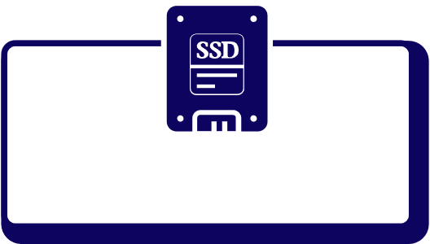
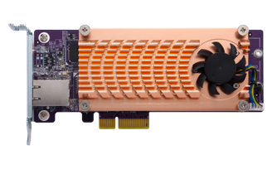
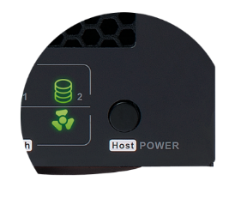
QGD-1600 hardware architecture
System power button (Rear)
Power Supply Total: 100W
System Power
Max: 48W
Max Power:
100W
2 x 2.5" SSD
Intel J4115 up to 2.5 GHz Quad-core
4G/8GB RAM
Host power controller
System power controller
PCIe Interface
2 x Internal LAN GbE
2 x PCIe Gen 2 x 2
Switch
HDMI 2.0
USB 3.0
USB 2.0
Host Interface
x 1
x 1
x 2
x 1
Microchip VSC7425
16-port GbE RJ45 with 2port SFP combo
Host power button
Notes:
First, let's take a look at the QGD-1600. It comes equipped with an Intel J4115 quad-core processor, delivering robust NAS performance for the switch.
Moving on to the network ports, since we've combined NAS and switch capabilities, the QGD-1600 offers 16 GbE RJ45 ports (including two RJ45/SFP combo ports), providing ample connectivity options for various purposes. Additionally, we provide 2 x 1 GbE internal bandwidth for communication between the NAS and the switch.
By default, it comes with 4GB or 8GB of memory, with the option to expand up to 8GB.
The QGD-1600 series also features two built-in 2.5" SSD slots, offering a cost-effective solution with excellent performance.
Furthermore, there are two PCIe Gen2 x2 expansion slots, allowing for the addition of 2.5G/10G network cards, QM2 M.2 SSDs, and other expansion cards.

Slide 6
QGD-1600 hardware features
Front
Combo Port
(RJ45,SFP)
Host Interface
LED Status
LCM
HDMI
(H)47.2 × (W)436.2 × (D)326.2 mm
USB 3.0
Reset button
(QTS / Switch)
Host
Power Button
2 x USB2.0
Rear
System power button
2 x PCIe Gen2 x2

Slide 7
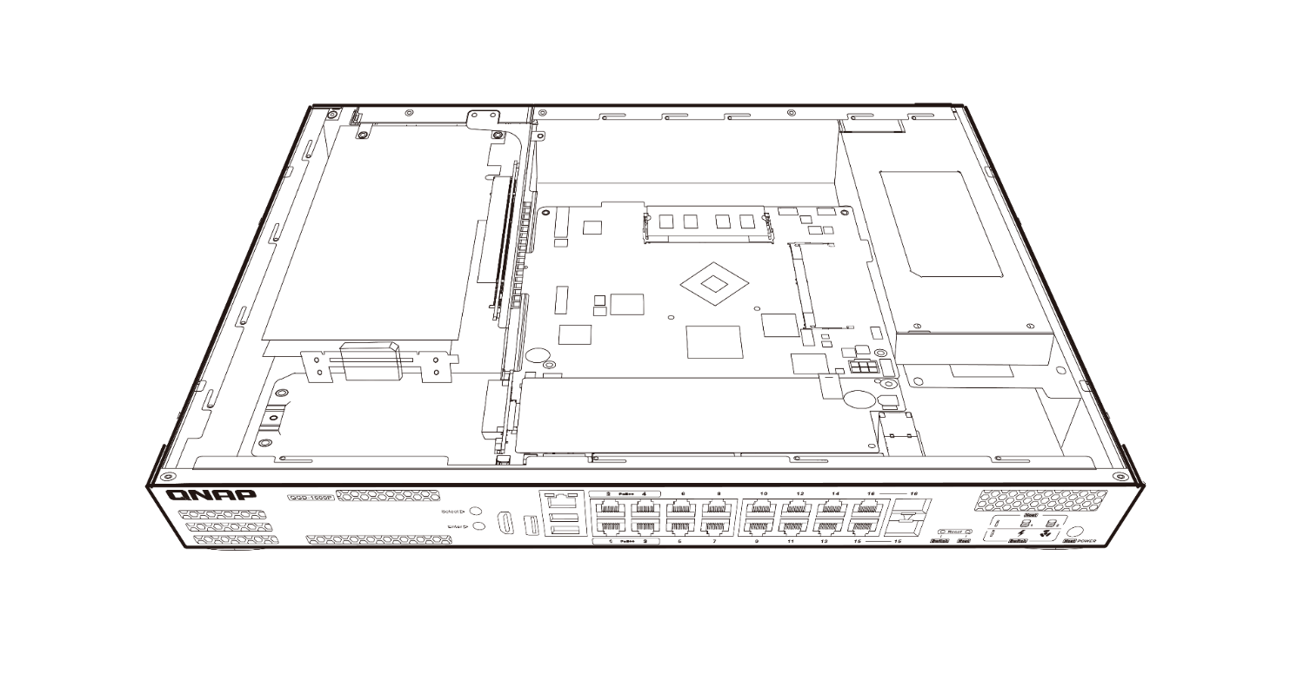
QGD-1600 internal view
2 X PCIe Gen2 Slots
DDR4 Memory
Supports installation of 10GbE NICs, QM2 expansion cards or USB 3.2 Gen 2 (10Gbps) expansion cards for maximum application expansion flexibility.
Supports two DDR4 dual-channel SO-DIMM memory slots up to 8GB (2 x 4GB).
2 X 2.5” SATA 6Gb/s SSD/HDD Slots
Intel® Celeron® 4-core CPU
Two 2.5” SSD/ HDD SATA slots are built in, allowing you to store surveillance video files
The Intel® Celeron® J4115 quad-core 1.8 GHz processor with 2.5GHz burst speed delivers efficient computing power to Guardian.

Slide 8
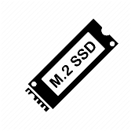
QGD-1602 hardware architecture
System power button (Rear)
Power Supply
8GB RAM
(up to 64GB)
System Power
2 x 2.5" SSD
Intel Atom C3558/
C3758 4/8-core
Host power controller
System power controller
PCIe Interface
2 x Internal 10GbE
2 x PCIe Gen 3
2 x M.2 NVMe
Switch
USB 3.0
Host Interface
x 2
2 x 10GbE SFP+
Microchip VSC7448
4 x RJ45
Improved features
2 x 1GbE
2 x 5GbE
16 x RJ45
8 x 1GbE
8 x 2.5GbE
Host power button
Notes:
First, let's take a look at the QGD-1602. It comes equipped with either an Intel Atom C3558 quad-core processor or an Intel Atom C3758 eight-core processor, providing robust NAS performance for the switch.
Moving on to the network ports, as we've integrated NAS and switch functionality, the QGD-1602 offers 8 GbE RJ45 ports, 8 2.5GbE RJ45 ports, and 2 10GbE SFP+ ports, offering a multitude of connectivity options for various purposes. Additionally, we provide 2 x 10 GbE internal bandwidth for communication between the NAS and the switch.
By default, it comes with 8GB or 16GB of memory, with the option to expand up to 64GB.
The QGD-1602 series also features two built-in 2.5" SSD slots, delivering a cost-effective solution with excellent performance.
Furthermore, there are two PCIe Gen3 x4 expansion slots, allowing for the addition of 2.5G/10G network cards, QM2 M.2 SSDs, QXP USB, and other expansion cards.

Slide 9
QGD-1602 hardware features
Front
2 x 1G/2.5G/5GbE
Multi-Gigabit host ports
8 x 2.5GbE
Multi-Gigabit switch ports
Host Power button
LCM
2 x 10GbE SFP+ ports
USB 3.2 Gen1 5Gbps
2 x 1GbE host ports
8 x 1GbE switch ports
Separated Host/Switch system indicator and reset button
Back
System power
PCIe Gen3 slot x 2

Slide 10
QGD-1602 internal view
Intel® Atom® Processor
DDR4 Memory
2 x PCIe Gen3 x2 (x4 connector) Slots
2.5-inch
HDD / SSD slots
2 x M.2 NVMe SSD slots

Slide 11
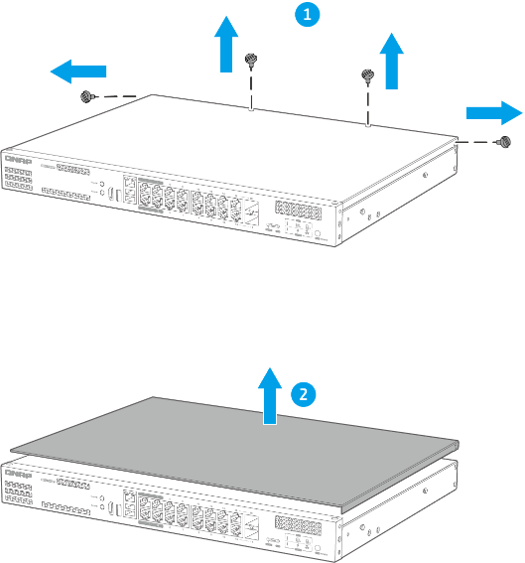
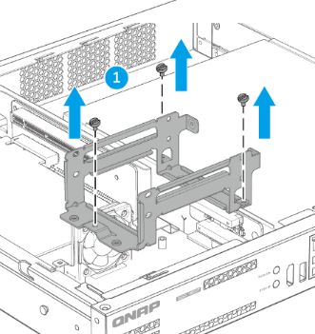
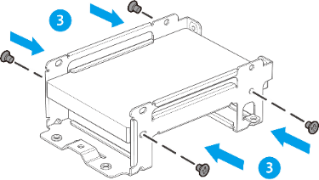
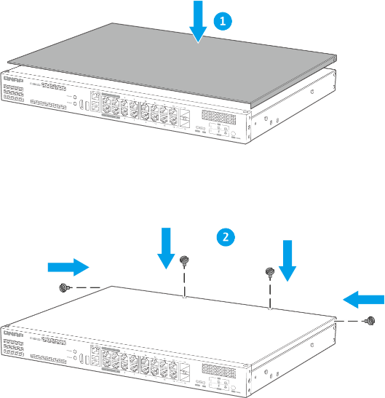
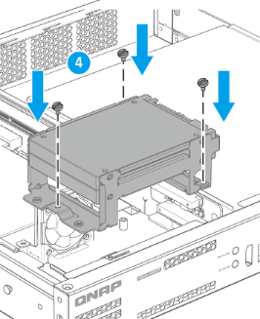
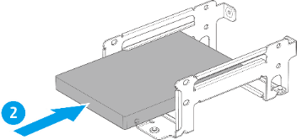
Hard disk and SSD installation
Step 1
Step 2
Step 3
Open the cover of the switch
Remove the hard disk slot, put it in the hard disk and fix it, and then fix the hard disk slot
Cover the cover of the switch
2.5-inch SSD

Slide 12
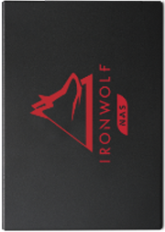
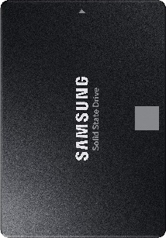
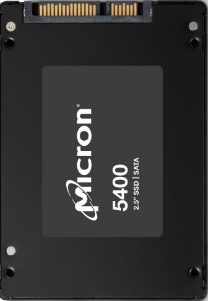
Choose the HDD/SSD for Guardian
Solid State (SSD)
For users who are looking for efficient computing power
Suitable for NAS
Maximum capacity up to 3.84TB (Seagate IronWolf 125)
(WD Red™ SA500 NAS SATA SSD)
High performance & capacity
Maximum capacity up to 3.84TB (Samsung 870 EVO)
Industrial reliabilty
Maximum capacity up to 7.68TB
(Micron 5400)
Visit QNAP website for more supported HDD

Slide 13
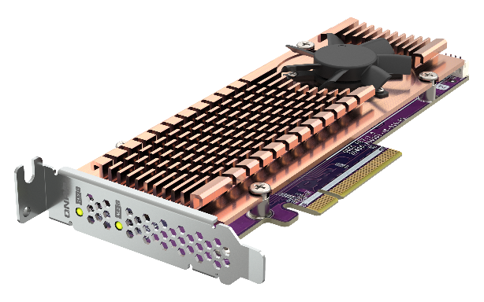
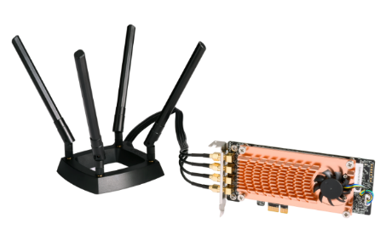
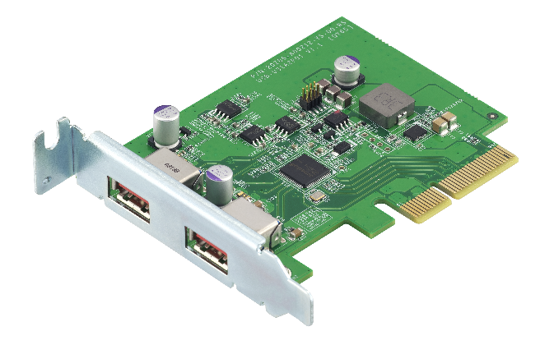
Extend Guardian functionality with the PCIe slot
The Guardian QGD-1600/1602 features two PCIe expansion slots, and you can flexibly configure a variety of QNAP PCIe expansion cards as needed.
QM2
QWA-AC2600
USB 3.1 Gen 2 (10Gbps)
SSD
QM2-2S-244A
QM2-2P-344A
QM2-2P-384A
QWA-AC2600
QXP-10G2U3A
Notes:
Both QGD-1600 and QGD-1602 feature two PCIe expansion slots, allowing for greater versatility and efficiency. You can flexibly configure QNAP QM2 M.2 SSD/10GbE PCIe expansion cards based on your needs. For example, you can add M.2 SSD caching or 10GbE network connectivity to the QGD-1600P. It's also compatible with wireless cards, such as the QNAP QWA-AC2600, turning the QGD-1600P into a wireless access point. Furthermore, the USB 3.1 10Gbps expansion card enables easy connections to external USB storage devices, facilitating fast transfers of large files, such as multimedia content.
QGD-1600/1602皆具備二個 PCIe 擴充槽，讓應用更廣、效率更高。您可依需求彈性配置 QNAP QM2 M.2 SSD/10GbE PCIe 擴充卡，在QGD-1600P上增添 M.2 SSD 快取或 10GbE 網路傳輸；相容無線網卡 (如：QNAP QWA-AC2600) 搭配 WirelessAP Station 讓QGD-1600P成為無線網路基地台；USB 3.1 10Gbps 擴充卡可輕鬆連結外接式 USB 儲存裝置，透過 USB 介面快速完成影音媒體等大檔傳輸。

Slide 14
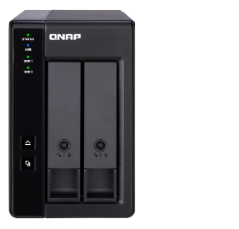
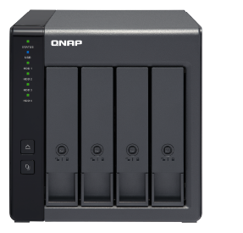
Efficient and economical, flexible expansion of storage space
The TR-002/004 and TR-004U are the best choice for you to expand your Guardian storage space. The USB 3.2 Gen1 Type-C transmission interface makes storage and backup tasks smoother!
USB 3.2 Gen1
USB 3.2 Gen1
USB 3.2 Gen1
TR-002
RAID enclosure
TR-004
RAID enclosure
TR-004U
RAID enclosure
Notes:
The TR-002/004 and TR-004U are your top options to expand your Guardian storage space. With the USB 3.2 Gen1 Type-C transmission interface, storage and backup tasks become much smoother.
You'll benefit from various features like iSCSI initiator, VJBOD, USB JBOD (3.0, 3.1), USB External RAID Device, External Storage Device (USB Disk), HybridMount, and VJBOD Cloud.
Additionally, we offer Thunderbolt JBOD, SAS JBOD, and TL SATA JBOD for your convenience.
下面別看
iSCSI initiator, VJBOD, USB JBOD (3.0, 3.1), USB External RAID Device, External Storage Device (USB Disk), HybridMount, VJBOD Cloud. Thunderbolt JBOD, SAS JBOD, TL SATA JBOD

Slide 15
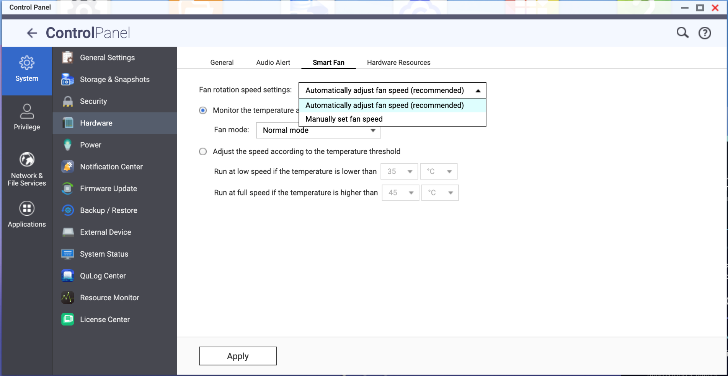
High quality hardware components
Smart fan
Support automatic and manual adjustment of fan speed, effectively improve the hardware cooling capacity of the mechanism
Notes:
In our Guardian series, we've incorporated smart fan control into the hardware design. Users have the option to let the system automatically adjust fan speeds based on system temperature, or they can manually set fan speeds to their preference.

Slide 16
Metal body for efficient heat dissipation and anti-interference
With metal body design, the thermal conductivity is better, the heat dissipation is more outstanding, and the electromagnetic interference can be effectively shielded to ensure long-term stable operation, which provides a strong guarantee for the efficient and stable operation of the overall network.
Notes:
The entire QGD Guardian series features a metal chassis design. This not only enhances thermal conductivity and heat dissipation but also effectively shields electromagnetic interference, ensuring long-term stability. This design is a strong guarantee for the overall network's efficient and stable operation.

Slide 17
Software Advantages
Guardian's unique strengths and features

Slide 18
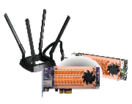
QGD-1600/1602 software architecture
Support remote storage, cloud storage via VJBOD Cloud or HybridMount
QTS Operating System
Docker Service
Cloud manager
QVR Pro
Cloud agent
CentOS
SMB / NFS / AFP / FTP / RTRR / iSCSI
VJBOD
MySQL
Ubuntu
Mobile apps and utilities
App Center
Container Station
VM Service
Storage management
VM management
(KVM)
RouterOS
AP Controller
QTS
App Center
device management
Object-based Storage
File-based Storage
Guardian Network Switch Manager
Linux Host
SIP Server
Network & Virtual Switch
RAID expansion enclosure
Virtualization Station
External devices
Network & Virtual Switch
Physical Switch
Virtual Switch
Notes:
After introducing the hardware features, let's explore how QNAP Guardian brings innovative software applications to users.
As you can see in this illustration, the most prominent feature is our Guardian Smart Edge Switch, which is equipped with the QTS operating system. We've virtualized the switch system within the QTS OS, simplifying your operations through a single interface.
With QTS capabilities, you can harness a wide range of rich applications available on NAS, including comprehensive storage, backup, snapshots, and more. You can also access a plethora of applications through the App Center, such as QVR, and further expand your functionality by installing PCIe extension cards. This allows you to add various features like external JBOD or Wi-Fi access points, enhancing the versatility of your network.

Slide 19
L2 Network Management Advantages
Guardian's unique strengths and features

Slide 20
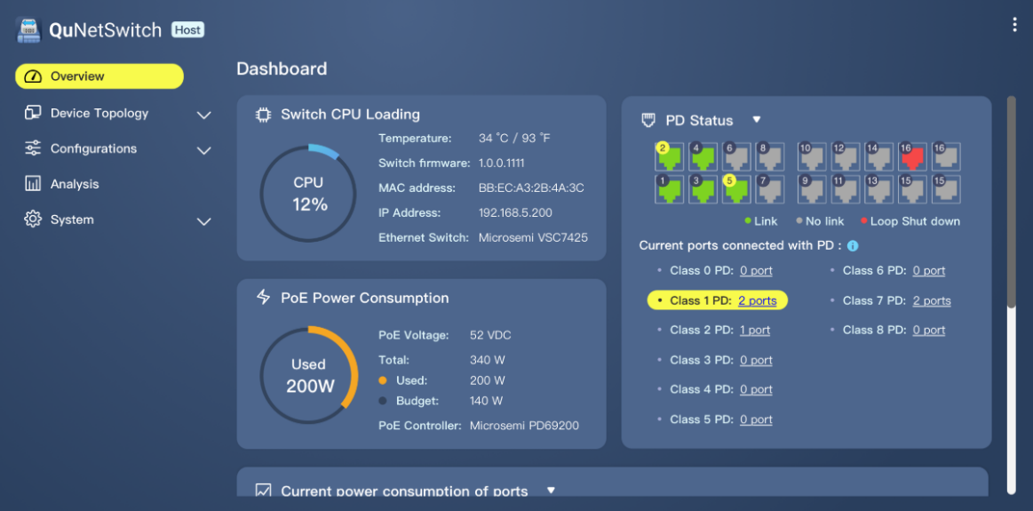
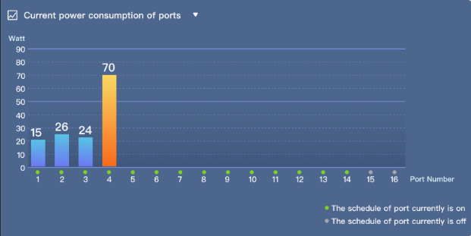
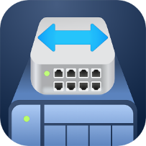
QuNetSwitch's friendly and intuitive graphical management user interface
Guardian provides an intuitive and friendly web management interface that allows users to easily perform device monitoring, configuration, firmware updates, and advanced network management functions.
Notes:
QGD Guardian offers advanced switch functionality with QuNetSwitch. It comes with an intuitive, user-friendly web management interface that empowers users to effortlessly monitor devices, configure settings, perform firmware updates, and access advanced network management functions.

Slide 21
Complete Layer 2 network management function
IGMP Snooping
VLAN
Optimizing multicast performance helps in-line media streaming, VoIP and other bandwidth-intensive applications that are sensitive to time delays.
Enhance network security by isolating traffic within the enterprise based on requirements such as administrators, general users, employees, or visitors.
Link Aggregation (LACP)
Quality of Service
Combine two physical lines to form a high-speed virtual data transmission path, increase transmission speed, and enhance network connection reliability.
Different network usage priorities can be configured according to the port or VLAN group to ensure the quality of service and optimize network transmission efficiency.

Slide 22
Complete Layer 2 network management function
Access-Control List (ACL)
Loop detection and protection
Support for access control mechanisms, you can set multiple access rules, specify specific protocols, IP addresses, subnet masks, and port access conditions.
When the network generates a loop, the network that generates the loop will be closed, effectively avoiding network interruption.
Port Mirroring
Jumbo frame
Allows network administrators to capture data (packets) for specific ports to monitor the network or troubleshoot.
Support Jumbo fram huge packet selection, which helps improve overall data transmission efficiency.

Slide 23
QTS Applications
Guardian's unique strengths and features
Notes:
Now, let's take a look at the applications of Guardian when combined with QTS,

Slide 24
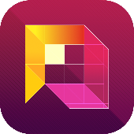
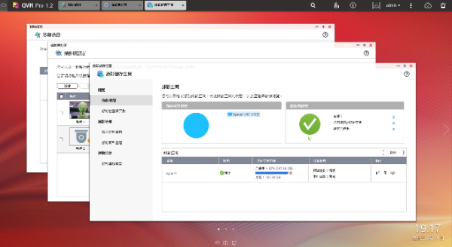
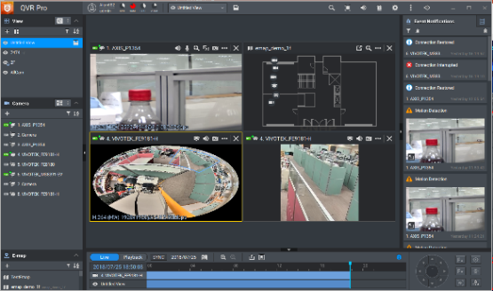
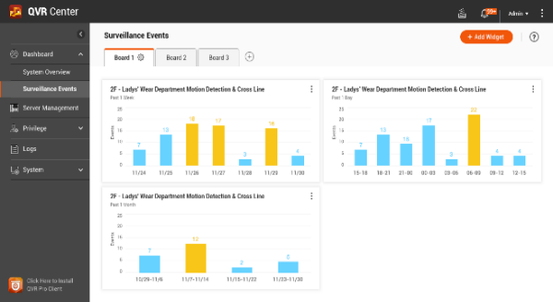
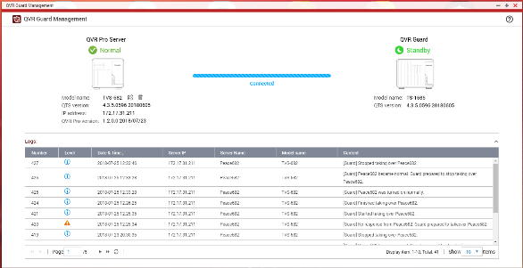
Guardian X QVR Pro complete solution
QVR Pro
QVR Pro Client
QVR Center
QVR Guard
Notes:
Let's start from QVR as an example.

Slide 25
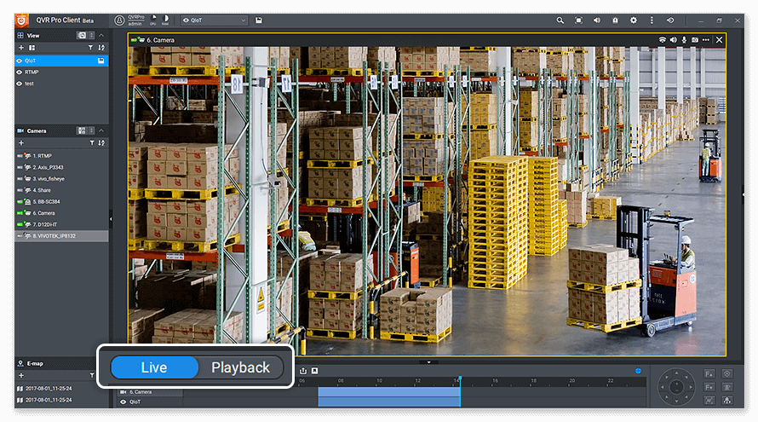
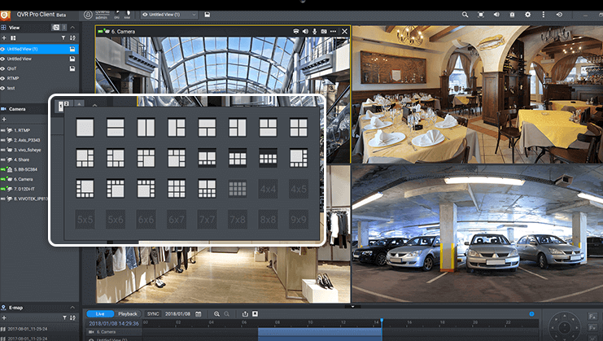
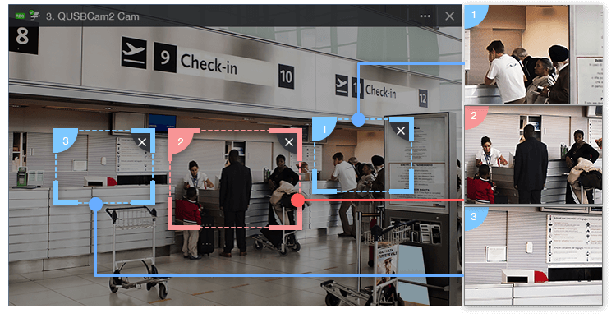
Guardian X QVR Pro complete solution
Instant Playback
Dynamic Layout
Region of Interest
Monitor the live view of multiple channels and play recordings on a single interface. With just one click you can switch between live, individual playback and sync playback modes. You can also view recordings at a specific time by clicking the time line or by selecting a time range.
The QVR Pro Client provides a highly-customizable display panel. You can change each channel’s display ratio, arrange the display, or use the built-in display module to fulfill your surveillance needs.
The updated Region of Interest (ROI) feature supports multiple regional images from the same camera in live view and playback mode. You can define and enlarge multiple areas on the overview image with no selection limitations or additional licenses required.
Notes:
Instant Playback:
Let's start with the Instant Playback feature. This allows you to monitor the live view of multiple channels and play recordings, all from a single interface. With a single click, you can seamlessly switch between live view, individual playback, and sync playback modes. You also have the flexibility to access recordings at specific times by simply clicking on the timeline or selecting a time range.
Dynamic Layout:
Now, let's talk about the Dynamic Layout feature. The QVR Pro Client offers a highly customizable display panel. You can adjust the display ratio for each channel, arrange the layout to your preference, or utilize the built-in display module to tailor your surveillance display to meet your exact needs.
Region of Interest (ROI):
Lastly, we have the updated Region of Interest (ROI) feature. This feature supports multiple regional images from the same camera in both live view and playback mode. You can define and zoom in on multiple areas in the overview image without any selection limitations or the need for additional licenses. It offers you great flexibility for your surveillance needs.

Slide 26
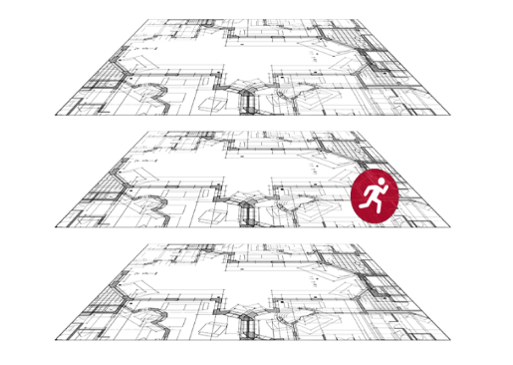
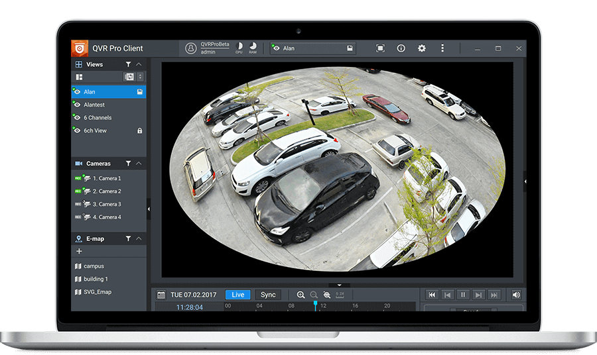
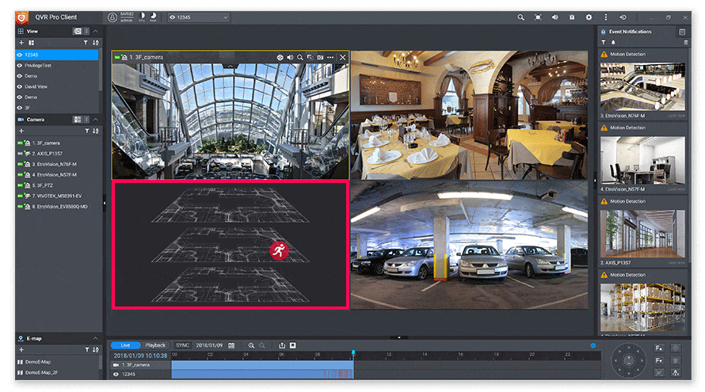
Guardian X QVR Pro complete solution
Qdewarp Technology
E-map
Multiple Notification Methods
The innovative Qdewarp enables users to view standard fisheye camera recordings in proportional ratios and sizes without affecting original recordings. The distorted parts on the edges can be turned into a clear panoramic view.
If an event occurs, you can quickly know the camera’s location on the e-map to ensure a timely response.
The event notification provides multiple ways of being informed of emerging events, including flashing red borders of channels, alert buzzers, and the motion icon on the e-map.

Slide 27
Run virtual machines and containers, one machine and multiple systems
Virtualization Station and Container Station lead a full range of hybrid virtual application solutions. Regardless of your needs, you can rely on QNAP's complete virtualization application support. Choosing the right deployment strategy for your virtualization needs can be easy!
Virtualization Station
Container Station
Notes:
Virtualization Station enables you to run multiple Windows®, Linux®, UNIX®, and Android™ virtual machines (VMs) on the QGD-1600P. You can manage these VMs through a browser or Virtual Network Computing (VNC) connections. Enterprise organizations can leverage multiple VMs on the NAS to run various server applications.
Container Station seamlessly integrates both LXC and Docker® lightweight technologies. You can easily download thousands of applications from the Docker Hub® global repository, import/export software containers, and configure access rights. This offers easy installation, portability, and efficiency, providing numerous advantages.
Virtualization Station 可讓您在 QGD-1600P上運行多個 Windows®、Linux®、UNIX® 及 Android™ 虛擬機 (Virtual Machine)，並透過瀏覽器或 Virtual Network Computing (VNC) 連線管理虛擬機。企業組織可利用 NAS 上的多個虛擬機執行不同的伺服器應用。 Container Station 整合 LXC 與 Docker® 兩項輕量級技術。您可在 Docker Hub® 線上市集下載來自全球各地數以千計的應用程式，輕鬆匯入/匯出軟體容器與設定存取權，享有安裝簡便，可移動、有效率的諸多好處。

Slide 28
Guardian provides fast and convenient VM hosting and management services
Traditional NAS + Switch
Guardian Solution
RouterOS
VM
VM
RouterOS
VM
VM
Virtualization Station
Guardian vSwitch Mode VM Installer
Virtual Switch
Virtual Switch
NIC
NIC
WAN
LAN
Internet
LAN Networking Devices
Internet
LAN Networking Devices
Notes:
The Guardian all-in-one device can significantly reduce both manpower and equipment costs in IT setup. Previously, achieving the configuration required a combination of NAS, a switch, and NIC, but now you can achieve the same with just one Guardian device.

Slide 29
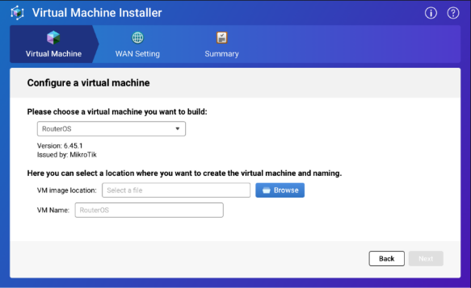
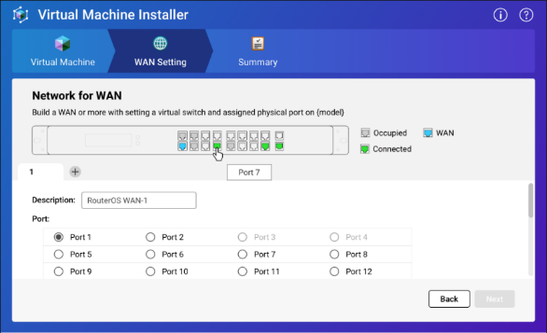
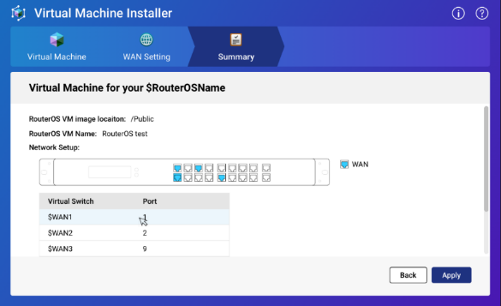
Support VM Installer for quick and easy VM software setup
Simple installation in three steps, saving a lot of setup troubles.
1
Select the VM service you want to install
2
Set the corresponding WAN Port
3
Finish the settings

Slide 30
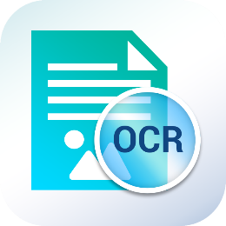
Double your productivity output
Access files on External Devices
Full-text Search
File Digitalization
Smart Filing
File Station
Use File Station to directly access files on USB devices - including optical disc drives. Files from USB devices can be easily backed up to the QGD.
Qsirch
Qsirch supports keyword search for finding images, music, videos, documents, and emails, making it easier than ever to locate files.
OCR Converter
OCR Converter extracts text from images, helping to facilitate file organization, editing, and searching.
Qfiling
Qfiling automates file organization. Files are automatically archived into folders based on your settings.

Slide 31
QTS / Guardian storage
VJBOD Cloud
Block based Cloud Gateway
Cloud Storage
Customer
File System
Ethernet
iSCSI
Target
VJBOD Cloud LUNs
LUN Size Provisioning
Dedicate
Stored space
Object
Storage
Connector
Object Storage
Object Storage
Object Storage
Fibre Channel
Block Access
Local
Applications
VJBOD Cloud
Volume (EXT4 File System)
Dedicate
Stored space
Object
Storage
Connector
Local Servers
File Access
File Services
SMB
HybridMount (Mode 1)
File based Cloud Gateway
NFS
File Access
Dedicate
Cache Volume
Cloud File
Storage
Cloud File
Storage
Cloud File
Storage
AFP
Virtual
File System
Object
Storage
Connector
Local Users
File Access
FTP
Dedicate
Cache Volume
Cache Engine
Cloud
File
Connector
Web
DAV
Local Disks/SSDs
Remote Storage
Qsync
HybridMount (Mode 2)
File Station Mount
WebDAV
Cloud
Connector
File
Station
File Station Access
SMB
NAS
File Access
File Access
Remote
File
Connector
Qfile
FTP
Data center

Slide 32
Local data cloud backup solution
Cloud object
storage space
APP Center
QNAP's VJBOD Cloud feature is a block-based Gateway block cloud gateway.
The VJBOD Cloud Gateway allows users to easily connect to the cloud's storage and convert it to disk on the local side.
Enterprise IT staff or general users can use the more familiar file access protocol (NFS, SMB, AFP, FTP, WebDAV) for access.
Storage & Snapshots
Snapshot
SMB
NFS
AFP
FTP
Client
WebDAV
Storage Space
Cloud Volume
(ext4 file system)/Shared Folder
Notes:
Guardian also offers on-site to cloud data backup functionality. QNAP's VJBOD Cloud feature acts as a block-based gateway to the cloud.
The VJBOD Cloud Gateway enables users to seamlessly connect to cloud storage and convert it into local disk storage. Both enterprise IT professionals and general users can access it using familiar file access protocols like NFS, SMB, AFP, FTP, and WebDAV.

Slide 33
HybridMount with 2 modes for data usage
 | Cloud Drive Mount | Network Drive Mount
Setup Method | Mount cloud drives | Choose ”File Cloud Gateway” mode and create a cache space
Connections | 2 life-time free connections Buy license for more connections No limit | No limit
Accessing Performance | Depends on network speed | High performance due to the cache space
Access in File Station | Supported | Supported
Access in SMB / NFS / AFP | NOT Supported | Supported
Sync with Cloud | Sync only when browsing | NOT Supported
Support QTS application | NOT Supported | Supported ...

Slide 34
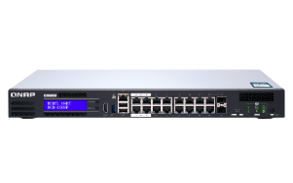
Synchronization and co-management of global multi-site office files
With a cloud space, it can be accessed all over the world and achieve file synchronization. Collect data from global locations and freely expand space.
Configure Guardian as a file-based cloud gateway at each point office.
Taipei
Tokyo
New York
Easy and efficient access to the cloud by office users
Support access protocol
local cache allows access to cloud files as if it were a local experience
Eliminate the traditional VPN time-consuming and laborious access method

Slide 35
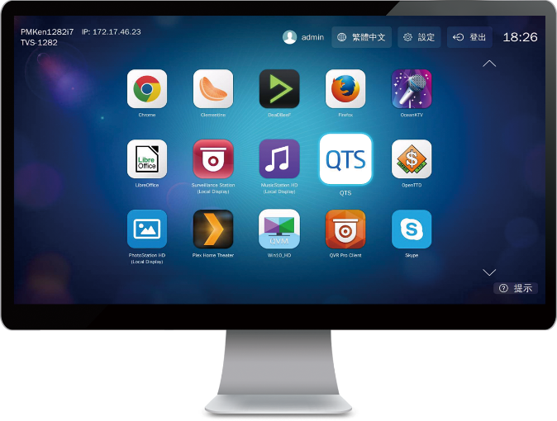
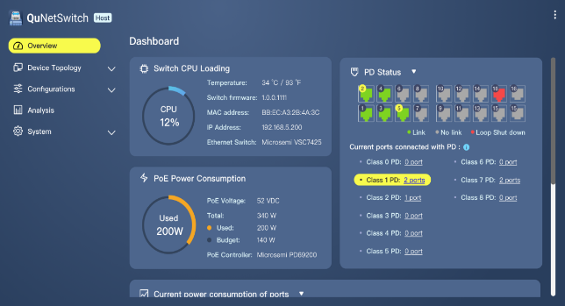
QNAP QvPC innovation technology
With QNAP's exclusive QvPC technology (QNAP virtualized Personal Computer Technology), you can connect your Guardian to a keyboard, mouse, and connect to the monitor via HDMI to use the Guardian switch as a PC.
Connect the mouse keyboard,
Guardian Switch can also be used as a PC

Slide 36
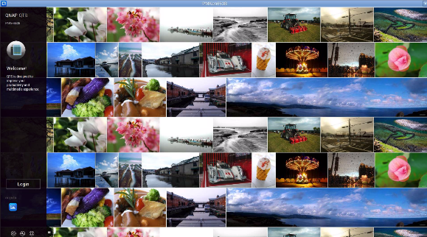
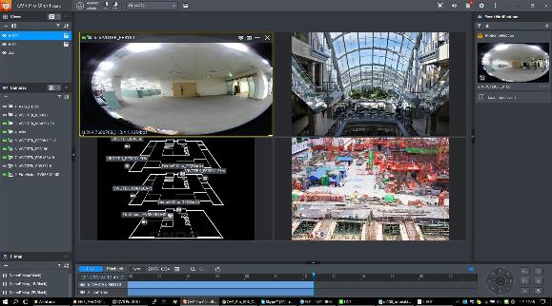
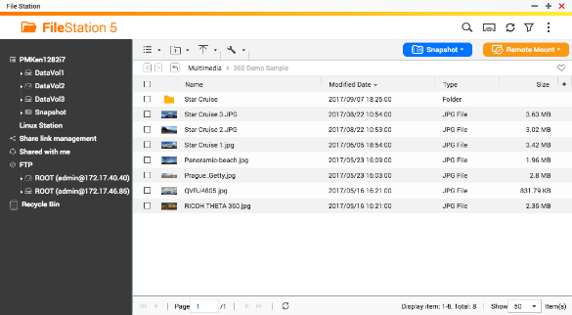
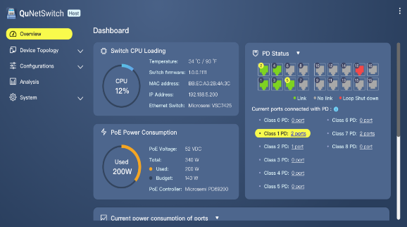
HD Station rich application
A variety of web apps let you get started quickly.
QTS
QVR Pro Client
QVR Pro Client can also view monitoring screens directly
File Station
QuNetSwitch
Note: QGD-1602 doesn’t have an HDMI output port; therefore, only QGD-1600 supports HD station.

Slide 37
ADRA NDR
Guardian's unique strengths and features

Slide 38
ADRA NDR
Global
Global
Global
Global
ADRA NDR for Global 1 Year Subscription
ADRA NDR for Global 3 Years Subscription
USD $399.00 /Year
USD $1,099.00 /3Year
Adaptive
Threat Detection
Threat Watch
Threat Trap
Real-time Threat Analysis
Correlation Analysis
Deep Threat Analysis
Isolation
Response
Access Switch
Isolate Victims/Zone
Risk Management
Note: After upgrading to ADRA NDR O.S., the QGD switch cannot run QTS NAS OS and VMs.
Notes:
Next, let's explore another software feature - "ADRA NDR."
What is NDR?
Network Detection and Response (NDR) is a security tool that monitors an enterprise's network traffic to gain visibility into potential cyber threats. NDR relies on advanced capabilities like behavioral analytics, machine learning, and artificial intelligence to uncover threats and suspicious activities.
QNAP's ADRA NDR offers powerful features such as Adaptive Threat Detection, Real-time Threat Analysis, and Isolation Response, assisting users in early detection of potential intranet threats.
ADRA NDR is available as a subscription service, with two options on our official website: $399 per year and $1099 per year.
It's important to note that ADRA NDR and QTS system are two separate operating systems. After upgrading to ADRA NDR software, the QGD switch cannot run the QTS OS and VMs

Slide 39
ADRA NDR key features
Near-Zero configuration
Deploy without changing network infrastructure
Line-rate performance (VMs/NAS/Server farm)
Transparent & Adaptive detection
Automated correlations and analysis
Automated Isolation
Notes:
Non-disruptive to network architecture, quick installation.
Maintains high efficiency without compromising transmission performance.
Can be deployed before servers or VM farms.
Transparent scanning, attackers remain undetected.
Fast screening detection, flexible deployment options and detection techniques.
Immediate blocking, enabling computer isolation and instant recovery.
不傷網路架構，快速安裝
保持高效，不因偵測而拉低傳輸效能
可建置於伺服器或VM Farm之前
透明掃描，攻擊者無法察覺
快篩偵測，佈署位置與偵測技術
即刻阻止，可以隔離電腦併即刻還原

Slide 40
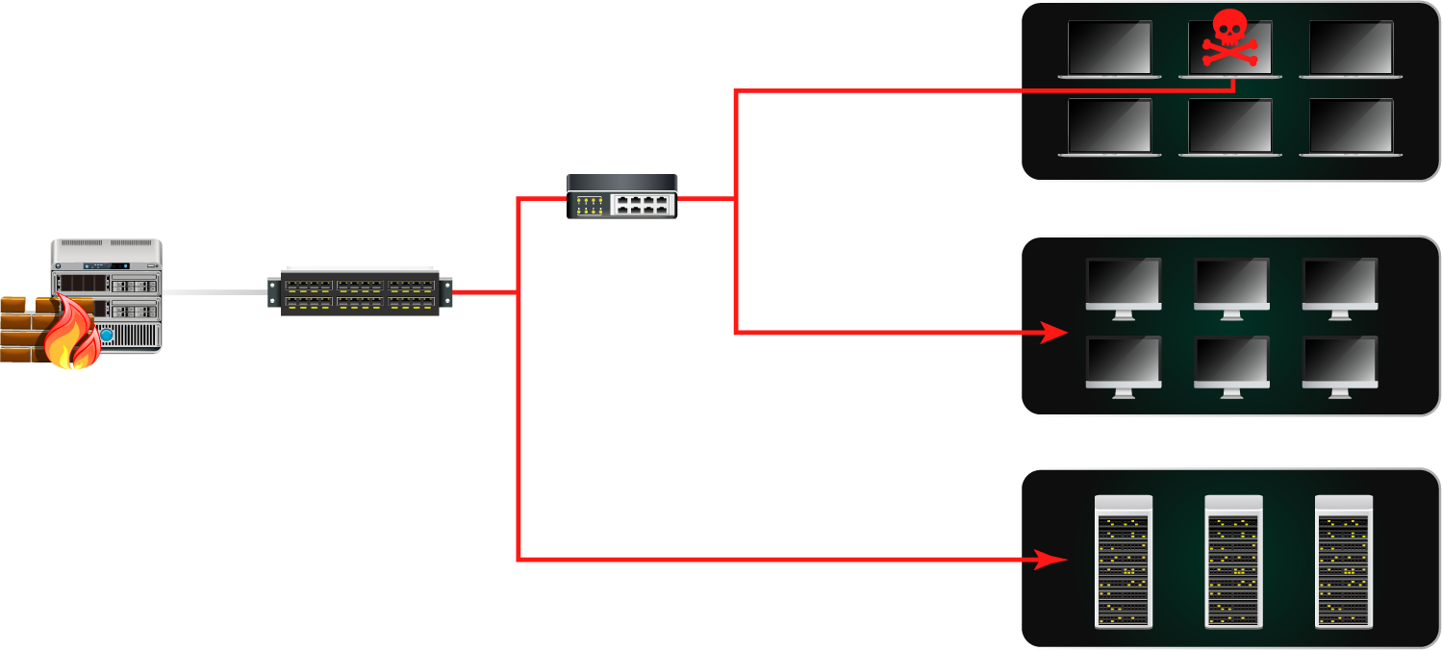
Firewall + ADRA
complete the secure network from internet to intranet
Office Automation
Distribution
Switch
Next Generation Firewall
Core
Switch
Production Lines
Server Farm
Notes:
Typically, NG Firewalls are primarily designed to protect against external threats. However, when combined with the features of ADRA NDR, IT administrators can swiftly identify suspicious activities within the intranet. For example, if a client PC gets infected and starts scanning IP addresses within the domain for potential attacks, Guardian equipped with ADRA can intercept and take appropriate actions, such as blocking the IP responsible.

Slide 41
Suspicious network activities detectable by ADRA NDR
Type | Threat behaviors
Scan | Device/network scanning TCP/UDP/ICMP/ARP scanning
Abnormal operation | Network flooding TCP flag attacking Unknown domain request Credential phishing
Vulnerability | CVE vulnerabilities relate zero day attack MS MAPP relate zero day attack Patch Tuesday relate zero day attack
Malware/Ransomware suspicious operation* | C&C call back Exploit-kit detect Network spoof DDoS
Note: ADRA is designed to detect the behaviors generated by malware/ransomware, rather than analyzing the content of files or performing decryption for analysis.

Slide 42
QGD family selection for ADRA NDR
Model series | Recommended max. number of detection devices | Recommended max. number of high-bandwidth detection devices | Recommended max. number of Threat Traps
QGD-1600P Series | 1-50 | 1-10 | 1-2
QGD-1602P-C3558-8G | 51-80 | 11-30 | 3-6
QGD-1602P-C3758-16G | 81-110 | 31-60 | 6-8
QGD-1600 Series | 1-50 | 1-10 | 1-2
QGD-1602-C3558-8G | 51-80 | 11-30 | 3-6
QGD-1602-C3758-16G | 81-110 | 31-60 | 6-8
Note: Choose the right model based on your number of detection edge devices and Threat Traps.

Slide 43
Guardian smart edge switches
Best Solution for ADRA
Guardian
QGD-1600
QGD-1602
Layer 2
Management
QTS
NAS O.S.
VM / Container supported
QVR Pro
Surveillance solution

Slide 44
Multi-purpose for one machine: Guardian's practical application in various environmental architectures

Slide 45
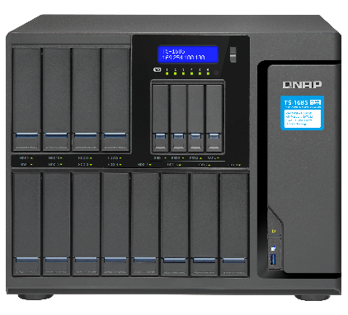
Guardian X QVR Pro User deployment diagram
TS-1685
ISP
internet
TS-1685
ISP
internet
VJBOD
HDMI
USB 3.0
TR-002 / TR-004
RAID expansion enclosure

Slide 46
Guardian commercial wireless AP Integrated Solution
Traditional Deployment
Guardian Solution
UniFi Cloud Key
UAP-AC-PRO
UAP-AC-LR
UAP-AC-M
UAP-AC-PRO
UAP-AC-LR
UAP-AC-M
Advantages
One machine covers all features, saving a lot of space
Highly expandable capabilities to meet future growth needs
Integrated solution
myQNAPcloud
UniFi
Controller
pfSense
(DHCP Server)
US-16-150W
LAN
USG-PRO-4
WAN
Guardian Smart Switch
Remote Access to UniFi Controller
Remote Access to UniFi Controller
Hybrid Cloud
Internet
Notes:
https://fccid.io/SWX-UAPACM/User-Manual/User-Manual-3092355
https://www.amazon.com/Ubiquiti-Unifi-Security-Gateway-USG-PRO-4/dp/B019PBEI5W
US-16-150W 279USD
Cloud Key 195USD
USG-Pro-4 287USD

Slide 47
Guardian X RouterOS X QWA-AC2600 network solution
Support for installing RouterOS, OpenWrt
VPN encryption transmission can be established at each office
Share the wireless network to the device with the QWA-2600AC wireless network card
WiFi
NAS
Device
Access Control
IP CAM
IoT
IP CAM
LAN
LAN
QWA-AC2600
HQ QGD with RouterOS
Branch QGD with RouterOS
WAN1
Internet
WAN2
Internet
WAN3
VPN Tunnel

Slide 48
Guardian X pfSense solution
QGD-1600/1602 supports the installation of pfSense firewall software on virtual machines to effectively block external network intrusion threats. In addition, for enterprise intranets, protection and blocking can be implemented according to requirements, which can effectively improve the information security of devices in each intranet.
Office A
Office B

Slide 49
Traditional IP Phone setup without QGD switches
Traditional VoIP Phone Deployment
Internet
Internet
IP PBX
IP PBX
Location B
Location C
Internet
IP PBX
PSTN
Router
Location A
Voice Gateway
Voice Gateway
Notes:
http://www.sipnet.com.tw/voip-sip/fxs-fxo.htm

Slide 50
Guardian brings next-gen IP Phone integrated solution
Guardian solution
Internet
Internet
IP PBX
IP PBX
Location B
Location C
Router
Internet
Location A
Voice Gateway
PSTN
Voice Gateway

Slide 51
Guardian’s diverse use scenes

Slide 52
Chain store solution
Install a Guardian switch at each branch to create a complete solution and back up the data to headquarters through remote storage.

Slide 53
Create a one-machine surveillance solution
Live Demo
TS-1655
ISP
internet
VJBOD
ISP
internet
Description：
Soft routing software installed on a virtual machine
Install QVR Pro
Expand your storage with VJBOD & USB RAID
With QWA-2600AC network card, support more devices wireless networking
TS-1685
QWA-AC2600
HDMI
USB 3.0
TR-002 / TR-004
RAID expansion enclosure

Slide 54
Guardian Smart Edge Switch
Different from the traditional exchangers on the market, you have a better choice!

Slide 55
Guardian Smart Edge Switch： four benefits of all-in-one integrated solution
1
2
3
4
Reduce costs
No need to buy a variety of different equipment, a single device can meet the needs of use; and save the cost of AC power, power lines, plugs and other materials.
Reduce learning costs
A single centralized management interface that saves you the cost of learning familiar with the operation of different devices.
Reduce maintenance costs
Provide you with a safer and more secure enterprise solution, no need to worry about the risk of single equipment damage, and effectively reduce the cost of subsequent maintenance.
High expandability
Highly flexible functional design to effectively meet the needs of the company's future growth environment.

Slide 56
LIVE DEMO

Slide 57
Innovative Hybrid managed switch
+ NAS/NDR combo solution
Notes:
QGD-1600 and QGD- 1602 is your best choice of your it infrastructure.
Thanks four your watching, I’m Alex Shh,
See you next time, bye bye!

