Slide 1
Notes:
Hello, I'm Chris Chang, Product Manager at QNAP, and today I'd like to introduce you to the new Dual-Port 10GbE SFP+ Intel710 Network Expansion Card.

Slide 2
10GbE Network, the Standard for High Productivity
10GbE Connectivity: The Future is Now!
QNAP has a complete 10GbE product architecture to help you easily upgrade to a high-speed environment!!!
The high specification 10GbE network is no longer just for enterprises. It's also a must have for professional audiovisual content creators. With 10GbE bandwidth, SOHO studios can maintain smooth operations and break through the efficiency barrier. Whether it's for mult-user collaboration, multimedia transfer and streaming, 4K/8K video editing and rendering, or online video editing and post-production.
10 GbE Network Solutions
Internet
QNAP 10 GbE Switch
Transferring an hour of 4K video with a file size of approximately 300GB takes about 50 minutes on a previous 1GbE network, but upgrading to a 10GbE network takes about 5 minutes to complete the same task – 10 times faster! This dramatically reduces waiting time and increases efficiency in a work environment where every second counts. A 10GbE network can be said to be the standard for high productivity!!!
10 GbE NAS Solutions
iMac / Macbook / Laptop / PC / Workstation Solutions
iMac
10 GbE Card
Built-in 10 GbE NAS
Thunderbolt to 10 GbE (RJ45)
Macbook / Laptop
10 GbE Ready NAS
QM2 Card
Thunderbolt to 10 GbE (SPF+)
PC / Workstation
Notes:
No longer reserved for large enterprises, 10GbE is now a must-have for professional audiovisual creators. 10GbE provides the speed and bandwidth needed for SOHO studios, multimedia streaming, 4K/8K video editing, and online video post-production to run smoothly and dramatically reduce the time needed to complete the same transfer tasks.

Slide 3
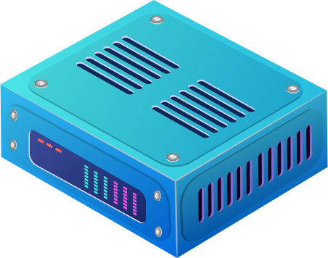
Virtual Machine (VM) Offers Multiple Advantages for Developers & Users
A must-have upgrade for program developers and technology enthusiasts!
VM provides a wide range of technical support for development. Application developers can use VM to create and manage development and test environments. These environments allow developers to run and test applications on different OS, ensuring cross-platform compatibility. For technology enthusiasts, VM can be used to create virtual desktop environments to run different OS, or to isolate different applications in separate virtual environments for increased security and stability. QXG-10G2SF-X710 provides a variety of VM-related features, including iSCSI, SR-IOV, etc., to increase your efficiency when using VM. If you are using VM, don't miss this opportunity to upgrade; if you are planning to use VM, QXG-10G2SF-X710 is the best way to get started with VM applications.
Virtual Machines
Virtual Machines
Virtual Machines
App
App
App
App
App
App
App
App
App
App 01
App 02
App 03
OS
OS
OS
OS
OS
OS
OS
OS
OS
Bins / Libs
Bins / Libs
Bins / Libs
VM
Guest OS
Guest OS
Guest OS
Virtualization Server
Virtualization Server
Virtualization Server
Hypervisor
Host OS
Physical Server 1
Physical Server 2
Physical Server N
Server
Shared Storage
Source: Microsoft Azure
圖片來源: Microsoft Azure
Notes:
As technology continues to evolve rapidly, virtual machines have become a must-have for both developers and technology enthusiasts. Virtual machines provide a wide range of development support, such as the creation and management of development environments, allowing application developers to test application compatibility on different operating systems, and for technology enthusiasts to create multiple virtual desktop environments that can be run on different systems while ensuring security and stability. QNAP's new QXG-10G2SF-X710 supports a wide range of VM performance enhancement features. If you are a VM user or plan to use it in the future, QXG-10G2SF-X710 is a must-have for you.

Slide 4
Specifications
2-port Intel 10GbE SFP+ NIC,
Easily build high-speed intranets
Notes:
At this part, I’ll introduce the specification of this card.

Slide 5
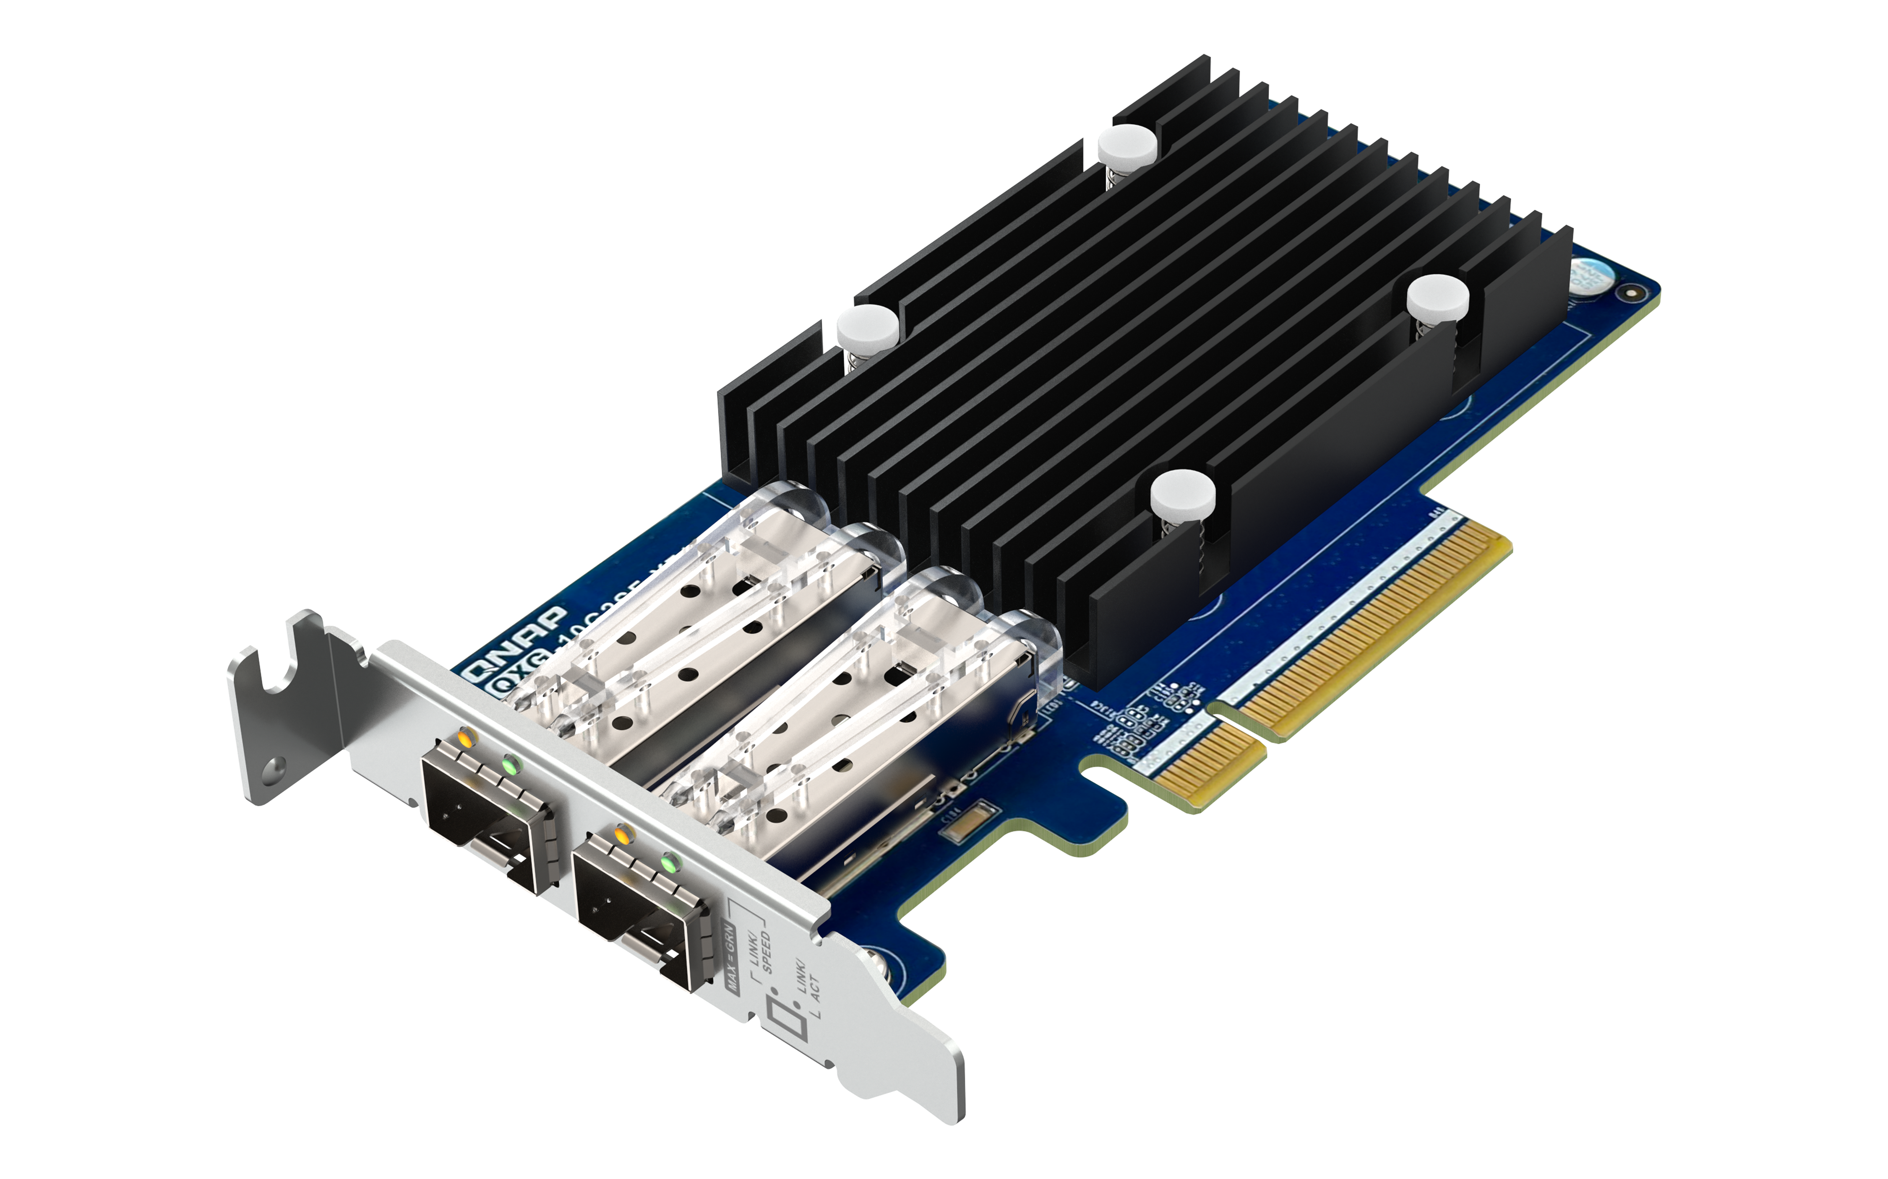
QNAP 2-port 10GbE SFP+ Network Card QXG-10G2SF-X710
Dual-Port 10GbE SFP+
Half-Height Network Card
2 x SFP+ 10GbE Ports
10G/1G Dual-Speed
Support iSCSI
Support SR-IOV
Intel® Ethernet
Controller X710-BM2
QXG-10G2SF-X710
Notes:
QXG-10G2SF-X710 is a dual-port 10GbE SFP+ half-height NIC that supports 10G/1G network transfer speeds and utilizes an Intel X710-BM2 network controller that supports iSCSI and SR-IOV.

Slide 6
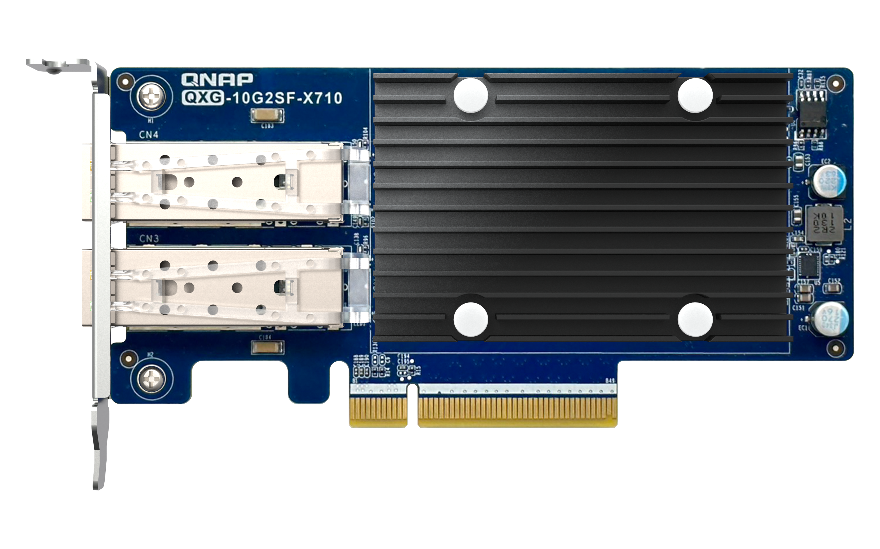
QXG-10G2SF-X710 External Configuration
Chip Cooling Module: Maximum contact area with high quality heat sink, achieve the best heat dissipation effect
2 x SFP+ 10GbE
Ports
PCI Express 3.0 x8 bus (backward support for PCI Express 2.0)
The interface provides up to 64Gbits/s bandwidth
Notes:
Next is the configuration of the card. On the left are the two 10GbE SFP+ fiber ports, and on the right are the card's chip cooling module and PCIe interface. The chip cooling module uses the largest contact area and high quality heat sinks to ensure optimal chip operation, while the PCIe interface is a third-generation x8 that provides up to 64Gbps bandwidth and backward support for second-generation interface.

Slide 7
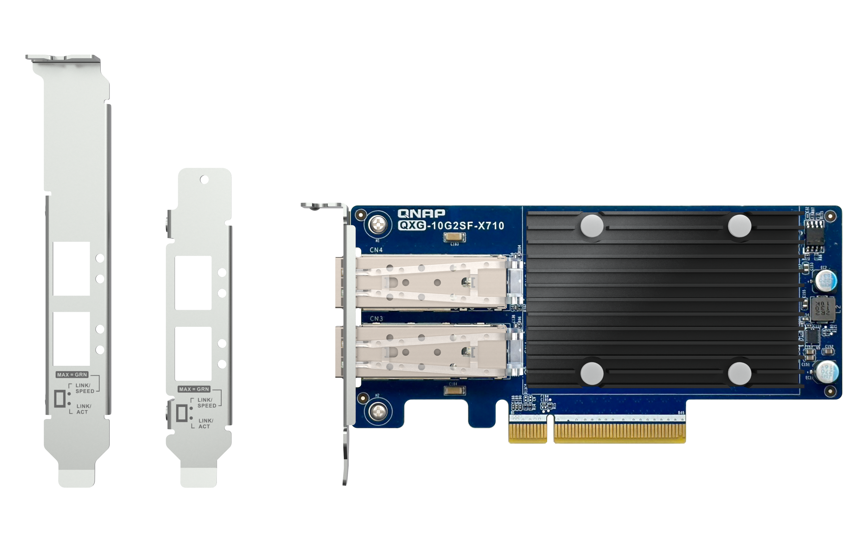
QXG-10G2SF-X710 with Various Brackets for Installation in any Kind of NAS and PC/Server Chasis
Bracket for certain QNAP NAS models
Pre-installed half-height low-profile bracket
Full-height bracket is included
Notes:
The QXG-10G2SF-X710 features a low-profile design with a pre-installed half-height bracket, and comes with a full-height bracket and a QNAP-specific bracket, allowing you to use the card perfectly in most situations.

Slide 8
Support iSCSI for Flexible Operation
QXG-10G2SF-X710 supports iSCSI function, which allows you to use QNAP NAS as a virtual disk directly when it is connected to client device such as PC, server and VM. Clients can also partition and format virtual hard disks as if they were local hard disks. Virtual hard disks can also be used as storage expansion devices or backup destinations, giving you more virtualization flexibility.
Initiator
Target
SCSI
SCSI
iSCSI
iSCSI
TCP/IP
TCP/IP
IP Network
Notes:
With iSCSI support of QXG-10G2SF-X710, QNAP NAS can be used directly as a virtual disk drive with computers, servers, or virtual machines, allowing you to utilize it in various modes to enhance the flexibility of virtualization.

Slide 9
Advantage and Benefits of SR-IOV
Advantage
Allow you to enjoy physical network service even on a virtual machine.
Benefit
If you need real-time service, such as ticket booking, internet cash flow, audio and video services, etc. You can directly enjoy the speed of the physical NIC to reduce network latency.
Reduce host CPU consumption
Reduce network bandwidth consumption and improve network efficiency by at least 20%.
Notes:
QXG-10G2SF-X710 also supports the SR-IOV function, which can be installed on the NAS to directly allocate bandwidth resources from the physical NIC to the virtual machine via Passthrough, reducing network bandwidth loss and improving network efficiency, which also helps to reduce the CPU utilization of the Hypervisor.

Slide 10
SR-IOV Support for Improved VM Networking Performance
QXG-10G2SF-X710 supports the SR-IOV function that can be installed on the NAS to allocate the bandwidth resource from the physical NIC directly to the VM, reducing network bandwidth consumption and improving network efficiency, as well as being more stable and reducing hypervisor CPU Utilization.
Without Acceleration
SR-IOV
Application
Hardware Acceleration
，Advanced Virtual Machine Performance
Guest OS Kernel
Specific QNAP NAS models and appliances support pass-through assignment of hardware resources to VM that can dramatically increase VM performance and enhance VM application poptential.
Hypervisor Kernel
Device
No Bypass
Bypass Hypervisor Kernel
Notes:
SR-IOV offers you many advantages and benefits. For example, if you have real-time service needs, you can directly enjoy the speed of the physical NIC, reducing network latency, reducing host CPU consumption, reducing network bandwidth consumption, and increasing network efficiency by at least 20%.

Slide 11
Notes for the Use of SR-IOV
SR-IOV requires a supported host model, BIOS version, and supported network card.
SR-IOV requires minimum software versions: QTS 4.5.2, QuTS hero h4.5.2 or QVS 3.5.3.
Currently, only Linux and FreeBSD driver are available for download from the Intel® website.
www.intel.com/content/www/us/en/developer/topic-technology/open/overview.html
VM Live Migration is not available when using SR-IOV (Device Passthrough).
Because the physical device used for the original virtual machine has been dynamically migrated, the original physical device ID will not be recognized when you migrate the virtual machine to the new NAS.
Notes:
The following are notes on the use of SR-IOV: SR-IOV can only be used with a supported model, BIOS version, and supported NIC; QNAP models must have at least QTS/QuTS hero 4.5.2 or QVS 3.5.3 software version to use SR-IOV; and QNAP QAT-series models must have the corresponding virtualization driver downloaded from the Guest OS; VM Live Migration is not available when using SR-IOV.

Slide 12
QNAP Product List with SR-IOV support
Minimum BIOS Version
Q05SAR01: TS-h686, TS-h886
Q047AR03: TS-1886XU-RP, TS-h1886XU-RP
QX31AR19: TDS-16489U, TDS-16489U R2
Q09ARR07: TS-h1290FX
Q03XAR15: TS-h2490FU
Q053AR20: TDS-h2489FU
QuCPE-7010-D2123IT-8G
QuCPE-7010-D2146NT-32G
QuCPE-7010-D2166NT-64G
QuCPE Supported
Minimum BIOS Version
Q03OAR05: QGD-1602P
Q03OAR16: QGD-1602
NAS Supported
QGD Supported
More Information of SR-IOV
Notes:
Here are the various QNAP models that support the SR-IOV function. For more information, please click the hyperlinks at the bottom right.

Slide 13
QXG-10G2SF-X710
Comes with a free 3-year
product warranty
More Information: QNAP Warranty Service
QNAP-Warranty Service Official Website
https://www.qnap.com/service/product-warranty/go/
Notes:
QNAP provides QXG-10G2SF-X710 with 3-year free product warranty, for more information about warranty, please click the hyperlink below.

Slide 14
Flexible Development of 10GbE in Your Device
QTS 5.0.1 or a later updated version
QuTS hero 5.0.1 or a later updated version
Windows 11
Windows Server 2022
Ubuntu 20.04/22.04 LTS
QTS
QuTS hero
Notes:
This card supports multiple OS for easy deployment， including Windows 11/Windows Server 2022， Ubuntu 20.04/22.04, QTS 5.0.1 or later, and QuTS hero 5.0.1 or later.

Slide 15
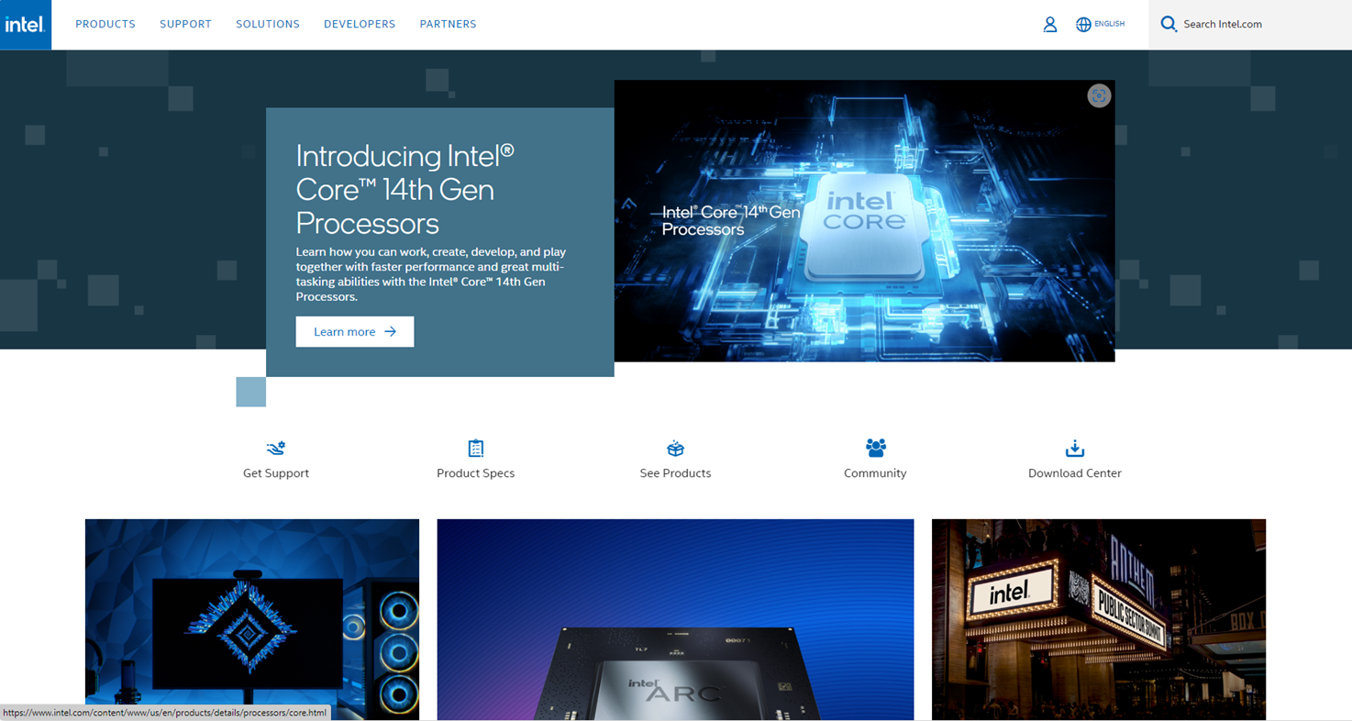
Intel Official Website NIC Driver Download
QXG-10G2SF-X710 Driver Download
Step 1: Go to Intel official website and type in "X710-BM2" at the top right.
Intel Official Website Address:
“https://www.intel.com.tw”
Notes:
Next, we will demonstrate how to download the driver from the Intel website. First, go to the website and search for X710-BM2 in the upper right corner.

Slide 16
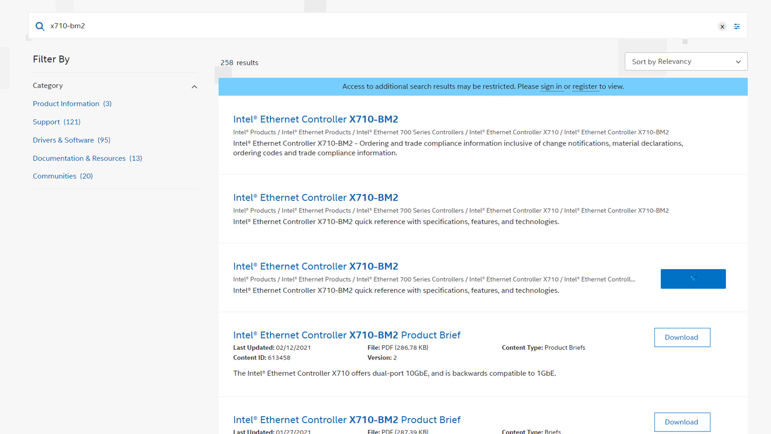
Intel Official Website NIC Driver Download
QXG-10G2SF-X710 Driver Download
Step 2: Please click "Drivers & Software" on the left side.
Notes:
Click on the Drivers and Software category on the left after seeing the search results.

Slide 17
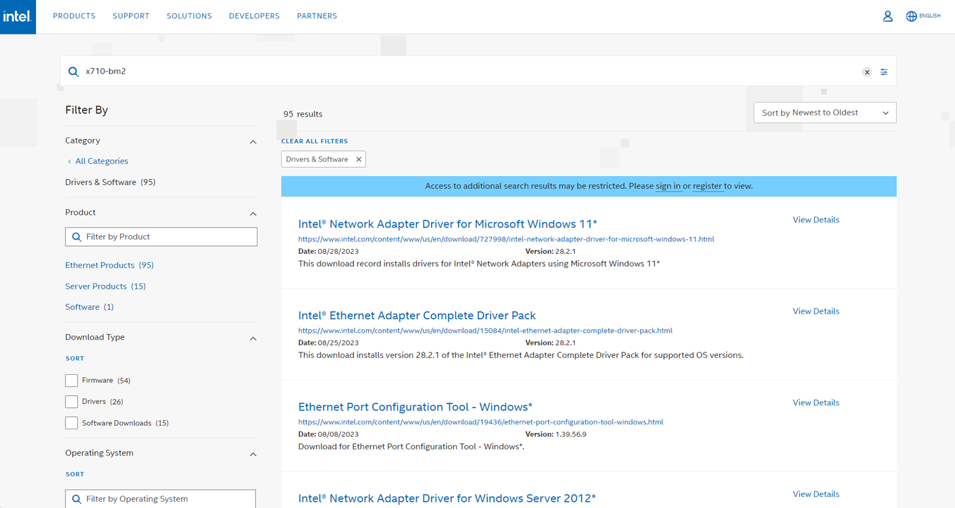
Intel Official Website NIC Driver Download
QXG-10G2SF-X710 Driver Download
Step 3: Please click "Intel® Ethernet Adapter Complete Driver Pack".
Notes:
After seeing the search results, find the NTEL Ethernet adapter complete driver pack and click on it.

Slide 18
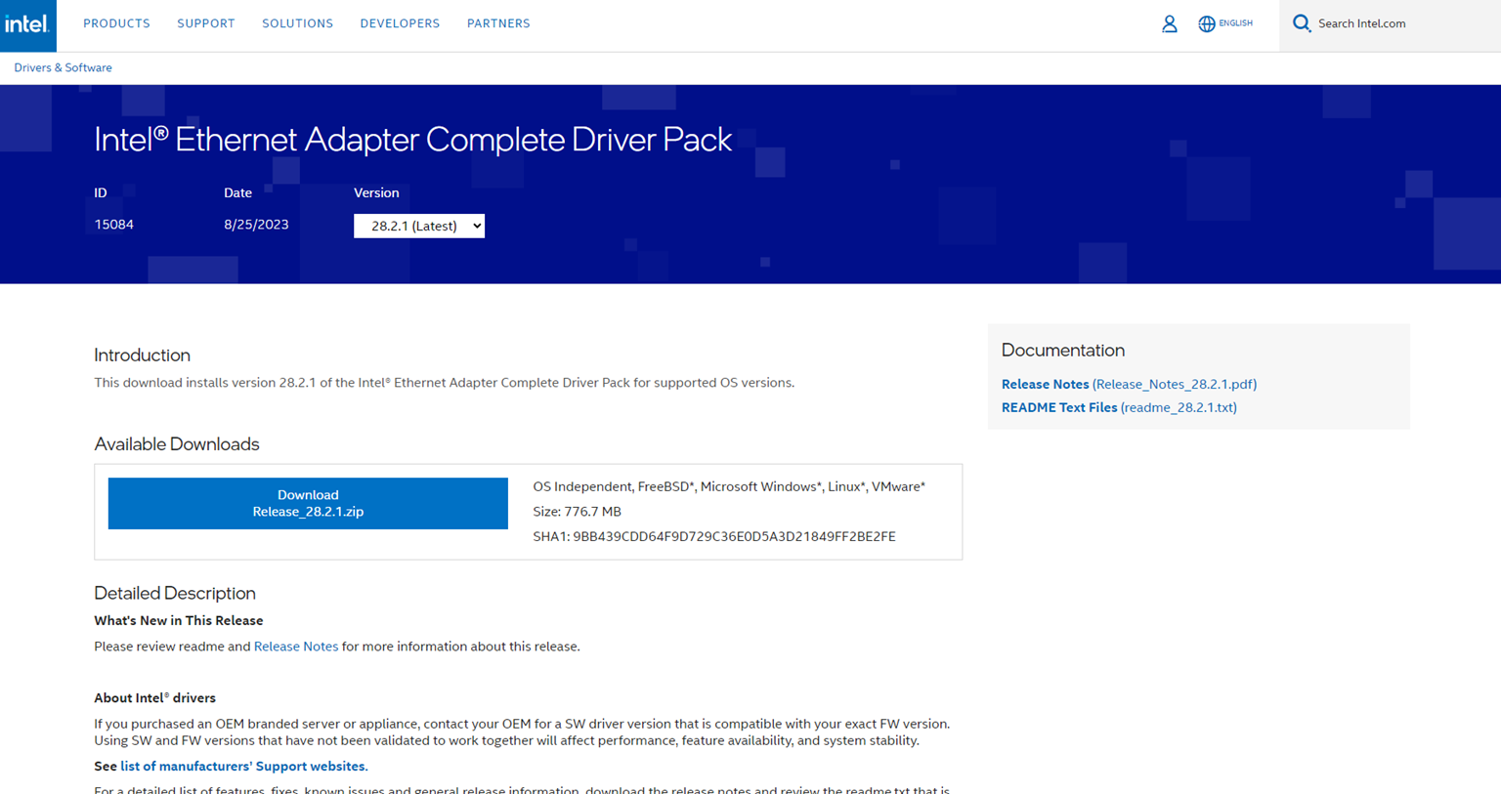
Intel Official Website NIC Driver Download
QXG-10G2SF-X710 Driver Download
Step 4: Click to download and install the driver to use QXG-10G2SF-X710 on your Windows/Windows Server/Ubuntu device.
Notes:
Click to download and install the driver to use QXG-10G2SF-X710 on your Windows/Windows Server/Ubuntu device.

Slide 19
QXG-10G2SF-X710 10GbE NIC Specifications
QXG-10G2SF-X710
Network Controller | Intel® Ethernet Controller X710-BM2
Transmission Speed | 10 GbE / 1 GbE Dual-Speed
Type of Port | SFP+
Number of Ports | 2
Support for QNAP OS | QTS 5.0.1 or Later Versions QuTS 5.0.1 or Later Versions
Support for other OS | Windows® (Driver Installation Required) Ubuntu® (Driver Installation Required)
PCIe Interface | PCI Express 3.0 x 8
Package Content | 1 x QXG-10G2T 1 x QIG (Quick Installation Guide) 3 x Bracket (Pre-Installed Half-Height Low Profile Bracket)
Year of Warranty | 3 Years
Notes:
Here is the important information of QXG-10G2SF-X710 listed in the table for your reference.

Slide 20
QXG-10G2SF-X710
Performance Test
Notes:
Next, we will proceed to the performance test of QXG-10G2SF-X710.

Slide 21
LIVE DEMO
2 x 10GbE SMB Sequential Throughput
Notes:
First of all, we will bring you a live demo of 2-port 10GbE SMB sequential throughput performance.

Slide 22
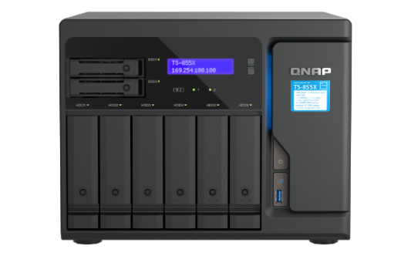
1000+MB/s Read/Write Performance, Transferring Large Files/Backups in a Snap
1 x 10GbE SMB
Sequential Throughput (1MB)
2 x 10GbE SMB
Sequential Throughput (1MB)
2,348 MB/s
2,363 MB/s
1,182 MB/s
1,181 MB/s
Write
Read
Write
Read
TS-855X
Test Environment:
NAS: TS-855X
CPU: Intel Atom® C5125 processor, Max 2800 MHZ (8C, 8T)
Volume type: Raid 5, Samsung 870 EVO 1TB x8
Client PC: Windows Server 2022, AMD EPYC 7302P 16-Core Processor 2.9Ghz, 96GB RAM
Notes:
Next, let us see the QXG-10G2SF-X710 test results in the QNAP lab, the first to see the performance of write and read, when using one 10GbE fiber port reached 1182MB/s and 1181MB/s, and using two 10GbE fiber ports can reach 2348MB/s and 2363MB/s. Truly achieve the transfer of files and backups in a snap.

Slide 23
Paired with QNAP Products
Realized Multiple Application Scenarios
Notes:
Lat but not least, we will introduce how the QXG-10G2SF-X710 can be used with QNAP products to realize various application scenarios.

Slide 24
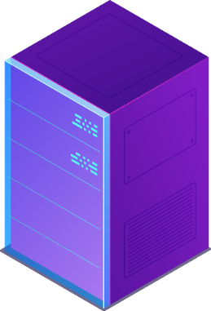
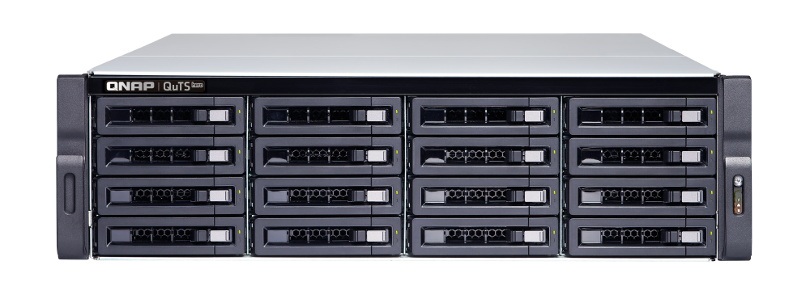
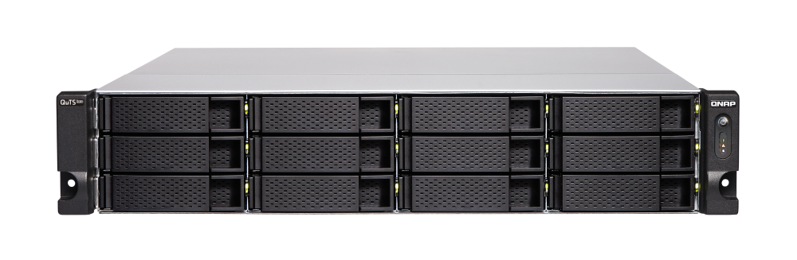
Easily Create a High-Speed 10GbE Network Studio Environments
QNAP's diverse product lineup allows you to use the QXG-10G2SF-X710 with a variety of QNAP's 10GbE switches and NASes to create a high-speed network environment on a lean budget, completely enhancing the productivity and experience of your editing team and other studio partners.
PC + QXG-10G2SF-X710
TS-h1683XU-RP
10GbE
10GbE
PC + QXG-10G2SF-X710
TS-h1886XU-RP R2
QSW-M3216R-8S8T
10GbE
10GbE
10Gbps
Notes:
QNAP's diversified product lines allow you to easily match QNAP's 10GbE switches and NAS to create a high-speed network environment on a compact budget, which thoroughly enhances the work efficiency and experience of your audiovisual editing team and other studio partners.

Slide 25
You'll also Need a Companion Switch to Unlock the Full Potential of 10GbE Netwoek
8 x 10GbE SFP+ Optical Fiber Port
8 x 10GbE RJ45 Ethernet Port
QSW-M3216R-8S8T
8 x 1GbE RJ45 Ethernet Port
8 x 2.5GbE RJ45 Ethernet Port
2 x 10/1GbE SFP+ Dual-Speed Optical Fiber Port
6 x 2.5GbE RJ45 Ethernet Port
4 x 10GbE SFP+/RJ45 Compound Port
QGD-1602
QSW-M2106-4C
More QNAP Switch with 10GbE Network Speed Support
Notes:
With QNAP's new 10GbE switch QSW-M3216R-8S8T, you can easily upgrade your 10GbE network environment, and it also comes with a considerable number of 10GbE fiber optic ports and Ethernet ports, which can greatly enhance your flexibility; if you have the dual needs of NAS and switch, you can refer to the QGD-1602 which can satisfy both your needs; if you need different network speed configurations and still want to retain the flexibility of fiber optic network and Ethernet, then you can refer to the QSW-M2106-4C. To learn more about QNAP switches, please click the hyperlinks below to view.

Slide 26
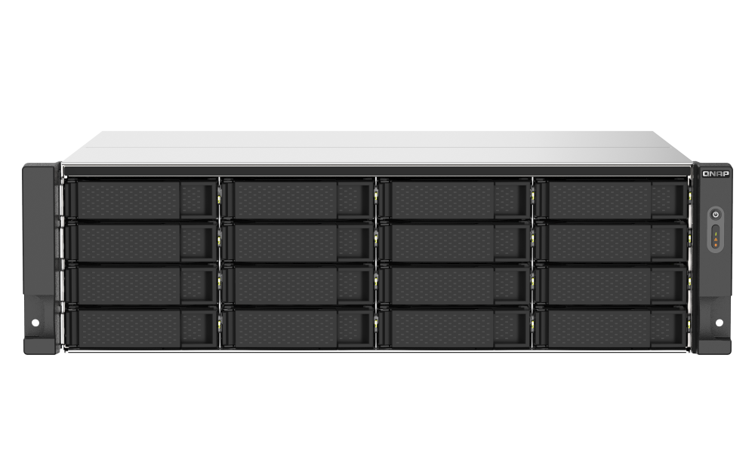
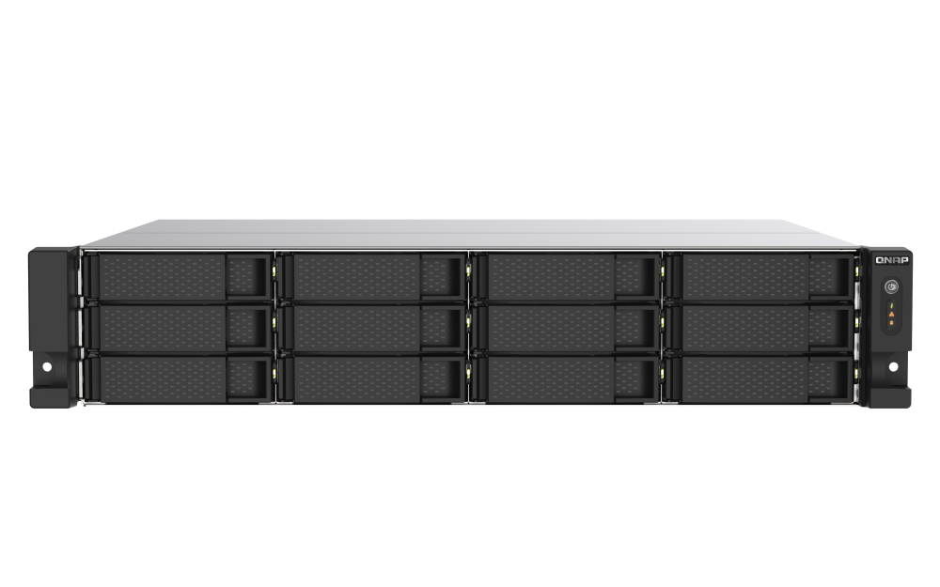
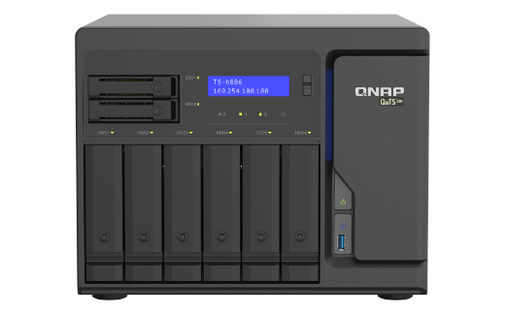
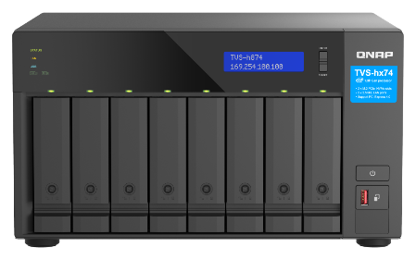
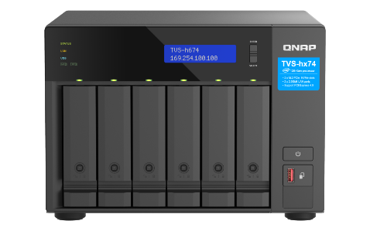
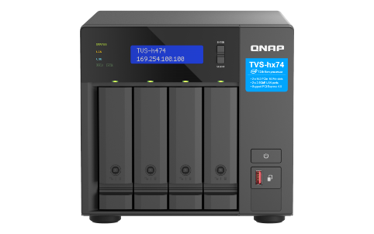
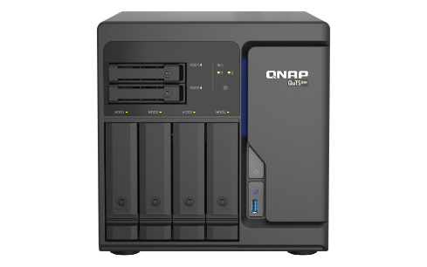
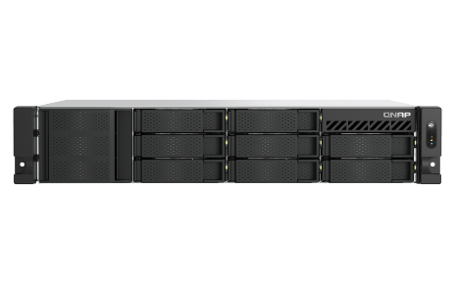
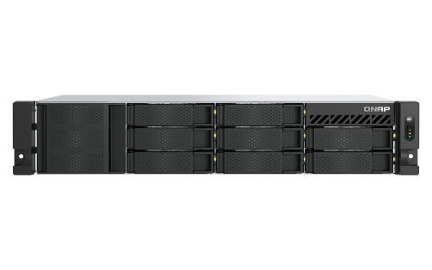
Many QNAP NAS models are Scalable for 10GbE High-Speed Network Transmission
TS-1673AU-RP
TS-1273AU-RP
TS-h886
TVS-h874
TVS-h674
TVS-h474
TS-h686
TS-855eU
TS-855eU-RP
TS-873AeU
More QNAP NAS with
QXG-10G2SF-X710 Support
Notes:
QNAP has a wide range of models that can be upgraded to 10GbE with the QXG-10G2SF-X710. For more information, please click the hyperlink in the lower right corner.

Slide 27
Create a Cost-Effective Virtualized Application Environment with QNAP NAS
Virtualization Station on QNAP NAS is a powerful Hypervisor software that supports multiple operating systems, including Windows®, Linux®, and QuTScloud, enabling you to create a virtualized environment on your NAS. You can set up and run multiple virtual machines based on available system resources. Virtualization Station also supports a variety of resource management and acceleration features, making it a high-performance and affordable platform for virtualization applications.
PC + QXG-10G2SF-X710
TS-1673AU-RP + QXG-10G2SF-X710
Notes:
For virtualization applications, you can create a cost-effective virtualized application environment with QNAP NAS. Virtualization Station on QNAP NAS is a powerful Hypervisor software that supports multiple operating systems and provides various resource management and acceleration features, making it the best platform for your virtualization applications.

Slide 28
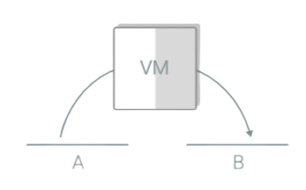
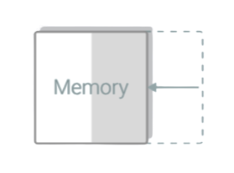
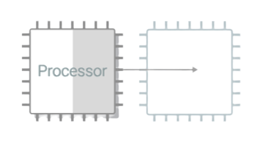
Virtualization Station Support a Wide Range of Powerful Features
Virtualization Station on QNAP NAS supports a wide range of operating systems. Users can download and use a variety of virtual devices directly from the application's VM Marketplace. Virtualization Station also provides a variety of resource configurations that you can choose according to your needs to maintain the best efficiency and stability of your VM. Virtualization Station offers several disaster recovery tools to protect against data loss. Options include local/remote backups, one-time/scheduled tasks, and more.
Dynamic
Memory Allocation
Live Migration
Memory Sharing
CPU Hot Add
More Information of Virtualization Station
Notes:
Virtualization Station comes with a variety of powerful features that you can download directly from the application's Virtual Machine Marketplace. Virtualization Station also comes with a variety of resource configuration settings, including live migration, dynamic memory allocation, memory sharing, and CPU hot add, as well as a variety of disaster recovery mechanisms to prevent service interruptions and data loss. For more information, please click the hyperlinks below.

Slide 29
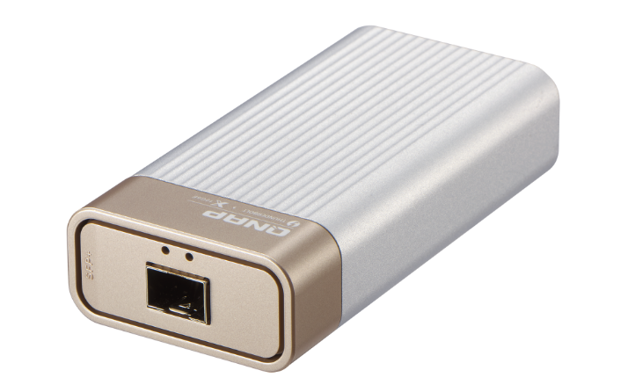
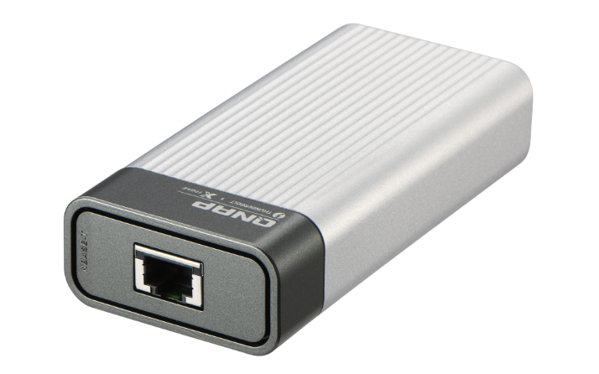
QNAP QNA Series Thunderbolt to 10GbE Adapters
Host with Thunderbolt 3
10G/5G/2.5G/1G/100M five speed
RJ-45 NBASE-T port
Host with Thunderbolt 3
10G/1G dual speed
SFP+ port
QNA-T310G1S
QNA-T310G1T
QNA series adapters are also compatible with Thunderbolt 4
Notes:
QNAP's diverse product line also includes a full range of 10GbE accessories. The QNA series adapter on the screen make it easy to connect your host to a 10GbE network environment via Thunderbolt even if you don't have a network port.

Slide 30
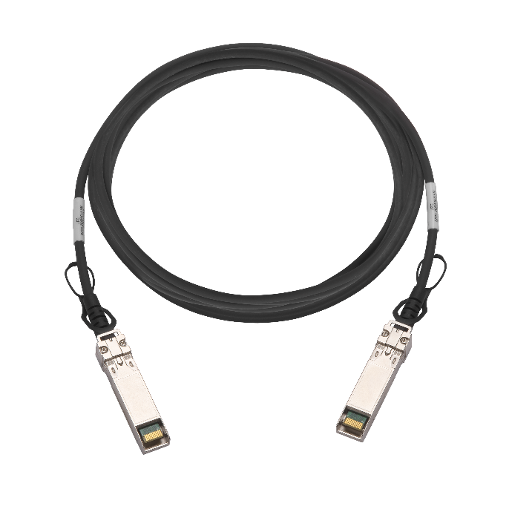
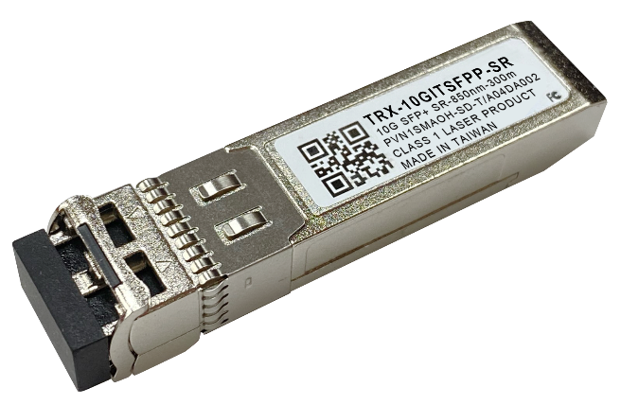
Complete Line of 10GbE Accessories
CAB-DAC15M-SFPP (1.5M)
CAB-DAC30M-SFPP (3M)
CAB-DAC50M-SFPP (5M)
TRX-10GITSFPP-SR
10GbE SFP+ DAC
10GbE SR Transceivers
Notes:
QNAP also offers related 10GbE fiber optic network accessories to make it easy to use the QXG-10G2SF-X710, which includes 10GbE SPF+ cables in different lengths and 10GbE Transceiver.

Slide 31
Dual Port 10GbE Dual Speed PCIe Gen3 Muti-Gig Network Expansion Card
The Best Way to Upgrade Your Network and VM Performance!
Copyright© 2023 QNAP Systems, Inc. All rights reserved. QNAP® and other names of QNAP Products are proprietary marks or registered trademarks of QNAP Systems, Inc. Other products and company names mentioned herein are trademarks of their respective holders.​​​​​​​
Notes:
The Dual-Port Dual-Speed 10GbE PCIe Gen3 Network Expansion Card QXG-10G2SF-X710 is the best choice to enhance your network and VM performance!
I'm Chris, thanks for watching, look forward to seeing you next time, bye bye.

