Slide 1
Notes:
Hello, I'm Chris Chang, Product Manager of QNAP, and today I'm bringing you this new 10G network expansion card, QXG-10G2T.

Slide 2
10GbE networks are already a necessity in business applications!
It's all about speed
10GbE delivers outstanding performance in small network environments
10GbE is an
essential foundation
for maximizing performance
In a SMB or SOHO environment, tools such as Airdrop or Cloud Access make it easy to transfer files. However, when there are a large number of files, the wait time becomes longer and delays occur between devices, causing many people to still use USB to share large files. To address the long wait times caused by device latency or the inconvenience of using USB, we highly recommend upgrading to a 10GbE network for small network environments. A 10GbE network can open a large file in seconds, allowing you to easily share and collaborate with friends, and conveniently backup large files to your computer or NAS over the network in minutes, without the use of USB. Compared to a traditional 1Gbps network, all operations take 1/10th of the time, and 1/100th of the time compared to a 100Mbps network. If you're a Youtuber, an independent developer, or a user of large data transfers, upgrading to a 10GbE network is an option you won't want to miss. With the bandwidth provided by a 10GbE network, you can easily upload and centrally store your materials, program files, and valuable data to a NAS, providing you with a wide range of benefits that not only streamline your workflow, but also preserve the storage space of your workstations, which in turn saves waiting time and dramatically improves your work efficiency.
10GbE
Multi-Gig Internet
Wi-Fi 6
NAS
Notes:
In a business or studio environment, we often need to share files with colleagues via the cloud, but when it comes to large files, using the existing 2.5G or 1G network requires long waiting time, so many people still use USB for sharing large files. To overcome the long waiting time and inconvenience of using USB, QNAP strongly recommends upgrading your small network environment with a 10G network, which can open a large file in seconds, making it easy to share and collaborate with colleagues. Back up large files to your computer or NAS in minutes via 10G network without using USB, dramatically improving efficiency and convenience. In fact, it takes only 1/10th of the time compared to the previous 1G network. If you are an audio/video editor, independent developer, or a user of mass data transfer, upgrading to a 10G network is definitely a good choice that you can't afford to miss. Uploading and centralizing your clips, program files, and valuable data to a NAS via a 10G network not only streamlines your workflow, but also saves storage space on the work equipment. The storage space on the work equipment can be preserved, thus saving waiting time and greatly improving work efficiency.

Slide 3
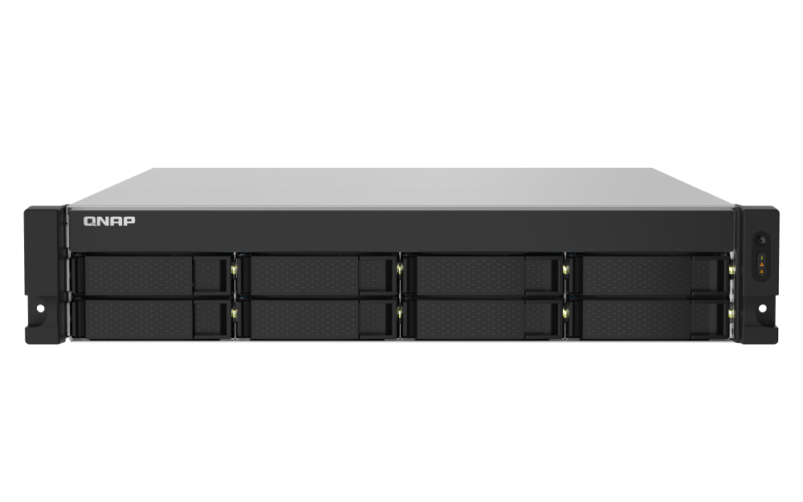
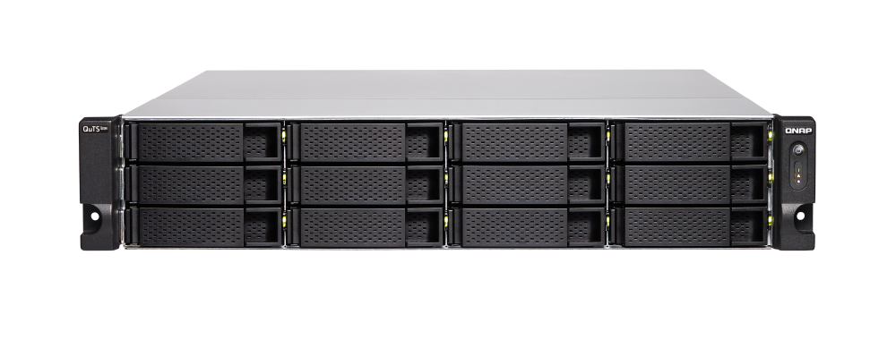
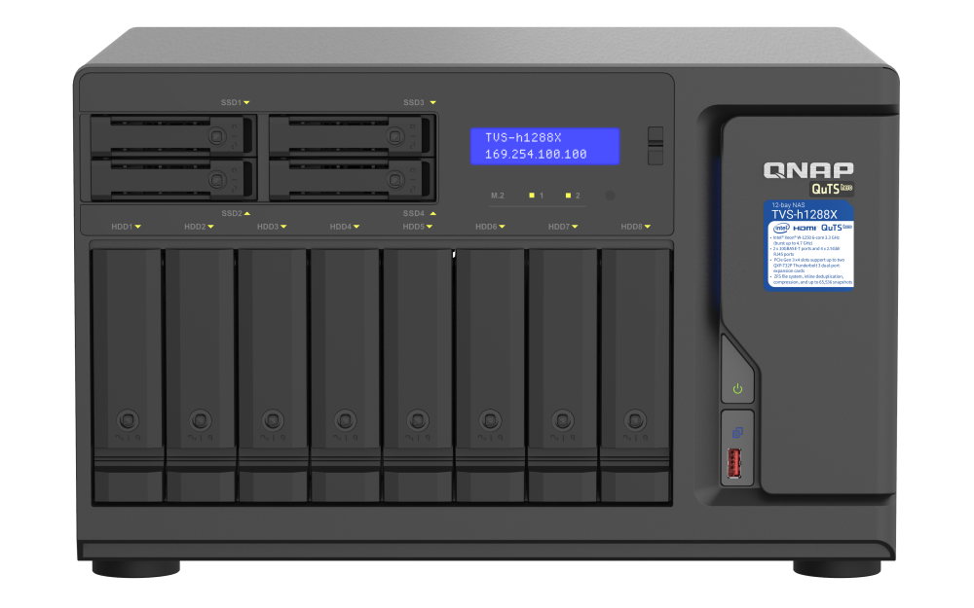
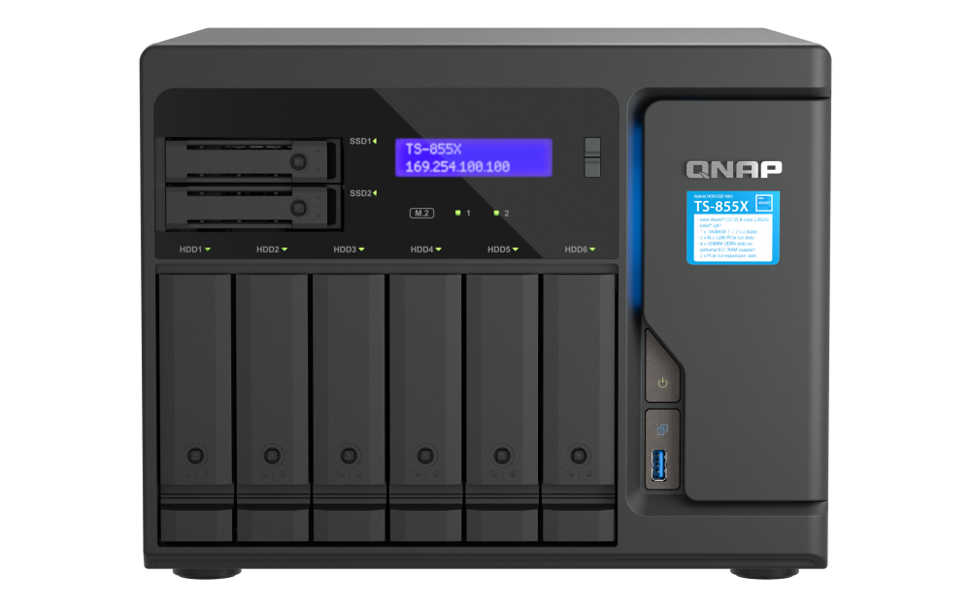
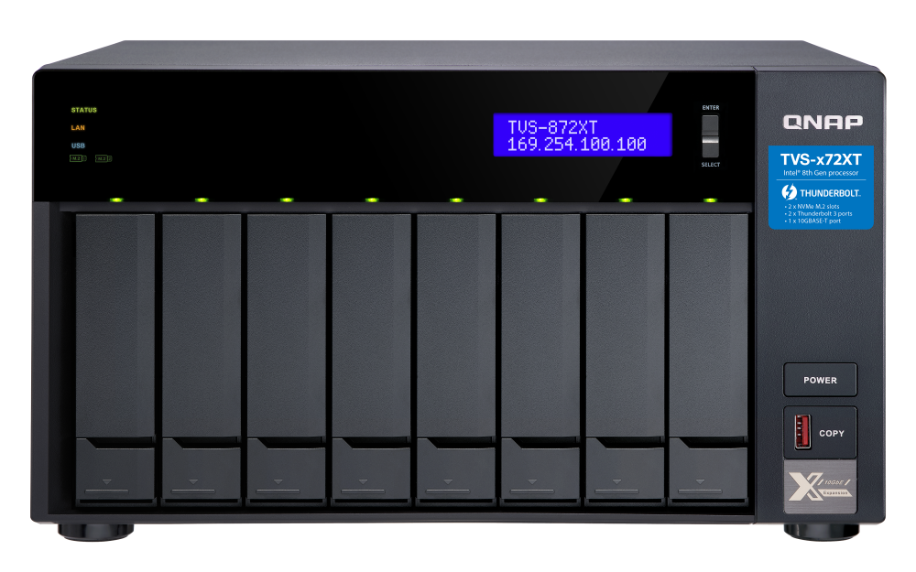
Many QNAP NAS models with 10GbE support
Enjoy higher speed with a QNAP 10GbE NAS. Upgrading your PC/server with 10GbE has become necessary for the optimal performance.
Nearly 40% of QNAP NAS come with built-in 10GbE ports, including enterprise NAS, Thunderbolt NAS, high-end SMB, middle-range SMB, entry-level SMB, etc. When purchasing or upgrading a QNAP NAS for your business or studio, there is a very high chance that you will choose one of the above QNAP NAS series with built-in 10GbE ports, and it is essential to upgrade your other devices with 10GbE network to match the newly purchased QNAP NAS !!!!
Enterprise NAS
High-end SMB
Middle-range SMB
Entry-level SMB
Thunderbolt NAS
TVS-h1277XU-RP
TS-832PXU-RP
TVS-h1288X
TS-855X
TVS-872XT
Notes:
Nearly 40% of QNAP NAS across various series including Enterprise, Premium SMB, Mid-range SMB, Entry-level SMB, and Thunderbolt NAS have built-in 10G network. In the future, there is a very high chance that businesses or studios will choose the above QNAP NAS series with built-in 10G networking when they purchase a new QNAP NAS. Upgrading your other devices with 10G network is a must for you to fully utilize the transfer performance of the newly purchased QNAP NAS.

Slide 4
Specifications
Easily build 10-gigabit high-speed intranets with RJ45 ports
Notes:
Next, I'll introduce the specifications of QXG-10G2T.

Slide 5
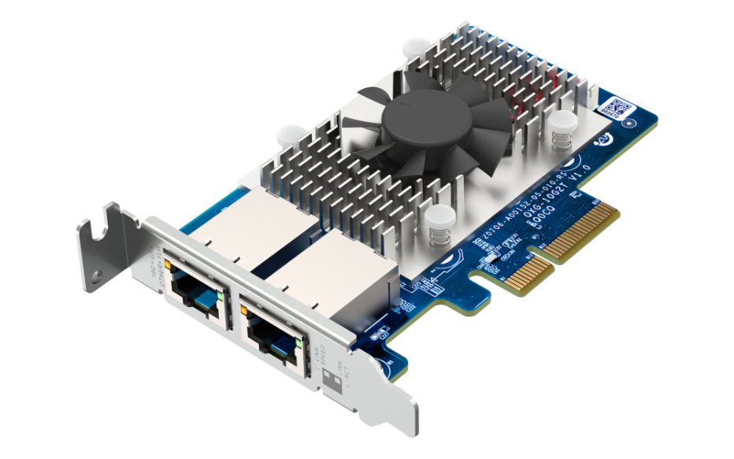
QNAP new 10GbE high speed network card QXG-10G2T
Multi-Gig leading brand
Powerful CPU offload
Add high-speed 10GbE network ports to your QNAP NAS, Windows® and Ubuntu ® computer/server
Dual-Port 10GbE BASE-T Half Height Network Card
2 x RJ45 10GBASE-T
5-Speed 10/5/2.5/1GbE, 100Mb
QXG-10G2T
Marvell AQtion AQC107
Notes:
First of all, this card is a dual-port 10GBASE-T half-height card with two RJ45 10GBASE-T network ports, supporting five network transmission speeds: 10/5/2.5/1G and 100Mb. The network controller chip is the AQC107 from Marvell, a leading Multi-Gig brand. It provides powerful CPU offload capabilities.

Slide 6
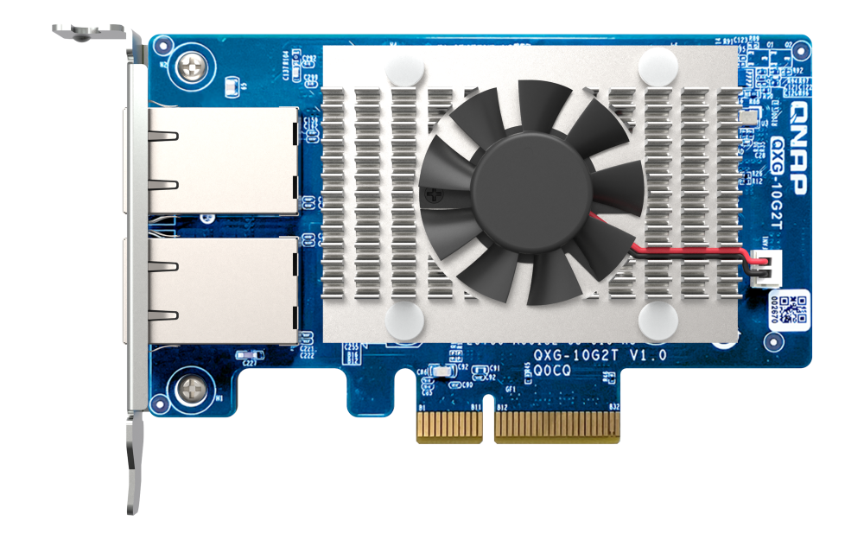
High-performance QXG-10G2T hardware design
Chip Cooling Module: Maximum contact area with the cooling fins, achieve the best heat dissipation effect.
Fan: Outperforms competing 10GbE NIC with heat-reducing fans to keep the platform cool.
2 x RJ45 10GBASE-T Ports
PCI Express 3.0 x4 bus (backward support for PCI Express 2.0)
The interface provides up to 32Gbit/s bandwidth
Notes:
Next, we can see the card's external configuration. It can be divided into three main parts. The blue block on the left is the card's two RJ45 10GBASE-T network ports; the green block on the upper right is the card's custom-designed cooling module and fan, which outperforms other 10G cards, ensuring that the chip always maintains optimal performance; the pink block on the lower right is the card's PCIe transfer interface, which uses a 3rd Gen x4 bus to provide up to 32Gbits of transfer

Slide 7
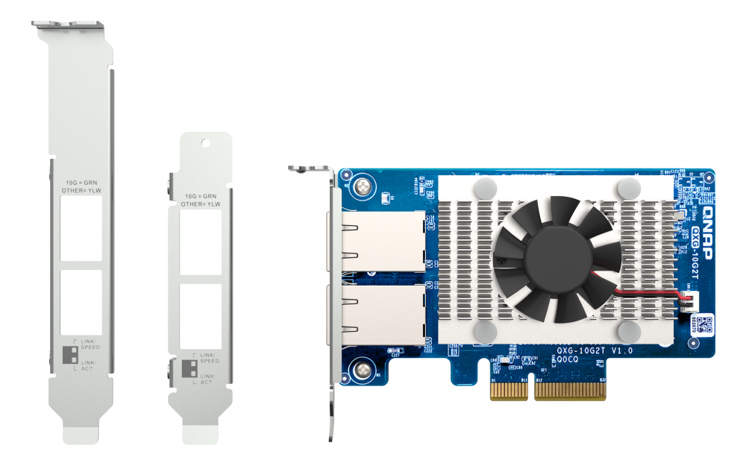
QXG-25G2SF-E810 with various brackets for installation in any kind of NAS and PC/server chassis
Bracket for QNAP NAS models
Pre-installed half-height low profile bracket
Full-height bracket is included
Notes:
The QXG-10G2T comes with a half-height bracket pre-installed at the factory. A full-range version and a special QNAP tablet stand are included, making it easy to use this network expansion card in most situations.

Slide 8
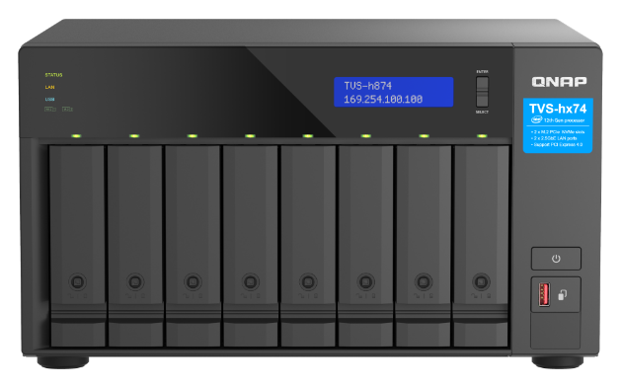
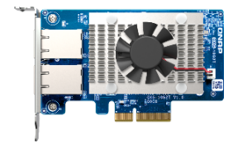
Easy upgrade to 10GbE network via RJ45 cable, support CAT 6 or higher-level cable for 10GbE
Recommend to use CAT 6 or higher level cable !
Support Multi-Gigabit
NBASE-T Industry Standard
CAT 5e
1/2.5 Gbps
 | CAT 5e | CAT 6 | CAT 6A
100M | V | V | V
1G | V | V | V
2.5G | V | V | V
5G | V | V | V
10G | ꓫ | V (55m) | V
TVS-h874
10GbE
NIC
CAT 6
10Gbps
TVS-h874
Notes:
This card uses a 10GBASE-T RJ45 network port and is recommended to be used with CAT 6 or higher cables to directly upgrade to a 10G network. CAT 5e can only support up to 5G network speeds.

Slide 9
Offload features to low CPU utilization and enhance host performance
QXG-10G2T has powerful CPU Offload, which supports a variety of offload and checksum computing optimization techniques, reduces host CPU burden and improves network efficiency. This feature of QXG-10G2T plays an important role on environments that increasingly require high-performance networks and high packet volumes, helping you to increase throughput, reduce latency and optimize system performance.
QXG-10G2T delivers a
High-performance
experience at all times
Notes:
To reduce the load on the host CPU and increase network efficiency, the QXG-10G2T features a powerful CPU OFFLOAD that supports a variety of offloading and calibration calculation optimization techniques. This feature of the QXG-10G2T helps you increase throughput, reduce latency, and optimize overall system performance in situations where high-performance networking and large packet volumes are required.

Slide 10
Flexible development of 10GbE Multi-Gig in NAS, PC, Servers
QTS 5.0.1
or later
QuTS hero h5.0.1
or later
Windows 10/11
Ubuntu 22.04 LTS
QTS
QuTS hero
Notes:
This card supports a wide range of operating systems, making it easy to use this card on multiple systems. The QXG-10G2T supports Windows 10&11, Ubuntu 22.04, QTS 5.0.1 or later, and QuTS hero 5.0.1 or later.

Slide 11
Marvell official website NIC driver download
Windows 10/11 Driver Download
Step 1: Visit the Marvell official website and click on "Support" on the top of the page.
Marvell Official Website Address:
“https:// www.marvell.com”
Notes:
We are now going to show you how to download the drivers for Windows 10 & 11 and Ubuntu 22.04 from the official website of Marvell. In order to download the drivers for Windows 10 & 11, the first step is to enter the official Marvell website to get to the page shown in the presentation, and then click on the Support tab at the top.

Slide 12
Marvell official website NIC driver download
Windows 10/11 Driver Download
Step 2: Click “Publick Driver Downloads” in Tools & Resources.
Notes:
Step 2: Click “Publick Driver Downloads” in Tools & Resources.

Slide 13
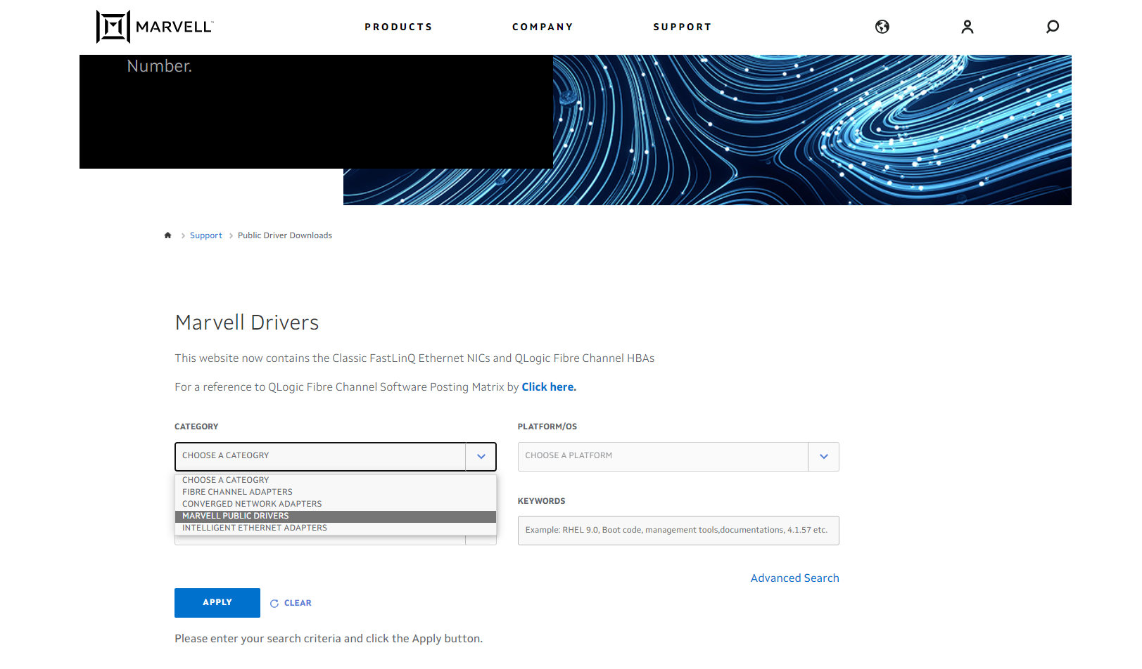
Marvell official website NIC driver download
Windows 10/11 Driver Download
Step 3: Select “Marvell Public Drivers” in CATEGORY section.
Notes:
Step 3: Select “Marvell Public Drivers” in CATEGORY section.

Slide 14
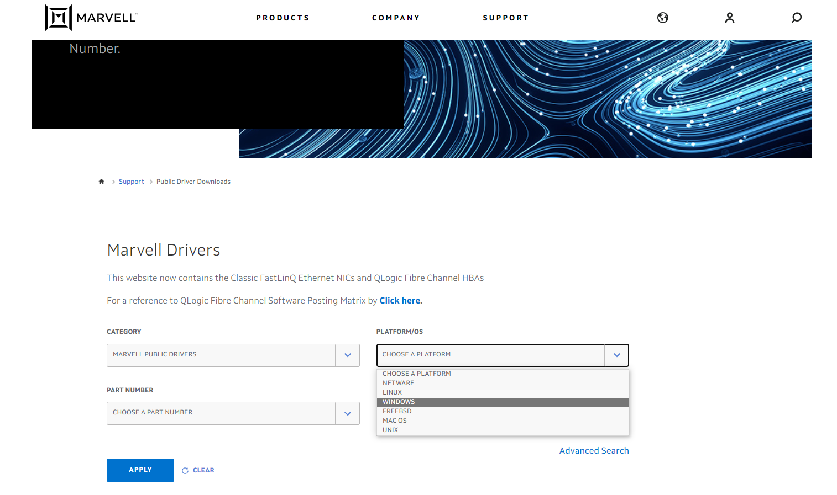
Marvell official website NIC driver download
Windows 10/11 Driver Download
Step 4: Select “Windows” in PLATFORM/OS section.
Notes:
Step 4: Select “Windows” in PLATFORM/OS section.

Slide 15
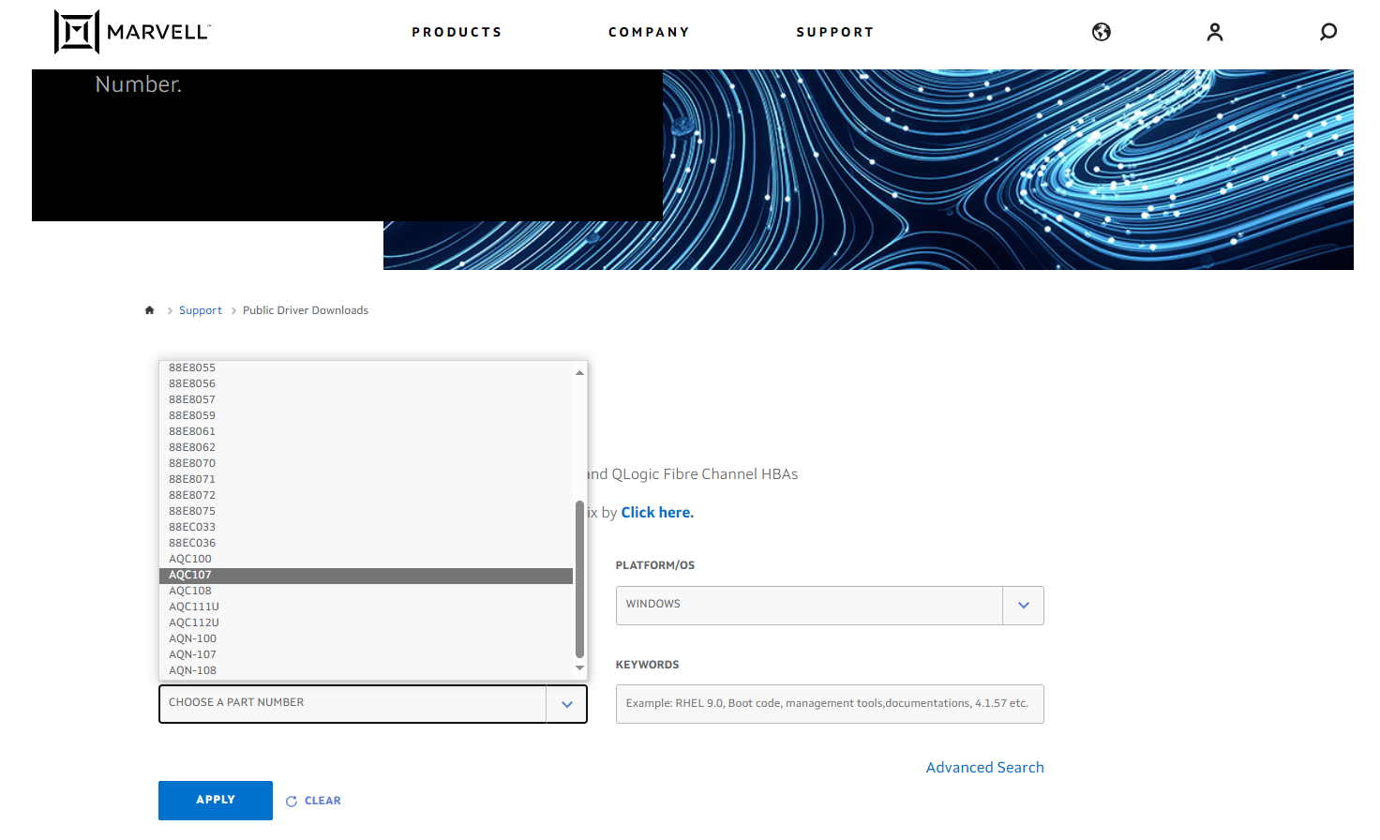
Marvell official website NIC driver download
Windows 10/11 Driver Download
Step 5: Select “AQC107” in PART NUMBER section and apply.
Notes:
Step 5: Select “AQC107” in PART NUMBER section and apply.

Slide 16
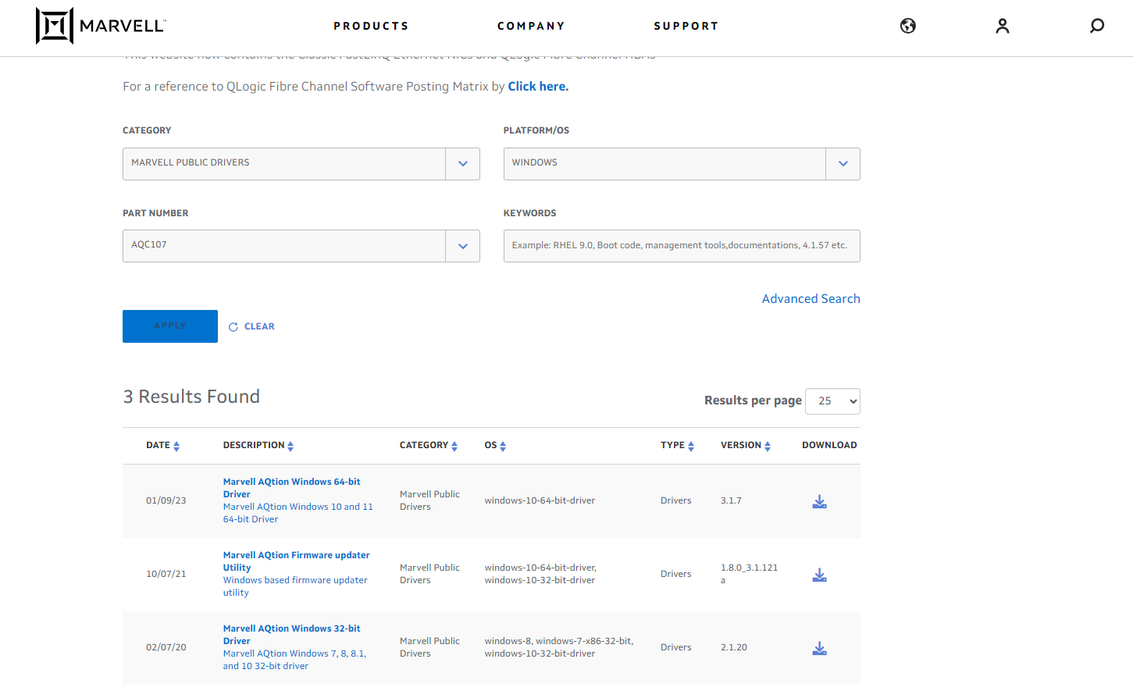
Marvell official website NIC driver download
Windows 10/11 Driver Download
Step 6: After applying the search criteria, you will see Results Found at the bottom, click "Marvell AQtion Windows 10 and 11 64-bit Driver" to download and install the driver, and then you can use the QXG-10G2T Network Expansion Card in Windows 10/11 OS.
Notes:
Step 6: After applying the search criteria, you will see Results Found at the bottom, click "Marvell AQtion Windows 10 and 11 64-bit Driver" to download and install the driver, and then you can use the QXG-10G2T Network Expansion Card in Windows 10/11 OS.

Slide 17
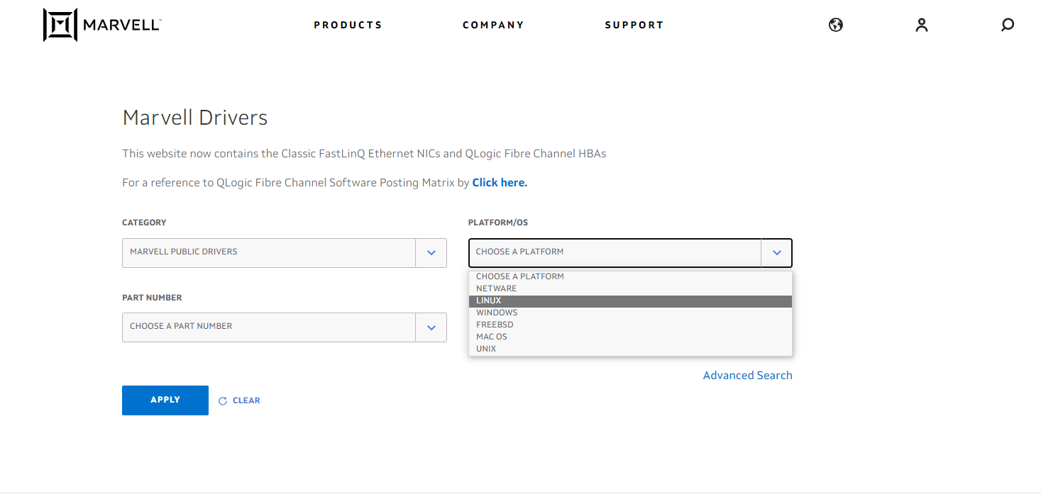
Marvell official website NIC driver download
Ubuntu Driver Download
Step 1 to Step 3 are the same as the Windows 10/11 driver download, please refer to the previous section of the presentation to complete and enter the Step 4 action page.
Step 4: Select “LINUX” in PLATFORM/OS session.
Notes:
To download the driver for Ubuntu 22.04, the Step 1 to Step 3 are the same as the Windows 10/11 driver download, please refer to the previous section of the presentation to complete and enter the Step 4 action page. After entering the page, Step 4: Select “LINUX” in PLATFORM/OS session.

Slide 18
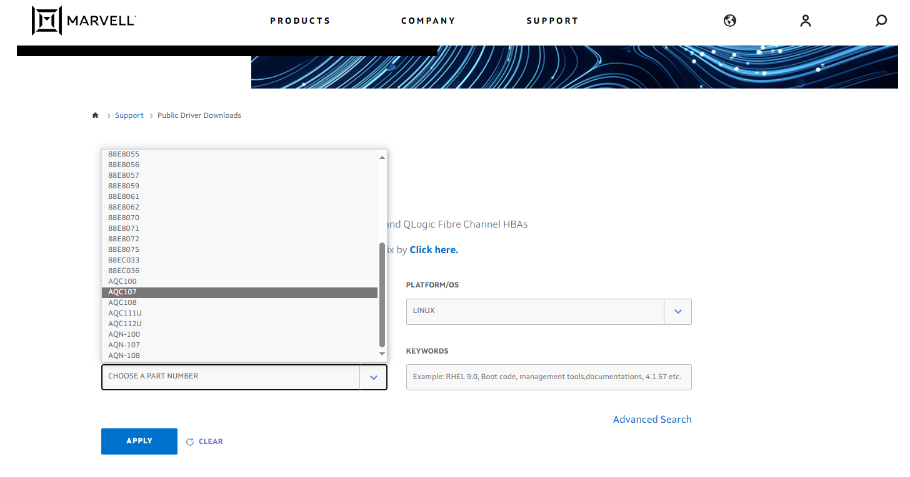
Marvell official website NIC driver download
Ubuntu Driver Download
Step 5: Select “AQC107” in PART NUMBER section and apply.
Notes:
Step 5: Select “AQC107” in PART NUMBER section and apply.

Slide 19
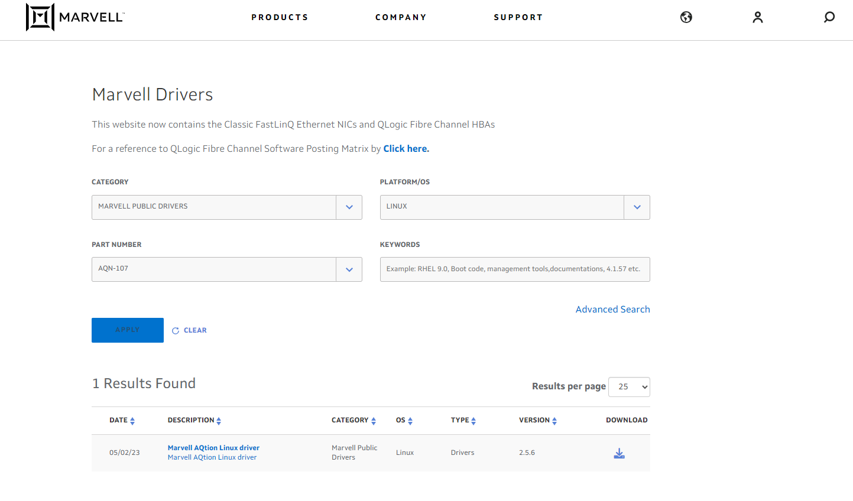
Marvell official website NIC driver download
Ubuntu Driver Download
Step 6: After applying the search criteria, you will see Results Found at the bottom, click "Marvell AQtion Linux Driver" to download and install the driver, you can use QXG-10G2T network expansion card in Ubuntu OS.
Notes:
Step 6: After applying the search criteria, you will see Results Found at the bottom, click "Marvell AQtion Linux Driver" to download and install the driver, you can use QXG-10G2T network expansion card in Ubuntu OS.

Slide 20
QXG-10G2T 享有 2 年的免費產品保固
QXG-10G2T
comes with a free
3-year product warranty
More information: QNAP Warranty Service
QNAP-Warranty Service Official Website
https://www.qnap.com/service/product-warranty/go/
Notes:
QNAP provides a free 3-year warranty for this card. To learn more about the warranty, click the QNAP Warranty link below. You can also enter the URL in the search engine to go there.

Slide 21
QXG-10G2T product specs
QXG-10G2T
Network Controller | Marvell AQtion AQC107
Transmission Speed | 10/5/2.5/1GbE, 100M
Type of Port | NBASE-T；RJ45
Number of Ports | 2
Support for QNAP OS | QTS 5.0.1 or Later Updated Version QuTS 5.0.1 or Later Updated Version
Support for other OS | Windows® (Driver installation required) Ubuntu® (Driver installation required)
PCIe Interface | PCI Express 3.0 x 4
Package Content | 1 x QXG-10G2T 1 x QIG (Quick Installation Guide) 3 x Bracket (Pre-installed half-height low profile bracket)
Year of Warranty | 3 year
Notes:
Here is the detailed specification for QXG-10G2T, the important information is organized in the table for your convenience, above is all of the specification introduction for QXG-10G2T.

Slide 22
QXG-10G2T
Performance Test
Notes:
Next, we'll move on to the performance test of the QXG-10G2T.

Slide 23
LIVE DEMO
2 x 10GbE SMB Sequential Throughput
Notes:
First up is a live demo of SMB sequential throughput performance with two 10GbE ports.

Slide 24
Up to 1000+MB/s read/write performance, transferring files/backups in a snap
1 x 10GbE SMB
Sequential Throughput (1MB)
2 x 10GbE SMB
Sequential Throughput (1MB)
2,226 MB/s
2,354
MB/s
1,182
MB/s
1,177
MB/s
Write
Read
Write
Read
TS-855X
Test Environment:
NAS: TS-855X
CPU: Intel Atom® C5125 processor, Max 2800 MHZ (8C, 8T)
Volume type: Raid 5, Samsung 870 EVO 1TB x8
Client PC: Windows Server 2022, AMD EPYC 7302P 16-Core Processor 2.9Ghz, 96GB RAM
Notes:
Above is the LIVE DEMO of the card, then we have the performance test in the QNAP lab. Underneath the presentation is the lab's test bed. We can see that with only one 10G port, the QXG-10G2T achieves nearly 1200MB/sec transfer speed for read/write; with two 10G ports, the transfer speeds are 2226MB/sec and 2354MB/sec for read/write.

Slide 25
Large file transfer speed is also impressive
1 x 10GbE Windows File Drag (10GB)
2 x 10GbE Windows File Drag (10GB)
1,830
MB/s
1,051
MB/s
1,074
MB/s
919
MB/s
Upload
Download
Upload
Download
TS-855X
Test Environment:
NAS: TS-855X
CPU: Intel Atom® C5125 processor, Max 2800 MHZ (8C, 8T)
Volume type: Raid 5, Samsung 870 EVO 1TB x8
Client PC: Windows Server 2022, AMD EPYC 7302P 16-Core Processor 2.9Ghz, 96GB RAM
Notes:
Upload and download speeds reach 919MB/s and 1051MB/s respectively with one 10G port, and 1074MB/s and 1830MB/s with two 10G ports, which is quite fast for large file transfers.

Slide 26
QNAP Solutions
Multiple QNAP high-speed solutions and build a high-speed network environment
Notes:
The last section will introduce how QXG-10G2T can be paired with QNAP products to realize multiple speed boosting solutions and build a high-speed network environment.

Slide 27
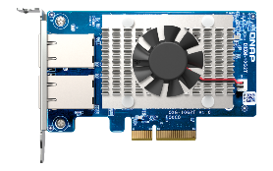
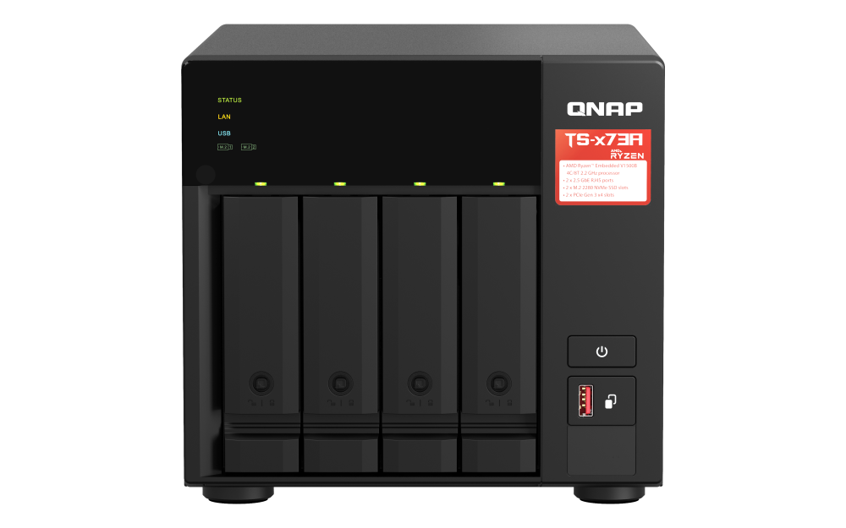
Build a high-Speed hybrid network architecture with a Qhora-301W SD-WAN Wi-Fi 6 router
Build a high-speed hybrid network configuration with the QHora-301W, supporting high-speed Wi-Fi 6 wireless transmission and 10GbE wired network, as well as providing enterprise-grade SD-WAN VPN networking capability, which can be deployed at one time through the cloud for multi-site LAN networking, satisfying the multiple needs of remote, wireless, and wired connectivity of the enterprise's new-age network architecture, and rapidly building private networks at multiple sites, significantly saving IT manpower and management costs.
QHora-301W
New Generation WiFi 6 Dual 10GbE
SD-WAN Router
Internet
Wi-Fi 6 Wireless Device
10Gbps RJ45
1 Gbps
1 Gbps
10Gbps RJ45
PC + QXG-10G2T
TS-473A + QXG-10G2T
Notes:
First of all, you can build a high-speed hybrid network architecture with QHora. Using QHora-301W to build a high-speed hybrid network configuration, it supports WIFI6 wireless transmission and 10G wired network, and provides enterprise-grade SD-WAN VPN networking capability. The cloud deployment of multi-point LANs at a time satisfies the multiple requirements of enterprises for the network architecture of the new era of long-distance, wireless, and wired connectivity, and quickly organizes a private network to significantly reduce IT manpower and management costs.

Slide 28
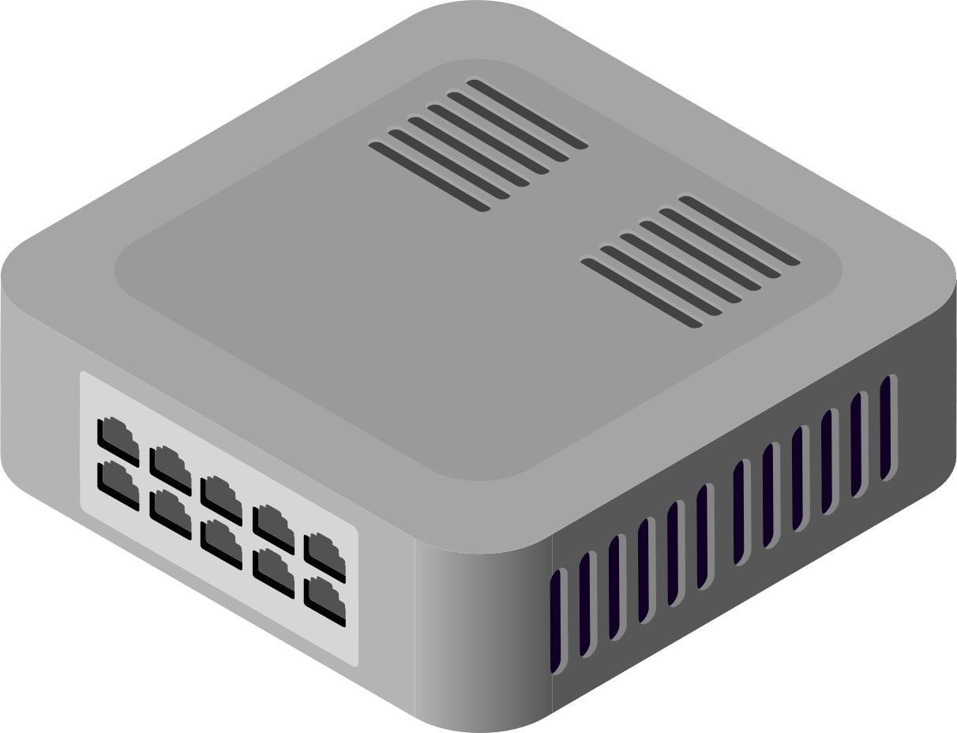
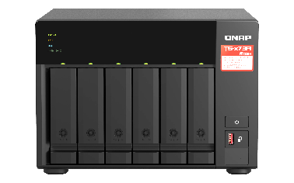
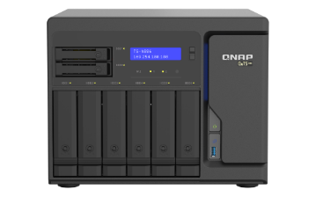
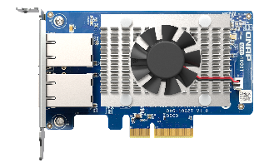
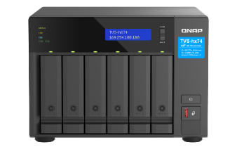
PC / Workstation economical speed up choice
QNAP diverse product lines enable you to quickly upgrade from a 1GbE network environment to 10GbE. Allowing you to quickly add high-speed 10GbE ports to QNAP NAS, Windows® and Ubuntu® computers/server, accelerating large-size sharing and intensive data transfers for high-bandwidth applications.
CAT 5e
1GbE
CAT 5e
1GbE Switch
TS-673A
QXG-10G2T
QXG-10G2T
10Gbps
CAT 6
TS-h886
CAT 6
CAT 6
QXG-10G2T
QSW-M1208-8C
TVS-h674
Notes:
The second is the economical PC/workstation solution. With QNAP's diversified product lines such as network switches, you can quickly upgrade your entire network environment to 10G with the QXG-10G2T. This will accelerate large file sharing and intensive file transfer to meet high-bandwidth application scenarios.

Slide 29
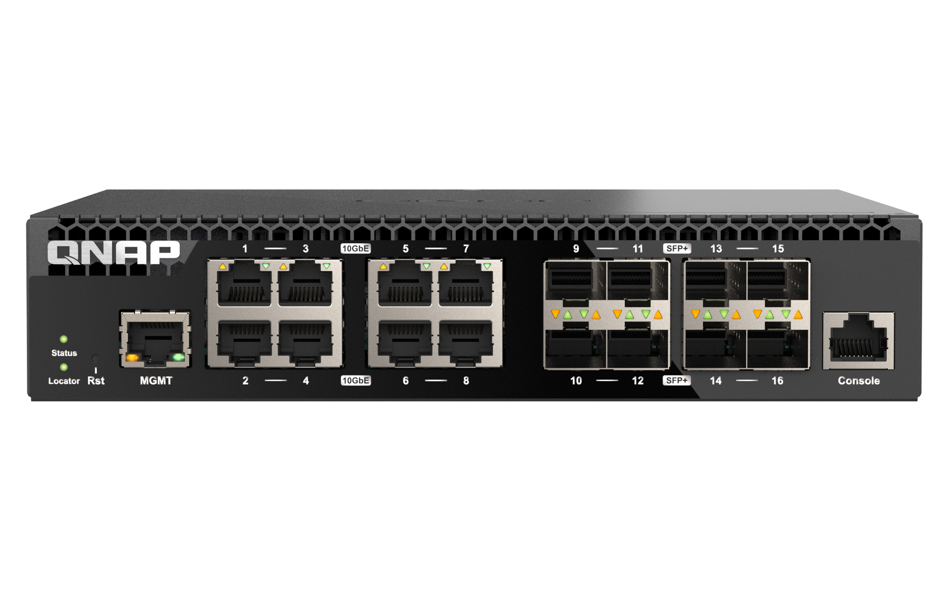
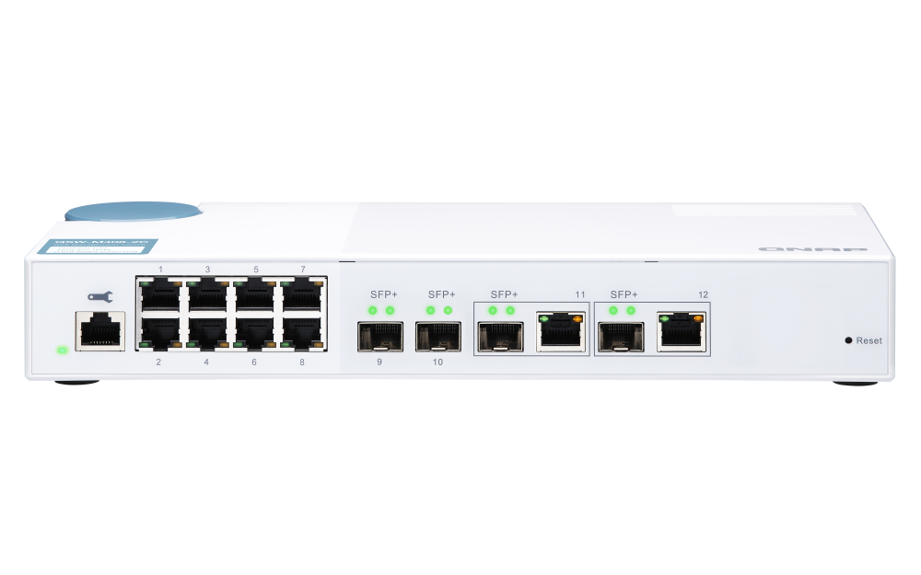
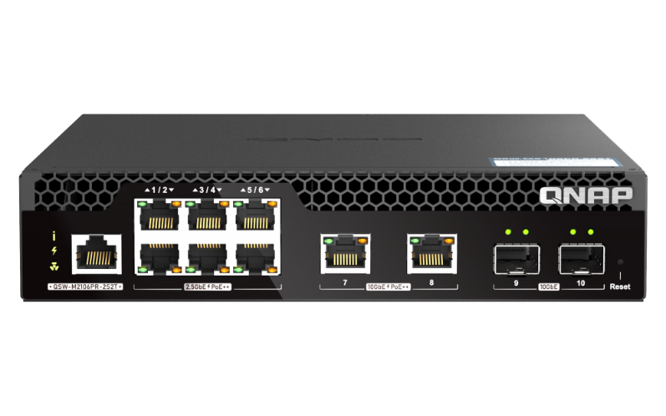
Select from a variety of QNAP managed 10GbE network switches, Create multiple 10GbE high-speed collaborative aggregation networks
8 x 10GbE SFP+ Optical Fiber Port
8 x 10GbE RJ45 Ethernet Port
QSW-M3216R-8S8T
2 x 10GbE SFP+/10GBASE-T Compound Port
2 x 10 GbE SFP+ Optical Fiber Port
2 x 10GbE 90 w PoE++
2 x 10GbE SFP+ Optical Fiber Port
8 x 1GbE RJ45 Ethernet Port
6 x 2.5GbE 90 w PoE++
QSW-M408-2C
QSW-M2106PR-2S2T
QSW-M408-2C
More QNAP Switch with 10GbE Network Speed Support
Notes:
QNAP is introducing a variety of 10G managed network switches that will allow you to easily set up a high-speed collaborative environment for multiple 10G aggregated networks. As you can see from the presentation, the QSW-M3216R-8S8T, QSW-M408-2C, and QSW-M2106PR-2S2T already offer a variety of port combinations in various quantities and types, including RJ45 Ethernet ports, Fiberoptic ports, Composite ports, and POE++, and more. Click the hyperlinks below to learn more about QNAP's network switches supporting 10G network speeds.

Slide 30
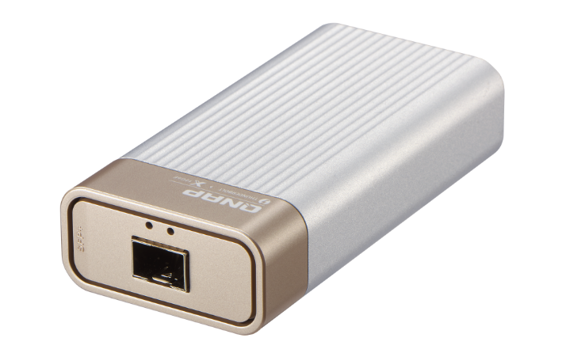
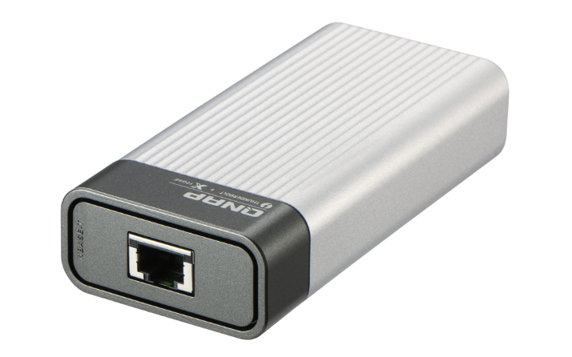
QNAP QNA Series Adapter
Host with Thunderbolt 3
10G/5G/2.5G/1G/100M five speed
RJ-45 NBASE-T port
Host with Thunderbolt 3
10G/1G dual speed
SFP+ port
QNA-T310G1S
QNA-T310G1T
Notes:
Last but not least, we would like to introduce you to QNAP's 10G network adapters, QNAP QNA series adapters, both of which require your host computer or laptop to support Thunderbolt 3 or above. The QNA-T310G1S with gold connector supports two speeds of 10/1G and uses SFP+ fiber ports, while the QNA-T310G1T with black connector supports five speeds of 10/5/2.5/1G and 100Mb and uses RJ45 NBASE-T Ethernet ports. This is the complete introduction of QXG-10G2T.

Slide 31
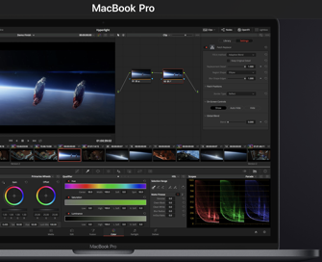
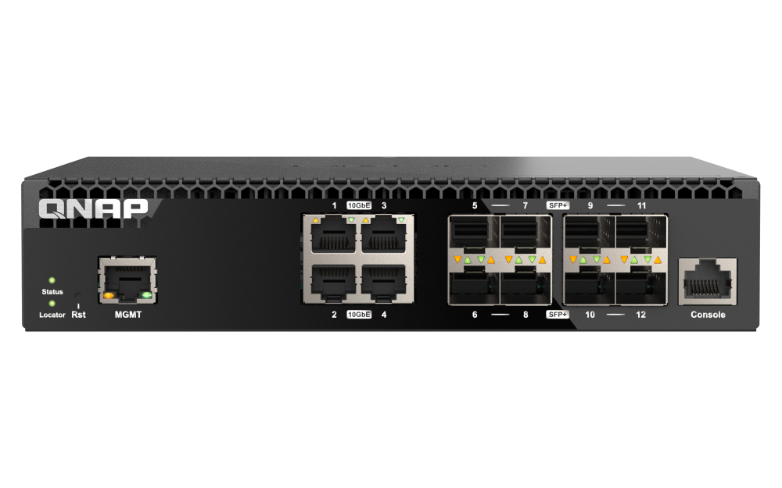
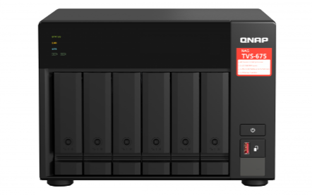
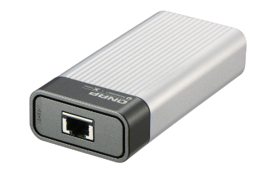
MAC / Windows laptop speed up solution
QNAP offers a wide range of accessories, so even if your device doesn't have a network port, there's a corresponding adapter to quickly upgrade your network environment to 10GbE. Equip with QNAP NAS and switch, let audio editors and other collaborative teams can also enjoy high-speed storage services.
Mac Audio Editing Workstation
Quick backup of video and audio editing files
Backup to
QNAP NAS
Thunderbolt 3
10GbE
QSW-M3212R-8S4T
QNA-T310G1S
Win 11 + QXG-10G2T
TS-855X
QNAP Switch
Thunderbolt 3
10GbE
QXG-10G2T
QNA-T310G1T
TVS-675
Notes:
The third is the MAC/WINDOWS Laptop Lightning Solution, which allows you to easily upgrade your device to a 10G network environment without a network port by using the adapters provided by QNAP's multi-product line. Together with QNAP NAS and network switches, AV editors and other collaborative teams can enjoy a high-speed storage experience.

Slide 32
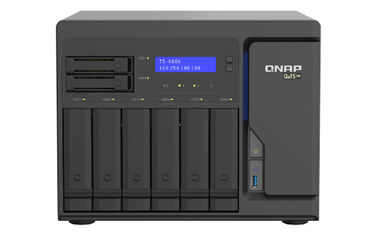
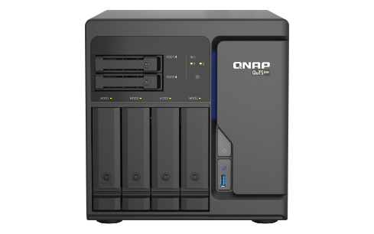
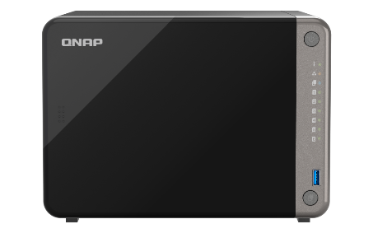
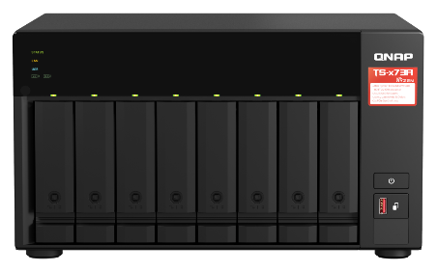
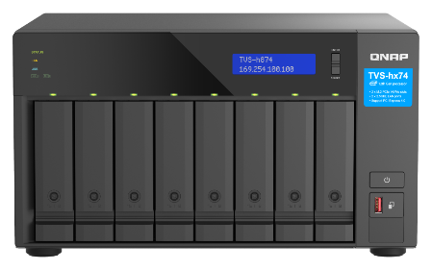
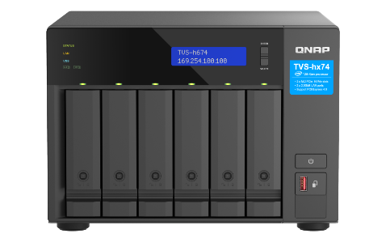
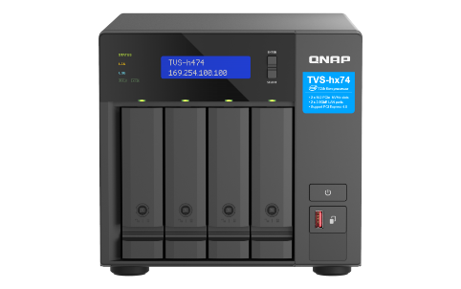
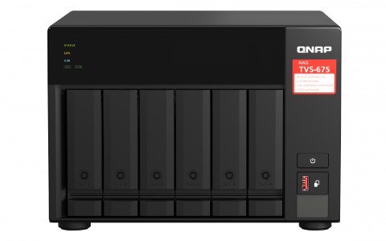
Versatile QNAP NAS with optional 10GbE NIC support for high-speed network transmission
TS-h886
TS-h686
TS-AI642
TS-873A
TVS-h874
TVS-h674
TVS-h474
TVS-675
TS-873AeU
TS-464U
More QNAP NAS with QXG-10G2T Support
Notes:
QNAP NAS has many models extendable for 10G network transmission. You can also click the hyperlinks on the bottom right to see more QNAP NAS supporting QXG-10G2T in addition to those shown in the presentation.

Slide 33
Efficient and Cost-effective Dual Port 10GBASE-T 5-Speed Network Expansion Card
Notes:
QXG-10G2T, an efficient and cost-effective dual-port 10GBASE-T 5-speed network expansion card. I'm Chris, thanks for joining us today.

