Slide 2
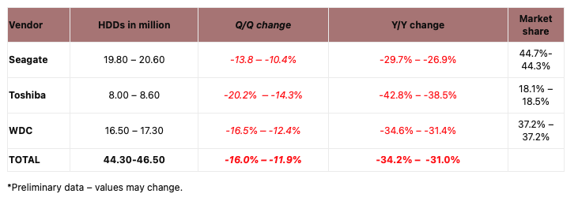
SSD prices are dropping and becoming the mainstream choice in the market
As HDD shipments continue to decline, SSDs are becoming the mainstream storage choice.
According to Storage Newsletter, HDD shipments in the second quarter of 2022 totaled 45 million units, a significant drop from the 2010 peak of 651 million units. Compared to the same period in 2021, shipments are down 26.9% to 29.7%. Shipments of 3.5-inch HDDs (including external HDDs) in the consumer market fell by more than 30%, and even worse than the 3.5-inch HDD consumer market, shipments of 2.5-inch HDDs fell by about 40%. In addition to the weak overall demand for HDDs, the decline in HDD shipments was also due to a large proportion of the impact of the development of solid state drives (SSDs). According to the statistics, the price of NAND Flash TLC and QLC chips have dropped by 8%~13% in Q2 2022 and will drop by another 5%~10% in Q3 2022, making SSDs affordable for both consumers and enterprises, and leading more users to look at next-generation storage options. Looking ahead, the market has moved significantly toward SSDs as a storage option.
Quoted from: Internet News
Image Source ：Storage Newsletter ​
Reference News
Overstocked Supply Chain to Drive NAND Flash Price Declines of 8-13% in 3Q22 - EE Times Asia (eetasia.com)
HDD Shipments Plummet 33% YoY on Weakening Demand | Tom's Hardware (tomshardware.com)
Notes:
SSDs are gradually becoming the mainstream choice in the market as prices drop. According to Storage Newsletter, shipments of traditional mechanical hard disk drives dropped significantly in the second quarter of last year, with shipments of 3.5-inch hard disk drives in the consumer market falling by more than 30%, and shipments of 2.5-inch hard disk drives falling by more than 40%. In addition to the weak overall market demand, a large part of the reason for the significant drop in shipments is the development of the SSD market. According to statistics, the price of raw materials for SSDs has dropped significantly in the second half of 2022, which has gradually brought the price of SSDs down to a price range that is acceptable to both individual consumers and enterprises, and has led to people starting to use SSDs as their main choice when purchasing storage products.

Slide 3
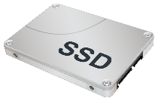
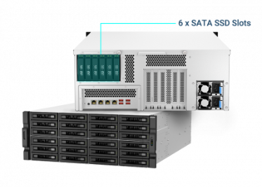
10GbE is no longer able to fully utilize SSD high-speed storage performance
QNAP Enterprise NAS
10GbE transmission rate
10GbE Network Transmission
Causes Bottlenecks
Limited IOPS
or
Below 2,000 MB/s
TS-h3087XU-RP
Different disk drive combinations
24 x SATA HDD + 6 x SATA SSD (Best capacity)
or 30 x SATA SSD (Best performance)
PC/Workstation
Notes:
However, as storage commodities are gradually upgraded to SSDs, we are beginning to notice that the 10GbE network transmission speeds we used in the past can no longer afford the performance required to fully utilize the high-speed storage features of SSDs. For example, in the case below, when using the QNAP Enterprise NAS TS-h3087XU-RP, if you insert all 30 drive with 2.5-inch SSD, it would cause a lot of problems between the PC and the NAS if you only use a 10GbE network. Using only a 10GbE network will cause a transmission bottleneck between the PC and the NAS. This transmission bottleneck will greatly waste the high-speed transmission features of SSDs. In order to avoid this situation, it is necessary to consider the increase of network transmission speed. Through the network expansion card to upgrade your device to 25GbE network transmission speed will be a smart choice, not only can quickly solve the transmission bottleneck problem, but also do not incur a huge amount of cost to upgrade the hardware device.

Slide 4
Agenda
Product Specification
QXG-25G2SF-E810 Performance Test
Build 25GbE Network Environment
Notes:
Moving on to the main event of the day, QNAP's new 25GbE network expansion card, the QXG-25G2SF-E810, I'll start with an overview of the card's specifications, followed by a performance test, and finally, a scenario in which the card can be used to easily upgrade to a 25GbE network.

Slide 5
Product Specification

Slide 6
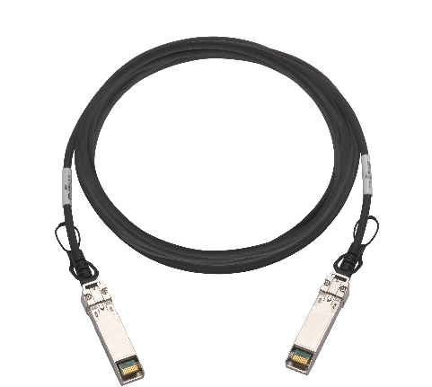
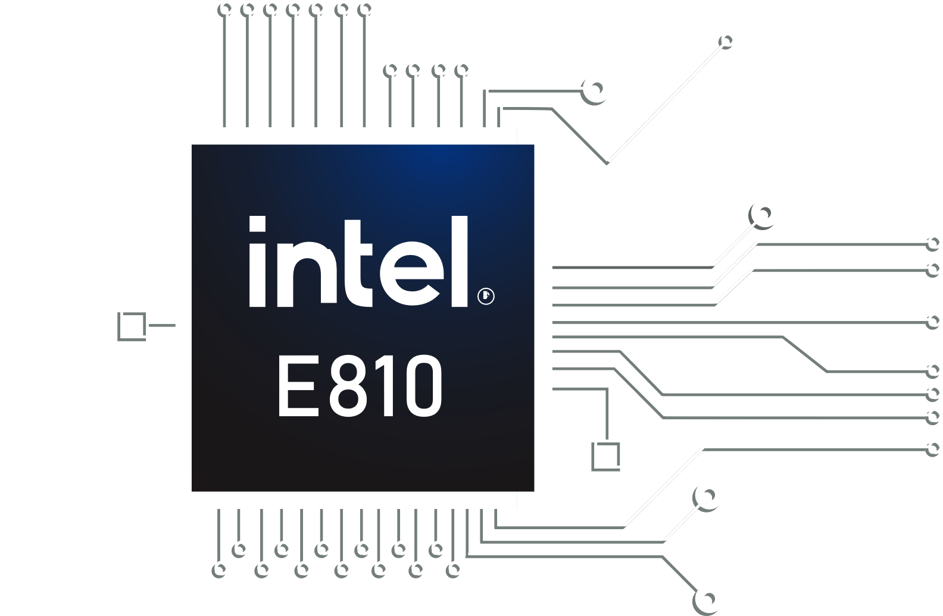
New 25GbE High Speed Network Interface Card QXG-25G2SF-E810
QXG-25G2SF-E810
Dual-Port 25GbE SFP28 Half-High NIC
2 x SFP28 ports
Support 25GbE / 10 GbE dual Speed
Support PCIe Gen 4, and compatible with PCIe Gen 3
Optional accessory available:
25GbE SFP28 DAC Cable
Intel® E810-XXVAM2 Network Chip
Notes:
QNAP's new QXG-25G2SF-E810 is a dual-port 25GbE SFP28 half-height NIC that utilizes Intel's E810-XXVAN2 network chip. Equipped with two SFP28 interfaces, it supports 25GbE SFP28 and 10GbE SFP+ at dual speeds and supports PCIe Gen4 and is compatible with PCIe Gen3. In addition, QNAP also has a 25GbE SFP28 cable available for purchase at the eShop.

Slide 7
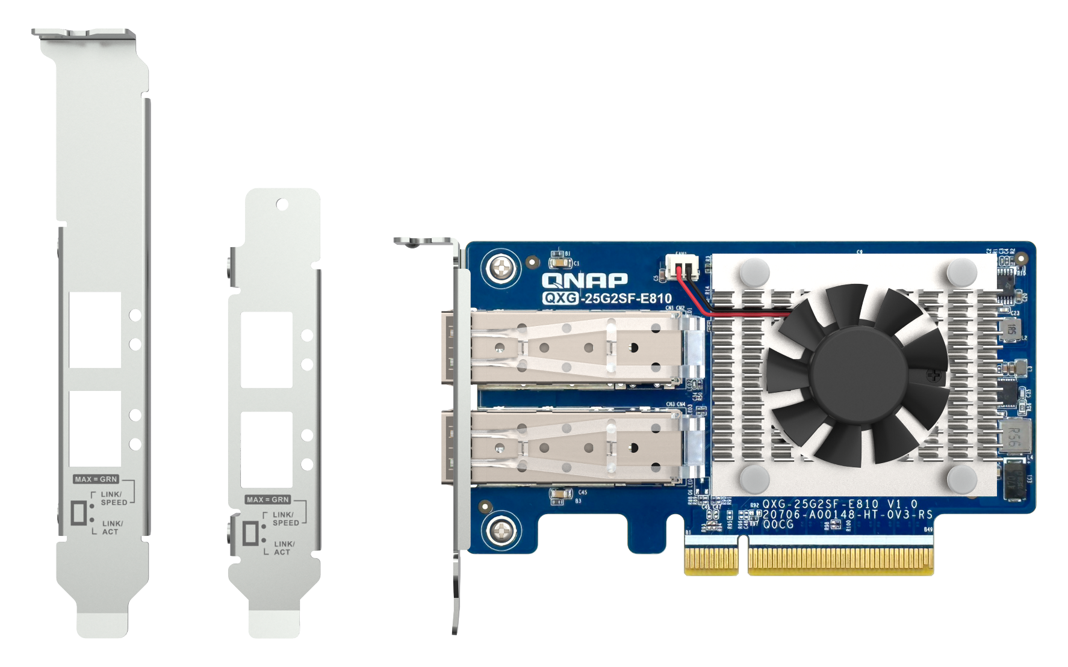
QXG-25G2SF-E810 with various brackets for installation in any kind of NAS and PC/server chassis
Bracket for certain QNAP NAS models
Pre-installed half-height low profile bracket
Full-height bracket is included
Notes:
The QXG-25G2SF-E810 has been carefully designed to fit into most chassis. The card comes pre-installed with a half-height Low Profile bracket, and a full-height Full Height bracket and a QNAP dedicated tablet stand are included with the card.

Slide 8
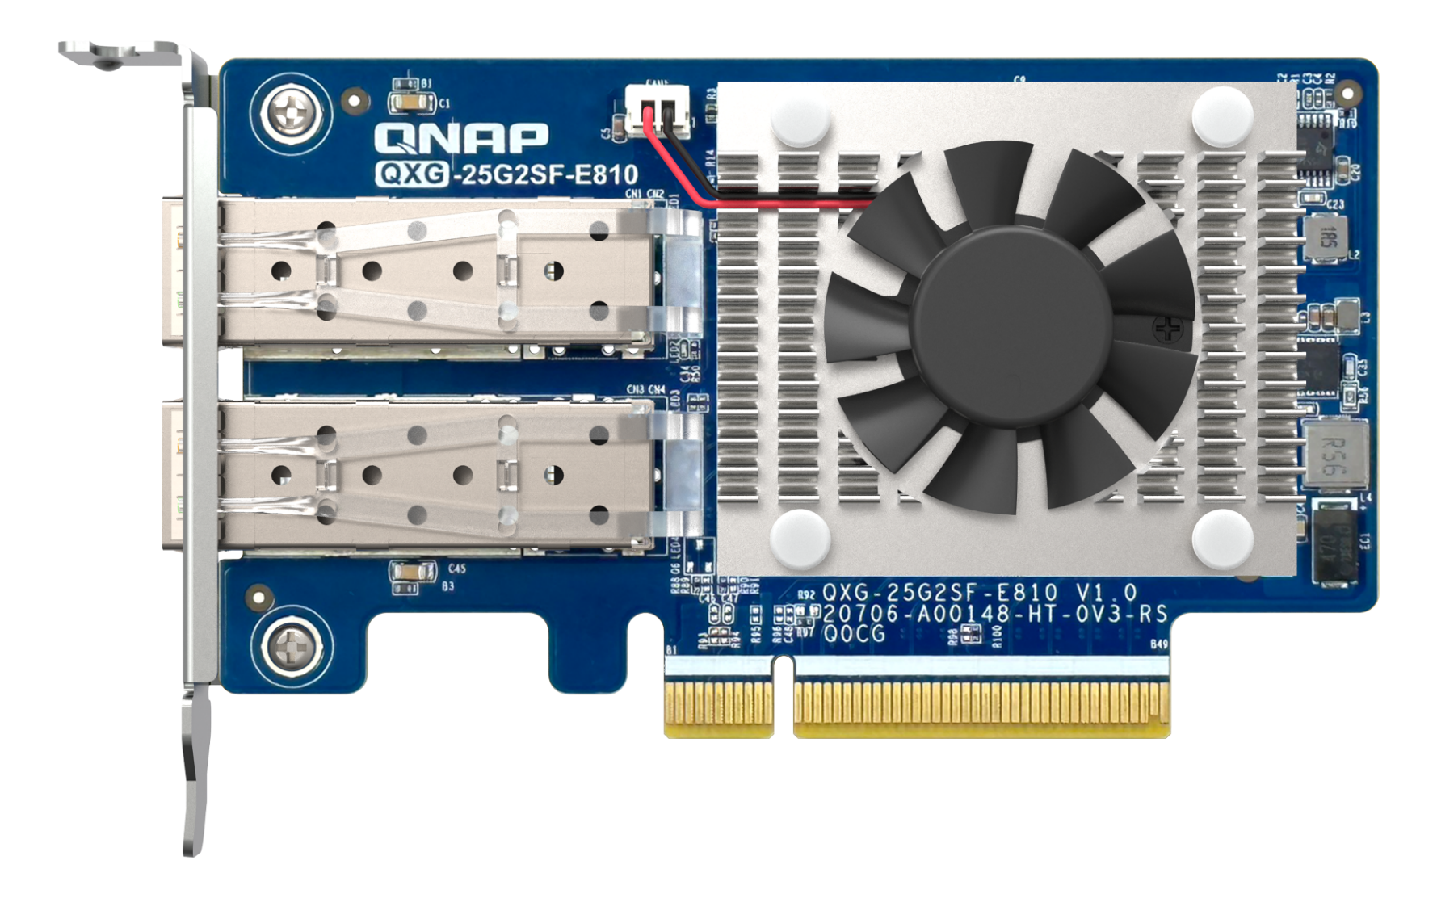
Performance-oriented QXG-25G2SF-E810 25GbE Network Interface Card
Heatsink cooling module: Maximum contact area with the cooling fan, achieving the optimal heat dissipation.
Fan: Outperforms competing 25GbE NIC with heat-reducing fan to keep the platform cool and maintains high performance.
2 x 25GbE SFP28 Ports
PCI Express 4.0 x8 bus (backward support for PCI Express 3.0)
The interface provides up to 128Gbit/s bandwidth
Notes:
Next, we move on to the QXG-25G2SF-E810's exterior configuration, which can be divided into three main parts. First, there are the two 25GbE SFP28 ports in the blue block on the left hand side; and then, we can see on the left hand side, the green block on the upper part is the Chip Cooling Module and fan specially designed for this card, which is designed to maximize the contact area of the chipset, and there are a large number of cooling fins. In the center is a cooling fan that you would be really hard to find on other 25GbE cards. The combination of these two features provides comprehensive cooling to keep the chip at peak performance. The pink area below is the gold finger of this card, which uses PCI express Gen4 x8 specification. This interface provides a theoretical bandwidth of up to 128Gbit/s and downward support for PCI express Gen3, so you don't have to worry about your device only having PCI express Gen3 and not being able to use this card.

Slide 9
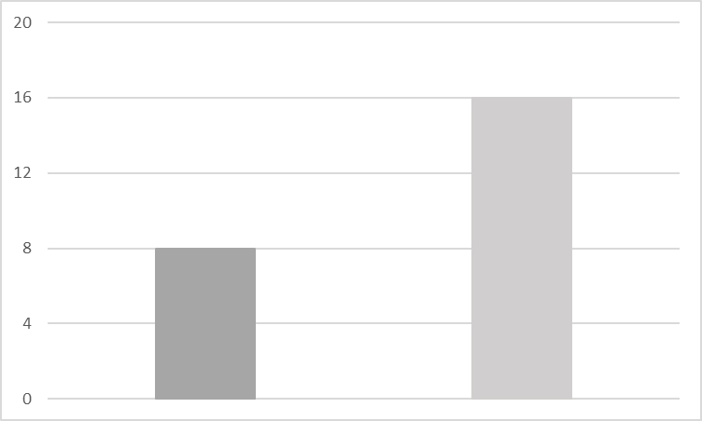
Using PCI Express Gen4 High Speed Data Bus
More flexibility, more bandwidth, the best answer for data-intensive work
PCIe Gen4 has twice the bandwidth of PCIe Gen3, up to 16 GT/s, and only requires Gen4 x 4 to utilize the full potential of the QXG-25G2SF-E810 dual-port 25GbE x 2 for a total of 50GbE.
Major PCIe interfaces are gradually moving from Gen3 to Gen4, and although Gen4 is backward compatible with Gen3, it is especially important to equip a complete set of devices with Gen4 interfaces to fully utilize the high bandwidth of Gen4 as the amount of data being transferred is increasing by leaps and bounds.
16 GT/s
GT/s
8 GT/s
Gen 3.0
Gen 4.0
Notes:
Next I will introduce the features of QXG-25G2SF-E810 one by one. This card utilizes a PCI express Gen4 high-speed data bus, which provides more flexibility, more bandwidth, and would be the best solution for data-intensive work. As you can see on the right hand side, Gen4 has twice the bandwidth of Gen3, up to 16GT/S, so your device only needs Gen4 x4 to fully utilize the QXG-25G2SF-E810's dual-port 25GbE X2 for a total of 50GbE transfer potential. In addition, the PCIe interface used by major manufacturers in the market is gradually moving from Gen3 to Gen4, so it is particularly important to equip hardware devices with complete Gen4 interfaces to fully utilize the high bandwidth characteristics of Gen4 in the future when the amount of data will only continue to multiply.

Slide 10
iSCSI Support for Fast Storage Connection
QXG-25G2SF-E810 supports iSCSI, which simplifies storage management while realizing high-speed access to enhance operational efficiency, and through the network, it realizes remote storage to achieve unlimited storage access, and in the virtualization environment, it can achieve seamless integration of virtual machines and storage devices, giving you an efficient and flexible storage solution.
Initiator
Target
SCSI
SCSI
iSCSI
iSCSI
TCP/IP
TCP/IP
IP
Network
Notes:
Unlimited remote storage, the QXG-25G2SF-E810's iSCSI function allows you to break the limit of storage boundaries. Initiator encapsulates SCSI commands and data in TCP/IP packets via iSCSI, and transmits them to Target via the IP network. iSCSI allows computers to connect to a remote device via the IP network, making it as easy as if the device were on-site. It provides great convenience and flexibility for data storage, virtualization, etc., and realizes seamless integration between different devices.

Slide 11
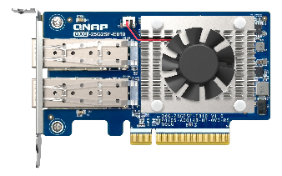
Flexible VLAN Support
QXG-25G2SF-E810 supports VLAN to help you create virtual network zones to separate your network into different areas for more secure and organized connections. It allows you to meet your different needs in a more organized and efficient way in complex network environments in different usage contexts.
QXG-25G2SF-E810
Switch
PC0
PC1
PC2
PC3
PC4
PC5
PC6
PC7
VLAN 1
VLAN 2
Notes:
VALN helps you take control of your network. QXG-25G2SF-E810 supports VLAN function, which can separate your network into different virtual network zones through the network switch settings, allowing you to keep different networks isolated from each other under different usage backgrounds and complexity levels, enhancing network security and realizing a more secure and orderly connection.

Slide 12
Automatic QoS for Performance & Efficiency
QXG-25G2SF-E810 supports On-chip QoS for dynamic resource allocation, priority scheduling, bandwidth control, traffic management and dynamic workload adjustment. On-chip QoS allows you to improve system performance and efficiency in a variety of application scenarios, ensure mission-critical execution and optimize resource allocation to meet the needs of different applications.
Receive
LLQ
Output Queue #1
IP
IP
IP
IP
IP
IP
50%
Classifier
Output Queue #2
IP
IP
IP
IP
IP
20%
CBWFQ
Scheduler
IP
IP
IP
IP
IP
Output Queue #3
IP
IP
IP
20%
Output Queue #4
IP
IP
IP
IP
10%
Transmit
Notes:
The QXG-25G2SF-E810 supports On-chip QoS function, which automates the management of network applications to realize dynamic resource allocation, priority scheduling, bandwidth control, traffic management and dynamic workload adjustment. This ensures mission-critical execution and improves overall system performance and efficiency in all situations.

Slide 13
Forward Error Correction (FEC) Ensures Data Accuracy
QXG-25G2SF-E810 supports Forward Error Correction (FEC), which is designed to minimize the Bit Error Rate (BER) and ensure data accuracy by allowing the receiver to quickly recover from packet errors caused by signal degradation that can occur at high network speeds and over long distances. There are three FEC modes in total, allowing you to flexibly plan your network environment with suitable cables and switches.
Mode | Latency | Distance
NO FEC | Lowest | Shortest
BASE-R FEC (Firecode) | ~ 80ns | Middle
RS-FEC (Reed Solomon) | ~ 260ns | Longest
Notes:
In QTS 4.5.3 / QuTS hero 4.5.2 or later, you can set the FEC mode according to your network environment in the network card setup page.
Windows / Linux requires a separate driver.
The transmitter must be set in the same mode as the receiver
If the QXG-25G2SF-E810 does not connect to the switch, please check whether the latest version of the switch's firmware supports FEC, and if the switch does not support FEC, please disable the FEC function of the NIC through the NAS or computer operating system.
Notes:
The QXG-25G2SF-E810 also supports Forward Error Correction (FEC), which is a function that targets packet omissions caused by signal degradation that can easily occur at high network speeds and over long distances, and quickly recovers the errors at the receiving end to reduce the bit error rate and improve data quality and accuracy. There are three different modes of forward error correction, allowing you to flexibly plan your network environment with suitable cables and switches.

Slide 14
Multiply Bandwidth, Maximize Performance: Experience a Performance Leap with SMB Multichannel
Since QTS 5.1.0 / QuTS hero h5.1.0, QNAP NAS fully supports SMB multichannel. The network fault tolerance makes the system operation more stable. Even if one network connection fails, the NAS still maintains the file transmission with the remaining number of connections to minimize the risk of interruption; when the network recovers, the total transmission bandwidth is immediately restored. With SMB Multi-Channel enabled, the system automatically explores all network ports on the NAS and automatically aggregates them, resulting in a large bandwidth stack that is ideal for 8K/16K multimedia and large file transfers.
QXG-25G2SF-E810
SMB Multichannel
PC
SFP28
SFP28
Combined bandwidth provides up to 50GbE data transfer potential through SMB Multichannel.
NAS
SFP28
SFP28
QXG-25G2SF-E810
Main Route
PC
SFP28
SFP28
Network fault tolerance setting (failover backup). Ensuring the continuity of network service.
NAS
SFP28
SFP28
Backup Route
SMB Multichannel System Requirements and Notes：
NAS and Client devices support SMB 3.0, QTS 5.1.0 or above, QuTS hero h5.1.0 or above, Windows 8.1 or above, Windows Server 2012 or above, macOS Big Sur 11.3.1 or above.
SMB Multi-Channel can only combine network ports of the same speed on a single device, e.g., 25GbE + 25GbE.
The same number of network ports must be used between the two devices.
If the two devices use different speed network ports, the performance of the two devices depends on the slower speed, e.g., if the NAS uses two ports of 10GbE and the PC device uses two ports of 2.5GbE, the SMB multichannel transmission speed between the two devices is only 5 Gbps.
Actual SMB multichannel transfer performance varies depending on the hardware configuration (e.g., CPU, memory, hard disk, switch, etc.) and performance of the NAS and client devices.
RSS, RDMA, and NIC Teaming are not supported in the latest version of SMB Multichannel.
Notes:
Since QTS 5.1.0 / QuTS hero h5.1.0, QNAP NAS fully supports SMB multichannel, which improves network transmission speed! The excellent network fault tolerance makes the system operation more stable. Even if one network connection fails, the NAS still maintains the file transmission with the remaining number of connections to minimize the risk of interruption; when the network recovers, the total transmission bandwidth is immediately restored. With SMB Multi-Channel enabled, the system automatically explores all network ports on the NAS and automatically aggregates them, resulting in a large bandwidth stack that is ideal for 8K/16K multimedia and large file transfers. What if your computer doesn't have a 25GbE network port? Don't worry, use the QXG-25G2SF-E810 Network Expansion Card to install on your computer's PCIe expansion interface, and you can get a solid network speed overlay between the NAS and your computer!Below are the requirements and notes for the SMB Multichannel system. It is important to note that firstly, only ports of the same speed can be combined on a single device; secondly, the same number of ports must be used between the two devices; and finally, if the ports of the two devices have different network speeds, the transfer performance depends on the slower speed.

Slide 15
Flexible Development of 25GbE in NAS, PC, Servers
Windows Server 2022
Ubuntu 20.04 LTS
Windows 10/11
QTS
QTS 5.0.1
or a later updated version
QuTS hero
QuTS hero 5.0.1
or a later updated version
Notes:
QXG-25X2SF-E810 supports a wide range of operating systems, giving you the flexibility to deploy a 25GbE network environment that suits your needs. Click the link below to quickly go to the Intel link to download Windows, Windows Server, and Ubuntu drivers; QTS and QuTS hero require version 5.0.1 or later to be supported.

Slide 16
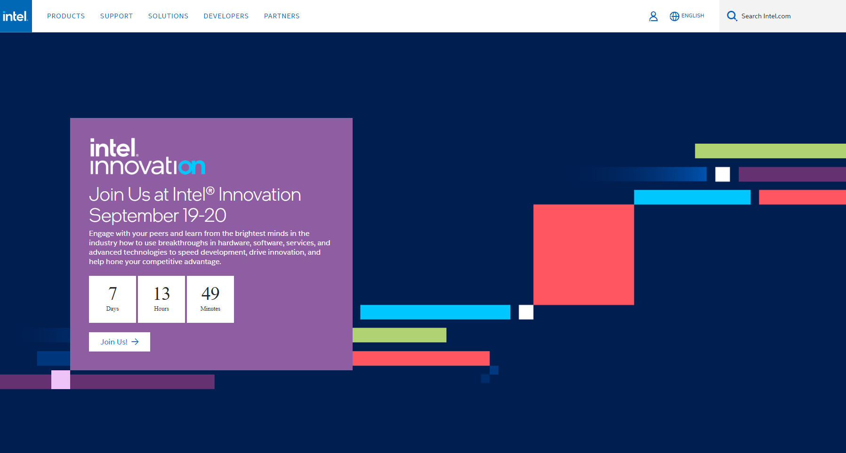
Intel Official Website Driver Download Step 1
Step 1: Go to Intel's official website. Click Search Intel.com in the upper right corner and type in E810-XXVAM2.
Notes:
Next, we will also show you how to find the place to download the driver if you go directly to Intel's official website. First of all, after entering Intel's official website, there is a place to search for intel.com in the upper right corner, click on this place and type in E810-XXVAM2.

Slide 17
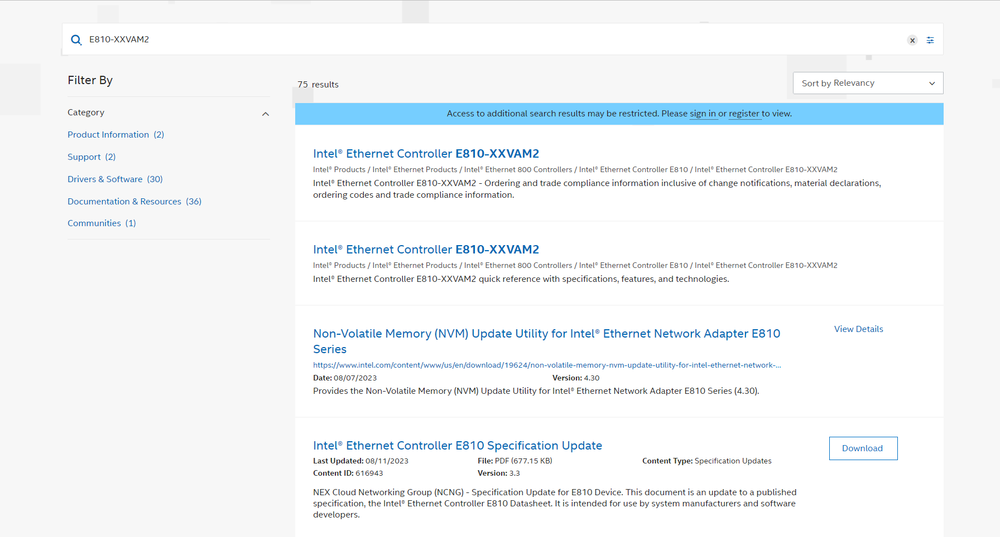
Intel Official Website Driver Download Step 2
Step 2: Click on "Drivers & Software" on the left when you see the search results.
Notes:
Once in the search results, you can see all the results related to E810-XXVAM2 in the center. Then move on to the left hand side of this page, you will see different filters, please click on Drivers and Software.

Slide 18
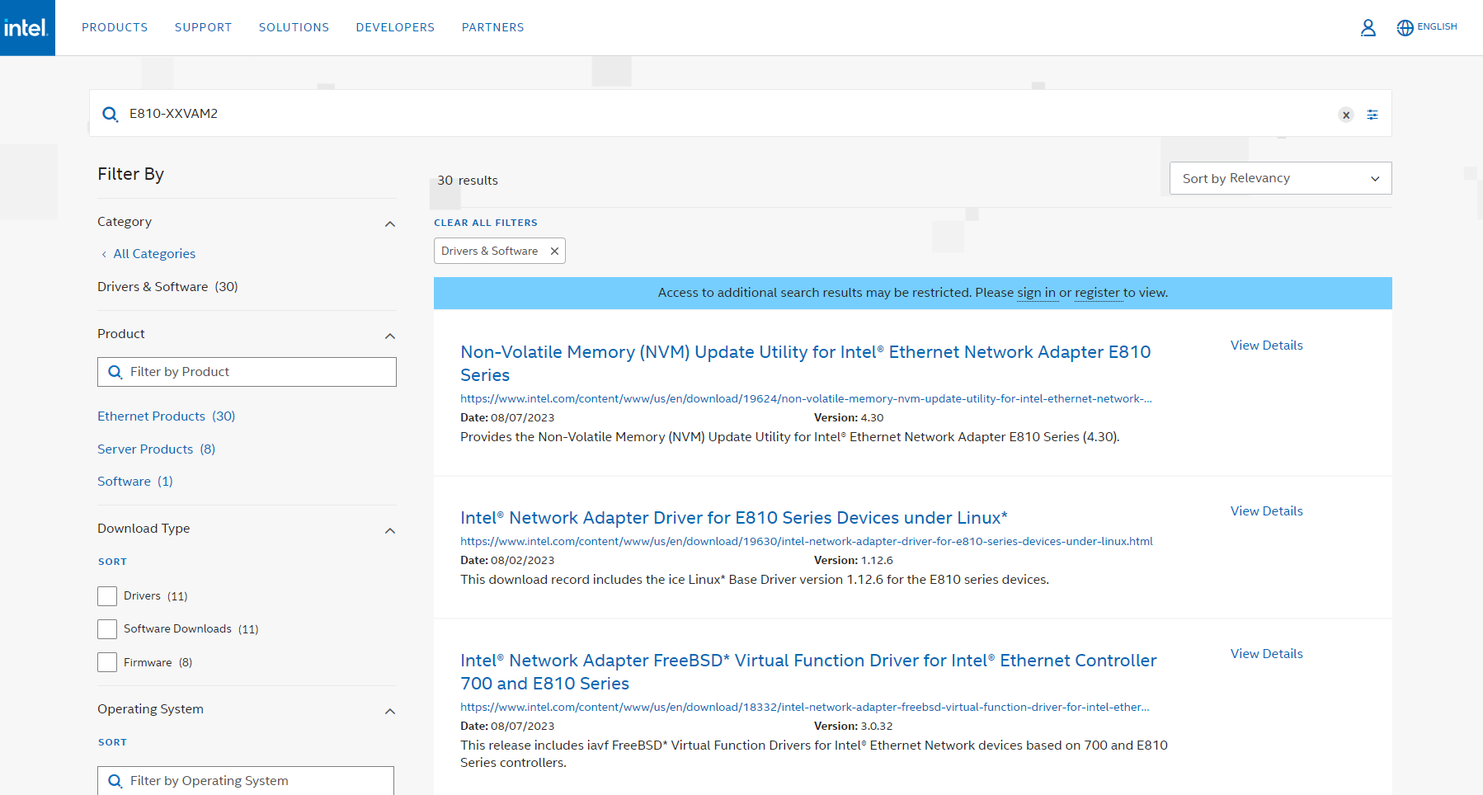
Intel Official Website Driver Download Step 3
Step 3: In the search results that appear in the middle of the screen, you can find the drivers you need for Windows, Windows Server, or Ubuntu.
Notes:
In the middle of the screen you can see the new search results, in these items you can easily find the drivers you need for Windows System, Windows Server and Ubuntu.

Slide 19
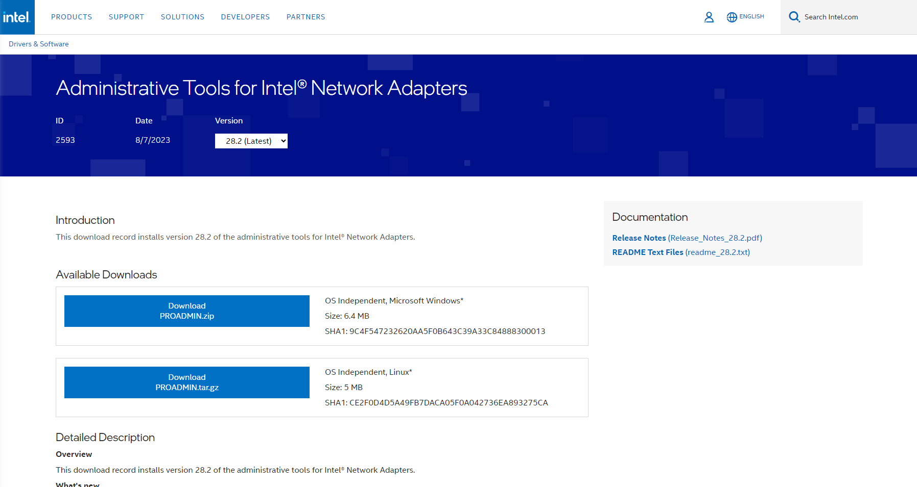
Windows 10/11 Driver Download
Windows 10/11 Driver Download
Download and install Windows driver package.
Notes:
The Windows 10/11 download driver page is called administrative tools for intel network adapters, click on it and you will see two download buttons. Please click on the button above to download and install the Windows driver package to use QXG-25G2SF-E810.

Slide 20
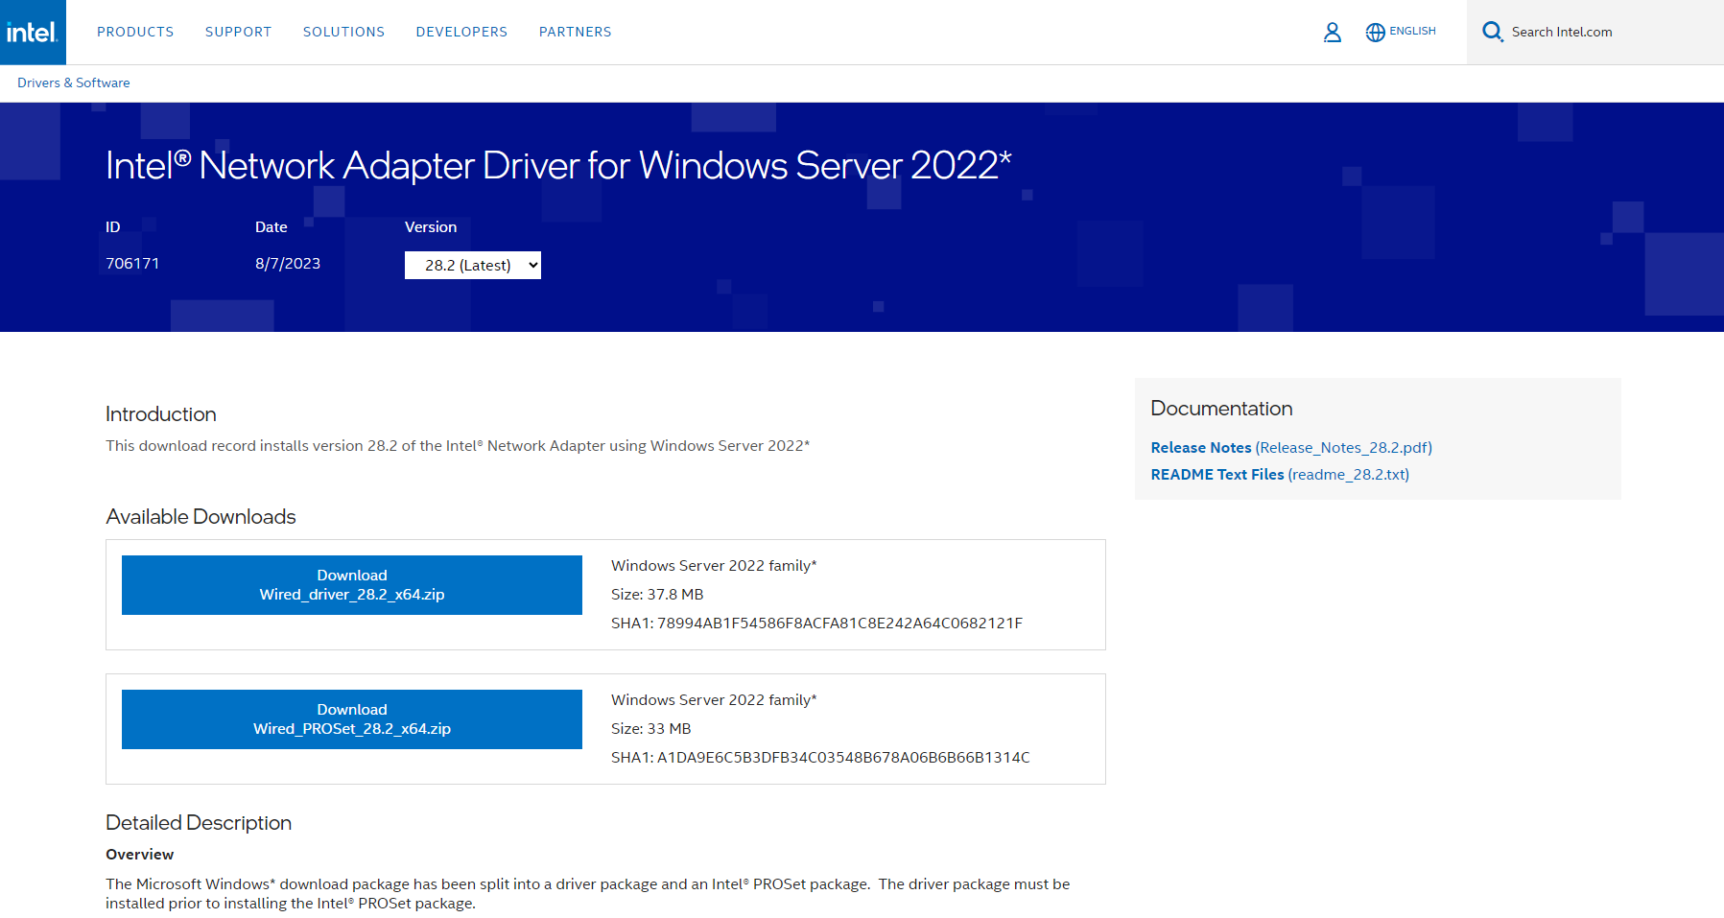
Windows Server 2022 Driver Download
Windows Server 2022 Driver Download
Step 1: Install the driver package firstly.
Step 2: install the Intel® PROSet package secondly.
Notes:
The Windows Server 2022 download driver page is called intel network adapter driver for Windows Server 2022. Click on it and you will see two download buttons. First of all, click the top button to download and install the driver package. After installation, click the bottom button to download and install the intel proset, and then you can use QXG-25G2SF-E810.

Slide 21
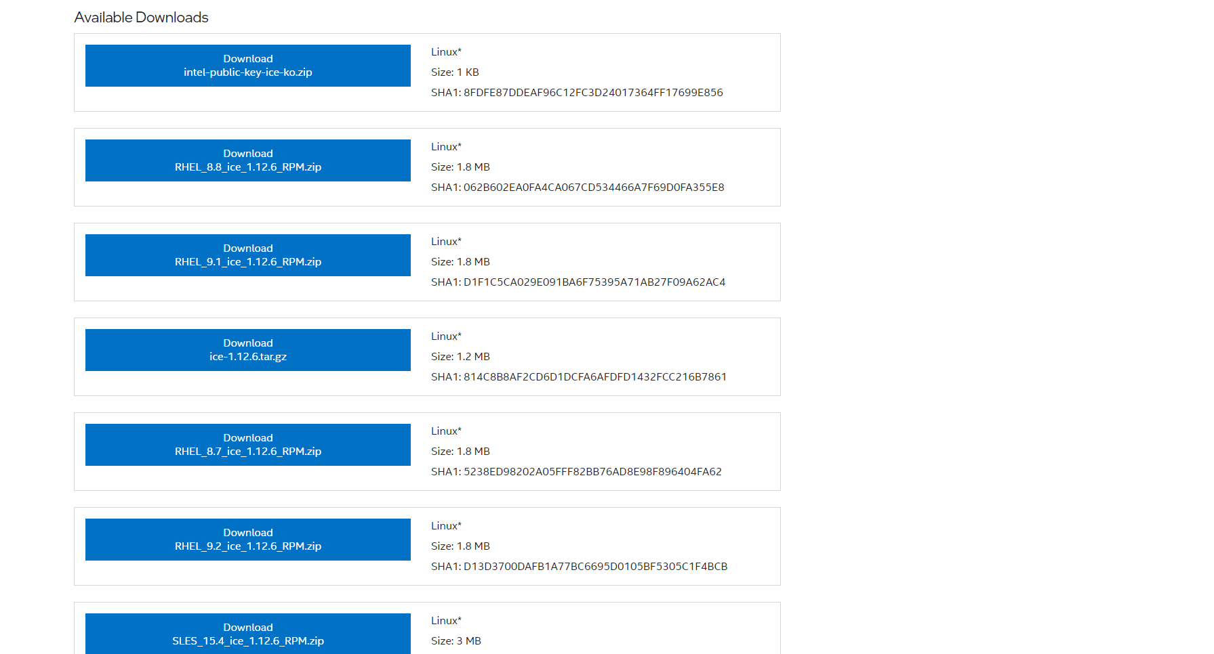
Ubuntu Driver Download
Ubuntu Driver Download
Click to download the driver package.
Notes:
The Ubuntu download driver page is called intel network adapter driver for E810 series devices under Linux. After clicking on it, you can see a lot of download buttons, click download RHEL_9.2_ice_1.12.6_RPM.zip and install the driver package, then you can use QXG-25G2SF-E810.

Slide 22
QXG-25G2SF-E810 is backed by a 3-year product warranty
QXG-25G2SF-E810 comes with a free 3-year product warranty.
More information: QNAP Warranty Service
QNAP-Warranty Service Official Website
https://www.qnap.com/service/product-warranty/go/
Notes:
The QXG-25G2SF-E810 is backed by a free 3-year warranty. For more information about the warranty, please click the QNAP Warranty link or type the QNAP Warranty Service Official Website URL in the search engine to go there.

Slide 23
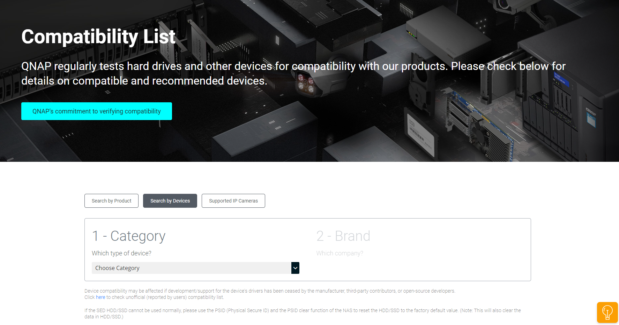
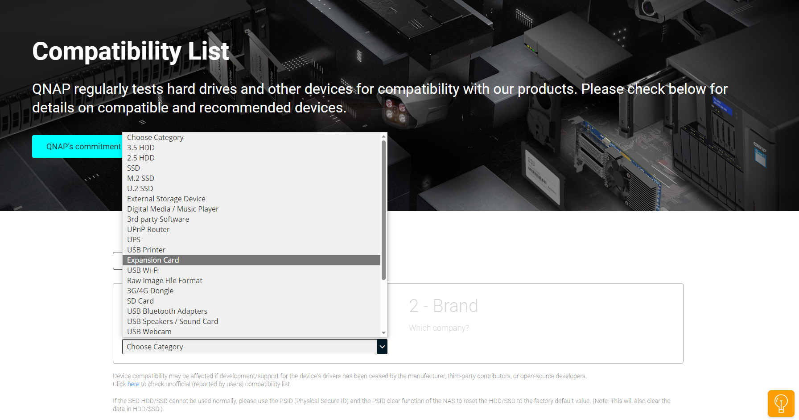
QXG-25G2SF-E810 NAS Compatibility Check
Step 1: Go to Compatibility List - QNAP and select search by devices.
QNAP-Compatibility List Official Website
https://www.qnap.com/go/compatibility/
c
Step 1
Step 2: In 1 - Category, select the type of device you want to query. Expansion Card will be used as a sample category for the following demonstration.
Step 2
Notes:
Next is the compatibility issue that we are all concerned about. Can I use the QXG-25G2SF-E810 25GbE expansion card with my existing machine or the machine I am planning to buy? If there is any incompatibility problem, it will be very troublesome. Here I will show you how to check the product compatibility on QNAP official website. First of all, click on the Compatibility List - QNAP link or type QNAP - Compatibility List short URL in the search engine to get there. Go to the page and select Search by Device. Then select the device type you want to check in the category. Expansion card will be used as a sample category for the following demonstration.

Slide 24
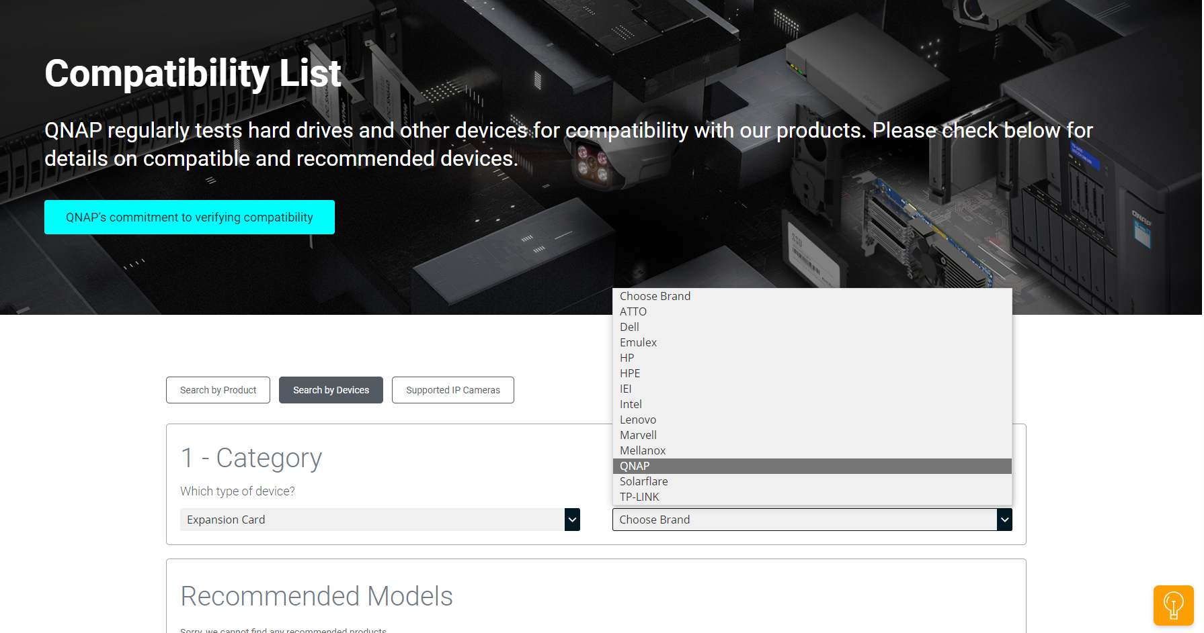
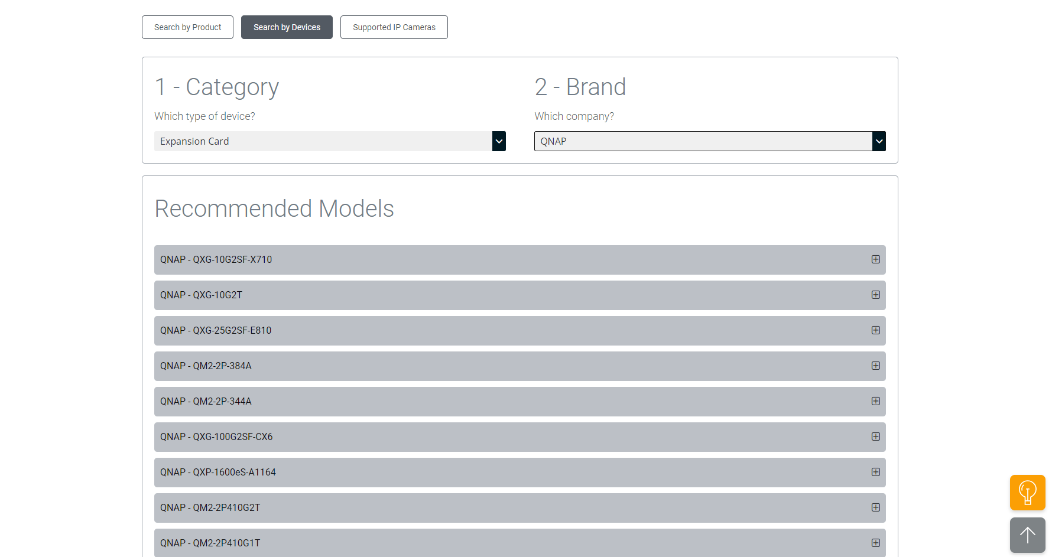
QXG-25G2SF-E810 Product Compatibility Check
Step 3: In 2 – brand, Choose the brand you want to inquire about. We will use QNAP as a sample brand for the following demonstration.
c
Step 3
c
Step 4: Below the recommended models you can see all the expansion cards available from QNAP.
Step 4
Notes:
After selecting the expansion card, choose the brand you want to inquire about. We will use QNAP as a sample brand for the following demonstration. After searching the brand, you can see all the QNAP's expansion cards in the recommended models below.

Slide 25
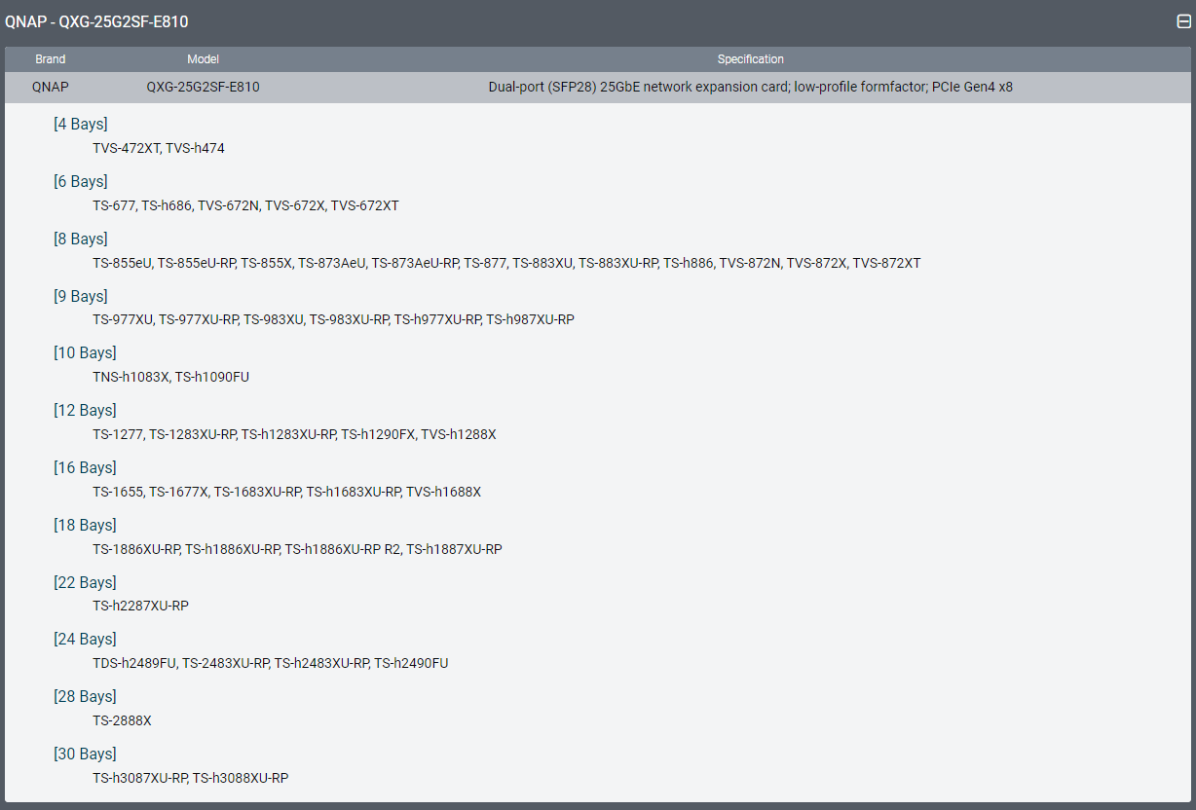
QXG-25G2SF-E810 Product Compatibility Check
Step 5
c
Step 5: Click on any of the recommended models. Take QXG-25G2SF-E810 as a sample case, you can see the brand, model, specification, and compatible QNAP products.
Notes:
Click on any of the recommended models. Take QXG-25G2SF-E810 as a sample case, you can see the brand, model, specification, and compatible QNAP products. Above is all of the product specification and information of QXG-25G2SF-E810 25GbE High Speed Network Expansion Card.

Slide 26
QXG-25G2SF-E810 Performance Test
Notes:
Next, we will move on to the QXG-25G2SF-E810 performance test, which includes file write, read, upload and download.

Slide 27
File Write and File Read
Notes:
Let we start the live demo session right away. I will demo file writing and file reading. The demo environment is IOmeter, 2-port 25GbE network, 1MB Sequential Transmission, 5 seconds ramp up time and 10 seconds seq run time. The device used is QNAP NAS TS-h2287XU-RP with QXG-25G2SF-E810.

Slide 28
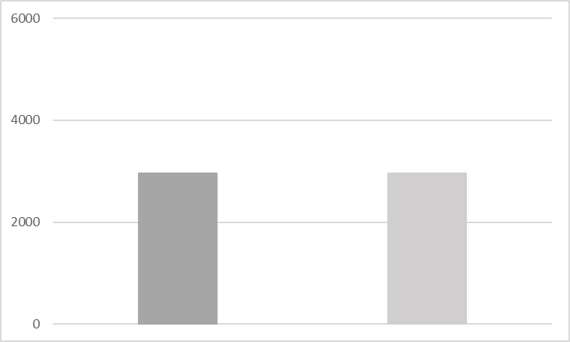
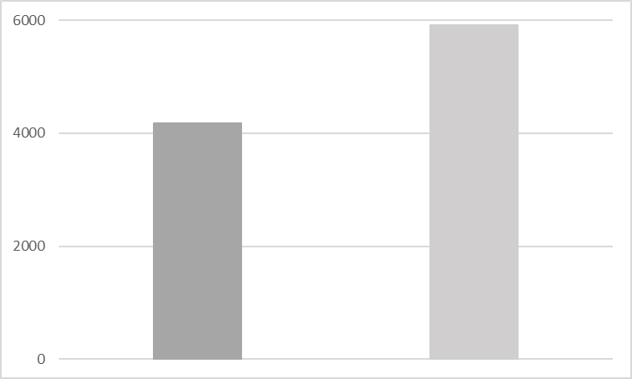
High-speed experience from QXG-25G2SF-E810 with Sequential Throughput
1 x 25GbE SMB
Sequential Transmission (1MB)
2 x 25GbE SMB
Sequential Transmission (1MB)
5,908 MB/s
4,173 MB/s
MB/s
MB/s
2,954 MB/s
2,954 MB/s
Write
Read
Write
Read
Test Environment
NAS: TVS-h874T
CPU: 12th Gen Intel(R) Core(TM) i7-12700, 2480 MHz (10C, 20T)
Volume type: Raid 5, Samsung 870 EVO 1TB x8
Client PC: Windows Server 2019, AMD EPYC 7232P 3.0Ghz (1290FX), 64GB RAM
Iometer: RAM*4, 30-sec ramp up time, 3-min seq run time, 16 worker, 4-outstanding
Notes:
This part is the performance data of the QXG-25G2SF-E810 network expansion card measured in the QNAP lab. Below is the information of the test environment. You can see that the write and read speeds both reached 2954 MB/s with one 25GbE port, and 4173 MB/s and 5908 MB/s with two 25GbE ports.

Slide 29
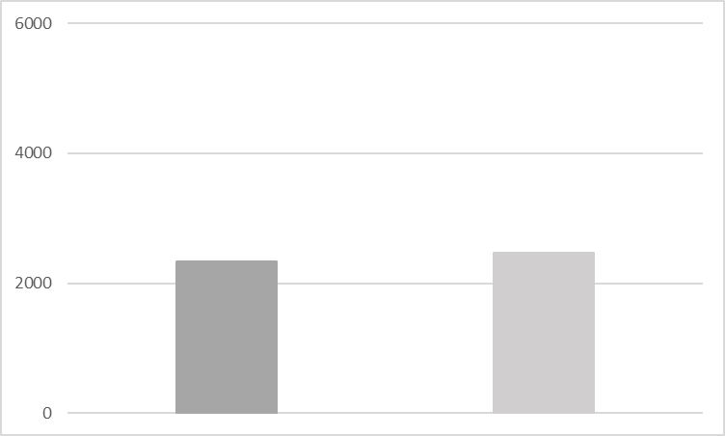
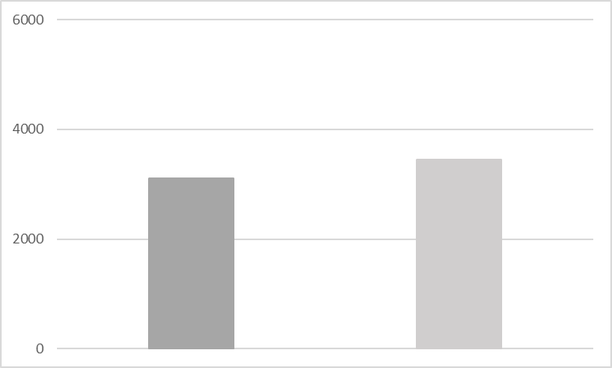
High-speed experience from QXG-25G2SF-E810 with Windows File Explorer
1 x 25GbE Windows
File Drag & Drop
2 x 25GbE Windows
File Drag & Drop (2 clients)
MB/s
MB/s
3,443 MB/s
3,109 MB/s
2,472 MB/s
2,340 MB/s
Upload
Download
Upload
Download
Test Environment
NAS: TVS-h874T
CPU: 12th Gen Intel(R) Core(TM) i7-12700, 2480 MHz (10C, 20T)
Volume type: Raid 5, Samsung 870 EVO 1TB x8
Client PC: Windows Server 2019, AMD EPYC 7232P 3.0Ghz (1290FX), 64GB RAM
Notes:
This part is the test data of file upload and download, test environment can be seen in the test environment information below. With one 25GbE port, the upload and download reached 2472 MB/s and 2340 MB/s respectively, while with two 25GbE ports, the upload and download reached 3109 MB/s and 3443 MB/s respectively.

Slide 30
Build 25GbE Network Environment
Notes:
The last part is how to easily build a 25GbE network environment with QNAP's new 25GbE high-speed network card, QXG-25G2SF-E810.

Slide 31
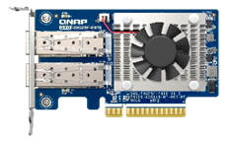
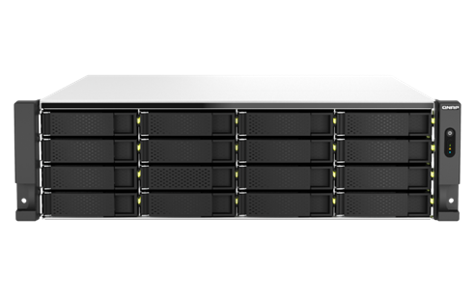
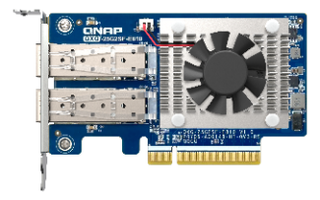
Highly efficient 25GbE network environment with QNAP NAS and 25GbE network switches
An affordable combination for a smooth, secure and scalable high-speed network environment.
QXG-25G2SF-E810
QXG-25G2SF-E810
25GbE
25GbE
Virtualization Machine
25GbE high-speed network switch
QNAP NAS
TS-h2287XU-RP
25GbE
25GbE
QXG-25G2SF-E810
QXG-25G2SF-E810
Multimedia Workstation
Multimedia Workstation
Notes:
With QNAP NAS and high-speed network switches, using multiple QXG-25G2SF-E810 25GbE network expansion cards to create a smooth, secure, and scalable high-speed 25GbE network environment for individual users or teams at an affordable budget.

Slide 32
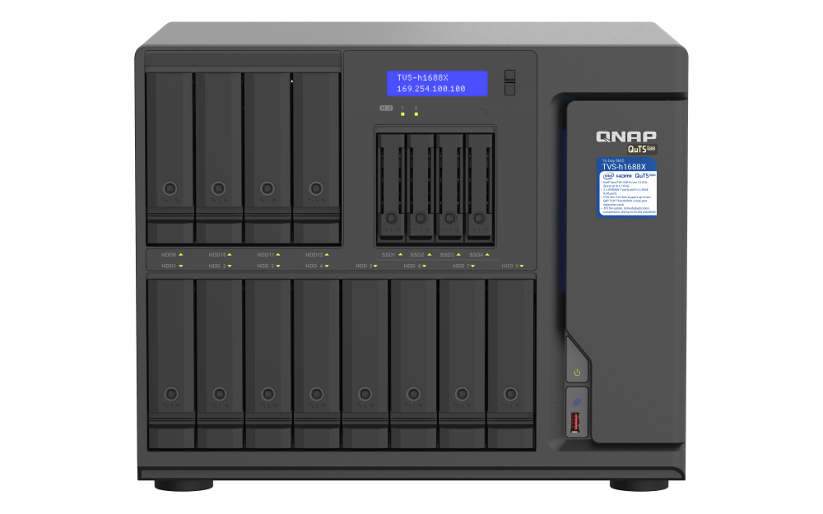
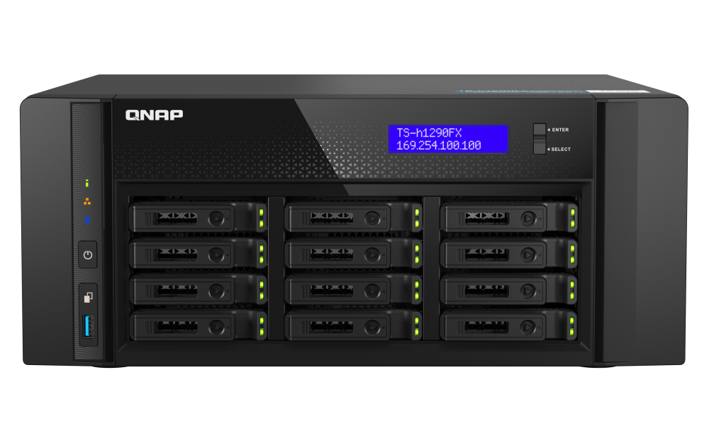
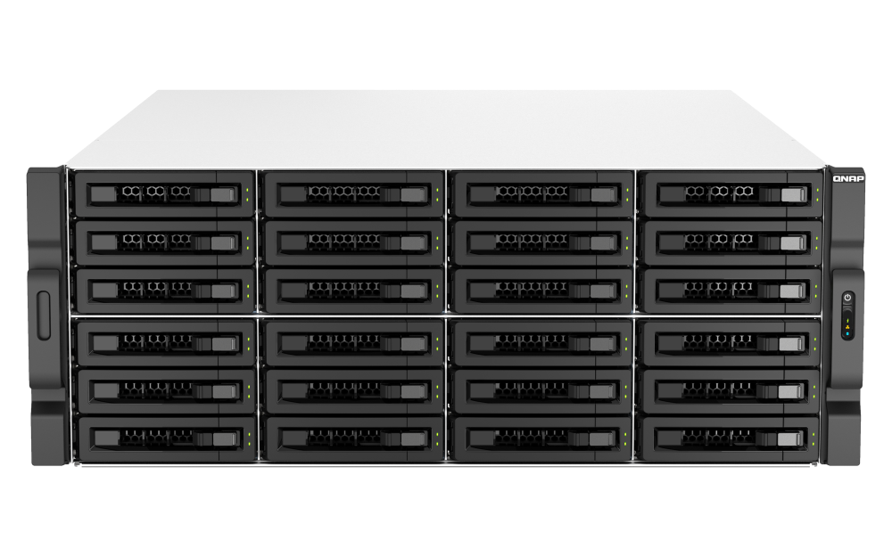
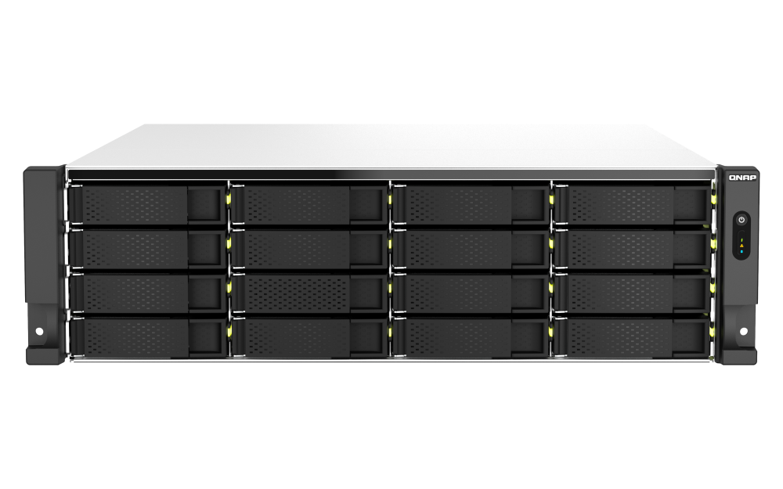
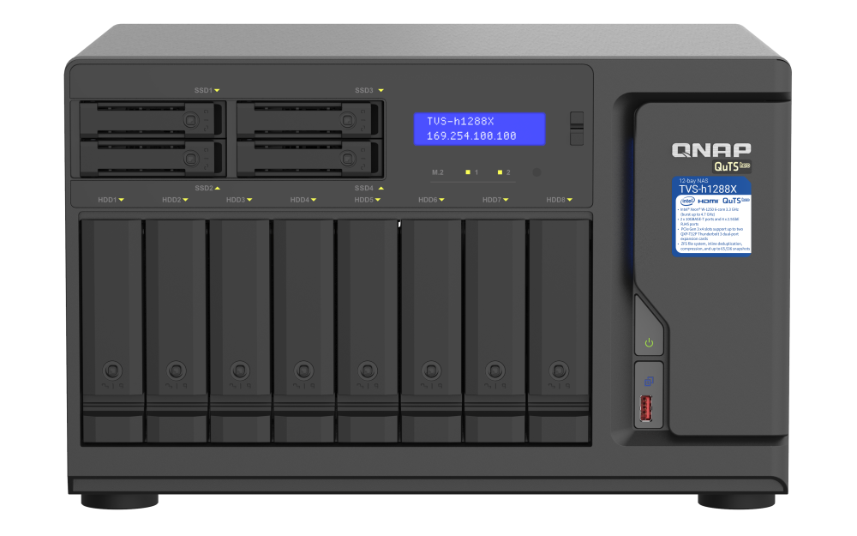
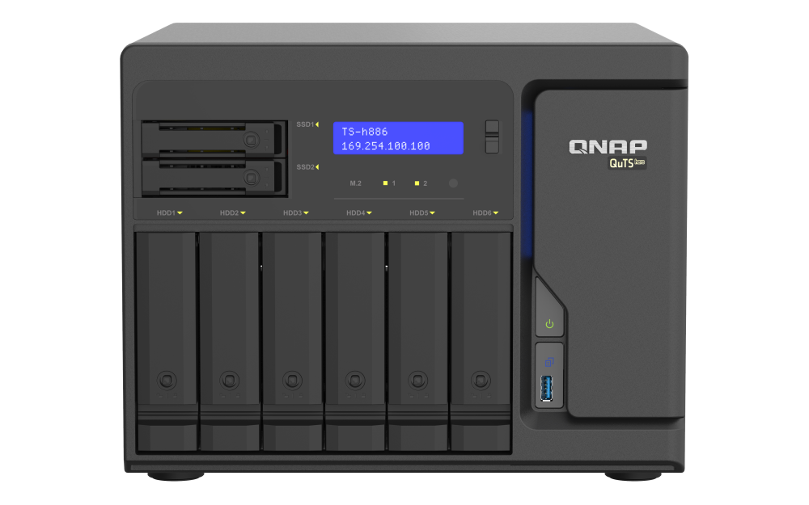
Multiple Scalable 25GbE Network QNAP NAS - Wide range of enterprise and high-end SMB NAS options
ES2486dc
TDS-h2489FU
TS-h2490FU
TVS-h1688X
TS-h1290FX
TS-h3087XU-RP
TS-h2287XU-RP
TVS-h1288X
TS-h2483XU-RP
TS-h1683XU-RP
TS-2483XU-RP
TS-h886
TS-h2477XU-RP
TS-h1677XU-RP
TS-h1277XU-RP
TS-855eU-RP
More QNAP NAS models with QXG-25G2SF-E810 support are available!​
Notes:
In addition to TS-h2287XU-RP, QNAP also offers a wide range of 25GbE expandable NAS models, from Enterprise to SMB NAS, Rackmount to Tower, QNAP has a complete lineup of NAS products to satisfy your diverse needs, and tailor-made for you to choose the QNAP NAS that best meets your needs. For more information about the QNAP NAS that can support the QXG-25G2SF-E810 25GbE network expansion card, you can either directly click the link below, or go to the official website of QNAP to check out the compatibility list.

Slide 33
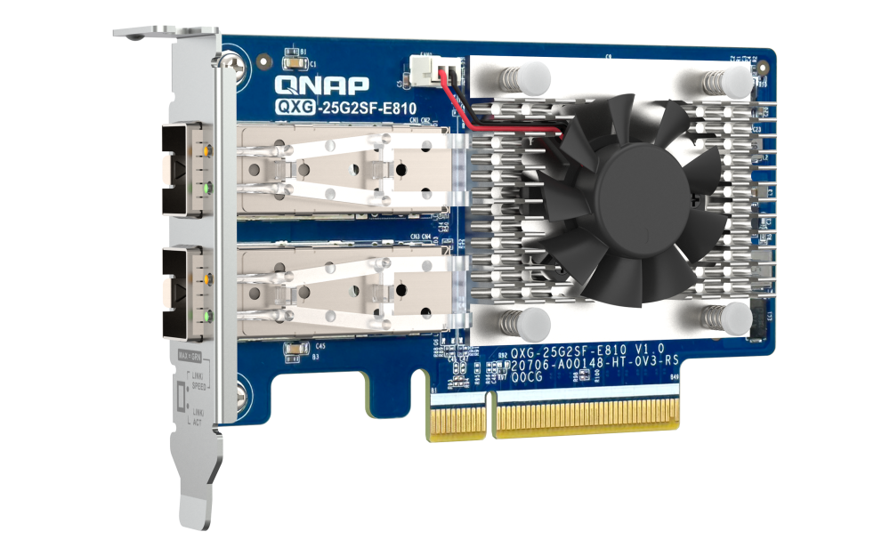
Coming Soon: QNAP 100GbE Network Switch (QSW-M7308R) with 4-Port 100GbE and 8-Port 25GbE
Available in October, 2023
High-speed 100GbE managed switch
QSW-M7308R-4X
4x 100GbE QSFP28 network ports (100G/10G/1G)
8x 25GbE SFP28 network ports (25G/5G/2.5G/1G/100M)
Total bandwidth up to 1200Gbps
Record up to 32000 different MAC addresses and their corresponding interface information
Equipped with L2 network management function
Supports Forward Error Correction for seamless connection with QXG-25G2SF-E810
Compliant with IEEE802.3az Energy Efficient Ethernet standard
QXG-25G2SF-E810
Notes:
For the 25GbE-supported high-speed switch, you can see the QSW-M7308R-4X, which QNAP expects to launch in October 2023, is a managed network switch with four 100GbE and eight 25GbE ports. The QSW-M7308R-4X has four 100GbE QSFP28 ports supporting 100G/1G dual speed and eight 25GbE SFP28 ports supporting 25G/5G/2.5G/1G/100M five speeds with a total bandwidth of up to 1,200Gbps, and supports Forward Error Correction (FEC) for seamless connectivity with the QXG-25G2SF-E810.

Slide 34
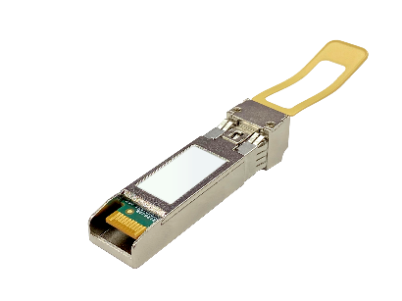
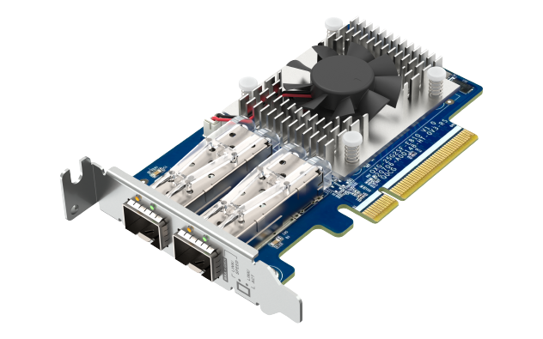
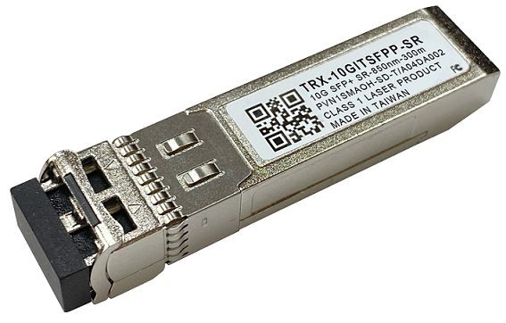
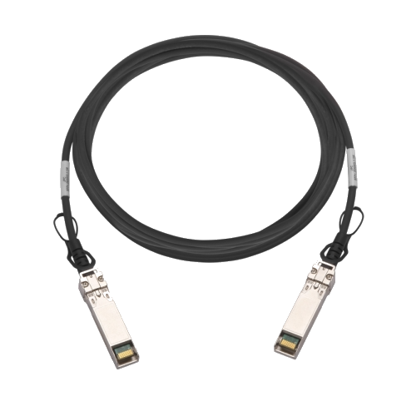
QNAP offers a complete line of 10GbE/25GbE accessories
25GbE SFP28 DAC
CAB-DAC15M-SFP28
CAB-DAC30M-SFP28
25GbE SR Transceiver
TRX-25GSFP28-SR
10GbE SFP+ DAC
CAB-DAC15M-SFPP
CAB-DAC30M-SFPP
CAB-DAC50M-SFPP
10GbE SR Transceiver
TRX-10GITSFPP-SR
QXG-25G2SF-E810
Notes:
QNAP also offers a complete line of 10GbE and 25GbE accessories, so you don't have to worry about where to buy the network accessories you'll need when using the QXG-25G2SF-E810. Including cables and fiber optic adapters, QNAP provides you with a complete product experience.

Slide 35
Notes:
QNAP QXG-25G2SF-E810 25GbE High-Speed Network Expansion Card is the best choice for upgrading your 25GbE network into the high-speed network era!

