Slide 1





Powered by Intel Atom® C5125 8-core 2.8GHz processor, support up to 128GB memory, hybrid storage architecture suitable for small and medium-sized enterprises backup and monitoring applications
Notes:
Hello everyone, welcome to todays QNAP livestream. Today, we'll have an introduce of our new hybrid NAS TS-855x.
Powered by Intel Atom® C5125 8-core 2.8GHz processor, support up to 128GB memory, hybrid storage architecture suitable for small and medium-sized enterprises backup and monitoring applications
So lets take a look in detail !

Slide 2






Powered by server-grade Intel 8-core CPU
strong performance and expandability
8
Intel 8-core CPU
1 x 10GBASE-T & 2 x 2.5GbE
Server-grade Intel Atom® C5125 2.8GHz 8-core processor provides powerful NAS performance
Integrated 10GBASE-T & dual 2.5 GbE network ports, provide smooth data transmission experience
Core
Dual M.2 PCIe SSD slots
2 x PCIe Gen3 x4 slots
Two PCIe Gen3 x4 M.2 2280 slots for optimal configuration of NVMe SSD and 3.5" SATA HDD
Provide a variety of expansions including 10G/25GbE network card, M.2, HBA and other expansion cards
Maximum 128 GB memory
Hybrid architecture
128 GB
Pre-installed 8 GB non-ECC memory with 4 x DDR4 UDIMM slots, optionally support highly reliable ECC memory modules
6 x 3.5”/2.5” SATA HDD + 2 x 2.5” SATA SSD provide a hybrid NAS with high cost performance ratio
Notes:
TS-855X is our hybrid NAS, 6 x 3.5”/2.5” SATA HDD + 2 x 2.5” SATA SSD provide a high cost performance ratio
powered by intel Atom C5125 8-core processor to provide powerful performance.
Sufficient 10GBASE-T & Dual 2.5 GbE network ports, provide smooth data transmission experience.
2 M.2 PCIe SSD slots for optimal configuration of SSD and HDD. And 2 PCIe Gen 3 x4 slots to Provide a variety of expansions including 5/10/25GbE network card, M.2, HBA and other expansion cards.
And pre-installed 8GB Non-ECC memory, with 4 DDR4 UDIMM slots can be expanded and also support ECC Memory.

Slide 3

Choose between
QTS and ZFS based QuTS hero
TS-855X is shipped with the QTS operating system, which has powerful data transmission performance and more efficient memory usage, and enjoys the Qtier automatic tiered storage function. You can also change to the QuTS hero operating system according to your needs
 | QuTS hero | QTS
Filesystem | ZFS | Ext4
SSD cache | Read Cache | Read/Write Cache Read Cache Write Cache
Inline Compression | Yes (LZ4 compression, ideal for RAW files and document files) | No
Inline Deduplication | Yes (At least 16 GB RAM required) | No
HBS with QuDedup for Remote Backup | Yes | Yes
Power Failure Protection (Software) | ZIL Copy-on-Write | No
Permission Management | Rich ACL (14 types) | POSIX ACLs (3 types) + certain special permissions
Capacity Expansion | Upgrade RAID capacity Change higher capacity disk drives Attach expansion enclosures/JBODs | Add a disk drive to a RAID group Upgrade RAID capacity Change higher capacity disk drives Attach expansion enclosures/JBODs
Data Security | Better (Self-Healing & Copy-on-Write) | Standard
Recommendation SSD Configuration for Video Editing Applications | Use SSD Pools Note: Set the block size 128K when creating Folders/LUNs | Editing (from original/RAW files): Use SSD Pools Post production: Enable Read/Write cache Note: Set the block size to 32K or 64K when creating Volumes, and choose “All I/O” for cache mode.
Notes:
TS-855x is shipped with the QTS operating system, which has powerful data transmission performance and more efficient memory usage, and enjoys the Qtier automatic tiered storage function. You can also change to the QuTS hero operating system according to your needs

Slide 4
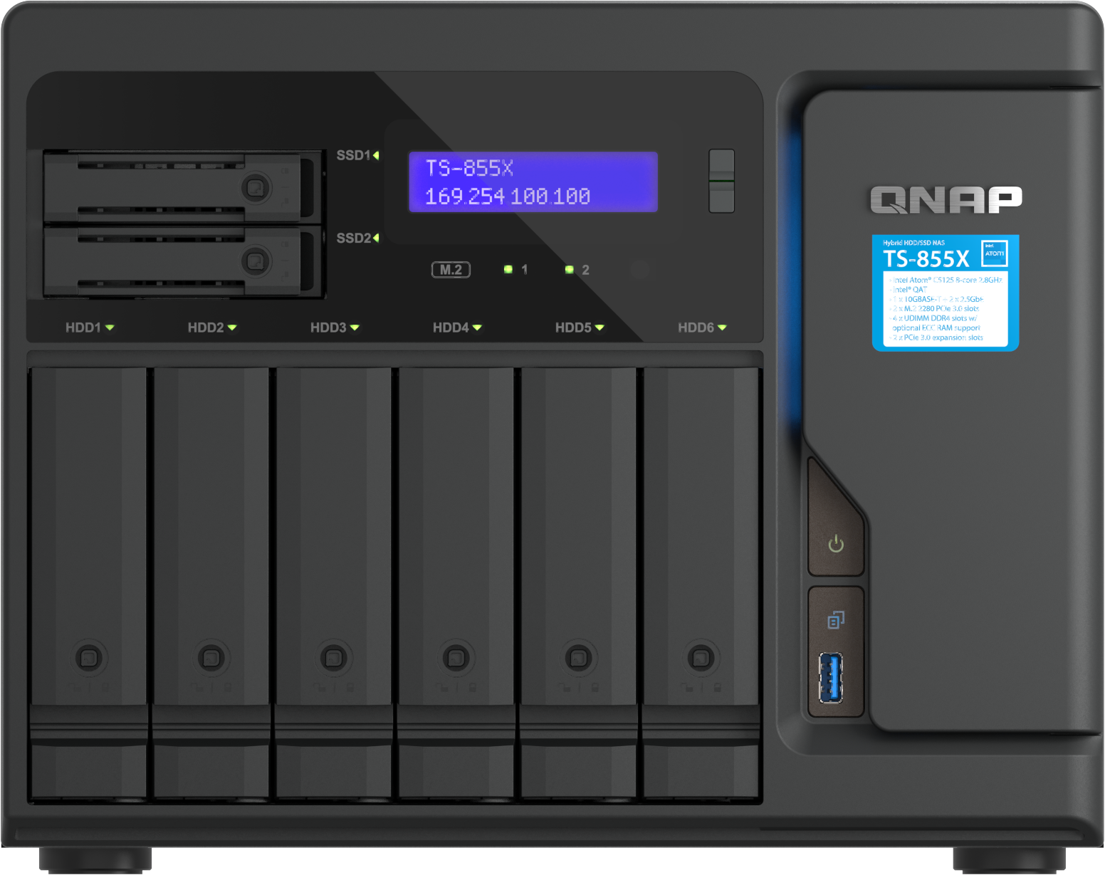
Support Intel QAT
and SR-IOV to increase efficiency
SR-IOV Network I/O Virtualization
SR-IOV
Install a PCIe network card that supports SR-IOV technology, and directly allocate the bandwidth resources of the physical network card to the virtual machine.
Intel® QAT hardware acceleration
QAT
Supports the Intel® QuickAssist hardware acceleration engine (Intel® QAT), which accelerates data compression/decompression, and can greatly improve the performance of encryption and decryption transmission operations
Notes:
And we also Support Intel QAT and SR-IOV to increase efficiency.
With SR-IOV you can Install a PCIe network card that supports SR-IOV technology, and directly allocate the bandwidth resources of the physical network card to the virtual machine.
And INTEL ATOM SUPPORT Intel® QAT hardware acceleration, Supports the Intel® QuickAssist hardware acceleration engine (Intel® QAT), which accelerates data compression/decompression

Slide 5
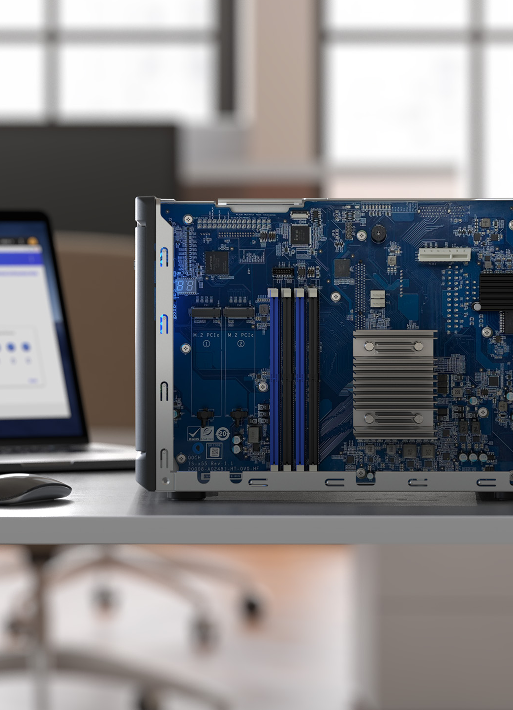
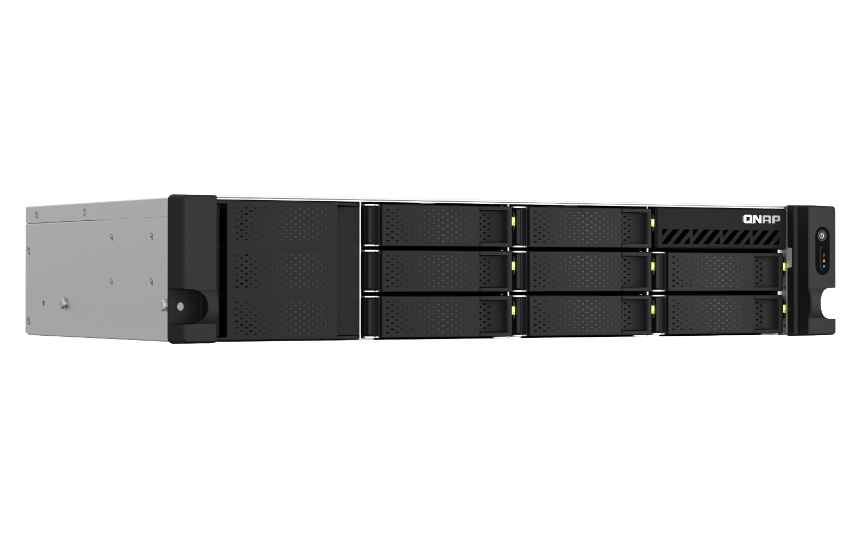
Hardware
TS-855X | 8-bay Hybrid HDD/SSD NAS
Notes:
Let's look at the hardware part

Slide 6
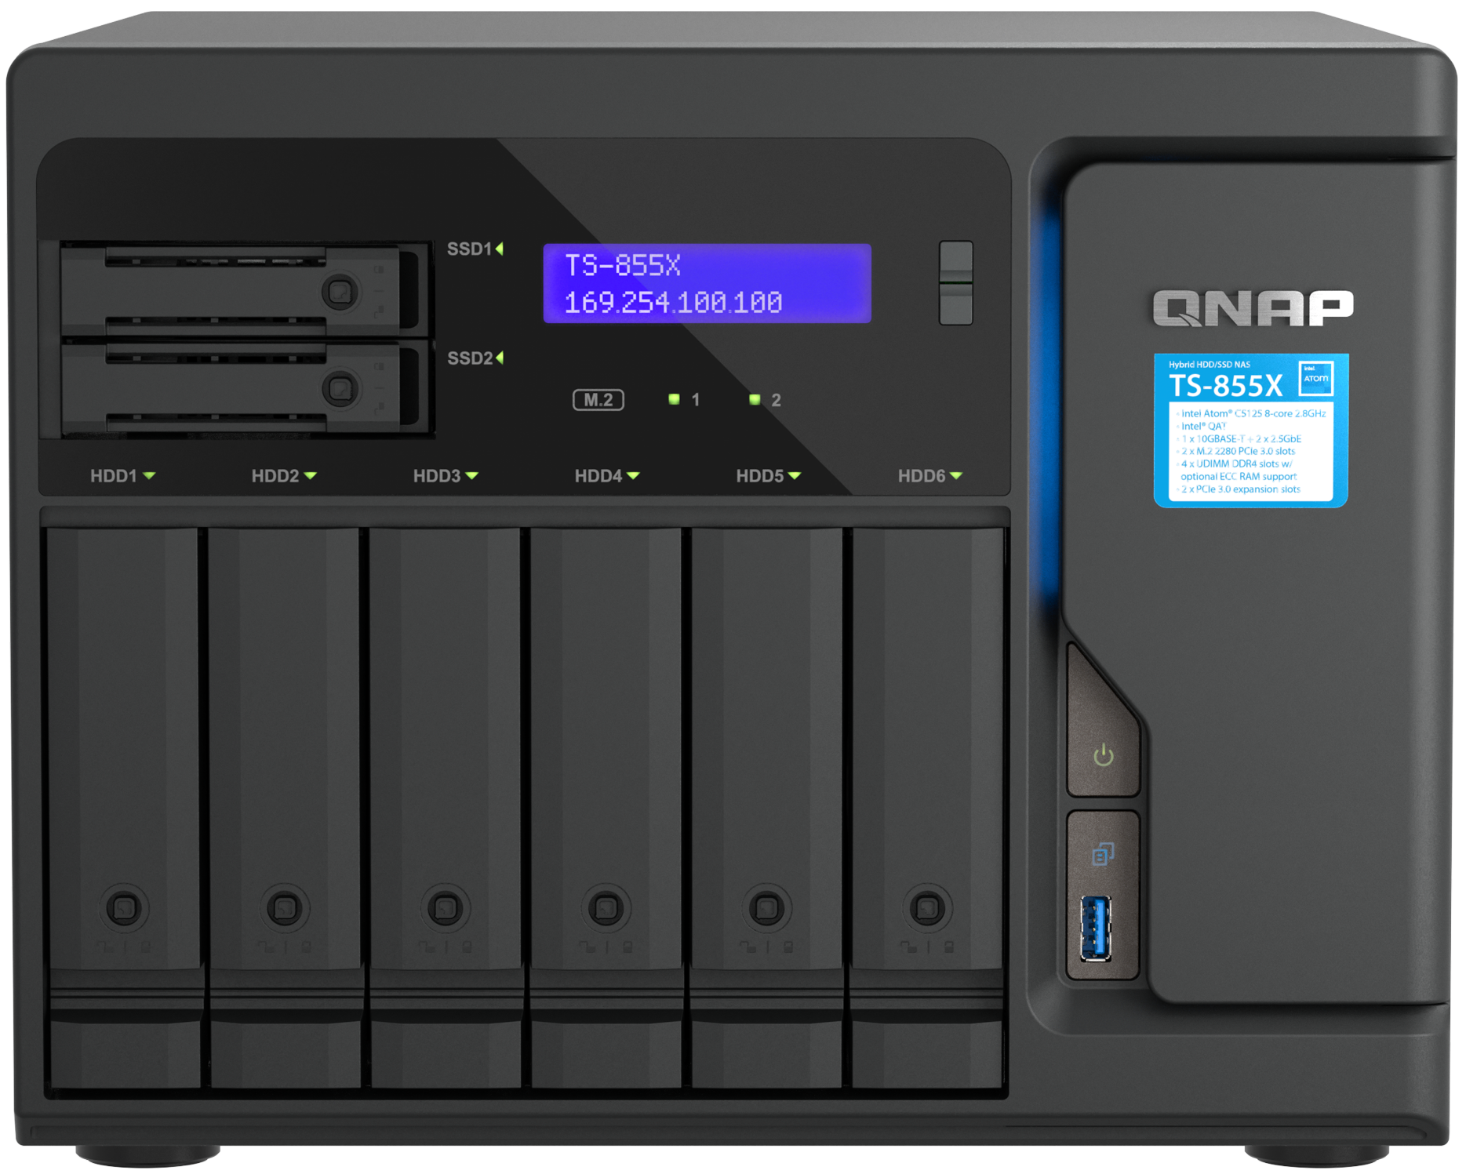

TS-855X front view
2 x 2.5”SATA
6Gb/s SSD tray
LCD panel
and buttons
HDD port LEDs
6 x 3.5"/ 2.5”SATA
6Gb/s HDD/SSD tray
Lockable tray with 2 keys provided
Power button
1 x USB 3.2 Gen 1
& OTC button
Notes:
補充 M.2 燈號 highlight 2280

Slide 7
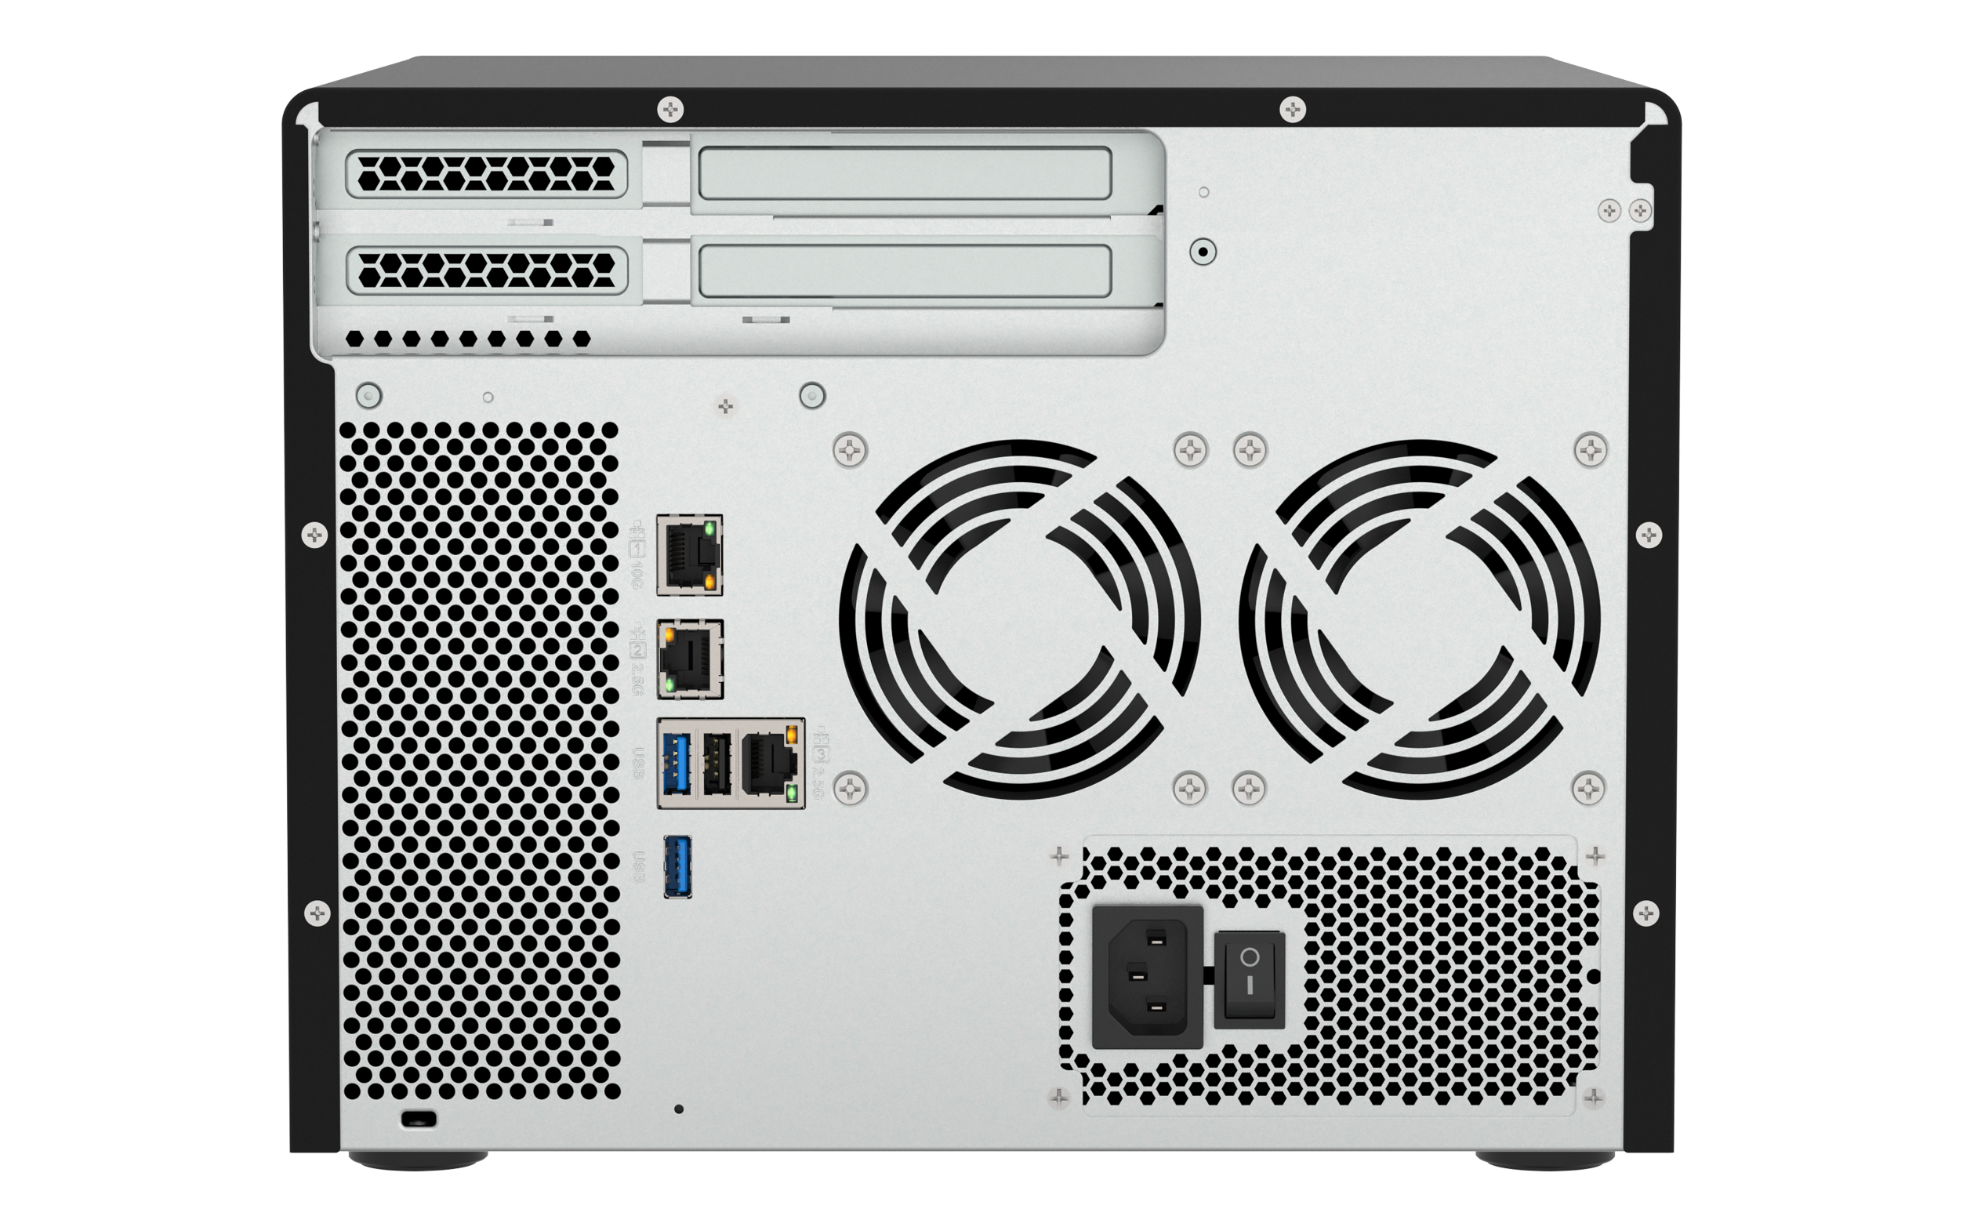
TS-855X rear view
Slot 2: PCIe Gen3 x4
Slot 1: PCIe Gen3 x4
1 x 10GBASE-T
Smart system cooling fans
2 x 2.5GbE
2 x USB 3.2 Gen 1 port
USB 2.0
100-240V power supply
Reset button
Notes:
K-lock 全名
DC 12V input

Slide 8
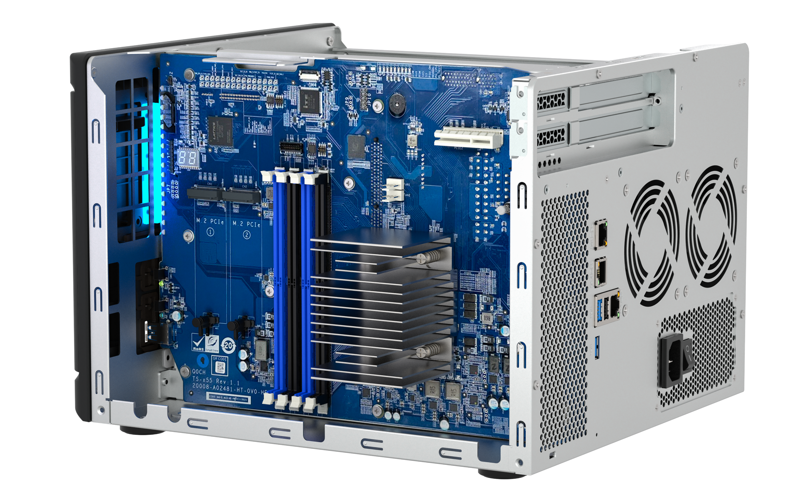
Internal design
4 x DDR4
UDIMM slots
1 x PCIe Gen3 x4 slot
1 x PCIe Gen3 x4 slot
2 x M.2 2280 PCIe Gen3 x4 slots
Notes:
K-lock 全名
DC 12V input

Slide 9
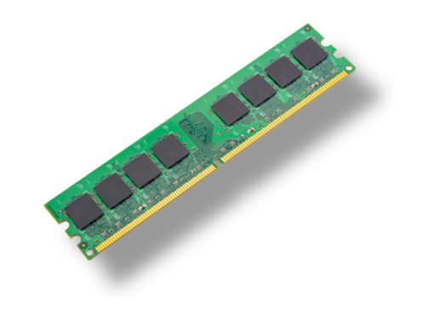

Support ECC Memory
(Error Correcting Code)
Reliable memory and avoiding data corruption
TS-855X supports ECC memory, automatically detecting and timely correcting single-bit errors
System supports up to 128GB (4 x 32GB) memory
The NAS is pre-installed with a 8GB non-ECC UDIMM memory by default.
ECC memory and non-ECC memory modules cannot be installed together
Notes:
The built-in Intel ATOM processor supports reliable ECC memory, automatically detecting and timely correcting single-bit errors. The system also supports up to 128GB of memory. In addition, the TS-855x are pre-installed with 8GB of non-ECC memory for shipping. The only thing need to attention to is that ECC and non-ECC memory cannot mix.

Slide 10

Features 10GBASE-T & 2.5GbE connectivity
1 x 10GBASE-T + 2 x 2.5GbE ports
Sufficient 10GBASE-T & Dual 2.5 GbE network ports, provide smooth data transmission experience
1 x 10GBASE-T
2 x 2.5GbE
Notes:
TS-855X Features 10GBASE-T & 2.5GbE connectivity , built-in 1 x 10GBASE-T + 2 x 2.5GbE ports provide smooth data transmission experience

Slide 11

Compared to the previous model
 | TS-855X | TS-h886 | TS-673A
SKU | TS-855X-8G | TS-h886-D1602-8G | TS-673A-8G
CPU | Intel ® Atom® C5125 8-core processor, 2.8GHz | Intel® Xeon® D-1602 2-core/4-thread processor, up to 3.2 GHz | AMD Ryzen™ Embedded V1500B 4-core/8-thread 2.2 GHz processor
Drive bay | 6 x 3.5-inch SATA 6Gb/s + 2 x 2.5-inch SATA 6Gb/s |  | 6 x 3.5-inch SATA 6Gb/s
O.S. | QTS (Pre-installed) / QuTS hero | QuTS hero (Pre-installed) / QTS | QTS (Pre-installed) / QuTS hero
Memory | 8 GB UDIMM DDR4 (1 x 8 GB) Max 128GB ( Support ECC ) | 8 GB UDIMM DDR4 ECC (2 x 4 GB) Max 128 GB ( Support ECC ) | 8 GB SODIMM DDR4 (1 x 8GB) Max 64GB ( Support ECC )
LAN | 1 x 10GBASE-T 2 x 2.5 Gigabit Ethernet Port (2.5G/1G/100M) | 4 x 2.5 Gigabit Ethernet Port (2.5G/1G/100M) | 2 x 2.5GbE (2.5G/1G/100M)
PCIe Slot | 2 x PCIe Gen3 x4 | 2 x PCIe Gen3 x8 | 2 x PCIe Gen3 x4
M.2 | 2 x M.2 2280 PCIe Gen 3 x4 | 2 x M.2 22110/2280 NVMe PCIe Gen3 x4 | 2 x M.2 2280 PCIe Gen3 x1
I/O | 1 x USB 2.0 3 x USB 3.2 Gen 1 | USB 3.2 Gen 1 | 3 x USB 3.2 Gen 2 Type-A 1 x USB 3.2 Geb 1 Type-C
Notes:
Compared to previous TS-h886 , our new TS-855x provide a cost effectiveness solution.
Powered by Intel atom C5125 8 core processor, and both hybrid design ,provide 6 3.5" SATA drive bays and 2 2.5" SATA drive bay.
Pre-installed a 8G UDIMM support up to 128GB and ECC supported.
For the LAN port , TS-855X built in 1 x 10GBASE-T port and 2 2.5 GbE port to provide a sufficient network environment.
And 2 PCIe Gen3 x4 slots to support various expansion card from QNAP and 2 M.2 2280 PCIe slot for optimal configuration of SSDs

Slide 12
Live Demo
Hardware introduction and RAM expansion
Notes:
1. Power off the device. 2. Disconnect the power cord from the electrical outlet. 3. Disconnect all cables and external attachments. 4. Remove the case cover. a. Loosen the screws. b. Slide the cover back. c. Lift the cover off the device.
5. Remove the fan module. a. Disconnect the fan cable from the system board. b. Remove the screw that secures the module to the chassis. c. Press the clip and then pull the module away from the system board.
6. Remove an existing module. a. Push the retention clips outward simultaneously to release the module. b. Verify that the module has tilted upward and is completely released from the slot. c. Hold the module by the edges. d. Carefully slide the module out of the slot.
Pull out the pushpin.

Slide 13
Boosted performance, flexible management, and higher security
Notes:
With our new operating system QTS 5.1.0, you can Experience “efficiency” with QNAP NAS!
QTS 5.1.0 comes with SMB multichannel for increased performance and fault-tolerant connections, advanced drive analysis and RAID disk replacement that safeguards your data, delegated administration to ease management workloads to Boosted performance, flexible management, and higher security

Slide 14

SMB Multichannel for doubled speed
A SMB 3 client automatically establishes multiple connections to the SMB server for a single SMB session. The connection also provides bandwidth aggregation and network fault tolerance.
Requirement: Both NAS and Client device support SMB 3.0 protocol. NAS: QTS 5.1.0 (or later), QuTS hero h5.1.0 (or later). Clients: Windows Server 2012 (or later), macOS Big Sur 11.3.1 (or later)
Without Multichannel
With Multichannel
Faster!
Network fault tolerance!
Notes:
A SMB 3 client automatically establishes multiple connections to the SMB server for single SMB session, and with the multiple connections achieves bandwidth aggregation and netowork fault tolerence.
With Multichannel we can provide faster and network fault tolerance solution.

Slide 15


Built in 10GBASE-T and dual 2.5 GbE ports bring essential performance out of the box
2 x 2.5GbE Windows
File Transfer
1 x 10GbE SMB
Sequential Throughput (1MB)
1,181MB/s
586 MB/s
1,181 MB/s
589 MB/s
Test environment：​
NAS: TS-855X
OS：QTS 5.0.1
Volume type: RAID 5; 8 x Samsung 860 EVO 1TB ​
Client PC: Windows Server 2016, Intel i7-6700 3.4GHz, 64GB RAM,
IOmeter : RAM*4, 30-sec ramp up time, 3-min seq. run time, 1 worker, 32-outstanding
12吋短機箱可支援市面上大部分的機櫃
內建2埠M.2(PCIe Gen 3 x1)，可提供SSD快取，加速隨機存取的速度
PCIe Gen 3 x 8插槽，提供各式應用的高速擴充卡
雙系統靈活切換配置QTS and QuTS hero
Notes:
TS-855x Built in 10GBASE-T and dual 2.5 GbE ports bring essential performance out of the box.
And below we can see the performance for each
The performance of 2 x 2.5GbE windows file transfer, 586 MB/s upload and 589 MB/s download
And 1 x 10GbE SMB Sequential Throughput 1181 MB/s for write and read

Slide 16
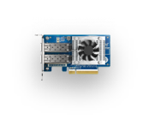
Dual PCIe Gen3 slots for
25GbE network expansion
1 x 25GbE SMB
Sequential Throughput (1MB)
2x 25GbE SMB
Sequential Throughput (1MB)
2,954 MB/s
3,505 MB/s
1,918 MB/s
2,288 MB/s
Test environment : ​
NAS: TS-855X
OS：QTS 5.0.1
Volume type: RAID 5; 8 x Samsung 860 EVO 1TB ​
Client PC: Windows Server 2016, Intel i7-6700 3.4GHz, 64GB RAM,
IOmeter : RAM*4, 30-sec ramp up time, 3-min seq. run time, 1 worker, 32-outstanding
QXG-25G2SF-CX6​
2 x 25GbE SFP28 NIC​​
12吋短機箱可支援市面上大部分的機櫃
內建2埠M.2(PCIe Gen 3 x1)，可提供SSD快取，加速隨機存取的速度
PCIe Gen 3 x 8插槽，提供各式應用的高速擴充卡
雙系統靈活切換配置QTS and QuTS hero
Notes:
Built in dual PCIe Gen3 slots support 25GbE expansion
And below we can see the performance for 25G

Slide 17






Certified for enterprises & virtualization,
8-core NAS for data storage & surveillance
Intel® 8-Core server-grade CPU
High performance processor suitable for virtual machines and multitasking
6 x SATA HDD + 2 x SATA SSD hybrid storage
Suitable for multi-device file backup and as a surveillance host
Virtualization station
Container station
QVR Elite
Qsync
HBS3
HDD+SSD
Certified for virtualization
Microsoft Hyper-V / Citrix ready /
VMware ready / Veeam ready
12吋短機箱可支援市面上大部分的機櫃
內建2埠M.2(PCIe Gen 3 x1)，可提供SSD快取，加速隨機存取的速度
PCIe Gen 3 x 8插槽，提供各式應用的高速擴充卡
雙系統靈活切換配置QTS and QuTS hero
Notes:
TS-855x equipped with a powerful Intel 8-core processor, with higher CPU benchmark than others.
this such high-performance processor is suitable for virtual machines and multi-tasking processing, and has also passed the certification of various virtual solution. And hybrid design is ideal for enterprises, no matter in the data storage and data backup can be configured more flexibly, which can easily meet the ever-increasing amount of data.

Slide 18






File Station is the ultimate and user-friendly web & iOS/Android-based file explorer
手機瀏覽
網頁瀏覽
File Station is a file management tool in QTS that enables QNAP NAS users to intuitively access shared folder content through web browsers.
Qfile
File Station
Local
NAS
Remote
NAS
Cloud Storage
Notes:
And for NAS, we need file management.
We provide File station, which make All the files and folders stored on your NAS and connected storage spaces are accessible through a familiar interface, and rich search/sort functions are available to help find files. Improve your work efficiency by connecting all your storage resources to QNAP NAS. Cloud storage, remote NAS, and USB storage devices can all be connected to provide central access and management for your files
The companion mobile app Qfile Pro allows you to remotely access your NAS files. It also is a handy tool for backing up mobile files such as photos, videos, and documents to your NAS

Slide 19










Easily make NAS your team collaboration portal with File Station
 | Edit with Office Online | View in Google Docs | Open with Google Chrome Extension
Requirement | CloudLink needs to be enabled | CloudLink needs to be enabled | Use Chrome with extension “Office Editing for Docs, Sheets & Slides” to open
Supported formats | .docx, .pptx, .xlsx | .doc, .ppt, .xls .docx, .pptx, .xlsx | .doc, .ppt, .xls .docx, .pptx, .xlsx
Capabilities | •File collaboration •Auto save to NAS in real time | •Document preview •Convert to Google docs for editing & saving in your Google Drive | •Document preview •Convert to Google docs for editing & saving in your Google Drive
Save to NAS in real time
Multi-user online editing
檔案即時同步並回存至NAS中
支援多人線上編輯
 | 以 Office Online 編輯 | 在 Google Docs 中檢視 | 以 Google Chrome 擴充功能開啟
必要設定 | 啟用 MyQNAPCloud CloudLink | 啟用 MyQNAPCloud CloudLink | 以 Chrome 瀏覽器開啟，並安裝擴充功能：Office Editing for Docs, Sheets & Slides
支援格式 | .docx, .pptx, .xlsx | .doc, .ppt, .xls .docx, .pptx, .xlsx | .doc, .ppt, .xls .docx, .pptx, .xlsx
支援能力 | 文件共同編輯與同步至 NAS 檔案 | 文件檢視 可轉成 Google 文件進行編輯 | 文件檢視 可轉成 Google 文件進行編輯
到 設定>文件 裡，選擇你習慣的預設開啟方式吧！
Notes:
The most commonly used document software in general enterprises is Office and Google Doc. You can use the web version of Office to directly open and edit Microsoft® Office documents stored in the QNAP NAS, which greatly saves the need to copy Word documents, Excel worksheets and The trouble of downloading PowerPoint from the NAS to the computer for modification!
Let NAS be an enterprise team workstation, and various files and functions make collaborative work easier. There are also some necessary settings to pay attention to here, such as...CloudLink needs to be enabled

Slide 20





Qsync 5.0 – Cross-device file sync for individuals and teams
Qsync enables efficient file synchronization between a QNAP NAS and linked devices such as computers, laptops, and mobile devices.
With Qsync, you can easily access data across all your devices and share it among your team members.
If you own many devices, any file changed on one device will be automatically synchronized with the others.
For team works, any file changed will be automatically distributed to your teams’ devices, accelerating and streamlining your workflows.
Notes:
As a NAS for data storage management, if multiple people and multiple devices are used, we also have Qsync to support cross-device team collaboration tools
Qsync enables efficient file synchronization between a QNAP NAS and linked devices such as computers, laptops, and mobile devices. With Qsync, you can easily access data across all your devices and share it among your team members.

Slide 21


DA Drive Analyzer disk failure prediction​
用 Windows 網路磁碟機快速搜尋 NAS 內的檔案
Each NAS can perform one disk prediction for free, and you can also pay to subscribe to enhance protection for all disks.
Disk health analysis and failure prediction
DA Drive Analyzer integrated ULINK AI predict technology can warn you before disk failure, help you protect valuable data
Notes:
the health of the disk after long-term use will decrease over time. At this time, there is a good helper. You can use the AI disk Health analysis tool by ULINK cloud. The DA Drive Analyzer for disk health analysis can predict the failure of the disk, which can predict the disk that is about to fail as soon as possible so that we can prepare the solution early to ensure that data won't be lost. Each NAS can perform one disk prediction for free, and you can also pay to subscribe to enhance protection for all Disk.

Slide 22






All-in-one solution for hosting virtual machines and containerized apps
Virtualization Station
Container Station
Virtualization Station allows you to create virtual machines (VM) on Turbo NAS, supporting Windows®、Linux® operating systems.
Experience LXD and Docker® lightweight virtualization technologies, download apps from the Docker Hub Registry®, import/export containers, and create abundant microservices.
Container Station
Container
Application
Application
Application
Filesystem
Filesystem
Filesystem
Host OS
Hardware
Notes:
With Intel Atom 8 core CPU, it can also be a virtual machine and container workstation
Virtualization Station is a fast and reliable hypervisor on QNAP NAS and appliances. You can run multiple virtual machines on Virtualization Station to meet versatile virtualization needs and to benefit from cost savings and advanced features.
QNAP Container Station exclusively integrates LXD and Docker®, Kata lightweight virtualization technologies, allowing you to operate multiple isolated Linux® systems on a QNAP NAS as well as download apps from the built-in Docker® Hub/LXD Image Server Registry.

Slide 23




Data security
QuFirewall
You can allow/deny IP addresses and regions to prevent unauthorized access and brute force attacks for safeguarding data and service security.
Malware Remover
Protect your NAS data against malware attacks
Notes:
And for data security
QuFirewall is the built-in firewall app used by the QTS, QuTS hero, QNE Network, and QuTScloud operating systems used by QNAP appliances. You can allow/deny IP addresses and regions to prevent unauthorized access and brute force attacks for safeguarding data and service security.
Malware Remover : Regularly scan your NAS using the latest malware definitions. When under attack, infected files will be immediately removed to ensure NAS data security.

Slide 24


Snapshots Help You Fight with
Ransomware Threats
TS-855X supports Snapshot , like taking a photo - within seconds the complete status of your NAS system and data is recorded.
QTS supports up to 1,024 snapshots, QuTS hero supports up to 65,536 snapshots
Mitigate the growing threat of ransomware
Step 1
Regularly update, and use Malware Remover
Step 2
Routinely back up to your NAS, and create multi-version snapshots
Step 3
Back up snapshots to another QNAP NAS
Notes:
TS-855x support Snapshot, like Taking a snapshot is like taking a photo - within seconds the complete status of your NAS system and data is recorded. If an unexpected situation arises on your system, you can revert to the state recorded by a snapshot. With greater space-efficiency and flexibility compared to traditional backup methods, snapshots are the best way to protect your files and data.

Slide 25





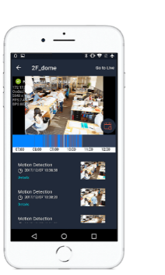
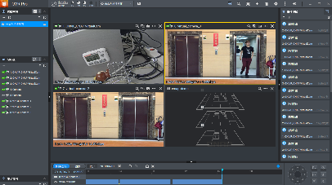

Your NAS is also a surveillance server
QVR Pro
QVR Pro Client
6,000+ Compatible cameras
8 embedded monitoring channels
Expand to 36 channels by purchasing QVR Pro licenses
View USB camera images through QUSBCam2
iOS & Android mobile devices
Support cross-platform ： Windows, Mac, Ubuntu
QVR Elite
The flexible subscription QVR Elite can be expanded to a maximum of 54 channels by purchasing licenses
Use HDMI output and USB keyboard and mouse to control the NAS through installing Graphic card
Notes:
QVR Pro, QNAP’s new surveillance solution, provides 8 embedded monitoring channels, allowing you to quickly build a home surveillance environment hosted on your QNAP NAS without any extra software needed. Businesses can easily expand the number of monitoring channels by purchasing QVR Pro licenses to deploy a large-scale surveillance network.
The QVR Pro Client mobile app provides multiple display layouts and allows you to monitor multiple channels simultaneously. Under single channel view, you can quickly switch between live and playback modes. If your network connection is slow or metered/capped, you can choose the low-bandwidth mode to view a bandwidth-optimized stream without affecting the quality of recordings.
And also a flexible subscription solution QVR Elite

Slide 26





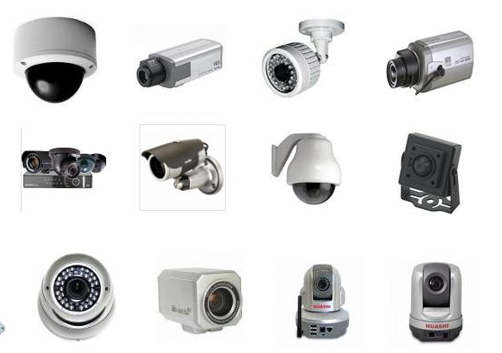






Compatible with a huge amount of camera models
over190 brands
over 6000 Models
ONVIF Profile Supported
RTSP Stream
Input / Output
RTMP Stream
Input
https://www.qnap.com/en/compatibility-qvr-pro
Notes:
We also compatible with more than 190 brands and more than 6,000 models of IPCAM on the market. In addition, it supports the ONVIF profile S open network video interface. Therefore, our surveillance solution is compatible with various cameras, allowing you to set up a surveillance system easily.

Slide 27










Supports up to 24 more HDDs with two JBOD units, add nearly 500TB ( 24 x 22TB ) of storage space
USB
Maximum of JBOD / RAID expansion enclosures​
TR-002​ | 2​
TR-004​ | 2​
TR-004U​ | 2​
TL-D800C​ | 1
TL-R1200C-RP​ | 1
TL-D400S​ | 2
TL-D800S​ | 2
TL-D1600S​ | 2
TL-R400S​ | 2
TL-R1200S-RP​ | 2
TR-002
TR-004
TL-D800C
TR-004U
TL-R1200C-RP
SATA
TL-D400S
TL-D800S
TL-D1600S
TL-R400S
TL-R1200S-RP
Note: These expansion units can only be used as an individual storage pool or volume on the NAS. Their storage pool or volume cannot be combined into the connected NAS. NAS applications cannot be installed on the them.
Notes:
We can choose a variety of expansion devices. There are 2-bay to 12-bay options for USB storage expansion, and some JBOD models support hardware RAID and power backup. And There are 4-bay to 16-bay options for SATA storage expansion. If you need capacity expansion, you can refer to the purchase.

Slide 28

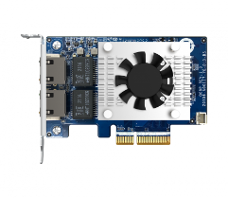
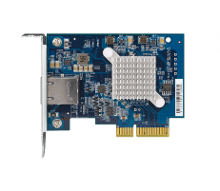
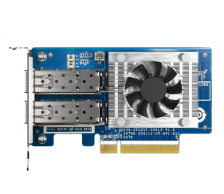

QNAP 16/32Gb Fibre Channel cards for a reliable, scalable and budget-friendly FC SAN storage solution
10GbE NIC
QXP-16G2FC : Dual ports 16Gbps
QXP-32G2FC : Dual ports 32Gbps
(FC HBA​ with 16/32Gb FC transceivers)
QXG-10G2TB
QXG-10G1T
2 x RJ45
1 x RJ45
25GbE NIC
5GbE NIC
QXG-25G2SF-CX6
(Support 25GbE SFP28, 10GbE SFP+)
QXG-5G1T-111C
QXG-5G2T-111C
For more, please check :
https://www.qnap.com/go/compatibility/
QXG-5G4T-111C
2 x SFP28 25Gb/s
1/2/4 x RJ45
Notes:
The TS-855x has a built-in two PCIe Gen3x4 slots. It can expand various network-related expansion cards designed by QNAP, and network speed is from 2.5GbE to 25GbE. You can find more about what you want in the compatibility sheet link below.

Slide 29

3-year standard warranty covering hardware repair and support services
TS-855X is backed by a 3-year warranty at no additional cost.
You can also purchase a warranty extension that extends your warranty coverage up to 5 years total (2-year extended warranty P/N: EXTW-BROWN-2Y).
SKU：TS-855X
Intel Atom® C5125 8-core CPU 2.8 GHz, , 8 GB DDR4 (1 x 8 GB)
Notes:
TS-855x is backed by a 3-year warranty at no additional cost.
You can also purchase a warranty extension that extends your warranty coverage up to 5 years total

Slide 30

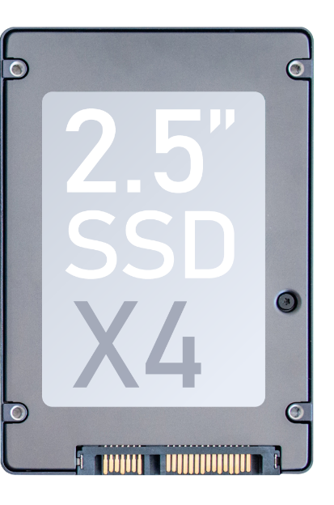



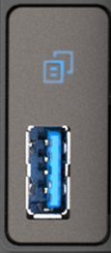


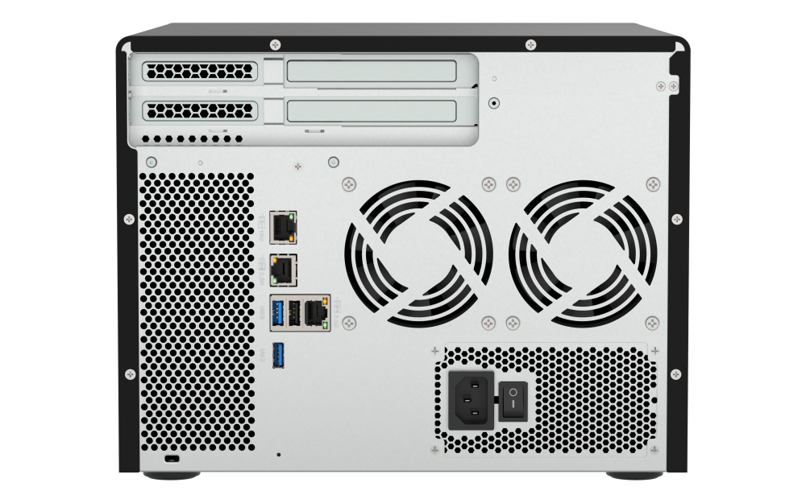




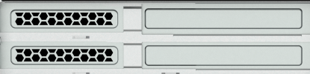
USB 3.2 Gen2 (10Gbps)
與 One-Touch-Copy
3個
PCIe Gen3 x4
擴充槽
Hybrid storage : SATA HDD + SSD
Support
5/10/25GbE
NICs
Supports both
2.5”
SSD
x2
3.5”
HDD
x6
Support
multiple JBOD
IntelQAT
USB 3.2 Gen1 (5Gbps) & One-Touch-Copy
Direct connection
2.5GbE
TS-855X
10
C5125 2.8 GHz
8-core
CPU
1 x 10GBASE-T +
2 x 2.5GbE
Availability at least until
2
128GB
2.5GbE
ECC Memory
2 x M.2 2280
PCIe Gen3 x4 slots
PCIe Gen3 x4
QVR Elite
Surveillance solution
SR-IOV
Up to 5 years warranty
Notes:
Before the ending, I will have this page to sum-up the features of TS-855x. Let’s summarize briefly what we have looked at.
TS-855x is a hybrid NAS. There are 6 3.5" SATA drive bay and 2 2.5 SATA drive bay, Powered by Intel Atom 8-core CPU. In addition to being a dedicated virtualization machine, it can also be used as a monitoring machine for large-capacity expansion.
in addition to having rich scalability and diverse applications, it can also be supplied for a long time until 2027, which can reduce the investment cost of re-planning hardware equipment due to Product discontinued

Slide 31
Powered by Intel Atom® C5125 8-core 2.8GHz processor, support up to 128GB memory, hybrid storage architecture suitable for small and medium-sized enterprises backup and monitoring applications
Copyright© 2023 QNAP Systems, Inc. All rights reserved. QNAP® and other names of QNAP Products are proprietary marks or registered trademarks of QNAP Systems, Inc. Other products and company names mentioned herein are trademarks of their respective holders.​​​​​​​
Notes:
Thank you for watching the TS-855x NAS live stream. I’m andy. See you next time. bye

