Slide 1
Boosted performance, flexible management, and higher security.

Slide 2
Efficiency and Security

Slide 3
SMB Multichannel
Multiplies the Speed!
When others are struggling on 1 Gbs to 2 Gbs, QNAP provides 2.5 Gbs ports. And furthermore: 2.5x2=5; 2.5x4=10…

Slide 4
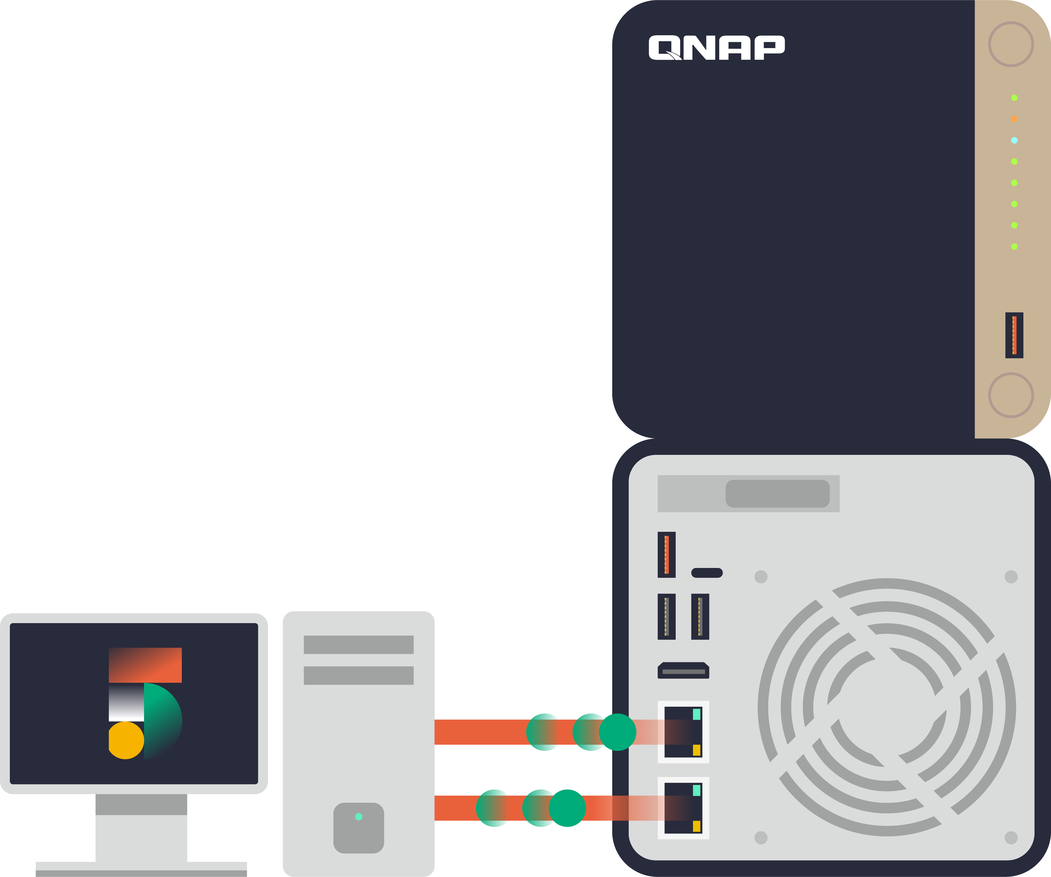
SMB Multichannel
Full throughputs by aggregating the network bandwidths!
Crystal Disk Mark | 2.5G x1 | 2.5G x2
1MB Throughput Write (MB/s) | 294 | 592
1MB Throughput Read (MB/s) | 295 | 590

Slide 5
SMB Multichannel
A SMB 3 client automatically establishes multiple connections to the SMB server for single SMB session, and with the multiple connections achieves bandwidth aggregation and netowork fault tolerence.
Without Multichannel
With Multichannel
Faster!
Network fault tolerance!

Slide 6
SMB Multichannel – Network Fault Tolerance
Simultaneously apply a set of network connections, and the client can still continue without interruption despite the loss of some network connections.

Slide 7
SMB Multichannel V.S. Link Aggregation
SMB Multichannel
Link Aggregation (Port Trunking / LACP)
General facilities
SMB only
Faster and fault tolerance
Special NIC and switch are needed (IEEE802.3ad)
Works for different protocols
Fault tolerance

Slide 8
Video Editing Scenario
25 Gbps x2
Each 10 Gbps
video ingestion server
NAS
Now with Multichannel PC user can reach 50Gbps performance
Test Environment:
TS-h1290FX(7302P), Micron 7400 U.3 SSDx12
Windows Server 2019 AMD 7232P 3.0GHz, QXG-25G2SF-CX6LX

Slide 9
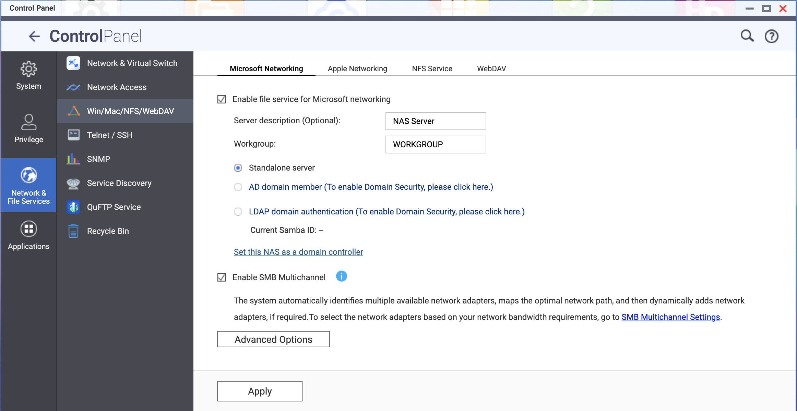
Enable in Control Panel

Slide 10
Other Information
Other Information
Theoretically, SMB multichannel aggregates all the bandwidth bundled. In practical, the performance varies upon the CPU, Storage, Memory, and I/O controller of the host and the client machines.
Clients supported:
Win8.1 or later
Win Server 2012 or later
macOS Big Sur 11.3.1 or later
SMB 3 is required for both the server and the client sides.
The current version does not support RSS, RDMA, or NIC Teaming.

Slide 11
Secure and Still Fast!
SMB Signing with GMAC algorithm

Slide 12
SMB Signing
SMB signing essentially signs each packet with a digital signature so the client and server can confirm authenticity and prevent hacking.
However, such action requires heavy calculation and had impacted the performance of data transmission.
QTS 5.1.0 now will automatically negotiate the better-performing cipher method when connecting to client computer that supports AES-128-GMAC ( Windows Server 2022 and Windows 11 for SMB 3.1.1 signing ).

Slide 13
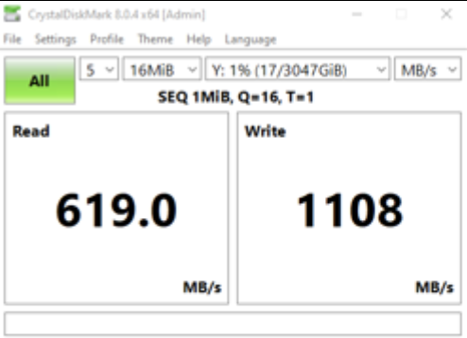
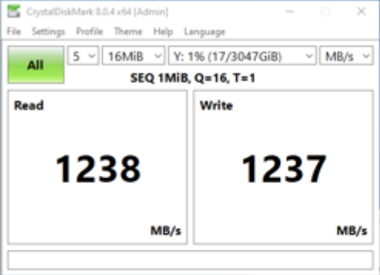
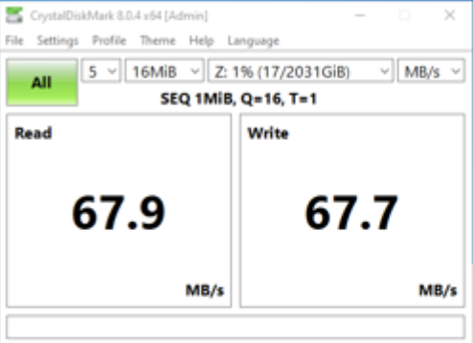
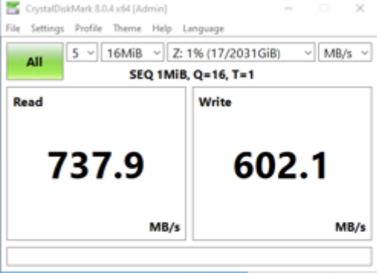
SMB Signing with GMAC: Secure and Fast!
In 10 GBs network, AES-NI enabled CPU, new GMAC algorithm outperforms the former CMAC one significantly.
CMAC
GMAC
x86
X2 Faster
ARM 64
X10 Faster
TS-h1887XU
TS-1232PXU

Slide 14
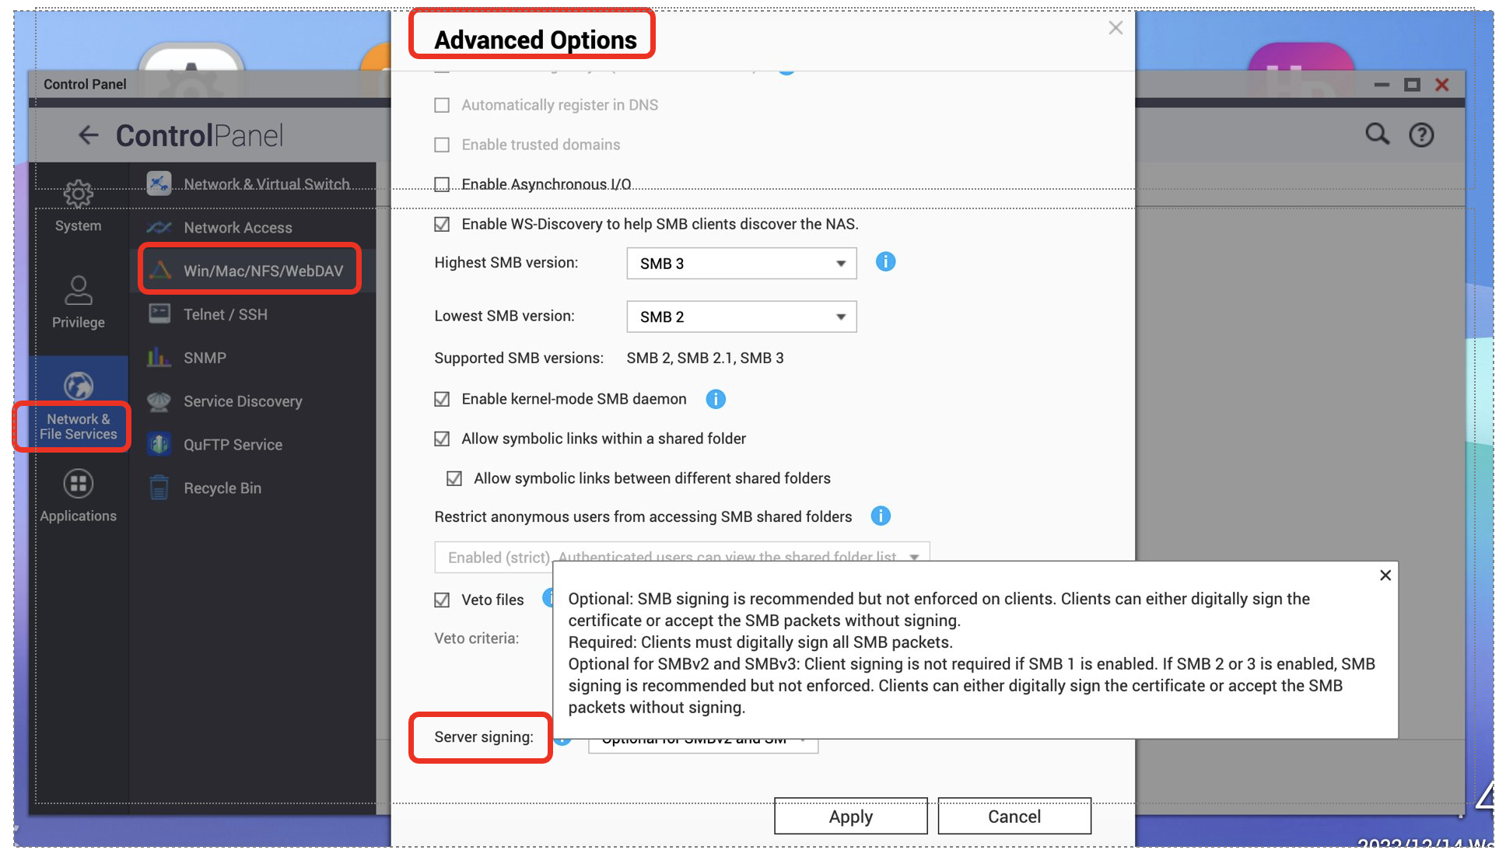
SMB Signing: Enabled either by the client or the server configuration
 | Server requre signing | Server not requre signing
Client requre signing | Signed | Signed
Client not requre signing | Signed | Not signed

Slide 15
Authentication with QANP Authenticator
Passwordless, or combine password as 2 factor authentication.

Slide 16
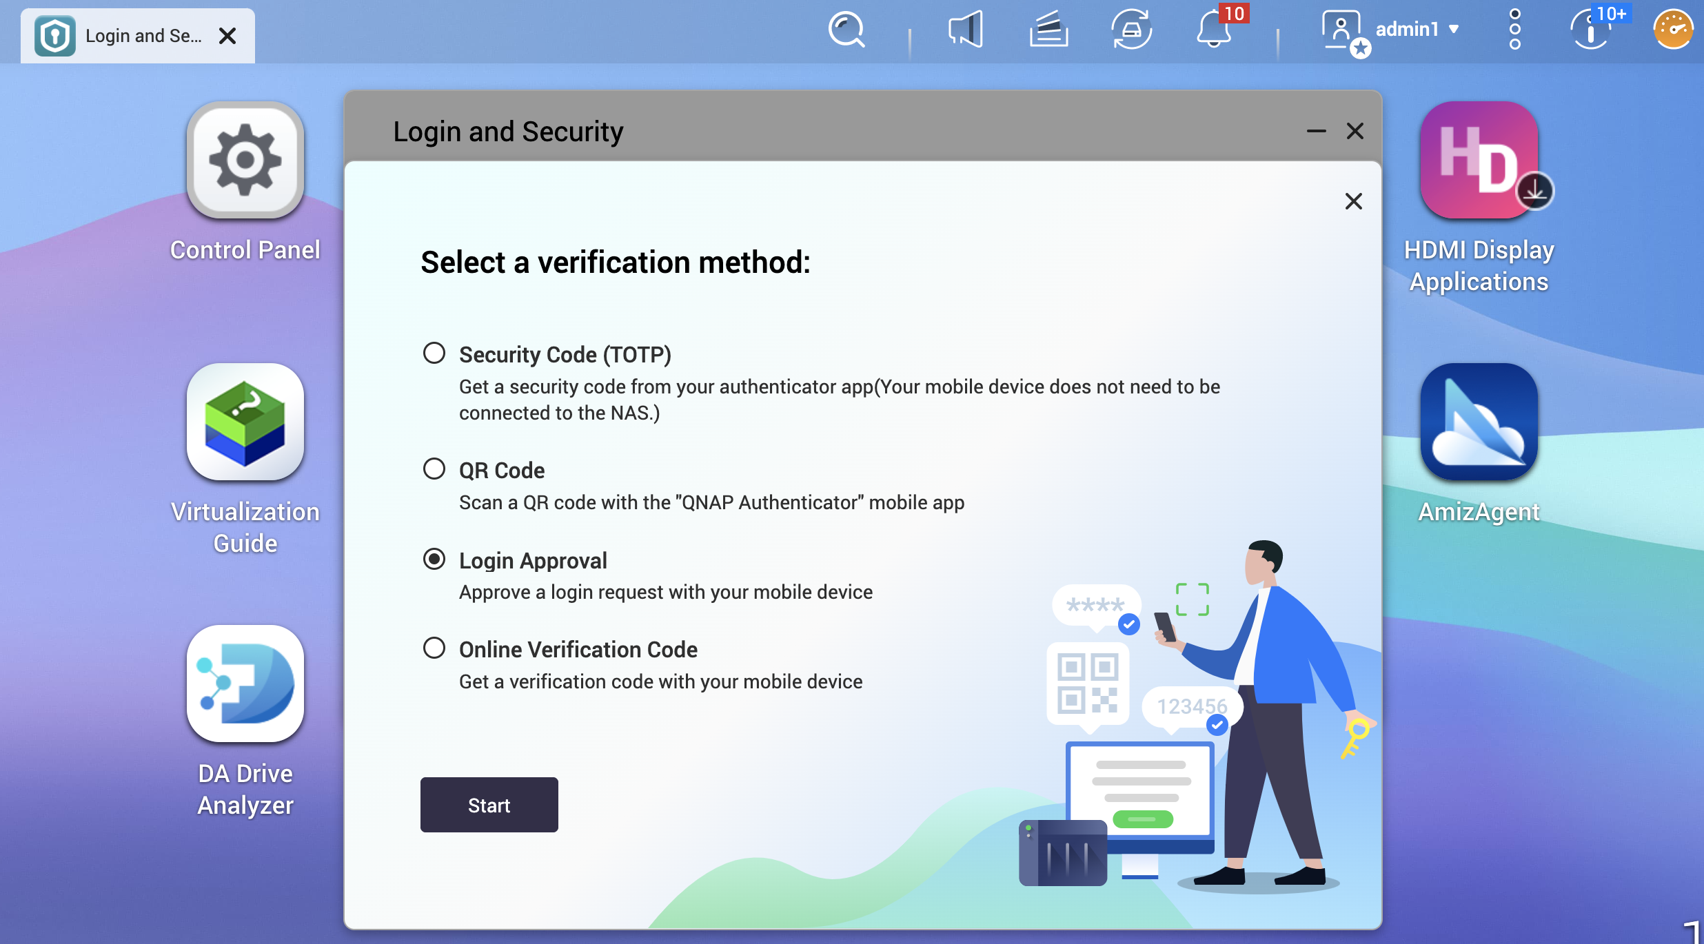
QNAP Authenticator
New 2 Step Verification
Password
Options with
Security Code (TOTP, Time-based One-Time Password; Mobile device does not need to connect to NAS)
QR Code
Login Approval
Online Verification Code

Slide 17
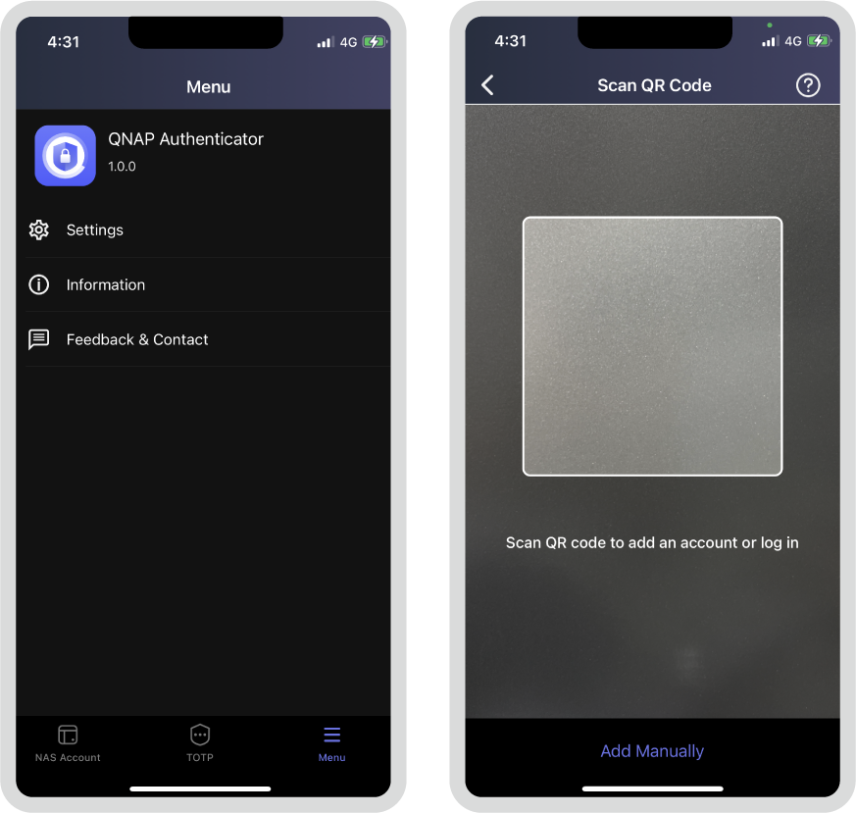
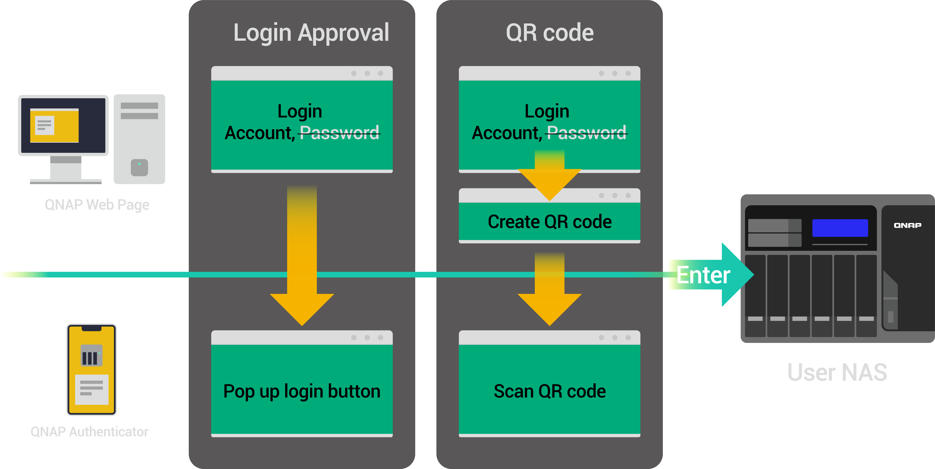
QNAP Authenticator: Passwordless
If 2 Step Verification is not necessary, QNAP Authenticator can still let you not to memorize password by “Log-in Approval” or QR Code

Slide 18
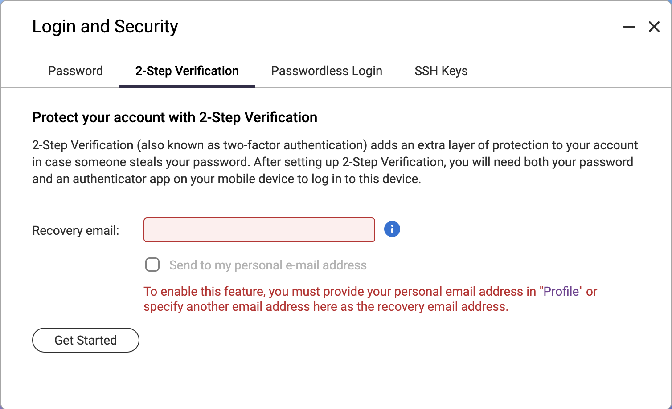
Configure from “Login & Security”
[Note] to send a recovery email, the QTS should login to QNAP ID, or the SMTP service should be enabled on Notification Center

Slide 19
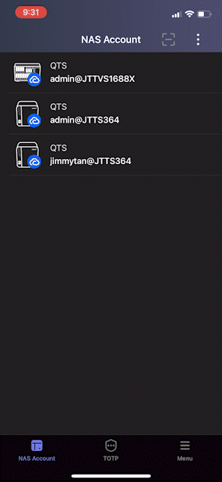
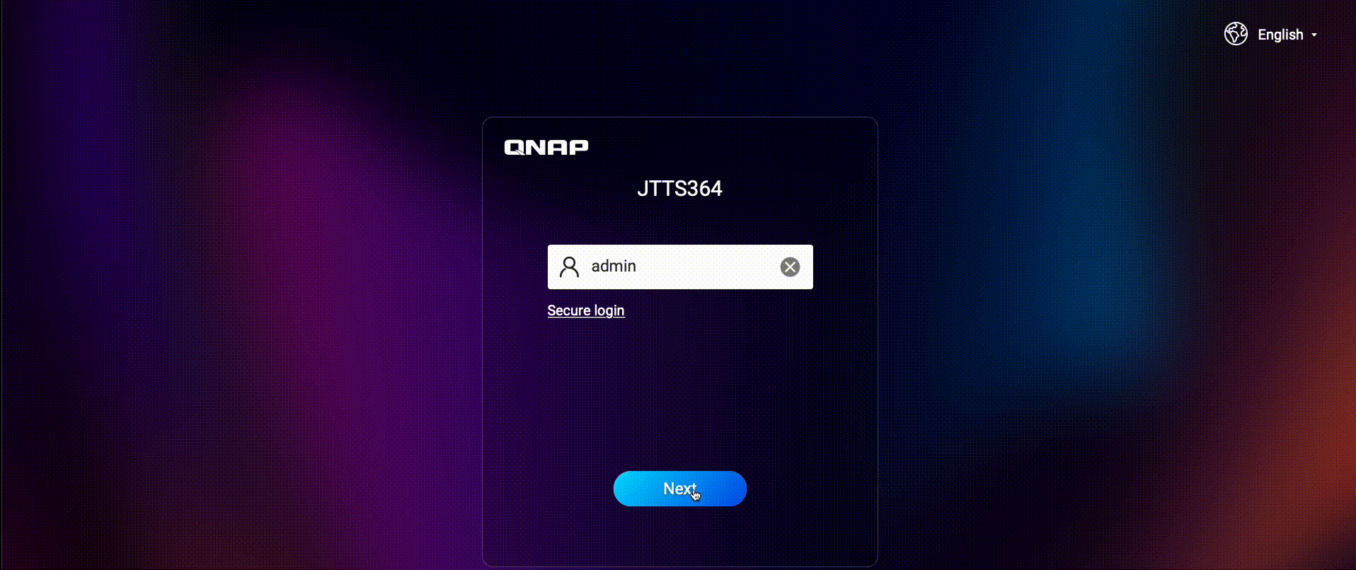
QR Code Log-in Demo
(Mobile device can reach the NAS via network)
NAS Log-in Page

Slide 20
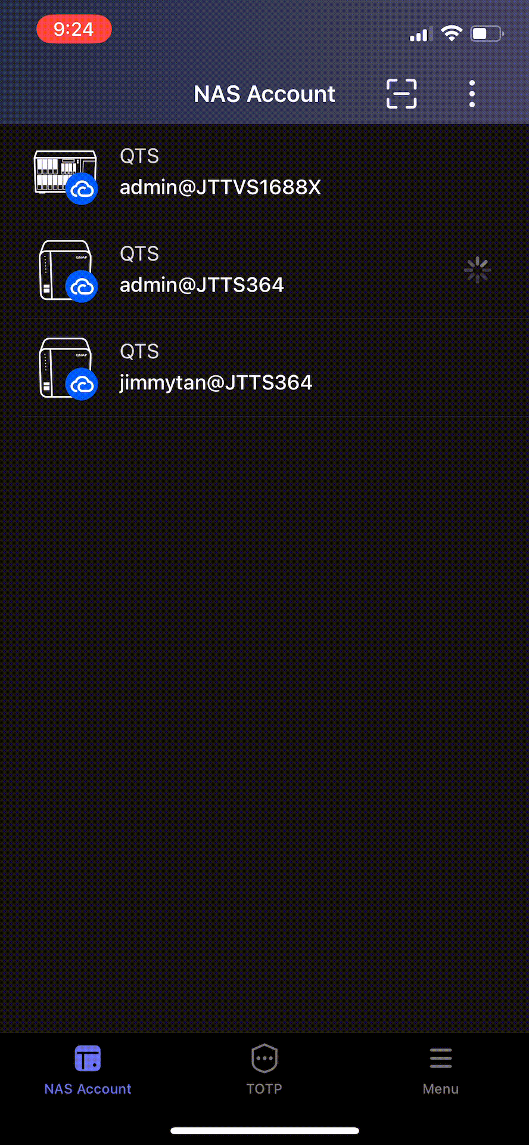
Log-in Approval Demo
NAS Log-in Page
(Mobile device can reach the NAS via network)

Slide 21
Manageable Privileges –
Delegated Administration
Do you give out your safe combination to the electrician when he fixes the light in the garage?

Slide 22
Delegated Administration
Administrator group users have the highest privileges including access sensitive data.
User group users have almost none administrative privileges.
Sole administrator may cause heavy workloads and poor responsiveness.
Many administrators may cause improper authority and pose the risk of data leakage.

Slide 23
New 8 Roles delegateable to the User group users
Administrator Have full authority of the NAS, and the only role who can delegate roles. | System Management Have the most administrative capability under Administrator including all privilege of other delegated roles. | Backup Management Manage and monitor backup jobs of the NAS.
Backup Operation Execute backup jobs of specified shared folders. | User and Group Management Create or delete local accounts for individual users and groups. | Shared Folder Management Manage shared folders and grant access rights for users or groups.
Application Management Install, update, and manage apps in the App Center. | Access Management Manage overall accessibility of the NAS. | System Monitoring Oversee utilization of NAS system and storage resources.

Slide 24
Delegated Administration: System Management
Have the most administrative capability under Administrator including all privilege of other delegated roles.
Scenario:
IT director John is the administrator and delegates the role System Management to the User group “IT Staff”.
John sets permission of the shared folder “Confidential” as “deny access” for User group “IT Staff”.
Bob in “IT Staff” group can now update the firmware but not touch the data of “Confidential”.
Permissions | Remarks
Use Control Panel of the NAS Possess most administrative tasks under the administrator’s control Have privileges of all the other delegated roles | Have restrictions on SSH, telnet, and role delegation Unable to open apps that are only accessible to administrators

Slide 25
Delegated Administration: Backup Management
Manage and monitor backup jobs of the NAS.
Permissions | Remarks
Execute owned and the other’s backup jobs with Hyper Data Protector and Hybrid Backup Sync. Restore owned backup jobs. | Can not restore the other’s backup jobs.
Scenario:
IT lead Eric has a business trip to the overseas branch. He delegates the role Backup Management to the colleague Jean to handle the backup tasks until his return.
Jean can maintain backup jobs created by Eric without administrator permission.

Slide 26
Delegated Administration: Backup Operation
Execute backup jobs of specified shared folders.
Permissions | Remarks
Create and execute backup jobs with Hyper Data Protector and Hybrid Backup Sync for the folders with access permissions. Restore data with the owned backup jobs. | Can only access folders with read/write permission as backup source and destination when processing backup jobs
Scenario:
Departmental Manager, Heidi, is delegated with the role “Backup Operation”.
She can manage the backup jobs of her own scope and frequency since she knows better about her departmental data.

Slide 27
Delegated Administration: Backup Management v.s. Backup Operation
Backup Management
Backup Operation
Can execute but not restore the backup jobs already created by the others even without access right of the target shared folders.
Role for a position to monitor overall backup routines of the NAS.
Can only backup or restore the shared folders with access permission.
Role for data owner who has more knowledge of owned data.

Slide 28
Delegated Administration: User and Group Management
Create or delete local accounts for individual users and groups.
Permissions | Remarks
Create, edit, and delete local users and groups. Edit properties of domain users and groups. Manage users and user groups in Qmanager mobile app. | “Shared Folder Management” role is also necessary for efficiently managing user accounts and granting shared folder access permissions in a workflow
Scenario:
The HR staff Henry is arranging on-boarding for the new employees. Being delegated with both User and Group Management and Shared Folders Management roles, he can create local user accounts and assign them to specific groups; no need to wait for the support from the IT staff and can complete onboarding efficiently.

Slide 29
Delegated Administration: Shared Folder Management
Manage shared folders and grant access rights for users or groups.
Permissions | Remarks
Create, edit, and delete shared folders Create and edit shared folders in Qmanager mobile app | Unable to create a shared folder if the delegated user is not assigned the role "User and Group Management" Unable to configure advanced permissions and folder aggregation Unable to create a snapshot shared folder.
Scenario:
Marketing Department Manager Emily kicks off a new project, and she as a Shared Folder Management role creates a shared folder for this new project for streamlined collaboration. Also delegated with User and Group Management role, Emily can grant or remove folder access permissions if the original member quits or new members join the project.

Slide 30
Delegated Administration: Application Management
Install, update, and manage apps in the App Center.
Permissions | Remarks
Access the App Center on the NAS and through Qmanager app Install, update, and view apps | Unable to manually install apps or configure settings in the App Center Unable to open apps that are only accessible to administrators Unable to access networking apps, such as Network and Virtual Switch
Scenario:
Administrator Alice assigns Application Management role to R&D department manager Zack so he can easily access the App Center and install necessary apps for development based on project needs.
Hence, Zack downloads QuObject to create object storage environment on the NAS for new app development and testing.

Slide 31
Delegated Administration: Access Management
Manage overall accessibility of the NAS.
Scenario:
To improve security control and react to security incidents more quickly, several members in the IT team are assigned Access Management role. They are more aware of company IT policy to manage firewall and security settings, and can work as a team to share workloads, especially improving troubleshooting efficiency in an emergency to prevent data leaking. They can receive security notification in a timely manner and solve problems in the shortest time.
Permissions | Remarks
Configure security settings in Control Panel Use all features of QuFirewall | Unable to access networking settings and the Network and Virtual Switch

Slide 32
Delegated Administration: System Monitoring
Oversee utilization of NAS system and storage resources.
Scenario:
Given the permission of System Monitoring role, the 3rd party maintenance provider, IT assistant or each department manager can regularly check the status of the department NAS system to ensure system performance and operation stability.
Permissions | Remarks
View NAS system condition and information from Resource Monitor and Dashboard Use the Resource Monitor in Qmanager | Cannot modify any data or configuration of the NAS

Slide 33
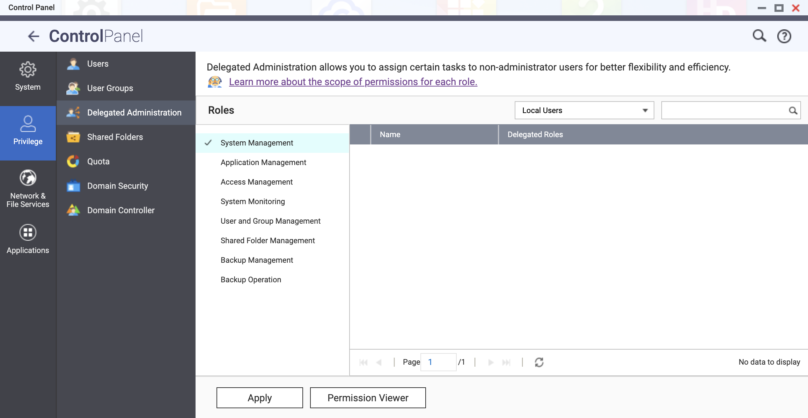
Delegate in Control Panel

Slide 34
Not Wait Until RAID Rebuild - Predictive Migration
When 10T HDD requires around 1 week to rebuild, spending less than 1 day to migrate in advance makes sense…

Slide 35
Predictive Migration: Protect Your Data Before Drive Fails.
When a drive has failed, RAID will rebuild its data to the new drive. Depending on the CPU or Drive bottlenecks, RAID rebuild can take days to weeks to complete, due to the process of heavy calculation.
On the other hand, before a drive fails, when the system can detect the risk of drive failing, it may start to migrate the data to the spare drive. Such process should complete within hours, because it copies the files and synchronizes without calculating from the RAID strips.

Slide 36
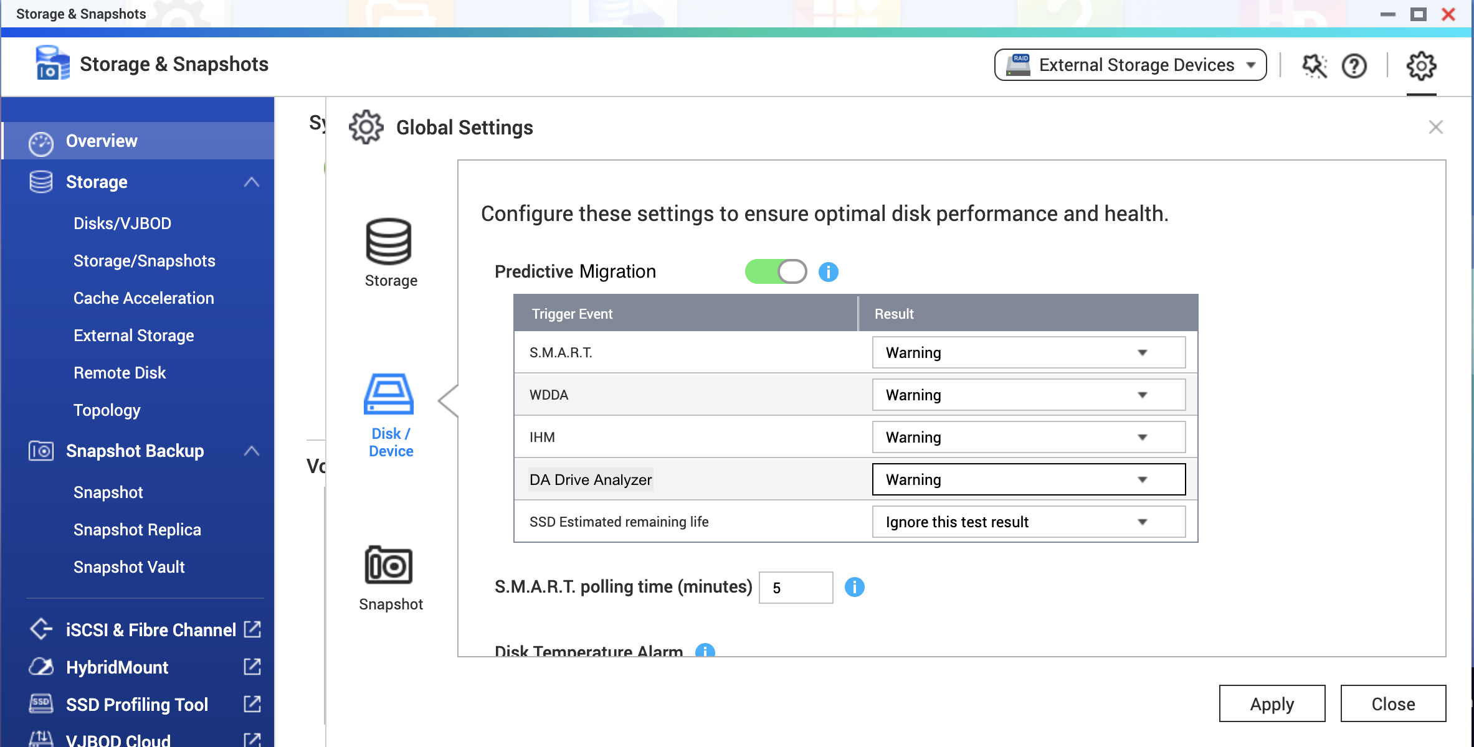
Predictive Migration
Depending on the drive health analytical tools, selected conditions can trigger data migration to the spare disk.
S.M.A.R.T.
WDDA
IHM
DA Drive Analyzer
SSD Estimated remaining life

Slide 37
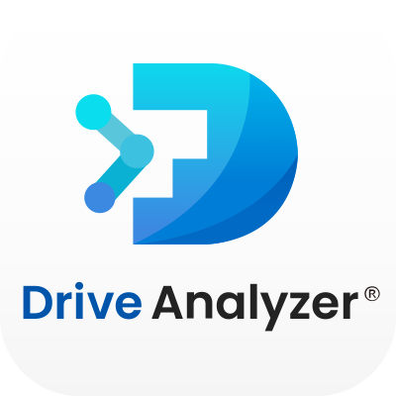
AI Prediction for Drive Health - DA Drive Analyzer
Prevent the long service down time or data loss because of the sudden failure of the drive.

Slide 38
DA Drive Analyzer
If the annual failure rate of a drive is 2%, then an 8-bays device may be at risk of 16% every year.
Along with the growth of the drive size, RAID rebuild and service down time can be weeks.
Studies show drives may fail without any S.M.A.R.T. warning.
Industrial expert ULINK Technology apply Machine Learning on 1.8 M drives to provide the drive health prediction for you to manage the replace plan.

Slide 39
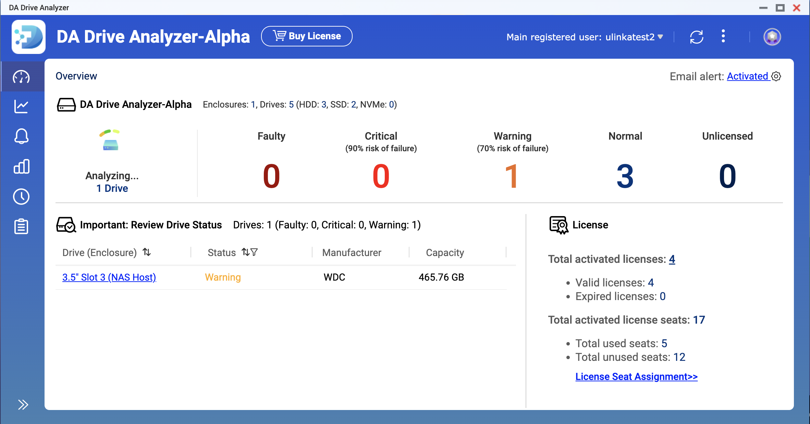
DA Drive Analyzer for NAS 1.1.0
Integration with “Storage & Snapshot”.
Integration with Predictive Migration.
Improved APP UI.
Upload log to show service readiness.
In-APP purchase workflow optimization.
DA Desktop Suite now supports PC and Mac (as monitor of NAS).
DA Portal new features.
One slot monitoring for free.

Slide 40
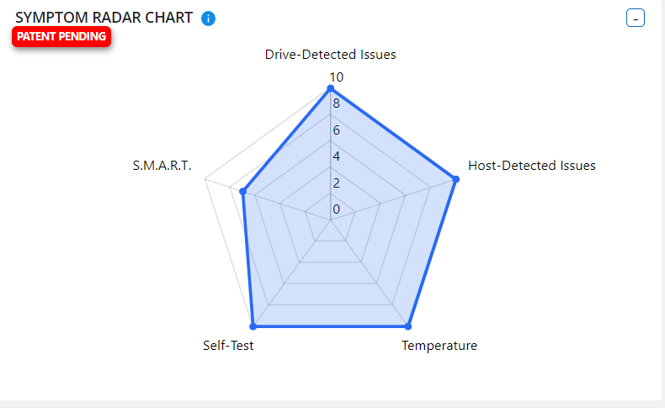
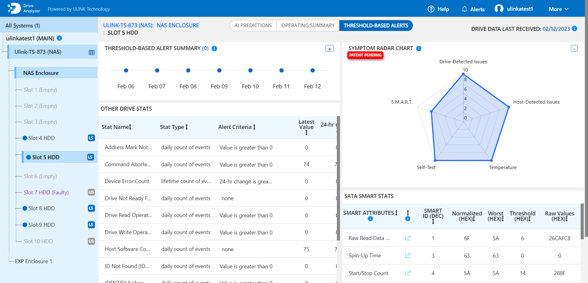
DA Portal New Feature – Radar Chart
A visualization of drive symptoms which will help users cluster and characterize drive symptoms. The radar chart will contain 5 axes: Self-Test, Host-Detected Issues, S.M.A.R.T., Temperature, and Drive-Detected Issues. Each axis will have a score that is calculated based on a cluster of related drive health indicators/symptoms.

Slide 41
Centralized System Monitor – AMIZ Cloud
Daily glance and action in time.

Slide 42
AMIZ Cloud
One portal, multiple systems.
Organized management (via Organization Center).
Dashboard of system health
Customized threshold alerts with various notification methods
Central App management
Basic system management

Slide 43
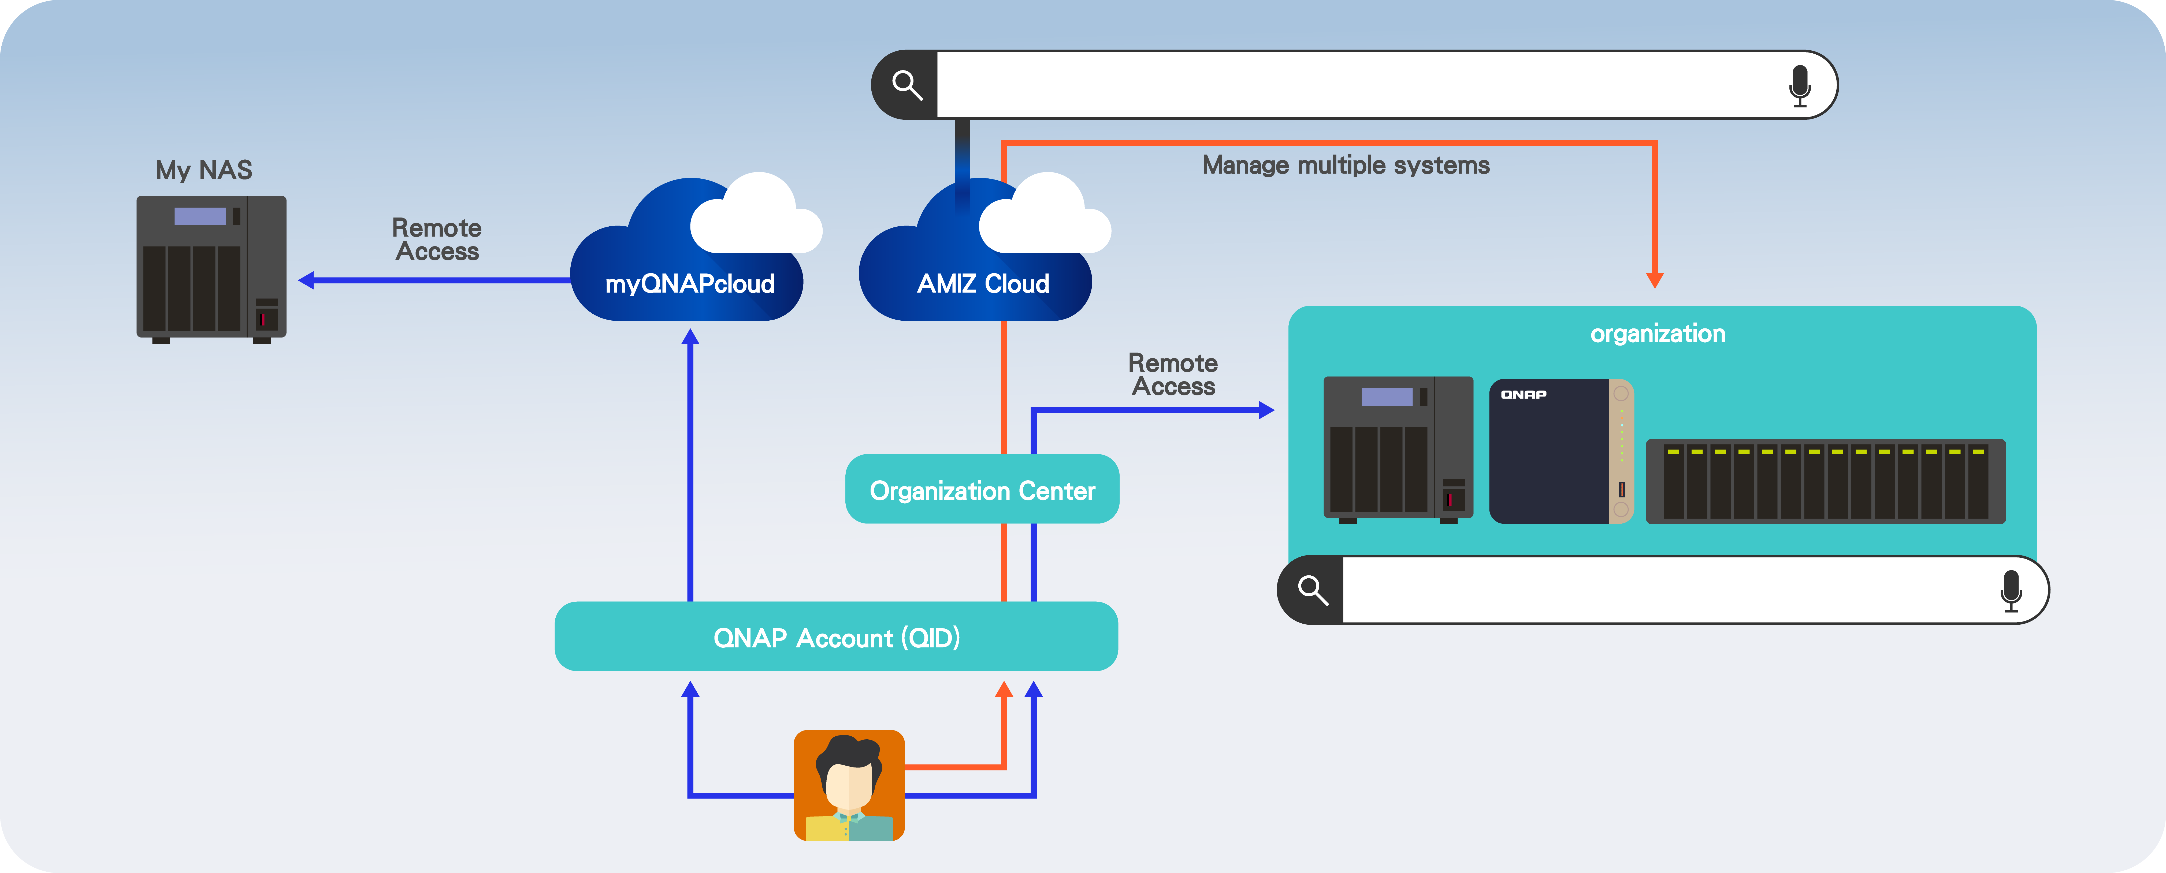
Grouped by Organization Center, Managed in Amiz Cloud
https://www.qnap.com/en/software/amiz-cloud
https://organization.qnap.com/

Slide 44
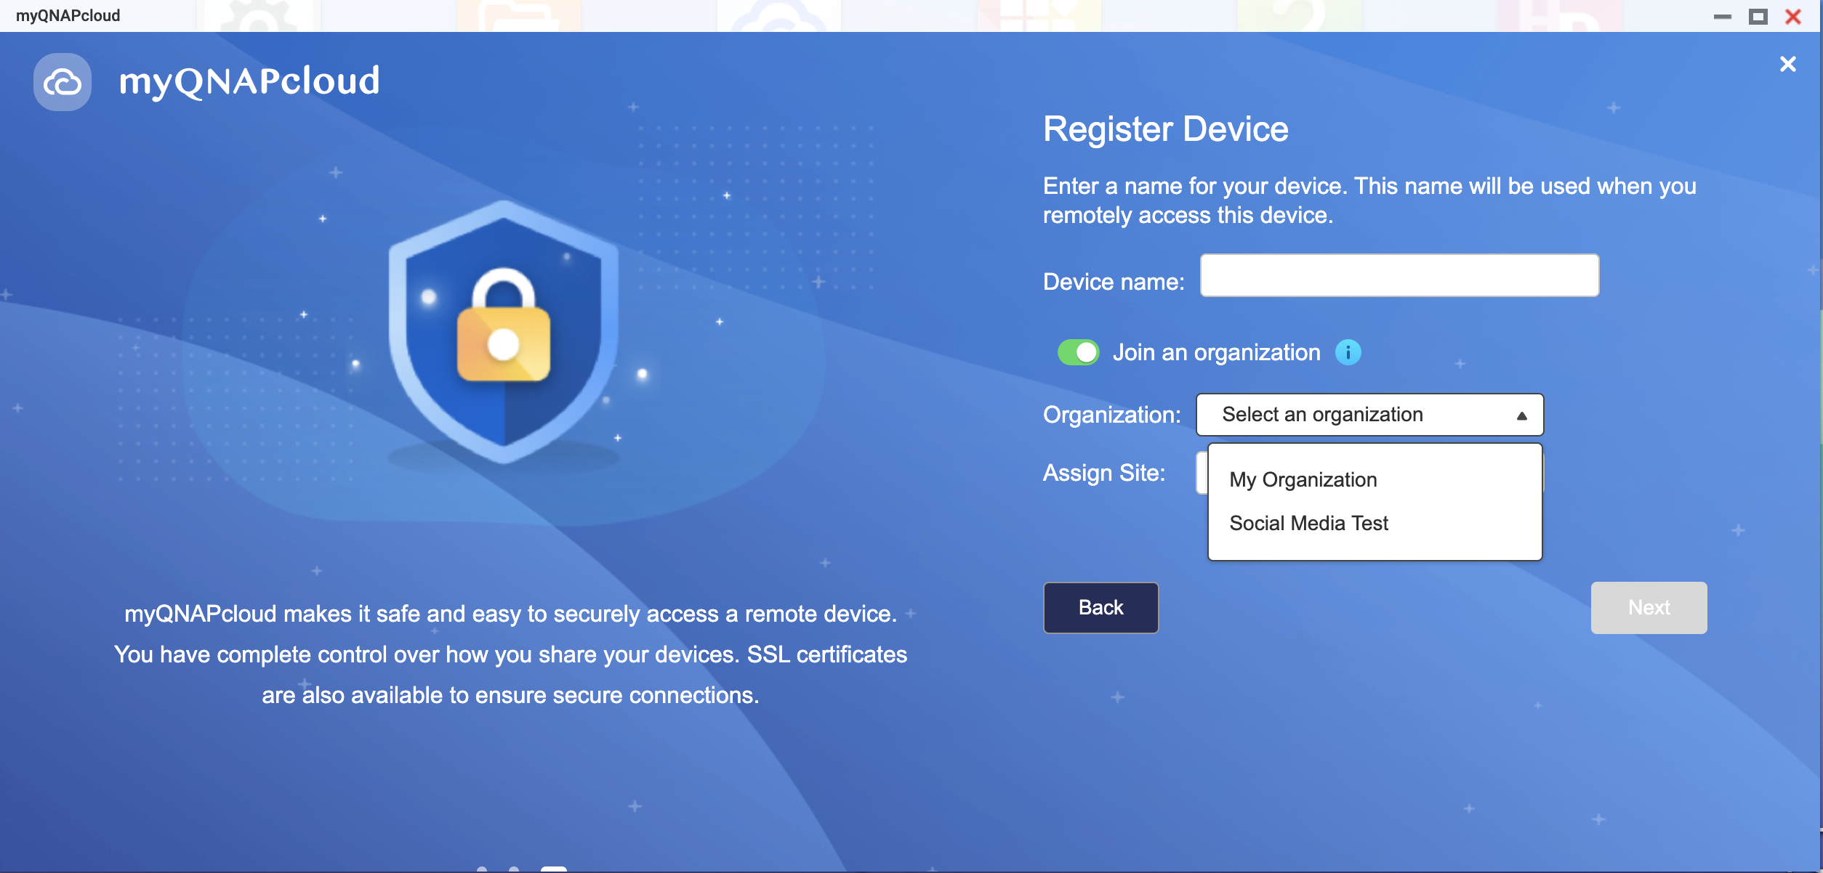
Initializing myQNAPcloud App to Join AMIZ Cloud
An agent will be installed on NAS which collects system information to AMIZ Cloud for you to manage the NAS.
2FA is needed when acting on NAS from AMIZ Cloud.

Slide 45
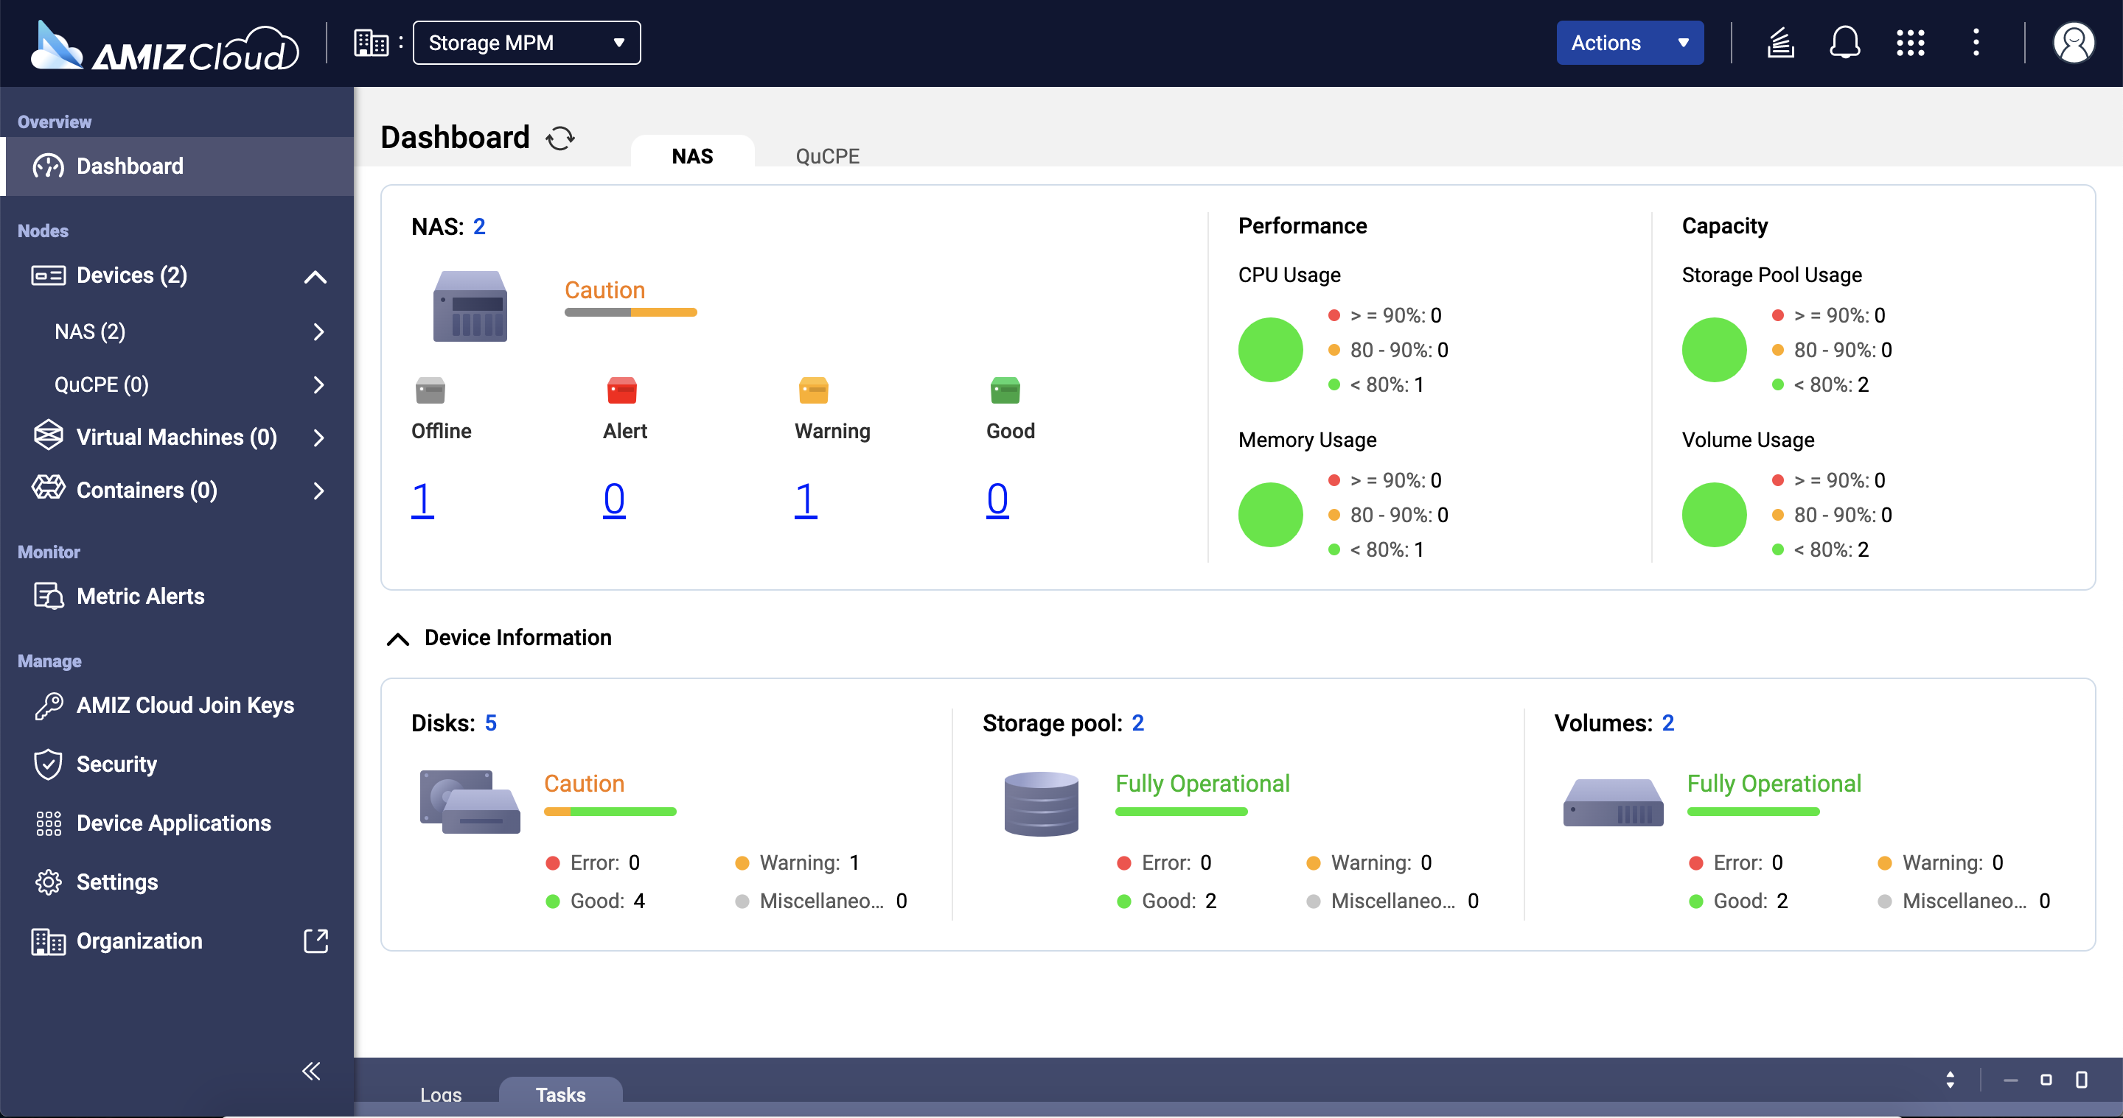
AMIZ Cloud: Dashboard
One glance and is aware of the current status.

Slide 46
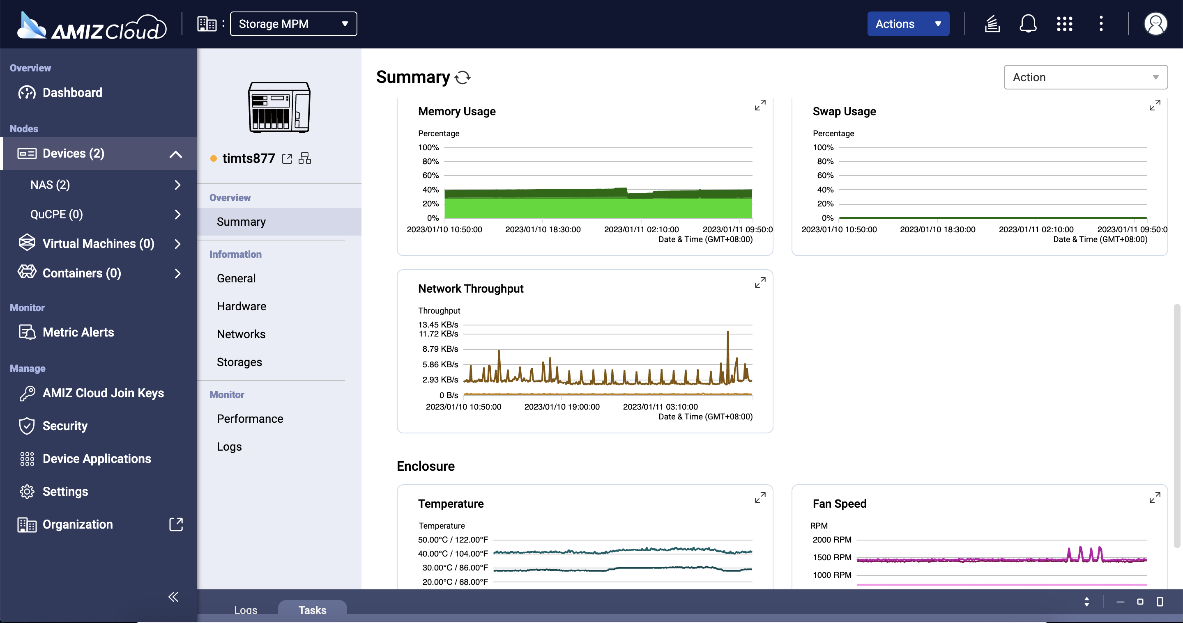
AMIZ Cloud: Detail of Individual Device
Check further when signal warns.

Slide 47
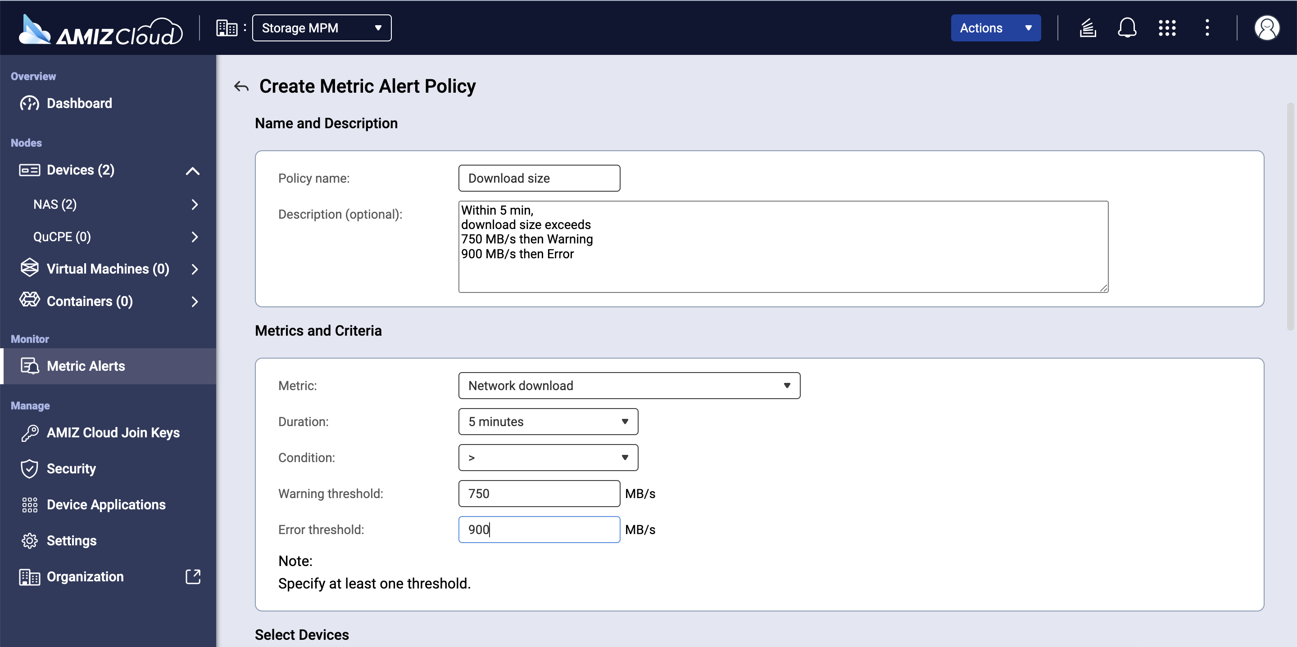
AMIZ Cloud: Customized Alerts
Set up policy and it alerts when reaching the thresholds.

Slide 48
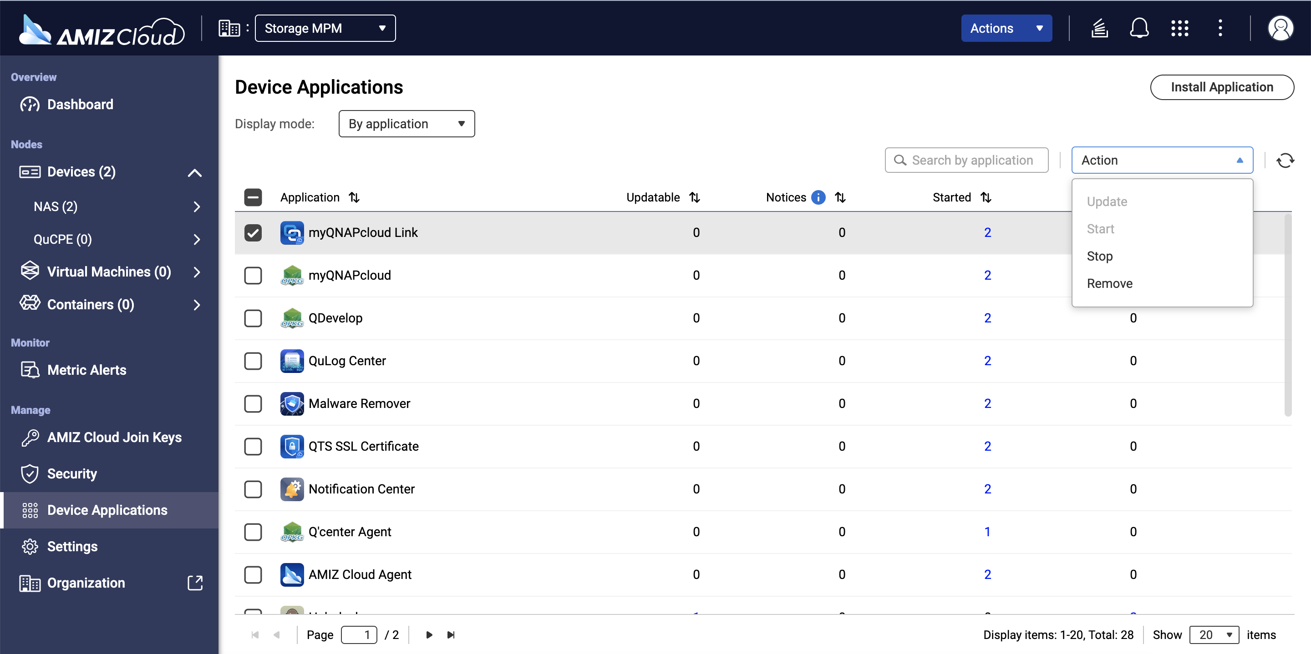
AMIZ Cloud: Manage Application from Central Portal
Update, Start, Stop, Remove

Slide 49
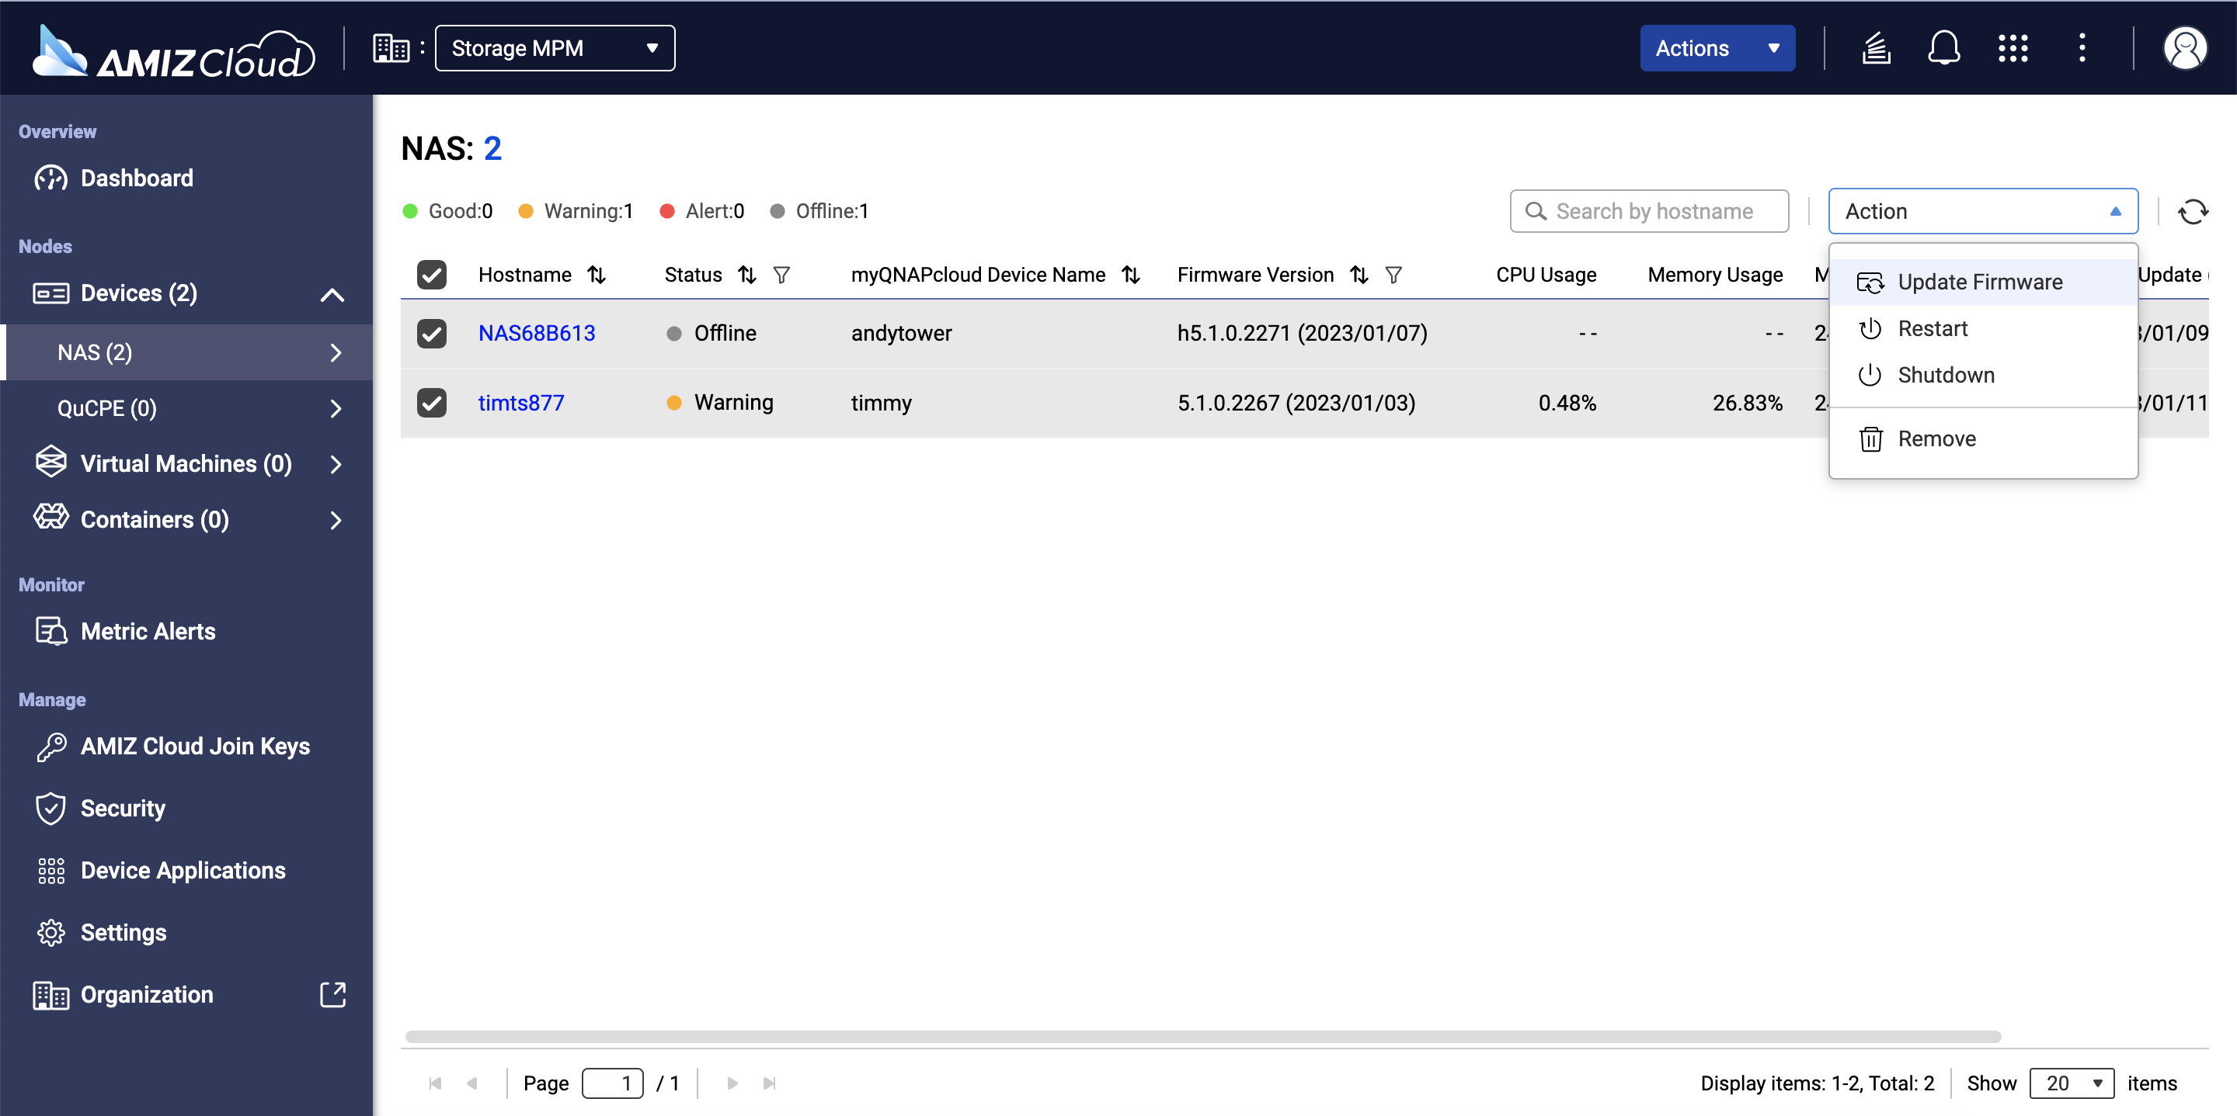
AMIZ Cloud: Basic Control from Central Portal
Update Firmware, Restart, Shutdown

Slide 50
Efficiency with Files – File Station
Just handy.

Slide 51
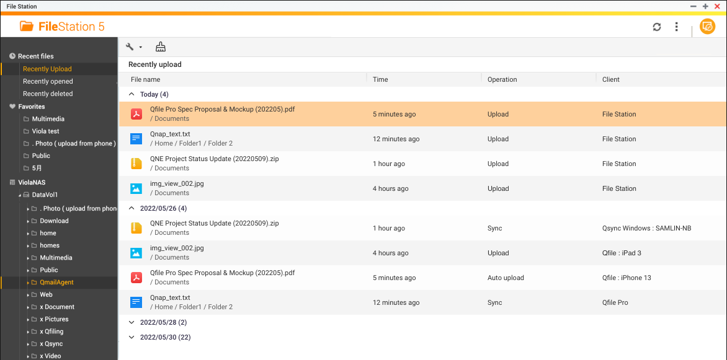
File Station – Recent Files Browsing
Easily locate the files with the fresh impression:
Recently uploaded
Recently opened
Recently deleted

Slide 52
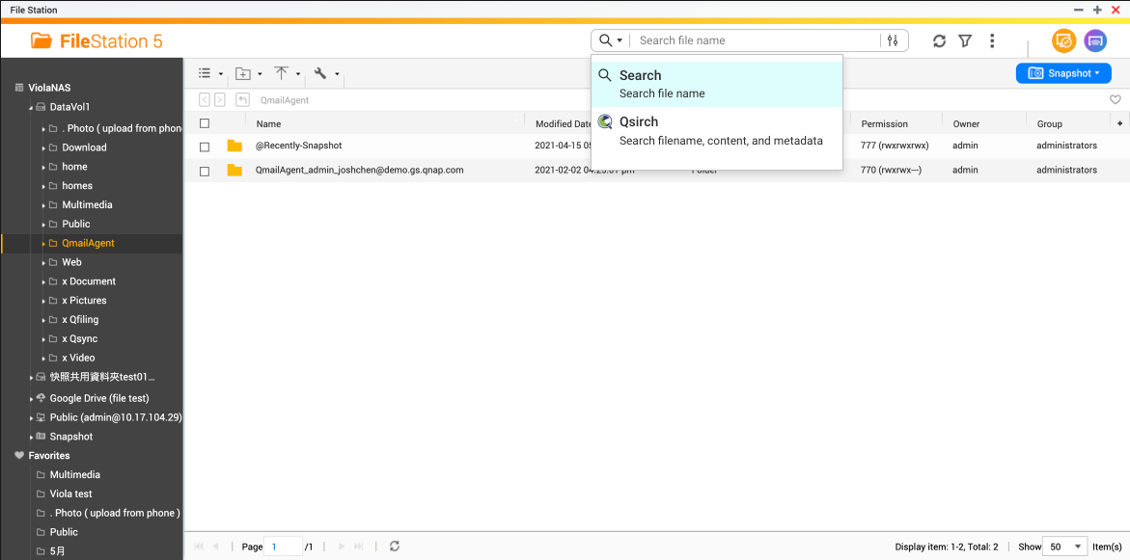
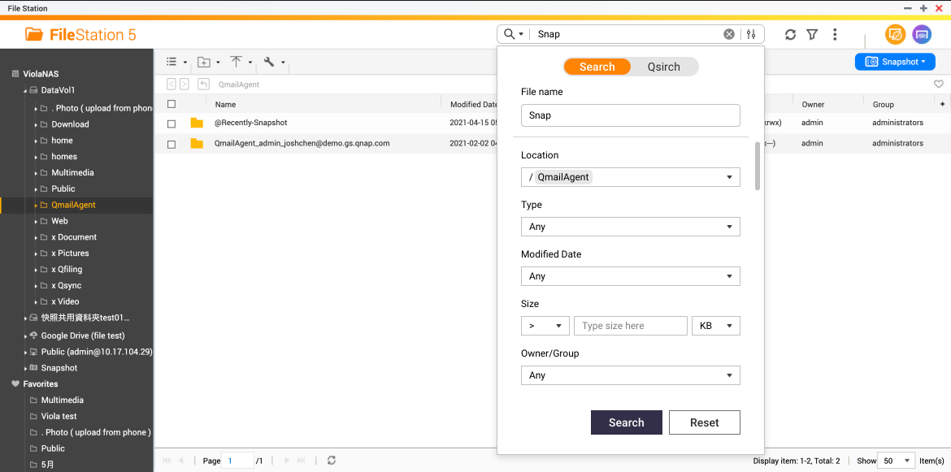
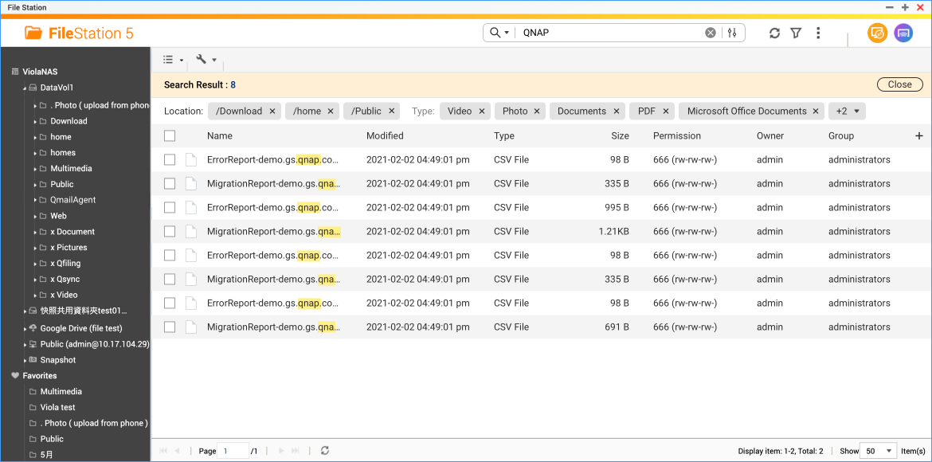
File Station – Qsirch Integration
With Qsirch app installed in NAS, File Station can take advantage of the outstanding search capability.

Slide 53
Firewall Friendly – NFS Fixed Ports Option
Don’t need to reconfigure firewall after NFS service restarts.

Slide 54
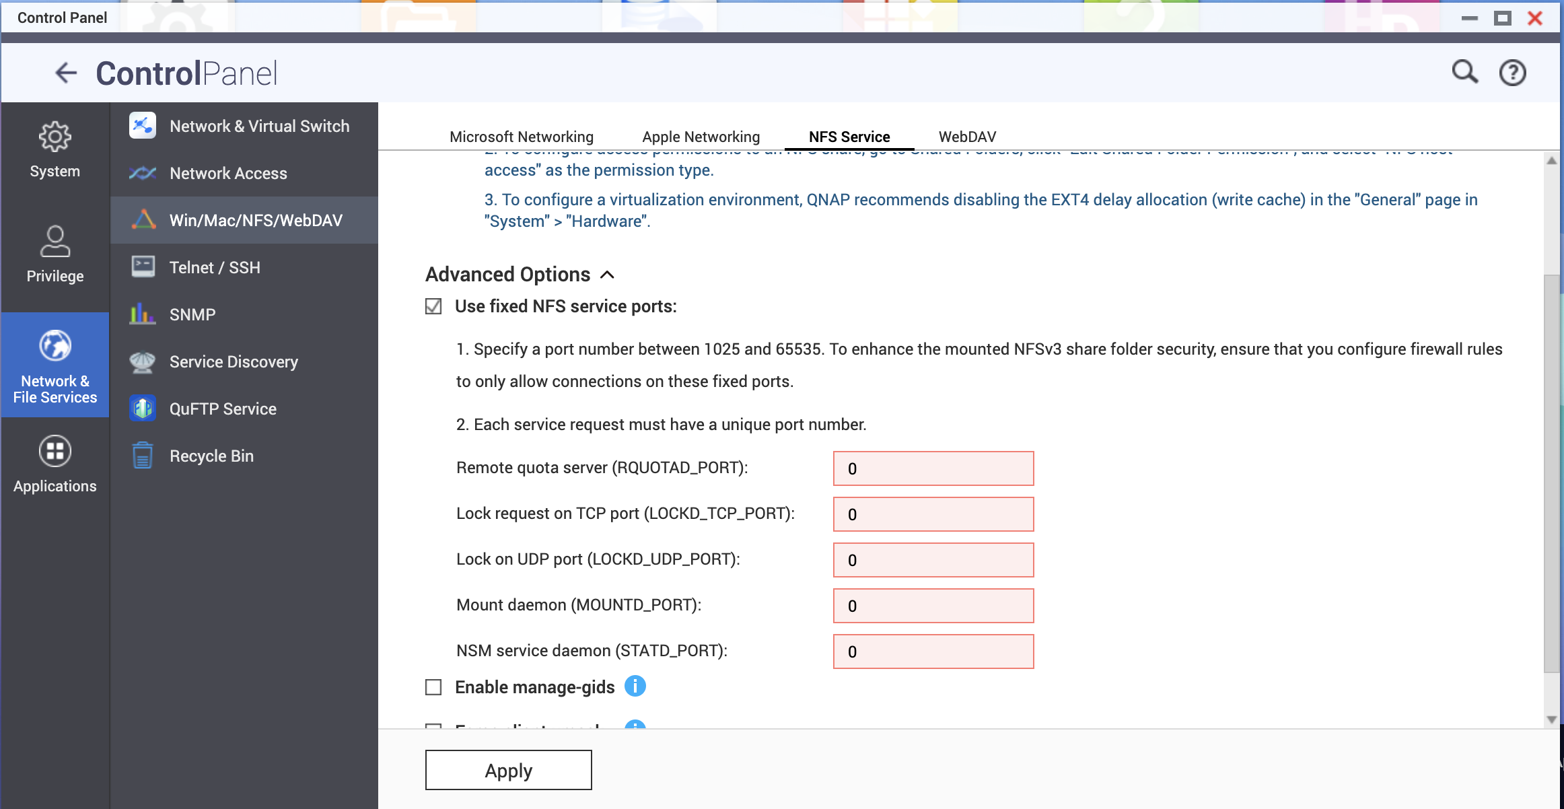
Option for Fixed NFS Service Ports
NFS dynamically assigns service ports which can cause problem of firewall configuration. New advanced option to set the static ports saves the trouble of firewall reconfiguration when NFS restarts.

Slide 55
Premium AI Acceleration – Hailo-8 M.2 Key Support
26 TOPS (trillion operations per second)!

Slide 56
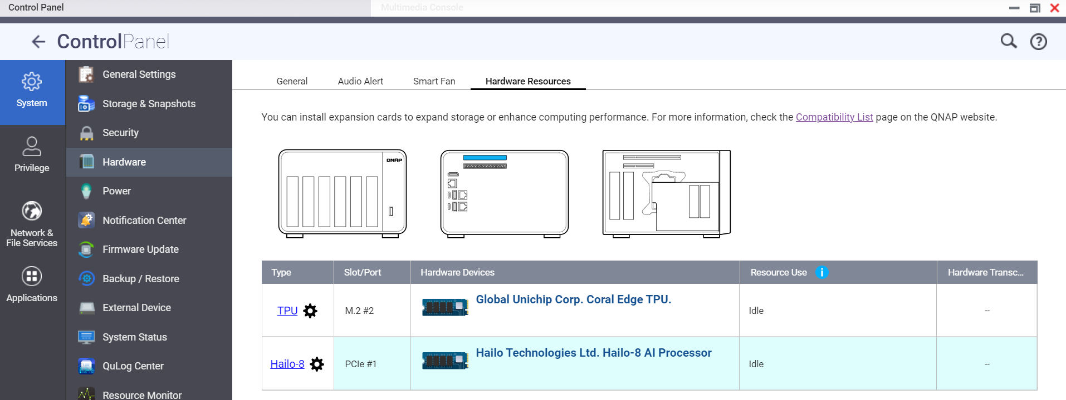
Hailo-8 M.2 B+M Key Support: Accelerate AI operation
AI related applications such as QVR Human or QuMagie can now be benefited from Hailo-8 AI acceleration.
Supports M.2 B+M formfactor and Hailo-8™ Century Evaluation Platform.
(trillion operations per second)

Slide 57
Efficiency and Security
Copyright© 2023 QNAP Systems, Inc. All rights reserved. QNAP® and other names of QNAP Products are proprietary marks or registered trademarks of QNAP Systems, Inc. Other products and company names mentioned herein are trademarks of their respective holders.​​​​​​​

