Slide 2
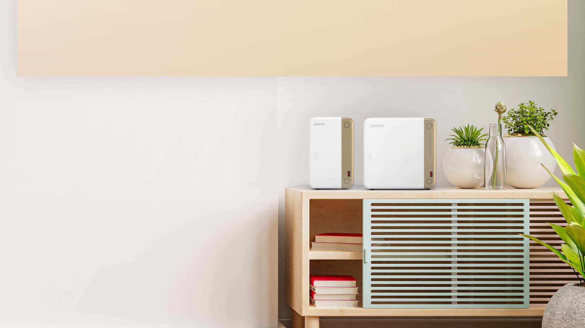
2.5GbE 2-bay TS-262 / 4-bay TS-462 for home users to enjoy digital life
Conveniently access files, data and multimedia stored in the NAS from all connected devices.
Equipped with a 2.5GbE network port and HDMI 2.0 port for smooth multimedia streaming.
Clean white-color housing with champagne gold tone for an aesthetic and functional design

Slide 3
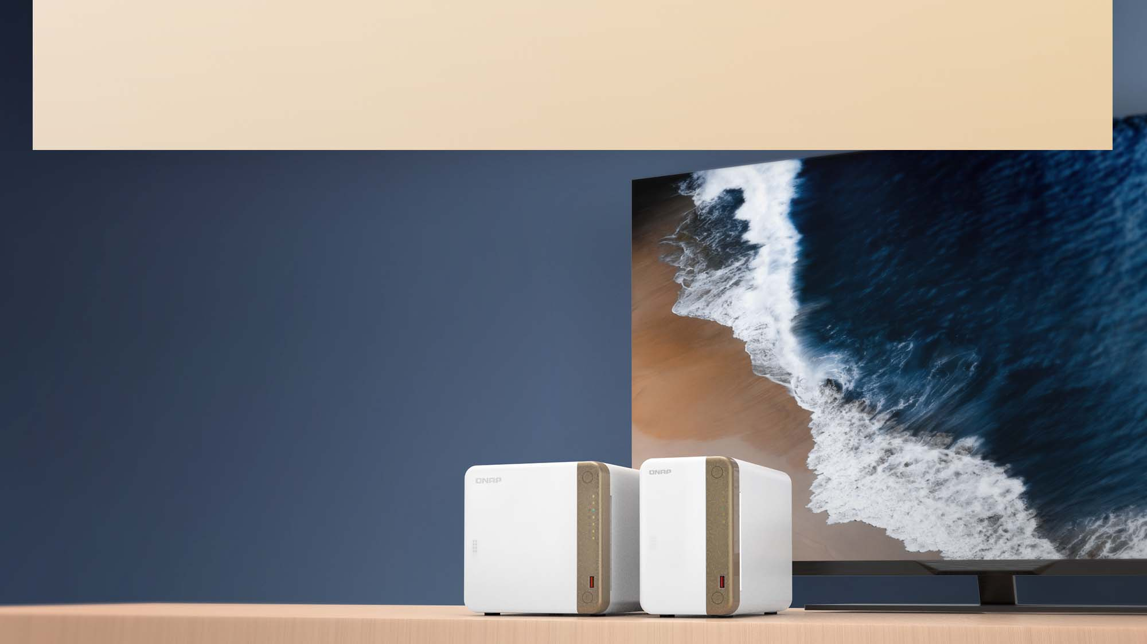




Latest Intel CPU, "Jasper Lake", with integrated GPU for transcoding and HDMI 4K output
Intel Celeron N4505
Dual core, 2.0 GHz burst up to 2.9 GHZ
Video output
Transcoding
4K
h.264
Up to 4K
Support 4K H.264
transcoding
Intel UHD Graphics
Support 4K @60Hz output and H.264 hardware transcoding

Slide 4



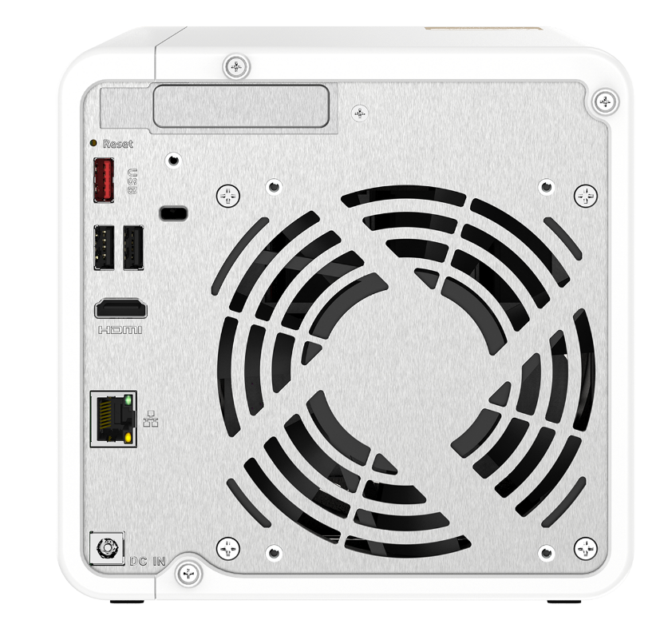


X 2.5
2.5 GbE for home user breaks the traditional Gigabit barrier
2.5 GbE Network port
The TS-262 & TS-462 have a single 2.5GbE RJ45 LAN port which supports existing CAT5e LAN cables.
 | CAT 5e | CAT 6 | CAT 6A
100MbE | ✔ | ✔ | ✔
1GbE | ✔ | ✔ | ✔
2.5GbE | ✔ | ✔ | ✔

Slide 5
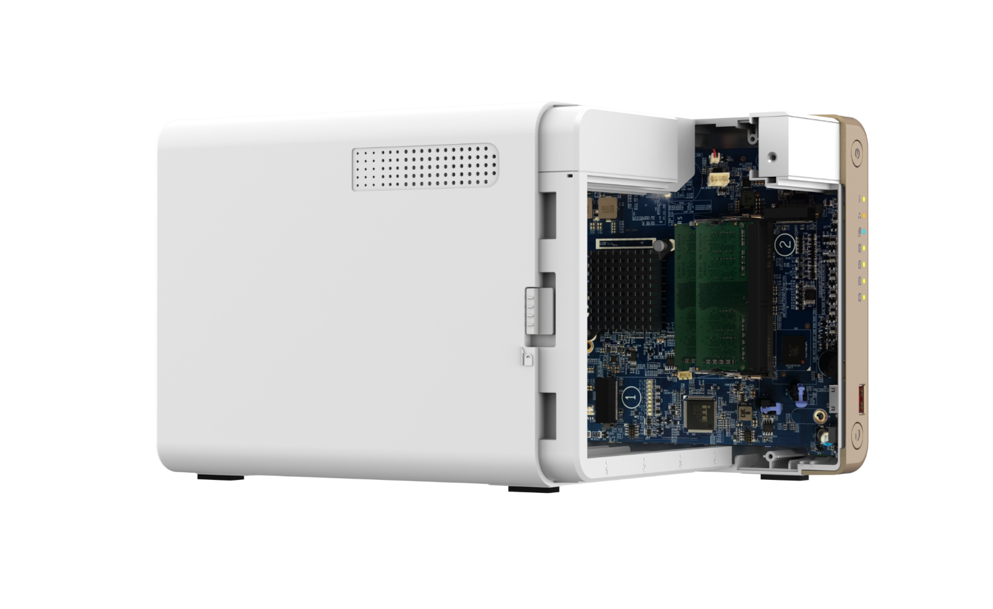

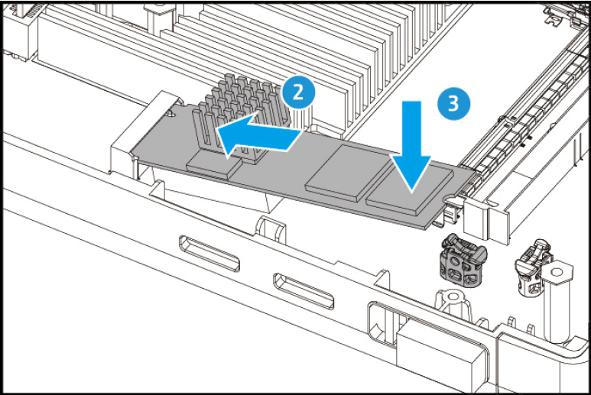
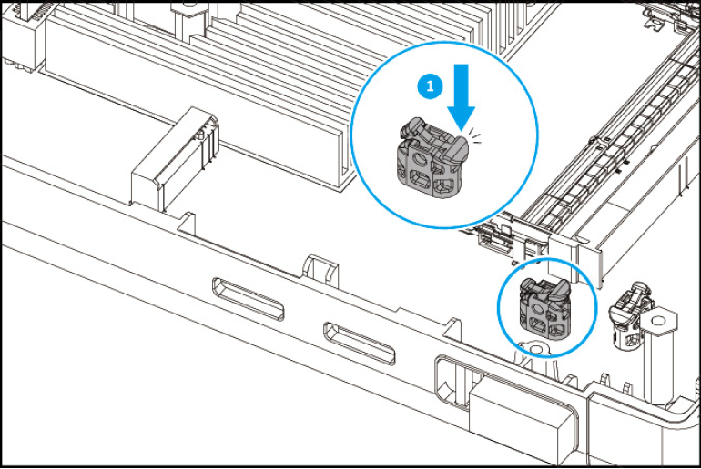

X 2.5
Offer M.2 PCIe Gen3 slots for SSD tiering/caching or edge acceleration
3-step installation, supports M.2 2280 PCIe Gen3 x1
- M.2 NVMe SSD
- Coral Edge TPU
Tooless installation
M.2 SSD
M.2 SSD
M.2 NVMe SSD

Slide 6


M.2 NVMe SSD cache for improved performance at a lower cost
Especially useful for RAID 5/6 and applications dealing with small files or concurrent user access.
QTS NAS
 | QTS 5.0.0 (and later)
SSD Cache Capacity | RAM Requirement
512GB | -
1TB | ≧ 2 GB
2TB | -
4TB | ≧ 4 GB
16TB | ≧ 8 GB (x86 CPU)
Improves I/O latency
For IOPS-demanding apps
Global SSD cache
Can share a single SSD volume/RAID with all volumes/iSCSI LUNs for a read-only or read-write cache.
Read-only Cache
Read-write cache
Read
Write
Application
HDD space
SSD space
Total capacity = HDD capacity

Slide 7








Qtier™ Drives Auto-Tiering constantly optimize data across storage tiers
Hot date
Automatically moves hot data to high-performance drives and cold data to lower-cost, higher-capacity drives.
Qtier
Engine
Warm data
Unlike SSD cache, the SSD capacity in Qtier can be used to store data.
Cold data
Before tiering
Frequently accessed data is not optimized
Start data tiering
After tiering
Data is optimized
Changes in data access pattern

Slide 8





Support HDMI 4K output
HDMI output for 4K resolution
With HDMI output, the TS-262 / 462 allows you to directly enjoy multimedia content, use web browsers, manage your NAS, or watch recorded surveillance footage or live feeds on your NAS.

Slide 9
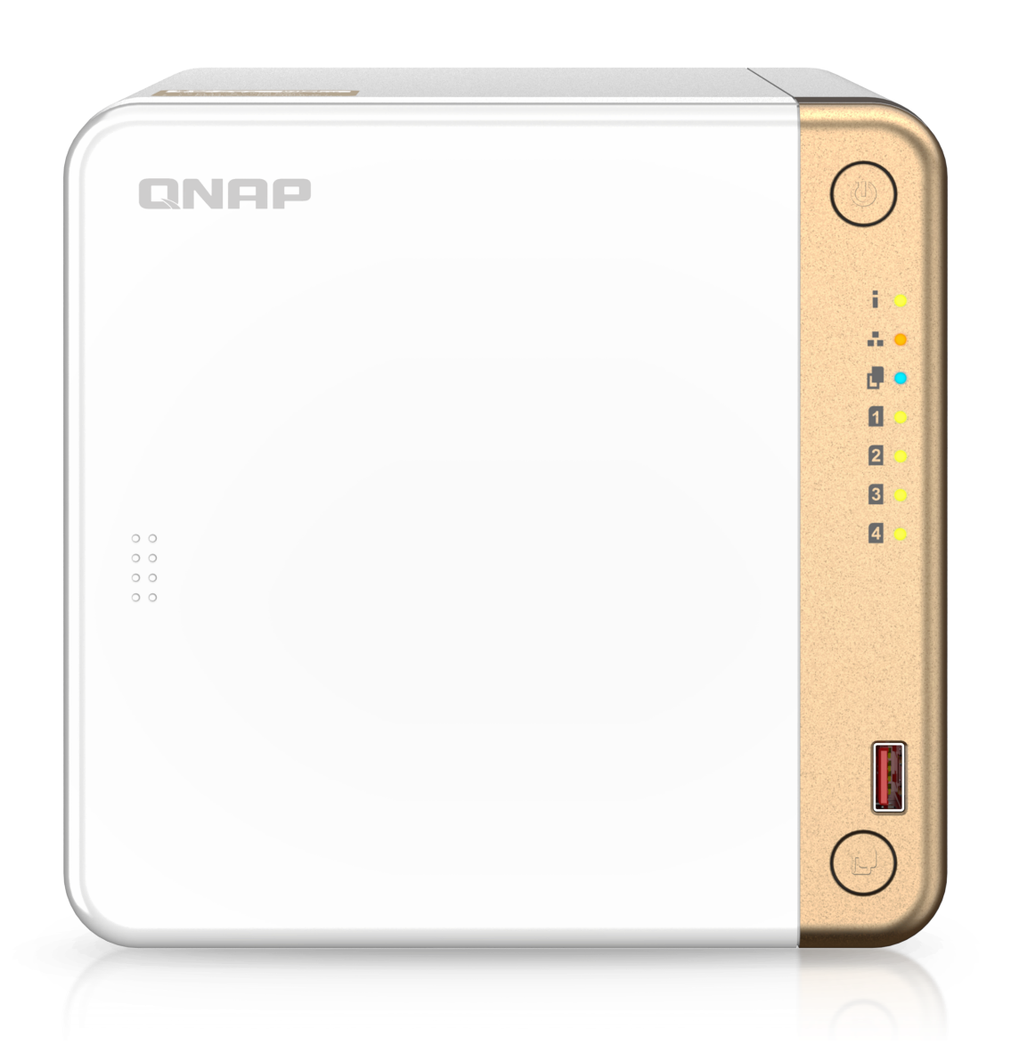
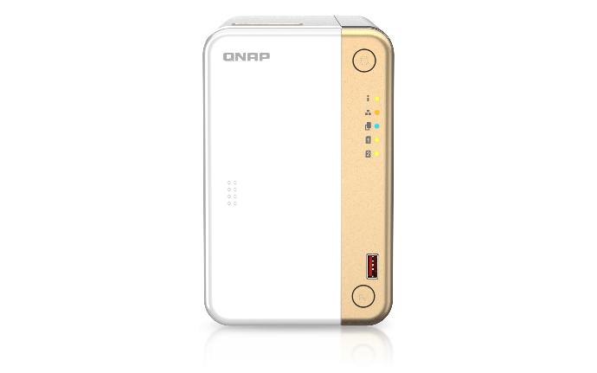
Front view of new TS-262 / TS-462
TS-462
Power button
LED indicators：
Status、LAN、USB Copy
Disk#1~#4
Disk#1~#2 (TS-262)
TS-262
IR Receiver
Optional RM-IR004
remote control accessory
USB 3.2 Gen2 (10Gbps)
USB One-Touch-Copy

Slide 10

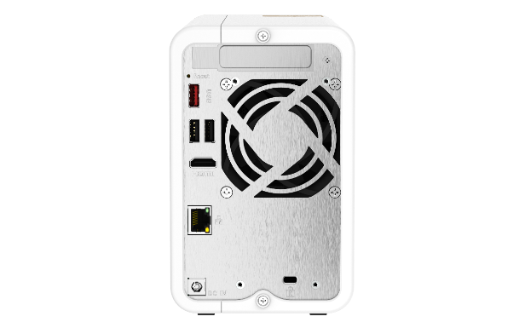
Rear view of new TS-262 / TS-462
TS-462
PCIe Gen3 x2
PCIe Gen3 x2
Reset
USB 3.2 Gen2 Type-A
K-Lock
USB 2.0 Type-A
HDMI 2.0
12CM Smart Fan
7CM Smart Fan(TS-262)
TS-262
2.5GbE NBASE-T
12V DC Power input

Slide 11

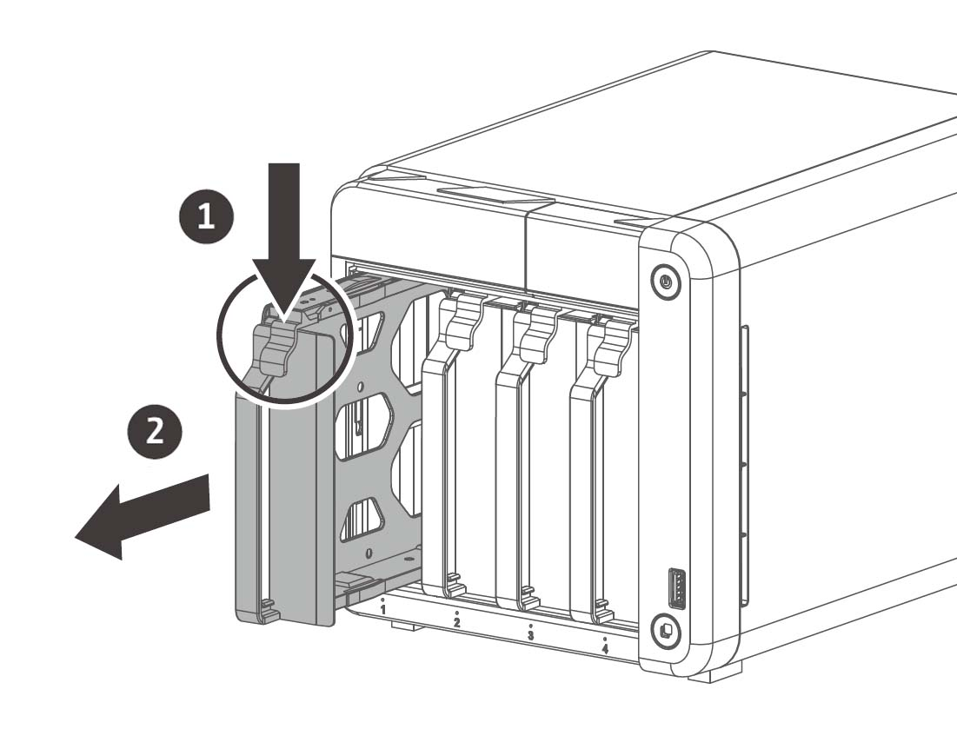
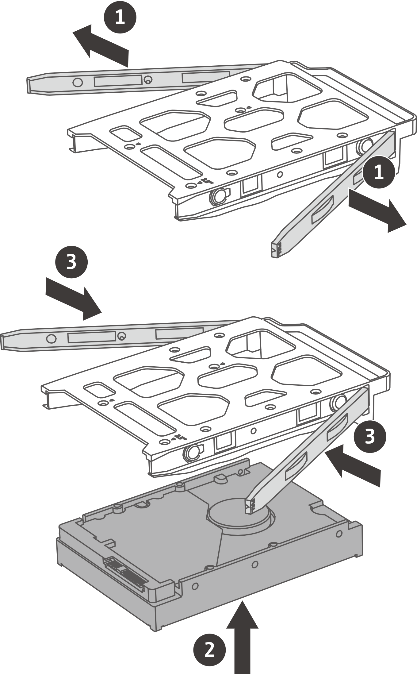
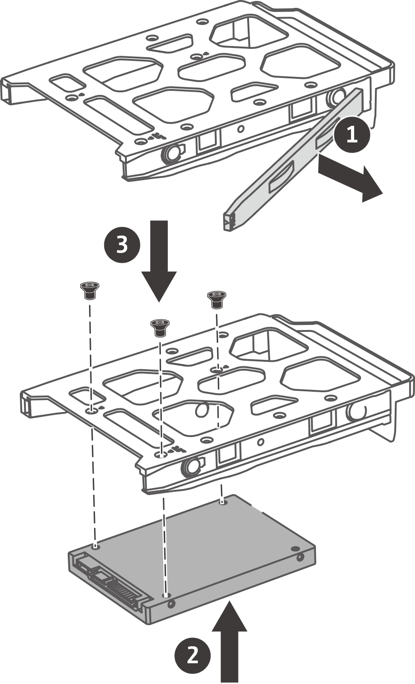
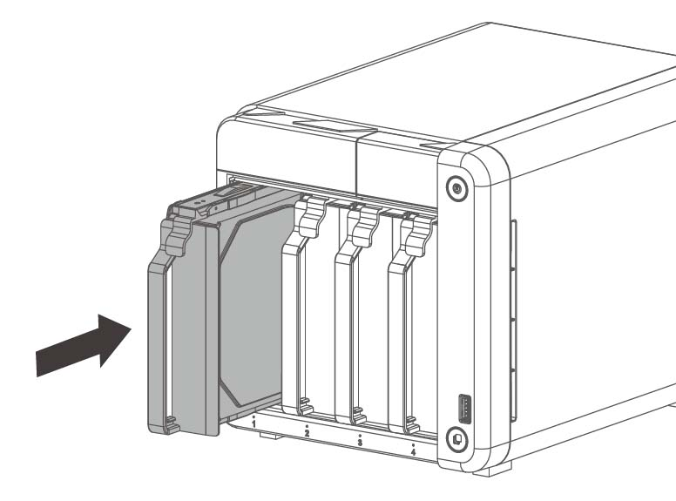
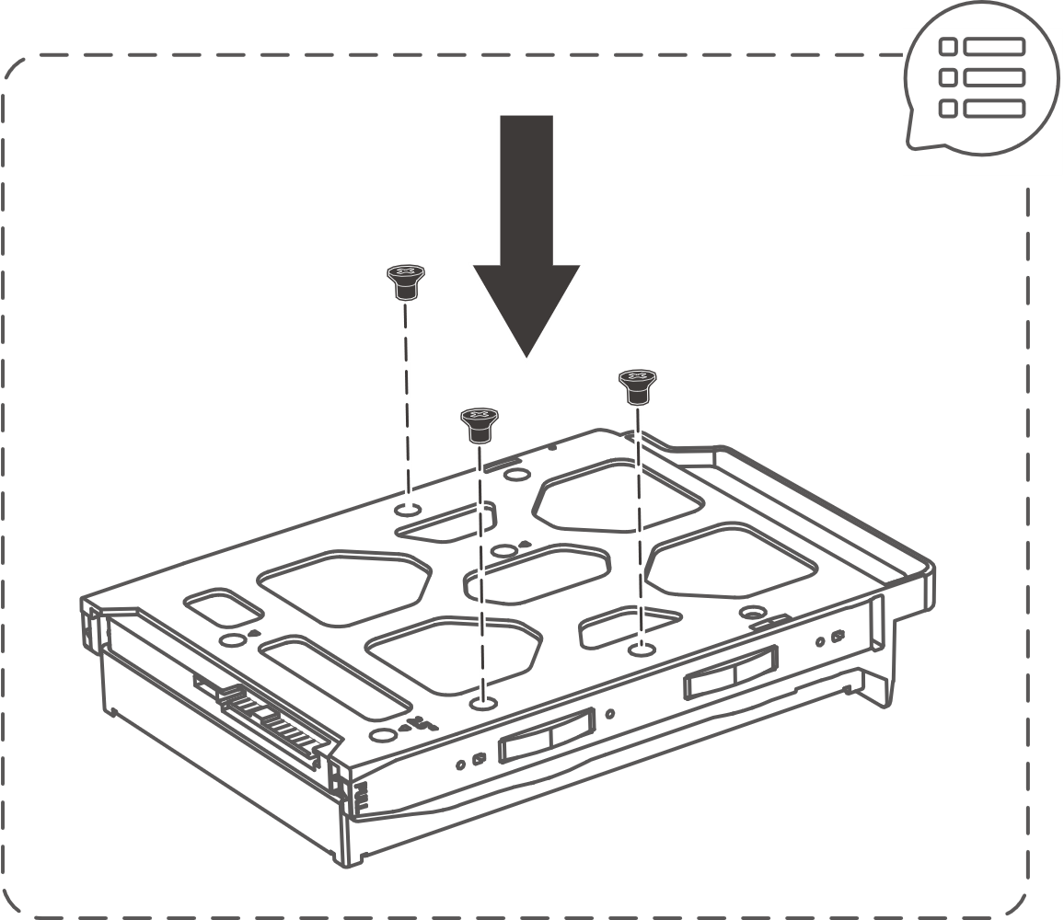
Easy to install HDDs and SSDs
Install 3.5-inch without tools , easy to install 2.5-inch SSD also
01
02
03
3.5-inch HDD
2.5-inch HDD / SSD

Slide 12
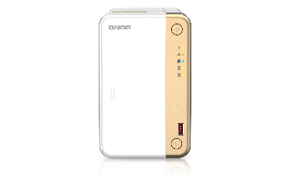

Specification of TS-262 / TS-462
Model | TS-262 | TS-462 | TS-462
SKU | TS-262-4G | TS-462-2G | TS-462-2G | TS-462-4G
CPU | Intel® Celeron® N4505 2-core/2-thread processor, burst up to 2.9 GHz
Default Memory | 4GB Onboard , non-expandable |  | 2 GB SO-DIMM DDR4 (1 x 2 GB), Max 16GB (2 x 8GB) | 4GB Onboard , non-expandable
Maximum Memory | 4GB |  | 16GB | 4GB
Bay count | 2 |  | 4 | 4
M.2 SSD slots | 2 x M.2 2280 PCIe Gen3 x1 slot
Ethernet | 1x 2.5GbE NBASE-T
HDMI | 1 x HDMI 2.0 (4K @60Hz)
PCIe | 1 x PCIe Gen3 x2 slot
USB | 2 x USB 3.2 Gen2 Type-A (10Gbps) + 2 x USB 2.0
External adapter | 65W |  | 90W

Slide 13

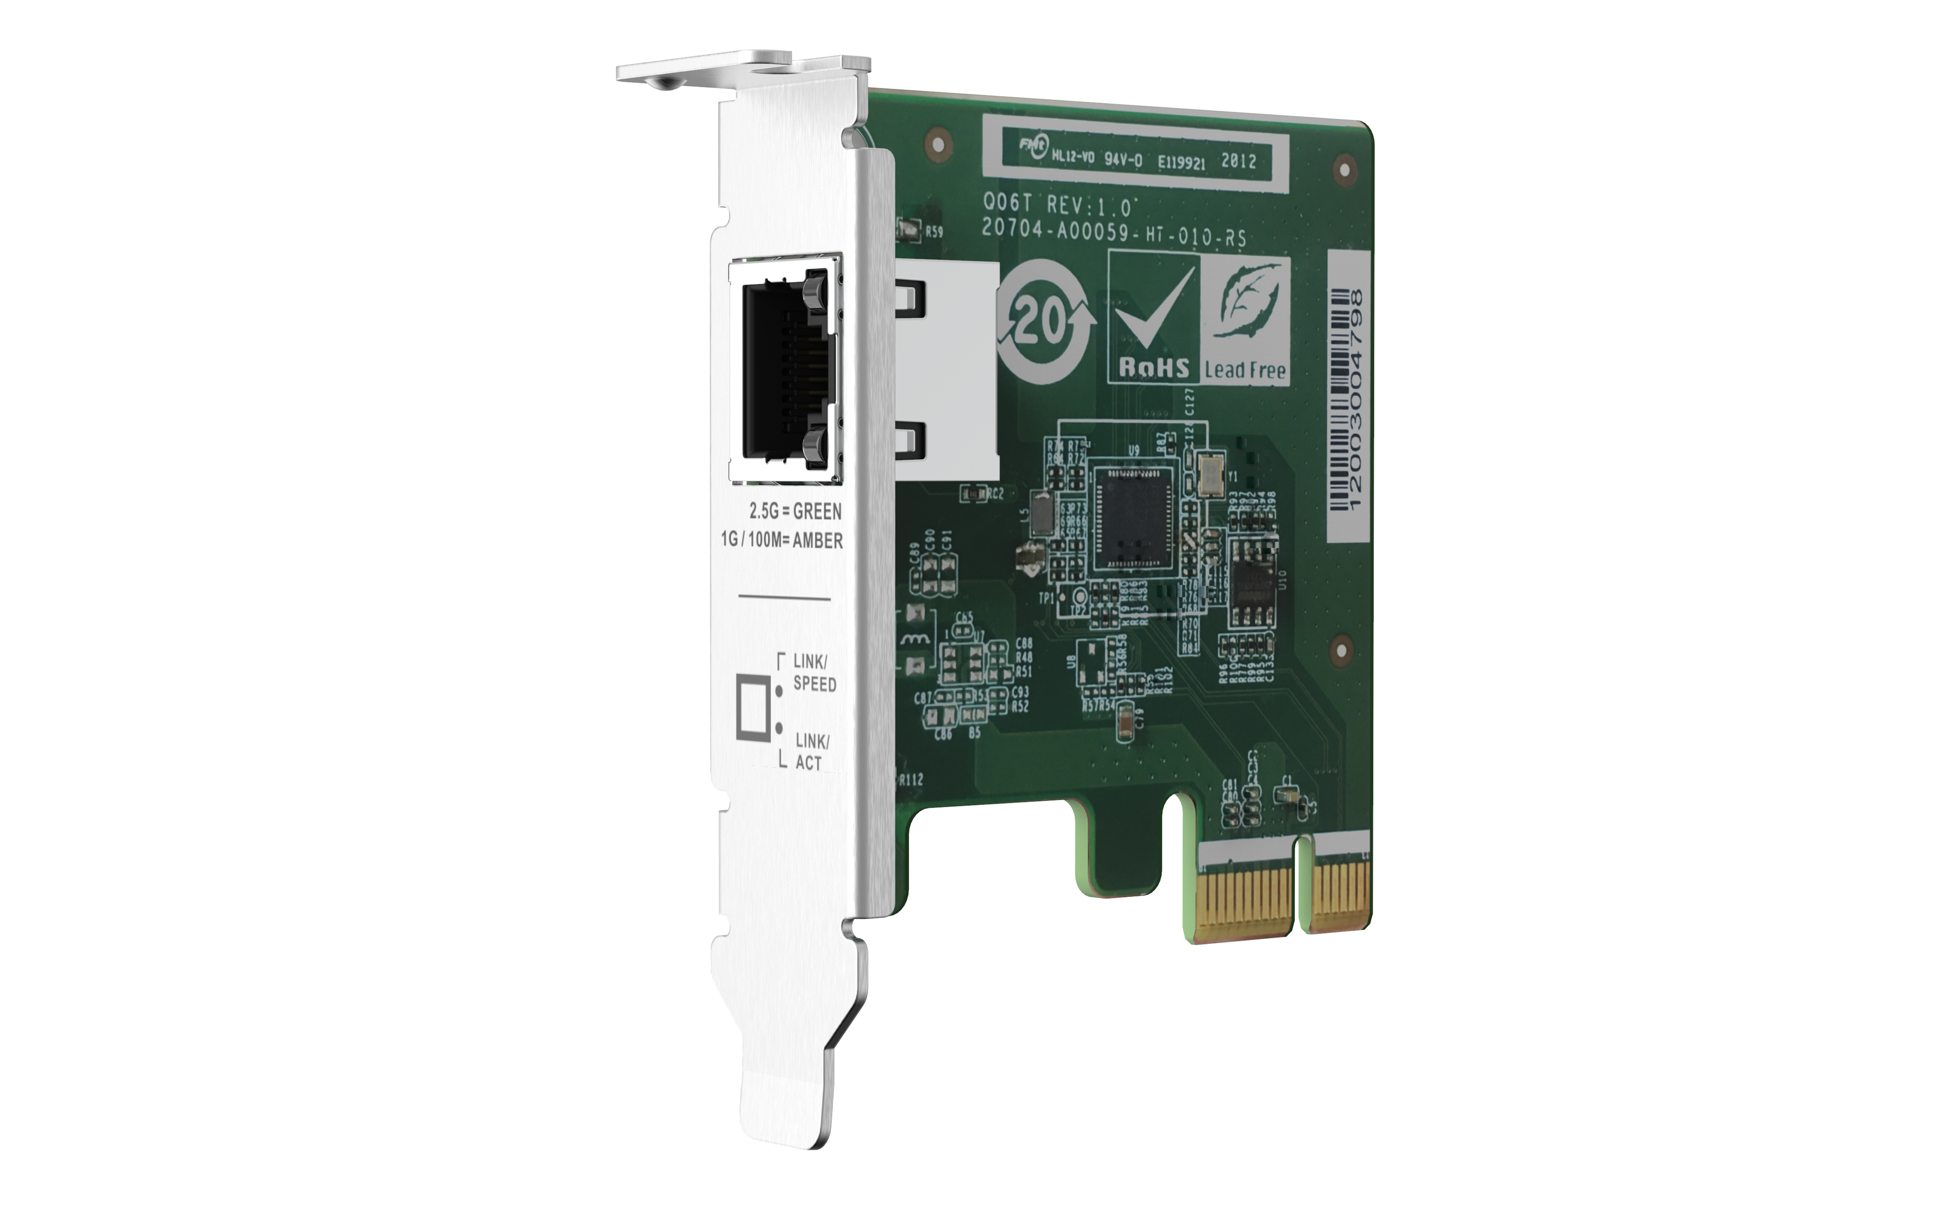
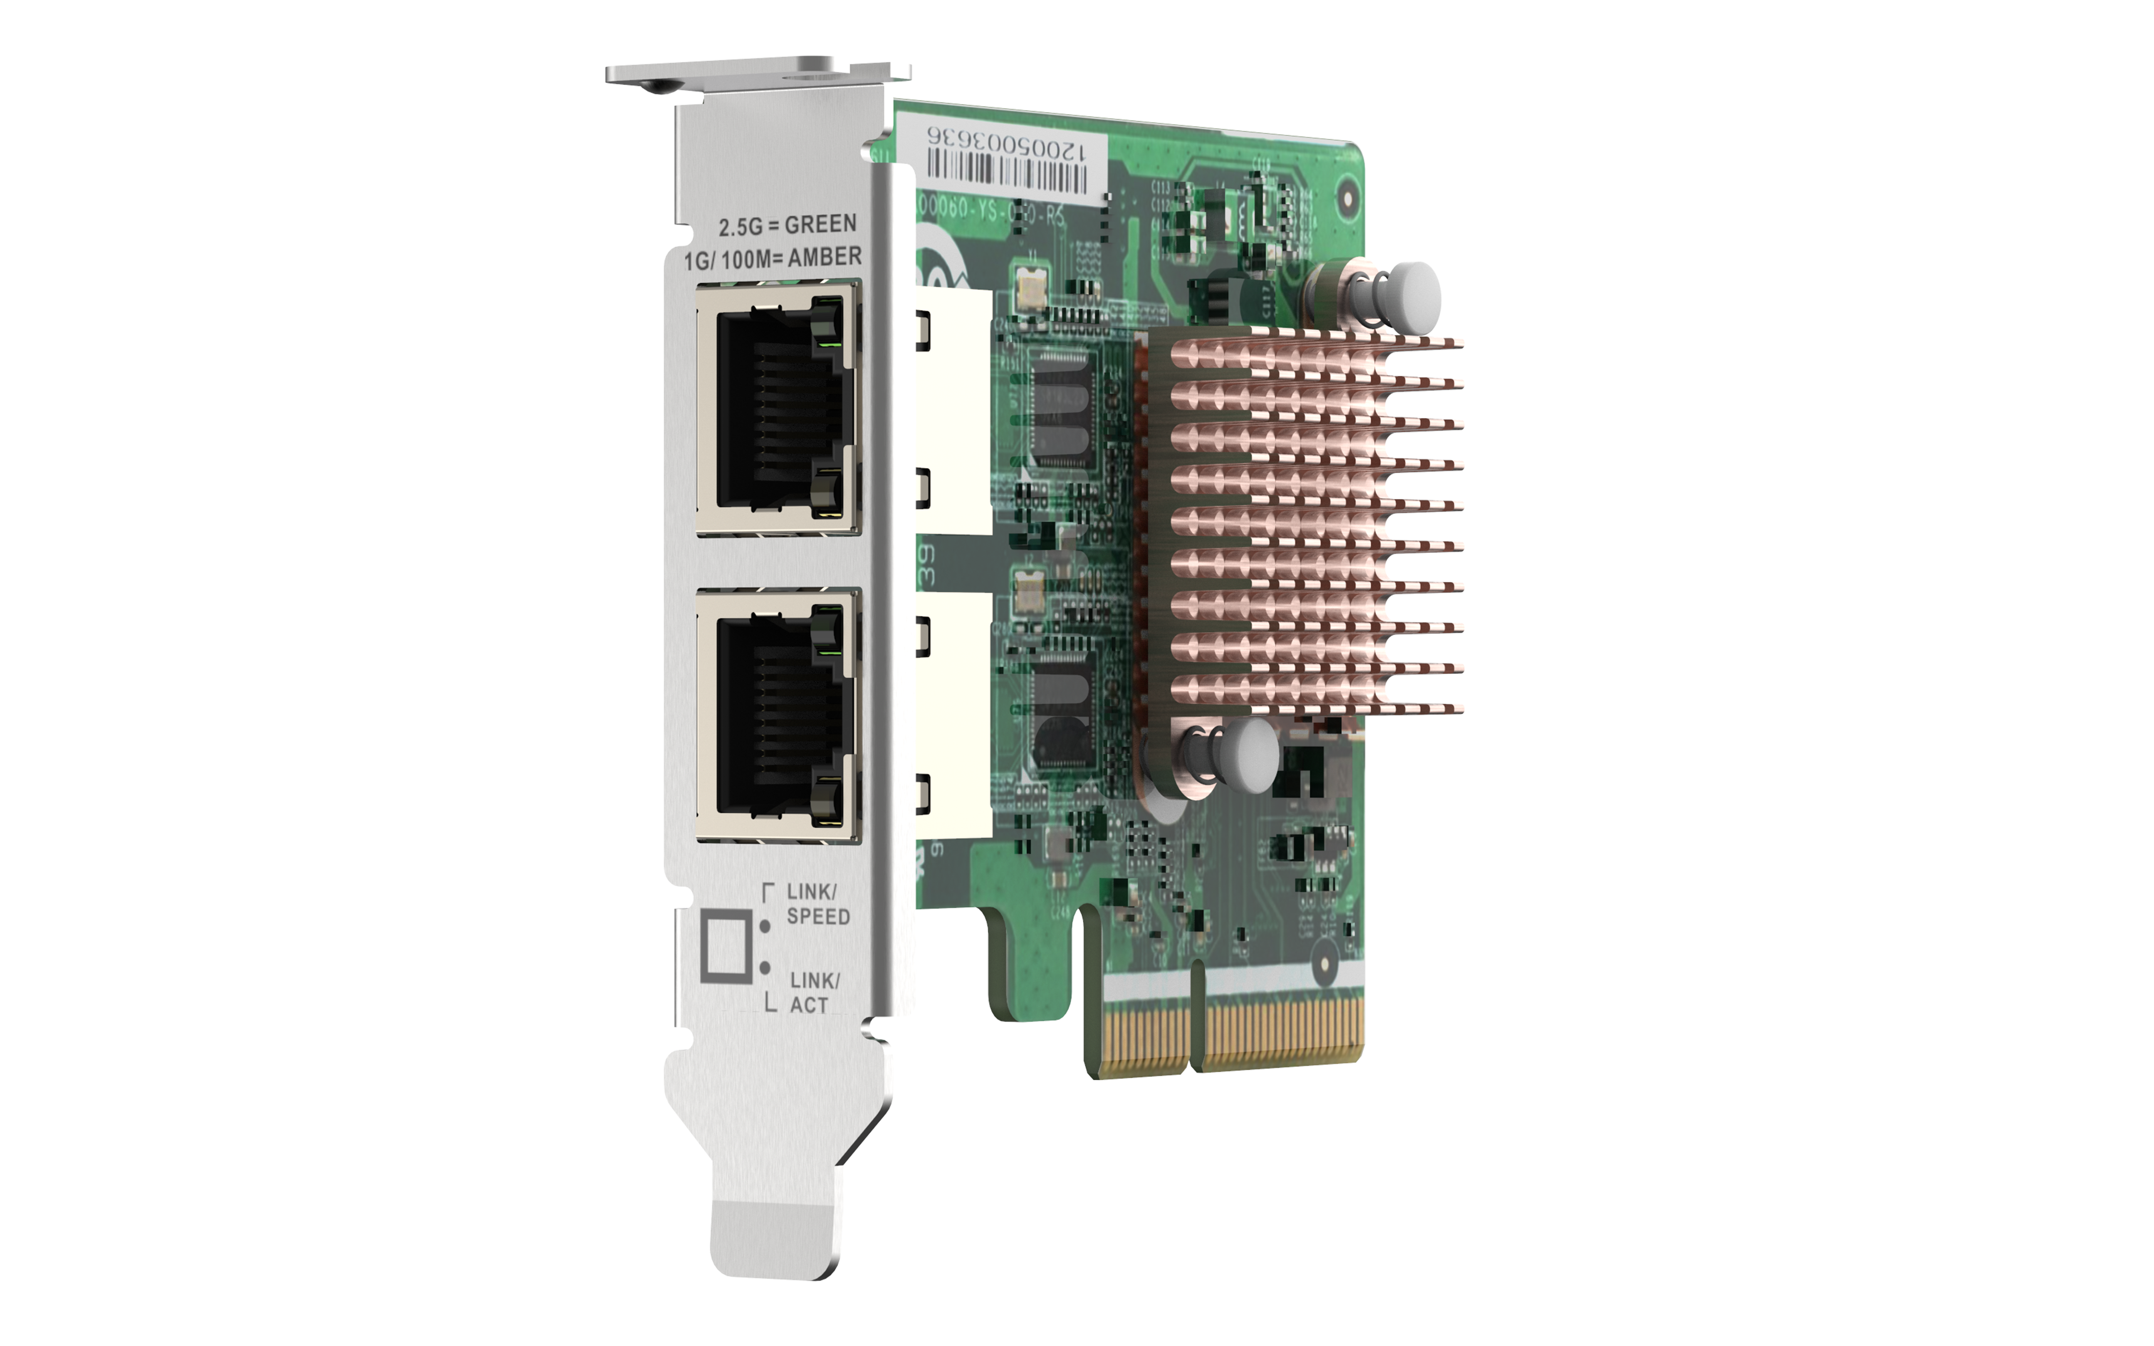
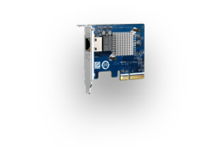
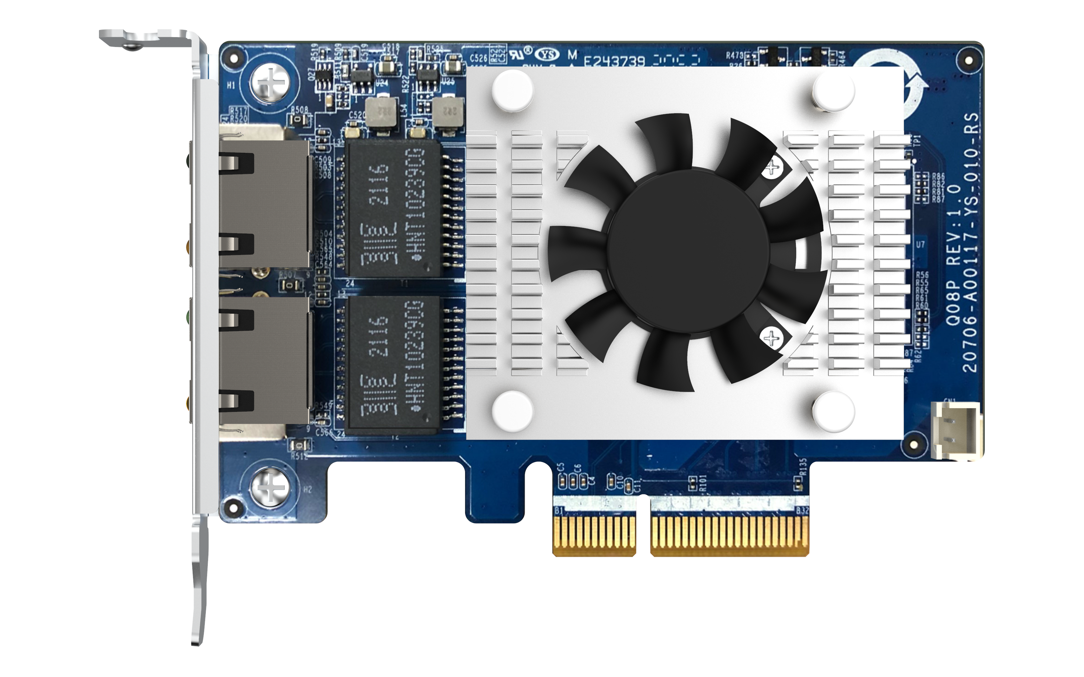
PCIe 3.0 slot for various 5GbE & 10GbE PCIe NICs
QXG-2G1T-I225
1 x 2.5G/1G/100M/10M Port
PCIe Gen3 x2
QXG-2G2T-I225
2x 2.5G/1G/100M/10M Ports
QXG-5G1T-111C
1 x 5G/2.5G/1G/100M Port
QXG-5G2T-111C
2 x 5G/2.5G/1G/100M Ports
QXG-10G1T
1 x 10G/5G/2.5G/1G/100M Port
QXG-10G2TB
2x 10G/5G/2.5G/1G/100M Ports
For more please check compatibility list
https://www.qnap.com/en/compatibility/?model=598&category=11

Slide 14

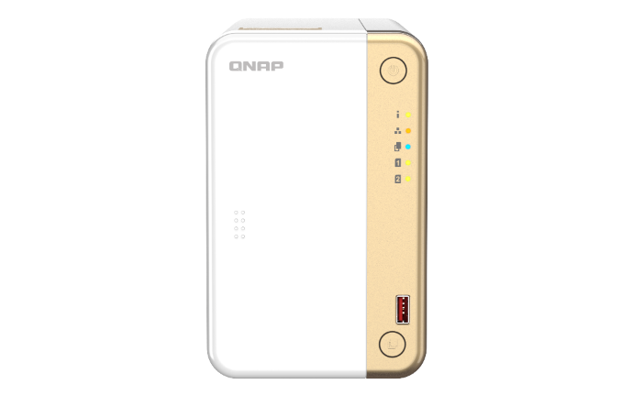
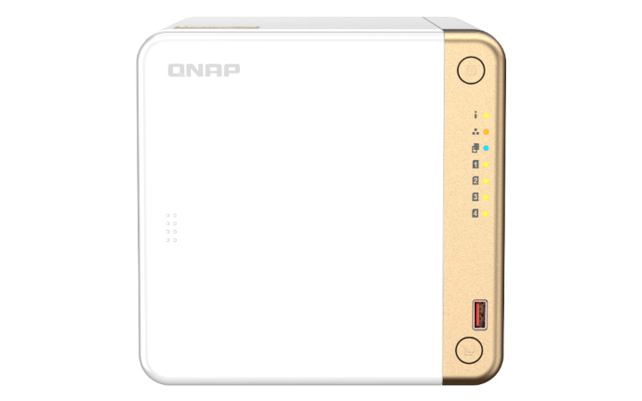
Full 2.5GbE Ethernet performance for 2.5X faster file transfer
1 x 2.5GbE File Transfer
295 MB/s
293 MB/s
TS-262
TS-462
Tested in QNAP Lab:
NAS: TS-462; 4GB DDR4; 4 x Samsung 860 EVO 1TB SSD; RAID5
PC: Intel Xeon W-1250 3.3GHz; 32GB RAM; QXG-2G4T-I225; Windows Server 2019

Slide 15

TS-262: optional 10 GbE for high-speed network transmission
1 x 10GbE Windows File Transfer
2 x 10GbE SMB Sequential Throughput
1,181 MB/s
1,644 MB/s
1,505 MB/s
751 MB/s
Test environment:
NAS | TS-262-4G, QTS 5.0.0, 2 x Samsung 860 Evo 1TB SSDs, RAID 1, thick volume
Client PC | Intel i7-6700 3.4GHz, 64GB RAM
IOmeter | RAM*4, 30-sec ramp up time, 3-min seq. run time, 1 worker, 32-outstanding

Slide 16
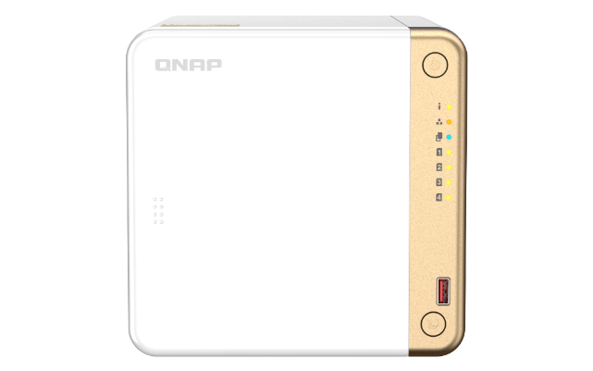
TS-462: optional 10 GbE for high-speed network transmission
1 x 10GbE Windows File Transfer
2 x 10GbE SMB
Sequential Throughput
1,077 MB/s
1,623 MB/s
1,378 MB/s
650 MB/s
Test environment:
NAS | TS-462, QTS 5.0.0, 4 x Samsung 850 Pro 512GB SSDs, RAID 5, thick volume
Client PC | Intel i7-6700 3.4GHz, 64GB RAM

Slide 17
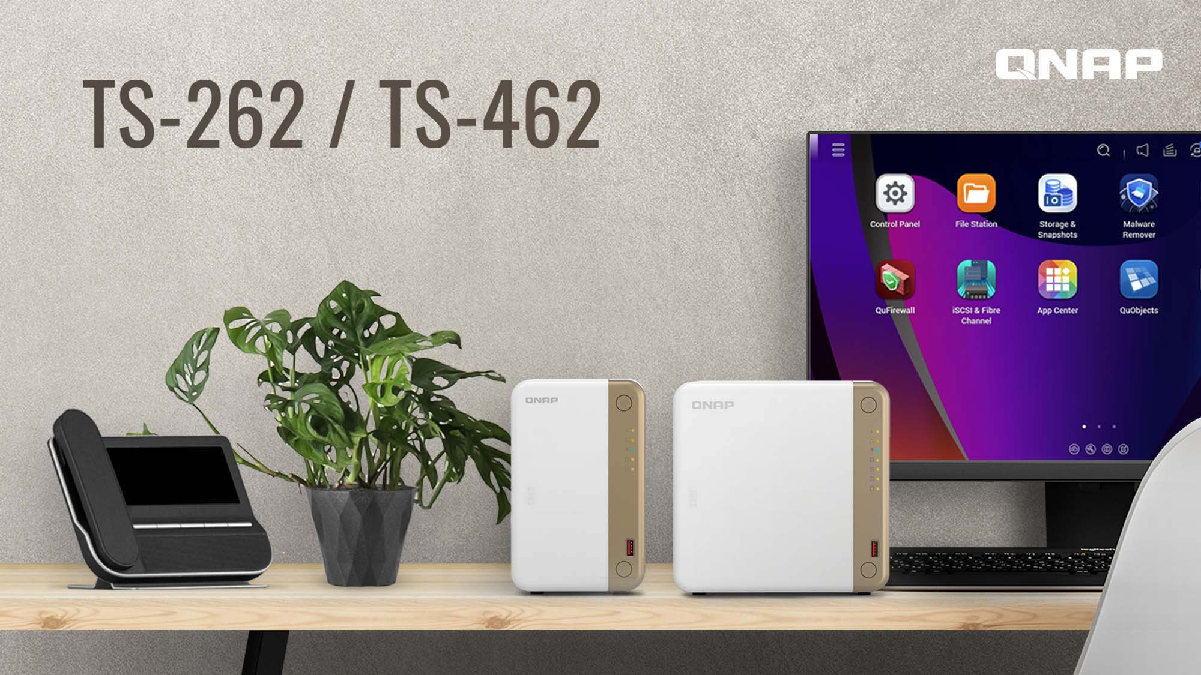

Live Demo

Slide 18





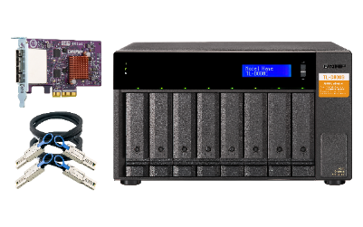
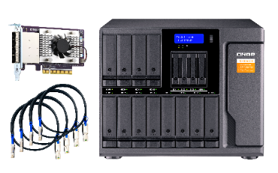
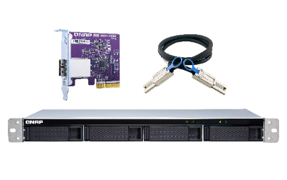
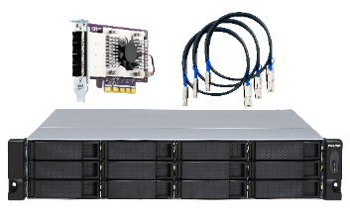

Optional Support USB / SATA JBOD & RAID Storage Expansion Unit
Maximum of JBOD / RAID expansion enclosures
TR-002 | 2
TR-004 | 2
TR-004U | 2
TL-D800C | 2
TL-R1200C-RP | 2
TL-D400S | 1
TL-D800S | 1
TL-D1600S | 1
TL-R400S | 1
TL-1200S-RP | 1
USB
TR-002
TR-004
TL-D800C
TR-004U
TL-R1200C-RP
SATA
TL-D400S
TL-D800S
TL-D1600S
TL-R400S
TL-R1200S-RP

Slide 19



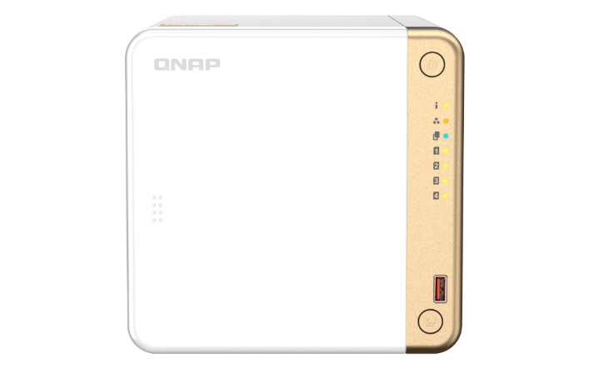



QNAP enclosure supports 2 modes on NAS
TS-262 / TS-462 supports up to two QNAP TR or TL enclosures.
Internal mode with storage pool support or external mode with cross-platform compatibility with Windows/Mac computers.
Mode 1: Expanding the NAS with a new volume
Mode 2: Work as a backup destination for snapshot replica
TR & TL enclosures
TR & TL enclosures

Slide 20
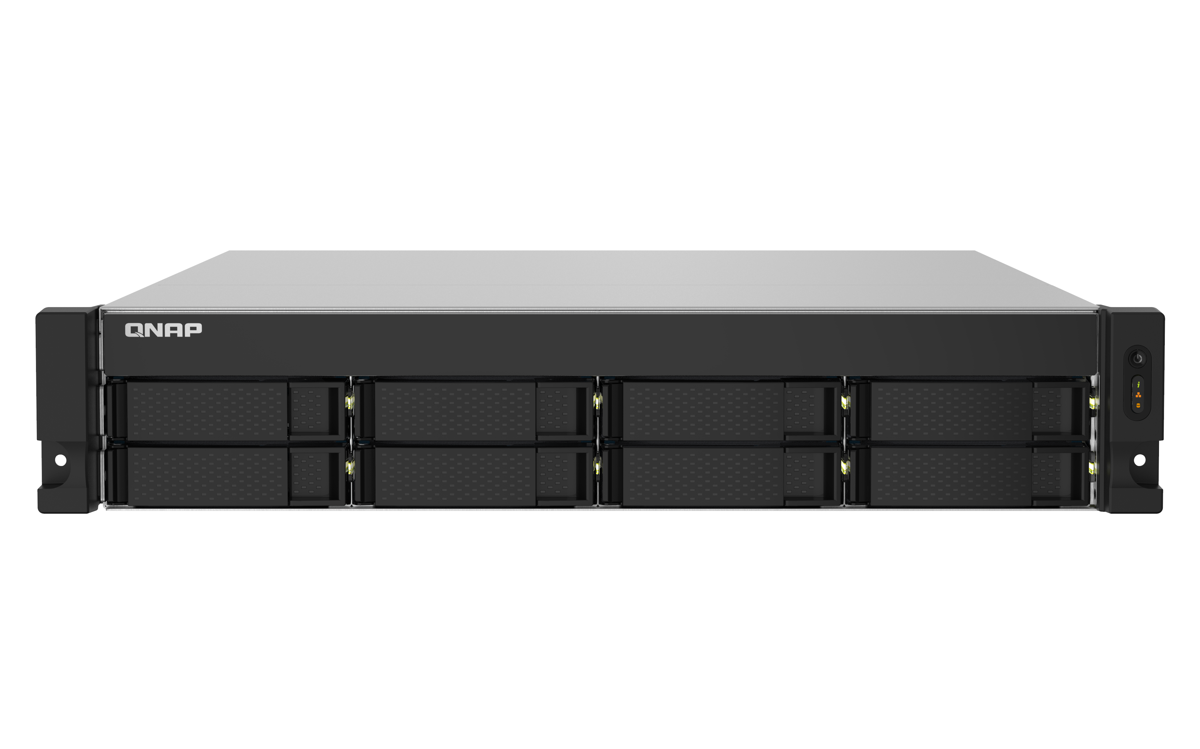



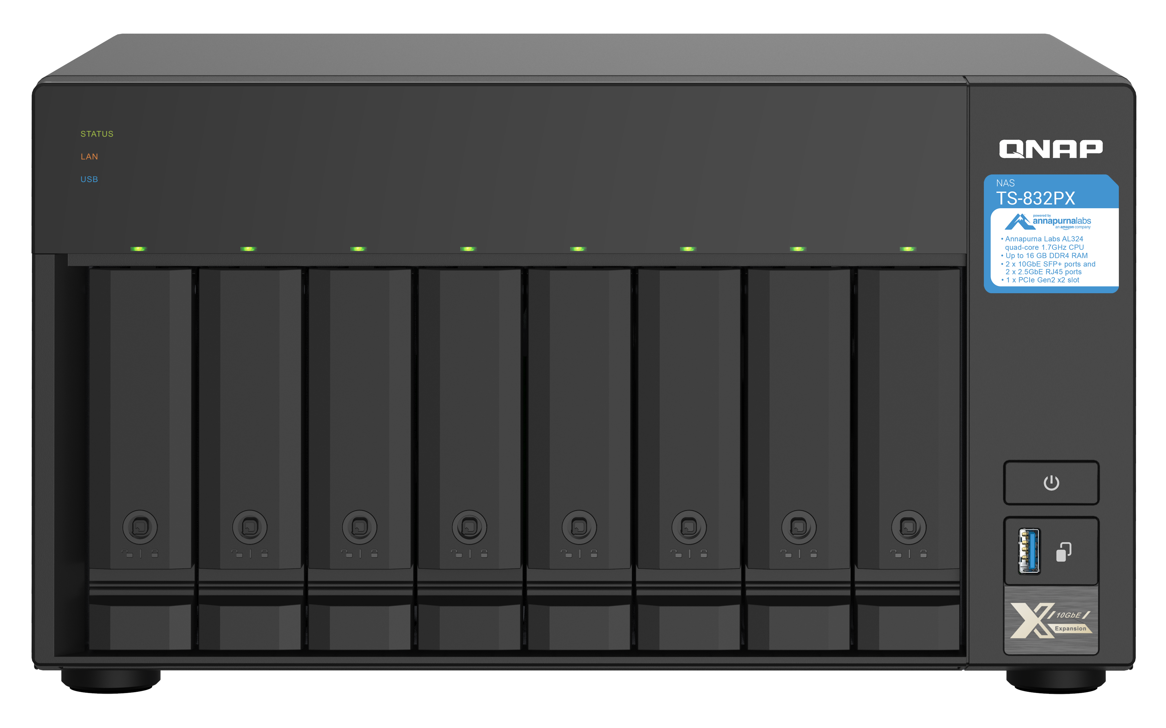
Use Virtual JBOD to expand NAS capacity
Max. 8 VJBOD connections
TS-832PXU
2.5GbE / 1GbE
iSCSI VJBOD connection
TS-462
TS-832PX

Slide 21

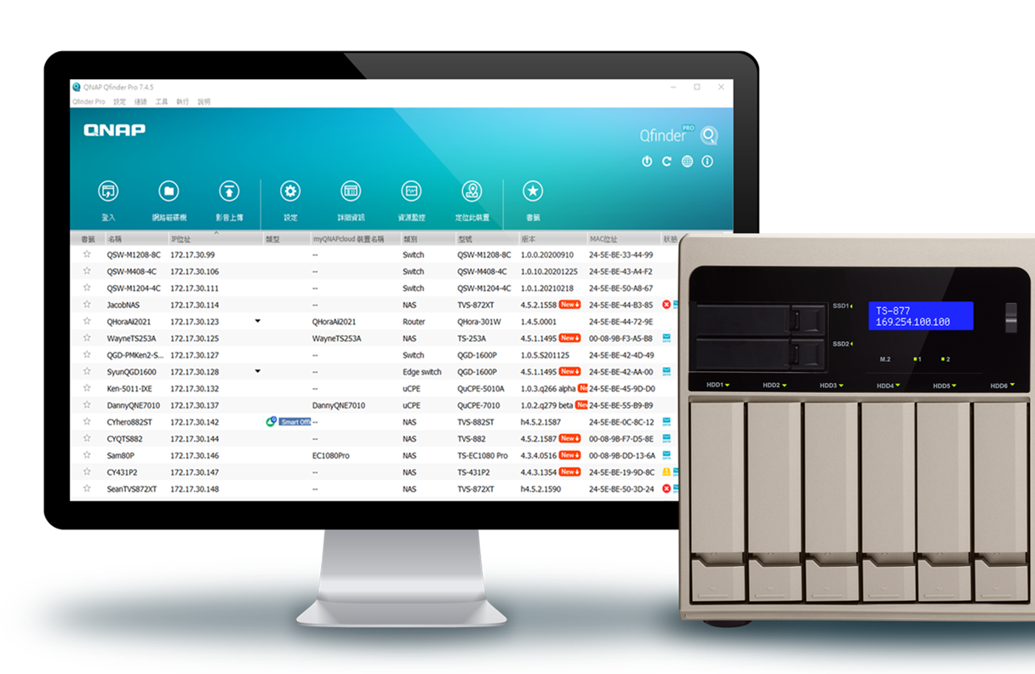

Qfinder Pro
Helps you find, connect and set your NAS
Connect to the NAS via Qfinder Pro for initial setup
Search and connect to the NAS under the same network IP to operate

Slide 22
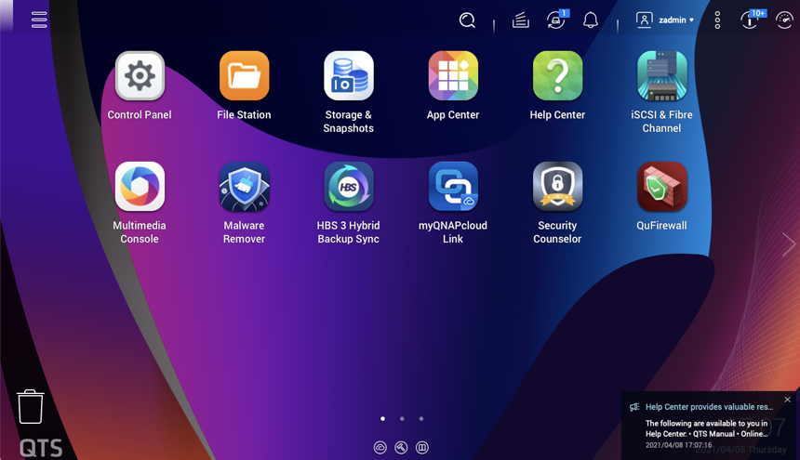
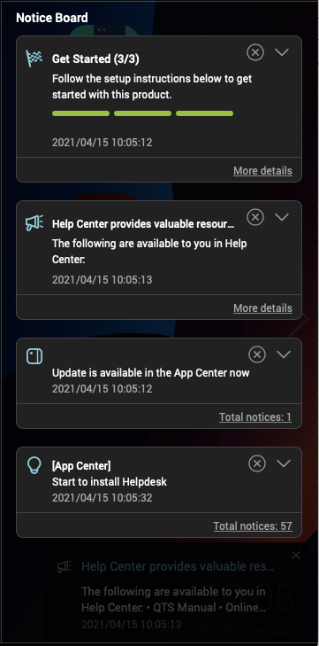
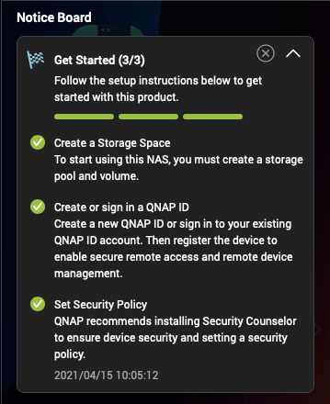
Support the latest QTS 5.0.1 NAS operating system
Support the latest transport layer security protocol TLS 1.3, with better security and faster speed
Optimize the QTS UI , and the notification panel will pop up the instructions at any time
Improve NVMe SSD cache performance , reducing memory workload
Faster WireGuard VPN service for fast and secure connection

Slide 23
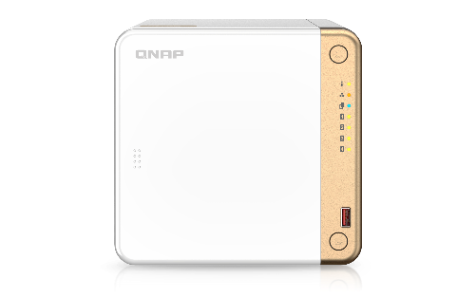
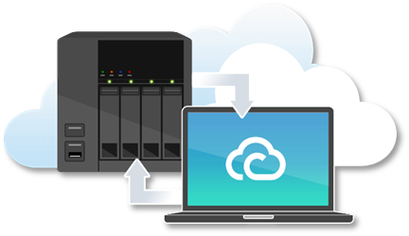

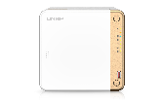
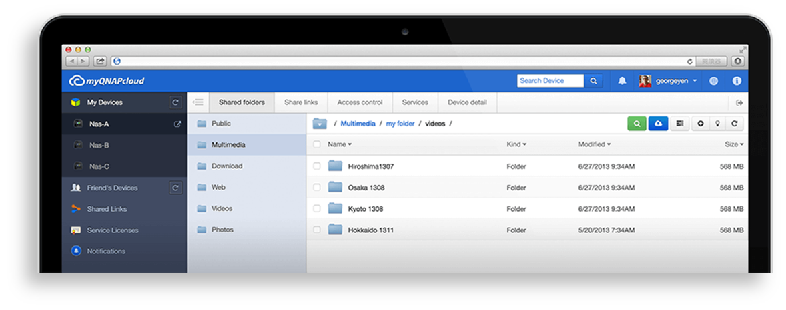
Access and share data anytime with myQNAPcloud
Remote connection
Support both Email and Mobile phone number to registration and login

Slide 24





















Backup data with deduplication
HBS 3 (Hybrid Backup Sync 3)
Keep 3 copies, on 2 types of storage, and store 1 copy off-site to ensure your data safety
From local NAS
（via HBS 3）
From remote NAS
( via File Station）
Carry and Use
(QuDedup Extract Tool )
Backup/Restore
.qdff
Tokyo
Taipei
.qdff
TCP BBR
File Station with QuDedup
(soon)
.qdff
New York
.qdff
CIFS / NFS / FTP
.qdff
Taipei
Access from Cloud
Beijing
File Station with QuDedup
(soon)

Slide 25


DA Drive Analyzer ,
Predict Drive Failure and Minimize Downtime
1 free disk prediction per NAS
Paid subscription for additional disks for added protection
Predict Drive Failure and Minimize Downtime
DA Drive Analyzer integrates ULINK cloud artificial intelligence technology, which can notify you before disk failure, helping you prevent data loss or downtime loss caused by unwarranted disk damage.

Slide 26


Snapshots Help You Fight with Ransomware Threats
TS-262 / 462 supports Snapshot , like taking a photo - within seconds the complete status of your NAS system and data is recorded.
Mitigate the growing threat of ransomware
Step 1
Regularly update, and use Malware Remover
Step 2
Routinely back up to your NAS, and create multi-version snapshots
Step 3
Back up snapshots to another QNAP NAS

Slide 27


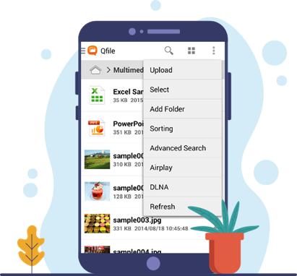
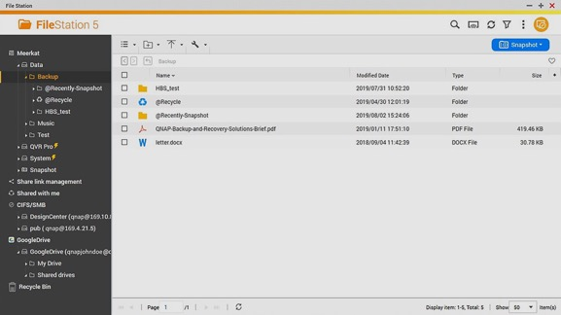
File Station –
Multifunctional file browser
File Station not only allows you to manage the files stored in the NAS, but also the files on the cloud space can be easily managed. Through simple and intuitive operations, you can quickly upload files from devices such as computers, drag and drop files between different folders, delete files, and set file and folder permissions to protect important data from prying eyes.
Manage your files with the Qfile mobile app

Slide 28


Intelligent and automated file management
Qsirch 5
Qfiling 3
Google™ like Search Tool for NAS
All you need to do is categorize your files, set a schedule !
Enables you to find files based on filename, content, and metadata.
Can choose from a variety of search options to quickly find documents, images, videos, emails, and other NAS-based files.
Available using a companion mobile app, browser extension, and Mac® Finder
Source
Schedule
Filter
Edit
Destination
2 tasks：Archive task、Recycle task
3 types of setting：one-time、Scheduled、Real-time
9 editing modules：Such as Face Blur、Video transcoding、Encryption & Decryption...

Slide 29





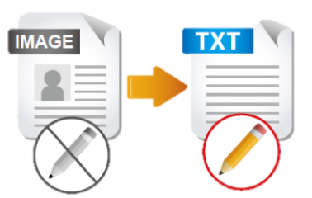




QNAP meets all needs for
File Management
File Station
OCR Converter
Qsirch
Qfiling
Store and backup
File Digitization
Search
Archive
With OCR Converter, Qsirch can search for image context.

Slide 30
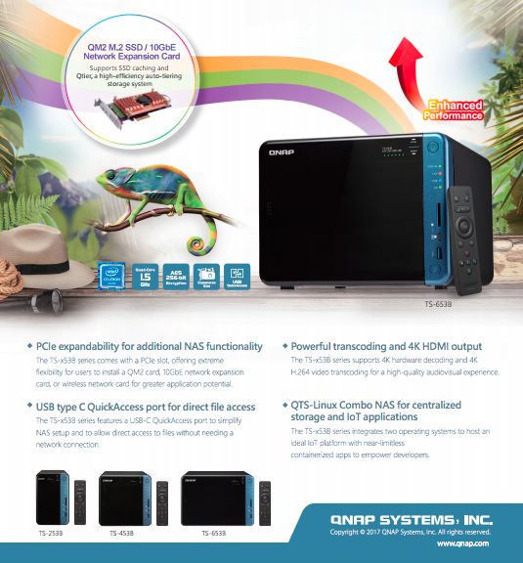






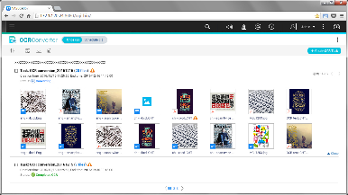
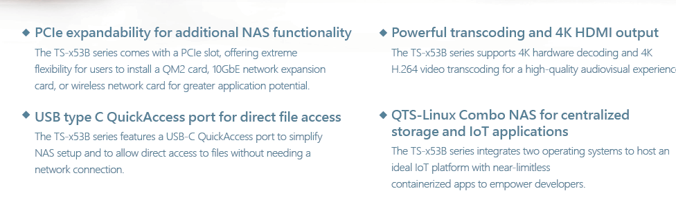
OCR: Best solution for document digitization
Picture with text
Searchable documents
Seach
Edit
Archive

Slide 31

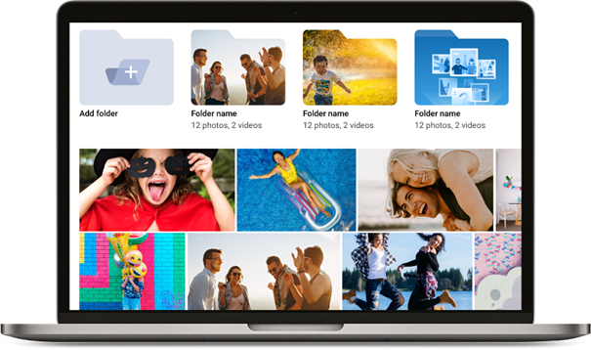










Faster image identification with integrated Intel® OpenVINO™ AI engine.
QuMagie
  Organize photos with similar faces using facial recognition
QNAP NAS
Mobile
Mobile
Browse,manage Photos
Upload, Back-up
Photos
PC
手持裝置
QuMagie
Camera
Share Photos
Social Media
手持裝置
PC
QNAP AI Core

Slide 32




Qsync , Cross-device file sync for individuals and teams
When there are different devices such as laptops and mobile phones, as long as the files are modified on a single device, the modified files will be automatically synchronized to other devices.
When team members collaborate and communicate, files can be automatically pushed to the binding devices of all members, making the workflow faster and collaboration smoother.

Slide 33
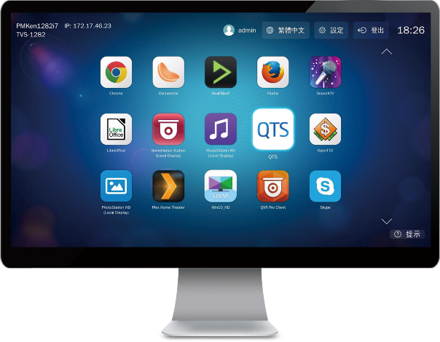

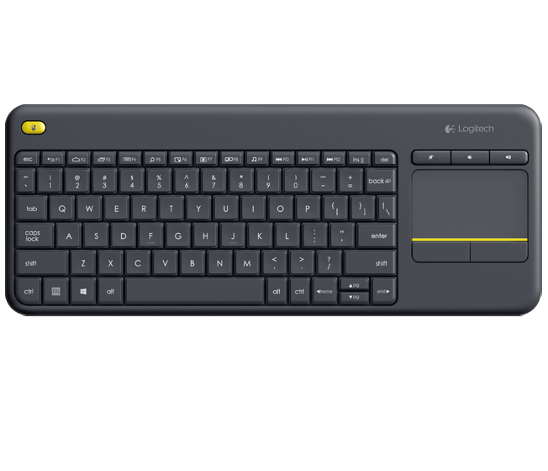
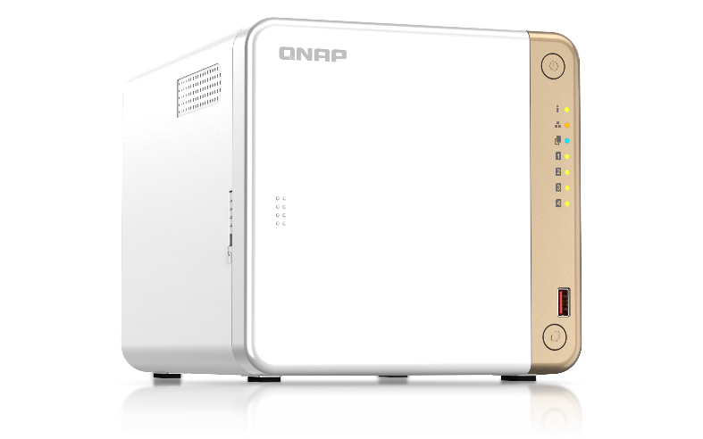

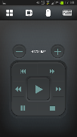
HybridDesk Station for various A/V needs
USB
HDMI
Support RM-IR004 remote control or USB wireless keyboard and mouse control
Network
Qremote App

Slide 34



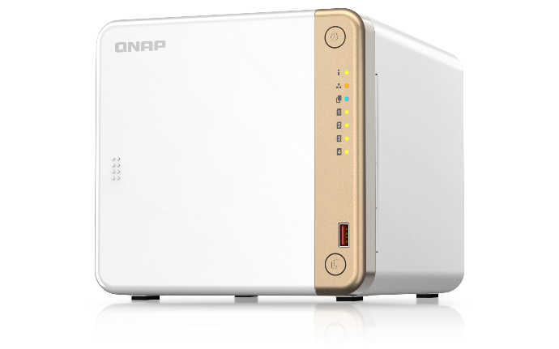


Versatile HybridDesk Station apps
System Management
surveillance
Social Media
QTS
FileStation HD
Skype
Facebook
QVR Pro Client
Multimedia
Media management
Browser & Productivity
HD Player
Clementine
Spotify
TuneIn Radio
PhotoStation HD
VideoStation HD
MusicStation HD
Chrome
Firefox
LibreOffice

Slide 35




Full 4K UHD multimedia experience
4K HDMI v2.0 60Hz output
Plex Server streaming & transcoding
Use Cinema28 for
multi-room streaming

Slide 36





QVR Elite
Smart Surveillance System
Record using the MP4 Format
Flexible Subscription
2 channels are included for free
(expandable)
Expandable Capacity

Slide 37












QVR Elite with powerful IP surveillance camera management and support
More than 180 Brands
More than 6700 Models
ONVIF Profile support
Record into QVR Elite by using the RTSP/RTMP link with no integration needed. Multiple video sources are supported - not just IP cameras.
https://www.qnap.com/en/compatibility-qvr-pro

Slide 38

Built-in Firewall for QNAP Appliances
QuFirewall
User 1
You can allow/deny IP addresses and regions to prevent unauthorized access and brute force attacks for safeguarding data and service security.
User 2
Internet
Firewall
NAS
QuFirewall

Slide 39



Secure communication for peace of mind
QVPN
In addition to establishing a VPN client connection to a remote server, QVPN can also be used.
Supports WireGuard® to provide faster and more stable VPN connections, and to easily set up VPN.

Slide 40

QuFTP remote file FTP access service
Updated independent
Support FTP server
Support FTP client
Support TLS setting
Support QoS setting

Slide 41




Under the similar appearance of TS-x62 / TS-x64, how should we choose ?
Model​ | TS-262 | TS-462​ | TS-264​ | TS-464
Sku | TS-262-4G | TS-462-2G TS-462-4G | TS-264-8G​ | TS-464-4G TS-464-8G
TA | SOHO / Home NAS |  | Entry SMB​
CPU​ | Intel® Celeron® N4505 2-core/2-thread processor, burst up to 2.9 GHz​ |  | Intel® Celeron® N5095 4-core/4-thread Processor , burst up to 2.9 GHz​
Memory​​ | 4GB onboard not expandable | TS-462-2G : 2GB(1x 2GB)DDR4 (2 x SODIMM slots, max. 16GB total)​ TS-462-4G : 4GB onboard not expandable | TS-464-4G 4GB (1x 4GB) DDR4 (2 x SODIMM slots, max. 16GB total)​ TS-264-8G / TS-464-8G : 8GB onboard not expandable
M.2 SSD | 2 x M.2 2280 PCIe Gen 3 x1​ |  | 2 x M.2 2280 PCIe Gen 3 x1​
Ethernet | 1 x 2.5 GbE​ |  | 2 x 2.5 GbE​
HDMI​ | 1 x HDMI 2.0 (4K @60Hz)​ |  | 1 x HDMI 2.0 (4K @60Hz)​
PCIe ​ | 1 x PCIe Gen3 x2 slot​ |  | 1 x PCIe Gen3 x2 slot​
USB​ | 2 x USB 3.2 Gen2 Type-A (10Gbps) + 2 x USB 2.0​ |  | 2 x USB 3.2 Gen2 Type-A (10Gbps) + 2 x USB 2.0​

Slide 42



Shipped with 2-year standard warranty, optional up to 5-year coverage
TS-262 / TS-462
Backed by a 2-year warranty at no additional cost.
Extend hardware warranty up to 5 years
You can also purchase a warranty extension that extends your warranty coverage up to 5 years.
Learn More: QNAP warranty services
TS-262
TS-462

Slide 43

Level up your daily storage experience !
Copyright© 2023 QNAP Systems, Inc. All rights reserved. QNAP® and other names of QNAP Products are proprietary marks or registered trademarks of QNAP Systems, Inc. Other products and company names mentioned herein are trademarks of their respective holders.​​​

