Slide 1



Powered by Intel Atom® C5125 8-core 2.8GHz processor, support up to 128GB memory, large-capacity hybrid storage architecture suitable for small and medium-sized enterprises backup and monitoring applications
2 x M.2
PCIe slots
2 x 2.5GbE RJ45
3 x PCIe Gen 3 slots
Maximum
128GB memory
Optional
NIC

Slide 2

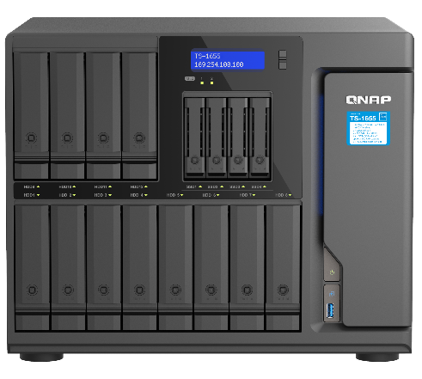








Hybrid HDD + SSD architecture, powered by Intel 8-core CPU, 2.5GbE, and PCIe to provide performance and 25GbE expandability
8
Intel 8-core 2.8GHz CPU
Dual 2.5 GbE RJ45 ports
Intel Atom® C5125 2.8GHz 8-core processor w/ AES-NI encryption acceleration for powerful performance
Sufficient 2.5 GbE network bandwidth provides smooth data transmission experience
Core
Dual M.2 PCIe SSD slots
Hybrid HDD + SSD storage
Two PCIe Gen3 x2 M.2 2280 slots for optimal configuration of NVMe SSD caching or Qtier™️ drives auto tiering
12 x 3.5”/2.5” SATA HDD + 4 x 2.5” SATA SSD provide a hybrid NAS with higher capacity and performance
Maximum 128 GB Memory
3 x PCIe Gen3 x4 slots
128 GB
Pre-installed 8 GB Non-ECC RAM, with 4 x DDR4 UDIMM slots for up to 128 GB total, and optional ECC memory support
A variety of expansion options including 10G/25GbE network, QM2 M.2 SSD, Fibre Channel (FC) and other expansion cards
12吋短機箱可支援市面上大部分的機櫃
內建2埠M.2(PCIe Gen 3 x1)，可提供SSD快取，加速隨機存取的速度
PCIe Gen 3 x 8插槽，提供各式應用的高速擴充卡
雙系統靈活切換配置QTS and QuTS hero

Slide 3

QTS or switch to QuTS hero operating system for optimal data integrity and reliability
TS-1655 is shipped with the QTS operating system, which has powerful data transmission performance and more efficient memory usage, and enjoys the Qtier automatic tiered storage function. You can also change to the QuTS hero operating system according to your needs
 | QuTS hero | QTS
Filesystem | ZFS | Ext4
SSD cache | Read Cache | Read/Write Cache Read Cache Write Cache
Inline Compression | Yes (LZ4 compression, ideal for RAW files and document files) | No
Inline Deduplication | Yes (At least 16 GB RAM required) | No
HBS with QuDedup for Remote Backup | Yes | Yes
Power Failure Protection (Software) | ZIL Copy-on-Write | No
Permission Management | Rich ACL (14 types) | POSIX ACLs (3 types) + certain special permissions
Capacity Expansion | Upgrade RAID capacity Change higher capacity disk drives Attach expansion enclosures/JBODs | Add a disk drive to a RAID group Upgrade RAID capacity Change higher capacity disk drives Attach expansion enclosures/JBODs

Slide 4
TS-1655
Hardware
& Performance

Slide 5
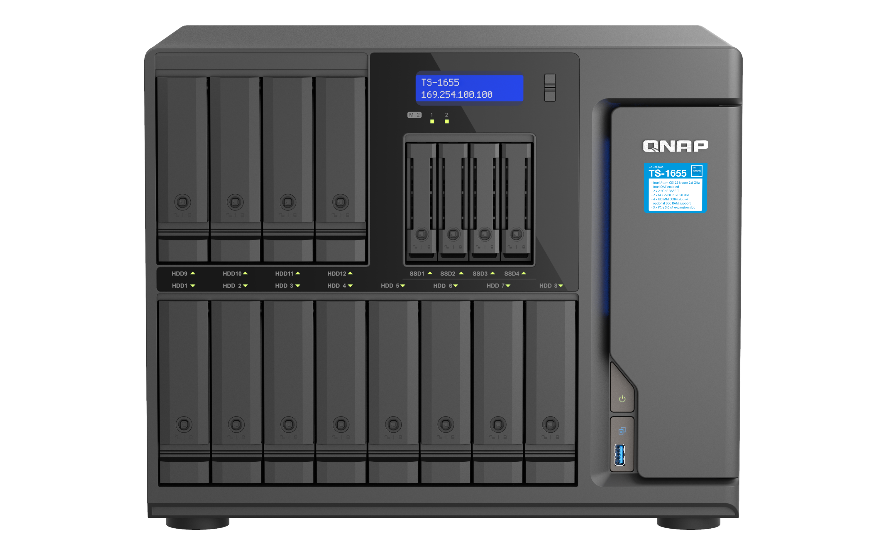


8-core TS-1655 front view with 12 x 3.5-inch SATA HDD/SSD + 4 x 2.5-inch SATA SSD bays
TS-253E / TS-453 機身圖
12 x SATA 6Gbps 3.5”/2.5” HDD/SSD bays
LCM system indicator
( Displays the NAS name, IP address and other information, and easily operate the NAS shutdown or restart )
4 x SATA 6Gbps 2.5” SSD bays
( Can be used with Qtier* or SSD Cache to increase NAS efficiency )
*Qtier™️ is not supported by QuTS hero NAS O.S.
HDD/SSD/M.2 SSD LED indicators
Keylock trays with 2 keys included
Power button & power LED
USB One Touch Copy button
USB 3.2 Gen 1 port
Ordering SKU: TS-1655-8G

Slide 6
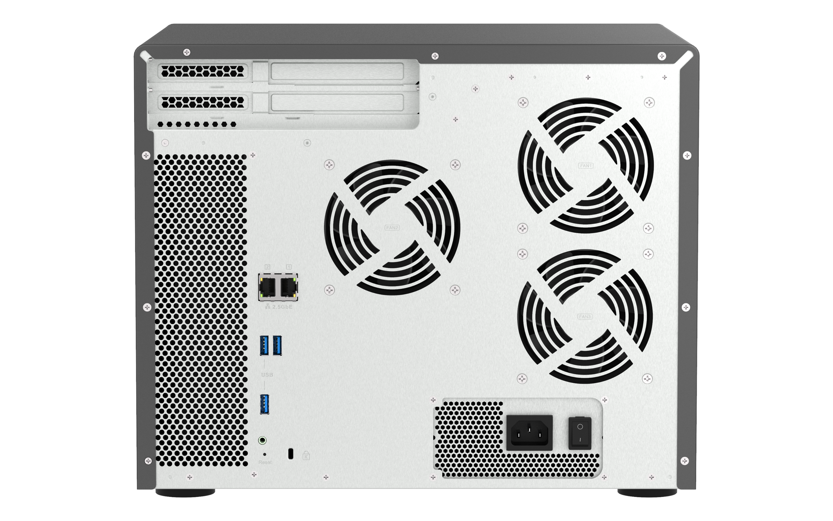
TS-1655 rear view with 3 x PCIe slots, 2 x 2.5GbE, and 3 x USB-A ports for great expandability
TS-253E / TS-453E 背面圖
3 x PCIe Gen3 x4 slots
2 x Half-height
1 x Full-height
3 x 9cm Smart Fan
2 x 2.5 Gigabit Ethernet ports,
compatible with 1GbE/100MbE
2 x USB-A 3.2 Gen 1 ports
Internal power supply
USB-A 3.2 Gen1 port
3.5mm COM port
Reset
Kensington Lock

Slide 7
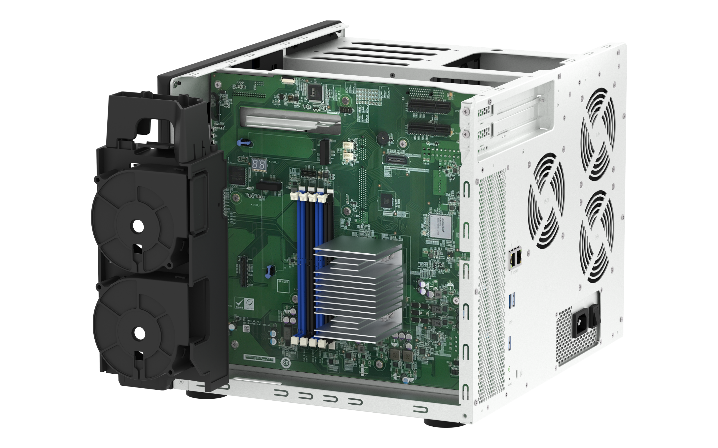
High-performing TS-1655 supports up to 128GB RAM with dual M.2 PCIe SSD slots & 3 x PCIe slots
TS-253E / TS-453 機身圖
3 x PCIe Gen3 x4 slots
2 x M.2 2280 slots
( PCIe Gen3 x2 )
2 x internal cool & quiet smart fans
4 x UDIMM memory slots, up to
128GB total and optional ECC memory support
(1 x 8GB non-ECC RAM module is pre-installed in the TS-1655-8G ordering SKU. ECC and non-ECC RAM modules cannot be installed together. Refer to the product page for compatible RAM modules.)

Slide 8
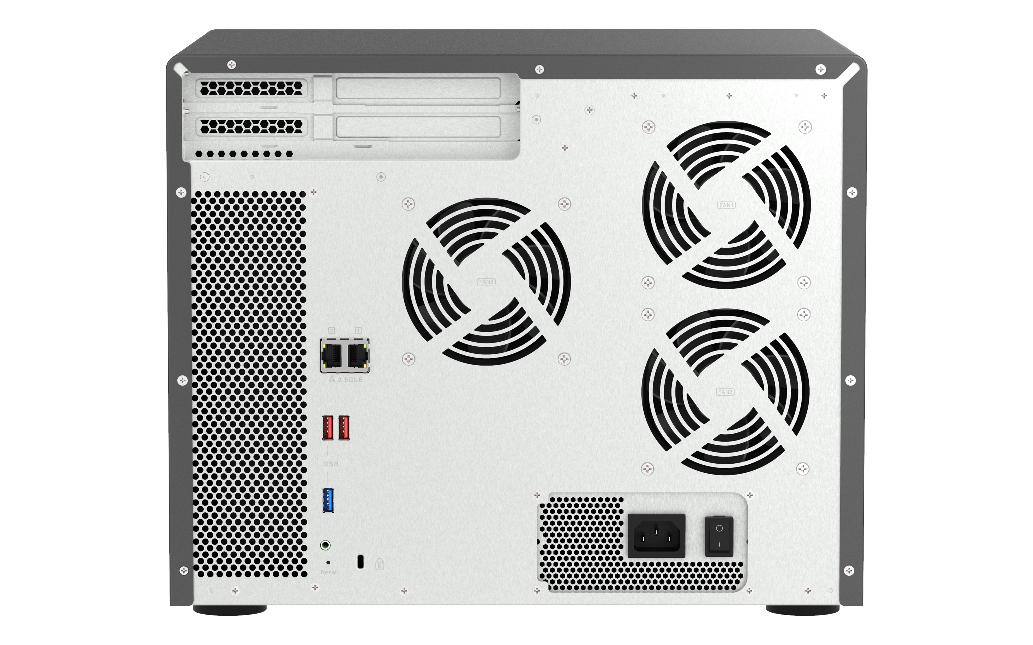
Advanced features including an optional graphics card and Intel® QAT & SR-IOV to increase efficiency
Higher-end GPU cards for display/transcoding
Dual Half-height PCIe Gen3 x4 slots
Size: 150 x 68.9 x 18.76 mm (5.90 x 2.71 x 0.74 inches)
GPU
Provides an additional graphics card installation. PSU with 1 x 8-pin and 1 x 8-pin (6-pin + 2-pin) graphics card power cables.
Maximum supported card size:
260 x 111.15 x 37.52 mm (10.25 x 4.38 x 1.48 inches)
Full-height PCIe Gen3 x4 slot
Size: 260 x 111.15 x 37.52 mm (10.25 x 4.38 x 1.48 inches)
Compatibility : https://www.qnap.com/go/compatibility/?model=716&category=25
SR-IOV Network I/O Virtualization
SR-IOV
Install a compatible PCIe 10GbE or 25GbE network card that supports SR-IOV technology, and directly allocate the bandwidth resources of the physical network card to the virtual machine in QNAP Virtualization Station.
Intel® QAT hardware acceleration
QAT
Integrates the state-of-the-art Intel® QuickAssist hardware acceleration engine hardware (Intel® QAT), which accelerates data compression / decompression, and can greatly improve the performance of encryption and decryption transmission operations
12吋短機箱可支援市面上大部分的機櫃
內建2埠M.2(PCIe Gen 3 x1)，可提供SSD快取，加速隨機存取的速度
PCIe Gen 3 x 8插槽，提供各式應用的高速擴充卡
雙系統靈活切換配置QTS and QuTS hero

Slide 9

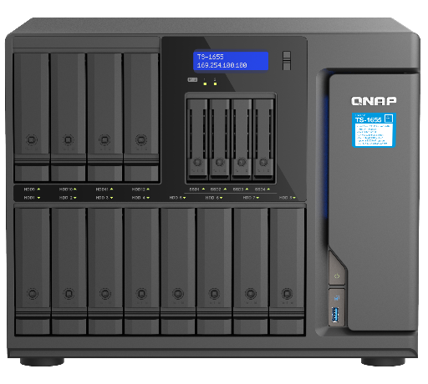
Dual 2.5 GbE ports bring essential performance out of the box. Class-leading 10GbE champion is here.
2 x 2.5GbE Windows
File Transfer
2 x 10GbE SMB
Sequential Throughput (1MB)
2,362 MB/s
586 MB/s
1,936 MB/s
525 MB/s
Note: An optional QNAP QXG-10G2TB 2-port 10GBASE-T NIC is installed on TS-1655 NAS.
Test environment：​
NAS: TS-1655 with QXG-10G2TB
OS：QTS 5.0.0
Volume type: RAID 5; 16 x Samsung 860 EVO 1TB ​
Client PC: Windows Server 2016, Intel i7-6700 3.4GHz, 64GB RAM, QNAP LAN-10G2T-X550 NIC
IOmeter : RAM*4, 30-sec ramp up time, 3-min seq. run time, 1 worker, 32-outstanding
12吋短機箱可支援市面上大部分的機櫃
內建2埠M.2(PCIe Gen 3 x1)，可提供SSD快取，加速隨機存取的速度
PCIe Gen 3 x 8插槽，提供各式應用的高速擴充卡
雙系統靈活切換配置QTS and QuTS hero

Slide 10
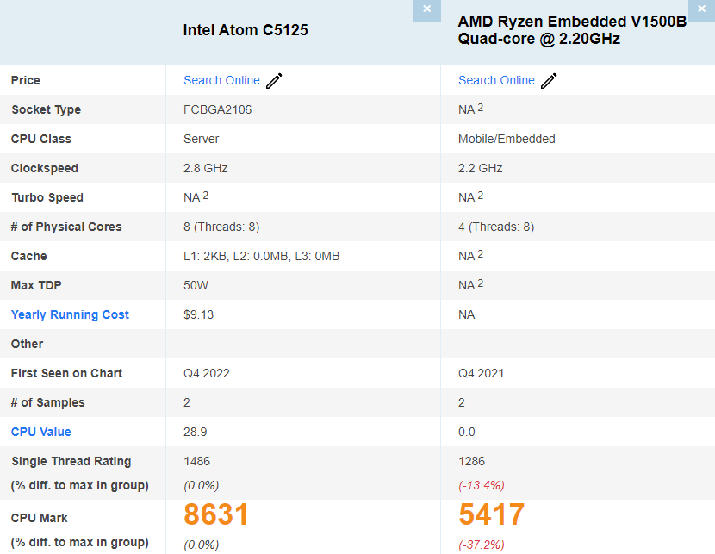



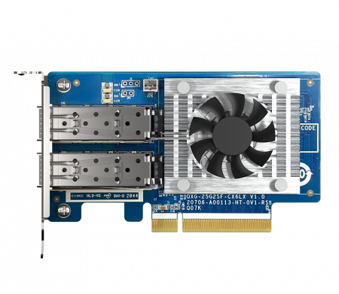
Max out its performance potential with 25GbE NIC, up to 3,499 MB/s for your future business growth
TS-1655 NAS with Intel Atom® C5125 8-core CPU provides excellent performance when compared with other 12-bay HDD NAS with AMD V1500B CPU!
2 x 25GbE SMB
Sequential Throughput (1MB)
3,499 MB/s
https://www.cpubenchmark.net/compare/5091vs4624/Intel-Atom-C5125-vs-AMD-Ryzen-Embedded-V1500B-Quad-core
2,591 MB/s
Compared with the QNAP TS-1635AX ARM 4-core 1.6 GHz, TS-1655 SMB sequential throughput performance is twice faster!
2.24X
Read ↗
Write↗
2.12X
Test environment：
NAS: TS-1655 with QXG-25G2SF-CX6
OS：QTS 5.0.1
Volume type: RAID 5; 16 x Samsung 860 EVO 1TB
Client PC: Windows Server 2019, AMD EPYC 7302P 3.0GHz, 128GB RAM, QNAP QXG-25G2SF-CX4 NIC
IOmeter : RAM*4, 30-sec ramp up time, 3-min seq. run time, 1 worker, 32-outstanding
QXG-25G2SF-CX6 2-port 25GbE NIC​

Slide 11
High-performance, Large-capacity File backup & Surveillance Server

Slide 12






Certified for enterprises & virtualization, large-capacity 8-core NAS for data storage & surveillance
Intel® 8-Core 2.8 GHz CPU
High performance processor suitable for virtual machines and multitasking
12 x SATA HDD + 4 x SATA SSD Large hybrid storage
Suitable for multi-device file backup and as a surveillance host
Virtualization station
Container station
QVR Pro
Qsync
HBS3
HDD+SSD
Certified for virtualization
Microsoft Hyper-V / Citrix ready /
VMware ready / Veeam ready
12吋短機箱可支援市面上大部分的機櫃
內建2埠M.2(PCIe Gen 3 x1)，可提供SSD快取，加速隨機存取的速度
PCIe Gen 3 x 8插槽，提供各式應用的高速擴充卡
雙系統靈活切換配置QTS and QuTS hero

Slide 13



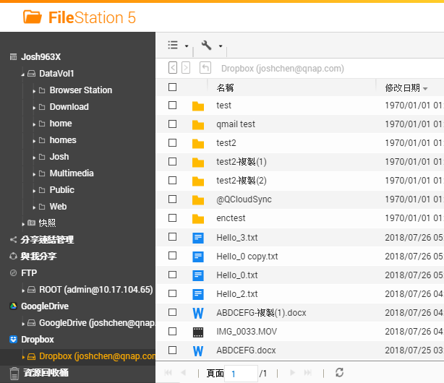
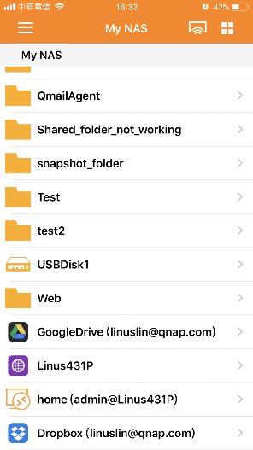
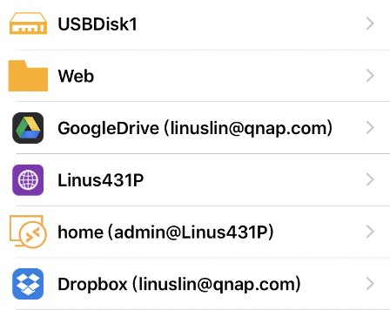
File Station is the ultimate and user-friendly web & iOS/Android-based file explorer
手機瀏覽
網頁瀏覽
File Station is a file management tool in QTS that enables QNAP NAS users to intuitively access shared folder content through web browsers.
Qfile
File Station
Local
NAS
Remote
NAS
Cloud Storage

Slide 14


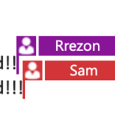


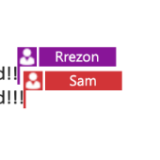

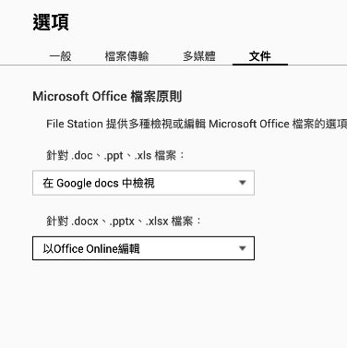


File Station is compatible with popular office apps and even productive online multi-user collaboration
 | Edit with Office Online | View in Google Docs | Open with Google Chrome Extension
Requirement | CloudLink needs to be enabled | CloudLink needs to be enabled | Use Chrome with extension “Office Editing for Docs, Sheets & Slides” to open
Supported formats | .docx, .pptx, .xlsx | .doc, .ppt, .xls .docx, .pptx, .xlsx | .doc, .ppt, .xls .docx, .pptx, .xlsx
Capabilities | •File collaboration •Auto save to NAS in real time | •Document preview •Convert to Google docs for editing & saving in your Google Drive | •Document preview •Convert to Google docs for editing & saving in your Google Drive
Save to NAS in real time
Multi-user online editing
檔案即時同步並回存至NAS中
支援多人線上編輯
 | 以 Office Online 編輯 | 在 Google Docs 中檢視 | 以 Google Chrome 擴充功能開啟
必要設定 | 啟用 MyQNAPCloud CloudLink | 啟用 MyQNAPCloud CloudLink | 以 Chrome 瀏覽器開啟，並安裝擴充功能：Office Editing for Docs, Sheets & Slides
支援格式 | .docx, .pptx, .xlsx | .doc, .ppt, .xls .docx, .pptx, .xlsx | .doc, .ppt, .xls .docx, .pptx, .xlsx
支援能力 | 文件共同編輯與同步至 NAS 檔案 | 文件檢視 可轉成 Google 文件進行編輯 | 文件檢視 可轉成 Google 文件進行編輯
到 設定>文件 裡，選擇你習慣的預設開啟方式吧！

Slide 15
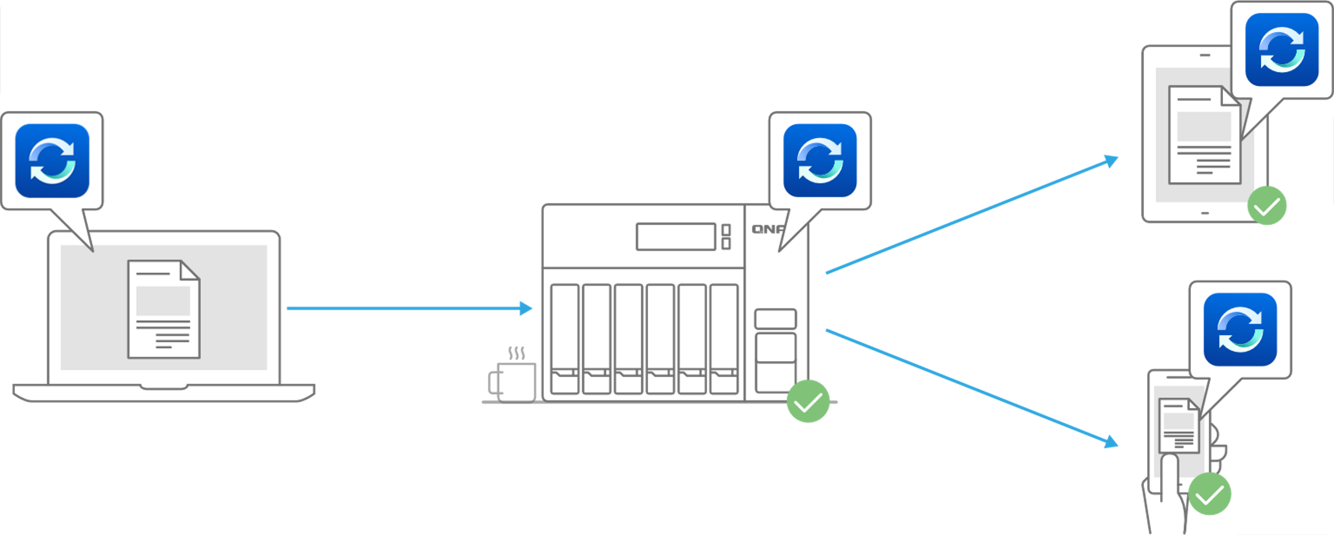



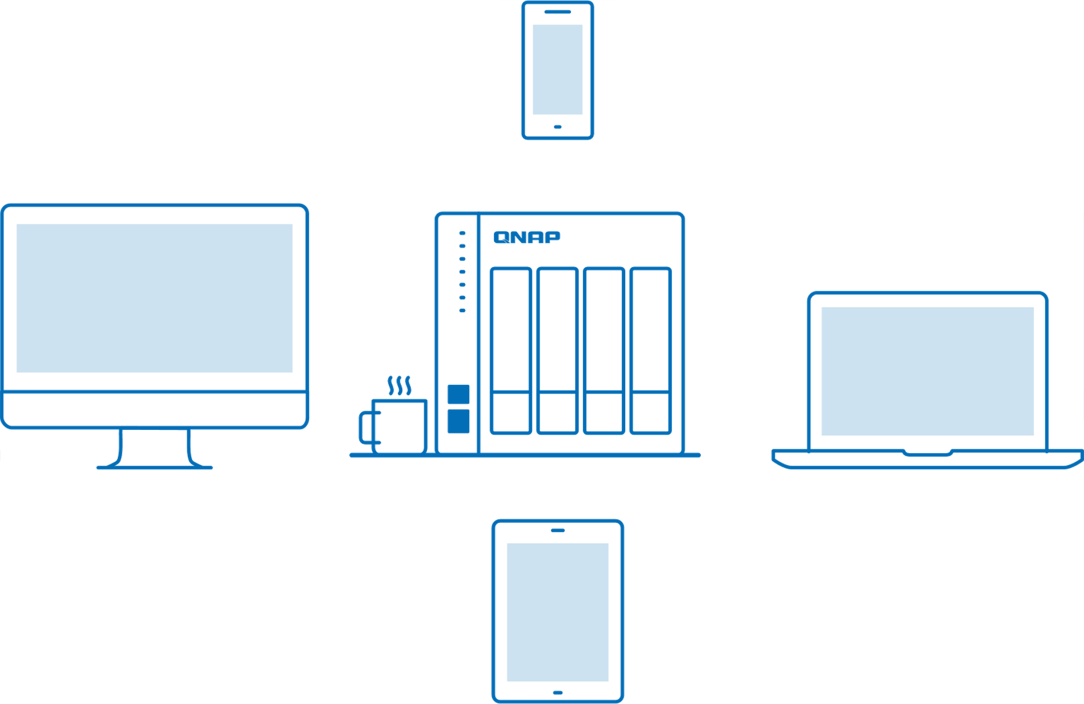
Qsync 5.0 – Cross-device file sync for individuals and teams
Qsync enables efficient file synchronization between a QNAP NAS and linked devices such as computers, laptops, and mobile devices.
With Qsync, you can easily access data across all your devices and share it among your team members.
If you own many devices, any file changed on one device will be automatically synchronized with the others.
For team works, any file changed will be automatically distributed to your teams’ devices, accelerating and streamlining your workflows.

Slide 16




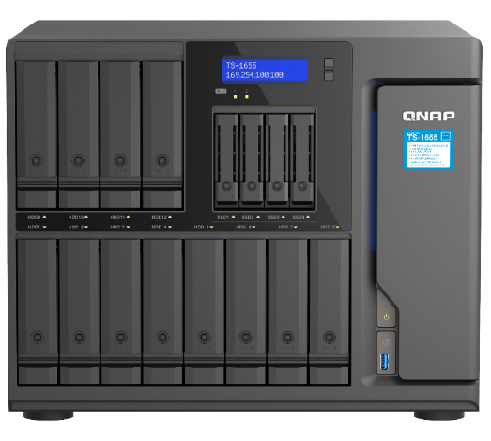
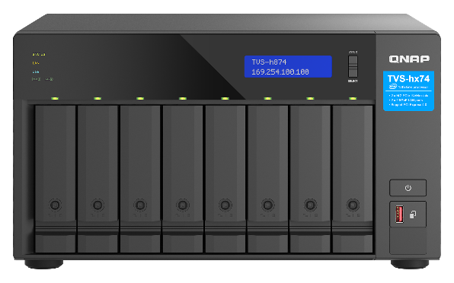
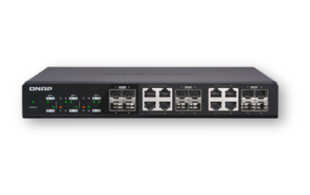
License-free scheduled & real-time backup solutions to provide complete data backup protection
HBS 3 (Hybrid Backup Sync 3) :
File level, multi-version management: RTRR, Rsync, FTP, WebDAV, and CIFS/SMB protocols.
RPO : daily / scheduled
Snapshot :
File level, multi-version management.
Lightweight snapshot w/o performance impact.
RPO : hourly / daily / yearly
Snapsync :
Block level, Mirror the data copy and always kept up to date.
RPO : real-time

Slide 17









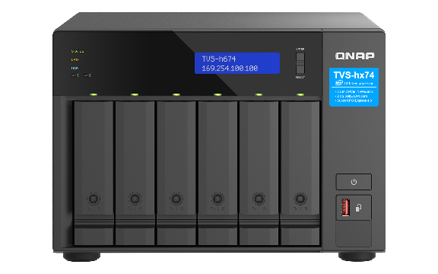

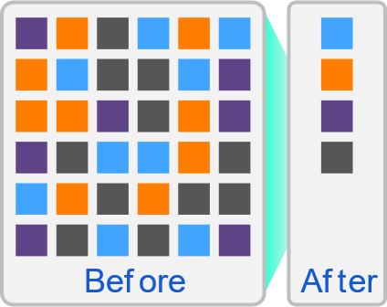








Easy to use HBS 3.0 app fulfilling backup
3-2-1 practice with deduplication
HBS 3 (Hybrid Backup Sync 3)
Local NAS access
(via HBS 3)
Remote NAS access
( via File Station )
Portable use
(QuDedup Extract Tool)
Backup/Restore
.qdff
Tokyo
Taipei
.qdff
TCP BBR
File Station with QuDedup
.qdff
New York
.qdff
CIFS / NFS / FTP
.qdff
Taipei
File Station with QuDedup
Paris
Cloud access

Slide 18









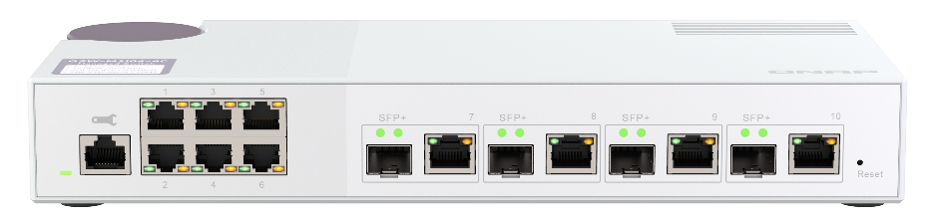



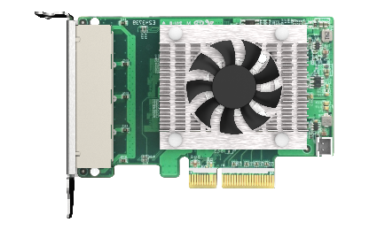
Up to 14 clients direct 2.5GbE LAN connection with optional NICs. Multi-device backup from near & far
Connect to Intranet Devices
Qsync
Cloud Backup
HBS3
QNAP
QSW-M2106
(2.5G/10G switch)
Qsync
HBS3
Up to
14 x 2.5GbE devices
Qsync
Remote backup
Install 3 x QXG-2G4T-I225
12吋短機箱可支援市面上大部分的機櫃
內建2埠M.2(PCIe Gen 3 x1)，可提供SSD快取，加速隨機存取的速度
PCIe Gen 3 x 8插槽，提供各式應用的高速擴充卡
雙系統靈活切換配置QTS and QuTS hero

Slide 19
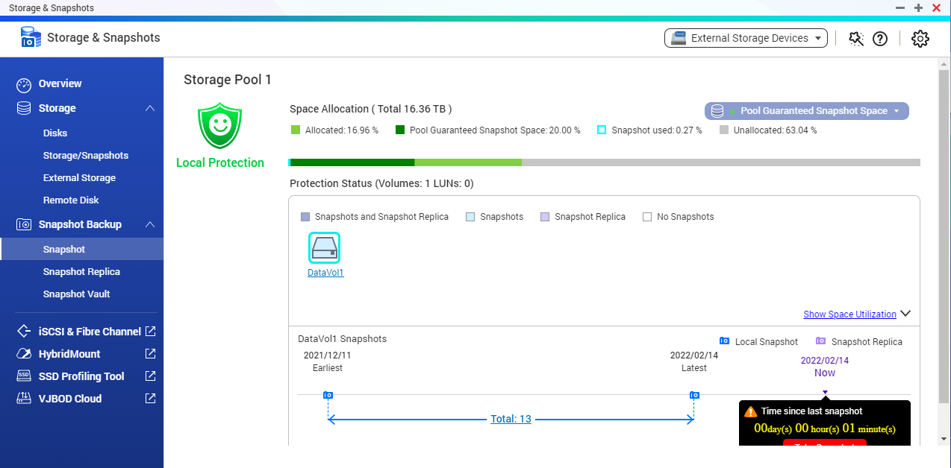
Snapshot fights against ransomware or accidents. Protect and restore your data. Easy, and fast!
TS-1655 supports Snapshot, which is like taking a photo - within seconds the complete status of your NAS data is recorded. Maximum snapshots #s for QTS: 1,024, QuTS hero: 65,536
Mitigate the growing threat of ransomware
Step 1
Regularly update, and use Malware Remover
Step 2
Routinely back up to your NAS, and create multi-version snapshots
Step 3
Back up snapshots to another QNAP NAS

Slide 20

Real-time SnapSync ensures minimal RPO with real-time disaster recovery
Back up data from the local NAS to another QNAP NAS using block-level replication in real time.
Snapshot Replica
Realtime Snapsync: RPO=0
Normal
Normal
Disaster Recovery (RPO=0)
By schedule
Snapshot send
Real-time Snapshot
Secondary NAS
Secondary NAS
Primary NAS
Primary NAS
(Round Trip Latency < 10ms)

Slide 21






Hyper Data Protector is an all-in-one license-free backup solution for virtual machines
Supports VMwareⓇ and Microsoft Hyper-V
Unlimited VM backups and license-free
Active backup solution
Restore at any time point
Constant monitoring
Hyper Data Protector
Microsoft Hyper-V

Slide 22





Protect Enterprise SaaS data with
Boxafe backup / recovery solution for
Google™ Workspace and Microsoft 365®
Keep important data in your hands
Move older data out of the cloud to reduce cost
Google™ Workspace
Microsoft 365®
Gmail
Backup all your emails and attachments in Gmail
Outlook
Backup all your emails and attachments in Outlook
Google Drive
Backup all your file versions in Google Drive and supports My Drive and Shared Drive
Contacts (People)
Backup all your contacts in Outlook People
Calendar
Backup all your events and attachments in Outlook Calendar
Contacts
Backup all your contacts in Google Contacts
Calendar
Backup all your events and attachments in Google Calendar
OneDrive
Backup all your files in OneDrive and support SharePoint

Slide 23
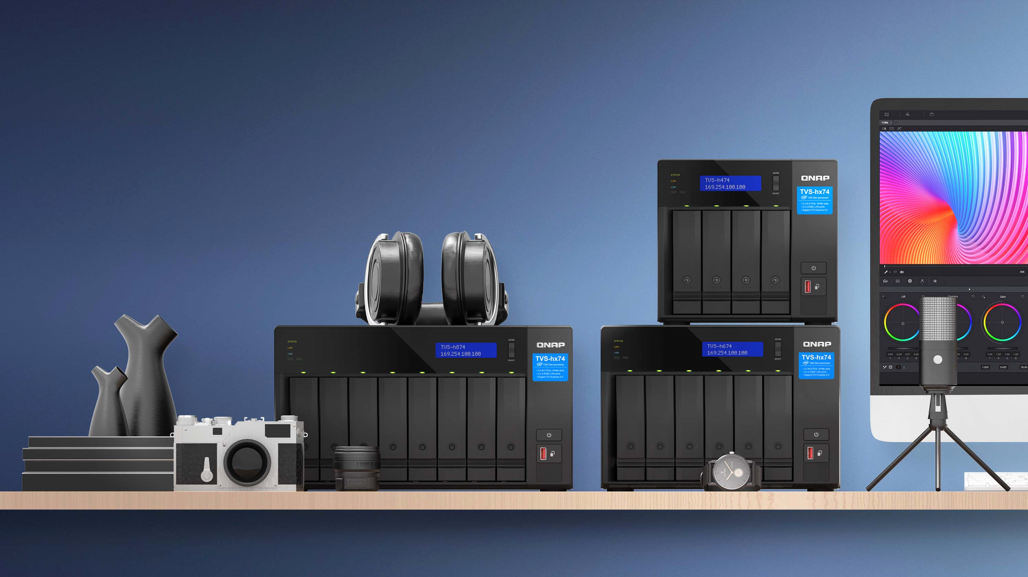
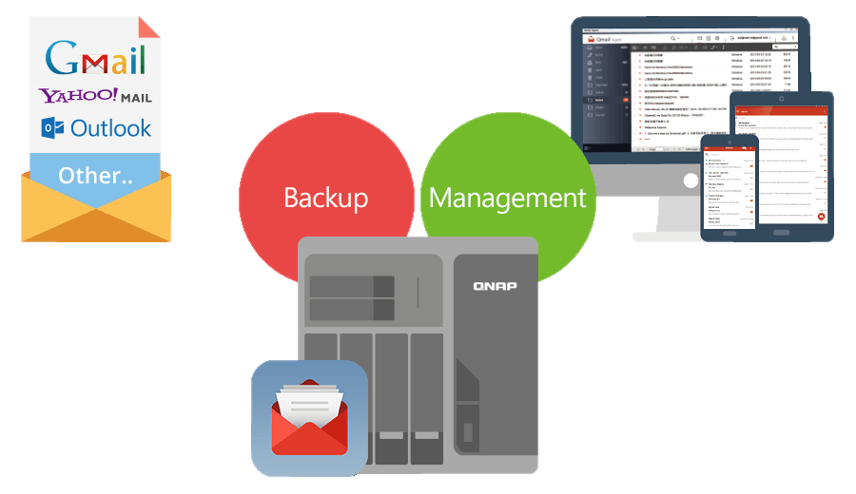

Easily backup/recover emails and efficiently manage multiple email accounts with QmailAgent
Best Email Retention Solution
Collectively manage and back up your personal and business emails.
Easily auto back up all your emails and attachments.
Quickly search and gain access to specific messages.
Back up emails for disaster recovery.
Encryption service protects backed up private emails.
Sync
Sync

Slide 24

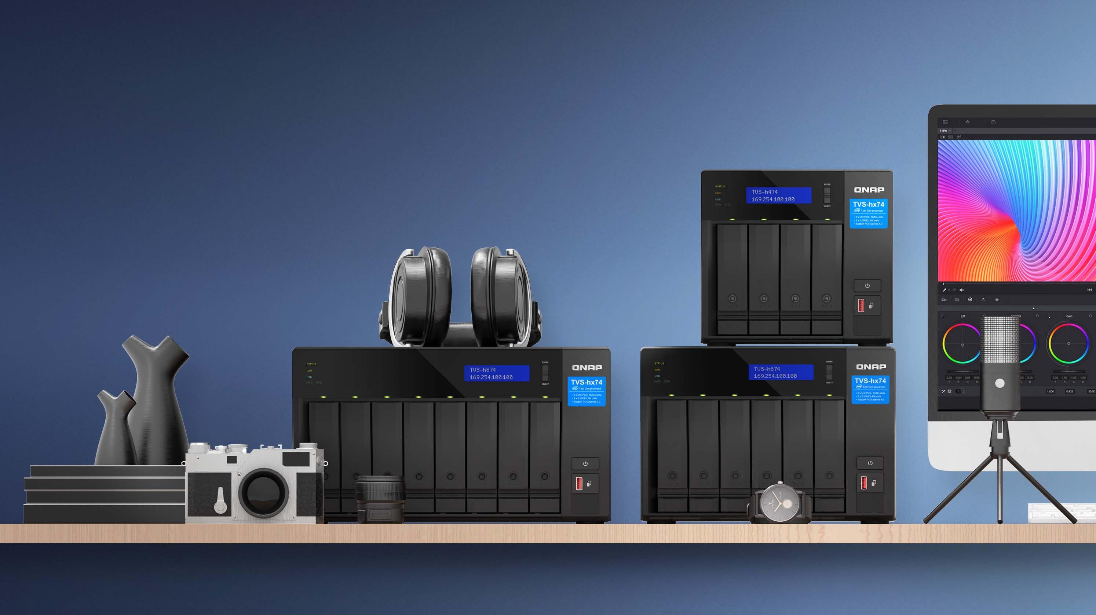





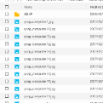














Mount cloud storage and file servers with HybridMount for greater storage & faster access
 | Network Drive Mount | File Cloud Gateway
Setup Method | Mount cloud drives | Select “File Cloud Gateway” mode and create a dedicated cache space
Connections | No limit | 2 free and perpetual connections. Purchase license for more connections
Access Performance | Depends on network speed | High performance thanks to caching
Access in File Station | Supported | Supported
Access through SMB / NFS / AFP | Not Supported | Supported
Sync with the cloud | Sync only when browsing | Sync constantly for quick access
Integration with QTS Apps | Not supported | Supported
Online collaboration
File data analysis
Slower
Internet
NAS
cache
1
2
3
META
DATA
LAN
Faster

Slide 25

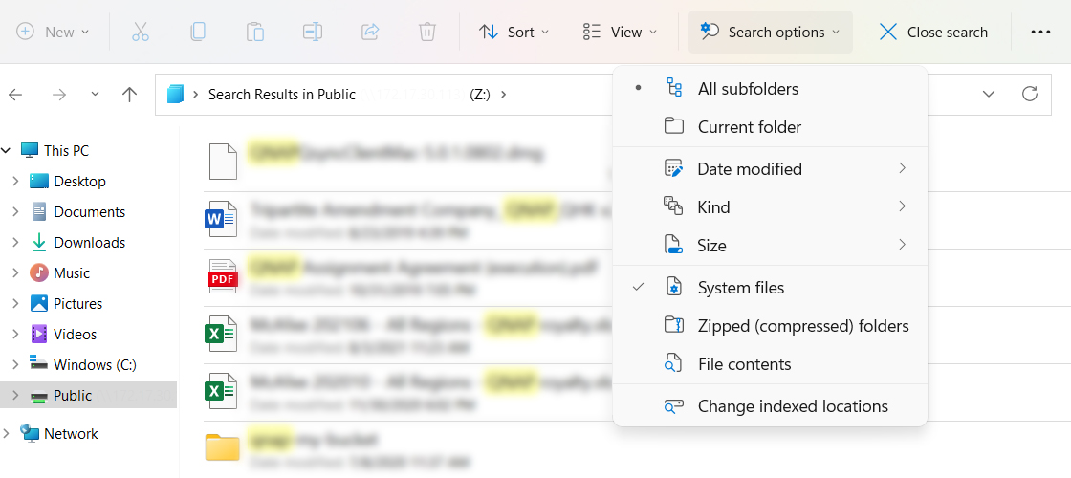
Convenient file search with Windows® Search Protocol (WSP) support for NAS shared folders
用 Windows 網路磁碟機快速搜尋 NAS 內的檔案
Windows® 10/ Windows Server® 2016 (or later) users can easily search NAS shared folders via Windows® when an SMB drive is mounted to the NAS. Advanced file search by time, file type, or size is supported for greater convenience.
For an optimized full-text search experience, we recommend Qsirch PC Edition !
The most powerful search engine that integrate with NAS and PC local search

Slide 26






All-in-one solution for hosting virtual machines and containerized apps
Virtualization Station
Container Station
Virtualization Station allows you to create virtual machines (VM) on Turbo NAS, supporting Windows®、Linux® operating systems.
Experience LXD and Docker® lightweight virtualization technologies, download apps from the Docker Hub Registry®, import/export containers, and create abundant microservices.
Container Station
Container
Application
Application
Application
Filesystem
Filesystem
Filesystem
Host OS
Hardware

Slide 27
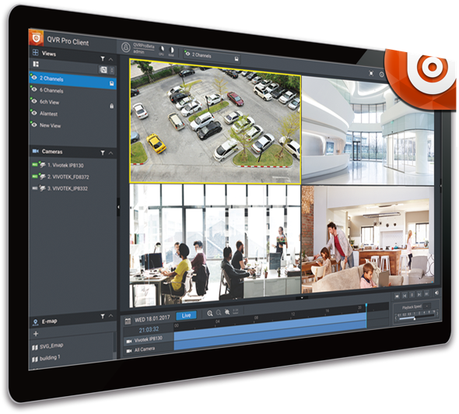


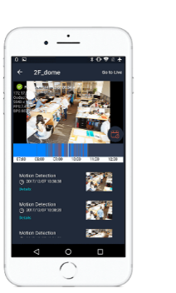
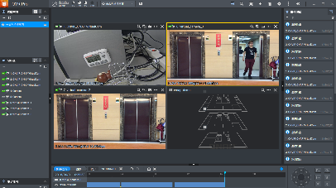

Build a comprehensive surveillance system with a TS-1655, QVR Pro/Elite, and IP cameras
QVR Pro
QVR Pro Client
6,000+ Compatible cameras
8 embedded monitoring channels
expand up to 100 channels by purchasing QVR Pro licenses*
View USB camera images through QUSBCam2
iOS & Android mobile devices
Support cross-platform ： Windows, Mac, Ubuntu
QVR Elite
The flexible subscription QVR Elite can be expanded to a maximum of 120 channels by purchasing licenses*​
Use HDMI output and USB keyboard and mouse to control the NAS through installing Graphic card
* TS-1655 with 16GB memory.​

Slide 28
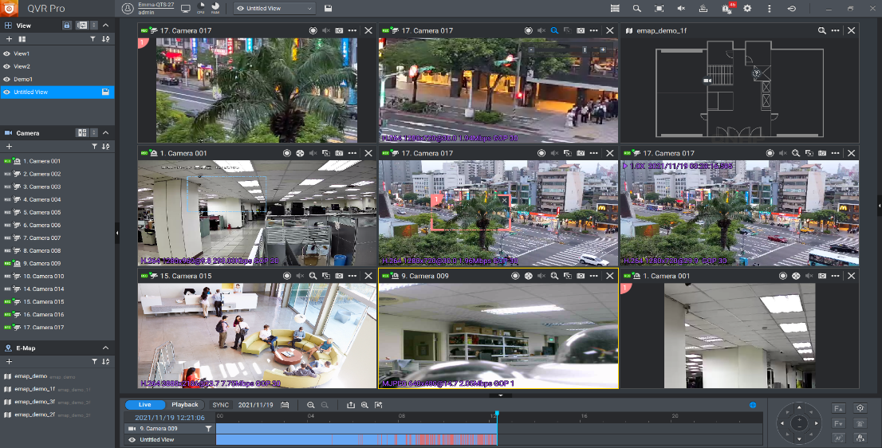
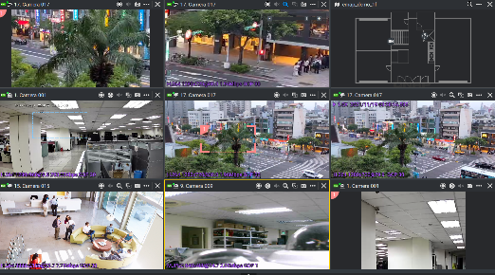

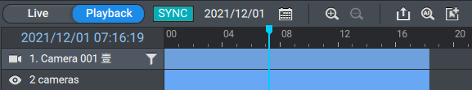
Unified interface for live view & playback​, anywhere with a PC/Mac QVR Pro Client or mobile device
Monitor the live view of multiple channels and playback on 1 single interface.
1-click to sync playback all video views​​
1 click to jump to the previous playback time​​
1 click to switch between Live & Playback​​

Slide 29
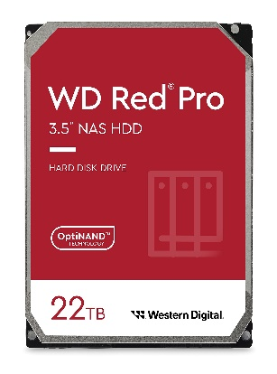
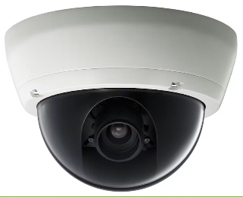

1-year+ of continuous surveillance recording storage with 264TB raw capacity in 1 single NAS
22TB x 12 = 264TB raw capacity
QVR Pro
8-channel included
Support up to 100ch*
* TS-1655 with 16GB memory.
8 channels, footage preserved for 365+ days
8 cameras; reserved for 365 days; 1920x1080(h.264/medium quality;30FPS); total 182TB required
12吋短機箱可支援市面上大部分的機櫃
內建2埠M.2(PCIe Gen 3 x1)，可提供SSD快取，加速隨機存取的速度
PCIe Gen 3 x 8插槽，提供各式應用的高速擴充卡
雙系統靈活切換配置QTS and QuTS hero

Slide 30

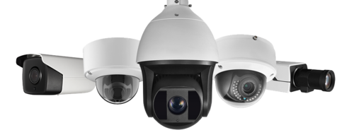



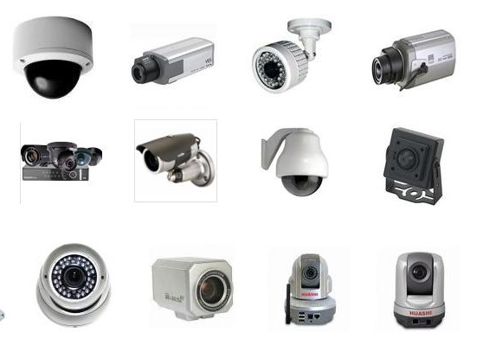






Compatible with a huge amount of camera models and camera features
Over 190 Brands
over 6000 Models
ONVIF Profile Supported
RTSP Stream
Input / Output
RTMP Stream
Input
https://www.qnap.com/en/compatibility-qvr-pro

Slide 31
Back up Mac with a shared Time Machine account in HBS 3
Create a VM in Virtualization Station

Slide 32
Multiple Accessories and
Storage Expansion
Solutions

Slide 33
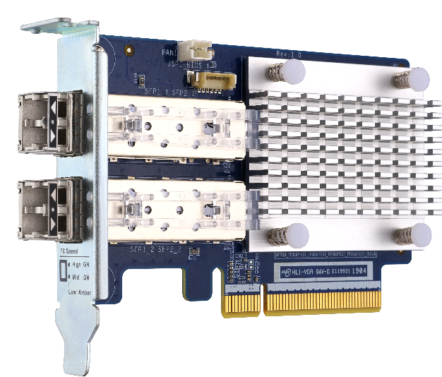


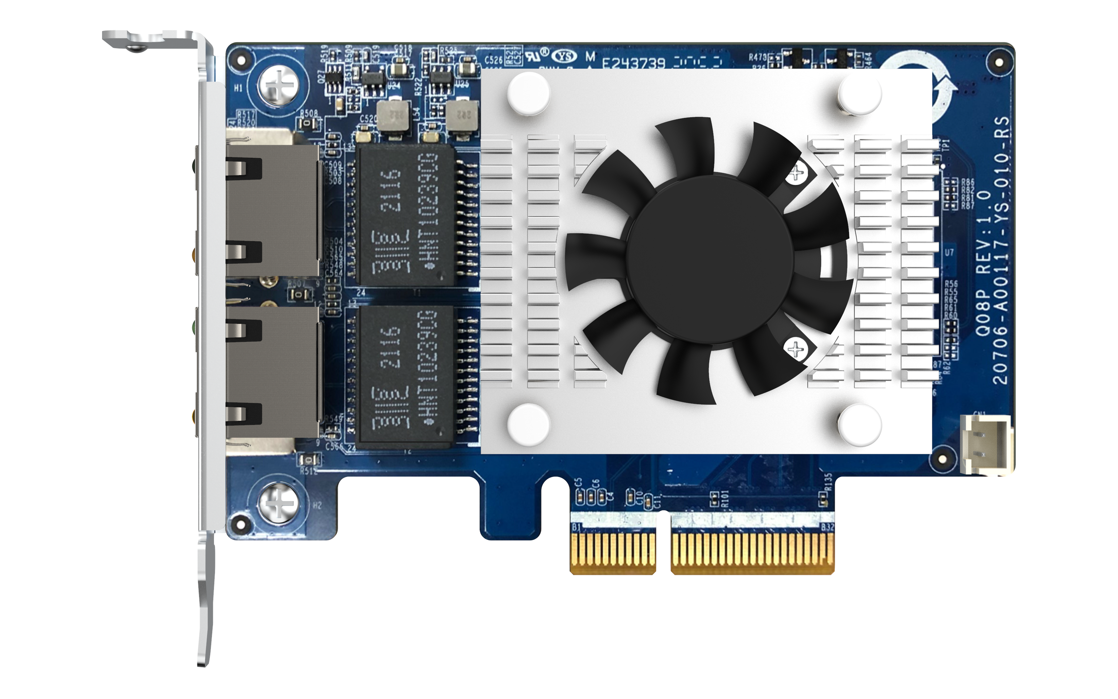
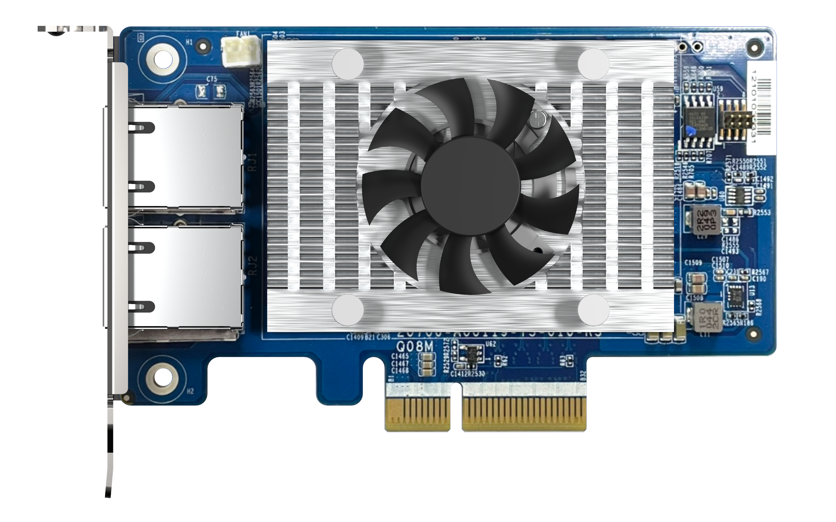
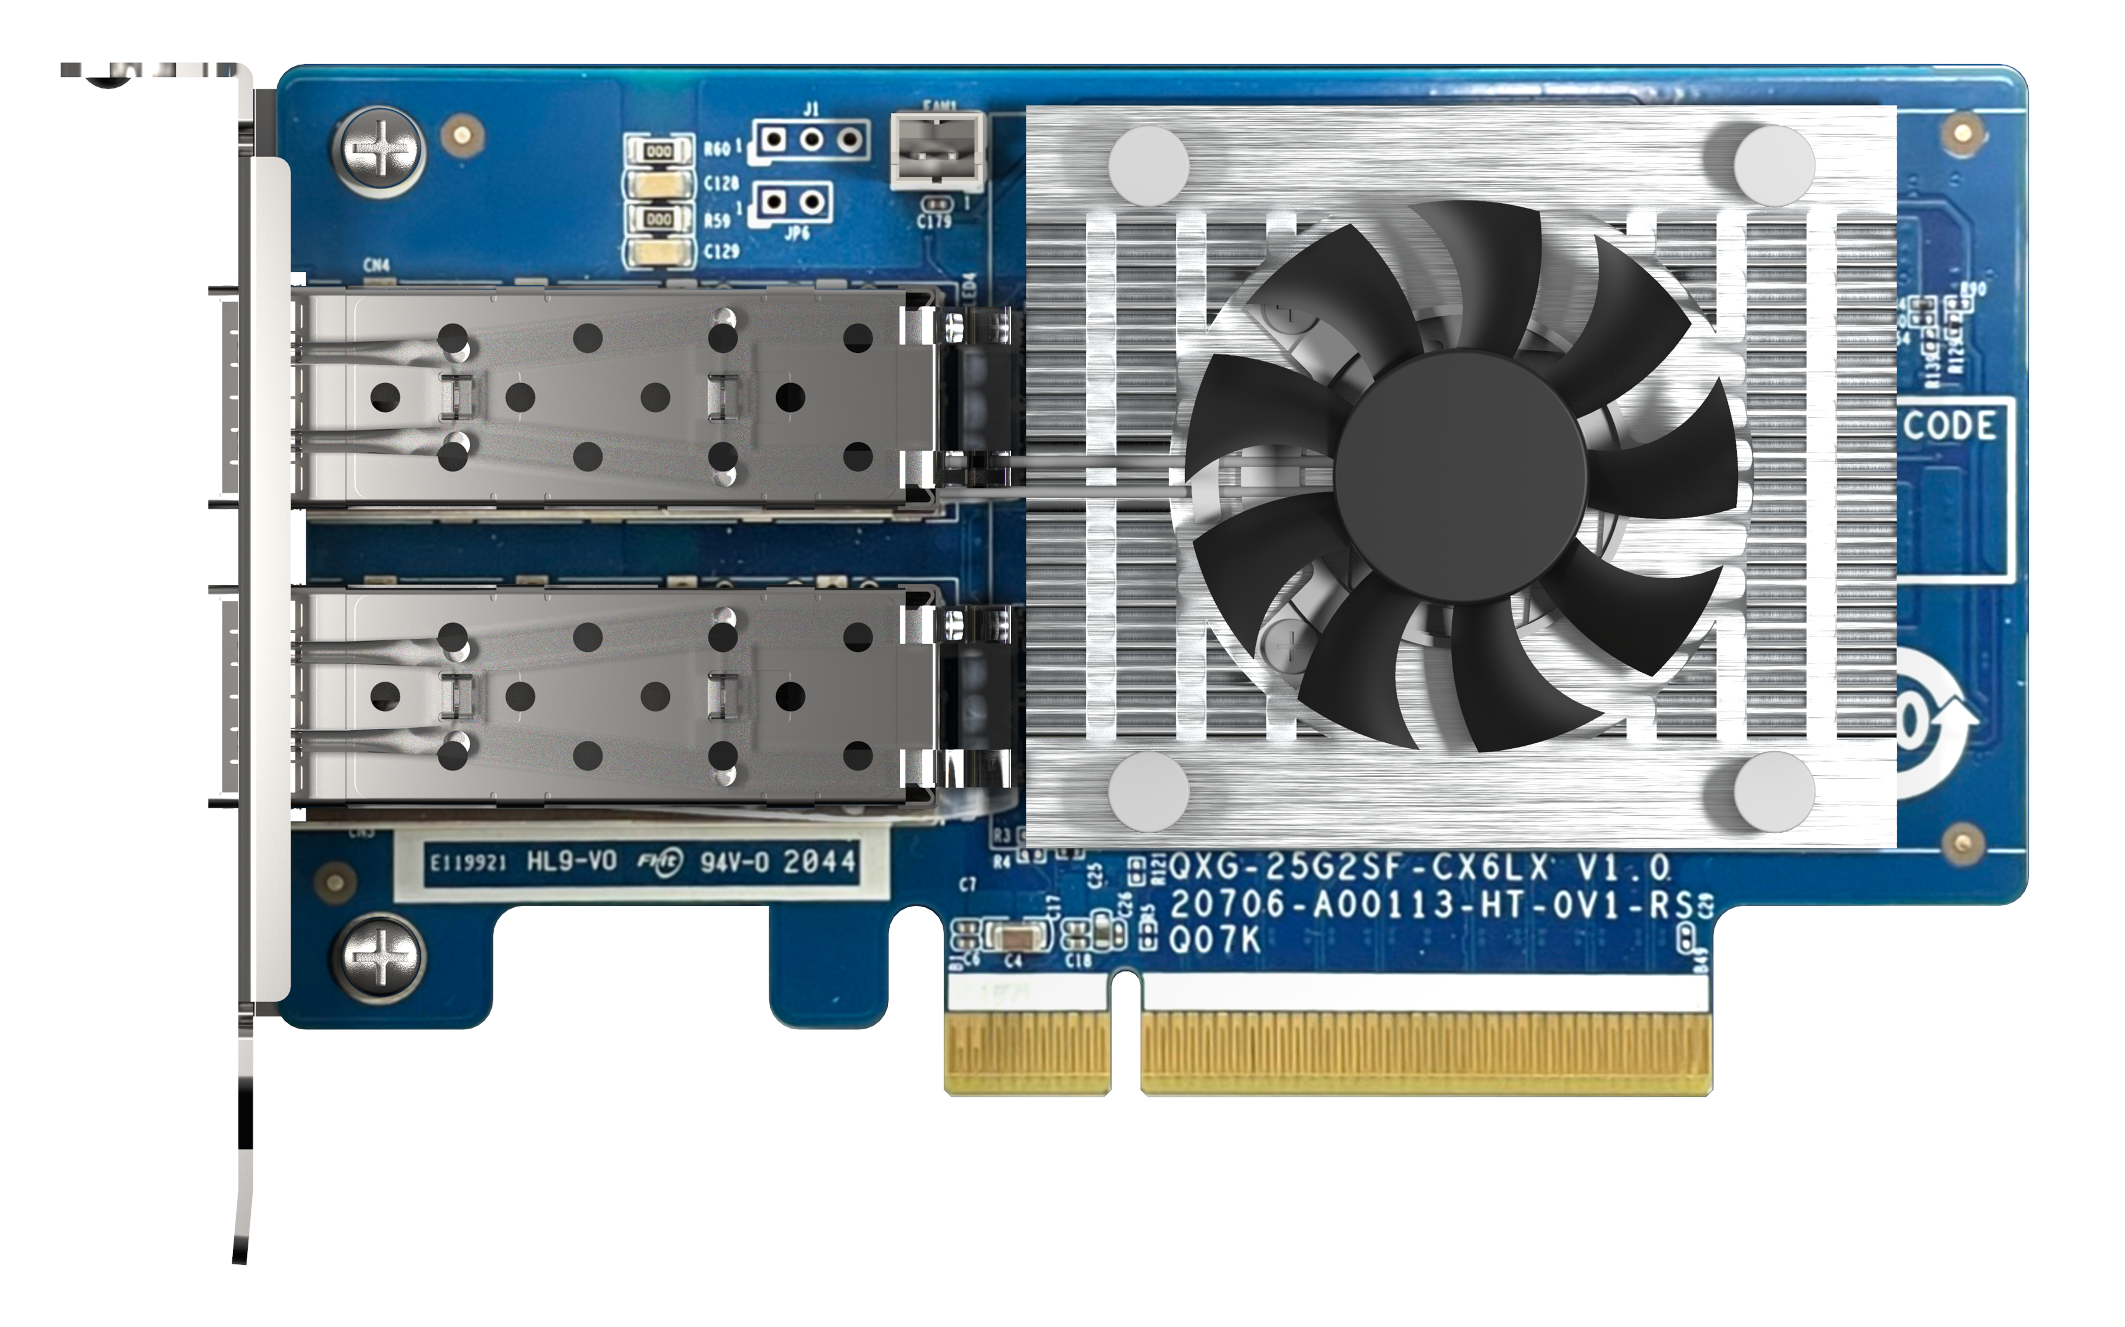
QNAP 16/32Gb Fibre Channel cards for a reliable, scalable and budget-friendly FC SAN storage solution
QXP-16G2FC
Dual-port 16Gbps
QXP-32G2FC
Dual-port 32Gbps
Manage Fibre Channel connection using QTS/QuTS hero iSCSI & Fibre Channel NAS application
FC HBA
with 16/32Gb FC transceivers
QXG-10G2TB
2x 10G/5G/2.5G/1G/100M
QXG-10G2T-X710
2x 10G/5G/2.5G/1G/100M
QXG-25G2SF-CX6
2x 25G SFP28

Slide 34
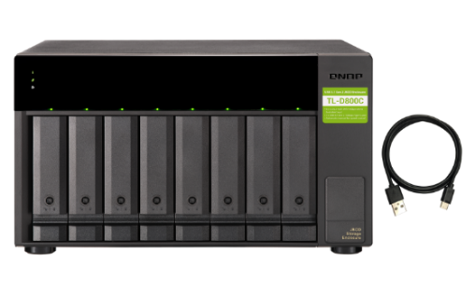
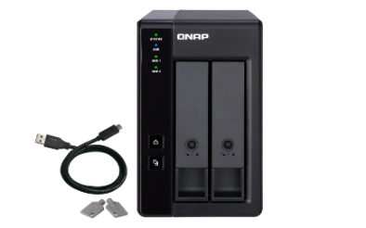
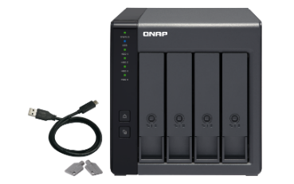
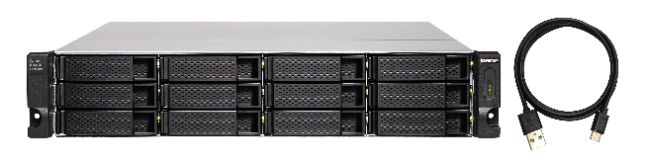

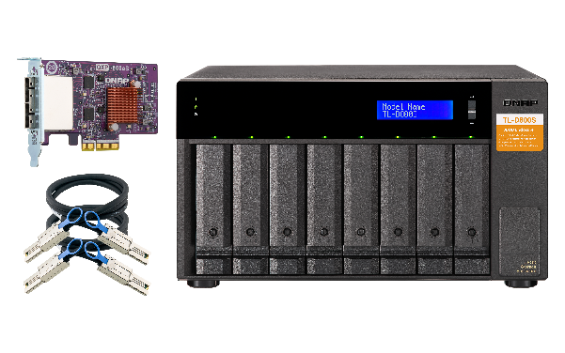
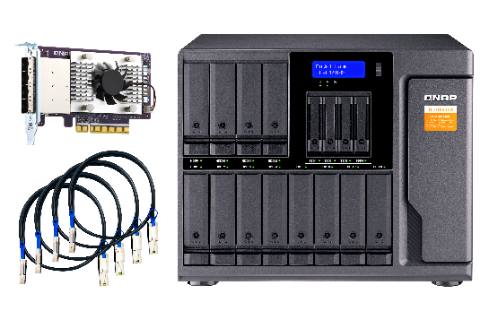
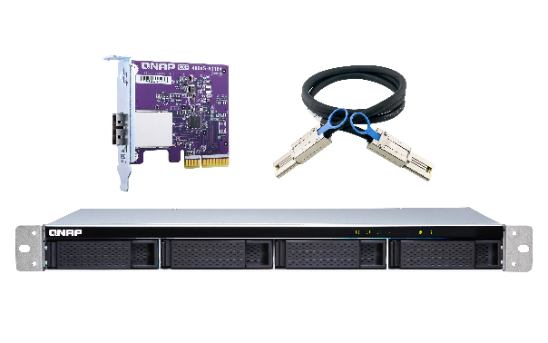


Supports up to 24 more HDDs with two JBOD units, add nearly 500TB ( 24 x 22TB ) of storage space
USB
Maximum of JBOD / RAID expansion enclosures​
TR-002​ | 2​
TR-004​ | 2​
TR-004U​ | 2​
TL-D800C​ | 1
TL-R1200C-RP​ | 1
TL-D400S​ | 2
TL-D800S​ | 2
TL-D1600S​ | 2
TL-R400S​ | 2
TL-R1200S-RP​ | 2
TR-002
TR-004
TL-D800C
TR-004U
TL-R1200C-RP
PCIe
TL-D400S
TL-D800S
TL-D1600S
TL-R400S
TL-R1200S-RP
Note: These expansion units can only be used as an individual storage pool or volume on the NAS. Their storage pool or volume cannot be combined into the connected NAS. NAS applications cannot be installed on the them.

Slide 35

3-year standard warranty and up to 5 years with an optional extended 2-year warranty for peace of mind
The TS-1655 is covered by a 3-year free product hardware warranty. QNAP provides warranty service to help your organization continue to operate and provide uninterrupted services to your customers.
If you need a longer warranty period, you can purchase the QNAP Extended Warranty Service (extra 2-year extended warranty EXTW-BROWN-2Y ), enjoying a maximum 5-year product warranty.
NAS ordering P/N：TS-1655-8G
Intel Atom® C5125 8-core 2.8 GHz CPU, 8 GB UDIMM DDR4 (1 x 8 GB non-ECC RAM)

Slide 36



















USB 3.2 Gen2 (10Gbps)
與 One-Touch-Copy
3個
PCIe Gen3 x4
擴充槽
Support 10/25GbE
NICs
TB
Raw capacity
Hybrid storage
Supports both
2.5”
SSD
X4
3.5”
HDD
X12
Support
multiple JBOD
IntelQAT
USB 3.2 Gen1 (5Gbps) & One-Touch-Copy
Direct connection
2.5GbE
TS-1655
C5125 2.8 GHz
8-core
CPU
2.5GbE X2
Availability at least until
128GB
3
GPU
PCIe graphics card
support
ECC Memory
2.5GbE
2 x M.2 2280
PCIe Gen3 x4 slots
PCIe Gen3 x2
QVR Pro
Surveillance solution
SR-IOV

Slide 37
is your best choice
Larger capacity, more functions
The first choice for multi-device backup and surveillance host
Copyright© 2023 QNAP Systems, Inc. All rights reserved. QNAP® and other names of QNAP Products are proprietary marks or registered trademarks of QNAP Systems, Inc. Other products and company names mentioned herein are trademarks of their respective holders.​​​​​​​

