Slide 2
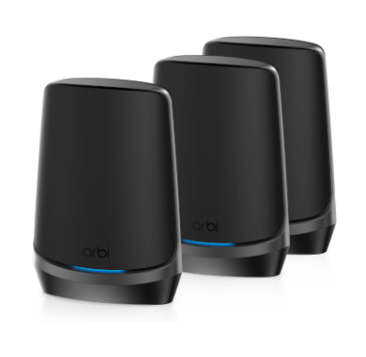
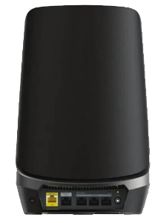
越來越龐大的資料傳輸量, 越來越快的無線網路
不斷演進的影音格式
Video format evolution (720p→1080p→4K Ultra HD >8K UHD→10K)
WiFi: WiFi5→WiFi6→WiFi6E→WiFi7
隨著無線網路技術的升級, 實體線路速度也必須跟著往上, 要搭配2.5GbE port甚至10GbE port
 | 1080p 60 ProRes HQ | 4K ProRes HQ 24 | 4K RAW BMPC 24 | 8K RedCode Raw 75
File size per hour | 223.77GB | 318GB | 741.6GB | 7.29TB
10GbE port
2.5GbE port
Netgear RBKE963B
WiFi 6E MESH system
Notes:
https://www.netgear.com/home/wifi/mesh/rbke963b/

Slide 3
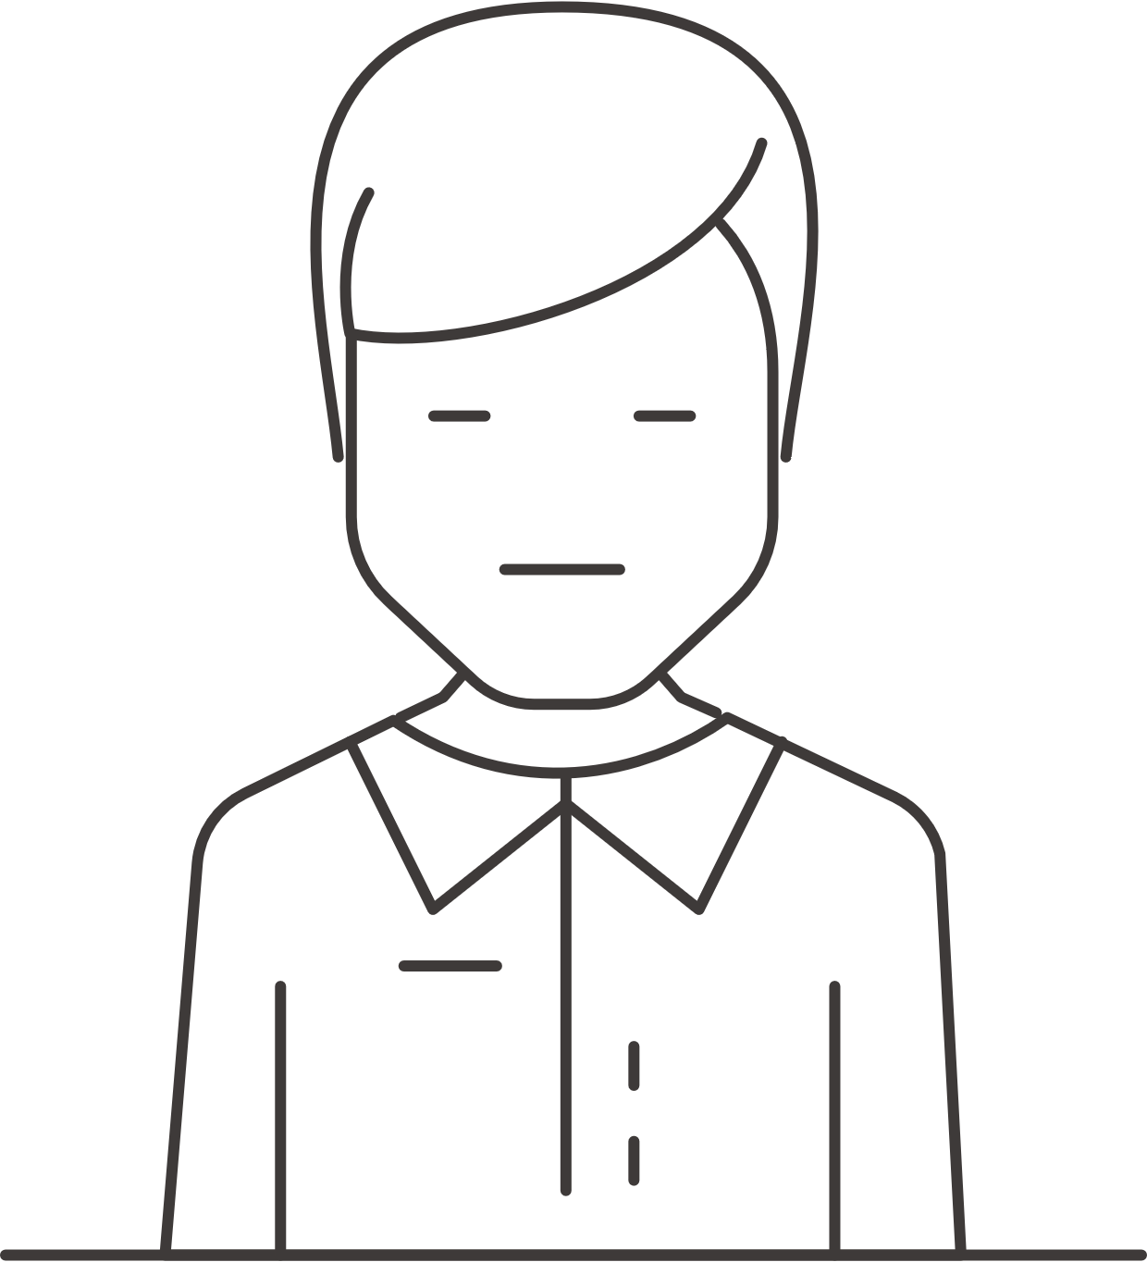
想花多少時間等待?
備份1 TB所需預估時間
條件 : Effective Data Rate 95%, Payload Data Rate (w/ Overhead) 90%
10Gbps
17m09s
2.5Gbps
1h8m35s
1Gbps
2h51m28s
100Mbps
1d4h34m38s

Slide 4
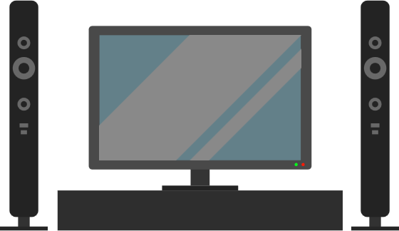
真的需要全10GbE交換器嗎?
雖然10GbE很快, 但還是有其他機器不是10GbE…..
1Gbps
PC
2.5Gbps
Notebook
1Gbps
Smart TV

Slide 5
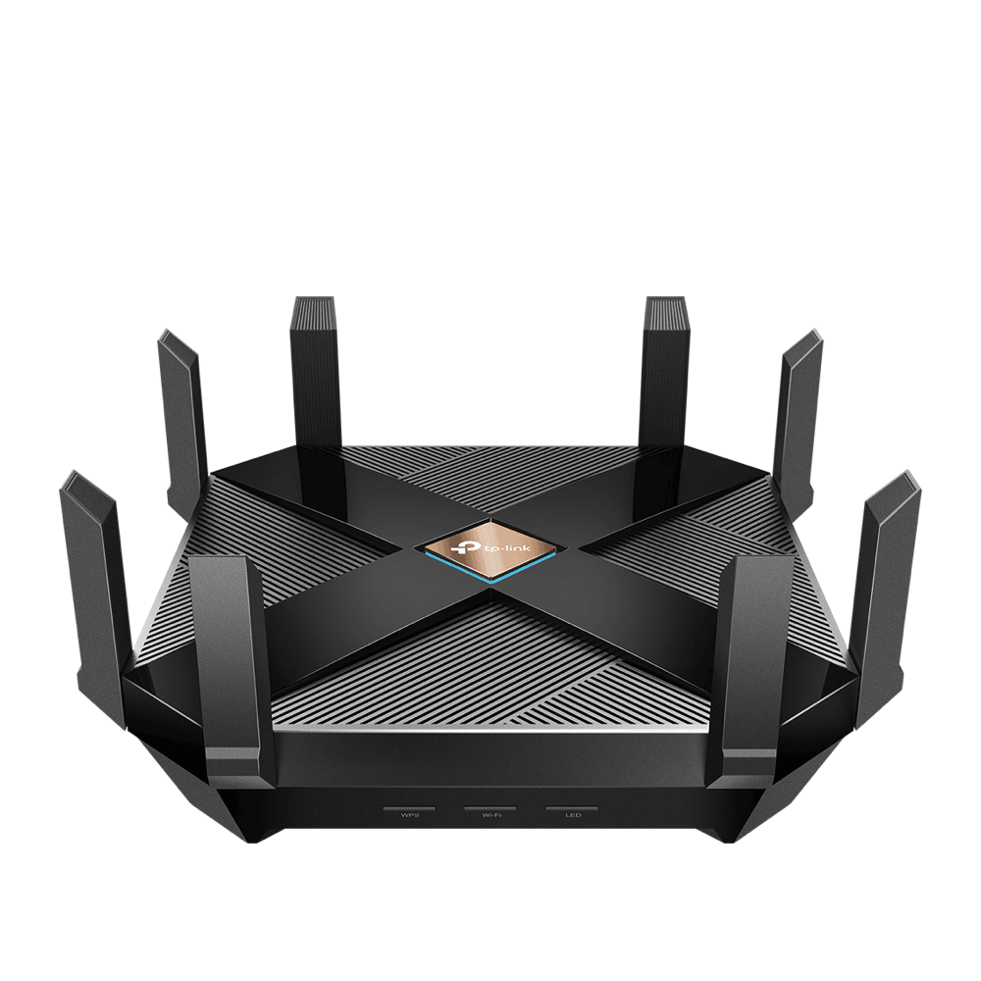
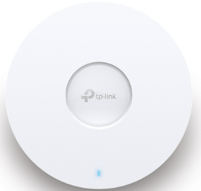
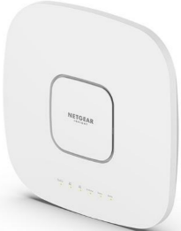
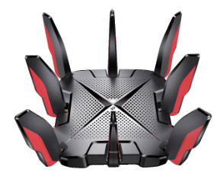
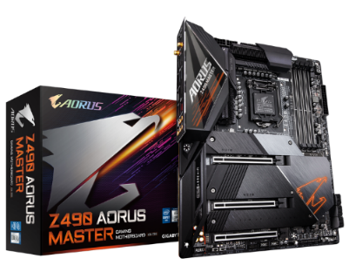
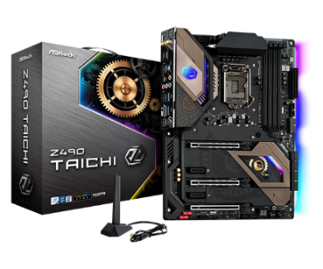
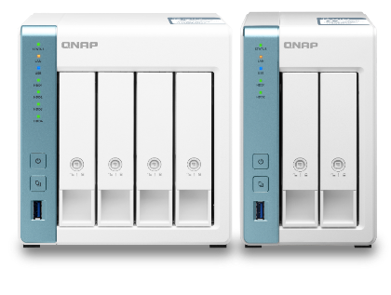
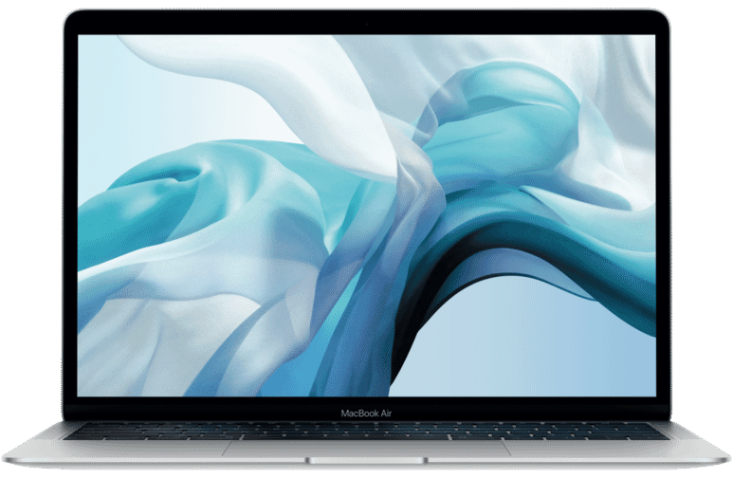
1GbE目前夠用， 以後呢?
越來越多設備配備2.5GbE
購買交換器，與其之後受限， 不如一次到位2.5GbE
TP-Link EAP670
Netgear AXE7800
TP-Link Archer AX6000
TP-Link Archer GX90
Gigabyte Z490 AORUS MASTER
Apple MacBook
Asrock Z490 Taichi
QNAP TS-431P3
QNAP TS-231P3

Slide 6
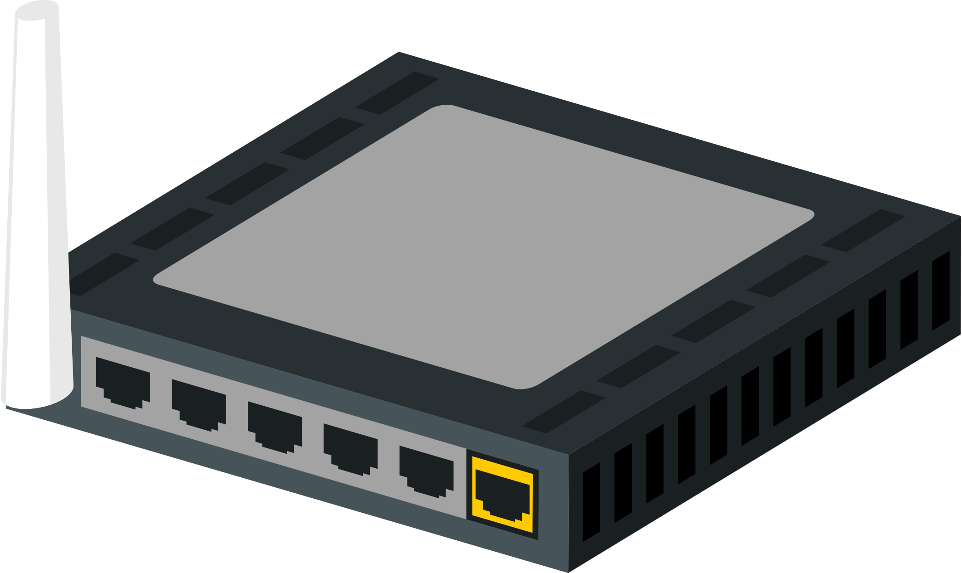
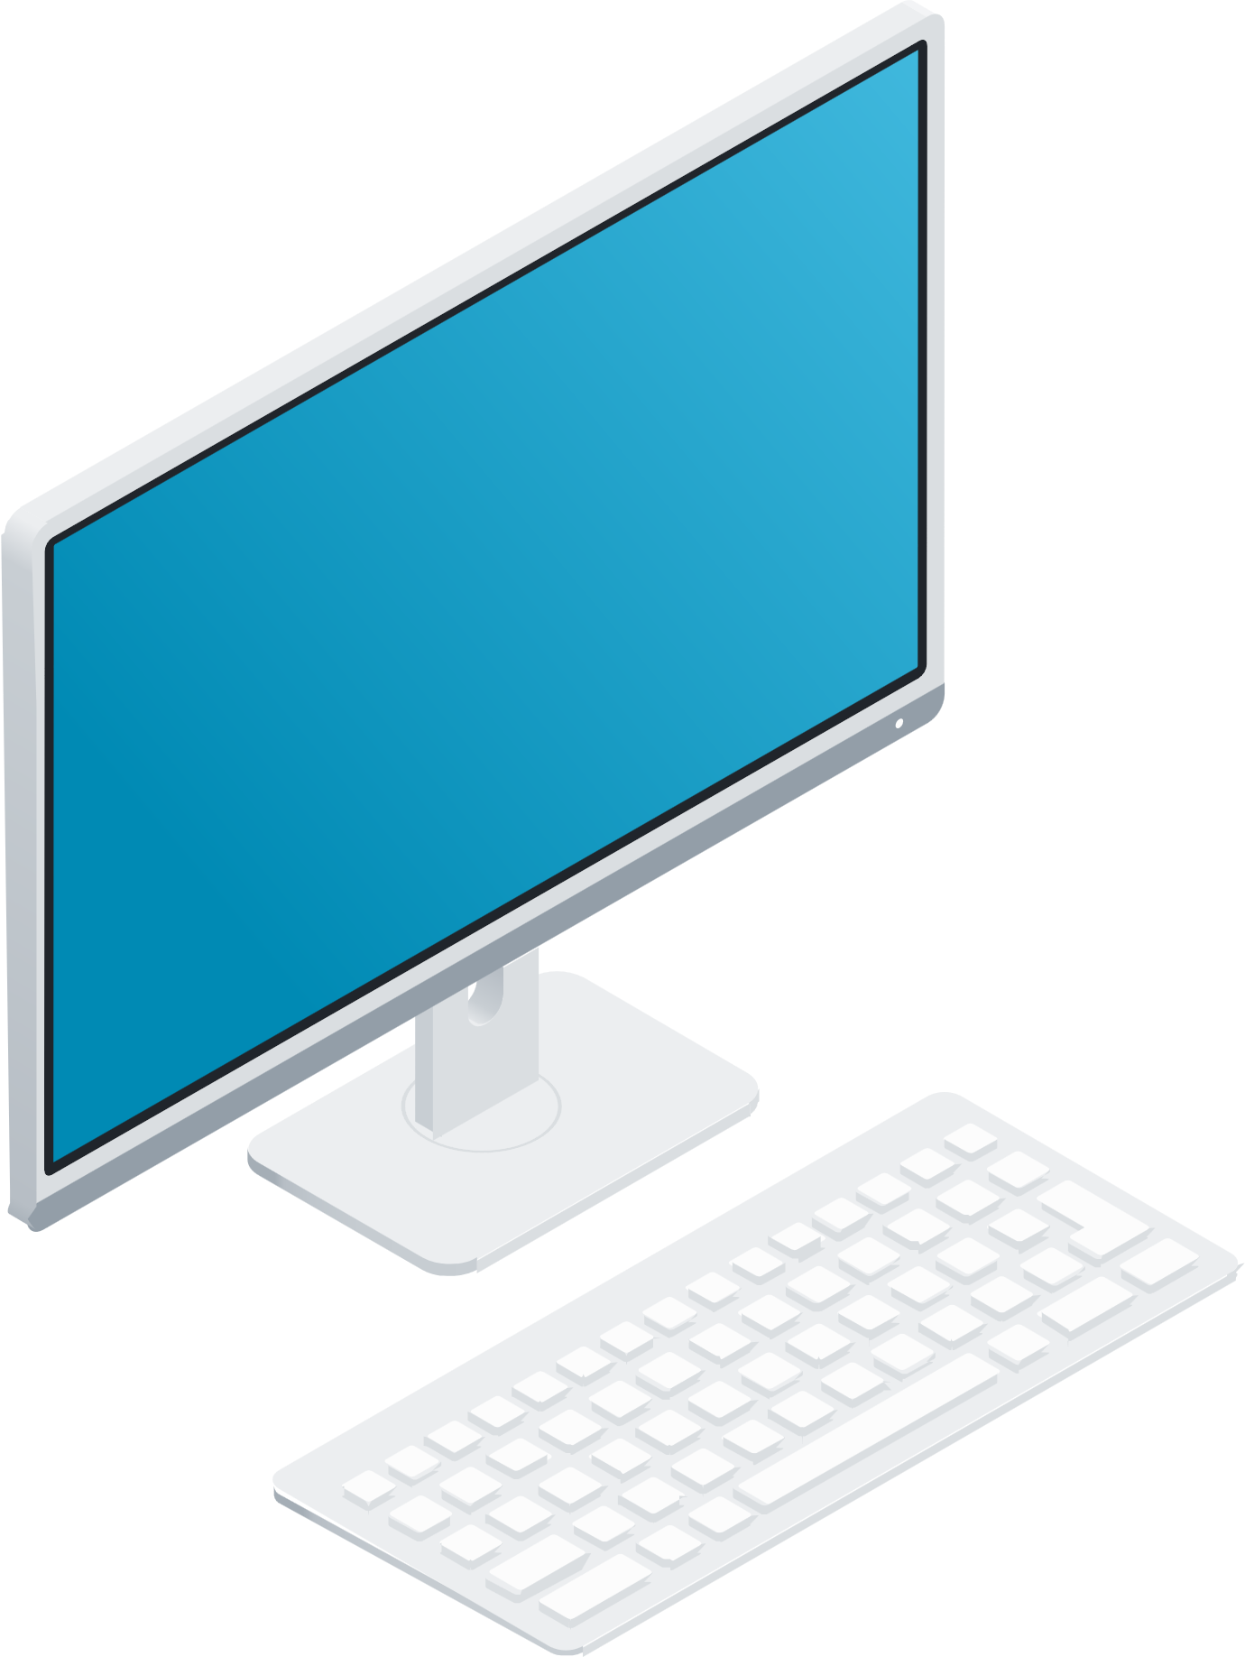
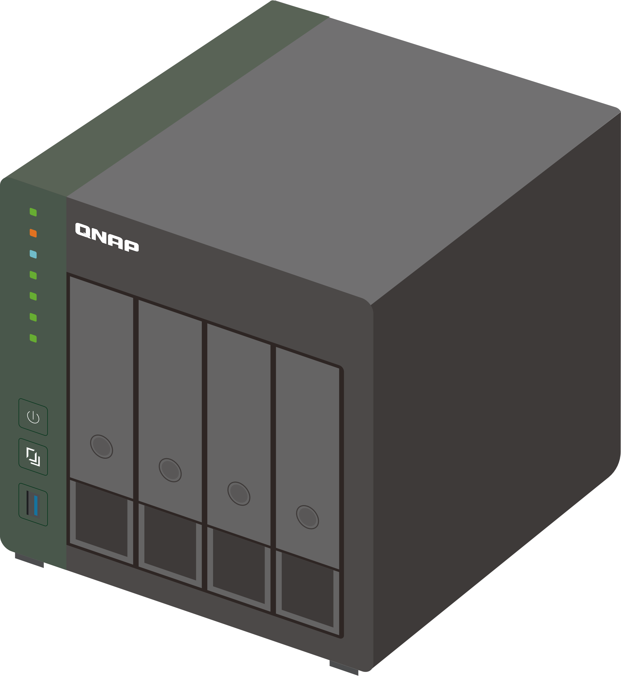
別讓交換器成為網路瓶頸
1GbE

Slide 7
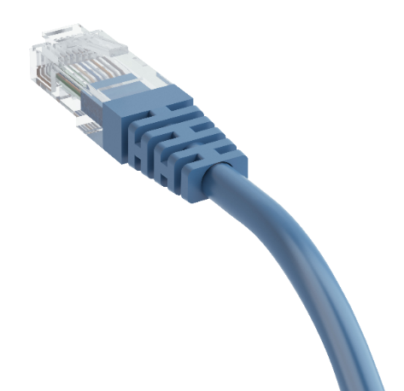
2.5GbE可以直接使用原本Cat5e的網路線
省去重新拉線佈線的麻煩
 | CAT 5e | CAT 6 | CAT 6A
100M | ✔ | ✔ | ✔
1G | ✔ | ✔ | ✔
2.5G | ✔ | ✔ | ✔
5G | ✔ | ✔ | ✔
10G | X | ✔(55m) | ✔

Slide 8
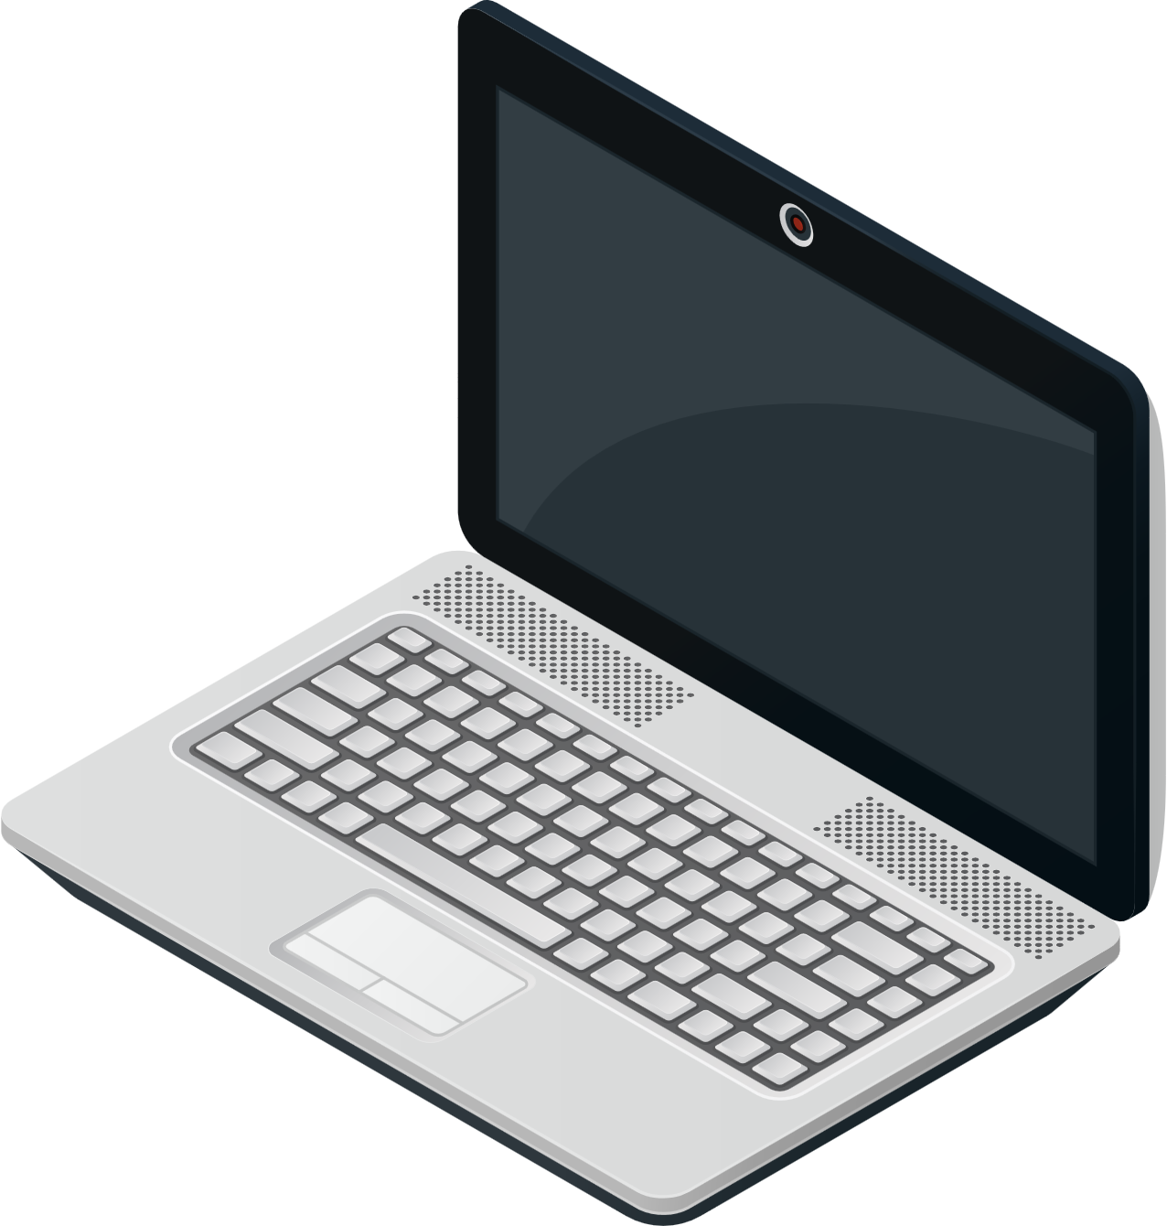
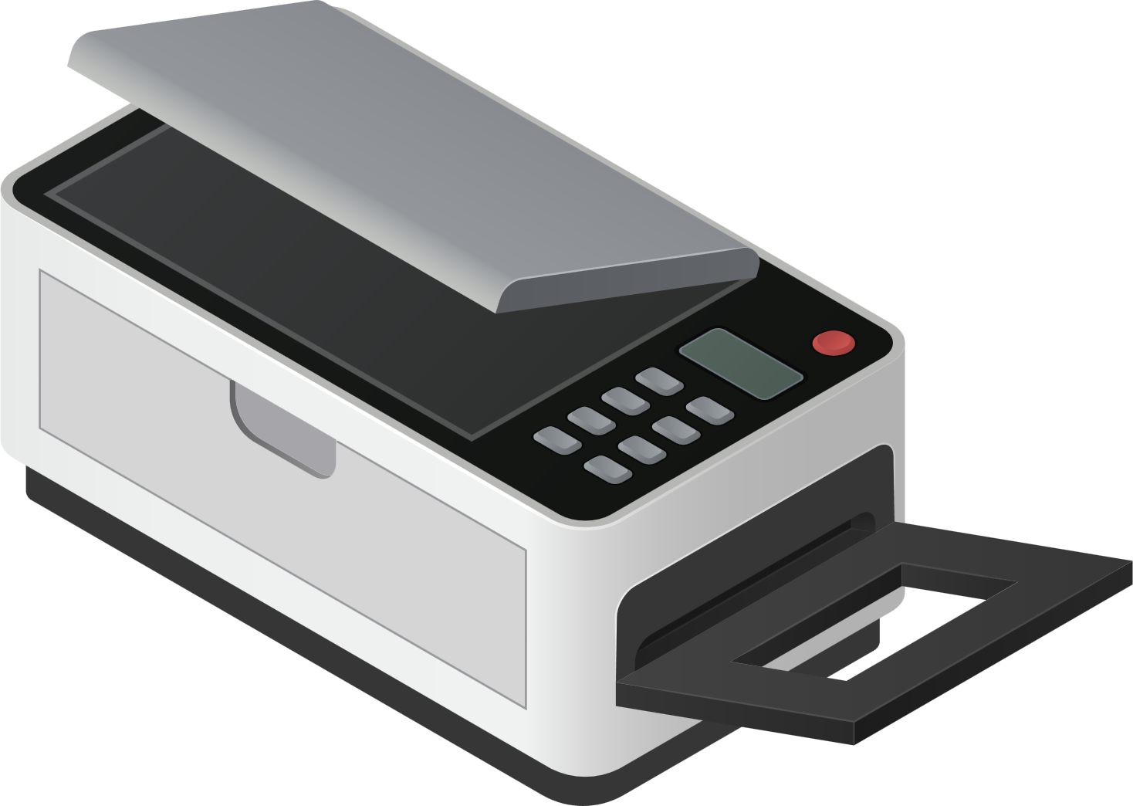
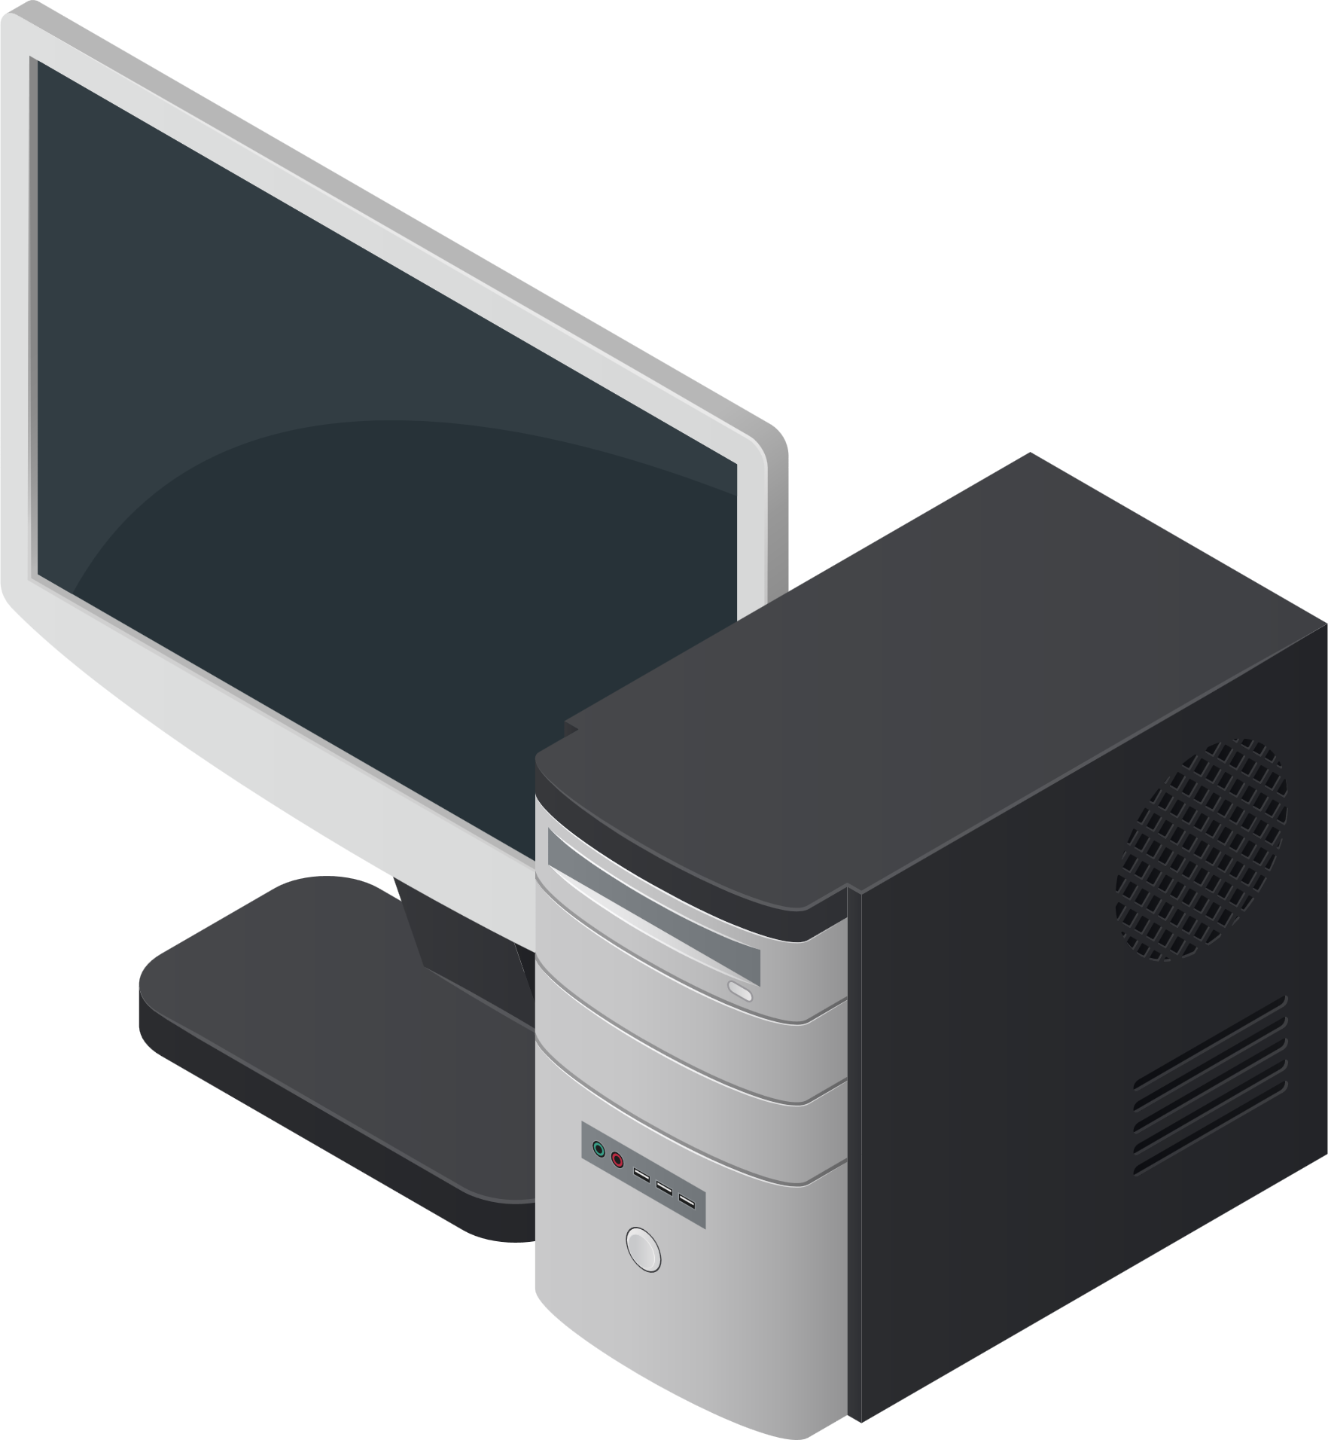
自由搭配現有網速的設備
如果現有網路設備只有1GbE或甚至100MbE，
一樣可以無痛直連
2.5GbE
100MbE
1GbE

Slide 9
只是802.3at足夠嗎?
WiFi spec | Band & Model | PoE Power Consumption
AX8400 | Abuba, 650 Series | 46.5W
AX6000 | Abuba, 550 Series | 38.2W
AX8400 | RUCKUS, R760 | 36.08W
AX6000 | RUCKUS, R850 | 31W
AX6000 | Netgear, WAX630 | 30.1W
AX4200 | Abuba, 630 Series | 29.4W
AX7800 | Netgear, WAX630E | 27.6W
AX6000 | Abuba, 530 Series | 26.4W
AX3600 | Netgear, WAX620 | 25.5W
AX3600 | RUCKUS, R750 | 22.34W
AX3000 | RUCKUS, R650 | 21.59W
AX5400 | Aruba, 510 Series | 20.8W
AX1800 | Netgear, WAX610 | 15.3W
802.3bt(60/90W)
802.3at(30W)
Demand of PoE also getting higher
Notes:
Netgear
WAX610 :AX1800, 2x2+2x2, 15.5W, 2.5G port
WAX615: AX3000, 2x2+2x2, 21.2W, 2.5G port
WAX620: AX3600, 4x4+4x4, 25.5W, 2.5G port PoE+
WAX630: AX6000, 4x4+4x4+4x4, 30.1W, 2.5G port PoE++
WAX630E:AX7800, 2x2+4x4+2x2, 27.6W, 2.5G port PoE++
Ubiquiti
U6-Enterprise:AX100000 2x2+4x4+4x4, 22W. 2.5G port PoE+
U6-Pro: AX5400 2x2+4x4, 13W. 1G port PoE+
U6-LR: AX3000 4x4+4x4, 16.5W, 1G port PoE+
RUCKUS
R850, AX6000 4x4+4x4+4x4, 31W, 5G port
R760, AX8400 4x4+4x4+4x4 (6E), 36.08W, 10G PoE++
R750, AX 3600 4x4+4x4, 22.34W, 2.5G port, PoE+
R650, AX3000 2x2+4x4, 21.59W, 2.5G port, PoE+
Aruba
510 series, AX5400 2x2+4x4, 20.8W, 2.5G
530 series, AX3000 4x4＋4x4, 26.4W. 5G port PoE++
550 series, AX6000 4x4+4x4+4x4, 38.2W, 5G port, PoE++
630 series, AX4200 2x2+2x2+2x2(6E), 29.4W, 2.5G port PoE++
650 series, AX8400 4x4+4x4+4x4(6E), 46.5W,5G port PoE++

Slide 10
QSW-M2106PR-2S2T 規格
 | QSW-M2106PR-2S2T
Management | Layer2 Web Managed switch
Number of Port | 10
2.5 GbE RJ45 (Support 2.5GbE/1GbE/100M) | 6, support 802.3bt (90W)
10 GbE RJ45 (Support 10GbE/5GbE/2.5GbE/1GbE/100M) | 2, support 802.3bt (90W)
10 GbE SFP+ (Support 10GbE/1GbE) | 2
Power budget | 310W
Switch bandwidth | 110Gbps
Packet buffer size​ | 12Mbit
Jumbo Frame​ | 9Kbytes
MAC table | 16K
Fan design | With fan
Form factor | Half-rackmount

Slide 11
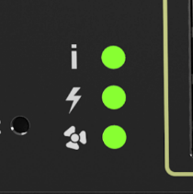
QSW-M2106PR-2S2T 面板配置
獨立風扇狀態燈
考量QSW-M2016PR-2S2T會有PoE供電需求，散熱系統尤其重要
獨立燈號設計一目瞭然
PoE總供電量最高
310W
Console port
6 x 2.5GbE RJ45 with 802.3bt(90W)
2 x 10GbE RJ45 with 802.3bt(90W)
2 x 10GbE SFP+

Slide 12
半機櫃設計-更彈性地空間利用
單台 QSW-M2106PR-2S2T 裝在 1U 機櫃
混搭 QSW-M2106PR-2S2T 與 QSW-M2106R-2S2T在 1U 機櫃
Note1: QSW-M2106PR-2S2T only
Note2: Requires separate 2-in-1U rackmount kit. Please visit https://shop.qnap.com.

Slide 13
QSW-M2106PR-2S2T 軟體介紹

Slide 14
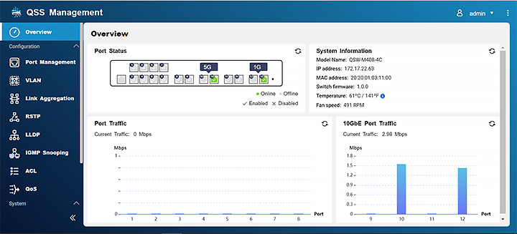
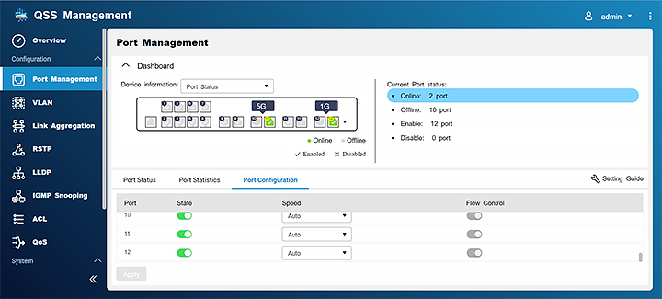
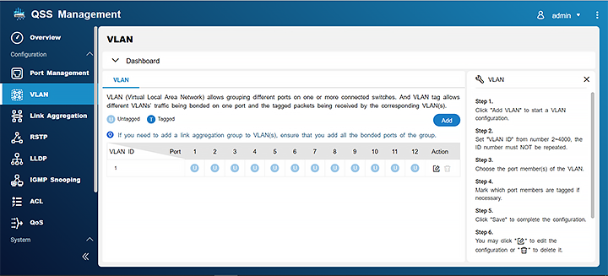
簡單明瞭的介面設計
簡潔、圖像化
設定引導

Slide 15
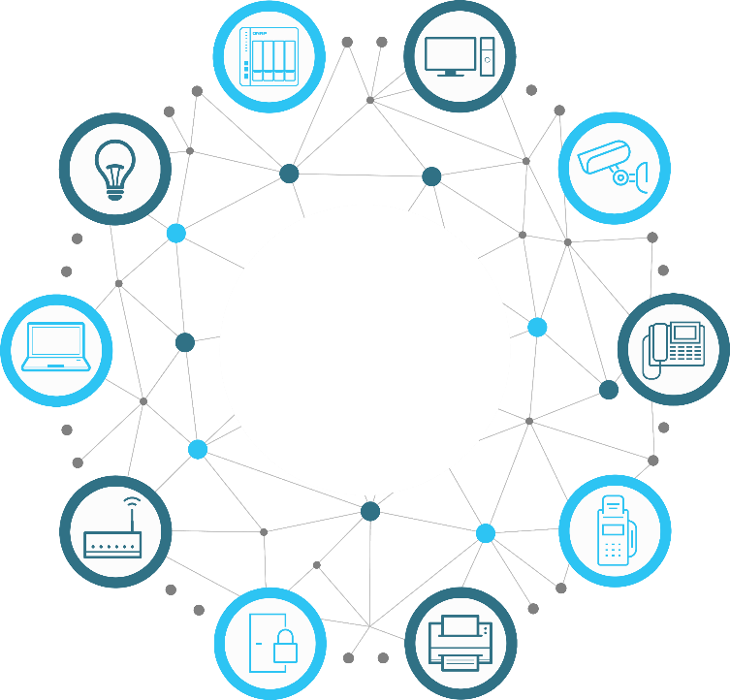
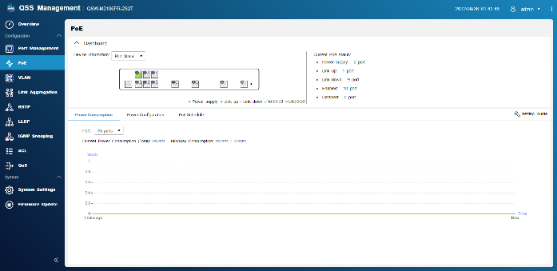
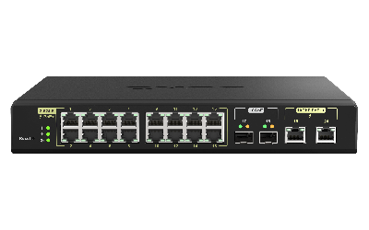
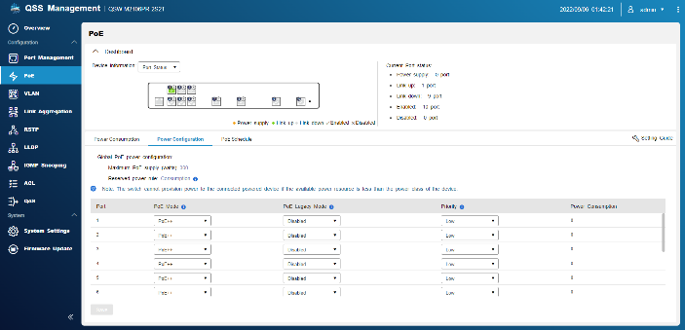
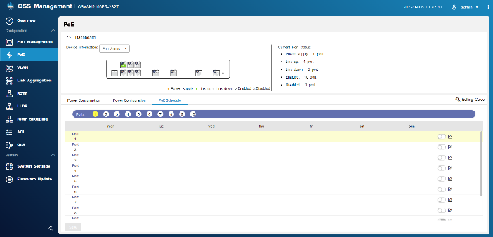
完整掌控PoE使用狀態
監看PoE的使用情況
用電優先及遠端重啟
設定排程控制供電時間
PoE

Slide 16
明確分割工作室內各別網路
虛擬區域網路 (VLAN) 可以明確獨立出不同的部門網路
方便管理, 不同網路間可有條件相連
也可分隔員工及來賓網路

Slide 17
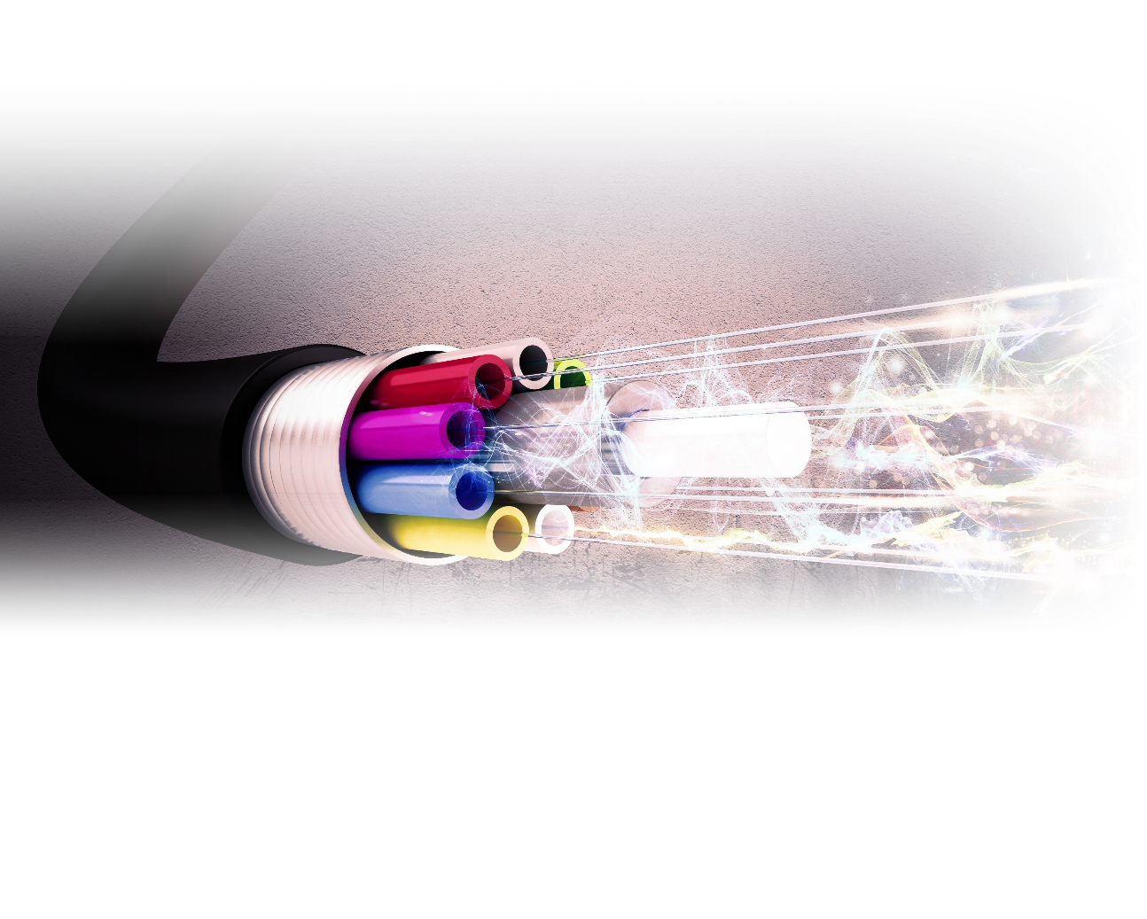
多接條網路線也可以提高網速
鏈路聚合 (LAG, Link Aggregation) 可以讓多條網路線的網速相加， 變成更大的網路頻寬
快速又直接的讓網速更上一層樓

Slide 18
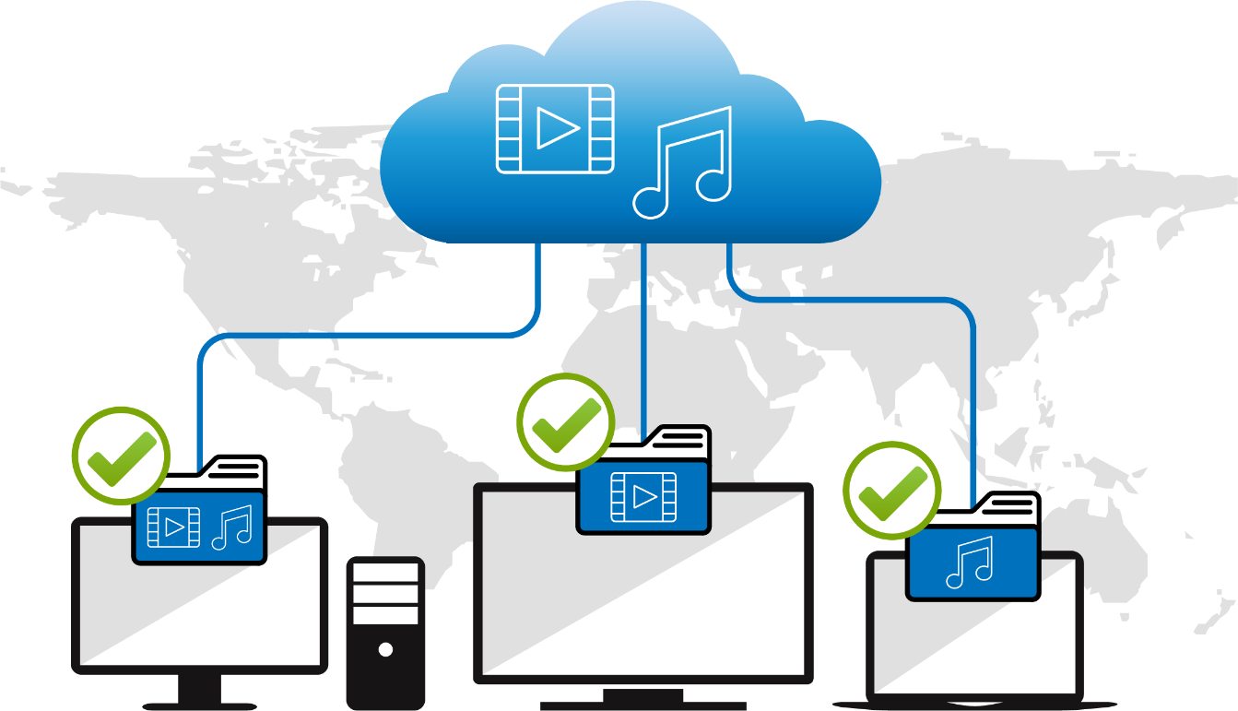
準確記錄及配發影音串流給設備
群組監聽協定 (IGMP snooping) 可以準確記錄所有影音串流分配方式
不會因為誤傳或少傳封包導致影音中斷或品質不佳

Slide 19
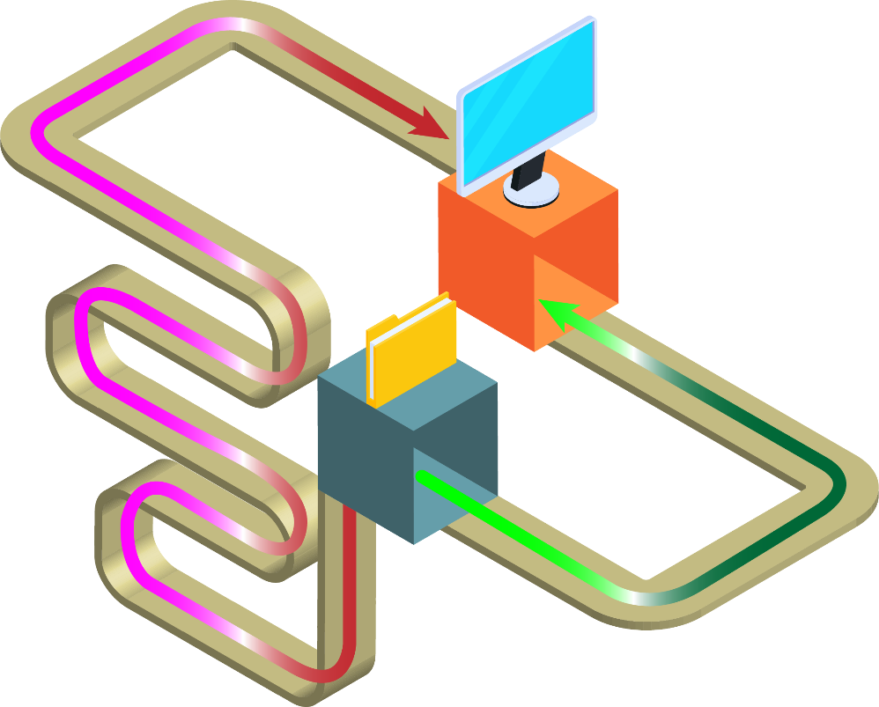
隨時優化網路傳輸路徑
透過生成樹協定 (RSTP, Rapid Spanning Tree Protocol) 隨時監控及優化網路傳輸路徑
網路架構再複雜, 檔案永遠用最快的路徑來傳輸

Slide 20
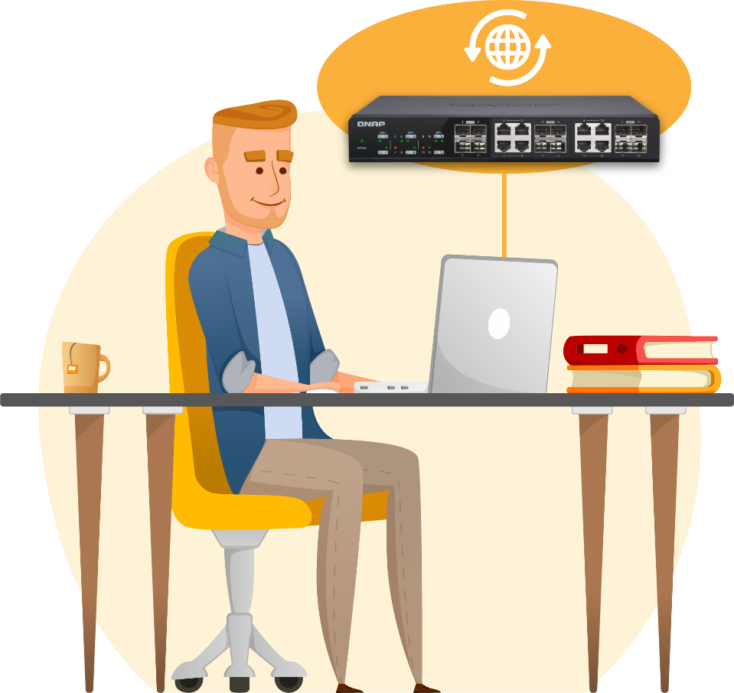
軔體版本檢查
交換機自動偵測有無新軔體
一鍵自動更新
手動更新

Slide 21
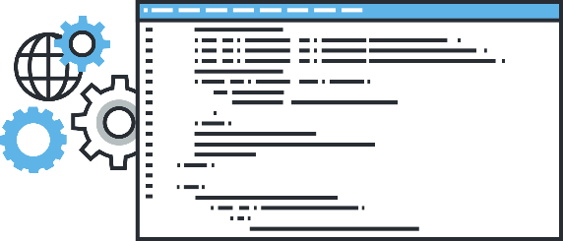
當然 QSW-M2106PR-2S2T 還有很多功能
透過流量控制 (IEEE 802.3x) 監看網路擁塞情況, 避免掉包
週邊設備偵測 (LLDP), 讓管理者一目了然那些設備連接到交換機
節能設計 (IEEE 802.3az) 及風扇轉速控制, 減少不必要的電能消耗

Slide 22
QNAP 提供完整10GbE/2.5GbE解決方案， 讓你網路不卡關

Slide 23
QNAP 2.5GbE 非網管型交換器
QSW-1108-8T
QSW-2104-2T
4x 2.5GbE RJ45
2x 10GbE RJ45 (2T)
Auto loop detected
Desktop design
Fan less design
8x 2.5GbE RJ45
Auto loop detected
Desktop design
Fan less design
QSW-2104-2S
QSW-1105-5T
4x 2.5GbE RJ45
2x 10GbE SFP+ (2S)
Auto loop detected
Desktop design
Fan less design
5x 2.5GbE RJ45
Auto loop detected
Desktop design
Fan less design

Slide 24
QNAP 2.5GbE 網管型交換器
QSW-M2106R-2S2T
6x 2.5GbE RJ45
2x 10GbE RJ45
2x 10GbE SFP+
Layer 2 Management
Rack mount and 2 for 1 design
QSW-M2106-4C
6x 2.5GbE RJ45
4x 10GbE SFP+/RJ45 combo
Layer 2 Management
Desktop design
QSW-M2106-4S
QSW-M2106PR-2S2T
6x 2.5GbE RJ45 with 802.3bt (90W)
2x 10GbE RJ45 with 802.3bt (90W)
2x 10GbE SFP+
Power budget: 310W
Layer 2 Management
Rack mount and 2 for 1 design
6x 2.5GbE RJ45
4x 10GbE SFP+
Layer 2 Management
Desktop design
QSW-M2108-2C
QSW-M2116P-2T2S
16x 2.5GbE RJ45 with 802.3at(30W)
2x 10GbE RJ45 with 802.3 bt(90W)
2x 10GbE SFP+
Layer 2 Management
Power budget: 280W
Rackmount design
8x 2.5GbE RJ45
2x 10GbE SFP+/RJ45 combo
Layer 2 Management
Desktop design
QSW-M2108-2S
QSW-M2108R-2C
8x 2.5GbE RJ45
2x 10GbE SFP+/RJ45 combo
Layer 2 Management
Rack mount and 2 for 1 design
8x 2.5GbE RJ45
2x 10GbE SFP+
Layer 2 Management
Desktop design

Slide 25
如果預算足夠，您也可以選擇全10GbE交換器
Managed switches
QSW-IM1200-8C
3 x powers with redundant design
4 x10GbE SFP+
8 x10GbE SFP+/RJ45 combo
Layer 2 management
Rackmount
Fan less
QSW-M1204-4C
8x 10GbE SFP+
4x 10GbE SFP+/RJ45 combo
Layer 2 Management
Rack mount design
QSW-M804-4C
QSW-M1208-8C
4x 10GbE SFP+
4x 10GbE SFP+/RJ45 combo
Layer 2 Management
Rack mount design
4x 10GbE SFP+
8x 10GbE SFP+/RJ45 combo
Layer 2 Management
Rack mount design
Unmanaged switches
QSW-1208-8C
4x 10GbE SFP+
8x 10GbE SFP+/RJ45 combo
Rack mount design

Slide 26
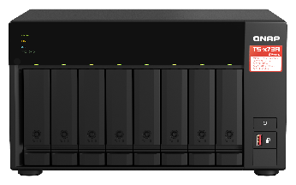
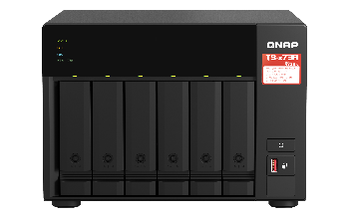
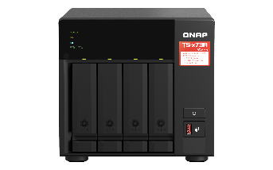
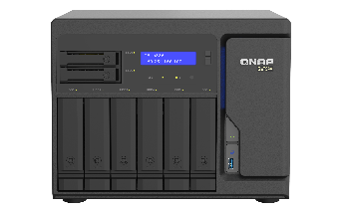
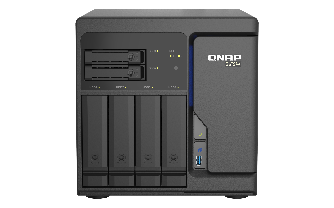
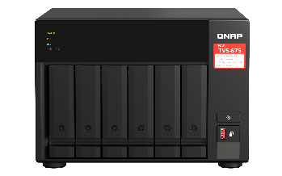
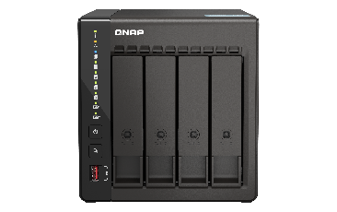
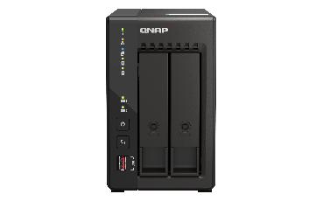
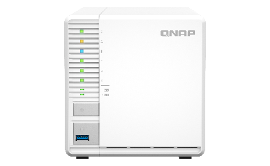
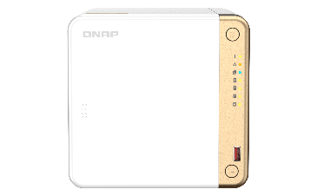
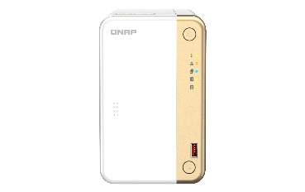
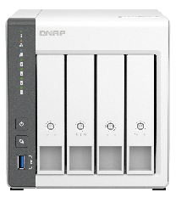
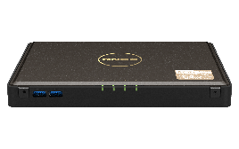
搭配內建2.5GbE桌上型NAS
SMB
Enterprise
SMB
TS-873A
TS-673A
TS-473A
TS-h886
TS-h686
TVS-675
SMB
Home/SOHO
TBS-464
TS-453E
TS-253E
TS-462
TS-262
TS-433
TS-364

Slide 27
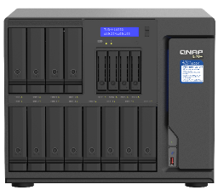
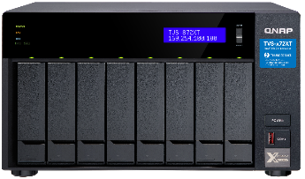
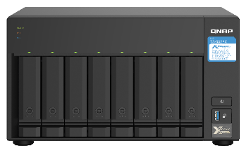
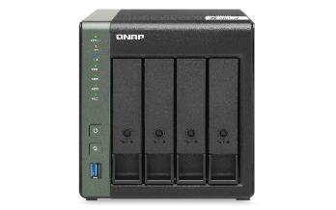
搭配內建10GbE桌上型NAS
With 10GbE BASE-T
｜
With 10GbE SFP+
TVS-h1688X /
TVS-h1288X
TVS-872XT / TVS-672XT / TVS-472XT
TS-832PX
TS-431X3
10GbE + 2.5GbE
10GbE + 2.5GbE
With 10GbE BASE-T
TS-i410X

Slide 28
搭配機架型2.5/5/10GbE NAS
With 10GbE BASE-T or SFP+
With 2.5GbE BASE-T
TS-435XeU
TS-1886XU-RP R2
TS-873AeU/873AeU-RP/1273AU-RP/1673AU-RP
TS-X64U/X64eU series
TS-hx77XU-RP
TS-hx83XU-RP
TS-hx87XU-RP
TS-x32PXU
+ 2 x 10GbE SFP+

Slide 29
網路擴充: 豐富的各式PCIe網路擴充卡
10GbE series
5GbE series
2.5GbE series
QXG-10G2TB
QXG-10G2T-X710
QXG-5G Family
QXG-2.5G Family
1 x RJ45
1 x RJ45
2 x RJ45
2 x RJ45
2 x RJ45
2 x RJ45
QXG-10G2T-X107
QXG-10G1TB
4 x RJ45
4 x RJ45
2 x RJ45
1 x RJ45

Slide 30
網路擴充：豐富的各式攜帶式網路擴充卡
QNA-UC5G1T
QNA-T310G1T
USB 3.2 Gen 1
Thunderbolt 3
RJ45 NBASE-T
4速: 5G/2.5G/1G/100M
10GbE NBASE-T port
5 速: 10G/5G/2.5G/1G/100M
透過隨插即用的USB 為你的筆記型電腦或 PC 升級成 5GbE 的高速網路
透過 Thunderbolt 3 快速將你的筆記型電腦或 PC 升級到 10GbE 的高速網路
https://www.qnap.com/en/product/qna-uc5g1t
https://www.qnap.com/en/product/qna-uc5g1t
https://www.qnap.com/en/product/qna-tb-10gbe
Notes:
QSW-308

Slide 31
是您最好的選擇！
©2022著作權為威聯通科技股份有限公司所有。威聯通科技並保留所有權利。威聯通科技股份有限公司所使用或註冊之商標或標章。檔案中所提及之產品及公司名稱可能為其他公司所有之商標 。​

Slide 32
Notes:
QSW-M2116PR-2S2T才有PoE

Slide 33
is your best choice !
Copyright© 2022 QNAP Systems, Inc. All rights reserved. QNAP® and other names of QNAP Products are proprietary marks or registered trademarks of QNAP Systems, Inc. Other products and company names mentioned herein are trademarks of their respective holders.​

