Slide 1
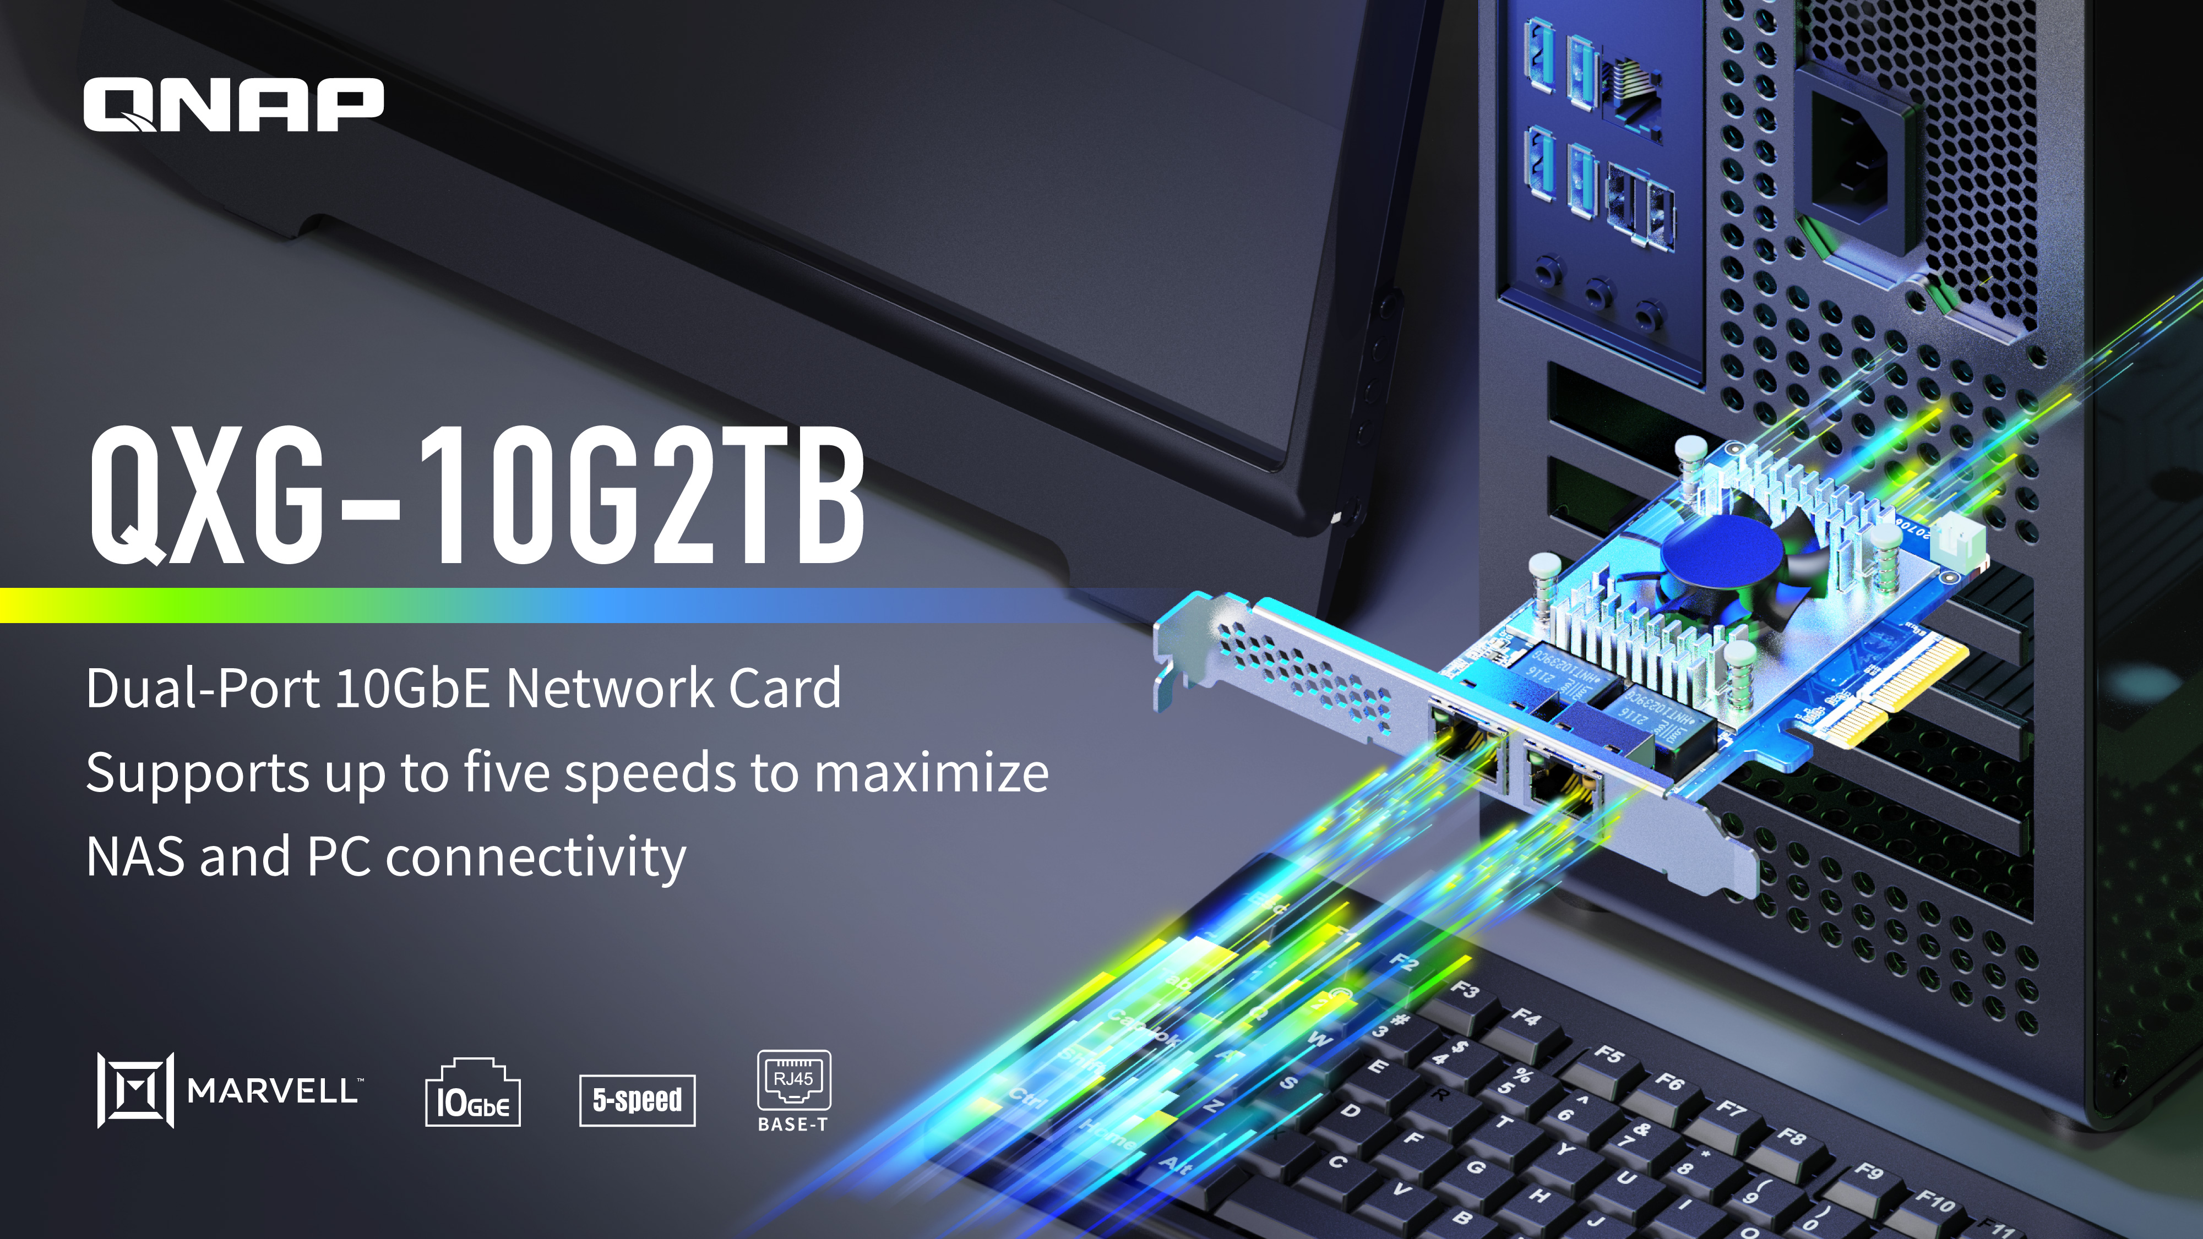
Notes:
Hello everyone, welcome to today's QNAP livestream, I'm Andy, product manager at QNAP,
today I will introduce to you a network expansion card QXG-10G2TB that provides two network ports and supports 5-speed, not only can support QNAP NAS for network expansion, and can also add 10Gbps high-efficiency network environment to your Windows Ubunto computer

Slide 2
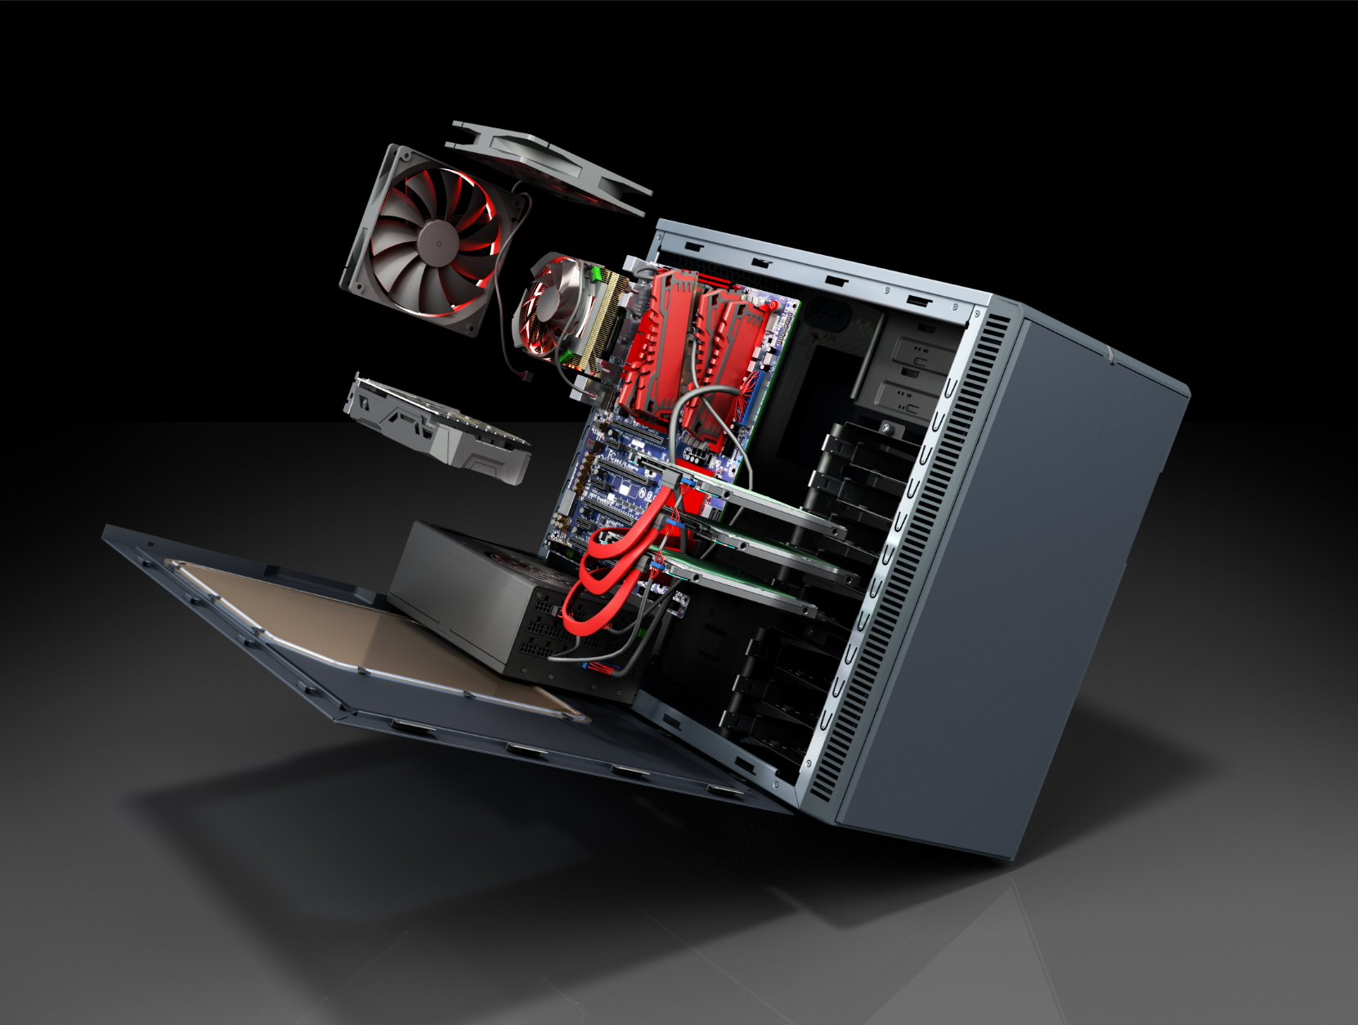

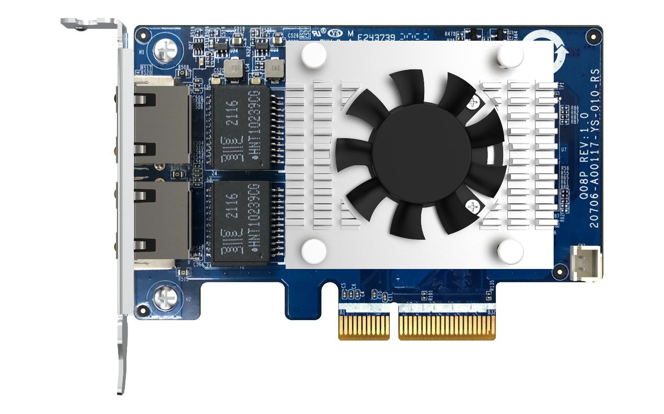
Dual port 10GbE PCIe Gen3 Multi-Gig Expansion Card
PCIe supported NAS、PC / Workstation
Build a high-speed network environment with QNAP 10GbE switches
10GbE is fully popularized ,
easily create a high-speed application
Notes:
10GbE is fully popularized , easily create a high-speed application
This page show the features of this card. First of all, QXG-10G2TB provides two ports and supports five network transmissions, 10G / 5G /2.5G /1G 100M
And not only supports our NAS models, but also can be used with PCs or workstations with PCIe expansion slots
And it can also be used with QNAP's 10G switch and NAS to establish a high-speed transmission environment, accelerating file sharing and intensive data transfer.

Slide 3


QNAP New 10GbE Network Interface Card
QXG-10G2TB
QXG-10G2TB
Dual-port 10GbE BASE-T low profile NIC
Marvell AQtion AQC113C
Multi-Gig Leading solution
Allows you to quickly upgrade high-speed 10GbE ports to QNAP NAS, Windows® and Ubuntu® computers/servers as needed
2 x RJ45 10GBASE-T
5-speed; 10/5/2.5/1GbE, 100M
Notes:
QXG-10G2TB is a Dual-port 10GbE BASE-T low profile NIC , two RJ45 ports with 5 speed
The controller is equipped with Marvell, the leader in Multi Gig, powered by Marvell AQtion AQC113C
, allowing you to quickly add high-speed 10GbE network transmission to QNAP NAS, Window® and Ubuntu® computers/servers according to your needs

Slide 4


Take advantages of existing infrastructure
Current LAN cables may already be capable for > 1Gbps speeds!
 | CAT 5e | CAT 6 | CAT 6A above
100M | ✔ | ✔ | ✔
1G | ✔ | ✔ | ✔
2.5G | ✔ | ✔ | ✔
5G | ✔ | ✔ | ✔
10G | X | ✔(55m) | ✔
Original CAT 5e can reach to 5Gbps
CAT 6 above cable reaches 10Gbps
Build a high-speed network environment with QNAP 10GbE switches
Notes:
This table shows the network cables and network transmission speed . You can see that the general network cable CAT5e can support up to 5G network transmission, and 10G needs to be matched with cables of CAT 6 or above.
If we want to build a 10G network environment , we also need to prepare a 10GbE switch , and there are several network switch provide by QANP also , we will have a brief later.

Slide 5
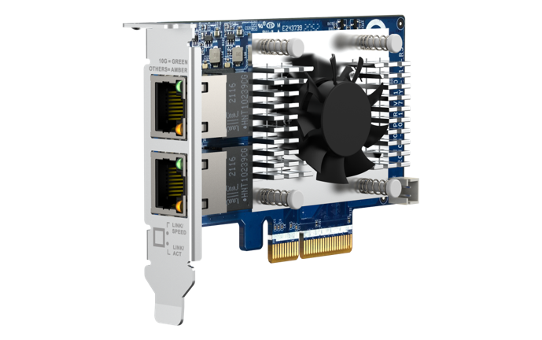
QXG-10G2TB
Hardware specification
QXG-10G2TB | QXG-10G2TB
Ethernet Controller | Marvell AQtion AQC113C​
Transmission Speed | 10/5/2.5/1GbE, 100M​
Connector | NBAST-T; RJ45​
Port# | 2​
Support QNAP OS | QTS 4.5.4 and later QuTS hero h4.5.4 and later
Support 3rd party OS | Windows® 10 (Driver is required ) Ubuntu® 20.04 + Marvell 2.5.5 ( Driver is required )
PCIe interface | PCI Express 3.0 x4
Package content | 1 x QXG-10G2TB 1 x QIG (Quick Installation Guide) 3 x brackets (pre-install half-height on NIC when shipping)
warranty | 2 years
 | QXG-10G2T-X710
網路控制晶片 | Intel Ethernet Controller 700
傳輸速度 | 10/5/2.5/1GbE, 100M
連接埠 | NBAST-T; RJ45
埠數 | 2
支援 QNAP 作業系統 | QTS 4.5.2 或之後的版本 QuTS hero 4.5.1 或之後的版本
支援其他作業系統 | Windows/Windows Server/Linux
PCIe 介面 | PCI Express 3.0 x4
包裝內容 | 1 x QXG-10G2T-X710 1 x QIG (快速安裝指南) 3 x 擋版 (出貨時預先安裝短擋版於網路擴充卡上)

Slide 6
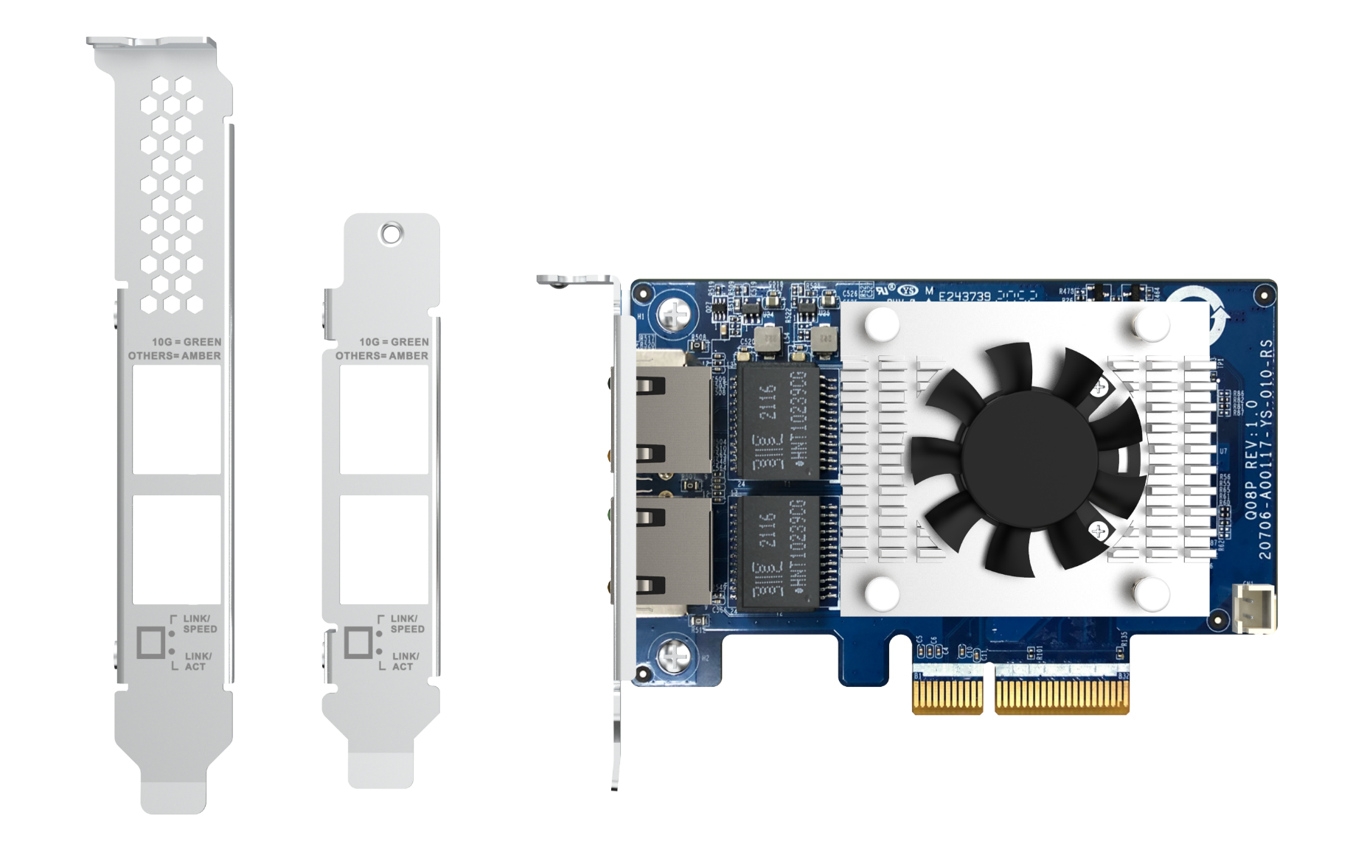
QXG-10G2TB 10GbE NIC overview
Dual-port 10GbE (BASE-T) connector
(10/5/2.5/1G,100M)
Heatsink & fan for controller chipset
With the high-efficiency heatsink & fan module, it can avoid over-temperature in the high-speed transmission environment
PCIe Gen3 x4 interface
Pre-install Low profile bracket
include Full height special bracket for selected QNAP NAS
Notes:
This page also provides the appearance configuration diagram of the QXG-10G2TB
From the left, there are Dual-port 10GbE (BASE-T) connector support 5 speed(10/5/2.5/1G,100M) and on the right, you can see A high-performance, active cooling module And this is also the specification that the general network card does not have.
and PCI Express 3.0 x4 interface can also be seen at the bottom
The next thing is that our card also comes with a bracket. When it is shipped, a half-height bracket will be pre-installed, and full-height bracket will be included in the package for everyone to replace, so that the chassis is full-height or full-height. It can be installed at half height, and can also be used with Low-profile design to fit most chassis

Slide 7
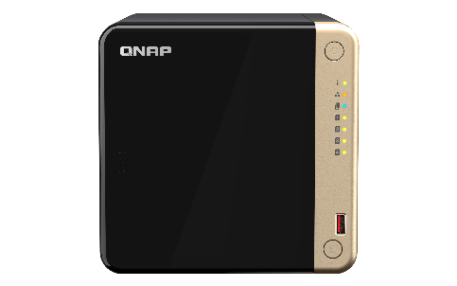
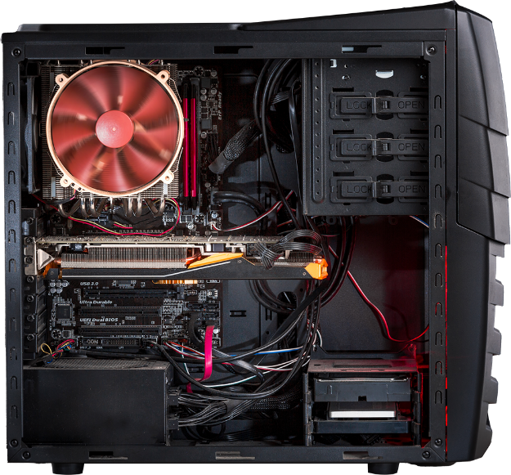
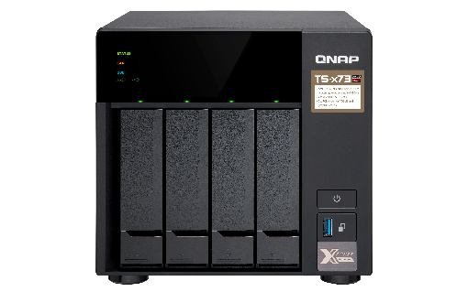
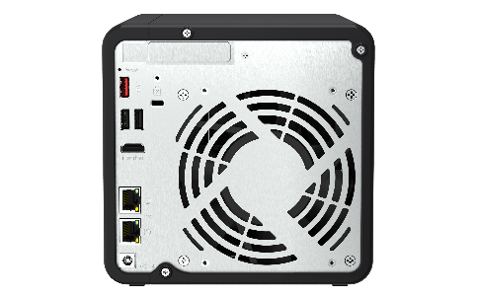
PCIe supported NAS
PCIe supported
PC/Workstation/Server
Supports QTS / QuTS hero,
Windows and Linux
* the compatible QNAP NAS can be found in QNAP compatibility list
The driver is featured in QTS 4.5.4 / QuTS hero h4.5.4 or above version. Please update to latest version
Driver is required to download in QNAP download center and install to your PC
Notes:
QXG-10G2TB supports QNAP operating system , QTS and QuTS hero, also windows and linux , allowing you to attain optimal business performance for a wider range of system applications and services.
It supports NAS with PCIe slots and the driver is featured in QTS 4.5.2 and QuTS hero h4.5.2 , but we recommend to update to latest version , and it also support PC , workstation with PCIe slots , the driver is required to download and install to your pc

Slide 8
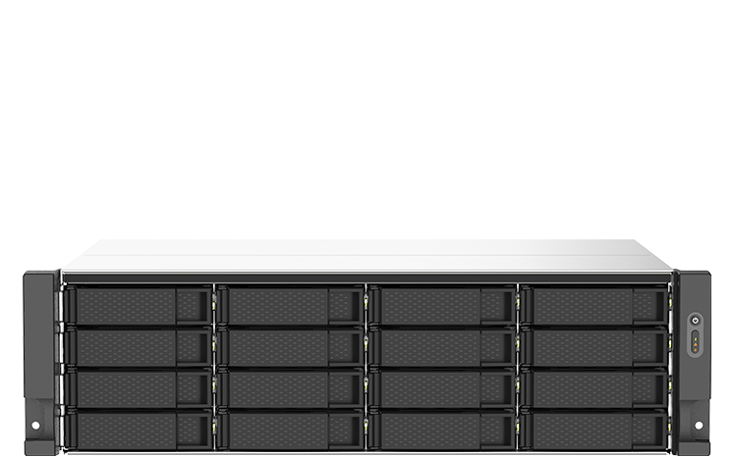


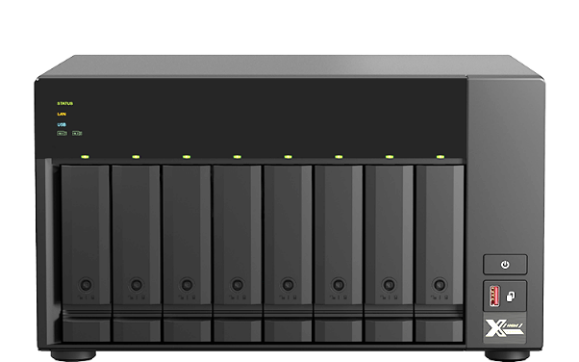
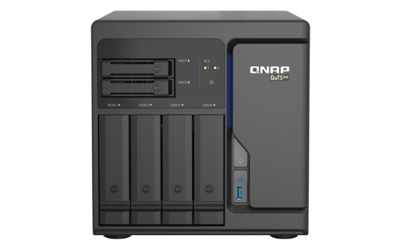
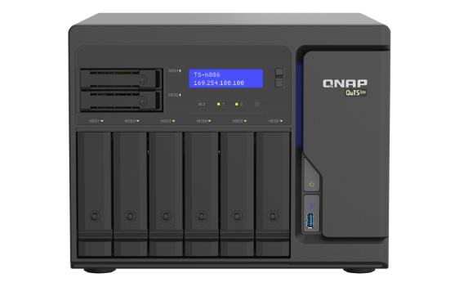
Extend your QNAP NAS with 10GbE NIC
OK
TS-x73AU series
TS-x73A series
TS-h686
TS-h886
AMD Ryzen™ V1500B quad-core
2 x 2.5GbE ports (2.5/1GbE, 100/10M)
AMD Ryzen™ V1500B quad-core
2 x 2.5GbE ports (2.5/1GbE, 100/10M)
Intel Xeon D series
4 x 2.5GbE ports (2.5/1GbE, 100/10M)
Slot 1: PCIe Gen3 x4
Slot 2: PCIe Gen3 x4
Slot 1: PCIe Gen 3 x4
Slot 2: PCIe Gen 3 x4
Slot 1: PCIe Gen3 x8
Slot 2: PCIe Gen3 x8
*Find out supported QNAP model on our Compatibility list.
Notes:
And here show some compatible QNAP NAS for QXG-10G2TB , we have
You can also *Find out supported QNAP model on our Compatibility list.

Slide 9


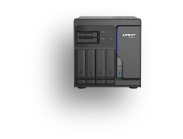


With QXG-10G2TB, you can enjoy high-speed network transmission
1 x 10GbE Windows
File Transfer (TS-h686)
2 x 10GbE SMB Sequential Throughput (TVS-h874)
1,134 MB/s
1,144 MB/s
2,344MB/s
2,362 MB/s
Test environment:
NAS | TS-h686, QuTS hero h4.5.2, 6 x Samsung 850 Pro 512GB SSDs, RAID 0, thick volume
Client PC | Windows 10, Intel Core i7-6700 CPU 3.40GHz ,64GB RAM
Test environment:
NAS | TVS-h874 QuTS hero h5.0.0, 8 x SSDs, RAID 5, thick volume
Client PC | Windows server 2019, Intel Xeon 3.6GHz, 32GB RAM
IOmeter | RAM*4, 30-sec ramp up time, 3-min seq. run time, 1 worker, 32-outstanding
Notes:
And this page show the performance of the card , provide Up to 1000+MB/s Read/Write performance
We have TS-h686 install QXG-10G2TB to transfer 10 GB file to PC
We can see the result below , 1144 MB per second for download 10GB file and 1132 MB per second for upload 10GB file

Slide 10


2 x 10GbE SMB Sequential Throughput
Notes:
And next I will do the demo of 10GB file drag and drop via the card,

Slide 11

Create 10 GbE high-speed network environment with QNAP switch

Slide 12
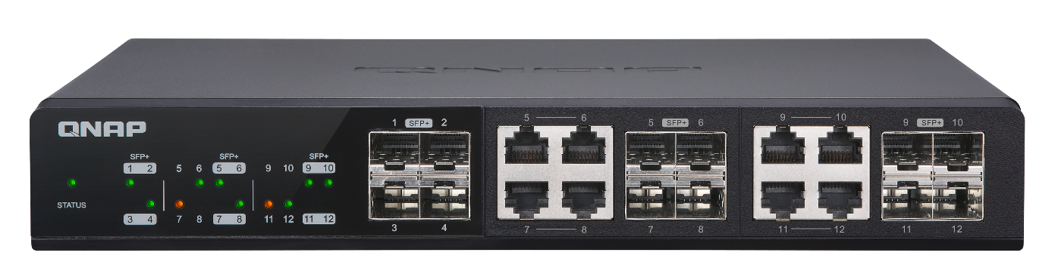
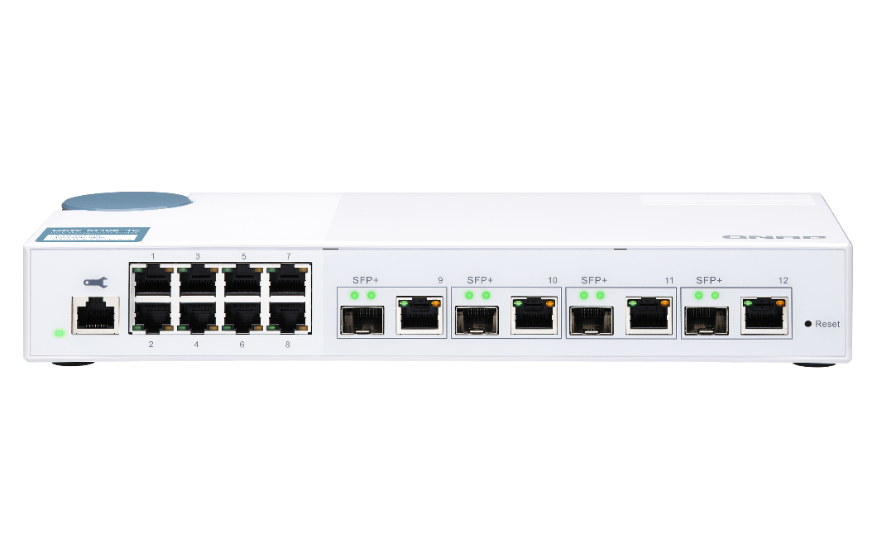
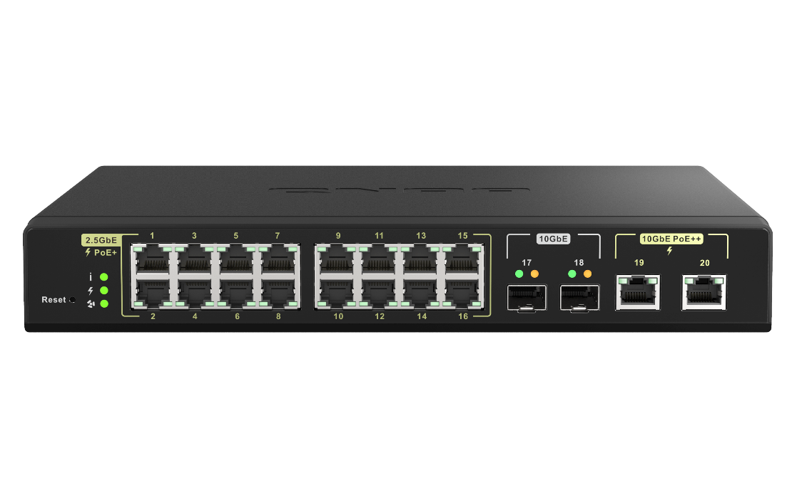
QNAP managed 10GbE switch for multi-10GbE aggregated multi-user cooperating
4 x 10GbE SFP+ ports
8 x 10GbE SFP+ & RJ45 Combo ports
QSW-M1208-8C
8 x 10GbE SFP+ ports
4 x 10GbE SFP+/10GBASE-T combo ports
16 x 2.5GbE 30-watt PoE+
2 x 10GbE 90-watt PoE++
2 x 10GbE SFP+ ports
QSW-M408-4C
QSW-M2116P-2T2S
Notes:
For QNAP managed 10GbE switch , we have QSW-M1208-8C、QSW-M408-4C、QSW-M2116P-2T2S and for more , can be found on our website

Slide 13



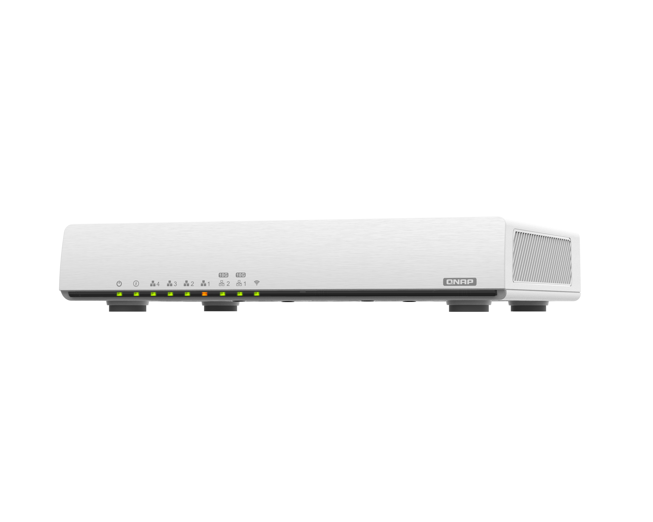


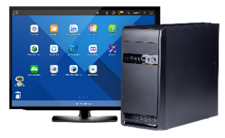
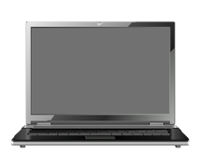



Build a high-speed network with QHora SD-WAN Router
QHora-301W supports high-speed Wi-Fi 6 and 10GbE connections, while also providing an enterprise-grade SD-WAN VPN to allow multi-site VPN deployment via the cloud. Combined with a budget-friendly price, the QHora-301W is a solid foundation for building a next-generation network.
QHora 301W
Wifi 6 Dual port 10GbE Router
Internet
Wi-Fi 6 device
10Gbps RJ45
1 Gbps
1 Gbps
10Gbps RJ45
PC + QXG-10G2TB
1G Notebook
Smart TV
NAS + QXG-10G2TB
Notes:
QHora-301W supports high-speed Wi-Fi 6 and 10GbE connections, while also providing an enterprise-grade SD-WAN VPN to allow multi-site VPN deployment via the cloud. Combined with a budget-friendly price, the QHora-301W is a solid foundation for building a next-generation network.

Slide 14

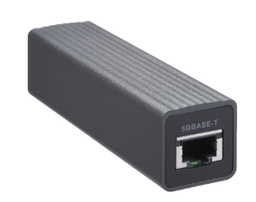
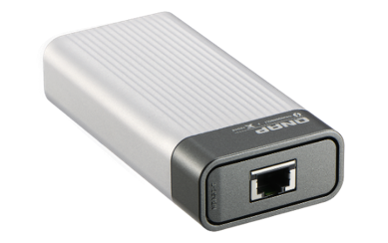
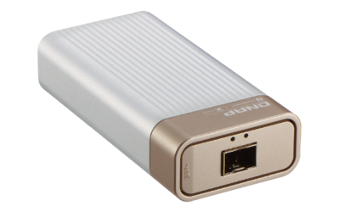
QNA series for 10GbE
QNA-UC5G1T
QNA-T310G1T
QNA-T310G1S
USB 3.0
Thunderbolt 3
Thunderbolt 3
RJ45 NBASE-T
4 speed: 5G/2.5G/1G/100M
10GbE NBASE-T port
5 speed: 10G/5G/2.5G/1G/100M
10GbE SFP+ Port
Supported speed:10Gbps/1Gbps
Notes:
And if there is no fiber (SFP+) and (RJ45) interfaces in your device, QNAP also provides accessory to help you build a high-speed network transmission environment

Slide 15

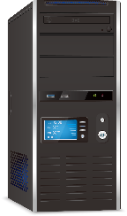

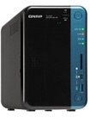




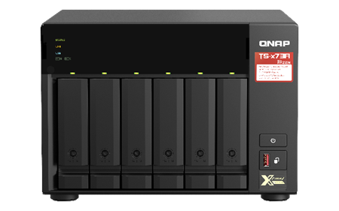

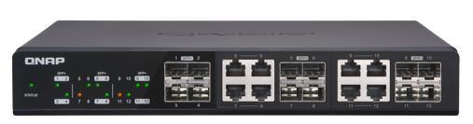
PC/ workstation speed up
Through QNAP's diverse product line, you can easily upgrade to a 10GbE network environment. It allows you to quickly add high-speed 10GbE network ports to QNAP NAS, Window® and Ubuntu® computers/servers according to your needs, speeding up large-scale sharing and intensive data transfer to meet high-bandwidth application scenarios.
1GbE
CAT 5e
CAT 5e
1GbE Switch
CAT 6
CAT 6
10Gbps
TS-x73A
QXG-10G2TB
CAT 6
CAT 6
QXG-10G2TB
QXG-10G2TB
QSW-1208-8C
TS-h686
Notes:
QXG-10G2TB and QNAP switch can provide you with an economical speed-up solution. It can be seen that in the past ,1G environment is built with Cat 5e and 1GbE switch
Now with QXG-10G2TB and QSW switch, you can directly upgrade your PC to 5Gbps network transmission environment, and to 10Gbps, you need to use Cat 6 or higher level to create a high-speed network environment and speed up the file Sharing and intensive data transmission to meet high-bandwidth application scenarios.

Slide 16





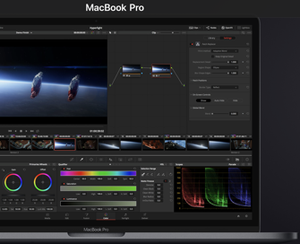

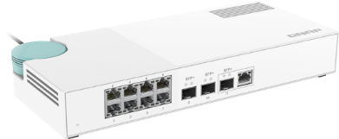


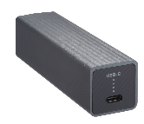
Mac/Windows laptop speed up instantly
QNAP also provides a diverse product line of accessories. Even if there is no network port in your device, there are corresponding adapters, which can quickly upgrade your network environment to more than 5 GbE. With QNAP NAS, video editors and other collaborative teams can enjoy high-speed storage services.
Video Editing workstation
Back-up your masterpiece
Backup to
QNAP NAS
QXG-10G2TB
Thunderbolt 3
10GbE
QNA-T310G1T
TS-h686
Laptops for cooperation
QNAP Switch
QXG-10G2TB
USB 3.0
5GbE
QNA-UC5G1T
TVS-x73A
Notes:
If there is no RJ45 ports in your device, QNAP also provides you with corresponding accessories to give you a lightweight speed-up solution. Whether it is Thunderbolt or USB interface, with QNAP QSW switch and NAS, let you enjoy a high-speed network transmission environment, and reducing your workload.
For video editing , the editor can easily back up their works to QNAP NAS through 10GbE or 5 GbE network transmission , to ensure data security and also co-wok with team

Slide 17
Dual port 10GbE PCIe Gen3
Multi-Gig Expansion Card
 | QXG-10G2TB | QXG-10G2T-107 ( EOL )
Ethernet Controller | Marvell AQtion AQC113C​ | Marvell AQtion AQC107S
Transmission Speed | 10/5/2.5/1GbE, 100M​ | 10/5/2.5/1GbE, 100M
Connector | NBAST-T; RJ45​ | NBASE-T; RJ45
Port# | 2​ | 2
Support QNAP OS | QTS 4.5.4 and later QuTS hero h4.5.4 and later | QTS / QuTS hero (latest version recommended)
Support 3rd party OS | Windows® 10 (Driver is required ) Ubuntu® 20.04 + Marvell 2.5.5 ( Driver is required ) | Windows® (Driver is required) Linux® (Driver is required)
PCIe interface | PCI Express 3.0 x4 | PCI Express 2.0 x4
Package content | 1 x QXG-10G2TB 1 x QIG (Quick Installation Guide) 3 x brackets (pre-install half-height on NIC when shipping) | 1 x QXG-10G2T-107 1 x QIG (Quick Installation Guide) 3 x brackets (pre-install half-height on NIC when shipping)
warranty | 2 years | 2 years
 | QXG-10G2T-X710
網路控制晶片 | Intel Ethernet Controller 700
傳輸速度 | 10/5/2.5/1GbE, 100M
連接埠 | NBAST-T; RJ45
埠數 | 2
支援 QNAP 作業系統 | QTS 4.5.2 或之後的版本 QuTS hero 4.5.1 或之後的版本
支援其他作業系統 | Windows/Windows Server/Linux
PCIe 介面 | PCI Express 3.0 x4
包裝內容 | 1 x QXG-10G2T-X710 1 x QIG (快速安裝指南) 3 x 擋版 (出貨時預先安裝短擋版於網路擴充卡上)
Notes:
Marvell AQtion AQC113C which feature in multi-gigabit Ethernet MAC Controller with a full-reach, low-power, high-performance, multi-gigabit

Slide 18


Dual-port 10 GbE five-speed PCIe Gen3 Muti-Gig network expansion card, the best choice for your high-speed network environment !
Copyright© 2022 QNAP Systems, Inc. All rights reserved. QNAP® and other names of QNAP Products are proprietary marks or registered trademarks of QNAP Systems, Inc. Other products and company names mentioned herein are trademarks of their respective holders.​​​​​​​​

