Slide 1
Notes:
Hello everyone, welcome to QNAP LiveSream, I am Andy, Product Manager of QNAP, today I will introduce to you a dual-port 100 GbE network card equipped with NVDIA ConnectX-6 DX, which can provide up to 200 GbE total network bandwidth , to greatly improve network performance

Slide 2
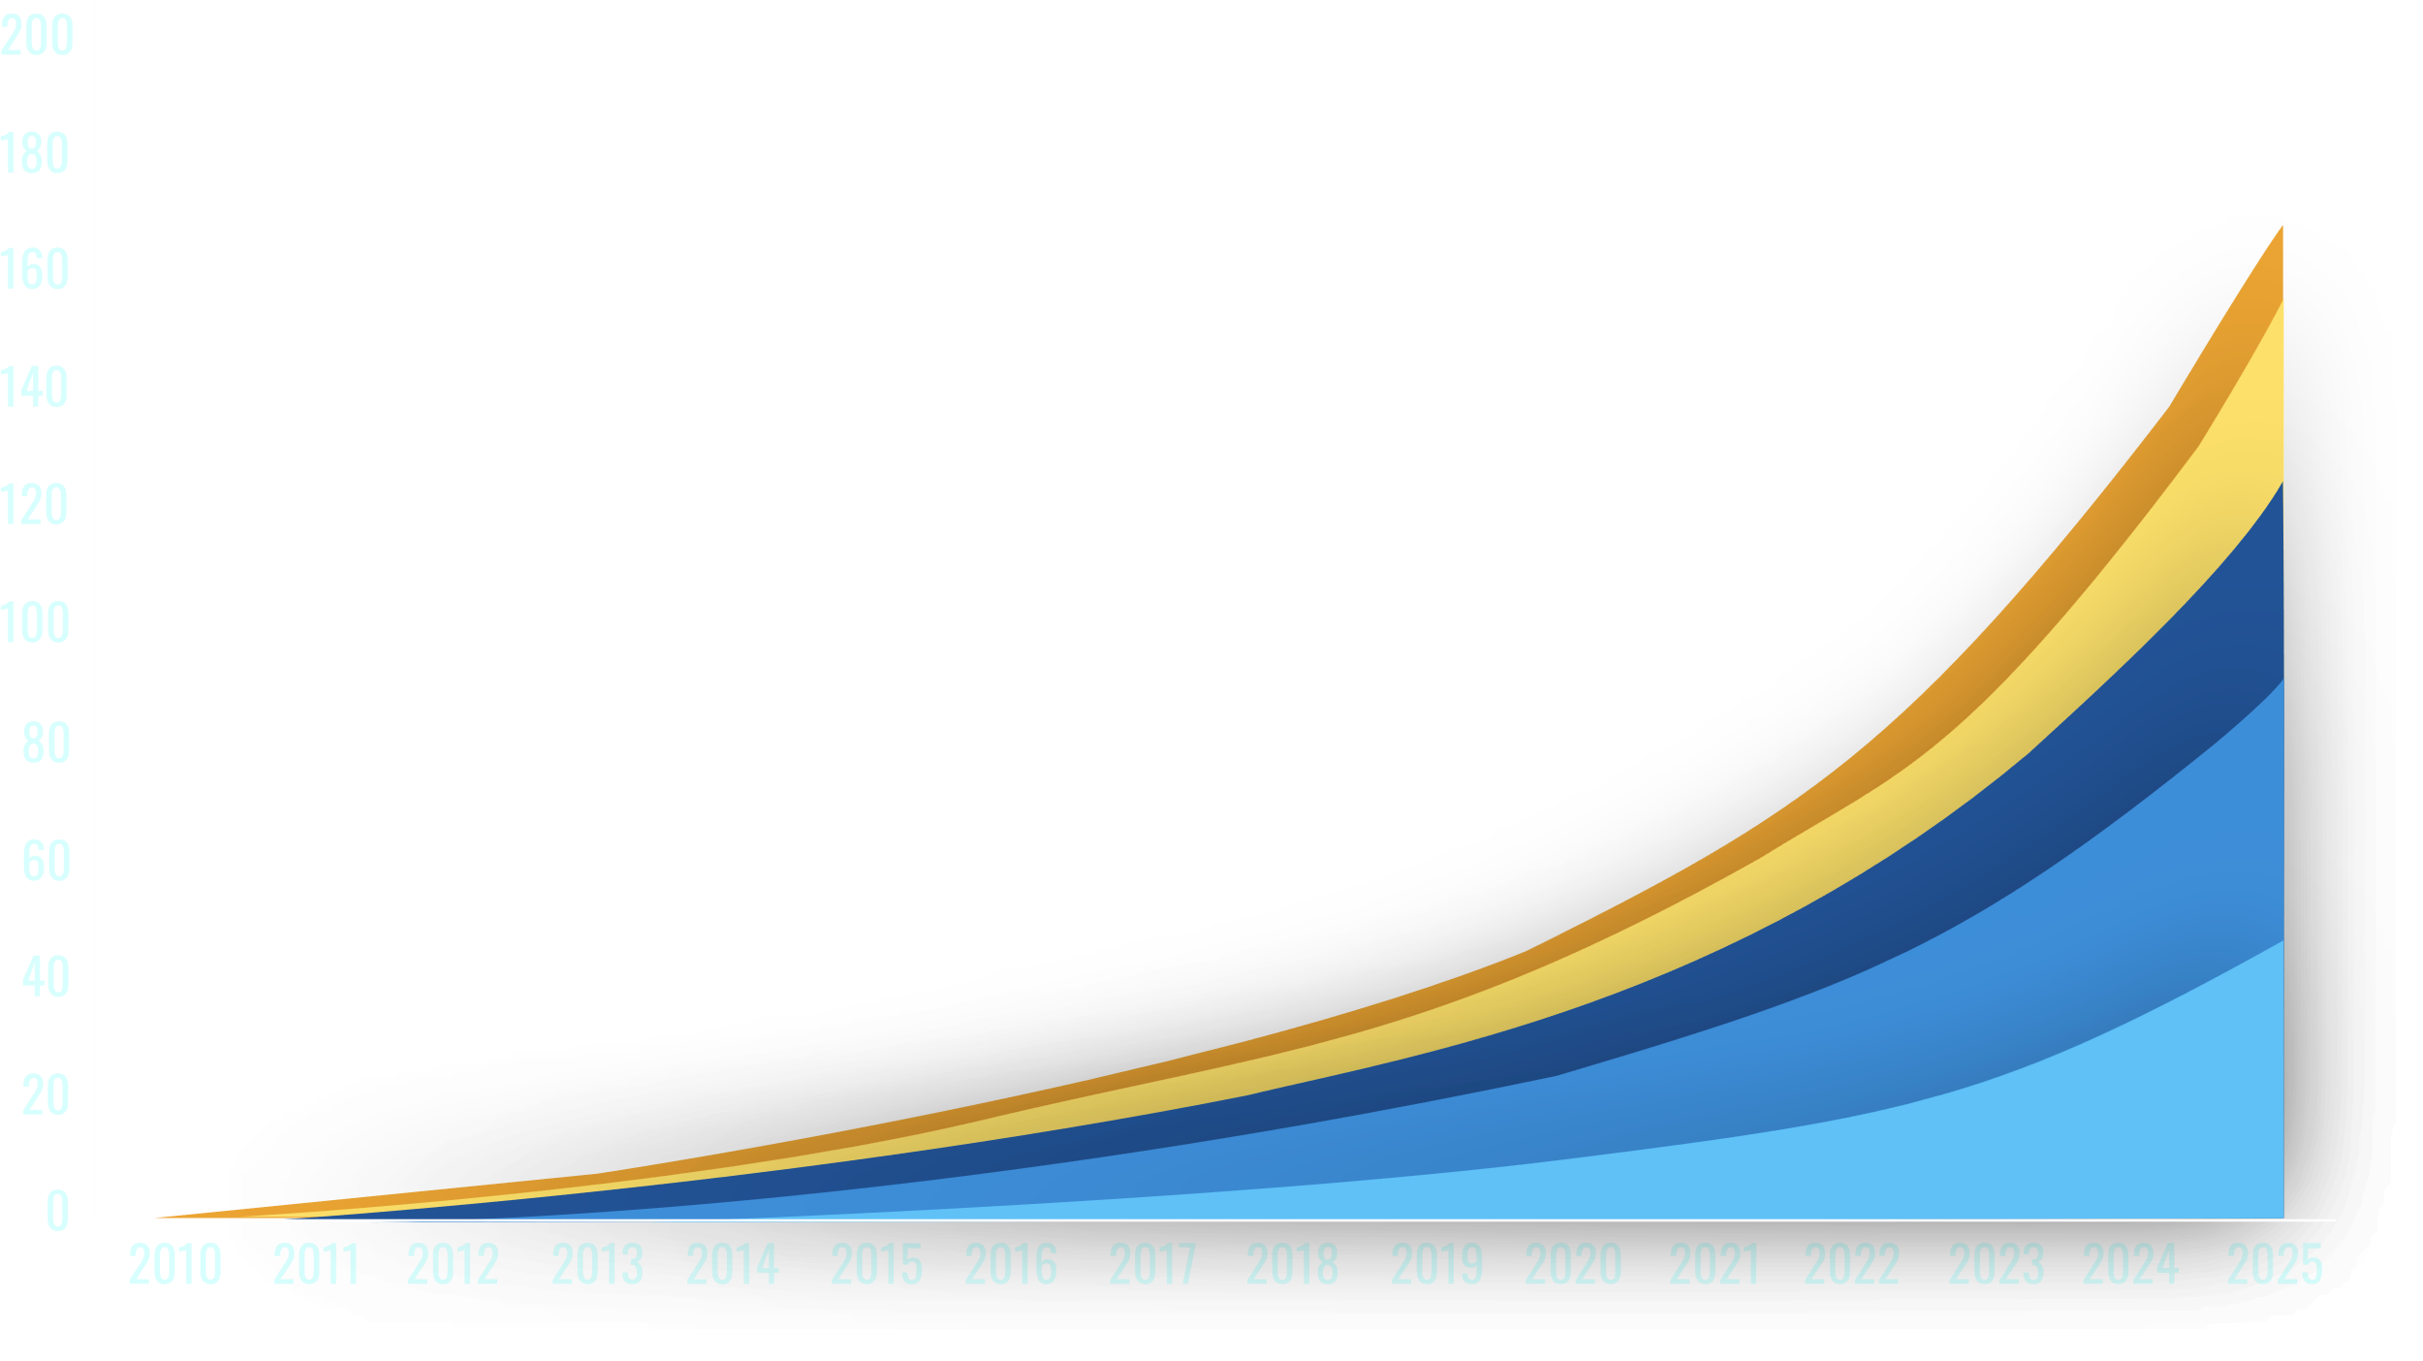
The amount of data is growing rapidly, you need fast and secure network transmission
IDC estimates that by 2025, the total amount of new data generated in the world will reach 175ZB. Secure, advanced and fast network transmission will be your must-have environment to accelerate and protect the cloud and data center workload.
Source：
Notes:
According to IDC's relevant report, in 2025, the total amount of new data generated worldwide will reach 175 Zettabytes. In the face of such a huge amount of data, secure, advanced and fast network transmission will be an indispensable environment for enterprises. , in order to accelerate data transfer and reduce workload in the cloud and data center

Slide 3
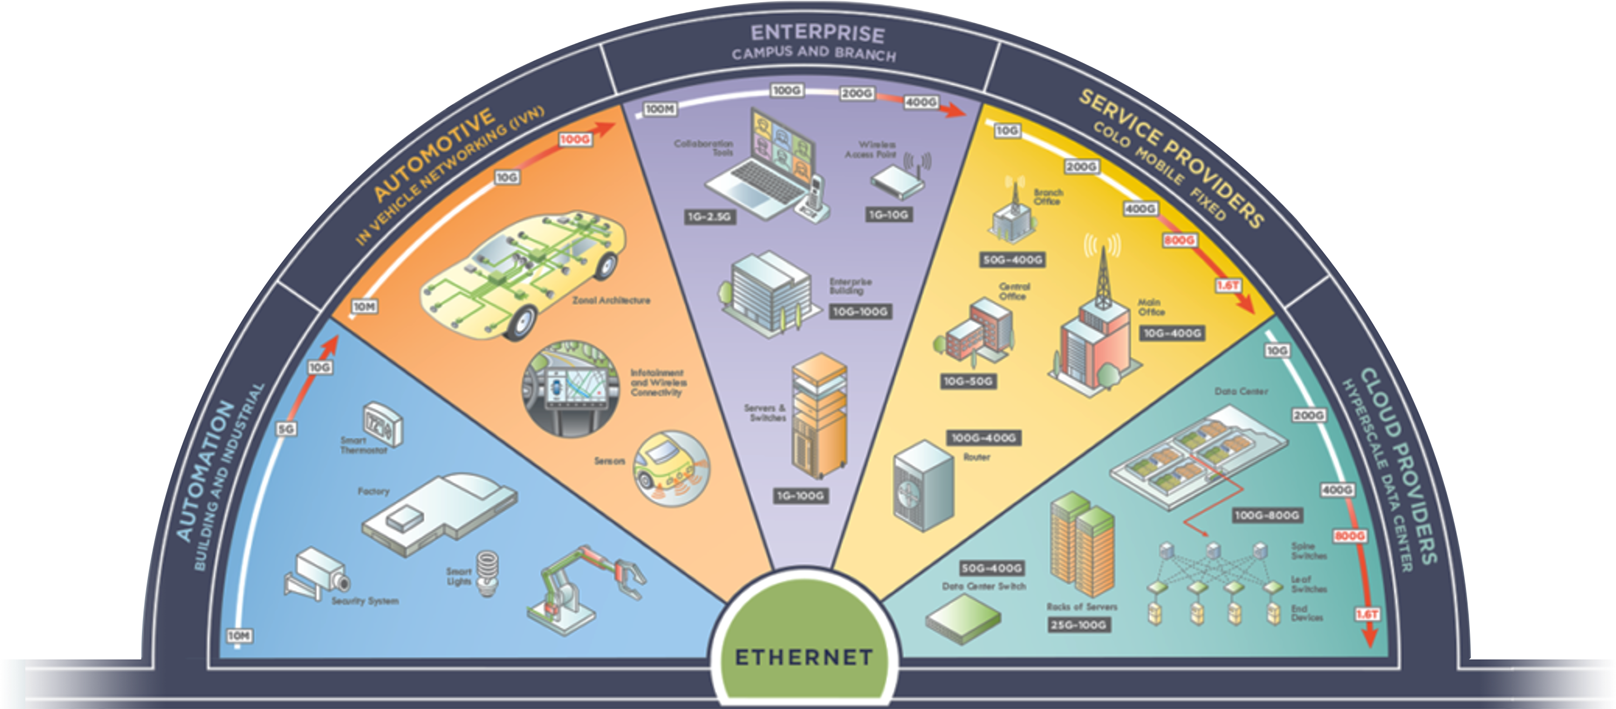
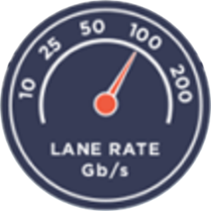
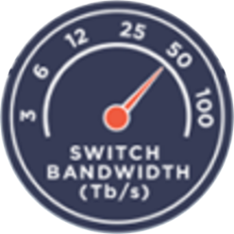
High-speed Internet has become indispensable for enterprise users
According to the data of the Ethernet Alliance in 2022, with the continuous advancement of technology, the network speed demand of enterprise users has reached as high as 200Gbps.
Source :
Ethernet Alliance © 2022
Notes:
According to the relevant information of the Ethernet Network Alliance this year, it is also explained that with the continuous progress of information, such as the purple block in the middle of the figure, the network speed demand of enterprise users has reached 200G, or even 400G. Therefore, you also need high-speed network expansion to address increasingly demanding IT challenges and trends.

Slide 4
200GbE networking capability, Hardened virtualization and encryption acceleration
NVIDIA
200GbE
RoCE
Mellanox
ConnectX-6 Dx
Total
bandwidth
V1/V2
supported
X16 PCIe
Dual port
SR-IOV
Gen4 and
Gen3
100GbE
QSFP28
Notes:
QXG-100G2SF-CX6 with ConnectX-6 Dx SmartNIC is the industry's most secure and advanced cloud network interface card for accelerating mission-critical data center applications such as security, virtualization, SDN/NFV, giant data, machine learning, and storage space. Provides two 100Gb/s ports for a massive 200Gb total bandwidth and can connect up to 16 lanes of PCIe, even on PCIe Gen 3.0 systems. ConnectX-6 Dx is also NVIDIA's world-class, award-winning ConnectX network interface card family, featuring industry-leading 50Gb per second (PAM4) and 25/10Gb per second (NRZ) SerDes technology and support for new features to accelerate the cloud and data center loads. Offers several innovations, including programmable congestion control, selective repetition, and zero-touch RoCE, enabling a scalable, robust, and easy-to-deploy RoCE solution. It also supports SR-IOV to enhance the configuration of network resources for VMware® virtualized applications, suitable for big data analysis, machine learning and virtualized environment applications.

Slide 5
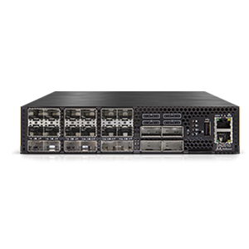
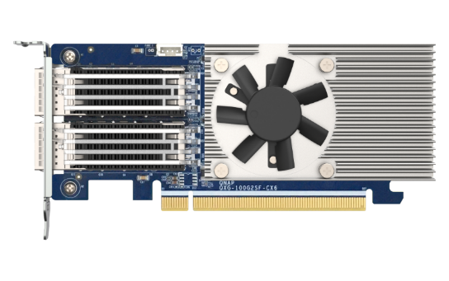
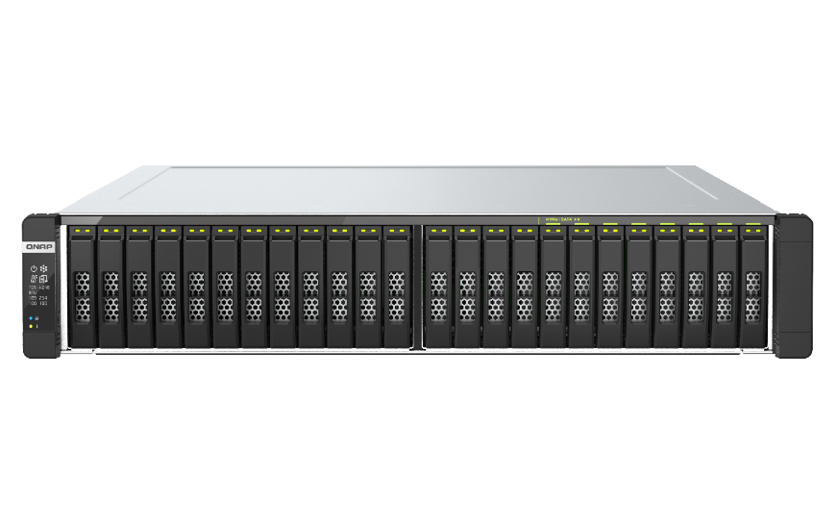
Through the QXG-100G2SF-CX6 , we can enjoy 200GbE total bandwidth, under 4K/8K video editing requirement
Connect the two 100GbE ports on the QXG-100G2SF-CX6 to a 100GbE or faster network switch for a 200GbE total bandwidth, allowing you to co-work across teams in today's ever-increasing amount of information
25 GbE
100G / 25G Switch
Video Editing Team
100 GbE
100 GbE
QXG-100G2SF-CX6
10 GbE
100G / 25G Switch
100 GbE
25 GbE
25 GbE
All-Flash NAS
Share with other teams
Notes:
In the face of a large number of 4K/8K video editing needs, through the QXG-100G2SF-CX6, you can enjoy the total bandwidth of 200G, and cross-team cooperation can also be unimpeded
It allows the video editing team to edit and transmit 4K/8K video through a total of 200 GbE network bandwidth, and quickly upload it to the All-flash NAS, and then share it with other teams synchronously,

Slide 6
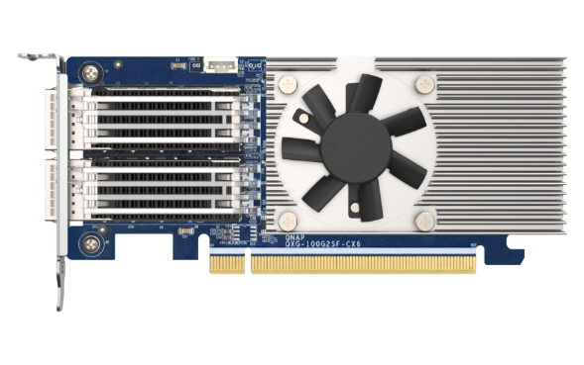
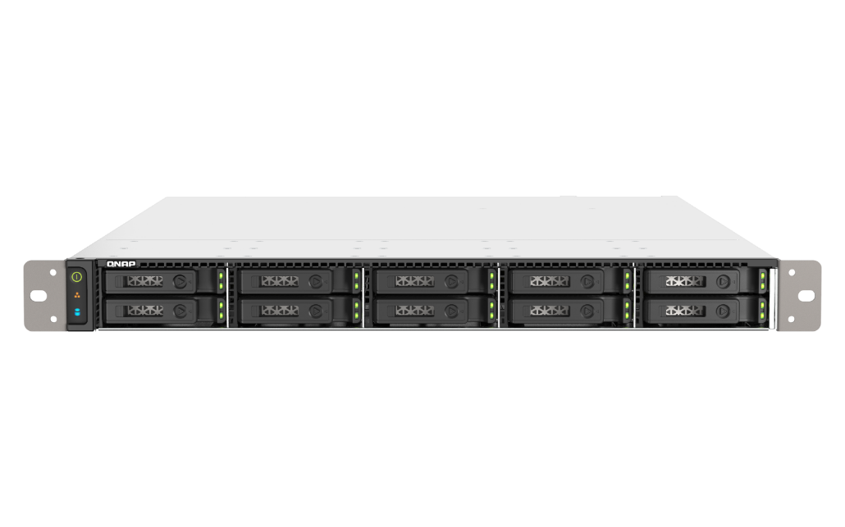
Direct 100GbE network transmission, Allows two workstations to work independently and efficiently
Directly connect the two 100GbE network ports on the QXG-100G2SF-CX6 to workstations
Allowing different workstations to operate independently in a high-speed network environment and enjoy efficient transmission and storage services
Also saves the cost of network switches
100 GbE
QXG-100G2SF-CX6
100 GbE
All-Flash NAS
Notes:
You can also connect the two 100GbE ports on the QXG-100G2SF-CX6 directly to a workstation
1. Allow two workstations to work independently and efficiently, and enjoy efficient transmission and storage services
2. The cost of network switches can also be saved by directly connecting the workstations

Slide 7
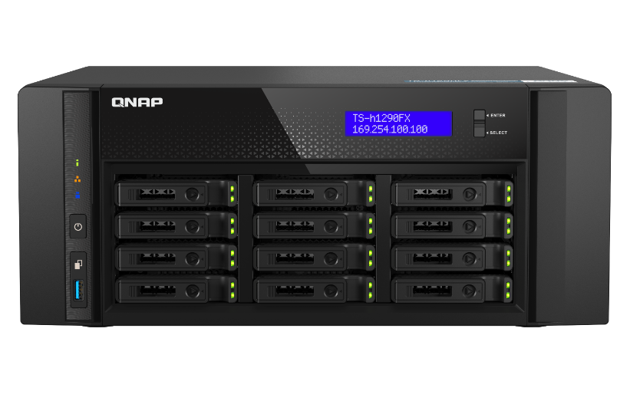
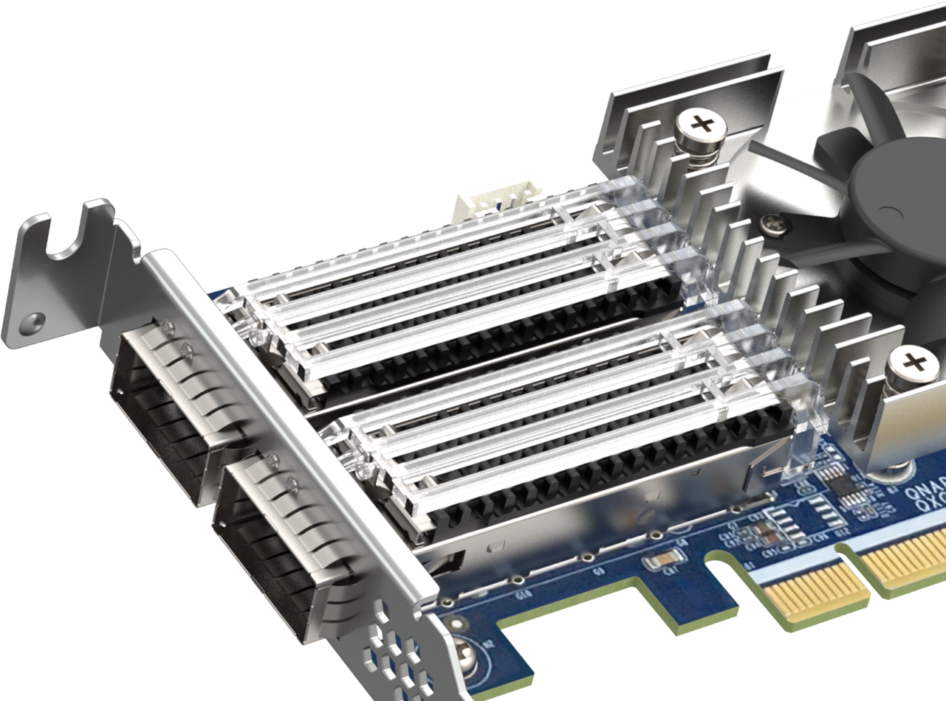
Supports QNAP All-Flash Array Series
TS-h2490FU
TS-h1290FX
TS-h1090FU
TDS-h2489FU
Notes:
QXG-100G2SF-CX6 supports QNAP full flash series NAS models, including TS-h2490FU, TS-h1090FU, TS-1290FX, and TDS-h2489FU

Slide 8
TS-h1090FU NAS SKUs
TS-h1090FU-7232P-64G
AMD EPYC 8 C / 16 T, 3.1 GHz (Max. 3.2GHz)
64 GB DDR4 RDIMM ECC Memory (8 x 8GB)
2 x SFP28 25GbE ports +2 x 2.5 GbE ports
TS-h1090FU-7302P-256G (By Request)
AMD EPYC 16 C / 32 T, 3.0 GHz (Max. 3.3GHz)
256 GB DDR4 RDIMM ECC Memor (8 x 32GB)
2 x SFP28 25GbE ports +2 x 2.5 GbE ports
TS-h1090FU-7302P-128G
AMD EPYC 16 C/ 32 T, 3.0 GHz (Max. 3.3GHz)
128 GB DDR4 RDIMM ECC Memory (8 x 16GB)
2 x SFP28 25GbE ports +2 x 2.5 GbE ports
Notes:
And here are the models of our ALL-FLASH models, TS-h1090FU, which provides two SFP28 25GbE ports and two 2.5GbE ports, with AMD EPYC 8-core and 16-core specifications for selection. The memory also has 64GB, 128 and 256G for reference

Slide 9
TS-h2490FU NAS SKUs
TS-h2490FU-7232P-64G
AMD EPYC 8 C/16 T, 3.1 GHz (Max. 3.2GHz)
64GB DDR4 RDIMM ECC Memory (8 x 8GB)
2 x SFP28 25GbE ports (25GbE/10GbE/1GbE)
TS-h2490FU-7302P-256G (By Request )
AMD EPYC 16 C/32 T, 3.0 GHz (Max. 3.3GHz)
256GB DDR4 RDIMM ECC Memory (8 x 32GB)
2 x SFP28 25GbE ports (25GbE/10GbE/1GbE)
TS-h2490FU-7302P-128G
AMD EPYC 16 C/32 T, 3.0 GHz (Max. 3.3GHz)
128GB DDR4 RDIMM ECC Memory (8 x 16GB)
4 x SFP28 25GbE ports (25GbE/10GbE/1GbE)
Notes:
The TS-h2490FU provides two SFP28 25GbE ports, with AMD EPYC 8-core and 16-core specifications to choose from, and the memory also has 64GB, 128 and 256G for reference

Slide 10
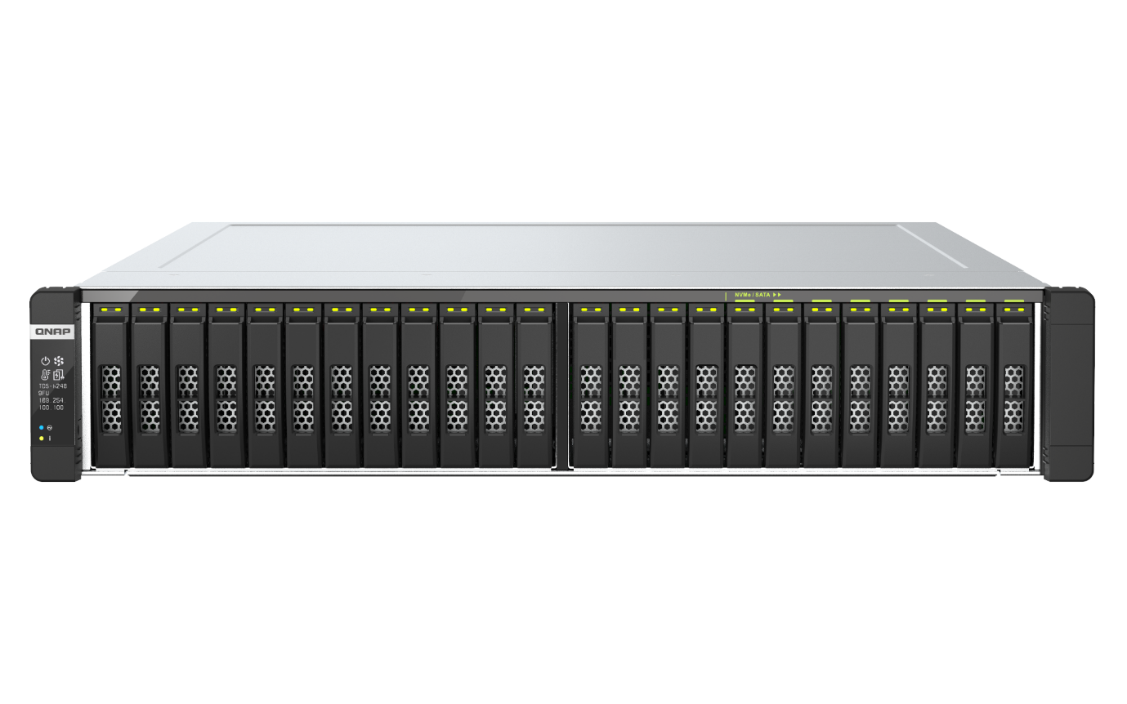
TDS-h2489FU NAS SKUs
TDS-h2489FU-4309Y-64G
2 x Intel Xeon Silver 4309Y 8C/16T, 2.8 GHz (Max. 3.6GHz)
64GB DDR4 RDIMM ECC Memory (8 x 8GB)
2 x SFP28 25GbE ports + 4 x 2.5 GbE ports
TDS-h2489FU-4314-256G
2 x Intel Xeon Silver 4314 16C/32T, 2.4 GHz (Max. 3.4GHz)
256GB DDR4 RDIMM ECC Memory (8 x 32GB)
2 x SFP28 25GbE ports + 4 x 2.5 GbE ports
TDS-h2489FU-4314-128G
2 x Intel Xeon Silver 4314 16C/32T, 2.4 GHz (Max. 3.4GHz)
128GB DDR4 RDIMM ECC Memory (8 x 16GB)
2 x SFP28 25GbE ports + 4 x 2.5 GbE ports
TDS-h2489FU-4314-512G (By Request) TDS-h2489FU-4314-1TB (By Request)
Notes:
Among them, TDS-h2489FU provides two SFP28 25GbE ports and four 2.5GbE ports, with two intel Xeon Silver 8 cores or 16 cores to choose from, and the memory also has 64GB, 128 and 256G, 512GB Even 1TB can refer to

Slide 11
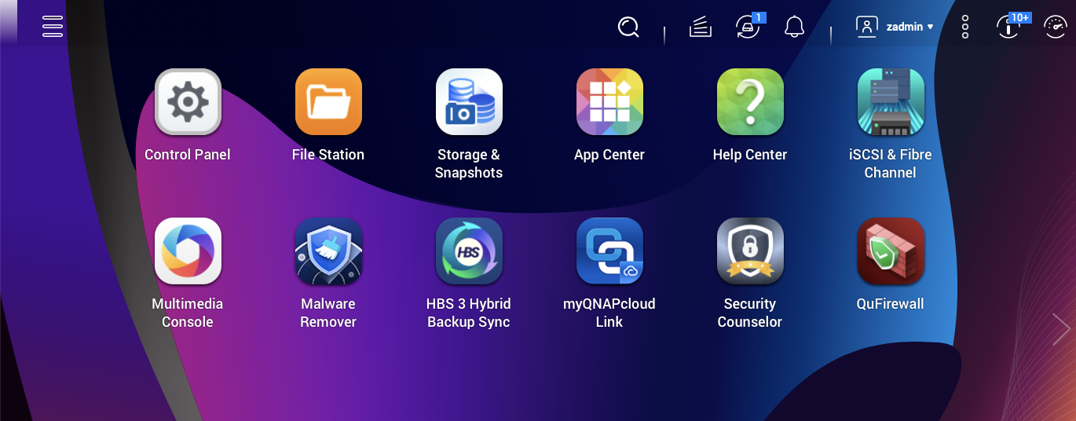
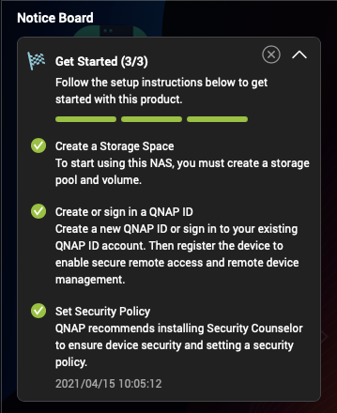
QuTS hero operating system
Kernel 5.10 LTS
User friendly interface
The QuTS hero operating system is based on the ZFS file system. It can provide the data integrity, safety, and efficiency required for all flash storage.
QuTS hero combines the app-based QTS with a 128-bit ZFS file system to provide flexible storage management, comprehensive data protection and optimized performance to meet the needs of business-critical applications.
Notes:
QuTS hero combines the app-based QTS with the 128-bit ZFS file system to provide flexible storage management, comprehensive data protection, and optimized performance to tackle the complexity and performance demands of modern IT. From storage management, virtualization, to collaborative media workflows, QuTS hero streamlines your business-critical tasks.

Slide 12
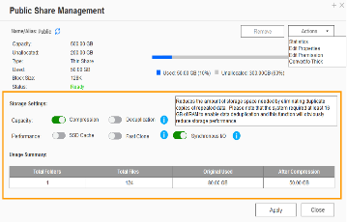
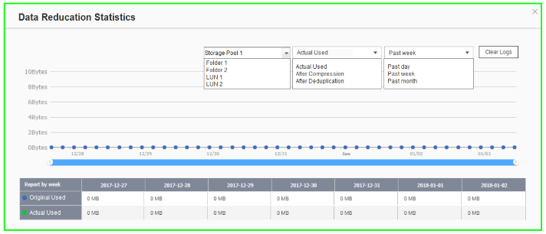
NAS & QuTS hero O.S. support powerful data reduction technologies to extend SSD endurance
TS-h1090FU 具備在線資料縮減技術， 能大幅延長 SSD 的使用壽命
Only available when during inline data process before writing
ZFS file system with inline deduplications and compresstion feature
It's the best choice to pair with the all-flash and SSD storage because it reduces the data size and pattern that need to be written to the SSD directly.
Write
A
B
C
D
A
B
C
D
A
B
C
D
D
C
A
B
D
C
A
B
Original Data
Compressed Data
Deduplicated Data
SSD Pool
Compression
Deduplication
Write to SSDs as sequential as much as possible.
Notes:
QuTS hero supports advanced block-based data reduction technologies (including inline data deduplication, compression, and compaction) to reduce file sizes, conserve storage capacity, and optimize performance. For example, if 20 virtual machines on a NAS are replicated using the same template, then storage space requirements for all 20 virtual machines can be reduced by up to 95%. Whether acting as primary or backup storage, optimizes storage utilization to provide a reliable storage cornerstone in the Big Data era. All-flash solutions thus achieve higher cost efficiency while improving both random write performance and SSD lifespan.

Slide 13
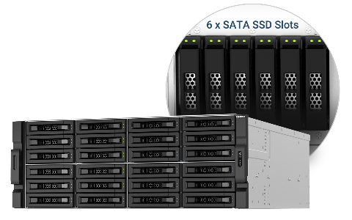
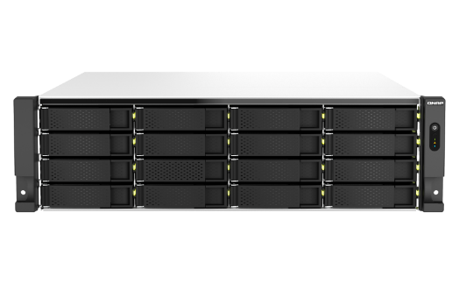
SnapSync
The most cost-effective backup, data protection, and disaster recovery solution
Schedule SnapSync: 5min~60min
Realtime SnapSync: RPO=0
Schedule SnapSync: 5min~60min
Realtime SnapSync: RPO=0
Production Server
Production Server
Normal
Disaster Recovery (RPO=0)
Normal
Normal
Disaster Recovery (RPO=0)
Normal
By schedule
By schedule
Snapshot send
Real-time Snapshot
Primary NAS
Snapshot send
Secondary NAS
Primary NAS
Real-time Snapshot
Secondary NAS
Secondary NAS
Primary NAS
Secondary NAS
Primary NAS
Direct connected via 25GbE (Round Trip Latency < 5ms)
Direct connected via 25GbE (Round Trip Latency < 5ms)
Notes:
SnapSync is a disaster recovery solution that lets you instantly back up data from your local NAS to another QNAP NAS using block-level geo-backup. Instant means that every time data is written to the local NAS, it is also written to the target NAS immediately, reducing the backup time required and reducing the risk of data loss.

Slide 14
QXG-100G2SF-CX6 view
A high-performance, active cooling module
2 x QSFP28 connectors
PCI Express 4.0 x16
(backwards compatible with PCI Express 3.0)
Notes:
This page also provides the appearance configuration diagram of the QXG-100G2SF-CX6.
From the left, there are two QSFP28 ports with heat sink modules, and on the right, you can see A high-performance, active cooling module And this is also the specification that the general network card does not have.
and PCI Express 4.0 x16 bus can also be seen at the bottom (can also backwards compatible with PCI Express 3.0)

Slide 15
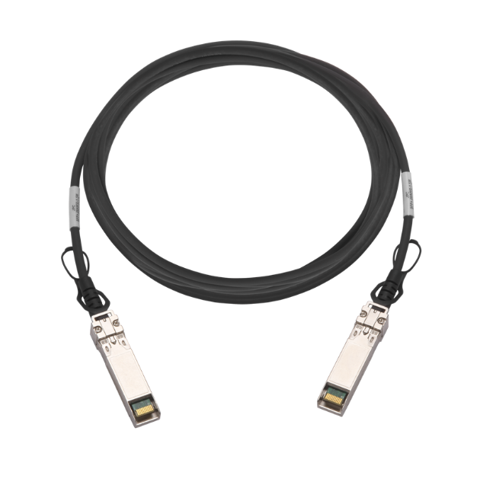
SFP, SFP+, SFP28, QSFP28 Transceivers and Optional Accessory CAB-DAC15M-QSFP28
The QXG-100G2SF-CX6 network expansion card can be used with high-speed network switches, and can be directly connected to 100GbE ports through two CAB-DAC15M-QSFP28 to create up to 200GbE network bandwidth
1 GbE
10 GbE
25 GbE
40 GbE
100 GbE
SFP
SFP+
SFP28
QSFP+
QSFP28
CAB-DAC15M-QSFP28
Notes:
We just mentioned that our connector is QSFP28. Then let’s talk about it additionally to briefly introduce different Transceivers for you. You can see that the rightmost is our QSFP28, which is the 100GbE transceiver. Looking to the left, you can see that there are corresponding transceiver for different network speeds, and the QXG-100G2SF-CX6 network expansion card can be used with high-speed network switches, and can be connected directly through two CAB-DAC15M-QSFP28. Connect 100GbE port to create up to 200G network bandwidth

Slide 16
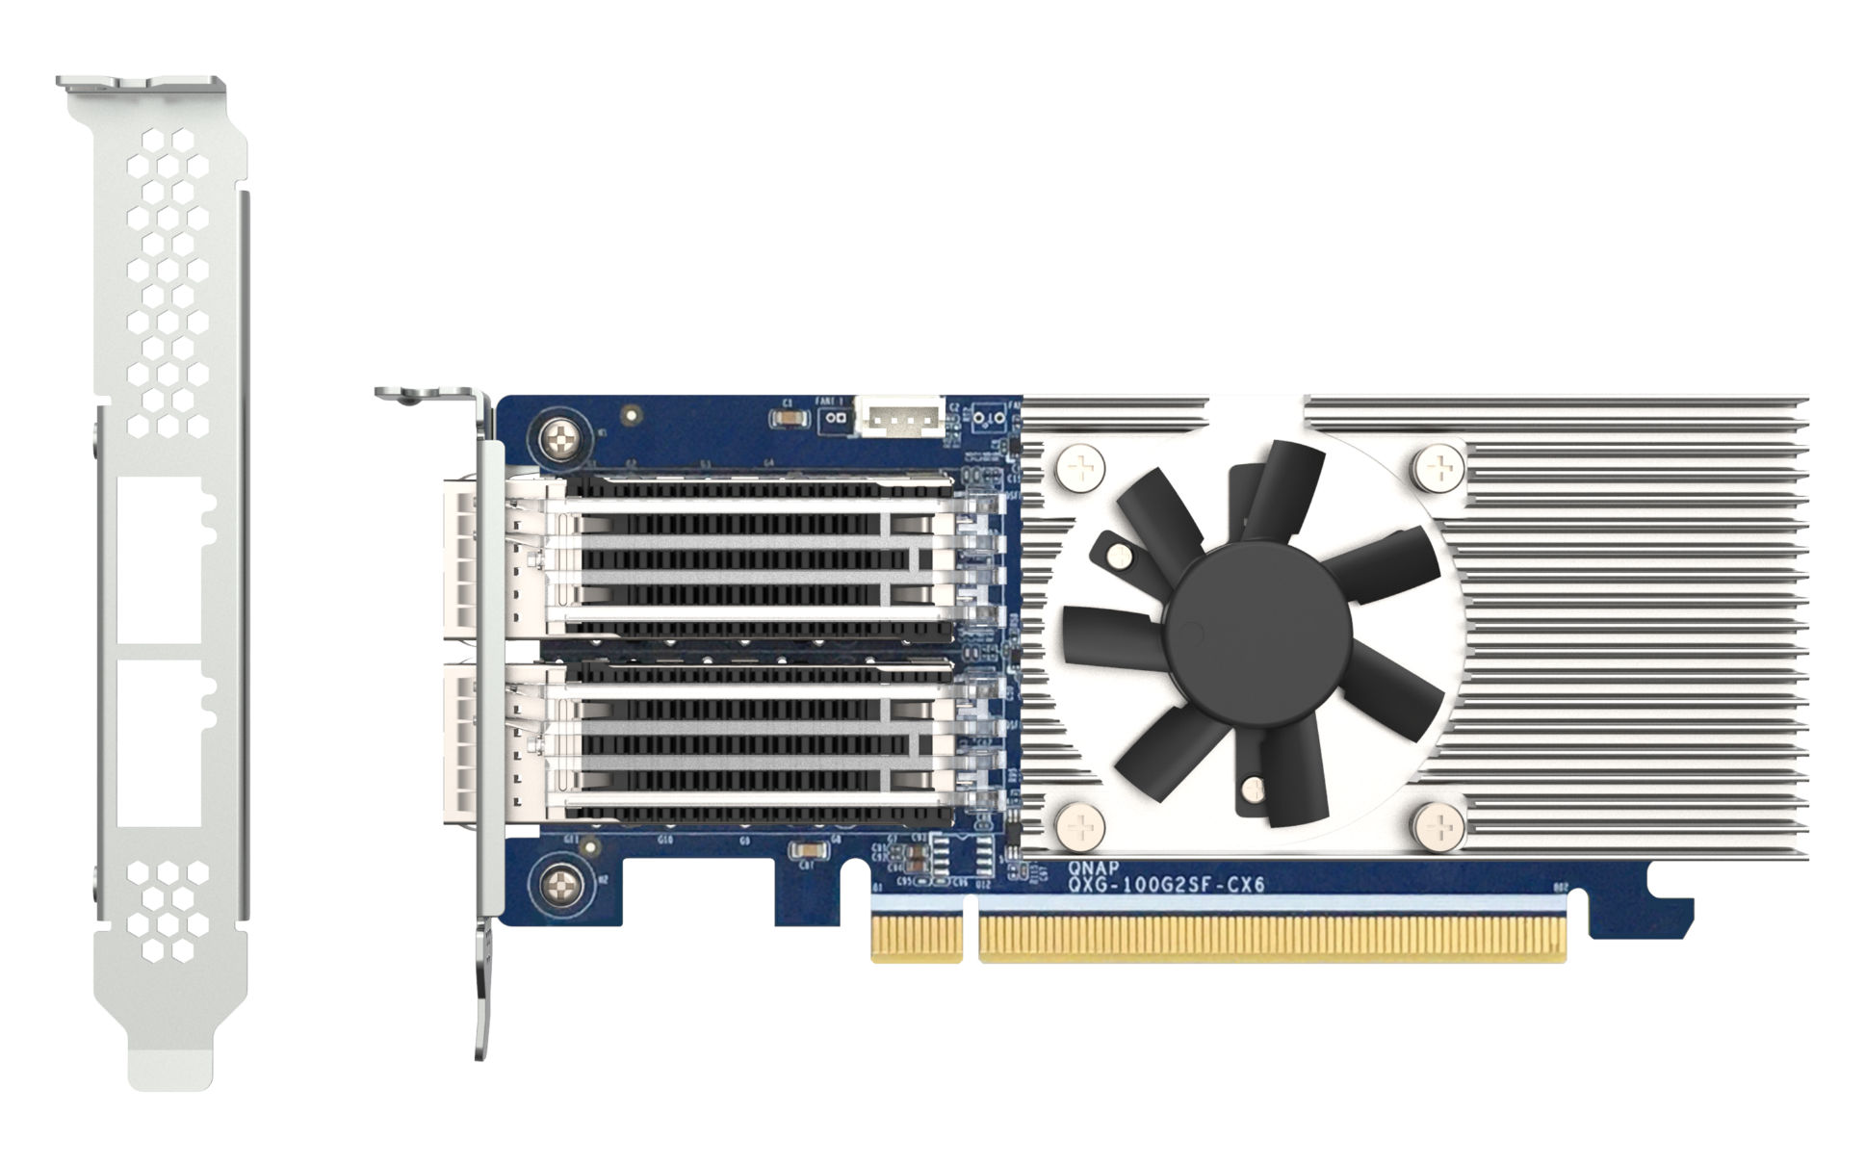
QXG-100G2SF-CX6 low-profile design for general chassis including full-height/low-profile brackets
Pre-installed low-profile bracket
158.8mm
Full-height bracket included
68.9mm
Notes:
The next thing is that our card also comes with a bracket. When it is shipped, a half-height bracket will be pre-installed, and a full-height bracket will be included in the package for everyone to replace, so that the chassis is full-height or full-height. It can be installed at half height, and can also be used with Low-profile design to fit most chassis, the length is 158.8mm, and the height is standard low profile 68.9mm

Slide 17
Supports SR-IOV for Improved Network Efficiency
Smart NIC SR-IOV
(Single Root I/O Virtualization)
VM
VM
VM
VF Driver
VF Driver
VF Driver
By installing an SR-IOV compatible PCIe SmartNIC, you can allocate bandwidth resources from a physical network card directly to VMs. With traffic bypassing the Hypervisor vSwitch, it helps enhance I/O throughout and network efficiency, ensuring reliable VM applications and reduced CPU overheads.
NAS OS
NIC
Virtual Function
Virtual Function
Virtual Function
1. SR-IOV is supported by specific QNAP NAS models and should work with SR-IOV compatible adapters.。https://www.qnap.com/en/software/virtualization-station 2. Both the NAS that installs the QXG-100G2SF-CX6 and the receiving-end devices must support RoCE. If the receiving devices do not support RoCE, it will use TCP/IP.
Virtual Ethernet Bridge + Classifier
Notes:
QXG-100G2SF-CX6, also support SR-IOV (Single Root I/O Virtualization), can directly allocate the bandwidth resources of the physical network card to the virtual machine, greatly reduce the CPU load of the hypervisor, reduce the consumption of network bandwidth, and improve the network performance. Road efficiency and stability.
However, only certain NAS models support SR-IOV technology and need to be equipped with a network card that supports SR-IOV. It can be viewed from the following URL https://www.qnap.com/zh-tw/software/virtualization-station
2. Both the NAS on which the QXG-100G2SF-CX6 is installed and the receiver device must support the RoCE protocol. If the receiver does not support it, it will return to TCP/IP transmission.

Slide 18
Supports RoCE for Reduced Latency and Enhanced Performance for VM Environments
The QXG-100G2SF-CX6 supports RoCE, which can access a network directly in RAM to effectively reduce latency and enhance performance and efficiency for VMware® virtualization environments.
Without RoCE
Memory
Ethernet
Ethernet
Memory
Socket Layer and Network Drivers
Socket Layer and Network Drivers
With RoCE
Memory
Socket Layer and Network Drivers
Socket Layer and Network Drivers
Memory
Ethernet
Ethernet
Notes:
The QXG-100G2SF-CX6 supports RoCE, which can access a network directly in RAM to effectively reduce latency and enhance performance and efficiency for VMware® virtualization environments.

Slide 19
Supports iSER for Improved VM Performance
The QXG-100G2SF-CX6 supports iSER, combining iSCSI and RDMA (Remote Direct Memory Access), which can bypass general network drivers, the socket layer, and to directly enter memory buffers of the server and storage. Response time is also reduced to ensure service quality of the NAS.
Without iSER
Memory
Ethernet
Ethernet
Memory
Socket Layer and Network Drivers
Socket Layer and Network Drivers
With iSER
Memory
Socket Layer and Network Drivers
Socket Layer and Network Drivers
Memory
Ethernet
Ethernet
Notes:
The QXG-100G2SF-CX6 supports iSER, combining iSCSI and RDMA (Remote Direct Memory Access), which can bypass general network drivers, the socket layer, and to directly enter memory buffers of the server and storage. Response time is also reduced to ensure service quality of the NAS.

Slide 20
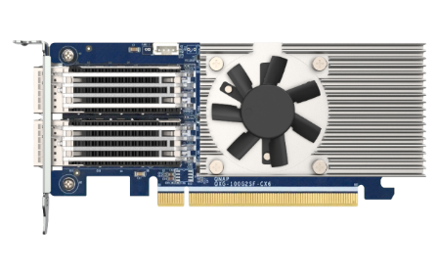
QXG-100G2SF-CX6 Supports nearly 200 Gbps of total bandwidth
QXG-100G2SF-E810
1 x 100GbE iPerf Test
QXG-100G2SF-CX6
2 x 100GbE RDMA Performance
23,367 MB/s
23,380 MB/s
11,905 MB/s
11,894 MB/s
Environment : NAS | TS-h2490FU-7232P-64GB with QXG-100G2SF-E810
Client PC | OS: Ubuntu 20.04 , CPU: Xeon Scalable ,RAM: 64GB
NIC: QXG-100G2SF-E810, MTU 9000
Environment : NAS | 2 TDS-h2489FU Intel Xeon 4300 series connect each other
NIC: QXG-100G2SF-CX6, MTU 9000
Notes:
QXG-100G2SF-CX6 can create a total bandwidth of nearly 200 Gbps for you. Compared with the previous QXG-100G2SF-E810, we actual use two TDS-h2489FU equipped with Intel Xeon 4300 series , can provide read and write up to each The bandwidth of 23,300 MB per second under RDMA performance test, creates an efficient transmission experience for you, and I will also Demo for you later

Slide 21
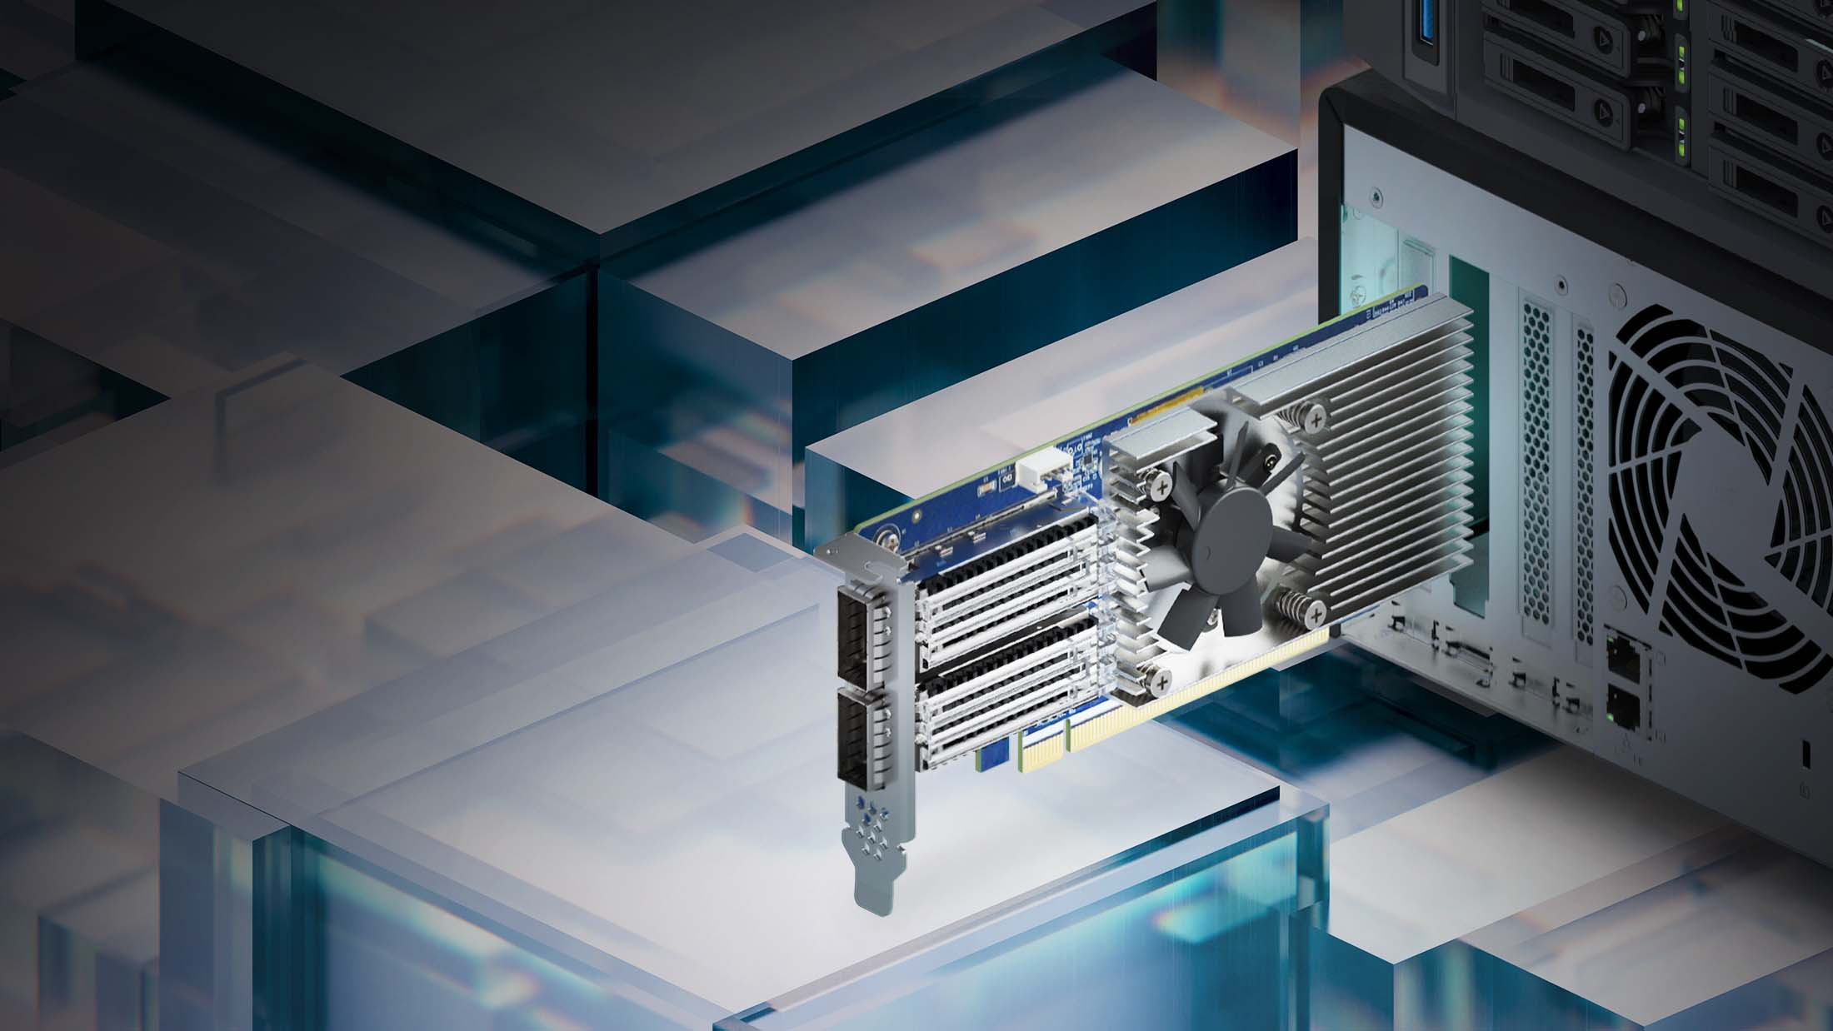
Notes:
I will do a Demo based on the performance of this card. Here, two TDS-h2489FUs are used, and QXG-100G2SF-CX6 is installed to perform dual ports and read-write bidirectional transmission to test the performance of iperf.

Slide 22
QXG-100G2SF-CX6 with greatly improved network bandwidth
 | QXG-100G2SF-CX6 | QXG-100G2SF-E810
Ethernet controller | Mellanox CX-6 Dx | Intel E810-CAM2
SerDes | 50Gb/s(PAM4) ; 25/10Gb/s (NRZ) | 50Gb/s (PAM4) ; 25Gb/s(NRZ)
Total throughput | 200G | 100G
Port speed | 100Gbps | 100Gbps
Connector | QSFP28 | QSFP28
Port split | Not supported | 4 x 25GbE or 8 x 10GbE
Port count | 2 x QSFP28
Feature | RDMA, RoCE v1/v2, SR-IOV(1K VFs & 8 PFs), iSER | iWARP/RDMA ,RoCE v2, iSER, SR-IOV (256VFs & 8PFs)
PCIe | PCIe Gen4 x16 (Compatible with Gen3 with limited bandwidth)
Support OS (QNAP) | QTS 5.0.0 and later QuTS hero h5.0.0 and later | QTS, QuTS hero
Support OS (3rd party) | Windows Server 2016 / 2019 , Linux | Windows Server 2016 / 2019 , Linux
Warranty | 2 years | 2 years
Notes:
On this page, we will also take a detailed look at the specifications, and also compare with the previous QXG-100G2SF-E810 network card
for network controller, QXG-100G2SF-cx6 is equipped with Nvdia Mellanox CX6 - DX, and DX is also specially designed for Datacenter in this series
In SerDes, the CX6 supports PAM4 at 50Gb/s and NRZ at 25 and 10Gb/s,
Connector is QSFP28, providing two ports with a total bandwidth of 200GbE. It also supports RDMA, RoCE v1/v2, SR-IOV (1K VFs & 8 PFs), iSER, and SRioV can support 1K VF, which greatly improves Virtualization applications,
as for the part of the operating system that supports QTS 5.0.0 or above or QUTS hero 5.0.0 or above, it is recommended to update to the latest here
Third-party operating systems are also available for various platforms such as Windows server 2016 / 2019 and Linux

Slide 23
Copyright© 2022 QNAP Systems, Inc. All rights reserved. QNAP® and other names of QNAP Products are proprietary marks or registered trademarks of QNAP Systems, Inc. Other products and company names mentioned herein are trademarks of their respective holders.​​​

