Slide 1
Notes:
Software define routing with 10GbE/2.5GbE high speed SD-WAN/Multiple VPN router

Slide 2
QHora-321/322 is a router can bring you
Less default setting for limited the deployment
Fully user defined WAN/LAN and multiple ports binding, let router fit your network requirement
Multiple VPN deployment
Higher port speed gives you much efficiency to data transparent
The basic port speed is 2.5GbE, and up to 10GbE to QHora-322

Slide 3
Evolution for user experience improvement on QuRouter

Slide 4
Flexible and straight forward QuRouter
Integrate relate configuration into same function page
Check status and interface configuration at same page
Include the design concept of switch
Increasing more possibility for software define routing

Slide 5
Diverse used scenarios

Slide 6
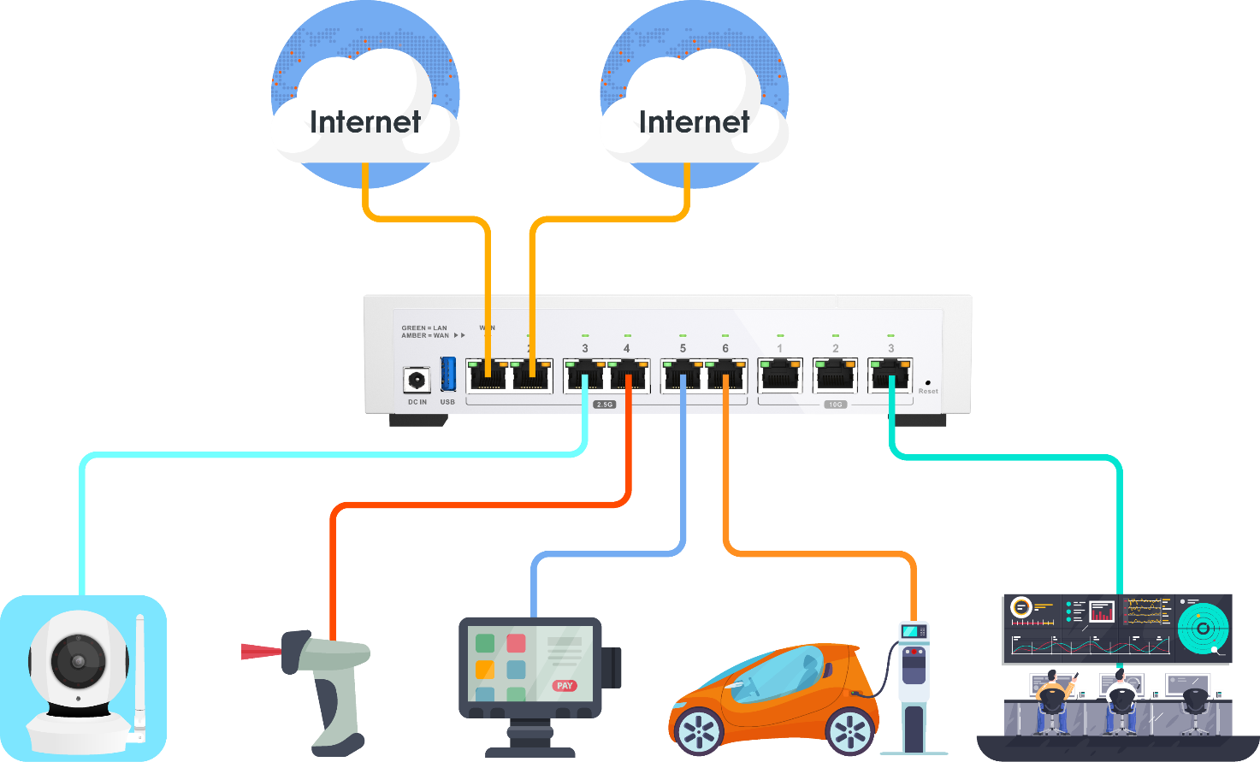
IoT – edge devices separate in difference networks and independent to each other
ISP 1 with 60Mbps for master
ISP 2 with 20Mbps for backup
Less edge devices can connect to router directly
It do have difference purpose for each devices, which means need independent network for each IoT device
Totally independent network which means no VLAN or Bridge setting request
IP Cam
192.168.1.100
Bar code scanner
192.168.10.150
PoS
192.168.30.130
Charging pile
192.168.111.50
Monitor device
192.168.200.100

Slide 7
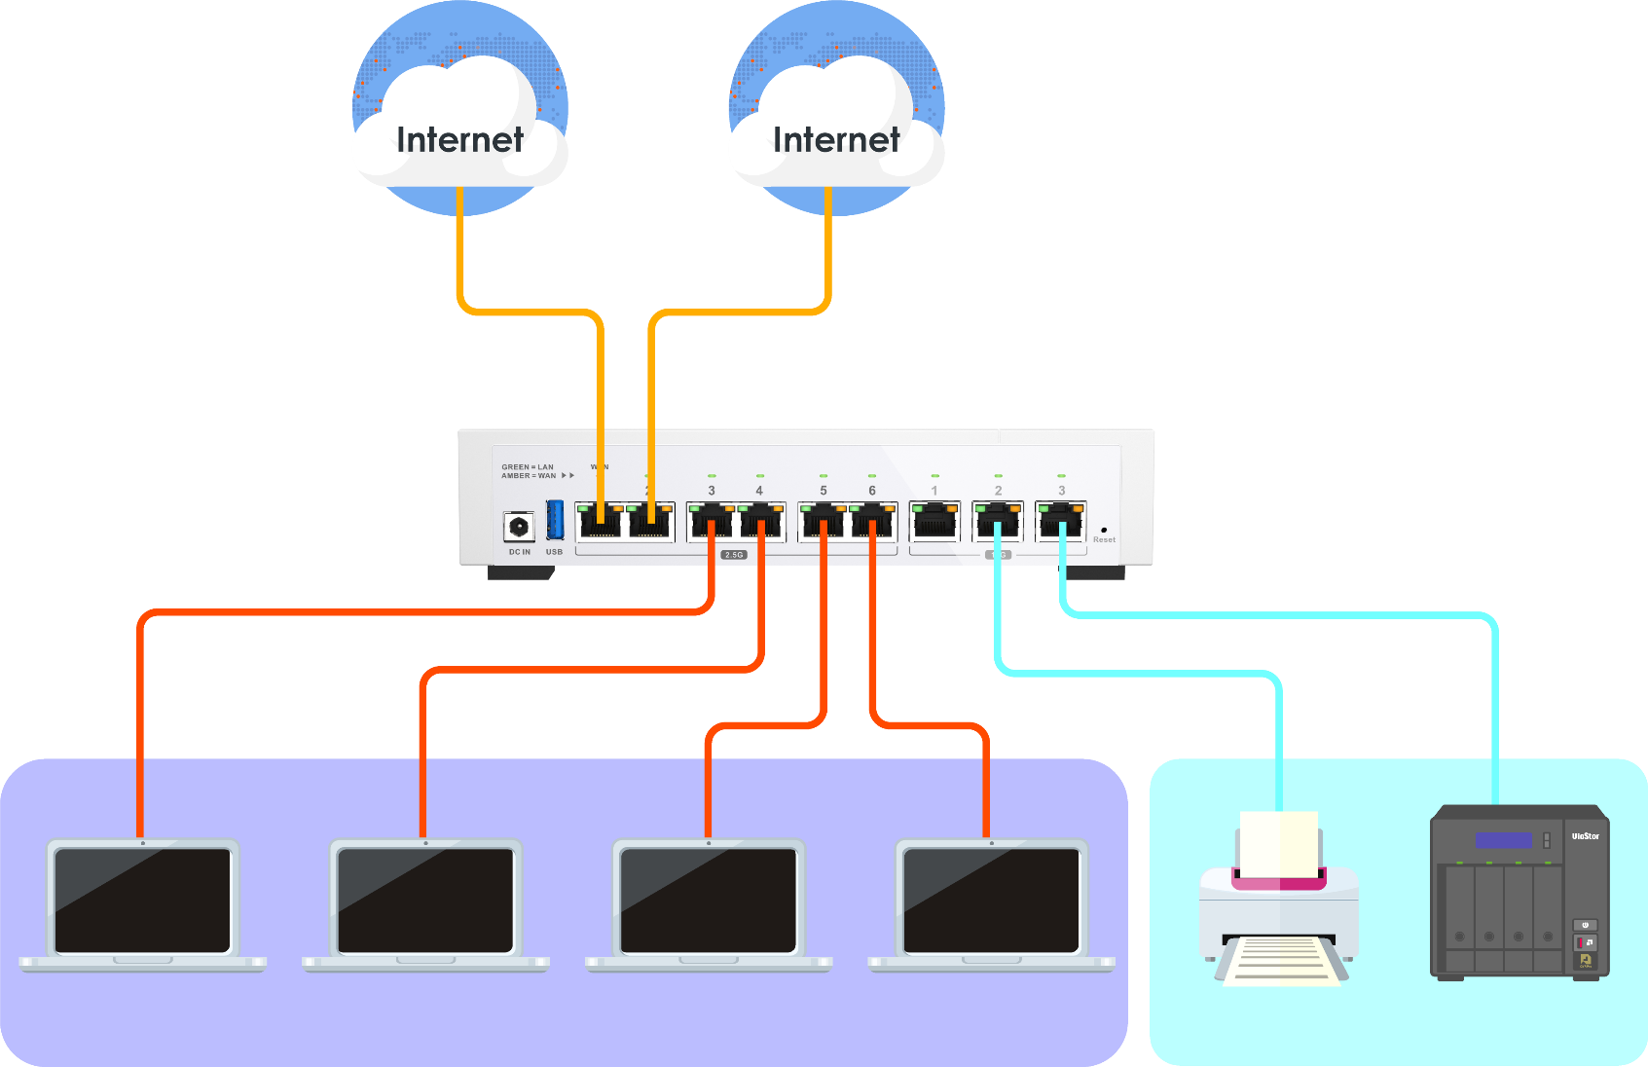
SOHO/SB – few edge devices in same subnet, no additional switch and AP request
ISP 1 with 60Mbps for master
ISP 2 with 20Mbps for backup
There are not so much edge devices, which means can connect to router directly
Need to parallel multiple physical interfaces for assigning same subnet network
It needs dual WAN for back up usage
192.168.1.10
192.168.1.20
192.168.1.30
192.168.1.40
192.168.2.150
192.168.2.160
Employee network
Office device
Employee network: 192.168.1.x Office device network: 192.168.2.x

Slide 8
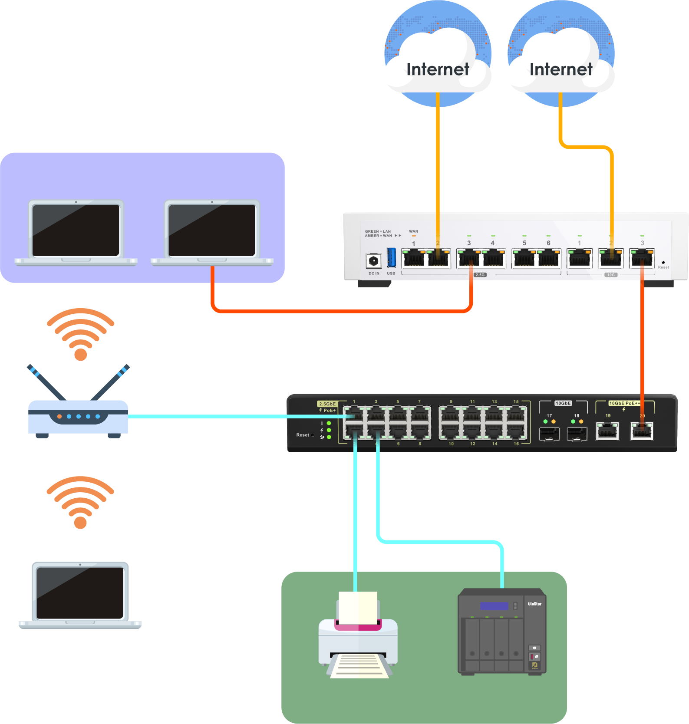
SB – Employee and guest network, need to be independent and wireless requirement
Backbone network to building
ISP with 10Mbps
Employee network
192.168.120.110
192.168.120.120
Using VLAN for separating different network
For AP deploy to give guest network, which means further PoE switch is needed
Dual WAN deployment is needed for load balance and backup
PVID 20
tag 10 tag 20 tag 30
Employee SSID
PVID 20
tag 20 tag 30
PVID 30
Guest SSID
192.168.130.100
Office device
Office device VLAN 10: 192.168.110.x
Employee network VLAN20: 192.168.120.x
Guest network VLAN30: 192.168.130.x
Guest network
192.168.110.10
192.168.11020

Slide 9
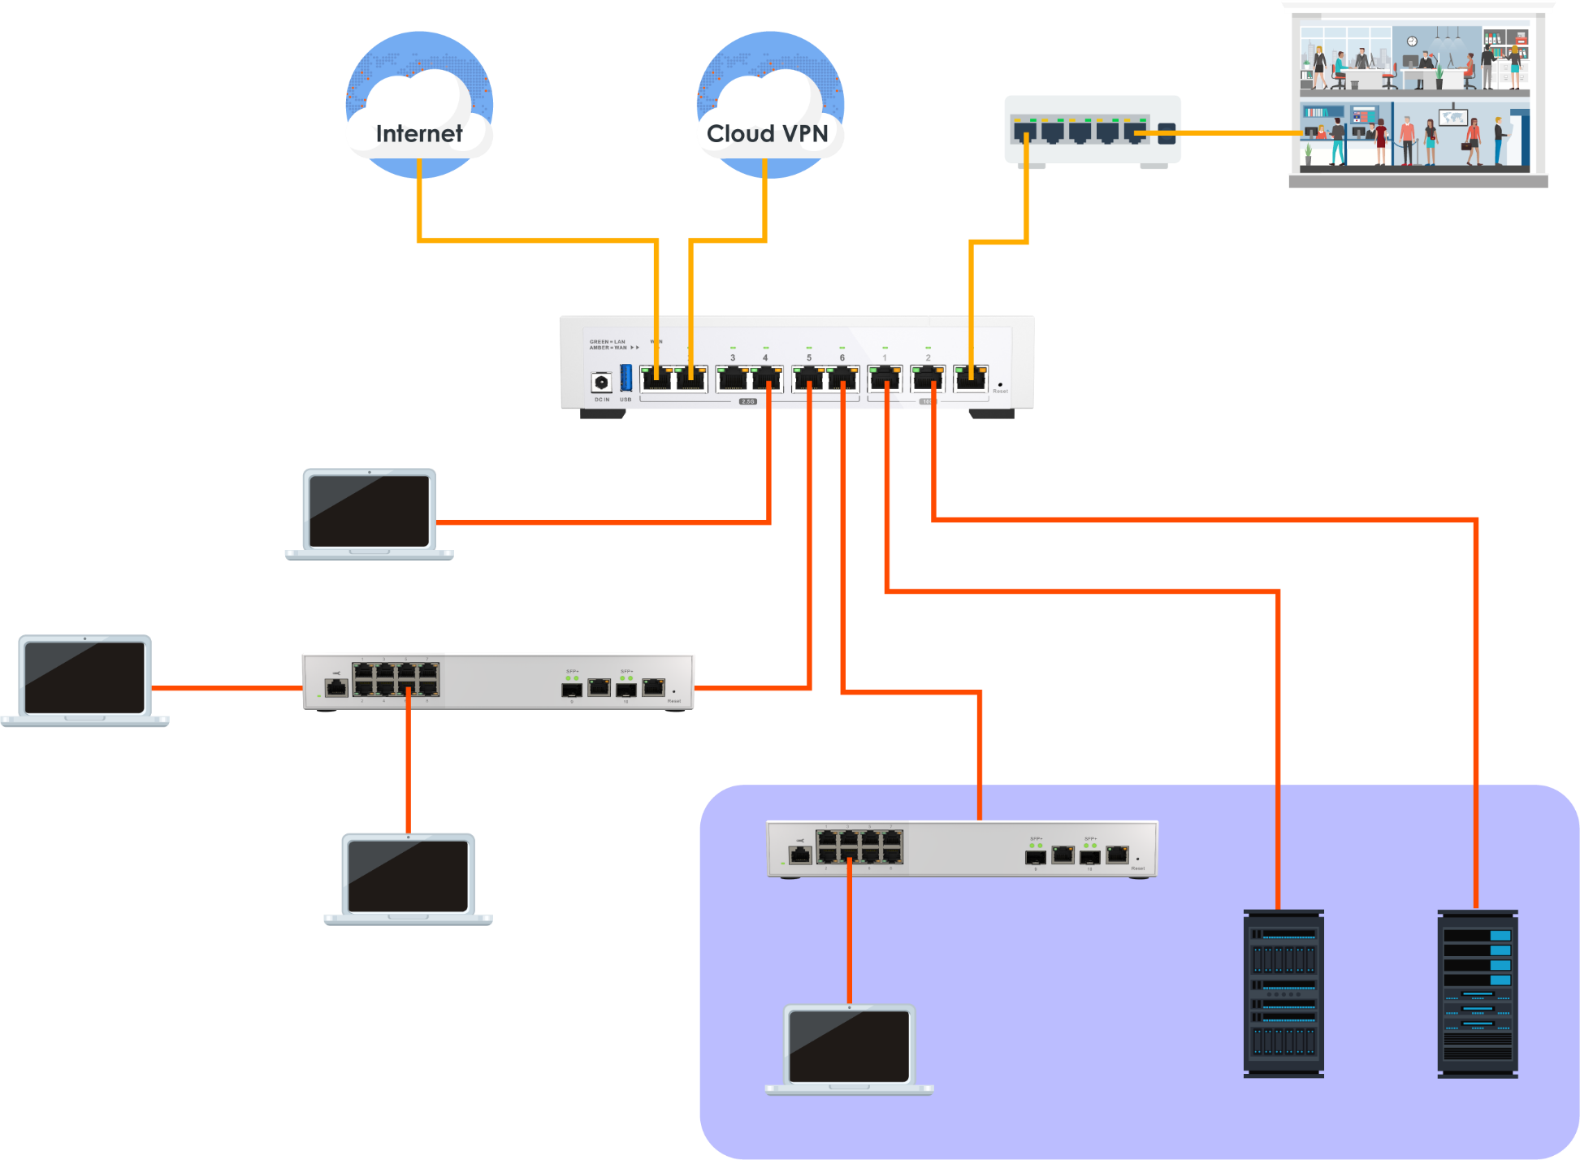
ISP1
ISP2+VPN
SMB/MB – Networking between HQ and branch office
HQ
tag 40
It do have connect/load share/backup requirement between HQ and branch office
Multiple VLANs deployment need also consider about the network at HQ
Need to manage the routing for specific service usage
PVID 40
PVID 10
192.168.140.100
PVID 10
PVID 30
tag 20
tag 30
tag 10
192.168.130.20-23
PVID 20
PM department
192.168.120.30-33
PVID 10
Sales department
Develop department VLAN10: 192.168.110.x Sales department VLAN20: 192.168.120.x
PM department VLAN30: 192.168.130.x
IT department VLAN40: 192.168.140.x
192.168.110.40-45
192.168.110.10
192.168.110.20
Develop department

Slide 10
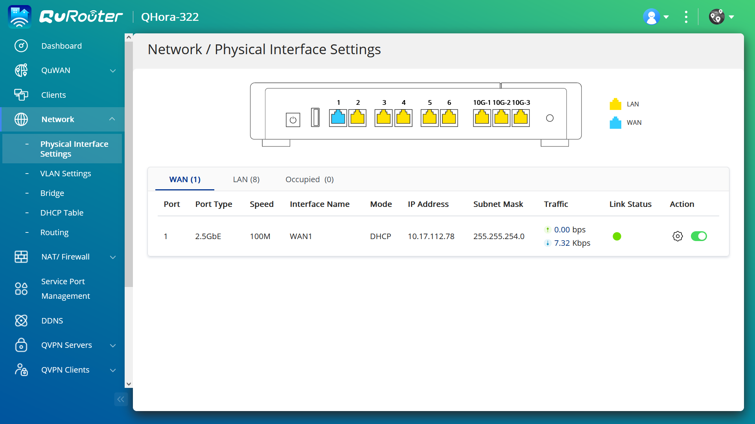
Interface introduction

Slide 11
Physical interface settings-Dashboard

Slide 12
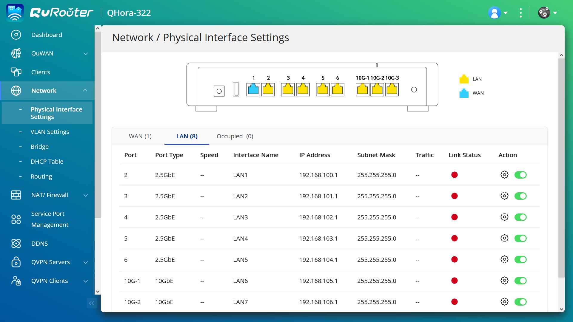
Physical interface
settings-Dashboard(con’t)

Slide 13
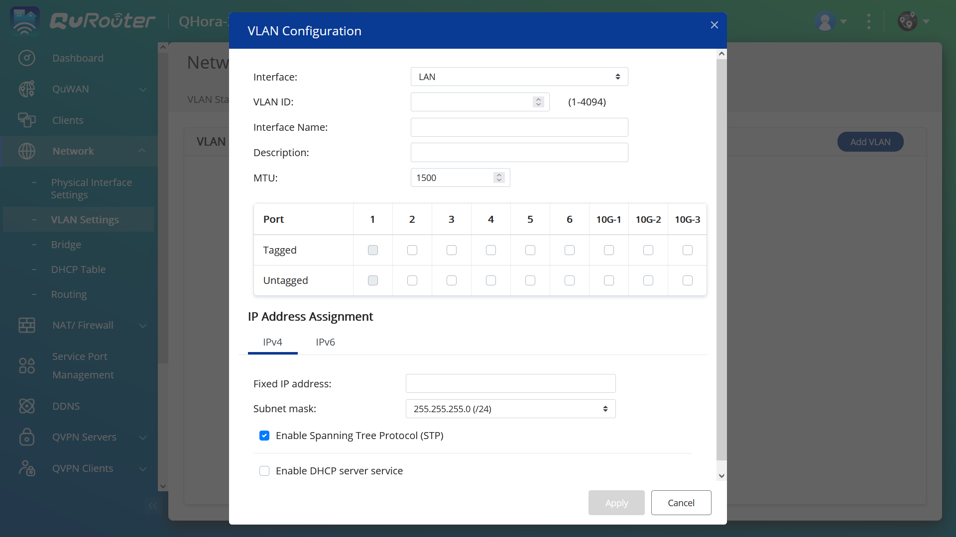
VLAN setting dashboard

Slide 14
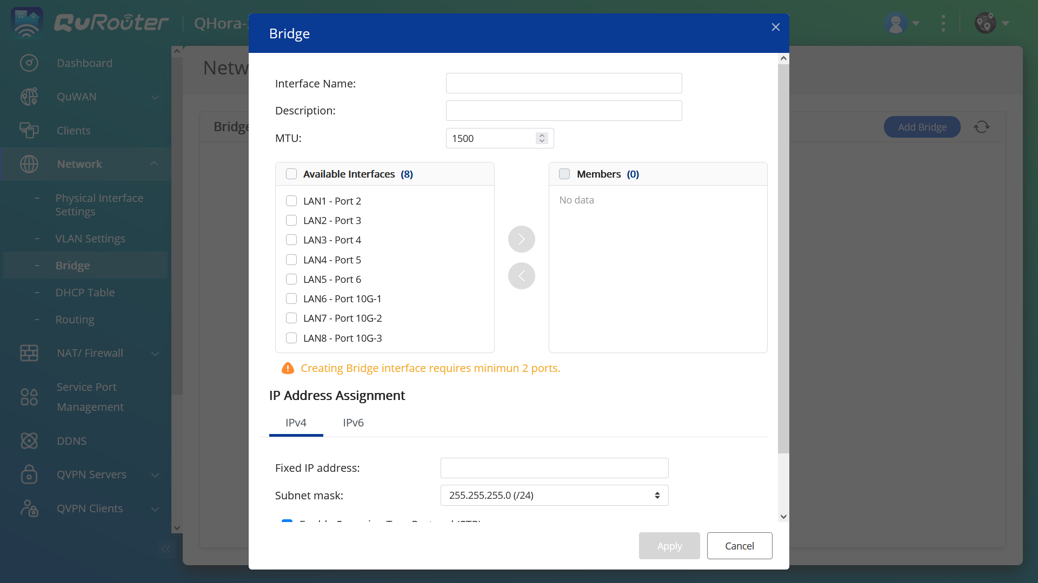
Bridge setting dashboard

Slide 15
QuWAN makes multiple sites connection much easy

Slide 16
It is an important topic for SMB, Chain stores to make secure connections between each other
SMB
Chain store
1 or 2 offices need communicate as a office intranet
It has a high-speed NAS storage data in the office
Remote access requirement for employees for connecting back to office network, and need consider about security of connection
Need also think about how to let employees who WFH can easily access office network
Multiple stores and need make sure the connection with HQ is always working, security is also a topic
Less high networking performance needed, usually it only need make sure POS can connect with HQ, do data sync and backup
It is important to have central management with multiple devices
To deploy a higher-level device in HQ is required
It may setup a store become a hub for region, help for load sharing to HQ

Slide 17
QHora-321/322 enrich the QNAP QuWAN router series
Multiple SD-WAN high speed router deployment
Single SD-WAN high speed router deployment
QHora-321 6 x 2.5GbE RJ45 + QuWAN solution
QHora-322 3 x 10GbE + 6 x 2.5GbERJ45 +
QuWAN solution
SD-WAN high speed WiFi 6 deployment
QHora-301W 2 x 10GbE + 4 x 1GbE RJ45 +
QuWAN solution

Slide 18
What requirements are going to need for SMB deployment?
Secure network connection is needed for communication, no matter the access back to office from outside, or inside between each office network
Office devices have upgraded their network speed, it must have corresponded router to handle it
WFH employees
Office1
Office2
Field sales
Secure connection
Secure connection
Secure connection

Slide 19
What is going to change once
QHora-321/322 join to SMB network?
QuWAN can provide auto VPN connection between each office
QVPN can help to extend to requirement of WFH or remote access needed
WFH employees
Office1
Office2
Field sales
QHora-322
QHora-301W
QVPN
QVPN
2.5GbE
10GbE
10GbE
2.5GbE
2.5GbE

Slide 20
Different QuWAN relate products make more possibility for SMB deployment
With QHora-301W/QMiro-201W can provide additional WiFi connection
Can build up QuWAN mesh connections because they are all belong to QuWAN support products
WFH employees
Office1
Office2
Field sales
QMiro-201W
QHora-322
QHora-301W
QVPN
WiFi
2.5GbE
10GbE
10GbE
WiFi
10GbE

Slide 21
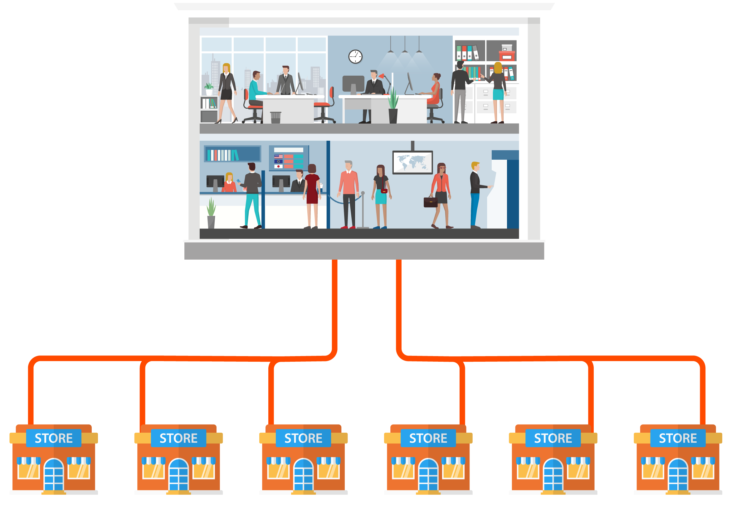
What requirements are going to need for Chain stores deployment?
Secure connection connect back to HQ is necessary for each store
Massive deployment
HQ
Secure connection

Slide 22
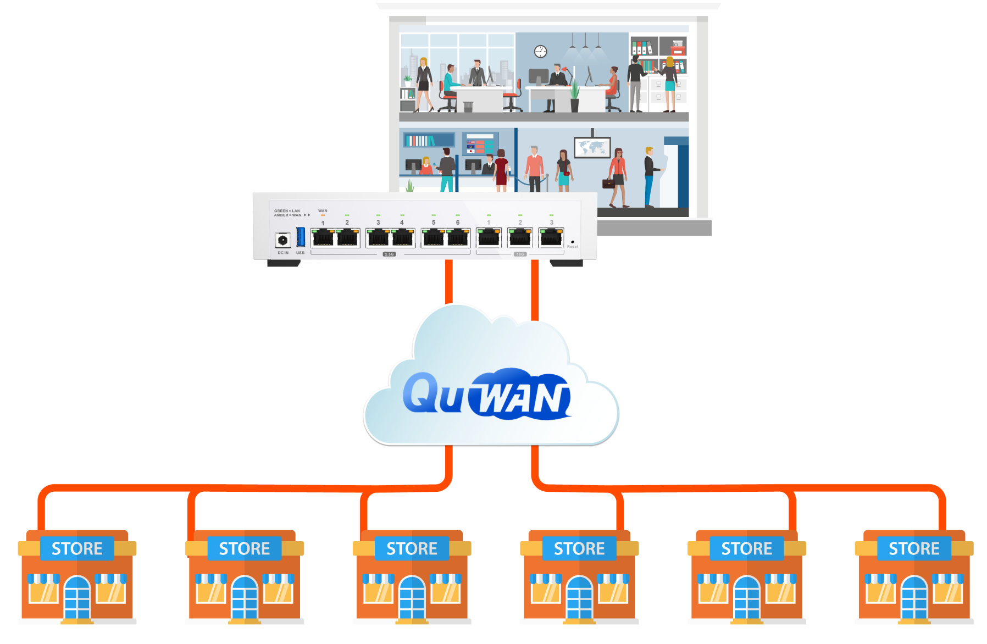
What is going to change once QHora-321/322 join to Chain stores network?
QuWAN can make network between HQ and store become a secure and encrypt intranet
Can manage all QuWAN devices from cloud
HQ
QHora-322

Slide 23
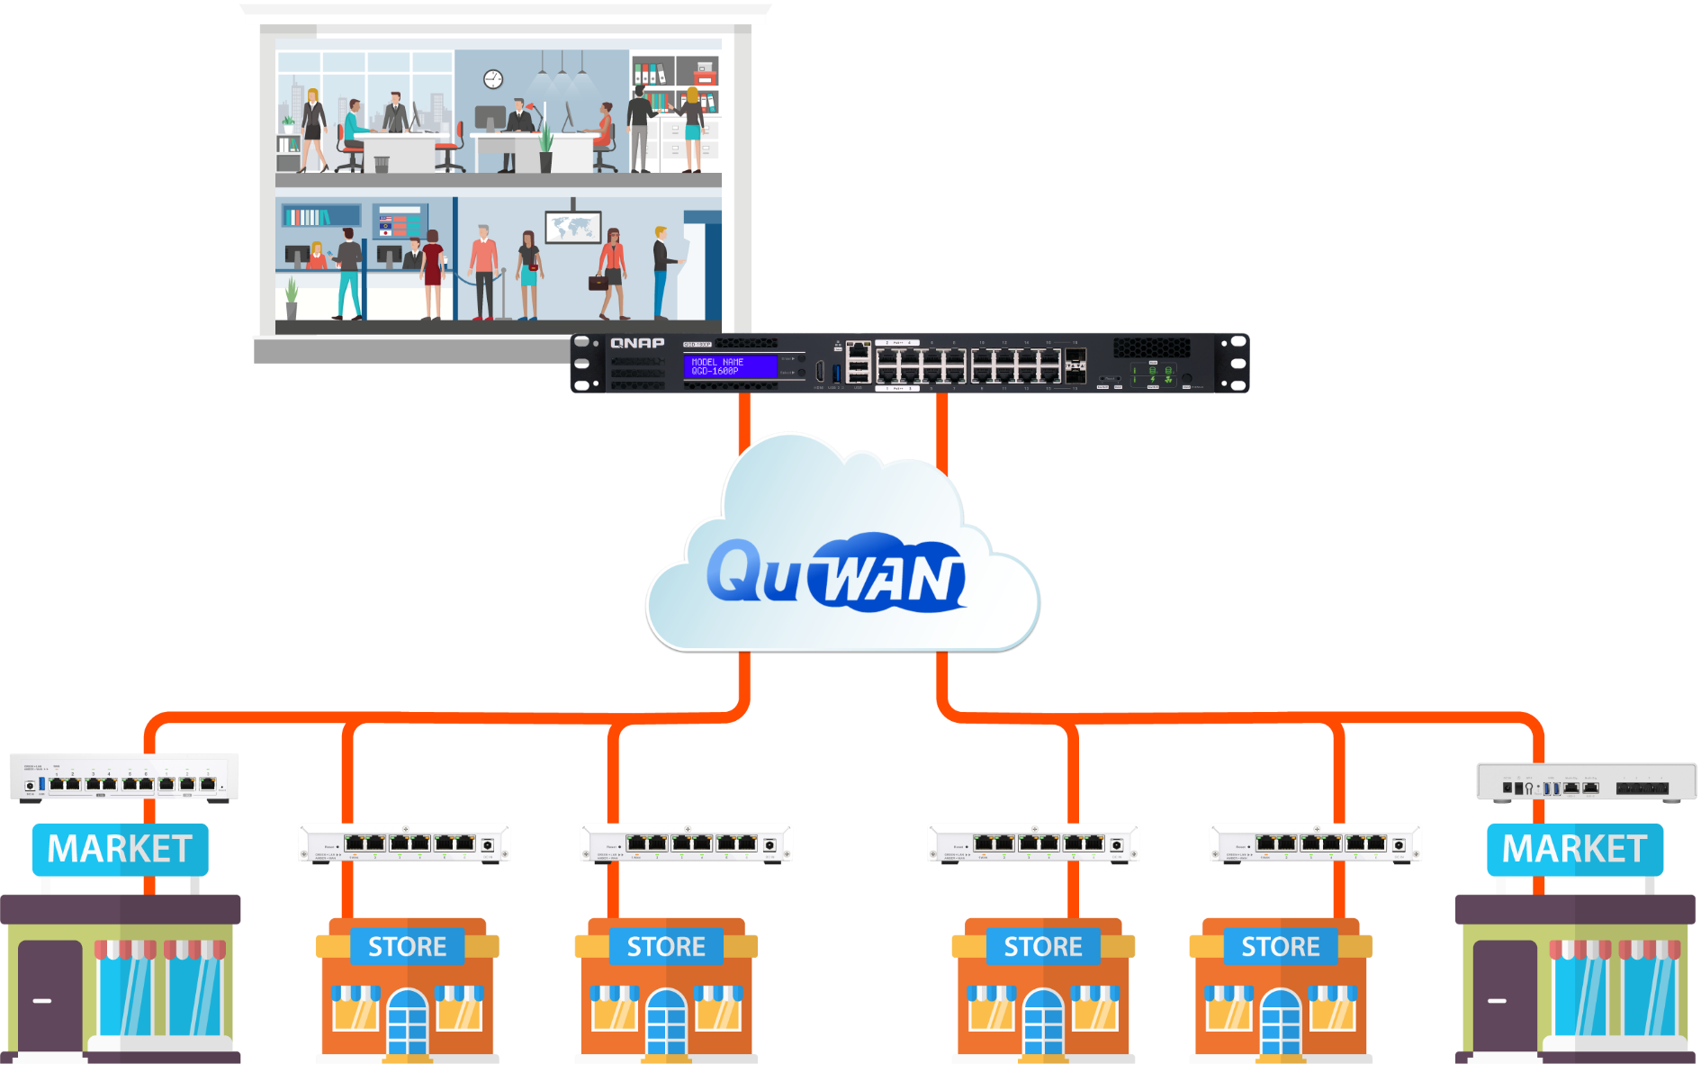
Can have different deployment for specific deployment to dedicate store by using QuWAN relate products
It can choose using QHora-322 for larger store
It can choose QHora-301W for the store need WiFi deployment
It can deploy high-end device at HQ to providing much powerful process
HQ
QGD-1600P
QHora-322
QHora-301W
QHora-321
QHora-321
QHora-321
QHora-321
Dist large store
Store with WiFi service

Slide 24
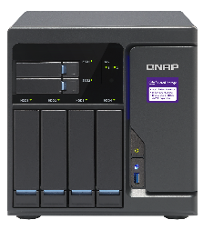
It makes QuWAN more possibility now because QHora-321/322 become part of it
SMB/SB Router
QHora-321
Home WiFi mesh router
QuWAN vRouter
QHora-322
QHora-301W
QMiroPlus-201W
QMiro-201W
QNAP Products support QuWAN
QNAP NAS series
QNAP QGD smart switch series
QNAP QuCPE Virtualization Equipment

Slide 25
Massive VPNs

Slide 26
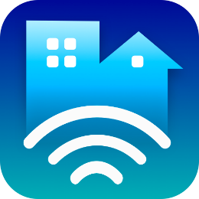
QHora-321/322 improve the number of VPN tunnel up to enterprise level
 | QHora-321 | QHora-322
Tunnels of Qbelt | 700 | 1000
Support massive user account generate on QuWAN | V | V
QVPN

Slide 27
HW SPEC

Slide 28
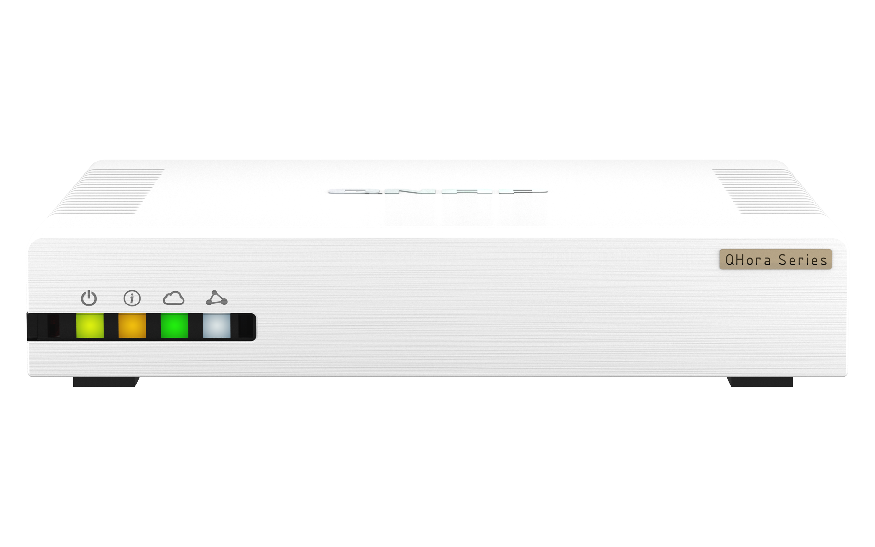
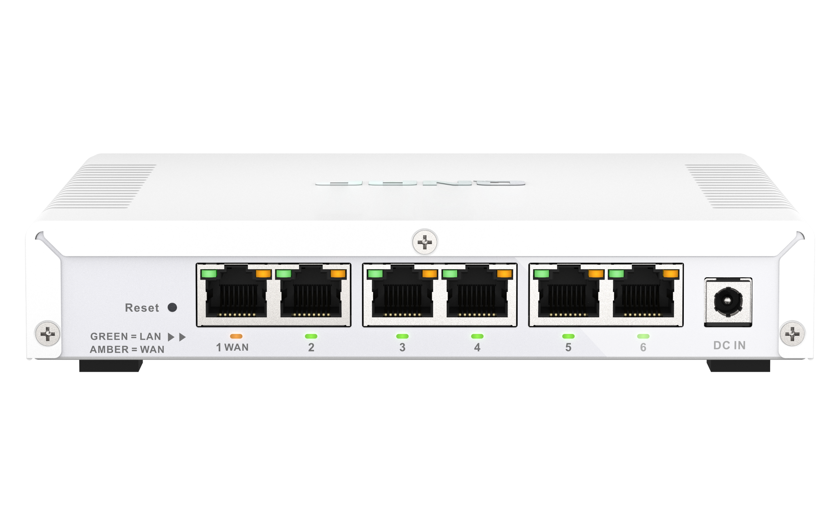
QHora-321 panel
6x2.5 GbE RJ45

Slide 29
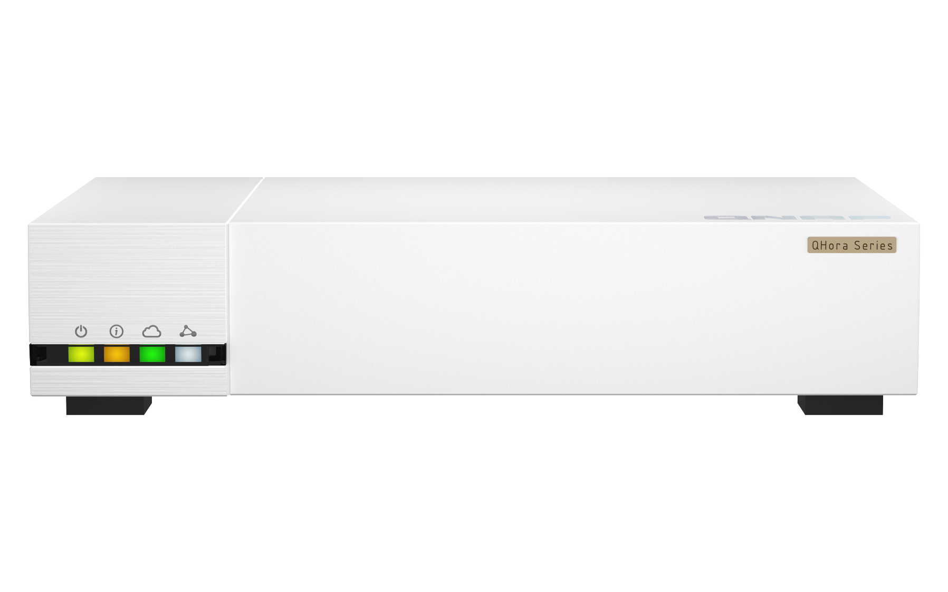
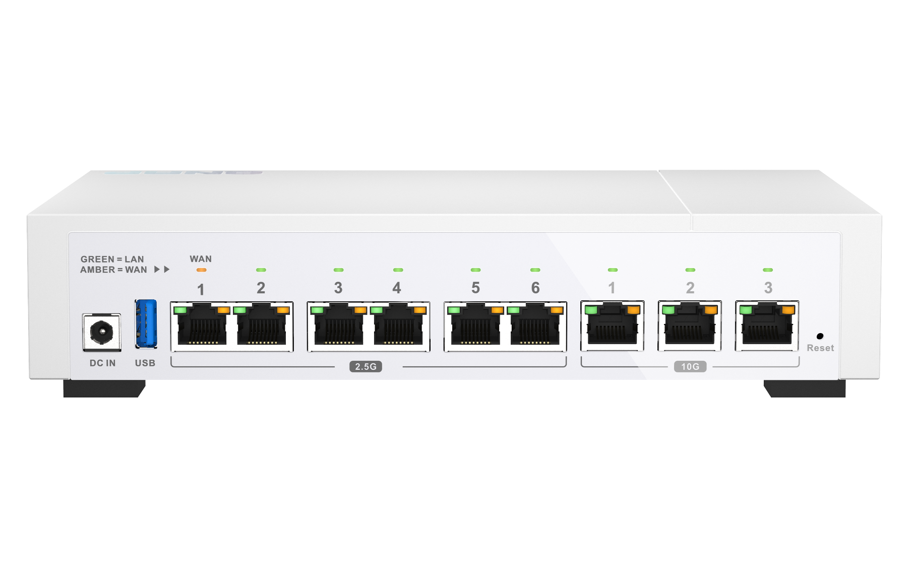
QHora-322 panel
6x2.5GbE RJ45
3x10GbE RJ45

Slide 30
LED-Front panel device status
Location | Status | Icon | Description
First from the left (Yellow green) | Device power status |  | Off: Power OFF Steady: Power ON Keep blinking with Device status LED in 1sec on/off period: System Error
Second from the left (Amber) | Device local status |  | Off: Device is power off Steady: Device is booted up and initialized success Keep blinking with 1sec on/off period: Device is initializing Keep blinking with 2sec on/off period: Device is being firmware updating Keep blinking with Power LED with 1sec on/off period: System Error
Third from the left (Blue green) | Device connection status with QuWAN Orchestrator |  | Steady: Connected to QuWAN Orchestrator and can be managed. Keep blinking with 0.5sec on/off period: Device is joining to QuWAN Orchestrator. Keep blinking with 2sec on/off period: Lost connection to the QuWAN Orchestrator (Device joined to QuWAN before but lost connection now) Off: Did not join to QuWAN Orchestrator .
White from the left (White) | Device auto mesh connection status |  | Steady: All QuWAN mesh VPN tunnels on this device are connected Keep blinking with 2sec on/off period: All/ Partially of QuWAN mesh VPN tunnels on this device disconnected Off: Did not join to QuWAN Orchestrator.

Slide 31
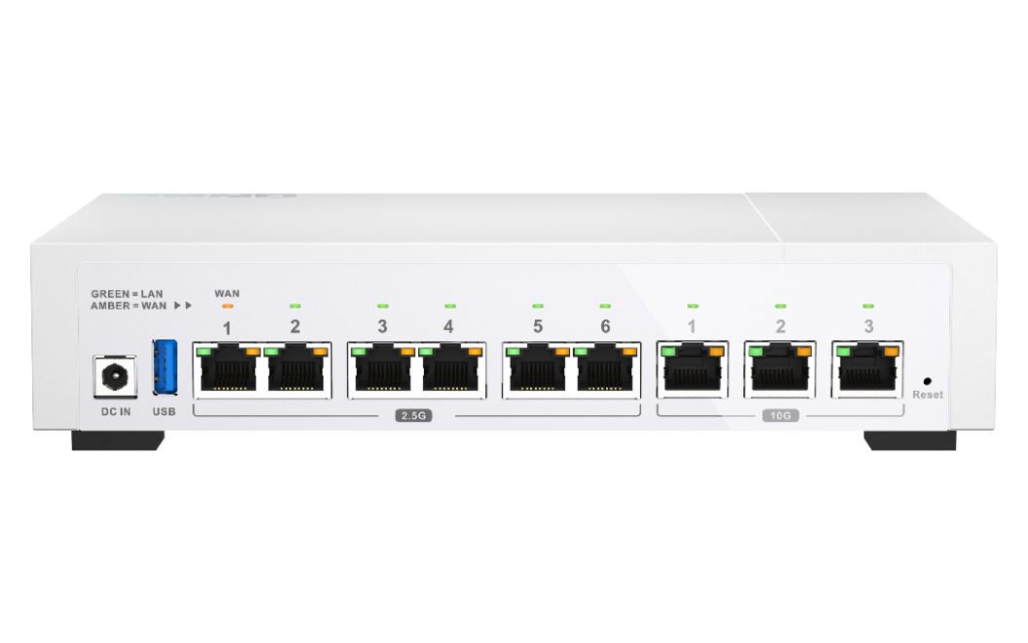
LED-Interface indicator and port status
Interface indicator
Port Role | Color of LED
WAN | Amber
LAN | Green
QHora-321 RJ45 port LED behavior
Port number | Port speed | LED color | Behavior
1-6 | 2.5GbE | Green(Left) | Link is operating at 2.5 Gbps, flashing: link up, off: no link
 |  | Amber(Right) | Link is operating at 1G/100M bps, flashing: link up, off: no link
QHora-322 RJ45 port LED behavior
Port number | Port speed | LED color | Behavior
2.5GbE 1-6 | 2.5GbE | Green(Left) | Link is operating at 2.5 Gbps, flashing: link up, off: no link
 |  | Amber(Right) | Link is operating at 1G/100M bps, flashing: link up, off: no link
10GbE 1-3 | 10GbE | Green(Left) | Link is operating at 10 Gbps, flashing: link up, off: no link
 |  | Amber(Right) | Link is operating at 5G/1G/100M bps, flashing: link up, off: no link

Slide 32
QHora selection guide

Slide 33
Which QHora is suitable for my deployment?
 | QHora-301W | QHora-321 | QHora-322
10GbE RJ45 port | 2 | - | 3
2.5GbE RJ45 port | - | 6 | 6
WiFi 6 | Y | - | -
QuWAN | Y | Y | Y
QuWAN QVPN support | Y | Y | Y
Max QBelt VPN connections | 30 | 700 | 1000
Max performance of QBelt VPN* | 116Mbps | 160Mbps | 160Mbps
Suggest scenario | Multiple sites with SD-WAN deploy request High speed NAS with 10GbE connection request High speed Wifi connection | Multiple sites with SD-WAN deploy request Multiple VPN clients connections request | Multiple sites with SD-WAN deploy request Multiple VPN clients connections request High speed NAS with 10GbE connection request
Note: based on the lab test with iperf, the result may be different based on real network deploy at your place.

Slide 34
Copyright© 2022 QNAP Systems, Inc. All rights reserved. QNAP® and other names of QNAP Products are proprietary marks or registered trademarks of QNAP Systems, Inc. Other products and company names mentioned herein are trademarks of their respective holders.​​​​​​​
Notes:
Software define routing with 10GbE/2.5GbE high speed SD-WAN/Multiple VPN router

