Slide 2
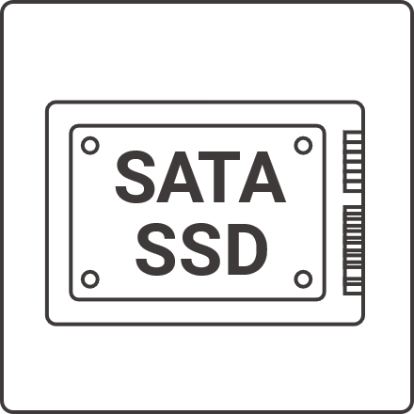
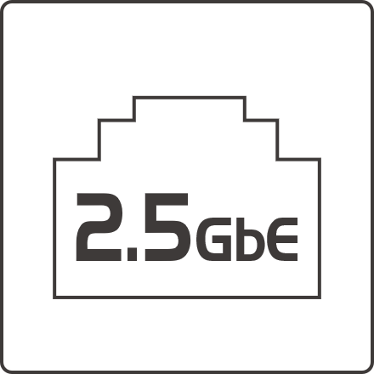
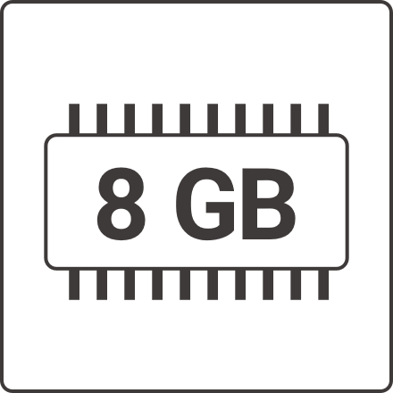
Main Features of TS-410E 2.5-inch SATA SSD silent NAS
2.5-inch SATA SSD
Dual 2.5 GbE network ports
It supports four 2.5-inch SATA SSD slots, providing sufficient data capacity
2.5 GbE network bandwidth for smooth data transfer experience
Fanless, silent design
4K HDMI
Easy to install and use NAS in sound-sensitive environments
Provides one HDMI output for monitoring or as a PC screen
Quad-core processor
Built-in 8GB memory
High-efficiency Intel Celeron J6412 4-core burst 2.6Hz processor fully supports various applications of NAS workstations
Sufficient memory makes NAS applications more flexible
12吋短機箱可支援市面上大部分的機櫃
內建2埠M.2(PCIe Gen 3 x1)，可提供SSD快取，加速隨機存取的速度
PCIe Gen 3 x 8插槽，提供各式應用的高速擴充卡
雙系統靈活切換配置QTS and QuTS hero

Slide 3
Silent NAS: Avoid noise damage to health and productivity
Noise has obvious hazards to human health and even work efficiency. According to the WHO noise guidelines for Europe released (2018), tonal noise in ventilation systems can negatively impact human health. Studies have shown that long-term exposure to this sound increases the risk of high blood pressure, cardiac arrest, tinnitus, hearing damage, sleep problems, and stress. That noise also negatively impacts children's cognitive development. See also Interface (2019), a global commercial flooring company, conducted workplace research revealing how sound and acoustics affect employees in commercial environments. The survey, conducted in partnership with Radius Global Market Research, revealed that noise affects and negatively affects 69% of employees' focus, productivity, and creativity. Most NAS have installed fans. It will make a noise. QNAP has designed a TS-410E 2.5-inch SSD NAS that is completely silent and suitable for various sound-sensitive environments, eliminating all doubts about the above hazards.
Link: https://www.who.int/europe/health-topics/noise#tab=tab_1
https://www.interface.com/US/en-US/about/press-room/Acoustics-Office-Study
Hearing loss
Health hazard
Low productivity

Slide 4
Best silent storage product
Fanless minimalist design
The TS-410E aluminum chassis has a fanless design, perfectly matching storage operations in sound-sensitive environments, such as recording studios that require silence. It can store precious audio files through ethernet from DAW(Digital Audio Workstation).

Slide 5
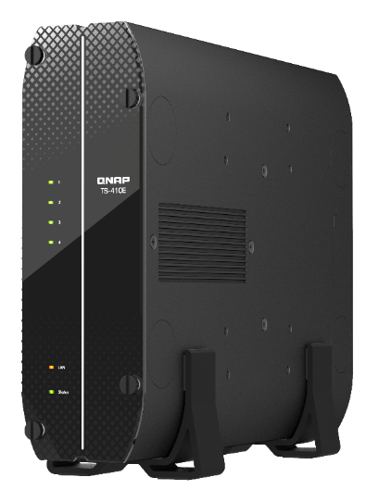
Silent NAS for installation in sound-sensitive office environments
First choice for data storage in sound-sensitive environments
Set up TS-410E in the office for data backup and storage, which no longer have to endure the fan noise of general NAS. QNAP offers a better economical option than expensive soundproofed cabins in space-constrained and sound-sensitive environments.

Slide 6
Compact chassis with anti-skid stands
Anti-skid stands
The special vertical stands with anti-skid rubber can be placed on the desktop without taking up space so that the desktop space can be effective. Moreover, its compact chassis can place anywhere in the office.
Equipped vertical anti-skid stand in the pack.

Slide 7
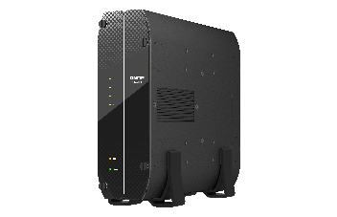
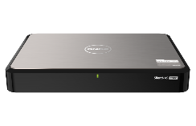
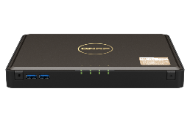
How to Choose a Desktop Dual 2.5 GbE Low Noise NAS
QNAP provides three desktop low-noise NAS supporting dual-port 2.5GbE for customers. This time, the main recommendation is the new TS-410E, which supports 2.5-inch SSD and has a fanless design, especially suitable for sound-sensitive NAS surroundings. The HS-264 is also a fanless design, and users usually choose this model because it supports 3.5-inch large-capacity hard drives. Finally, TBS-464 supports PCIe NVMe SSD and has the highest drives access performance and the thinnest size.
2.5 GbE NAS | HS-264 | TBS-464 | TS-410E
Noise | Good | Better | Best (noiselessness)
Capacity | Biggest | Mid | Big
Size | Thin | Thinnest | Compact and vertical
NEW

Slide 8
Why choose the 2.5-inch SATA SSD drive for NAS?
2.5-inch SATA SSD advantages
2.5-inch SSD is reliable and silent
Compared with M.2 NVMe PCIe SSD, 2.5-inch SATA SSD has more space for placing flash chips, thus higher data storage capacity. In addition, it has better heat dissipation performance and does not require additional heat sinks. The 2.5-inch SATA SSDs provide a balanced choice between high capacity and performance.
The traditional HDD which rotates the disk plates to read/write the data is not suitable in any place with vibration. HDD can also be easily damaged due to movement and collision. 2.5-inch SATA SSD stores data in flash chip without disk head and therefore it is better against shock & vibration. The performance of SSD is also much faster than HDD.
2.5吋SATA SSD
NVMe M.2 PCIe SSD
SSD
HDD

Slide 9
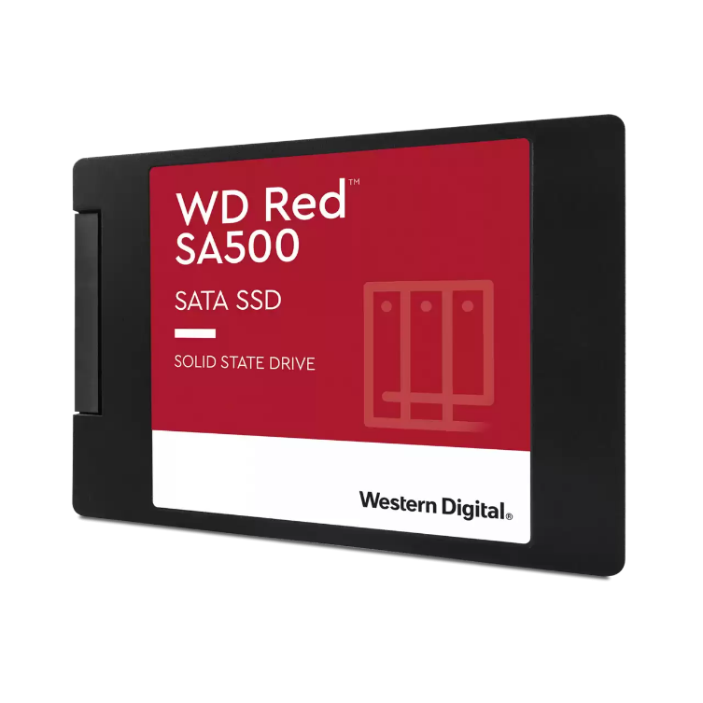
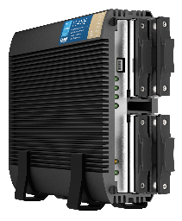
Recommended WD Red SA500 4TB 2.5”SATA SSD
Western Digital
Western Digital is an innovator and leader in the storage industry. They are producing reliable and high-performance mechanical hard drives and solid-state drives through their leading technology. Their products are suitable for deployment in offices, mobile fields, data centers, embedded systems, and consumers in electronic devices.
WD Red SA500 SSD series
WD Red™ SSD’s superior endurance can handle the heavy read and write loads demanded by NAS for 24/7 operation. It with high performance and high response speed. There are several capacity options for customers to choose from 500GB, 1TB, 2TB, and 4TB. We are recommended for installation in the TS-410E Silent NAS, providing sufficient performance and longevity.
TS-410E provides four 2.5" SATA slots

Slide 10
Quad-core Intel Celeron J series, up to 2.6GHz Wide operating temperature range, long-term supply until at least 2029
When small and medium-sized businesses are are buying data storage equipment, they need flexible and long-term implementation according to the demand of the project stage. When the initial budget is relatively limited, the NAS is purchased for the creation of related applications. However, when they want to deploy or expand, they often found out that the originally purchased NAS model was discontinued because the CPU was end of life (EOL). Therefore, they need to re-evaluate a new NAS model. The TS-410E uses the Intel Celeron J6412 CPU with long-term availability until at least 2029, solving customers' long-standing problems.
2.6GHz
Burst
J6412
Elkhart Lake
4-core
4-thread
AES-NI encryption
Volume & folder support
TDP
10W

Slide 11
Which RAID mode to use in a 4-bay NAS for data protection?
RAID (Redundant Array of Independent Disks) is a technology that uses more than two disks to form a fault-tolerant protection mechanism, which can protect data when a certain number of disks are damaged. When protection is the priority using four disks to create an array in TS-410E, we recommend RAID 6. If you think performance is the priority, we recommend RAID 10.
 | Single | JBOD | RAID 0 | RAID 1 | RAID 5 | RAID 6 | RAID 10
Minimum number of disks | N/A | 1 | 2 | 2 | 3 | 4 | 4
Allow number of disks fault | 0 | 0 | 0 | N-1 | 1 | 2 | Each group of RAID 0 allow one
Capacity equals several disks | 1 | N | N | 1 | N-1 | N-2 | N/2
Protection | N/A |  |  | High | Mid and lower | Upper Mid | Upper Mid
Performance | Single | N | High | Single | Mid | Mid and lower | Upper Mid

Slide 12
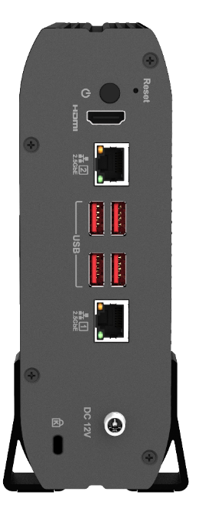
Dual 2.5 GbE Network ports are enterprise network standard
Dual 2.5 GbE Network ports
The general network 1GbE network speed can no longer fit the basic storage needs of today's enterprises. Therefore, the new TS-410E NAS is standard equipped with two 2.5 GbE network ports. In addition, through Port Trunking network link aggregation, the NAS can provide up to 5 Gbps data transmission bandwidth in a multi-client environment.
2 x 2.5 GbE

Slide 13
4 ports USB 3.2 Gen 2 (10Gbps)
4 ports USB 3.2 Gen 2
In addition to connecting to QNAP TL USB JBOD for capacity expansion or backup, it provides a smoother file transfer experience than a general NAS. You can use HDMI to connect the screen, and the USB interface can also be connected to a keyboard and mouse to operate directly or as a PC. It can also be connected to a UPS to keep the system continue. A sufficient number of USB ports to meet the needs of various situations.
USB 3.2 Gen 2 port
JBOD
UPS

Slide 14
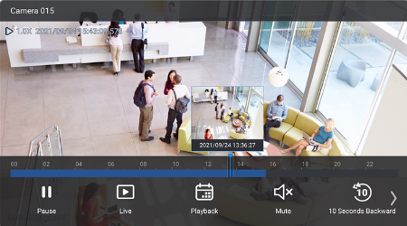
Support HDMI 4K screen output
HDMI monitor output with 4K resolution
The HDMI connects to the screen as a monitor. When USB connects to a keyboard and mouse simultaneously, it can use as a PC, and the HybridDesk Station can install to turn it into a home theater.

Slide 15
Supports four SATA SSD slots
Four 2.5" SSD slots are visible after removing the front cover
Hot-swappable SATA slots
3
1
reserved for engineering
SSD LED 1~4
4
2
LAN
Status

Slide 16
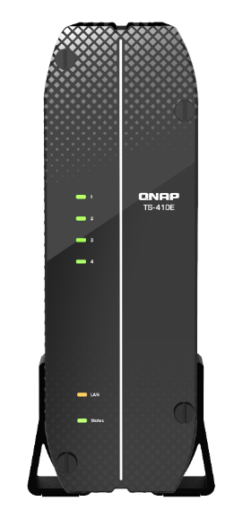
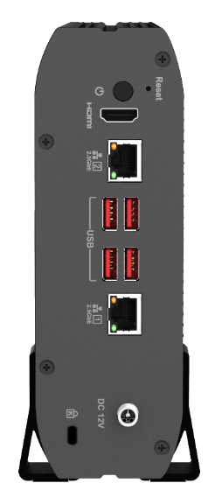
TS-410E I/O and size
Power button
Reset button
HDMI
2.5 GbE
SSD LED 1~4
USB 3.2 Gen2
LAN
Status
DC 12V input
K-Slot
60 (H) x 180 (W) x 254 (D) mm / 2.36 (H) x 7.09 (W) x 10 (D) inch

Slide 17
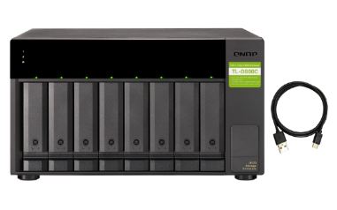
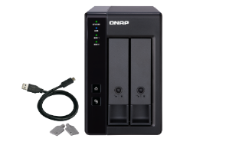
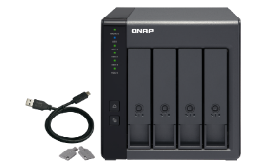
Optional storage expansion unit that supports USB JBOD & RAID
TR-002
TR-004
TL-D800C
2-bay
Desktop USB 3.2 Gen 2 JBOD
Supports hardware RAID
4-bay
Desktop USB 3.2 Gen 1 JBOD
Supports hardware RAID
8-bay
Desktop USB 3.2 Gen 2 JBOD
TS-410E supports the maximum number of JBODs
TR-002 | 2
TR-004 | 2
TL-D800C | 1
TR-004U | 2
TL-R1200C-RP | 1
TR-004U
TL-R1200C-RP
4-bay
Rackmount USB 3.2 Gen 1 JBOD
Supports hardware RAID
12-bay
Rackmount USB 3.2 Gen 2 JBOD
Redundant power supply

Slide 18
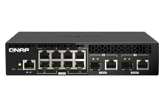
Optional network switch
No need to replace existing wiring upgrade to 2.5 GbE
QSW-1108-8T (unmanaged)
8 x 2.5G
RJ45 Multi-Gig
Fanless and Metal Chassis
 | CAT 5e | CAT 6 | CAT 6A
100M | ✔ | ✔ | ✔
1G | ✔ | ✔ | ✔
2.5G | ✔ | ✔ | ✔
5G | ✔ | ✔ | ✔
10G | X | ✔(55m) | ✔
QSW-1208-8C (unmanaged)
QSW-308-1C (unmanaged)
8 x 10G/5G/2.5G
RJ45 Multi-Gig
1 x 10G/5G/2.5G
RJ45 Multi-Gig
QSW-M408-4C (managed)
QSW-M2108R-2C (managed)
4 x 10G/5G/2.5G
RJ45 Multi-Gig
2 x 10G/5G/2.5G
RJ45 Multi-Gig

Slide 19
2 x 10 GbE for 10GB file transfer performance
2 x 2.5GbE Windows file transfer (10GB)
2 x 2.5GbE Windows file transfer (10GB)
NAS encrypted volume
600
587
588
586
500
566
400
300
200
100
(MB/s)
0
Write
Read
Write
Read
Environment: NAS | TS-410E, QTS 5.0, 4 x Samsung 860 Pro 512GB, RAID 5, thick volume
PC | Windows Server 2019 Standard, Intel Core i7-6700 3.4 GHz, 32GB RAM
Tested in QNAP Labs. Figures may vary by environment.

Slide 20
2.5-inch SATA SSD installation
1
Put it flat
2
Loosen screws
3
Take out SSD Trays
4
Locked the drives
5
Insert trays
6
Locked the cover
7
Turn to vertical
8
Put it on stands

Slide 22
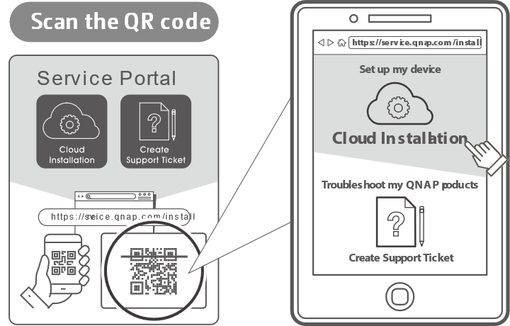
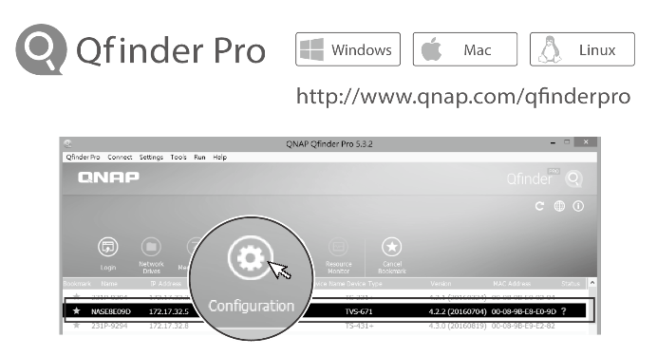
NAS quick installation
1
Scan the QR Code with your mobile phone to install
2
Download the Qfinder Pro program on your computer and install

Slide 23
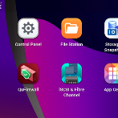
Build-in QTS 5.0 NAS multifunctional operating system
Supports WireGuard VPN
Safe and convenient connection
Upgraded Linux Kernel 5
Strengthen security to protect data assets
Improve overall NAS performance
Make NAS related applications more agile
Brand new UI
Simple, aesthetic, and smooth experience

Slide 24
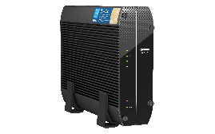
license-free HBS 3 (Hybrid Backup Sync 3) Three steps to the best data backup strategy
Simple 3-2-1 backup strategy (3 copies, 2 media, 1 remote backup)
2 Medium
3 copies
Copies1
NAS
Copies 2
NAS offsite
Copies 3
Google Drive
1 remote backup
2 種媒體
3個副本
副本 1
NAS
副本 2
NAS off-site
副本 3Google Drive
1 異地備援

Slide 25
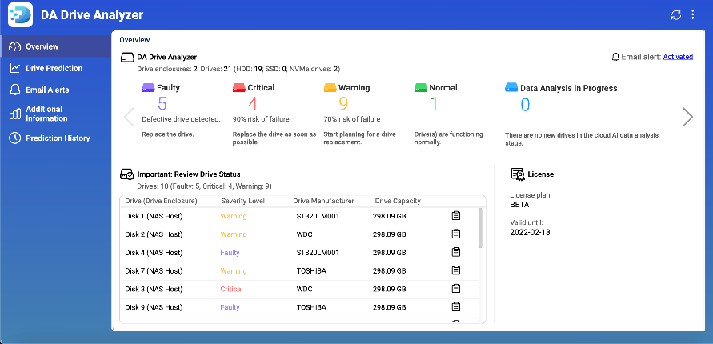
DA Drive Analyzer for disk failure prediction​
Each NAS can support one disk prediction for free, and you can also have a paid subscription to support all disks.​
Disk health analysis and failure prediction
DA Drive Analyzer integrates ULINK AI prediction technology which can warn you before disk failure and help you protect valuable data.​

Slide 26
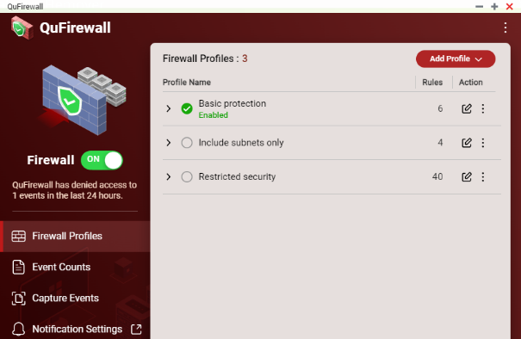
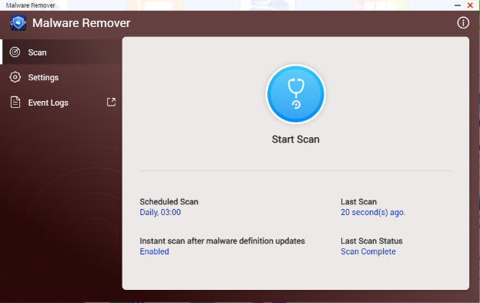
Data security: safeguard your NAS data​​
Malware Remover
QuFirewall
Regularly scan your NAS check for and download the latest malware definitions. Then, when attacked, the infected files can be excluded in real-time, helping to improve the level of NAS data security.​​
You can allow/deny IP addresses and regions to prevent unauthorized access and brute force attacks for safeguarding data and service security.​

Slide 27
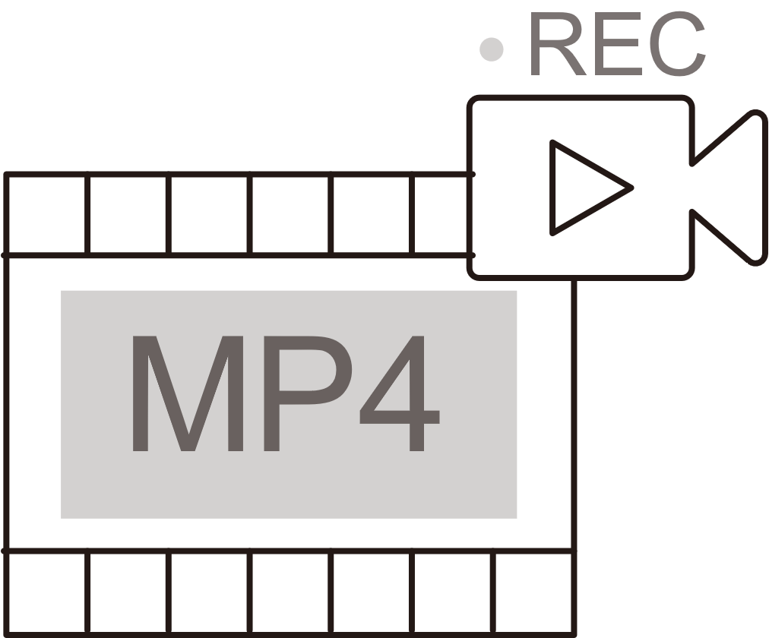
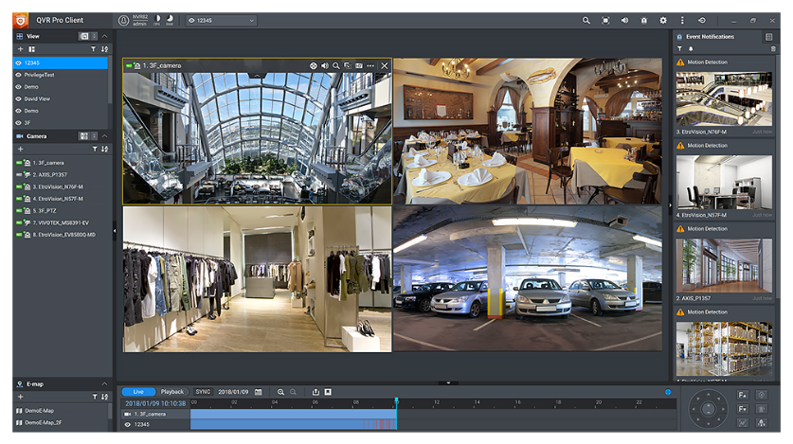
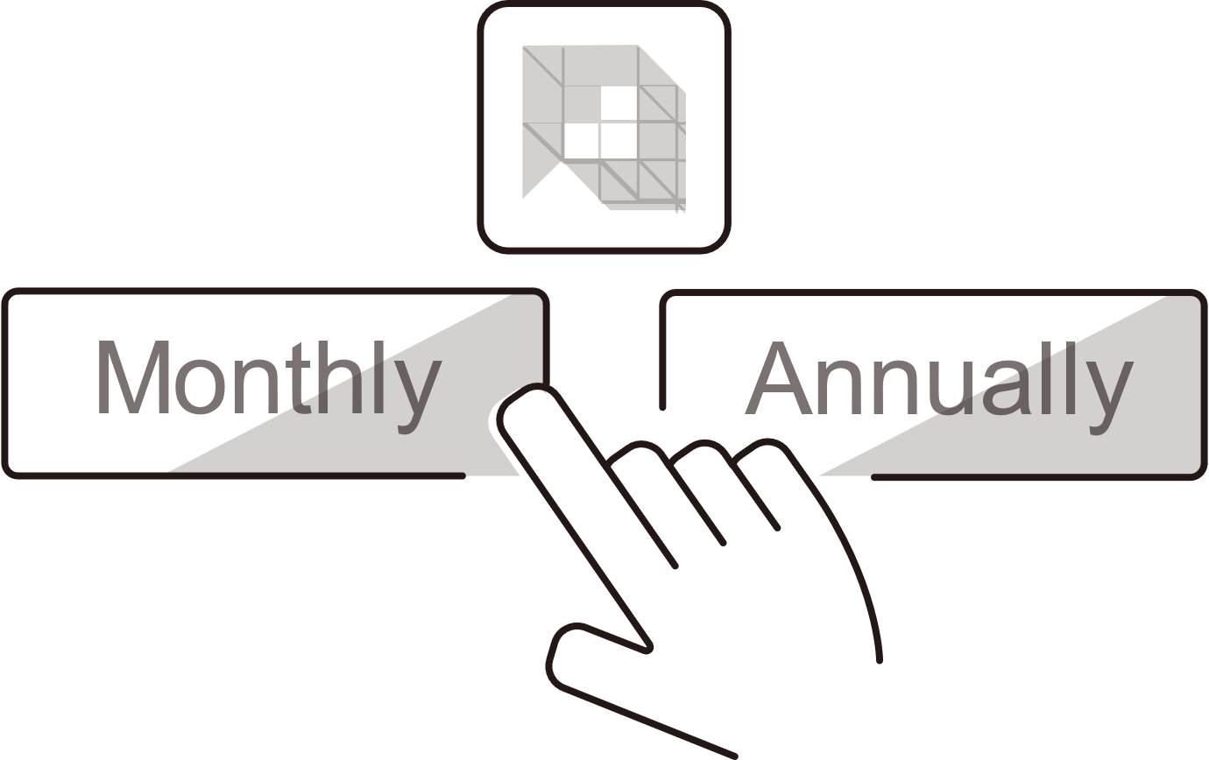
QVR Elite- Surveillance System
MP4 Recording Format​​
Flexible Subscription​​
Base embedded channels​​
(Flexible expansion)​​
Expandable Capacity​​

Slide 28
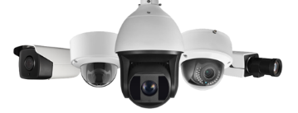
Compatible with a huge amount of camera models
Over 180 Brands​
Over 6,700 Models​
ONVIF Profile Supported​
RTSP Stream
Input / Output
RTMP Stream
Input
https://www.qnap.com/en/compatibility-qvr-pro

Slide 29
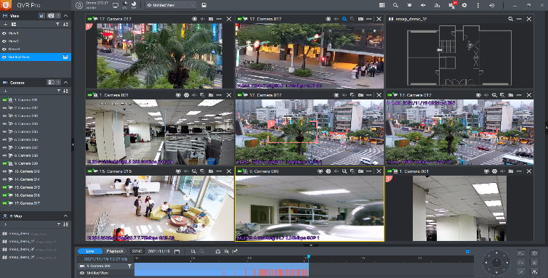
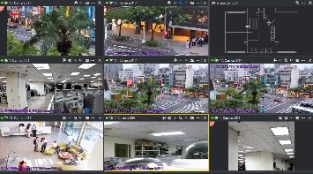
Unified interface for live view & playback​, anywhere with a PC or mobile device
Monitor the live view of multiple channels and playback on 1 single interface.
1-click to sync playback all video views​​
1 click to jump to the previous playback time​​
1 click to switch between Live & Playback​​

Slide 30
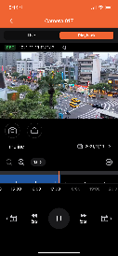
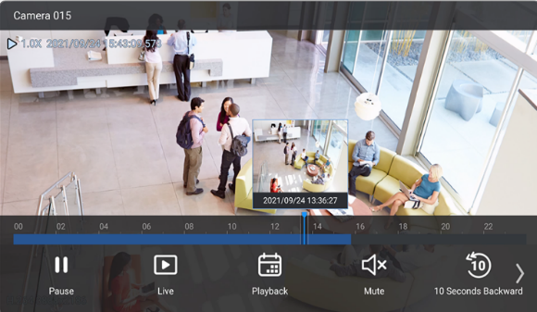
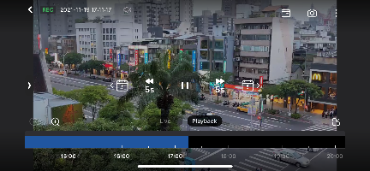
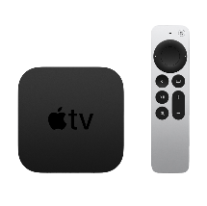
Surveillance Client for mobile and home environment​
QVR Pro Client
Mobile device recording and playback
QVR Viewer
Apple TV Monitoring App
Mobile device recording and playback protect important people, things, and objects anytime, anywhere.​
The new Apple TV monitoring application is a convenient APP installed on Apple TV for monitoring and playback.​

Slide 31
Qsirch full-text search tool for browsers
PC Edition
The most powerful search engine that integrate with NAS and PC local search.
NAS Edition
Search massive data in the NAS.
Qsirch is a fast, full-text search engine that enables you to find files based on filename, content, and metadata. Qsirch’s search functions are also available using a companion mobile app, browser extension, and Mac® Finder.
Find everything
Full-text
search
AI search
Multiple filters

Slide 32
Qfiling auto archive and filing
Qfiling automates your file organization. All you need to do is categorize your files, set a schedule, and Qfiling will do the rest. It’s easy, smart, and efficient!
Flexible
Customize the filing and batch editing rules.
Efficient
Scheduling for auto filing.
Total Control
With system logs, filing
status is easily accessible.

Slide 33
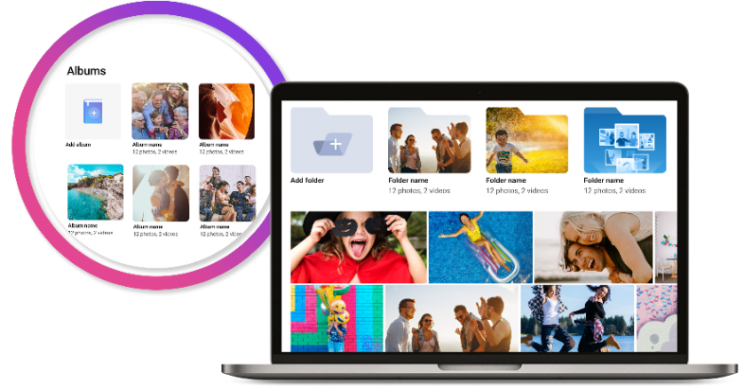
For video streaming and suitable as a multimedia server
影音串流，作為多媒體伺服器也很合適
Various multimedia files, such as photos, music, and video files, can be easily centrally stored. Enjoy your NAS collections on your phone, tablet, or TV.
Use Cinema28 to stream multimedia to various AV playback devices.
Stream/Transform Multimedia to Various AV Devices with Plex
Play via Qmedia on Apple TV/Fire TV/Roku/Android TV
QuMagie AI smart album, automatic face recognition, and object classification

Slide 34
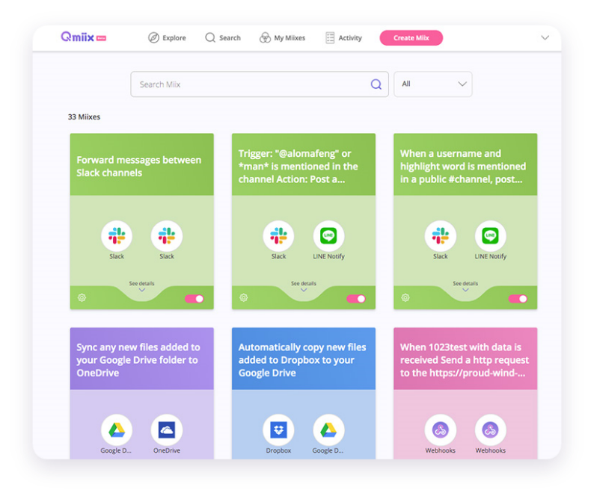
Customize and automate workflows across multiple clouds, NAS, and applications to help save time and cost
Qmiix
Cross-Platform Workflow Automation Solutions
Qmiix can connect and automate workflows between QNAP NAS, cloud services, social networking, and communication software, simplifying routine tasks such as backup, document posting, and event notification. In addition, Qmiix provides efficient communication channels and a flexible multi-cloud backup environment to enhance the productivity of SMEs and collaborative teams.

Slide 35
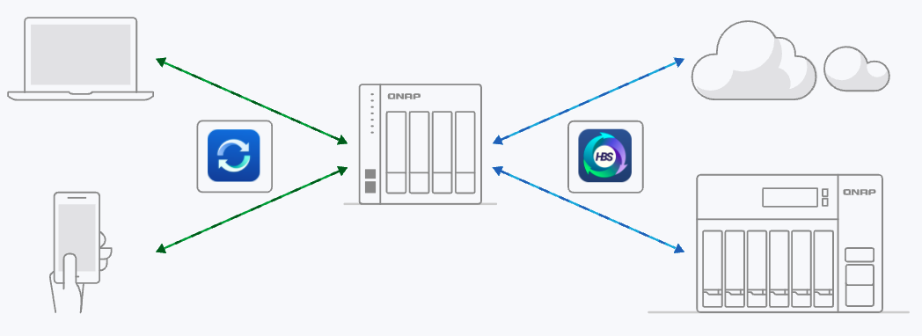
Qsync cross-device file synchronization technology for individual and team collaboration
Qsync allows you to conveniently synchronize real-time files between your QNAP NAS and bound devices, suitable for desktops, laptops, and mobile devices. As a result, you can access the newest data on all your devices and easily share it with your work team or family members.
Centralized management of binding devices to improve security and management efficiency
Sync files to other NAS or cloud with Hybrid Backup Sync
Central control mode and user-defined mode flexible configuration
Up to 64 version-controlled, restore data at any time
Remote erase to delete synced files from lost devices
NAS installed Qsync Central
App

Slide 36
Lighter, faster VPN service for personal use
更輕量, 更快速的個人用 VPN 服務
The new QVPN supports WireGuard VPN, which is lighter, easier to set up, supports multiple user platforms, and greatly improves the speed. It is an essential tool for personal users and works from home.
The Kernel layer processes the VPN encrypt packet directly, and the transmission speed is faster.
Login with key only. (No general account management)

Slide 37
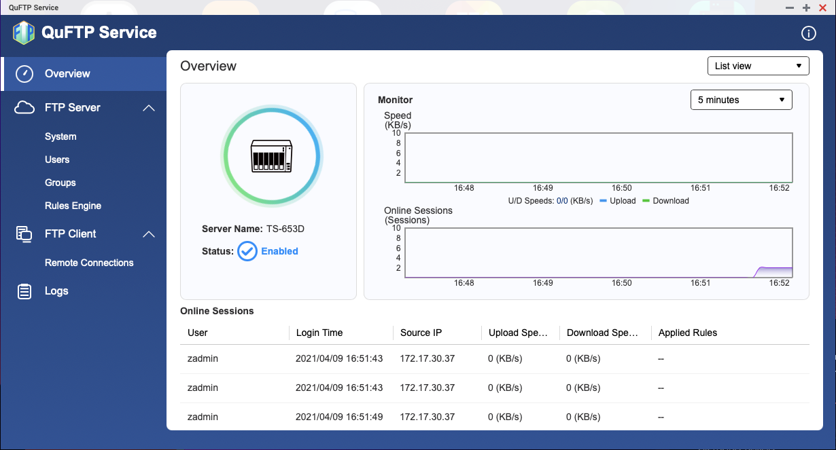
QuFTP remote file FTP access service
Can be updated independently
Supports FTP server
Supports TLS settings
Supports QoS settings
Support specification setting
Supports FTP client

Slide 38
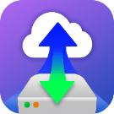
Turn the NAS into a local computer through Ubuntu Linux Station, or connect at any time through the remote
Remotely connect to Ubuntu Linux Station anytime
Using a remote connection, you can connect to the Ubuntu operating system at any time through the Internet
Ubuntu Linux Station turns a NAS into a computer
Connect a keyboard, mouse and HDMI monitor to your NAS and instantly turn it into an Ubuntu computer
Ubuntu Linux Station
VJBOD Cloud Gateway
Initiator
Local user
iSCSI
Target
雲端物件
儲存空間
Initiator
iSCSI
Cloud LUN
Client
Application
Server
SMB/NFS/AFP/
FTP/WebDAV
Cloud Volume
/Shared folder
快照
快照
Local user

Slide 39
App Center
Wide variety of applications
NAS functions beyond imagination
QNAP APP Center includes various applications. You can install and expand multiple functions of the NAS on-demand. QNAP keeps developing products and seeks cooperation with related application software. We evolve every second, care about users' needs, and continuously try various forward-looking ideas. It is the only constant persistence of QNAP in the rapidly changing AI era.
https://www.qnap.com/zh-tw/app_center/

Slide 40
Extended warranty up to 5 years
The TS-410E comes with a 3-year warranty. However, if you need a longer warranty period, you can purchase the QNAP Extended Warranty Service (QEWS) to stretch your warranty coverage to up to 5 years.

Slide 41
TS-873AeU系列
輕量2U短機身機架型NAS的唯一選擇

