Slide 1
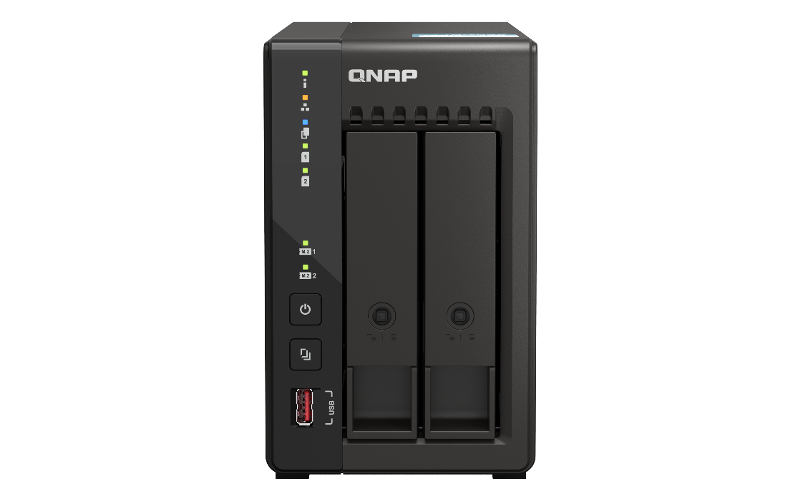
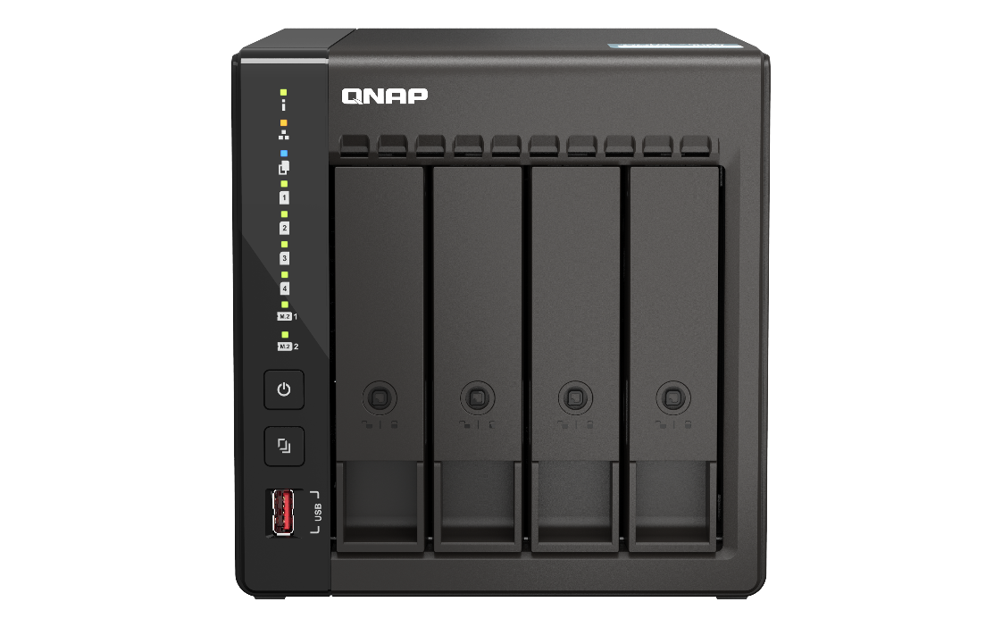
v1.1 202408
TS-x53E
Intel Celeron® 高效四核心處理器， 2/4-bay穩定長期供應的 NAS，具有雙 2.5GbE 網路埠和雙 HDMI 螢幕輸出。是MSP、SI 進行長期專案需求的理想選擇。
Intel® J6412 Quad-Core Long-Term Availability NAS for Business and Professional Users
TS-253E
TS-453E
Provides dual-port 2.5 GbE, 4K HDMI dual-screen output, and dual M.2 PCIe SSD expansion slots
Andy Chuang

Slide 2
Post-epidemic accelerates enterprise transformation, sustainability and maintenance will be the key
「 This is a year for global corporate information leaders to plan for the future .」John-David Lovelock , Vice President of Research at Gartner Inc said.
Affected by the epidemic in recent years, work modes have become more diverse and flexible, and many companies have also begun to think about how to make IT assets more flexible and to overcome time and location constraints for flexible configuration.
TS-253E / TS-453E can be supplied stably until 2029, providing SMB with flexible deployment according to staged needs.
Source：Commercial Times (https://reurl.cc/M0EO2K)
TS-253E
TS-453E

Slide 3
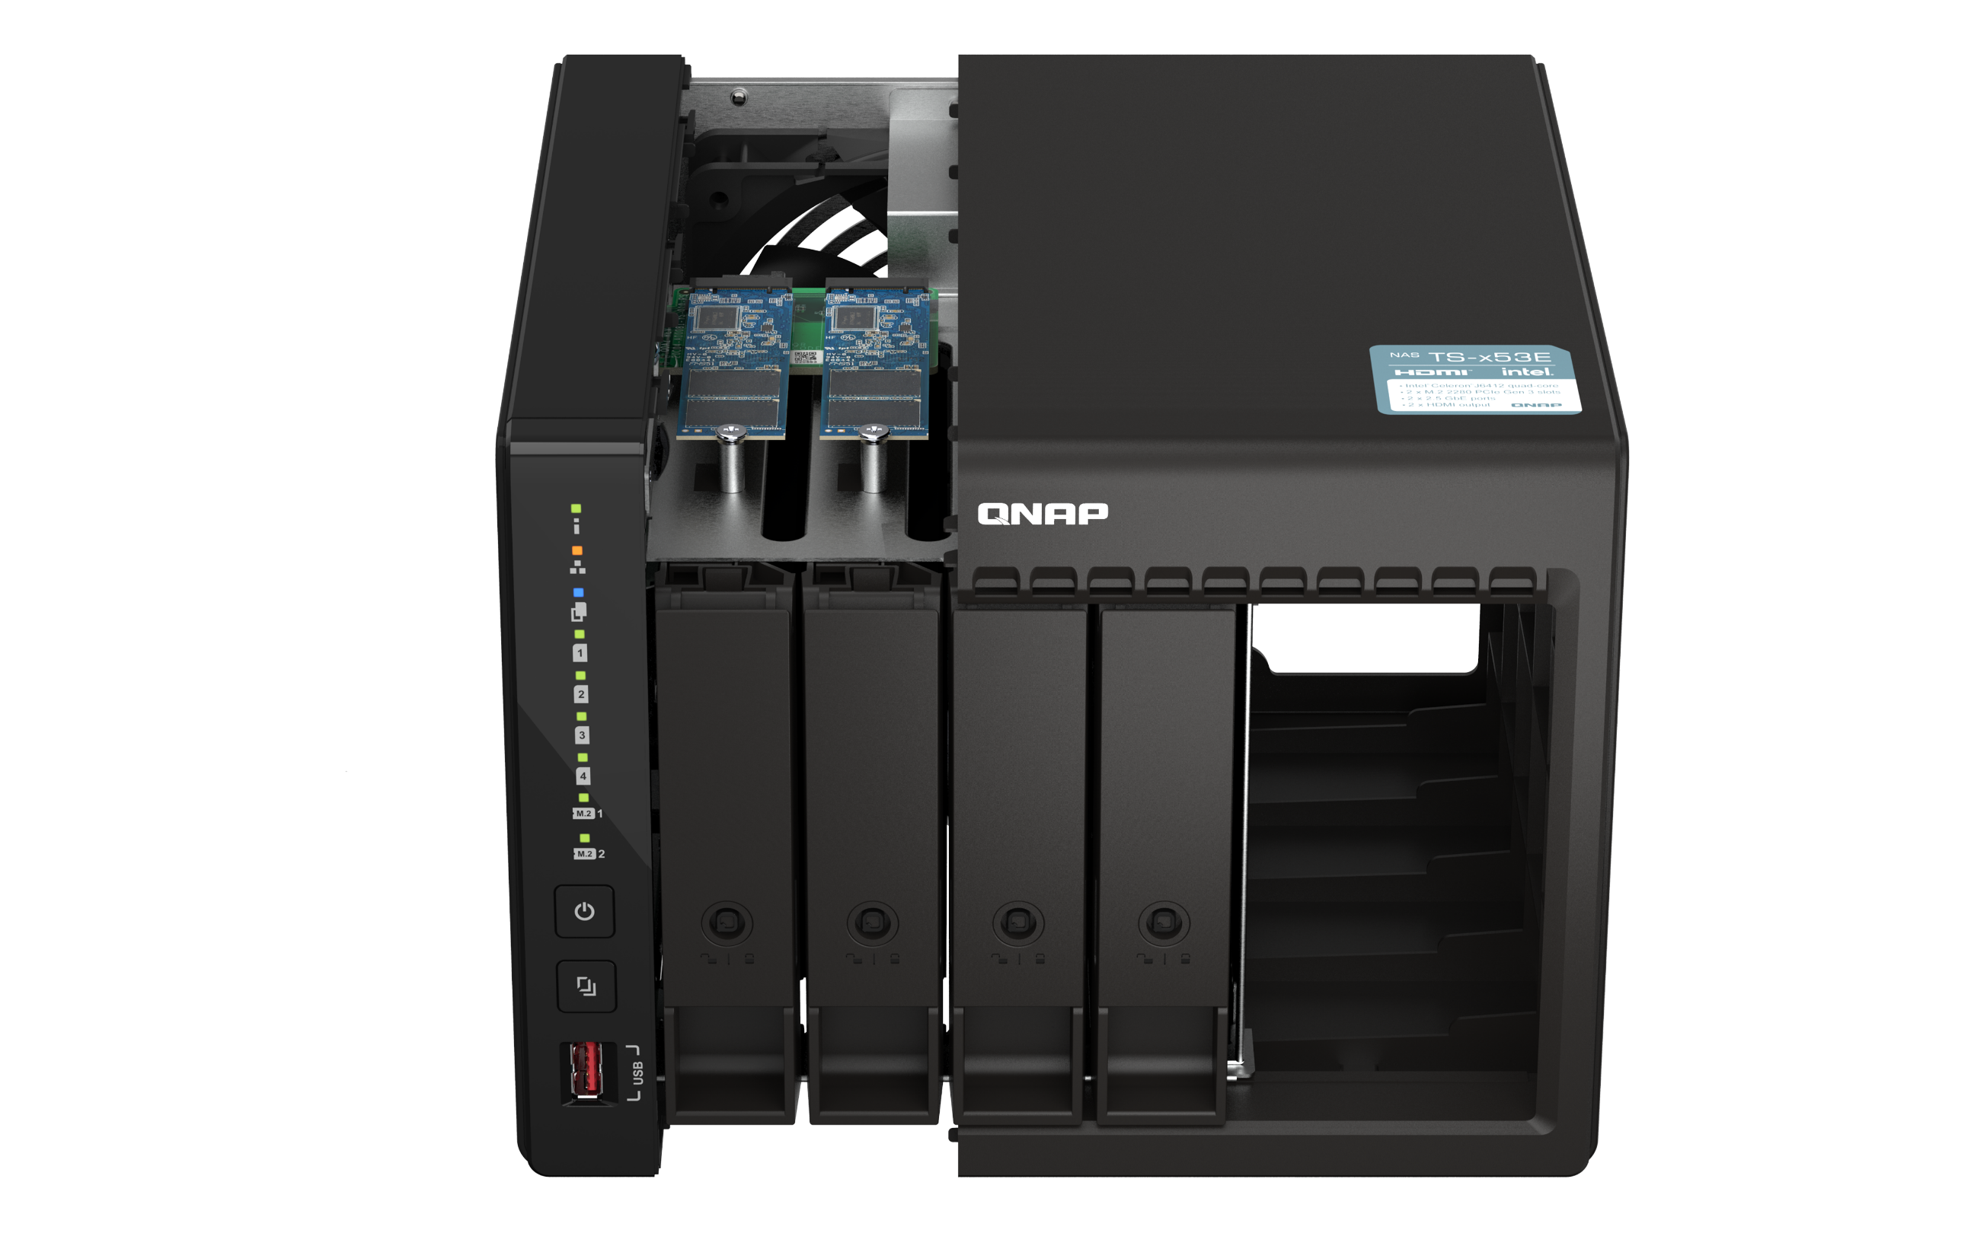
SSD prices are expected to fall, affordably improve storage performance now
SSD has become popular. It is time to upgrade now !
The cost per GB of storage for SSDs continues to decline, and the storage capacity continues to grow. In addition, SSD provides better storage performance compared to traditional hard drives.
Type | 3Q22F
Enterprise SSD | Expected to be flat
Client SSD | decline 3~8%
3D NAND Wafers (TLC & QLC ) | decline 5~10%
Total NAND Flash | decline 0~5%
Source：TrendForce, 2022.06

Slide 4
TS-253E / TS-453E NAS Main Features
Long-term availability NAS
Dual 2.5 GbE ports
Stable long-term availability until 2029
Sufficient 2.5 GbE network bandwidth for smooth data transfer experience
Dual M.2 PCIe SSD expansion slots
Dual 4K HDMI ports
Provide dual-port screen output for monitoring or A/V needs
Optimum configuration of SSD and HDD
Quad - core processor
8 GB RAM on board
2.6
Sufficient memory makes NAS applications more flexible
Intel Celeron J6412 4-core burst 2.6 GHz processor, supports various applications of NAS
GHz
12吋短機箱可支援市面上大部分的機櫃
內建2埠M.2(PCIe Gen 3 x1)，可提供SSD快取，加速隨機存取的速度
PCIe Gen 3 x 8插槽，提供各式應用的高速擴充卡
雙系統靈活切換配置QTS and QuTS hero

Slide 5
Powered by an Intel Celeron J6412 high-efficiency quad-core processor
搭載Intel Celeron J系列高效4核心處理器
Intel J6412 quad-core processor, burst frequency up to 2.6GHz, and support AES-NI encryption
Processor Graphics
Intel® UHD Graphics for 10th Gen Intel® Processors, support 4K output
CPU Specifications | CAT 5e
Total Cores | 4
Total Threads | 4
Burst Frequency | 2.60GHz
Processor Base Frequency | 2.00GHz

Slide 6
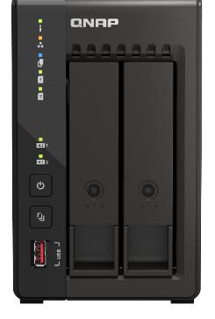
Outperforms competing products in the same class with a built-in 8 GB on board memory
搭載Intel Celeron J系列高效4核心處理器
TS-253E / TS-453E with integrated large 8GB memory
Compared to comparable NAS that generally use lower-capacity memory to save cost, TS-253E / TS-453E are designed with 8 GB large-capacity memory, which can make the overall NAS run more smoothly.
8 GB
QVR Elite
Includes 2 Free Channels
Snapshots
Supports up to 1024
Runs more apps through App Center

Slide 7
Dual 2.5 GbE high-speed network ports
X 2.5
雙 2.5 GbE 高速網路埠
Dual 2.5 GbE ports *
Provide up to 5Gbps data transfer capability through Port Trunking network aggregation.
*Also compatible with 1GbE & 100MbE
High-speed transmission with CAT 5e
 | CAT 5e | CAT 6 | CAT 6A
100M | ✔ | ✔ | ✔
1G | ✔ | ✔ | ✔
2.5G | ✔ | ✔ | ✔
5G | ✔ | ✔ | ✔
10G | X | ✔(55m) | ✔

Slide 8
TS-253E / TS-453E front view
TS-253E / TS-453 機身圖
TS-253E
TS-453E
LED indicators with adjustable brightness：Status, LAN, USB Copy Drive
4 x SATA 6Gb/s 3.5”/2.5” HDD/SSD
2 x SATA 6Gb/s 3.5”/2.5” HDD/SSD
LED indicators for M.2 SSD
Power button
USB Copy button
USB 3.2 Gen 2 port
Tray with lock kit

Slide 9
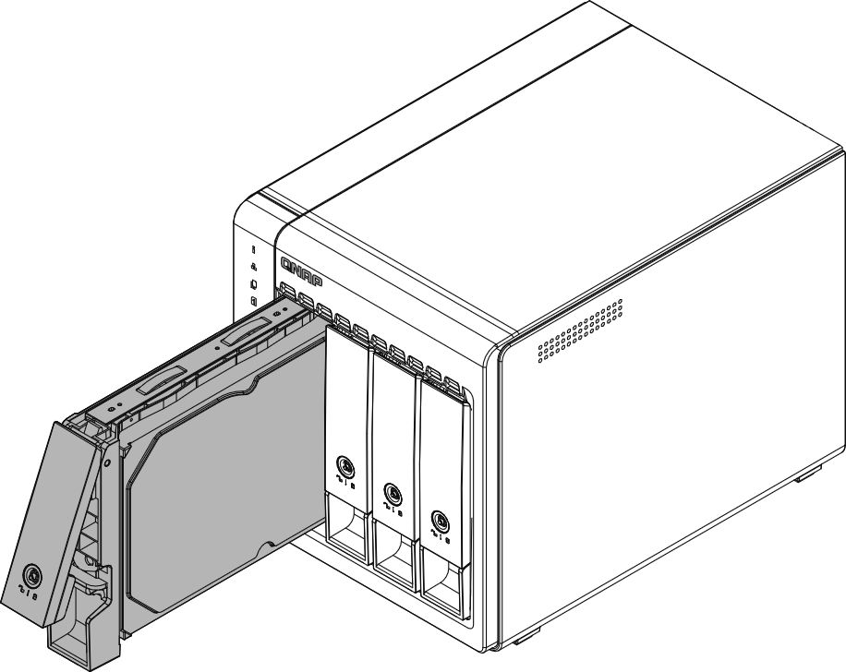
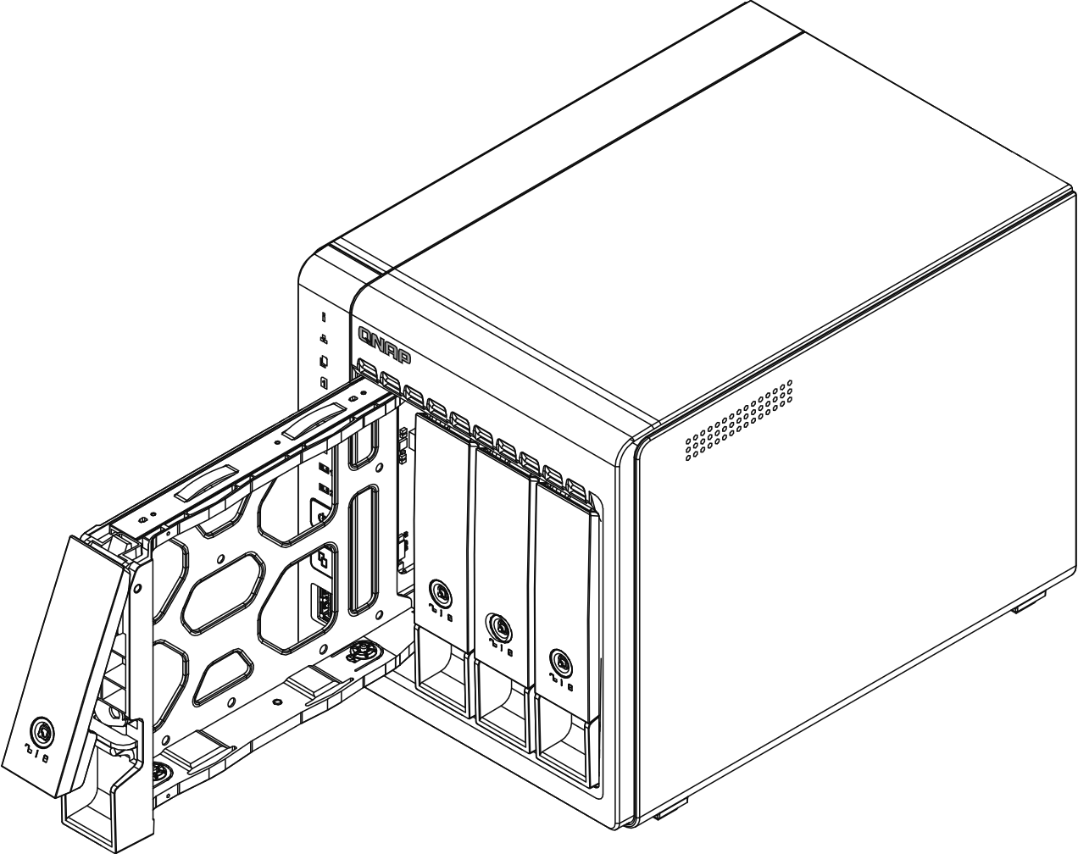
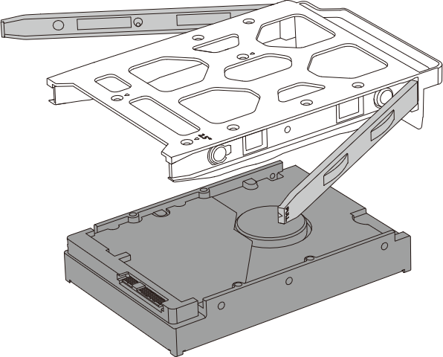
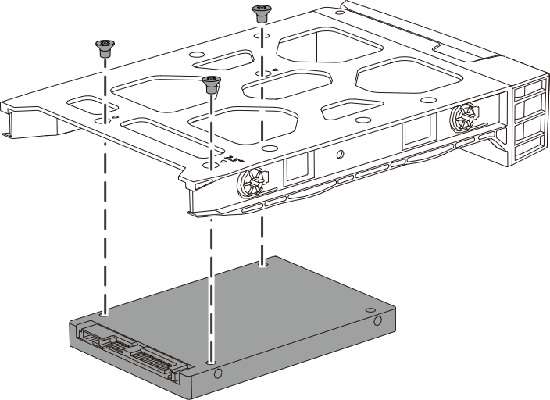
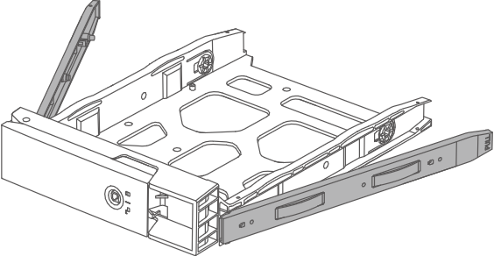
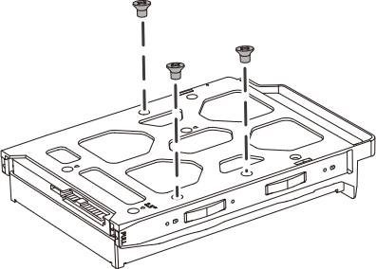
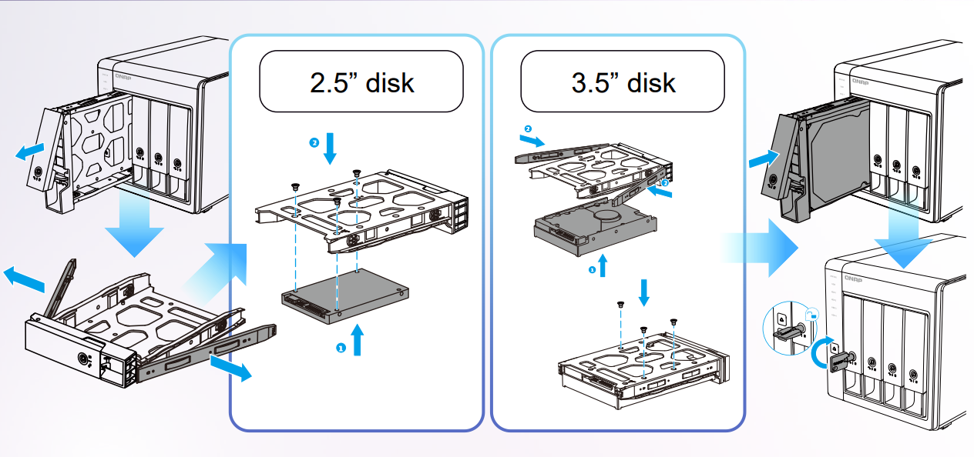
Installing 2.5" / 3.5" SATA HDD or SSD
安裝 2.5" / 3.5" 硬碟
2.5” SSD
3.5” SATA HDD
Lock kit for Tray safty
Install 2.5’’ SSD with screws
Install 3.5’’ drives without tools

Slide 10
Attain greater NAS performance by installing M.2 2280 NVMe PCIe SSDs (sold separately)
安裝 M.2 2280 NVMe PCIe SSD（另外添購）
提升 NAS 效能
Dual M.2 2280 PCIe Gen3 x2 slots
support NVMe SSD
providing SSD cache, and Qtier automatic tiered storage, so that SSD and HDD storage space can achieve the best configuration at any time.

Slide 11
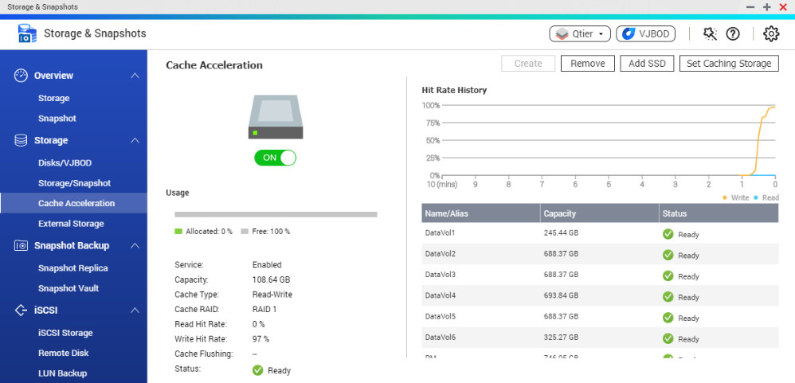
M.2 NVMe SSD cache for improved performance at a lower cost
Especially useful for RAID 5/6 and applications dealing with small files or concurrent user access.
TS-253E / TS-453E on board 8 GB RAM can provide up to 16TB SSD cache volume
Improves I/O latency
For IOPS-demanding apps
Global SSD cache
Can share a single SSD volume/RAID with all volumes/iSCSI LUNs for a read-only or read-write cache.
Read-only Cache
Read-write cache
Read
Write
Application
HDD space
SSD space
Total capacity = HDD capacity

Slide 12
Qtier™: drives auto-tiering constantly optimize data across storage tiers
Hot data
Automatically moves hot data to high-performance drives and cold data to lower-cost, higher-capacity drives.
Qtier
Engine
Warm data
Cold data
Unlike SSD cache, the SSD capacity in Qtier can be used to store data.
Before tiering
Frequently accessed data is not optimized
Start data tiering
After tiering
Data is optimized
Changes in data access pattern

Slide 13
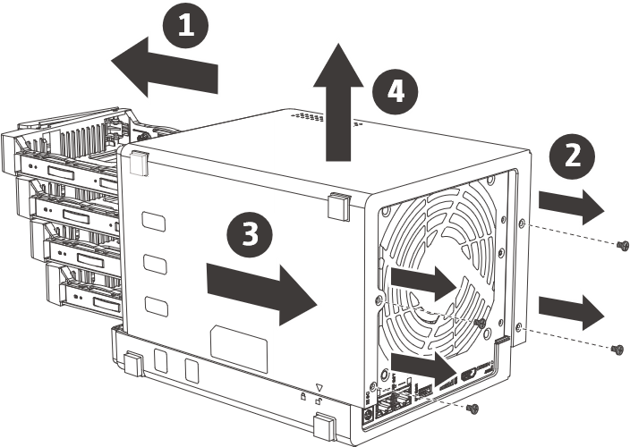
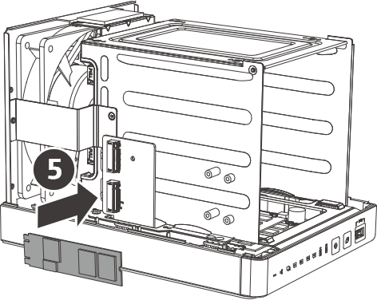
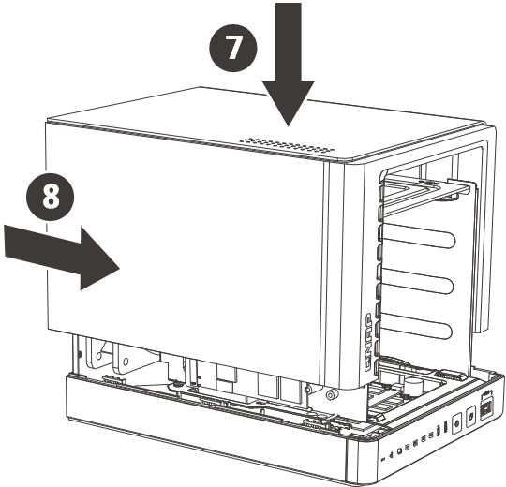
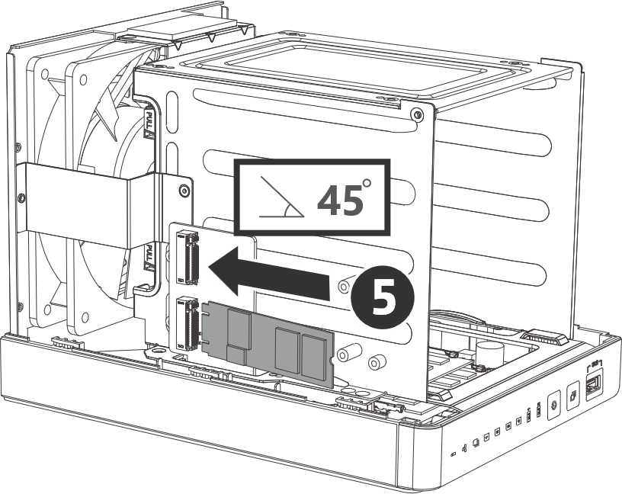
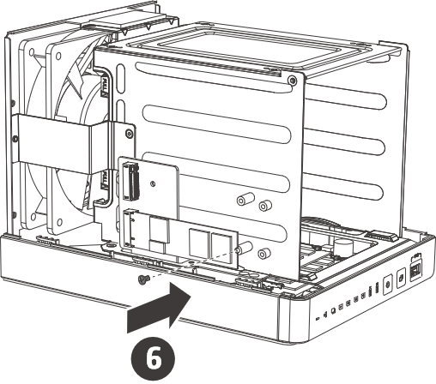
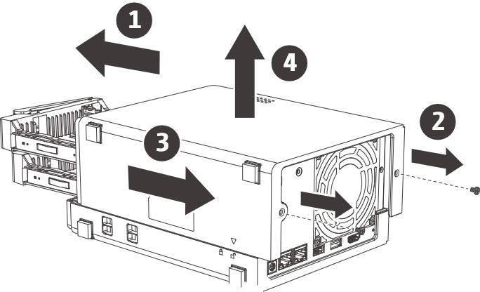
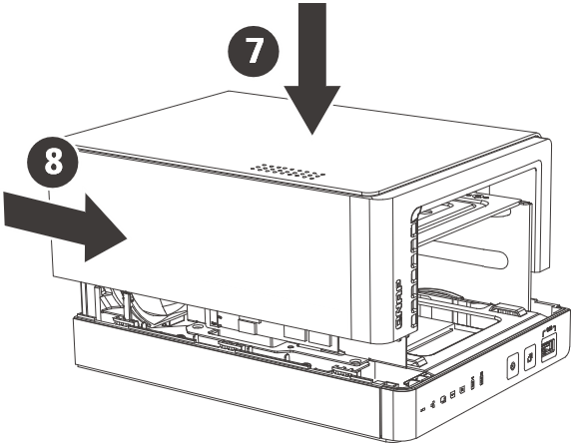
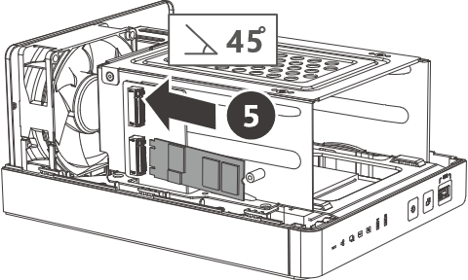
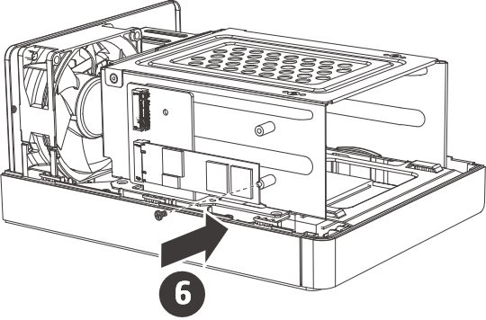
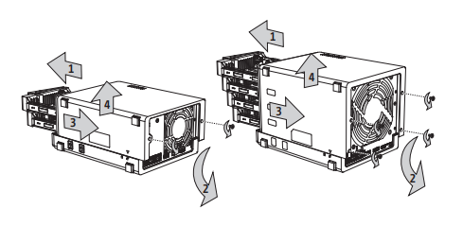
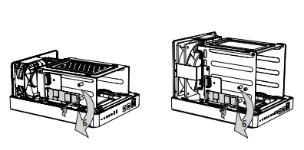
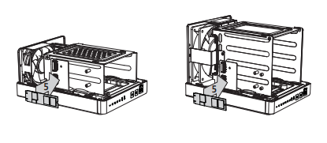
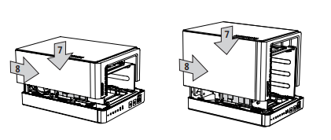
Installing M.2 2280 NVMe PCIe SSD
安裝M.2 2280 NVMe SSD
Step 1
Step 2
Step 3
Step 4
Unscrew and take off casing​
Install M.2 SSD at 45 degree angle
Screw M.2 SSD on the slot​
Put back the casing
TS-453E
M.2 SSD
TS-253E
M.2 SSD
Step 1
Step 3
Step 2
Step 4

Slide 14
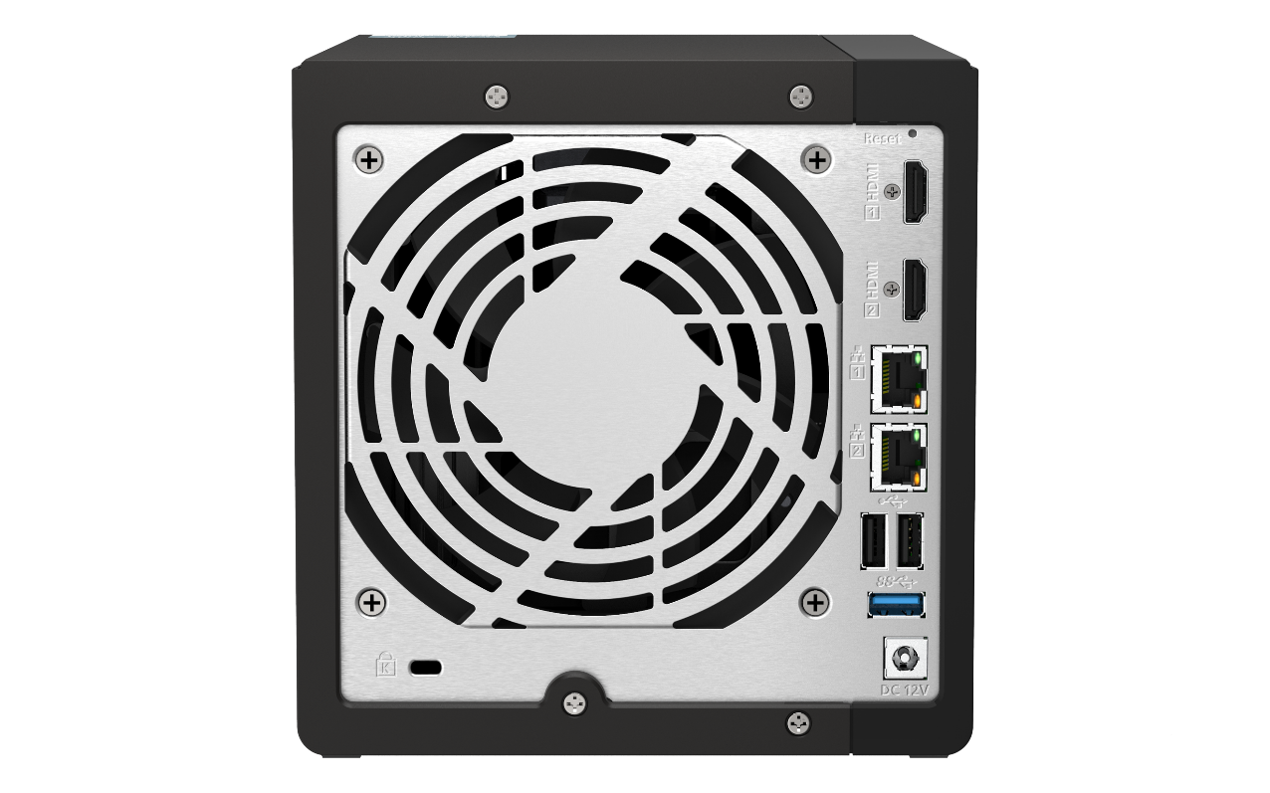
TS-253E / TS-453E rear view
TS-253E / TS-453E 背面圖
TS-453E
TS-253E
2 x HDMI 1.4b
7CM
Smart fan
12CM
Smart fan
2 x 2.5 Gigabit Ethernet
port
2 x USB 2.0 port
USB 3.2 Gen 2 port
K-Lock
12V DC power input

Slide 15
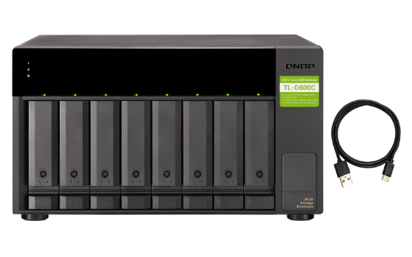
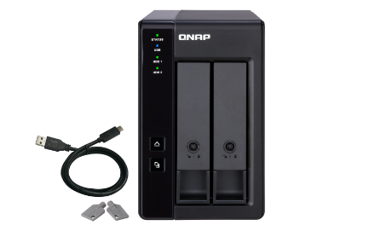
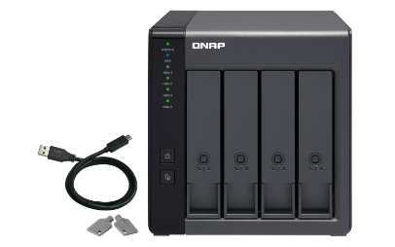
Add more storage with QNAP USB JBOD & RAID storage expansion units
TR-002
TR-004
TL-D800C
2-bay
Desktop SATA 6Gb/s JBOD Support hardware RAID
4-bay
Desktop SATA 6Gb/s JBOD Support hardware RAID
8-bay
Desktop USB 3.2 Gen 2 JBOD
Maximum of JBOD / RAID expansion enclosures
TR-002 | 2
TR-004 | 2
TR-004U | 2
TL-D800C | 1
TL-R1200C-RP | 1
TR-004U
TL-R1200C-RP
4-bay
Rackmount USB 3.2 Gen 1 JBOD Support hardware RAID
12-bay
Rackmount USB 3.2 Gen 2 JBOD Support dual power backup

Slide 16
1 x 2.5GbE for 10GB file transfer with excellent performance
1 x 2.5GbE Windows file transfer (10GB)
1 x 2.5GbE Windows file transfer (10GB)
NAS encrypted volume
300
295
295
294
295
250
200
150
100
50
(MB/s)
0
Upload
Download
Upload
Download
Environment: NAS | TS-453E, QTS 5.0, 4 x Samsung 860 Pro 512GB, RAID 5, thick volume
PC | Windows Server 2016 Standard, Intel Core i7-6700 3.4 GHz, 64GB RAM
Tested in QNAP Labs. Figures may vary by environment.

Slide 17
2 x 2.5GbE for 10GB file transfer with the best performance in dual-client transfer
2 x 2.5GbE Windows file transfer (10GB)
2 x 2.5GbE Windows file transfer (10GB)
NAS encrypted volume
600
576
578
578
500
558
400
300
200
100
(MB/s)
0
Upload
Download
Upload
Download
Environment: NAS | TS-453E, QTS 5.0, 4 x Samsung 860 Pro 512GB, RAID 5, thick volume
PC | Windows Server 2016 Standard, Intel Core i7-6700 3.4 GHz, 64GB RAM
Tested in QNAP Labs. Figures may vary by environment.

Slide 18
TS-253E / TS-453E
TS-253E
TS-453E
Live Demo
Andy Chuang

Slide 19
TS-253E / TS-453E
TS-253E
TS-453E
Software Introduction
Andy Chuang

Slide 20
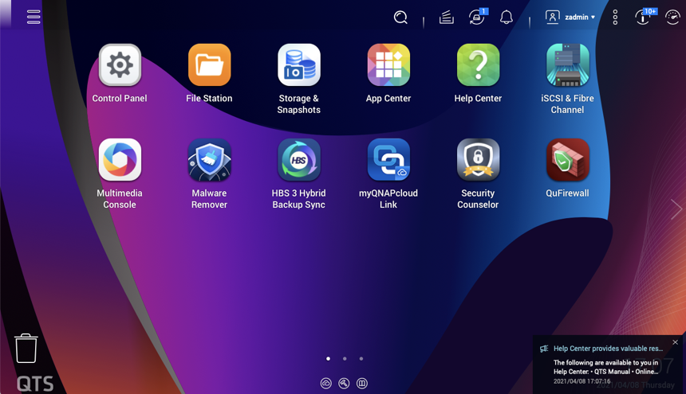
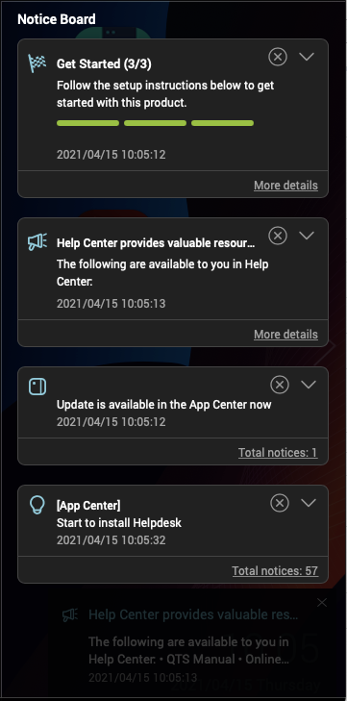
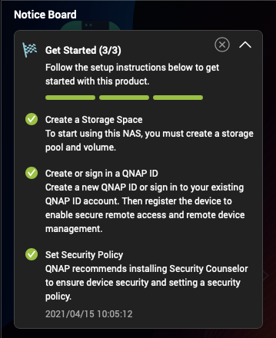
Equipped with the latest QTS 5.0 NAS operating system
New Linux Kernel 5.10 improved security
Smooth and reactive user interface
Increased NVMe SSD cache performance
Supports WireGuard VPN

Slide 21
Choose between QTS and ZFS based QuTS hero
TS-253E/TS-453E are shipped with the QTS operating system, which has powerful data transmission performance and more efficient memory usage, and enjoys the Qtier automatic tiered storage function. You can also change to the QuTS hero operating system adds support for WORM (Write Once, Read Many) and other features.
 | QuTS hero | QTS
Filesystem | ZFS | Ext4
SSD cache | Read Cache | Read/Write Cache Read Cache Write Cache
Inline Compression | Yes (LZ4 compression, ideal for RAW files and document files) | No
Inline Deduplication | Yes (At least 16 GB RAM required) | No
HBS with QuDedup for Remote Backup | Yes | Yes
Power Failure Protection (Software) | ZIL Copy-on-Write | No
Permission Management | Rich ACL (14 types) | POSIX ACLs (3 types) + certain special permissions
WORM (Write Once, Read Many) | Yes | No
Data Security | Better (Self-Healing & Copy-on-Write) | Standard
Recommendation SSD Configuration for Video Editing Applications | Use SSD Pools Note: Set the block size 128K when creating Folders/LUNs | Editing (from original/RAW files): Use SSD Pools Post production: Enable Read/Write cache Note: Set the block size to 32K or 64K when creating Volumes, and choose “All I/O” for cache mode.

Slide 22
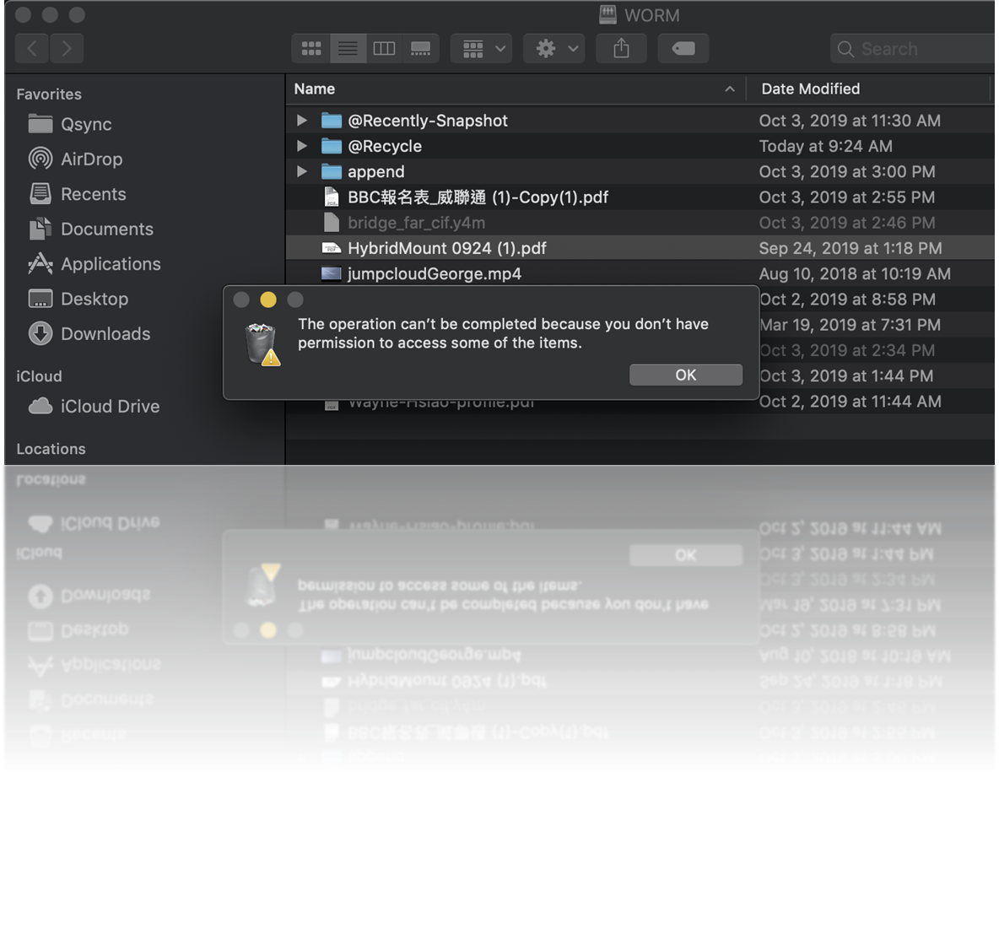
WORM (Write Once Read Many times)
WORM is used to avoid modification of saved data. Once this feature is enabled, data in shared folders can only be read and cannot be deleted or modified to ensure data integrity.
Enterprise Mode
remove the shared folder through QuTS hero UI or SSH commands (QCLI).
Compliance Mode
Have to take the Storage Pool offline and remove the Pool if want to destroy data.

Slide 23
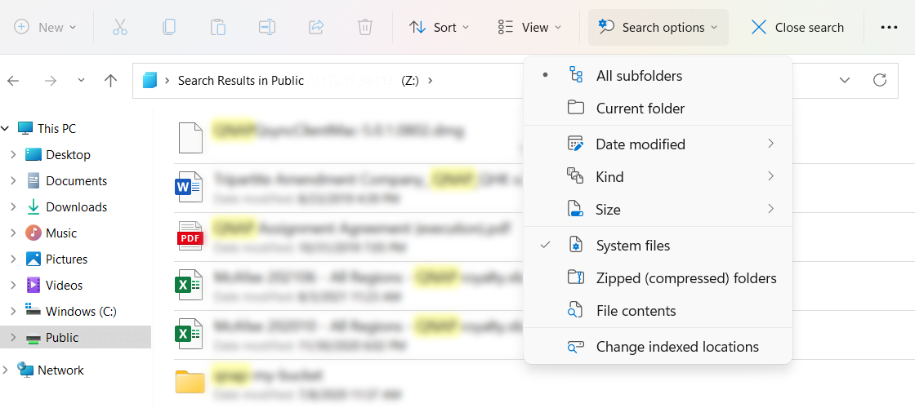
Windows Search Protocol (WSP) support for NAS shared folders
Windows® 10/ Windows Server® 2016 (or later) users can easily search NAS shared folders via Windows® when an SMB drive is mounted to the NAS. Advanced file search by time, file type, or size is supported for greater convenience.
*QTS 5.0.1 provided

Slide 24
Windows Search Protocol (WSP) support for NAS shared folders
Windows® 10/ Windows Server® 2016 (or later) users can easily search NAS shared folders via Windows® when an SMB drive is mounted to the NAS. Advanced file search by time, file type, or size is supported for greater convenience.
*QTS 5.0.1 provided

Slide 25
TS-253E / TS-453E natively supports exFAT
From QTS version 5.0, exFAT is natively supported free of charge on TS-253E / TS-453E . exFAT is a file system optimized for flash storage (such as SD cards and USB devices) and helps accelerate large media file transfer.
File System | exFAT | NTFS | FAT32
Maximum File Size | 16EB | 16TB | 4GB
Typical Usage | Next-generation USB drives and SD cards (such as SDXC) that require higher capacities and faster speeds | The file system used by Windows | The standard file system used by normal USB drives

Slide 26
Faster image identification with integrated Intel® OpenVINO™ AI engine
QuMagie
Organize photos with similar faces using facial recognition
QNAP NAS
Mobile
Browse, Manage Photos
Mobile
Upload, Backup Photos
Camera
QuMagie
PC
QNAP AI Core
Share Photos
PC
Social Media

Slide 27
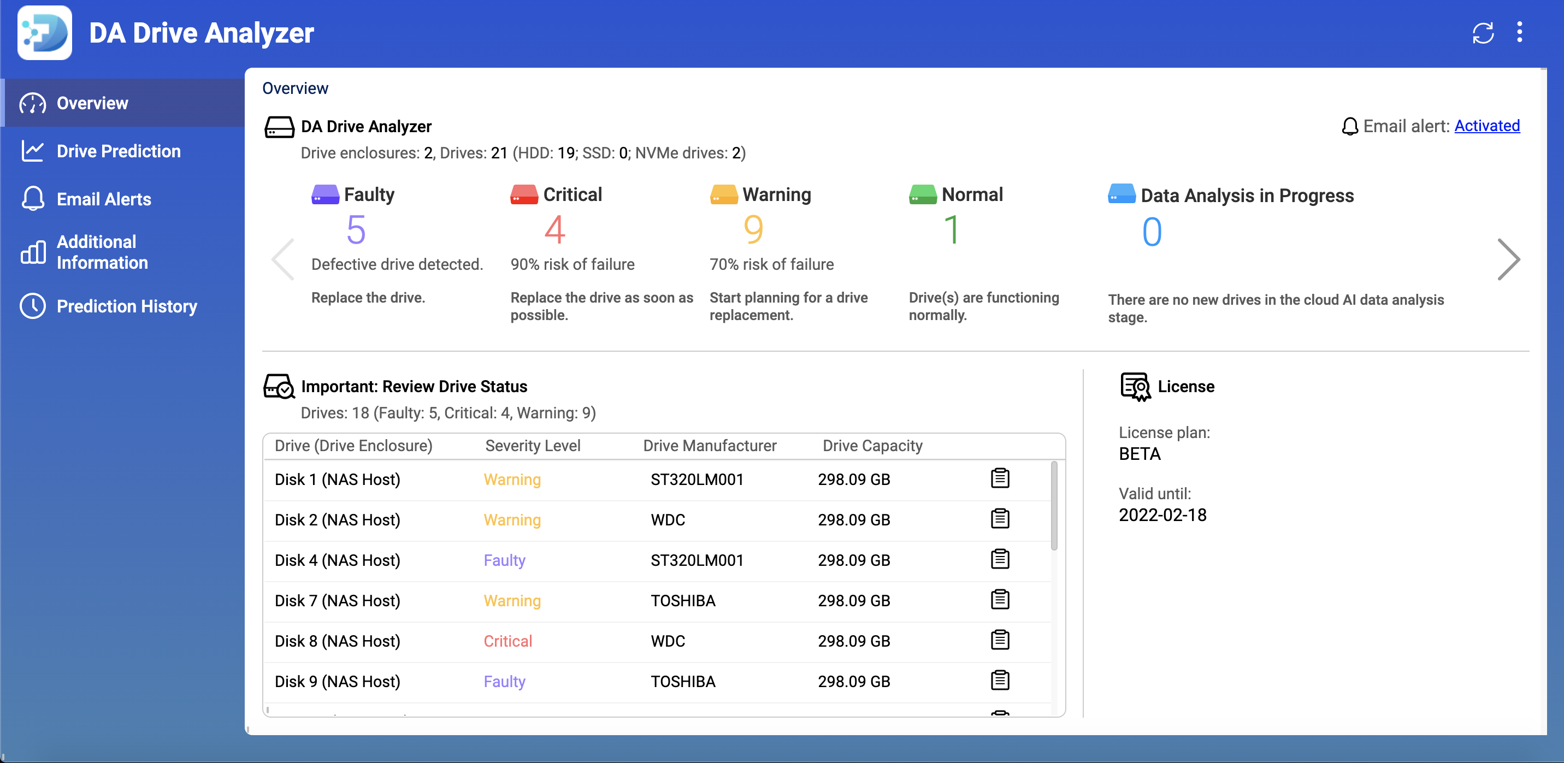
DA Drive Analyzer , predict drive failure and minimize downtime
1 free disk prediction per NAS
Paid subscription for additional disks for added protection
Predict Drive Failure and Minimize Downtime
DA Drive Analyzer integrates ULINK cloud artificial intelligence technology, which can notify you before disk failure, helping you prevent data loss or downtime loss caused by unwarranted disk damage.

Slide 28
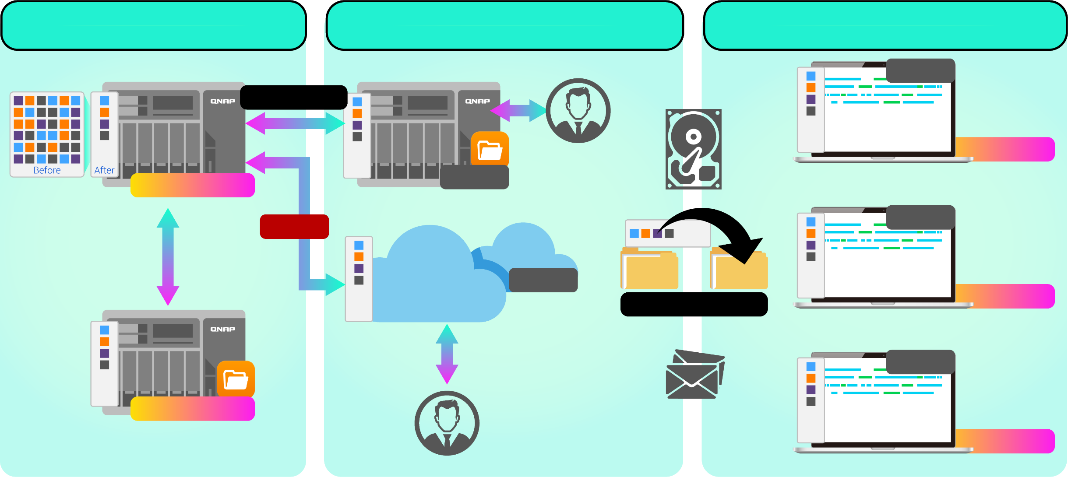
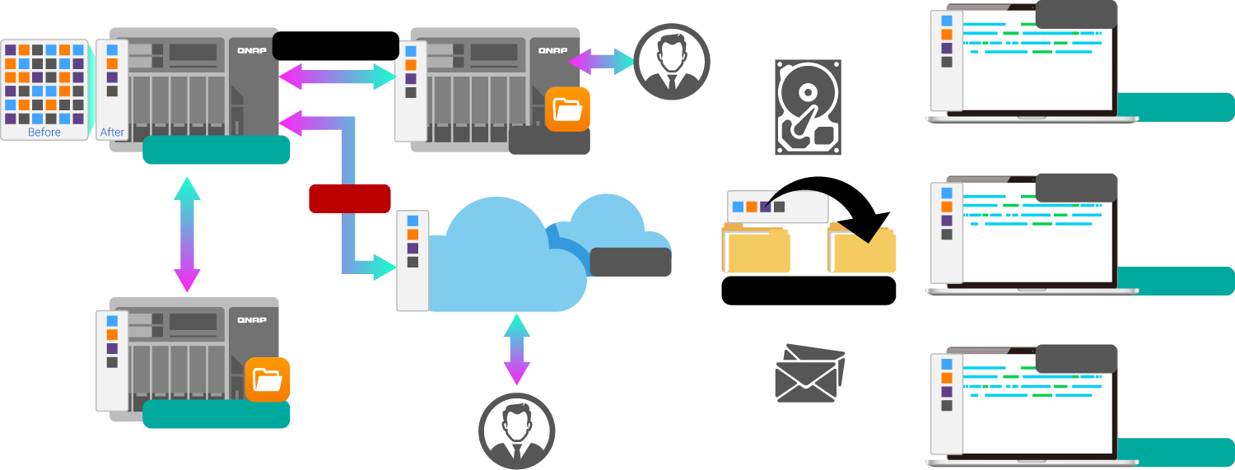
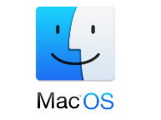
Backup data with deduplication in HBS 3
Hybrid Backup Sync 3
Keep 3 copies, on 2 types of storage, and store 1 copy off-site to ensure your data safety.
From local NAS
(via HBS 3)
From remote NAS
(via File Station )
Carry and Use
(QuDedup Extract Tool)
.qdff
Backup/Restore
Tokyo
Taipei
.qdff
File station with QuDedup (soon)
.qdff
TCP BBR
.qdff
CIFS / NFS / FTP
New York
.qdff
Taipei
Access from Cloud
File station with QuDedup (soon)
Beijing

Slide 29
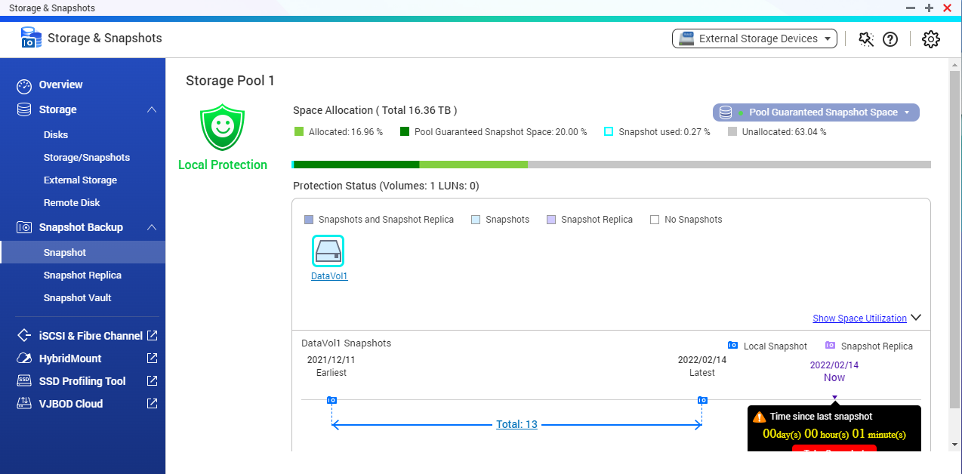
Snapshots help you fight with ransomware threats, security threats and human errors
TS-253E / TS-453E supports Snapshot, like taking a photo - within seconds the complete status of your NAS system and data is recorded.
Mitigate the growing threat of ransomware
Step 1
Regularly update, and use Malware Remover
Step 2
Routinely back up to your NAS, and create multi-version snapshots
Step 3
Back up snapshots to another QNAP NAS

Slide 30
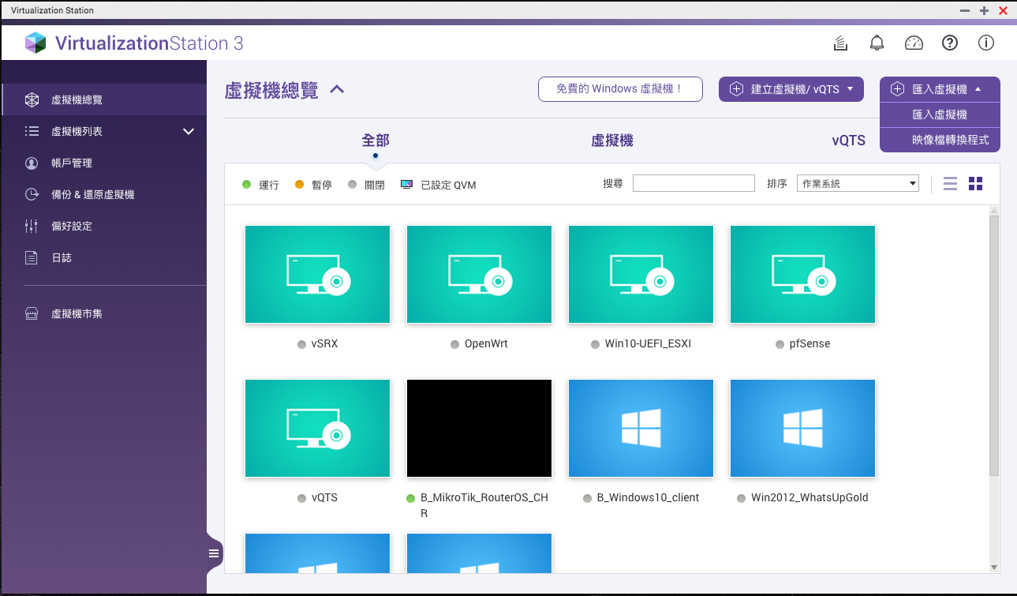
Virtualization Station for running VMs
Virtualization Station
With Virtualization Station, you can create multiple virtual machines to run various operating systems such as Windows, Linux, UNIX and Android on TS-253E / TS-453E.

Slide 31
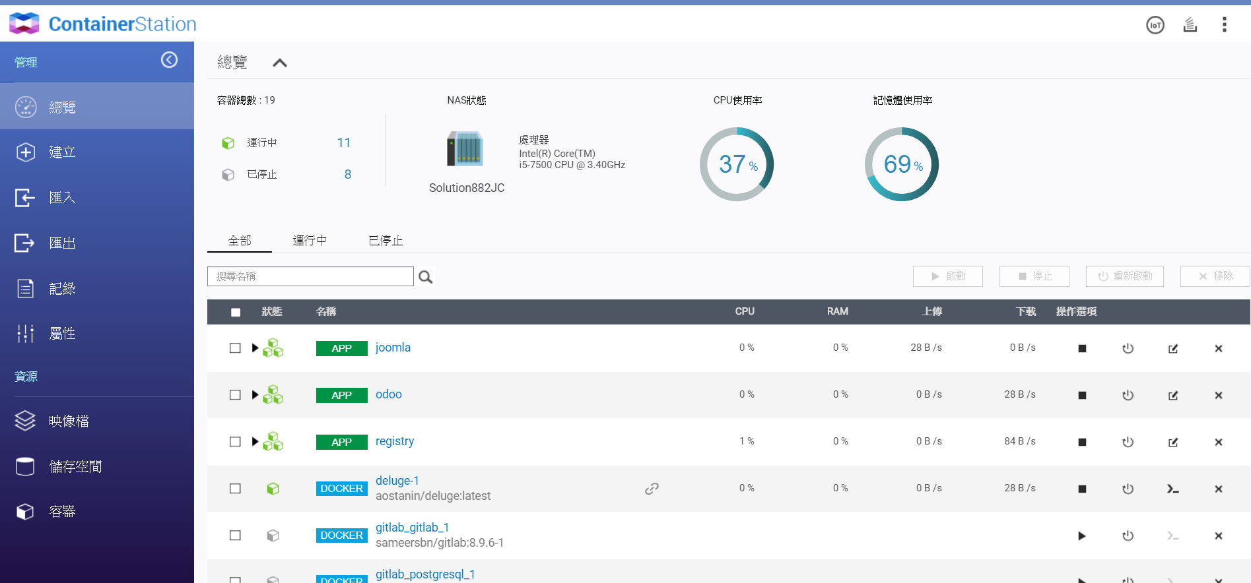
Container Station for containerized apps
Container Station
Exclusively integrates LXD and Docker®, Kata lightweight virtualization technologies, allowing you to operate multiple isolated Linux® systems on a QNAP NAS as well as download apps from the built-in Docker® Hub/LXD Image Server Registry.

Slide 32
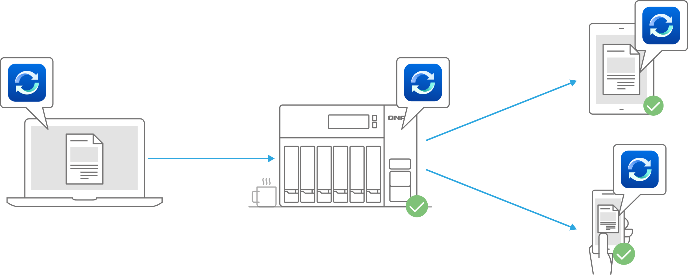
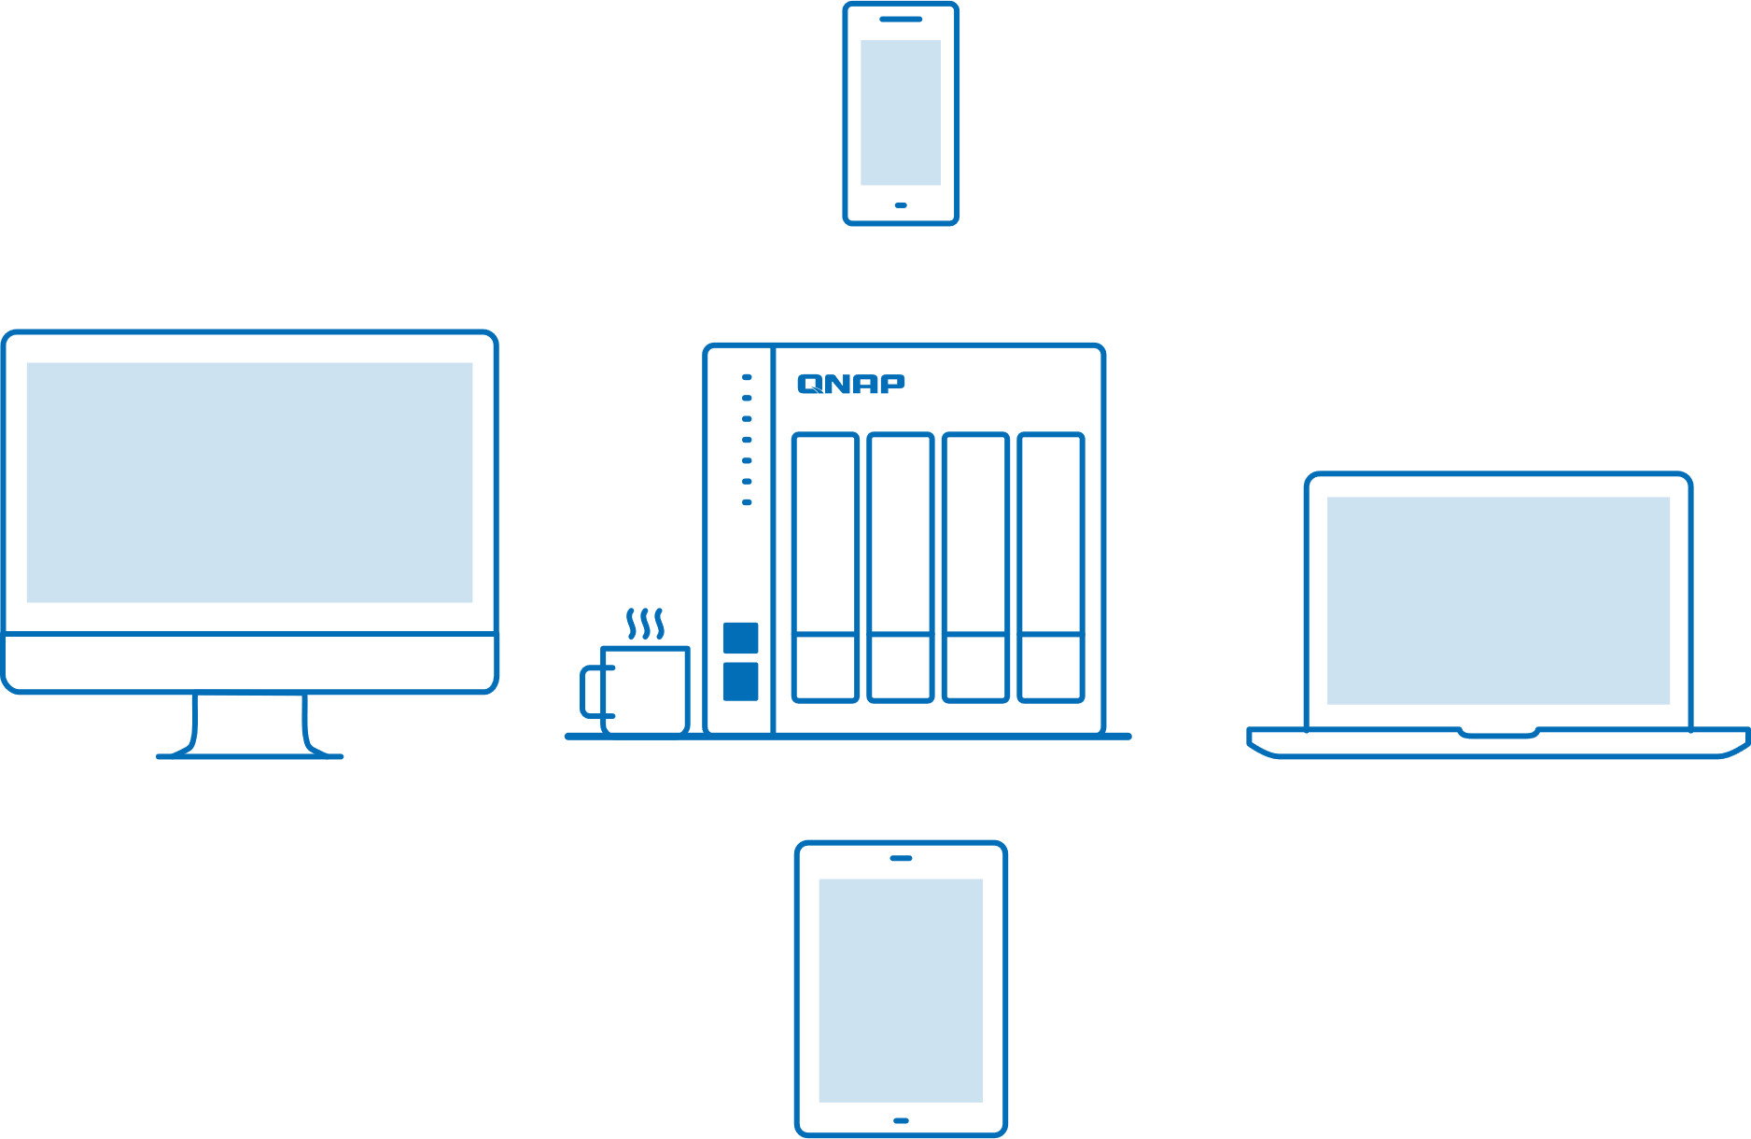
Qsync , cross-device file sync for individuals and teams
When there are different devices such as laptops and mobile phones, as long as the files are modified on a single device, the modified files will be automatically synchronized to other devices.
When team members collaborate and communicate, files can be automatically pushed to the binding devices of all members, making the workflow faster and collaboration smoother.

Slide 33
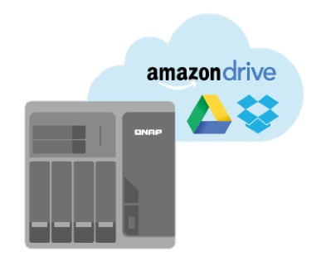
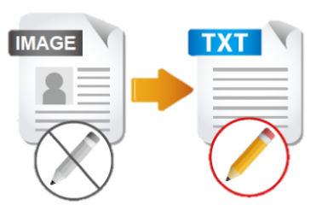
The NAS provides a productive office file management flow with useful apps
File Station
OCR Converter
Qsirch
Qfiling
Store and backup
File Digitization
Search
Archive

Slide 34
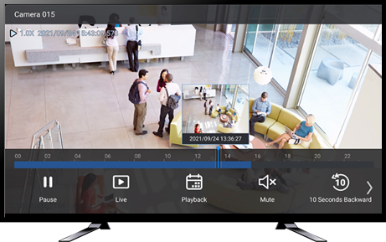
TS-253E / TS-453E support dual HDMI 4K output
支援 HDMI 4K 螢幕輸出
Dual HDMI 4K output
Directly connect the dual-screen output, you can extend and mirror the screen, use it as a large-screen monitor, or install the HybridDesk Station to turn it into a theater.

Slide 35
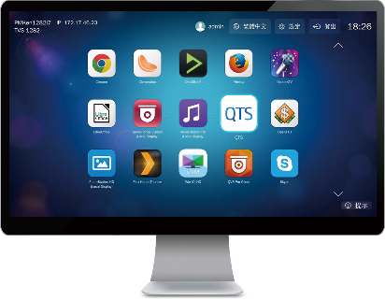
HybridDesk Station for various A/V needs
HDMI
USB
Network
Mouse &
Keyboard
Qremote App

Slide 36
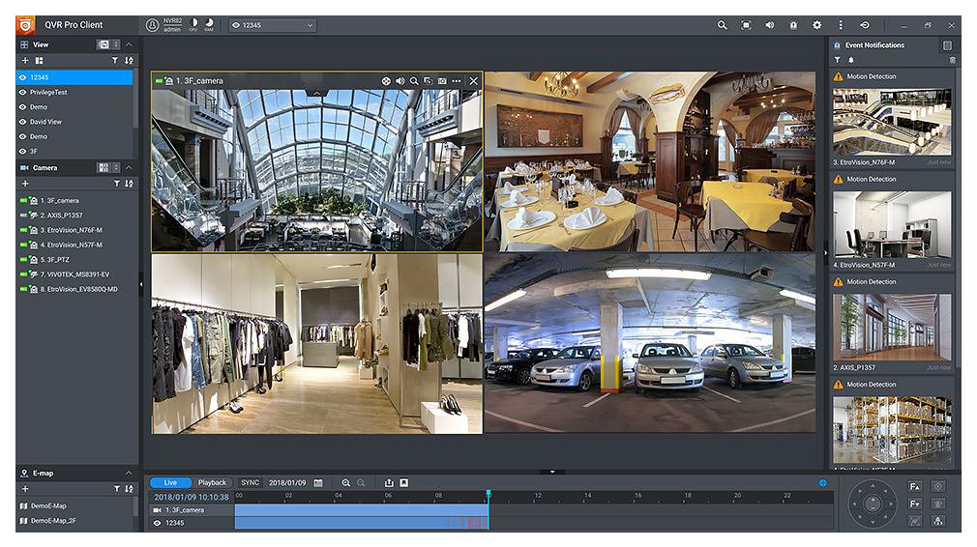
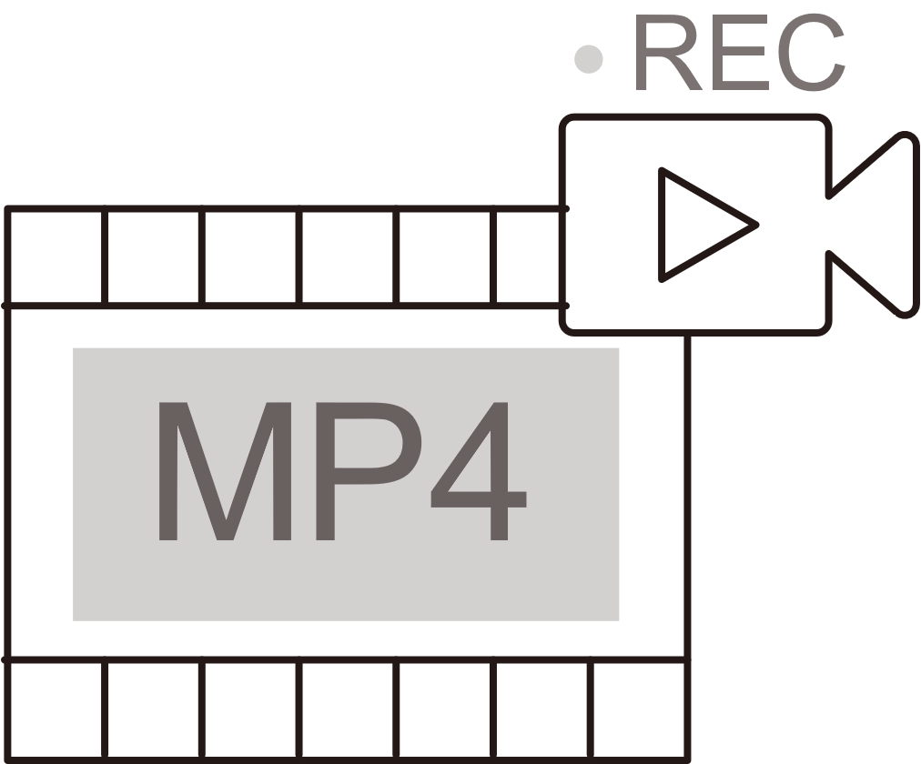
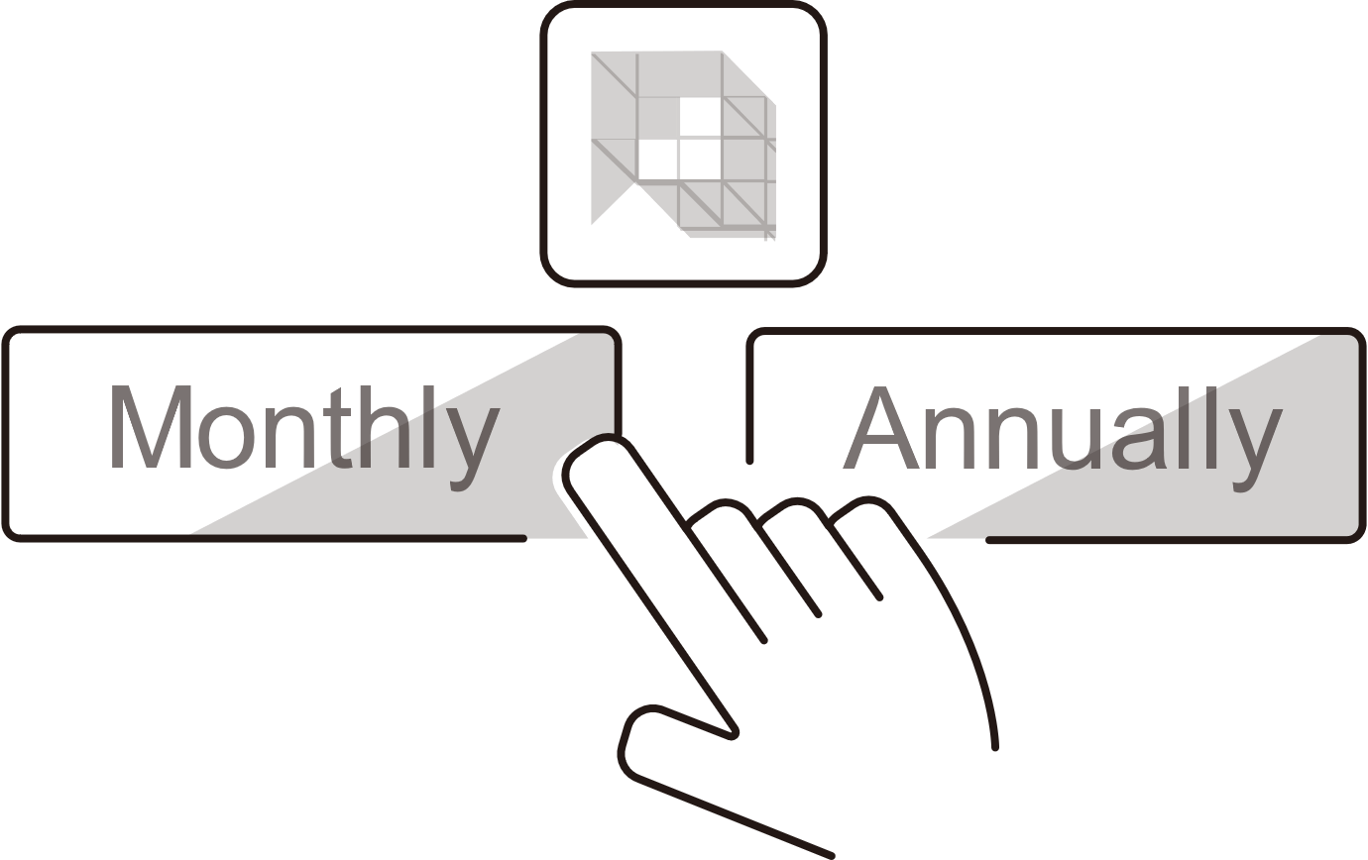
QVR Elite 24 x7 smart surveillance system
Record using the MP4 Format
Flexible Subscription
2 channels are included for free
(expandable)
Expandable Capacity

Slide 37
QVR Elite with powerful IP surveillance camera management and support
More than 180 brands
More than 6700 models
ONVIF Profile support
Record into QVR Elite by using the RTSP/RTMP link with no integration needed. Multiple video sources are supported - not just IP cameras.
https://www.qnap.com/en/compatibility-qvr-pro

Slide 38
Upgrade to a surveillance video wall solution or use dual apps with dual HDMI output
Assign many IP CAMs in video wall mode in different HDMI monitors
We can move the QVR monitoring output to another screen and operate other APPs on the original screen

Slide 39
Through Mirror output, the same picture can also be output to different screens
Through Mirror output, the same picture can also be output to different screens
With Mirror output, the same picture can be output to monitors in different places for monitoring

Slide 40
Built-in firewall for QNAP appliances
QuFirewall
User 1
You can allow/deny IP addresses and regions to prevent unauthorized access and brute force attacks for safeguarding data and service security.
User 2
Internet
Firewall
NAS
QuFirewall

Slide 41
Secure communication for peace of mind
QVPN
In addition to establishing a VPN client connection to a remote server, QVPN can also be used as a VPN server.
Supports WireGuard® to provide faster and more stable VPN connections, and to easily set up VPN

Slide 42
QuFTP remote file FTP access service
Updated independent
Support FTP server
Support FTP client
Support TLS setting
Support QoS setting

Slide 43
The new TS-253E / TS-453E with greatly improved performance
與前代機種之規格比較
 | TS-251+ | TS-253E | TS-451+ | TS-453E
SKU | TS-251+-2G TS-251+-8G | TS-253E-8G | TS-451+-2G TS-451+-8G | TS-453E-8G
CPU | Intel® Celeron® J1900 4-core/4-thread processor, burst up to 2.42 GHz | Intel® Celeron® J6412 4-core/4-thread processor, burst up to 2.6 GHz | Intel® Celeron® J1900 4-core/4-thread processor, burst up to 2.42 GHz | Intel® Celeron® J6412 4-core/4-thread processor, burst up to 2.6 GHz
O.S. | QTS | QTS | QTS | QTS
Memory | Max 8 GB DDR3L (2 x 4 GB) | 8 GB DDR4 onboard not expandable | Max 8 GB DDR3L (2 x 4 GB) | 8 GB DDR4 onboard not expandable
LAN | Gigabit Ethernet Port (RJ45) x 2 | 2 x 2.5 Gigabit Ethernet Port (2.5G/1G/100M) | Gigabit Ethernet Port (RJ45) x 2 | 2 x 2.5 Gigabit Ethernet Port (2.5G/1G/100M)
M.2 | - | 2 x M.2 2280 PCIe Gen 3 x2 | - | 2 x M.2 2280 PCIe Gen 3 x2
I/O | USB 2.0 x 2 2 x USB 3.2 Gen 1 HDMI x 1(Max 1080p) | USB 2.0 x 2 2 x USB 3.2 Gen 2 HDMI x 2 (up to 3840 x 2160 @ 30Hz) | USB 2.0 x 2 2 x USB 3.2 Gen 1 HDMI x 1 (Max 1080p) | USB 2.0 x 2 2 x USB 3.2 Gen 2 HDMI x 2 (up to 3840 x 2160 @ 30Hz)

Slide 44
Shipped with 3-year standard warranty, optional 2 additional years of coverage
TS-253E / TS-453E
Backed by a 3-year warranty at no additional cost.
TS-253E
TS-453E
Extend hardware warranty
up to 5 years
You can also purchase a warranty extension that extends your warranty coverage up to 5 years: LW-NAS-PEACH-2Y.

Slide 45
TS-x53E
Intel Celeron® 高效四核心處理器， 2/4-bay穩定長期供應的 NAS，具有雙 2.5GbE 網路埠和雙 HDMI 螢幕輸出。是MSP、SI 進行長期專案需求的理想選擇。
Intel® J6412 Quad-Core Long-Term Availability NAS for Business and Professional Users
為SOHO與專業用戶打造的Intel®四核心長期供貨NAS
提供雙埠2.5 GbE、4K HDMI雙螢幕輸出，以及雙M.2 PCIe SSD 擴充槽
TS-253E
TS-453E
Provides dual-port 2.5 GbE, 4K HDMI dual-screen output, and dual M.2 PCIe SSD expansion slots
v1.1 202408
Copyright© 2024 QNAP Systems, Inc. All rights reserved. QNAP® and other names of QNAP Products are proprietary marks or registered trademarks of QNAP Systems, Inc. Other products and company names mentioned herein are trademarks of their respective holders.​​​​​​​
Andy Chuang

