Slide 1
Company Profile
2022

Slide 2
About QNAP
Product Applications
Full QNAP Product Lineup
Operational Sustainability
Global Businesses Deployment
Manufacturing and Quality Control

Slide 3
About QNAP
The name of QNAP originates from “Quality Network Appliance Provider”.
We are committed to developing software applications, dedicated to optimizing hardware design, and have established our own production lines to offer comprehensive and cutting-edge technological solutions.
QNAP was established in 2004
We have 12 subsidiaries / 5 offices in 28 countries around the world to serve our customers
More than 1300 fantastic employees work at worldwide locations of QNAP
Over 600 engineers dedicated to R&D and innovation

Slide 4
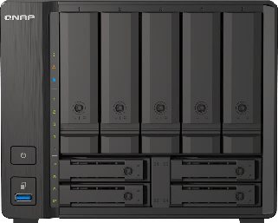
Values
Smart innovation that integrates storage, networking, and video communication to redefine modern IT solutions
Vision
Software-defined architectures to establish future-proof digital information flow
Mission
Drive enterprise digital transformation with innovative information technology

Slide 5
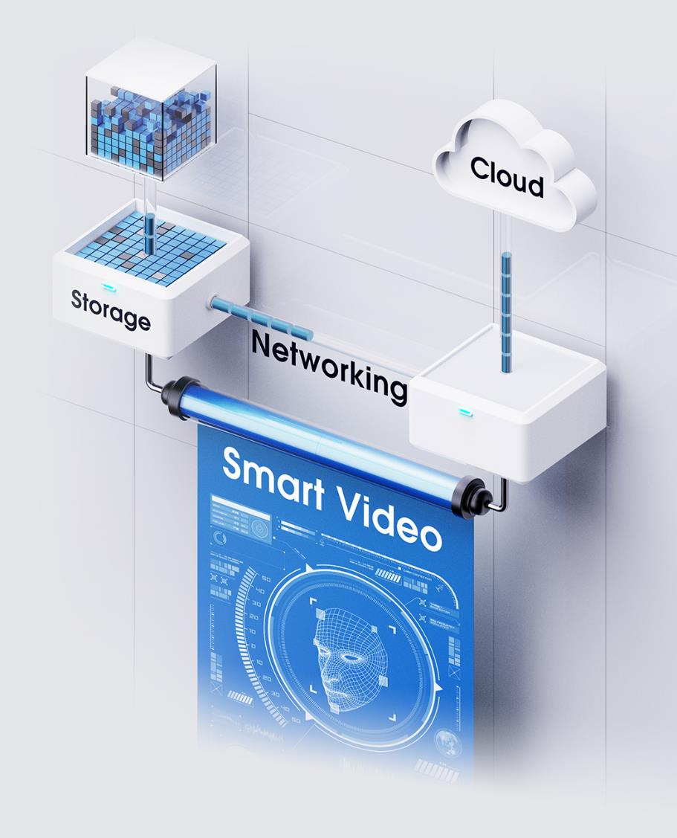
Core Competency
Virtualized Storage and Network Communication
Integrated Hybrid Cloud and AI Value-added Information Technology
In-house Production foundation and Full-process Production Lines
Vertical Market Deployment for High-Penetration Businesses
Local Before-and-After Sales Services from Worldwide Subsidiaries

Slide 6
Yearbook
TH office: Established in Bangkok, Thailand, offering before-and-after sales services
UK office: Established in Swindon, UK office and warehouse offer services to customers in UK & Ireland
HK office: Established in Kowloon Bay, offering before-and-after sales services to the customers in Hong Kong and Macau
NL Warehouse
Established in Bleiswijk, responsible for deliveries to European countries
JP office
Established in Tokyo, offering before-and-after sales services
European Headquarters: Based in Willich, Germany, the warehouse and service center covers European customers
QNAP Headquarters Established in Taipei
2004
2012
2016
2018
2022
2009
2015
2017
2021
US office/Warehouse Established in Pomona, California, mainly offering services to customers in the Americas
CA office: Established in Markham, Canada, offering before and after sales services
DE office: Established in Willich, Germany, the office and warehouse offers high-end models to European customers
IT office: Established in Rome, Italy, offering before-and-after sales services
QIN: Established in Bengaluru, India, with an R&D and after-sales service center
GeneVisio Co. Ltd.: Dedicated to 5G networks and telecommunications, offers the core solutions of 5G networks

Slide 7
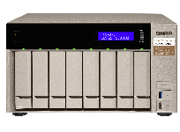
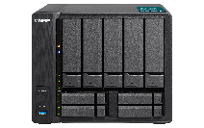
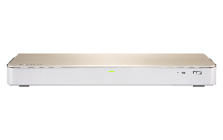
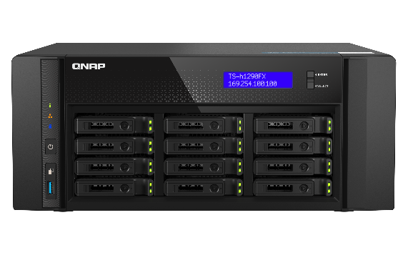
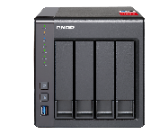
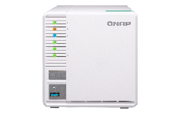
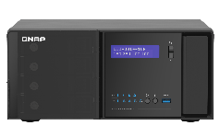
Awards
2017 Red Dot Award: Product Design
2018 Red Dot Award: Product Design
CES 2019
Innovation Awards
TVS-873 10GbE Business NAS
TVS-951X 9-bay 10GbE Multimedia NAS
HS-453DX Fanless NAS
2017 EHA (European Hardware Awards)
2018 Best Choice Award
2021 Red Dot Award: Innovative Product Design
NAS Excellence Awards
TS-328 3-bay RAID 5 NAS
QGD-3014-16PT Desktop Smart Edge PoE Switch
2022 Red Dot Award: Product Design
TS-451+ Quad-Core NAS for homes and businesses
TS-h1290FX Desktop 12-bay All-Flash NAS

Slide 8
Worldwide Deployment of Subsidiaries
The deployment of QNAP subsidiaries around the world is shown as follows
UK
2022 Willich
Swindon 2018
Germany (Headquarters in Europe)
Sales / Marketing / Warehouse / After-Sales Service
Sales / Marketing / Warehouse / After-Sales Service
Canada
Ontario 2015
2021 New Taipei City
Taiwan (GeneVisio Co., Ltd.)
Sales / Marketing / Technical Support
Core Solutions of 5G Network
2016 Tokyo
Japan
USA
Pomona 2009
Sales / Marketing / After-Sales Service
Sales / Marketing / Warehouse / After-Sales Service
2018 Kowloon Bay
Hong Kong
Italy
Roma 2015
Sales / Marketing / Technical Support
Sales / Marketing / After-Sales Service
2018 Bangkok
Thailand
Sales / Marketing / Warehouse / After-Sales Service
2017 Bengaluru
India
Sales / Marketing / R&D / Technical Support

Slide 9
Corporate Leadership
Chairman of QNAP
Teddy Kuo
General Manager of QNAP
Meiji Chang
QUS
QCA
QDE
QGV
QHK
QIT
QJP
QTH
QUK
QIN
James Wu
Regional VP of US
Siimon Tsai
Regional VP of Canada
Dale Chen
Regional VP in Europe
Bryon Lin
General Manager of GeneVisio Co., Ltd.
Banson Chang
Regional VP of Asia Pacific
Tony Chou
Regional Manager of Southern Europe
Jack Yang
Regional VP of Japan & Korea
Banson Chang
Regional VP of Asia Pacific
Posen Wang
Regional Manager of UK
Prasanna Mumbai
Office Manager of India R&D Center

Slide 10
Major Customers
Agents

Slide 11
Major Customers
eShop

Slide 12
Major Customers
Retailer

Slide 13
Major Customers
Reseller

Slide 14
Xizhi Headquarters
Number of Employees
456
Scope of Business
Administration
General Affairs
Finance
Legal
Information
Sales and Marketing
Product Development
R&D
Testing
Technical Support
Logistics

Slide 15
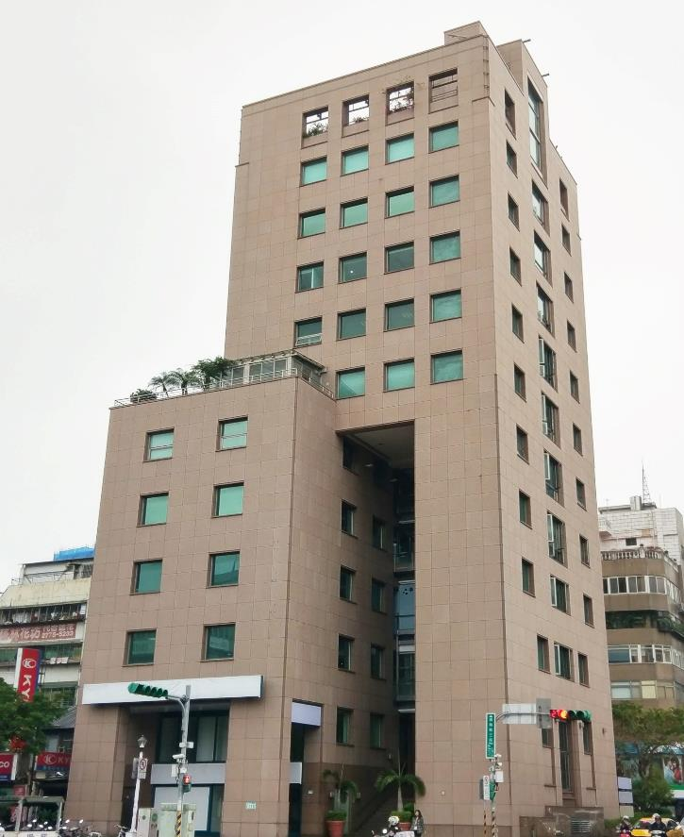
Xinsheng Office
Number of Employees
118
Scope of Business
Product Development / R&D

Slide 16
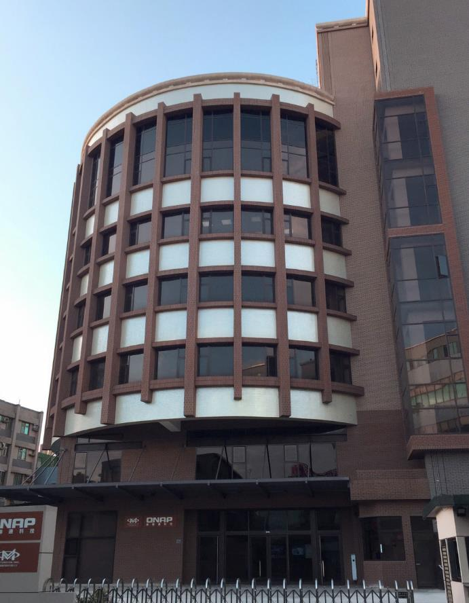
Hsinchu Office
Number of Employees
98
Scope of Business
Product Development / R&D

Slide 17
Taichung Office
Number of Employees
18
Scope of Business
Product Development / R&D

Slide 18
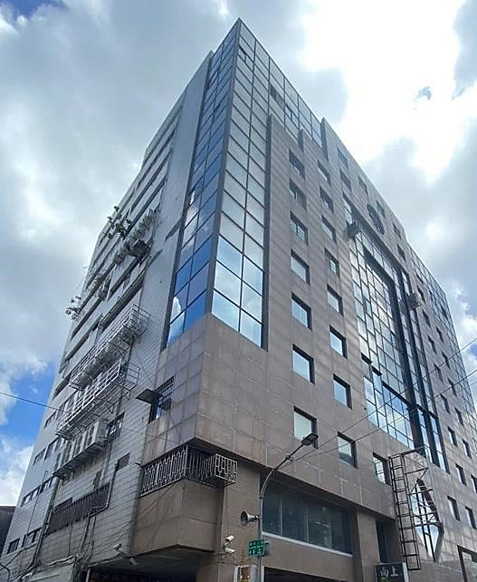
Kaohsiung Office
Number of Employees
57
Scope of Business
Product Development / R&D

Slide 19
Product Applications

Slide 20
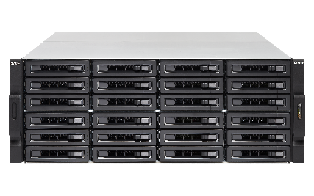
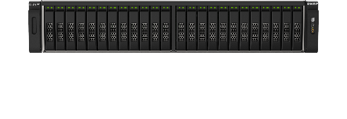
Information Engineering
IT Storage Architecture
Data Backup and Recovery
Infrastructure as a Service (IaaS)
Workspace Collaboration
Network Infrastructure

Slide 21
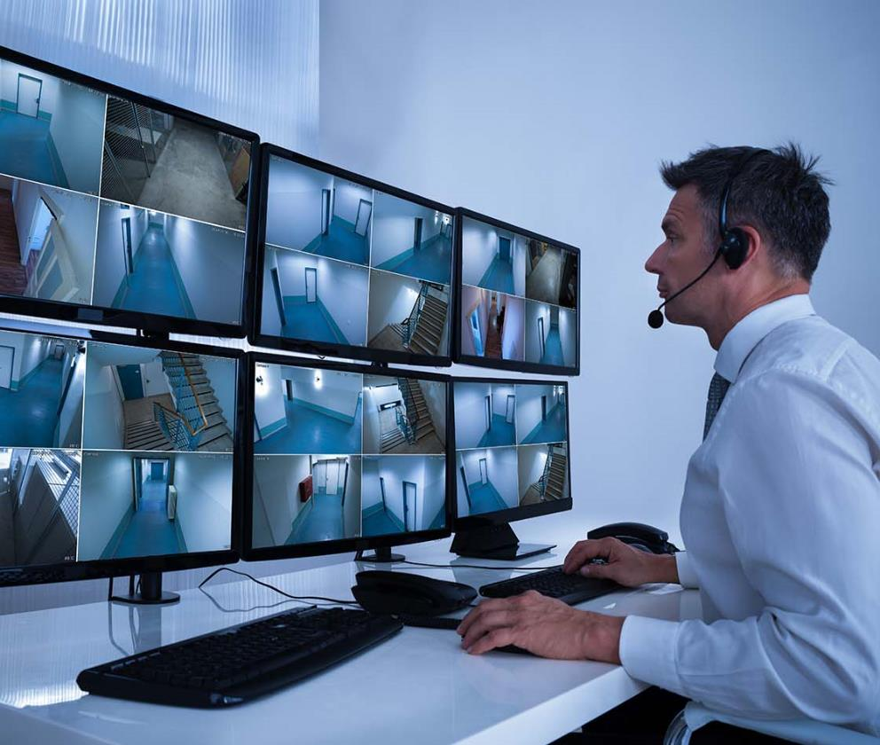
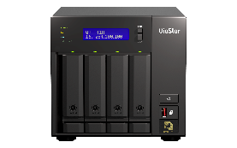
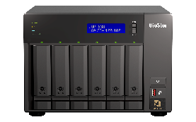
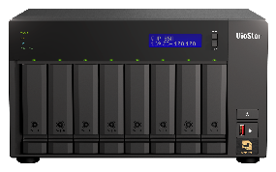
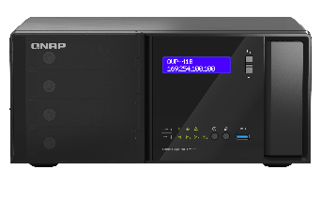
Video Surveillance & Teleconferencing
Live Stream and Surveillance
AI-powered Surveillance Event Search
High-availability Recording Takeover
HD Wireless Projection
Multipoint Video Conference System

Slide 22
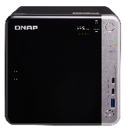
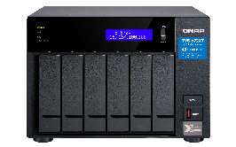
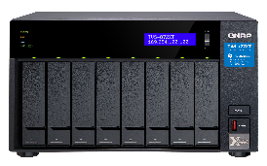
Content Creator & Video Editing
4K High Resolution Online Editing
Thunderbolt High-speed Transmission
Petabyte-scale File Storage
Integrates Non-linear Editing Applications
Direct-attached Storage

Slide 23
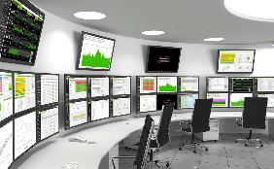
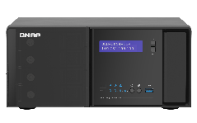
Retail & Department Stores
AI Smart Retail Data Analysis
Facial Recognition Tracking with Non-overlapping Camera Views
Heat maps of People Flow
Computes Visit Duration and Conversion
Centralized Cloud Management

Slide 24
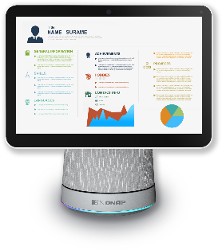
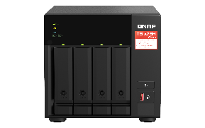
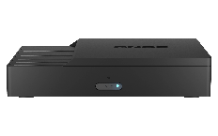
Healthcare
Storage and Backup of Confidential Data
Machine Learning Model for Medical Imaging
Extraction of Medical Journals and Documents
Telemedicine and Interaction
DICOM Integration

Slide 25
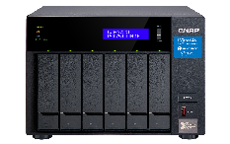
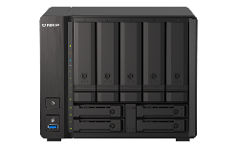
Education
Multipoint Data Sharing and Synchronization
FTP File Management System
Small form factor Classroom
Storage Device
Remote Learning and Interaction
Campus Safety Surveillance
Product
Short-Chassis Rackmount Model - TS-873AeU / TS-864eU-RP / TS-435XeU
Desktop NAS – TVS-672XT / TS-h973AX
KoiBox

Slide 26
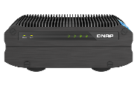
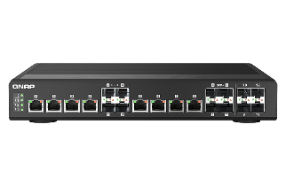
Industrial Manufacturing
NAS with Wide‑temperature and Wide-voltage Power Supply
Network Switch with Industrial Network Management
Objective Ransomware Information Defensive System
PoE++ / PoE+ Power over Ethernet Switch
IoT Private Cloud Platform
Product
TS-i410X, QSW-IM1200-8C, ADRA-3010P, QGD-1602P

Slide 27
Full QNAP Product
Lineup

Slide 28
All-flash storage. Ultimate performance.
QNAP’s All-Flash Storage Solutions feature ZFS data reduction and SSD optimization technologies to maximize SSD performance and lifespan. Perfect for keeping your business agile and efficient!
Flash-optimized storage
Inline data compression and compaction
Write amplification is an undesirable effect of SSDs, bringing challenges to flash memory performance and endurance. QNAP’s exclusive Write Coalescing algorithm is engineered for flash optimization by transforming all random writes to sequential writes along with reduced I/O. It not only effectively increases random write performance for all-flash environments but can also improve SSD lifespans.
Inline data compression shrinks file sizes to lower storage I/O workloads for improved performance. It also helps optimize storage utilization of SSD over-provisioning.
Quality of service
SSD TRIM
Quality of Service helps optimize resource allocation based on I/O and bandwidth for LUNs/shared folders at different service levels. QoS prioritizes the performance of business-critical applications that run concurrently with non-critical applications as well as reducing "noisy neighbor" problems.
While almost all SSDs have shown consistent write performance degradation, TRIM helps overcome write performance drops. SSD TRIM allows the system to inform SSDs to delete unneeded data blocks. Deletion tasks are processed during system idle times, meaning it does not have to wait for when new data is written to the block.

Slide 29
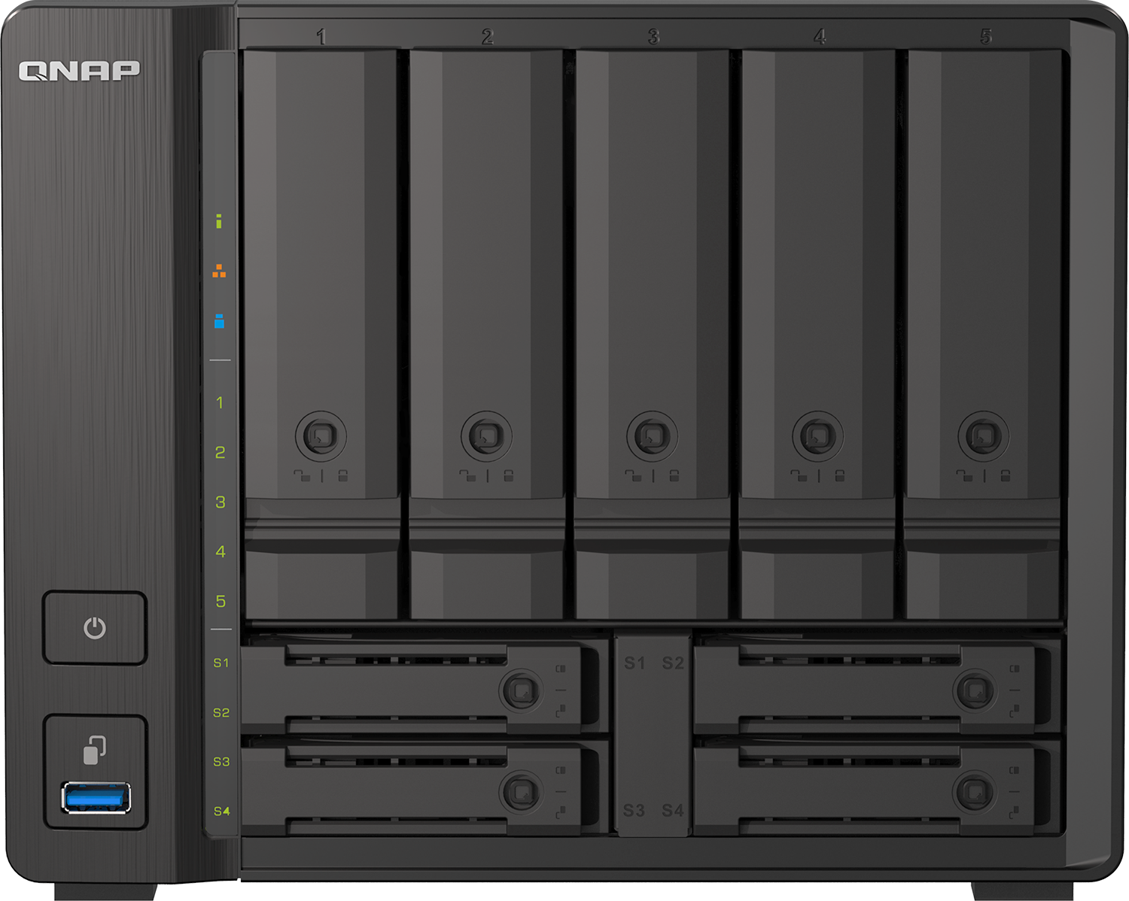
High-performance ZFS-based OS with greater reliability
QNAP’s QuTS hero operating system combines the app-based QTS with a 128-bit ZFS file system to provide flexible storage management, comprehensive data protection and optimized performance to meet the needs of business-critical applications.
Efficient data reduction technology
Up to petabyte capacity per shared folder
Inline data deduplication is block-based and runs before data is written to storage. This greatly optimizes storage usage while significantly decreasing storage capacity requirements. Coupled with inline compression and inline compaction technologies, ZFS significantly reduces the overall storage footprint - especially helpful for increasing SSD storage efficiency when highly-repetitive data or massive small files are generated.
The 128-bit ZFS filesystem has huge capacity potential and natively supports standard RAID levels and additional ZFS RAID layouts (RAID Z). ZFS-based QNAP storage solutions provide up to 5PB capacity for individual shared folders, enabling enterprises to tackle storage-demanding applications.
Near-limitless, instant snapshots
Real-time SnapSync
ZFS supports up to 65,535 snapshots for iSCSI LUN and shared folders to accomplish well-rounded snapshot versioning. If 1 snapshot is created every hour, 24 snapshots per day, then up to 7 years of snapshots can be created without needing to delete any!
The advanced block-based real-time SnapSync ensures that a primary and secondary NAS always keep the same data, providing the strongest support for nonstop business operations and helping users remove the risk of data loss!

Slide 30
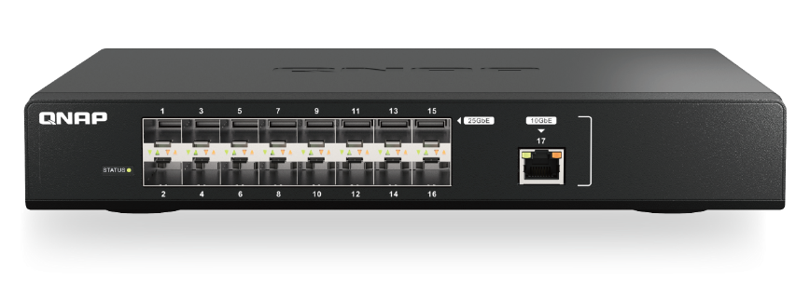
High-speed 25GbE networking
Enable lightning-fast throughput for bandwidth-demanding tasks such as virtualization, massive data transmission, and fast backup/restoration.
25GbE-ready All-flash NAS
The TS-h3088XU-RP provides a built-in dual-port 25GbE SFP28 SmartNIC with the NVIDIA® Mellanox ConnectX-4 Lx SmartNIC controller that supports iSCSI Extensions for RDMA (iSER) to increase performance of data transfer between NAS and ESXi server and offload CPU workloads.
Affordable 25GbE managed switch
The QSW-M5216-1T is a 25GbE Layer 2 web managed switch that provides flexible network interfaces for high compatibility at an affordable price, enabling small businesses to quickly upgrade to an ultra-high-speed backbone network by integrating to existing network infrastructure.

Slide 31
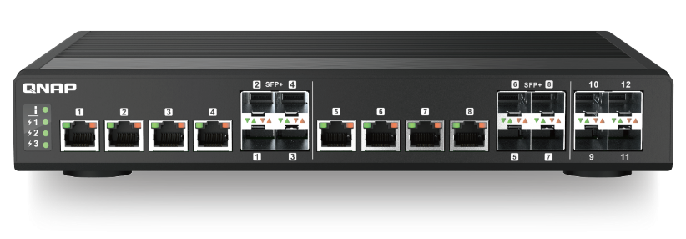
10GbE connectivity:
The future is now!
10GbE connectivity improves overall network performance and everyday tasks with ten times the bandwidth of 1GbE. By offering 10GbE-ready NAS, network adapters and switches, QNAP is a one-stop provider for everything you need to create your own 10GbE environment.
10GbE NAS solutions
QNAP provides a range of NAS with integrated hardware and software solutions that can make the most of the incredible bandwidth provided by 10GbE networks.
10GbE network adapters
10GbE switches
QNAP provides 10GbE PCIe expansion card and Thunderbolt to 10GbE adapters to empower devices with 10GbE connectivity. The QM2 Expansion Card not only includes 10GbE connectivity, but also provides the ability to add M.2 SSDs to your workstation or NAS.
QNAP’s QSW Series 10GbE switches supports 10GBASE-T and NBASE-T standards, allowing you to take advantage of higher network speeds with existing Cat 5e and 6a cables. Both SFP+ (fiber) and RJ45 (copper) ports are available for servicing a range of network needs.

Slide 32
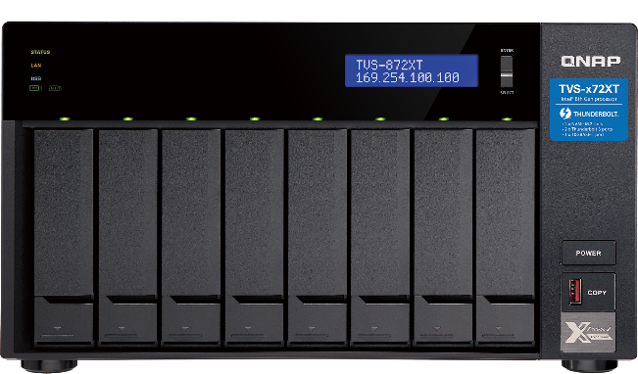
Breakthrough performance and outstanding connectivity with Thunderbolt NAS
QNAP offers the very best in connectivity with Thunderbolt™ NAS. Providing speed and versatility that standard NAS cannot match, video production professionals using QNAP Thunderbolt™ NAS enjoy enhanced workflows, unprecedented speed, and incredible versatility.
Ultra-high speed transfer
High availability with USB Type-C
With transfer speeds of up to 40GbE, file sharing and high-resolution multimedia editing is greatly boosted.
Compatible with USB Type-C, Thunderbolt NAS can easily centralize file storage and sharing from any USB Type-C device without needing a different cable.
Facilitate 10GbE workflows with Thunderbolt-to-Ethernet
Collaboration station for Mac and Windows
The increased bandwidth of Thunderbolt 3 enables smooth video editing and faster file sharing for photographers, video editors and graphic designers. Several Thunderbolt™ devices can be connected to the Thunderbolt NAS to process real-time photo and audio editing simultaneously without impacting system performance.
The innovative T2E Converter bridges Thunderbolt and Ethernet networks, allowing Thunderbolt-enabled computers to connect to these networks via their Thunderbolt connection to the Thunderbolt NAS. This saves a 10GbE port and eliminates the need for extra adapters or network cards.

Slide 33
Flexible and economical storage expansion
RAID Support
QNAP DAS supports various RAID levels to improve performance and data protection.
Simple Interface
The QNAP External RAID Manager helps monitor the DAS system, drives, and health status. It automatically sends system alerts to your PC if an error occurs.
Direct-attached Storage (DAS) adds additional storage capacity to your PC by being directly connected via USB or another port. DAS is usually plug-and-use to a single device and is suitable for users who seek extra storage space and not the advanced features and network connectivity of NAS.
For NAS Expansion
QNAP DAS can be used with either USB Type-C, SATA, or SAS for faster data transfer and can be easily managed using QTS / QuTS hero Storage & Snapshots. The TL series is suited for NAS expansion.
Effortless Setup
The DAS is completely plug-and-use and does not require any network configuration. An eject button is included to quickly remove the DAS from the connected computer.
For PC Expansion
QNAP DAS are ideal choices for PC users looking to expand their storage space. They use USB Type-C, SATA, or SAS for faster data transfer and support software and hardware-controlled RAID configurations for flexible storage configuration.

Slide 34
Next-generation intelligent IP surveillance and remote backup solution
Records using the MP4 video format
QVR Elite records video files in the universal MP4 format, allowing for smooth playback on any device. In addition, you can conveniently back up recordings to other QTS / QuTS hero NAS or cloud storage space using Hybrid Backup Sync or HybridMount.
Easy capacity expansion
Create multiple recording spaces for QVR Elite recordings. If you run out of storage space, you can easily expand your NAS storage by connecting to QNAP expansion enclosures.
With the subscription-based QVR Elite smart surveillance solution you only pay for the channel licenses you need, allowing you to affordably safeguard your property. You can arrange a dedicated, independent storage space for surveillance data on the QNAP NAS and enjoy simplified camera management, storage space allocation, camera live viewing and playback. Recordings are saved as MP4 files for playback on nearly every device.
Low cost: flexible subscription plan
QVR Elite is subscription-based, with monthly, yearly, and 3-year subscription plans. You can build a robust surveillance system with a low-cost monthly price of US $1.99 per channel. You can alter the subscription based on your needs to reach higher cost efficiency.
Direct monitoring on an HDMI display
Easily play recordings with a connected HDMI display using the QVR Smart Client. Search for event recordings within a time period and detection area specified in the user interface.
Leverage AI-based applications for value-added services
QVR Elite’s surveillance footage can be processed by multiple QNAP AI-based video analytics applications (such as QVR Face, QVR Human, QVR DoorAccess) to empower surveillance systems with smart door access, facial recognition, human counting capabilities and more.
QVR Pro Client: Centralized monitoring and management
QVR Pro Client enables monitoring multiple channels simultaneously. Flexibly switch between live view and playback mode to easily fulfill centralized monitoring and management.

Slide 35
Easily build a personal cloud and access anywhere
An easy-to-use, all-in-one backup solution
The QNAP NAS can do many things, but at its heart is a complete backup solution to protect your files and data. By regularly backing up your files and device content, you can make data loss a thing of the past.
Greater multimedia enjoyment
In contrast to the limited storage space and potential security issues with public cloud services, the QNAP NAS is advantageous for establishing a secure and large-capacity personal cloud.
The QNAP NAS comes with a wide range of media applications, including Photo Station, Video Station and Music Station, allowing you to easily manage and view your media files.
Easy and secure remote connection with myQNAPcloud
myQNAPcloud allows you to remain connected to your QNAP NAS using a unique domain name. No complex routing or configuration is required, and myQNAPcloud strengthens SSL Certificate keys to 2048-bits to enable secure remote access, management, and sharing files and check your system status from anywhere.
A secure backup center with snapshot protection
Snapshots are essential for NAS data protection, and their block-level feature makes it a dependable data protection method in the face of growing ransomware threats.
Connect to a TV or monitor with HDMI
With HDMI output, the QNAP NAS allows you to directly enjoy multimedia content, use web browsers, manage your NAS, or watch recorded surveillance footage or live feeds on your NAS.

Slide 36
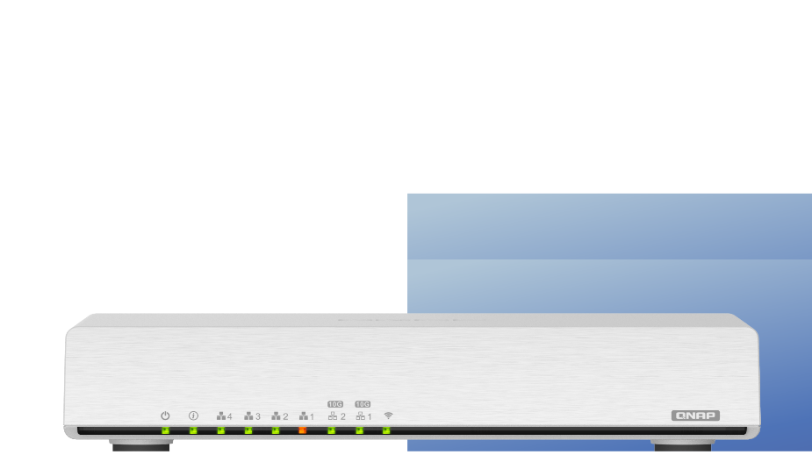
QuWAN SD-WAN solution for resilient IT infrastructure
QNAP’s QuWAN SD-WAN solution features Auto Mesh VPN, IPsec encryption and cloud-centric management. Compatible with a wide range of QNAP solutions, QuWAN enables SMBs to efficiently build a dependable network at a cost-effective price, and to facilitate digital transformation, multi-site expansion and remote working.
Auto mesh VPN
WAN optimization
Automatically establishes a mesh VPN and removes the need for manual static VPN settings.
QuWAN adopts load balancing technologies to combine the bandwidth of different ISPs and to prioritize bandwidth utilization.
Cloud management
Cost optimization
The QuWAN Orchestrator provides powerful and convenient central network management.
Optimizes fiber/network transmission to lower the cost of VPN equipment and bandwidth expenses.
Network security
Web GUI
Adopts Deep Packet Inspection to analyze L7-Payloads for content information from websites and devices.
Provides user-friendly functionality, including a dashboard, eMap, traffic analysis, and more.

Slide 37
Enjoy a high-coverage Mesh Wi-Fi experience
The QMiro-201W and QMiroPlus-201W support tri-band Wi-Fi 5 wireless transmission and Mesh Wi-Fi handover, ensuring stable Wi-Fi connections and greater signal quality via a Mesh Wi-Fi network.
Connect your Home with High-Coverage Tri-Band Mesh Wi-Fi
Dedicated Tri-band Mesh Wi-Fi for smooth connections
QMiro-201W / QMiroPlus-201W adopts Wi-Fi Handover technology, allowing multiple users to be automatically connected to the router with the strongest Wi-Fi signal with a single SSID. With dual-band 2.4GHz/5GHz, QMiro-201W / QMiroPlus-201W also provides a dedicated Mesh 5GHz frequency for high-bandwidth connections between Mesh Wi-Fi routers, guaranteeing smooth and stable Wi-Fi connections.
Supports tri-band Wi-Fi of 2.4GHz, 5GHz and a dedicated Mesh Wi-Fi 5GHz band for high-bandwidth connections between Mesh Wi-Fi routers. Unlike conventional dual-band routers whose 5GHz band must be shared between Wi-Fi clients and Mesh Wi-Fi routers, the QMiro-201W /QMiroPlus-201W guarantees smooth and stable Wi-Fi connections.

Slide 38
Smart Video
Conferencing Solution
Running KoiMeeter video conferencing operating system
KoiMeeter provides an dedicated solution for small meeting rooms with support for wireless presentations, cross-platform communication and local storage.
All-in-one: video calling, wireless presentation and meeting recordings.
QNAP Smart Video Conferencing Solution is a high-quality video conferencing system, providing an ideal solution for small meeting rooms with support for wireless presentations, cross-platform communication and local storage.
Free yourself from cables with 4K wireless projection
4K wireless projection provides a seamless wireless projection experience free from complex cabling and without needing additional projection devices.
Up to four-way video conferencing and collaboration
Multi-point video conferencing with the QNAP KoiBox-100W, KoiMeeter, the KoiMeeter mobile app, and compatible SIP systems.
Local storage for record and store meetings
Install a 2.5-inch SATA drive and locally store all your meeting videos, audio and shared files while also enabling further usage as training materials.
Optimized cloud meeting experience
The QNAP Smart Video Conferencing Solution supports popular cloud meeting services, such as Zoom®, Skype™, Microsoft Teams®, Cisco Webex®, and Google Meet™ for streamlining communication between different platforms.

Slide 39
Operational Sustainability

Slide 40
Worldwide Quality Control Processes Certified by ISO
The quality of QNAP products and services is accredited by international certifications, demonstrating the conformity to high-quality standards
ISO 14001
Environmental Management System
ISO 45001
Occupational Health and Safety Management System
CSR Certification
ISO 27017
Cloud Information Security
ISO 27018
Cloud PII Protection Management
ISO 9001
Quality Management System
ISO 27001
Information Security Management System

Slide 41
QNAP ESG Guideline
Environmental protection, employee health and safety, and social participation fulfill corporate social responsibility and the pursuit of business continuity
Environmental Sustainability
Employee
Care
Corporate Governance
Environmental Policy
Carbon reduction management
Green procurement
Environmental sustainability education
Supply chain management
Energy and waste management
Employee compensation and benefits
Labor rights
Employment environment
Competency management
Labor relation
Education & training
Integrity management
Organization strategy
Regulations compliance
Information transparency
Internal control
Stakeholder compunctions
Customer Engagement
Social Involvement
Product and service liability
Ensuring confidentiality of customer information
Customer relationship maintenance
Green products
Social care
Community involvement
Charitable activities
Corporate image

Slide 42
Green Product Design Management
QNAP takes Sustainable Development Goals (SDG 12) as its corporate philosophy, and also regards the sustainability of the Earth as its corporate vision. Starting from product design, elimination of hazardous elements and packaging design, with innovative thinking, we are dedicated to developing Green products with low consumption and low correlation elements.
Green Materials
Green Packaging
Product Recycling
RoHS II
RoHS China
REACH
United States “TSCA” regulation
Taiwan EPA
Conflict Free Minerals Policy
EU Deca-BDE, PFOS and DMF
EU Packaging and Packaging Waste Directive 94/62/EC
The total amount of Pb, Cd. Hg and Hexavalent Cr doesn’t exceed 100mg/kg (ppm)
Waste Electrical and Electronic Equipment (WEEE) Directive

Slide 43
RoHS Compliance
Program Management
Product Record Management
PLM RoHS components database provides detailed RoHS components information management
RoHS compliance with QNAP’s lead-free production
Agile Advantage
Product sourcing
Document Management & Control
Green Production
AGILE ENTERPRISE INTERGRATION
RoHS Compliance
Incoming material tested for hazards and especially for Cr, PBB and PBDE
View & Markup
Quality Management
SPECTRO XEPOS
Benchtop X-Ray Fluorescence Spectrometer

Slide 44
Environmental Responsibility
QNAP plans to reduce CO₂ emissions by 4% in 5 years
Operation guidelines related to environmental protection management, environmental management systems (ISO 14001)
Energy saving appliance replacement, and tracking CO2 emissions
Reduce electric consumption by using LED lights and inverter air conditioners throughout the company
Waste gas
Waste water
Waste
Carbon emissions

Slide 45
Supply Chain Management
QNAP has a skilled supply chain management team that proactively uses advanced ERP tools to hep customers gain a competitive edge
QNAP ensure that our customers can reduce their TCO (Total cost of ownership) with the following criteria
Reduced Inventory
Stable Quality
Time to Market
Reliable Source
Competitive Costs
Conflict Mineral Procurement Strategy

Slide 46
Global Deployment of QNAP

Slide 47
Qidu Factory
Gross Building Area
19,180
square meters
PCBA Capacity in 2021
30K per month
SMD x5 & DIP x2
System Capacity in 2021
28K per month
Assembly Line x 13

Slide 48
USA
Office / Warehouse Center
Time of Establishment
2009
Location
Pomona CA

Slide 49
USA
Office / Warehouse Center
Number of Employees
47
Scope of Business
Before & After Sales Services
Warehouse Center

Slide 50
Germany
European Headquarters
Time of Establishment
2022
Location
Willich

Slide 51
Germany
European Headquarters
Number of Employees
50
Scope of Business
Before & After Sales Services
Warehouse Center

Slide 52
Canada
Office
Time of Establishment
2015
Location
Markham, Ontario

Slide 53
Canada
Office
Number of Employees
11
Scope of Business
Before & After Sales Services

Slide 54
Italy
Office
Time of Establishment
2015
Location
Roma

Slide 55
Italy
Office
Number of Employees
8
Scope of Business
Before & After Sales Services

Slide 56
Japan
Office
Time of Establishment
2016
Location
Tokyo

Slide 57
Japan
Office
Number of Employees
15
Scope of Business
Before & After Sales Services

Slide 58
India
Office
Time of Establishment
2017
Location
Bengaluru (Bangalore)

Slide 59
India
Office
Number of Employees
48
Scope of Business
R&D and After Sales Service

Slide 60
Thailand
Office
Time of Establishment
2018
Location
Bangkok

Slide 61
Thailand
Office
Number of Employees
7
Scope of Business
Before & After Sales Services

Slide 62
UK
Office / Warehouse Center
Time of Establishment
2018
Location
Swindon

Slide 63
UK
Office / Warehouse Center
Number of Employees
13
Scope of Business
Before & After Sales Services
Warehouse Center

Slide 64
HK
Office
Time of Establishment
2018
Location
Kowloon Bay

Slide 65
HK
Office
Number of Employees
7
Scope of Business
Before & After Sales Services

Slide 66
GeneVisio
GeneVisio Co. Ltd.
Time of Establishment
2021
Location
New Taipei City

Slide 67
GeneVisio
GeneVisio Co. Ltd.
Number of Employees
17
Scope of Business
Core Solutions of 5G Network

Slide 68
Quality Management and Production Process of QNAP

Slide 69
QNAP Quality Control Management
Design
Manufacturing
Customer
Quality Assurance
Quality Assurance
Quality Assurance
R&D
IQC
Customer
Component yield rate
Annual customer satisfaction survey & feedback
NPI
ECR/ECN
P/N approval
LQC
First article inspection
On line audit
FAE & RMA
QA Lab
OQC
Customer application service
Return product analysis
Technical support
DOA & RMA
Product lifecycle management
Production traceability
Quality traceability
Mechanical/signal/environmental reliability capability
Networking products reliability capability
Certifications (EMC/Safety)
Finish goods yield rate
QE
Analysis defect symptom
Feedback issues
Track improvement

Slide 70
Mechanical Reliability Capability
Vibration Test
Drop Test
Shock Test
3D Printing RP sample
Thermal Analysis Lab
Natural Convection Chamber
IR Camera
Temperature Data Acquisition

Slide 71
Experienced Heat Flow Engineering
Data Collection
Model Building
Running and debug
Post Processing
Thermal Simulation Report
Power consumption
Mechanical drawing
Material property
Component spec.
Customer request
Geometry simplifying
Material property setting
Condition setting
Grid generation
Grid quality improvement
Model check
Temperature profile
Air flow profile
Temperature results
Temperature profile
Flow profile
Optimal Heat Sink Simulation
System Thermal Simulation

Slide 72
Environmental Reliability Capability
Thermal Shock With Humidity
Hosedown IPX6
Air Leak Tester IPX7 / IP69K
Dust Test
LCD Display and Compatibility Test
Acoustic Noise Testing
Salt Spray Tester
Natural Convection Chamber
Represents real interior environment for in-wall mounting system

Slide 73
Signal Validation Test
Radio Frequency Testing
Impedance Test
Bluetooth
WLAN
Throughput Test
Agilent Network Analyzer
Anritsu MT8852
Anritsu MT8860C
IxChariot / LitePoint IQxel
Signal / Power / Spectrum
Agilent Signal Gen.
Agilent Power Meter
Agilent Spectrum Analyzer
Tektronix Signal Measurement Labe
(4 channel 200GS/s)
Sifos POE Tester PSE & PD
(802.3/at/af/bt compliance)

Slide 74
Networking Specific Design and Validation Facilities
Testing Center
LAN Performance Test
LAN Performance Test
Spirent 400G Test
Spirent dX3 G400G
Seven-Speed Appliance
Spirent Testing Center
Spirent CHS-9000A
Spirent N11U
100/1G/10G/25G/40G/100G Ethernet (12-Port Dual Media QSFP+)
Test 16 port RJ45 or fiber (SFP+)*3
Test 16 Port RJ45 10G/5G/1G/100M/10M
Test Standard RFC2544 or RFC 2889
WiFi-modules
10/100/1G Ethernet (12-Port Dual Media QSFP+)
Test 36 port RJ45 or fiber (SFP+)
Test Standard RFC2544 or RFC 2889
100/1G/10G/25G/40G/100G Ethernet (12-Port Dual Media QSFP+)
Test 16 port RJ45 or fiber (SFP+)
Test Standard RFC2544 or RFC 2889
PAM4:
8 x 400GbE, 16 x 200GbE, 32 x 100GAUI-2, 64 x 50GAUI-1
NRZ(25G)
16 x 100GAUI-4, 32 x 50GAUI-2, 32 x 25GAUI
NRX(Others): 16 x 40GbE, 32 x 10GbE

Slide 75
Networking Specific Design and Validation Facilities
100G Load Tester
100G Load Tester
100G Load Tester
400G Real Time Signal
NOVUS 100GE
XENA 10/40/100-GigE
Spirent CF20 L4-L7
Tektronix DPS77004SX
Enable high-density multi-rate native 100/50/40/25/10 GE testing
Leverage affordable lower-density 4-port full feature configuration with field-upgradable option to 8-ports
12 slots in a 4U form factor
High port density e.g. 144x10GE ports
Support copper and optical Gigabit Ethernet and 0/40/100/200/400-Gigabit Ethernet modules
1G/10G/40G and 100G interfaces
Web-based test controller
70 GHz ATI Performance Oscilloscope Systems: 2 x 70 GHz, 200 GS/s or 4 x 33 GHz, 100GS/s
2 x DPS77004SX required for 400GbE PAM4 real-time signals

Slide 76
High Reliability PCBA Production & Quality Management
Omron VT-X750
High-speed automated X-ray CT inspection system
ERKA SERIO 8000
3D Solder Paste Inspection (SPI)
Panasonic NPM-W2 / NPM-W2S
Pyramax 150A z12
TR7700 SIII Plus
TR7006L
YG100
TR7500
YG88

Slide 77
Production History Management
Manufacturing
Line Quality Control
Visual inspection (cosmetic)
Functional test (simulation test)
First article inspection
On line audit according to checklist
LQC-SMT 100% inspection
LQC-DIP 100% inspection
LQC-ASSY 100% inspection
MFG
LQC
Quality Engineering
Analyze defects and take action
Feedback to related department for future improvements
Track improvement efficiency
QE
OQC
Outgoing Quality Control
Visual inspection (AOI)
ECN change review
ORT test
FCT test
Project Quality Management
PGM
Lead team members push quality improvement for quality yield rate
4M management
Follow up customer requirements
Good Quality
Customer

Slide 78
Product Traceability
Data Collection
Inspection
Record date
FIFO control
Working order
Reel ID
Use the product
Data code
Incoming lot
Reel ID
Vendor Info
Storage
Production
IQC
Warehouse
Part Release
MFG
Customer
Reel ID
Reel ID
Working Order
SN
Trace
Trace
Trace
Request feedback
Trace
Part information DC, Lot, Vendor
Reel ID
Working order
SN, symptom
Storage date
Traceability

Slide 79
Production History Management
Production Line
Work Order/ Revision
Employee
Production History
Process
Time
Part No. / Desc. / Revision
RoHS Validation
Vendor / AML
Components
Product S/N
S/N or Date code
MAC Address
Half-Finished Product History
IQC / LQC / OQC Data
Reason Analysis
Repair History
Quality Data
Defects Statistics
Duty Analysis
Shipment No.
Original Order
No.
Uses barcode scanners to track product serial numbers in key assembly station, and input error messages for product control and quality issue tracking.
Shipping
Shipment Data and Warranty

Slide 80
RMA Service Process
Customer Reports Defects
RMA No. Release
Review Shipping Doc.
Customer Returns Units
Inspect Received Units (Model, Q’ty etc.)
In Warranty
Function Test and Final Check
Start Repair
Check Warranty
Duplicate & Analyze
File Repair Report
Out of Warranty
Quotation Signed
Quote Customer
Return to Customers

Slide 81
IT Infrastructure at QNAP
Vendors
QNAP
Customers
CRM/SRM
Design Engineering
Jira / PLM / PDM / CIS
Collaborate
Collaborate
Materials Planning
e-P
ERP / ASCP
eCommerce /EDI
Enterprise Portal / B2B / B2C / RMA
Logistics
ASN QC reports
MES / WMS / HMS / gRMA
Delivery / Quality RMA
BI / EIP
VIP Portal
Notes (Workflow & KM)
Global System
Data Retrieved from IEI / MES / ERP / EIP System
WMS: Warehouse Management System, ASCP: Advanced Supply Chain Planning

Slide 82
Get in Touch
www.qnap.com
Facebook
YouTube
Instagram
Subscribe

Slide 83
Copyright© 2022 QNAP Systems, Inc. All rights reserved. QNAP® and other names of QNAP Products are proprietary marks or registered trademarks of QNAP Systems, Inc. Other products and company names mentioned herein are trademarks of their respective holders.​​​​​​​

