Slide 1
Qboost
Enhances NAS system performance
QNAP Systems, Inc.
Notes:
http://172.17.31.247:8080/cgi-bin/
TS-1635 with snapshot

Slide 2
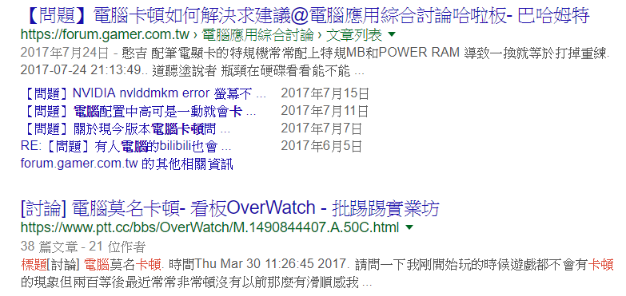
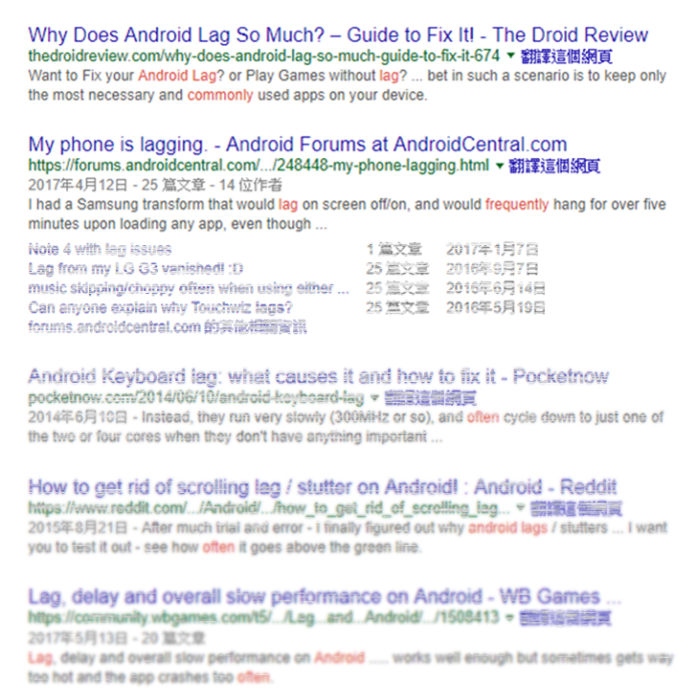
wasting time
Still
because of lagging？
Lowers your working efficiency
Notes:
(放搜尋系統卡頓的訊息)

Slide 3
Qboost
Application
Scheduling
Optimize
Clear

Slide 4
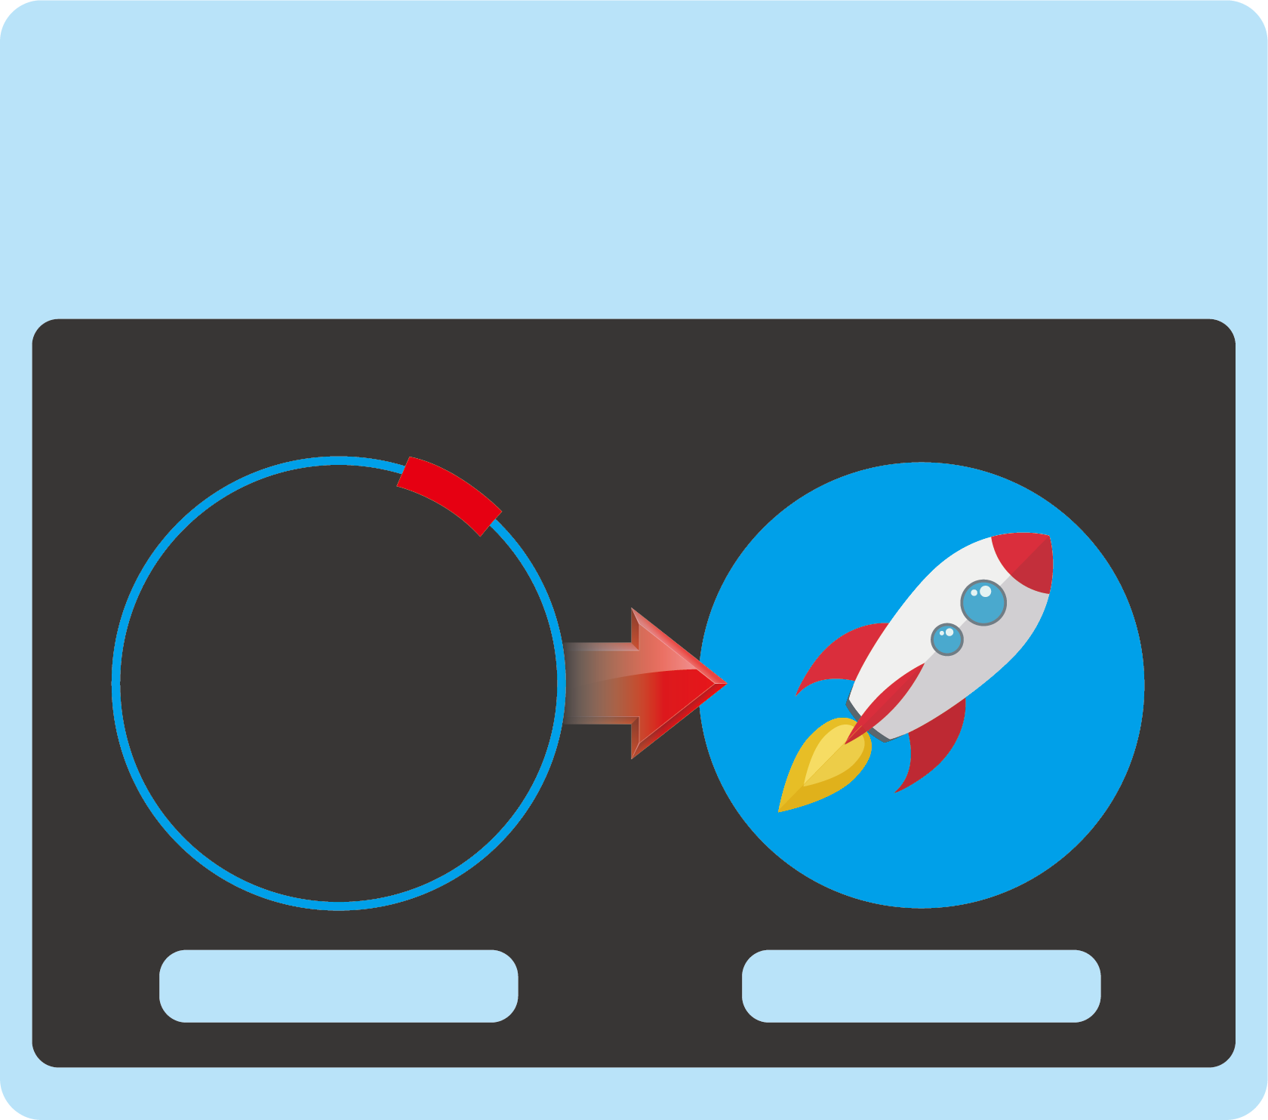
Qboost
Clean cache memory
Clean swap memory
Optimize
Free Memory
Free Memory
9%
170MB
Optimize
Optimizing…

Slide 5
Qboost
Delete unnecessary system files
Empty Recycle Bin
Clear
Junk Files
Junk Files
Choose files to delete
Unnecessary system files
Recycle Bin
Note: Files will be permanently deleted
Clear

Slide 6
Lots of applications can take a huge amount of memory, and Optimize can not release cache memory effectively. What can we do?

Slide 7
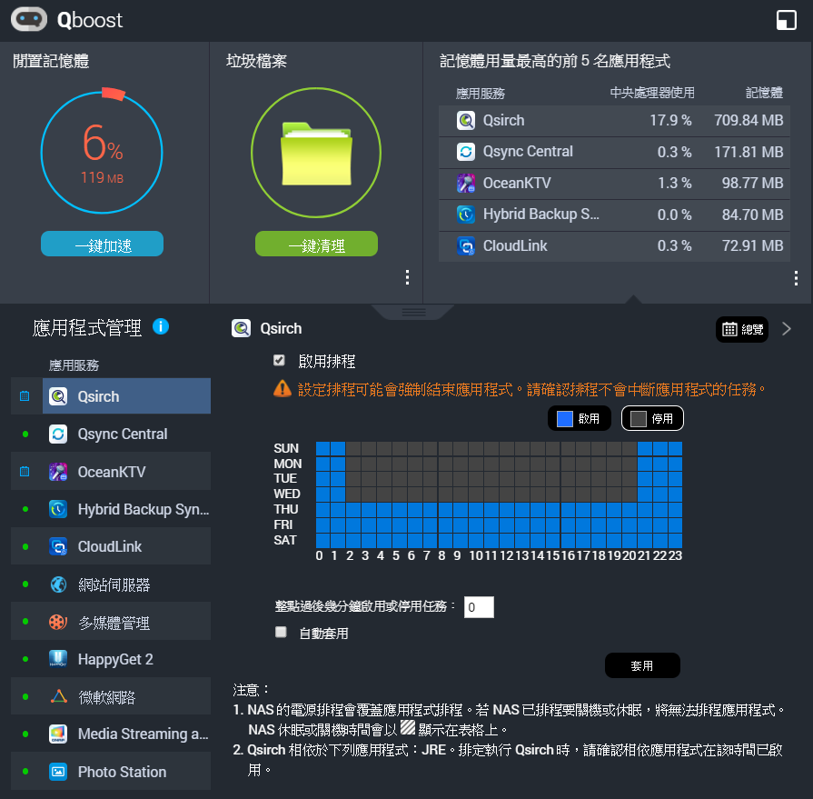
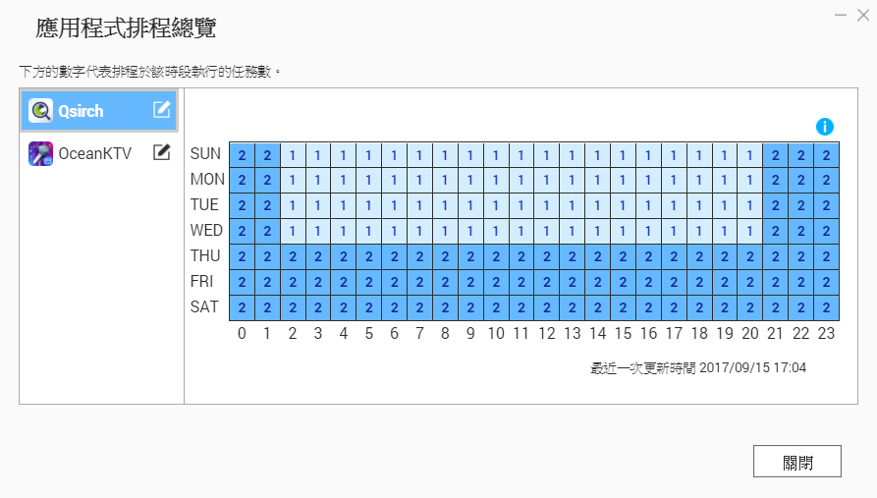
Qboost
Set schedules to enable / disable applications
Allocate system resources more efficiently
Application Scheduling
Schedule OceanKTV manually
During weekdays, you're too busy to launch OceanKTV for some good time. You can only sing with the app in weekends.
But the app still takes up resources, even it's not active.

Slide 8
Demo Qboost
Optimize, Clear,
Application scheduling

Slide 9
Three solutions
Clear
Cleans up junk files
Recycles storage space
Optimize
Releases memory
Increases operating speed
Application Scheduling
Allocates system resources efficiently

Slide 10
Qboost: See you in QTS 4.3.4

Slide 11
USB One Touch Copy
for mobile devices

Slide 12
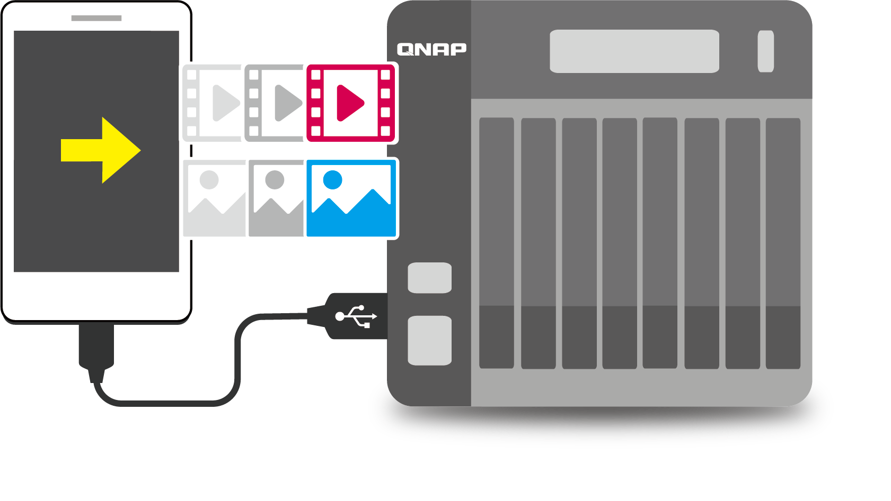
How to back up lots of videos, photos on mobile devices
Back up to public cloud
cons：Limited to Internet speed, Time consuming.
Back up to other storage devices
cons：Your phone is connected to the computer.
After reading files, you may need to move those
files to another storage devices.
Back up to QNAP NAS
using a direct USB connection.

Slide 13
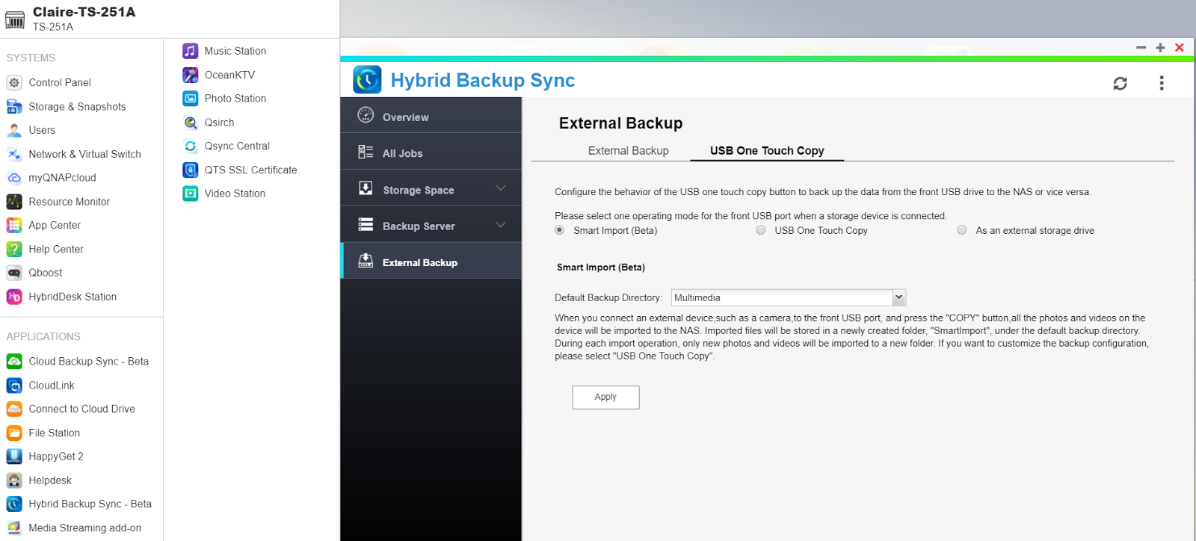
USB One Touch Copy Support
3
2
1

Slide 14
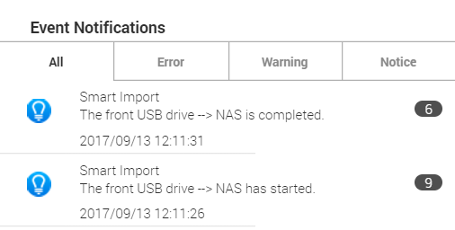
USB One Touch Copy Support
Connect the mobile device to the front
USB port
Press the Copy button for 2 seconds (or until a short beep) to start backup
Backup task completed
(short beep/ indicator is off)
Unplug the mobile device

Slide 15
Demo
USB One Touch Copy support for mobile devices

Slide 16
USB One Touch Copy Support
Pros：
An one touch button to backup all videos and photos
Create folders depending on imported date
Filters files automatically, will not import the same files twice
Seamless post-import processing in related applications
ex. Photo Station “Face Detection”

