Slide 1
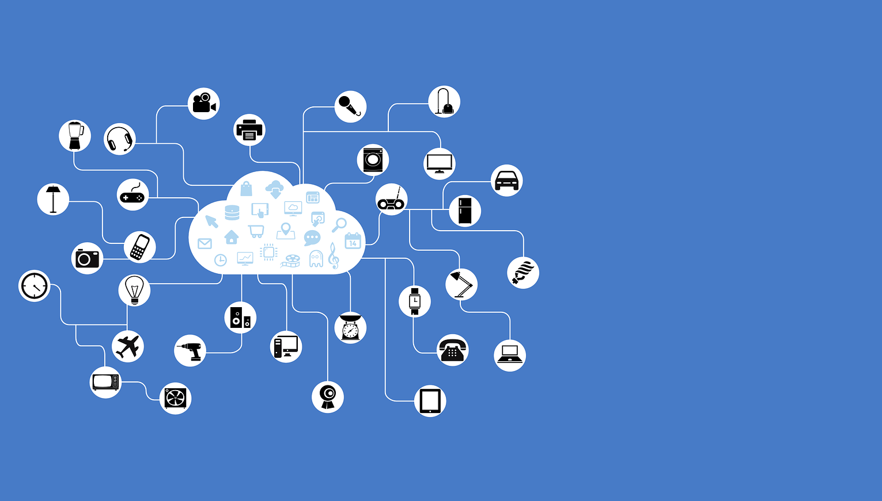
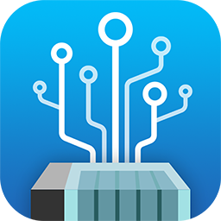
IoT devices are everywhere, Do you have the right SW for that ?

Slide 2
Public Cloud VS Private Cloud
Public Cloud
Publicly-shared virtualized resources
Supports multiple users
Suitable for non-confidential information
Supports connectivity over the Internet
Paid for monthly or by usage
Private Cloud
Privately shared virtualized resources
A cluster of dedicated users
Suitable for confidential information & core systems.
Connectivity over Internet, fiber and private network
One-time cost

Slide 3
Don’t feel like paying continuously while enjoying the benefit of IoT?
QNAP has a solution for you !

Slide 4
QIoT Container
Use containers to build a micro service architecture
QNAP Systems, Inc.

Slide 5
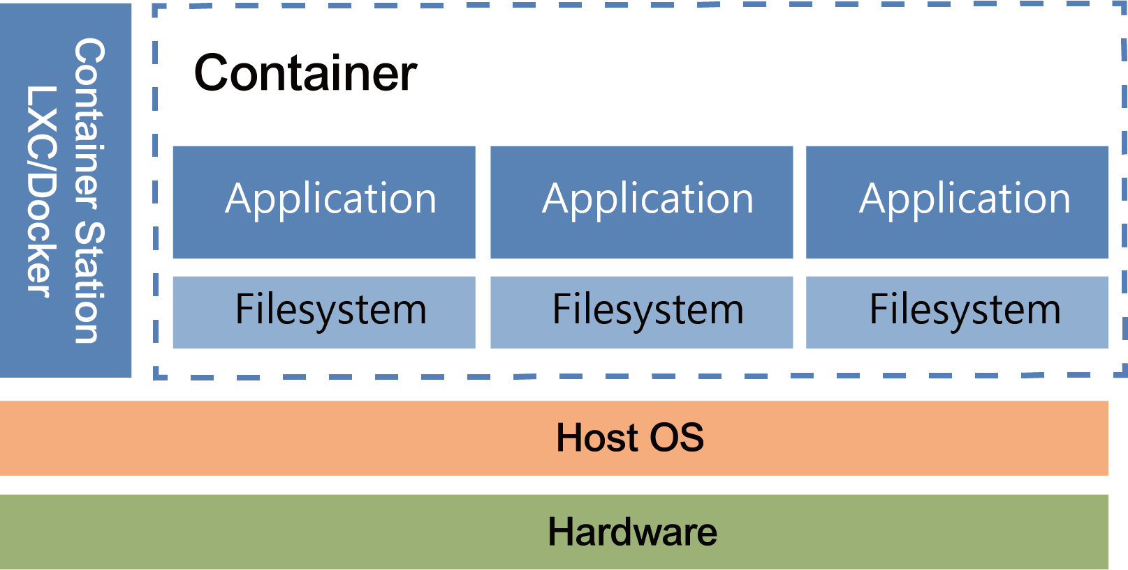
Lightweight app virtualization solution
Container Station supports a lightweight virtualization. By sharing the kernel with the host system, users can apply this on various cloud service platforms that support Docker® without installing the operating system.
Install &Login
Notes:
在微服務架構的應用中添加新功能，並不需要重寫整個應用，只需將新功能直接加入現有應用中。

Slide 6
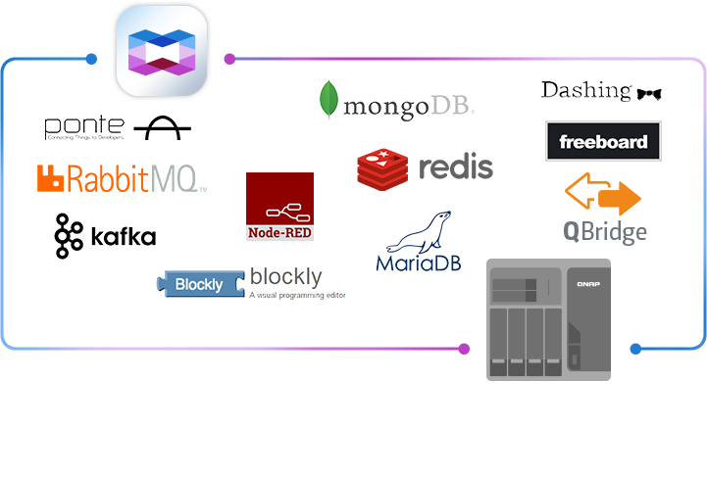
Rich containerized apps
Container Station provides popular and fully-configured applications with just one click to deploy them.
Download any of the 45,000+ applications from our built-in Docker® Hub Registry.
Simply search "IoT" in Container Station, deploy proper containers, and create diverse IoT applications with QIoT Containers.
Install &Login

Slide 7
 | QIoT Container | QIoT Suite Lite
Feature | Quickly and easily install lightweight modules | turnkey solution include connection mechanism, rules engine and dashboard
Strength | Flexibility | Stability
Target Audience | Geek, IT, willing to using new software module and familiar with integration. | Maker , IoT device , things, easily connect

Slide 8
QIoT Suite Lite
Create your private IoT cloud platform
QNAP Systems, Inc.

Slide 9
QIoT Suite Lite
Integrated Intelligent IoT Platform
Ecosystem partnership model : Create win-win
Key success Drivers:
Strategic Alliance Partners
SI with Domain Knowledge
Applications - driven
QIoT Suite Lite

Slide 10
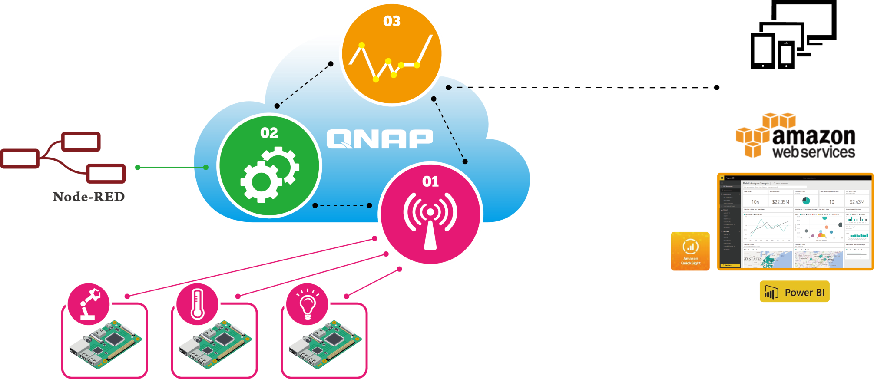
Designed for the most Demanding Requirements
Stage 2. Data Processing
Stage 3. Data Visualization
Rules Setting
Threshold
Local Storage
Show Data in Charts & Tables
Applications
Stage 1. Data Collecting
Sensors
Devices
Development Board
Notes:
這是舊有的

Slide 11
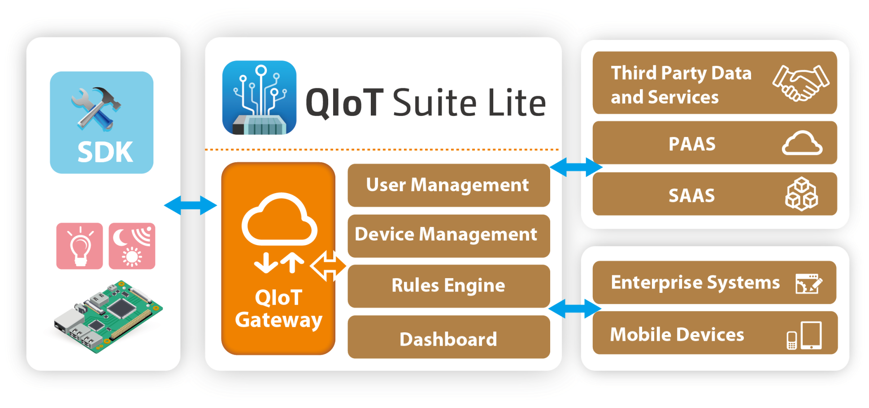
QIoT Suite Lite

Slide 12
Protocol & developing board
Support Protocol:
MQTT, MQTTS, HTTP, HTTPS and CoAP
Quick set up :
Arduino Yun - Python
Raspberry Pi - Node.js
MTK 7688(Duo) – Python
Intel Edison - Node.js

Slide 13
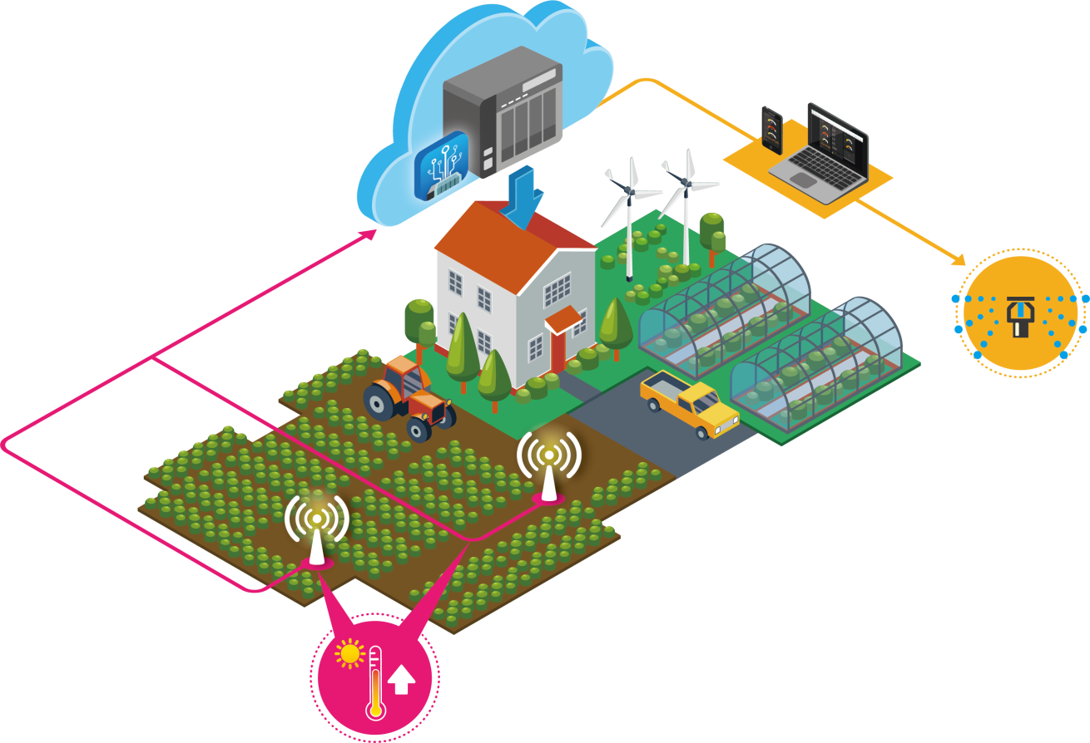
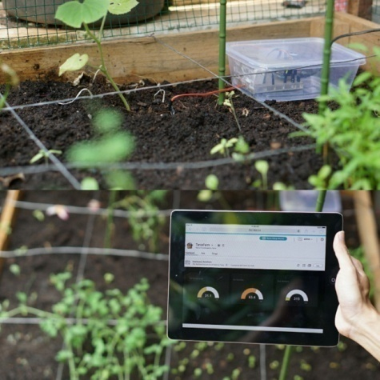
Smart Farm application
Analyzing Data
Action can be taken in real-time.
Operation efficiency.
Visualizing Reports
Optimize farm management &
resource usage.
3
Generating reports & taking actions
2
Data collecting
& processing
1
Data transmission

Slide 14
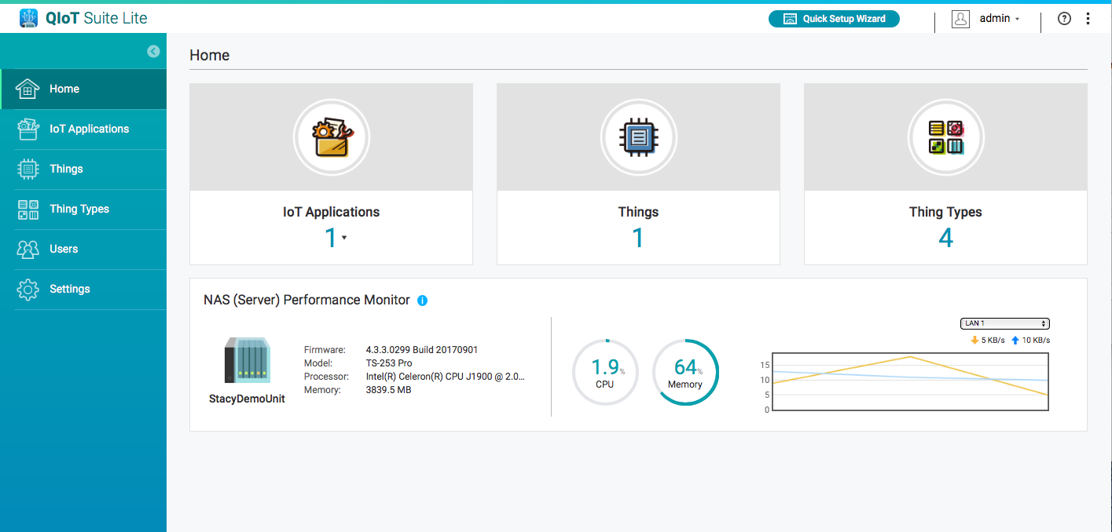
Friendly Interface
User Management control authentication, establish secure connection
Current platform status

Slide 15
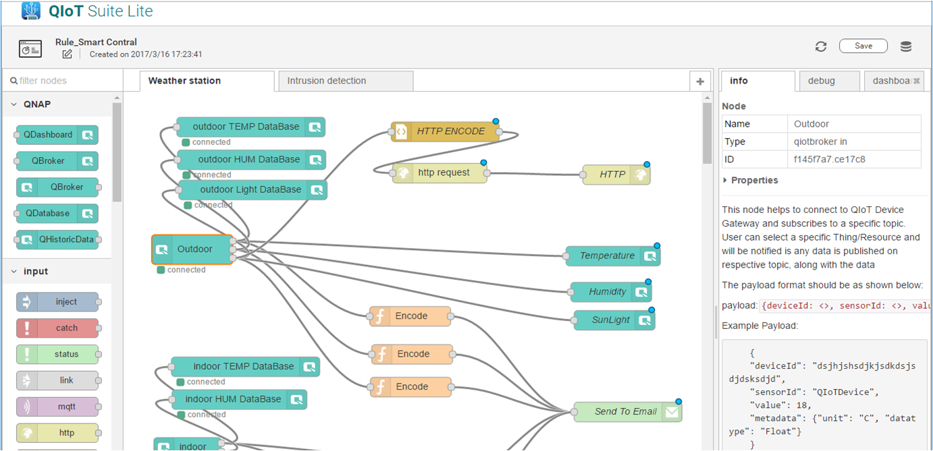
Rule Engine
Customized Node-RED provides graphic interface design

Slide 16
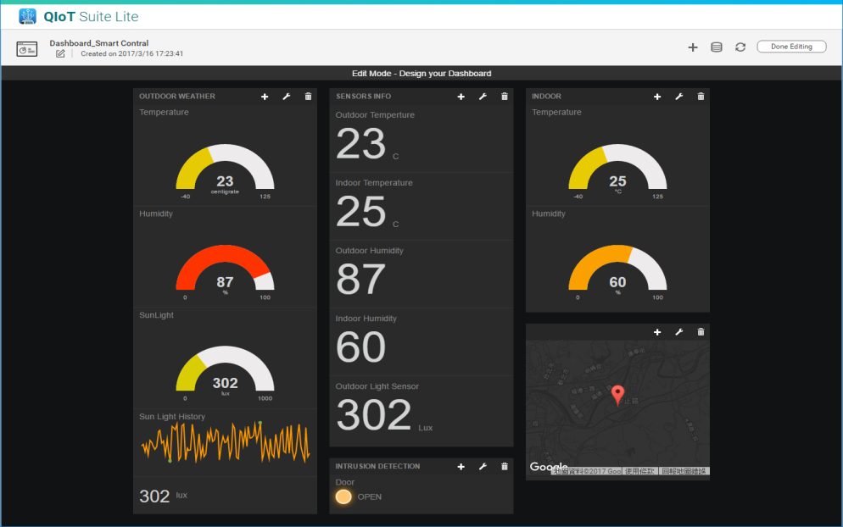
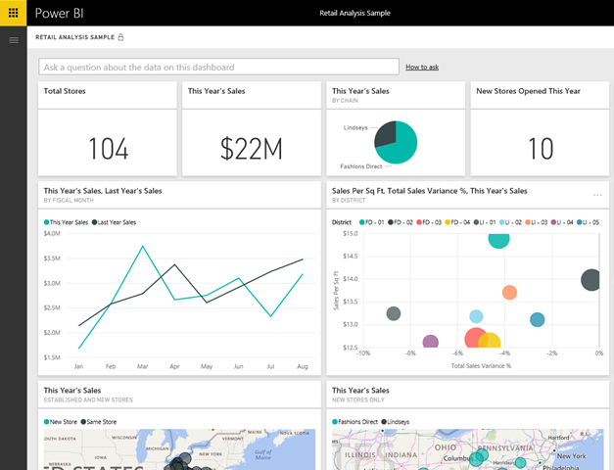
Transfer Data to Third Party Services
Push the collected data to Power BI for further
data analysis

Slide 17
Something you should know about QIoT
Quickly develop QIoT in 3 steps

Slide 18
Start QIoT 1-2-3
√ Developing board
√ Sensor
√ Controller
√ Rules Engine
√ Dashboard
√ Visualized data

Slide 19
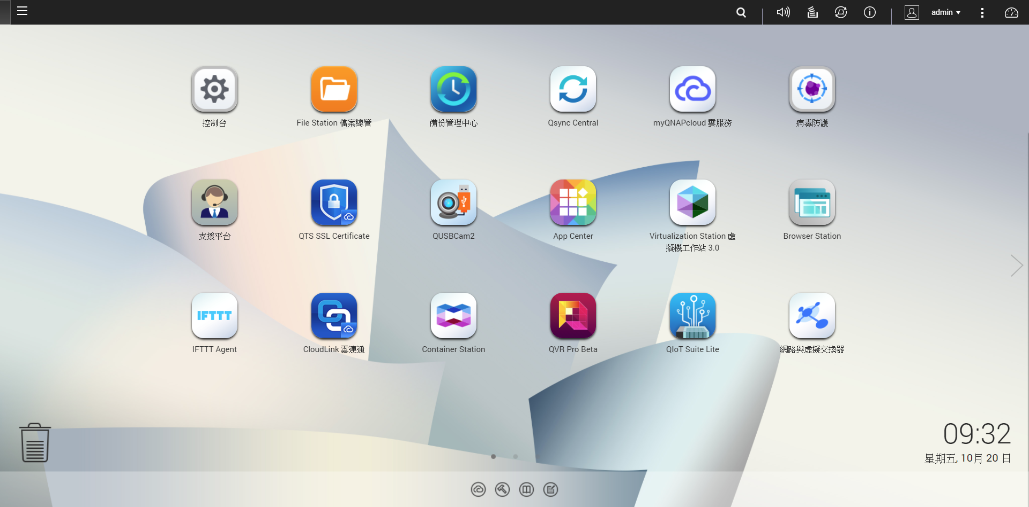
Download Container Station & QIoT Suite Lite
Download from App Center
> Container Station
> QIoT Suite Lite

Slide 20
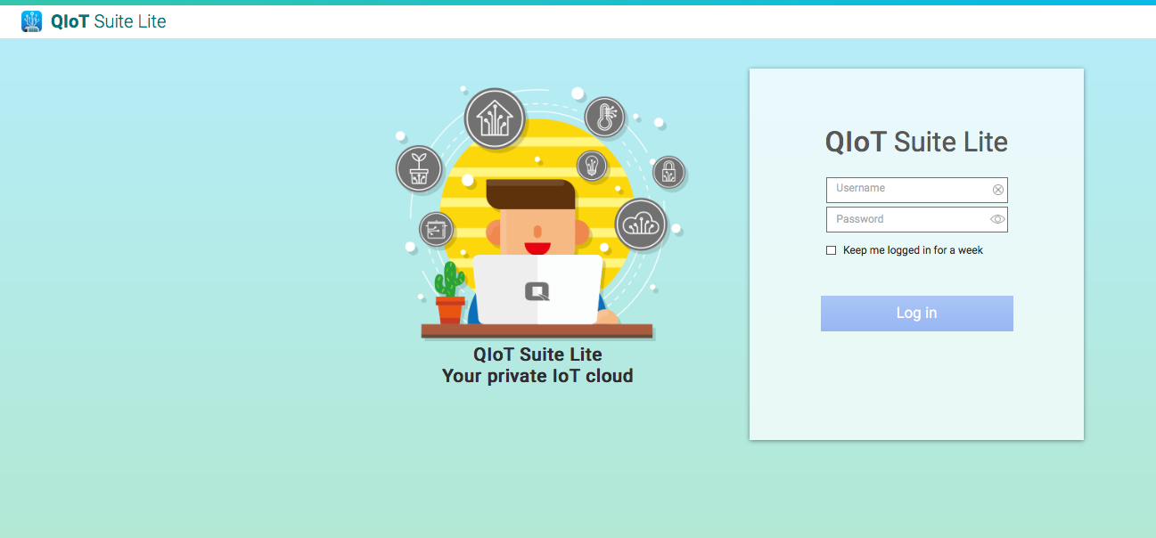
Log in
Notice
Default login ID： admin
Same password as your QTS admin account

Slide 21
User-friendly Interface
Current status of NAS

Slide 22
Step 1：Create application
1.1 Add developing board - Raspberry pi
1.2 Add sensor - Sensor
1.3 Create connection file of MQTT

Slide 23
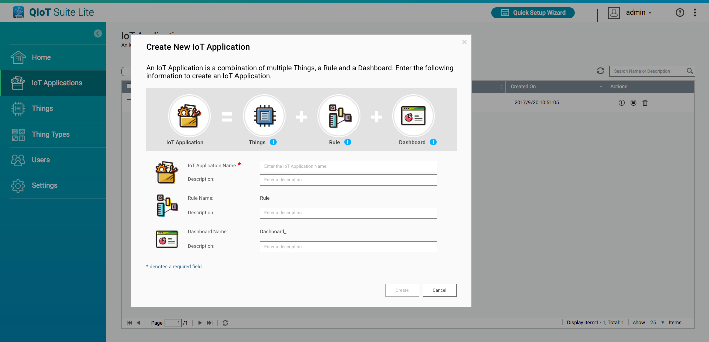
Define the name of application

Slide 24
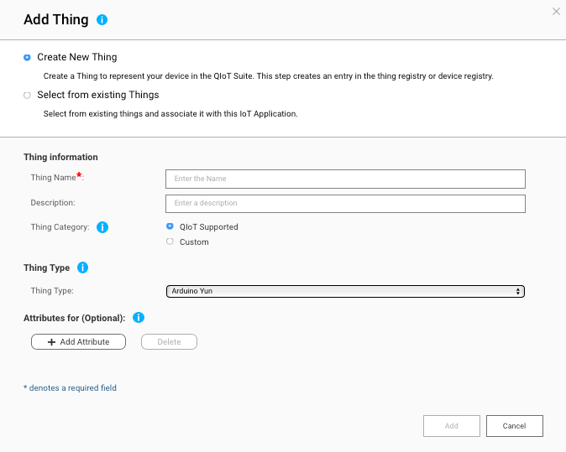
Add device

Slide 25
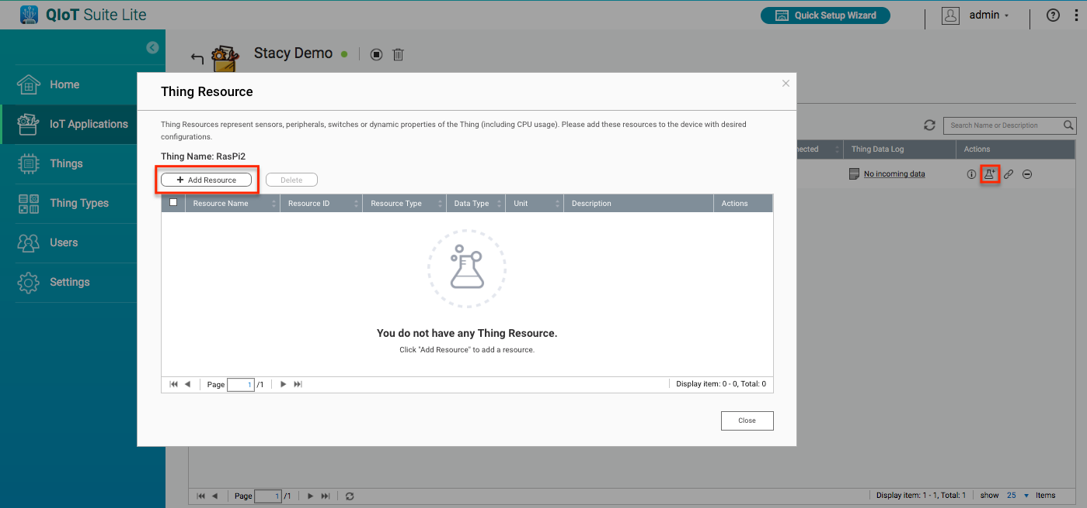
Add sensor
2
1

Slide 26
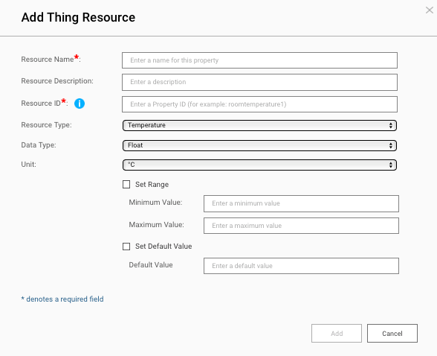
Sensor setting
Notice
Check if Resource ID is the same as it is in the code folder.
Related to mqtt topic, http url and coap url.

Slide 27
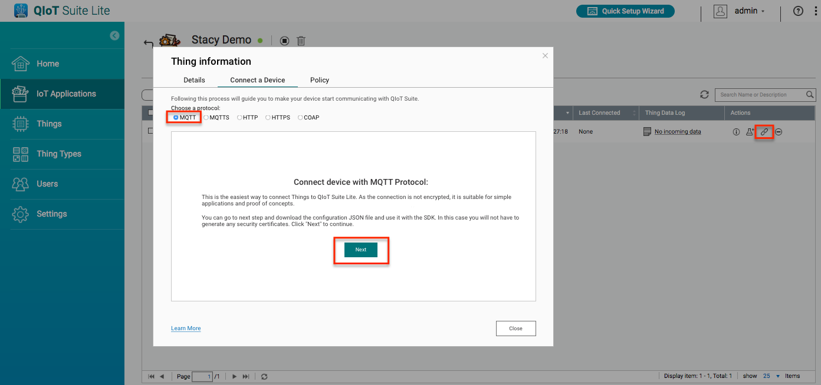
Connection file of protocol
Notice
Confirm the protocol of front device, then choose the proper one in order to create the relative connection file..
2
1
3

Slide 28
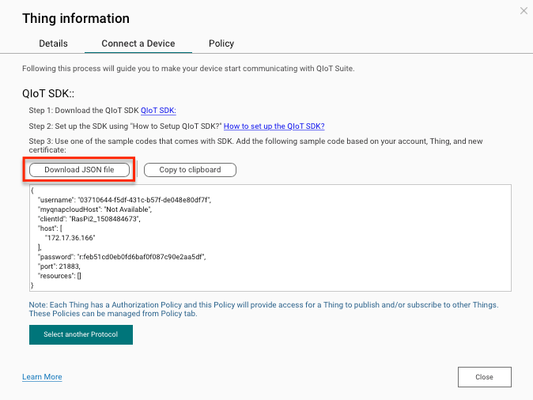
MQTT Connection Setting file
Temporary save the connection file in order to upload the file to developing board for the connection later on.

Slide 29
Information in the connection file
Notice
The connection file includes:
>QIoT Suite Lite Server IP address
>MQTT user ID and password
>MQTT port
>Sensor ID
>Sensor topic

Slide 30
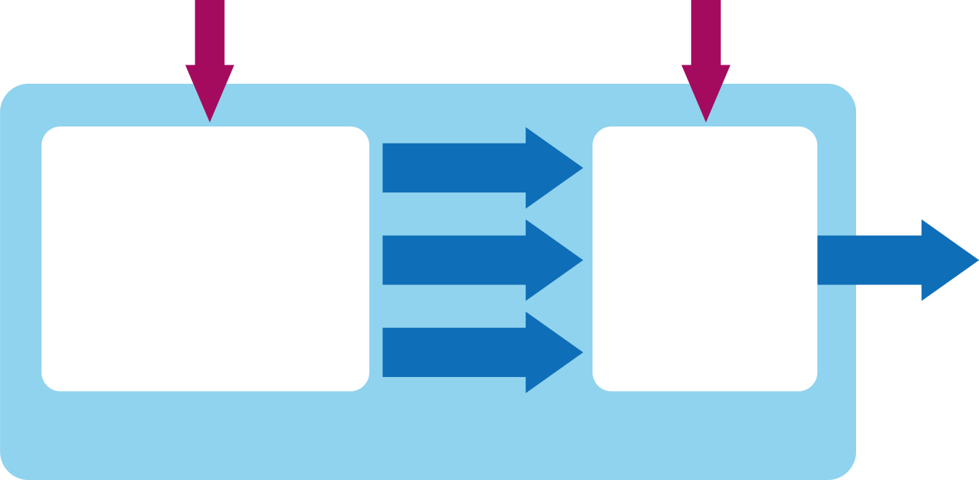
Mechanism
Upload
Run
IP
Resourceinfo.json
PORT
XXX.js
Topic…etc
QIoT
Information
Program
Raspberry Pi

Slide 31
Step 2：
Developing board setting
1.1 Upload custom code and connection file
to Raspberry Pi
1.2 Setting of operating environment and
execute main program
Update Node.js
Install dependency package

Slide 32
Software requirement
Windows : putty+FileZilla
Mac+Linux : Terminal+FileZilla

Slide 33
Custom code
Current example contains the following directories and files:
lib : To place the libraries used for the connection
res : upload “resourceinfo.json” to this folder
ssl : To place ssl key and certificates (for MQTTS and Https)
main.js : Main program
package.json : The dependencies setting
setup.sh : Automatically install the library required for this program

Slide 34
Filezilla Setting
Notice
Default by Raspberry
User ID: pi
Password: raspberry
port: 22

Slide 35
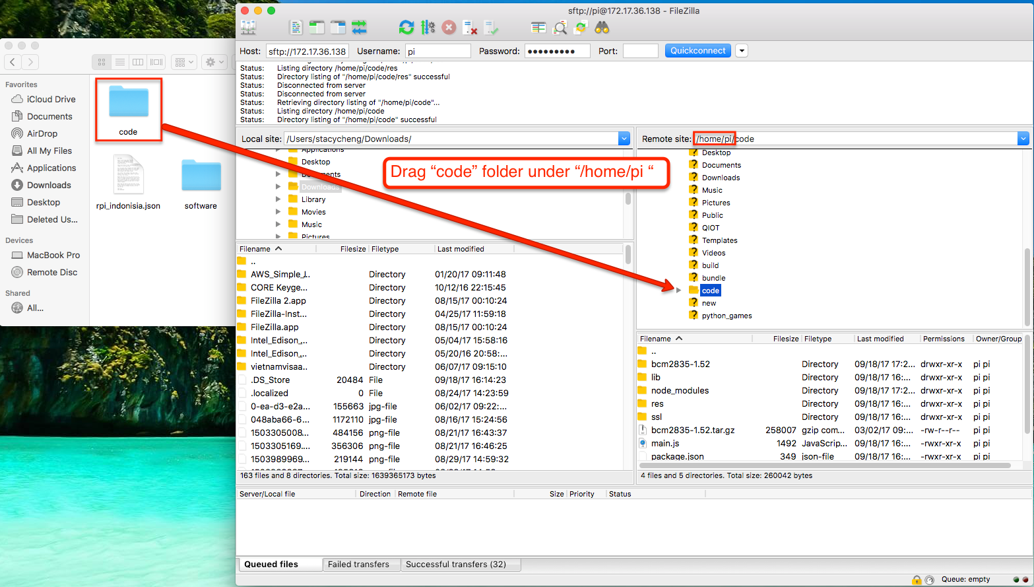
Upload custom code

Slide 36
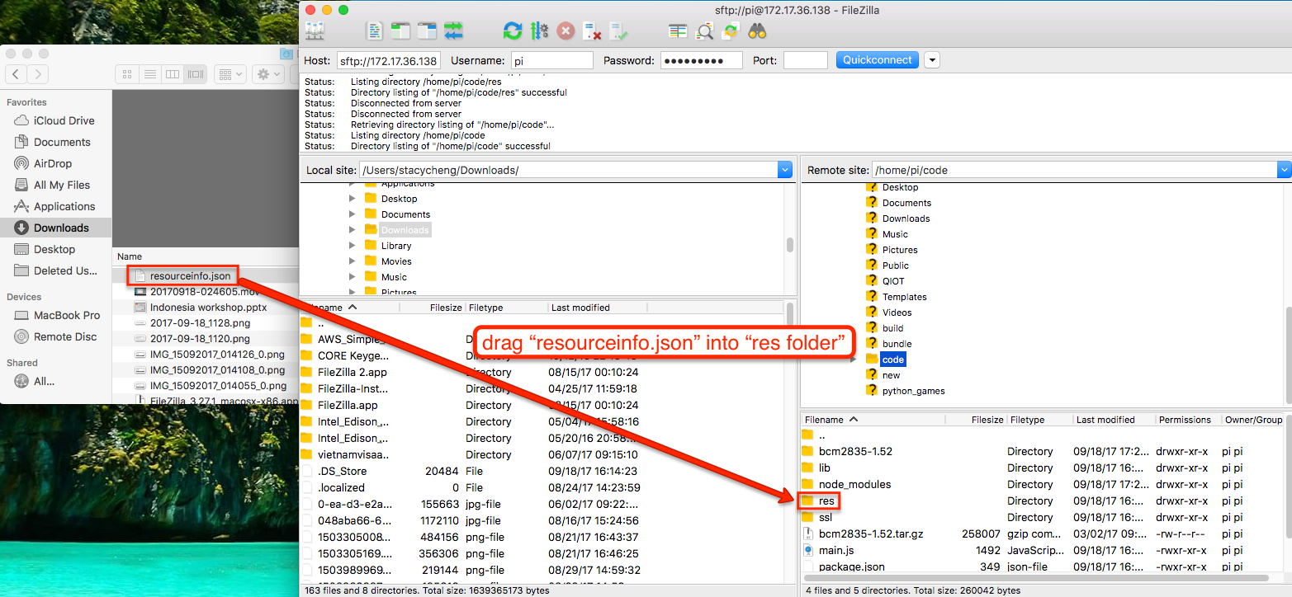
Upload connection file

Slide 37
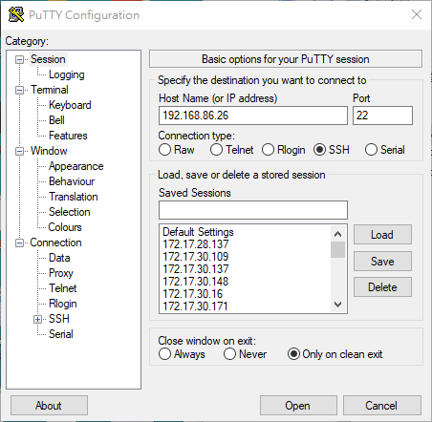
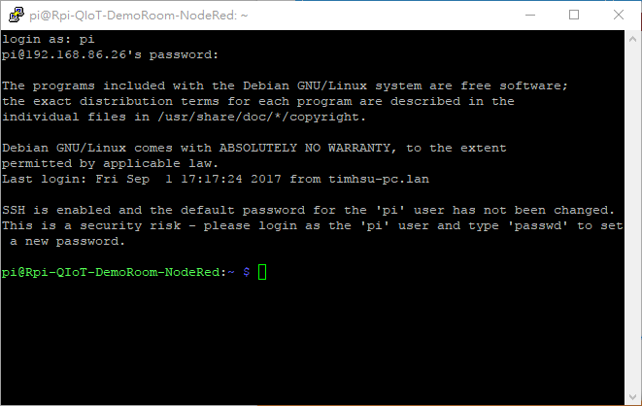
Setting of operating environment and execute main program -Windows

Slide 38
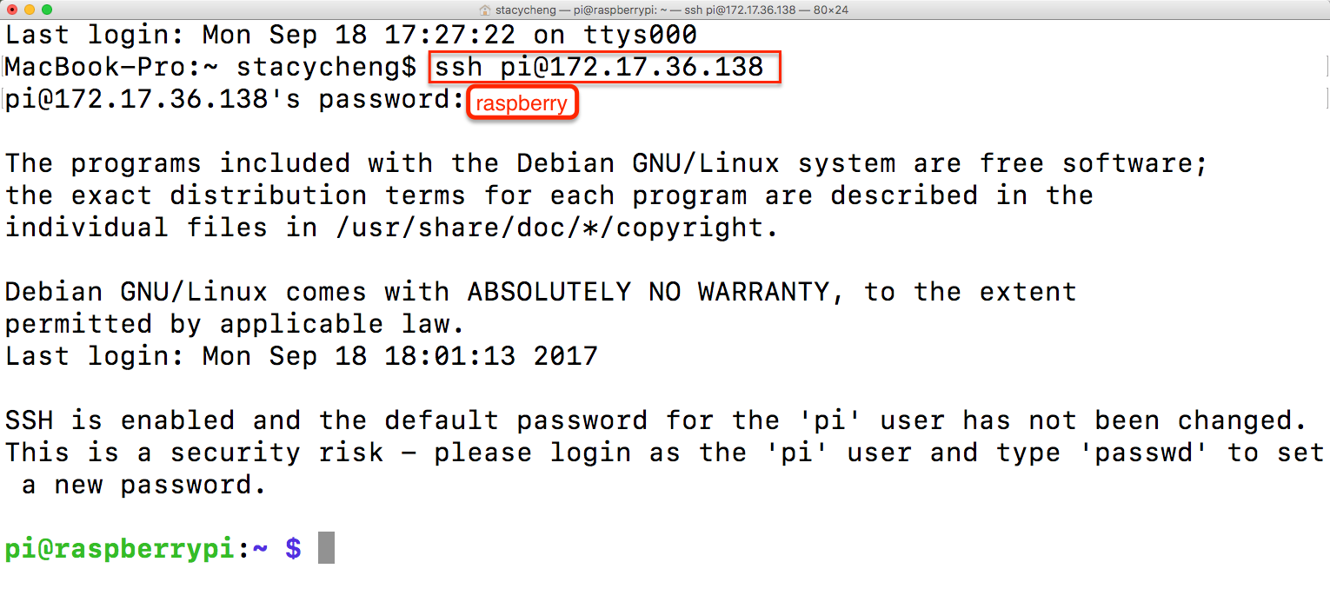
Setting of operating environment and execute main program -Mac

Slide 39
Setting up the operating environment
Upgrade node.js to v6 version :
sudo apt update
curl -sL https://deb.nodesource.com/setup_6.x | sudo -E bash -
sudo apt install nodejs
Install dependencies :
cd ~/code
bash setup.sh
Notice
This step can take a while, please be patient.

Slide 40
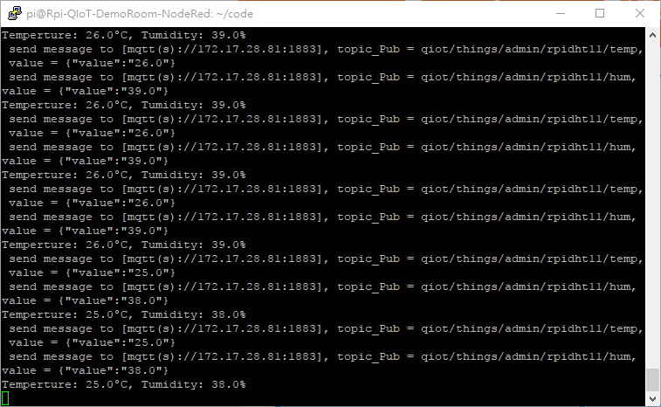
Executing main program
command :
cd ~/code
node main.js
Notice
Please do not close this window after executing command to ensure the program runs in background.

Slide 41
Step 3：Rules
1.1 Data visualization
1.2 Debug node

Slide 42
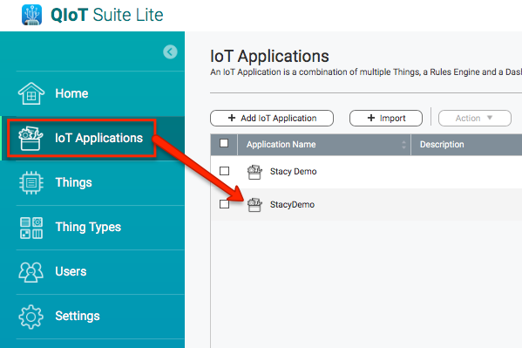
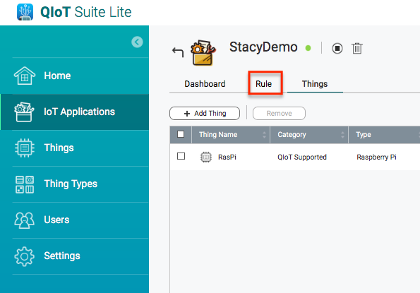
How to get to rules engine page

Slide 43
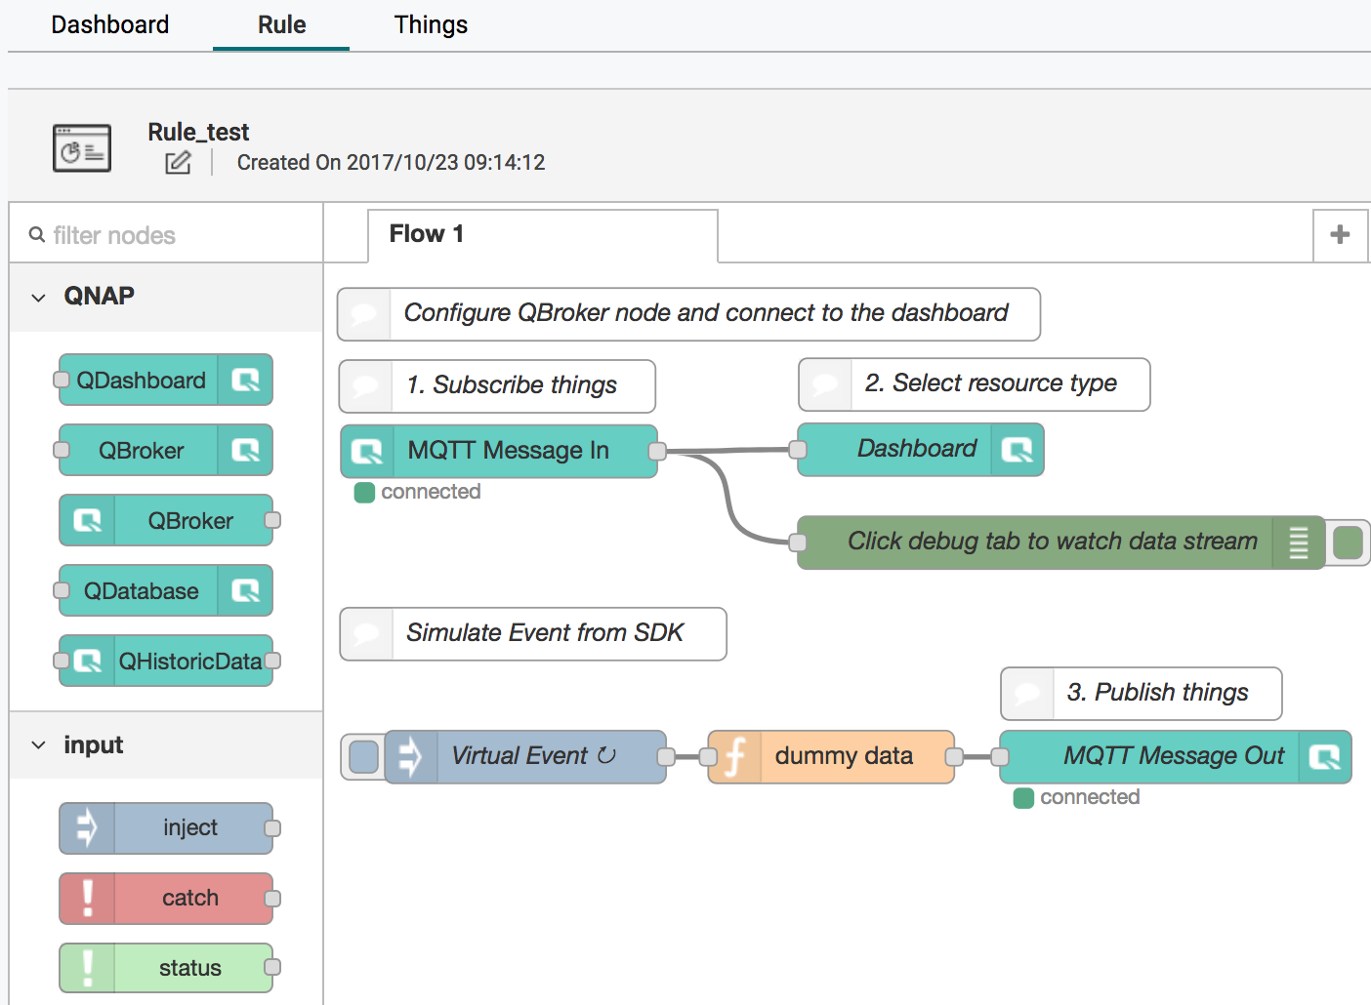
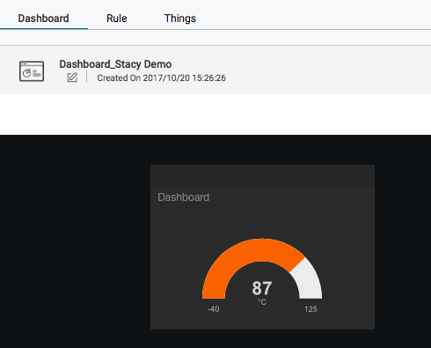
Rules engine by default
Notice
Default rule can be found in this page when new application is added.
> Generates random number
>Dashboard setting

Slide 44
Rule Setting
Rule 1 : Output to dashboard
Rule 1 : Show needed information for debugging

Slide 45
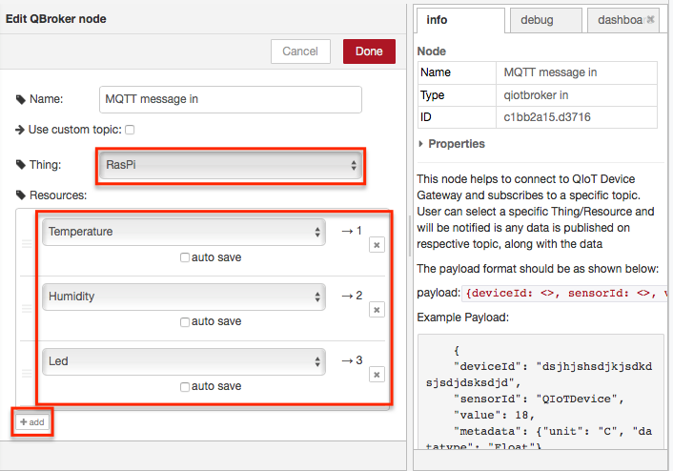
Broker node setting
1
Notice
Related information and setting pops out by double clicking on the Node.
3
2

Slide 46
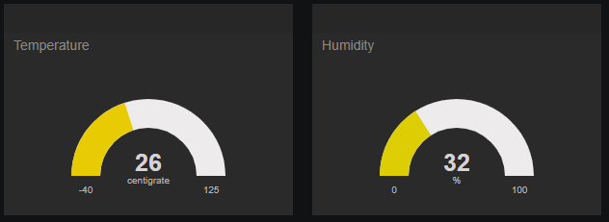
Rule 1 : Dashboard

Slide 47
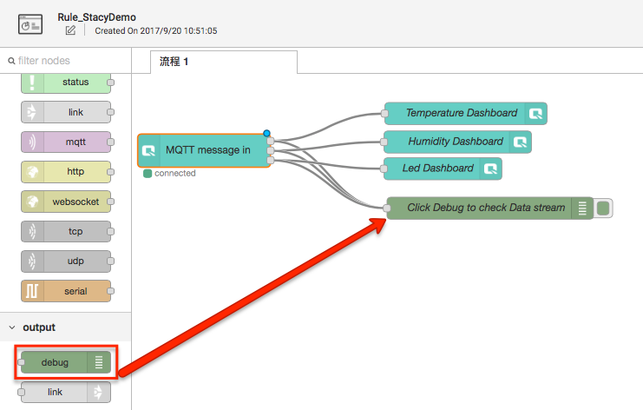
Rule 2 : Debug node setting
As easy as drag and drop debug node and connect with broker in node!

Slide 48
System requirement
QNAP QTS version：4.3.0 or higher
CPU：x86, ARM,
Minimum RAM：4GB(X86), 2GB (ARM)
Must have Container station

Slide 49
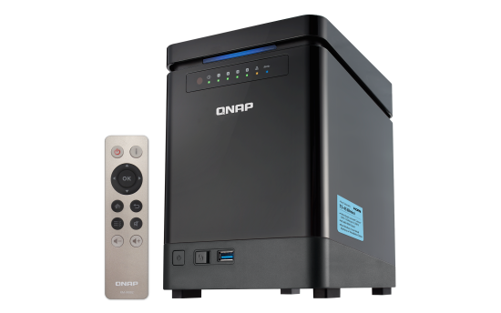
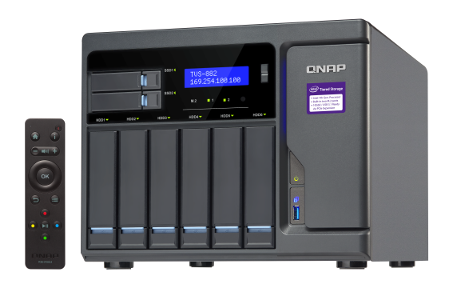
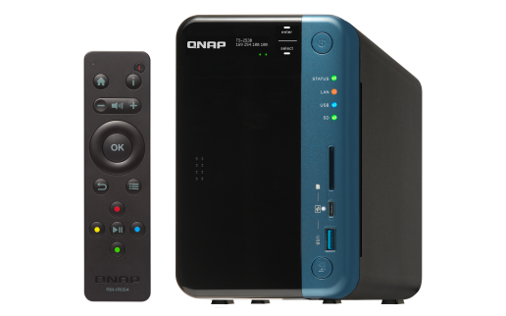
Recommended models
TS-253B
CPU: Intel® Celeron® J3455 quad-core 1.5 GHz, up to 2.3 GHz
RAM: 4GB
RAM upgrade: up to 8GB
TS-453Bmini
CPU: Intel® Celeron® J3455 quad-core 1.5 GHz, up to 2.3 GHz
RAM: 4GB
RAM upgrade: up to 8GB
TVS-882
CPU: Intel® Core™ i5-6500 3.2 GHz quad-core processor
RAM: 16GB
RAM upgrade: up to 64GB

Slide 50
Various of products
Enterprise – Enterprise level NAS
SMB - Thunderbolt NAS
SMB – High level
SMB – Middle level
SMB – Entry level
Home – High level
Notes:
----- 會議記錄 (17/2/23 20:02) -----
x53 & x51 a pro b 也試著看
x63 全部

Slide 51
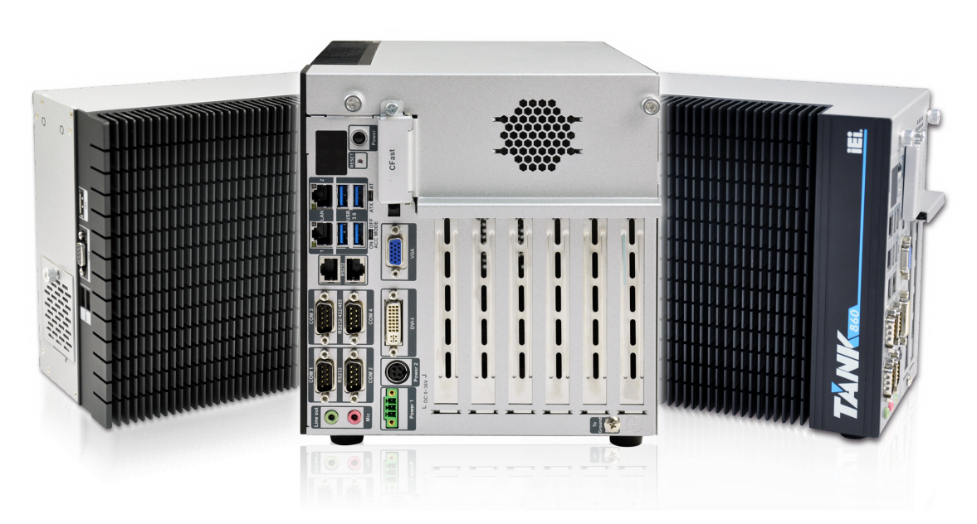
Support IEI TANK
QTS system specifically designed for QNAP NAS, provides robust base operating platform
24/7 storage, high expansion capacity, efficient operation
Diversity of product options offering suitable solutions for different business scale

Slide 52
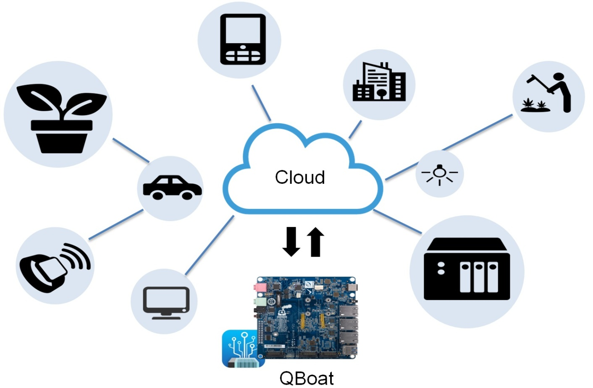
More QIoT application
QBoat Sunny

Slide 53
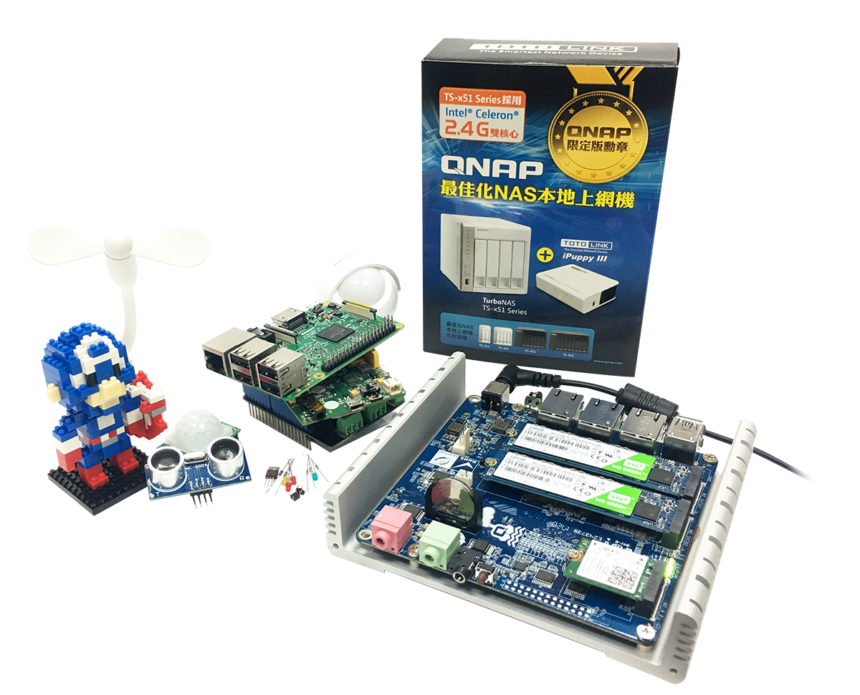
Very First DIY IoT Server
QBoat Sunny
First ARM model support by QIoT
Perfect DIY IoT server for Maker

Slide 54
Reference
Web:
https://www.qnap.com/solution/qiot-suite/en/index.php
Blog :
https://qiot.qnap.com/blog/en/
SDK , Sample code :
https://github.com/qnap-dev/qnap-qiot-sdks
Partner :
http://qiot.qnap.com/en/partner

