Slide 1
3 Leading Technologies to Maximize ROI
Qtier Pool
RAID 50/60
iSCSI VJBOD

Slide 2
Your problem, our solution:
Maximize the Value of Expensive SSD

Slide 3
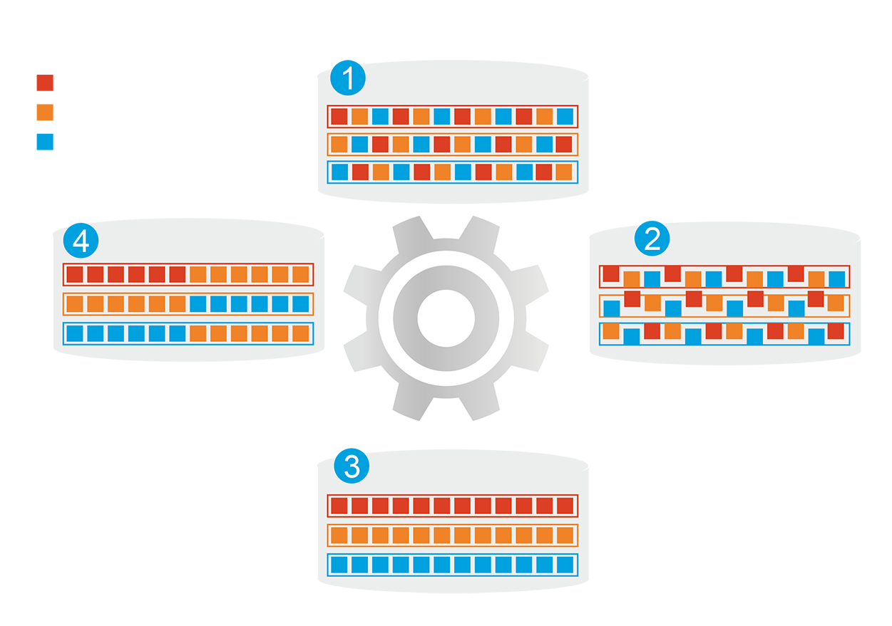
Hybrid Storage System
Before tiering: Frequently-accessed data performance is not optimized
Automatically moves data between different tiers
SSD cache capacity will not be limited by RAM size
Frequently-accessed data
Infrequently-accessed data
Rarely-accessed data
Changes in data access patterns
Start data tiering
How Qtier Works
After tiering: Frequently-accessed data performance is optimized
Notes:
3

Slide 4
Replace SSD Cache with Qtier 2.0TM
SSD Cache
Application Layer
Cannot be used to store data
Fixed bypass options
> For short term performance boost
SSD
HDD
Sequential
Qtier 2.0
Random
Tier can store data
IO Aware and Tiering On Demand
> For both short and long term performance improvements
SSD Cache
Qtier 2.0
Notes:
SSD tier can store data
IO Aware and Tiering On Demand

Slide 5
Qtier 2.0 IO Aware Qtier
SSD tier has a cache-like reserved space to handle burst IO in real time
Increased performance is more obvious compared to SSD cache on applications with sequential pattern but still need to access metadata (for example, backup)
Date
free
Burst I/O at C and D
Move D to reserved space on SSD
A
B
A
B
D
SSD Tier
SSD Tier
C
D
C
HDD Tier
HDD Tier
BLK | Hit | Timeout
C | 50 | 0
D | 50 | 0
BLK | Hit | Timeout
C | 50 | 0
D | 200 | 0
Pre-Cache
Pre-Cache
Notes:
5

Slide 6
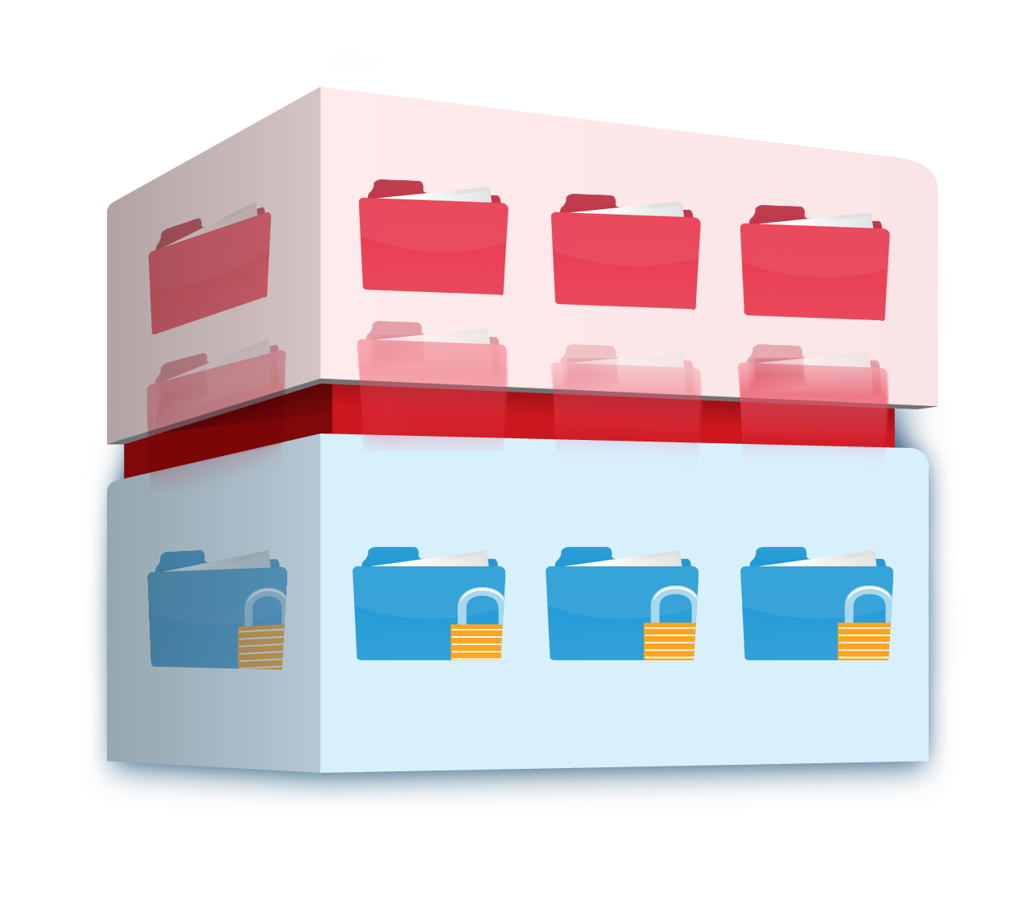
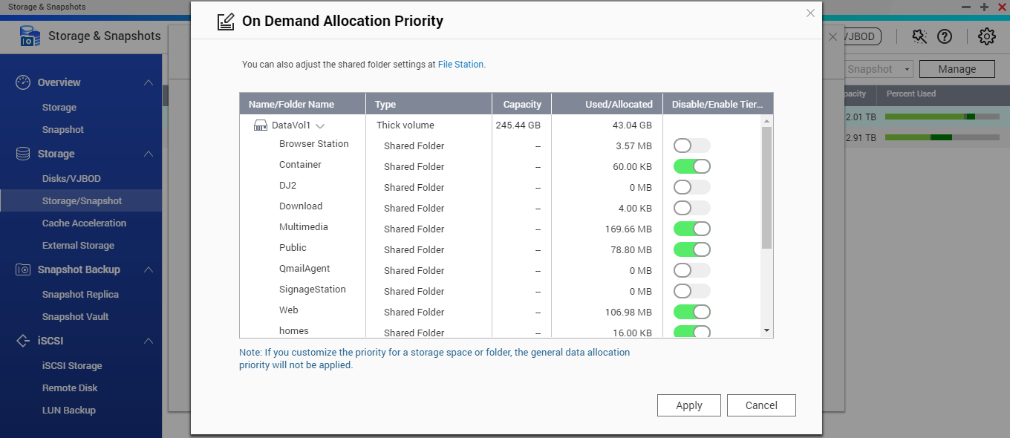
Qtier 2.0 Tiering On Demand
SSD only has limited capacity that can be used on key applications
Enable or disable auto-tiering for individual shared folder or iSCSI LUN
Hot data and reserved block
Cold and archived data
Notes:
6

Slide 7
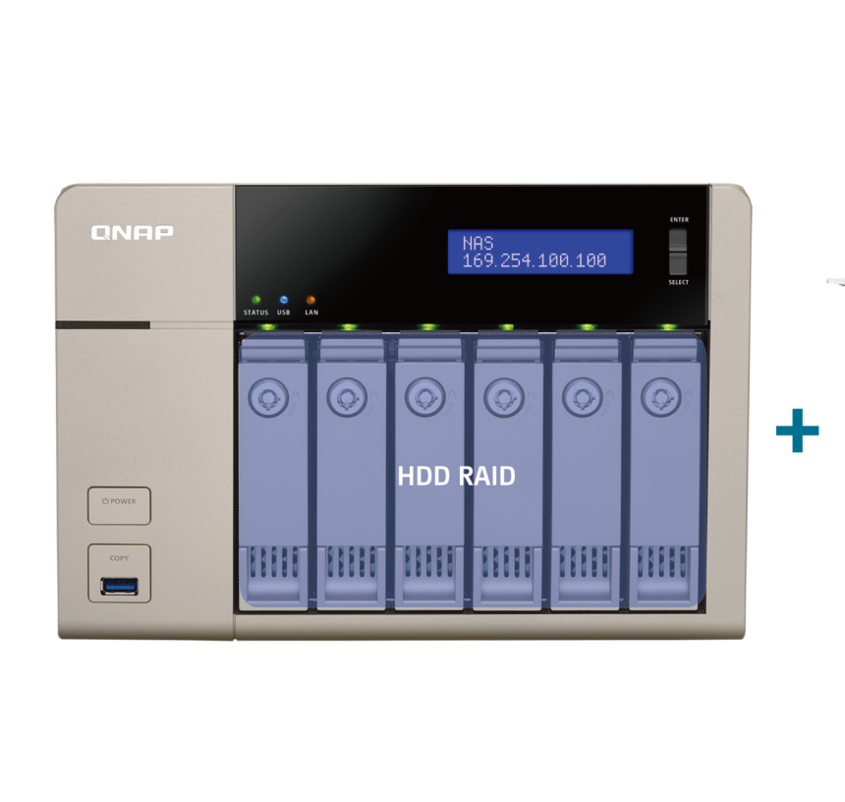
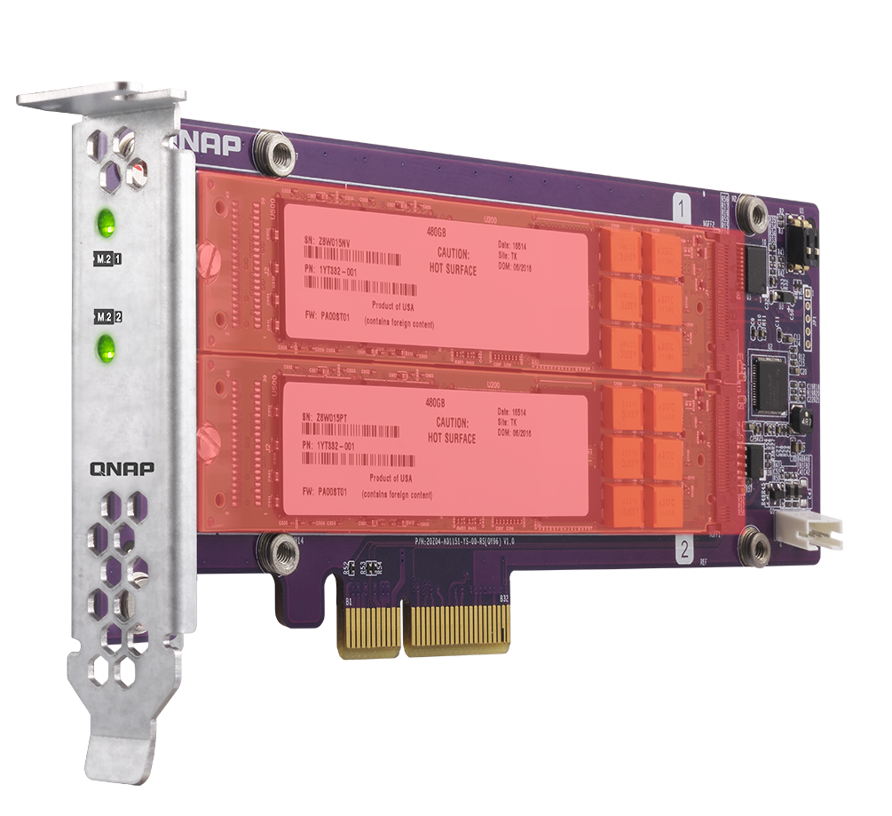
Uninterrupted Upgrade to Qtier Pool
Storage pool created after 4.2 can be upgraded
Add SSD/HDDs using free bays, an expansion unit, or the new QM2 SSD expansion card
QM2 SSD RAID
Notes:
7
流程圖 > 移除 Cache > 升級Qtier Pool

Slide 8
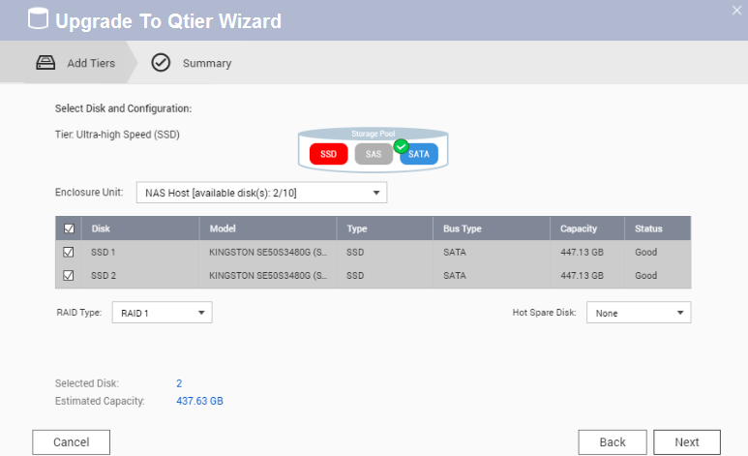
Switch from SSD Cache to Qtier
１
Step
Disable SSD Cache Online
Step
2
Confirm the SSD that will be added to the Storage Pool
Step
3
Upgrade to Qtier Pool !
Notes:
8
流程圖 > 移除 Cache > 升級Qtier Pool

Slide 9
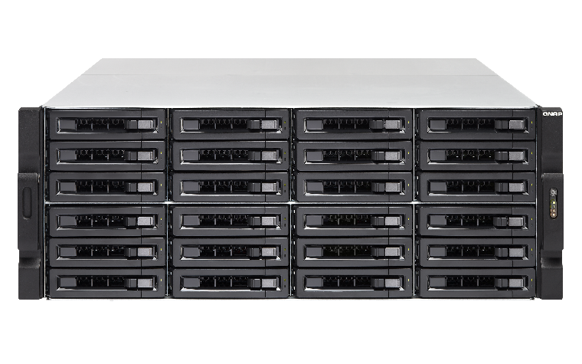
Utilizing the Performance of SSD
<Test> TVS-EC2480-SAS-RP
12 SSDs in RAID 10, 12 HDDs in RAID 6
5 VMs IOmeter test with standard 4K random read-write
Adopting Mellanox’s 40GbE iSER solution
40 GbE iSER
HOT Ultra-high
Performance
180,000 IOPS with 40TB
<1 ms
Response time
SATA HDD Capacity
Notes:
9

Slide 10
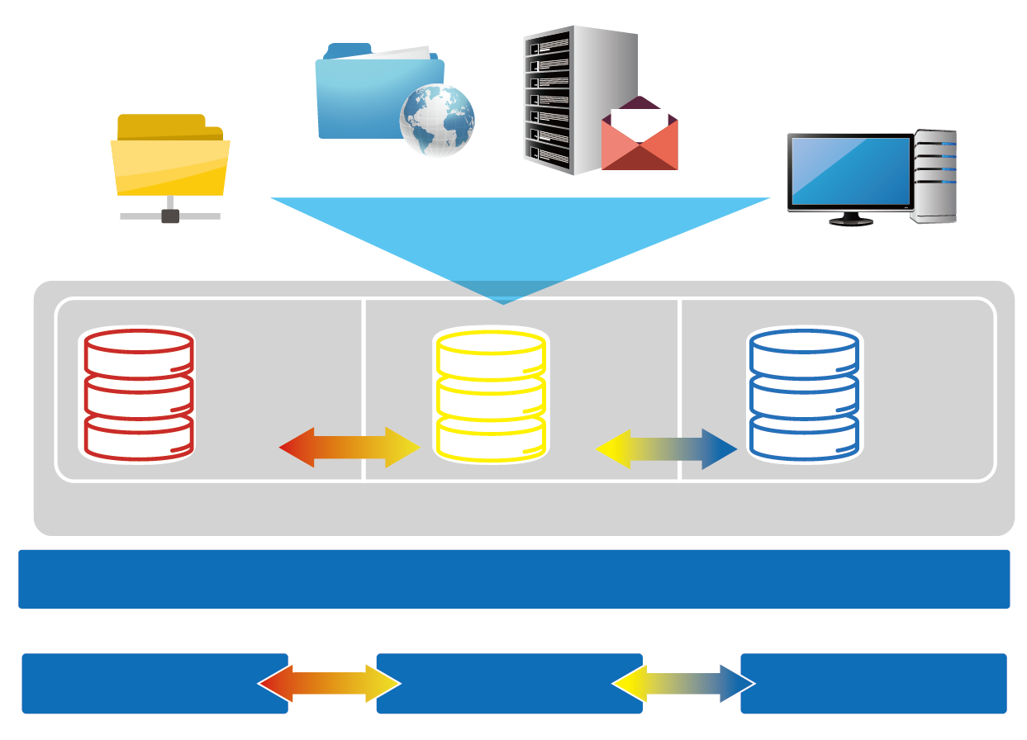
The Leading Tiering Technology
Web server
Email Server
Advantages
File server
Virtual Desktop Application
SSD as storage
Satisfy both random and sequential usages
Triggered by events, data tiering
PCIE NVMe,
M.2, General SSD RAID NL, SAS, SATA HDD
SAS HDD RAID
NL、SAS、 SATA HDD RAID
Use Cases
Qtier storage pool
File Server
Web Server
Mail Server
VDI Hosting
Local NAS

Local NAS
Expansion unit 1
Expansion unit 2
Notes:
10

Slide 11
Storage & Snapshot
Your problem, our solution: RAID 5/6 is not suitable
when more than 8 disks are used
QTS 4.3.4
Ripple
PM

Slide 12
RAID Protection Decreases as Capacity Increases
The risk of using RAID5/6 increases as capacity grows!
According to ServeTheHome RAID Calculator
Chance of a RAID 5 group failing within 5 years
Disks | Capacity | Risk
4 | 4TB | 0.1%
4 | 8TB | 0.2%
8 | 4TB | 1%
8 | 8TB | 2.2%
12 | 4TB | 4.1%
12 | 8TB | 6.5%
https://www.servethehome.com/raid-calculator/， conservative estimate assuming bit error chance is 10^(-15), 150MB/sec rebuild speed
Notes:
12
4~8~12 4TB 8TB

Slide 13
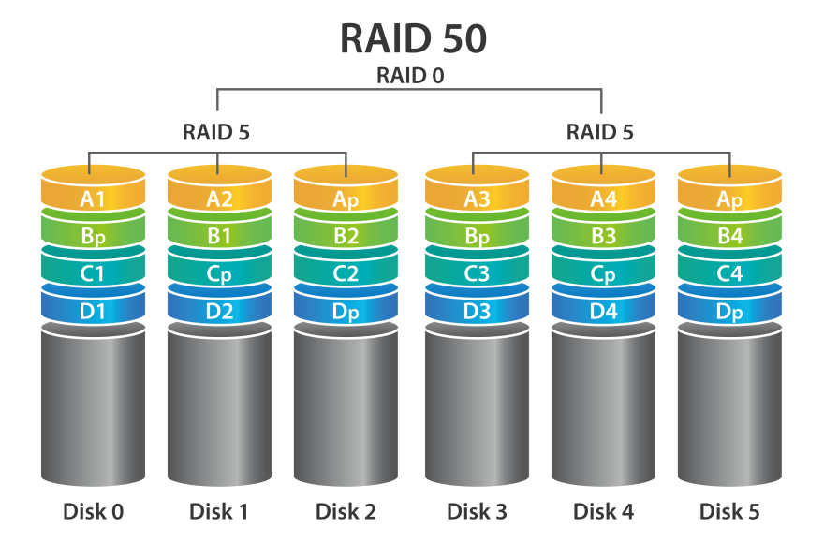
RAID 50 & 60 Reduce the Risk of RAID Failure
Less space used for redundancy + increased RAID protection
RAID type | Disks | Disk Failure Tolerance | Capacity | Chance of Failure
RAID 5 | 12 | 1 | 66TB | 6.15%
QNAP RAID 50 | 12 | 2 or more | 60TB | 0.6%
RAID 10 | 12 | 6 | 36TB | 0.2%
Actual disk failure tolerance depends on the number of RAID50/60 sub-arrays.
Notes:
13

Slide 14
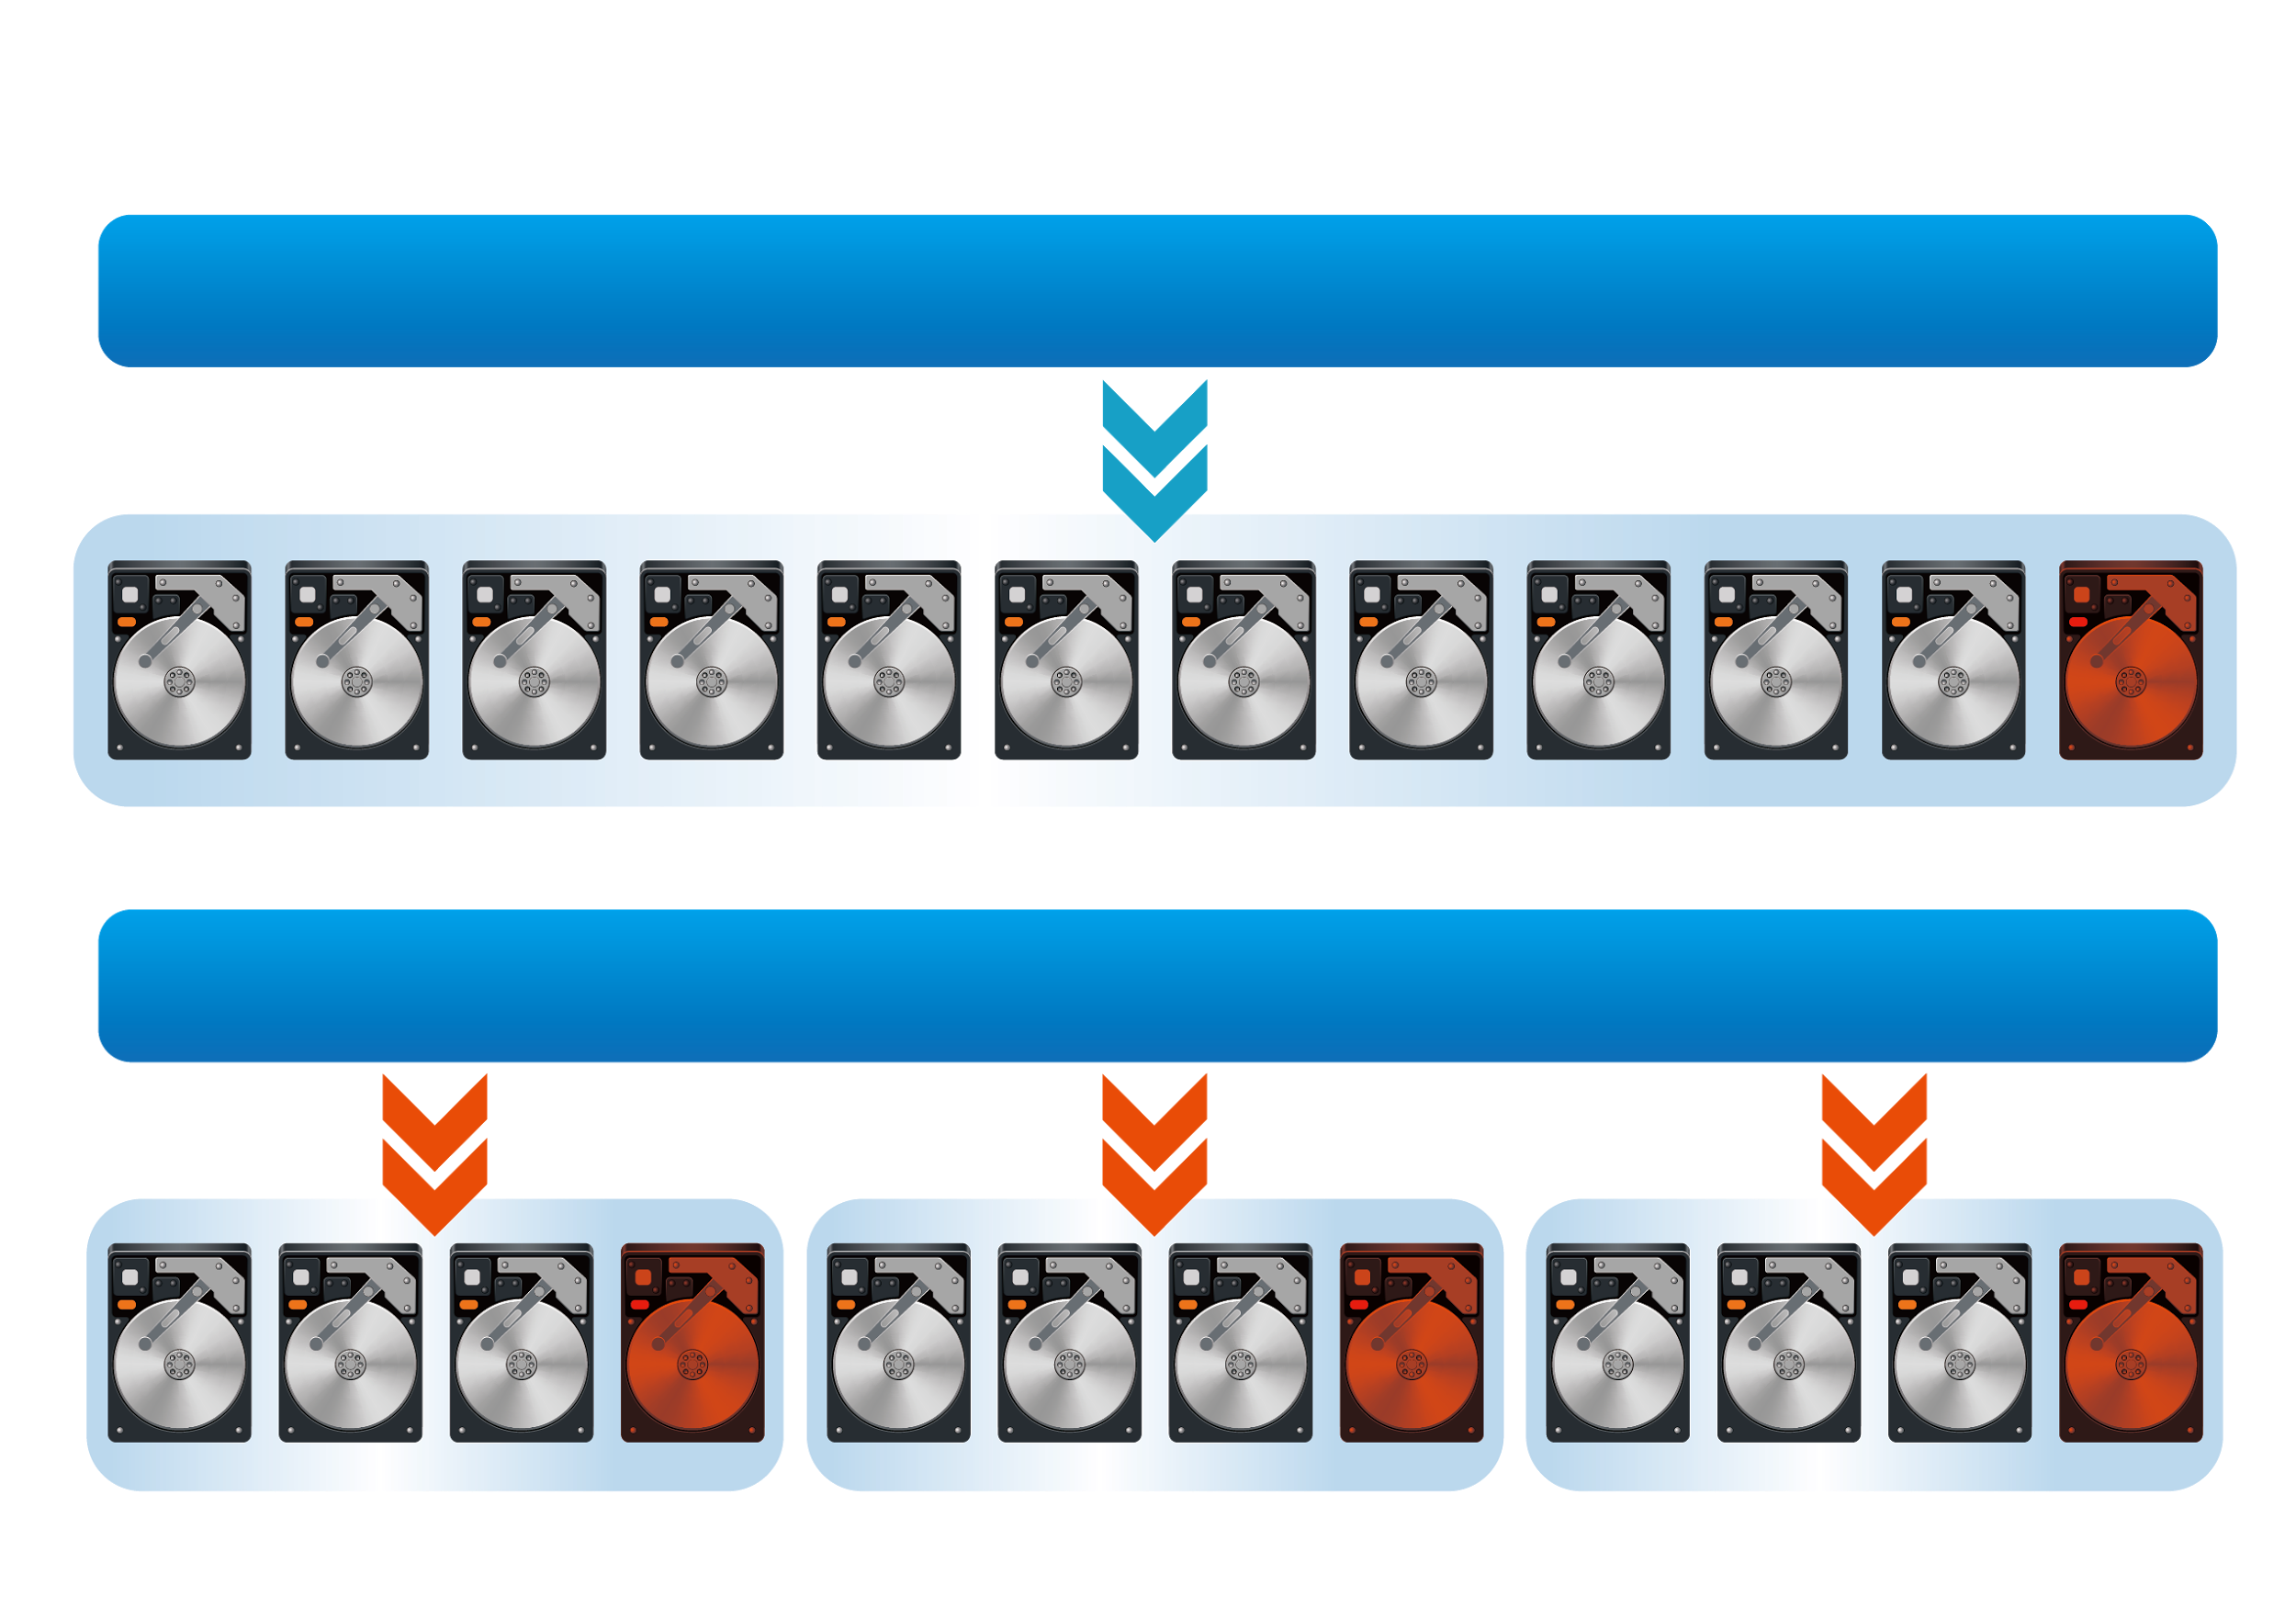
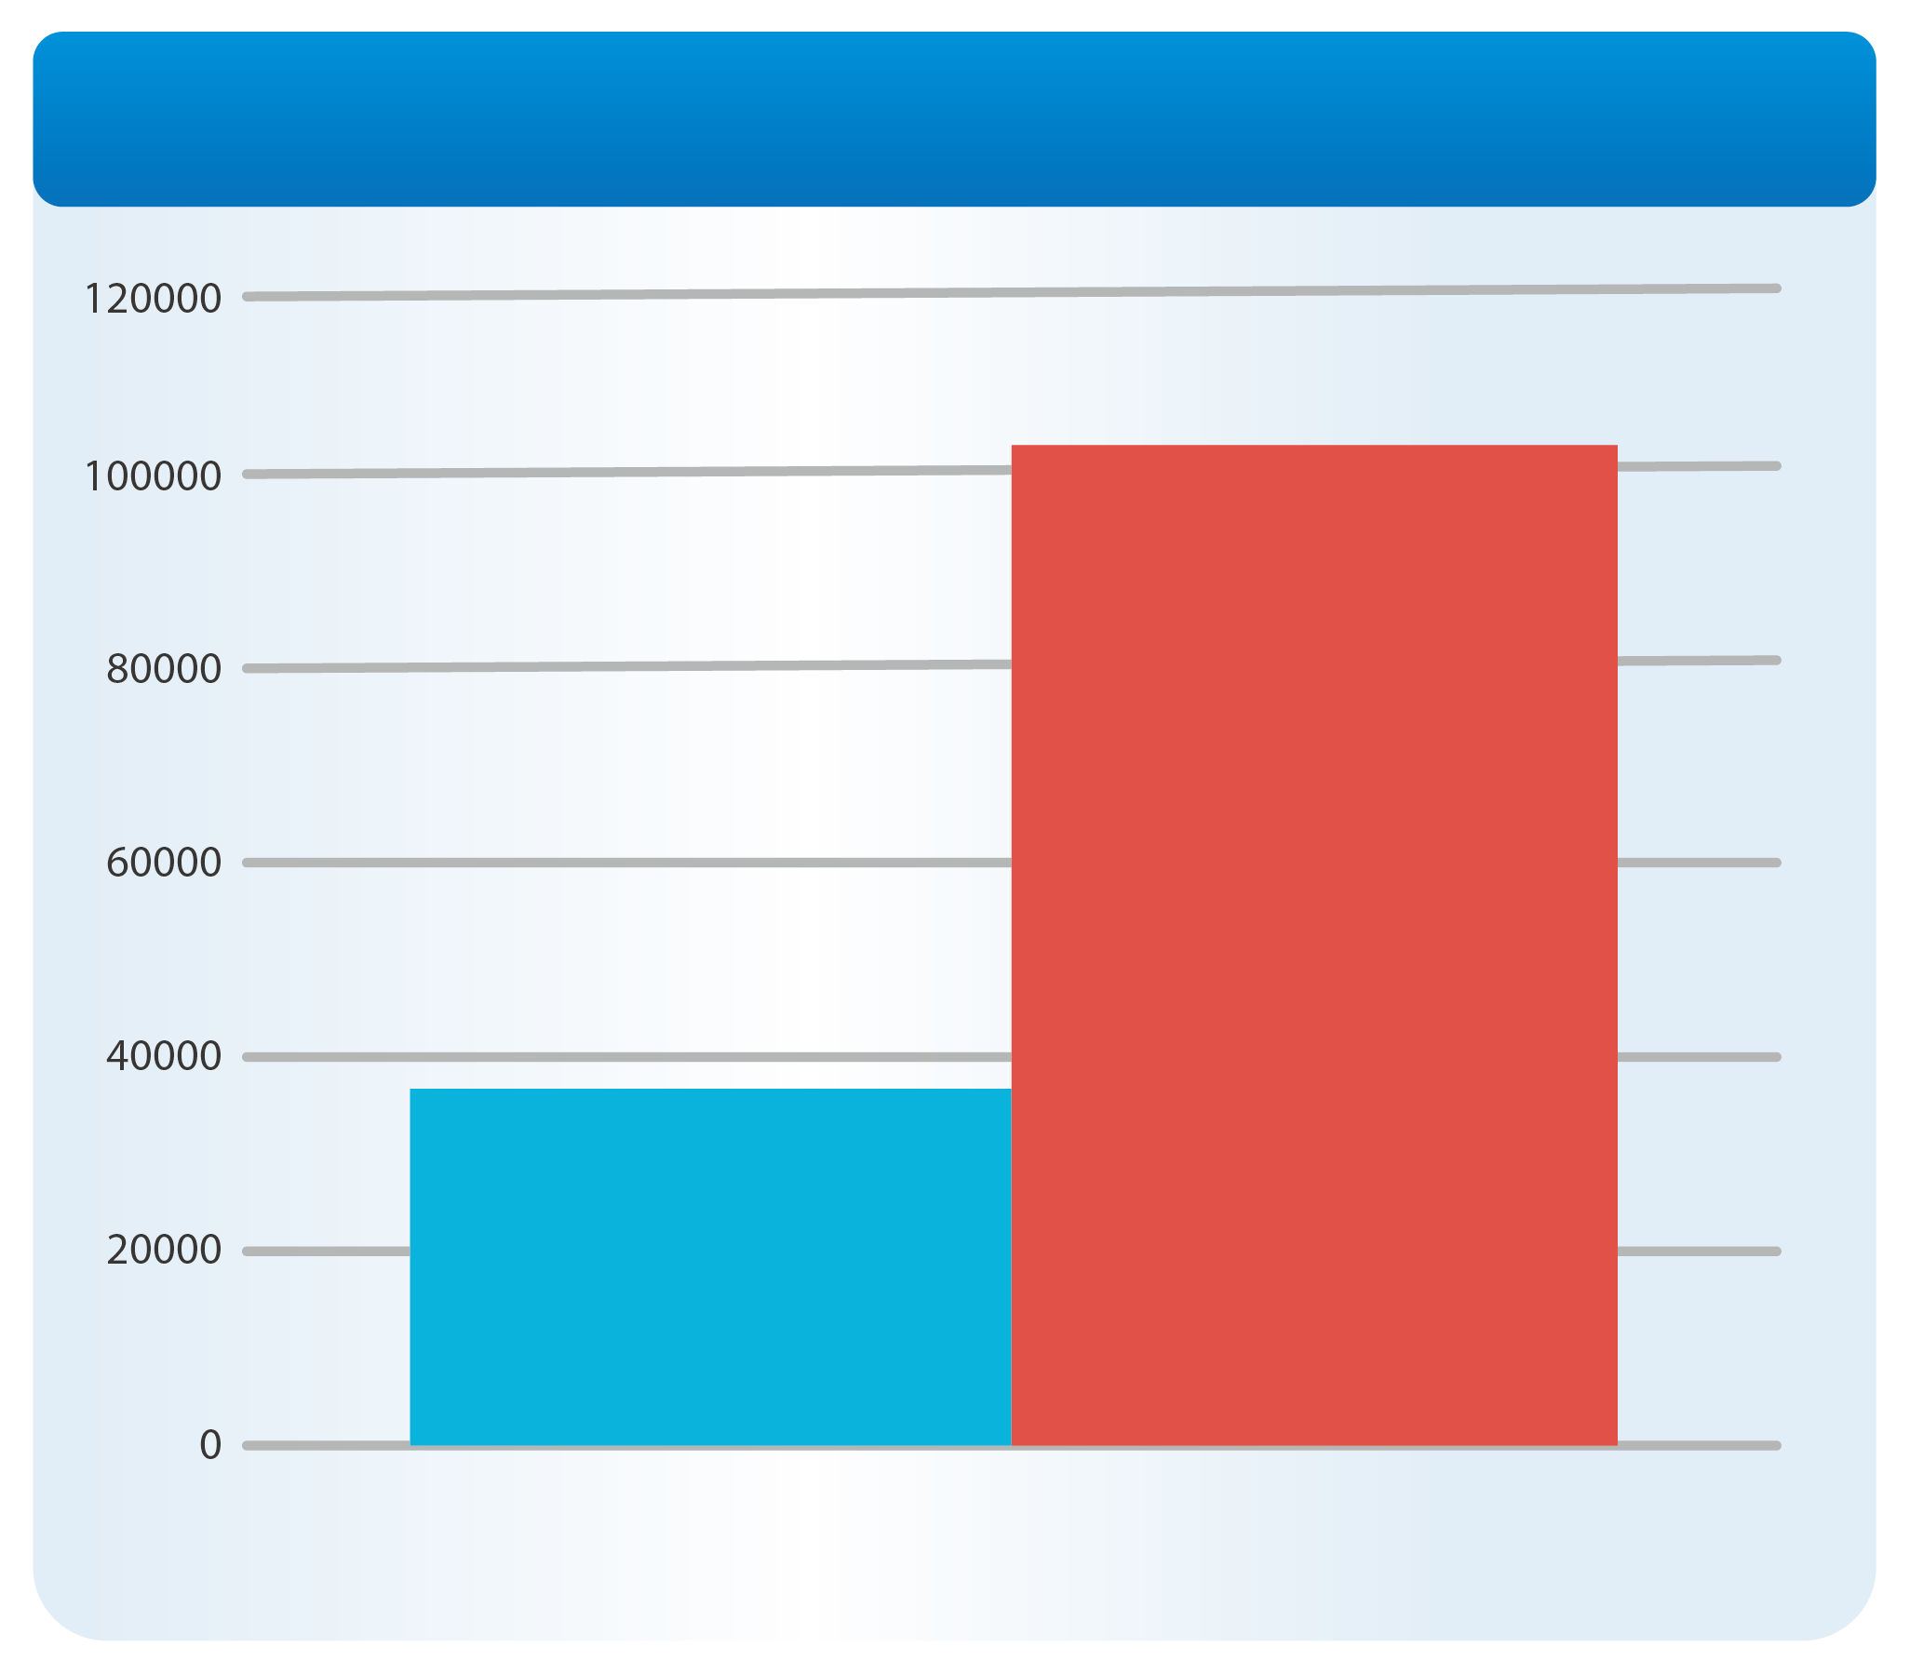
RAID 50 & 60 Increase “Random Write” Performance
Multiple RAID groups calculating parity at the same time
Comparison between RAID 50 (3 sub-groups) and RAID 5 (SSD RAID)
Increased to
RAID 5 Pool
Random Write IOPS
300%
RAID 50
With 3
Subgourps
RAID 50 Pool
Single RAID 5
Random Write 4K Performance
Notes:
14

Slide 15
Different Types of RAID Offered by QNAP
RAID Type | RAID 5 | RAID 6 | RAID 10 | RAID 50 | RAID 60
# of Disks | At least 3 | At least 4 | At least 4 | At least 6 | At least 8
Disk Failure Protection | 1 | 2 | Half of the disk | 2~5 | 4~10
Write Performance | ★★ | ★ | ★★★★ | ★★★ | ★★★
Capacity | ★★★★ | ★★★ | ★ | ★★★ | ★★
Use Cases | Backup only | General application | For VDI hosting and database | High frequency backup | For VDI or media editing that need high capacity
Notes:
15

Slide 16
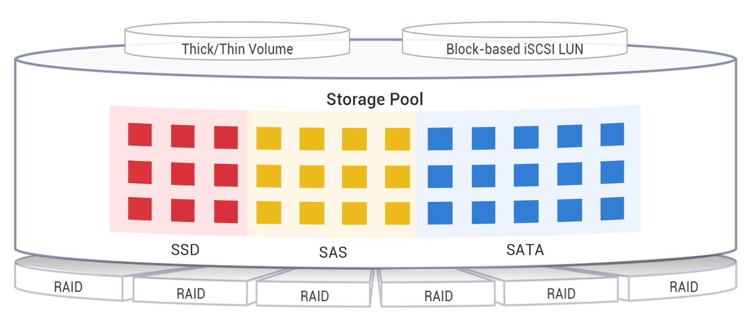
Deploying RAID 50/60 With Qtier
HDD RAID 50 = High capacity backup server
HDD RAID 60 + Read-Only SSD Cache = High capacity file server
SSD RAID 50 + HDD RAID 60 = High capacity and performance virtual storage server
The RAID 50/60 Pool cannot be expanded with striping after creation .
Notes:
16

Slide 17
Your problem, our solution: iSCSI VJBOD Expansion with Maximized ROI
PM

Slide 18
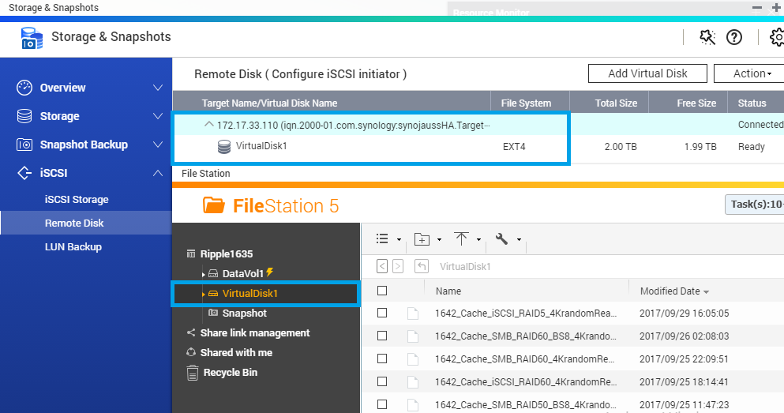
Dual Mode: iSCSI Initiator and Target
Major storage vendors support iSCSI Target
QNAP NAS supports both iSCSI Initiator and iSCSI Target
１
Mount iSCSI target from other storage
Use the unique iSCSI expansion (VJBOD)
2

Slide 19
Use iSCSI Initiator to Mount Other Storage
iSCSI Initiator and Target are industry standards
QNAP iSCSI Initiator can be used with EMC, NetApp, Synology, QSAN iSCSI target without modifications
Unused space can be mounted to QNAP for various features
* Logo belong to each company.

Slide 20
Block-based vs File-based iSCSI LUN
File-based iSCSI LUN Allocate space in Volume
Blocked-based iSCSI LUN Allocate space in pool
Easily allocate and manage space Support VAAI thin provisioning Avoid interference from volume
Applications
Shared Folder
File-Based iSCSI LUN
Clear
interference
Volume
Block-based
iSCSI LUN
Storage Pool

Slide 21
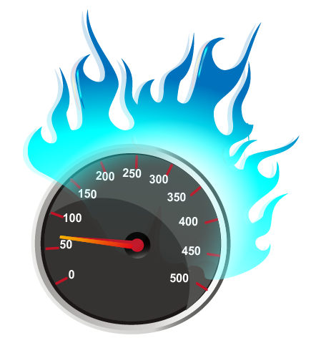
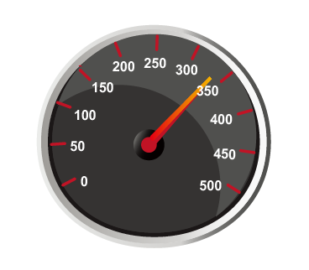
Block-based iSCSI LUN
Effectively provide stable performance
TS-1635 Block-based / File-based LUN with RAID 50, 12HDD, no Cache
When shared folders are being accessed
Maximum Response Time Test
Difference
6
333
51
Times
ms
ms
File-based
Higher means mean higher latency
Block-based

Slide 22
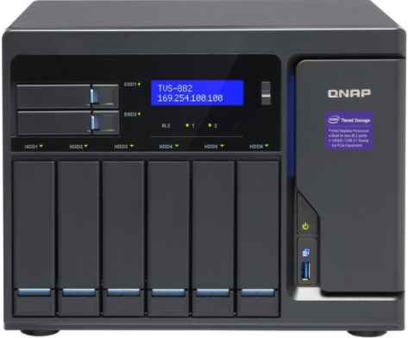
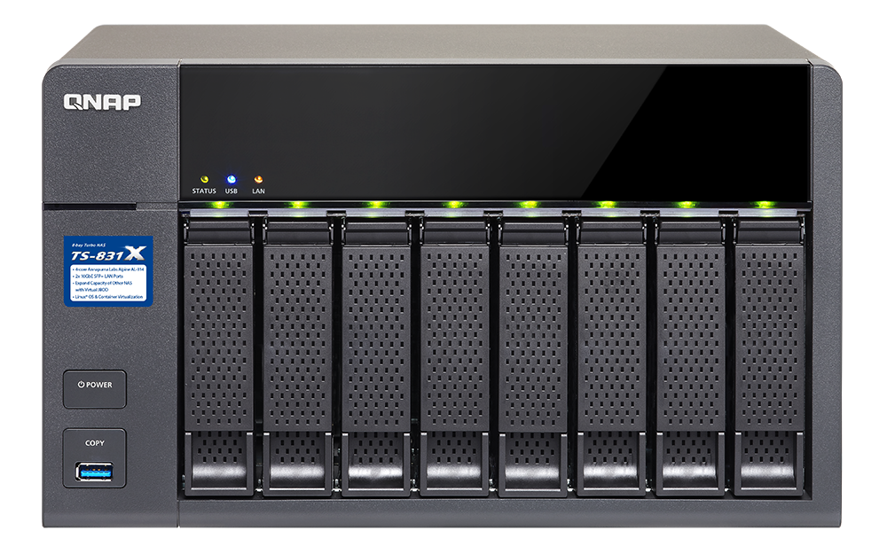
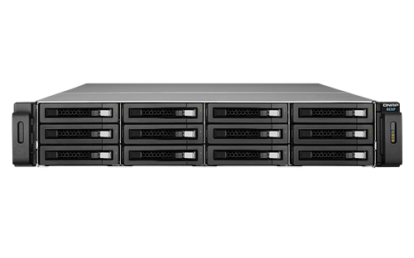
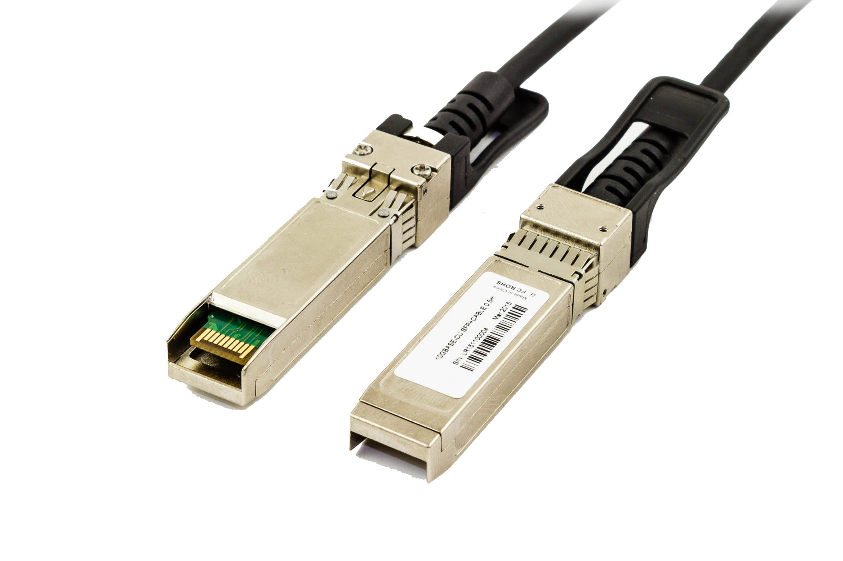
Use iSCSI / JBOD to Expand NAS
NAS + iSCSI Target ：Limited functions without knowing target storage condition
NAS + JBOD： Limited ports with RAID protection on the host
TVS-882
TX-831X
RAID
TS-1263U-RP
REXP-1220U-RP#1
REXP-1220U-RP#1

Slide 23
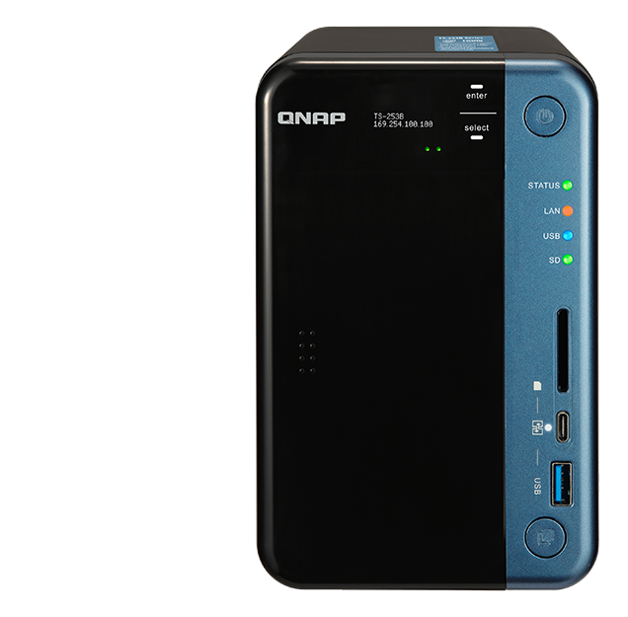
Replacing JBOD with iSCSI VJBOD
Uses VJBOD to mount a LUN as a local disk
Create Storage Pool, take snapshot, use media library, Qsirch indexing
Fully utilize storage space of NAS
Container Station
iSCSI LUN
2 x 10G SFP+
TS-831X
Virtual Pool 1
RAID
Ethernet, flexible conncetion
Virtual Pool 2
Notes:
23
NAS > eSATA < JBOD > LUN backup > to other NAS

Slide 24
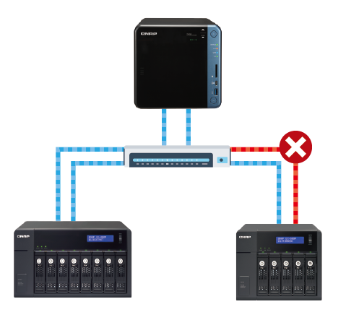
Backup Connection For Data Security
Combining QNAP NAS Port Trunking (Multiple connections, same IP):
Create Backup Connection
Achieve Load Balance with supported switch
Use with 1GbE, 10GbE and 40GbE
Ethernet
Notes:
24

Slide 25
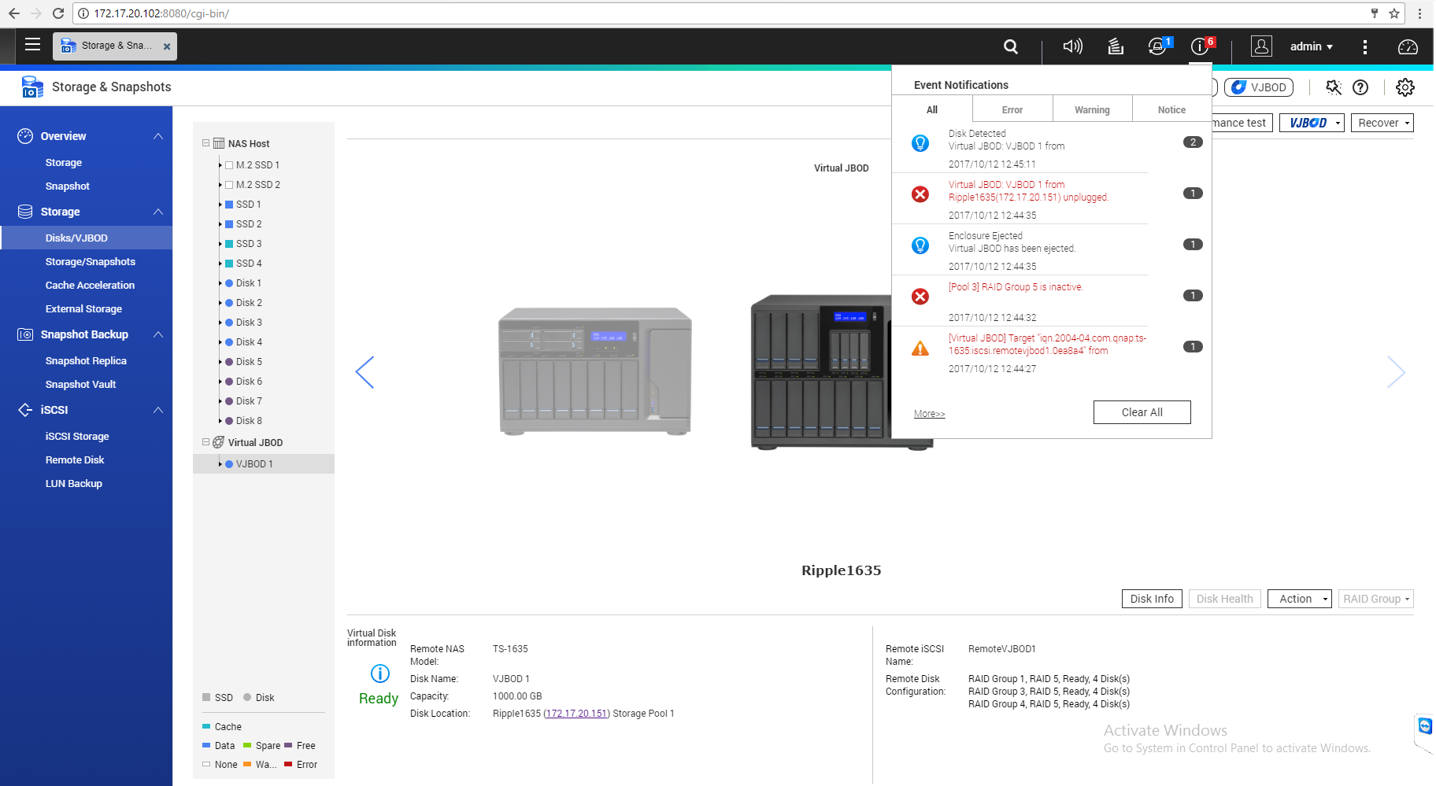
Auto Recovering for Building a Safer Connection
Enhanced iSCSI stability and security, quickly disconnect an abnormal connection to avoid misjudgment from application
Doesn't need manual recovery when network is temporarily blocked
Use Mac address to search NAS
Recover after
reconnected
Notes:
25

Slide 26
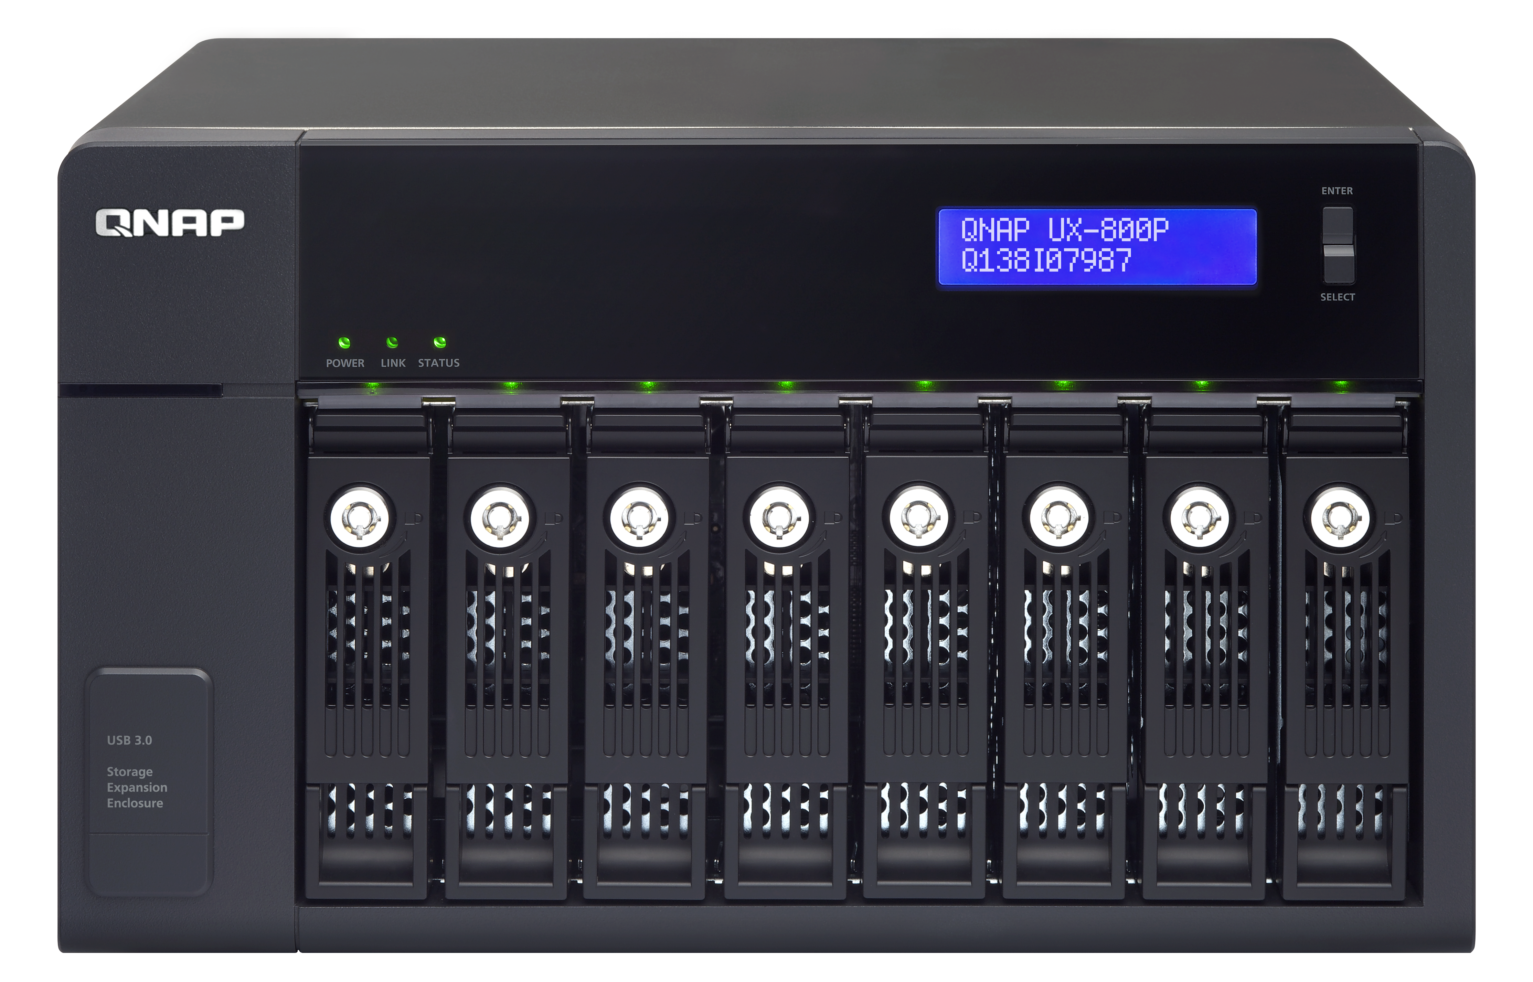
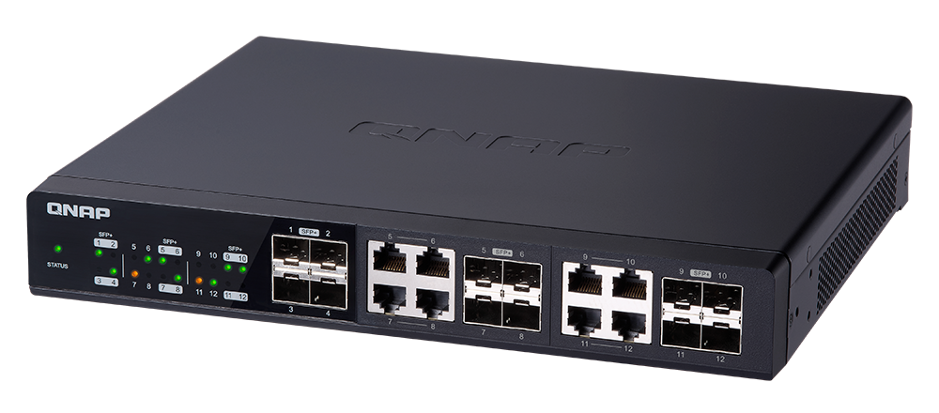
Combining JBOD and VJBOD for Max. Capacity
With a 8-bays NAS and 4 UX-800P，Maximum 300TB* (8TB per disk)
Add Virtual JBOD:
Over 1 PB total raw storage space
Total > 1 PB
USB 3.0
JBOD 8TB x 8 x 6 = 384TB
iSCSI
8TB x 8=64TB
8TB x 12 x 8 = 768TB
Notes:
26

Slide 27
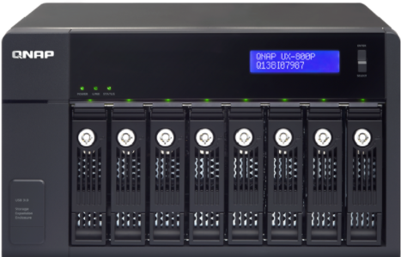
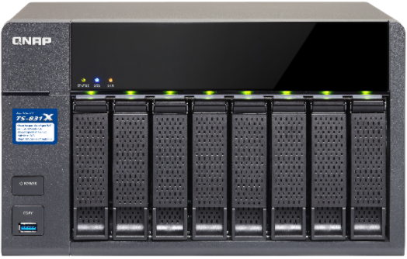
Using VJBOD to Run Backup
Traditional JBOD：
Use host device’s resource for backup
JBOD
Application
LUN backup to remote
Remote Side
VJBOD：
Run LUN backup from expansion unit directly
VJBOD

Slide 28
3 Leading Technologies for Maximizing ROI
Z
Z
Z
Z
Z
Z
Z
Qtier 2.0
Hybrid Storage Pool
iSCSI VJBOD
Storage Space Expansion
１
3
RAID 50 & 60
for Advanced Data Protection
2
Notes:
28

