Slide 1
Company Profile
2022

Slide 2
OUR SERVICES / ABOUT QNAP
QNAP (Quality Network Appliance Provider) is devoted to providing comprehensive solutions in software development, hardware design and in-house manufacturing. Building on the solid foundations of our storage, networking and smart video innovations, QNAP now provide a revolutionary Cloud NAS solution that joins our cutting-edge subscription-based software and diversified service channel ecosystem. QNAP envisions NAS as being more than simple storage and has created a cloud-based networking infrastructure for users to host and develop artificial intelligence analysis, edge computing and data integration on their QNAP solutions.

Slide 3
OUR MISSION - Stay One Step Ahead
QNAP offers advanced technologies and comprehensive solutions to ensure our users will always be in the lead.
EXPERTISE IN BUSINESS DOMAINS
IT and Engineering
Surveillance
Media and Entertainment
Retail and Grocery
Healthcare
Education
Finance and Banking
Manufacturing
Architecture and Design
Non-Profit and Public Sector

Slide 4
1300
Employees Worldwide
Global Expansion Strategy
Headquartered in Taipei
15 subsidiaries in 28 countries
1300+ employees worldwide
600+ R&D engineers

Slide 5
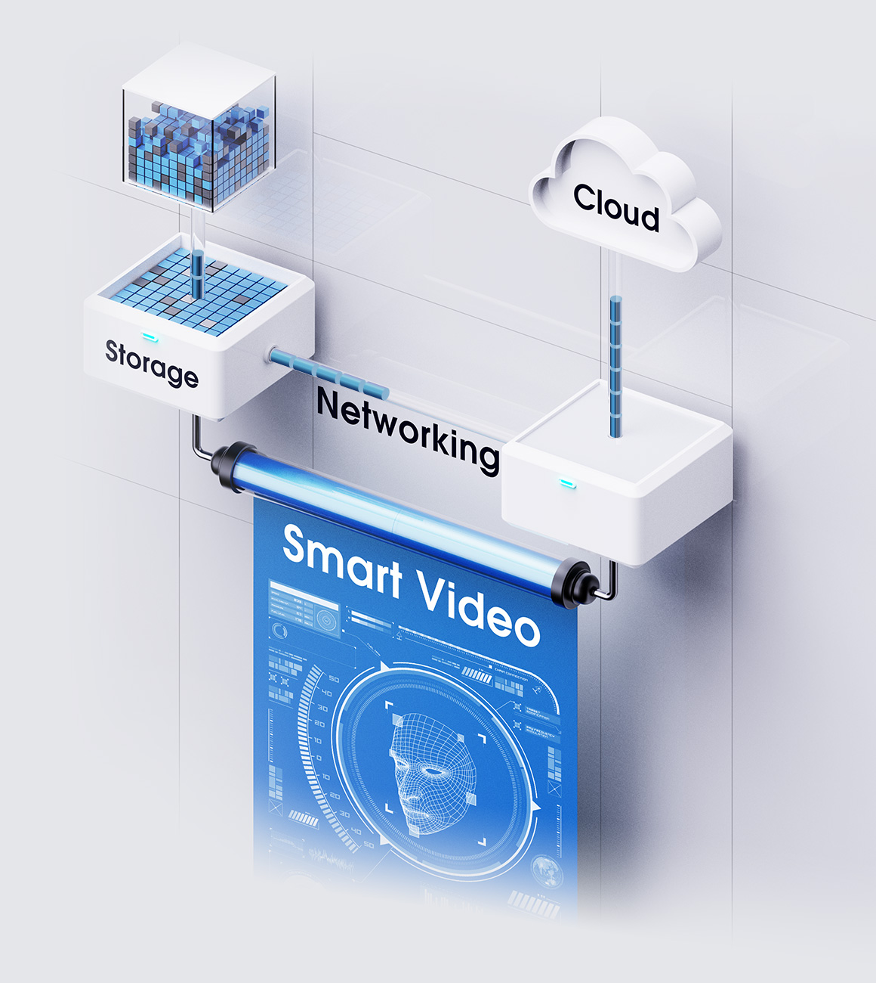
In-house Manufacturing
QNAP offers high-quality storage, networking and smart video products based on the principles of usability, high security, and flexible scalability. QNAP’s own factory with full-process production lines are certified to ISO 9001 Quality Management Systems, ISO 14001 Environmental Management Systems, ISO 45001 Occupational Health and Safety Management Systems, and ISO 27001 Information Security Management Systems.

Slide 6
QNAP
Leads the Way
Comprehensive products that reflect technology and market trends.

Slide 7
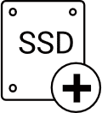
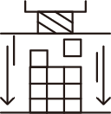
All-flash storage. Ultimate performance.
QNAP‘s All-Flash Storage Solutions feature ZFS data reduction and SSD optimization technologies to maximize SSD performance and lifespan - perfect for keeping your business agile and efficient!
Flash-optimized storage
Inline data compression and compaction
Write amplification is an undesirable effect of SSDs, bringing challenges to flash memory performance and endurance. QNAP’s exclusive Write Coalescing algorithm is engineered for flash optimization by transforming all random writes to sequential writes along with reduced I/O. It not only effectively increases random write performance for all-flash environments but can also improve SSD lifespans.
Inline data compression shrinks file sizes to lower storage I/O workloads for improved performance. It also helps optimize storage utilization of SSD over-provisioning.
Quality of service
SSD TRIM
Quality of Service helps optimize resource allocation based on I/O and bandwidth for LUNs/shared folders at different service levels. QoS prioritizes the performance of business-critical applications that run concurrently with non-critical applications as well as reducing "noisy neighbor" problems.
While almost all SSDs have shown consistent write performance degradation, TRIM helps overcome write performance drops. SSD TRIM allows the system to inform SSDs to delete unneeded data blocks. Deletion tasks are processed during system idle times, meaning it does not have to wait for when new data is written to the block.

Slide 8
All-flash Solutions for Critical Missions
Background
Solutions & Technologies
Enterprise services and applications usually rely on fast responses and non-interrupted servers. When unpredictable bursts of traffic or inadequate performance occurs, slow servers will directly impact ongoing business operations and end-users. QNAP’s all-flash solution can help maintain consistent, stable, and fast servers with flexible storage space. To assist in optimizing SSD investments, we also provide technologies for extending SSD lifespan.
Inline data deduplication, compression, and compaction
QSAL (QNAP SSD anti-wear leveling)
Write Coalescing
Software-defined over-provisioning
QoS - Gain optimal resource allocation for LUNs/shared folders at different service levels
SSD TRIM - Cleans deleted data blocks during system idle time to maintain SSD write performance
Support RDMA
High-availability technologies
Active-active storage system architecture
Supports up to 100Gb Ethernet
Snapshot and Real-time SnapSync

Slide 9
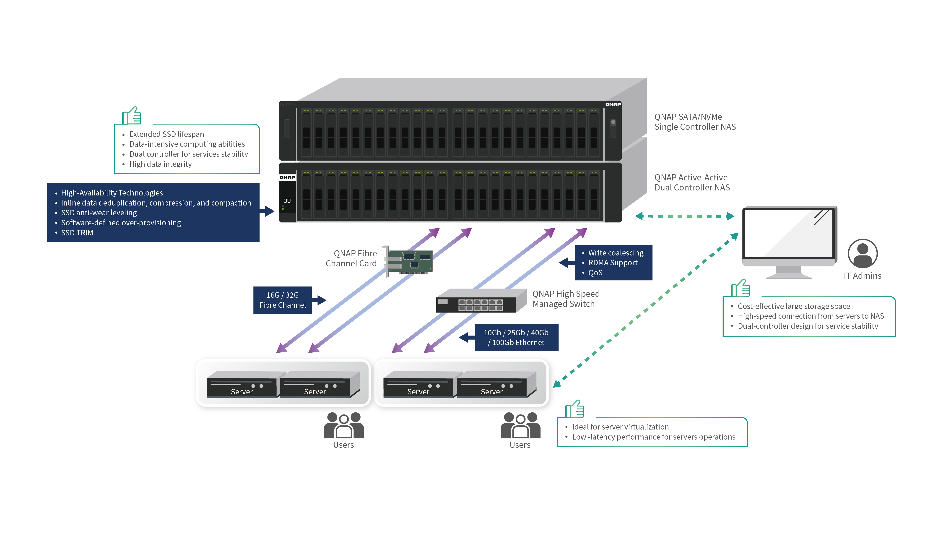
Benefits
Cost-effective large storage space
Low-latency performance for server operations
Data-intensive computing abilities
Dual-controller design for service stability
Extended SSD lifespan
High-speed connection from servers to NAS
High data integrity

Slide 10
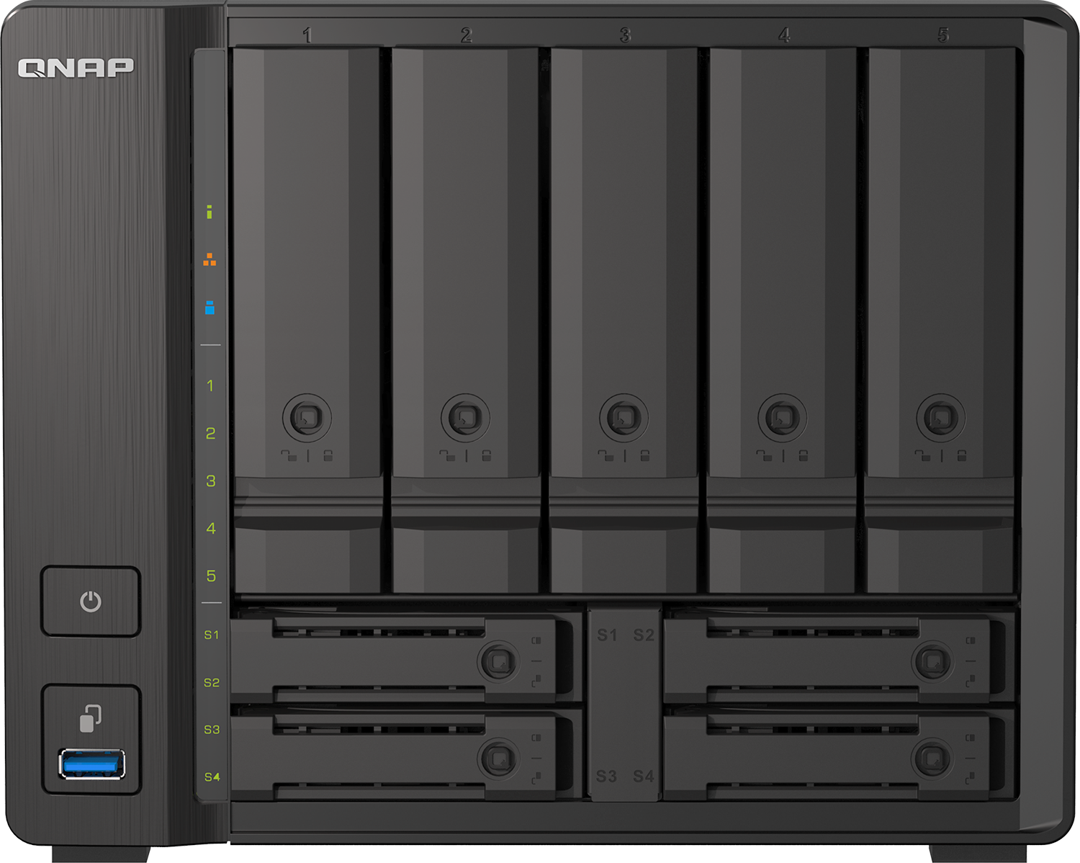
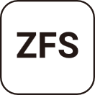
High-performance ZFS-based OS with greater reliability
QNAP’s “QuTS hero” operating system combines the app-based QTS with a 128-bit ZFS file system to provide flexible storage management, comprehensive data protection and optimized performance to meet the needs of business-critical applications.
Efficient data reduction technology
Up to petabyte capacity per shared folder
Inline data deduplication is block-based and runs before data is written to storage. This greatly optimizes storage usage while significantly decreasing storage capacity requirements. Coupled with inline compression and inline compaction technologies, ZFS significantly reduces the overall storage footprint - especially helpful for increasing SSD storage efficiency when highly-repetitive data or massive small files are generated.
The 128-bit ZFS filesystem has huge capacity potential and supports native handling of standard RAID levels and additional ZFS RAID layouts (RAID Z). ZFS-based QNAP storage solutions provide up to 5PB capacity for individual shared folders, enabling enterprises to tackle storage-demanding applications.
Near-limitless, instant snapshots
Real-time SnapSync
ZFS supports up to 65,535 snapshots for iSCSI LUN and shared folders to accomplish well-rounded snapshot versioning. If 1 snapshot is created every hour, 24 snapshots per day, then up to 7 years of snapshots can be created without needing to delete any!
The advanced block-based real-time SnapSync ensures that the primary NAS and the secondary NAS always keep the same data, providing the strongest support for nonstop business operations and helping users remove the risk of data loss!

Slide 11
Comprehensive Backup Solutions
Background
Solutions & Technologies
Traditional backup solutions require high costs for storage and software license fees. Accessing multiple backup platforms can also cause management difficulties and time-consuming processes. QNAP provides comprehensive multi-platform backup solutions to protect your data with high speed, high security and no extra license fees.
Boxafe – Google Workspace /Microsoft 365 SaaS backup
Hyper Data Protector – VMware vSphere/Microsoft Hyper-V VM backup/ Windows PC & server backup
Hybrid Backup Sync – QNAP NAS/file server/macOS/cloud storage backup
Snapshot – QNAP NAS protection/backup
Data reduction technology
Synthetic incremental backup
Global hot spare

Slide 12
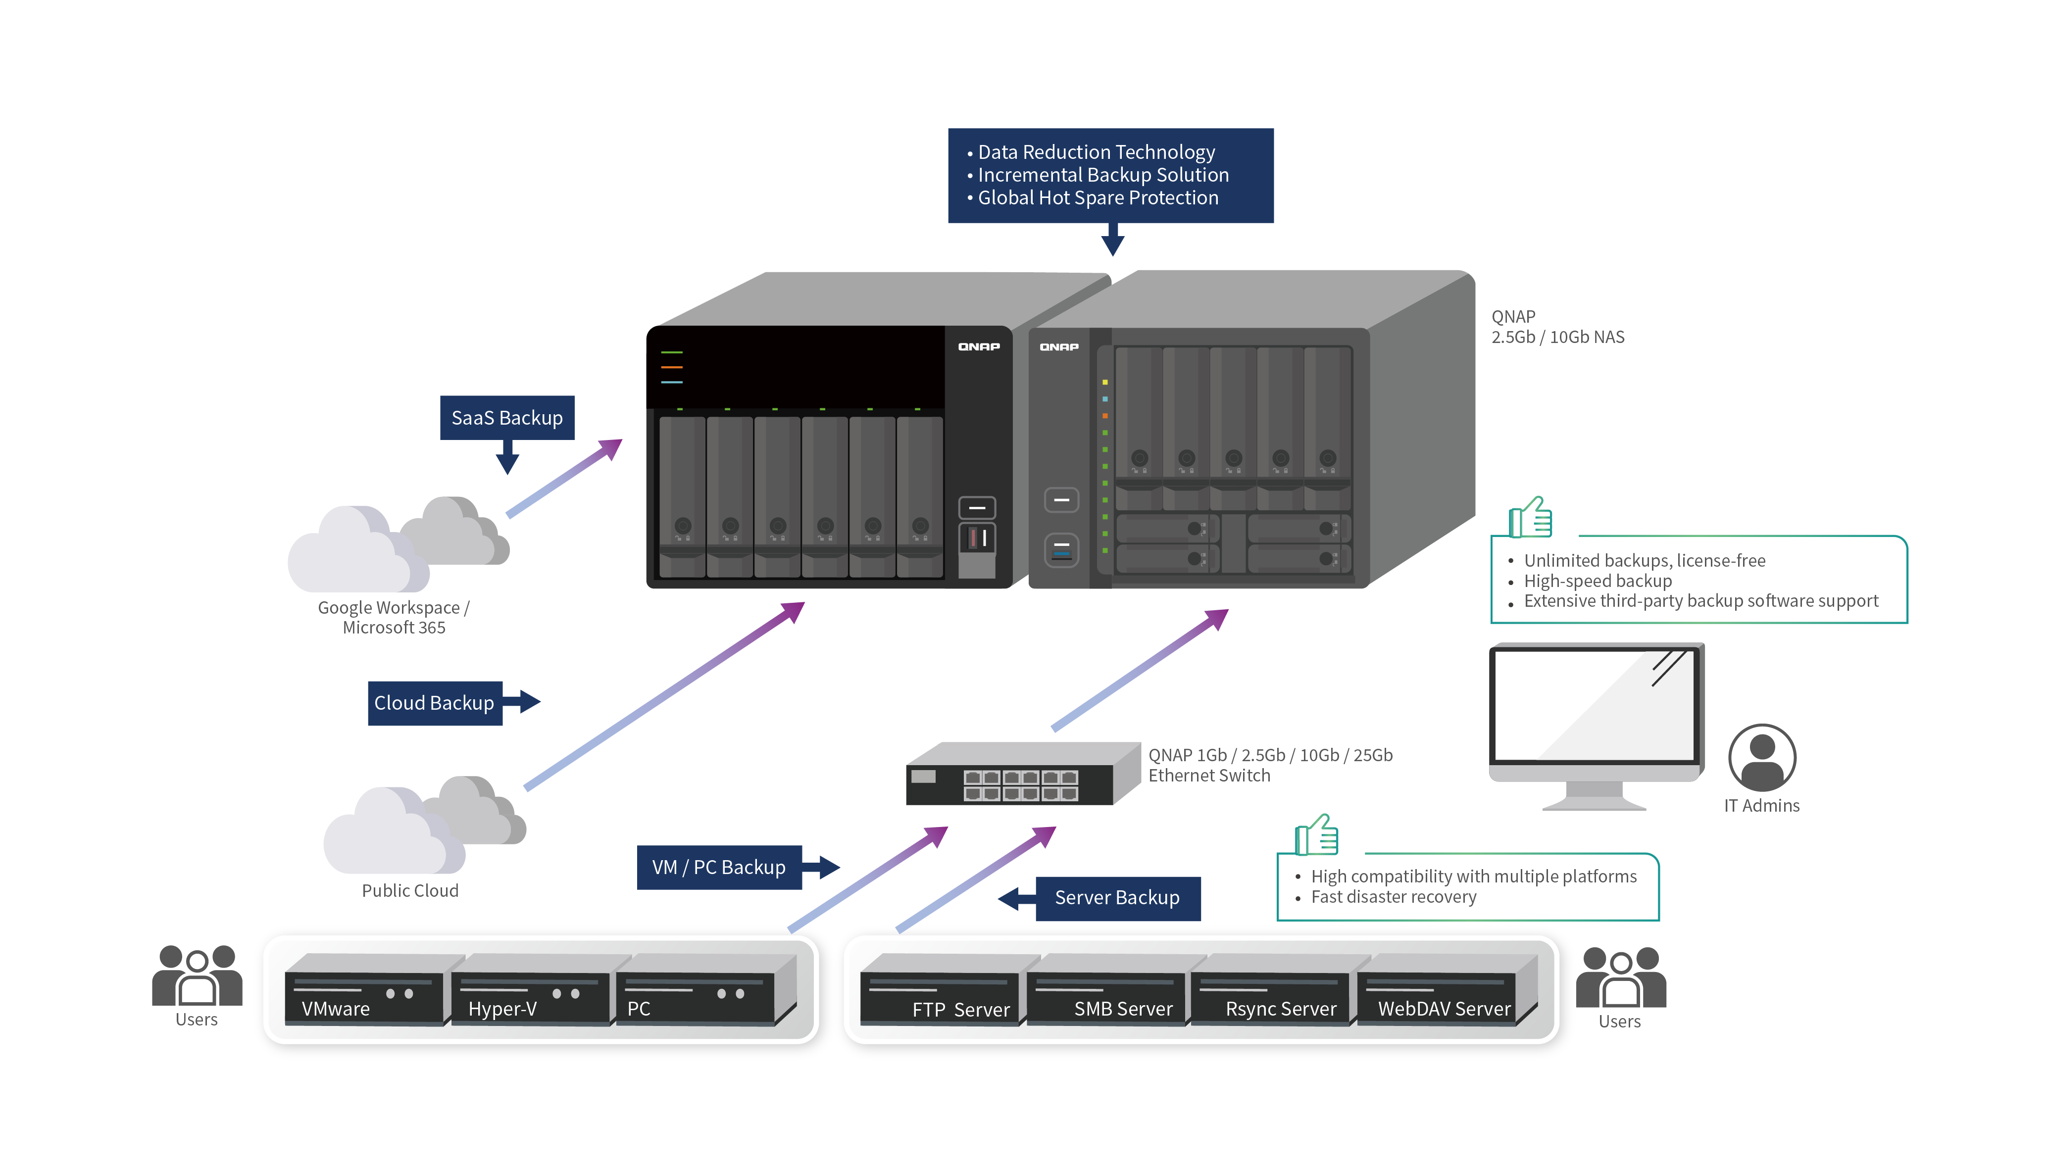
Benefits
Comprehensive backup solutions with no extra license fees
High compatibility with multiple platforms (including VMs, file servers, cloud data, and workstations)
High-speed backup
Fast disaster recovery
Extensive third-party backup software support (including VMware, Hyper-V, Veeam, NAKIVO, and more)

Slide 13
Enterprise Class Data Protection and File System (QuTS hero)
Background
Solutions & Technologies
Business data grows exponentially, and enterprises face combined issues of insufficient storage, deprecated software support, and system overload. If disaster recovery planning relies on outdated or inefficient systems, the entire enterprise is at risk of data loss or operational downtime. QNAP’s enterprise-class data protection provides a stable and secure system with real-time disaster recovery capabilities.
128-bit ZFS filesystem
Cross-device real-time SnapSync
LZ4 suites low-latency and high-performance storage
Write Once, Read Many (WORM)
Self-healing capabilities
QoS - Gain optimal resource allocation for LUNs/shared folders at different service levels
Real-time disaster recovery (RPO=0)
Multiple RAID configurations
Near-unlimited Snapshots

Slide 14
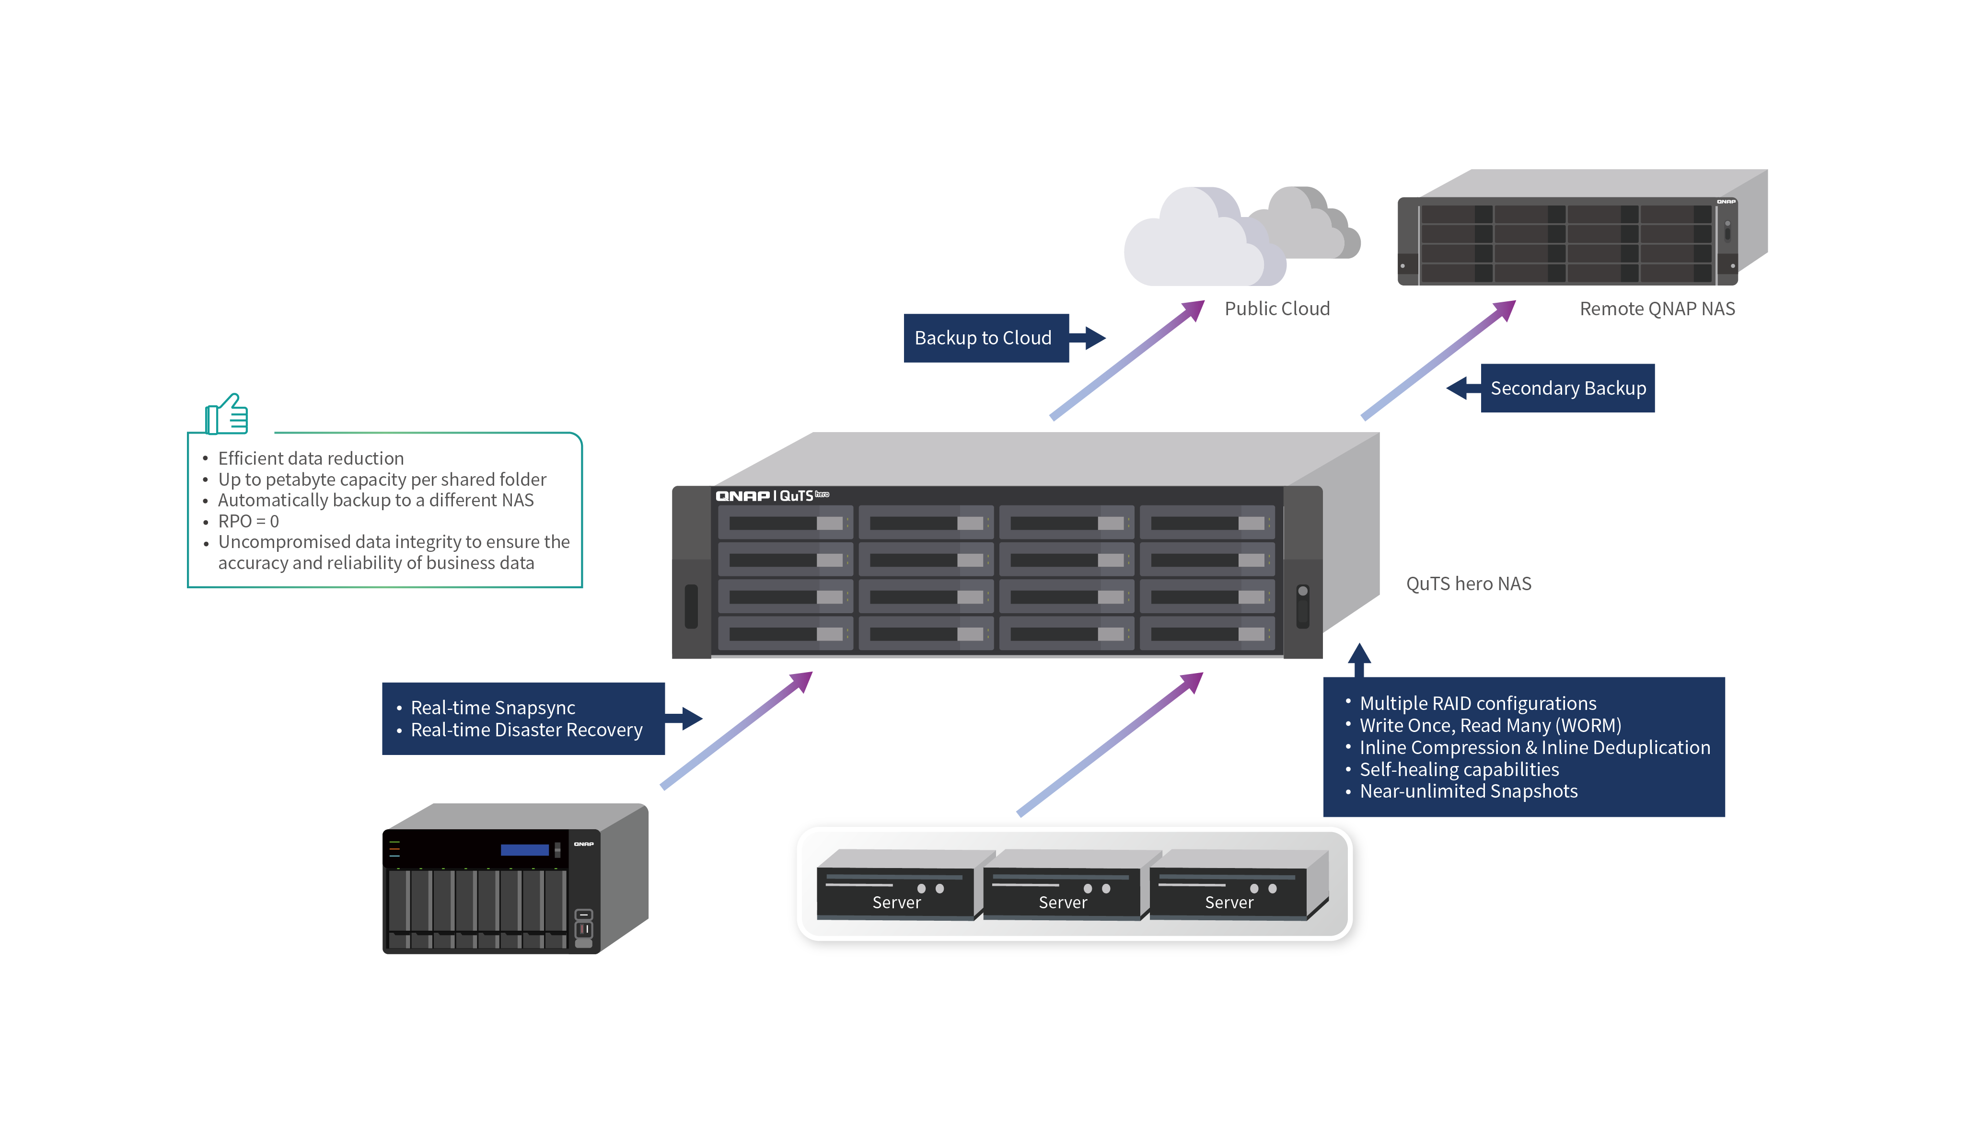
Benefits
Efficient data reduction
Up to petabyte capacity per shared folder
Automatically backup to a different NAS
Uncompromised data integrity to ensure the accuracy and reliability of business data

Slide 15
Hybrid Cloud Solutions
Background
Solutions & Technologies
When enterprises have everything on cloud, downloading and uploading data incurs high costs and slows down workflows. QNAP’s hybrid cloud solution provides a gateway to help maximize the value of cloud services. We also have solutions for enterprises that want to transfer their work from local storage to the cloud. QNAP’s hybrid cloud solution provides easy cloud management and data security for their first steps on cloud.
HybridMount - File-based Cloud Gateway
VJBOD Cloud - Block-based Cloud Gateway
QuTScloud - virtual NAS
Cloud Storage Mount
QuObjects - S3 compatible storage

Slide 16
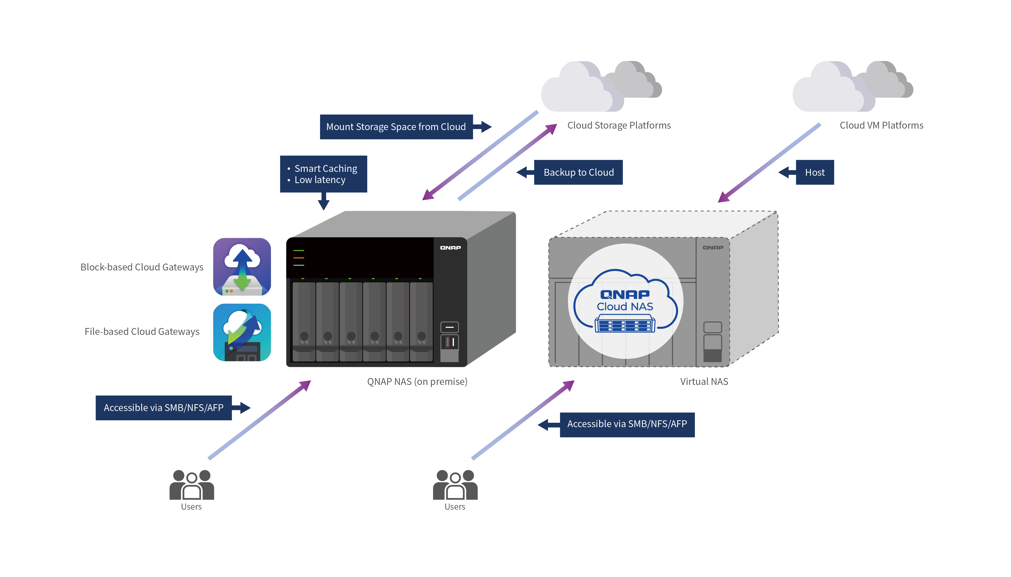
Benefits
Local caching that enables low-latency access to frequently used cloud data
Supports a wide range of cloud storage services
Save traffic and bandwidth costs when accessing cloud data
Improve R/W performance
Multiple file access protocols
Hybrid cloud environment for tiered storage
Utilize QNAP NAS Apps

Slide 17
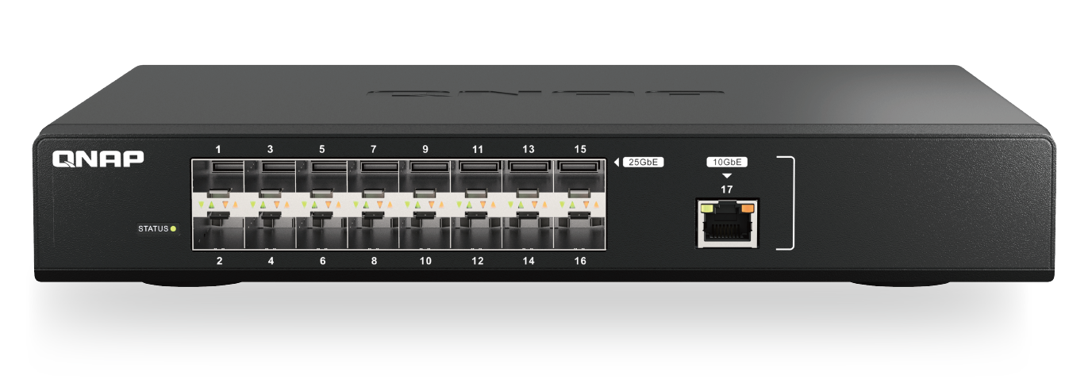
High-speed 25GbE networking
Enable lightning-fast throughput for bandwidth-demanding tasks such as virtualization, massive data transmission, and fast backup/restoration.
25GbE-ready All-flash NAS
The TS-h3088XU-RP provides a built-in dual-port 25GbE SFP28 SmartNIC with the NVIDIA® Mellanox ConnectX-4 Lx SmartNIC controller that supports iSCSI Extensions for RDMA (iSER) to increase performance of data transfer between NAS and ESXi server and offload CPU workloads.
Affordable 25GbE managed switch
The QSW-M5216-1T is a 25GbE Layer 2 web managed switch that provides flexible network interfaces for high compatibility at an affordable price, enabling small businesses to quickly upgrade to an ultra-high-speed backbone network by integrating to existing network infrastructure.

Slide 18
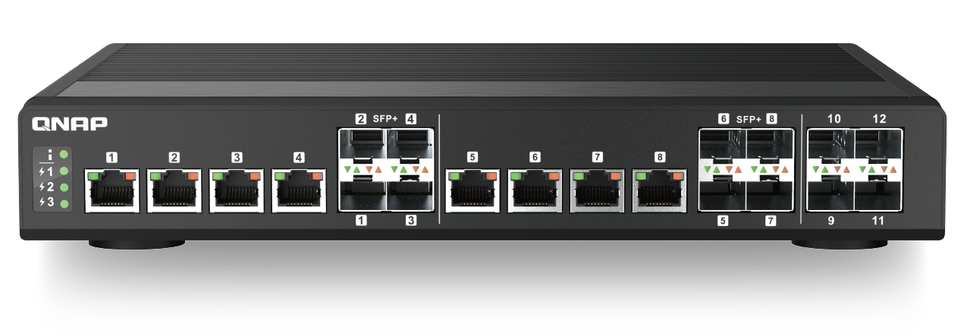
10GbE connectivity:
The future is now!
10GbE connectivity improves overall network performance and everyday tasks with ten times the bandwidth of 1GbE. By offering 10GbE-ready NAS, network adapters and switches, QNAP is a one-stop provider for everything you need to create your own 10GbE environment.
10GbE NAS solutions
QNAP provides a range of NAS with integrated hardware and software solutions that can make the most of the incredible bandwidth provided by 10GbE networks.
10GbE network adapters
10GbE switches
QNAP provides 10GbE PCIe expansion card and Thunderbolt to 10GbE adapters to empower devices with 10GbE connectivity. The QM2 Expansion Card not only includes 10GbE connectivity, but also provides the ability to add M.2 SSDs to your workstation or NAS.
QNAP’s QSW Series 10GbE switches supports 10GBASE-T and NBASE-T standards, allowing you to take advantage of higher network speeds with existing Cat 5e and 6a cables. Both SFP+ (fiber) and RJ45 (copper) ports are available for servicing a range of network needs.

Slide 19
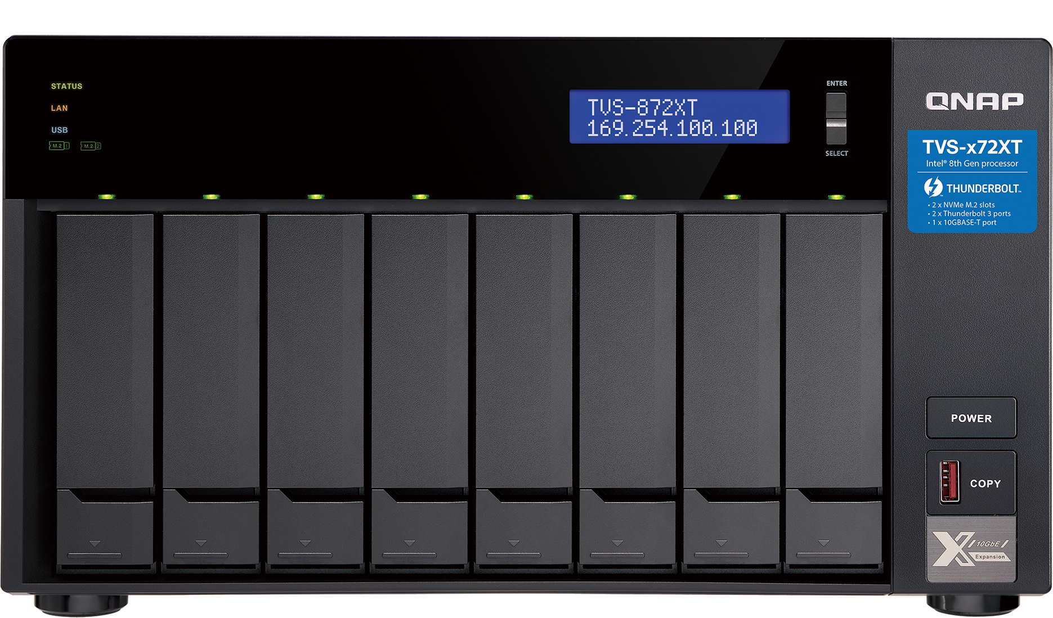
Breakthrough performance and outstanding connectivity with Thunderbolt NAS
QNAP offers the very best in connectivity with Thunderbolt™ NAS. Thunderbolt™ NAS is far superior in providing both the best in speed and versatility that non-Thunderbolt NAS cannot offer, video production professionals using QNAP Thunderbolt™ NAS enjoy efficient workflows, unprecedented speed, and incredible versatility.
Ultra-high speed transfer
High availability with USB Type-C
Edit right off your NAS with blazing fast Thunderbolt™ 3 connectivity. With potential speeds of up to 40Gbps, connect your compatible Macs and other Thunderbolt™ 3 devices directly to the NAS and work unaffected by other network traffic.
The usage of USB Type-C by Thunderbolt 3 provides a universal connection from QNAP NAS to Thunderbolt devices as well as countless USB Type-C devices through a single cable, allowing file sharing and centralized data storage without the hassle of stringing multiple cables.
Facilitate 10GbE workflows with Thunderbolt-to-Ethernet
Collaboration station for Mac and Windows
The increased bandwidth of Thunderbolt 3 enables smooth video editing and faster file sharing for photographers, video editors and graphic designers. Several Thunderbolt™ devices can be connected to the QNAP Thunderbolt NAS to process real-time photo and audio editing simultaneously without impacting system performance.
The innovative T2E Converter bridges Thunderbolt and Ethernet networks, allowing Thunderbolt-enabled computers to connect to these networks via their Thunderbolt connection to the QNAP Thunderbolt NAS. This saves a 10GbE port and eliminates the need for extra adapters or network cards.

Slide 20
High-speed Connectivity Solutions
Background
Solutions & Technologies
IT equipment and devices are constantly improving in both performance and the interfaces they use. As enterprises upgrade their devices, they should take care to use the right solutions to maximize the interconnectivity potential and compatibility of systems to ensure that their workflows are not affected. To increase the transfer speed and workflows, QNAP provides various solutions with huge storage space and flexible interfaces.
Thunderbolt™ 4/3, 10GbE, 25GbE, 40GbE, and up to 100GbE connectivity supported
Extension for Fiber Channel SAN
Ethernet with RDMA support
QNAP switches provide multiple ports and up to 100Gbps connection

Slide 21
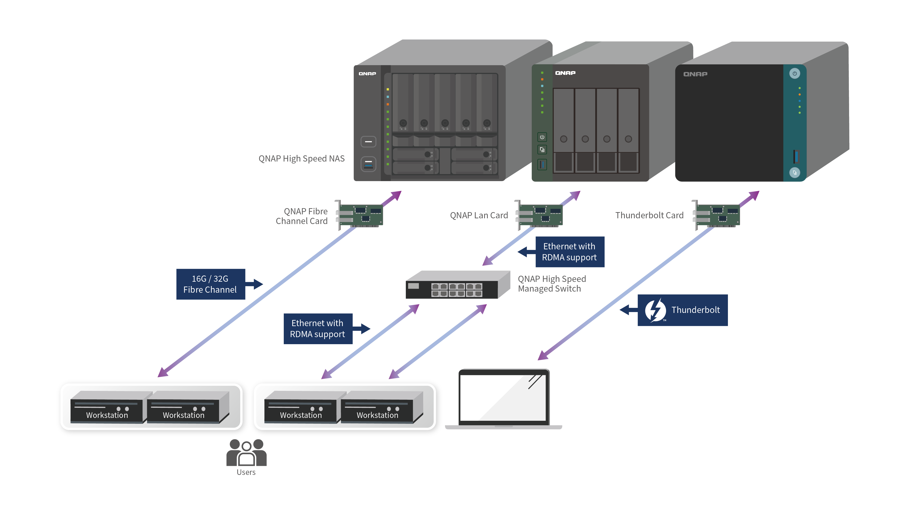
Benefits
Maximize performance
Increase productivity
High-speed connectivity
Budget friendly
Smooth multi-site collaboration and cross-team workflows

Slide 22
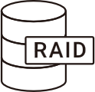
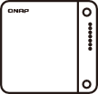
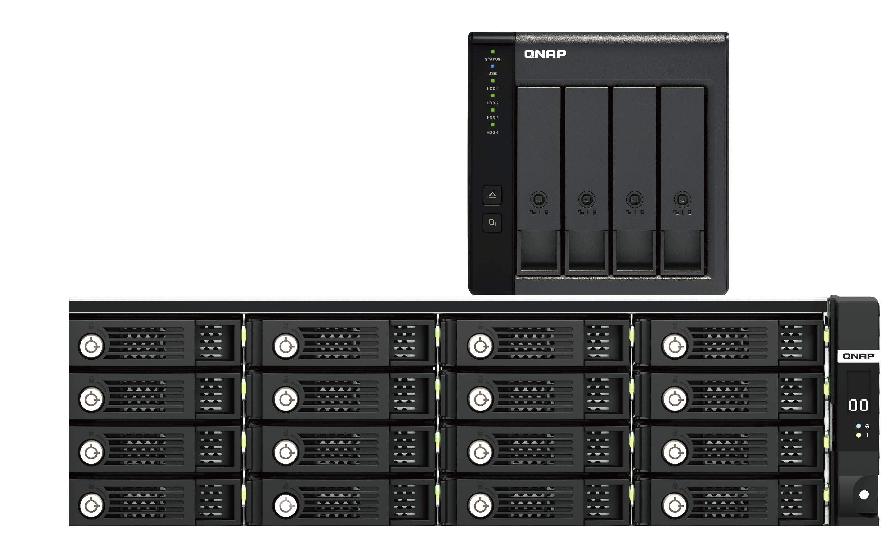
Flexible and economical storage expansion
RAID Support
QNAP DAS supports various RAID levels to improve performance and data protection.
Simple Interface
The QNAP External RAID Manager helps you monitor the DAS system, drives, and health status. It automatically sends system alerts to your PC if an error occurs.
Direct-Attached Storage (DAS) adds additional storage capacity to your PC by being directly connected via USB or another port. Compared with Network-Attached Storage (NAS), DAS is usually plug-and-use to a single PC and is suitable for users who seek to simply expand the storage of a single PC and not the advanced features and network connectivity of a NAS.
For NAS Expansion
QNAP DAS can be used with either USB Type-C, SATA, or SAS for faster data transfer and can be easily managed using QTS / QuTS hero Storage & Snapshots. The TL series is suited for NAS expansion.
Effortless Setup
The DAS is completely plug-and-use and does not require any network configuration. An eject button is included to quickly remove the DAS from the connected computer.
For PC Expansion
QNAP DAS are ideal choices for PC users looking to expand their storage space. They use a USB Type-C, SATA, or SAS port for faster data transfer and support software and hardware-controlled RAID configurations for flexible storage configuration.

Slide 23
Storage Expansion
Background
Solutions & Technologies
QNAP provides professional expansion products for all kind of devices. We understand speed and space are the major factors when expanding storage, so QNAP’s expansion solutions focus on ensuring stable, fast connectivity with the capability for massive storage expansion.
Software RAID
Daisy Chaining
Supports Broadcom® SAS DataBolt™ technology
Supports Windows®, Mac®, and Ubuntu® servers
QNAP JBOD Manager – monitor JBOD drive health
QNAP External RAID Manager - monitor DAS system, drives, and health status
Dual-controller and short-depth design
High availability

Slide 24
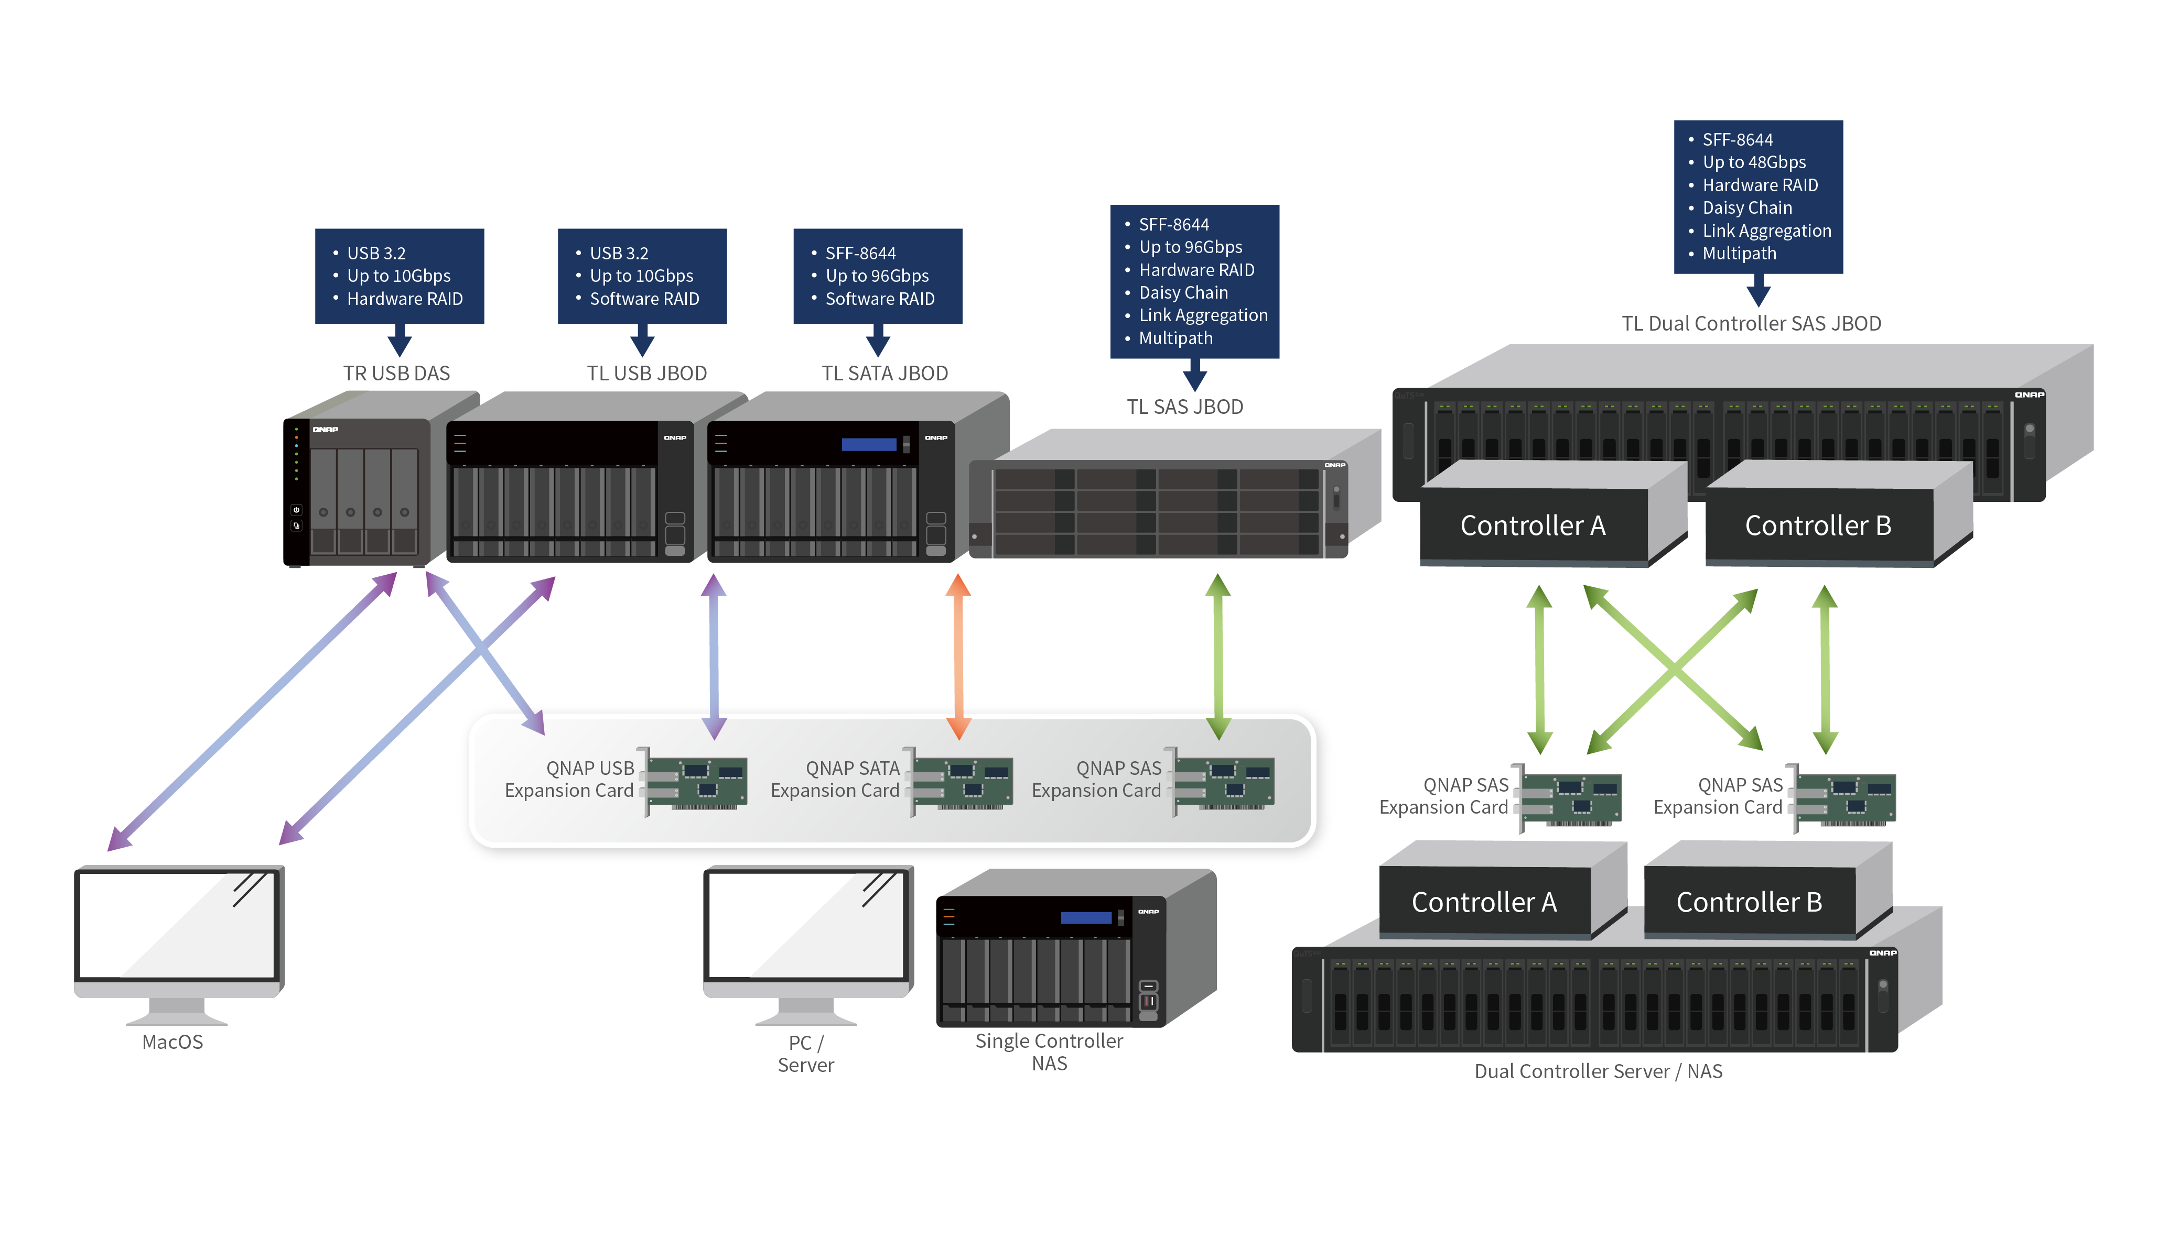
Benefits
High speed
Multipath
Link aggregation
Flexibly scale up the storage capacity

Slide 25
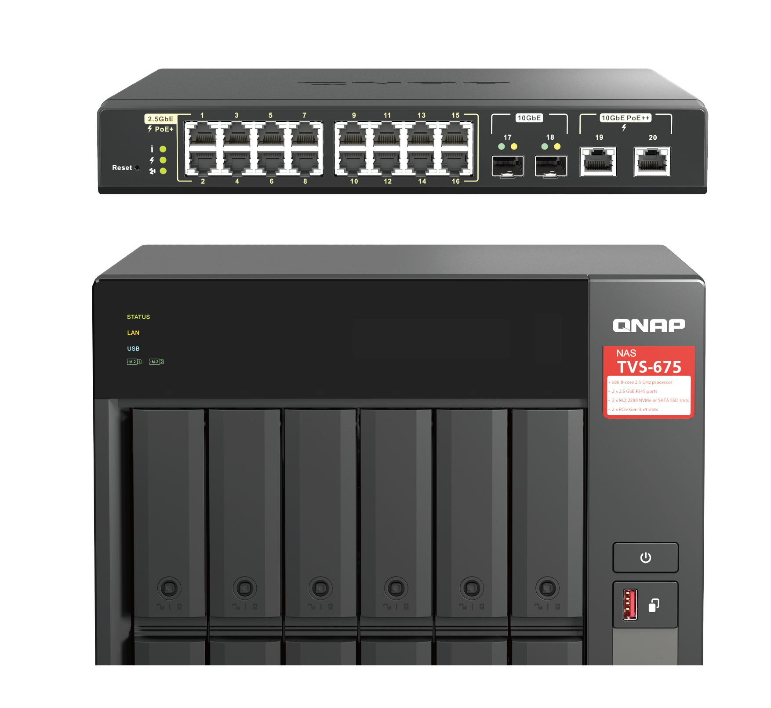
Records using the MP4 video format
Next-generation intelligent IP surveillance and remote backup solution
QVR Elite records video files in the universally-supported MP4 format, allowing for smooth playback on all your devices. In addition, you can conveniently back up recordings to other QTS / QuTS hero NAS or Cloud storage space using Hybrid Backup Sync or HybridMount.
Easy capacity expansion
You can create multiple recording spaces for QVR Elite recordings. If you run out of storage space, you can easily expand your NAS storage by connecting to QNAP expansion enclosures.
With the subscription-based QVR Elite smart surveillance solution you only pay for the channel licenses you need, allowing you to affordably safeguard your property. You can arrange a dedicated, independent storage space for surveillance data on the QNAP NAS and enjoy simplified camera management, storage space allocation, camera live viewing and playback. Recordings are saved as MP4 files for playback on nearly every device.
Low cost: flexible subscription plan
QVR Elite is subscription-based, with monthly, yearly, and 3-year subscription plans. You can build a robust surveillance system with a low-cost monthly price of US $1.99 per channel. You can alter the subscription based on your needs to reach higher cost efficiency.
Direct monitoring on an HDMI display
Easily play recordings with a connected HDMI display using the QVR Smart Client. Search for event recordings within a time period and detection area specified in the user interface.
Leverage AI-based applications for value-added services
QVR Elite’s surveillance footage can be processed by multiple QNAP AI-based video analytics applications (e.g. QVR Face, QVR Human, QVR DoorAccess) to empower your surveillance systems with smart door access, facial recognition, human counting capabilities and more.
QVR Pro Client: Centralized monitoring and management
QVR Pro Client enables you to monitor multiple channels simultaneously. Flexibly switch between live view and playback mode to easily fulfill centralized monitoring and management.

Slide 26
Smart Surveillance Solutions
Background
Solutions & Technologies
Building a smart surveillance system with QNAP is easier than you thought. QNAP provides various solutions from PoE switches to surveillance software to AI video analytics to provide professional surveillance systems. Our comprehensive surveillance solutions also provide great flexibility to fit various usage environments and situations.
HDMI local monitoring and playback
Real-time video analytics
Easy API Integration
AI-powered image recognition
Supports ONVIF/ QUSBCam2
Managed Rackmount PoE Switches

Slide 27
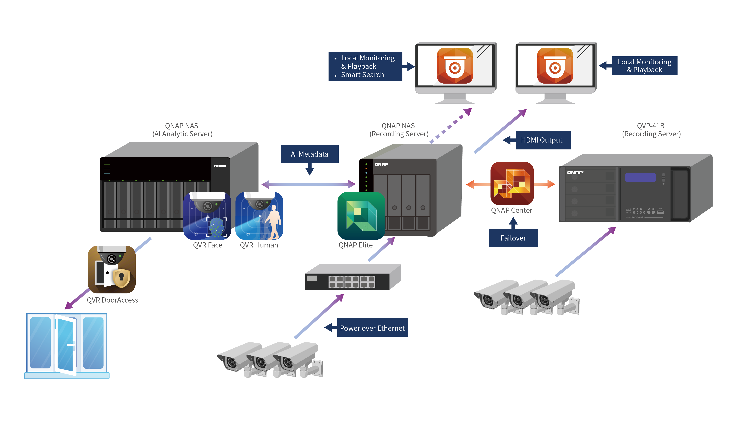
Benefits
Central management with distributed deployment
Easy monitoring via HDMI or client apps
Role privilege
Optimal bandwidth management
Flexible recording space management
Auto failover to ensure uninterrupted recording

Slide 28
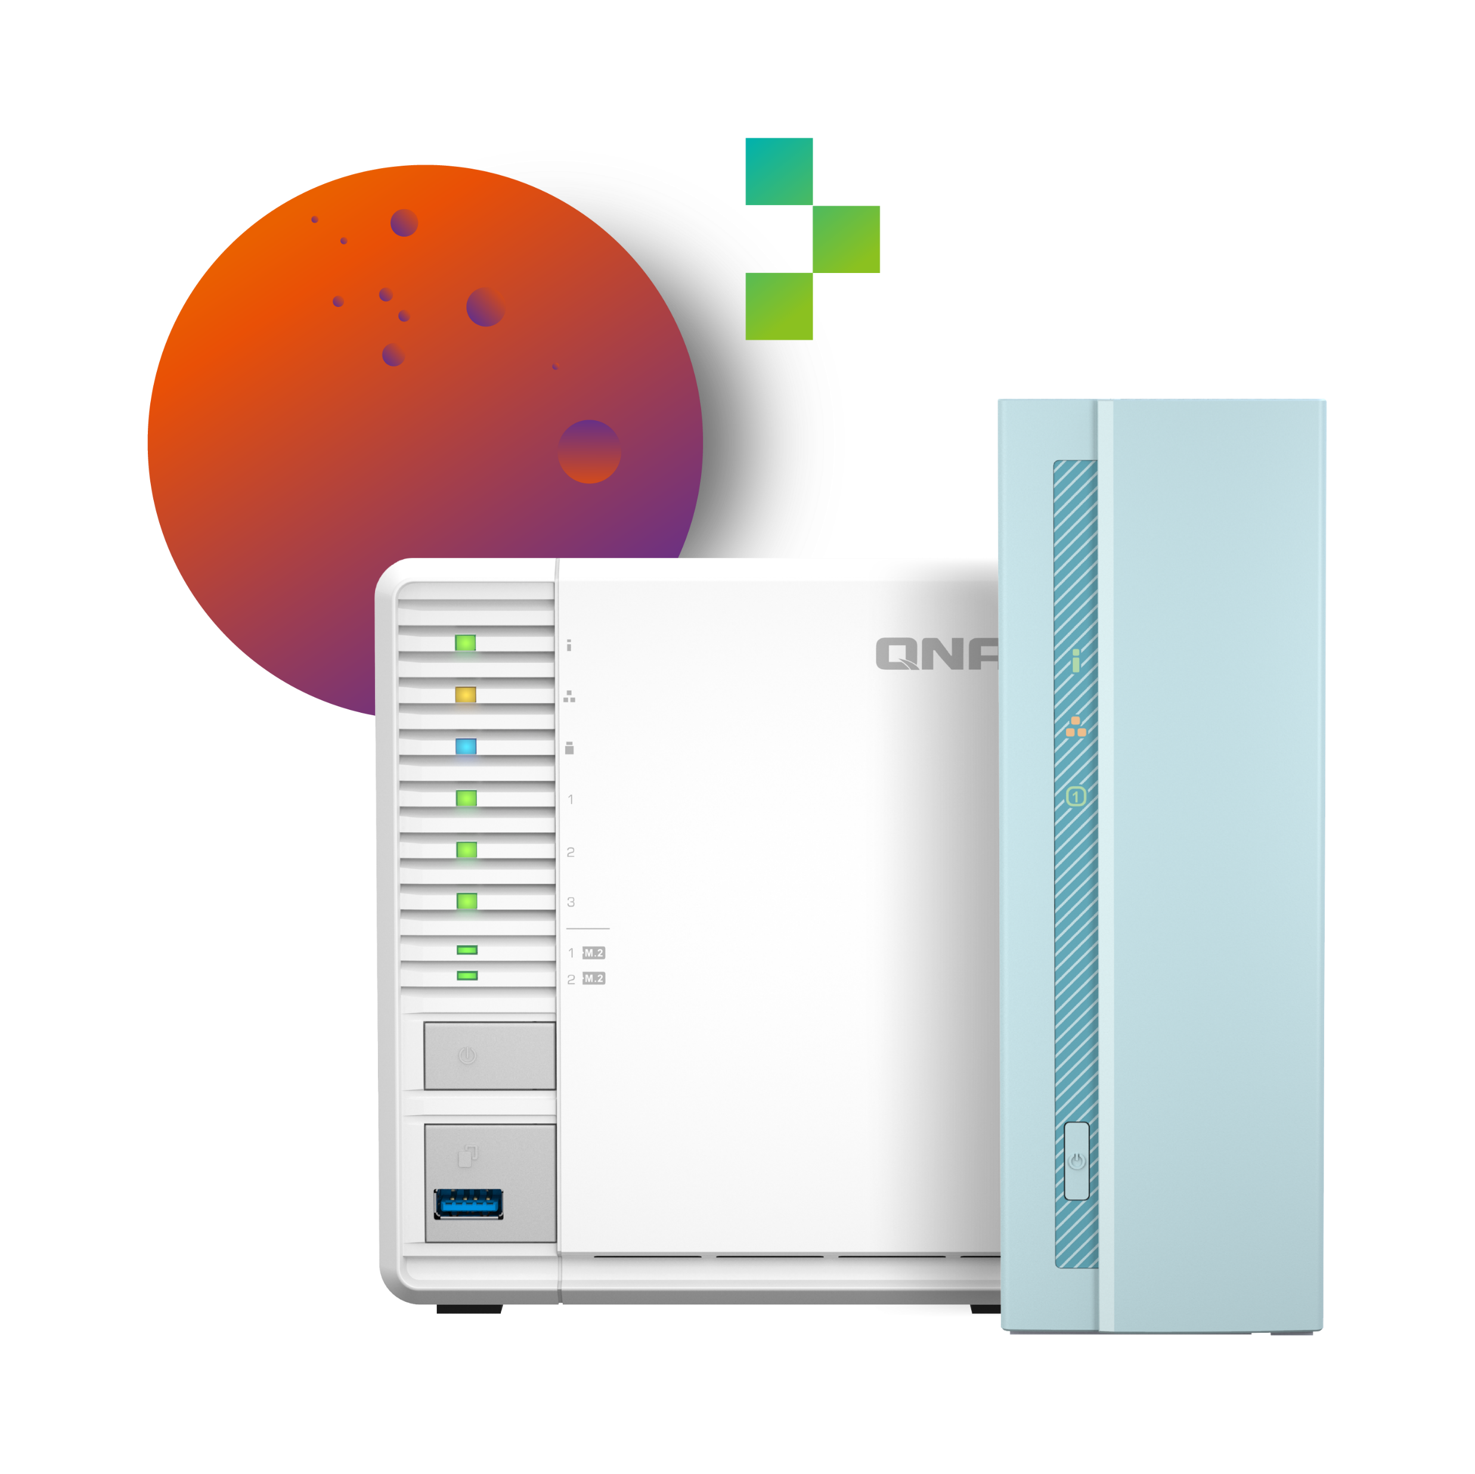
Easily build your personal cloud and access anywhere
An easy-to-use, all-in-one backup solution
The QNAP NAS can do many things, but at its heart is a complete backup solution to protect your files and data. By regularly backing up your files and device content, you can make data loss a thing of the past.
Greater multimedia enjoyment
In contrast to the limited storage space and potential security issues with public cloud services, the QNAP NAS is advantageous for establishing a secure and large-capacity personal cloud.
The QNAP NAS comes with a wide range of media applications, including Photo Station, Video Station and Music Station, allowing you to easily manage and view your media files.
Easy and secure remote connection with myQNAPcloud
myQNAPcloud allows you to remain connected to your QNAP NAS using a unique domain name. No complex routing or configuration is required, and myQNAPcloud strengthens SSL Certificate keys to 2048-bits to enable secure remote access, management, and sharing files and check your system status from anywhere.
A secure backup center with snapshot protection
Snapshots are essential for NAS data protection, and their block-level feature makes it a dependable data protection method in the face of growing ransomware threats.
Connect to a TV or monitor with HDMI
With HDMI output, the QNAP NAS allows you to directly enjoy multimedia content, use web browsers, manage your NAS, or watch recorded surveillance footage or live feeds on your NAS.

Slide 29
Team Collaboration Solutions
Business Challenge
Solutions & Technologies
Teamwork is the lifeblood of enterprises, and issues that arise from insufficient file management (including protecting files from accidental deletion/modification and losing track of where the latest versions of files are stored) can pose a significant challenge. QNAP provide a comprehensive solution for storage, back-up and sharing, and provide numerous applications to improve common workflows.
File Station & Qfile
Qfiling - Automate organization
Qsirch - Full text search engine
Qsync - Multi-site synchronization
QNAP AI core

Slide 30
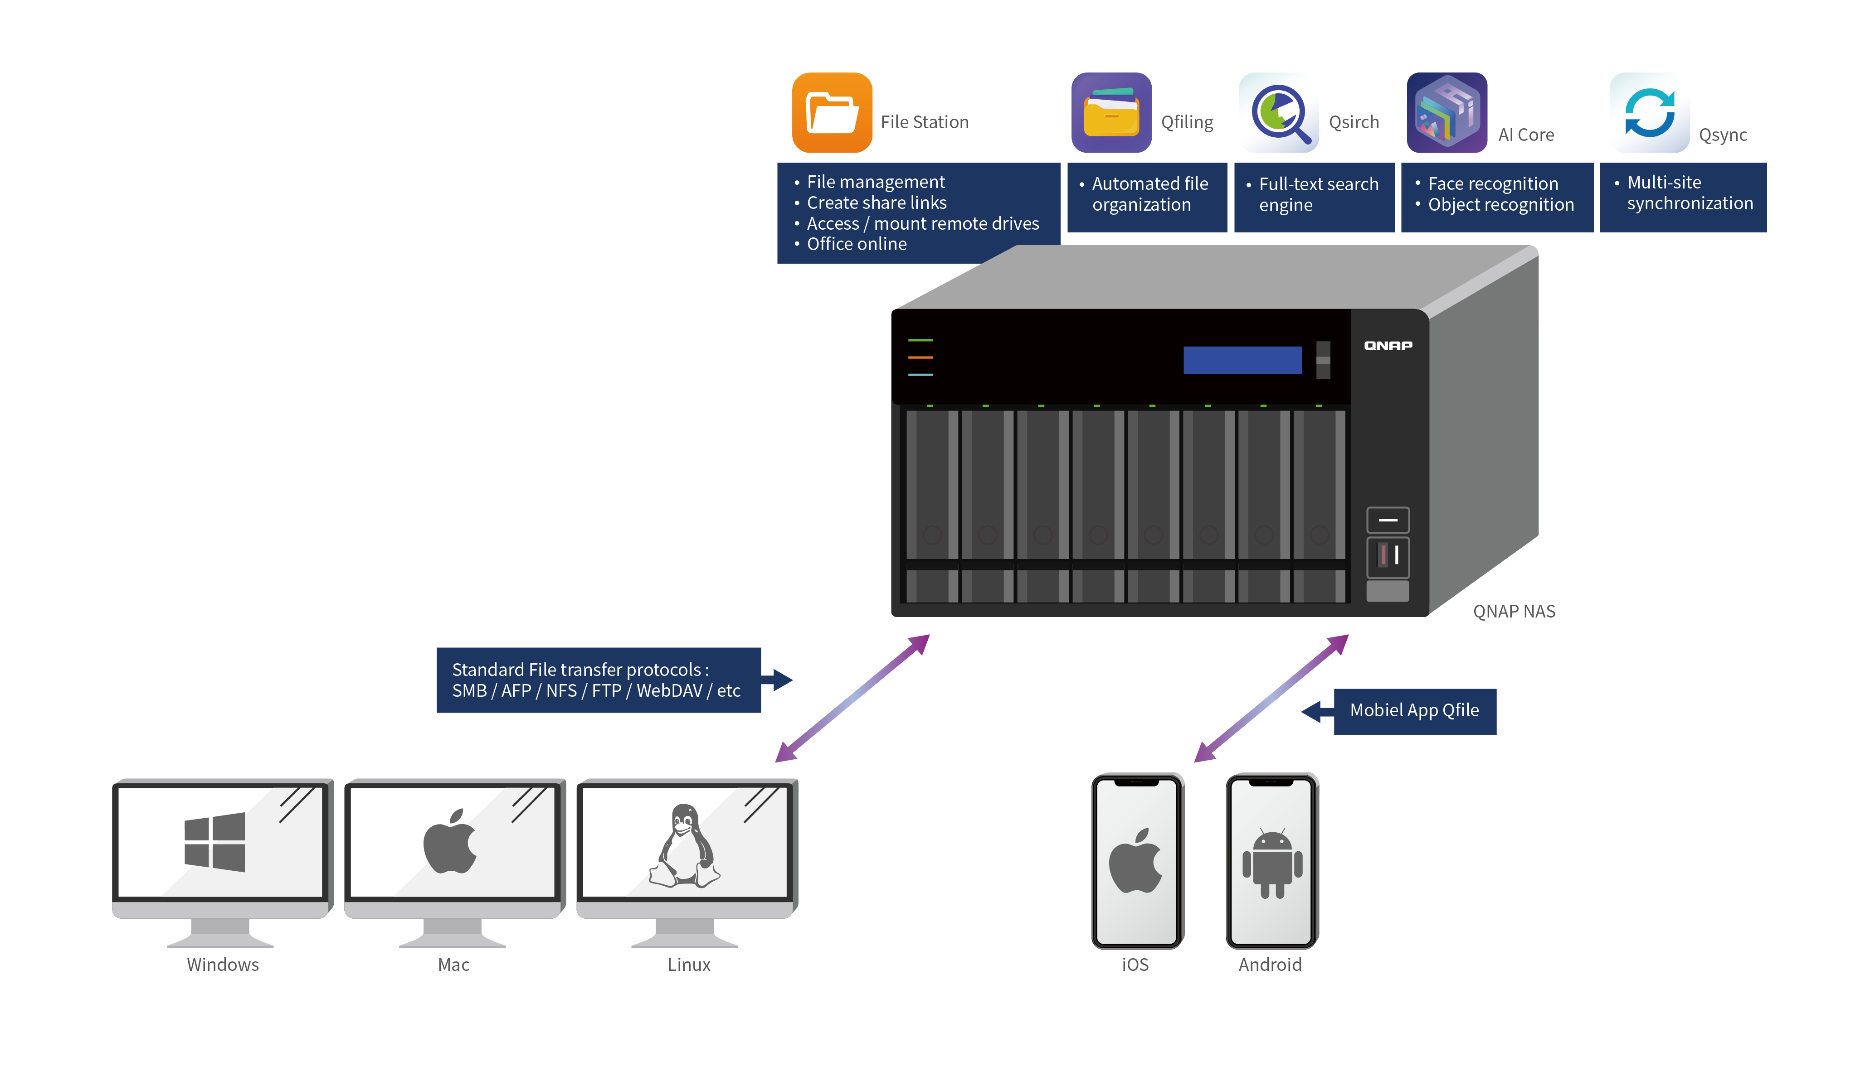
Benefits
Multiple protocols for every working environment
Office Online
Easy file management, organization, searching and sharing
AI-powered image recognition

Slide 31
QuWAN SD-WAN solution for resilient IT infrastructure
QNAP’s QuWAN SD-WAN solution features Auto Mesh VPN, IPsec encryption and cloud-centric management. Compatible with a wide range of QNAP solutions, QuWAN enables SMBs to efficiently build a dependable network at a cost-effective price, and to facilitate digital transformation, multi-site expansion and remote working.
Auto mesh VPN
WAN optimization
Automatically establishes a mesh VPN and removes the need for manual static VPN settings.
QuWAN adopts load balancing technologies to combine the bandwidth of different ISPs and to prioritize bandwidth utilization.
Cloud management
Cost optimization
The QuWAN Orchestrator provides powerful and convenient central network management.
Optimizes fiber/network transmission to lower the cost of VPN equipment and bandwidth expenses.
Network security
Web GUI
Adopts Deep Packet Inspection to analyze L7-Payloads for content information from websites and devices.
Provides user-friendly functionality, including a dashboard, eMap, traffic analysis, and more.

Slide 32
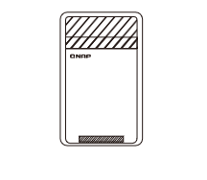
Enjoy a high-coverage Mesh Wi-Fi experience
The QMiro-201W and QMiroPlus-201W support tri-band Wi-Fi 5 wireless transmission and Mesh Wi-Fi handover, ensuring stable Wi-Fi connections and greater signal quality via a Mesh Wi-Fi network.
Connect your Home with High-Coverage Tri-Band Mesh Wi-Fi
Dedicated Tri-band Mesh Wi-Fi for smooth connections
QMiro-201W / QMiroPlus-201W adopts Wi-Fi Handover technology, allowing multiple users to be automatically connected to the router with the strongest Wi-Fi signal with a single SSID. With dual-band 2.4GHz/5GHz, QMiro-201W / QMiroPlus-201W also provides a dedicated Mesh 5GHz frequency for high-bandwidth connections between Mesh Wi-Fi routers, guaranteeing smooth and stable Wi-Fi connections.
Supports tri-band Wi-Fi of 2.4GHz, 5GHz and a dedicated Mesh Wi-Fi 5GHz band for high-bandwidth connections between Mesh Wi-Fi routers. Unlike conventional dual-band routers whose 5GHz band must be shared between Wi-Fi clients and Mesh Wi-Fi routers, the QMiro-201W /QMiroPlus-201W guarantees smooth and stable Wi-Fi connections.

Slide 33
SD-WAN Network Management Solutions
Business Challenge
Solutions & Technologies
When enterprises try switching their current network to SD-WAN to enjoy its benefits, hardware replacement costs and IT infrastructure redeployment are the main barriers. QNAP’s SD-WAN solution allows enterprises join in SD-WAN by active virtual router on an existing VMware platform. QNAP’s SD-WAN solution also provides hardware devices to help enterprises create a resilient IT infrastructure.
QuWAN Orchestrator - Cloud Management
QuWAN vRouter Edition for VMware Server
Deep Packet Inspection (DPI)
IPsec AES 256 encryption
Zero Touch Provisioning (ZTP)
Subscription-free on QNAP networking devices - QHora Router, QGD Switch, QuCPE Network Virtualization Premise Equipment, NAS

Slide 34
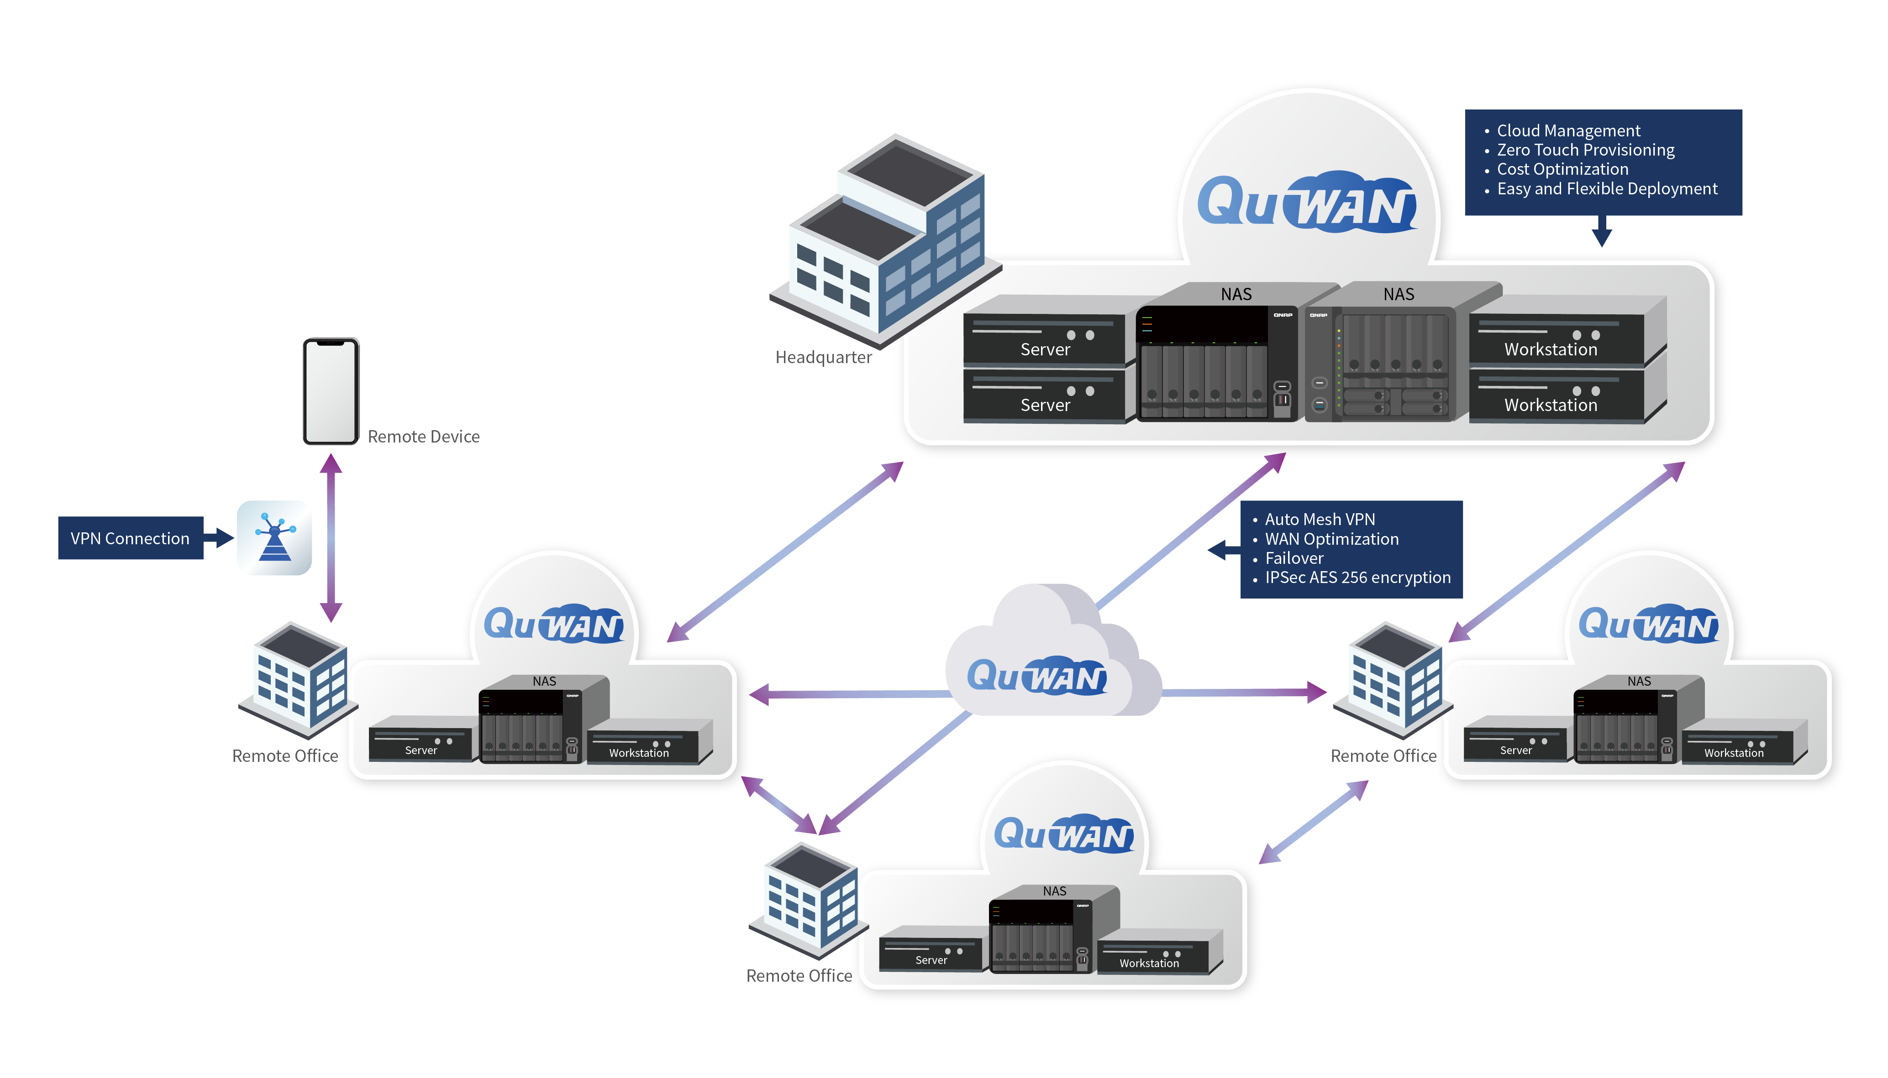
Benefits
Auto Mesh VPN
WAN optimization
Cost optimization
Network security
Web GUI
Easy and flexible deployment
Failover

Slide 35
Multi-site IT Management Solutions
Business Challenge
Solutions & Technologies
When devices are deployed in different sites and locations, IT teams usually must expand to cover the additional repairs, monitoring and management requirements. QNAP’s central management solution provides a single platform for remotely managing multiple QNAP NAS and monitoring all SNMP-enabled devices.
Q’center
Supports SNMP Network Management System (NMS)
DA Drive Analyzer
S.M.A.R.T. ID values
Firmware Lib
QuWAN Orchestrator for cross-site VPN

Slide 36
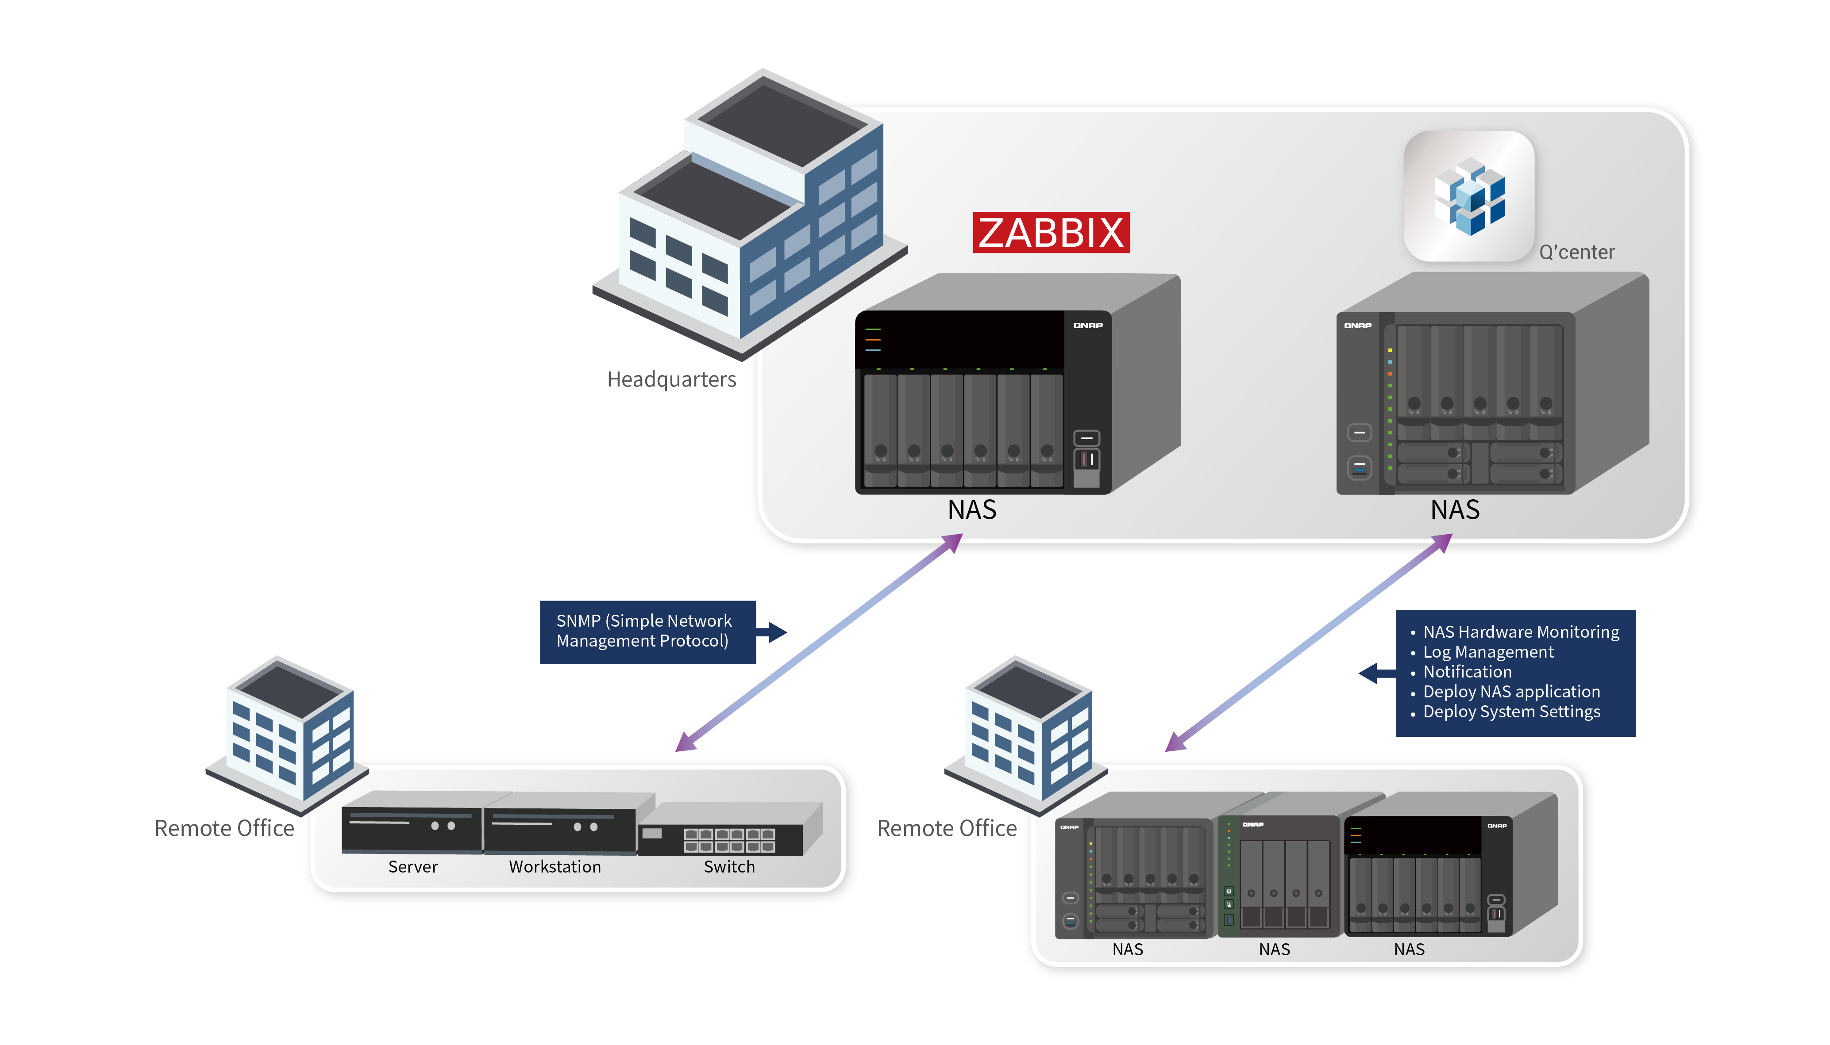
Benefits
Easy maintenance
Centrally monitor system logs of NAS and SNMP devices
Prevent drive failures
Prevent system crashes
Remotely repair system failures

Slide 37
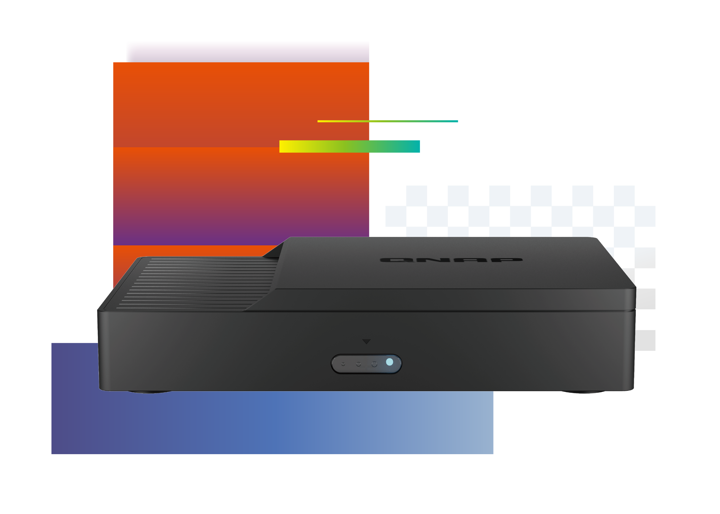
Smart Video
Conferencing Solution
Running KoiMeeter video conferencing operating system
KoiMeeter provides an dedicated solution for small meeting rooms with support for wireless presentations, cross-platform communication and local storage.
All-in-one: video call, wireless presentation and meeting recordings.
QNAP Smart Video Conferencing Solution is a high-quality video conferencing system, providing an ideal solution for small meeting rooms with support for wireless presentations, cross-platform communication and local storage.
Free yourself from cables with 4K wireless projection
4K wireless projection provides a seamless wireless projection experience free from complex cabling and without needing additional projection devices.
Up to four-way video conferencing and collaboration
Multi-point video conferencing with the QNAP KoiBox-100W, KoiMeeter, the KoiMeeter mobile app, and compatible SIP systems.
Local storage for record and store meetings
Install a 2.5-inch SATA drive and locally store all your meeting videos, audio and shared files while also enabling further usage as training materials.
Optimized cloud meeting experience
The QNAP Smart Video Conferencing Solution supports popular cloud meeting services, such as Zoom®, Skype™, Microsoft Teams®, Cisco Webex®, and Google Meet™ for streamlining communication between different platforms.

Slide 38
Enterprise-level Video Conferencing Solutions
Business Challenge
Solutions & Technologies
Traditional equipment for enterprise-level video conferencing can be complicated and expensive to set up and maintain. Technical barriers can also hinder audiovisual quality and may prevent participants from contributing. QNAP tackles these issues with a budget-friendly, easy-to-use, and high-performance video conferencing solution for group meetings and conference calls.
KoiMeeter
KoiBox
KoiTalk mobile app
Support participating SIP conference system
Support participating cloud meeting
P2P

Slide 39
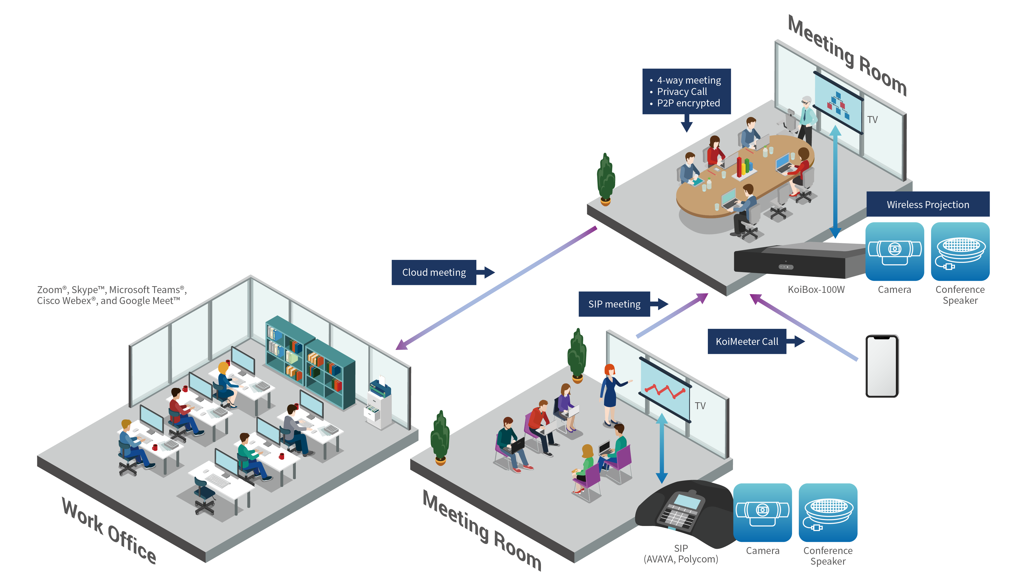
Benefits
4K wireless projections
Share mobile phone screens
Cross-platform communication
Local storage for meeting recordings
Built-in chat room

Slide 40
We value our users’ experience
QuTube
Professional video tutorials make it easier for you to understand QNAP products.
Warranty Service
Each QNAP product comes with a service warranty that guarantees you excellent service and peace of mind.
Service Portal
If at any time you need any assistance with your QNAP products, create and submit a support ticket. Our support team will contact you as soon as possible.
Sales Inquiry
Submit the form if you have any collaboration proposals or pre-sales inquiries.

Slide 41
Get in Touch with QNAP
www.qnap.com
Facebook
YouTube
Instagram
Subscribe

Slide 42
Copyright© 2022 QNAP Systems, Inc. All rights reserved. QNAP® and other names of QNAP Products are proprietary marks or registered trademarks of QNAP Systems, Inc. Other products and company names mentioned herein are trademarks of their respective holders.​​​​​​​

