Slide 1
Virtualization Station
Brings an Efficient Virtualization Environment – 4 essential aspects
Notes:
750, 000 download / 1st installation 200,000
during 4 years, user feedback
4 aspects to be considered for VEnvir.

Slide 2
Core values of Virtualization
Logically dividing the physical computer resource (CPU, memory, storage and network) into several units.
Efficiency
Flexibility
Compute
Storage
Networking
VM deployment
Disaster recovery
Notes:
Efficiency:
1. physical installation time
2. VM clone, backup
Flexibility:
1. allocate resource dynamically
2. Network can be virtualized and being customized

Slide 3
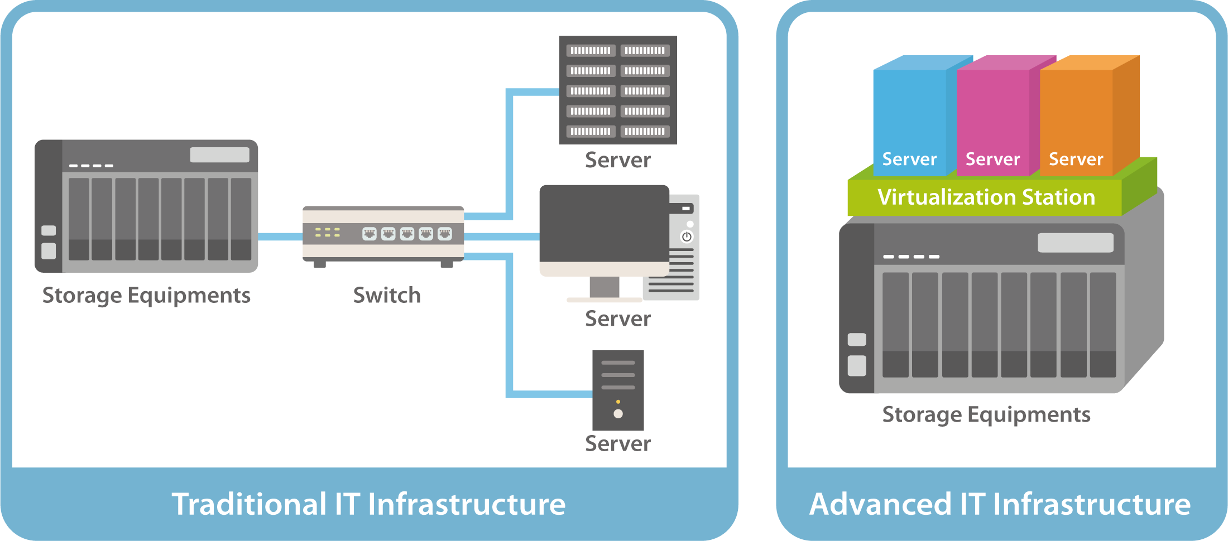
Running VM on the NAS？
IT infra-integration by virtualizing servers
NAS (storage) + VM (computing)
= converged-appliance
NAS VM used for
Server deployment
24/7 software
Temporary systems
I/O intensive access
Notes:
we firmly believe that leveraging Virtualization... and come up with a converged-appliance.
Trad: not easy to maintain
Adv: w/o going through network equipment
Combining storage, computing, network increase..
low down the traffic generated among..device

Slide 4
4 essential aspects
Environment settings
GPU support
Networking modes
Non-stop VM backup
Snapshot reverted online
OpenGL & Direct X required
Compatible with AMD & NVIDIA cards
VM console operation
VM Performance
Web – toolbar
HDMI output – QVM
Other remote utilities
I/O transmission
Number of concurrently running VM
Notes:
Based on what we have collected from user feedback, to provide an efficient VEnvironment, we should take care of 4 aspects.

Slide 5
Environment, suitable for VM running apps
Environment settings
GPU support
Networking modes
Non-stop VM backup
Snapshot reverted online
OpenGL, Direct X required
Compatible for AMD, NVIDIA cards
VM console operation
VM Performance
Web – toolbar
HDMI output – QVM
Other remote utilities
I/O transmission
Number of concurrently running VM
Notes:
1. proper networking for VMs
2. How to do VM backup in case of unexpected system shutdown? or take a snapshot for quickly roll back the status?
and, also does VM need to be shutdown?

Slide 6
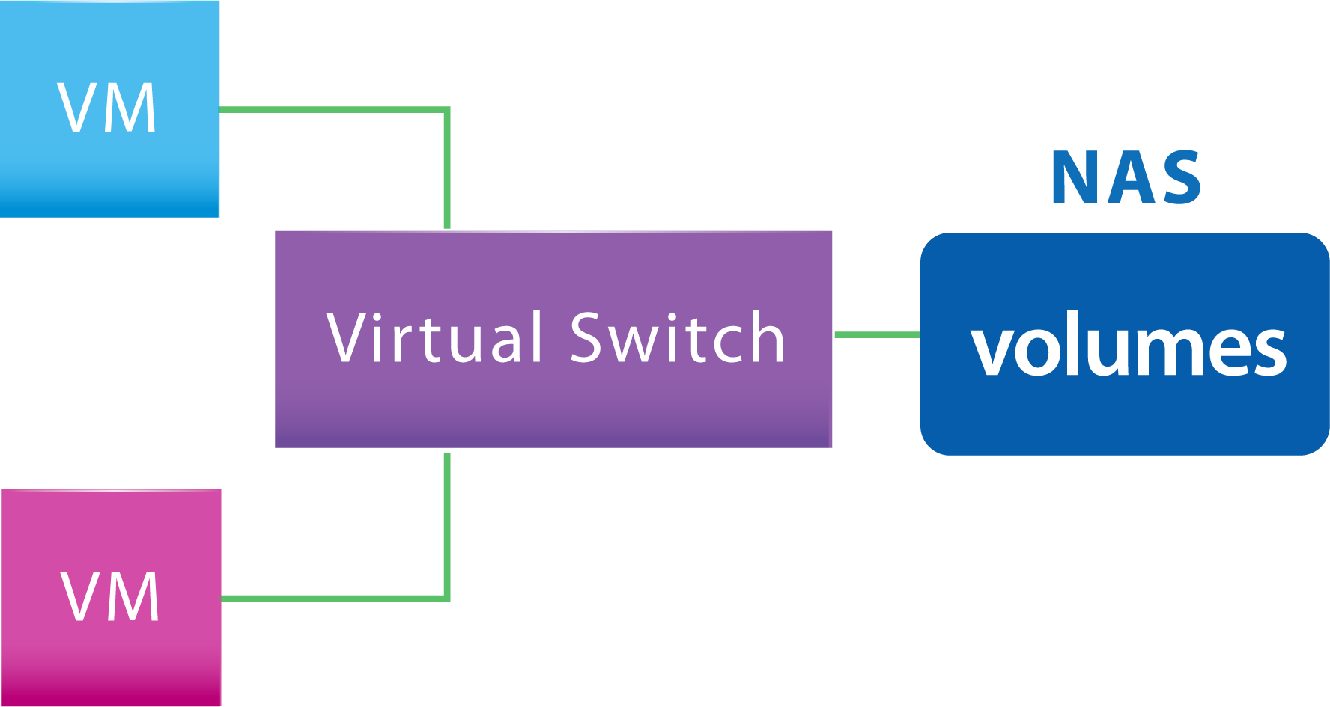
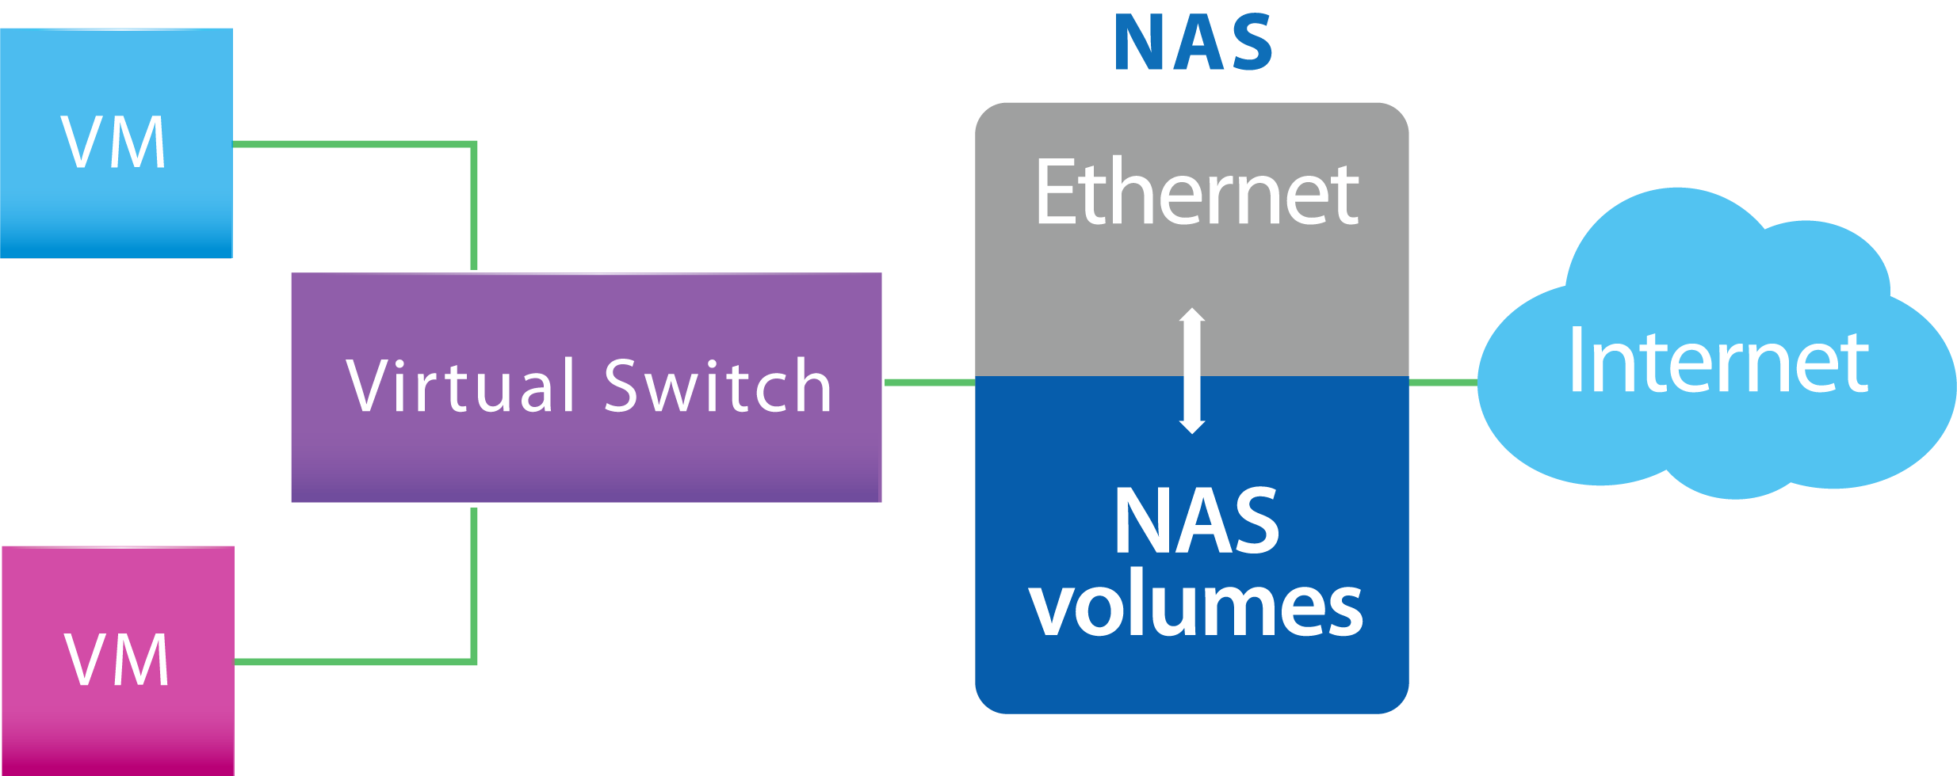
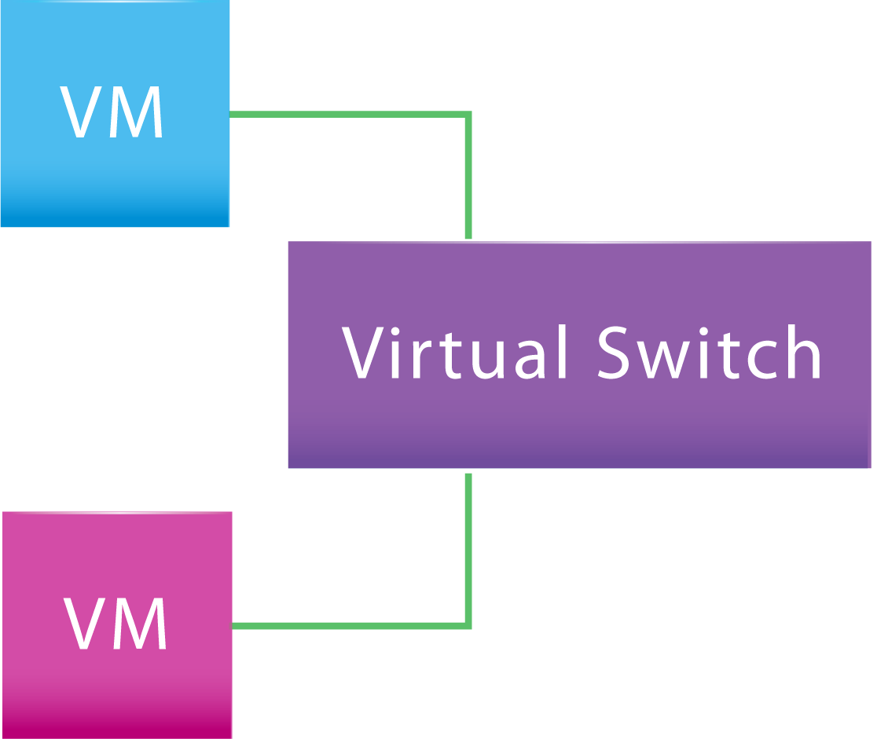
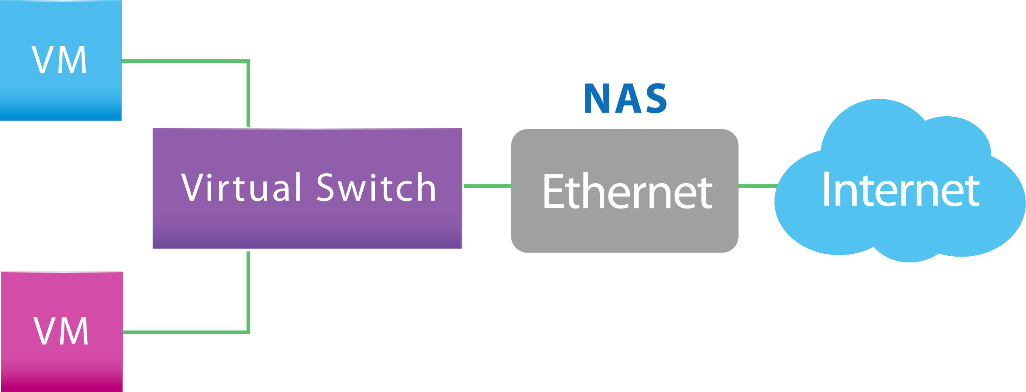
Custom virtual switch
Host
Provides different networking modes.
Internal high-speed network between NAS and VM
Bridged
Internal high-speed
Connects Ethernet interface
External-only
Dedicated bandwidth for VM
Notes:
To support different networking modes, our VSwitch can be customized. For example,
1. attach Ethernet interface
2. assign IP in the VSwitch
3. enable NAT or DHCP service

Slide 7
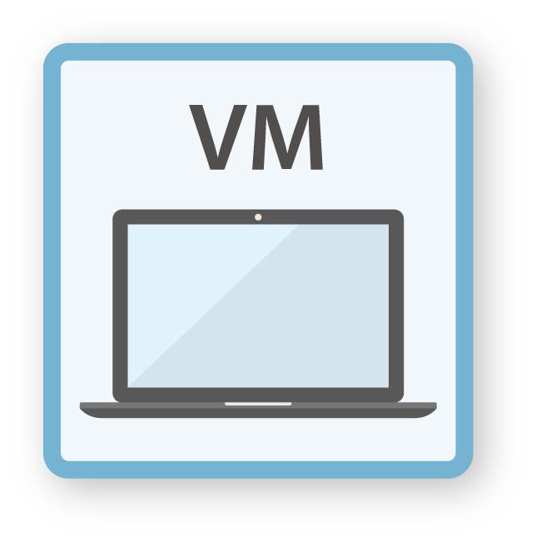
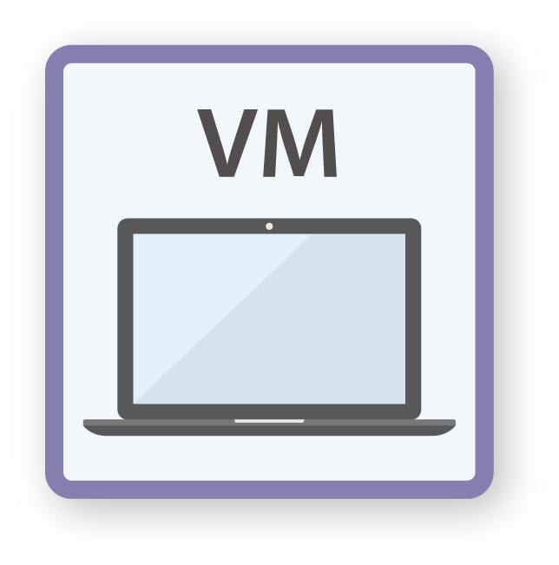
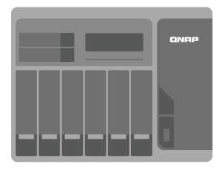
Non-stop VM backup, non-stop applications
Scheduling VM backup w/o powering off
Keeping multiple VM backups
Remote site recovery
Notes:
As everyone knows, we alsways need backup function for unexpected things happened.
The important question is should we power off VM?
In addition to scheduling backup,

Slide 8
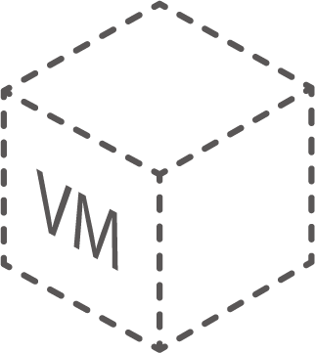
Environment settings comparison
Virtualization
Station
Virtual Machine
Manager
Notes:
1. VM Snapshot, online backup
2. Network & Virtual Switch setting
a. create a VSwitch
b. container together
c. NAT, DHCP server

Slide 9
GPU – accelerated computing
Environment settings
GPU support
Networking modes
Non-stop VM backup
Snapshot reverted online
OpenGL & Direct X required
Compatible with AMD & NVIDIA cards
VM console operation
VM Performance
Web – toolbar
HDMI output – QVM
Other remote utilities
I/O transmission
Number of concurrently running VM
Notes:
As we know, all the device of VM are emulated, so that CPU has to do image processing or graphic display. It is not where CPU good at.
Supporting GPU can lessen the work of the CPU and produce faster video and graphics.

Slide 10
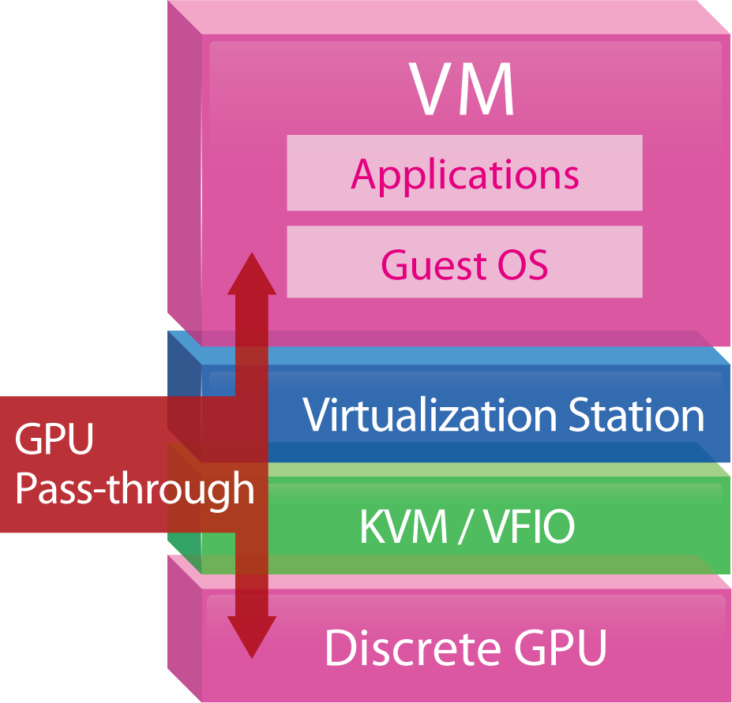
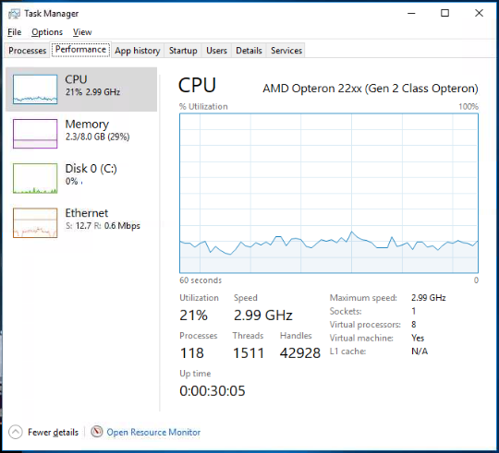
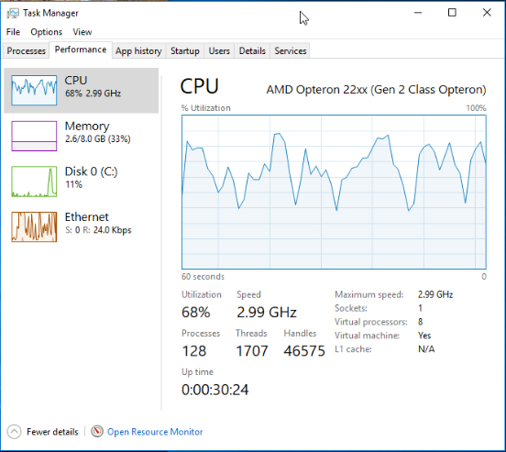
GPU – manipulating image processing
Supports
OpenGL & DirectX
Discrete GPU accelerates image processing and computer graphics, offloading CPU utilization
Tested in QNAP Labs. Figures may vary by environment. NAS：TS-1277 Ryzen 1700
QTS 4.3.4, Seagate ST4000VN0001
nVIDIA GeForce GTX 1060 6GB
GPU connected
GPU disconnected
Notes:
When some applications requesting DirectX, OpenGL support, discrete GPU card can

Slide 11
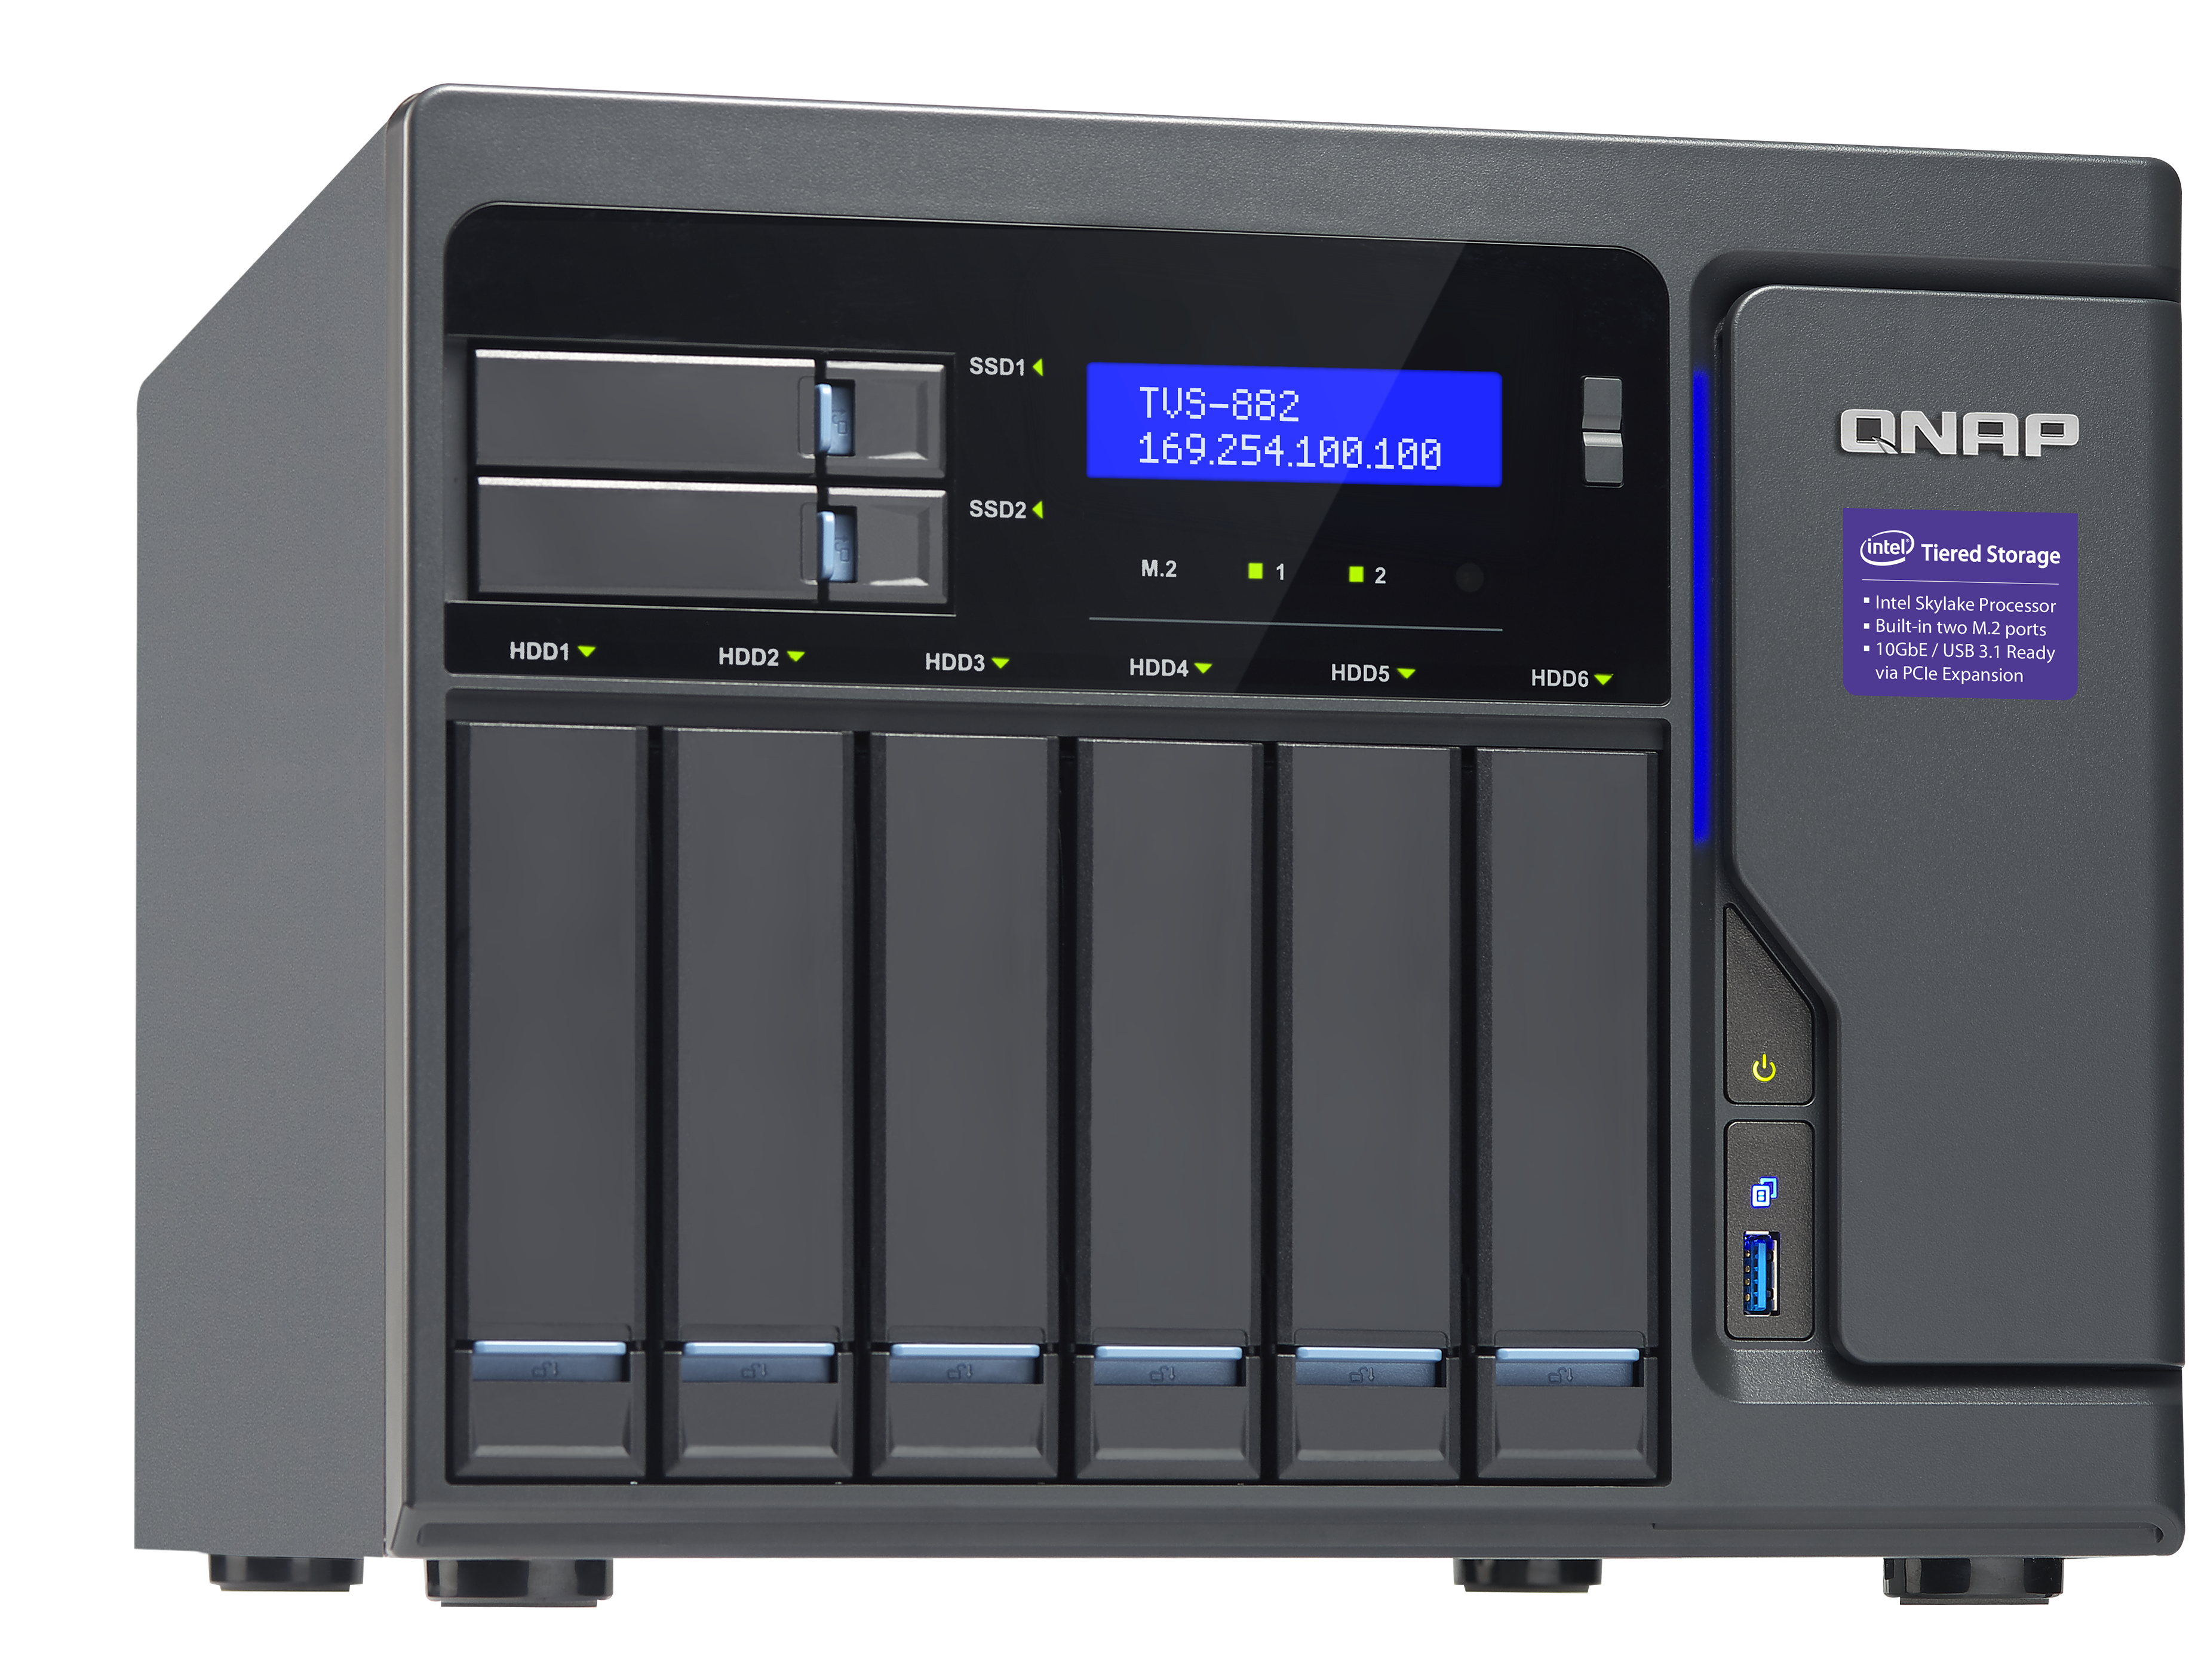
Live Demo
Virtualization Station
MSI GeForce® GTX 1060 6GT OCV1
NAS: TVS-882-i5-16GB
Firmware: QTS 4.3.3.0299
Guest OS: Windows 10 64-bit
GPU: NVIDIA® GeForce® GTX 1060
Core Clocks: 1759 MHz/ 1544 MHz
Memory: 6 GB GDDR5 (192-bit)
Notes:
1. Play 4K video, Task manager
2. Adobe Premiere, add an effect and render it out

Slide 12
Access VM console
Environment settings
GPU support
Networking modes
Non-stop VM backup
Snapshot reverted online
OpenGL & Direct X required
Compatible with AMD & NVIDIA cards
VM console operation
VM Performance
Web – toolbar
HDMI output – QVM
Other remote utilities
I/O transmission
Number of concurrently running VM
Notes:
When the VM has been created, how to access the console?

Slide 13
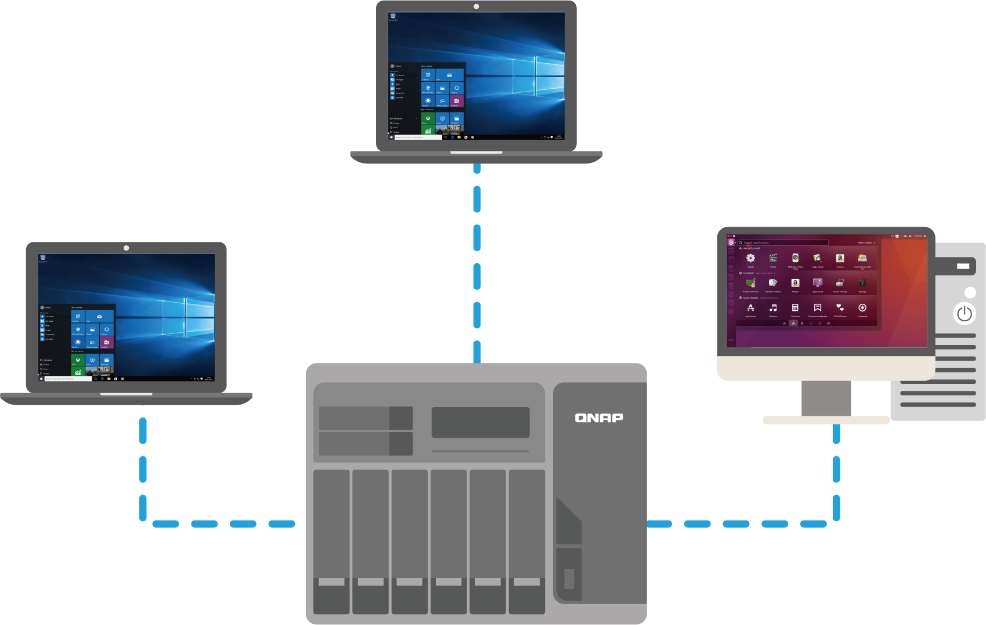
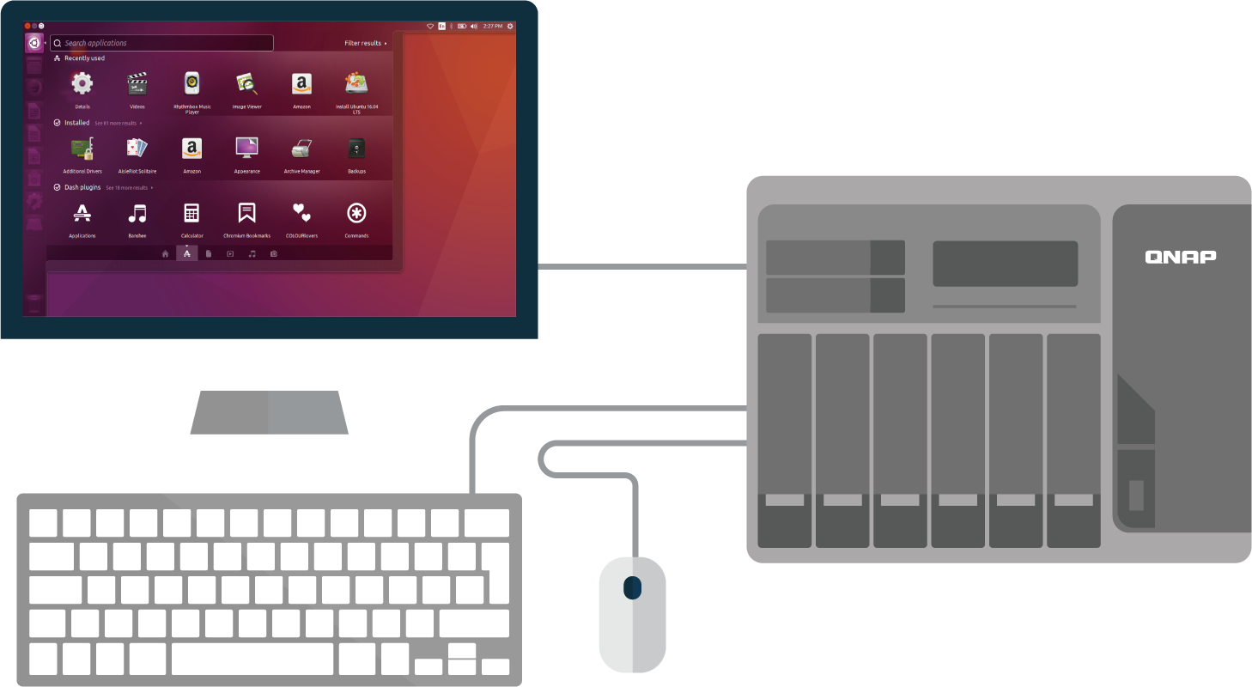
Web browsers & HDMI output
Remote access
Local HDMI output
Web browsers or remote connection utilities
Plugging in keyboard, mouse and monitor

Slide 14
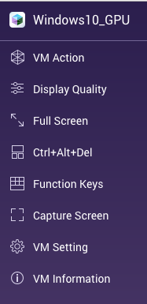
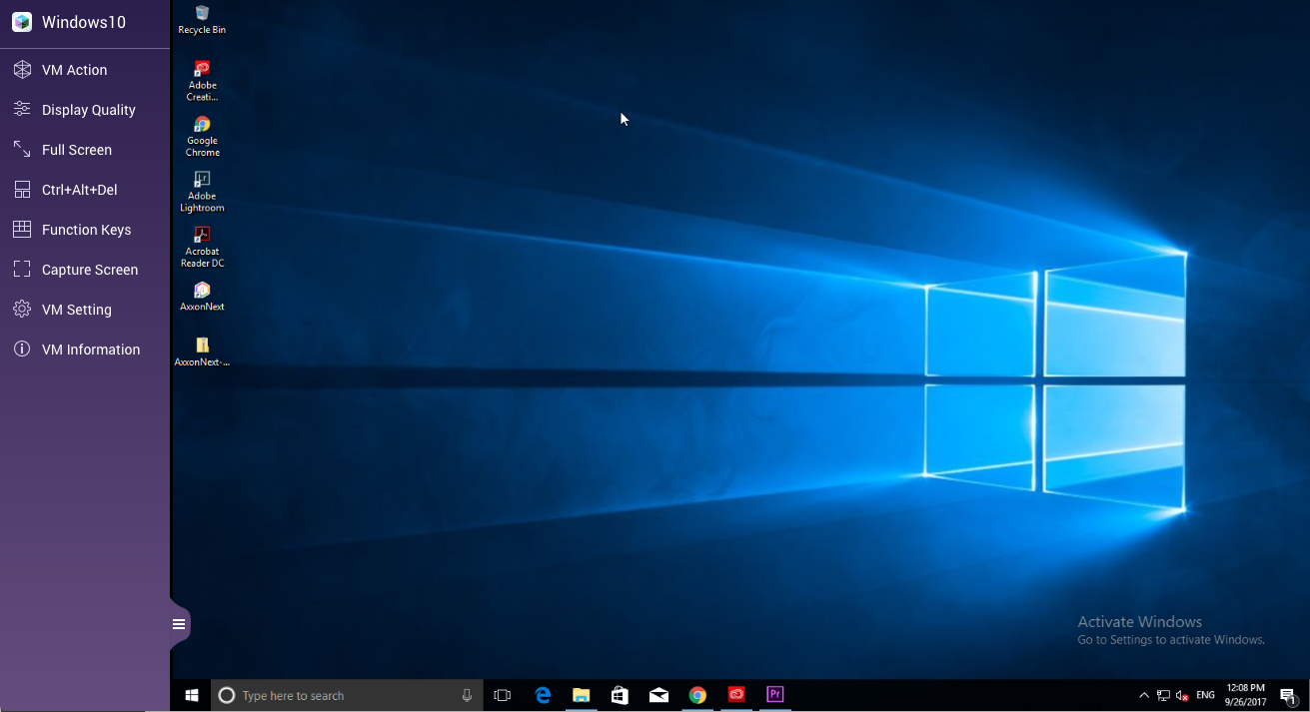
Web toolbar
VM Action
Function Keys
VM Settings
Display

Slide 15
Access VM console comparison
Virtualization
Station
Virtual Machine
Manager
Notes:
Toolbar comparison

Slide 16
VM Performance required
Environment settings
GPU support
Networking modes
Non-stop VM backup
Snapshot reverted online
OpenGL, Direct X required
Compatible for AMD, NVIDIA cards
VM console operation
VM Performance
Web – toolbar
HDMI output – QVM
Other remote utilities
I/O transmission
Number of concurrently running VM
Notes:
1. We need to know how to allocate the VM resource and
2. how to assess the NAS performance.

Slide 17
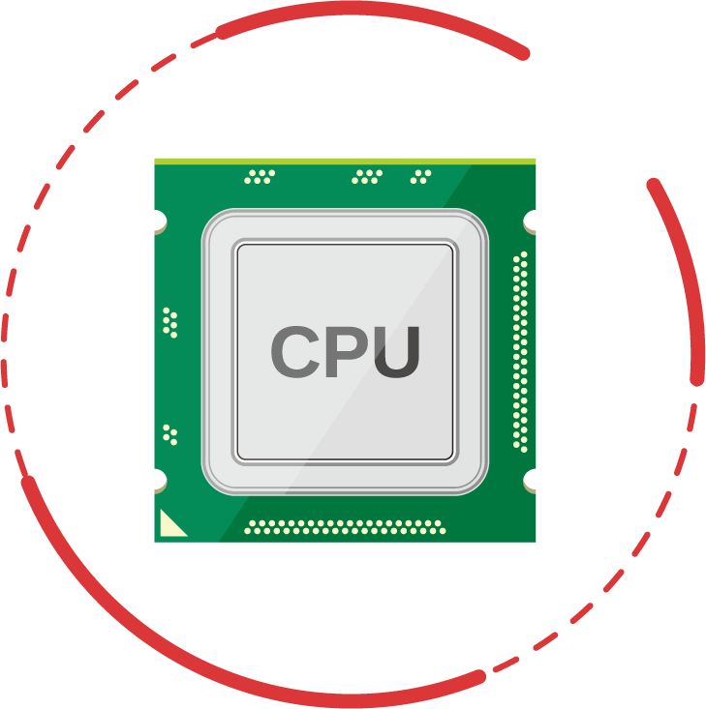
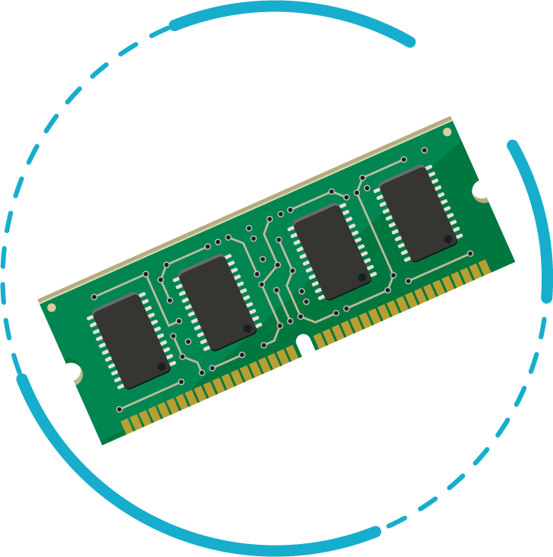
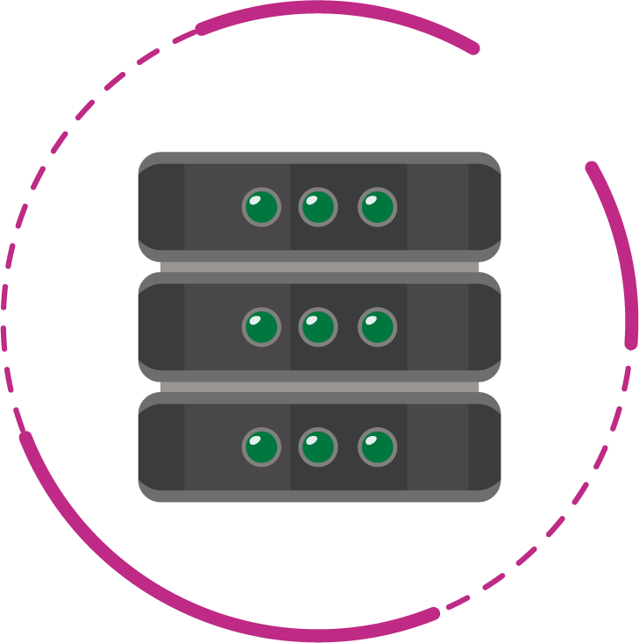
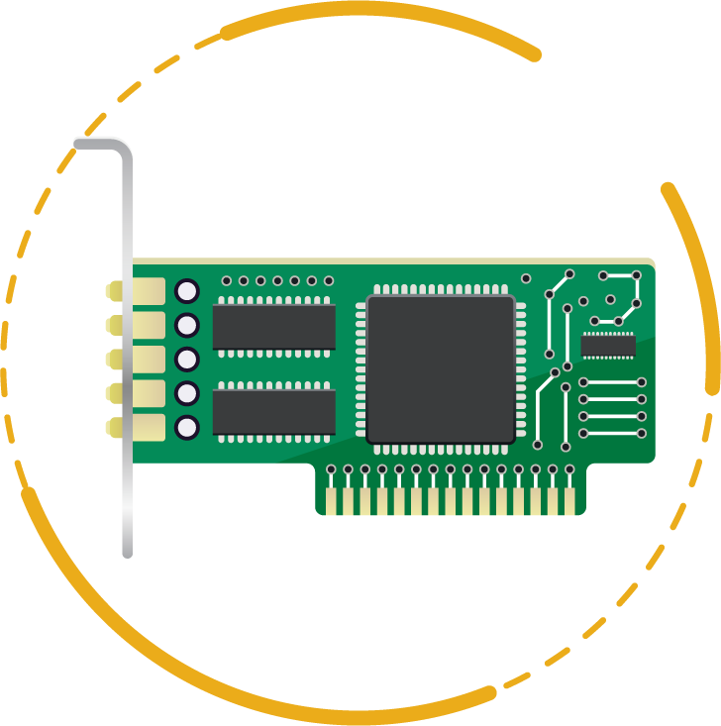
Assessment criteria
CPU
Memory
Disk I/O
Network I/O
Single/Multiple cores
VM cores allocation
Software transcoding
Read/Write
Latency
Read/Write
Zero-filling
Samba, iSCSI
VM-to-VM
VM-to-NAS
NAS-to-VM
Notes:
For performance assessment, we should take care of 4 parts
Speaking of CPU
Data transfer method including Samba and iSCSI

Slide 18
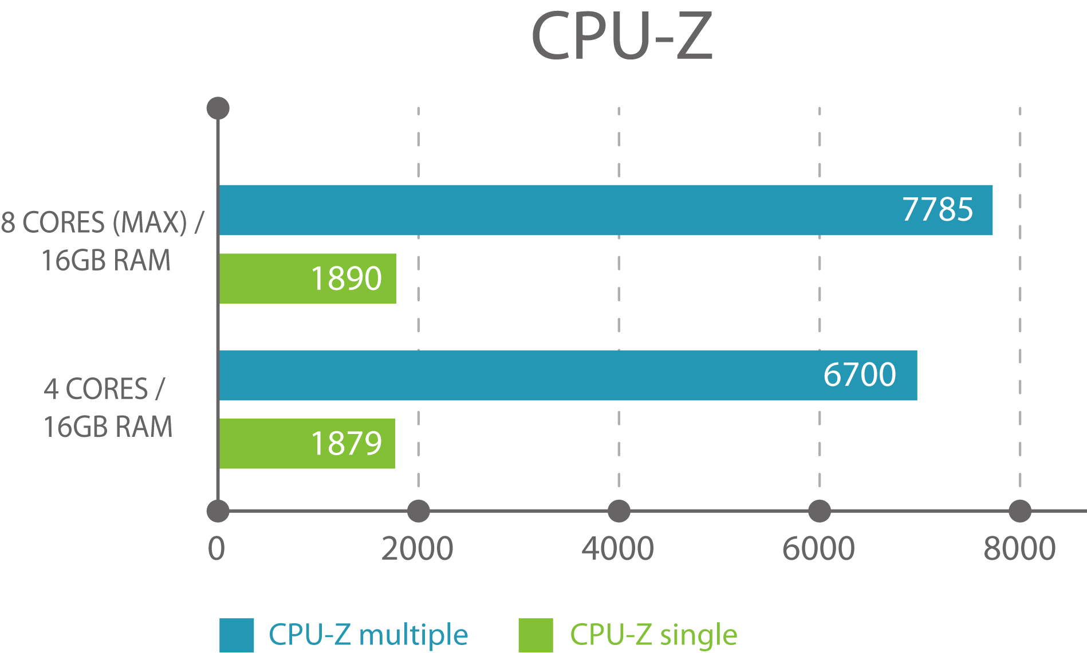
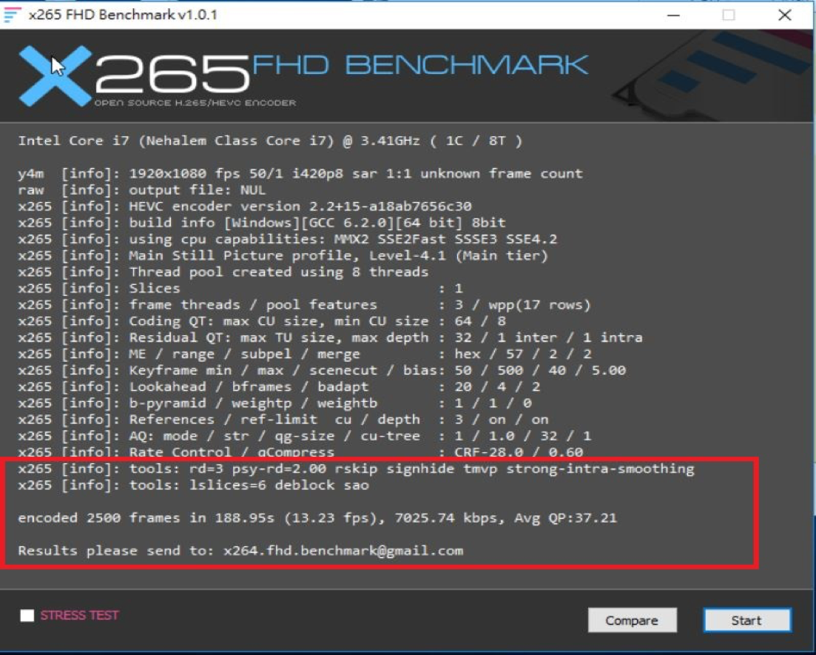
CPU Test
Encoded 2500 frames:
188.95 s / 13.23 fps
CPU
Cinebench
CPU-Z
Wprime 32M/ 1024M
x.265 FHD Benchmark
Tested in QNAP Labs. Figures may vary by environment. NAS：TVS-1282-i7
QTS 4.3.3, RAID 0 w/ 8 x WD Blue 500GB SSD
Notes:
We take two different settings, 4 cores and 8 cores with 16 GB memory.
the VM computing power is based on how many cores allocate.

Slide 19
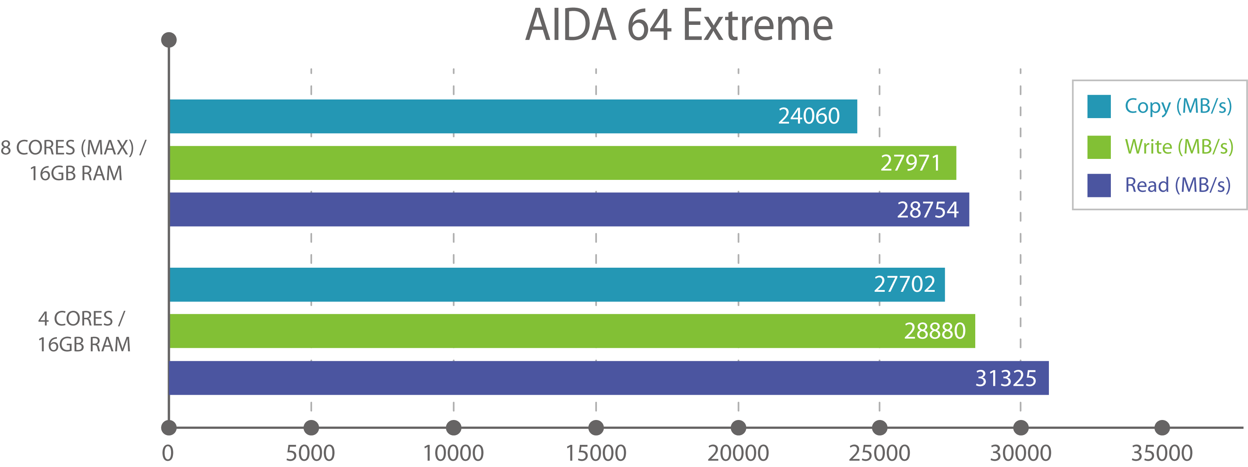
Memory Test
Memory
AIDA 64 Extreme
Tested in QNAP Labs. Figures may vary by environment. NAS：TVS-1282-i7
QTS 4.3.3, RAID 0 w/ 8 x WD Blue 500GB SSD
Notes:
the test result shows that different cores allocations doesn't affect the memory performance so that the VM memory allocation can refer to OS suggest. e.g.

Slide 20
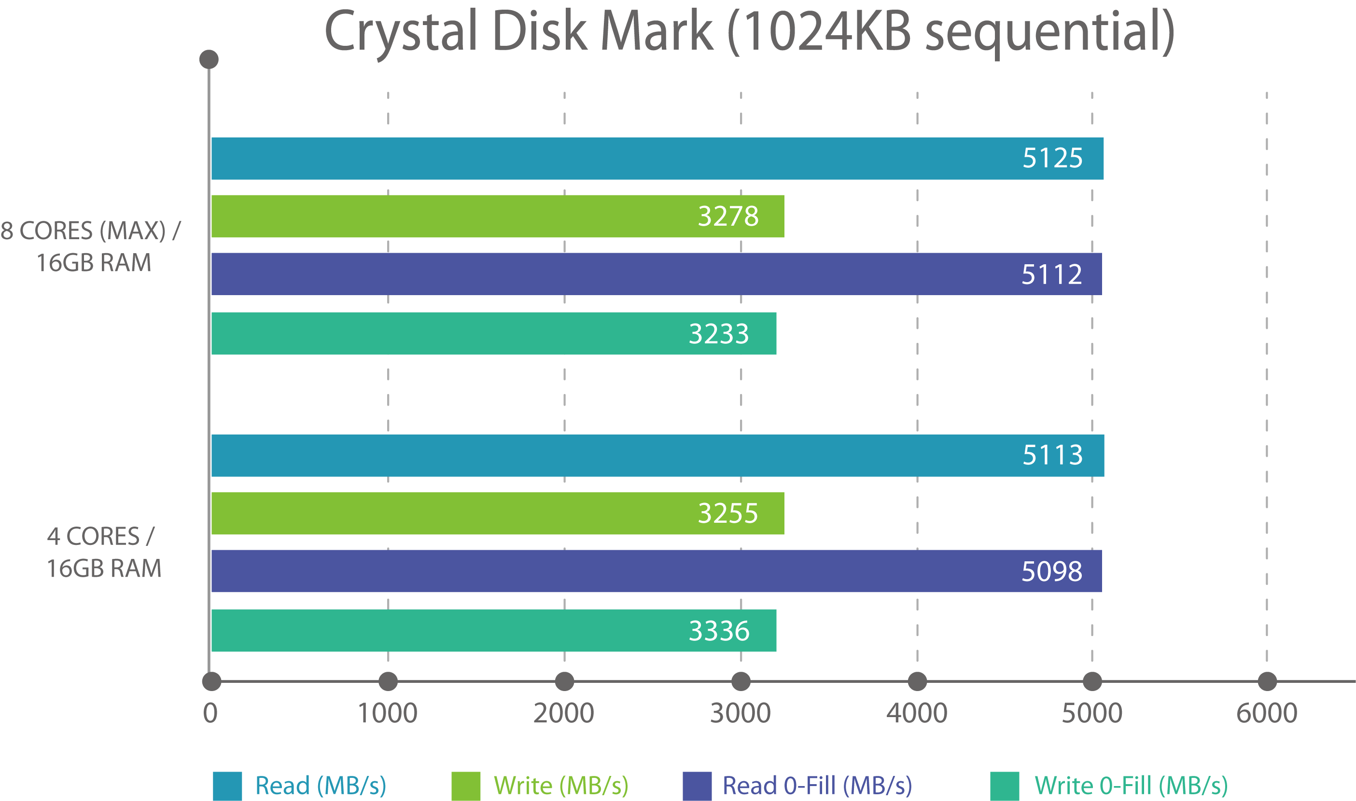
Disk I/O Test
Disk I/O
Crystal Disk Mark
Tested in QNAP Labs. Figures may vary by environment. NAS：TVS-1282-i7
QTS 4.3.3, RAID 0 w/ 8 x WD Blue 500GB SSD
Notes:
We have to do the R/W, fill-0/fill-1 test to see the I/O performance.
Same with memory, the disk I/O is not affected by cores allocation. Therefore, the disk I/O is subject to the NAS drive selection.

Slide 21
Network I/O Test
Network I/O
Crystal Disk Mark
Iperf
Tested in QNAP Labs. Figures may vary by environment. NAS：TVS-1282-i7
QTS 4.3.3, RAID 0 w/ 8 x WD Blue 500GB SSD
Iperf: -w 100M -t 60 -i 10
Notes:
For evaluate network performance, the different data transfer methods have to be considered such as iSCSI, Samba.
Moreover, we need to pay attention to the network transfer speed between NAS-VM and VM-VM.

Slide 22
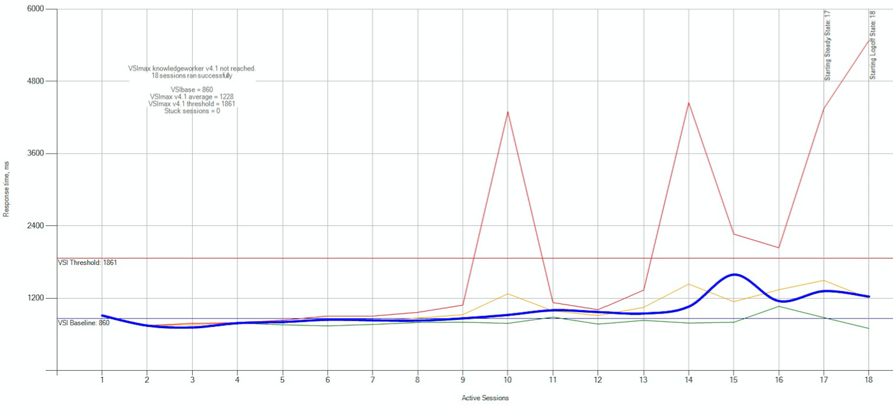
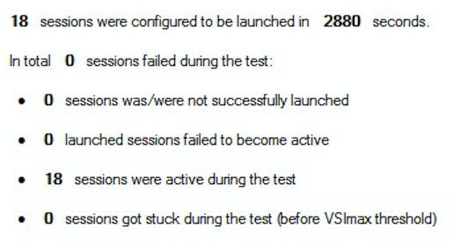
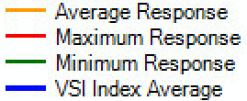
# of Concurrently running VM
Based on VDI (virtual desktop infrastructure) methodology
18 VMs available
Target VM:
Windows 10 64bits
Knowledge Worker
2 vcores
2 GB RAM
Tested in QNAP Labs. Figures may vary by environment. NAS：TVS-1282-i7
QTS 4.3.3, RAID 6 w/ 8 x Seagate ST4000VN000-2AH166 HDD
Notes:
The last and frequently asked question is about how many concurrently running VMs can be supported.
We selects the "Knowledge Worker" workload in LoginVSI.

Slide 23
Recap
Essential considerations for virtualization environment
Virtual Switch
Non-stop VM backup
Performance
Environment
GPU
Operation
Notes:
In order to provide an efficient VEnvironment, we need consider....

Slide 24
A suitable NAS for virtualization environment
 | QNAP | S vendor
Environment – networking modes | Multiple | Single
Environment – non-stop VM backup, snapshot | Local/Remote backup, online snapshot reverted | Snapshot for VM replication, offline snapshot reverted
GPU – DirectX, OpenGL | Yes | None
VM console – access operation | Local HDMI output, multi-functional web toolbar | Simple toolbar
VM performance – capable NAS | Many (SOHO to Enterprise-level) | Fewer (Mainly SOHO and SMB)

