Slide 1
QNAP SSD Cache

Slide 2
How is QNAP SSD Cache different from others?
Optimized SSD Cache configurations for business applications:
 | Other | QNAP
SSD Cache Utilization | One SSD device or RAID for one volume / LUN | Global cache for all volumes / LUNs
Enable/Disable SSD Cache | Service interrupted | Service up and running
SSD recovery after Hot plug (read cache) | Service interrupted | Service up and running
SSD recovery after Hot plug (read-write cache) | Service interrupted | Service up and running
Notes:
Synology 目前應該也可以上到4GB Write Cache:https://www.synology.com/zh-tw/knowledgebase/DSM/help/DSM/StorageManager/genericssdcache 其他Ivan提供的2,3,4項目可能也有變化。

Slide 3
Read Write Cache
The difference between Read-Only and Read-Write Cache:
Read Caching
Read / Write
Caching
When using Read-Write Cache, SSD cache should be created as a protected RAID to prevent data loss.
Total capacity=hard drive
Total capacity=hard drive
HDD STORAGE
SDD STORAGE
Notes:
Synology 目前應該也可以上到4GB Write Cache:https://www.synology.com/zh-tw/knowledgebase/DSM/help/DSM/StorageManager/genericssdcache 其他Ivan提供的2,3,4項目可能也有變化。

Slide 4
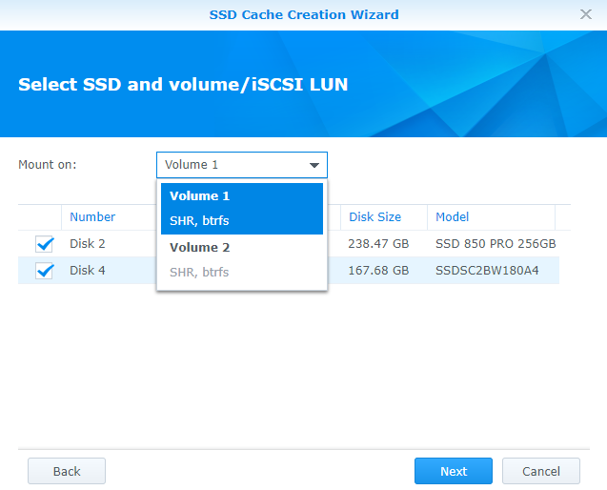
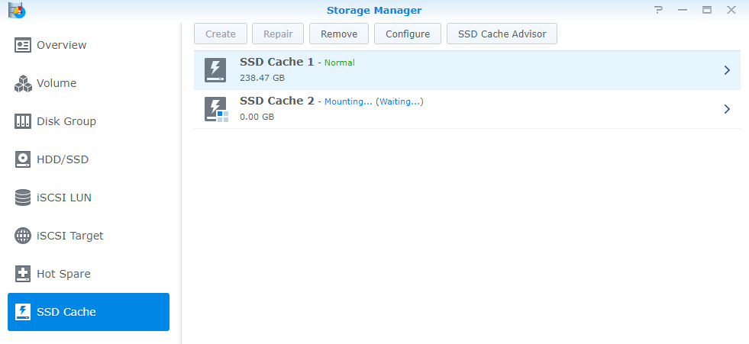
SSD Cache for one volume/LUN
SSD Cache that can only apply to one volume at a time: User can only select Read-Only Cache when have multiple volumes with 2 SSD.

Slide 5
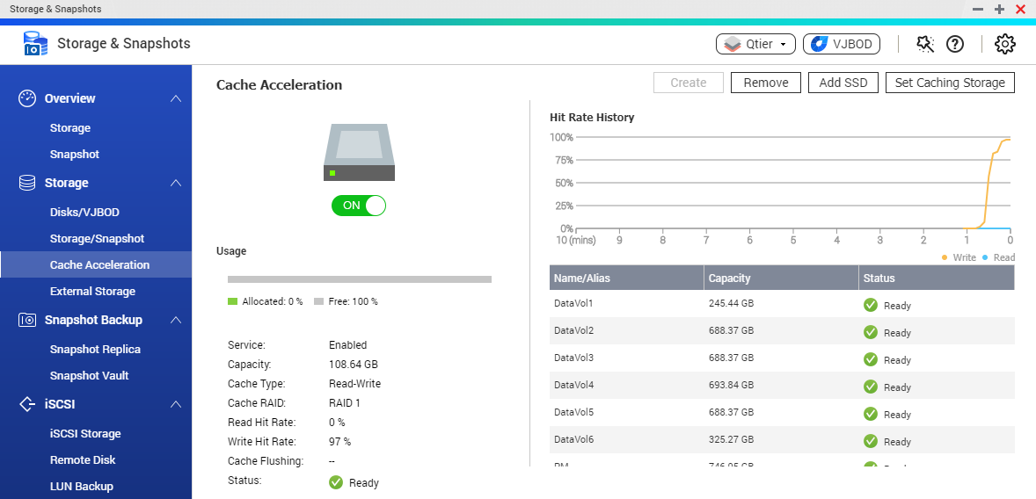
QNAP Global On-Demand SSD Cache
SSD Cache that can apply to all volumes and iSCSI LUN with single setup: Allows user to apply global Read-Write Cache on multiple volumes.

Slide 6
QNAP Hybrid Backup Sync Solid Backup Solutions for Data Security and Recovery
To realize 10GbE high performance backup experience
QNAP Systems, Inc.
Notes:
http://172.17.31.247:8080/cgi-bin/
TS-1635 with snapshot

Slide 7
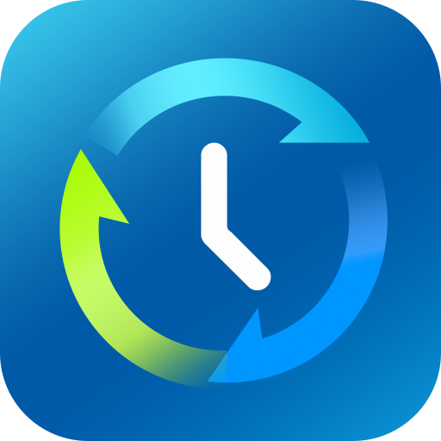
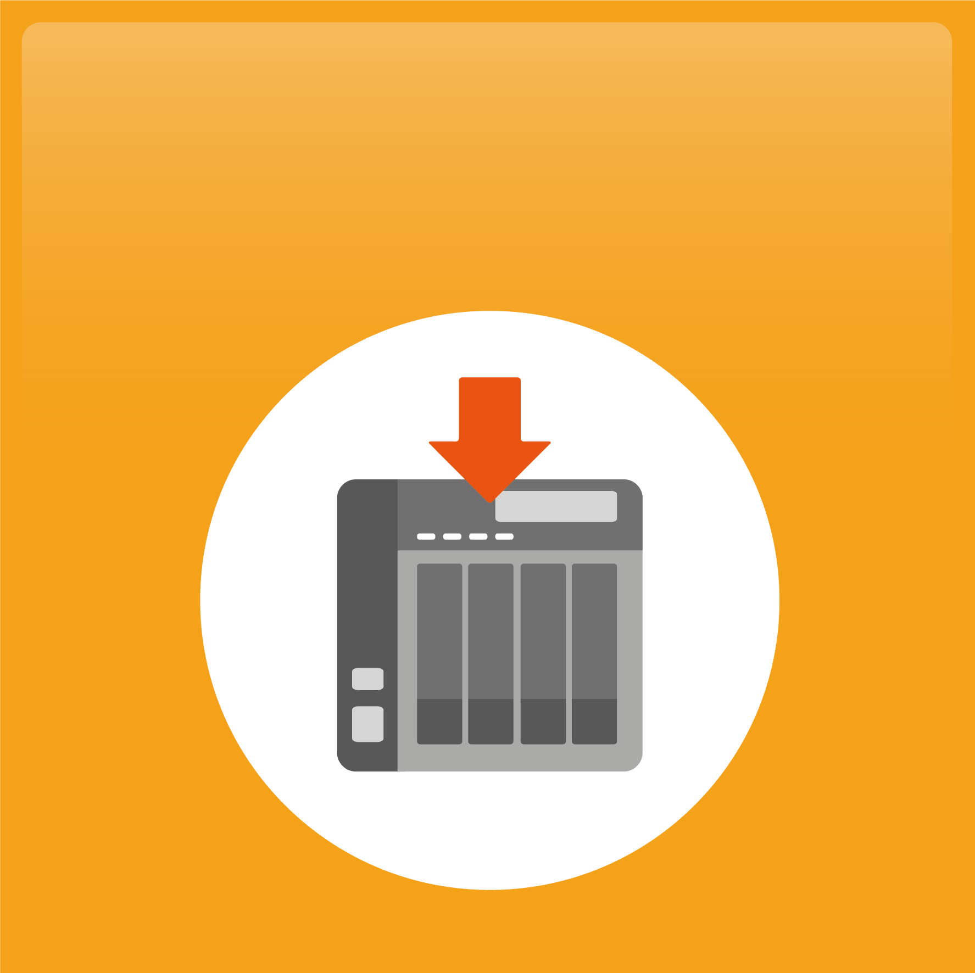
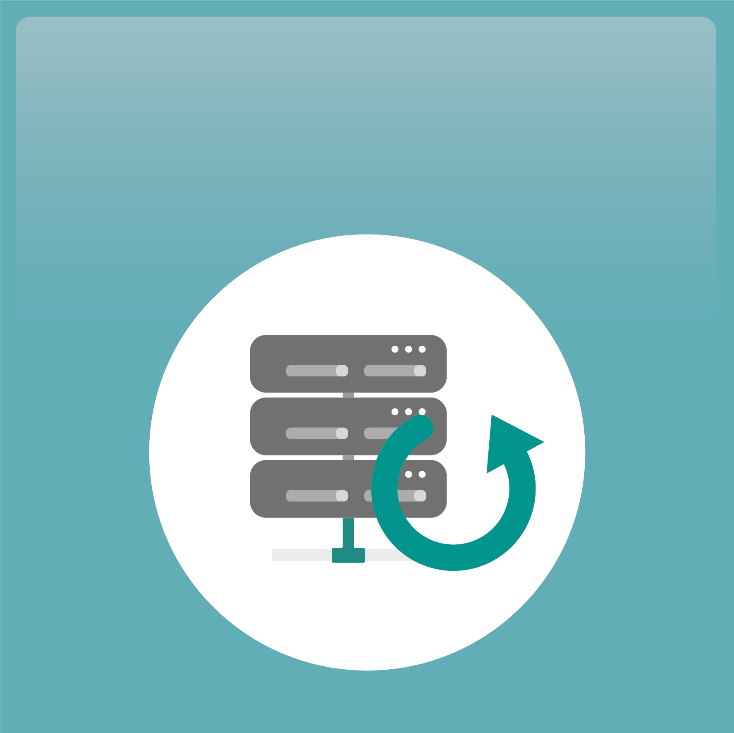
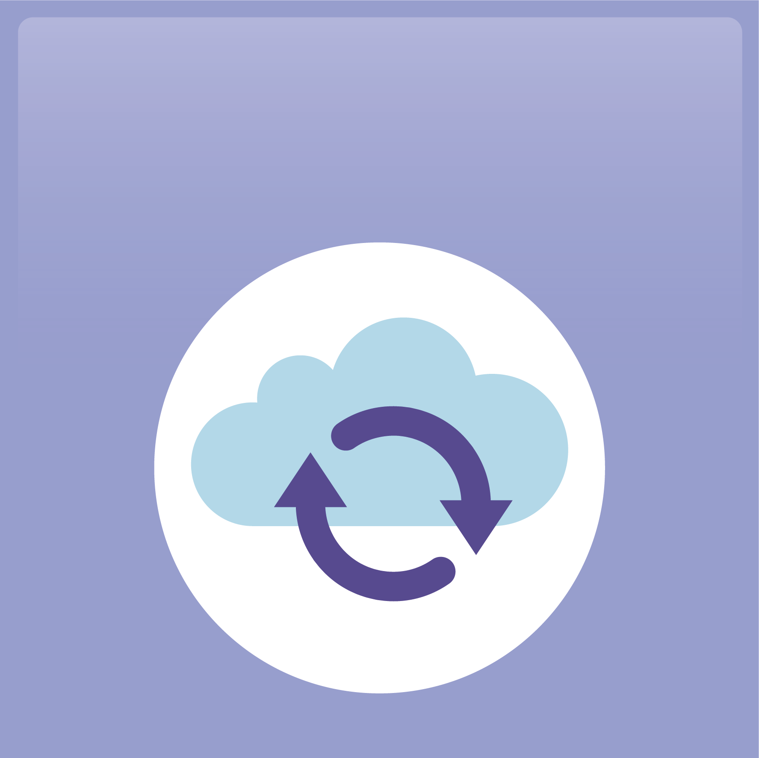
A Solid Data Protection Solution in one App
Hybrid Backup Sync
Backup
Restore
Sync

Slide 8
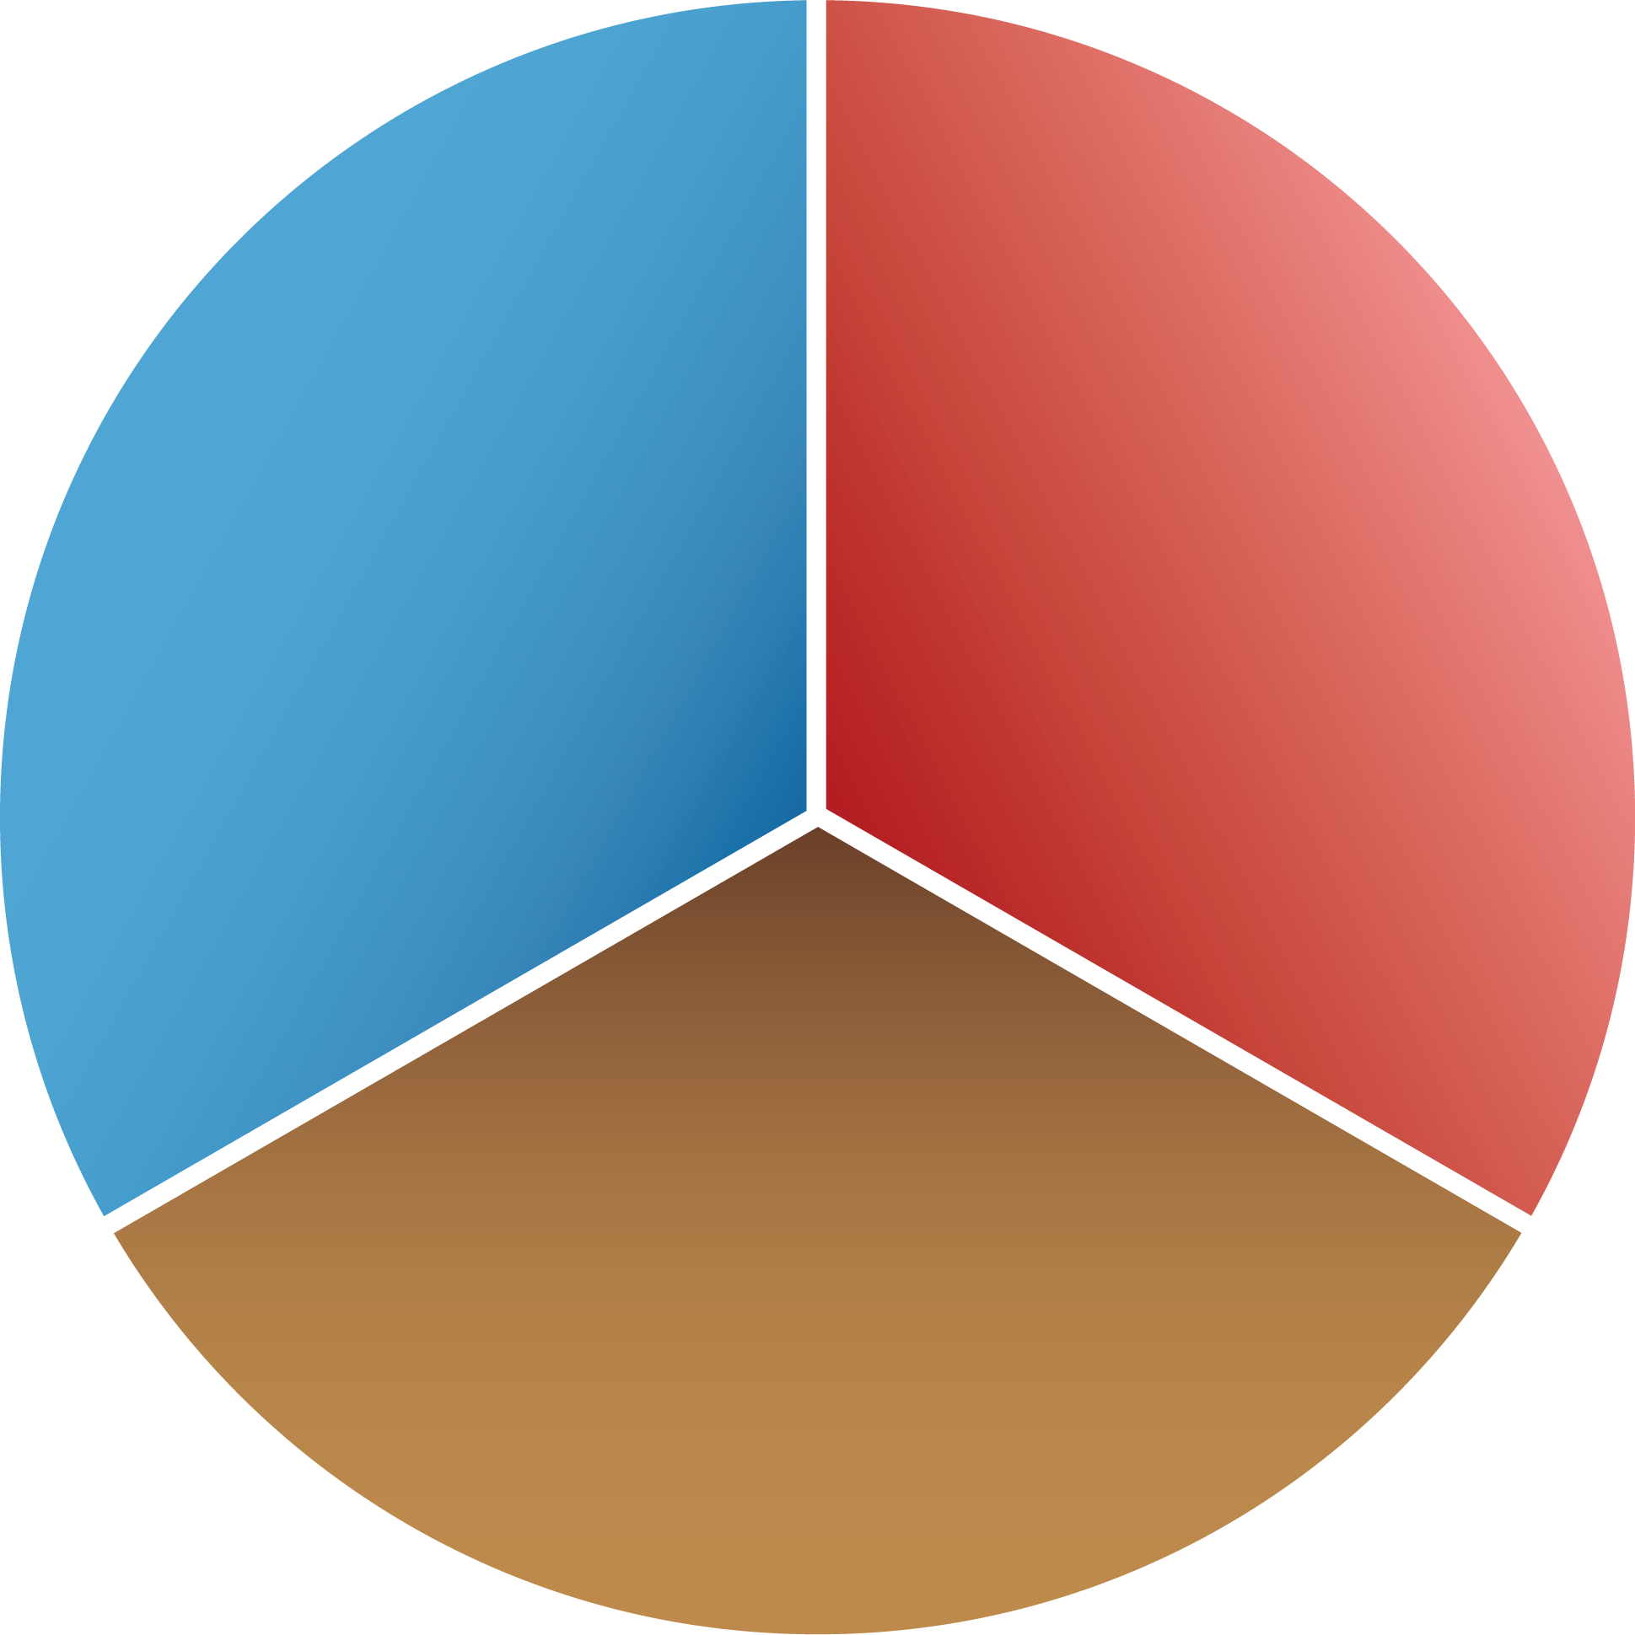
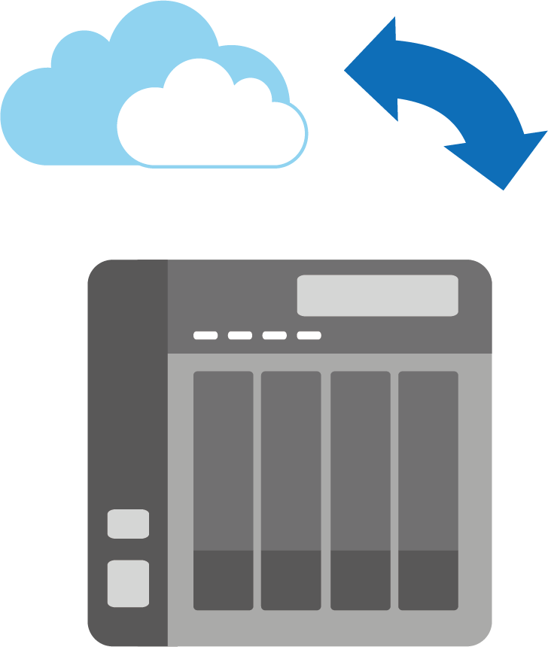
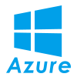
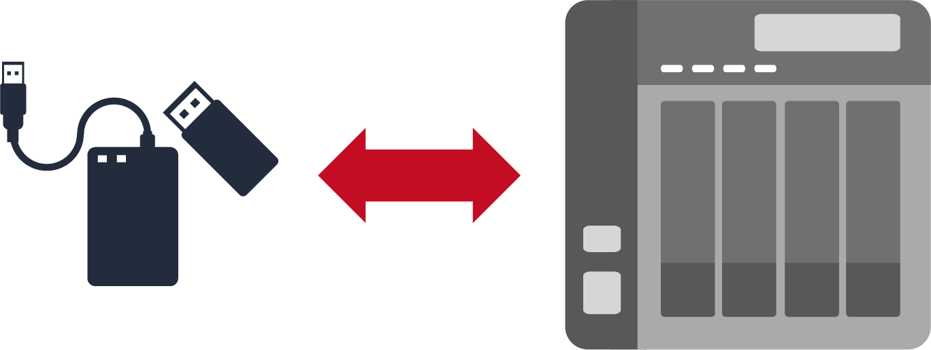
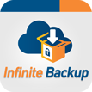
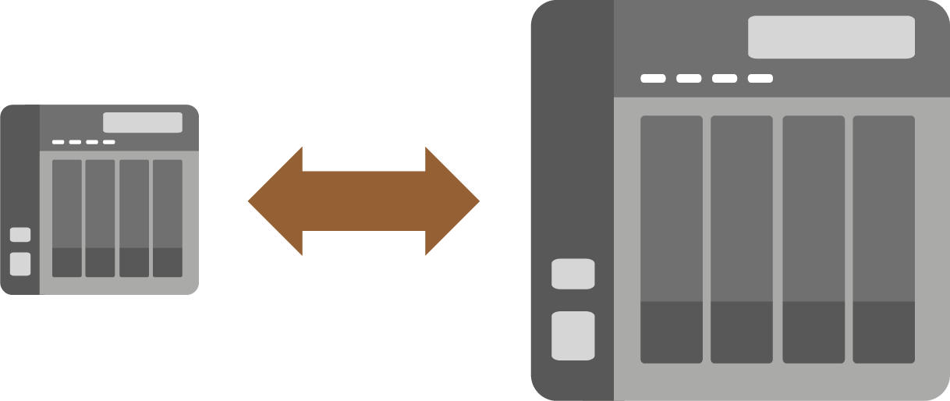
Backup – Hybrid Cloud Perfectly Integrated
Cloud
Local
Remote

Slide 9
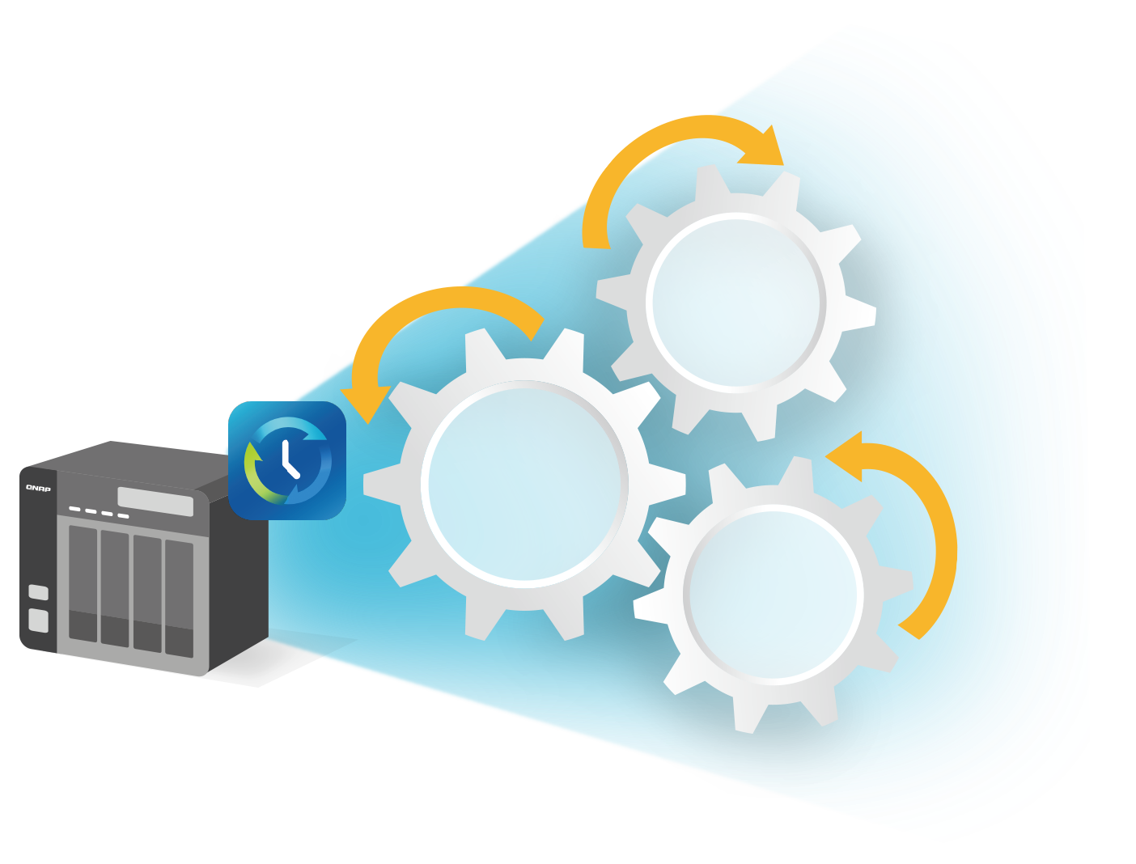
Backup - Essential of Smart Backup
Data
Reduction
Multi-Version
Backup
Data
Security

Slide 10
Multi-version Backup
Simple versioning
Smart versioning
NOW
JAN.
APR.
SEP.
DEC.

Slide 11
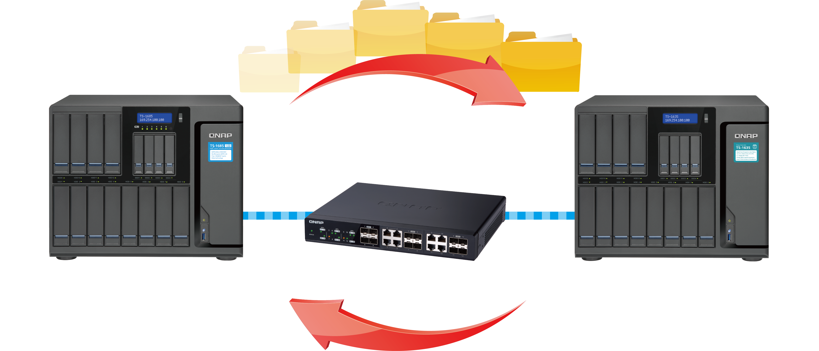
Back up over 10 Gigabit Ethernet
Economical enterprise-level disaster recovery solution
Highly Efficient Data Backup
Recover from Disaster in time
Protect the sensitive
and classified data
Backup
Disaster
Recovery

Slide 12
Demo – Remote Backup
10GbE Backup (RTRR) / 1GbE Backup (RTRR) performance comparison
Enable multi-version backup

Slide 13
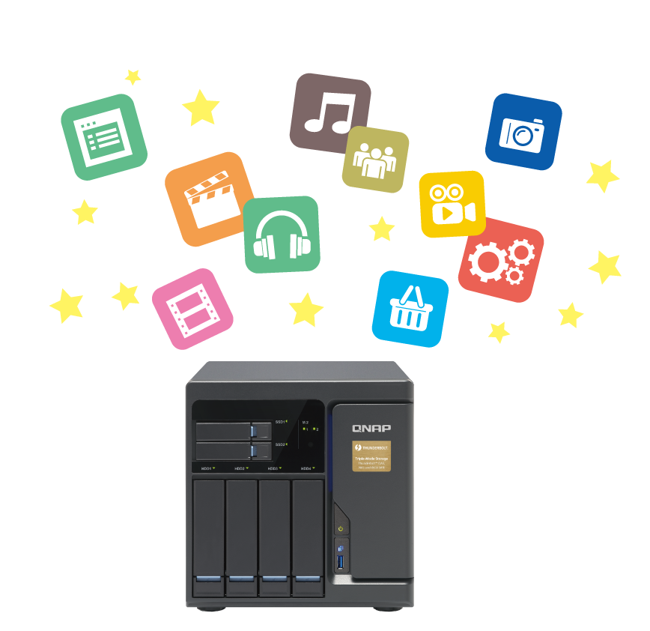
Cloud Security and Data Reduction
Secured connection (HTTPS)
Server-side encryption
Client-side encryption
Client-side-encryption
Secure connection
(HTTPS)
Server side encryption
01
Data Filter: Data size/Date/Type
02
Data Compression
03
Sparse File Detection

Slide 14
Demo – Cloud Backup
Client-side encryption

Slide 15
Sync – Access the data anytime and anywhere
One-way Sync
Active Sync
Two-way Sync
Cloud
Remote
Local

Slide 16
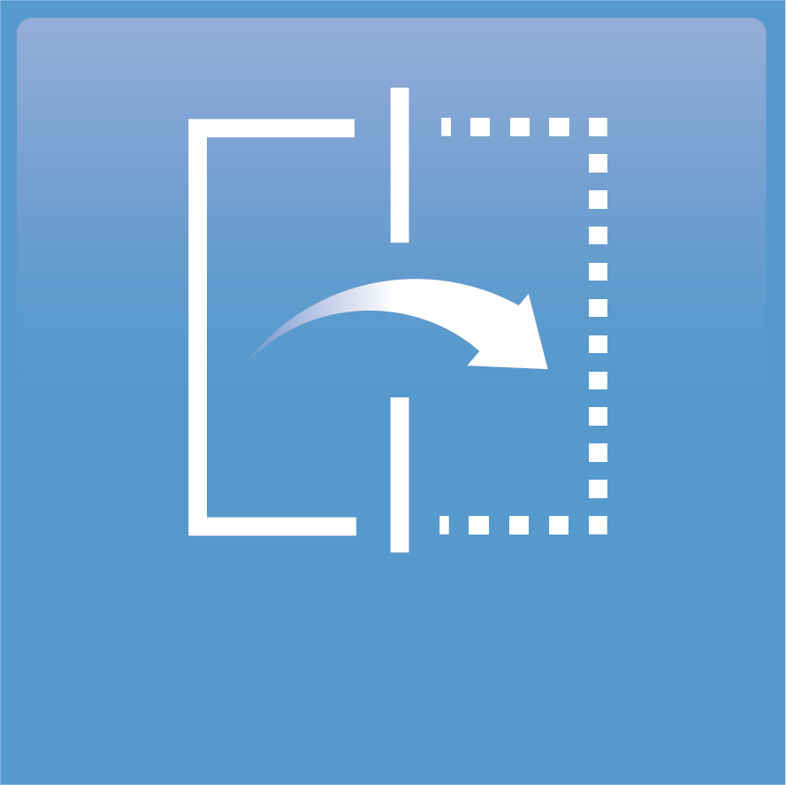
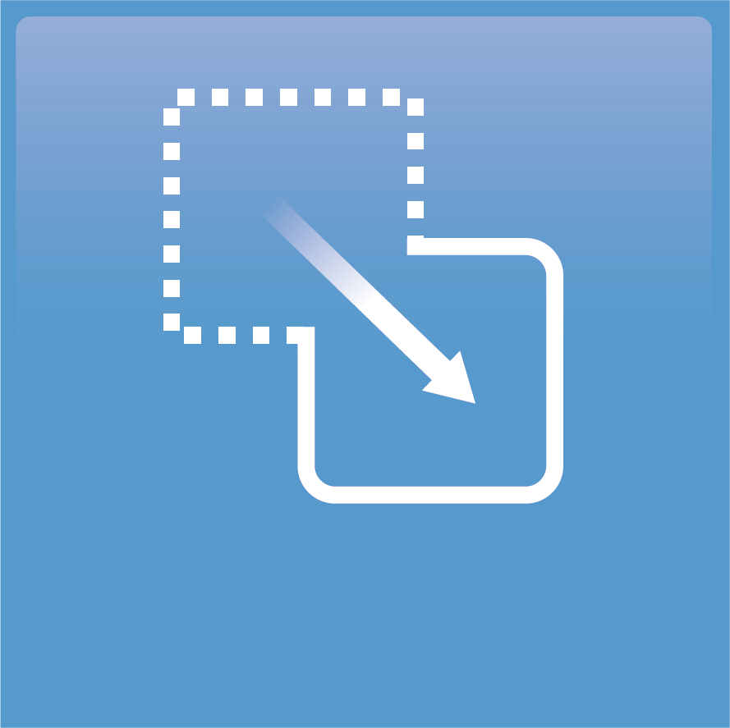
Cloud Sync - Flexible Settings to Meet Your Needs
Mirror
Copy
Move

Slide 17
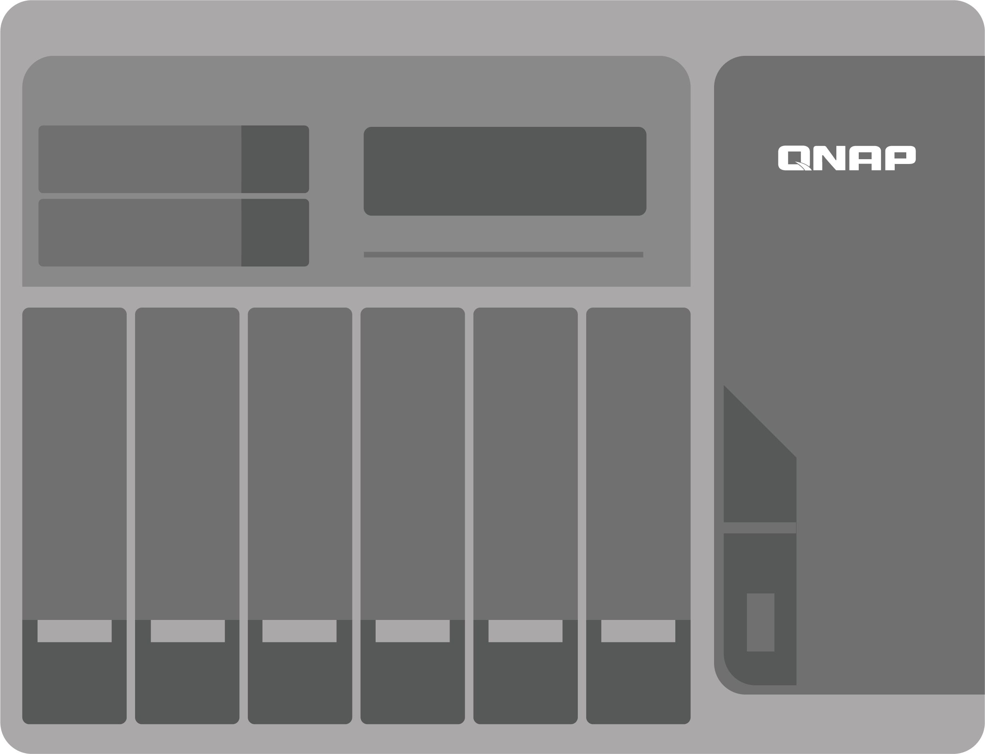
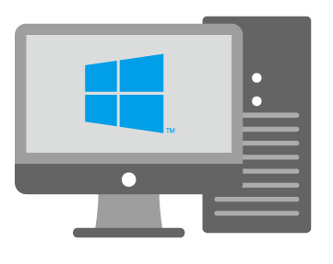
RTRR
CIFS/SMB
FTP
FTP
Demo – Sync
One-way sync job: RTRR / Rsync
Active sync job

Slide 18
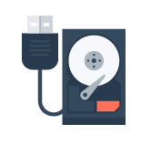
Comprehensive Data Protection Solutions
Local
Remote
Cloud
Taipei
Kaohsiung
RTRR
(Local to remote backup/sync)
Backup / Sync
360km
Mac Time Machine
Netbak Replicator
External Device
JBOD

Slide 19
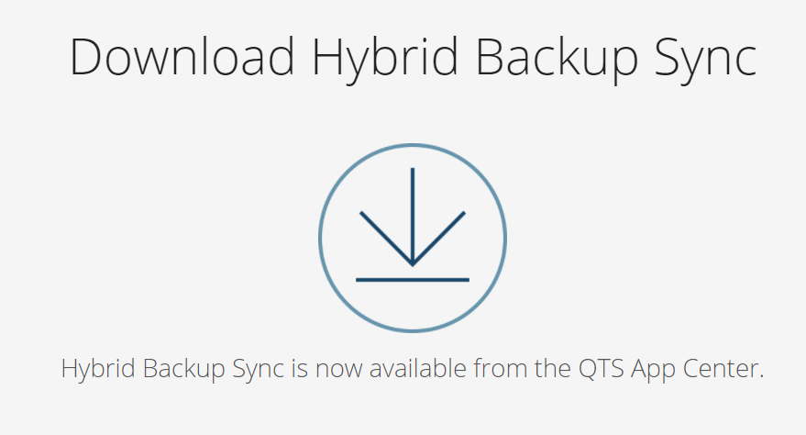
Get More information
https://www.qnap.com/solution/hybrid-backup-sync/en/

