Slide 2
Silence
Fits your home
HS-264 adopts a new and elegant appearance, with a fan less design and a metal hairline upper cover, which is both beautiful and heat dissipation, no longer have to worry about the fan being filled with dust or malfunctioning.
Notes:
HS-264 are designed in new housing with one piece heatsink, to brings you not only modern fashion but also quiet experience. Perfectly fitted your house.

Slide 3
QTS 5.0 + Linux Kernel 5.10
In order to provide the best performance, the HS-264 is equipped with QTS 5.0 and uses the new Linux kernel 5.10 to unleash the potential of the Intel® Celeron® N5105. QTS 5.0 optimizes overall system performance and enhances the versatility of the HS-264
AES-NI encryption
Volume & folder support
GPU up to 800 MHz
UHD Graphics
4-core
4-thread
2.9GHz
Burst
N5105
Jasper Lake

Slide 4
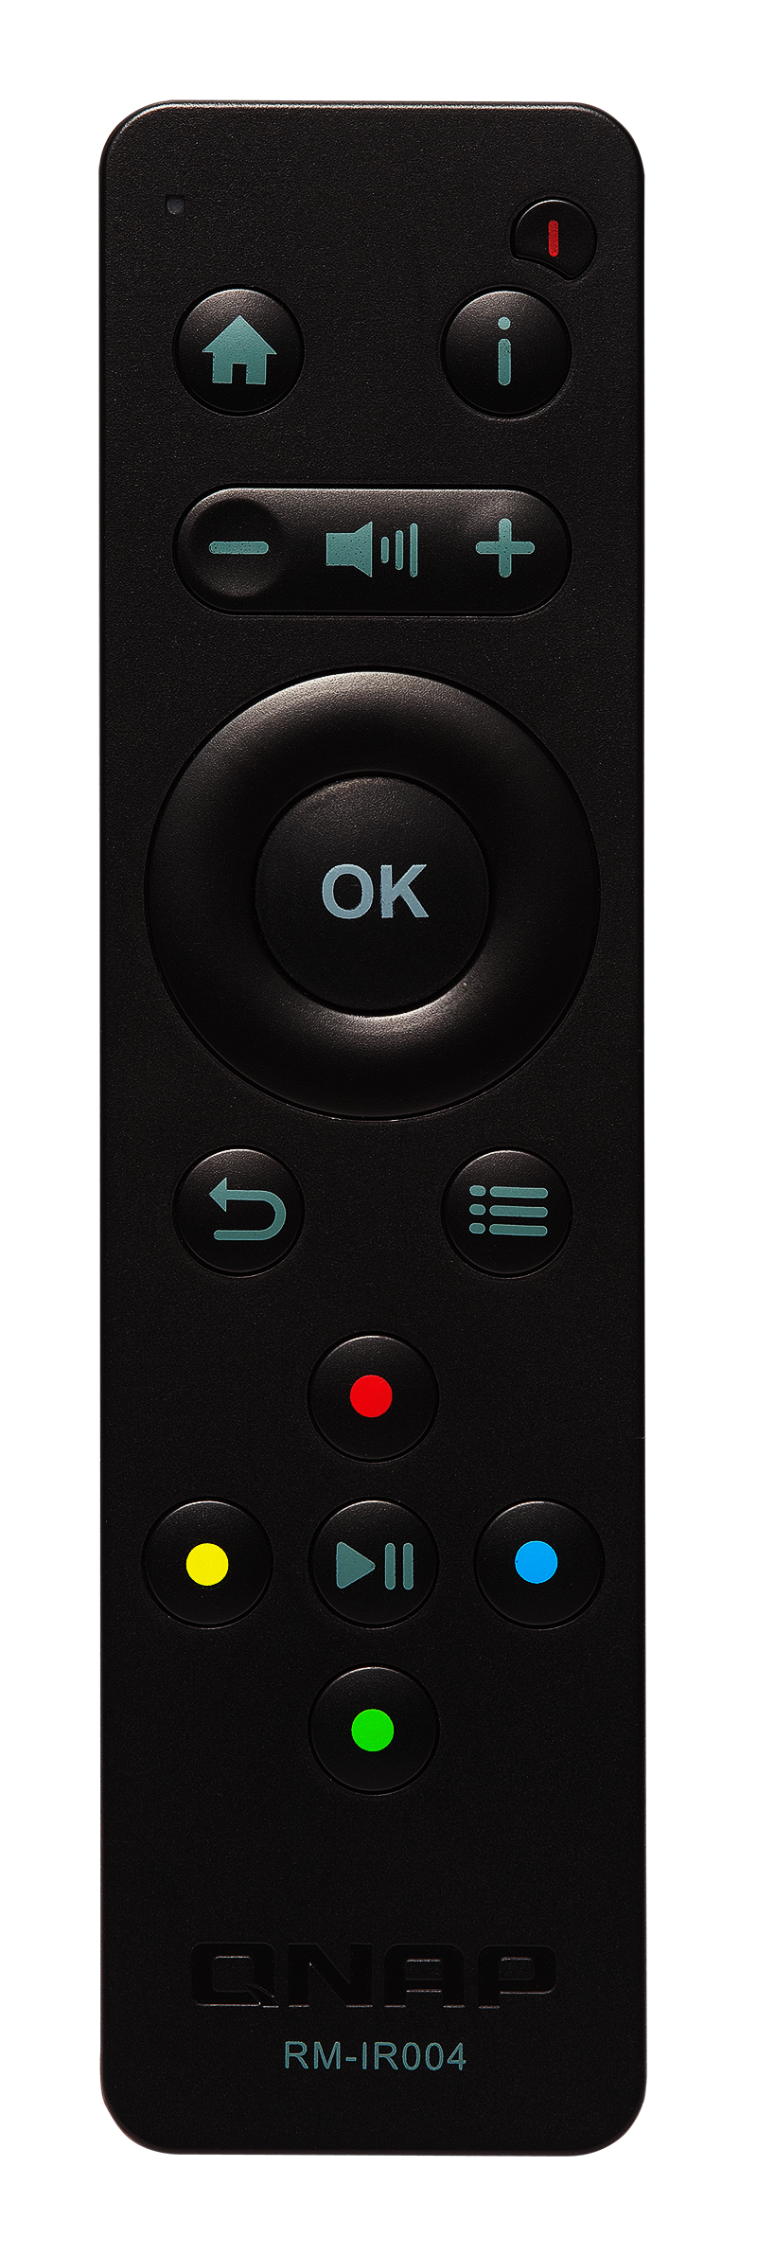
Front view of HS-264
Light weight and minimalist design
Power/status indicator
Optional RM-IR004 remote control
Hidden IR receiver

Slide 5
2 Bays
HDD/SSD
The new HS-264 has 2 built-in SATA 6Gbps hard drive bays, in addition to supporting large-capacity mechanical hard drive HDD, it can also support 2.5” solid state drive SSD to balance performance and capacity.
HDD for high capacity
SSD for performance and silence
SATA 6Gb/s

Slide 6
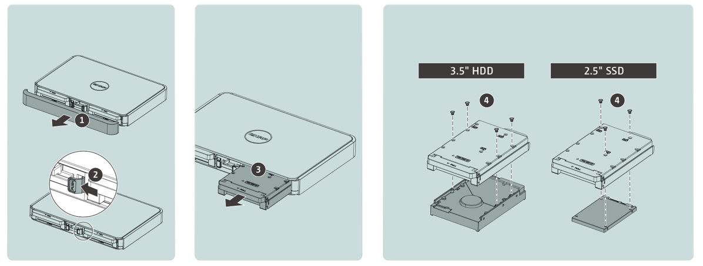
Easily install 2.5" or 3.5" HDD or SSD
1. Remove the front cover
2. Pull out the hard drive tray
3. Use the corresponding screws to install the disk

Slide 7
HS-264 rear view
Power input
HDMI 2.0
Kensington lock
2.5GbE (1G, 100M,10Mbps)
Reset button
USB 3.2 Gen2
(10Gbps)
Power switch

Slide 8
High-performance GPU with two HDMI outputs and up to 4K 60Hz resolution
New Graphic process unit
Intel UHD Graphics
Support up to 4K @60Hz HDMI outputs
Support h.264/265 hardware transcoding

Slide 9
Specifications
Ordering P/N | HS-264-8G
CPU | Intel Celeron N5105; quad-core, up to 2.9GHz
Graphics | Intel UHD Graphics (up to 4K output & transcoding)
Memory | 8GB not expandable
Drive bays | 2 x 2.5”/3.5” HDD/SSD SATA III 6Gbps
Ethernet | 2 x 2.5G NBASE-T
USB | 2 x USB 3.2 Gen 2 (10Gbps); Type-A
IR receiver | Support (Optional RM-IR004)
Kensington | Support
Power | External adapter 60W; 100-240VAC

Slide 10
2.5GbE provides nearly 295MB/s performance, much faster than 1GbE
Test environment：
PC:
CPU AMD EPYC 8-core CPU; 64GB Memory; Windows 10 Pro
NAS:
HS-264-8G
2 x Samsung 870 EVO 250GB SSD; RAID0
295
Download (MB/s)
295
Upload (MB/s)
Windows File Transfer

Slide 12
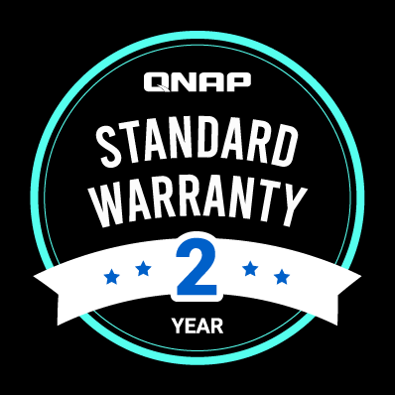
HS-264 available soon!
Comes with 2-year standard warranty, extend up to 5-year warranty
Warranty P/N:
EXTW-GREEN-3Y (For extra 3-year warranty)

Slide 13
New QTS 5.0
Faster, easier and more secure Support QVPN / WireGuard VPN

Slide 14
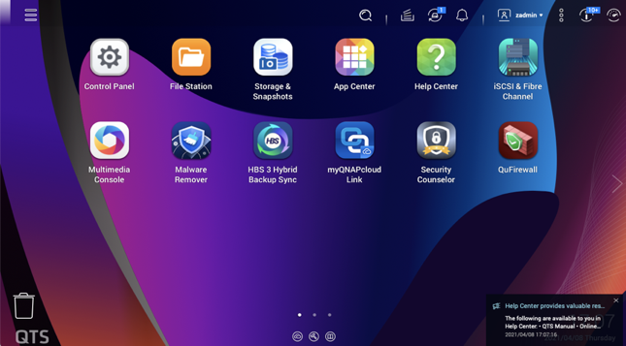
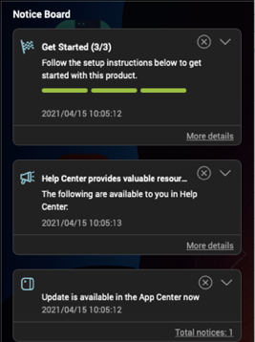
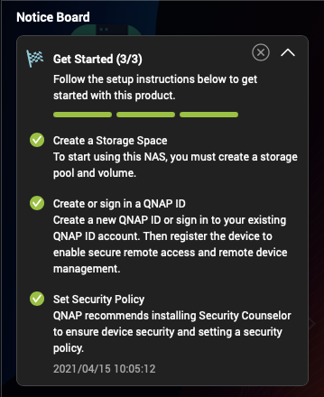
QTS 5.0 with Linux Kernel 5.10 improve security & optimize the user interface
Simplified OOBE installation steps & optimized user interface
Group notification
Guide

Slide 15
QVPN、QuWAN Mesh VPN
Offers a variety of VPN solutions
QuWAN Mesh VPN
QVPN
QuWAN SD-WAN supports IPsec VPN, allowing QNAP NAS and VMware Hypervisor platforms to build auto Mesh VPN networks for highly secure multi-site connections.
Learn more: QuWAN SD-WAN
Establish a VPN connection to a remote NAS and access its content/services from computers and mobile phones. You can also use the NAS as a VPN server through QVPN.
Learn more: QVPN

Slide 16
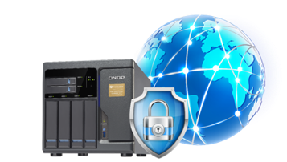
QTS 5.0 built in WireGuard VPN
The new QVPN's WireGuard VPN is lighter, easier to set up, supports multiple user platforms, and greatly improves the speed. It is an essential tool for individual users to work from home.
Connecting to a NAS is safer and more convenient.

Slide 17
File Management
QTS provides a variety of APPs to help you manage various files in the NAS

Slide 18
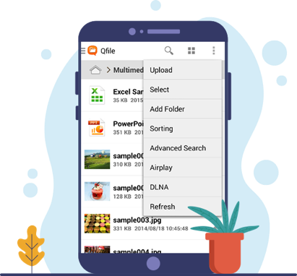
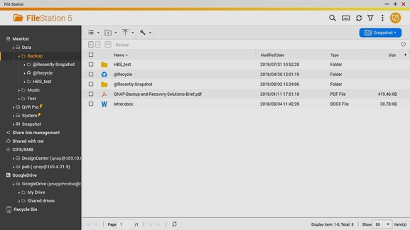
File Station – Multifunctional file browser
File Station not only allows you to manage the files stored in the NAS, but also the files on the cloud space can be easily managed. Through simple and intuitive operations, you can quickly upload files from devices such as computers, drag and drop files between different folders, delete files, and set file and folder permissions to protect important data from prying eyes.
Manage your files with the Qfile mobile app

Slide 19
File Station – Easy to share
Easily share QNAP NAS files with friends, family and colleagues. You can create a sharing link and send it to others via social networking sites or email. You can also add an expiration date or set a password to the link to make the file more secure. All created sharing links can also be managed in File Station, which is very convenient.
Microsoft Office on the web simplifies document editing

Slide 20
Handy tool to sorting and search files
Qfiling
Qsirch
Automatic batch classification and archiving of photos and files stored in the NAS. The fully automatic process allows you to no longer have to manually drag and drop files, saving time and convenience!
Just like a Google search! The powerful and powerful full-text search engine allows you to quickly find the files you need based on search criteria such as file creation/modification dates, keywords, and main colors in images.
Five kinds of advanced photo search: search by people, search by text in pictures, search by objects, search by color, search by map
Easy!
Productive!
Orderly!
Managing!

Slide 21
QuMagie - AI Smart Album Backup and Management
QNAP has created AI photo and video management tools for NAS. It is equipped with a new AI engine to provide smarter backup photo, video management and sharing tools.
Boost 41.7% performance with GPU
QNAP NAS
Smart Phone
Smart phone
Browsing and managing
Upload & backup
PC
手持裝置
QuMagie
Camera
Sharing
Social Media
手持裝置
PC
AI engine

Slide 22
Integrated Home Media Entertainment Center
QTS diversified APP to meet your needs

Slide 23
High-performance multimedia audio and video playback and streaming platform
Plex Server streaming and transcoding
QuMagie AI smart album
CAYIN MediaSign Player
HEVC (H.265) real-time transcoding
Use Cinema28 to stream multimedia to AV playback devices in conference rooms

Slide 24
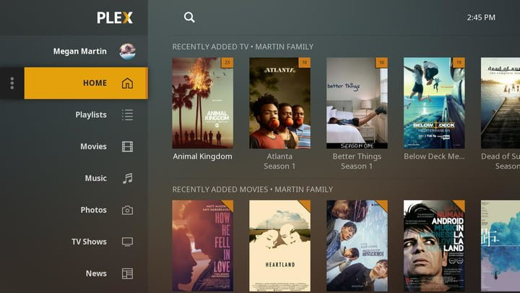
Build your personal multimedia library with Plex
With Plex Server, you can easily turn your NAS into a multimedia center in your home. You can stream Plex directly on your TV, tablet or mobile phone and play multimedia files stored in the NAS.

Slide 25
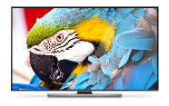
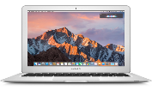
Supports connecting and streaming to various TV boxes or mobile devices
SmartTV
Computer
Smart phone
Tablet

Slide 26
Connect to TV, screen
Lots of probability through the HDMI output

Slide 27
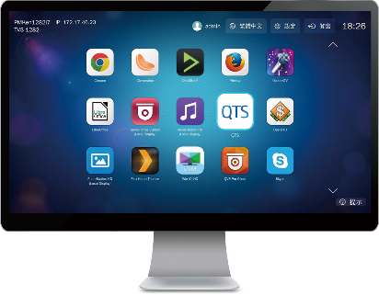
HybridDesk Station
USB
HDMI
Mouse &
Keyboard
Network
Qremote App

Slide 28
HybridDesk Station Applications
System Management
Surveillance
Social media
QTS
FileStation HD
QVR Pro Client
Skype
Facebook
Multimedia
Multimedia management
Tools
HD Player
Clementine
Spotify
TuneIn Radio
PhotoStation HD
VideoStation HD
MusicStation HD
Chrome
Firefox
LibreOffice

Slide 29
Qbutton - toggle within a touch
Play a list of your favorite songs and set other buttons to play the previous or next track
Watch the default Surveillance Station camera channels, start monitoring in seconds, and be safe
One-click restart or shutdown of the NAS, fast and convenient
Optional
RM-IR004 IR remote controller

Slide 30
Turn your NAS to Ubuntu PC with Linux Station
Connect the NAS to the monitor via HDMI
Then connect the mouse and keyboard to the NAS, and the NAS becomes an Ubuntu PC!
Supported Ubuntu
Ubuntu 18.04
Ubuntu 20.04

Slide 31
File Backup Solution
Back up your various data across platforms and devices

Slide 32
The importance of backup + how to prevent extortion

Slide 33
Is your digital data safe? How to keep data safe
Common Threats
While no one wants to lose their phone or crash their computer, life is full of surprises. If you regularly back up data to the NAS, the NAS can safely and centrally store your important data, and protect the data from accidents such as damage, disaster, hardware failure, and human negligence, and you will no longer have to worry about losing files.
Cyber security
Human error
There are complex security vulnerabilities hidden in digital devices and various types of information, coupled with the endless emergence of computer viruses and malware, information security threats are even more unavoidable.
Human errors such as accidental deletion of files/programs, misplacement of files, management errors, or unreadable file format errors occur almost every day.
Hardware failure
Natural disaster
Computers, mobile phones, tablets, especially digital products such as hard drives, can fail due to factors such as overuse or aging, and people are caught off guard.
Natural disasters (such as fires, earthquakes, floods, wind disasters, etc.) always come suddenly, and the probability that data may be lost or damaged during disasters cannot be ignored.
Notes:
https://www.qnap.com/event/2020/world-backup-day/zh-tw/’

Slide 34
Backup 3-2-1, keep your data safe!
According to the "Data Backup Options" published by the United States Computer Emergency Readiness Team (US-CERT), from home users to professional organizations, any computer user should back up important data to avoid data Accidental loss or damage. However, just storing a backup file may not be enough! To increase the chances of recovering lost or corrupted data, it is recommended that you follow the 3-2-1 backup principle.
Important data should be backed up at least 3 copies: 1 main file and 2 backup files.
Archives are stored on 2 different backup media
to protect against various types of hazards.
One of the backups is to be stored offsite
(outside the home or business).

Slide 35
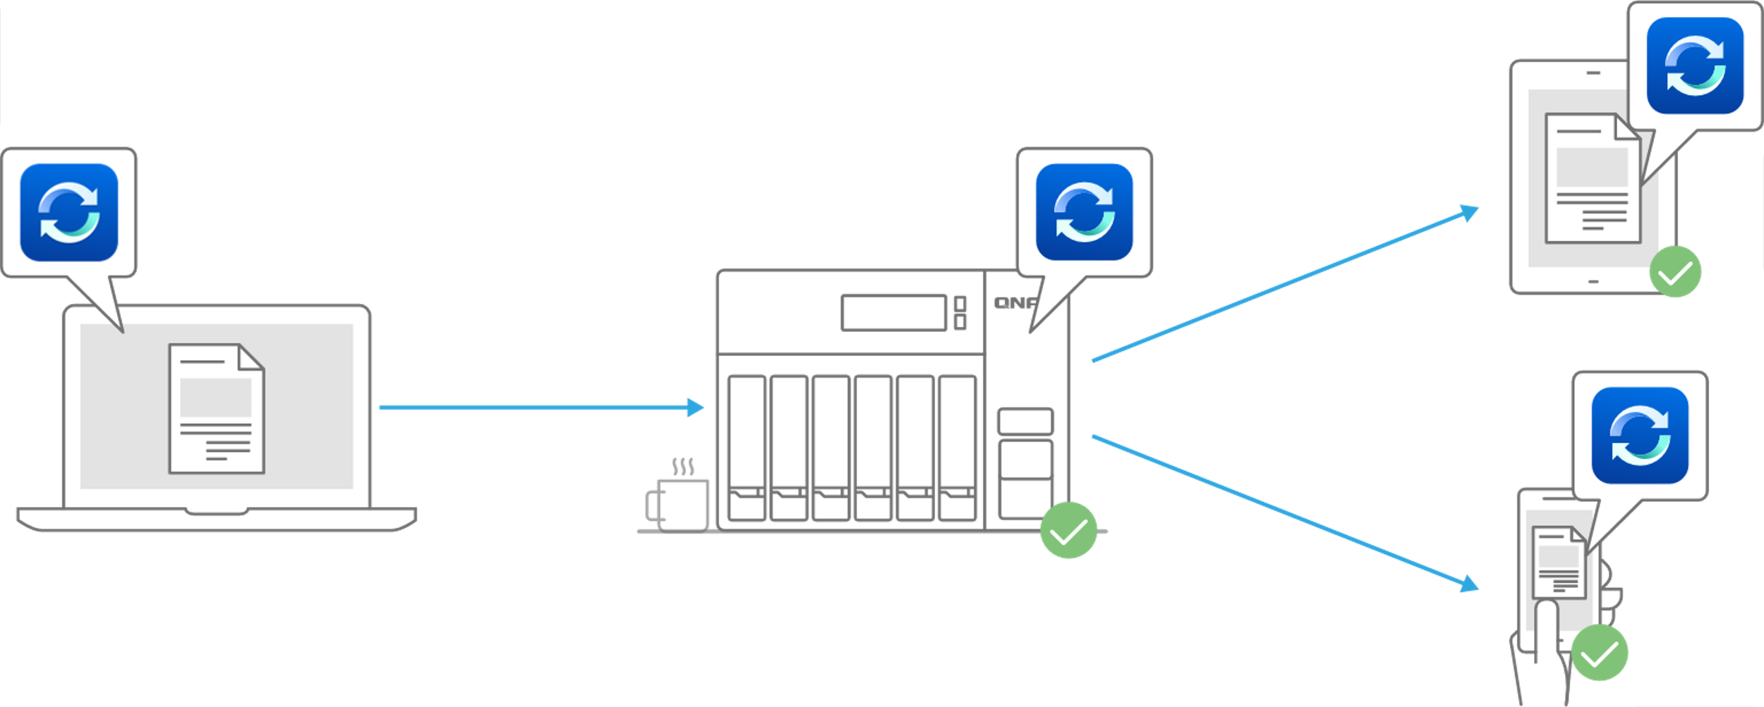
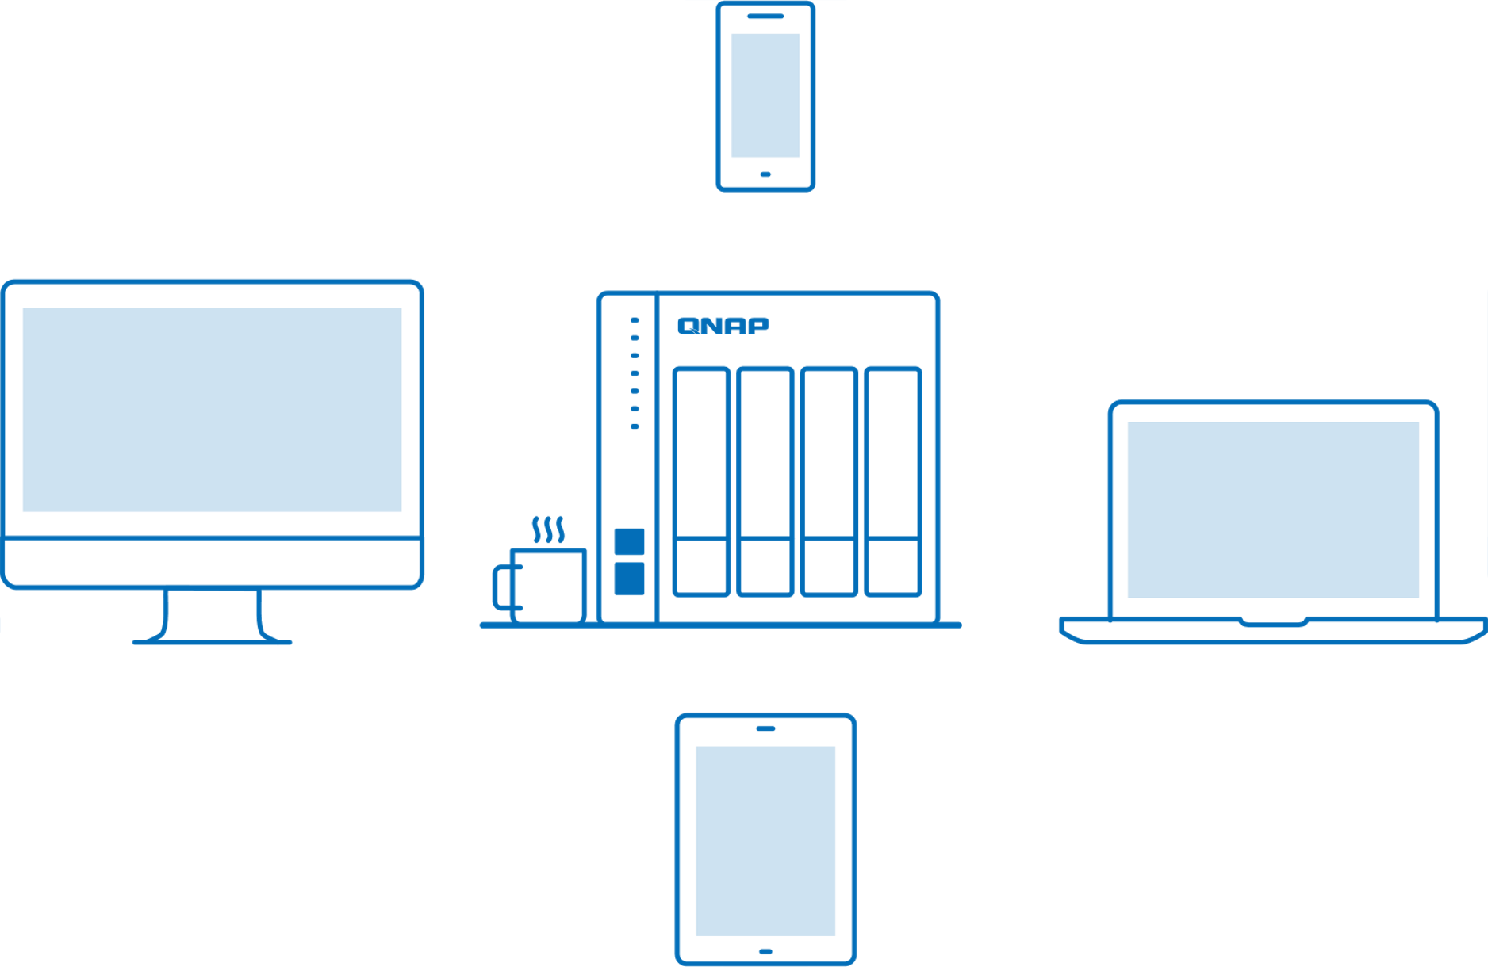
Qsync 5.0 cross-device file synchronization tool for personal and team collaboration
When team members collaborate and communicate, files can be automatically pushed to the binding devices of all members, making the workflow faster and collaboration smoother.
When there are different devices such as laptops and mobile phones, as long as the files are modified on a single device, the modified files will be automatically synchronized to other devices.
Windows &
macOS
Space saving mode!

Slide 36
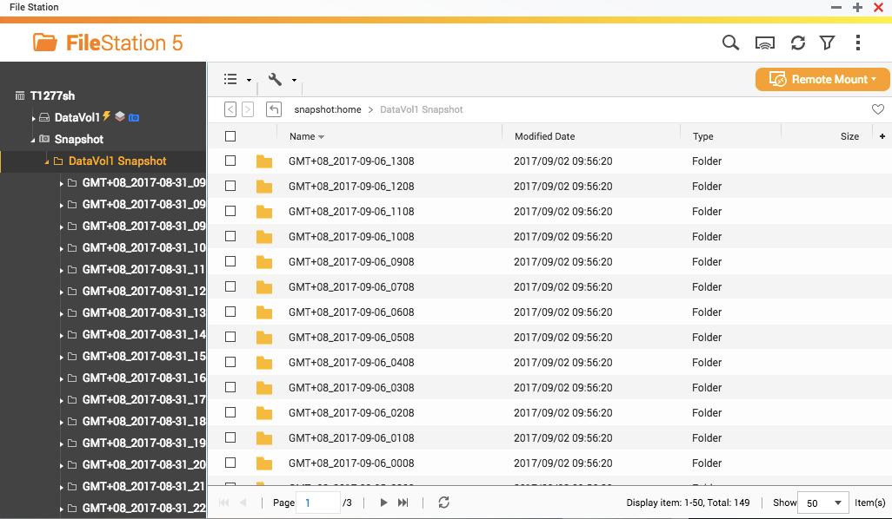
Most affordable enterprise-grade protection with up to 1024 snapshots
Max. snapshots per NAS
1024
Single volume/LUN Max. snapshots
256
Best Value Backup Choices

Slide 37
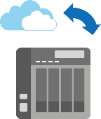
HBS3 offsite backup - multiple protection backup data
Offsite
Hybrid Backup Sync Hybrid Backup and Sync Center
Local
Cloud

Slide 38
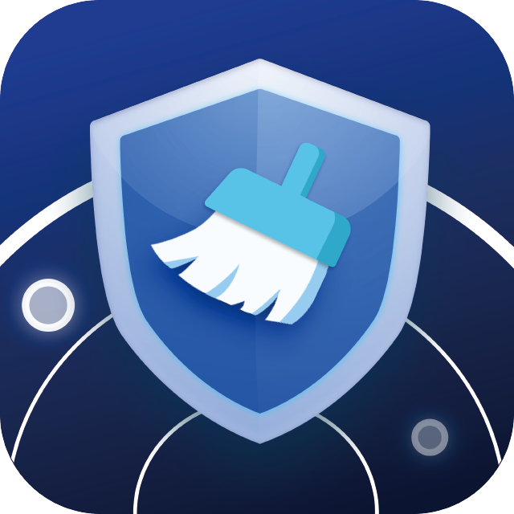
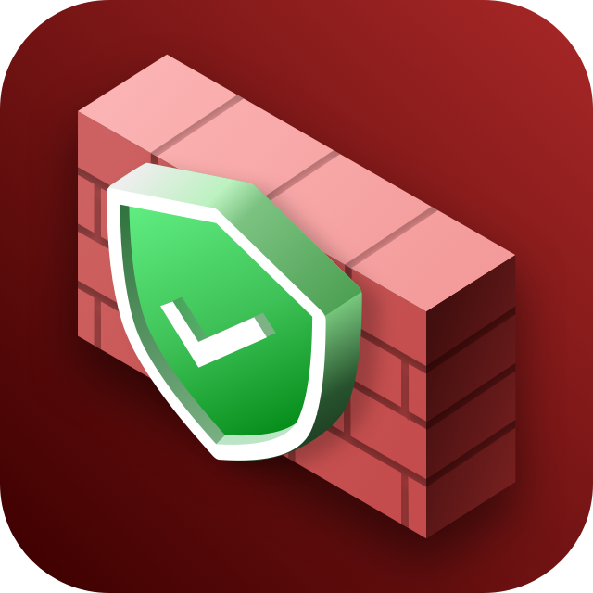
Keep your NAS safe with these tools
Malware Remover
Checks for weaknesses and offers recommendations to secure your data against multiple attack vectors. It also integrates anti-virus and anti-malware software to ensure complete protection of your QNAP NAS.
Learn more: Security Counselor
Security Counselor
Regularly scan your NAS using the latest malware definitions. When under attack, infected files will be immediately removed to ensure NAS data security.
QuFirewall
Supports IPv6 and GeoIP, allowing you to configure your firewall to allow/deny specific packets and IP addresses from certain countries for safeguarding data and service security.
Learn more: QuFirewall

Slide 39
Expansion
Faster Ethernet or larger storage

Slide 40
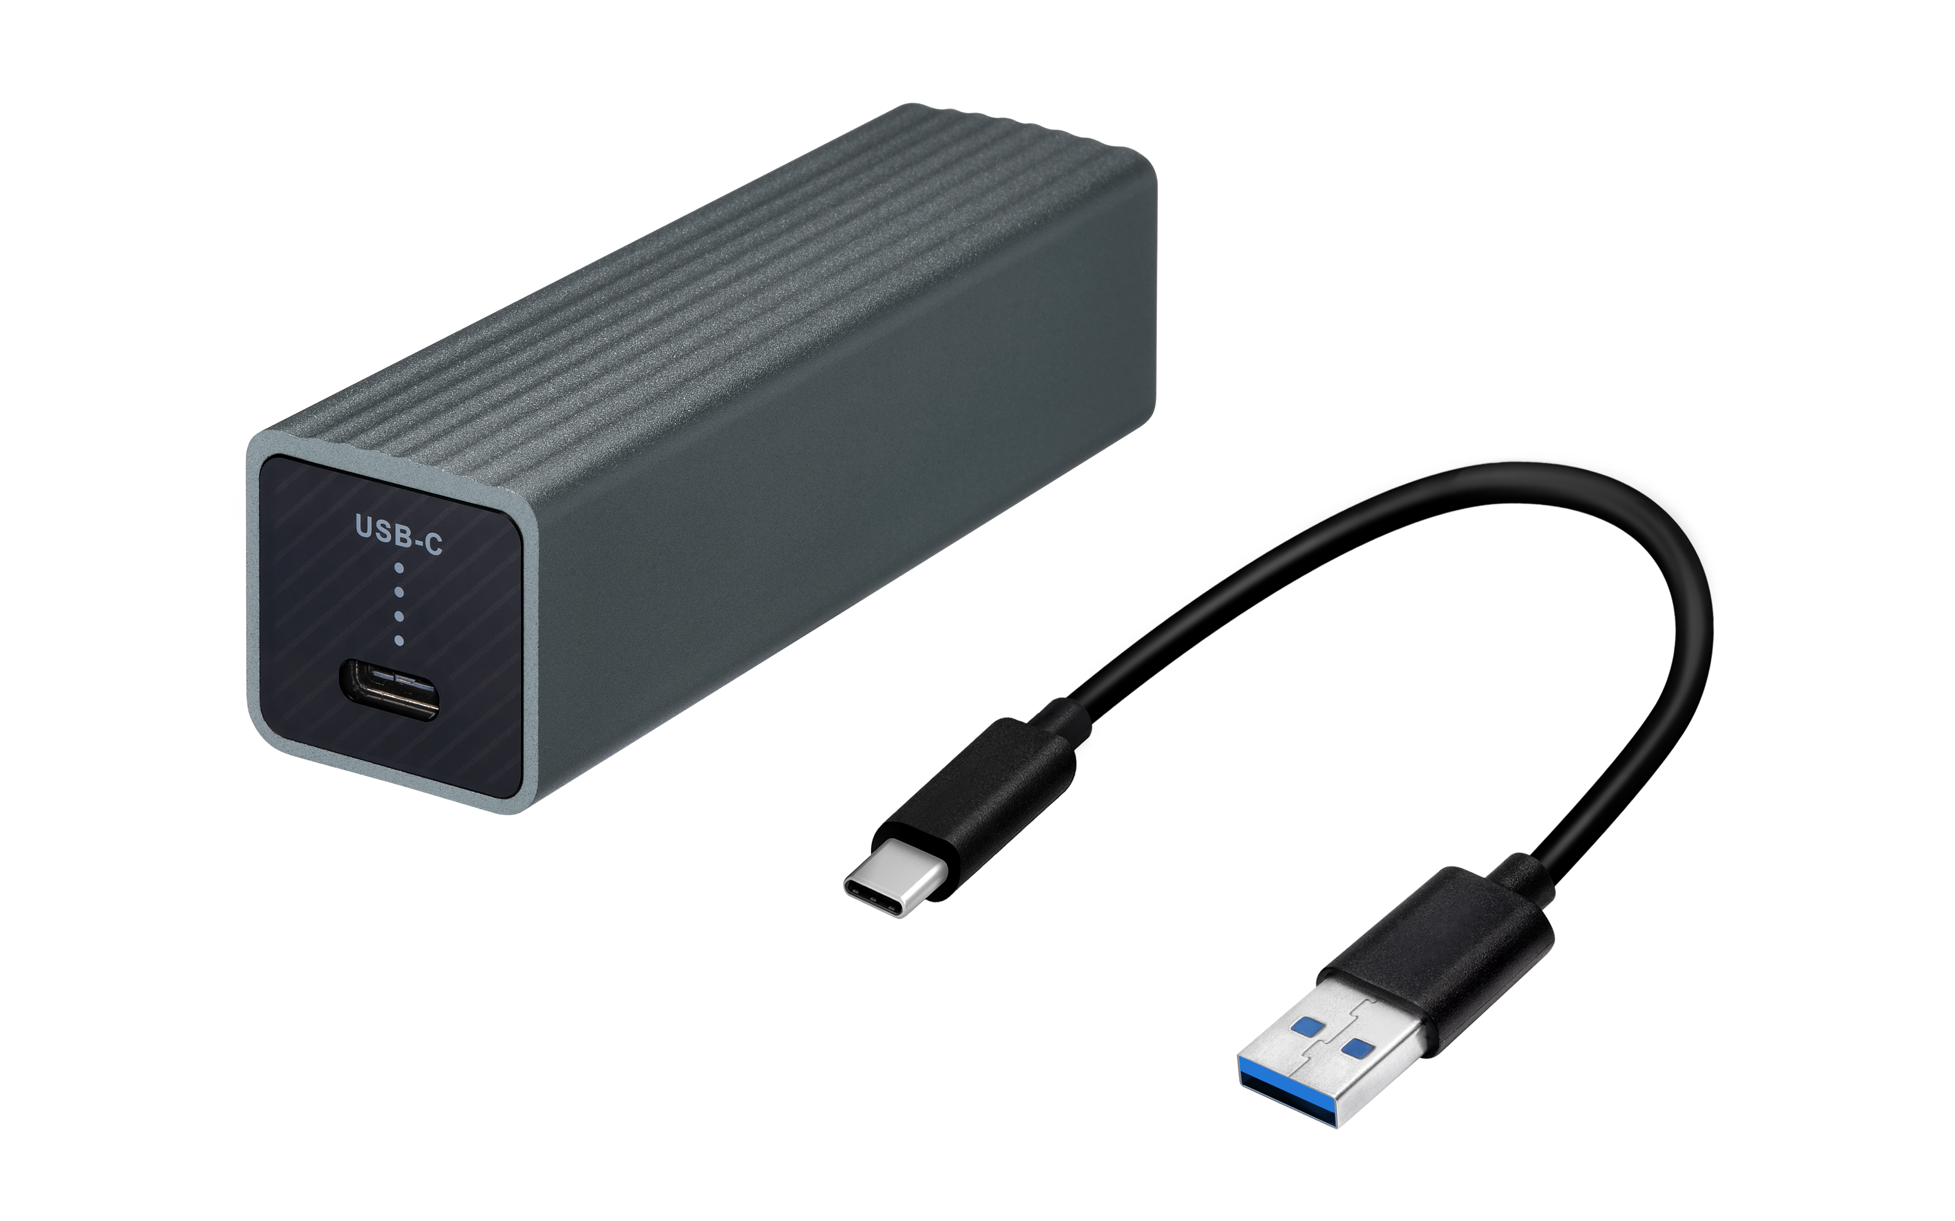
QNA-UC5G1T
Upgrade to 5GbE instantly
Is 2.5GbE network enough? Quickly upgrade to 5GbE NBASE-T via USB, compatible with Cat.5e/6a network connection cables, quickly increase the transmission speed by 2 times
*A USB-A to USB-C cable is included in the package

Slide 41
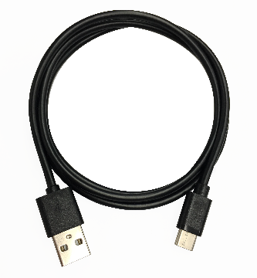
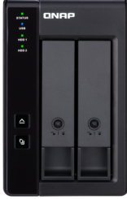
Storage： TR-002 / TR-004 USB RAID enclosure
Provides economical hardware RAID storage expansion requirements
NAS can access TR USB RAID storage expansion unit via USB port
Built-in USB Type-C provides plug and play function, supports USB Type-A & Type-C host
NAS supports up to 2 TR-002/TR-004 units
TR-002
TR-004
Comes with
USB 3.2 Gen2 10Gbps
USB 3.2 Gen1 5Gbps
USB 3.2 Gen2 10Gbps Type-C to Type-A cable

Slide 42
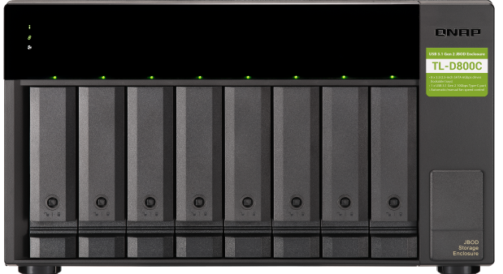
Storage：TL-D800C USB JBOD enclosure Provides economical USB 3.2 Gen2 10Gbps storage expansion requirements
NAS can access TL USB JBOD storage expansion unit via USB port
USB Type-C provides up to USB 3.2 Gen2 10Gb/s performance
Comes with
USB 3.2 Gen2 10Gbps Type-C to Type-A cable

Slide 43
QNAP Product
is your best choice
Copyright© 2022 QNAP Systems, Inc. All rights reserved. QNAP® and other names of QNAP Products are proprietary marks or registered trademarks of QNAP Systems, Inc. Other products and company names mentioned herein are trademarks of their respective holders.​​​​​​​

