Slide 2
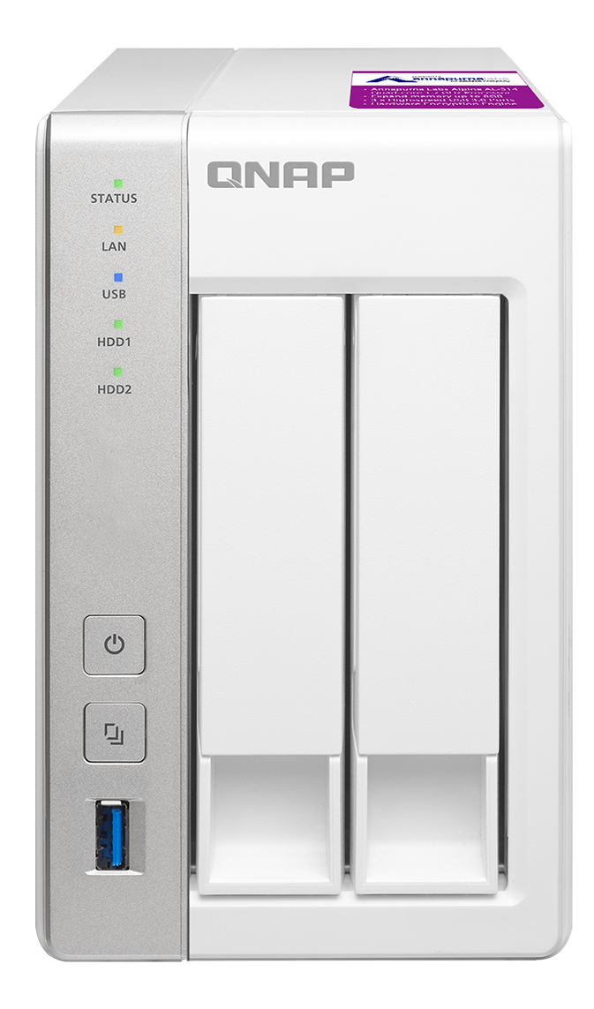
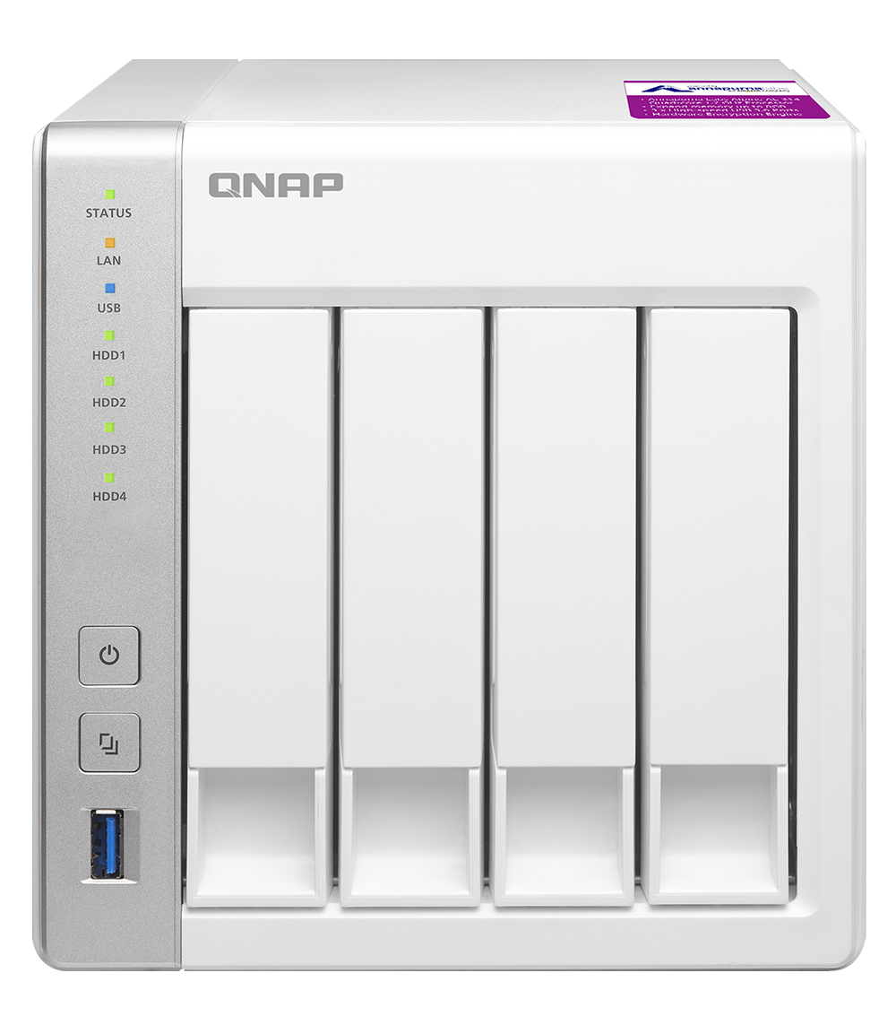
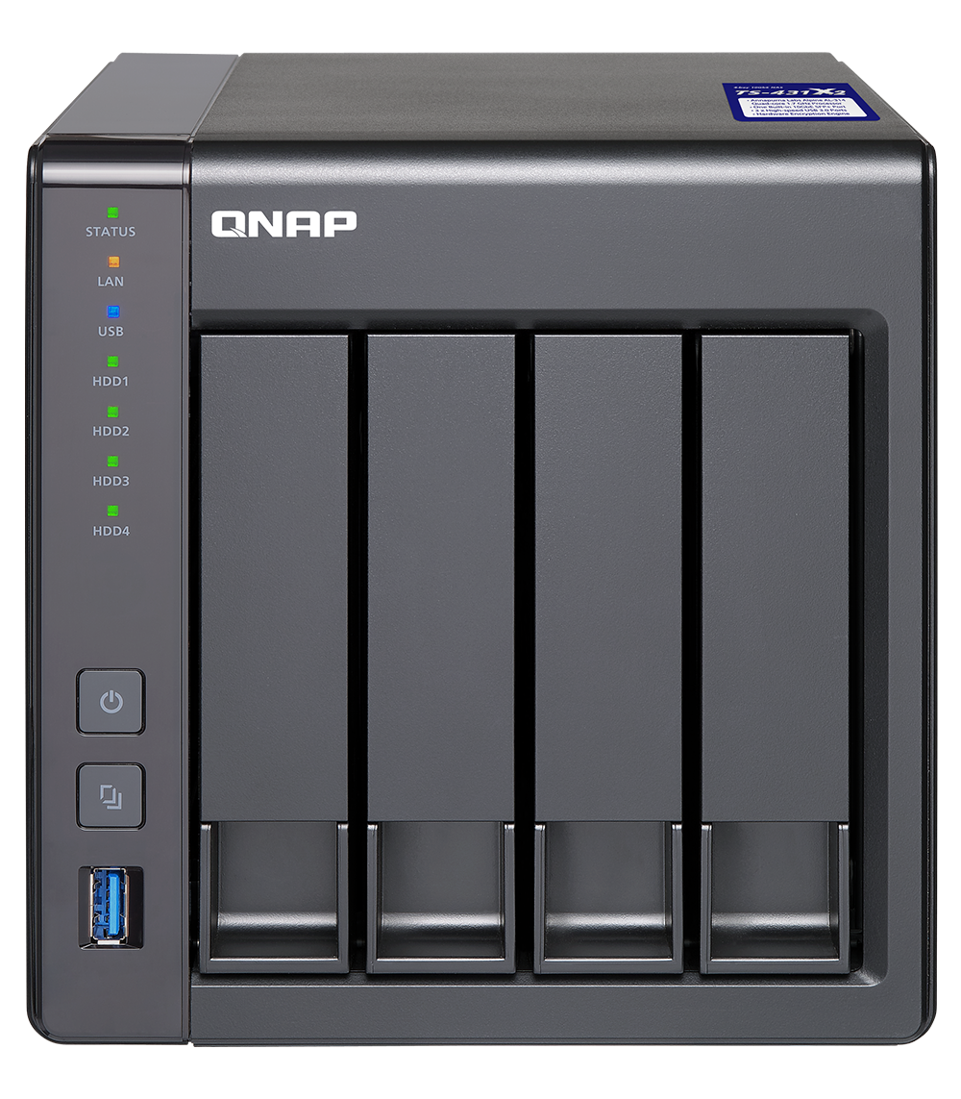
Quad core/10GbE Ready NAS
10GE
SFP+
TS-231P2-1G
1GB RAM
TS-431P2-1G
1GB RAM
TS-431X2-2G
2GB RAM
TS-431XeU-2G
2GB RAM
TS-231P2-4G
4GB RAM
TS-431P2-4G
4GB RAM
TS-431X2-8G
8GB RAM
TS-431XeU-8G
8GB RAM

Slide 3
Quad-core 1.7 GHz, with Encryption Engine
Annapurna Labs Alpine AL-314
TS-431P2 (2 x GbE)
200
221
220
195
100
160
0
(MB/s)
Download
Upload
Download
Upload
Normal volume
Encrypted volume
Tested in QNAP Labs. Figures may vary by environment Test environment: NAS operating system: QTS 4.3 (TS-431P2)
Volume type: RAID 5; 4 x Intel SSD S3500 240G
Client PCs: Intel® Core™ i7-6770 3.40GHz CPU; 32GB RAM; Windows® 10 64-bit; 10GB file transfer by Robocopy

Slide 4
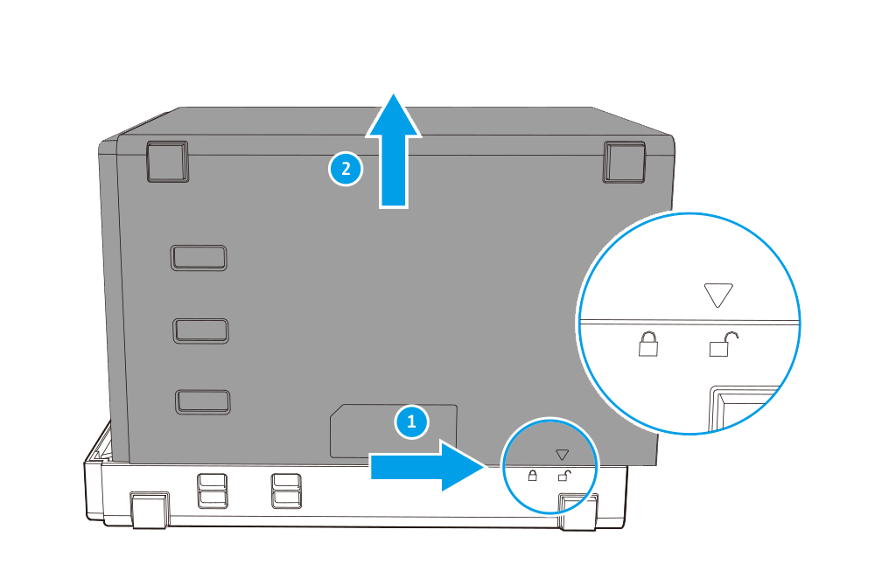
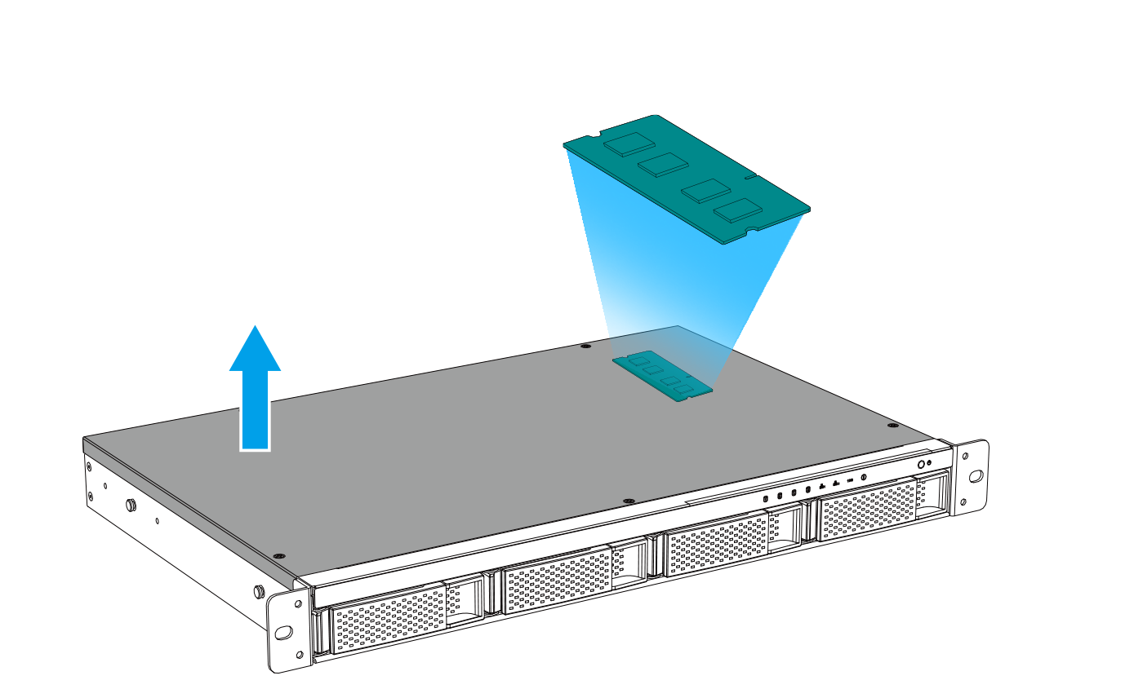
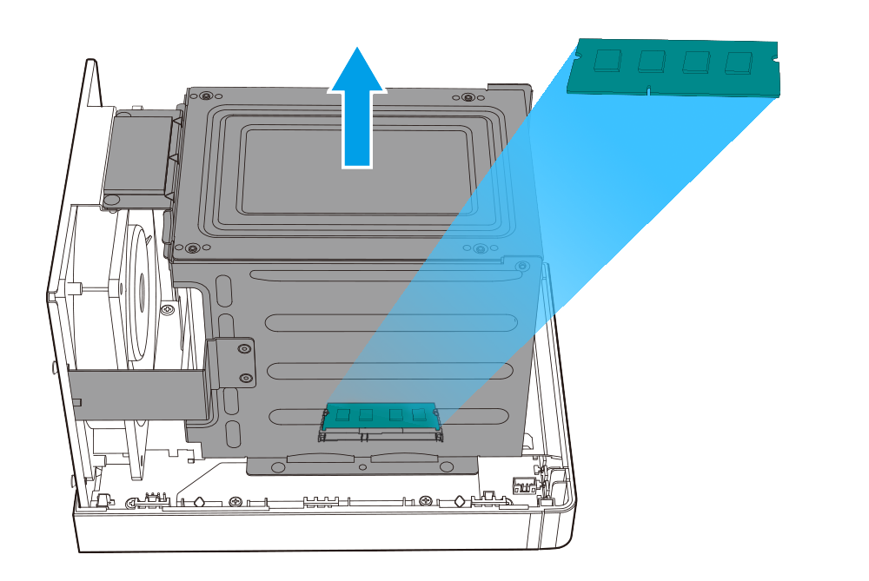
Memory Upgradable to 8GB DDR3 SODIMM
TS-231P2 TS-431P2
TS-431X2
TS-431XeU
QNAP
Accessory
2GB、4GB
8GB memory
* Certain screws need to be removed.

Slide 5
More powerful applications are available
All models
2GB memory
4GB memory
Container Station
Light virtualization
Qsirch
Search engine
Snapshot
Data protection
Qfiling
File organization

Slide 6
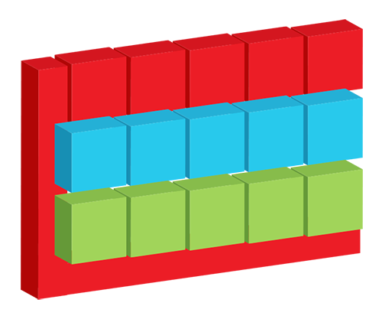
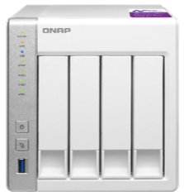
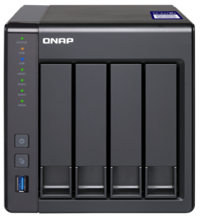
Enable snapshot with 4GB memory
Available snapshots
Different restoring method
on-demand
Volume Snapshot
Revert the whole volume/LUN
Restore selected file
Copy & paste in File Station
Local Restore
Block-based
iSCSI LUN
Snapshot
Remote Restore
Snapshot Replica
Snapshot Vault
Backup Snapshot Vault

Slide 7
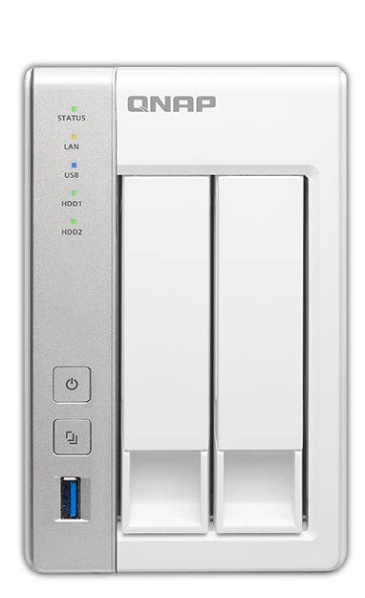
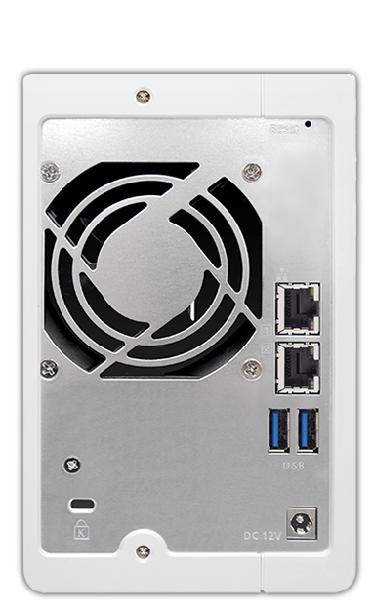
TS-231P2 I/O highlights
7cm system fan
LEDs:
STATUS, LAN, USB, HDD1-2
Reset button
2 x SATA 6Gb/s SSD or HDD slots
2 x GbE RJ-45 ports
Power button
2 x USB 3.0 ports
USB 3.0 port & one-touch-copy button
Kensington security slot

Slide 8
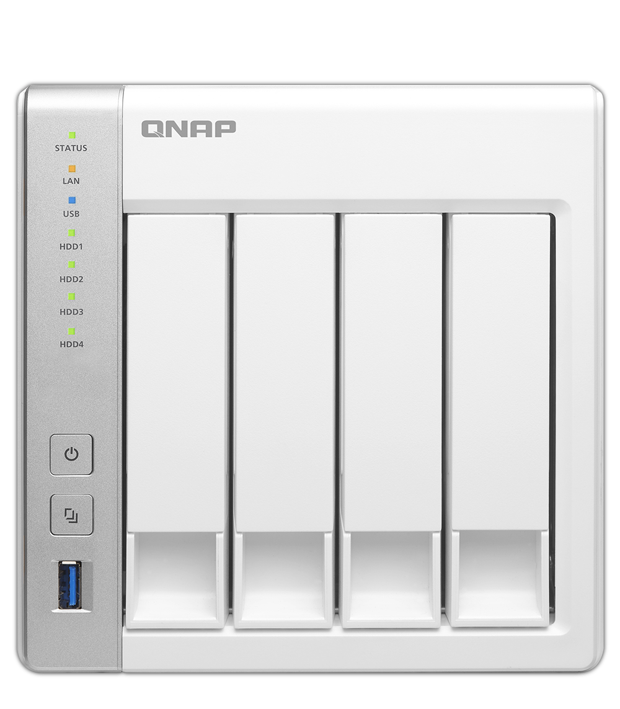
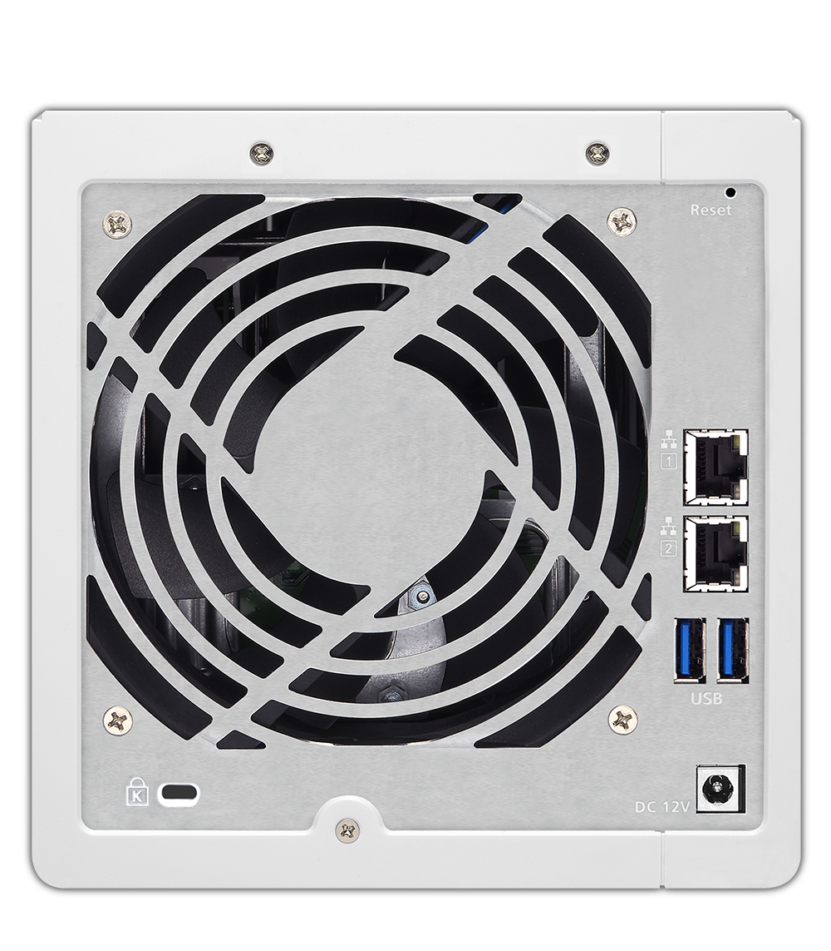
TS-431P2 I/O highlights
LEDs: STATUS, LAN, USB, HDD1-4
12cm system fan
Reset button
4 x SATA 6Gb/s SSD or HDD slots
2 x GbE RJ-45
ports
Power button
2 x USB 3.0
ports
USB 3.0 port & one-touch-copy button
Kensington security slot

Slide 9
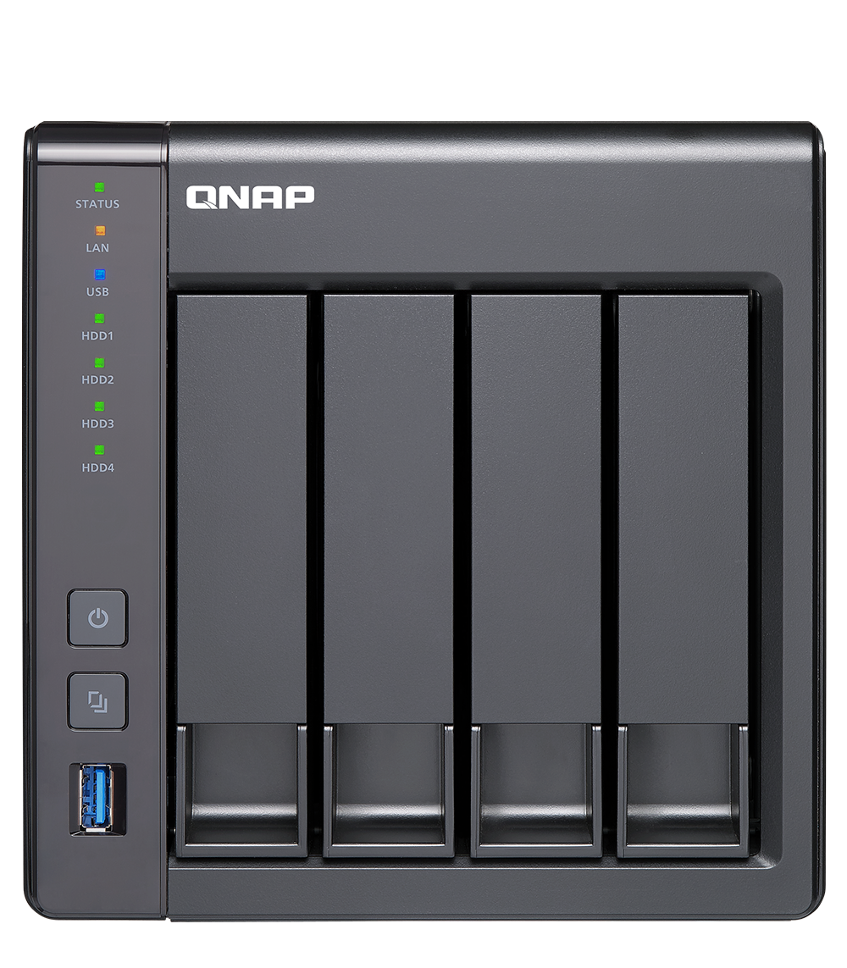
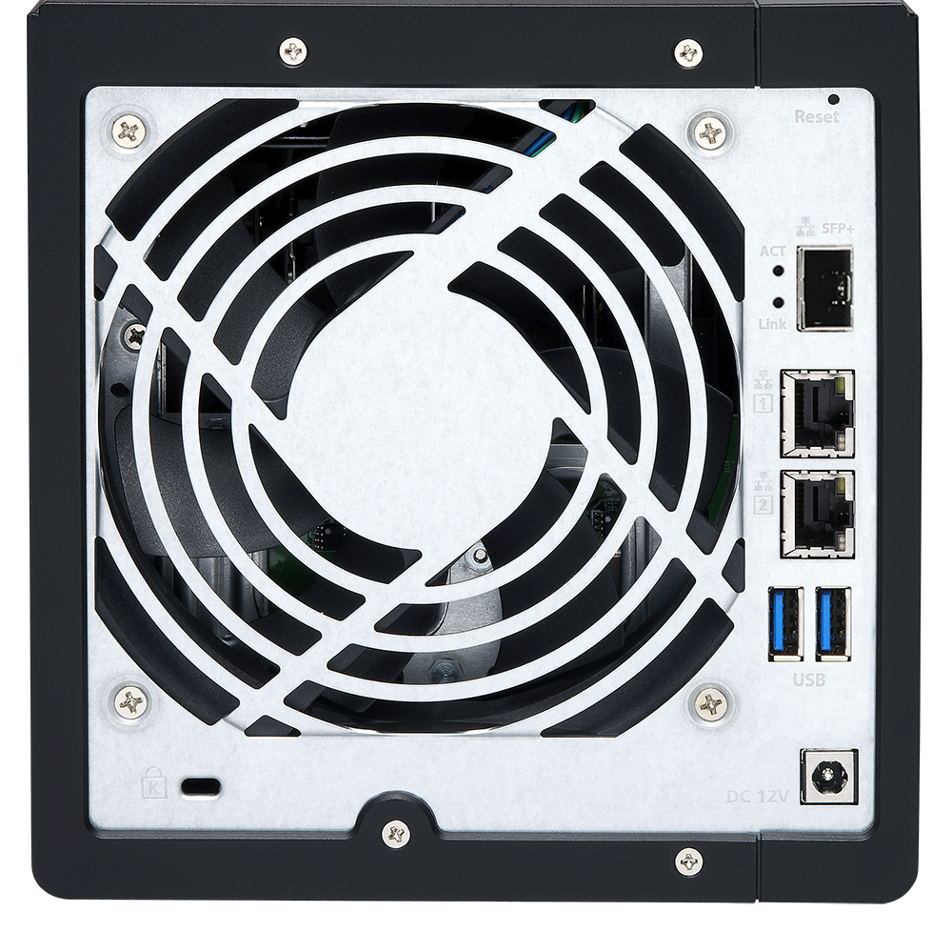
TS-431X2 I/O highlights
12cm system fan
LEDs: STATUS, LAN, USB, HDD1-4
Reset button
Built-in 1 x 10GbE SFP+ port
4 x SATA 6Gb/s SSD or HDD slots
2 x GbE RJ-45
ports
Power button
2 x USB 3.0
ports
USB 3.0 port & one-touch-copy button
Kensington security slot

Slide 10
TS-431XeU I/O highlights
Individual GbE & 10GbE LED on the front panel
Power button
4 x SATA 6Gb/s SSD or HDD slots
Reset button
Built-in 10Gb SFP+ port
4 x USB 3.0 ports
Kensington security slot
Console port
2 x GbE RJ-45 ports
4cm system fan

Slide 11
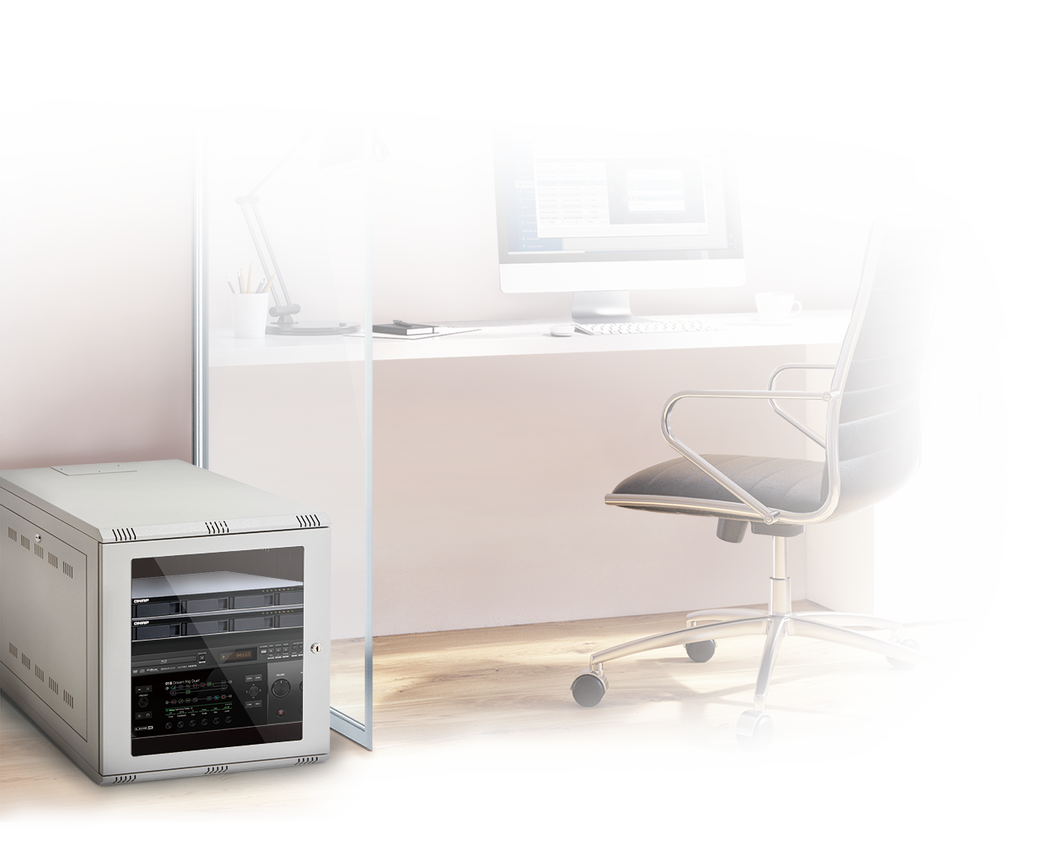
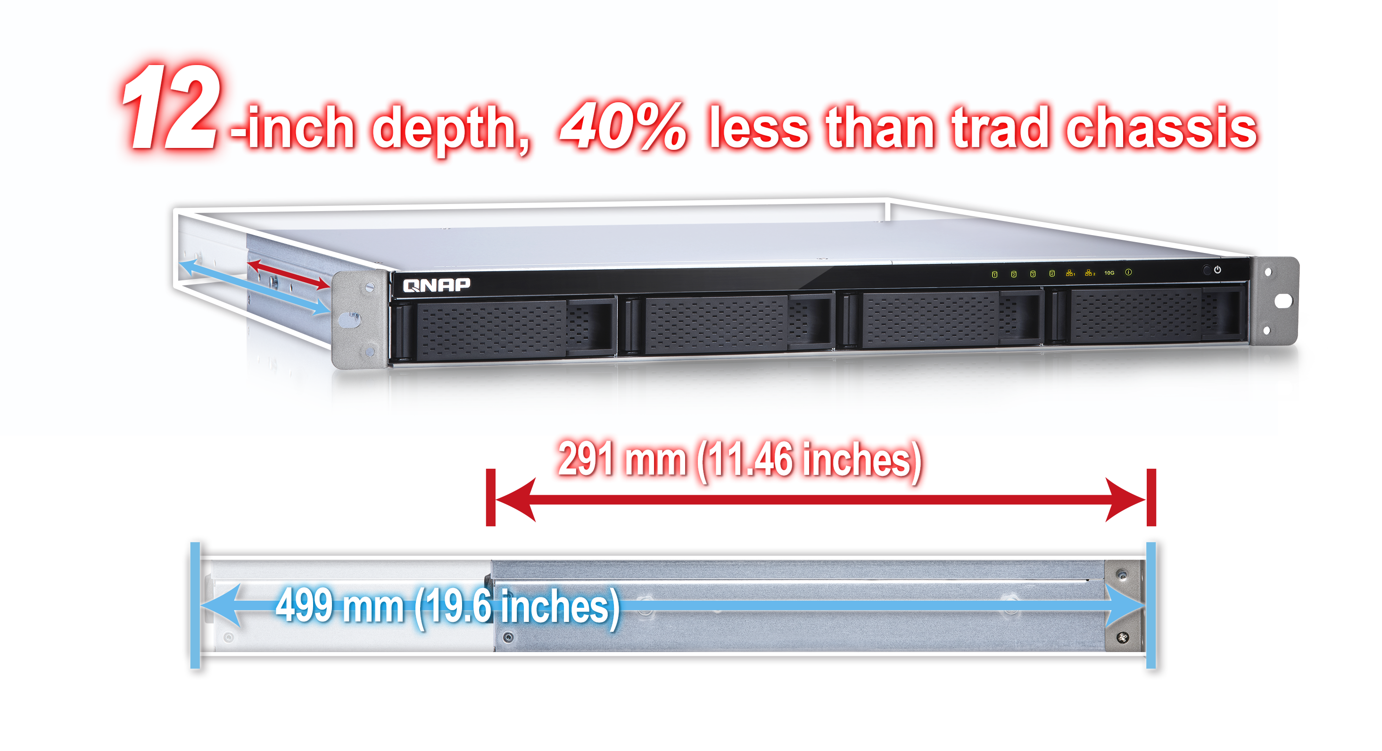
Deployable short-depth chassis TS-431XeU
Compatible with standard ANSI/EIA-RS-310-D
19-inch rack
With optional
RAIL-B02 Rail Kits

Slide 12
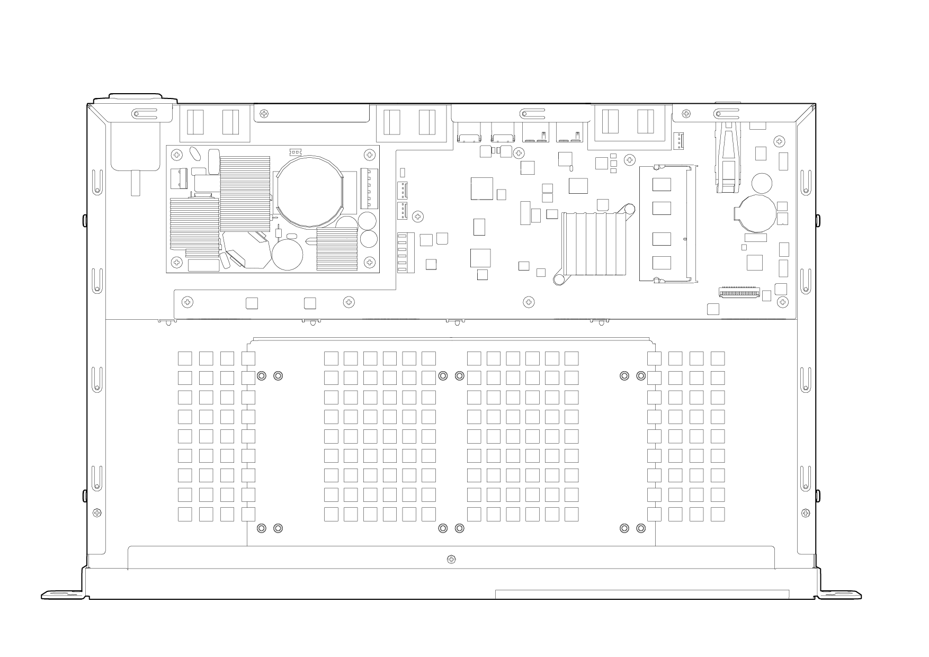
Environment friendly design of TS-431XeU
100W open frame, noise-reduced, fanless PSU
Three 4cm
quiet system fans
Power consumption
In operation
HDD sleep
30.99W
12.42 W
36.99W *
22.43W *
* reference 1U server
Noise level
20.3 dB(A)
37.7 dB (A) *
* reference 1U server
Power consumption is measured when fully loaded with 2TB NAS drives
Noise level test environment:
Refer to ISO 7779 ; Maximum HDD loaded ; Bystander Position ; Average data from 1 meter in front of operating NAS.(Using TS-431XU as reference of 1U single-PSU rackmount server)

Slide 13
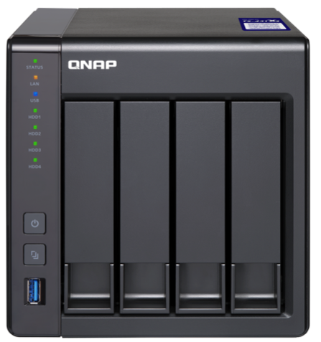
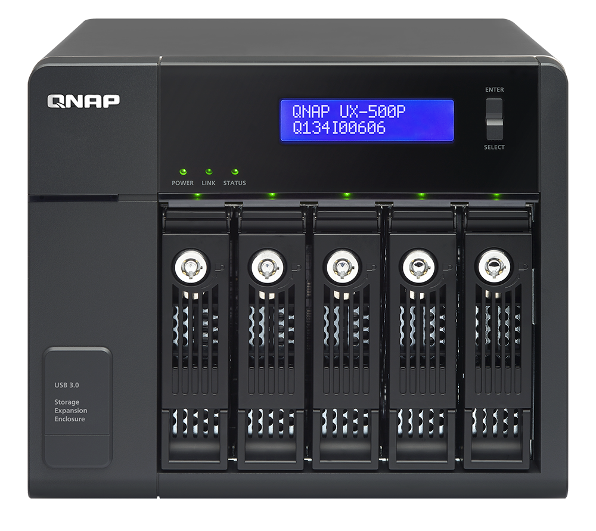
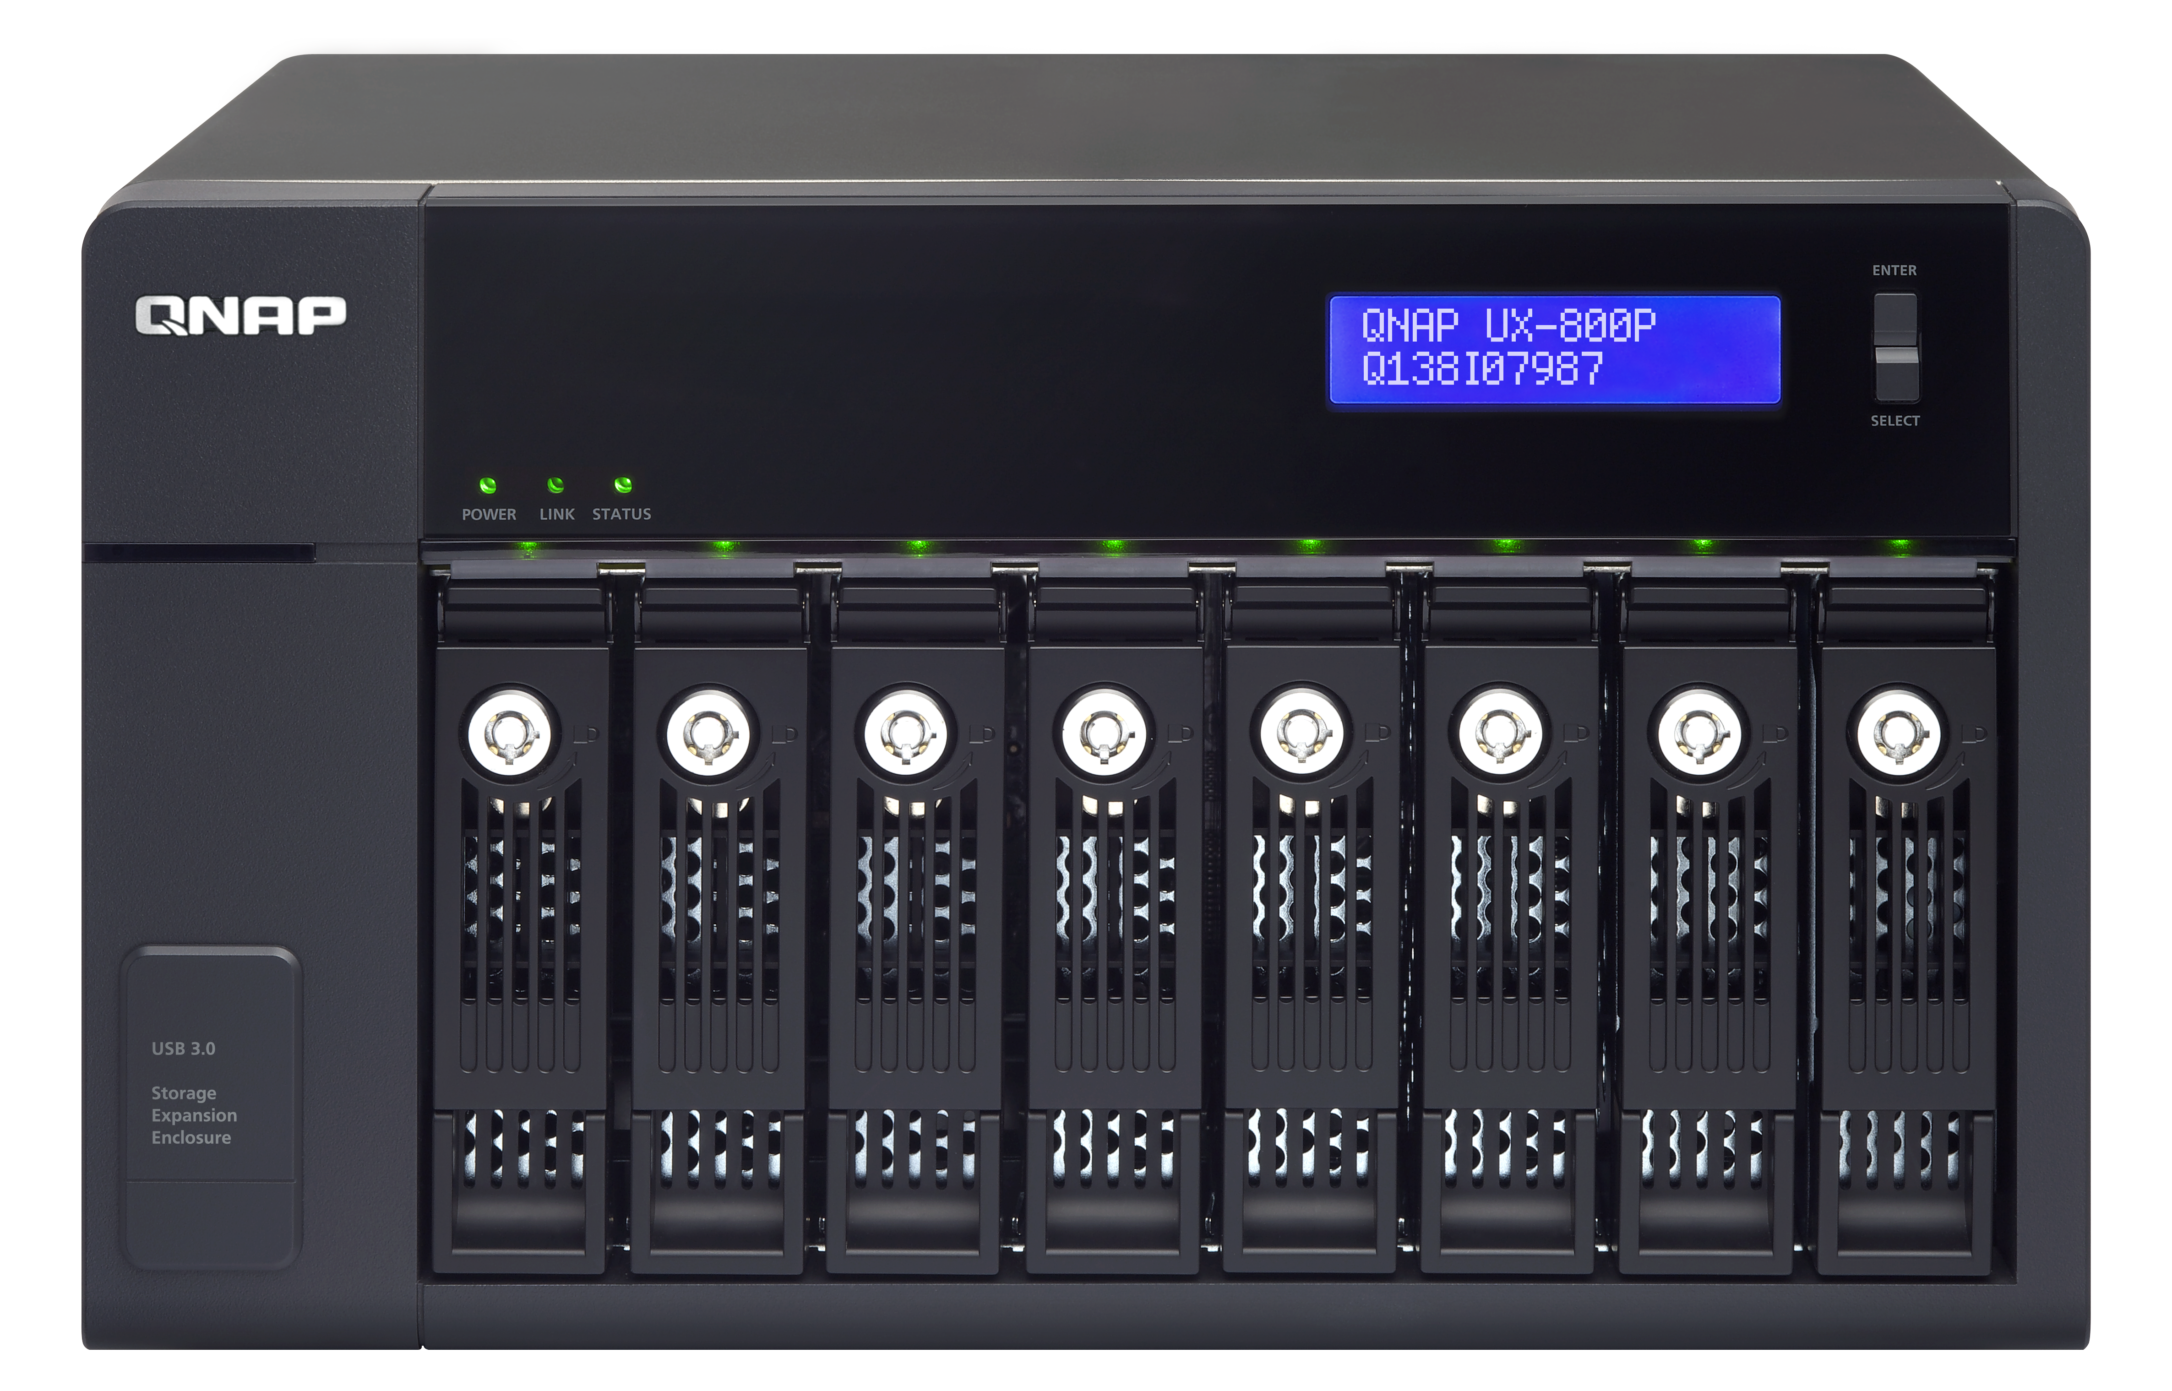
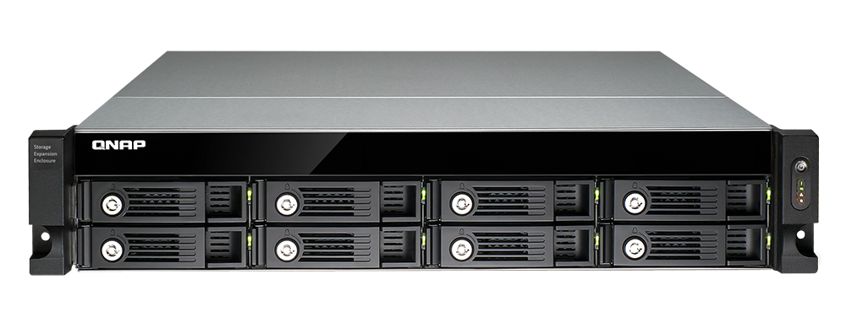
Online capacity expanding via USB JBOD
TS-431P2 TS-231P2 TS-431X2
TS-431XeU
Max. 2
Max. 2
Max. 2
Max. 1
UX-800U-RP
Expand up to 8 HDDs
UX-1200U-RP
Expand up to
12 HDDs
UX-500P
Expand up to 5 HDDs
UX-800P
Expand up to 8 HDDs
* When there are more than 16 disks (including NAS and expansion enclosure(s)),
it's recommended to upgrade system memory to at least 4GB.

Slide 14
Cost effective high-speed 10GbE environment
10GbE x1
10GbE x1
(Encrypted volume)
1200
1200
900
1055
1014
900
600
600
580
580
300
300
362
345
357
321
0
0
(MB/s)
(MB/s)
Download
Upload
Download
Upload
Download
Upload
Download
Upload
TS-431XeU
TS-431X2
TS-431XeU
TS-431X2
Tested in QNAP Labs. Figures may vary by environment Test environment: NAS operating system: QTS 4.3 (TS-431P2)
Volume type: RAID 5; 4 x Intel SSD S3500 240G
Client PCs: Intel® Core™ i7-6770 3.40GHz CPU; 32GB RAM; Mellanox 10GbE NIC ; Windows® 10 64-bit; 10GB file transfer by Robocopy

Slide 15
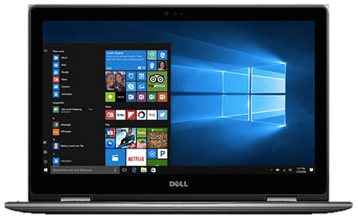
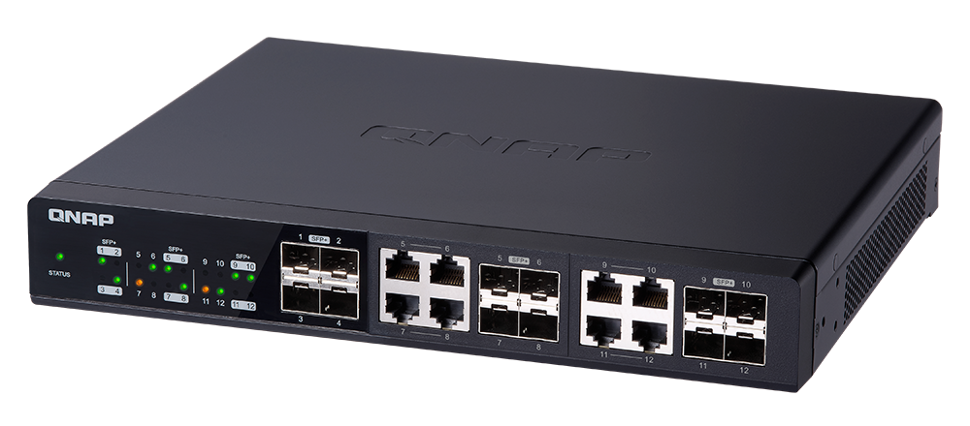
Collaboration and backup with 10GbE
Cost effective 10GbE collaboration & backup network environment!
10GbE switch
TS-431X2 / TS-431XeU

Slide 16
Video Surveillance Solutions
QNAP Systems, Inc.

Slide 17
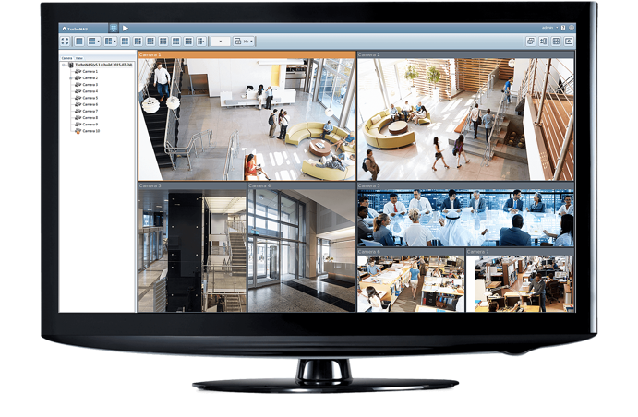
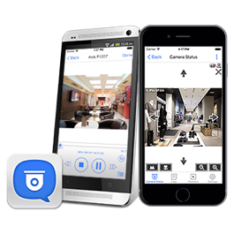
24x7 professional surveillance management
Surveillance Station 5.1
Recording channel
TS-231P2 TS-431P2
free: 2 maximum: 25
TS-431X2 TS-431XeU
free: 2 maximum: 30

Slide 18
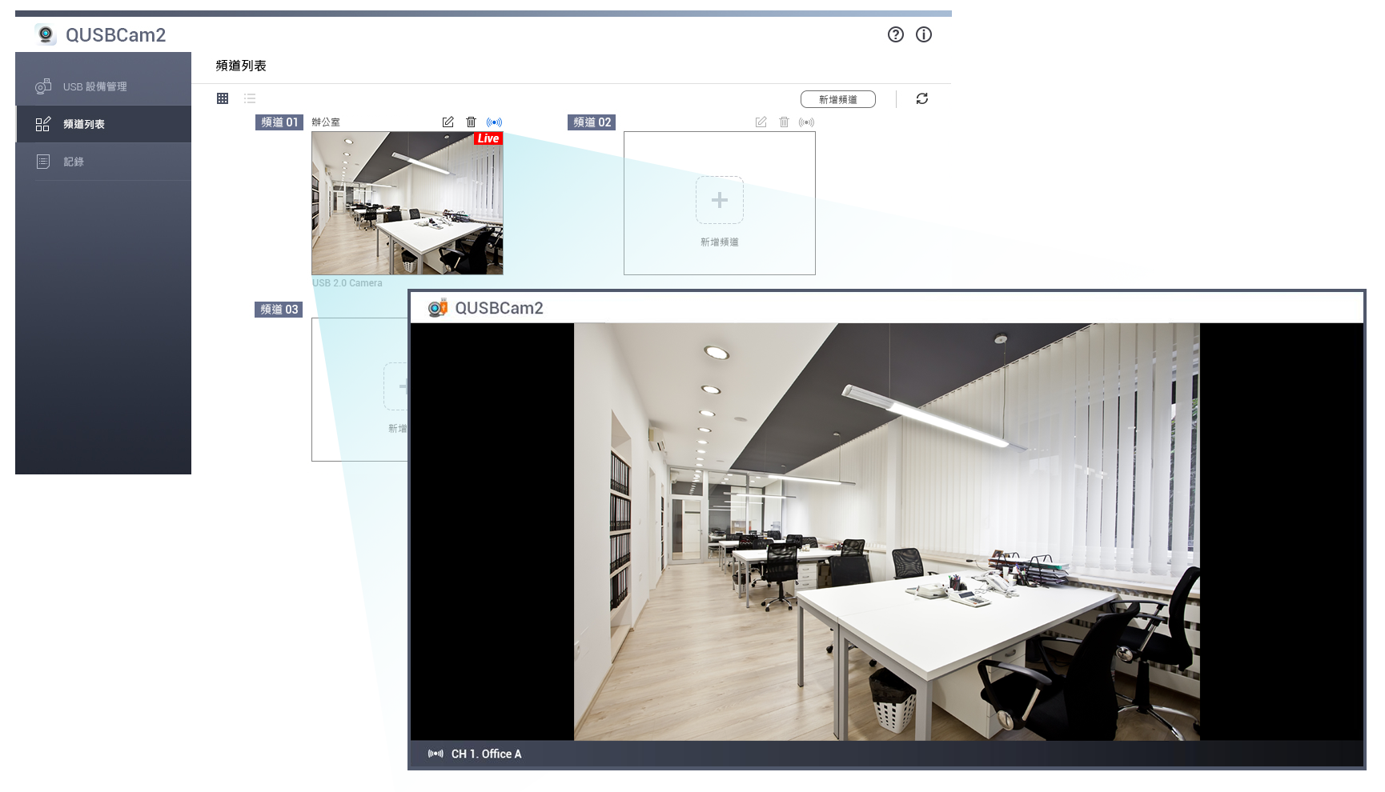
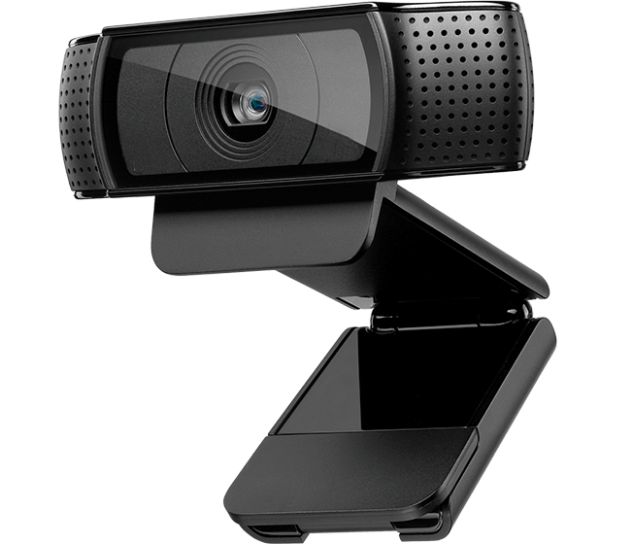
Turn an USB camera into an IP camera
QUSBCam2
View instant streaming online from a UVC compatible USB camera with 1080P
Surveillance Station 5.1
Record & Replay MPEG videos

Slide 19
Qphoto 3
Your photos on the move
QNAP Systems, Inc.

Slide 20
Collect the stunning moments of vacation.
Send me the pictures!

Slide 21
The Sakura is gorgeous, I’m gonna shoot a video!
There is only 500MB available,
I can’t take more videos…
4K video: 375MB/min

Slide 22
Then the tragedy happened at that night…
Phone’s in the toilet!
My phone was gone…
Precious pictures, videos, and memories were gone…
The friendship seemed to come to an end…

Slide 23
Photo/Video Instant Upload, expanding your storage
Before
ΩДΩ
I can’t have more photo or video.
Now
4G / Wi-Fi
Instantly uploading the photos and videos to the NAS when recording.
Notes:
----------------------------------------------------------------------------------
English:
Photo/Video Instant Upload, expanding your storage
Before:
I can’t have anymore photo or video.
Now:
Instantly uploading the photos and videos to the NAS when recording.
----------------------------------------------------------------------------------
逐字稿:
其實我身上發生的慘劇是可以避免的，就用Qphoto 3 即拍即傳功能，如果我早知道有這個應用，我就不會那麼慘了
即拍即傳，一秒擴容
就是只要用Qphoto拍照，就等於立即擴充好幾十倍容量，不用再擔心容量不足
像我以前想拍照或錄影，尤其是錄影，手機容量不足就要刪刪刪，多痛苦
現在有Qphoto 3，他可以拍照跟錄影即時上傳NAS，手機不存檔案，所以要拍多少就拍多少，等於帶一台NAS的容量在身上
剛剛錄那個櫻花就可以錄4K了，還可以錄很久，一小時、三小時，隨我高興

Slide 24
Bi-directional Mount in two steps
Photo Station 5.4/ Qphoto 3 - Photo/Video Instant Upload
1
Open Qphoto and click “take photos” or “record videos”
2
Select a destination folder. Start taking(recording)!
QTS 4.3.4 File Station - Mobile phone mounting.
1
Connect mobile phone and NAS
with USB connector.
2
Open File Station and start transfering the files!
Notes:
----------------------------------------------------------------------------------
English:
LIVE Demo - Bilateral Mount in two steps
Photo Station 5.4/ Qphoto 3 - Photo/Video Instant Upload
Open Qphoto and click “take photos” or “record videos”
Select a destination folder. Start taking(recording)!
QTS 4.3.4 File Station - Mobile phone mounting.
Connect mobile phone and NAS with USB connector.
Open File Station and start transfering the files!
----------------------------------------------------------------------------------
逐字稿:
現在來現場示範
示範錄影就好，跟jeffrey錄一小段影片
示範完Qphoto，講file station
除了Qphoto可以直接拍照錄影上傳NAS，現在file station也可以很方便地把手機裡面的照片傳到NAS，只要手機接USB插上NAS，就可以在file station裡面看到手機，然後就可以直接拖曳檔案到NAS囉
Demo操作步驟：
＊需搭配QTS 4.3 & Photo Station 5.4或之後版本
開啟Qphoto後登入NAS
預設進入shared photos頁面，即可看到右下角有拍照跟錄影按鈕
點選拍照或錄影按鈕，第一次使用的話，會要求選擇上傳路徑（注意：須上傳到共享的媒體資料夾，照片才可以在shared photos頁面看到）
開始拍照或錄影，完成後按左上角的回上一頁，回到shared photos頁面
如果上傳未完成，頁面最上方會出現即拍即傳上傳狀態，上傳完成的檔案會打勾，請在打勾後重新整理頁面，即可看到剛剛拍攝的檔案（注意：一定要用時間軸模式瀏覽，這樣最新拍攝的檔案才會在最上面，很明顯可以看到）
點開剛剛拍的影片或照片，給使用者看

