Slide 1
KoiBox
Video conferencing and wireless presentation solution

Slide 2
KoiBox
Introduction
Unbox & Setup
Using KoiBox
Sum up
Notes:
Hello everyone watching the QNAP channel, instead of the usual live studio recording, we will be going to the conference room of WIT, where our main character today - KoiBox Conference Video System.
We will start with a brief introduction, followed by a live setup and feature demonstration, and finally a quick summary.

Slide 3
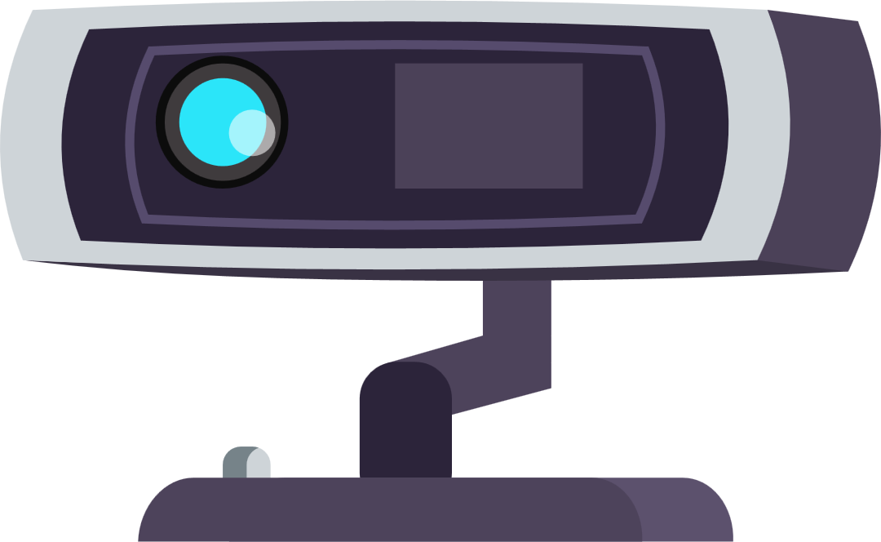
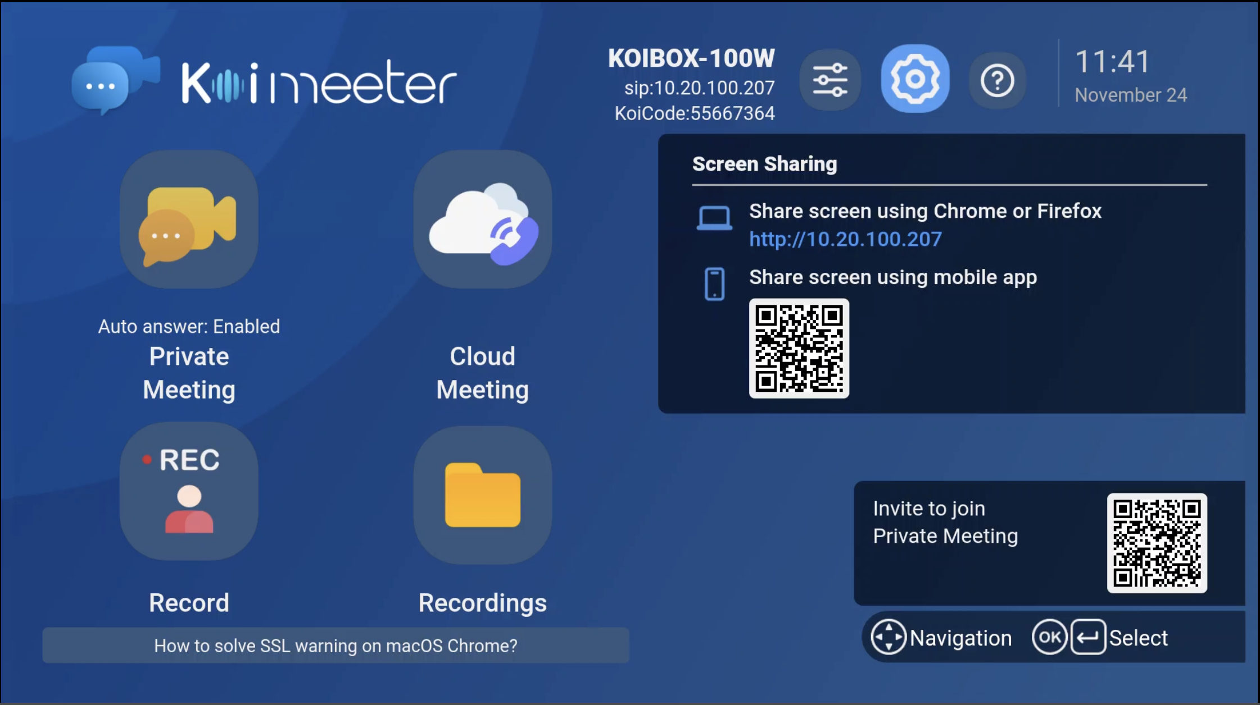
QNAP and KoiBox
KoiBox in the conference room
Taipei Headquarters
Branch Office
Shanghai
Japan
Germany ...
Notes:
This system, called KoiBox, has been commonly used in our company's internal meeting rooms, both at our headquarters in Taipei and in other company locations such as Japan, Germany, and Shanghai, China.

Slide 4
Why does QNAP use KoiBox?
Change in meeting style
Less people, more space - more hardware costs
Returning to the office from working from home
Interference when participating in online meetings
Meeting room devices should be shared
So does microphones and speakers, projection as well
Notes:
In QNAP's environment, before the epidemic, colleagues usually having meetings with many people in large meeting rooms. After the strike of the COVID, although discussing over the cloud from our own places becomes normal to all of us. We may still choose to discuss in small meeting rooms with a limit of two or three team members because a face-to-face discussion is still an effective method when we’re able to.
Under the "fewer people, more meeting rooms" model, traditional video conferencing systems are extremely expensive to set up, and QNAP itself, for example, has not been able to universally implement traditional video conferencing devices in all meeting rooms due to budgetary considerations.
In the case of working from home, everyone is prepared with a device for their own use, and everyone is physically distant from each other. So, there is no problem of audio interference, but once we resume normal work and participate into online discussions, these interference issues from nearby colleagues will arise.
A screen sharing device like a projector is common in the conference room because it can help to share one's laptop screen to others during face-to-face discussions in easier way, and presenter could operate his/her own computer normally. Following the same logic, if there is a shared conference device in the meeting room, attendees in the same room will not have to use their own PC to join the same meeting. Which could avoid the echo interference if they join the same meeting. Or, if they choose to join the meeting with only one laptop, they will be restricted by the angle of the built-in camera and microphone designed for personal and results poor quality, and the one who donate their computer could hardly, or just noting to do, during the meeting.
Under these requirements, a shared device in all meeting spaces is needed for us.

Slide 5
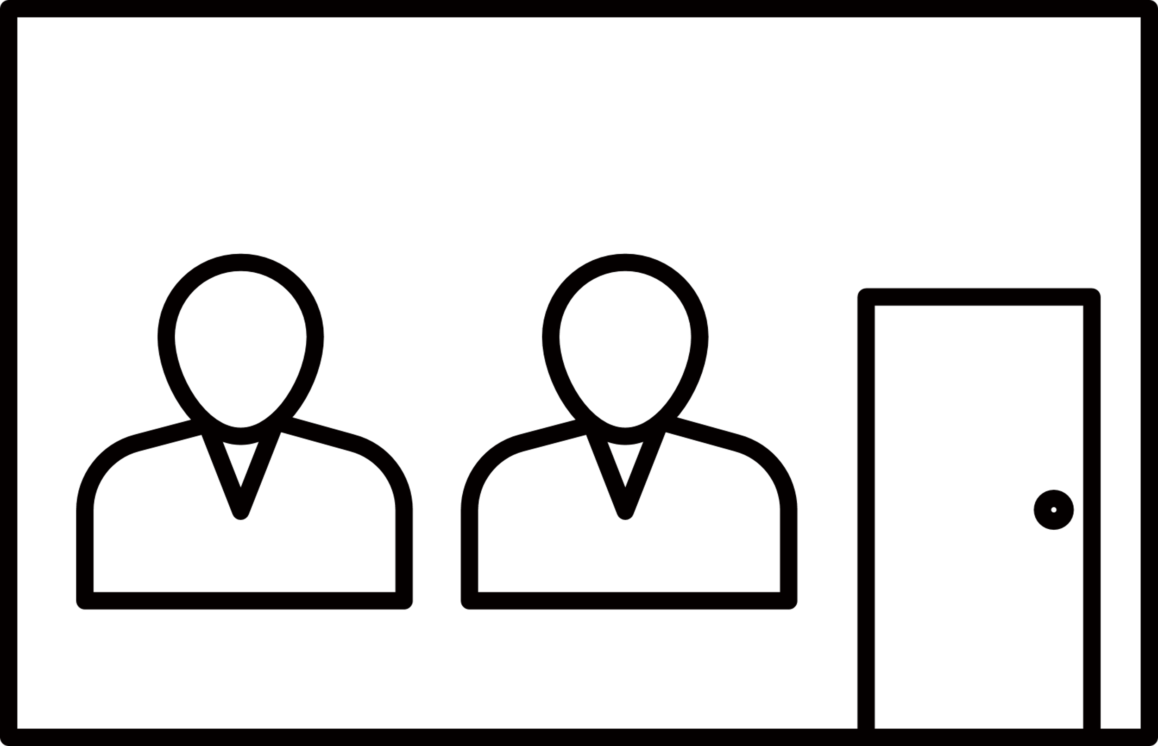
How QNAP uses KoiBox?
KoiBox is used in these ways at QNAP meeting room:
Wireless Projection
Recording
Join cloud meetings
Teams, Zoom, Skype, Meet…
Make private p2p meetings
With mobile app, other KoiBox, and SIP meeting devices.
Reasonably low unit prices allowed the company to turn all meeting rooms into video conference rooms within budget.
Notes:
In our meeting room, KoiBox is used in this way
Wireless projection function Projection is possible when connected to the same company LAN, and in the boss's office, an additional PIN code is set up for added privacy, which must be entered to connect.
Join cloud conferencing Cloud conferencing has become an acceptable option since working from home, and KoiBox supports joining and setting up meetings with Zoom, Skype, and Teams, as well as Meet and WebEx meetings.
Instant private P2P conferencing Normally, setting up a conferencing system requires IT personnel to do so. And even a virtual private network VPN as the backbone will be needed. KoiBox does not require such complicated setup. Up to four-way conference calls. Auto-answer can also be set up.
Join SIP Meeting
SIP-based conferencing systems such as Avaya were implemented before. We’re still use these existing SIP devices to conduct meetings with KoiBox. The two systems can co-exist so we don’t need to drop old equipment.
Video recording function
This is an additional feature that allows to directly record the discussion in the meeting room for later confirmation or record the meeting during a local meeting or P2P conference.

Slide 6
Why KoiBox, instead PC?
Unable to accept wireless projection
Meeting software must be installed
Synchronizing is troublesome
More difficult to manage remotely
Notes:
So why did we choose to use KoiBox instead of just setting up a PC for the conference room? There are several reasons.
Unable to accept wireless projection from laptops To show a slide or video, the presenter would need to pre-copy the file to a public computer, which is more dangerous than direct projection, either through a flash drive or by logging into the presenter's email address or cloud storage on the public computer.
After the operating system is set up, various meeting software must be installed, so you cannot start using it directly. Meeting software is not included in the operating system and often requires the creation of additional public accounts to operate, increasing the administrative effort.
Synchronizing data changes in a meeting is more troublesome During a meeting, the presenter may make changes to slides and documents directly during the discussion. If these changes are done directly on the presenter's computer, there is no need to worry about synchronization.
It is more difficult to manage remotely The computer is a standalone device, and although you can install a remote management program, it also requires additional configurations.
KoiBox allows you to keep things on your own laptop while attend a meeting, and at the same time, it is slightly affordable to set up, making it a good choice for our own meeting room.

Slide 7
Unbox and setup KoiBox
Notes:
Below we will introduce the process of setting up KoiBox and getting it ready to be used, starting from the unboxing of the actual machine, as well as a live demonstration of how to use the features introduced above.

Slide 8
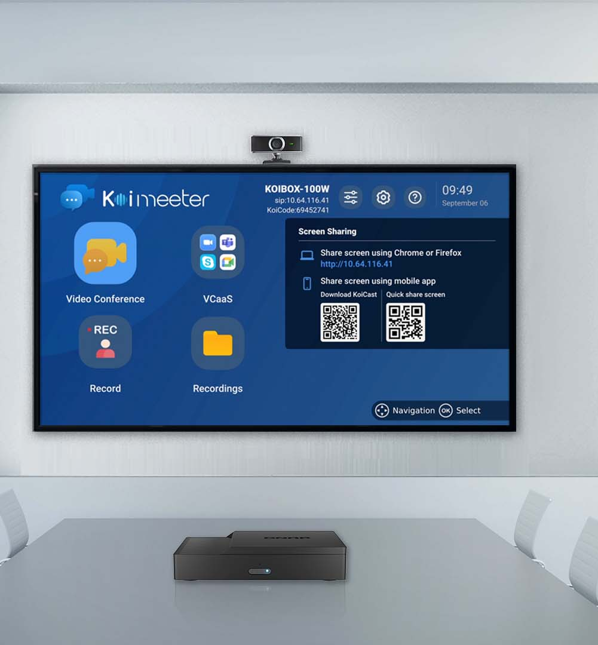
Using KoiBox

Slide 9
Sum up
KoiBox supports most USB cameras and Bluetooth keyboards, mice, and microphones
Supports Wi-Fi 6 wireless standard, compatible with QNAP Qhora-301W
Supports 2.5" SATA hard drive for conference recording and supports tool-less installation
No matter the size of the meeting, from multi-person cloud meetings to private meetings and local meetings, KoiBox can support them all
Notes:
This is how to install and set up KoiBox and how to use it in a conference. The KoiBox is designed to be as easy to understand and use as a telephone.
In terms of peripheral support, KoiBox supports Bluetooth and USB keyboards, mice, microphone devices, and most USB camera lenses on the market. If there is a special keyboard that needs to be supported, it can also be updated online and included in future versions of the software.
In addition to supporting wired network connection, it also supports the latest Wi-Fi 6 specification, which can connect with QNAP's QHora-301W Wi-Fi 6 professional router to provide stable and high-quality transmission.
If you need to save your recording files, you could purchase a 2.5" SATA hard drive. After opening the top cover of KoiBox, just follow the direction of the guide and insert the fixed hard drive body without any additional tools.
In summary, KoiBox provides the right solution for any meeting size. It can instantly upgrade any meeting room into a video conference room without the need for advanced network knowledge during installation and use.
Even with a limited budget, KoiBox can achieve the demand to have them in each room.
It is a product born from QNAP's own meeting room needs. Thank you for your participation today and welcome to contact us for more information.

Slide 10
Thank you
©2021著作權為威聯通科技股份有限公司所有。威聯通科技並保留所有權利。威聯通科技股份有限公司所使用或註冊之商標或標章。檔案中所提及之產品及公司名稱可能為其他公司所有之商標。

