Slide 2
Brand new QM2 M.2 PCIe NVMe SSD & 10GbE combo cards
New PCIe Gen4 QM2 product line
Add both M.2 SSD and 10GbE via a single PCIe slot
Support NAS (QTS、QuTS hero), Linux and Windows
QNAP high-speed ecosystem

Slide 3
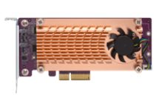
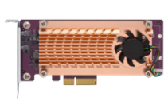
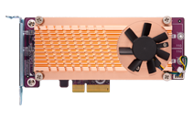
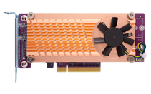
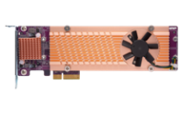
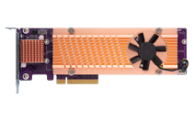
Add M.2 NVMe or M.2 SATA SSDs with the QM2 card series
QM2-2S-220A
QM2-2P-244A
QM2-2P-344
QM2-2P-384
2 x
M.2 SSD
PCIe Gen2
SATA
PCIe Gen2
PCIe NVMe
PCIe
Gen3
PCIe NVMe
PCIe
Gen3
PCIe NVMe
QM2-4S-240
QM2-4P-284
QM2-4P-342
QM2-4P-384
4 x
M.2 SSD
PCIe Gen2
SATA
PCIe Gen2
PCIe NVMe
PCIe
Gen3
PCIe NVMe
PCIe
Gen3
PCIe NVMe

Slide 4
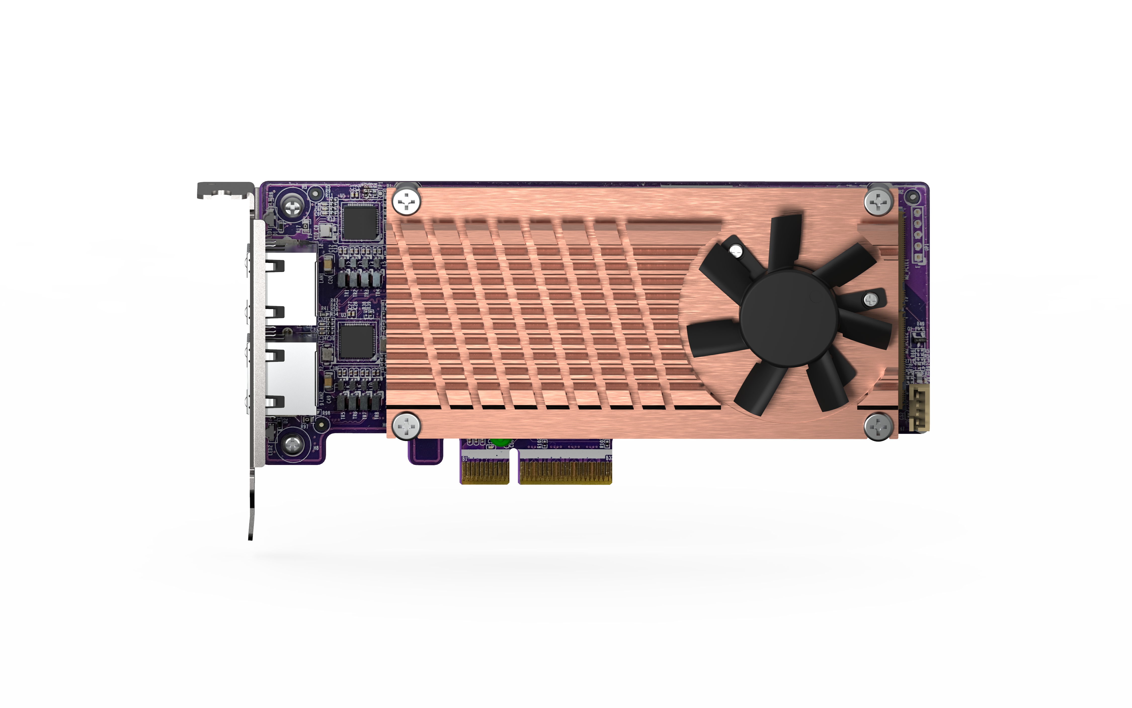
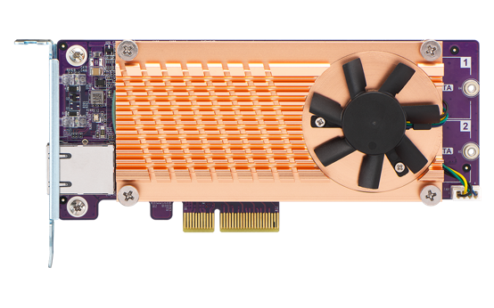
Add both M.2 SSD and 10GbE / 2.5GbE with the QM2 combo card series
QM2-2S10G1TA
QM2-2P2G2T
2 x M.2 SATA 6Gbps SSD 1 x 10GBASE-T
2 x M.2 PCIe Gen3 x4 NVMe SSD 2 x 2.5GbE BASE-T

Slide 5
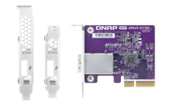
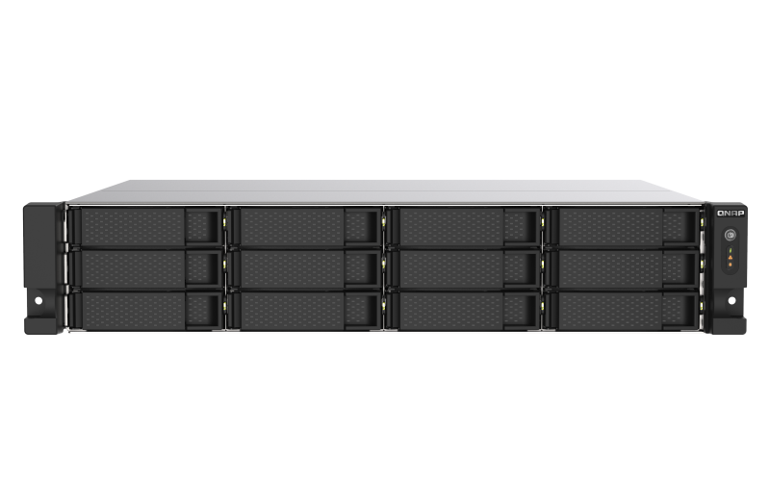
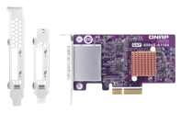
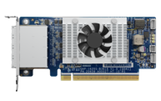
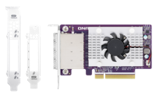
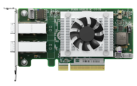
Free up a PCIe slot on NAS for other expansion cards
QM2 combo card series only uses a single PCIe slot and gives you both Ethernet and M.2 SSD storage expansion. Another slot can be used for capacity expansion purpose with SAS and SATA expansion cards & JBOD enclosures.
QNAP SATA HBA
QXP-400eS-A1164
QNAP SAS HBA
TS-1273AU-RP
QXP-800eS-A1164
QXP-1620S-B3616W
QXP-1600eS
QXP-820S-B3408

Slide 6
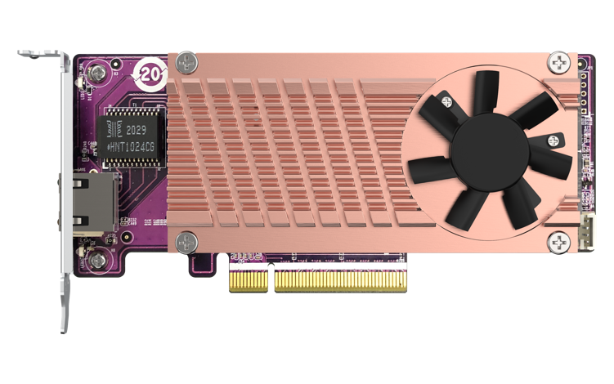
Brand new QM2-2P10G1TB with PCIe Gen3 speed and lower power consumption
QM2-2P10G1TB
NEW!
Upgrade to PCIe Gen3 x8 (Compared to the previous generation with PCIe Gen2: QM2-2P10G1TA)
High-efficiency IC – Marvell AQtion Ethernet Controller AQC113C (1/2 of power consumption)
Tool-less M.2 PCIe device (SSD, TPU) installation

Slide 7
The new Marvell AQC113C 10GbE controller with multi-gig speed and lower power consumption
Only ½ of power consumption compared to the last-gen AQC107
10Gb/5Gb/2.5Gb/1Gbps and 100Mbps RJ45 connectivity
25 Years of leading IC design experience, reliable and high efficiency Networking, Storage and Computing solution provider.
換Marvell Icon
I225-LM

Slide 8
Support dual M.2 PCIe Gen3 NNMe SSD + 10GbE 10GBASE-T multi-gig speed
Supplied with
Full-height &
half-height flat bracket
Marvell AQC113C 10GBASE-T
QM2-2P10G1TB
2 x M.2 2280 PCIe Gen3 x4 NVMe SSD slots
Total bandwidth: PCIe Gen3 x8

Slide 9
QM2-2P10G1TB design diagram
Marvell
AQC113C
PCIe NVMe M.2 2280
PCIe Gen3 x 4
PCIe Gen3 x 4
PCIe
Switch
PCIe NVMe M.2 2280
PCIe Gen3 x 4
PCIe Gen3 x 8

Slide 10
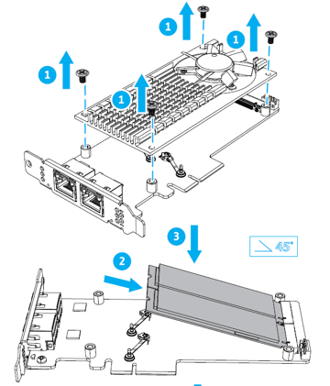
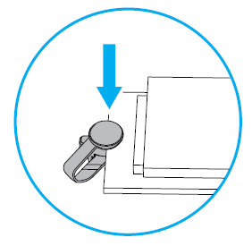
Toolless installation of M.2 NVMe SSDs
Click to install
Quick & easy to install the M.2 NVMe SSDs, without any screws!
Note: a screwdriver is required to remove the heatsink module.

Slide 11
QM2-2P10G1TB Half-height low profile design with active cooling module, fits every chassis
QM2-2P10G1TB
Preinstall half-height bracket
152.65 mm
Supplied with
Full-height & half-height flat bracket
68.9 mm
PCIe Gen 3 x8
Active Cooling module

Slide 12
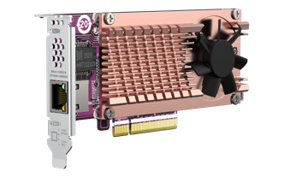
Specification of QM2-2P10G1TB
QM2-2P10G1TB
Ethernet controller | Marvell AQC113C; 5-speed
LAN port count | 1 x 10GBASE-T
M.2 SSD | 2 x M.2 2280 PCIe Gen3 NVMe SSD slots
PCIe total bandwidth | Gen3 x8
Dimensions | 152.65 x 68.9 x 18.9 (mm)
Transmission speed | 10Gbps/5Gbps/2.5Gbps/1Gbps/100Mbps
Supported OS | QTS/QuTS hero 4.5.3 or later Windows 10、11 (64bit) Linux Drivers are required for Windows and Linux
Package content | 1 x QM2；1 x QIG；3 x bracket (pre-installed half-height bracket)

Slide 13
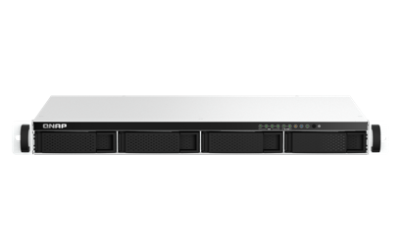
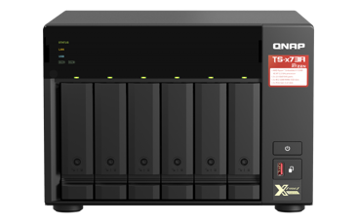
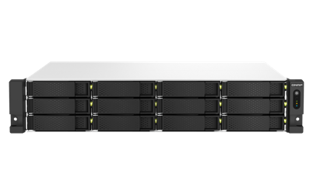
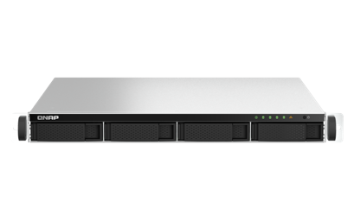
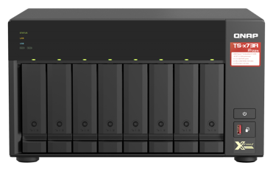
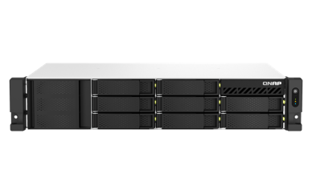
Your best partner ! Upgrade your NAS with QM2
TS-464eU
TS-673A
TS-1264U-RP
TS-464U
TS-464U-RP
TS-873A
TS-864eU TS-864eU-RP

Slide 14
QM2-2P10G1TB 10GbE transfer speed with M.2 NVMe SSD
Tested in QNAP Lab： PC: Intel® Core™ i7-6700 3.40GHz. Windows Server 2019. 64 GB memory. 10GbE NIC:X550 NAS: TVS-1282T, 4.5.3.1275, Samsung SSD850 Pro 512GB x 6 (RAID 0), 32 GB(8GB*4) memory, 10GbE NIC: QM2-2P10G1TB
Windows file transfer (10GB file, with M.2 NVMe SSD)
Download:
1,150MB/s
10GbE
Upload:
1,156MB/s
200
400
600
800
1000
MB/s

Slide 15
LIVE
10GB 檔案傳輸
2 x M.2 SSD RAID 0 透過 2.5GbE 傳輸

Slide 16
PCIe Gen4 NVMe M.2 SSD is getting popular on market in 2022
Most of M.2 SSD are moving to PCIe NVMe these years, Seagate、WD、Samsung have announced PCIe Gen4 M.2 SSD, provides PCIe Gen4 x4 per M.2 SSD for over 7000MB/s performance. It helps you to expand storage on your NAS, PC and laptop with QM2 series.
8GB/s
PCIe 4.0
4GB/s
PCIe 3.0
Bandwidth

Slide 17
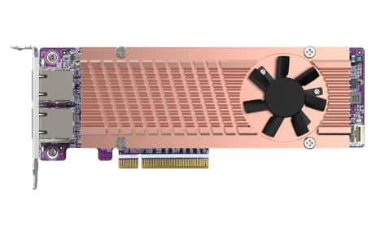
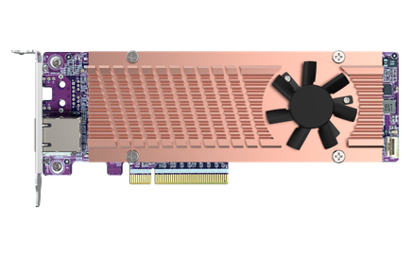
New PCIe Gen4 QM2 combo series Dual M.2 PCIe Gen4 NVMe SSD + 1 or 2-port 10GbE
QM2-2P410G2T
Supplied with
Full-height & half-height flat bracket
2 x M.2 2280 PCIe
Gen4 x4 NVMe SSD slots
Bandwidth: PCIe Gen4 x8
2 x 10GBASE-T
QM2-2P410G1T
Marvell AQC113C
2 x M.2 2280 PCIe
Gen4 x4 NVMe SSD slots
Bandwidth: PCIe Gen4 x8
1 x 10GBASE-T

Slide 18
The new Marvell AQC113C 10GbE controller with multi-gig speed and lower power consumption
Only ½ of power consumption compared to the last-gen AQC107
10Gb/5Gb/2.5Gb/1Gbps and 100Mbps RJ45 connectivity
25 Years of leading IC design experience, reliable and high efficiency Networking, Storage and Computing solution provider.
換Marvell Icon
I225-LM

Slide 19
QM2-2P410G1T and QM2-2P410G2T design diagram
Marvell
AQC113C
PCIe NVMe M.2 2280
PCIe Gen4 x 4
PCIe Gen 3 x 4
PCIe
Switch
Marvell
AQC113C
PCIe NVMe M.2 2280
PCIe Gen4 x4
PCIe Gen 3 x 4
PCIe Gen4 x 8

Slide 20
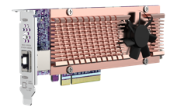
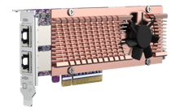
Specifications of the PCIe Gen4 QM2 combo cards
Ethernet controller | Marvell AQC113C; 5-speed | 5-speed
10GbE port | 1 x 10GBASE-T | 2 x 10GBASE-T
PCIe total bandwidth | Gen4 x8
M.2 SSDs | 2 x M.2 PCIe Gen4 x4 NVMe slots (compatible with PCIe Gen3 SSDs)
Dimensions | 187 x 68.9 x 19.35 mm
Transmission speed | 10Gbps/5Gbps/2.5Gbps/1Gbps/100Mbps
Supported OS | QTS/QuTS hero 5.0 or later Windows 10 、11 (64bit) Linux Drivers are required for Windows and Linux
Package content | 1 x QM2；1 x QIG；3 x bracket (pre-installed half-height bracket)
QM2-2P410G1T
QM2-2P410G2T

Slide 21
QM2-2P410G1T / QM2-2P410G2T Half-height low profile design with active cooling module, fits every chassis
QM2-2P410G1T/ QM2-2P410G2T
187 mm
Pre-installed Low-profile bracket
Supplied with
Full-height & half-height flat bracket
68.9 mm
PCIe Gen 4 x8
Active cooling module

Slide 22
Toolless installation of M.2 NVMe SSDs
Click to install
Quick & easy to install M.2 NVMe SSDs, no screws needed!
Note: a screwdriver is required to remove the heatsink module.

Slide 23
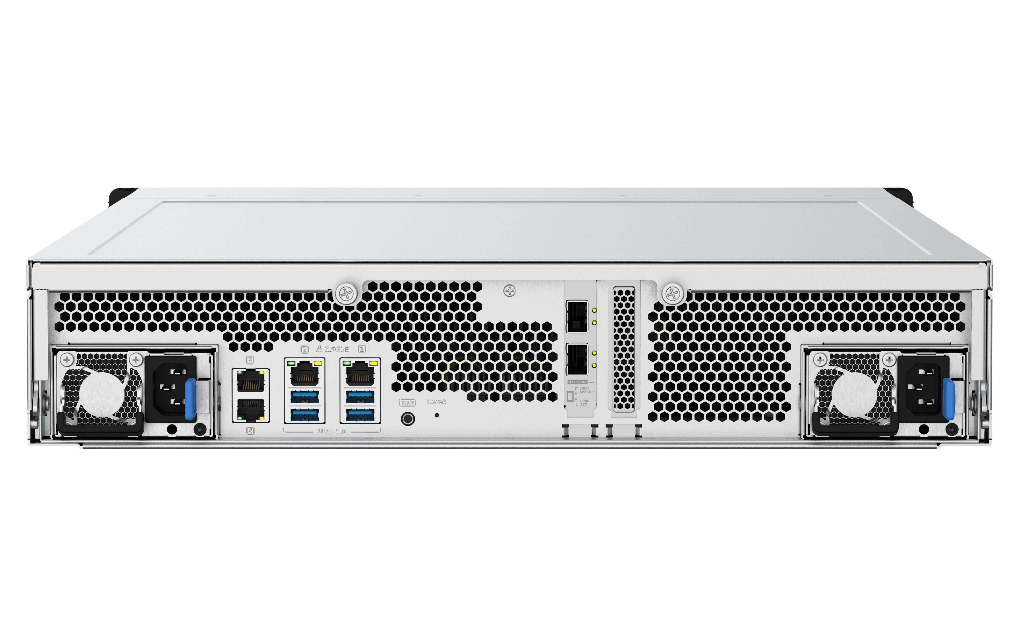
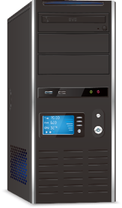
Support multiple operating systems such as QTS & QuTS hero, Windows, and Linux
QM2 cards not only support QNAP NAS OS - QTS & QuTS hero, but also support Windows 10/11 and Linux, brings you the high speed experience across different platforms.
Support NAS with PCIe
QTS / QuTS hero 5.0 and later
Drivers are required for Windows and Linux
https://www.qnap.com/go/download
TDS-h2489FU
New QNAP All-Flash-Array, with PCIe Gen4 U.2 SSD and PCIe Gen4 slots for expansion
Support PC/Workstation
*Please find compatible NAS models in our Compatibility List.

Slide 24
All flash NAS TS-h2490FU with PCIe 4.0 slots
TS-h2490FU
All Flash Array
24-bay U.2 PCIe Gen3 x4 drives
AMD EPYC 7332P 8C/16T or EPYC 7202P 16C/32T
2 or 4 x 25GbE SFP28 Ethernet
Slot #1: PCIe Gen4 x4
Slot #2: PCIe Gen4 x8 or x4
Slot #3: PCIe Gen4 x4

Slide 25
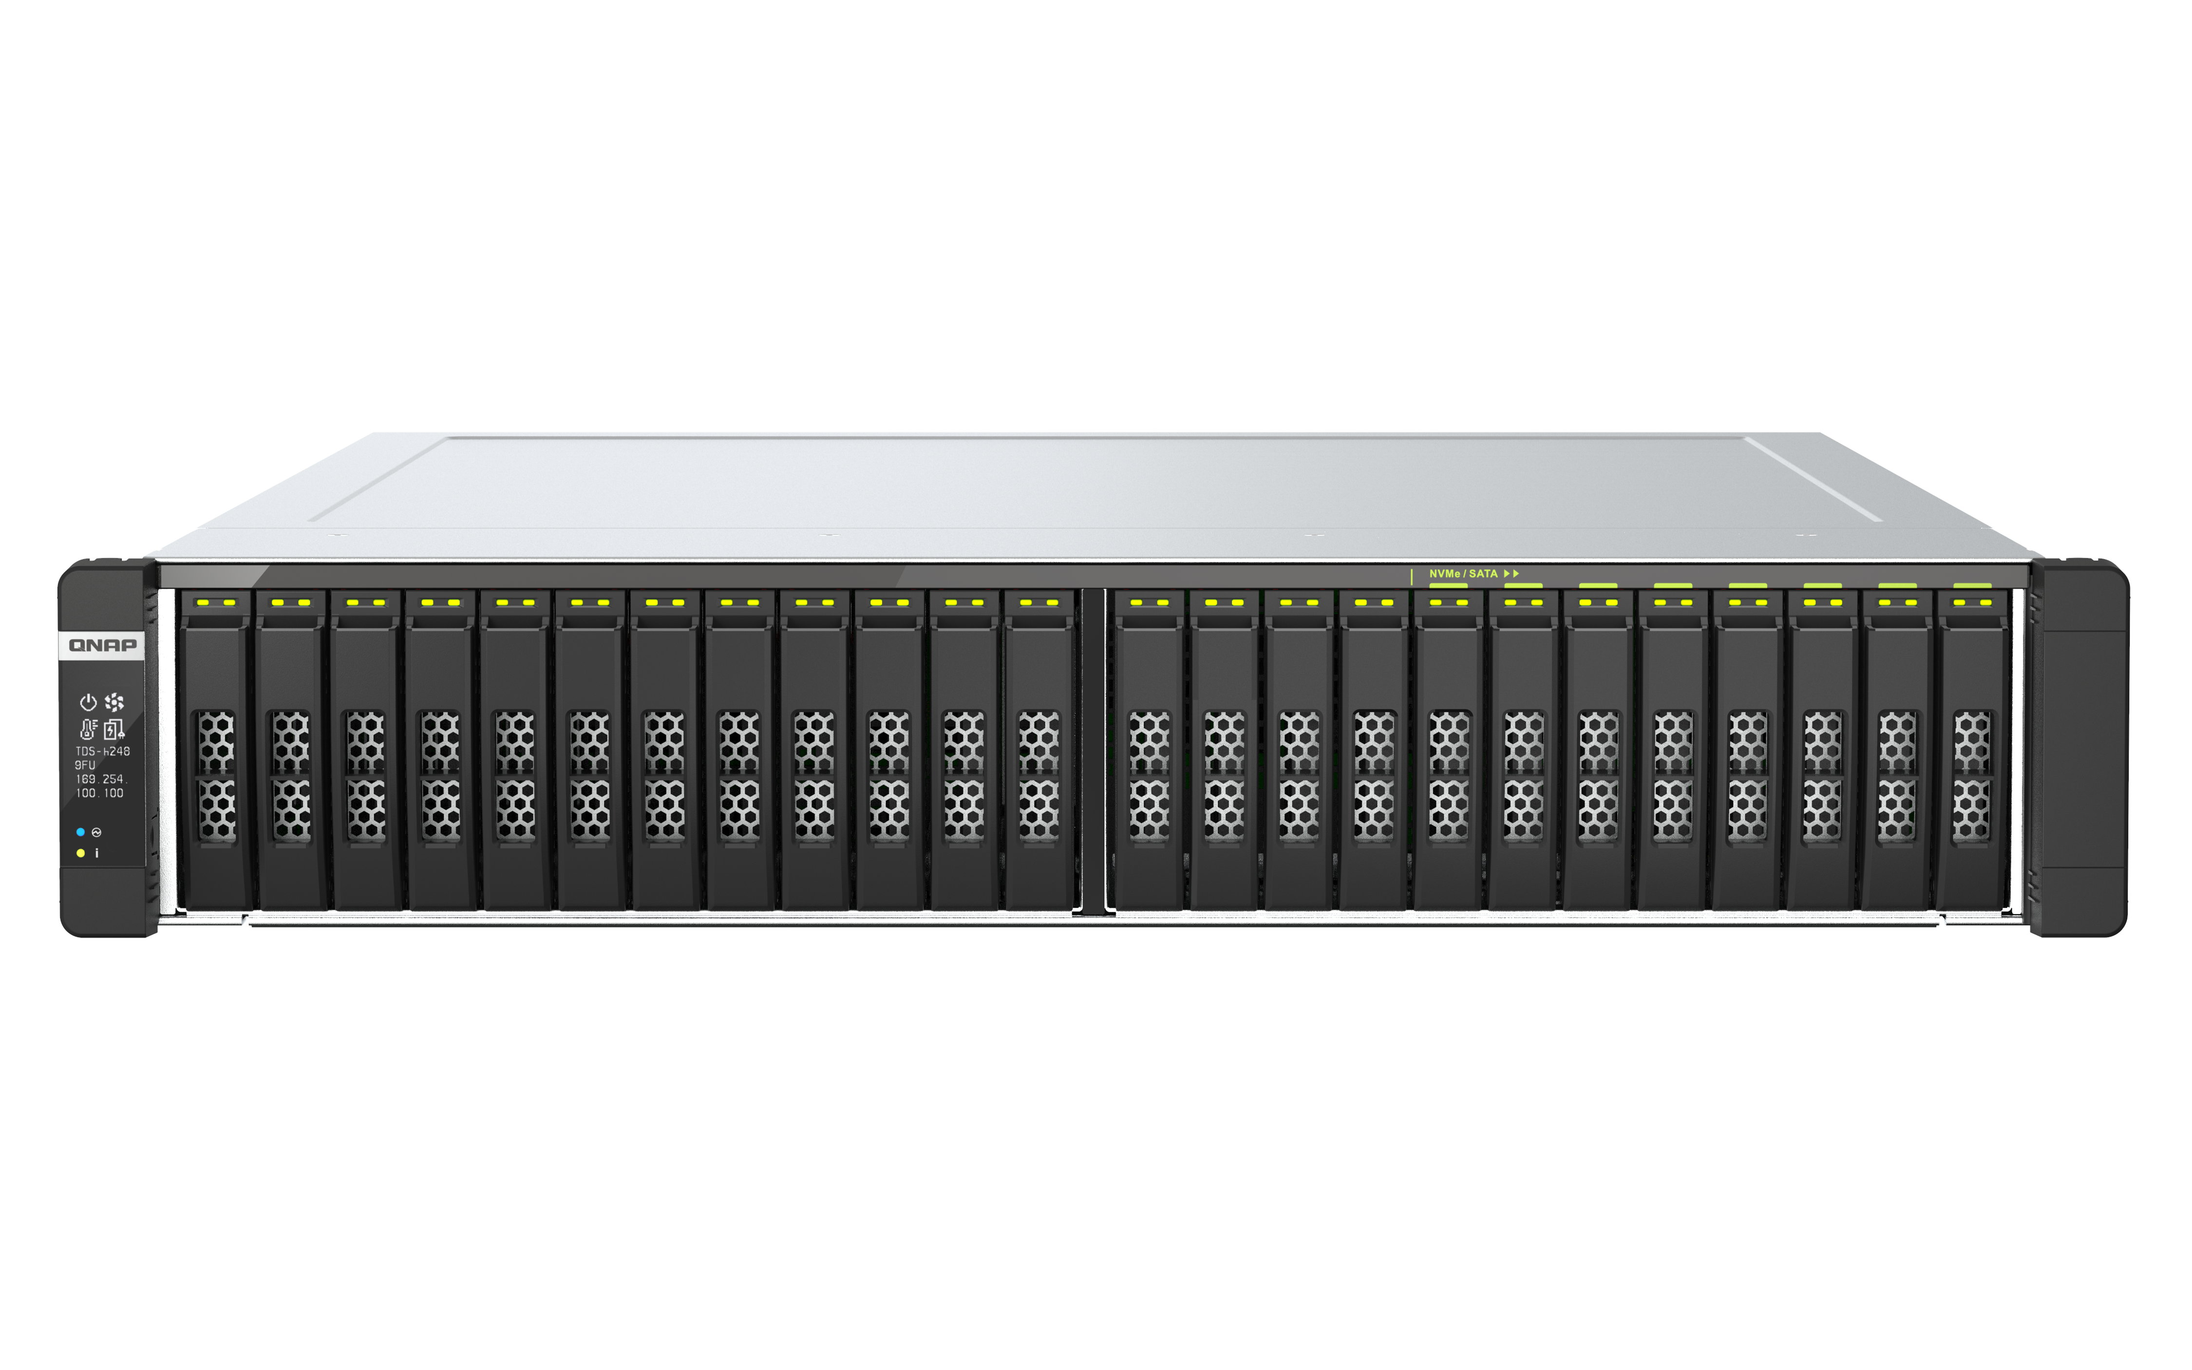
All flash NAS TDS-h2489FU with PCIe 4.0 slots
TDS-h2489FU
All Flash Array
24-bay U.2 PCIe Gen4 x4 drives
Dual Intel® Xeon® Silver 8 or 16-core
2 x 25GbE SFP28 Ethernet
Slot #1: PCIe Gen4 x16 (x8 if slot 2 is used)
Slot #2: PCIe Gen4 x8

Slide 26
Ultra fast performance with M.2 PCIe Gen4 NVMe SSDs
Tested in QNAP lab Environment： PC: Intel Core i7-6700; Windows 10; 64GB RAM; 10GbE NIC LAN-10G2T-X550 IronWolf 525 4TB x 2; RAID0
Read:
8,244 MB/s
SSD Speed
Write:
6,306 MB/s
2000
4000
6000
8000
10000
MB/s

Slide 27
Full 10GbE performance while accessing M.2 SSD on QM2-2P410G1T/ QM2-2P410G2T
Tested in QNAP lab Environment： PC: Intel Core i7-6700; Windows 10; 64GB RAM; 10GbE NIC LAN-10G2T-X550 NAS: TS-h2490FU (AMD EPYC 7302P 16-core/32-thread; 32GB RAM; Install QM2-2P410G1T
File transfer (10GB file, with M.2 NVMe SSD)
Download:
1,159MB/s
10GbE
Upload:
1,156MB/s
200
400
600
800
1000
MB/s

Slide 28
LIVE
10GB 檔案傳輸
2 x M.2 SSD RAID 0 透過 2.5GbE 傳輸

Slide 29
QNAP Multi-Gig
NICs & Switches

Slide 30
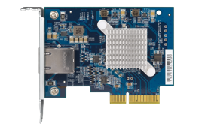
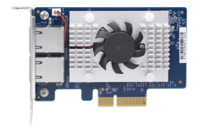
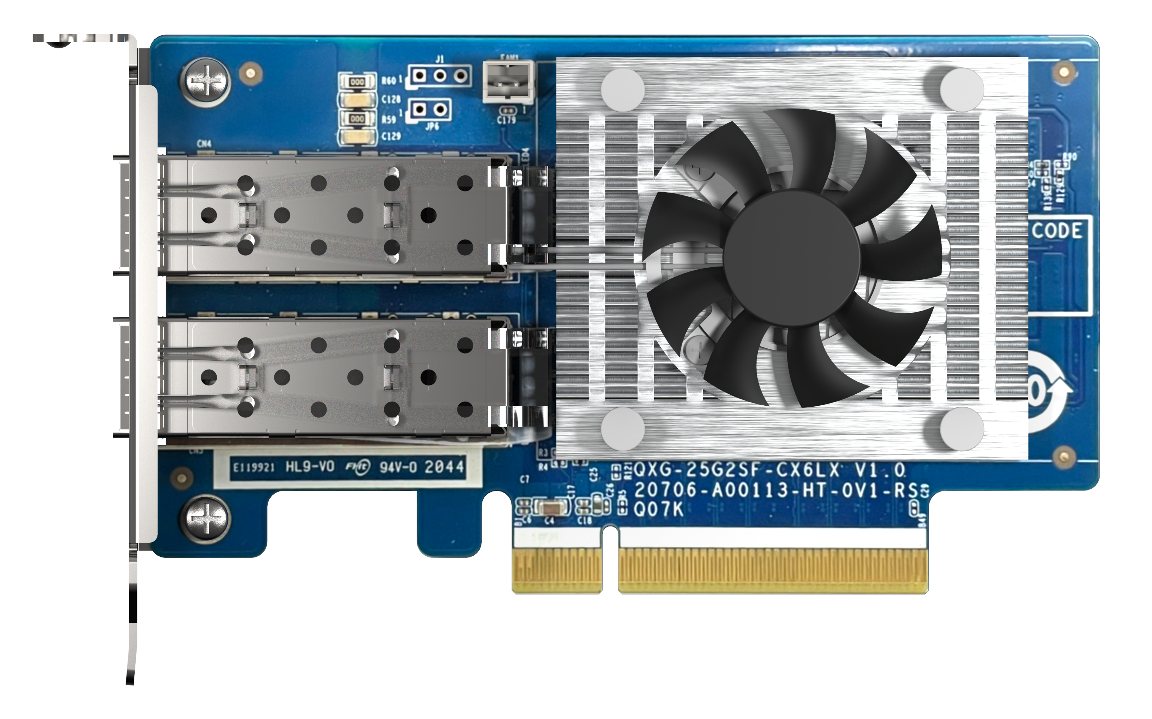
QNAP Multi-Gig NICs
5-speed Multi-Gig
25GbE
QXG-10G1T
QXG-10G2TB
QXG-25G2SF-CX6
Marvell AQtion AQC107
Single 10GbE NBase-T
PCIe Gen3 x4
Low Profile
Marvell AQtion AQC107
Dual 10GbE NBase-T
PCIe Gen3 x4
Low Profile
NVIDIA Mellanox Connect-X 6 Lx
Dual 25GbE SFP28 (compatible with 10GbE SFP+)
PCIe Gen4 x8
Low Profile
10GbE
25GbE

Slide 31
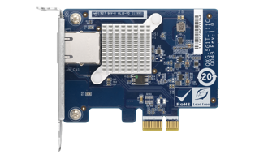
QNAP Multi-Gig NIC
4-speed Multi-Gig
4-speed Multi-Gig
QXG-2G1T-I225
QXG-2G2T-I225
QXG-2G4T-I225
QXG-5G1T-111C
QXG-5G2T-111C
QXG-5G4T-111C
Intel I225LM
1/2/4-port 2.5GbE NBase-T
PCIe Gen3 x1, Gen3 x2, Gen3 x4
Low Profile
Marvell AQtion AQC111C
1/2/4-port 5GbE NBase-T
PCIe Gen2 x1, Gen3 x2, Gen3 x4
Low Profile
2.5GbE
5GbE

Slide 32
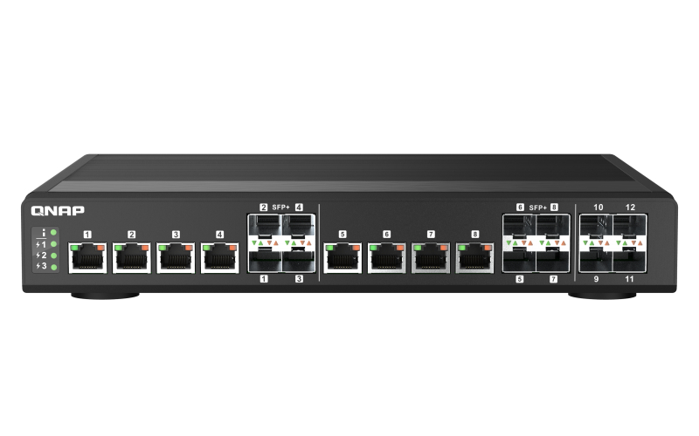
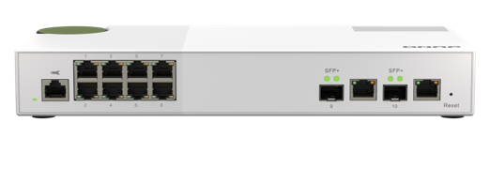
QNAP QSW 10GbE switches
QSW-IM1200-8C
QSW-M2108-2C
Fan less web-managed switch provides 8 x 10GbE RJ45/SFP+ combo ports and 4 x 10GbE SFP+ ports
Un-managed switch provides 8 x 2.5GbE and 2 x 10GbE combo 10GBASE-T/SFP+ ports

Slide 33
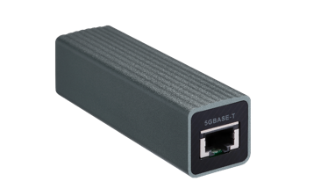
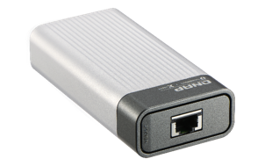
QNAP Multi-Gig network adapters
QNA-UC5G1T
QNA-T310G1T
Host with USB 3.2 Gen1
Host with Thunderbolt 3 or 4
5G/2.5G/1G/100M 4-speed
RJ45 NBASE-T connector
10G/5G/2.5G/1G/100M 5-speed
RJ45 NBASE-T connector
Compatible with NAS or Windows 10 PC/Laptop via USB
Compatible with Thunderbolt 3 or 4
Ｍac and Windows

Slide 34
©2021著作權為威聯通科技股份有限公司所有。威聯通科技並保留所有權利。威聯通科技股份有限公司所使用或註冊之商標或標章。檔案中所提及之產品及公司名稱可能為其他公司所有之商標

