Slide 1
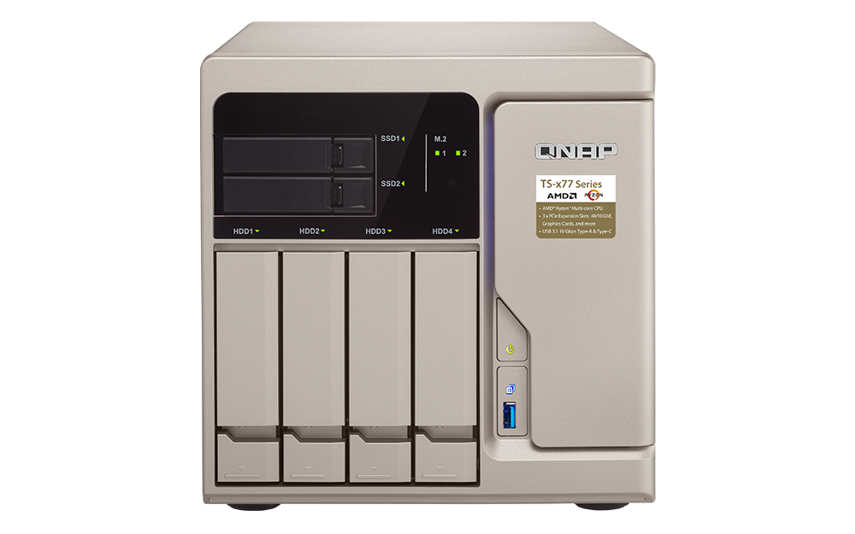
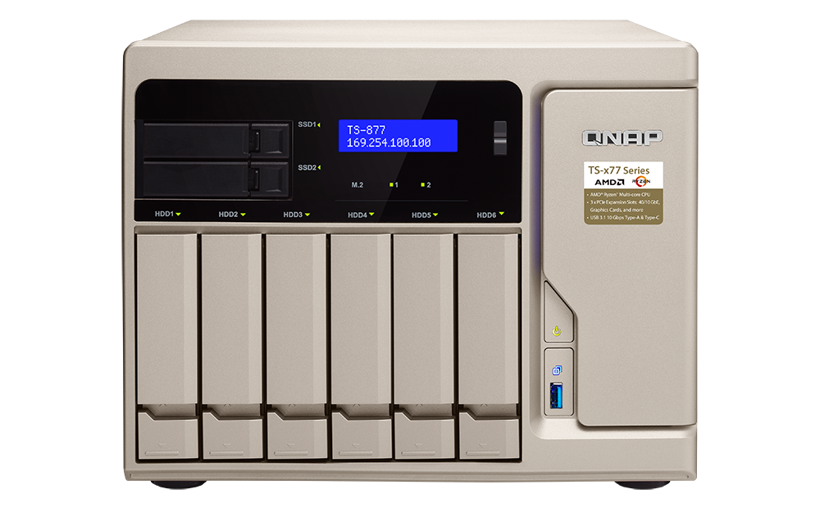
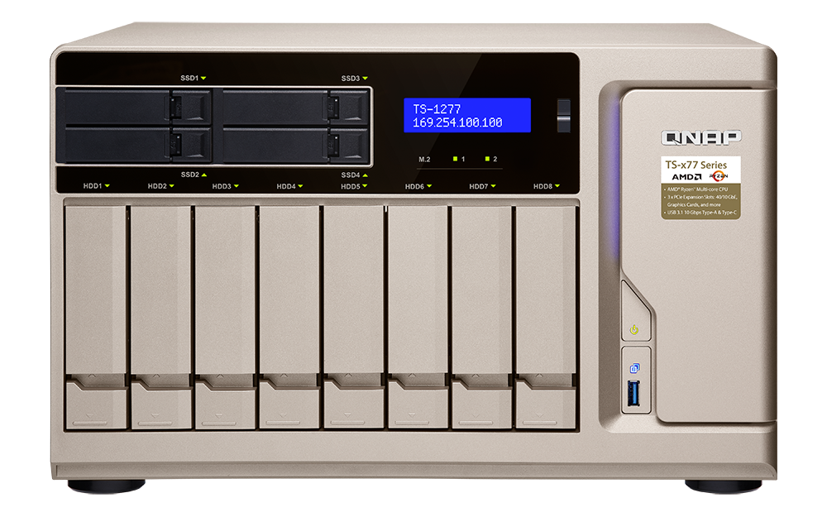
TS-x77 Series Supercharge business productivity with efficient, powerful multi-core processing
QNAP Systems, Inc.
TS-677
TS-877
TS-1277

Slide 2
Elite performance w/ 65W TDP
8-core, 16-thread | 3.0 GHz / 3.7 GHz
6-core, 12-thread | 3.2 GHz / 3.6 GHz
Notes:
標題可以再刪短一點

Slide 3
The power to work faster & smarter
TS-677-1600-8G
Ryzen 5 1600, 8GB RAM
TS-1277-1600-8G
Ryzen 5 1600, 8GB RAM
TS-1277-1700-16G
Ryzen 7 1700, 16GB RAM
TS-877-1600-8G
Ryzen 5 1600, 8GB RAM
TS-1277-1700-64G
Ryzen 7 1700, 64GB RAM
60%
TS-877-1700-16G
Ryzen 7 1700, 16GB RAM

Slide 4
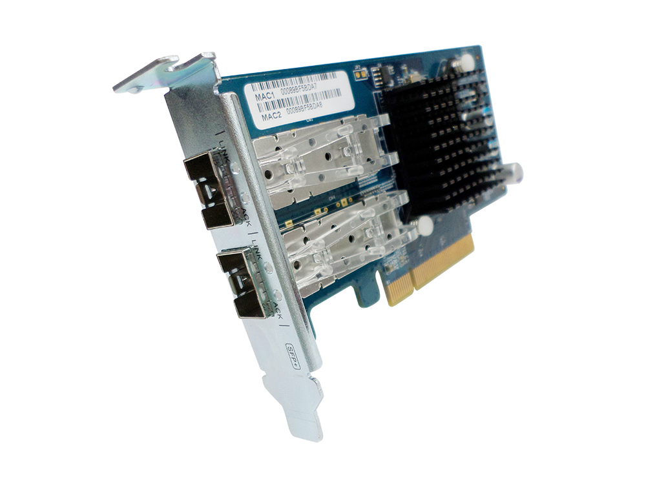
10GbE connectivity via a PCIe NIC
10GbE x 2
(Sequential file transfer)
10GbE x 2
(Encrypted sequential file transfer)
2250
2346
2250
2323
1859
1725
1500
1500
750
750
0
0
Download
Upload
Download
Upload
Tested in QNAP Labs. Figures may vary by environments.
Test environment: NAS: TS-1277-1700-16G with QTS 4.3.4
Volume type: RAID 5; 12 x Intel S3500 240GB SSDs (SSDSC2BB240G4)
Client PC: Intel® Core™ i7-4770 3.40GHz CPU; 16GB RAM; QNAP LAN-10G2SF-MLX 10GbE NIC ; Windows® 10 64-bit, IOMeter 64KB

Slide 5
Front overview
IR receiver
LED indicators w/ adjustable brightness:
HDD, SSD, M.2 SSD
LCD w/ Enter & Select buttons
USB 3.1
Gen 1 & Copy button
Power button
2, 4 x 2.5” SSD trays for Qtier auto tiering &
SSD caching
4, 6, 8 x 3.5” HDD trays w/ support for 2.5” drives

Slide 6
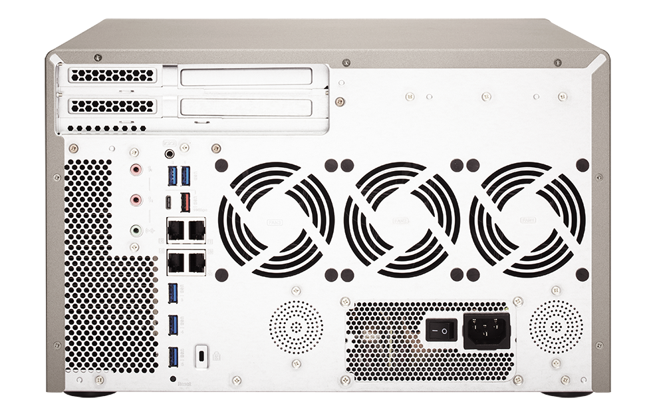
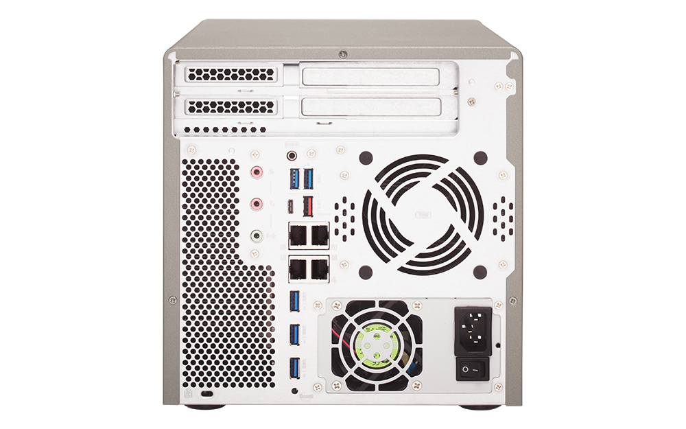
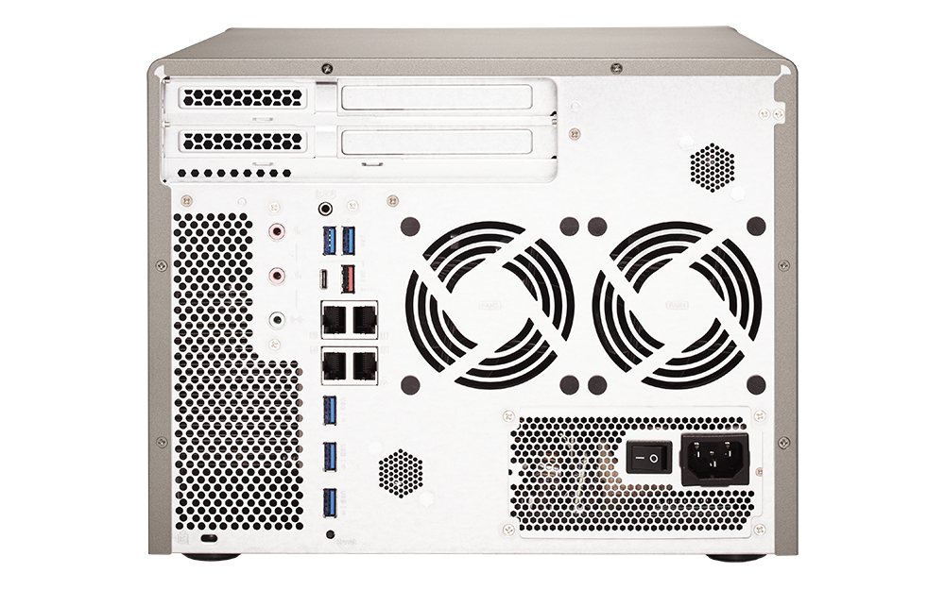
Rear overview
1 x USB 3.1 Gen 2
10G Type-A
1 x PCIe 3.0 x8
1 x USB 3.1 Gen 2
10G Type-C
1 x PCIe 3.0 x4
1 x PCIe 2.0 x4
2 x Dynamic Mic In
1 x Line out
2 x speakers
4 x GbE LAN
5 x USB 3.1 5G Gen 1

Slide 7
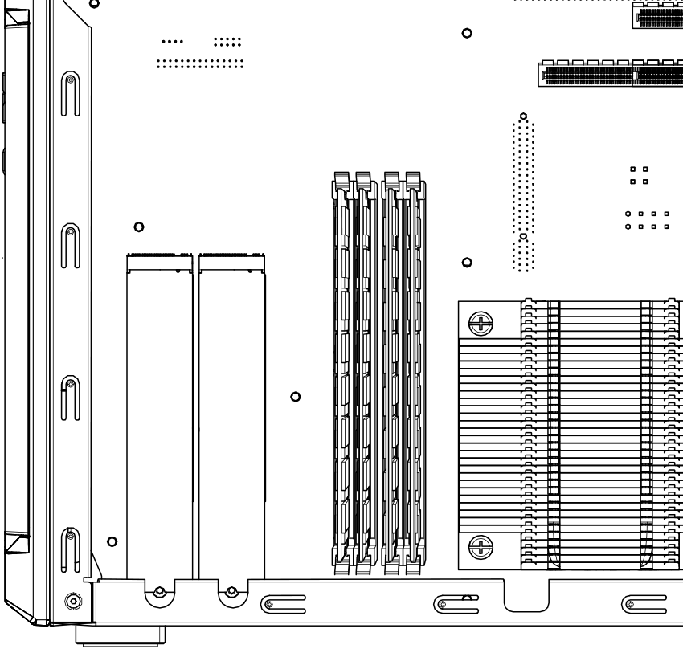
Under the hood
4 x DDR4 UDIMM RAM slots, max 64GB
2 x M.2 22110/2280/2260/
2242 SATA SSD slots
Dual fan coolers

Slide 8
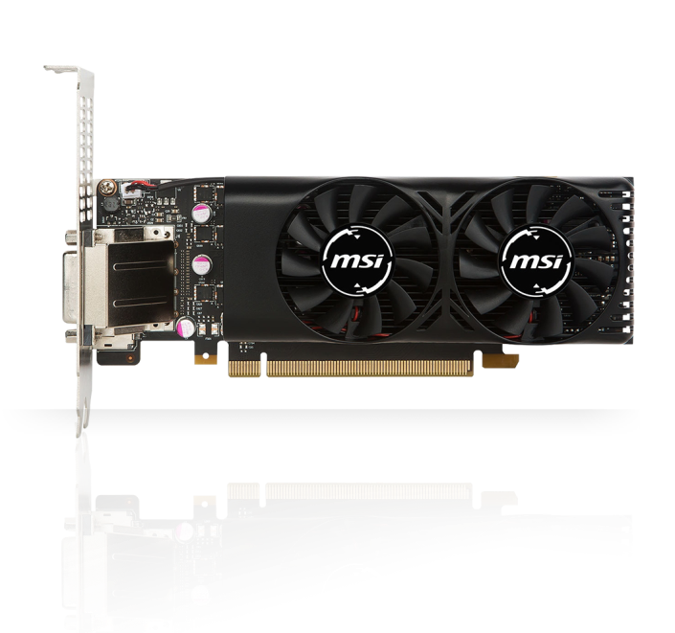
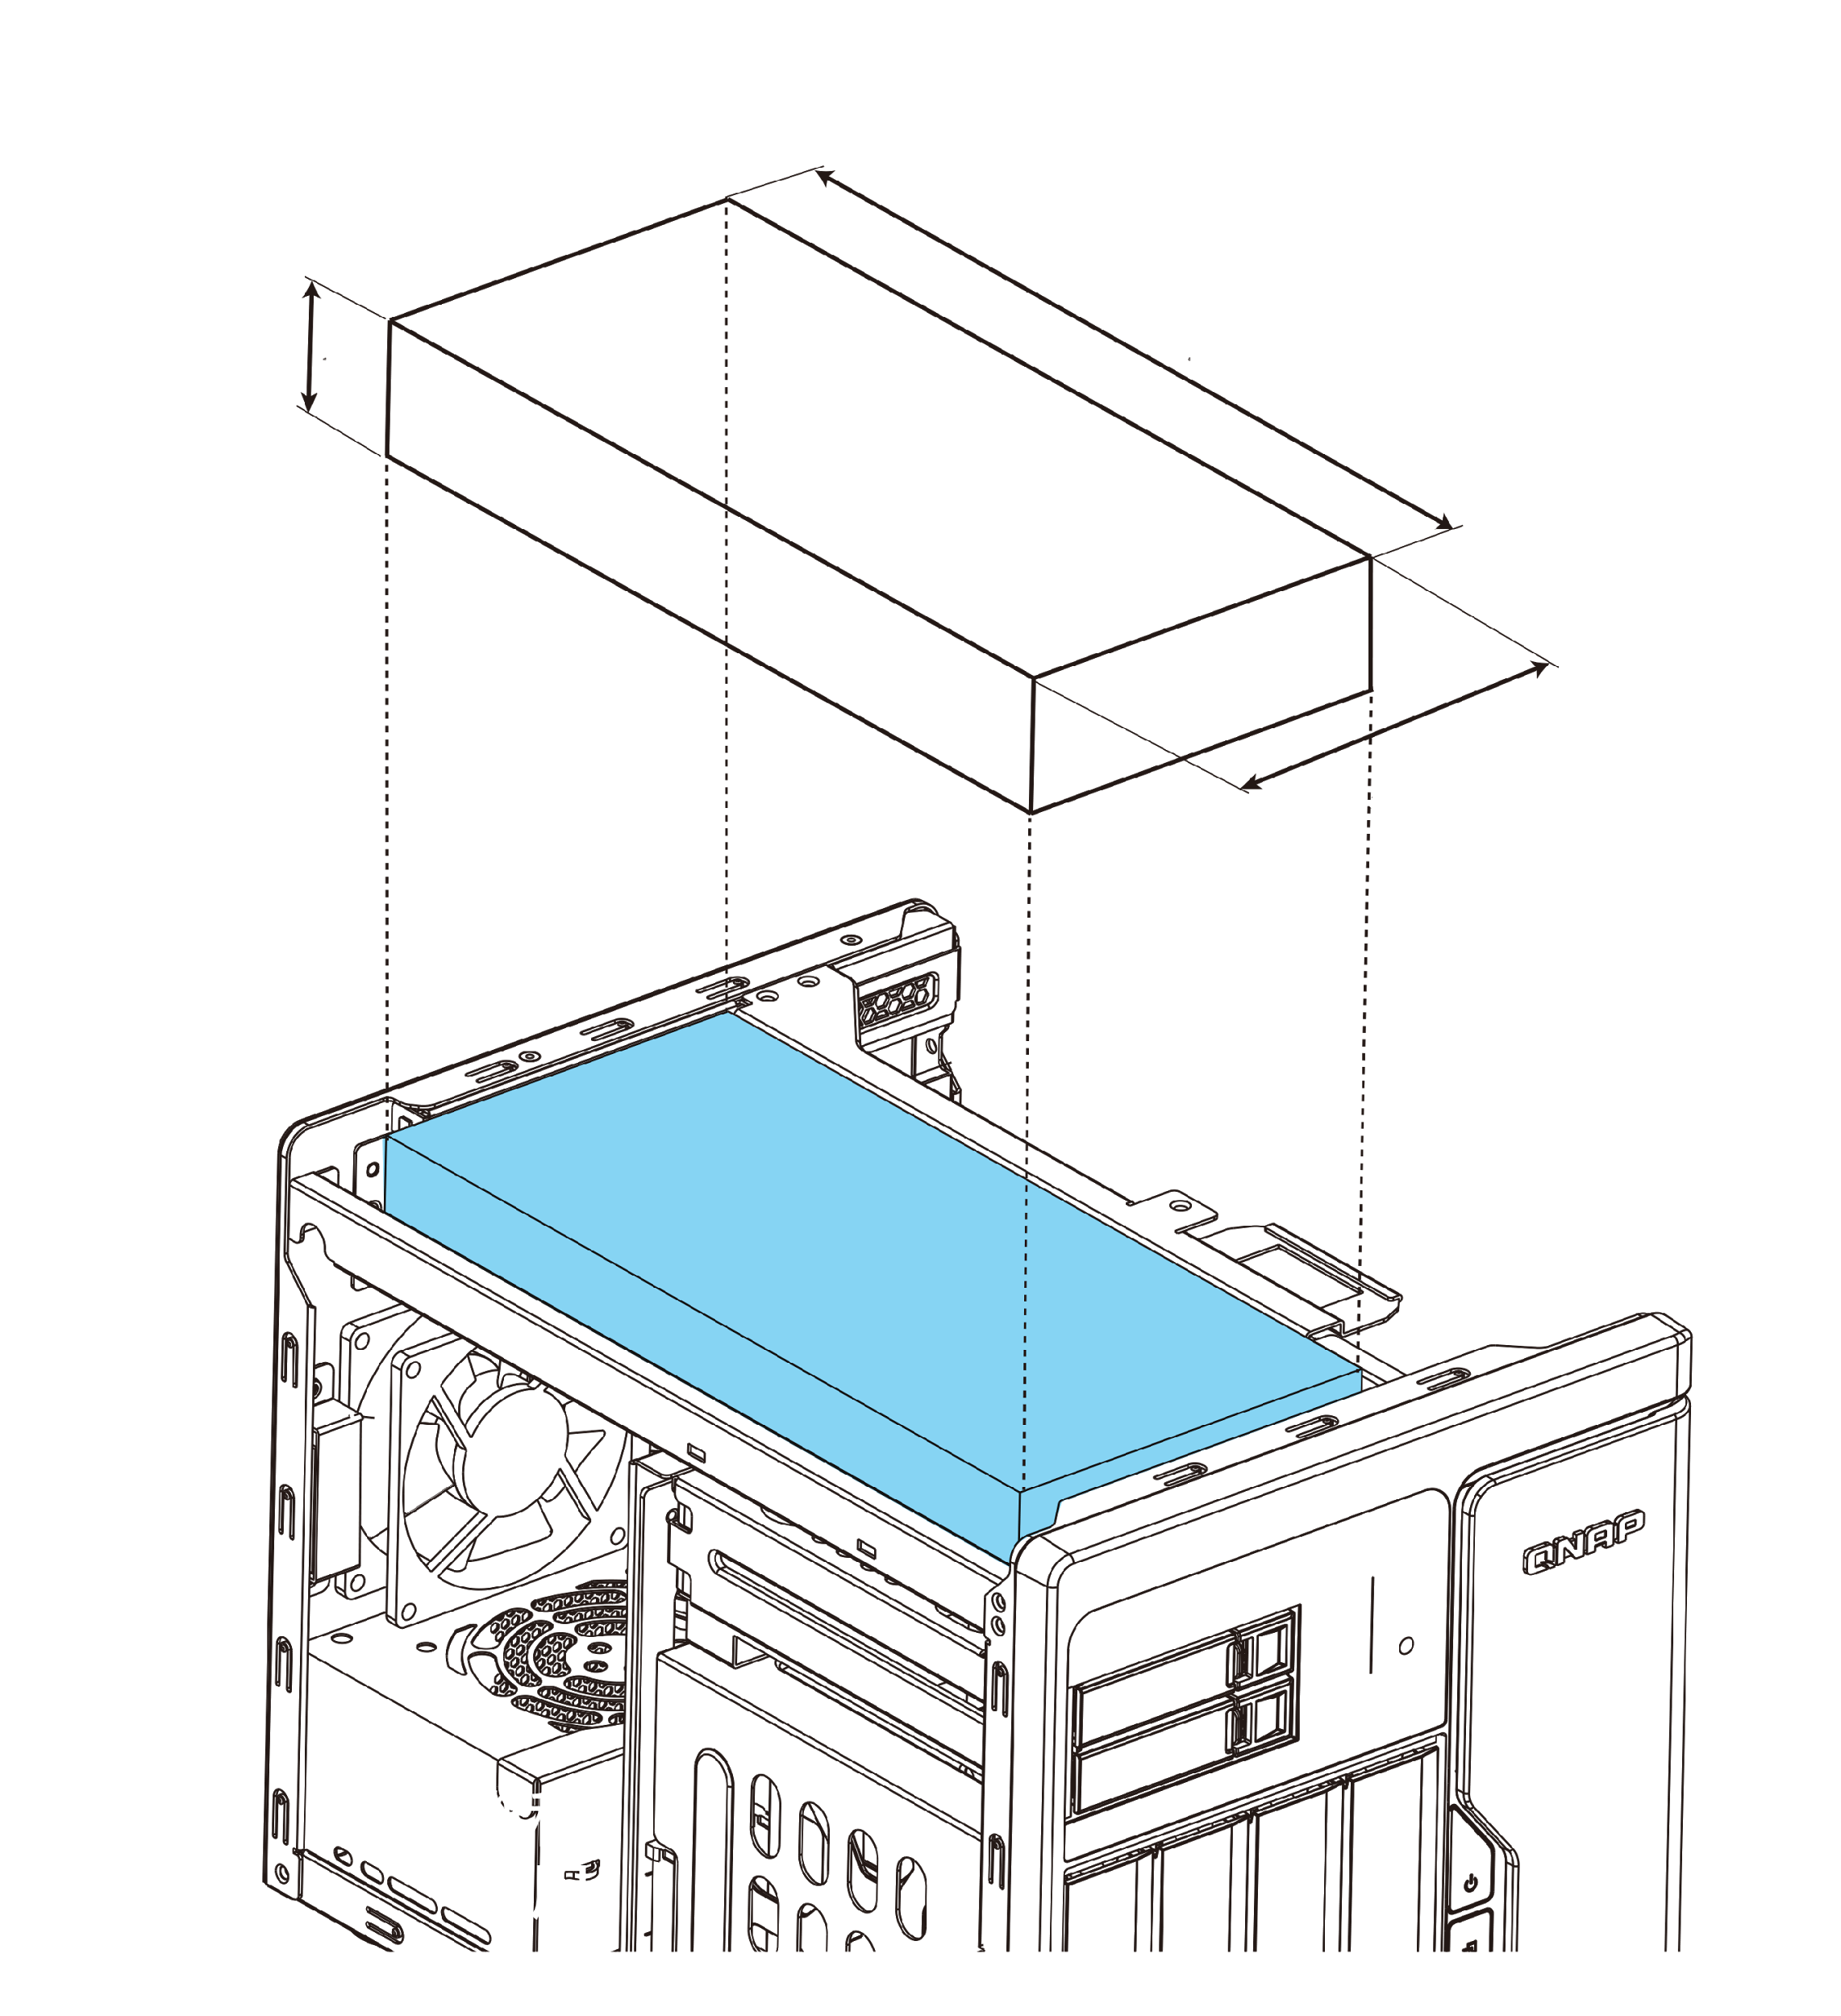
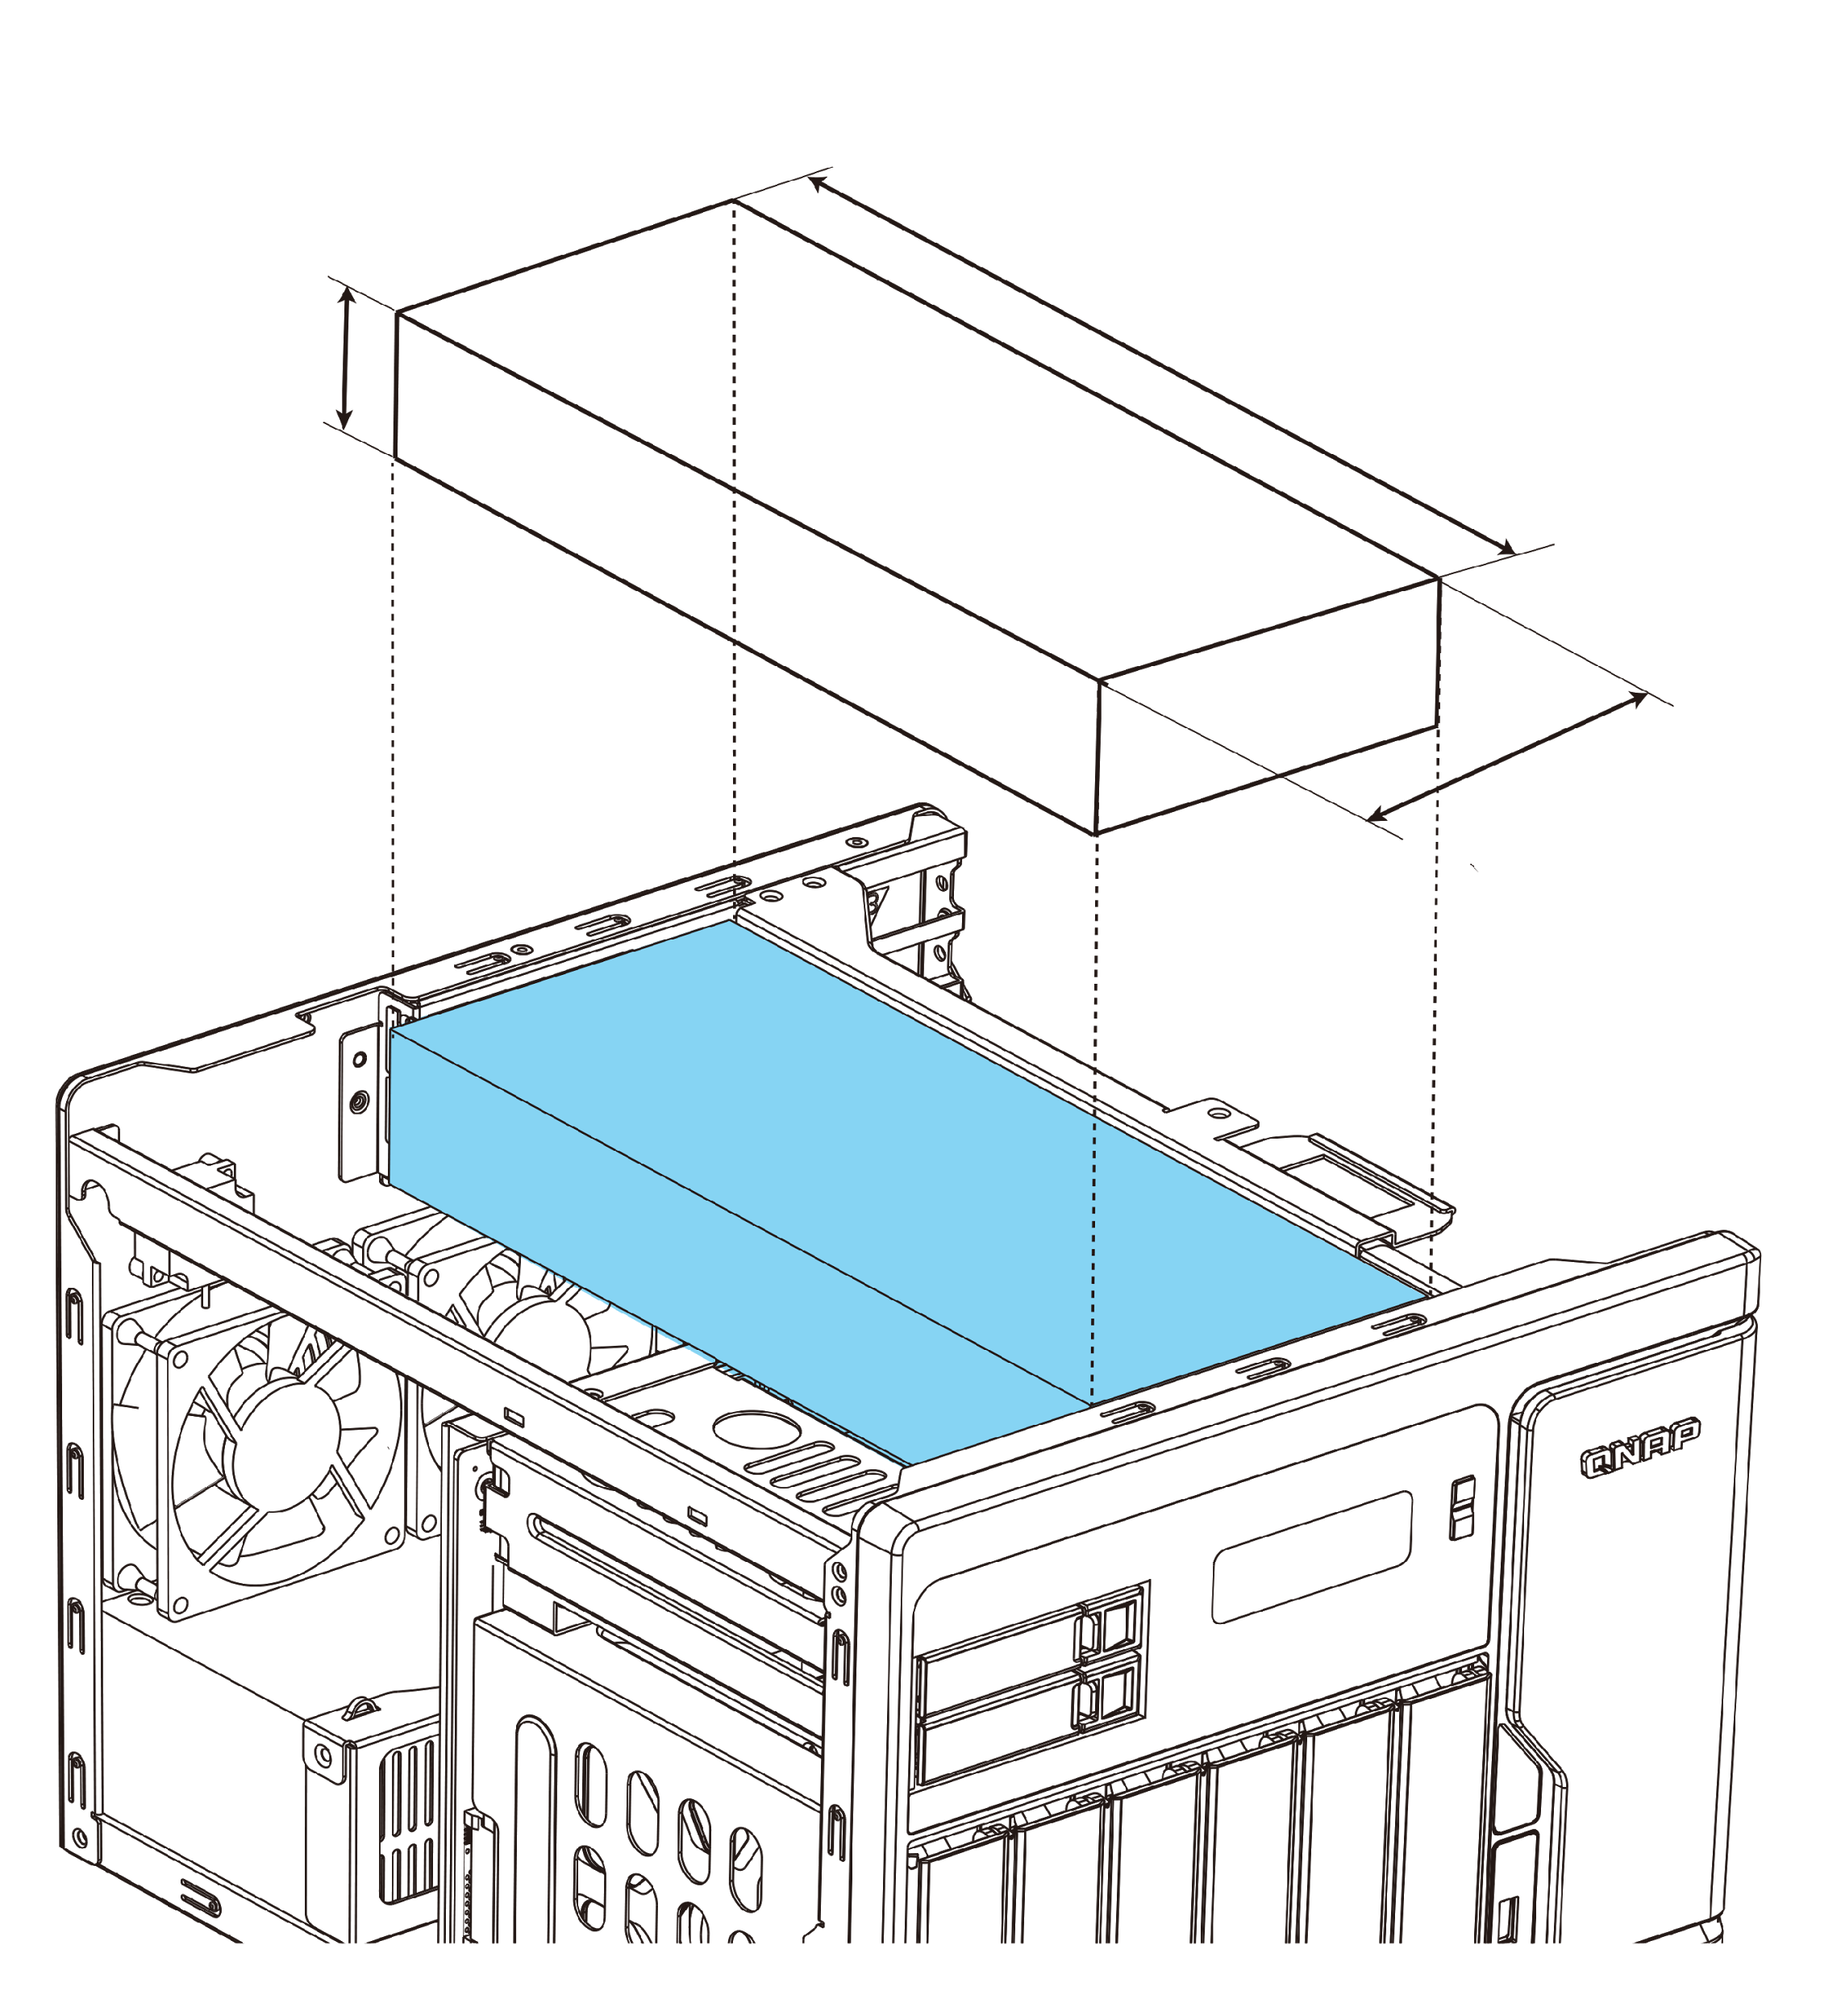
Do more w/ desktop GPU
40 mm
261 mm
TS-677
45 mm
266 mm
TS-877/1277
GTX 1050Ti
117 mm
122 mm
550W PSU
TS-1277
250W PSU
TS-677
450W PSU
TS-877

Slide 9
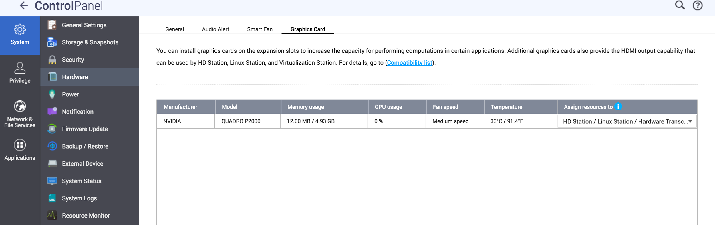
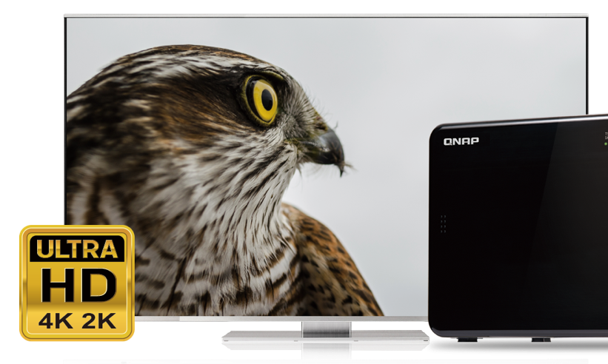
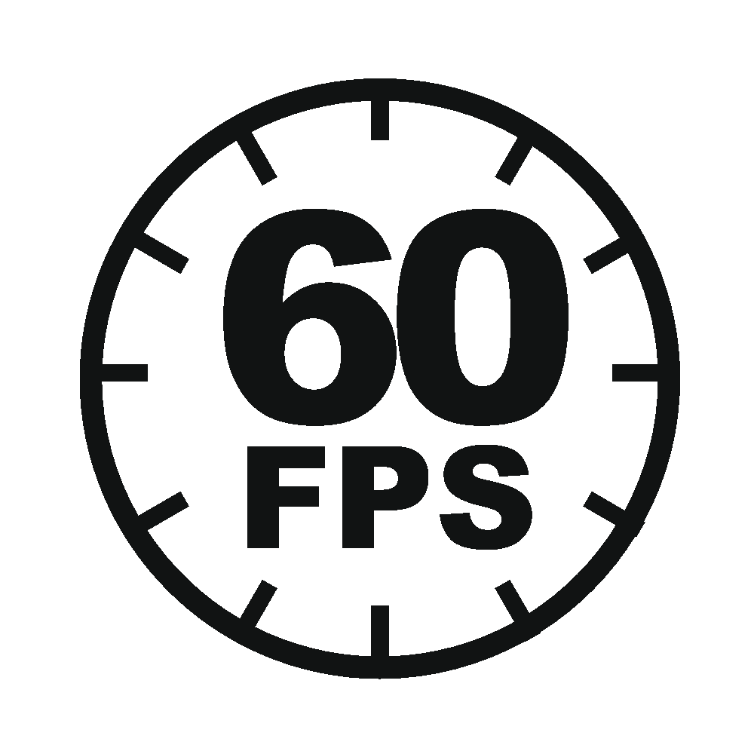
GPU passthrough & QTS utilization
Virtualization Station: AMD & NVIDIA GPUs
HD Station, Linux Station, hardware transcoding:
NVIDIA GTX 1050/1060/1070 & P2000 GPUs

Slide 10
TS-x77 Demo
Upgrade memory
Install M.2 SSD with the included heatsink
Install a graphics card
QTS
Control Panel - Hardware - Graphics Card
HybridDesk Station 4K 60P video playback

Slide 11
Coming soon in Q4
TS-1277-1700-64G
(4 x 16GB)
TS-877-1600-16G
(2 x 8GB)
TS-677-1400-8G
(2 x 4GB)
TS-1277-1700-32G
(2 x 16GB)
TS-877-1400-8G
(2 x 4GB)
TS-1277-1600-16G
(2 x 8GB)

Slide 12
360° Panorama
Photo & Video
QNAP Systems, Inc.

Slide 13
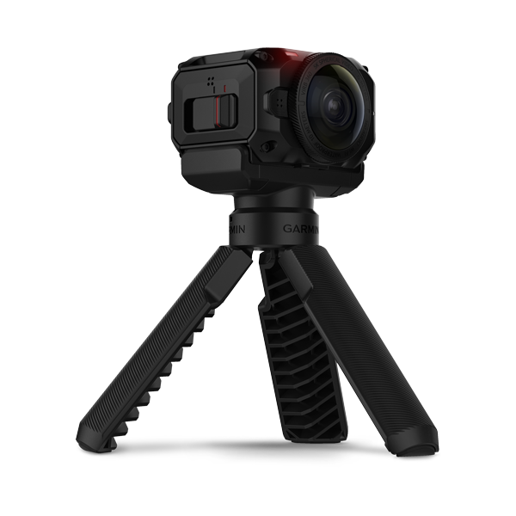
The Latest Trend of 360-degree Media Viewing
Various devices support shooting 360° photo or video
Well-known websites have supported 360 ° panoramic photos or video playback
Garmin
VIRB® 360
YouTube
Facebook

Slide 14
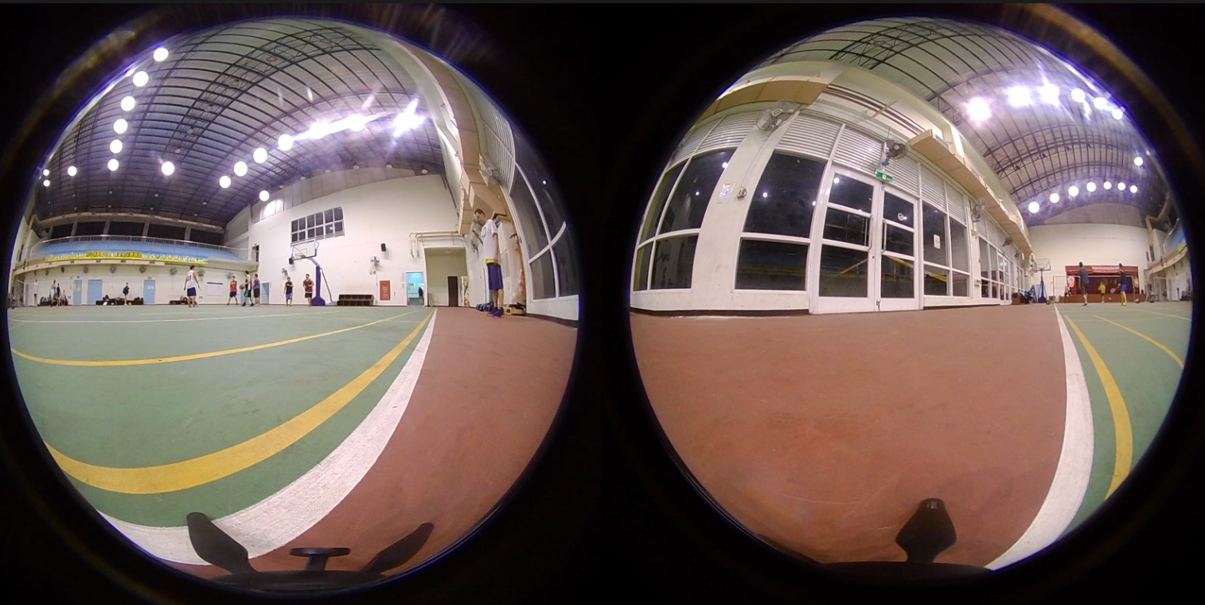
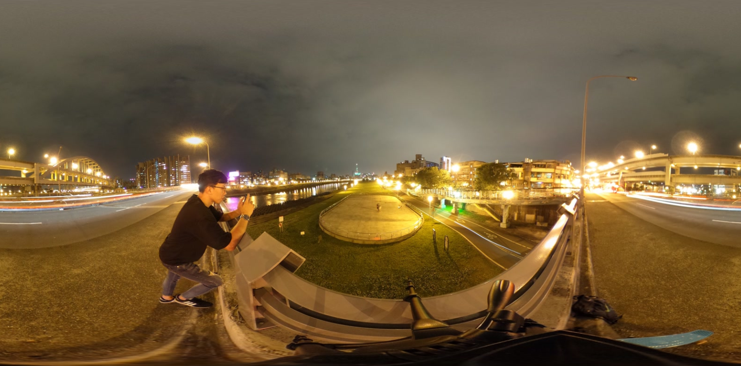
What’s 360° panoramic photo or video?
Use the 360 ° Panorama camera to record all angles
No stitching
Stitching by using the tools which are provided by the camera
Fisheye format
Stitching
Equirectangular format

Slide 15
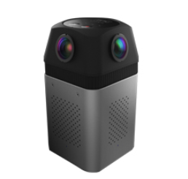
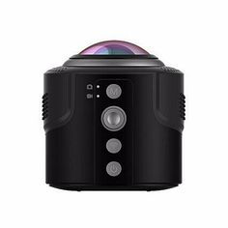
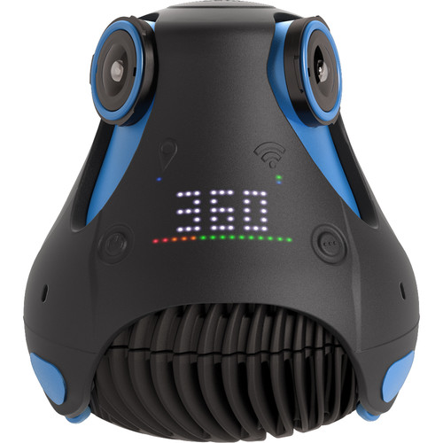
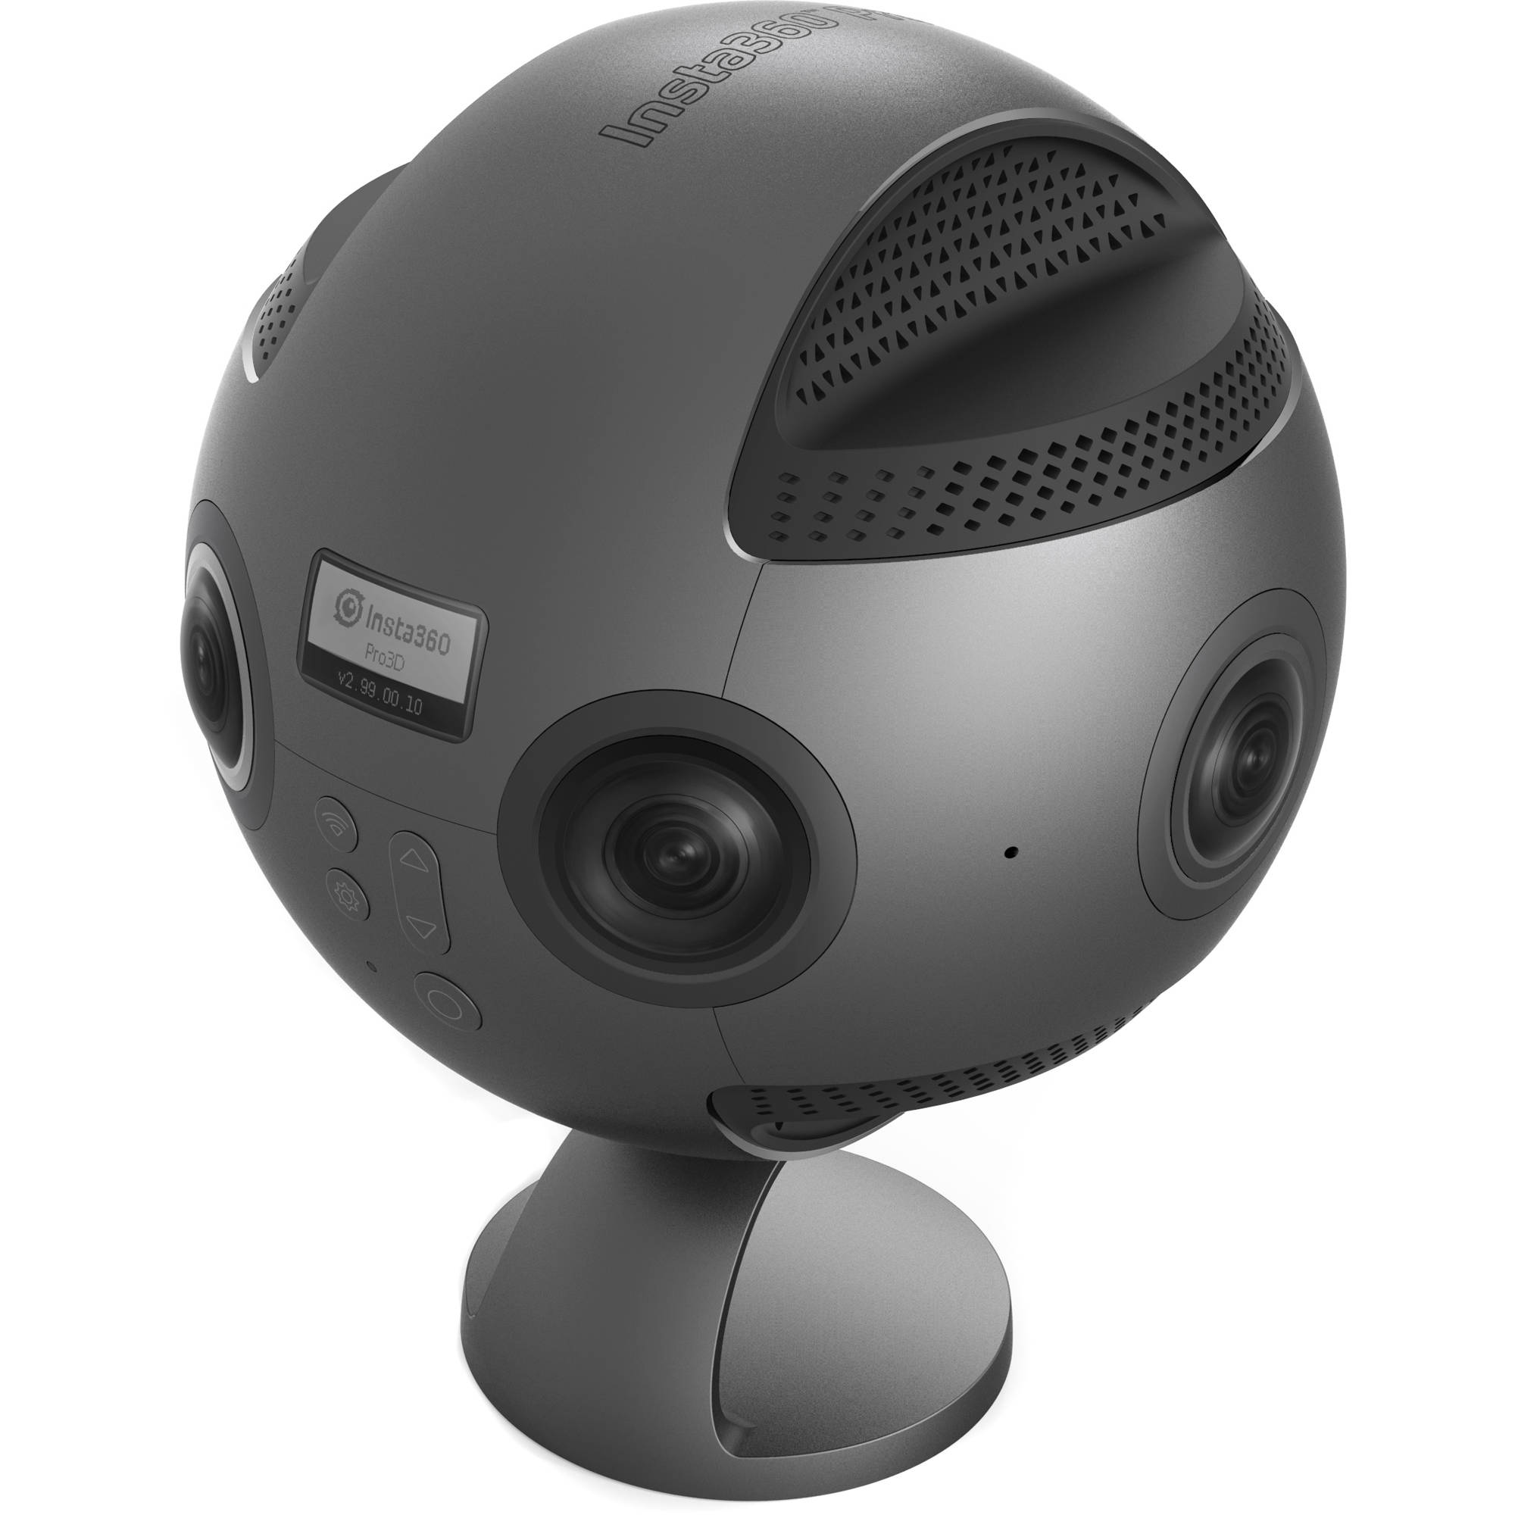
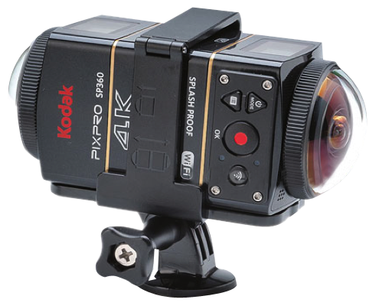
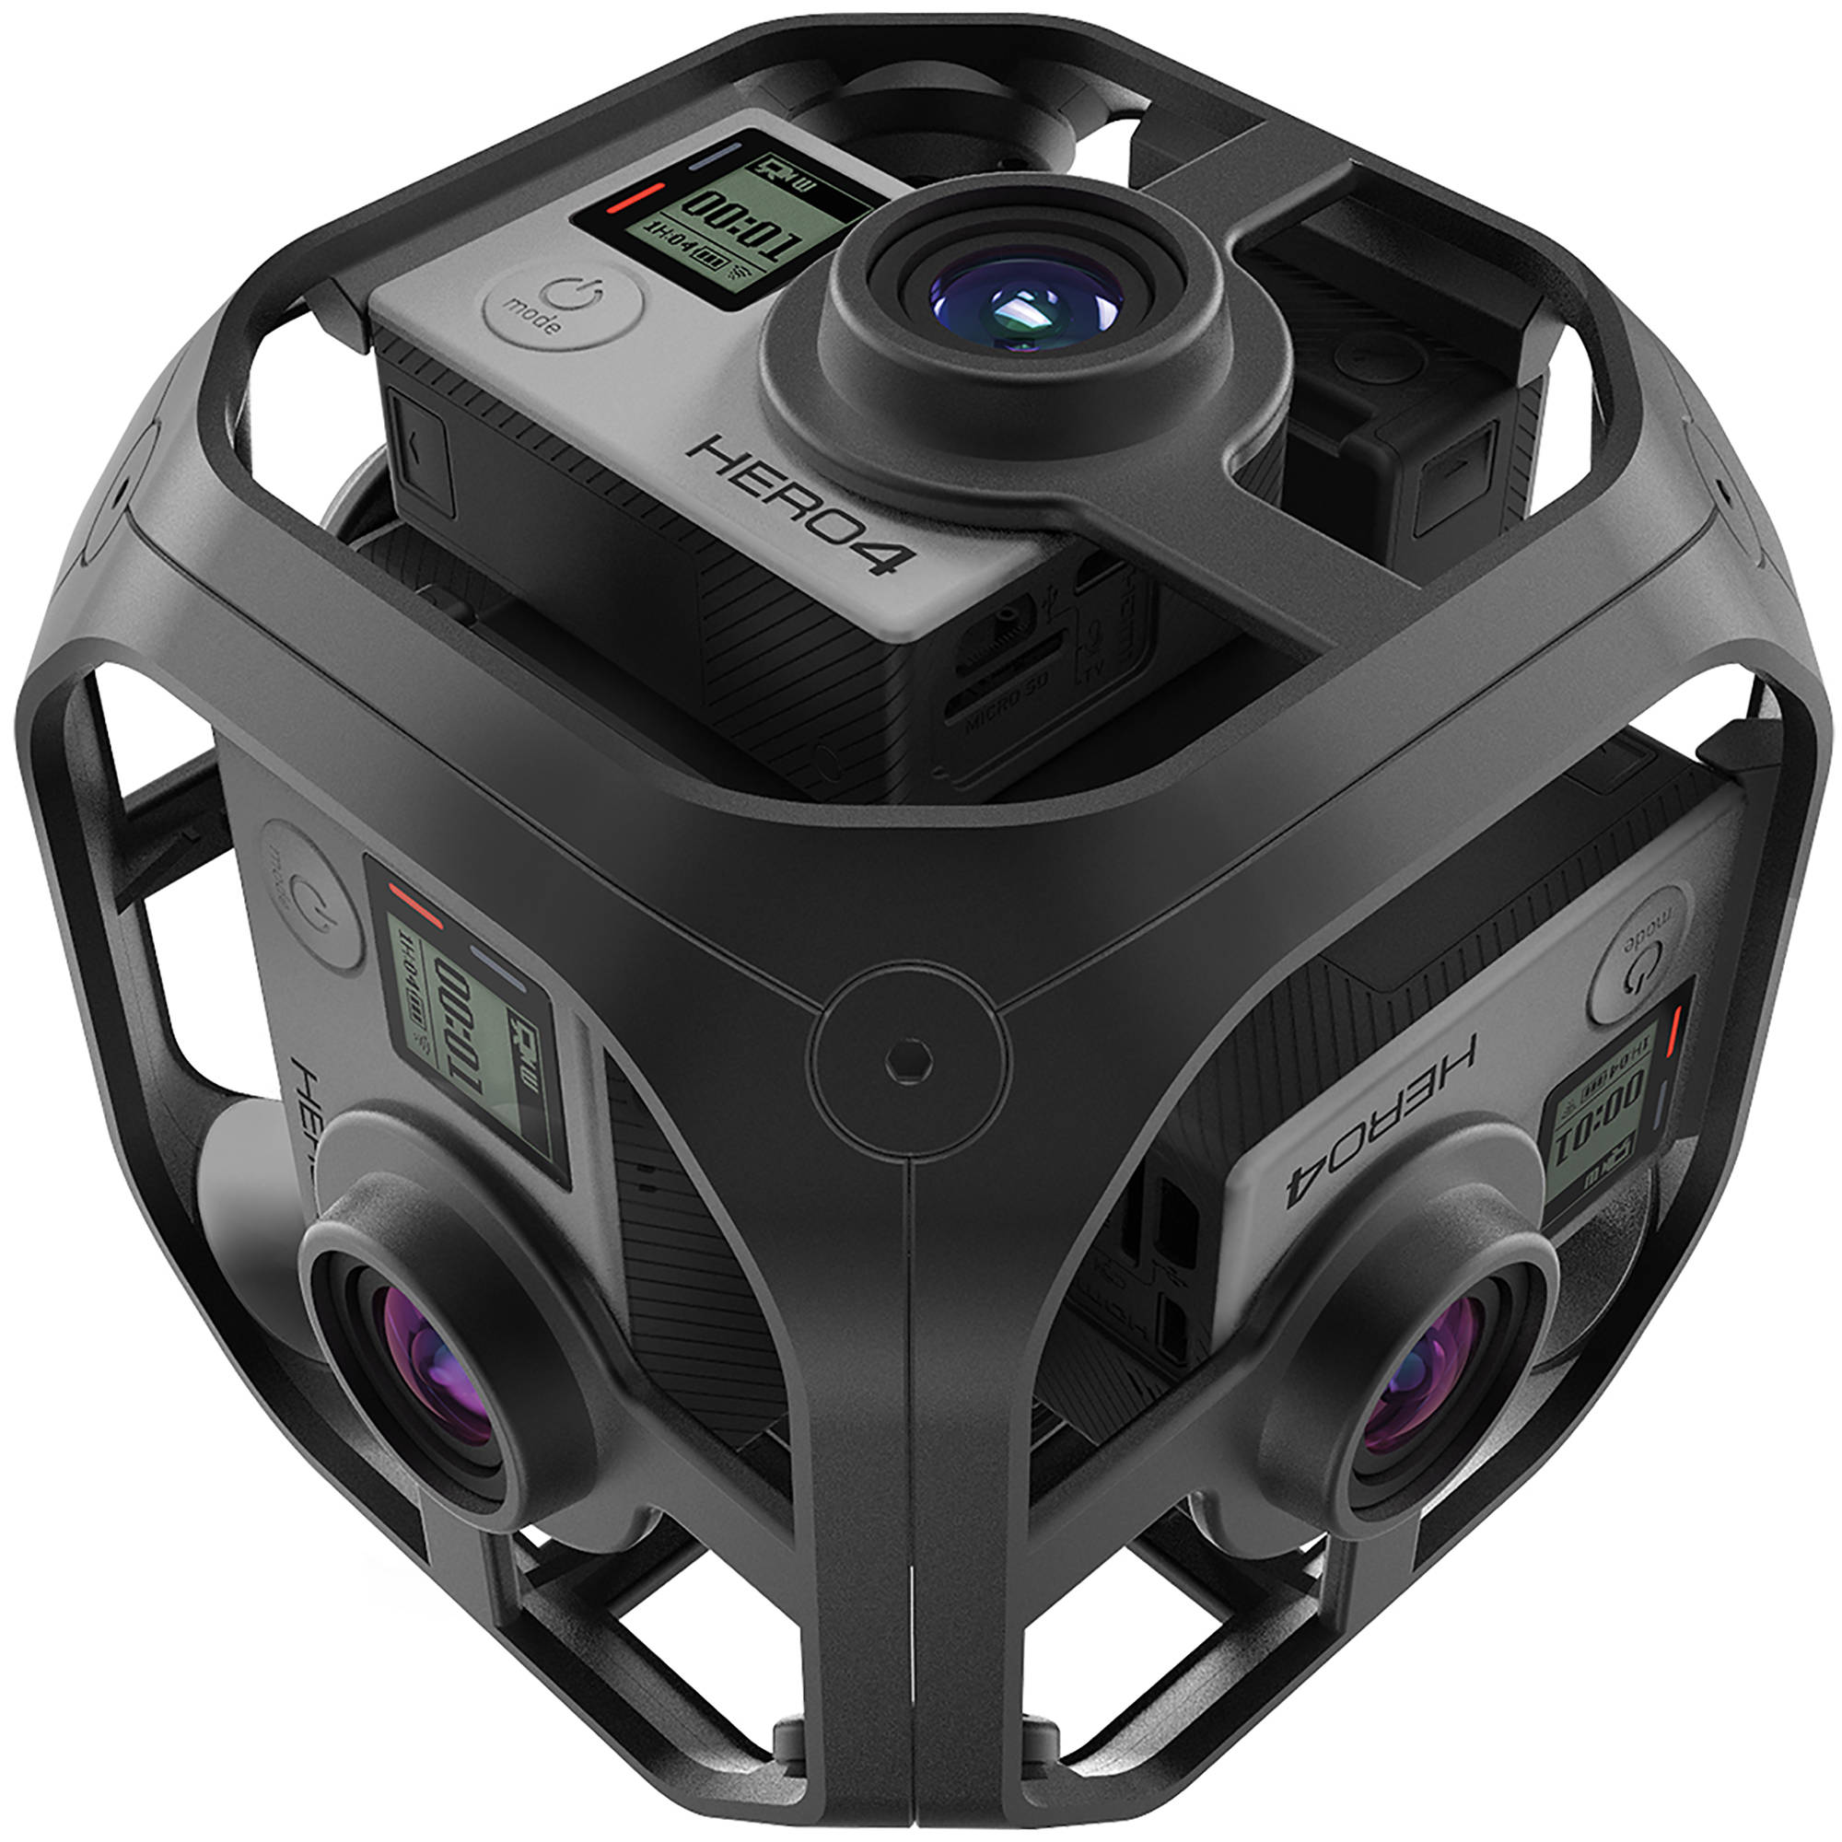
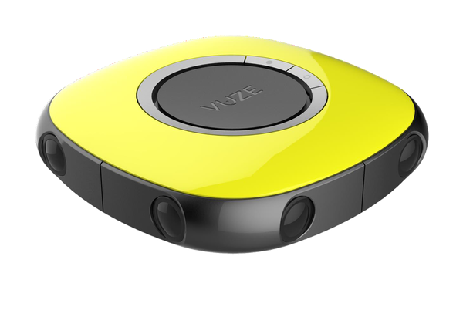
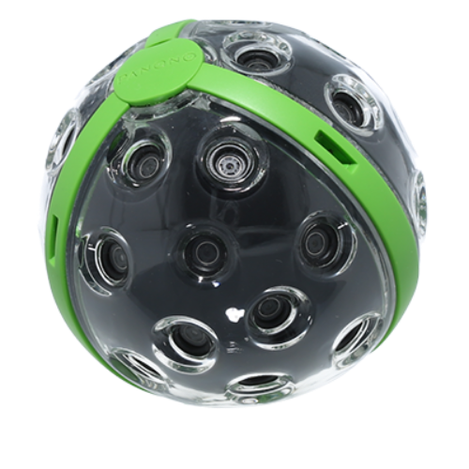
Popular 360 cameras
HOT
Single fisheye
Detu Sphere S
Dual fisheye
Ricoh Theta S
3 fisheye
GIROPTIC 360cam
4 fisheye
Detu F4
6 fisheye
Insta 360 Pro
2 standalone fisheye
Kodak SP360
6 cameras
GoPro Omni
8 cameras
Vuze 4K 3D 360 Spherical VR Camera
36 camaras
PANONO

Slide 16
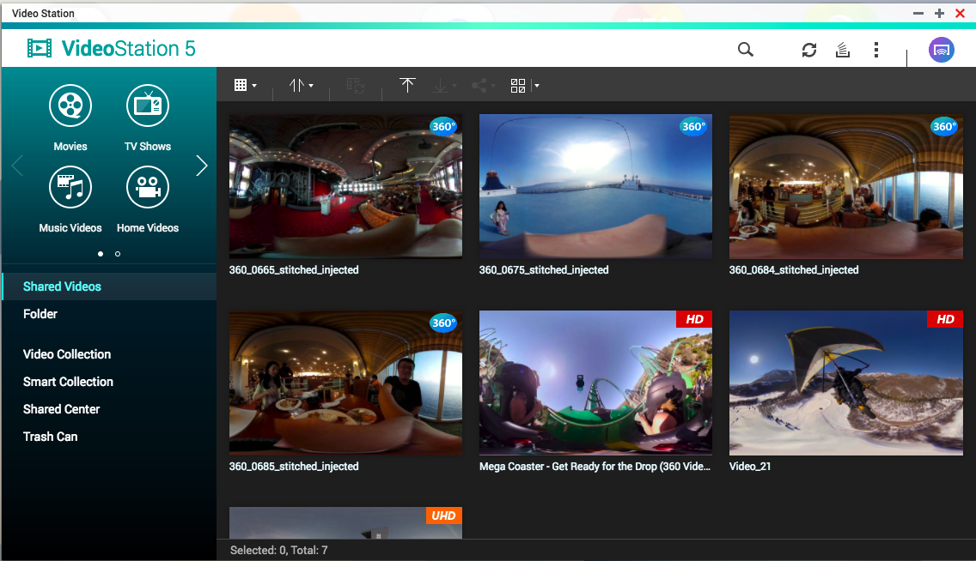
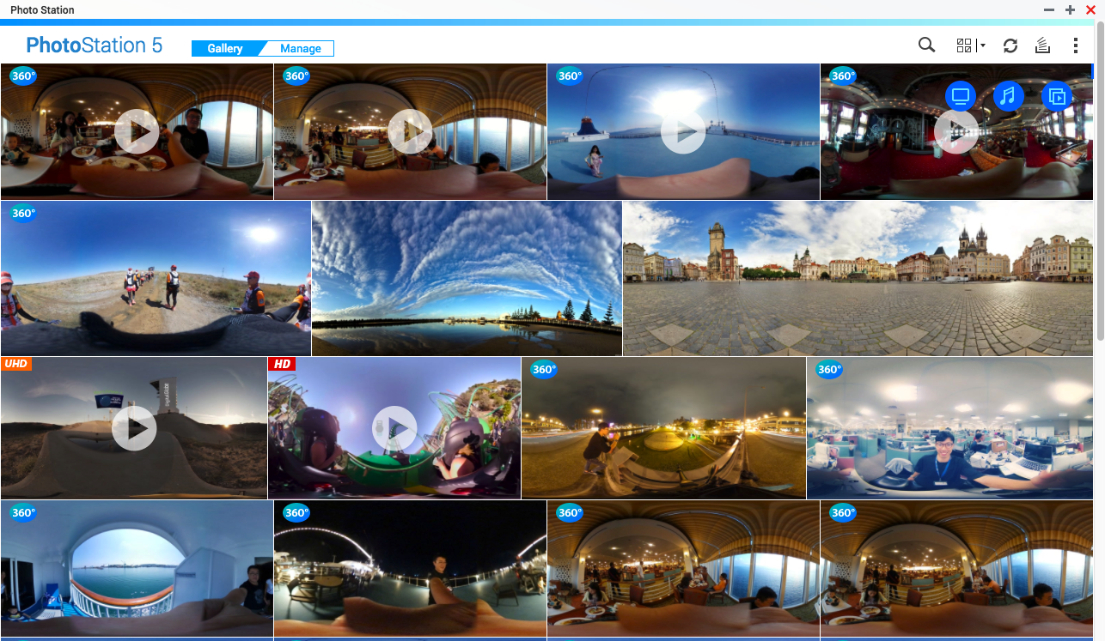
Supports 360° photo or video viewing on QTS 4.3.4

Slide 17
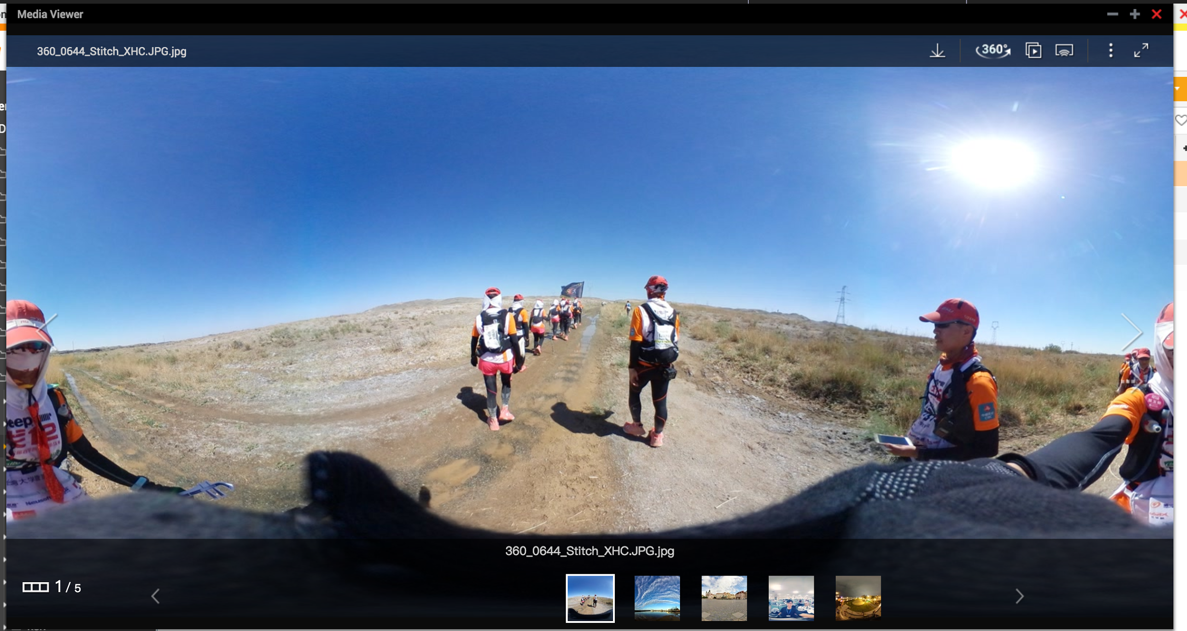
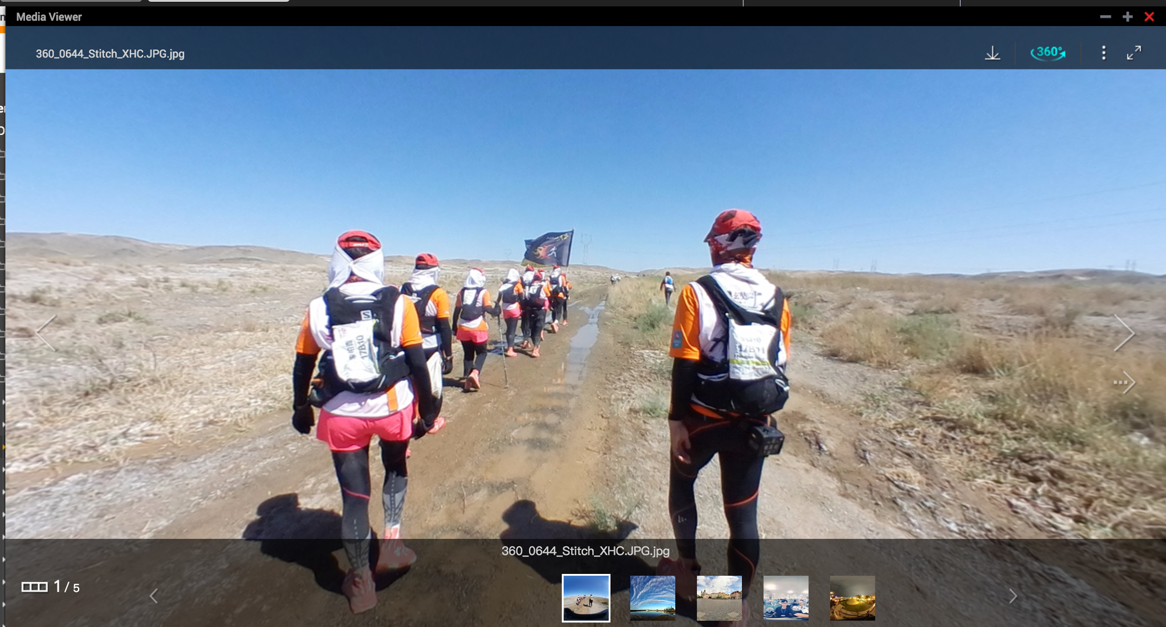
360° Photo and Video Viewing
Normal screen
360° playback screen
View different angles by using mouse

Slide 18
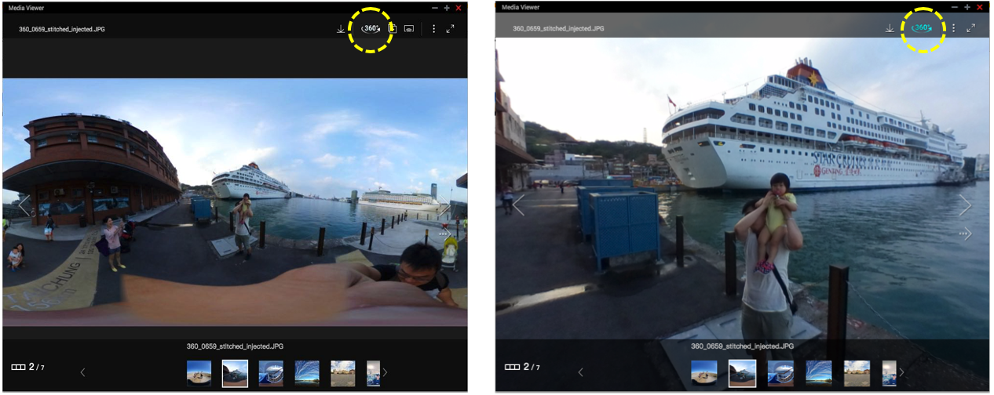
360° file information
If the file which have the following information, the player will initiate 360° playback function to view files
Projection Type= equirectangular
If the file doesn’t have this information, you can still play by clicking the 360° button

Slide 19
Supported Applications and Mobile Apps
Web-base Applications
File Station
Photo Station
Video Station
Qsirch
Mobile Apps
Qfile
Qphoto
Qvideo

Slide 20
Demo
TS-677
CPU：AMD Ryzen
RAM：8GB
GPU Card：Nvidia GTX 1050Ti
QTS Firmware 4.3.4
iPhone 6：
Giroptic iO 360 Camera
Qfile

Slide 21
THANK YOU

