Slide 1
Snapshots
for ARM-based NAS: Greater Data Protection
QNAP Systems, Inc.
Notes:
http://172.17.31.247:8080/cgi-bin/
TS-1635 with snapshot

Slide 2
ARM-based NAS: 40% of Market Share
NAS market share
40%
of NAS sold are ARM-based models
ARM
Advantage
60%
x86-based NAS
A high ROI storage solution for general users
Drawback
Fewer storage features due to hardware limitations
Notes:
標題可以再刪短一點

Slide 3
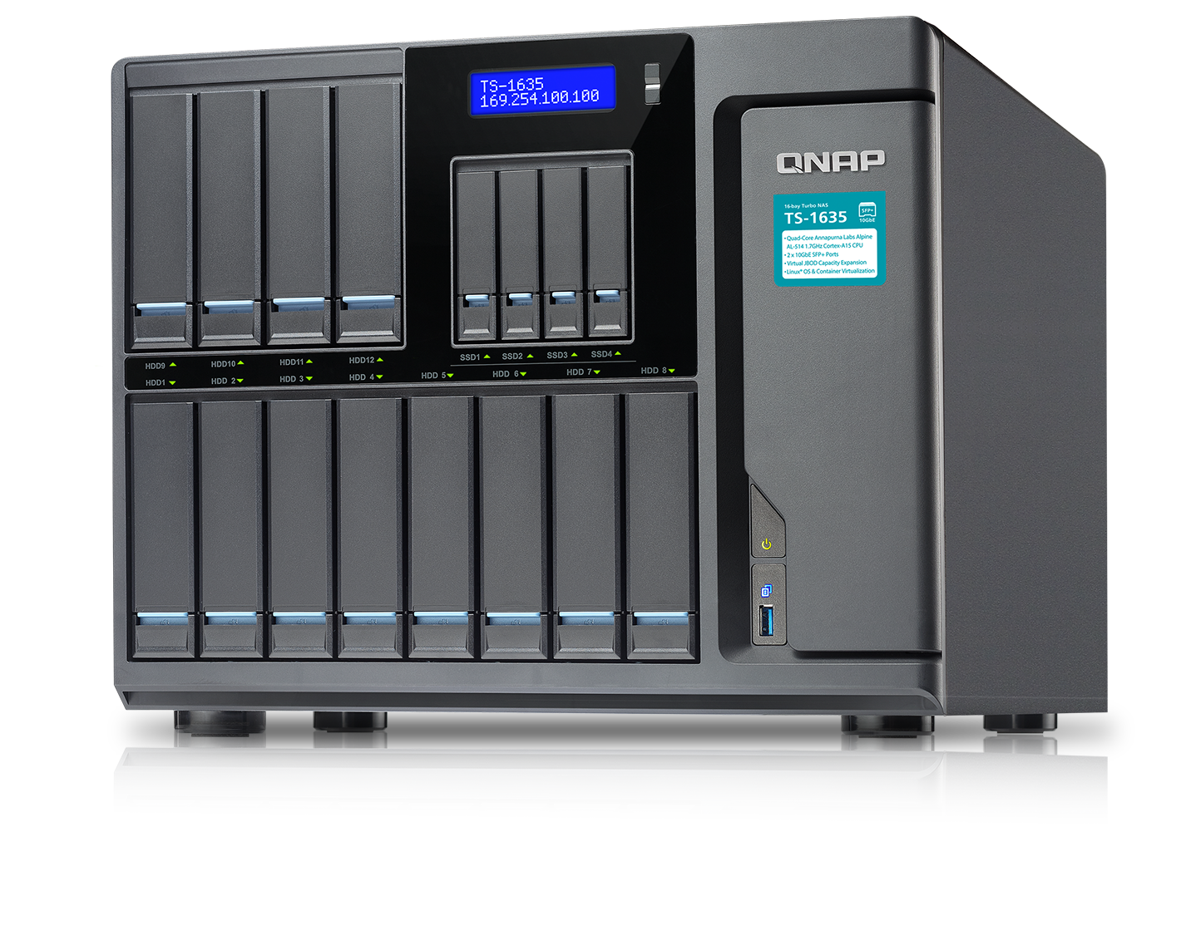
ARM-based NAS Now Supports Snapshots
Higher ROI
Before: Not supported due to limited memory and computing power.
Now: By working with Annapurna Labs, an Amazon company, ARM-based QNAP NAS can support snapshots from QTS 4.3.4.
QNAP NAS that utilizes Annapurna Labs processors: TS-x31X, TS-x31XU, TS-1635 and more.

Slide 4
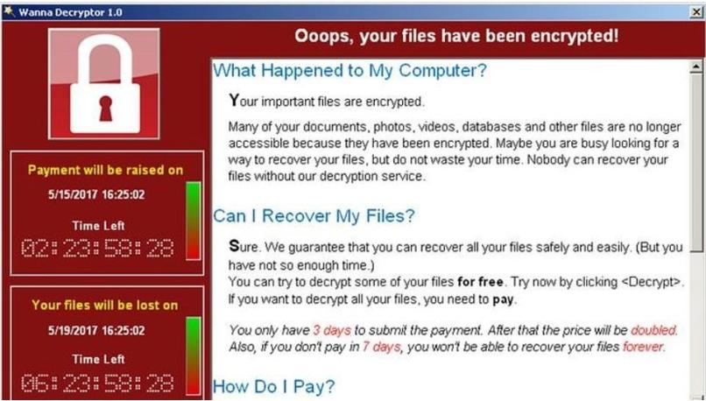
Fighting Ransomware Is Everyone’s Job Now
The WannaCry ransomware cyber-attack has hit more than 200,000 computers in 150 countries since Friday, Europol says.
Governments, hospitals and major companies have all found themselves battling the malware, which demands money in return for unfreezing computers.
- BBC
May 14, 2017: 12:54 PM ET

Slide 5
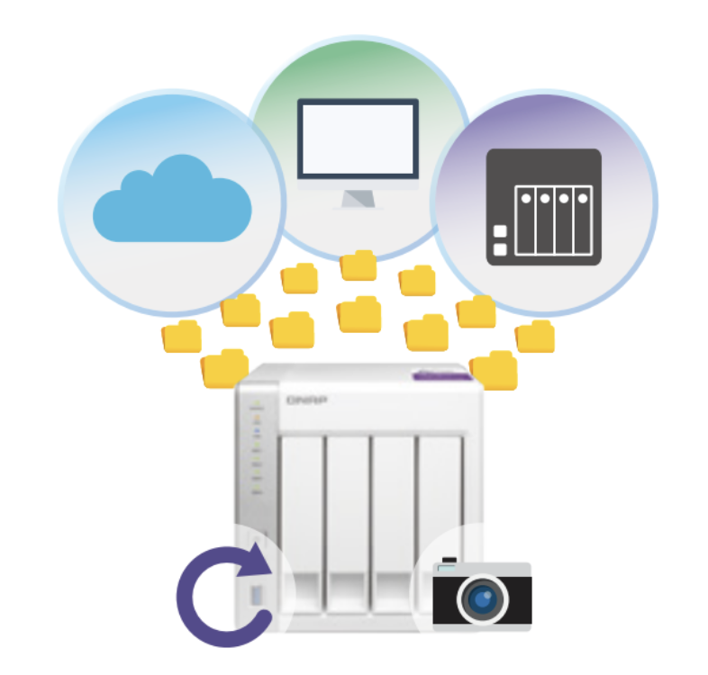
Why Are Snapshots Important?
Ransomeware can invade backup destinations through original data.
Data is protected by backups, but backups also need protection.
Block-based snapshot is the solution to protect backed up data.
Notes:
圖跟文字???好像搭不起來

Slide 6
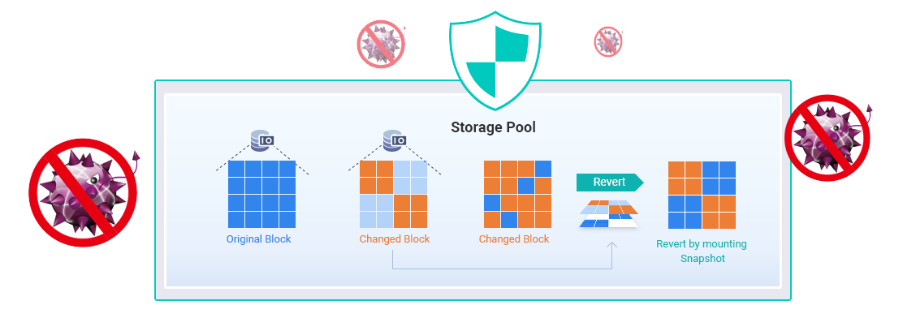
How Do Snapshots Work?
The QNAP implementation: block-based that are compatible with EXT4
Stored as read-only in the storage pool to prevent undesired modifications and to allow fast recovery
Only modified blocks will be stored. If more data is modified, more space is required to keep snapshots.
Notes:
字太多

Slide 7
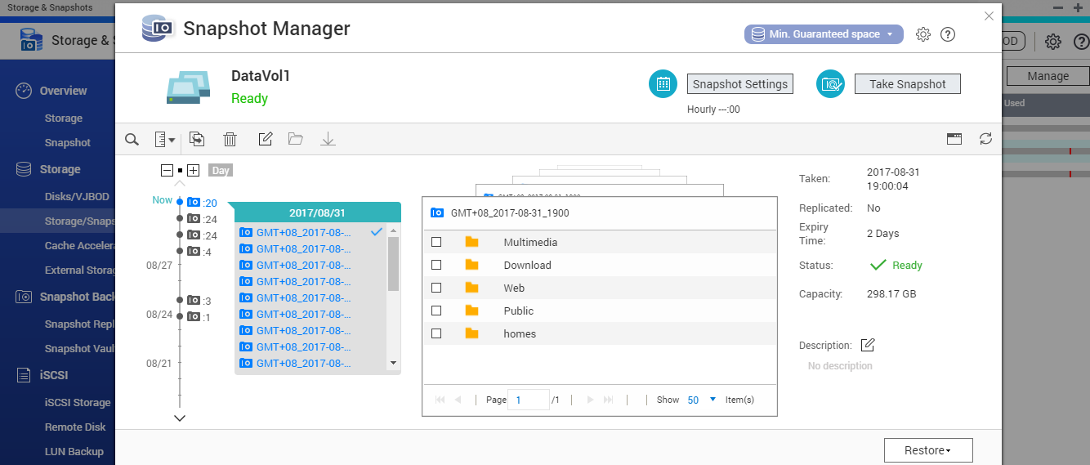
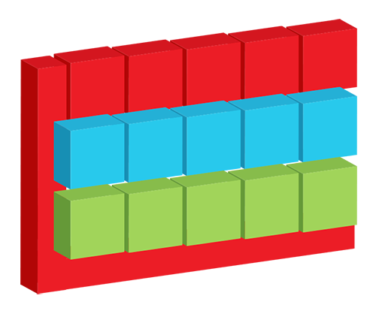
Snapshots for Both Volume and LUN
Whole volume/LUN snapshot
Up to 64 snapshots for each storage item for fast restoring.
Volume Snapshot
Block-based iSCSI LUN Snapshot
Notes:
磁碟區快照圖會再換

Slide 8
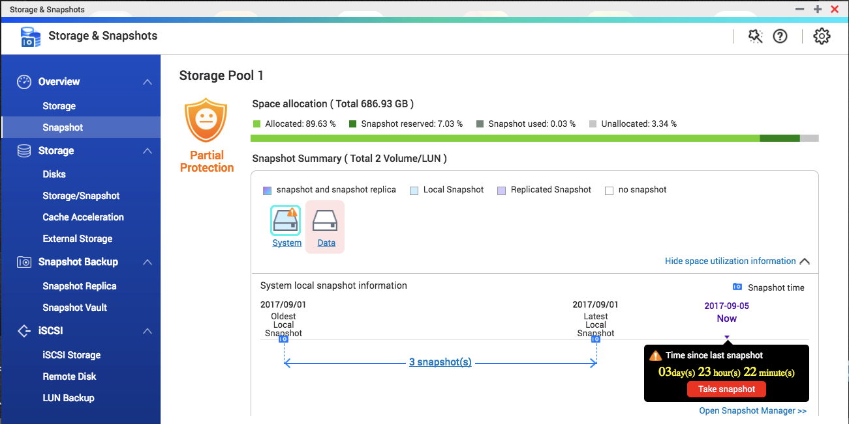
Protection Status at a Glance
Storage & Snapshots
A central storage and snapshots management interface
Snapshot Shared Folder
Create dedicated volume for each share to optimize snapshot protection

Slide 9
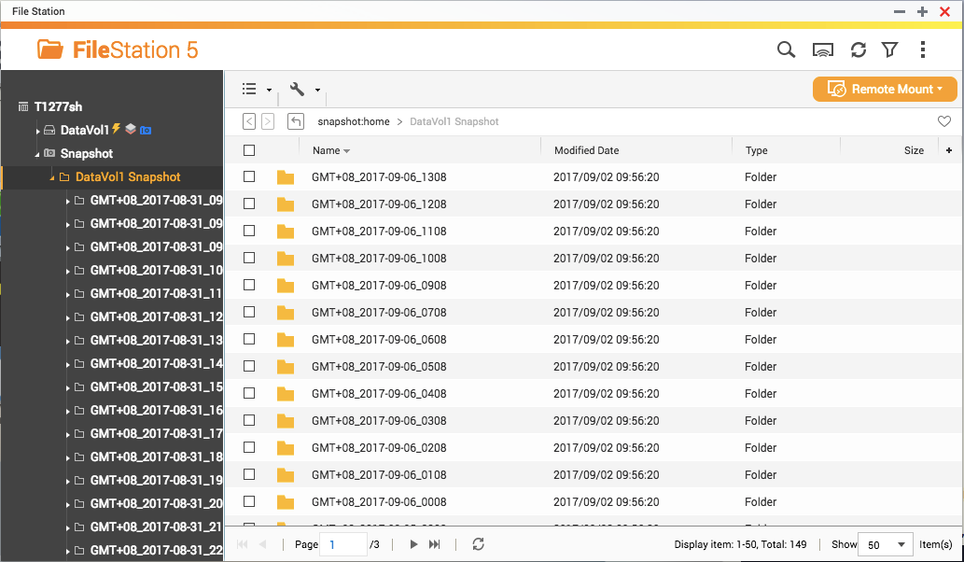
Intuitive Snapshot Management
File Station
Browse snapshots at where data has been used and quickly restore files through copy & paste.

Slide 10
Backup Snapshots to a Remote Site
Snapshot Replica
Snapshot Vault
Backup Snapshot Vault
Incrementally backup with snapshots
Restore from snapshots at a remote site
Multiple disaster recovery sites

Slide 11
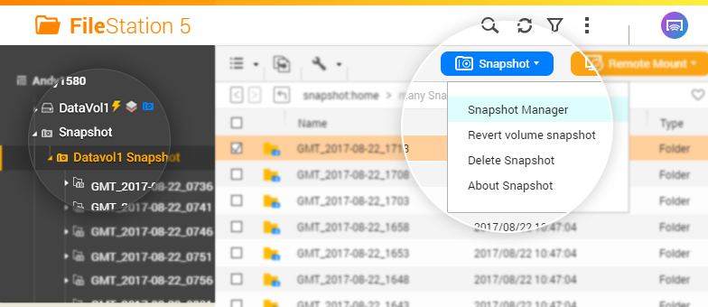
Select Different Restoring Methods On-demand
Local Restore
Revert the whole volume/LUN
Restore selected files
Restore to remote location
Copy & paste in File Station
Remote Restore
Restore from snapshot vault
Clone from snapshot vault
Copy & paste in File Station

Slide 12
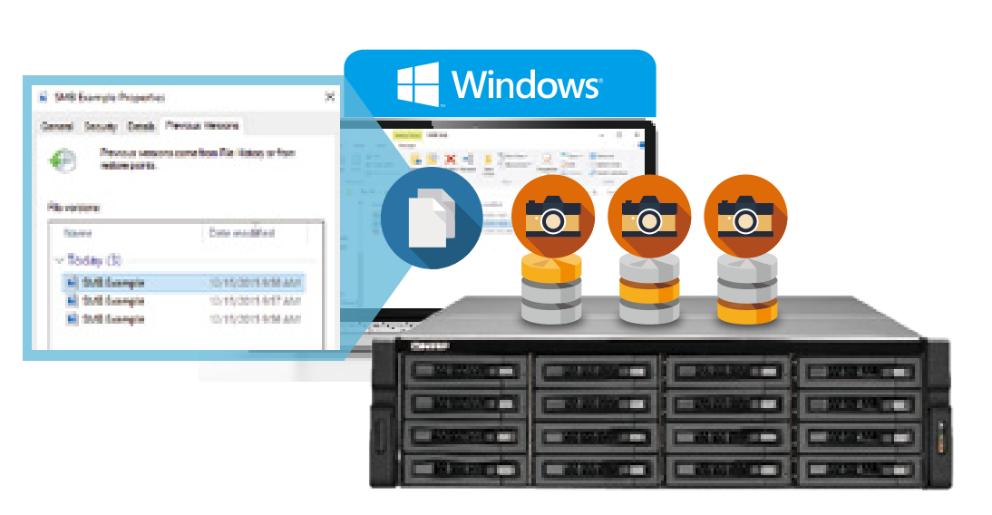
Supports Windows Previous Versions
Windows users can right-click on files in the NAS share folders to restore files directly
All users can view and restore contents of snapshots of privileged folders through SMB/CIFS/AFP/NFS protocols by copying and pasting

Slide 13
Plan Ahead Space Used for Snapshots
Snapshots will be stored in the free storage pool space, which may be allocated for other space usage at any time.
If free storage pool space is not enough, a thick volume can be converted to a thin volume to free up space
Storage Pool (10TB)
Volume 3TB (Thick)
Snapshot
Free
Volume 3TB (Thick)
Snapshot
Free
Volume 1TB / 3TB
(Thin)
Snapshot
Free

Slide 14
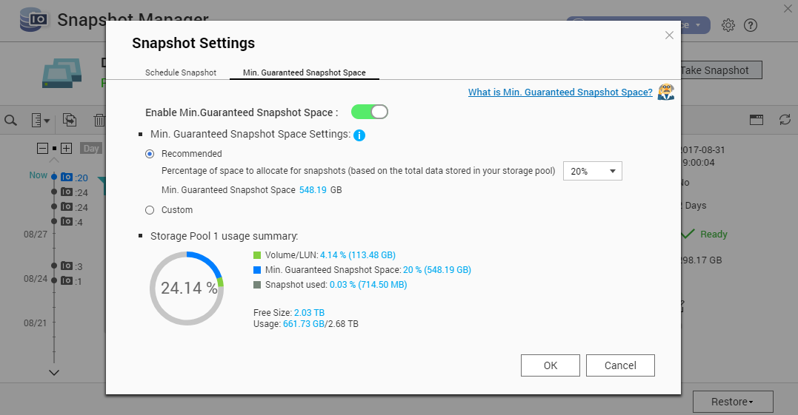
Supports Min. Guaranteed Snapshot Space
Creates a dedicated space in advance to store snapshots, to prevent ransomware from disrupting snapshot protections by keeping writing data

Slide 15
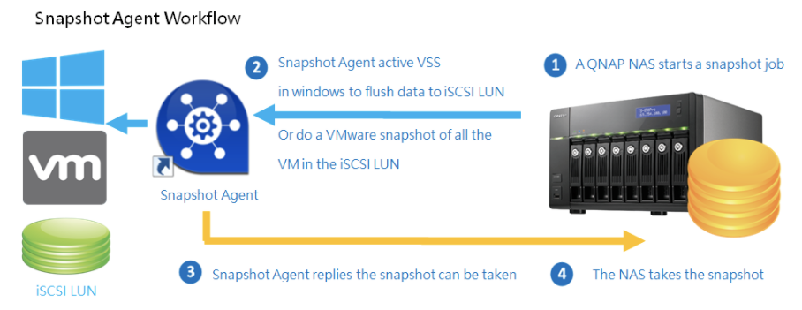
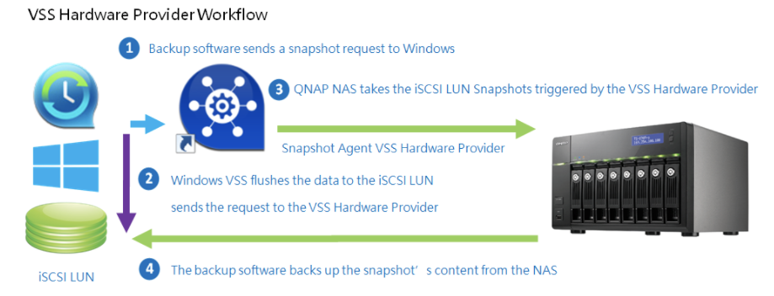
Snapshot Agents
Snapshot Agent helps to establish the communication between NAS, Microsoft® VSS, VMware® vSphere™ Client
Creates Application-consist snapshots

Slide 16
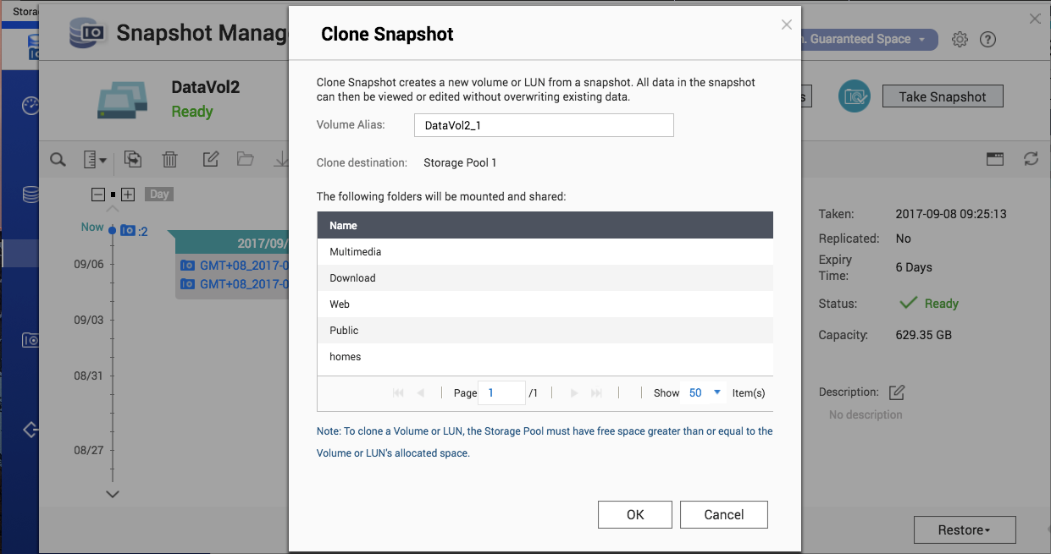
Snapshot Clone for Fast Creating Test Storage
Quickly creates a new volume or LUN based on a snapshot to test storage operations without affecting the production environment

Slide 17
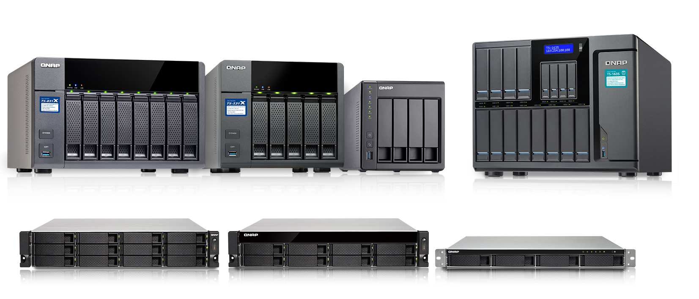
Coming Soon
Estimated time of release: Q4, 2017
Supported models: TS-x31X, TS-x31XU, TS-1635, etc.
To use the snapshot feature, at least 4GB RAM is required for the NAS

