Slide 2
Boxafe
中：全方位 Google Workspace 備份解決方案
英： Comprehensive SaaS Backup Solution for Google Workspace
Notes:
Boxafe
中：全方位 Google Workspace 備份解決方案
英： Comprehensive SaaS Backup Solution for Google Workspace

Slide 3
Boxafe secure and on-premise SaaS backup solution
The reasons why you need Boxafe
Boxafe comprehansively protect data in SaaS – Add support Microsoft Teams
IT friendly and easy management
Demo

Slide 4
Reasons Why You Need Boxafe Safeguard Business Data

Slide 5
Reasons why you need to backup SaaS content
Accidental Deletion
Malicious Deletion / Hacker
Ransomware Attack
Legal Compliance & Litigation Purpose
Keep previous data
SaaS providers asks you to protect data

Slide 6
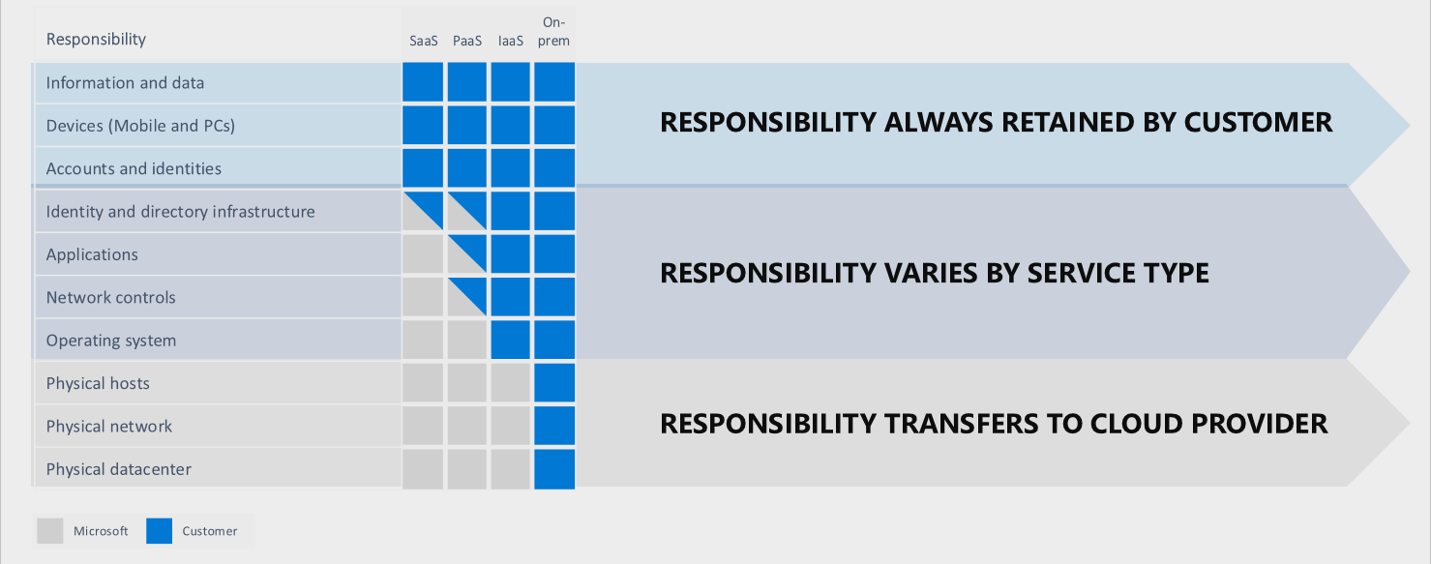
Microsoft’s Shared Responsibility Model
Microsoft tells you that it’s your responsibility to protect your data.
https://docs.microsoft.com/en-us/azure/security/fundamentals/shared-responsibility

Slide 7
Microsoft’s Standard Recovery Policy
Your data is not always protected by Microsoft!
30 days
(1 month)
14
days
Mail
Delete
Keep in recycle bin
Recoverable
Permanently deleted
Contacts
Delete
Keep in recycle bin
Recoverable
Permanently deleted
93 days
(3 months)
14
days
OneDrive
Delete
Keep in 1st and 2nd recycle bin
Recoverable
Permanently deleted
SharePoint
Delete
Keep in 1st and 2nd recycle bin
Recoverable
Permanently deleted

Slide 8
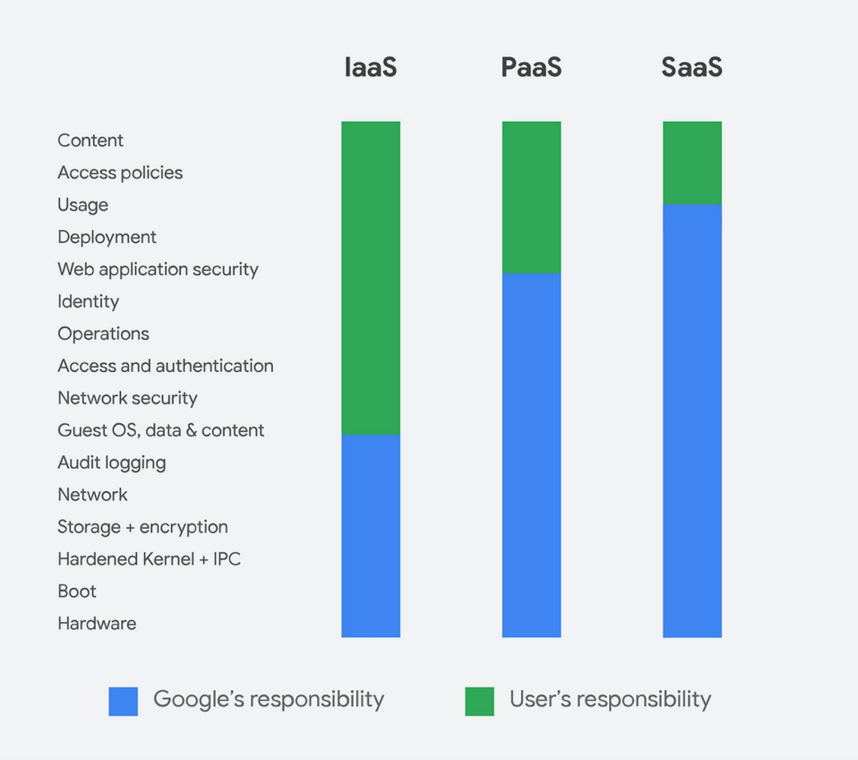
Google’s Shared Responsibility Model
Google tells you that it’s your responsibility to protect your content.
https://services.google.com/fh/files/misc/google_workspace_data_protection_guide_en_dec2020.pdf
Notes:
https://services.google.com/fh/files/misc/google_workspace_data_protection_guide_en_dec2020.pdf

Slide 9
Google’s Standard Recovery Policy
Your data is not always protected by Google!
30 days
(1 month)
Gmail
Delete
Keep in trash
Permanently deleted
Calendar
Delete
Keep in trash
Permanently deleted
Contacts
Delete
Recoverable
Permanently deleted
25 days
My Drive / Shared Drive
Delete
Keep in trash
Recoverable
Permanently deleted

Slide 10
Boxafe safeguards your Business data!
Boxafe protects
Gmail
Calendar
My Drive / Shared Drive
Contacts
Outlook (mail, calendar, contacts)
OneDrive
SharePoint
Teams
with
Friendly UI
Security
Reliability
Data Centralization

Slide 11
Boxafe safeguards your Business data!
Boxafe protects
Outlook (mail, calendar, contacts)
OneDrive
SharePoint
Teams
with
Friendly UI
Security
Reliability
Data Centralization

Slide 12
Boxafe safeguards your Business data!
Boxafe protects
Gmail
Calendar
My Drive / Shared Drive
Contacts
with
Friendly UI
Security
Reliability
Data Centralization

Slide 13
Boxafe is reliable
More than 20K organizations protect data by Boxafe
See what the users said:
We were looking for a flexible backup solution for Microsoft 365 and Google Workspace for our customers. Boxafe is working fine.
Great to have Boxafe to protect our Microsoft 365 environment.
It works great on the whole.
Backups have run now for all accounts and everything seems to work fine.

Slide 14
Boxafe comprehensively protect data in SaaS Add support Microsoft Teams Backup

Slide 15
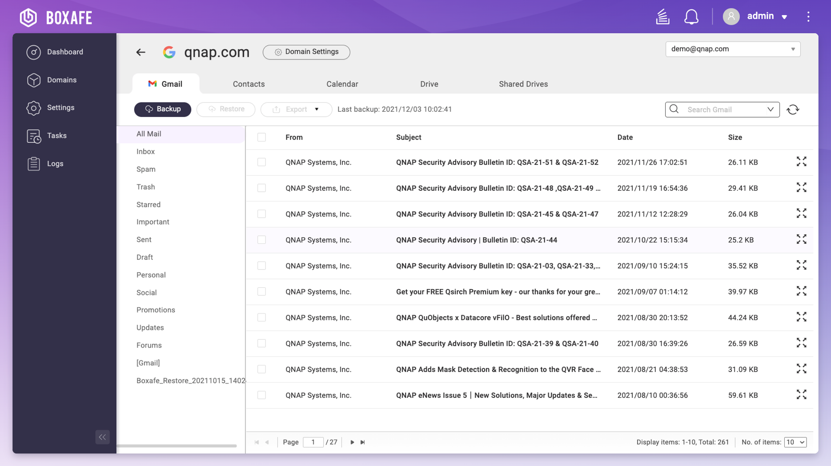
Google Workspace - Gmail
Comprehensive protection
Backup Items
Email content and attachment
Email folder structure
Search Criteria
Subject, From, To, Cc, Bcc, and location of email
Restore Options
Granularly restore
Cross-account restore

Slide 16
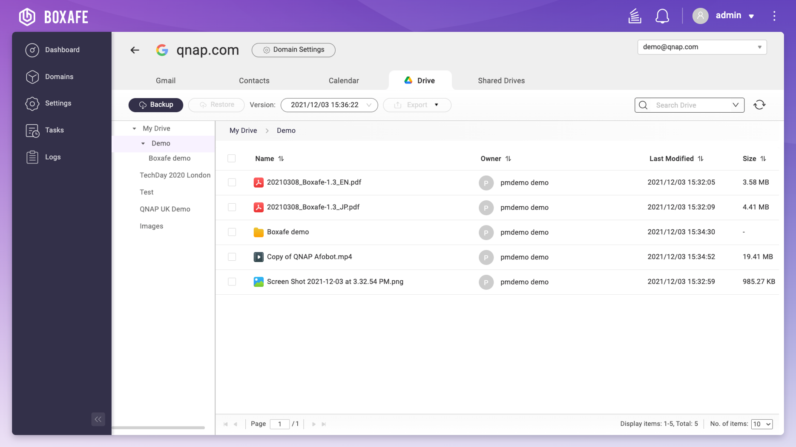
Google Workspace - Drive
Comprehensive protection
Backup Items
All files in My Drive and Shared Drive including Google Documents
Folder structure
File metadata and permissions
Search Criteria
File types, Owner, Date modified, Name
Restore Options
Granularly restore
Cross account / cross shared drive restore

Slide 17
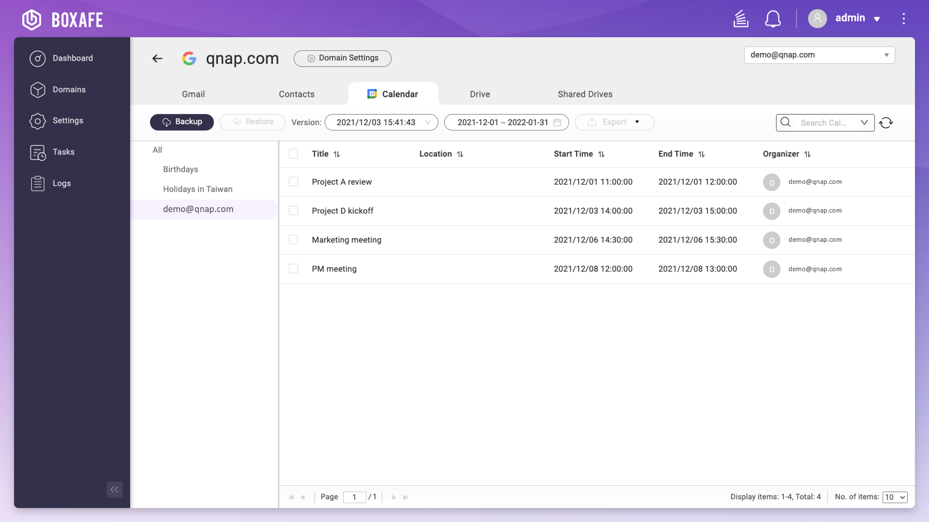
Google Workspace - Calendar
Comprehensive protection
Backup Items
All calendars and data including event information and attachments
Search Criteria
Calendars, Organizer, Title, and Location
Restore Options
Granularly restore
Cross-account restore

Slide 18
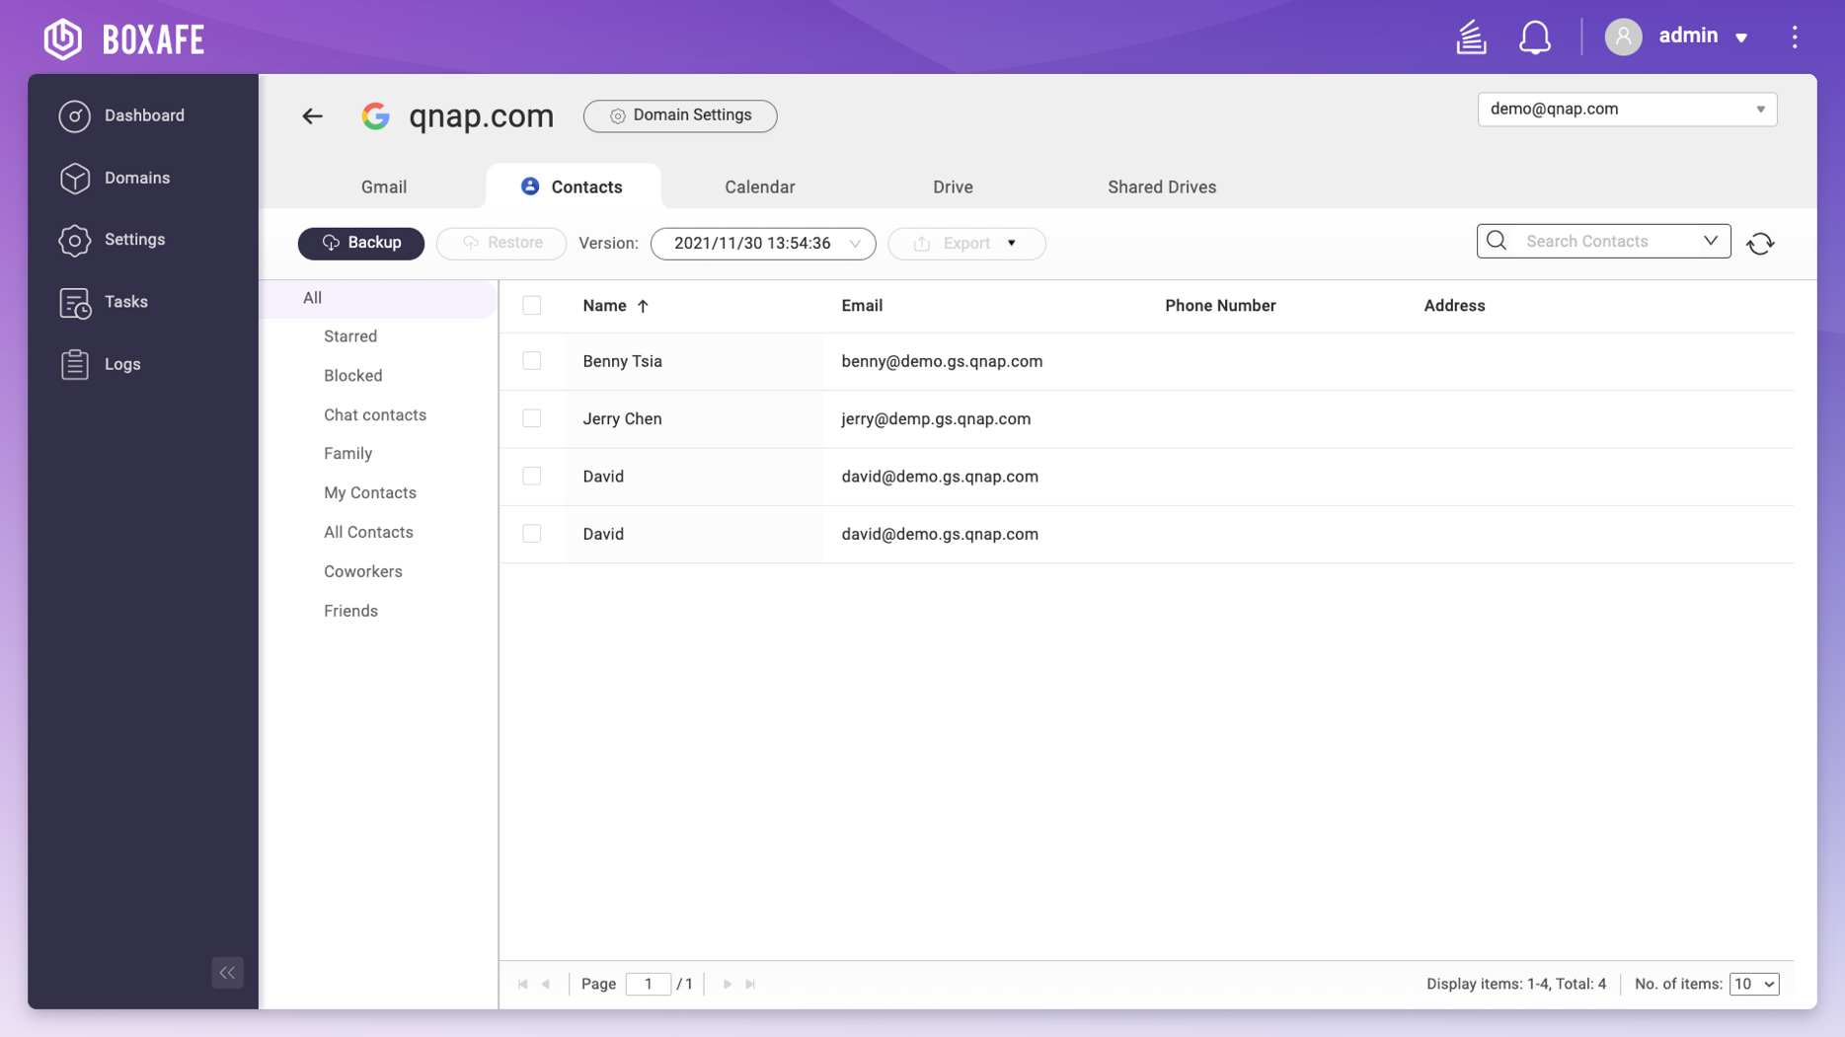
Google Workspace - Contacts
Comprehensive protection
Backup Items
All contacts data
Contact group
Search Criteria
Name, Email, Nickname, Occupation, and Phone number
Restore Options
Granularly restore
Cross-account restore

Slide 19
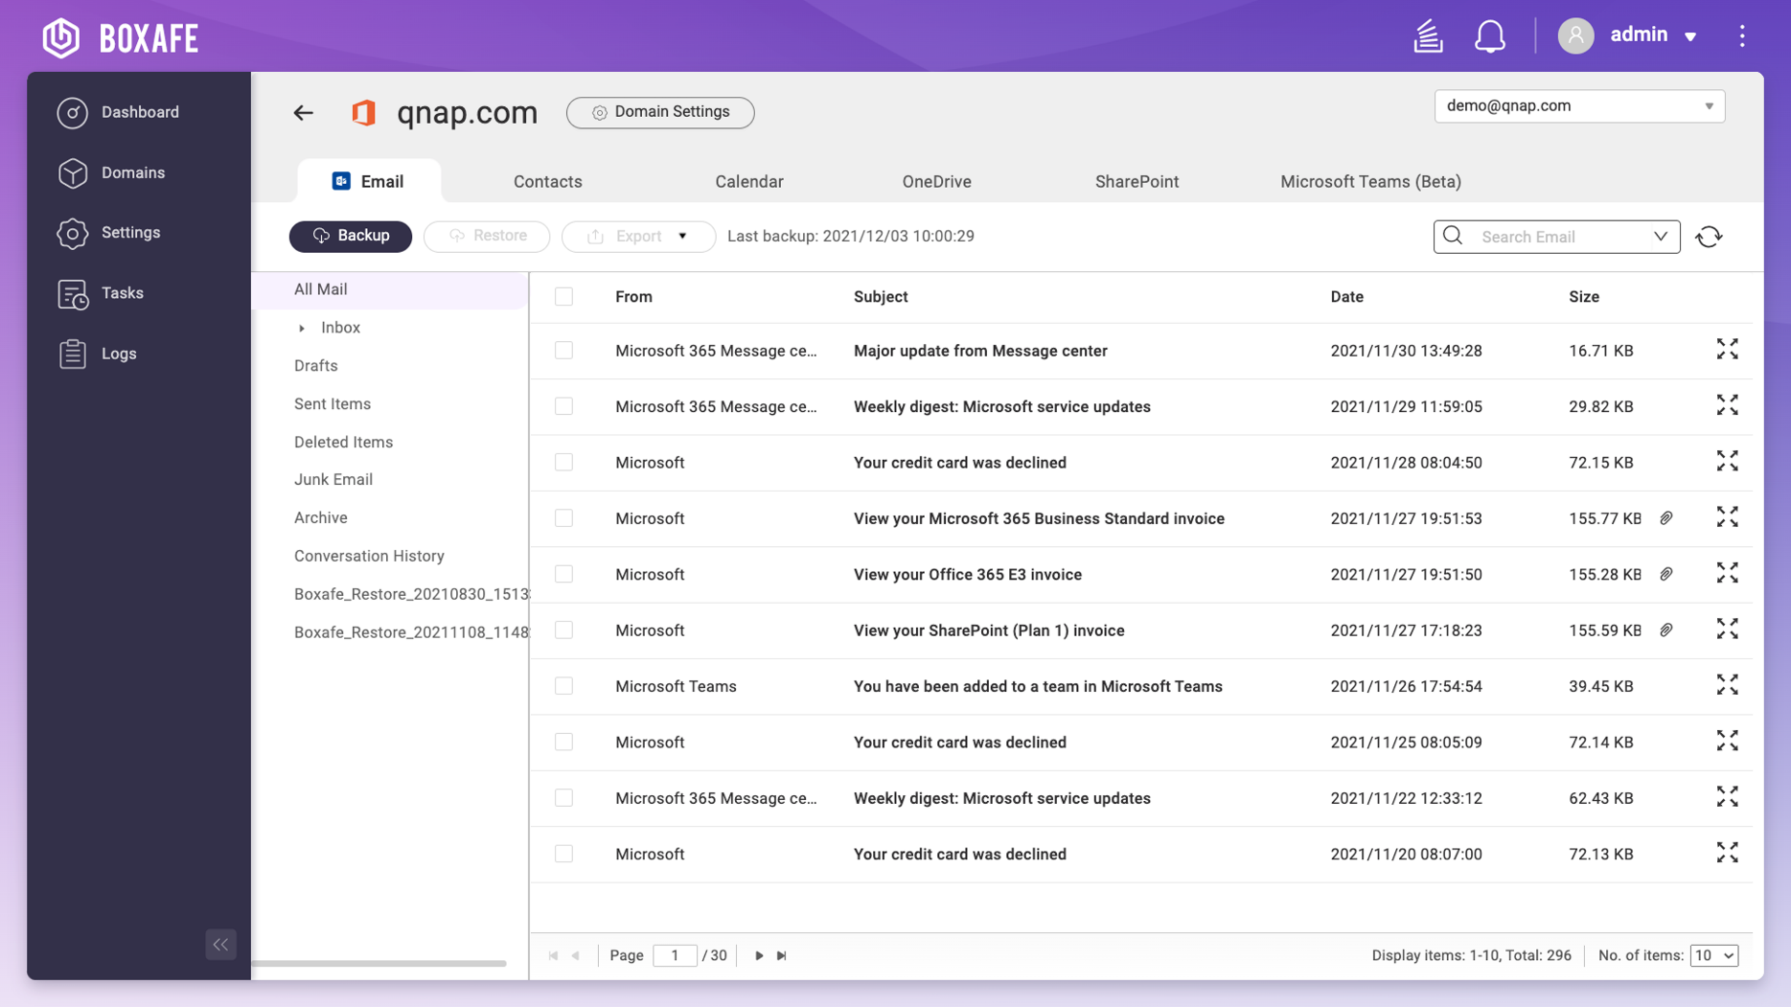
Microsoft 365 - Outlook mail
Comprehensive protection
Backup Items
Personal mailbox and shared mailboxes
Email content and attachment
Email folder structure
Search Criteria
Subject, From, To, Cc, Bcc, and location of email
Restore Options
Granularly restore
Cross-account restore

Slide 20
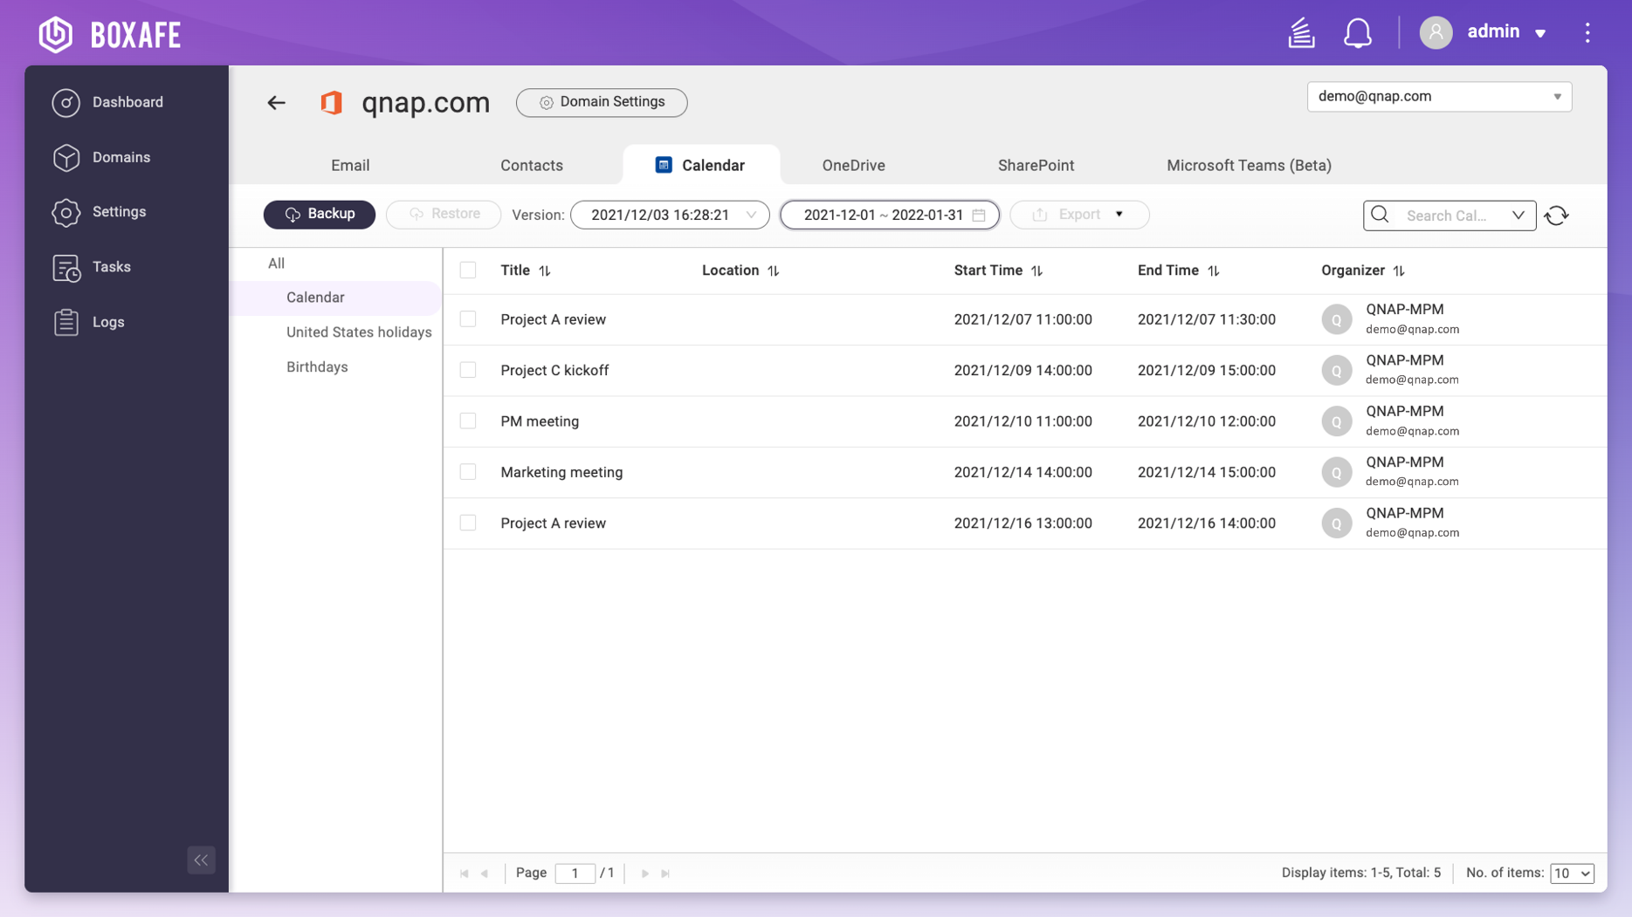
Microsoft 365 - Outlook calendar
Comprehensive protection
Backup Items
All calendars and data including event information and attachments
Search Criteria
Calendars, Organizer, Title, and Location
Restore Options
Granularly restore
Cross-account restore

Slide 21
Microsoft 365 - Outlook contacts
Comprehensive protection
Backup Items
All contacts data
Contact group
Search Criteria
Name, Email, Nickname, Occupation, and Phone number
Restore Options
Granularly restore
Cross-account restore

Slide 22
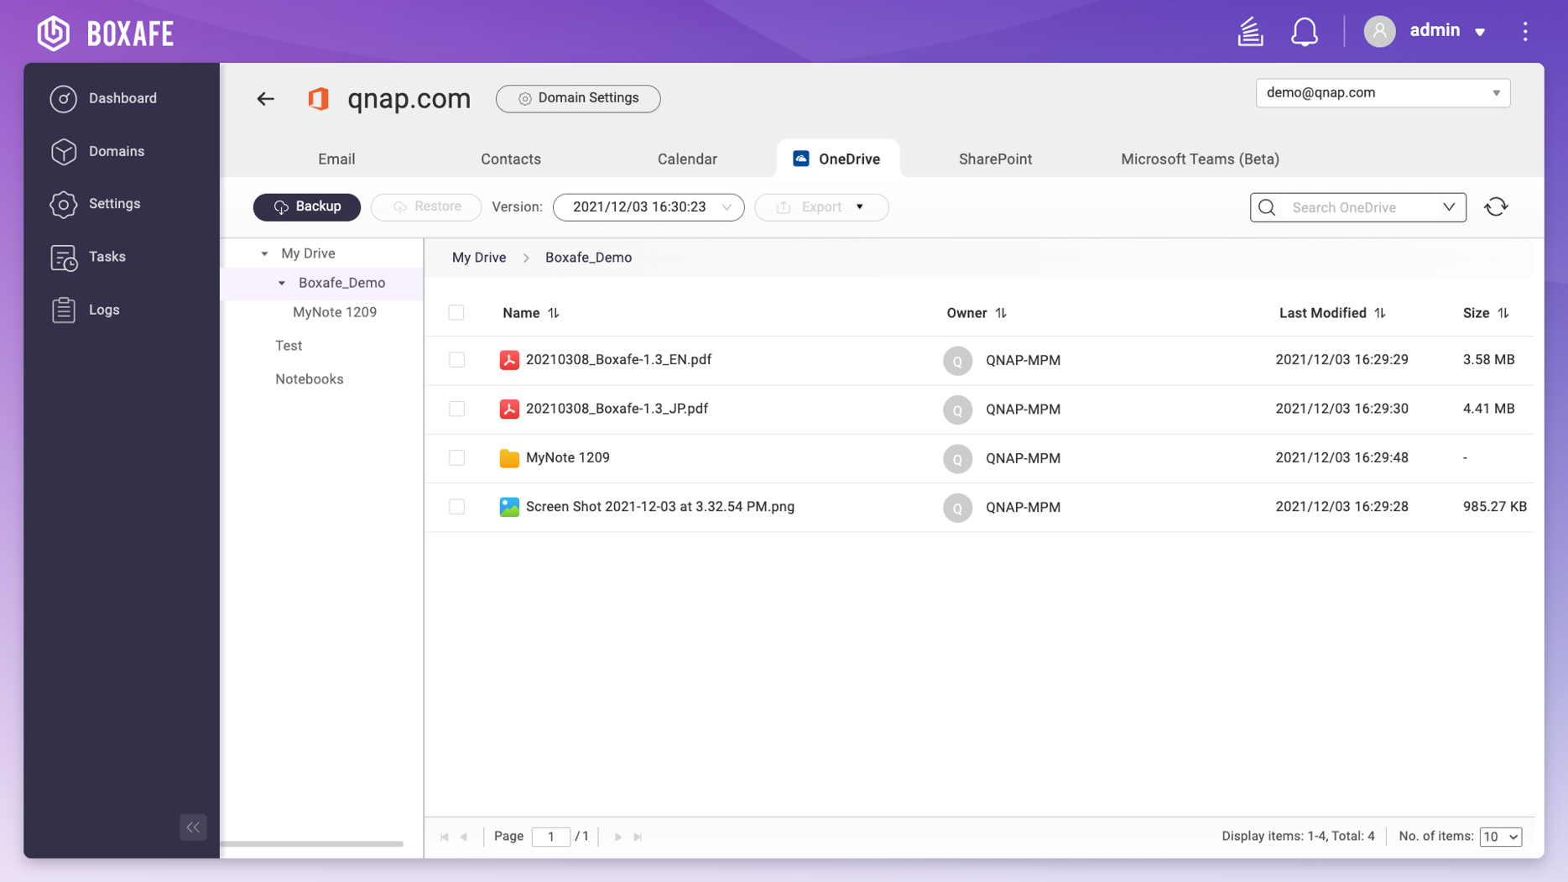
Microsoft 365 - OneDrive
Comprehensive protection
Backup Items
All files including OneNote
Folder structure
File metadata and permissions
Search Criteria
File types, Owner, Date modified, Name
Restore Options
Granularly restore
Cross account restore

Slide 23
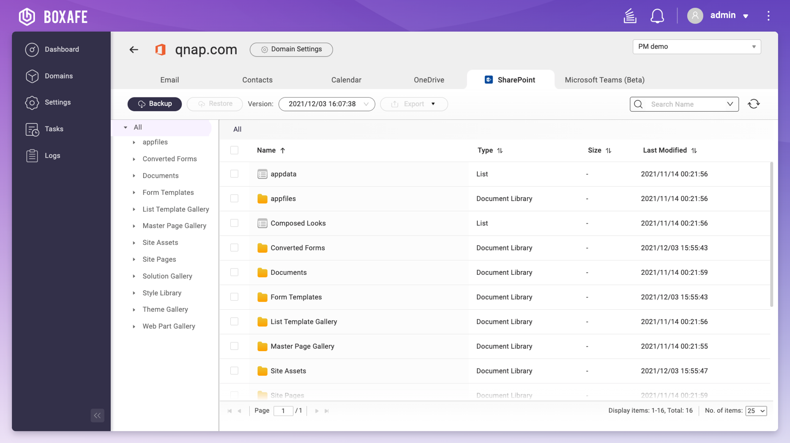
Microsoft 365 - SharePoint
Comprehensive protection
Backup Items
Document libraries
Page libraries
Lists
Site assets
OneNote
Search Criteria
File types, Date modified, Name
Restore Options
Granularly restore
Cross site restore

Slide 24
Boxafe 1.5 now supports Microsoft Teams backup!
What is Microsoft Teams?
An integrated service helps businesses for the purpose of
Communication
Meeting
File sharing
Notes:
https://www.microsoft.com/en-us/investor/events/fy-2021/earnings-fy-2021-q4.aspx

Slide 25
Comprehensive protection for Microsoft Teams
Boxafe backup all the data you care in Microsoft Teams:
Conversation:
posts in the channels
Site:
files shared in the Teams
Calendar:
Teams meeting information

Slide 26
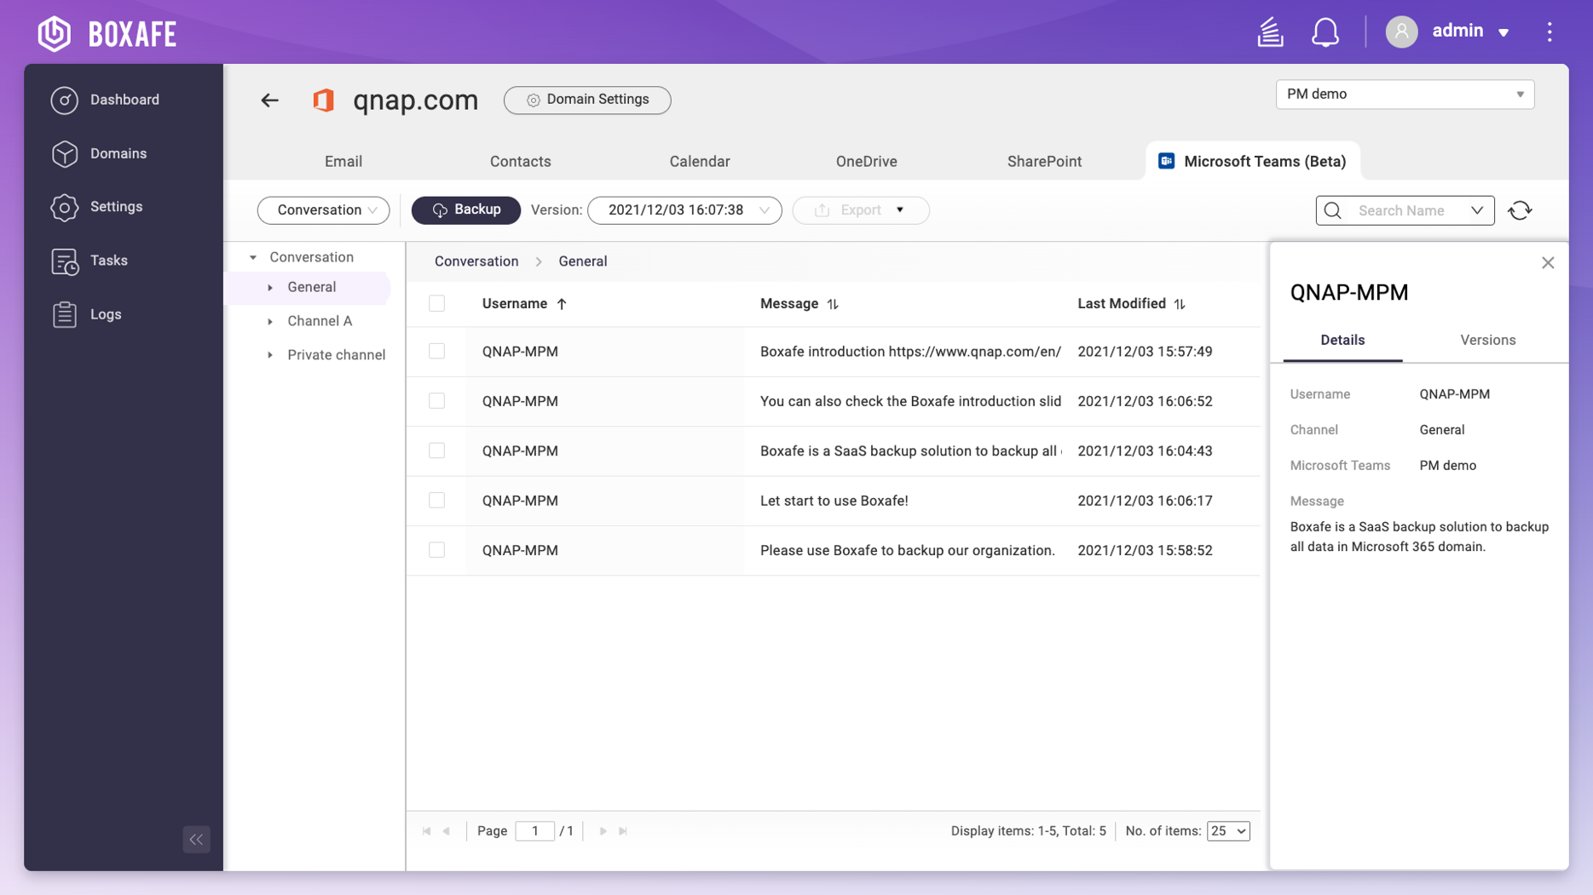
Microsoft 365 - Teams conversation
Comprehensive protection
NEW
Backup Items
Posts in every public and private channels
Search Criteria
Channel, Message text
Restore Options
Post can not be restored due to Microsoft limitation. You can export posts as the html file for audit purpose.

Slide 27
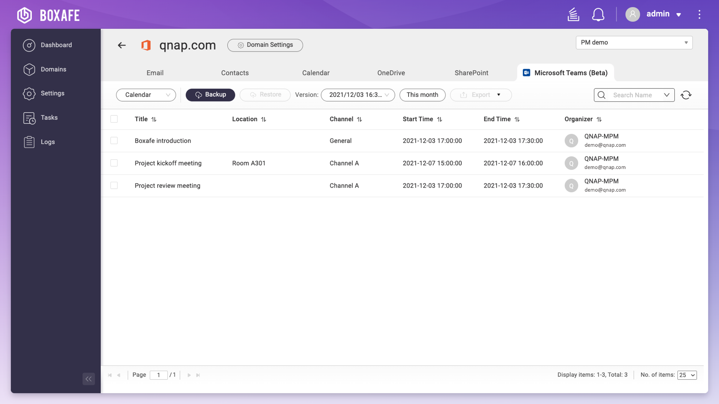
Microsoft 365 - Teams calendar
Comprehensive protection
NEW
Backup Items
All calendars and data including event information and attachments
Search Criteria
Organizer, Channel, Title, and Location
Restore Options
Granularly restore
Restore data to personal account

Slide 28
Microsoft 365 - Teams Site
Comprehensive protection
NEW
Backup Items
Document libraries
Page libraries
Lists
Site assets
OneNote
Search Criteria
File types, Date modified, Name
Restore Options
Granularly restore
Cross site restore

Slide 29
IT friendly and easy management

Slide 30
Dashboard for domains management
Manage multiple domains with dashboard
Protection status
Data consumption
Upcoming Scheduled Tasks
Recent Tasks Report

Slide 31
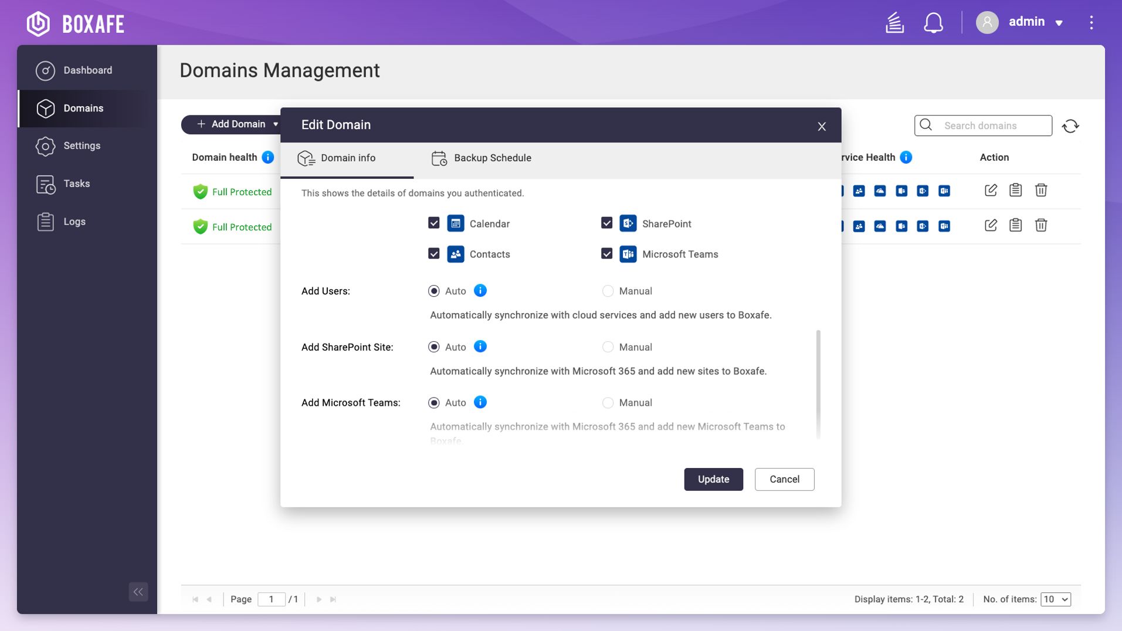
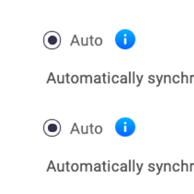
Add new accounts automatically
Ensure everything are protected!
When a new account, Google Shared Drive, Microsoft SharePoint, Teams are added on the cloud, Boxafe will automatically add them to the backup task

Slide 32
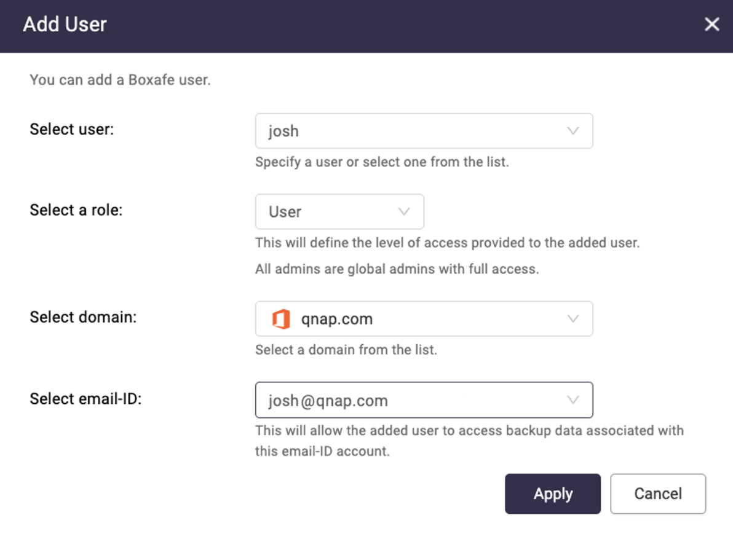
Multiuser access for self-service restore
Backed up data cannot be accessed by unauthorized personnel.
Restoring data to the cloud can be done by user.

Slide 33
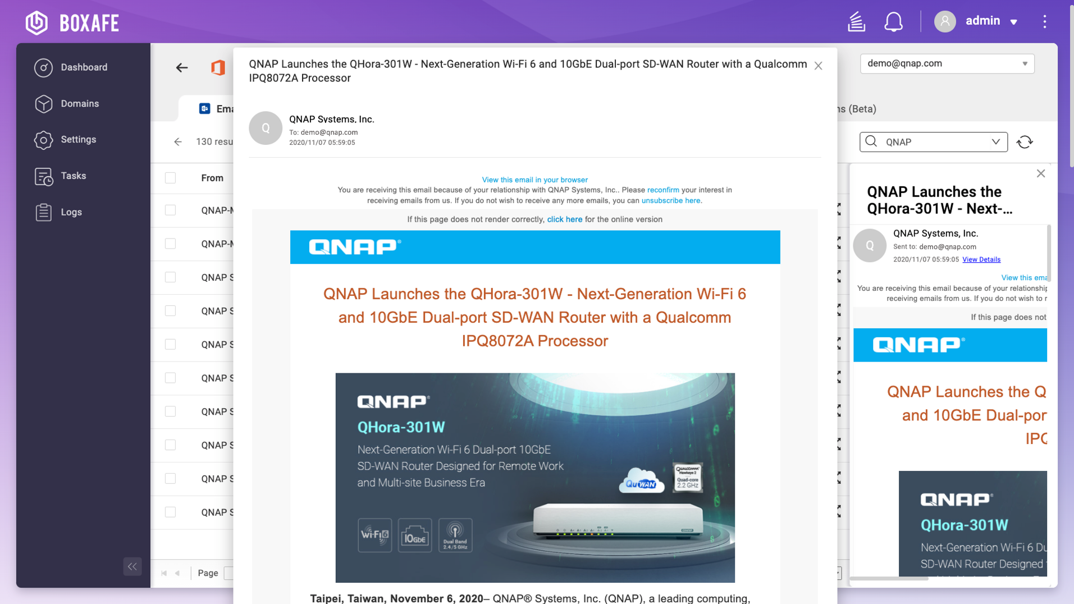
Backup data preview
Search and preview data before restoring

Slide 34
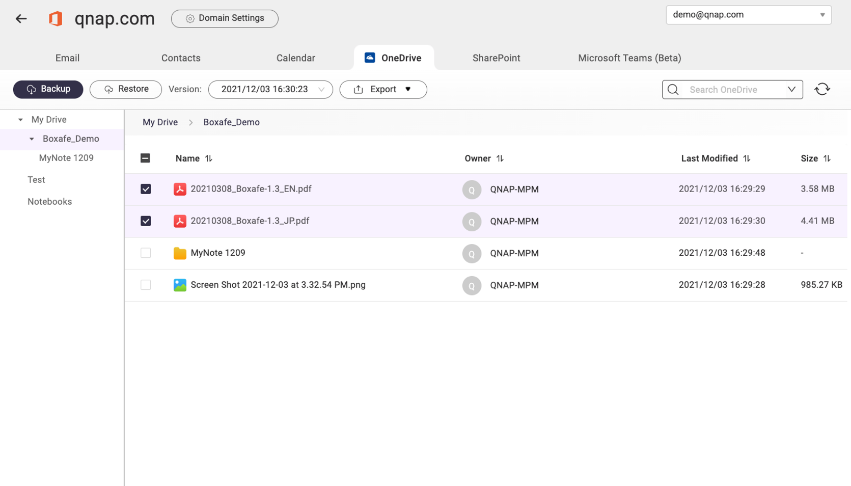
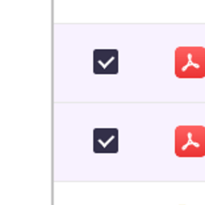
Select data for granular restore
Multiple select data to restore to the account. No need to restore full backup every time.
Restore to another account when the employee already left.

Slide 35
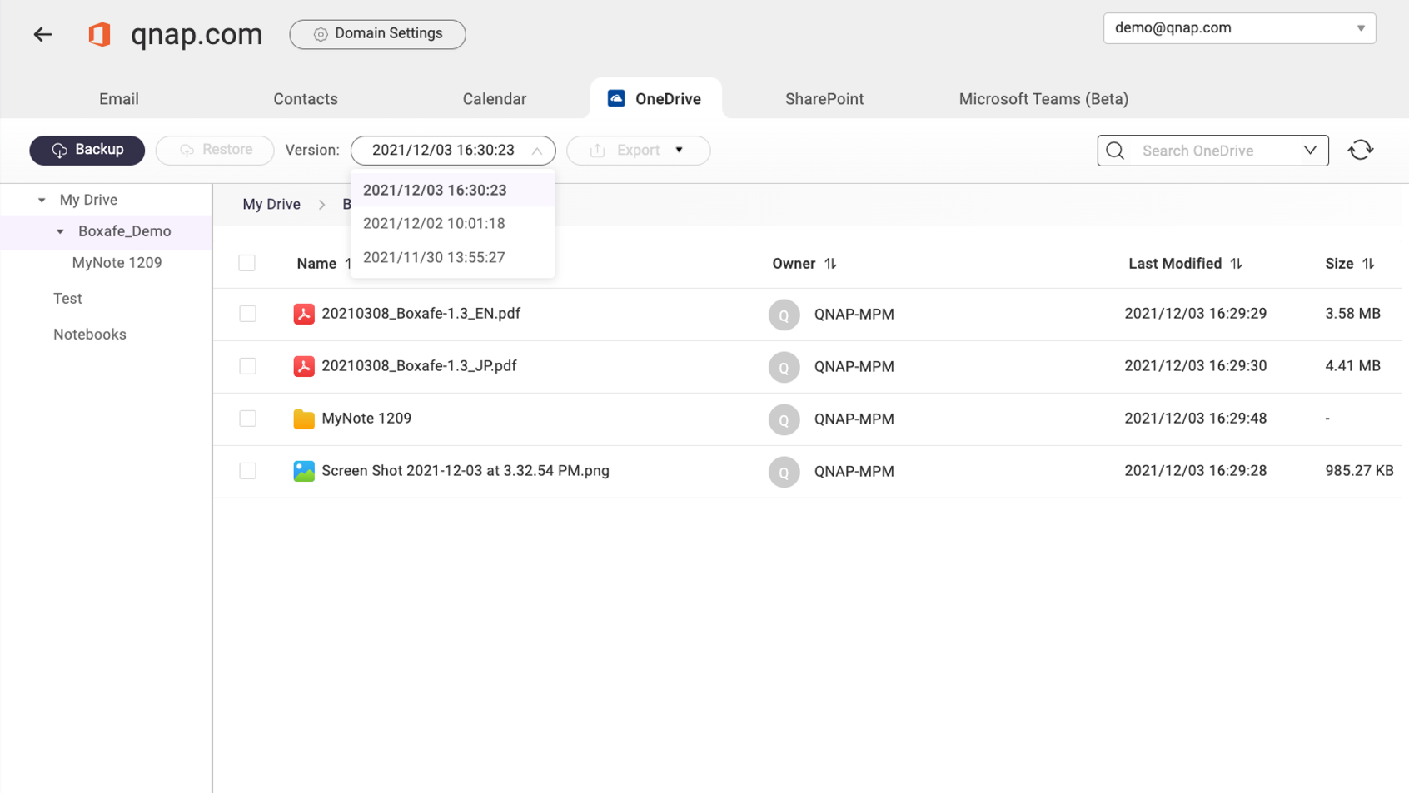
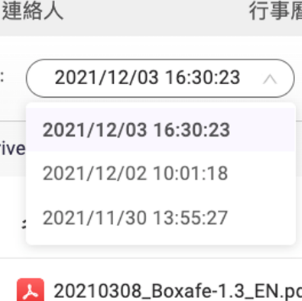
Schedule multi-version backup to reduce RPO
Boxafe makes differential backups and keep multiple versions.

Slide 36
Boxafe Architecture Diagram
Backup/Restore API calls
Worker pool
Store data
Launch workers
Secure, fully optimized and versioned storage
database
Job queue / executor
file storage
Read data
Ad-hoc job
Web server
API Endpoint
User Interface

Slide 38
Gmail
Calendar
My Drive / Shared Drive
Contacts
Outlook (mail, calendar, contacts)
OneDrive
Comprehensive Google Workspace and Microsoft 365 backup solution
Conversation
Calander
SharePoint
Teams
Site
Data preview for
granular restore
Backup everthing
in the domain
Multi-version
backup
Data centralization

Slide 39
Outlook (mail, calendar, contacts)
OneDrive
SharePoint
Comprehensive Microsoft 365 backup solution
Conversation
Calander
Site
Teams
Data preview for
granular restore
Backup everthing
in the domain
Multi-version
backup
Data centralization

Slide 40
Comprehensive Google Workspace backup solution
Gmail
Calendar
My Drive / Shared Drive
Contacts
Data preview for
granular restore
Backup everthing
in the domain
Multi-version
backup
Data centralization

