Slide 1
Notes:
用輕鬆一點的畫面類似小咖啡廳之類的 可以先用型錄封面

Slide 2
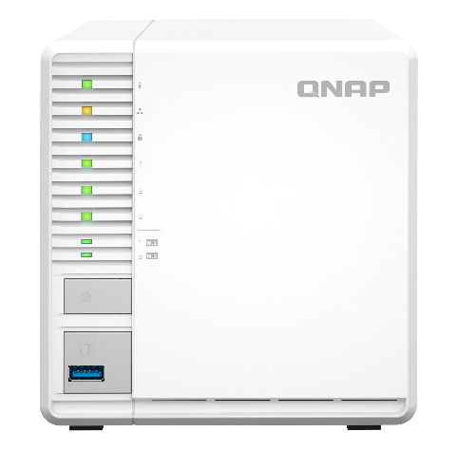
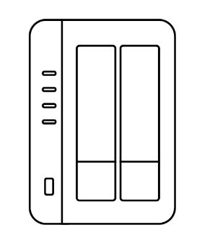
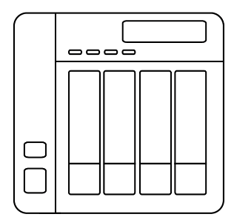
Cost effectively secures data with RAID5
2-Bay NAS
4-Bay NAS
RAID1 :
Space: 1: 1 x HDD
RAID5:
Space: 1 : 2 x HDD
RAID5 :
Space: 1 : 3 x HDD
HDD utilization: 50%
HDD utilization: 67%
Budget concern
Notes:
2-bay and 4-bay用線圖或卡通圖

Slide 3
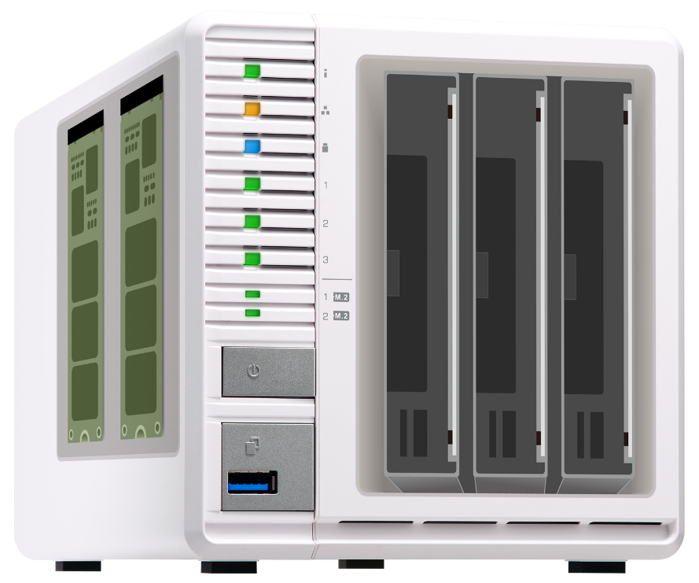
Flexibly use SSD cache or Qtier
RAID
1
RAID
5
2 x M.2 NVMe SSD
3 x SATA HDD
Better Performance
Data protection
High storage capacity
Data protection

Slide 4
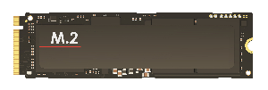
M.2 NVMe Gen 3 x 2 SSD
M.2 NVMe Gen 3 x 2 provide up to 16Gbps
PCIe Gen 3 provides up to 8Gbps bandwidth, it is double of PCIe Gen 2 providing 4Gbps
PCIe Gen 3 x 2
NVMe
PCIe Gen 3 x 2
NVMe

Slide 5
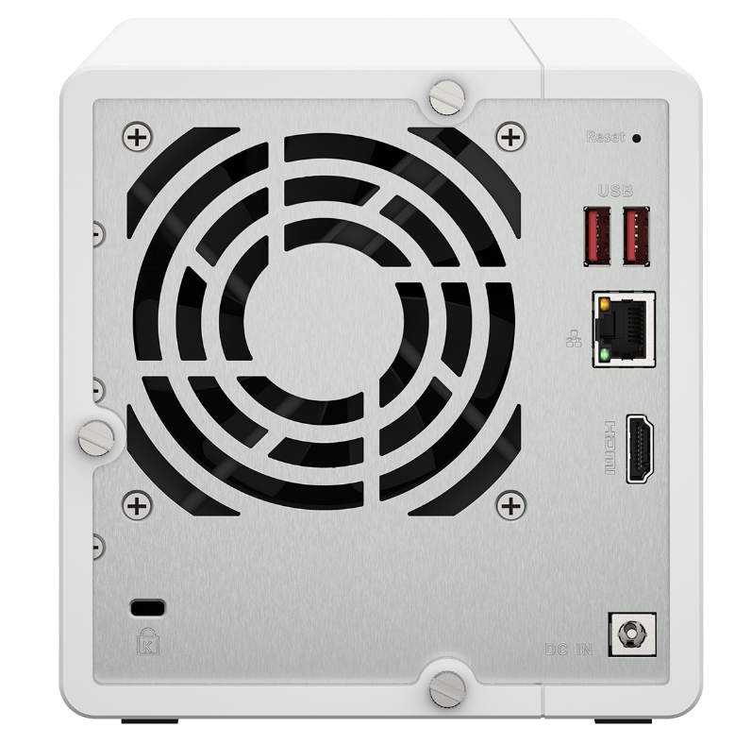
2.5GbE boost performance
2.5GbE Ethernet port
2.5GbE
271 MB/s
251 MB/s
Testing environment:
TS-364, QTS 5.0, 4GB RAM
3 x Samsung 850 Pro 512GB SSD (RAID 5)
Client PC: Windows Server 2019, Intel Core i7-6700, 64GB RAM, Intel X550 NIC

Slide 6
QTS 5.0 + Linux 核心 5.10
To provide the best performance of Intel® Celeron® N5105/N5095, TS-364 is shipped with QTS 5.0, using the new Linux kernel 5.10. QTS 5.0 optimizes overall system performance and NVMe SSD over-provisioning & cache performance to enhance TS-364 functionality.
AES-NI encryption
Volume & folder support
GPU up to 800 MHz
UHD Graphics
N5105/ N5095
Jasper Lake
4-core
4-thread
2.9GHz
Burst

Slide 7
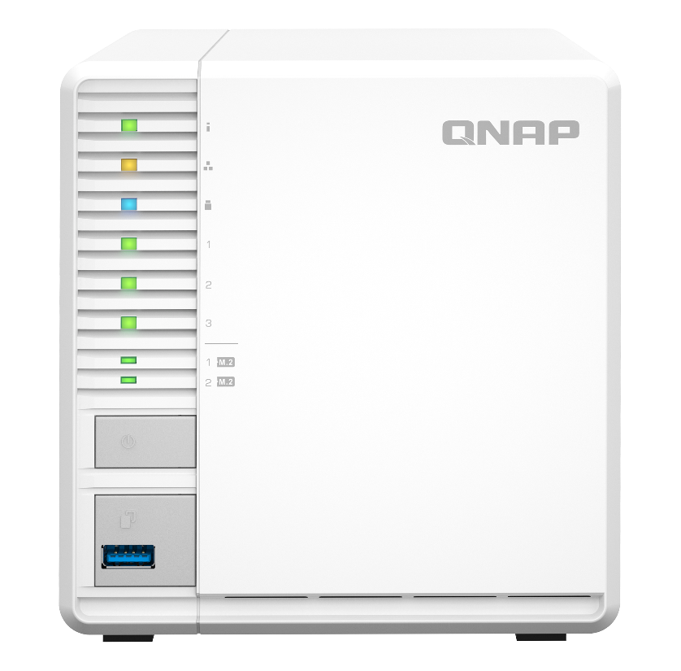
Front view
LED indicator：
Status, LAN, USB, HDD 1~3, M.2 slot 1~2
Power on button
USB3.2 Gen 1
One Touch Copy button

Slide 8
Rear view
Reset
2 x USB3.2 Gen 2 ports
2.5GbE RJ-45 port
Security lock
HDMI 1.4b output
Power input

Slide 9
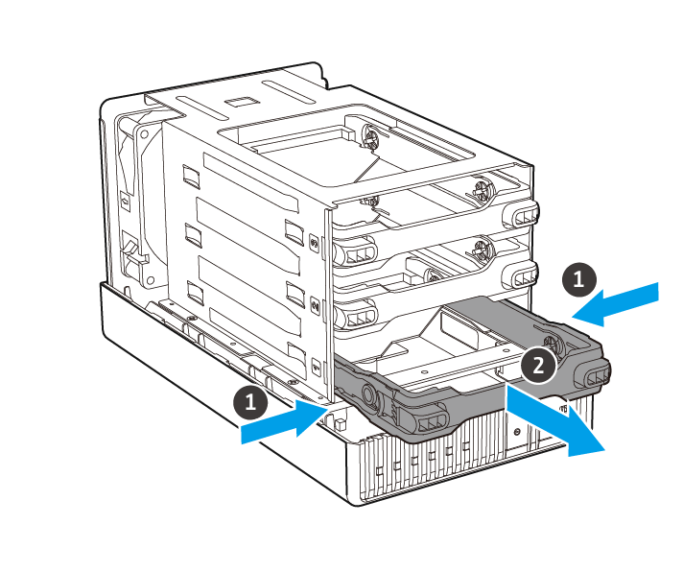
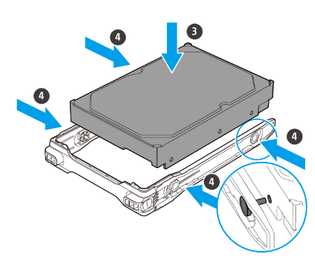
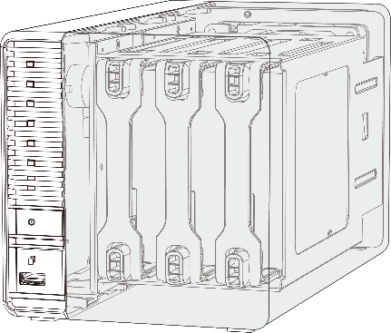
Hot swappable and invisible slots
Tool less installation
Prevent HDD mishandling
Anti-theft

Slide 10
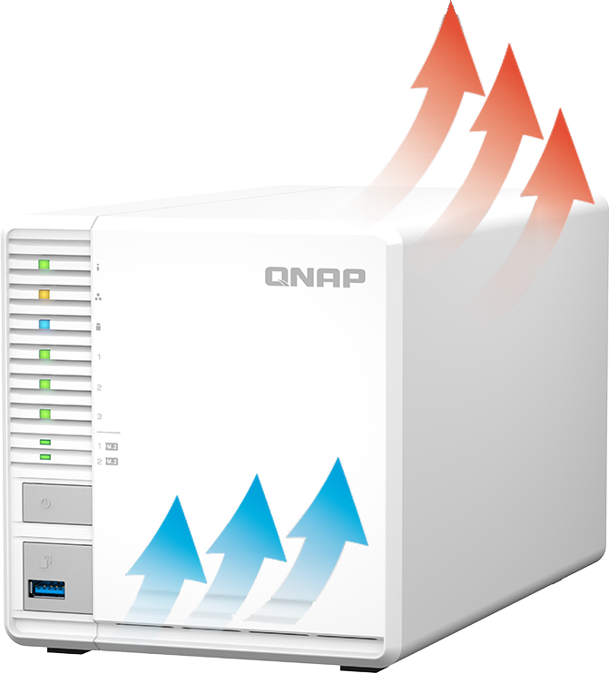
Elegant, quiet and energy saving
Standby：26.3 W
Operating： 32.8 W
Quiet cooling fan
Noise level：20.5 dB

Slide 11
Data Backup
Snapshot
Provides a complete data backup solution
Notes:
分頁要改

Slide 12
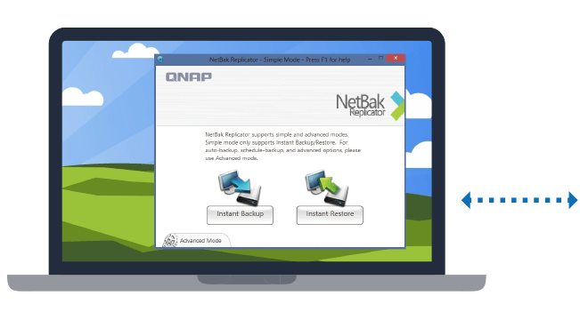
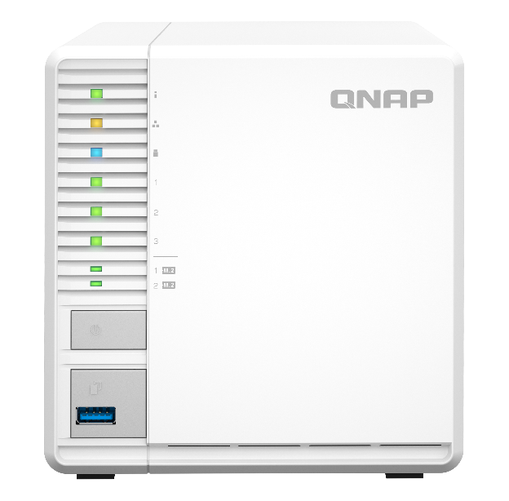
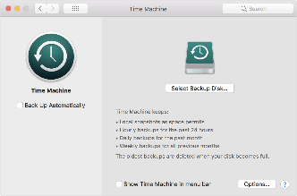
A complete backup solution
Data backup is the most effective way againsting ransomware
Mac O.S.
Time Machine
Real-time or scheduled back up to the TS-364 easily.
Windows
NetBak Replicator

Slide 13
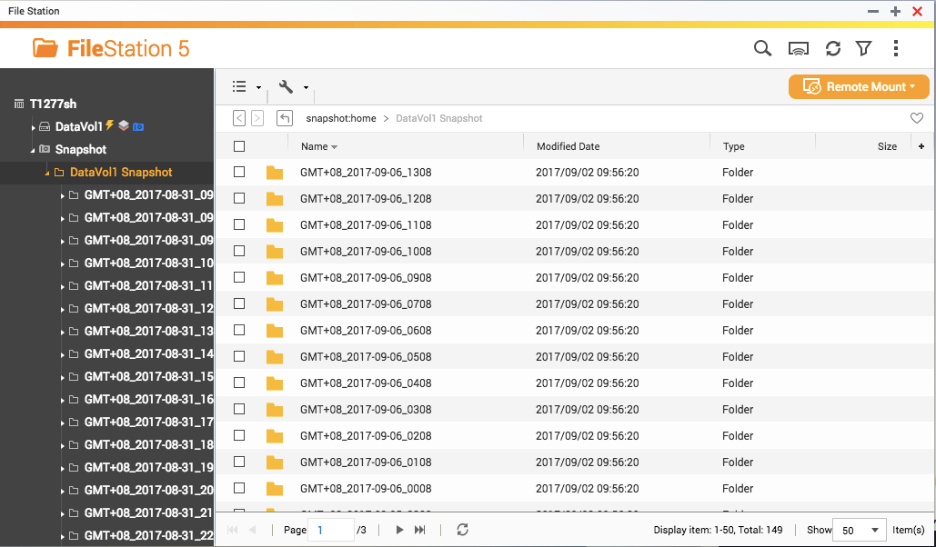
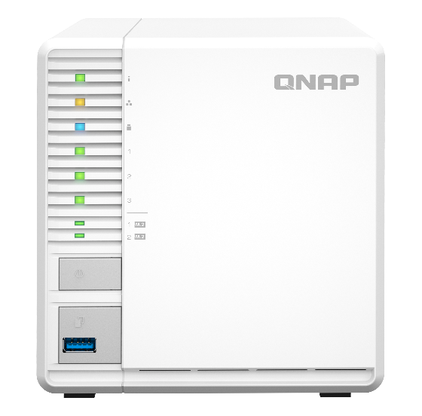
Protect your backup with QNAP Snapshot
1024
Whole NAS
-------------------------------------------
----------------------
Single Volume/Lun
256
Best option

Slide 14
Multi-layer protection for the backup
Hybrid Backup Sync
Cloud
Local
Remote

Slide 15
HDMI application
Hardware transcoding & streaming
Notes:
分頁要改

Slide 16
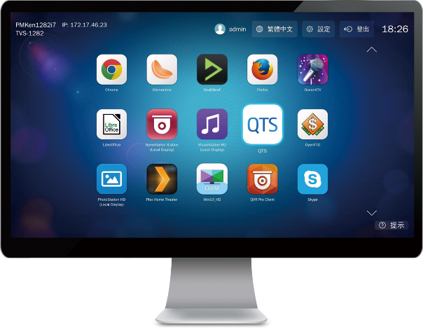
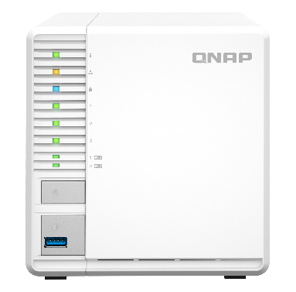
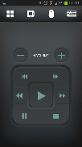
HybridDesk Station for various A/V needs
USB
HDMI
Mouse &
Keyboard
Network
Qremote App

Slide 17
Versatile HybridDesk Station apps
System Mgmt.
Surveillance
Comm. & Social
QTS
FileStation HD
Skype
Facebook
QVR Pro Client
Multimedia
Multimedia Mgmt.
Browser & Productivity
HD Player
Clementine
Spotify
TuneIn Radio
PhotoStation HD
VideoStation HD
MusicStation HD
Chrome
Firefox
LibreOffice

Slide 18
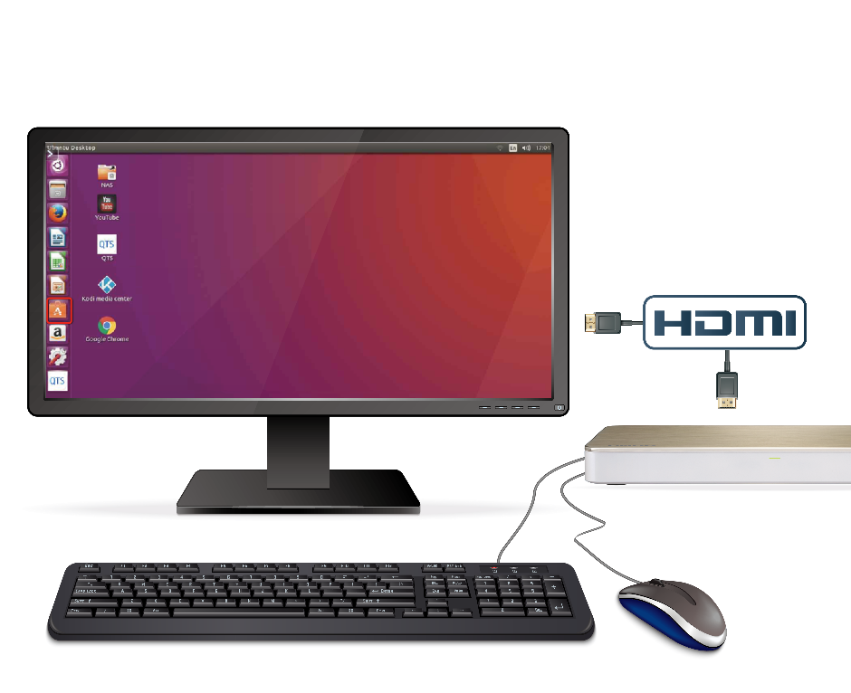
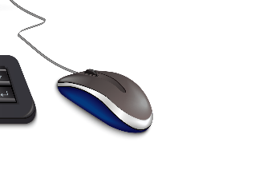
Linux Station turns NAS into a Ubuntu PC
1
HDMI output from NAS to a monitor
Multi-version Ubuntu
Ubuntu 18.04
Ubuntu 20.04
2
Connect a USB keyboard and a mouse to the NAS to start using Ubuntu

Slide 19
Streaming & accelerated transcoding
4K H.264 decoding & encoding for real-time or offline 4K video transcoding on various client players for smooth playback and support more clients
HDMI output for 4K content
Stream content through DLNA, AirPlay, Chromecast and Plex

Slide 20
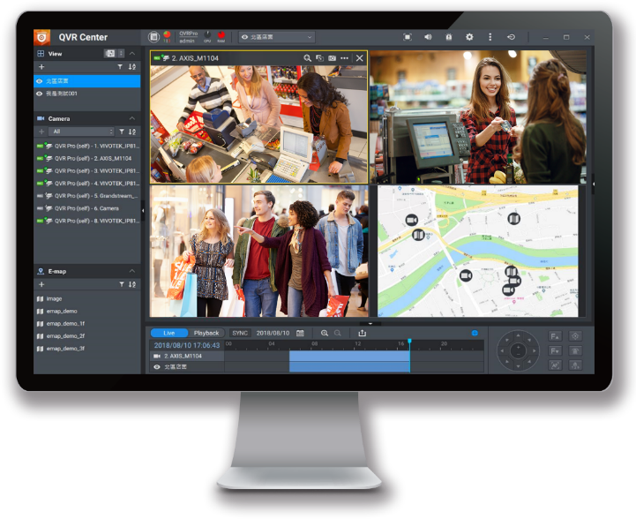
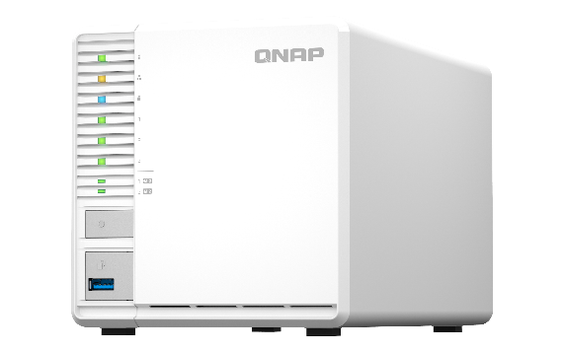
QVR Elite Smart Surveillance Solution
6,000+ IP cameras
2 embedded channels
Subscription-based BYOD license
Support QVR Face AI qpkg
Please go to the QVR NAS Selector to calculate the supported recording channels.

Slide 21
Data management
Qsirch
Full text search
Qfiling
Smart filing
Notes:
分頁要改

Slide 22
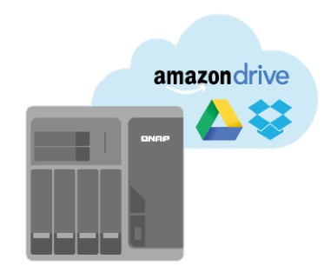
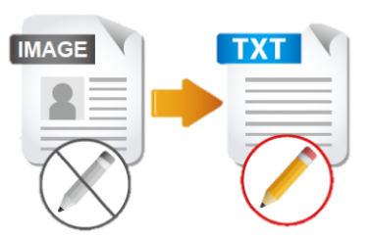
QNAP meets all needs for an office
File Station
OCR Converter
Qsirch
Qfiling
Store and backup
File Digitization
Search
Archive
With OCR Converter, Qsirch can search for image context.
Notes:
QTS4.3.4 P.58

Slide 23
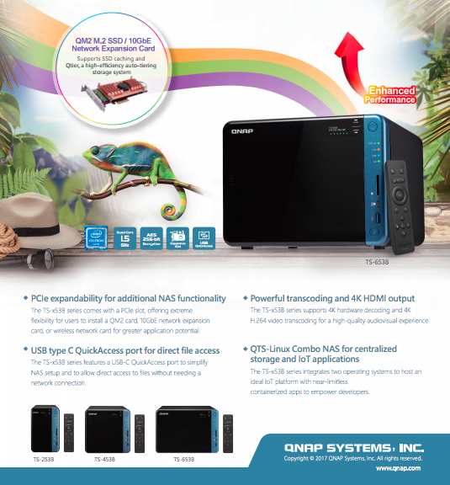
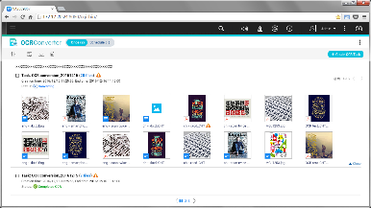
OCR: Best solution for document digitization
Picture with text
Searchable documents
Search
Edit
Archive
Notes:
QTS4.3.4 P.64

Slide 24
QuMagie
What is QuMagie?
QuMagie is an AI-powered photo management solution with flexible storage space
QuMagie is a free application within QNAP NAS system
QNAP NAS
Mobile
Mobile
Browse, Manage Photos
Upload, Backup Photos
PC
手持裝置
手持裝置
Camera
QuMagie
Share Photos
Social Media
手持裝置
PC
QNAP AI Core
Notes:
CHT: AI 智能相簿讓您聰明管理照片，搭配 NAS 彈性擴充儲存空間，隨拍即存不設限
ENG: The AI-powered photo management solution with flexible storage space

Slide 25
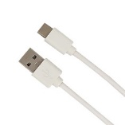
Coral M.2 Accelerator ( B+M key )
Coral M.2 Accelerator B+M key
Coral P/N: G650-04686-01
4 TOPS total peak performance (int8)
2 TOPS per watt (TOPS = trillion operations per second)
M.2 2280 B+M key form factor
PCIe Gen 2 x 1 interface
QNAP P/N: G650-04686-01-QNAP
Package contents
Coral M.2 Accelerator B+M key
QNAP Heatsink
NAS Installation guide

Slide 26
Coral USB Accelerator
30 mm (1.18 inch)
Coral USB Accelerator
Coral P/N: G950-06809-01 & G950-01456-01
4 TOPS total peak performance (int8)
2 TOPS per watt (TOPS = trillion operations per second)
No extra power adapter needed
USB 3.2 Gen 1 (USB 3.0) Type-C interface (data/power)
QNAP P/N: G950-06809-01-QNAP
Package contents
USB Accelerator
NAS installation guide
65 mm
(2.56 inch)

Slide 27
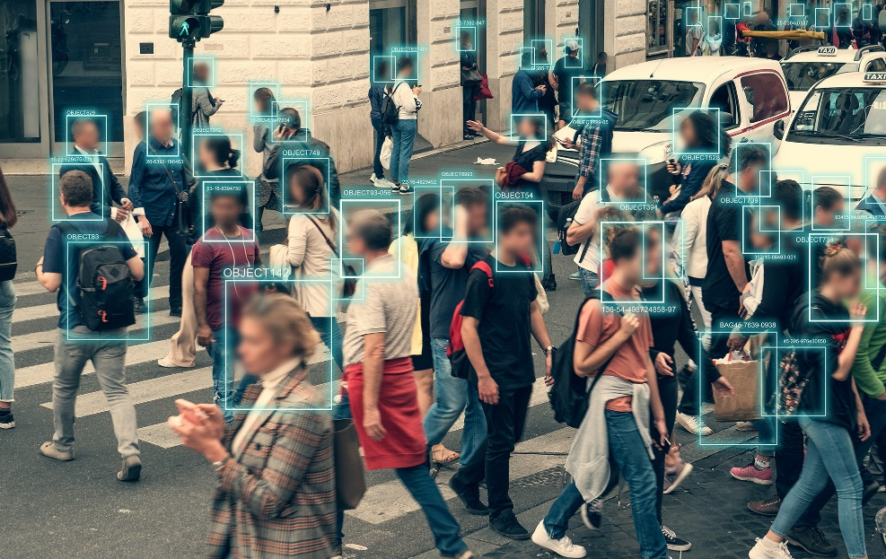
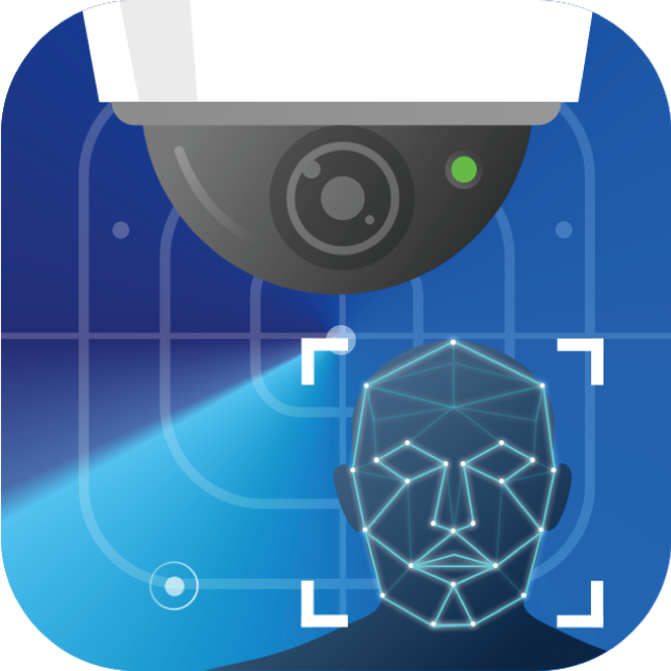
QVR Face / Human
QVR Face helps users build intelligent face recognition QVR Human proactively calculates the number of people passing through a specific region

Slide 28
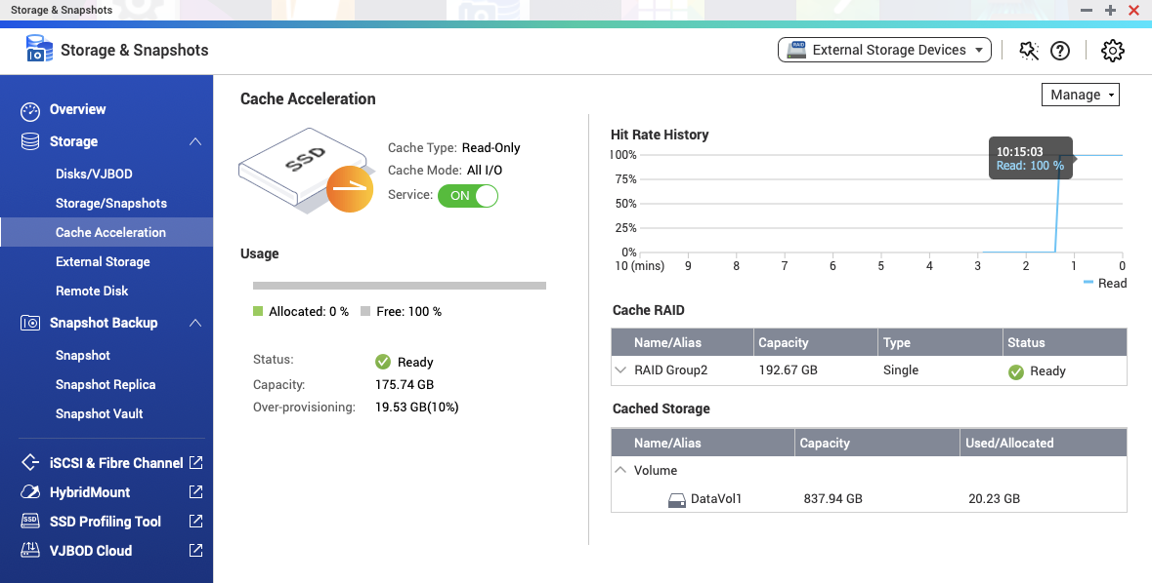
Improve NVMe SSD Performance
With the new kernel, NVMe usage efficiency is greatly improved Optimized cache module, SSD space can be used more efficiently, and memory usage is less then before Improve the efficiency of multi-users access to the same folder

Slide 29
Increase the level of security
Support TLS 1.3 The admin account is disabled by default Advanced encryption suite support adjusted safety settings and more stronger safety protection options SSH Key login Firmware automatic updates (recommended updates, automatic updates) App automatic updates (recommended updates, automatic updates)

Slide 30
Copyright© 2021 QNAP Systems, Inc. All rights reserved. QNAP® and other names of QNAP Products are proprietary marks or registered trademarks of QNAP Systems, Inc. Other products and company names mentioned herein are trademarks of their respective holders.​​​
Notes:
用輕鬆一點的畫面類似小咖啡廳之類的 可以先用型錄封面

